Slide 1
Real-time least-squares pulse fitting for digital spectroscopy
Christopher Crawford, University of Kentucky
SRO VIII workshop, 2021-04-29

Slide 2
Executive Summary
We present the SLS-RPP algorithm, which can do fully covariant nonlinear least-squares template pulse fitting in real-time on streaming data
For SRO: this enables the application of sophisticated Level-1 trigger logic, for example: low-threshold triggers and energy-summing cluster triggers
General and extensible building blocks for wide array of applications, and Generic runtime-configurable firmware
arXiv:2012.05937 [physics.ins-det]
https://leoburnett.com
Notes:
For those of you who are double- or triple- zooming, I learned to do executive summaries at Nuclear Science Advocacy Day today, so here you go:

Slide 3
Outline
0. Physics background
Nab: neutron decay correlations
Standard tools of digital spectroscopy (DPP)
Composition of digital logic building blocks
Trapezoid filter in two pieces
Sliding Least Squares (SLS) fitter
as a Finite Impulse Response (FIR) filter
Recursive Piecewise Polynomial (RPP) filter
implementation in FPGA
https://leoburnett.com
Notes:
This talk will be different from others in this workshop: instead of summarizing a broad range of progress, I will focus on explaining one particular algorithm for processing streaming data.
I fear that it is a little elementary for this audience, but it emphasizes the power you can achieve with very simple building blocks.

Slide 4
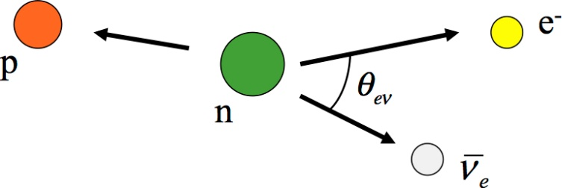
Neutron decay
UCNA Brown (2018)
UCNA (2018)
E_{e} dependence of a and A can separately confirm CVC and the absence of SCC.
[Gardner, Zhang, PRL 86, 5666 (2001), Gardner, hep-ph/0312124]
Notes:
This development was done in context of the Nab experiment, which will study neutron decay, not the average decay rate, but it’s dependence on the correlation of particle momenta, energy and spin, of the incoming and outgoing particles. By parity violation the correlations are all proportional to the axial coupling G_{A}, the average rate has been factored out of each expression.

Slide 5
The Nab experiment
Notes:
The electron-neutrino angle can be extracted from the outgoing electron and proton energy.
However, the proton energy is too small to detect, so we measure it’s time-of-flight in a field-expansion spectrometer.

Slide 6
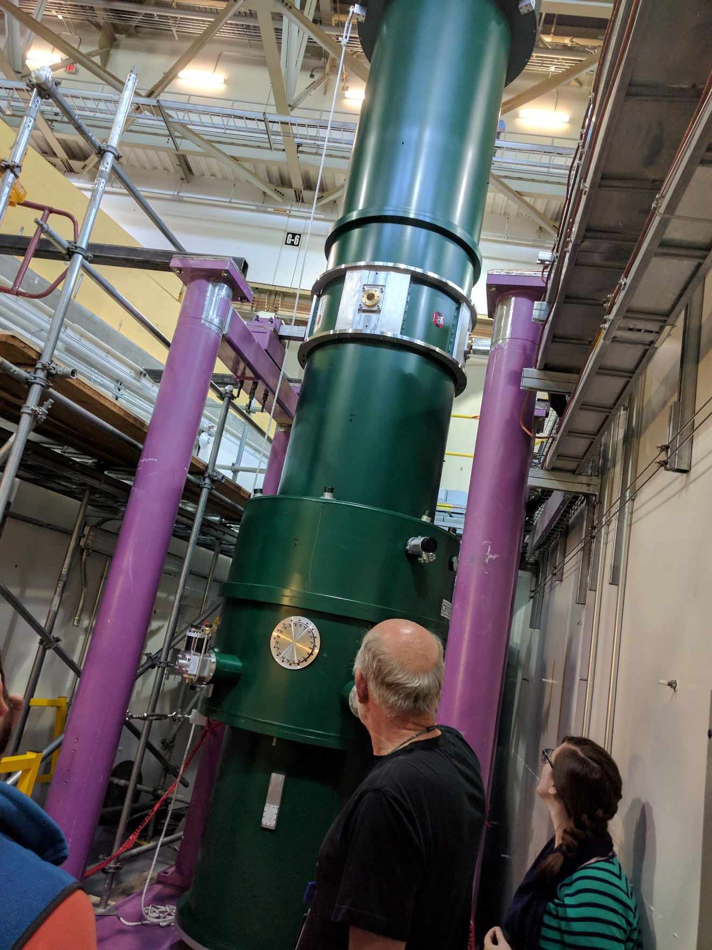
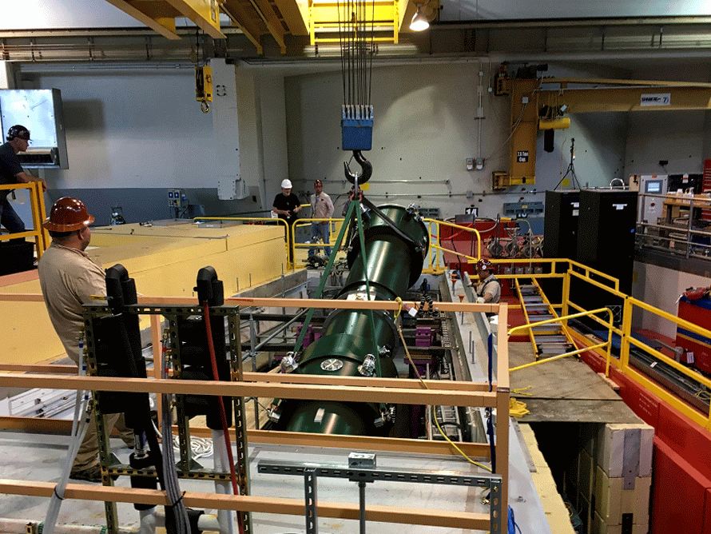
Notes:
Here is a clip of the installation of the 7 m SC solenoid to longitudinalize the proton’s momentum to get it’s total energy from the time-of-flight.

Slide 7
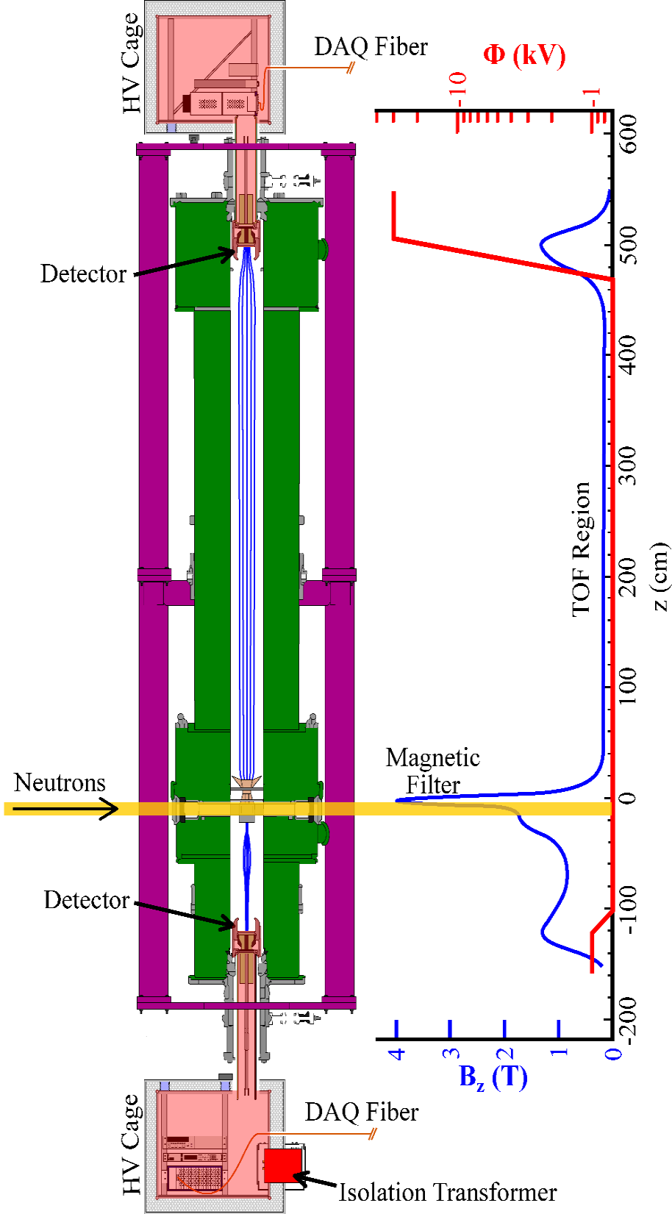
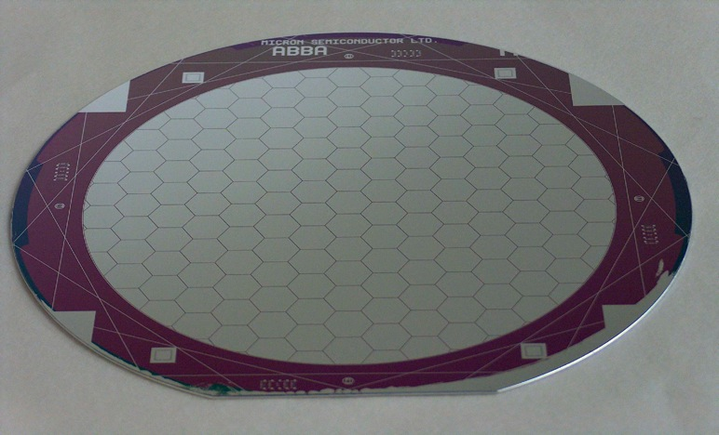
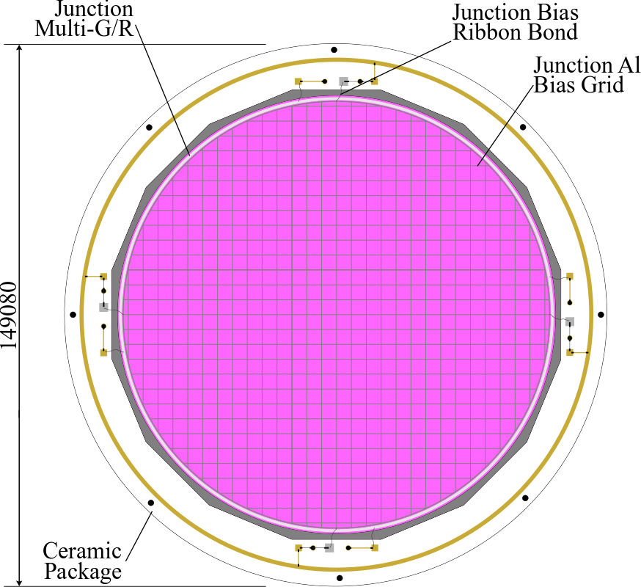
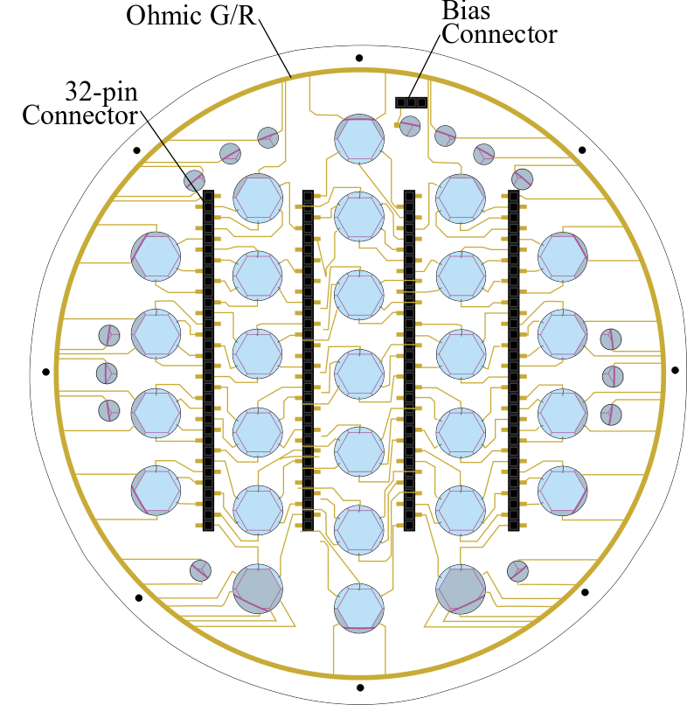
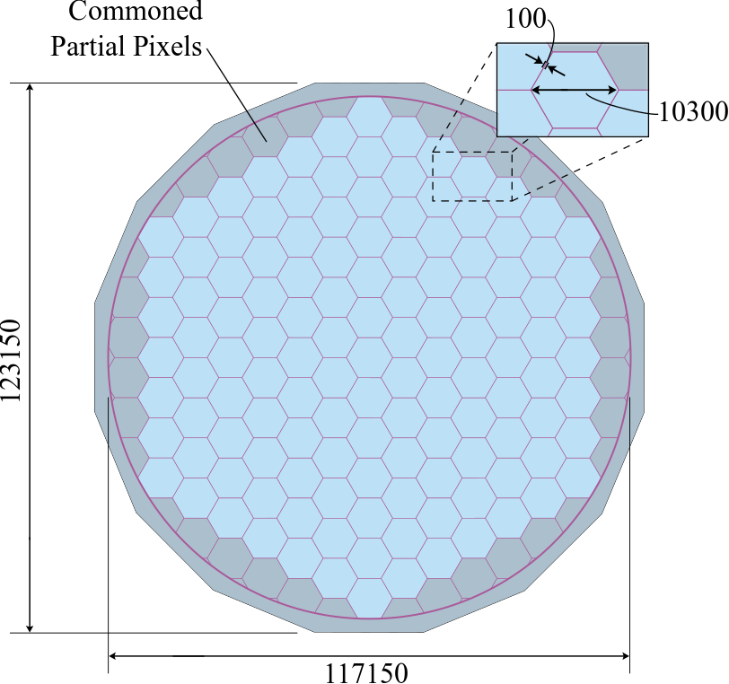
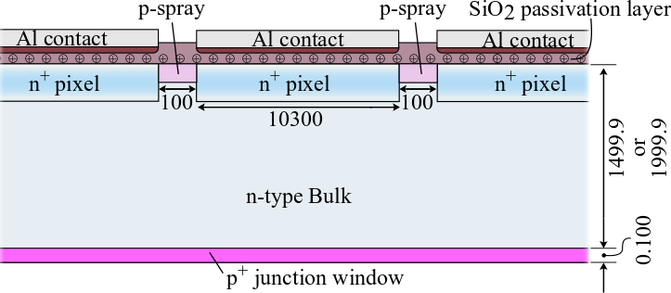
Event Structure 100-750 keV electron, 100 ps systematic, 2 keV resolution 30 keV (HV) proton, 12-40 μs TOF delay, 10 ns resolution
Data rate 250 Hz coincidence adjacent pixels; accidentals 2.5 kHz singles 256 channel digitizer, 250 MS/s rate, 14 bit ADC = 28 MB/s
Notes:
The electrons and protons are detected in an ion-implanted silicon detector with127 segments to filter out real coincidences, which occur along the same magnetic field line. One detector is at -30kV to accelerate the proton for detection.

Slide 8
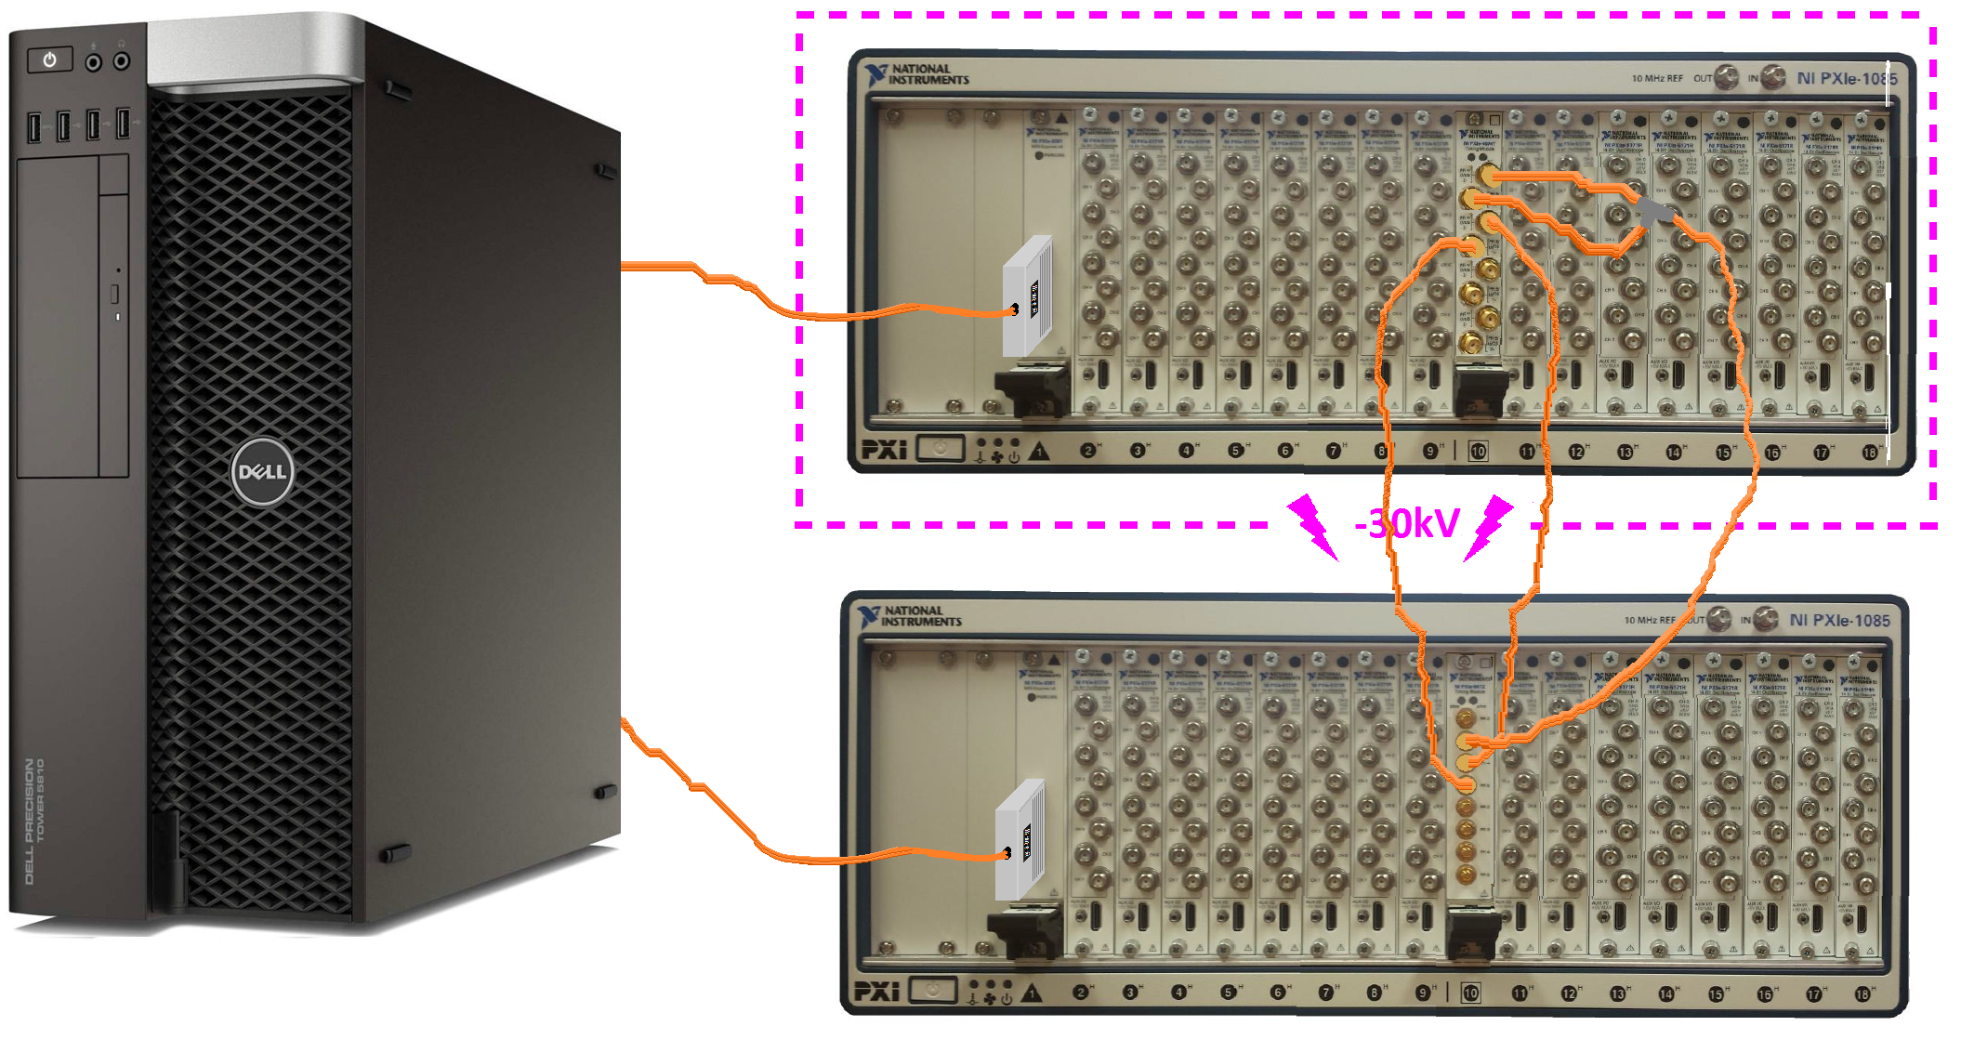
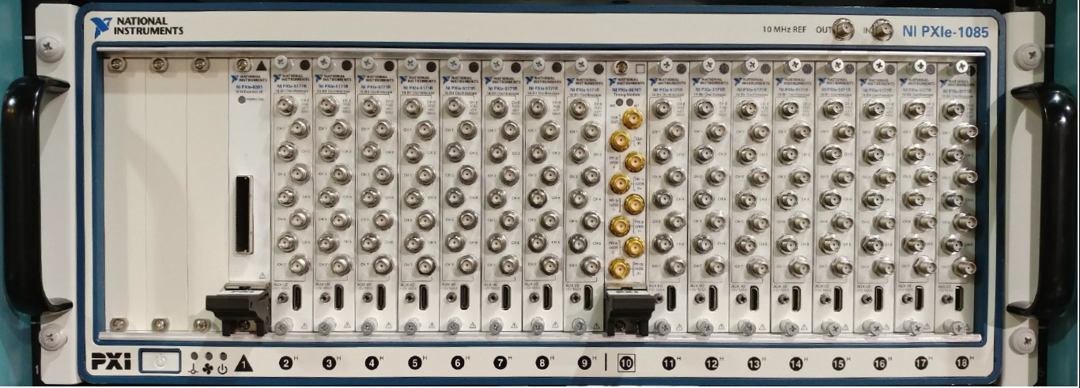
NI-5171R Digitizer
Single controller
for both detectors: global trigger and readout
128 channels per detector / chassis
Notes:
At the time we developed our DAQ system, NI was one of the only commercial boards with an open FPGA, programmable in LabVIEW, which I like a lot better on FPGA than CPU. The library includes an ADC block on one end a DRAM controller, and a PCI DMA-FIFO on the other, and you can put anything in between. It is nice to see Open-Source FPGA available in the new CAEN digitizers now.

Slide 9
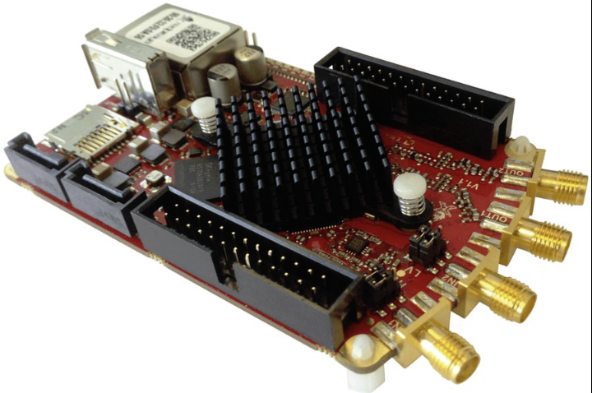
NI-5171R Digitizer
Single controller
for both detectors: global trigger and readout
Red Pitaya digitizer
Zynq 7010 SoC
4 GB RAM
2 ADC + 2 DAC @ 14 bit, 125 MS/s
open-source software AND firmware!
Readout and trapezoid firmware developed on NI-5171R
(Aaron Jezghani and David Mathews, UK)
Trapezoid filter firmware developed on STEMlab 125-14
(Yuke Wang, University of Kentucky)
Notes:
We have also worked with the much less expensive hobbyist board Red Pitaya, which has open-source firmware, and my students have developed readout and trapezoid filters on both boards.

Slide 10
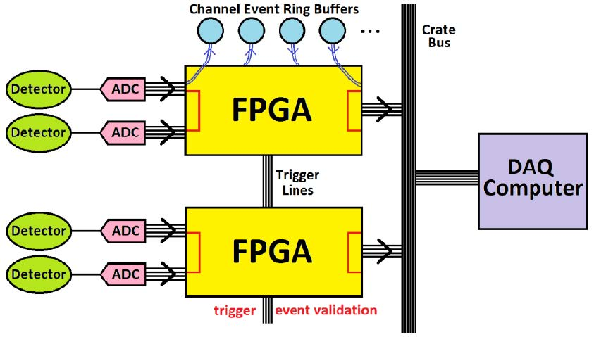
Event Buffered Digitizers
Notes:
We have taken a different approach to readout: instead of triggering individual event buffers, and then validating events for readout,

Slide 11
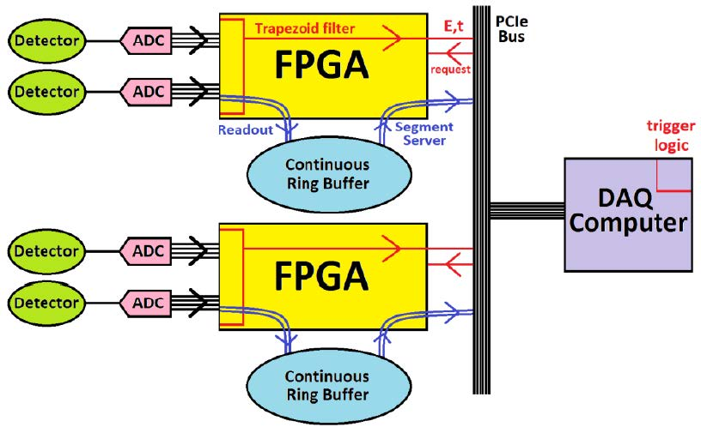
Continuous Buffered SRO
Notes:
The waveform is continuously buffered in a giant ring buffer, while simultaneously going through the energy and timing filters and discrimination. We avoid level 2 trigger logic by sending a lightweight stream of timing and energy events to global logic in CPU, which can then decide which segments to readout, including waveforms that did not trigger at all. In that sense it is streaming readout, and our approach is to filter down the data as soon as possible to minimize unnecessary network traffic. I will show next that it is possible to put completely generic filters on the FPGA, so that all custom triggering can developed and debugged fully on CPU, like Sergey talked about for CLASS12 yesterday.

Slide 12
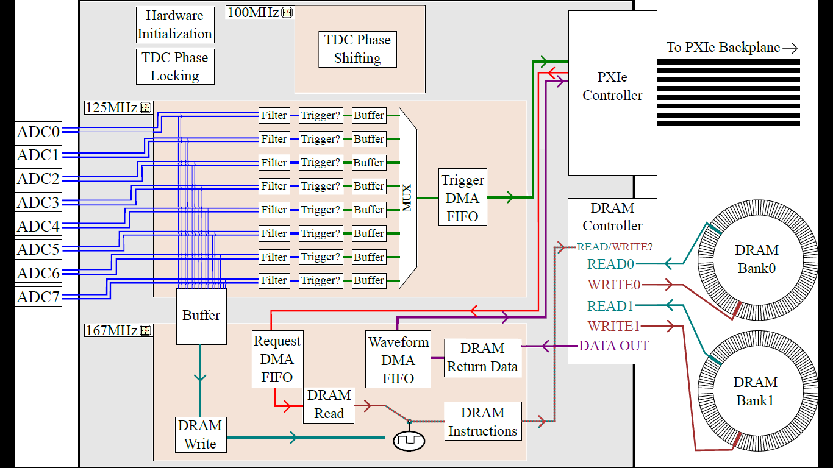
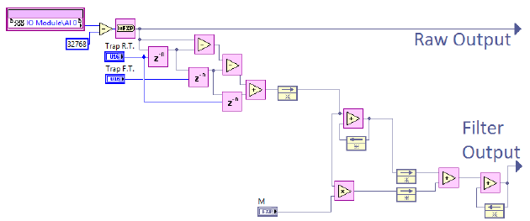
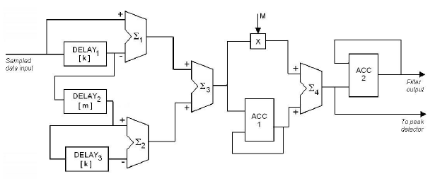
Firmware HDL (Verilog/VHDL)
Trapezoid Filter Schematic
module hold (clk, in, out); //***** Delay buffer *****
parameter bit = 64; //Size of input and output
parameter delay = 1; //Delay amount in clock cycles
input clk;
input signed [bit-1:0] in;
output signed [bit-1:0] out;
reg signed [bit-1:0] array [0:delay + 1]; //Array to hold inputs for delay
integer i; //Register for the for-loop
always @ (posedge clk) begin //Shifts all elements down in array
once
array [0] = in;
for (i = 0; i <= delay; i = i + 1)
array [i+1] <= array [i];
end
assign out = array[delay + 1]; //Assigns final element to output
endmodule
LabVIEW FPGA Module

Slide 13
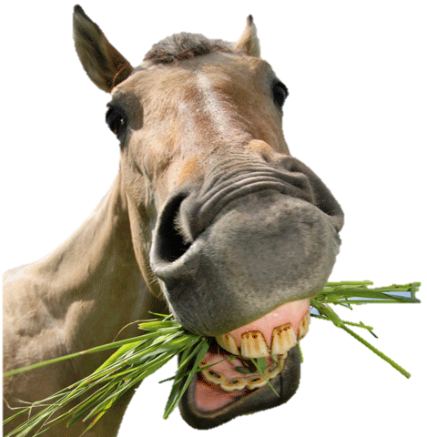
Digital FIR filters
E₁
E₁
E₂
E₂
t₁
t₂
t₁
t₂
Notes:
Before describing the Sliding Least Square-Recursive Piecewise Polynomial filter, I would like to describe the standard trapezoid filter in terms of basic building blocks, because may of the pieces are the same. Essentially, the trapezoid averages out charge on peak of a tail pulse minus the exponential decaying baseline to get precise energy resolution even in the case of ballistic deficit, where not all the charge is collected at once.

Slide 14
Building blocks
basic arithmetic adder, multiplier -> Multiply-Accumulate in DSP48 slice
unit impulse basis function delay (identity) shift register/buffer
unit step const function integration accumulator
properties of convolution
commutative (function <-> filter)
associative (build up complex filters in stages)
Notes:
For building blocks, we have basic arithmetic: adding can be done in the fabric, but Xilinx FPGA have special DSP slices to multiply efficiently.
Then there is just the delta function, which acts as a basis function on it’s own, or as a delay, when convolved with any input function. The value it picks of back here is output at this time, delayed by this much. In digital logic, this can be implements as a chain of shift registers, or a buffer.
The Heaviside step function represents both instant accumulation of charge, and as an integrator filter, when convolved with another function. It is implemented as an accumulator with a shift register to keep the running total.
The properties of convolution allow the interchange between function and filter (that’s why we flip one function when convolving), and allow us to build up a complex filter one convolution at a time.

Slide 15
Boxcar filter
Baseline subtract
Notes:
Ignoring the bleed resistor, the input voltage will be a step function as charge is collected.
You can average this with a boxcar filter, with a linear output as it crosses over the rising edge and averages more of the pulse. This is the delayed difference of two accumulators: each step you add one sample on the front and subtract it off the back.
We remove the baseline, by subtracting a second boxcar, with some separation to allow some time for charge collection. This gives rise to a trapezoid with a flat top of width the settling time, and rise and fall times for the duration of the average.

Slide 16
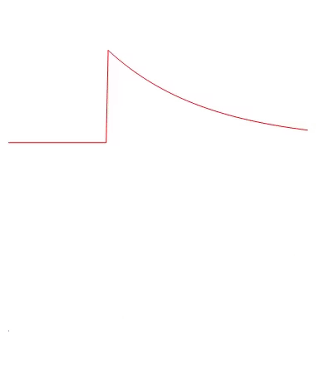
Tail pulse
pole-zero
Notes:
Adding back in the bleed resistor, the tail pulse can be straightened out by adding an integrated copy, so that the filter includes delta and an integrating step.

Slide 17
Trapezoid filter
Notes:
Combining these operations, the total filter is both the pole-zero and the double-box car. Convolving these together results in the trapezoid filter, but it is implements as a series of filters in digital logic.

Slide 18
Trapezoid filter

Slide 19
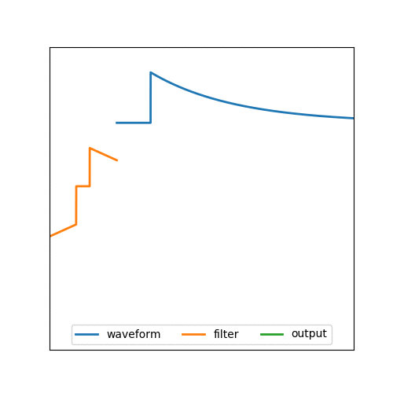
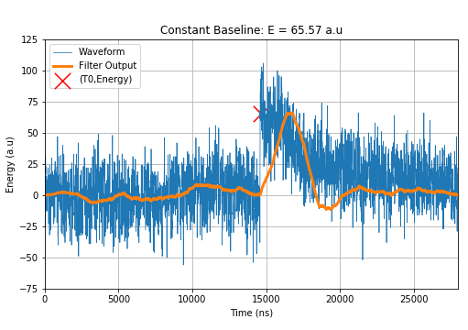
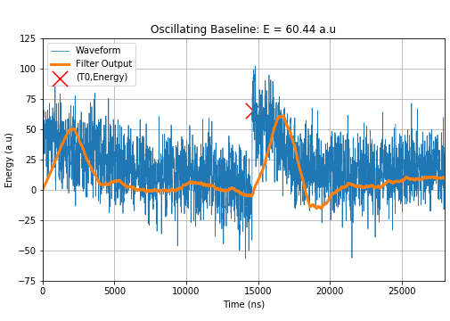
Full Trapezoid filter
David Mathews, University of Kentucky, APS DNP talk, April 2019

Slide 20
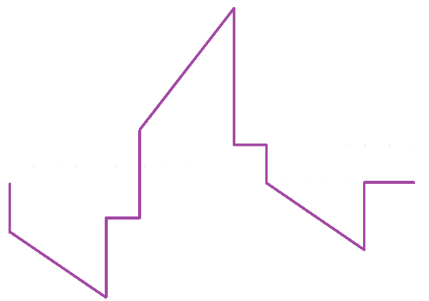
Double trapezoid filter
Flat top for precise energy measurement
Low-threshold trigger: long shaping-time to average out noise
Zero-crossing for precise trigger timing
Integrated baseline subtraction (zero net area filter)
energy
threshold
timing

Slide 21
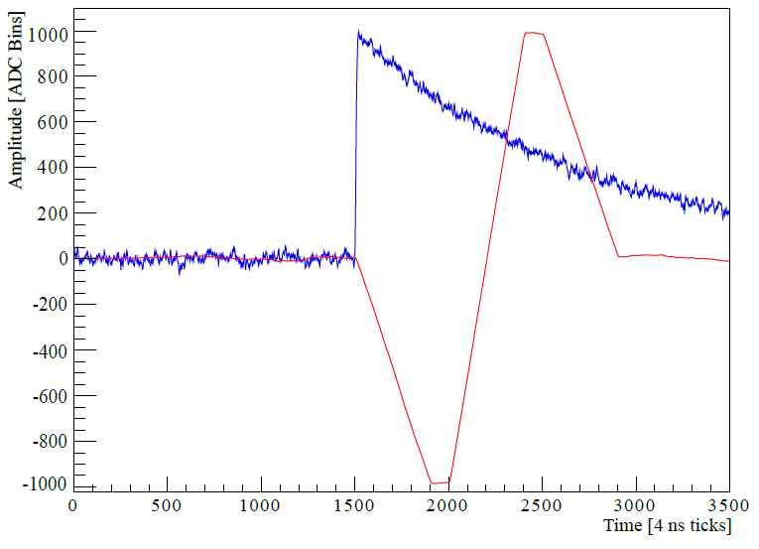
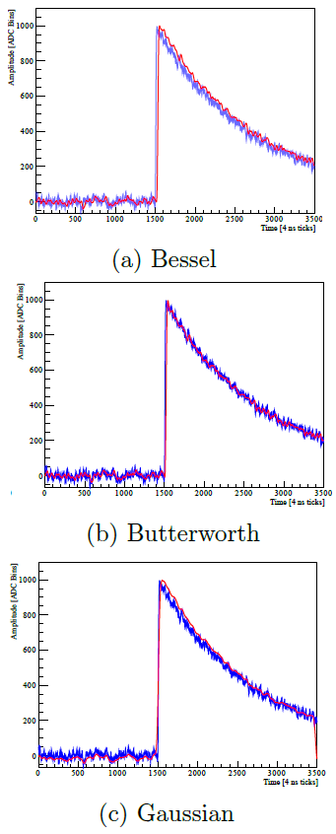
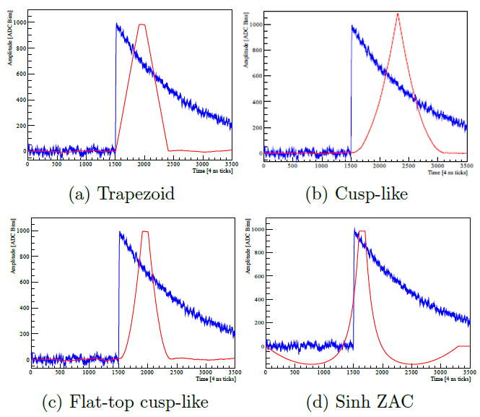
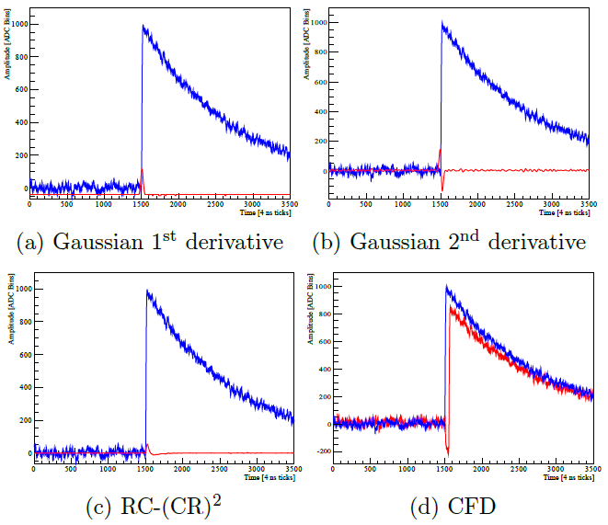
Motivation · Experiment · Detector · Timing · DAQ · DSP · Results
Digital Filters for Signal Processing
Energy Extraction
Noise Reduction
Arrival Time Determination
Aaron Jezghani, University of Kentucky, PhD Thesis
2020-01-10
UNAM-IF Lunchtime Seminar

Slide 22
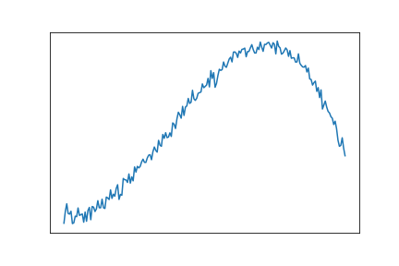
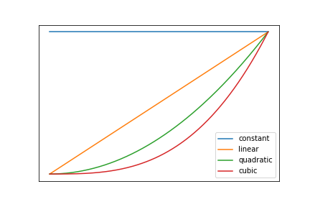
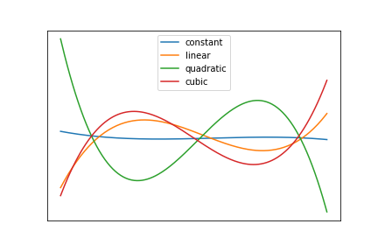
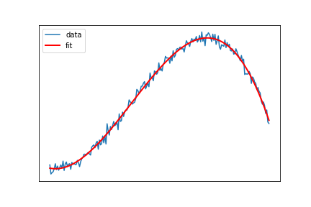
Generalized linear LSQ fitting
Original data
Fit Functions: Design Matrix A
Pseudoinverse of design matrix
Fit parameters
David Mathews, University of Kentucky, APS DNP talk, April 2019
Notes:
Now we apply these same principles to least squares pulse fitting.
In generalized linear fits, the design matrix is formed from a bunch of template waveforms and noise you want to reject. We fit the waveform to a linear combination of these templates. This is accomplished by multiplying by the pseudoinverse of the design matrix, which gives you each of the coefficients.

Slide 23
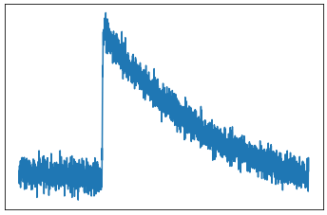
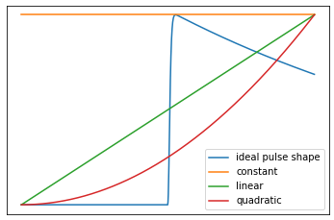
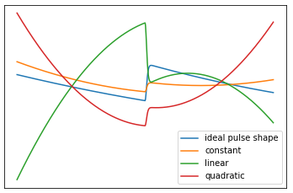
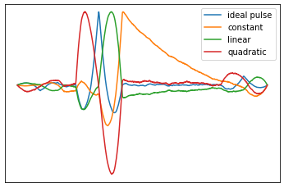
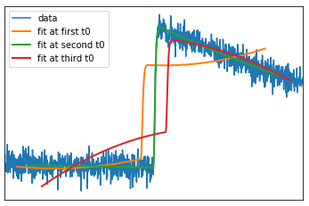
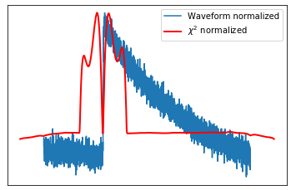
Add nonlinear parameter t0
Data:
Fit Functions:
Pseudoinverse Fit Functions
Calculate Fit Parameters:
Fit using Parameters
Find Best Fit with
David Mathews, University of Kentucky, APS DNP talk, April 2019
Notes:
Now we add the nonlinear fit parameter T0 by essentially performing the linear fit at each time. The matrix or dot products turn into convolutions or sliding dot products as we scan across the waveform. Here you can see all 4 coefficients as a function of T0, and a peak in the template amplitude with all noise amplitudes falling away as the template matches the waveform at just the right spot.
Here you can see a bad fit in orange just before it reaches T0, and the bad fit in red just afterward.
By expanding out the normal expression of chi2, we get an expression suitable for streaming implementation: convolution of waveform pointwise squared with a box filter, and pointwise sandwiching of the small vector of fit parameters around a constant matrix. We minimize this to complete the chi2 fit.

Slide 24
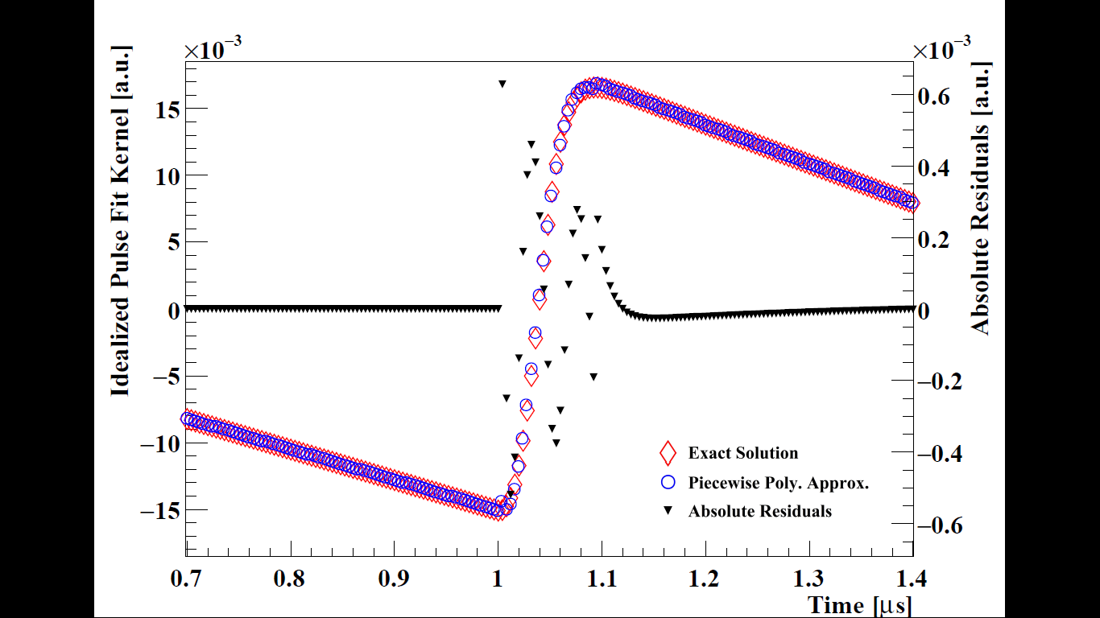
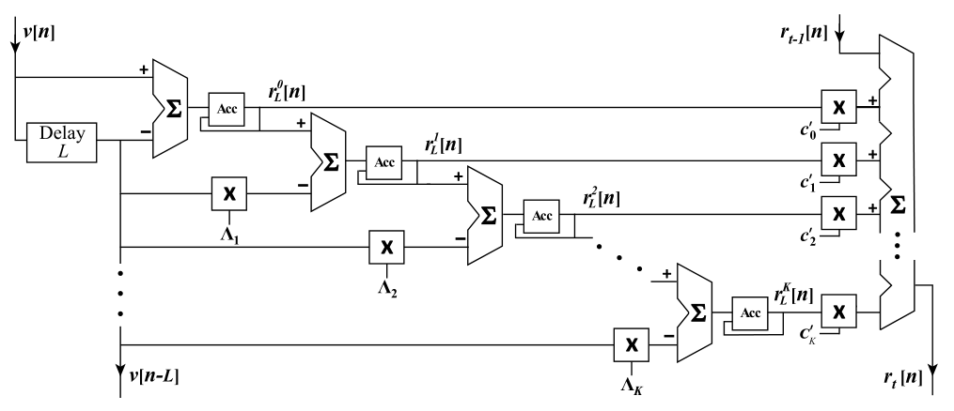
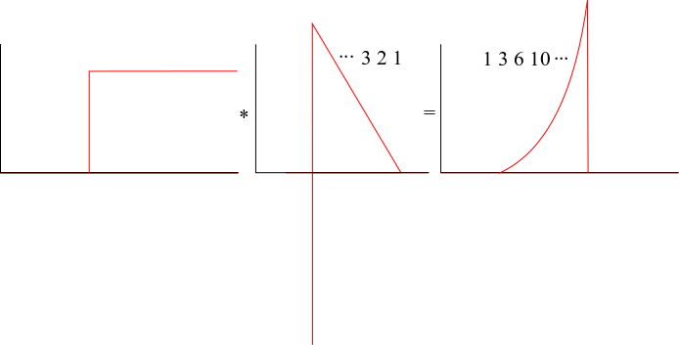
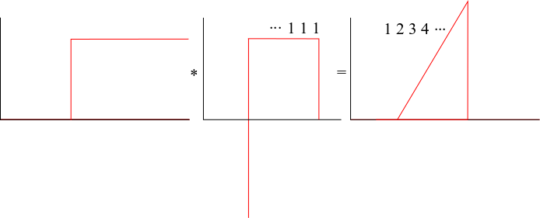
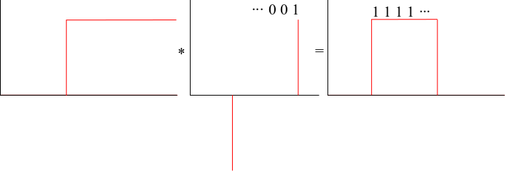
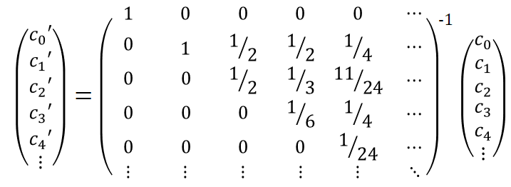
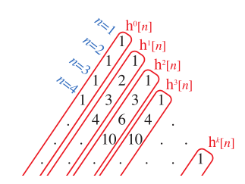
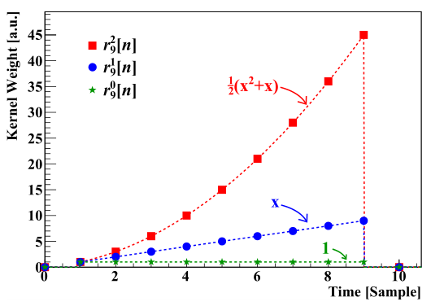
Generic Filter Design
…and extending beyond:
From Jordanov and Knoll:
$p_{2}^{L}\left[n\right]=\sum_{i_{2}=0}^{n}{\sum_{i_{1}=0}^{i_{2}}{\sum_{i_{0}=0}^{i_{1}}{v\left[i_{0}\right]−v[i_{0}−L]}−Lv[i_{1}−L] }−\frac{L^{2}+L}{2}v\left[i_{2}−L\right]}$ ($R_{2}\left(t\right)=\frac{t^{2}+t}{2}$)
$p_{m}^{L}\left[n\right]=\sum_{i_{m}=0}^{n}{\sum_{i_{m−1}=0}^{i_{m}}{⋯\sum_{i_{0}=0}^{i_{1}}{v\left[i_{0}\right]−v[i_{0}−L]}⋯−Λ_{m−1}v[i_{m−1}−L] }−Λ_{m}v\left[i_{m}−L\right], }$ $Λ_{m}=\frac{1}{m!}\prod_{j=0}^{m−1}{(L+j)}$
$p_{1}^{L}\left[n\right]=\sum_{i_{1}=0}^{n}{\sum_{i_{0}=0}^{i_{1}}{v\left[i_{0}\right]−v[i_{0}−L]}−Lv[i_{1}−L]}$ ($R_{1}\left(t\right)=t)$
$p_{0}^{L}\left[n\right]=\sum_{i_{0}=0}^{n}{v\left[i_{0}\right]−v[i_{0}−L]}$ ($R_{0}\left(t\right)=1)$
$$R_{m}\left(t\right)=c_{0}+c_{1}t+c_{2}t^{2}+c_{3}t^{3}+c_{4}t^{4}+⋯$$
$$P_{m}^{L}\left(n\right)=c_{0}^{′}p_{0}^{L}(n)+c_{1}′p_{1}^{L}(n)+c_{2}′p_{2}^{L}(n)+c_{3}′p_{3}^{L}(n)+c_{4}′p_{4}^{L}(n)+⋯$$
Aaron Jezghani, University of Kentucky, PhD Thesis
Notes:
The remaining task is to fit a convolution consisting of up to thousands of points on an FPGA.
We do this generically with a piecewise polynomial response function.
We already say how to build up each order of polynomial:
A step function (integrator) filters a step (constant) function into a linear function.
Likewise, it integrates a linear into a quadratic, and so on.
Actually, the numbers you get are the same as Pascale’s triangle for the exact same reason.
We subtract off the integral at the end to restrict the polynomial the interval 1..L
Here is the implementation in digital logic, using accumulators, delays, and multiplies.
Now we only need to transform our piecewise polynomial response function into the basis of the Pochhamer polynomials, and we can perform any generic FIR filter, including those needed for the SLS filter.

Slide 25
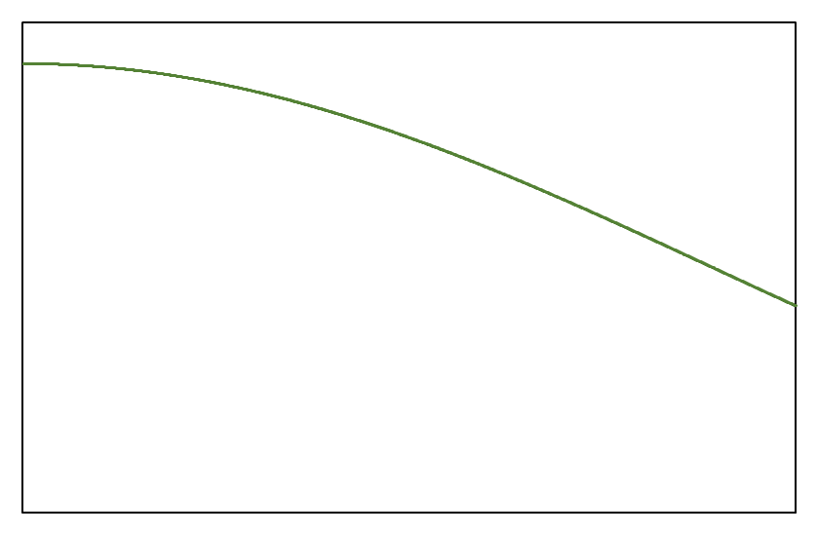
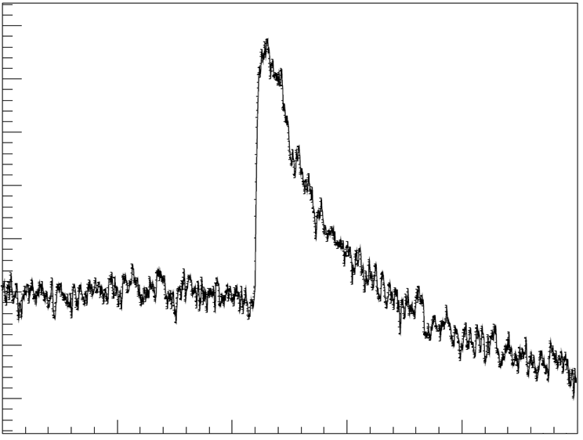
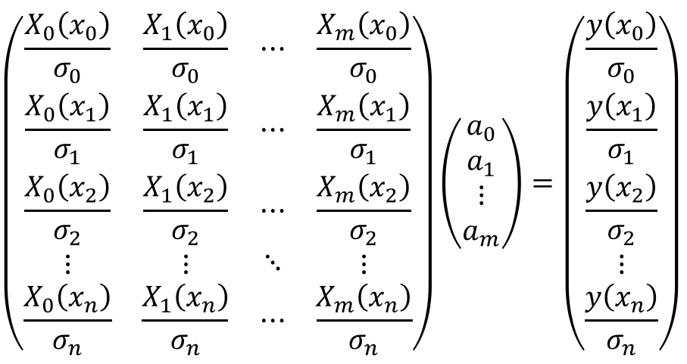
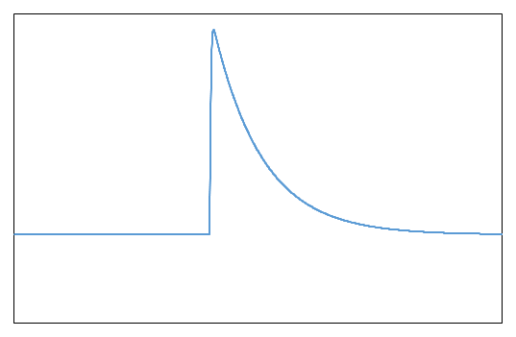
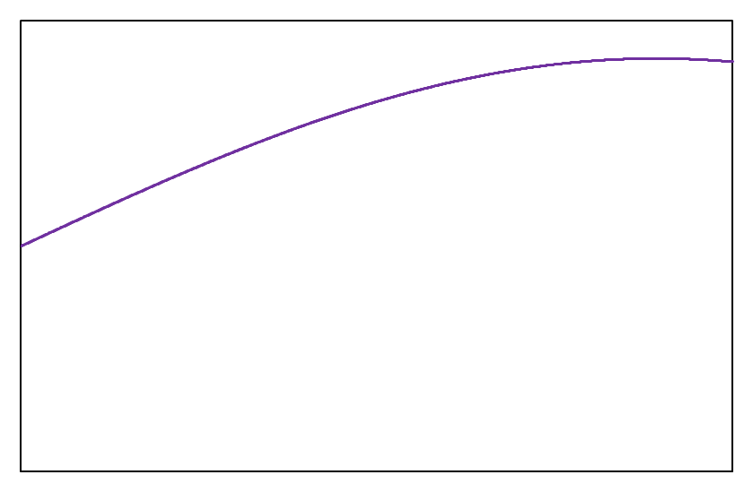
Motivation · Experiment · Detector · Timing · DAQ · DSP · Results
Sliding Least Squares Fitting
a = A⁺β
Cosine
a = A⁻¹β
Constant
Weighted
Data
Design
Matrix
Sine
Pulse
Fit
Parameters
Aaron Jezghani, University of Kentucky, PhD Thesis

Slide 26
Motivation · Experiment · Detector · Timing · DAQ · DSP · Results
Comparison with Synthetic Signals
Aaron Jezghani, University of Kentucky, PhD Thesis

Slide 27
Motivation · Experiment · Detector · Timing · DAQ · DSP · Results
Improved Peak Resolution
Pixel 64E
Pixel 64W
Trapezoid
Trapezoid
SLS Fit (FFT)
SLS Fit (FFT)
$σ=3.65$ keV
$σ=8.24$ keV
$σ=3.72$ keV
$σ=3.77$ keV
Aaron Jezghani, University of Kentucky, PhD Thesis
2020-01-10
UNAM-IF Lunchtime Seminar

Slide 28
Motivation · Experiment · Detector · Timing · DAQ · DSP · Results
Proton Detection in UCNB
Neutrons | HV On | AFP Off
Neutrons present to decay, so protons are present
Accelerating potential pushes protons to detectable energy (30 keV → 18 keV after dead layer)
Neutron spin points WEST → neutrinos preferentially go EAST → more same-side electron-proton coincidences in WEST detector
Neutrons | HV On | AFP Off
Neutrons present to decay, so protons are present
Accelerating potential pushes protons to detectable energy (30 keV → 18 keV after dead layer)
Neutron spin points EAST → neutrinos preferentially go WEST → less same-side electron-proton coincidences in WEST detector
AFP transport efficiency further reduces neutron density
e-p coincidences!
Neutrons | HV On | AFP Off
Neutrons | HV On | AFP On
Microphonics
Neutrons | HV Off | AFP On/Off
Neutrons present to decay, so protons are present
No accelerating potential to provide protons with sufficient energy for detection
Sanity check that any e-p “signal” is not just low-energy electrons from beta decay
Background | HV On | AFP On/Off
No neutrons to decay, so protons are absent
Accelerating potential to provide protons with sufficient energy for detection
Sanity check that any e-p “signal” is not just spurious noise due to HV or other particles being accelerated
Backscatters
Probably
Microphonics?
Neutrons | HV Off | AFP On/Off
Bkgd | HV On | AFP On/Off
Aaron Jezghani, University of Kentucky, PhD Thesis

Slide 29
Covariant LSQ Fitter
measure noise spectrum
acquire average template waveforms representing nonlinear variations of signal (pulse-shape)
LSQ inverse of design matrix w/r cross-correlation matrix to project out backgrounds
FIR filter for each response function approximated by piecewise polynomials
calculate X² in real-time, repeat linear LSQ fit for t₀ at minimum X²

Slide 30
Generic filter design!
Aaron Jezghani, University of Kentucky
Notes:
In conclusion, the addition of powerful digital filters into the streaming readout system can be used to form versatile trigger logic, or dramatic reduction in data size without loss of essential information and can all be done in real time at full digitization speed. Here, my student Aaron was playing around with a new filter to convert tail pulses into a cool logo basketball-winning logo (at least usually).

