Slide 1
Fermilab Facilities Report
Lydia Brynmoor
USQCD All-Hands Collaboration Meeting
April 19th, 2023

Slide 2
The HPC Support Team
We operate under Fermilab’s Computational Science and AI Directorate (CSAID)
Applications / Programming Jim Simone (Site Liaison)
Systems / Hardware Ed Simmonds (Group Leader), Tim Skirvin (HPC Architect)
Services / Support Ken Herner (GL & Acting Co-Site Manager), Lydia Brynmoor (Site Manager)
Batch Management Farrukh Khan (Group Leader, SLURM)
Storage Services Robert Illingworth (Group Leader), Dan Szkola (Lustre/ZFS)

Slide 3
Fermilab LQCD support - Service Desk
Emailing lqcd-admin@fnal.gov is the best way to reach us and will elicit the quickest response.
LQCD-Admin staff use Service Now (SNOW) ticketing system for tracking incidents and requests.
Email sent to lqcd-admin@fnal.gov automatically generates an Incident ticket.
In SNOW (ServiceNow) - We convert INC to RITM when appropriate.
INC – Incidents are for when something is broken. Higher priority and tracked closely
RITM – Requests are for all other questions or assistance. Still tracked but less detailed reporting up to management or DOE.
Must use ”Reply All” and put your response above the ”PLEASE REPLY ABOVE THIS LINE”.
Response time as well as time to resolve are tracked and reported.
Please do not contact any of the Fermilab LQCD support staff directly for support.
Our goal is to resolve issue within 3 business days.

Slide 4
Subscribe to the lqcd-users@fnal.gov LISTSERV
We ask all LQ users to subscribe to the lqcd-users email list in order to receive timely notifications about LQ operations and future announcements concerning the Fermilab lattice QCD clusters.
To subscribe to the lqcd-users@fnal.gov mailing list : 1. Send an e-mail message to listserv@fnal.gov. 2. MUST leave the subject line blank. 3. Type only the following in the body of the email message:
SUBSCRIBE lqcd-users FIRSTNAME LASTNAME

Slide 5
Fermilab Affiliate Accounts
Fermilab is continuing to streamline the Fermilab access process.
To access USQCD computing resources as a Fermilab affiliate, you need:
Fermilab Affiliate ID
Kerberos account
Unix account for the LQCD facility
Affiliate ID and Kerberos account Submit an online application form requesting an affiliate ID and Kerberos account here:
https://get-connected.fnal.gov/accessandbadging/access/
Extremely important to use: Affiliation: “lattice QCD” Contact: James Simone
Unix accounts on the LQCD cluster machines After you have received an email with information about your Kerberos account, We need an email from the PI of the project verifying your affiliation to the project.

Slide 6
Fermilab’s 2019 LQ1 CPU Cluster
Total of 179 nodes (7,160 cores)
On each worker node:
Dual 20-core Intel Xeon 6248 “Cascade Lake” 2.5 GHz processors (rated 42.35 sky-cores or 318 Gflops/sec)
192 GB RAM
Intel EDR (100 Gbps) OmniPath link
USQCD type A allocatable = 55.18 M sky-core-hrs.
See Call for Proposals for details
The LQ1 Cluster

Slide 7
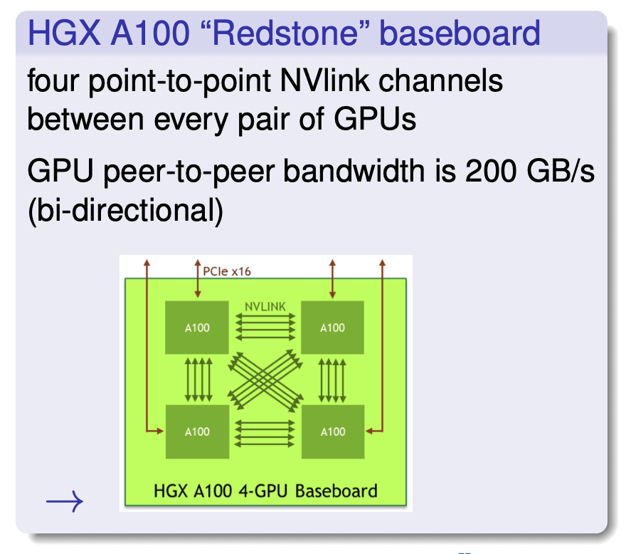
Fermilab’s 2023 LQ2 GPU Cluster
18 worker nodes -- total of 72 A100 GPUs.
Each worker:
"Redstone": quad A100 GPU with point-to-point NVlink.
Total of 320 GB HBM2e device mem., 1000 GB system RAM.
Dual NDR/200 IB network links.
Dual 2.8 GHz 32-core AMD EPYC zen3 (Milan) processors.
USQCD allocations began on October 10th
Jeopardy policy will start in July 2024
USQCD type A allocatable = 508 k a100-gpu-hrs
The LQ2 Cluster

Slide 8
Deployment challenges
Supply chain disruptions and uncertain economic conditions in 2023 significantly delayed the commissioning of the LQ2 cluster. Target date: October 1, 2023.
Integration of LQ2 with existing services (Lustre, login nodes, home, batch, NFS disk) required a downtime of both LQ2 as well as LQ1.
Newer LQ2 hardware needed more recent software not available in Enterprise Linux 7 (EL7).
LQ1 was running EL7 which would reach EOL on June 30, 2024. Fermilab security policy requires that all severs must upgrade to a supported OS before the EOL date.
We took a three-week downtime in Sept. 2023 to meet the LQ2 deployment milestone and have both clusters running a supported OS to minimize future downtimes.
Fully integrated LQ2 with existing LQ1 services.
Installed Alma Linux 8 (EL8) and newer compiler toolchains on both LQ2 and LQ1.
Unfortunately, no "friendly user" period on LQ2 and we fell a month behind in LQ1 availability

Slide 9
Comparison of LQ1 Delivered and Used Capacity
Goal: The aggregate resources Fermilab has committed to provide USQCD towards type A allocations
Used: This is the cumulative value of hours used by users. Always <= Provided.
Provided: This is the cumulative value of the CPU hours made available to users. Ideal scenario is that Used = Provided.

Slide 10
LQ1 Activity for Project Year 2023 - 2024

Slide 11
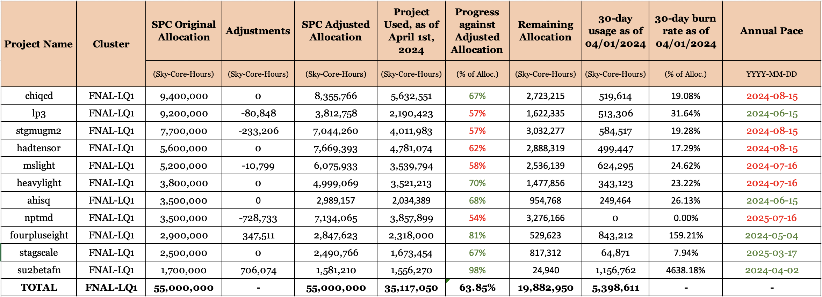
LQ1 Allocation for Project Year 2023 – 2024
These numbers from April 1st are at 80% through the program year
https://www.usqcd.org/jeopardy.pdf

Slide 12
Comparison of LQ2 Delivered and Used Capacity
Goal: The aggregate resources Fermilab has committed to provide USQCD towards type A allocations
Used: This is the cumulative value of hours used by users. Always <= Provided.
Provided: This is the cumulative value of the CPU hours made available to users. Ideal scenario is that Used = Provided.

Slide 13
LQ2 Activity for Project Year 2023 - 2024

Slide 14
Storage (Disk and Tape)
File Transfer :
Please use lqio.fnal.gov for large IO transfers to Lustre or tape.
- Has 100GigE interface Globus endpoint “lqcd lustre1” for /lustre1
https://computing.fnal.gov/lqcd/filesystems/

Slide 15
Storage (Disk and Tape)
Area | Description | Backup | Use Case
/project | Area typically used for approved projects. Visible on all cluster worker nodes via NFS file system. Typically, 6-10GB disk quota limit. | Nightly | Small files only
/home | Home area. Visible on all cluster worker nodes via NFS. Not suitable for configs or props. | Nightly | Can be used as a “run” directory for light production or testing. A quota of about 6 to 10 GB per home directory.
/pnfs/lqcd | Enstore Tape storage. Visible on cluster login head nodes only. Must use special copy command: ‘dccp‘ | No Backups | Ideal for permanent storage of parameter files and results.
/lustre1 | Lustre storage. Visible on all cluster worker nodes. Disk space quotas enforced. Check quota with: lfs quota -hg $projectName/lustre1. | No Backups | NOT suitable for large number of small files. Ideal for caching of very large data
/scratch Soon to be… /scratch/$user/$job | Local 892GB disk on each worker node. Any precious data needs to be copied off this area before a job ends since the area is automatically purged at the end of a job. | No Backups | Suitable for writing all sorts of data created in a batch job.

Slide 16
Quotas for allocated storage in Lustre
We track /lustre1 usage and quota based on group ownership.
Periodically, we run scripts to correct group ownerships and sticky bits
Since Lustre is designed for large file access, we have implemented limits on storage space and number of files
Can check quota space with “lfs quota -hg $projectName/lustre1

Slide 17
Changes coming soon to Lustre
We’ve added 1.2 PB to our /lustre1 filesystem now bringing the total to ~ 2 PB
Per user & job scratch structure coming soon via an environment variable “SCRATCH” that points to the appropriate directory.
New location of temp directory will also be specified via an environment variable, “TMPDIR”.

Slide 18
Data Management Planning
Each project is responsible for their own data management plan. You need to keep copies of critical data somewhere safe. Lustre is not backed up.
A project’s storage allocation is tied to the program year. Think of it like a lease on an apartment.
At the end of the year, you either renew your lease, negotiate to a larger or smaller space, or you vacate and move to another location.
Clear out promptly please. We need to provide the space to the next “tenant”.
Short term tape storage will be separate tapes by program year vs Long term.
https://computing.fnal.gov/lqcd/fermilab-data-management-guidelines-policies/

Slide 19
Questions
We asked you to use the lqcd-admin@fnal.gov email address, but if you have questions about this presentation, you are welcome to contact me directly:
Lydia Brynmoor <brynmool@fnal.gov>

Slide 20
End
Thank you.

