Slide 1
DarkLight at ARIEL Update July 2024

Slide 2
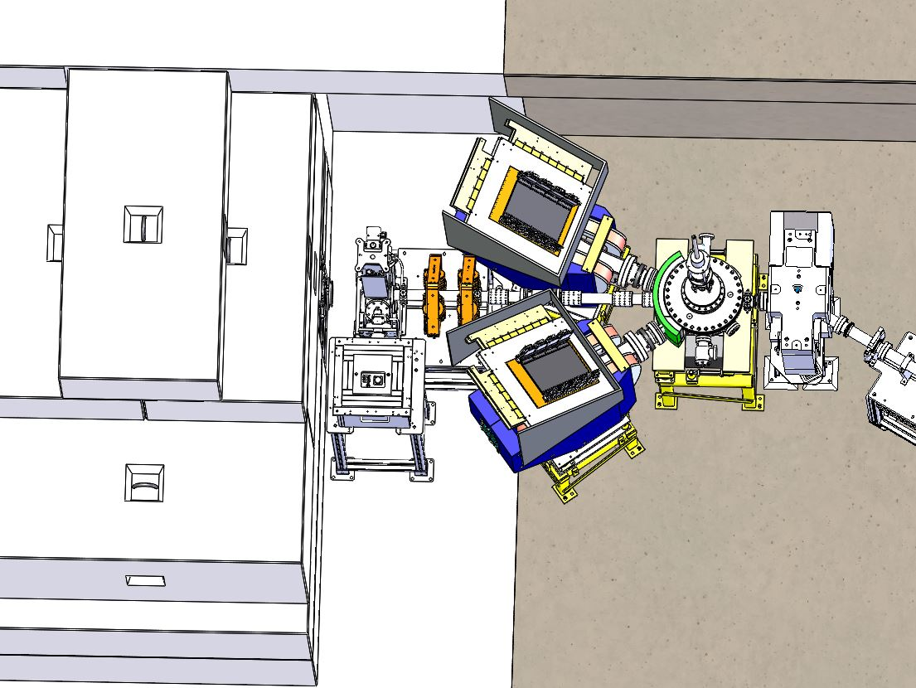
Latest Experiment layout

Slide 3
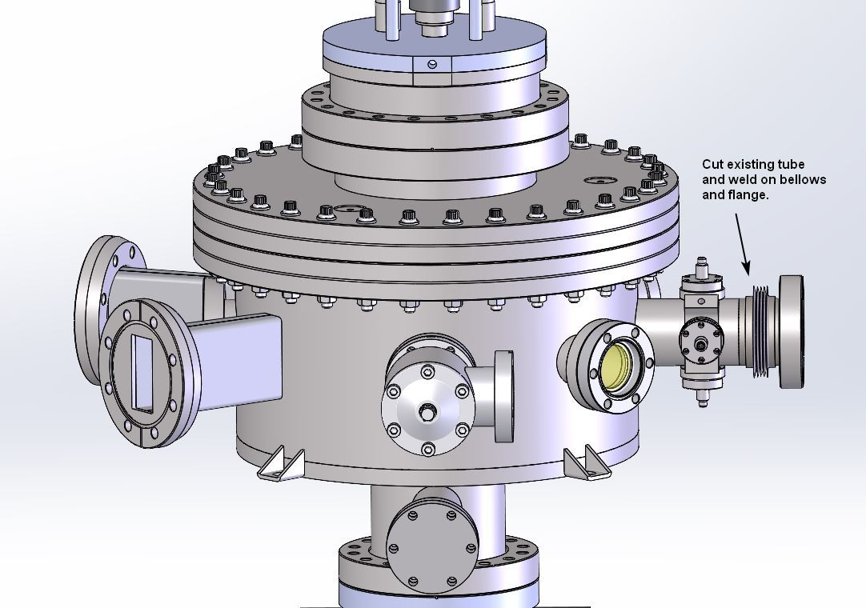
DarkLight Scattering Chamber
Adding bellows to inlet tube to chamber.
Bellows has been ordered and machine shop is ready to modify chamber.

Slide 4
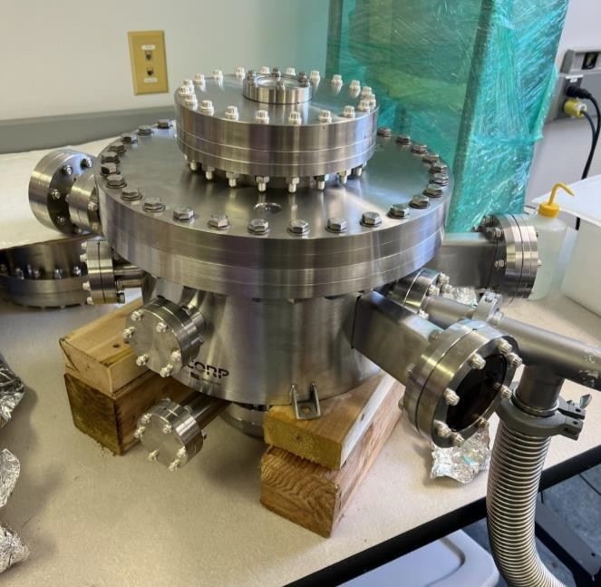
Scattering Chamber
Scattering chamber delivered and leak checked.

Slide 5
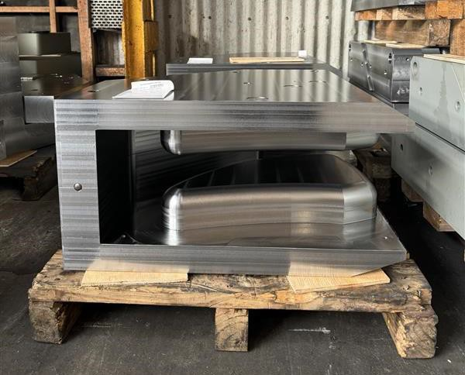
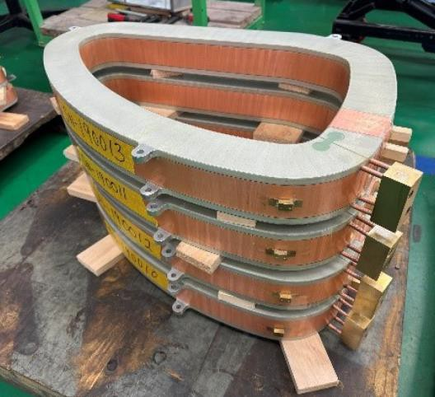
Dipole Magnets
Dipole Magnets are finished. We are currently working on getting them shipped to Bates.

Slide 6
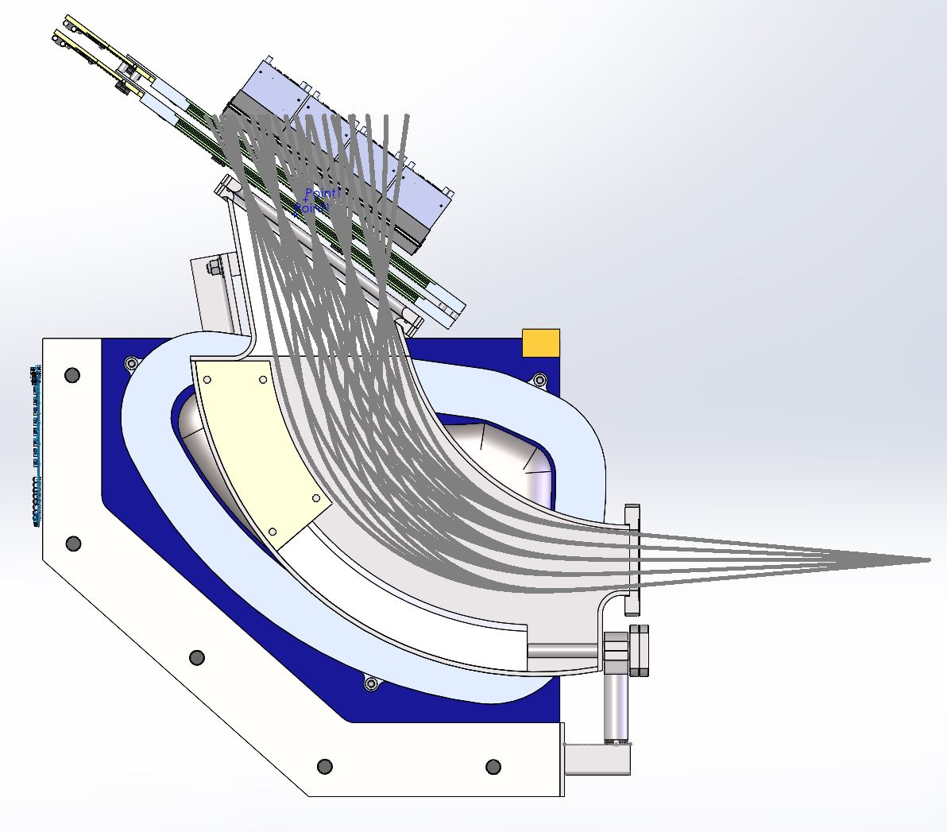
Section View of Electron arm w/ latest PEEK design
Modified PEEK shielding design for electron arm

Slide 7
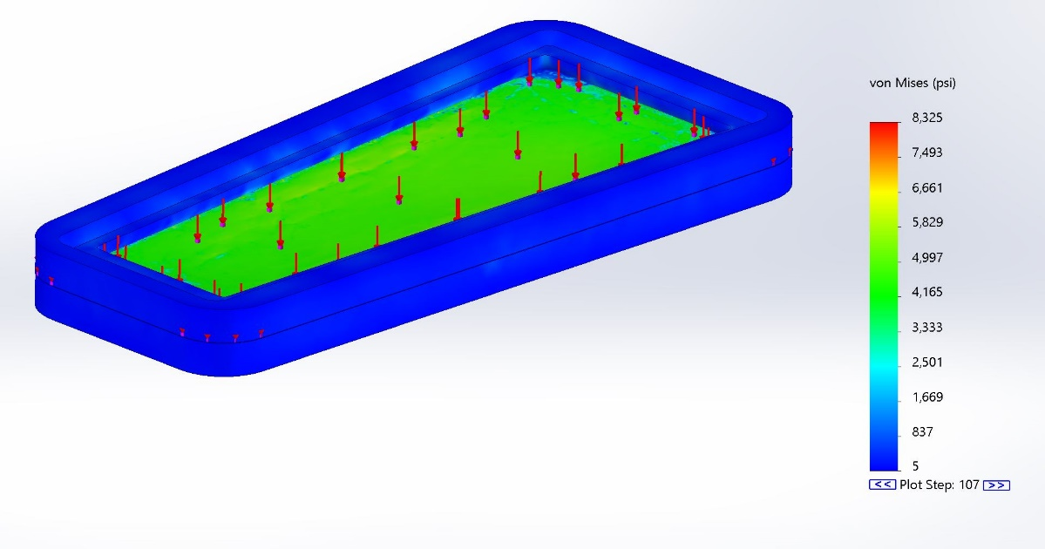
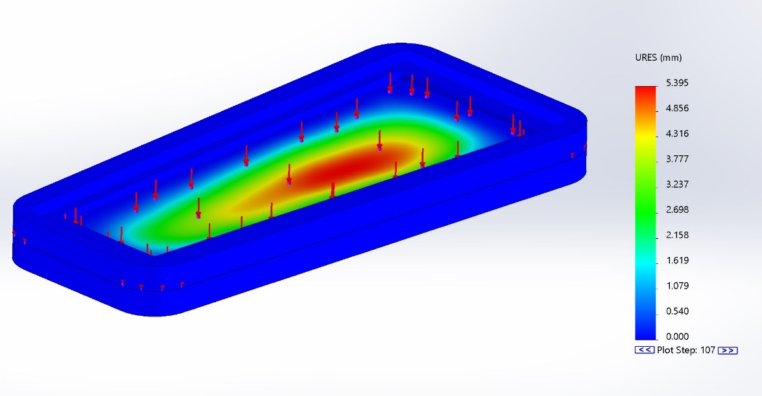
Thin window FEA analysis
Stress levels above yield (expected) but below ultimate strength of material.
The analysis shows approx. 5.4mm of displacement.

Slide 8
Spectrometer Window Testing
Testing on windows was carried out by hydro-testing.
Actual deflections were less than FEA results.
Testing demonstrated a safety factor of 4 before failure.
Will show video of a window test.

Slide 9
Summary
Upcoming steps for DarkLight effort includes:
Modifying scattering chamber inlet port for bellows addition.
Leak check of scattering chamber after modifications for bellows.
Fabricate stands for scattering chamber and dipole arms.
Modify magnets upon arrival.
Leak check dipole chamber upon its arrival.
Order all remaining hardware (mostly bolts, nuts, and gaskets)
Assemble complete system, leak check, and survey.

