Slide 1
Studying diffusion with conservation of center of mass using subMIT
SubMIT group meeting
Sunghan Ro
Julien Tailleur group, MIT
Reference: Han, Lake & Ro, Phys. Rev. Lett. 132, 137102 (2024)

Slide 2
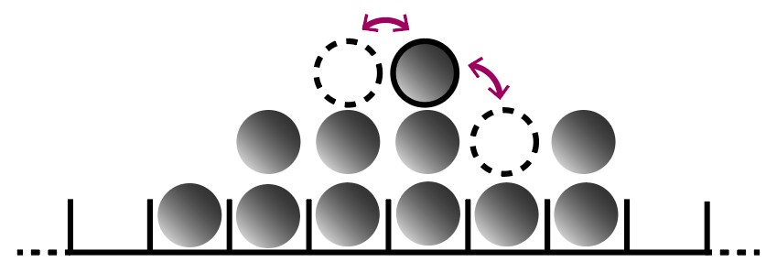
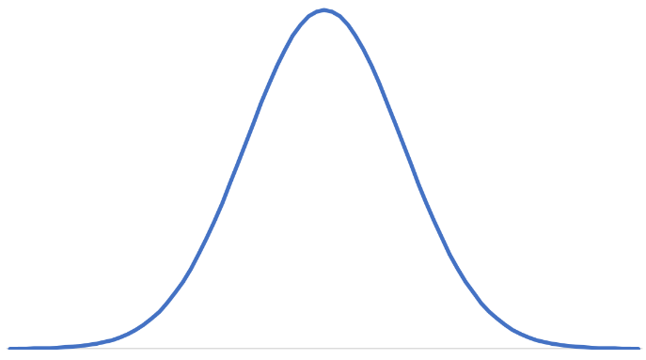
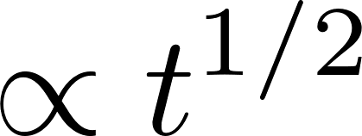
Normal diffusion

Slide 3
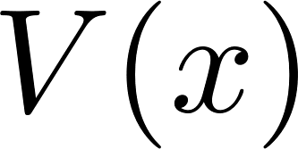
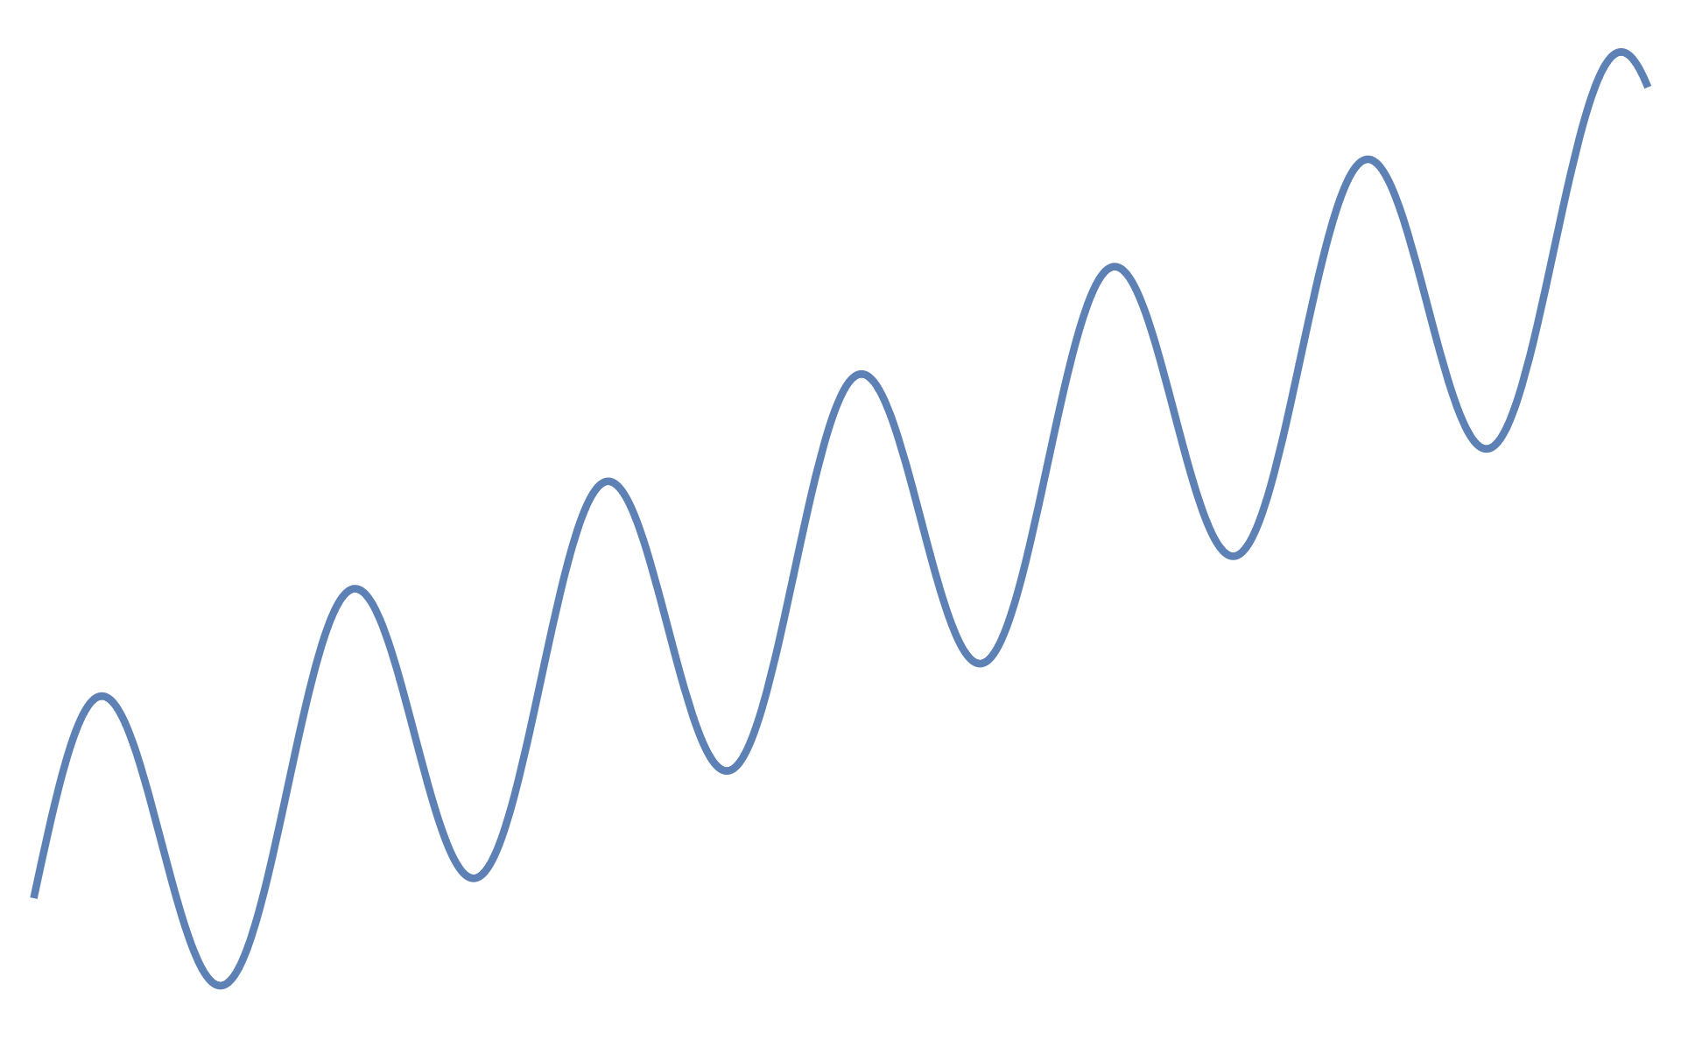
Diffusion with kinetic constraints

Slide 4
Diffusion with kinetic constraints

Slide 5
Diffusion with kinetic constraints

Slide 6
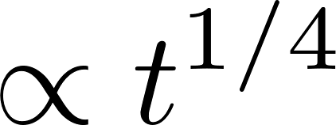
Dynamical scaling

Slide 7
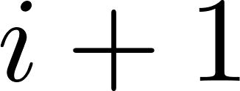
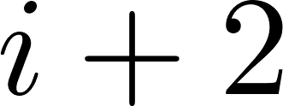
Model-based approach

Slide 8
Comparisons

Slide 9
Localization and the 2nd law

Slide 10
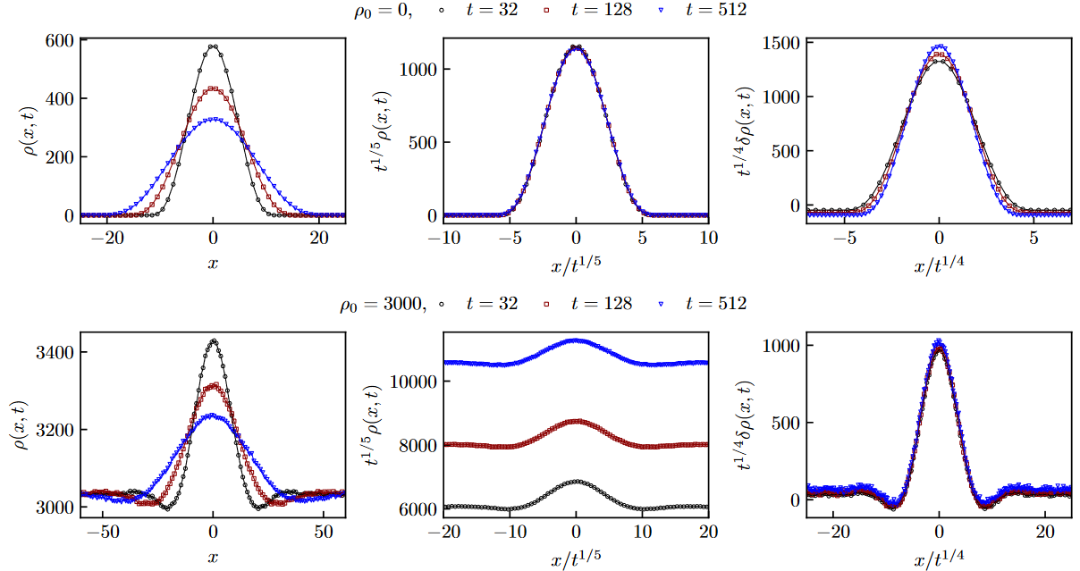
Crossover in finite sized systems

Slide 11
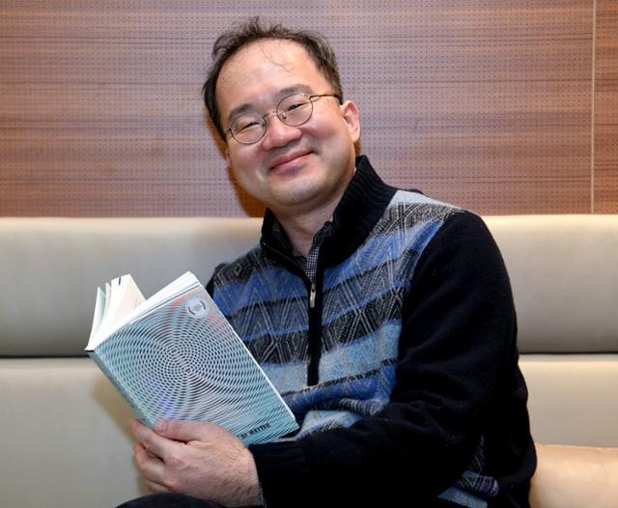
Acknowledgement

