Slide 1
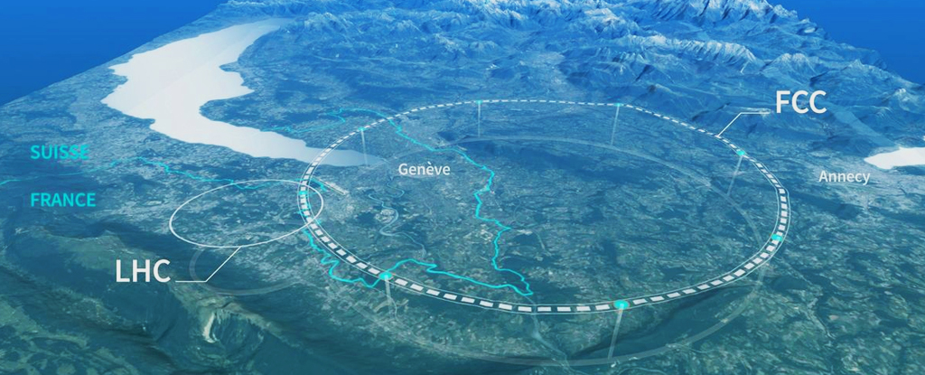
8.FCC - January Research Projects on
the Future Circular Collider (FCC-ee)
Introductory Lecture
[January 6, 2025]

Slide 2
Lecture Outline
Introduction of Course Personnel
Objective of the research projects
Organization of the Lectures
  Prerequisites
  Schedule: lectures and tutorials
  Final Conference and beyond
Course Content Overview
Overview of physics and projects

Slide 3
Personnel
Lecturers
  Christoph Paus, Eluned Smith
Tutorials and hands-on help
  Anja Beck, Jan Eysermans, Dolores Garcia, David Walter
Support
  Luca Lavezzo, Pietro Lugato, Kevin Yoon
Please all introduce yourselves!

Slide 4
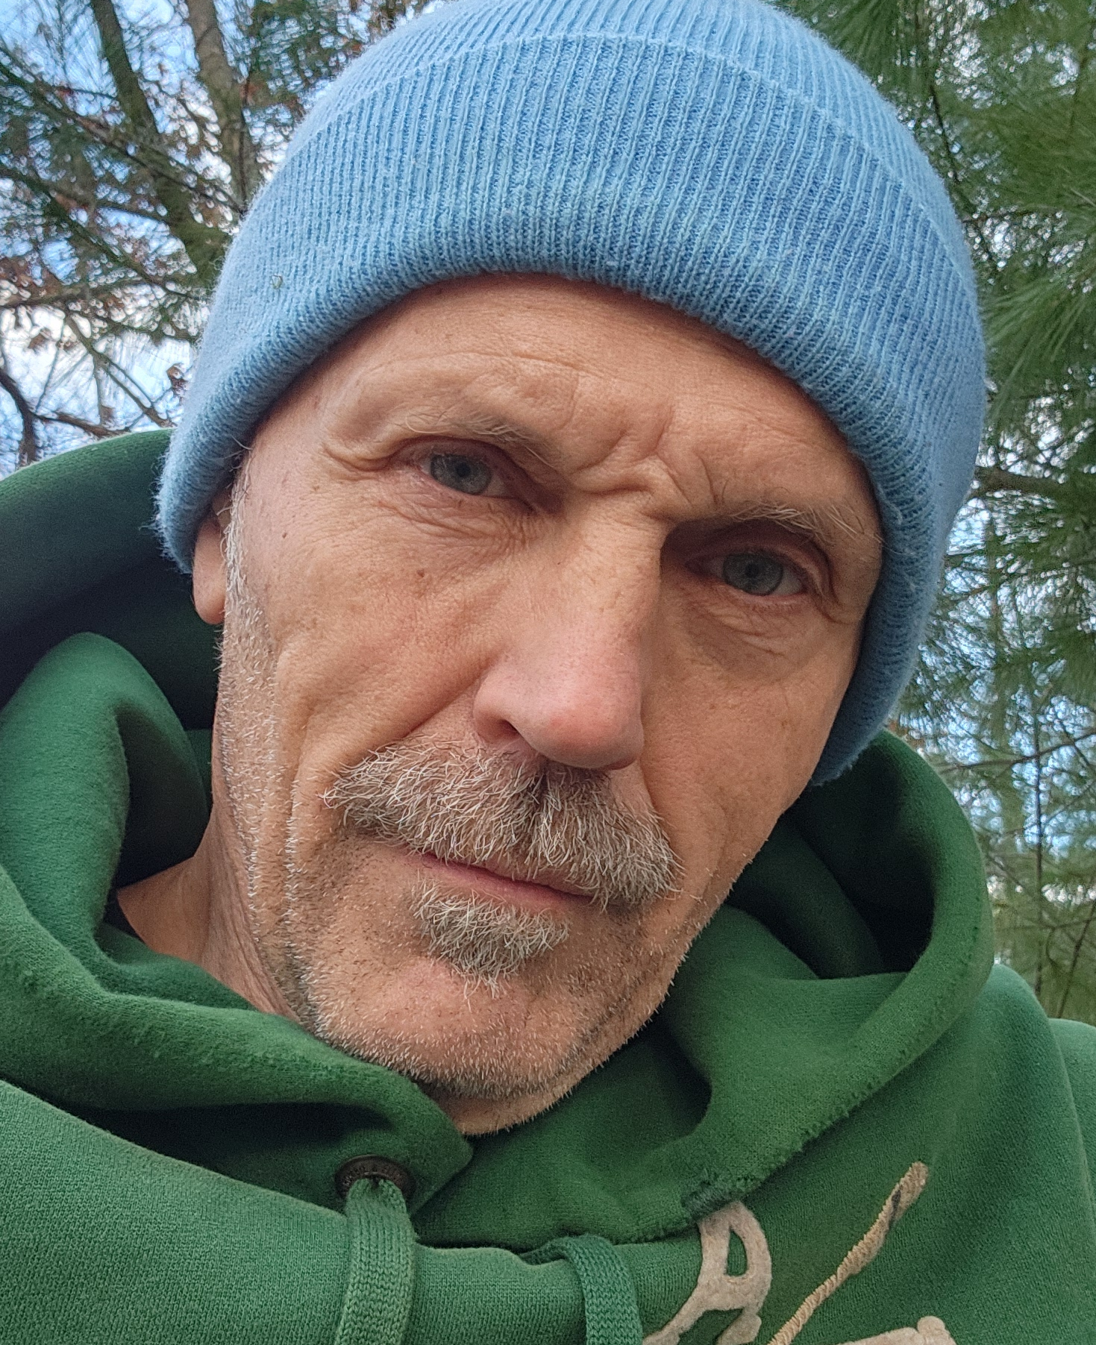
The Lecturer, today
Christoph Paus
  physics career
    started PhD 1992 at L3 (e⁺e⁻⁻, LEP, CERN)‏
    in 1998 moved to CDF (pp, TeVatron, FNAL)‏
    since 2006 mostly CMS (pp, LHC, CERN)
    started seriously on FCC in 2021‏
  physics measurements
    precision electroweak (Z boson mass & width, EWK parameters)‏
    B physics directly related to CKM matrix (Standard Model)‏
    Standard Model Higgs boson observation and properties
    Long series of various Dark Matter searches
    Searches for: Contact interactions, magnetic monopoles, pentaquarks, excited onia, rare decays

Slide 5
Objective of this Research Experience
Course focus
  introduce experimental methods
  perform typical measurements at the FCC-ee using simulated data
Not the purpose of this course
  provide fully fledge theoretical background
    quantum field theory courses good for that
    also nuclear and particle physics standard graduate courses
  provide in depth discussion of how detectors work
    nuclear and particle physics standard graduate courses
    maybe specialized course for detector design and construction
Goal in practical terms
  learn how to do research as an experimentalist at the FCC-ee
  be prepared to go to CERN and start an analysis in the summer
  .. or at least know how experimentalists work in High Energy Physics

Slide 6
Organization
Prerequisites
  Basic Physic classes AP level
  Nice to have: special relativity, quantum physics
  Stretch: have heard particle physics 1+2 but not needed
Dates
  Schedule has some flexibility
  First ~2 weeks lectures: Mon-Fri 9am–10:30am (24-506)‏
  First ~1 week tutorials: Mon-Fri 1pm–2pm (24-506)
  Daily support in person
  Research conference on Friday January 31, 2025

Slide 7
Organization
Execution
  Participation from outside MIT welcome, but local supervisor needed
  Lecture slides will be available from the Web
  Core of the experience
    Learn basic tools of the trade
    Perform a complete analysis on FCC-ee simulation
    Report about your project in short conference presentation
  It is possible to pair up and work together
  If there is time summarize analyses in a short note
  Conference at the end of the course, one topic per student

Slide 8
Technicalities
Access to computing resources
  Get account at MIT, if you are not at MIT
  request account by sending email to paus@mit.edu
Access to course software etc
  Make an account on subMIT our computing system
  Go to: https://submit-portal.mit.edu
  Follow instructions (possibly email submit-help@mit.edu)
Video tools
  Zoom: https://mit.zoom.us/j/93715345658?pwd=6B9qQHzLzNUSPWnn1JH7Onu7SmlITb.1

Slide 9
Course Content
Five big blocks
  Introduction and overview
  Experimental setup
  Fundamental measurements
  Overview of the FCC-ee program
  Key detector components
Lecture plan not exactly cast in stone
  if you have special wishes let us know

Slide 10
Course Content – more details
Introduction and overview
  introductory lecture
Experimental setup
  Particle accelerators
  Particle detectors
Fundamental measurements
  Cross sections, particle masses, particle lifetimes and widths
Overview of the FCC-ee program
  Physics at the Z pole, the Higgs and top thresholds, new physics
Key detector components
  Tracking, Calorimetry, and Particle Identification (Id)

Slide 11
Interesting Material
Videos: academic lectures and presentations
  CERN: https://cds.cern.ch/collection/Webcast?ln=en
  SLAC: https://indico.slac.stanford.edu/event/8587/page/92-past-ssi
  FNAL: visual media site check the archives
Wikipedia
  FCC: https://en.wikipedia.org/wiki/Future_Circular_Collider
  LHC: https://en.wikipedia.org/wiki/Large_Hadron_Collider
  CMS: https://en.wikipedia.org/wiki/Compact_Muon_Solenoid
  CDF: https://en.wikipedia.org/wiki/Collider_Detector_at_Fermilab
  also try google, YouTube etc.
  fantastic documentation on the Web though, read with care
References will be provided throughout the course

Slide 12
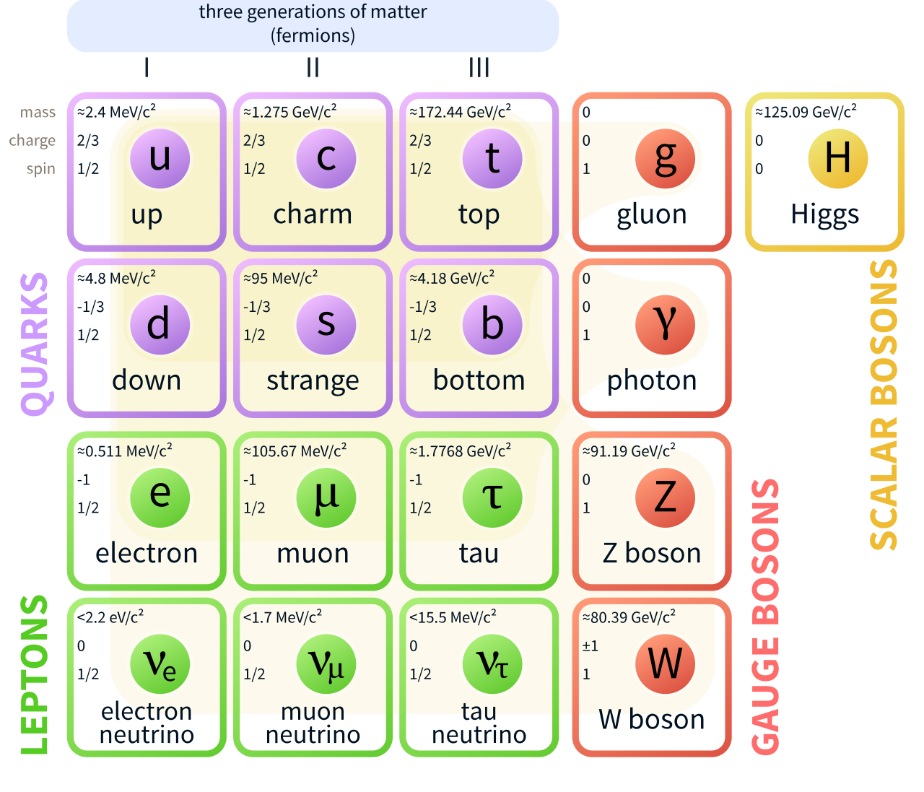

The Standard Model of Particle Physics
‘Last’ problem
  Local gauge invariance only conserved for massless particles
Solution (1964-6)
  There should be at least one field to couple to, to generate mass terms – implies that there is at least one Higgs boson.
  LHC found it 2012

Slide 13
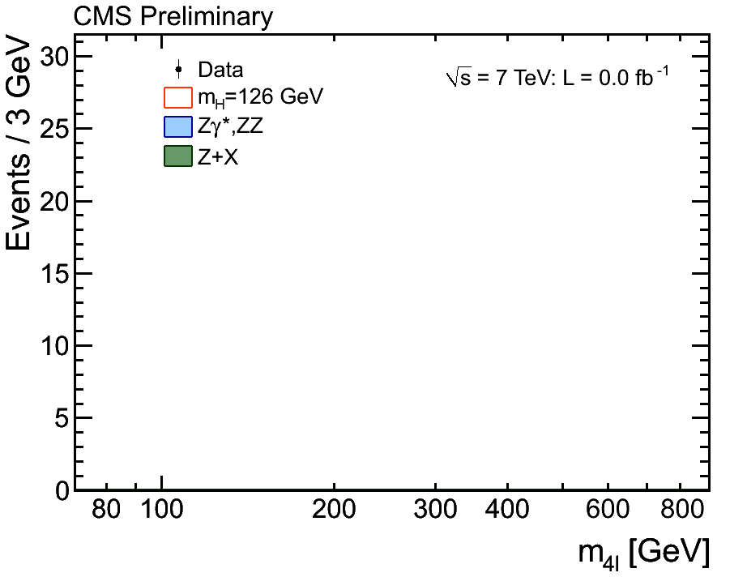
Run 1 at LHC brought the Higgs

Slide 14
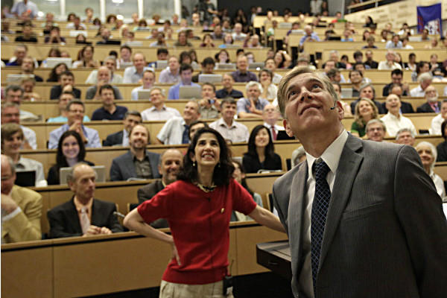
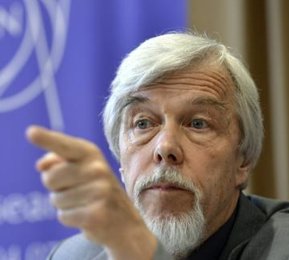
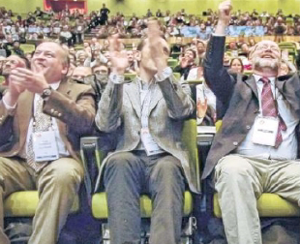
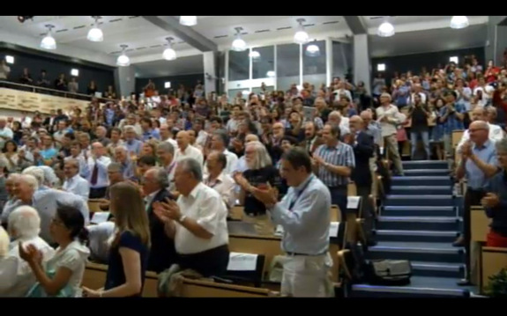
Historic Event: CERN–Melbourne
CERN
Melbourne
Rolf Heuer:
'We have it!'
4th of July 2012 – new Higgs–like particle discovery

Slide 15
The Standard Model of Particle Physics
Remaining obvious problems
  We have no explanation for what dark matter is
  Why is the value of the Higgs mass the known value? #HierarchyProblem
  Why are forces so different (electromagnetic, weak, strong)?
  Gravity is an alien to the Standard Model – it does not fit! It is super weak!
  Why do we see so much matter and very little anti-matter in the universe
  and there are more interesting questions ...
Theorists favorite solution(s) for 1-3
  Supersymmetry by giving each SM particle a super partner
  So far no trace found…

Slide 16
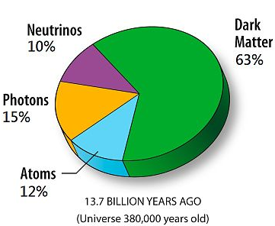
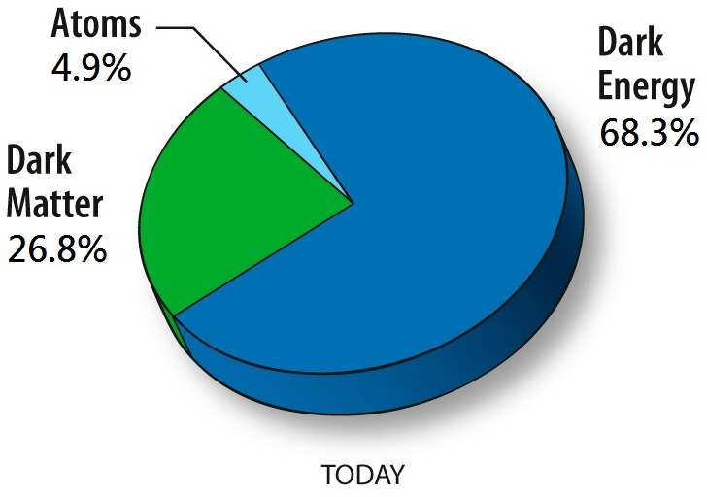
What was/is next for me?
Dark Matter
85.6% of all matter is dark!

Slide 17
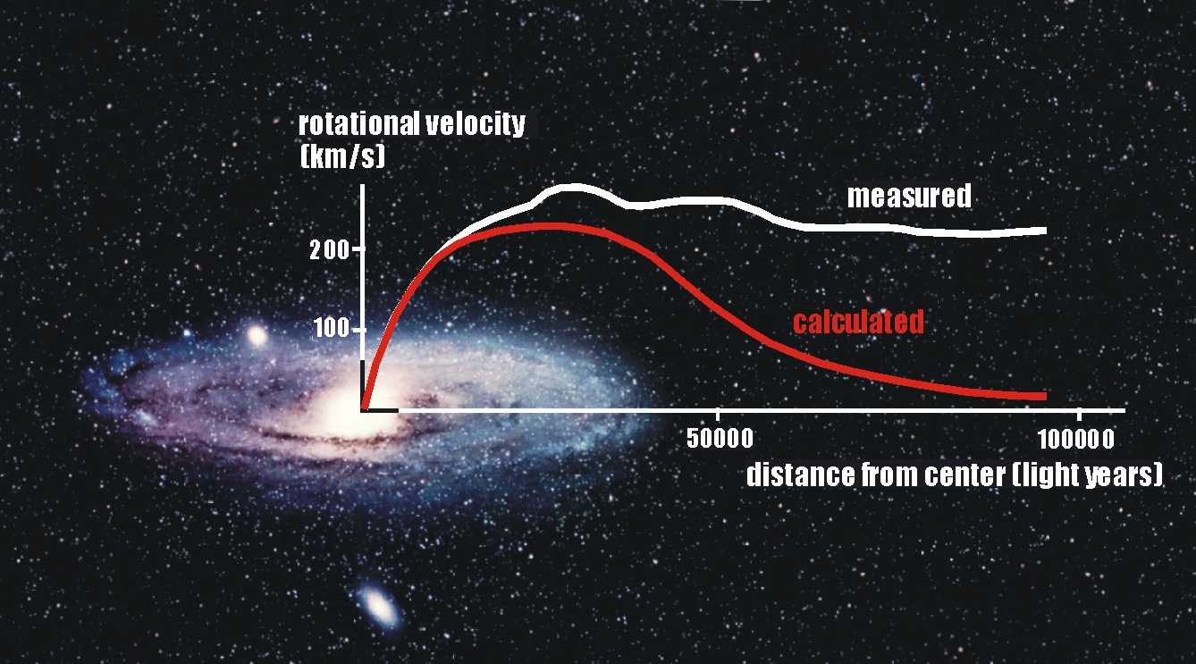
Rotational Velocity
gravitation
centripetal acceleration
Measured rotational velocity requires
additional 'dark' matter to be present.

Slide 18
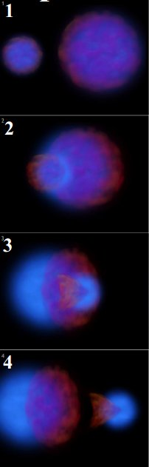

Gravitational Lensing
Bullet Cluster
visible matter
dark matter

Slide 19
Searching Dark Matter with CMS
Signature
  Dark matter does not interact with detector
  Sooo…. the detector is empty?
  But if the initial state has radiation …. Well defined:
Standard Model
particles
Dark Matter
particles
Radiation in the initial state
Lepton(s), Jet(s), Photon(s), V ...

Slide 20
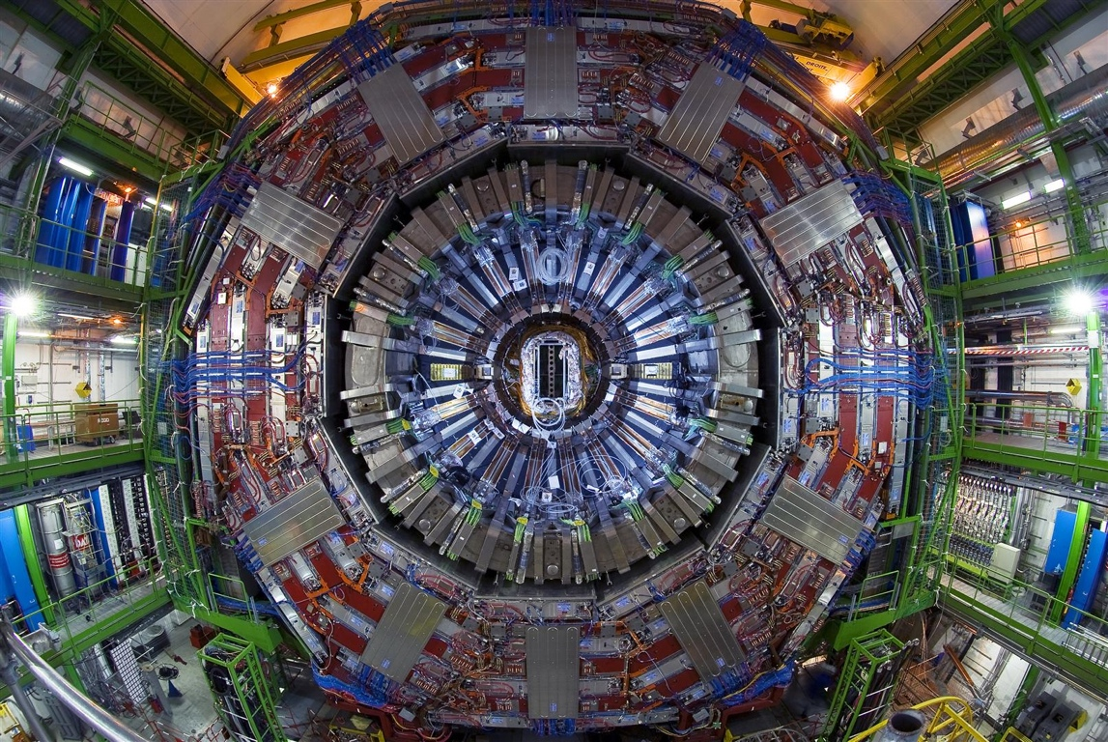

Compact Muon Solenoid

Slide 21
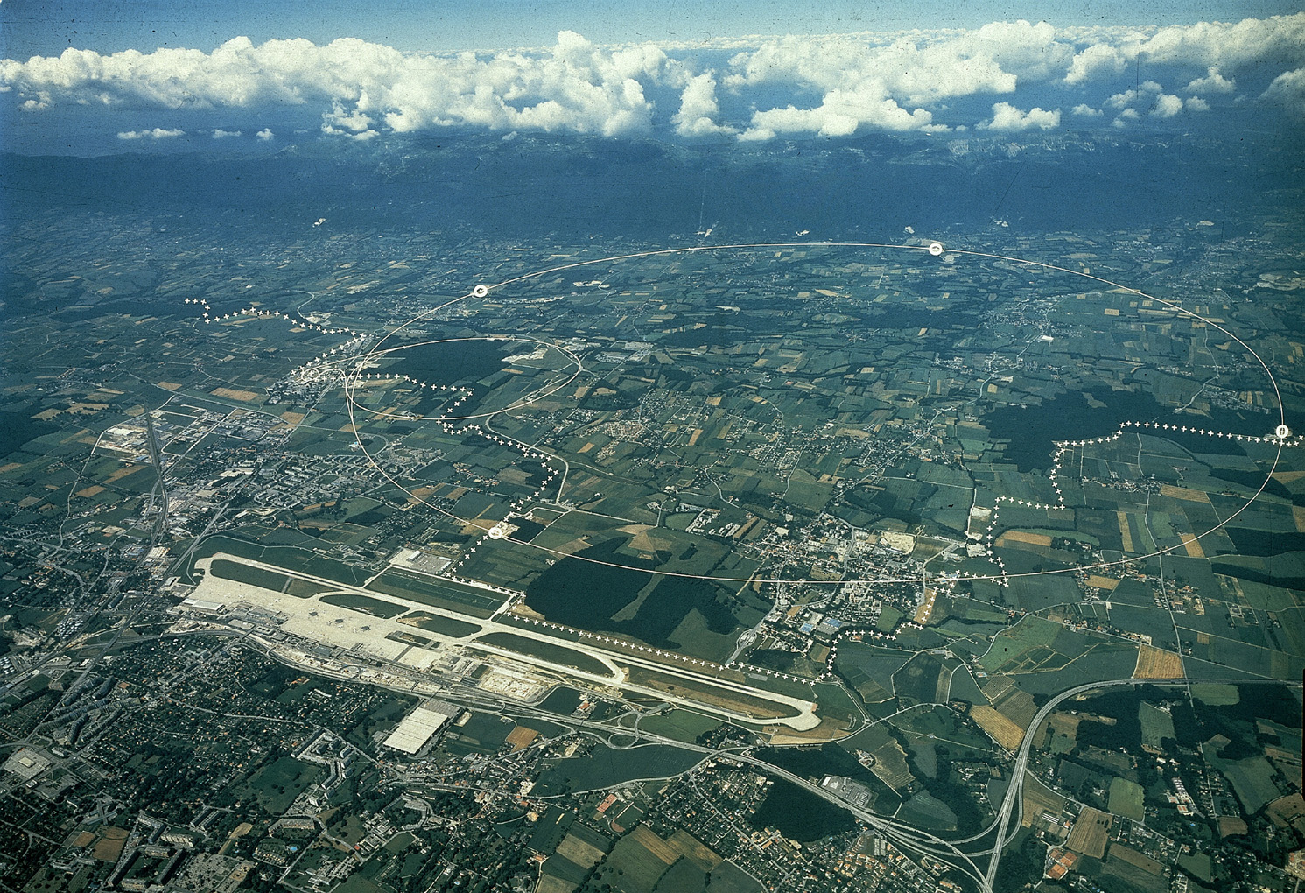
Overview: CERN (Geneva, Switzerland)‏
Check out serious YouTube: CERN LHC 2007
http://youtube.com/watch?v=s9XotvwgnaY
France
6 miles
Geneva airport
Switzerland
:
Check out fun YouTube: Day to Day Communications (1974)‏
http://youtube.com/watch?v=OymJC9KkWlg

Slide 22
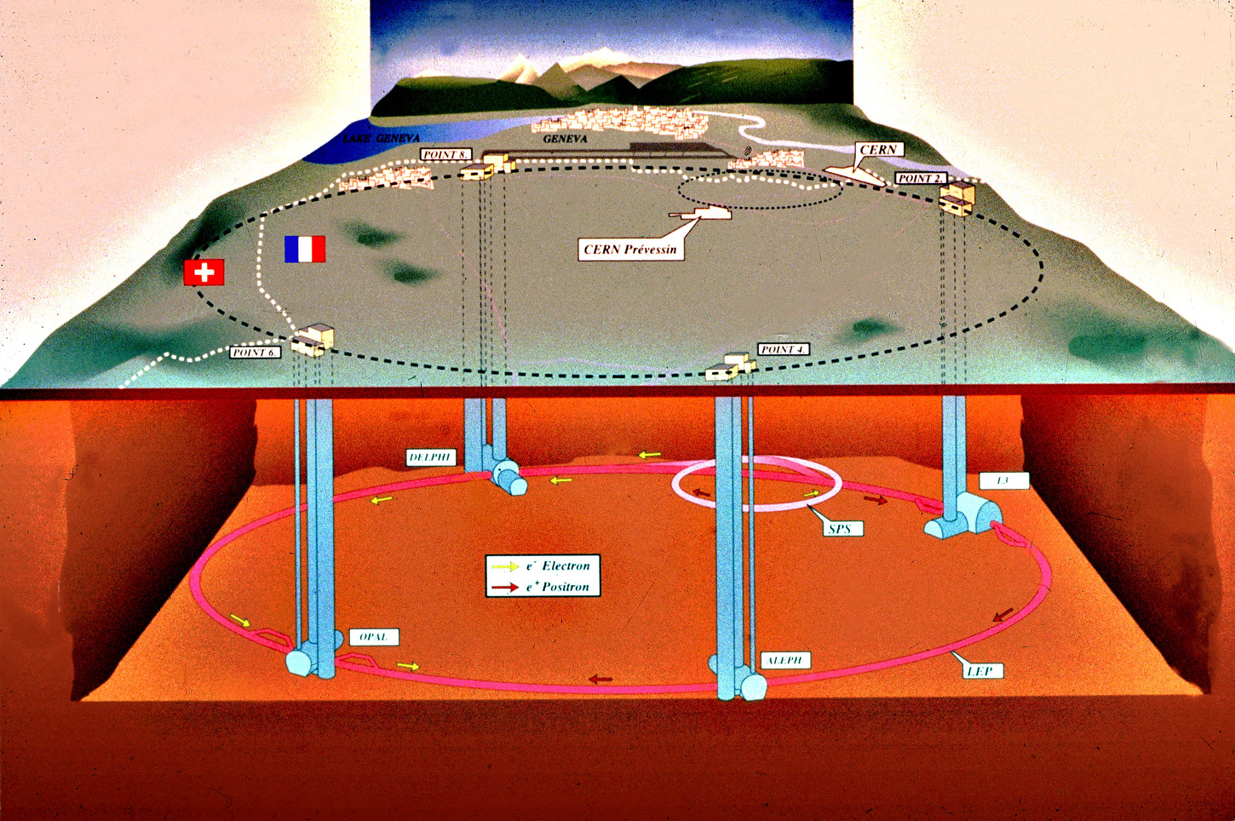
The LEP/LHC Tunnel Setup
Tunnel is 27 km long
50-150m below ground

Slide 23

The LEP/LHC Tunnel Setup
Tunnel is 27 km long
50-150m below ground

Slide 24
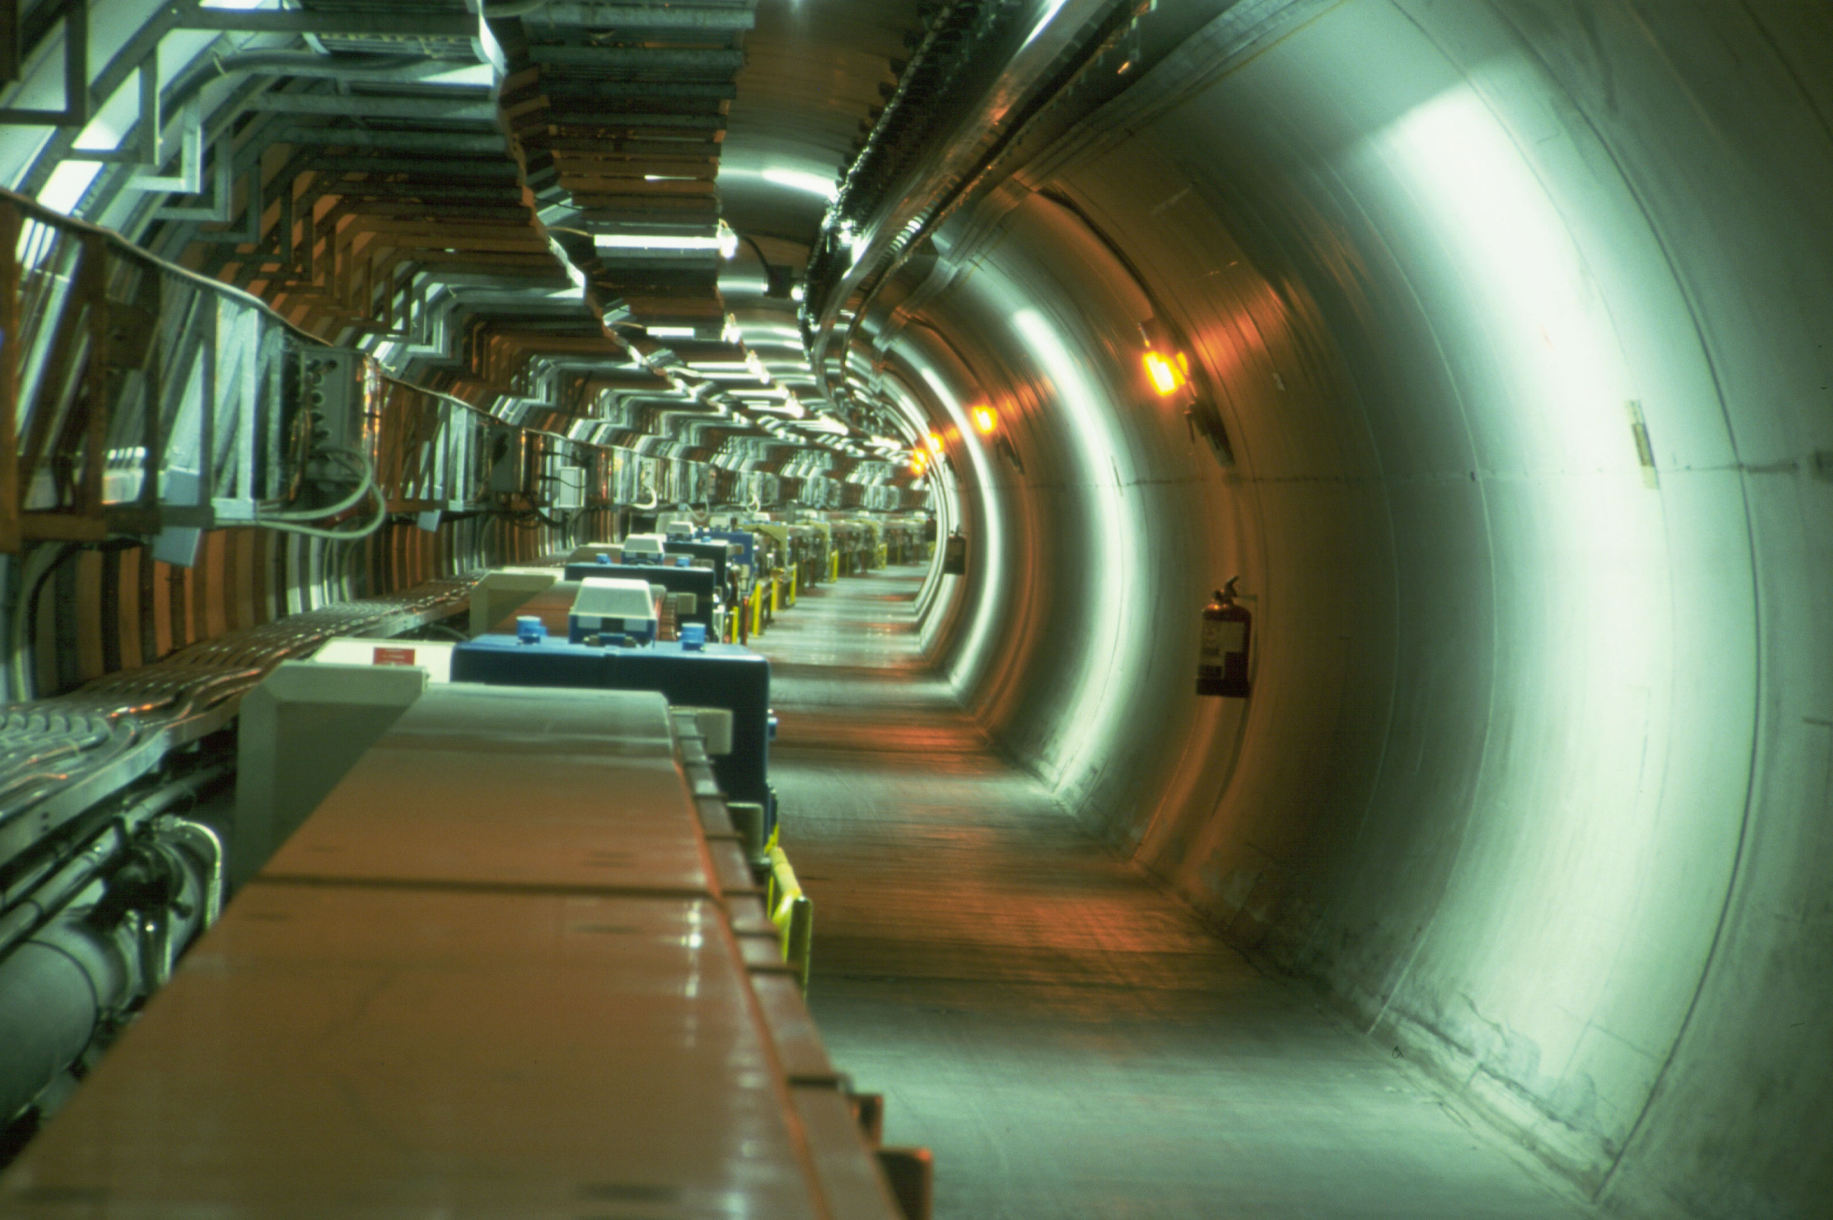
LEP Tunnel before LHC

Slide 25
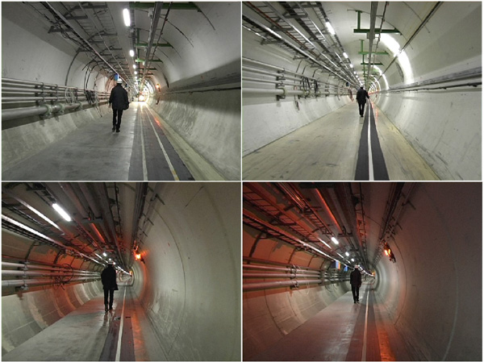
Empty Tunnel: LEP Disassembled

Slide 26
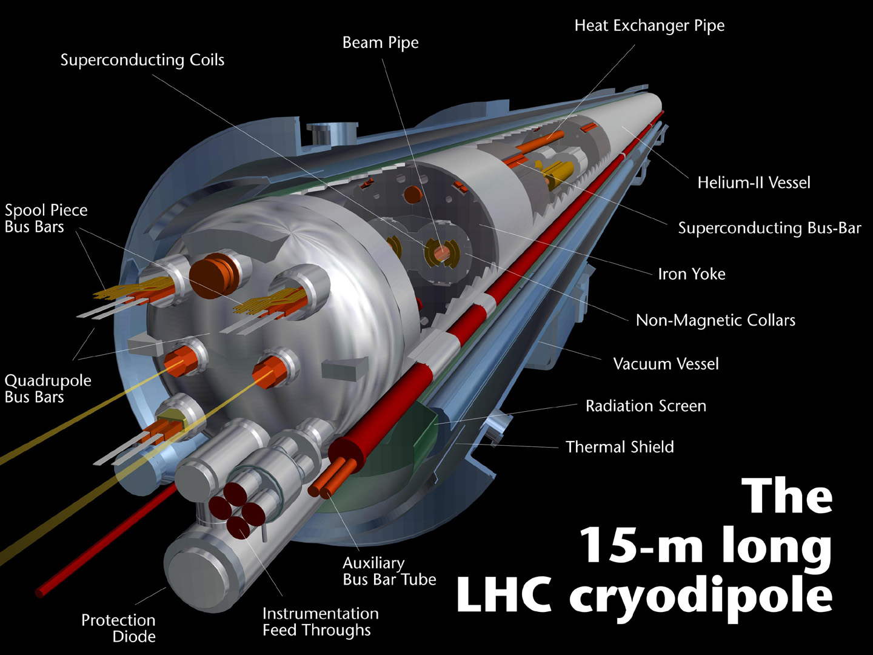
The LHC Dipoles

Slide 27
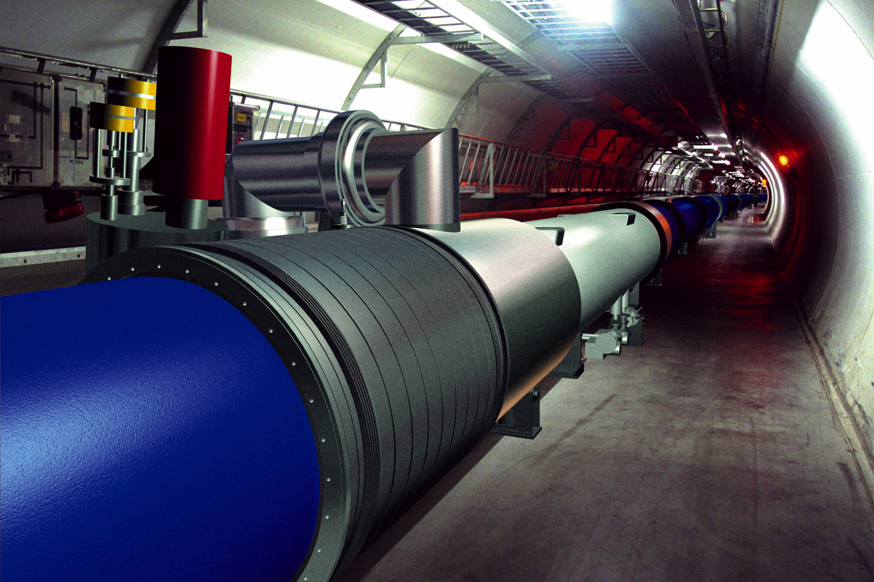
LHC Pictures: Simulation

Slide 28
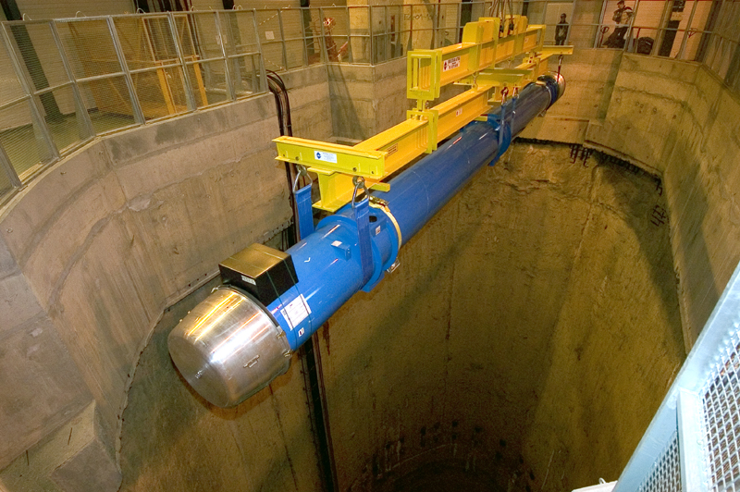
LHC Pictures: Real Dipoles

Slide 29

LHC Pictures: Tunnel with Beamlines

Slide 30
LHC Experiments
Two omnipurpose* detectors
  Atlas
  CMS (C.P. experiment)
One dedicated B physics experiment
  LHCb (Eluned Smith experiment)
One dedicated heavy ion experiment
  Alice
* multipurpose = do heavy ion and B physics as well

Slide 31
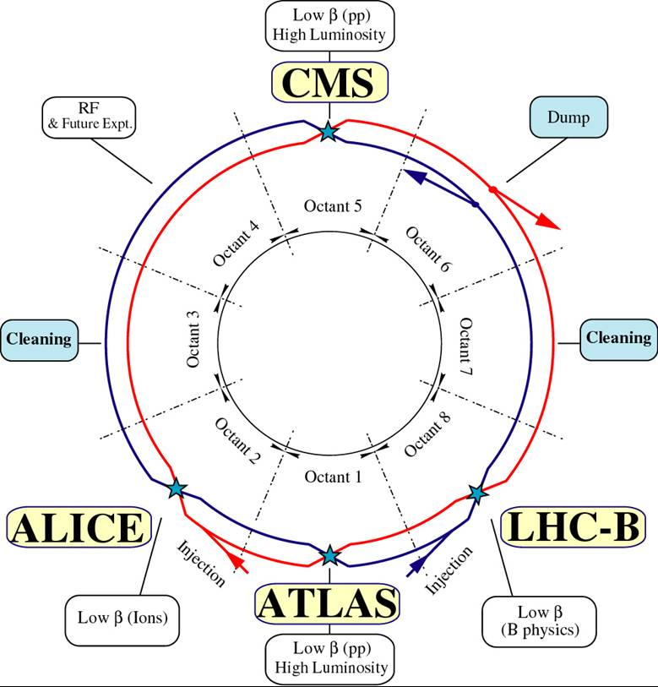
The LHC Experiments

Slide 32
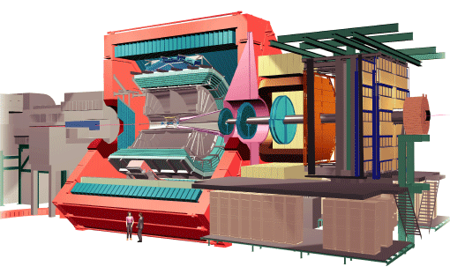

Alice: Detector Sketch
old L3 magnet
particle physicists do recycle

Slide 33
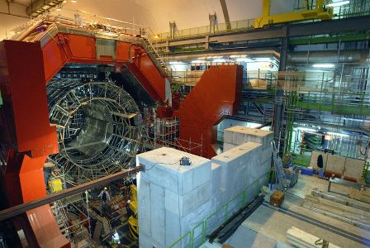
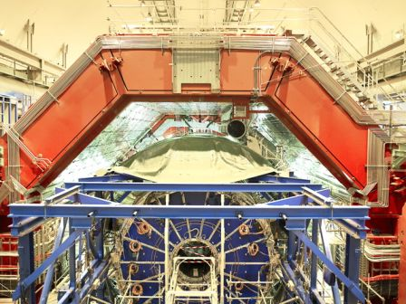
Alice: December 2006
April, 2007

Slide 34
Atlas/CMS Motivation
LHC is a new energy regime: uncharted territory
The guaranteed mission (seek and destroy)‏
  find the Standard Model Higgs: completes SM, for now
  do not find the SM Higgs: falsify the model because machine fully covers available phase space
The case for beyond the Standard Model
  new energy regime opens new doors
  anything beyond the Standard Model is a sensation
  be it SUSY, extra dimensions, leptoquarks, Z', .... or even better: the completely unexpected

Slide 35
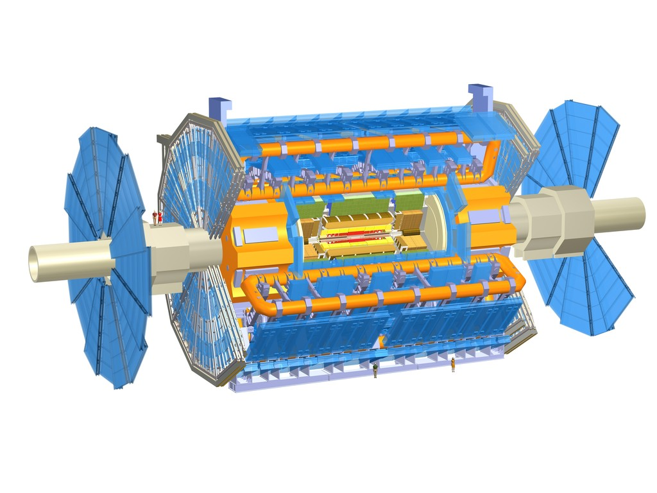
Atlas: Detector Sketch
the biggest collider detector ever, by far
eye catcher: central air core toroid magnet
7,000 ton weight, 25 m diameter, 45 m long
light weight construction: if wrapped in plastic it floats on water (22,000 m³)‏
still, weights more than half the Eiffel tower

Slide 36

Atlas: Real Installation

Slide 37
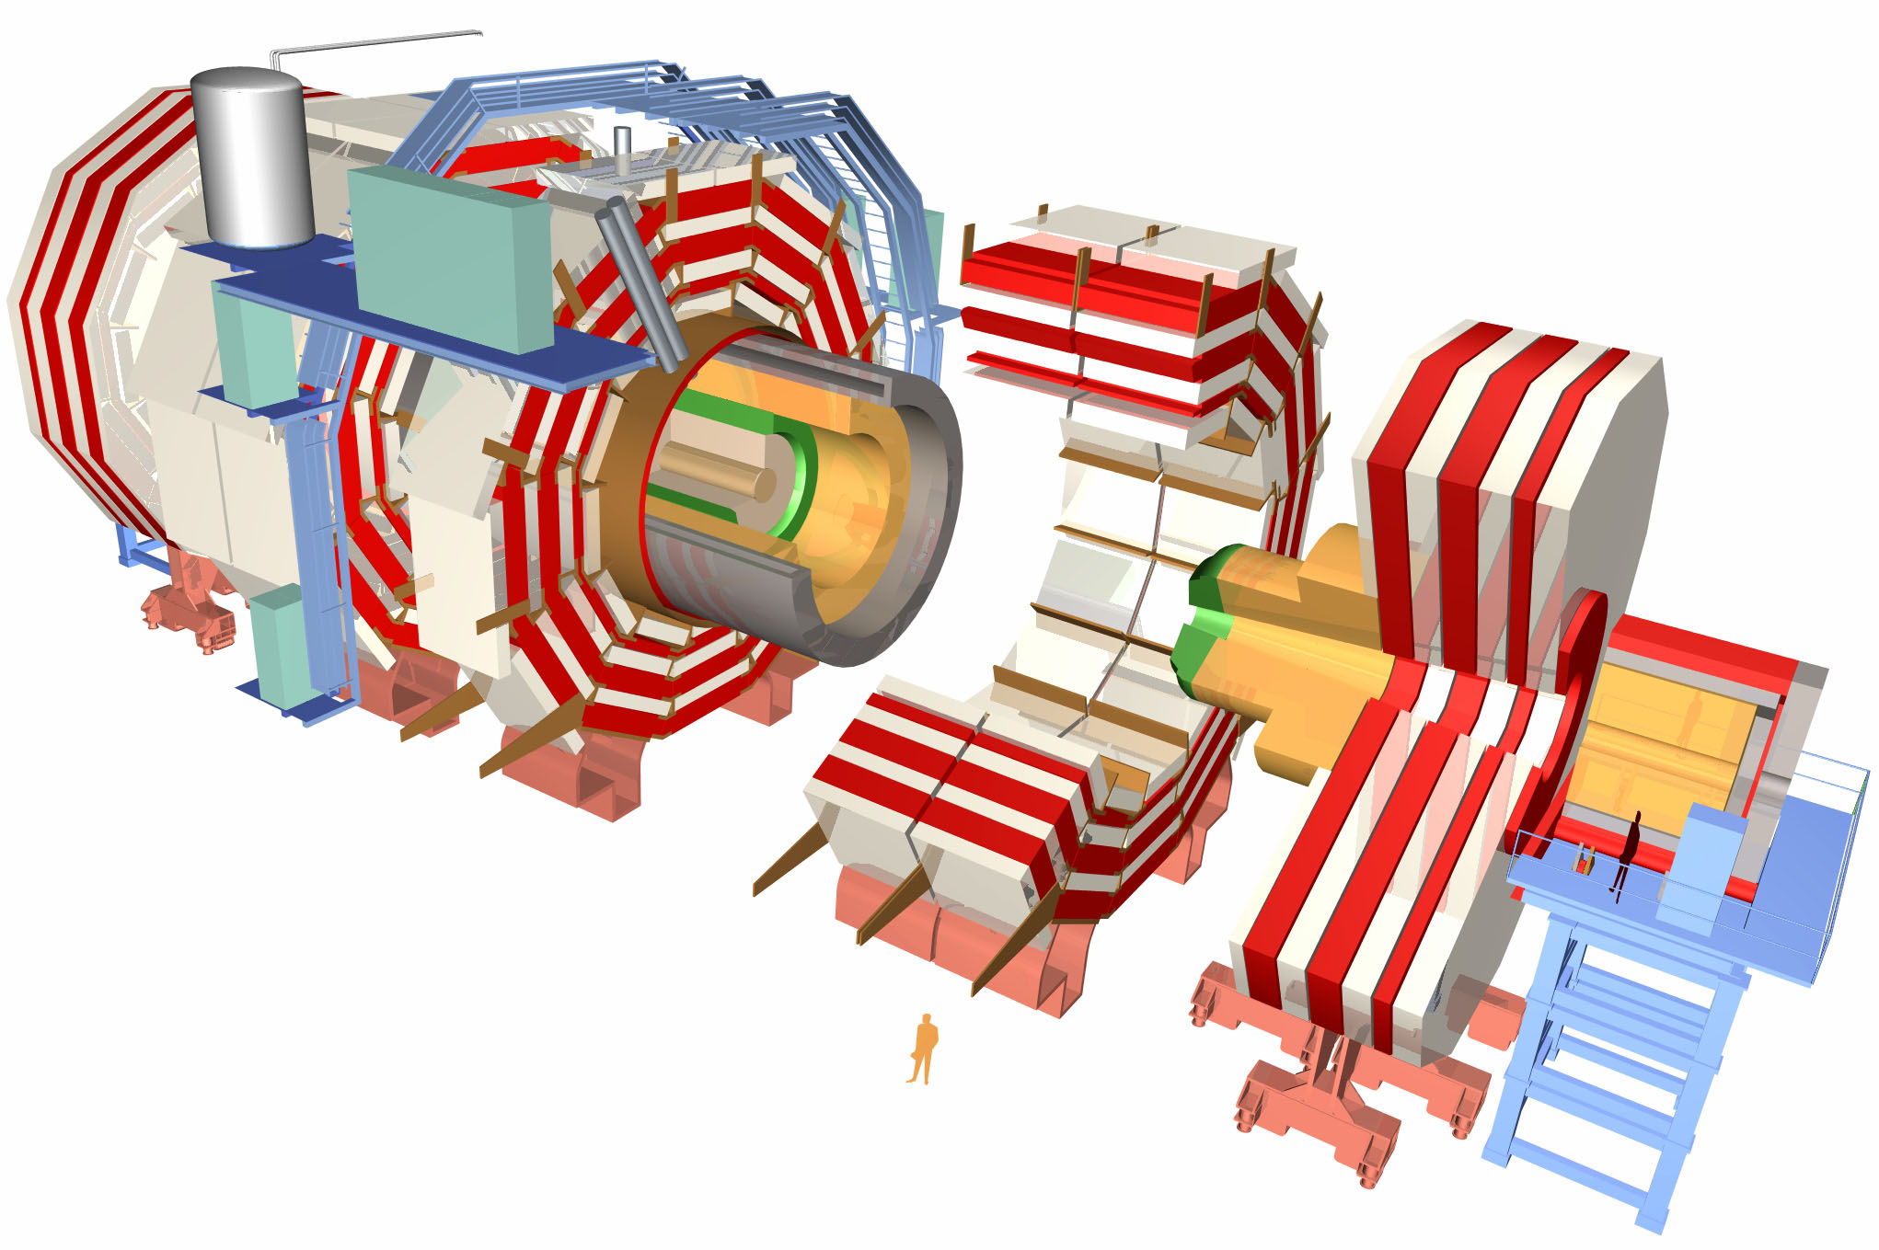
CMS – Compact Muon Solenoid
12,500 ton weight, 15 m diameter, 22 m long
compact does not mean small
volume smaller than Atlas by ~5.6, but
weights 30% more than the Eiffel tower
eye catcher: brilliant design in separately removable slices

Slide 38
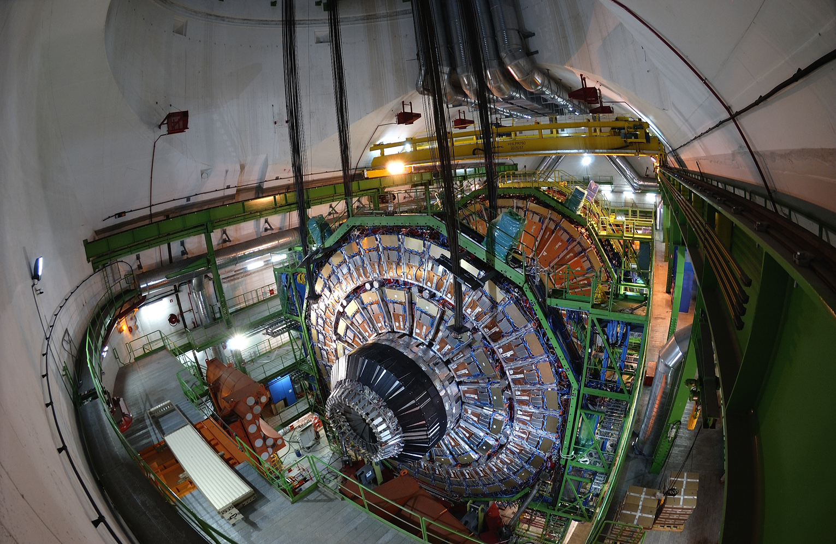
CMS: Installation

Slide 39
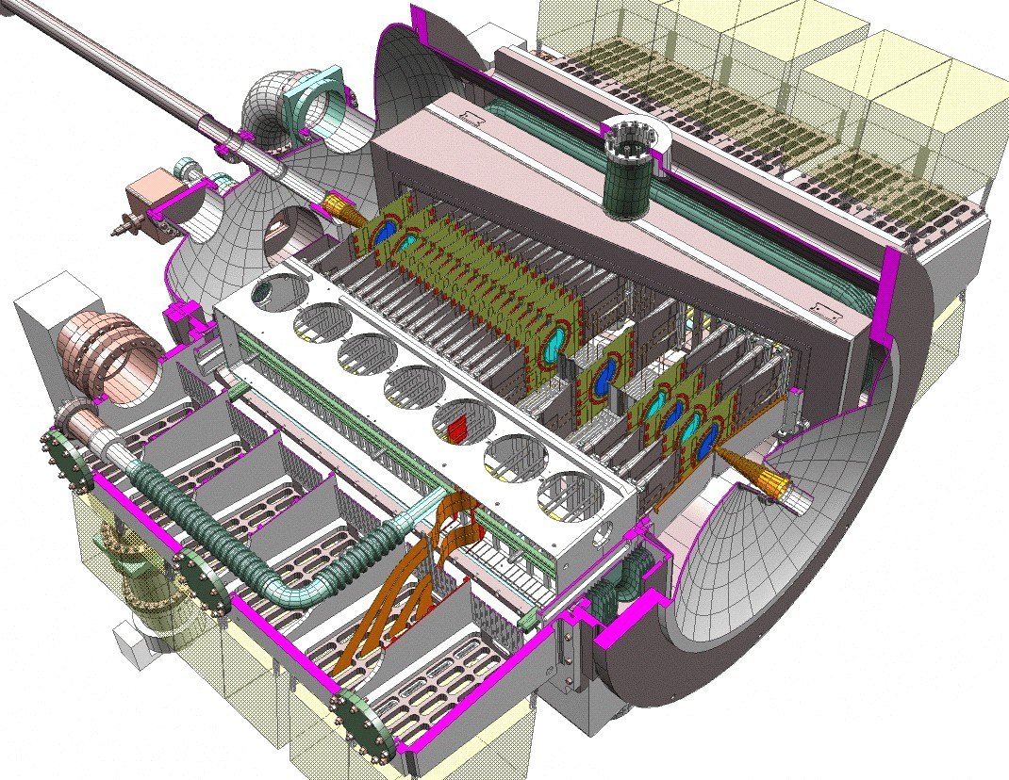
LHCb: Mission and Sketch
The Large Hadron Collider beauty experiment
for precise measurements of CP violation and rare decays

Slide 40
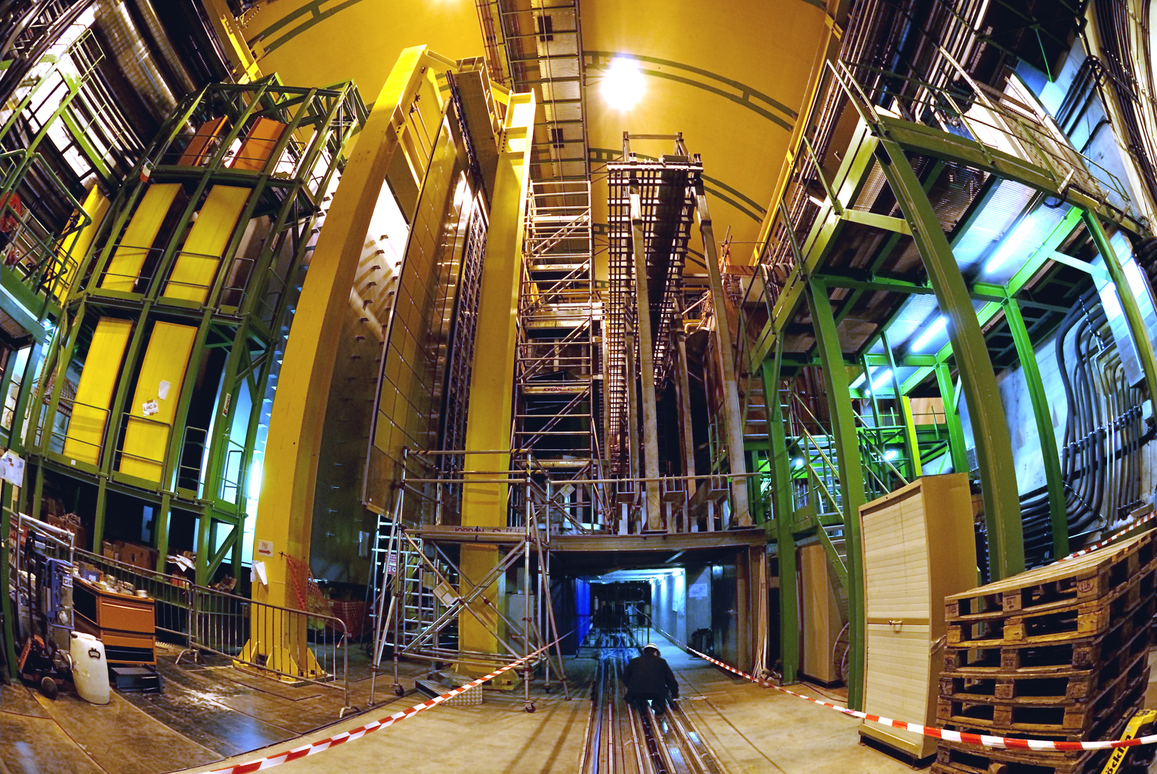
LHCb: At the Interaction Point

Slide 41
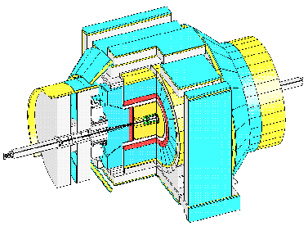
CDF: Sketch

Slide 42
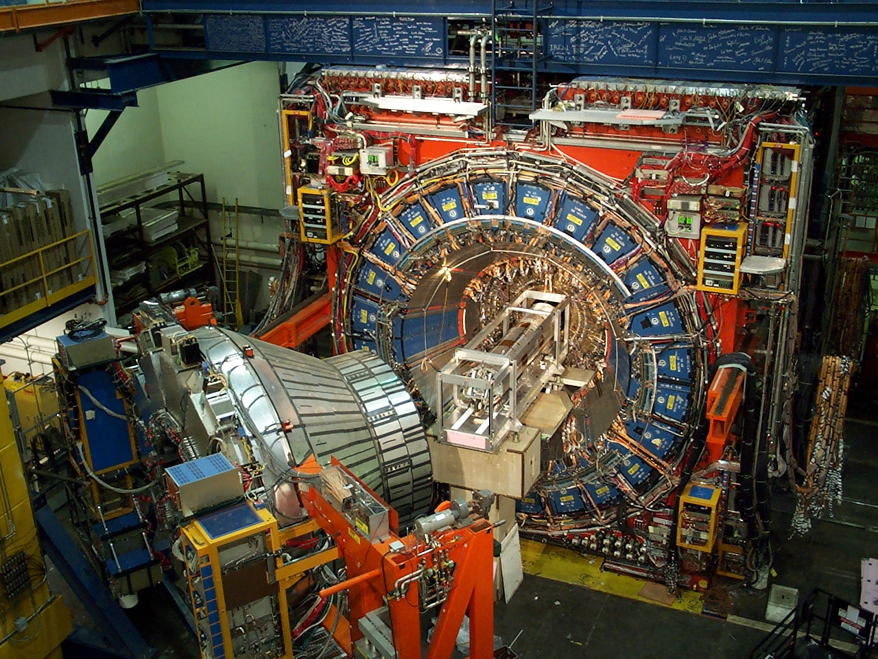
CDF Detector Pictures
_{Dimension:}
_{12mx12mx16m}
Dimensions

Slide 43
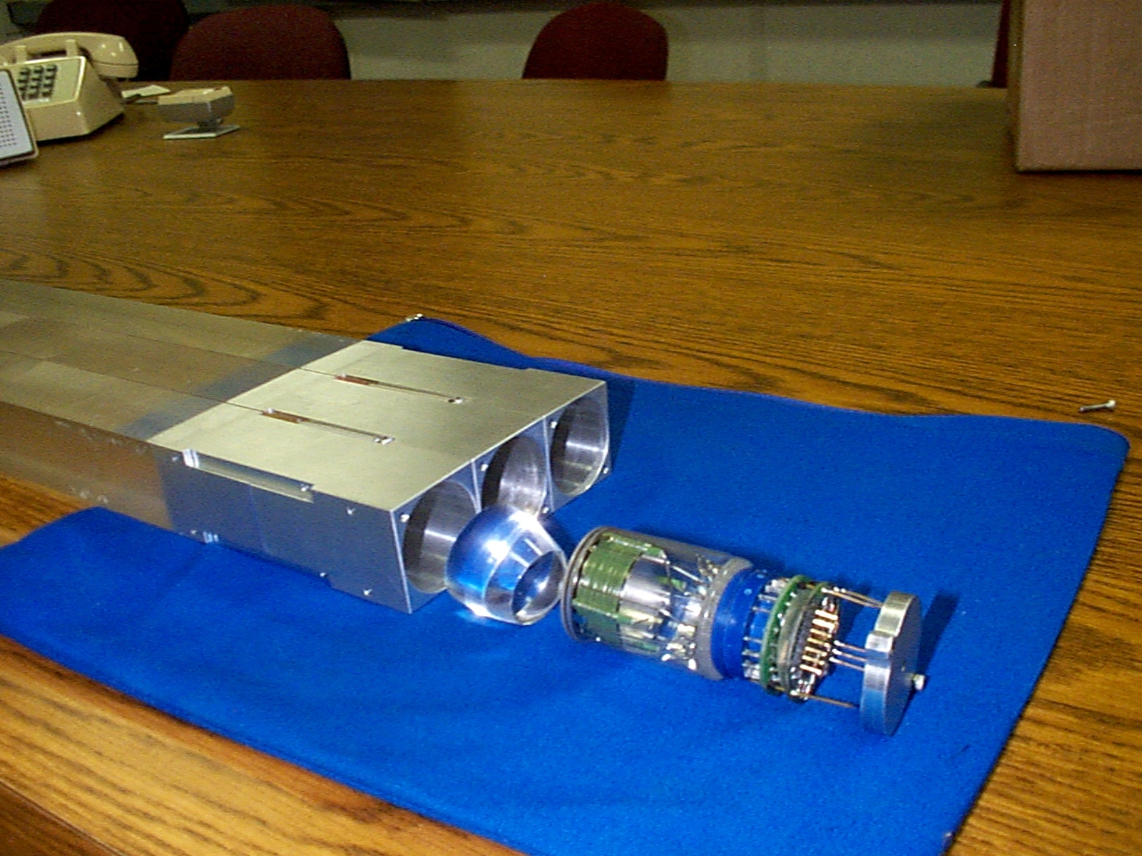
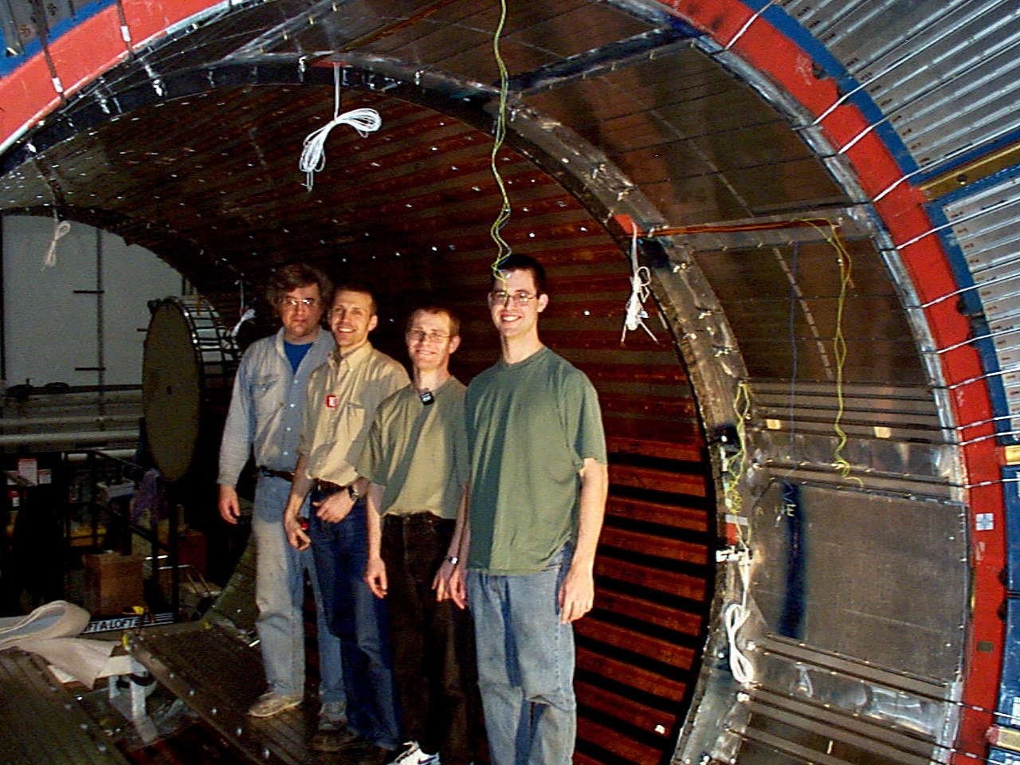
CDF: Time Of Flight Detector
scintillation bars
holders
happy MIT folks
photomultiplier
cone
pre-amp

Slide 44
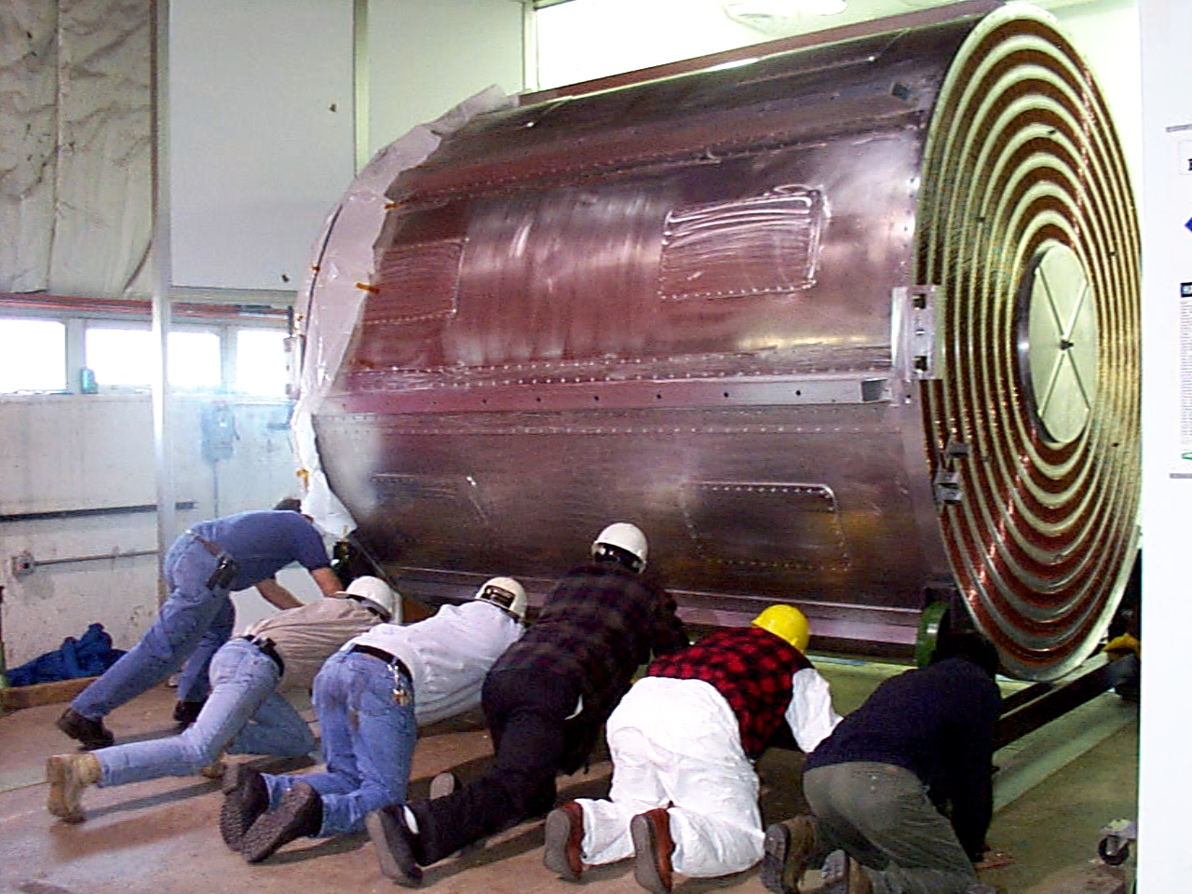
CDF: Central Outer Tracker

Slide 45
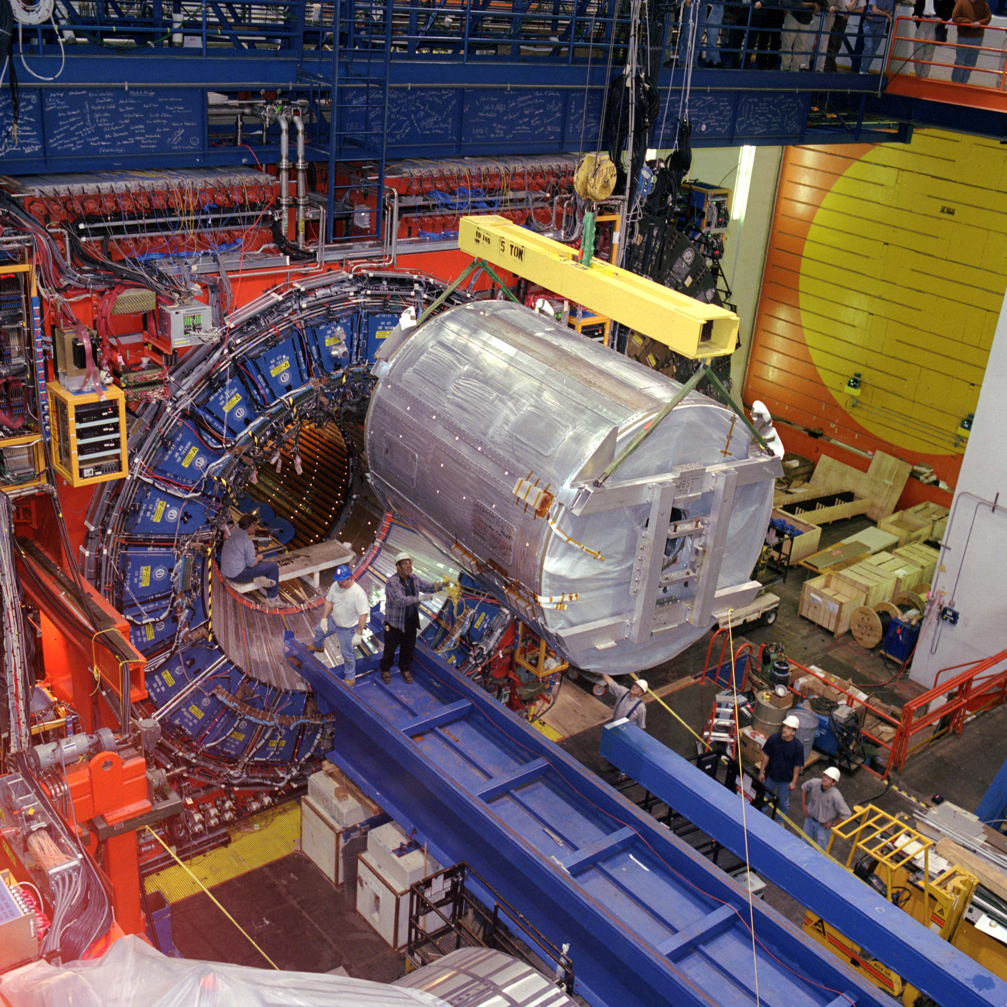
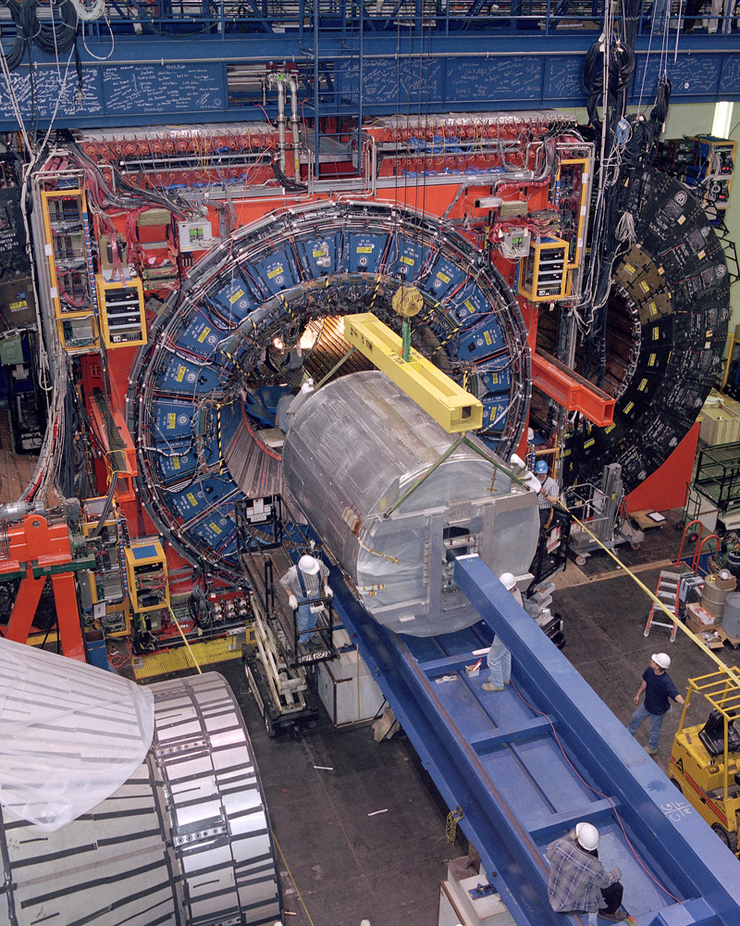
CDF: Central Outer Tracker

Slide 46
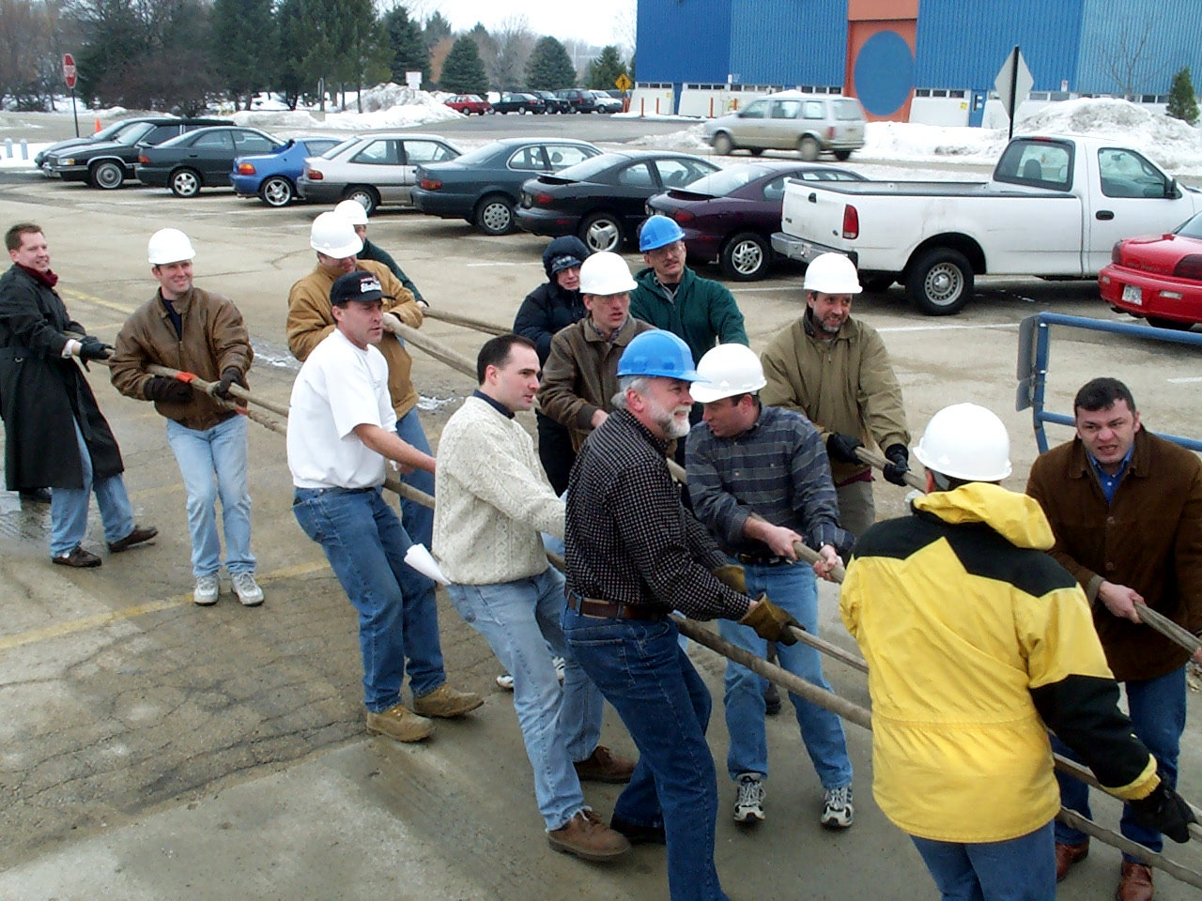
CDF: Silicon Detector

Slide 47
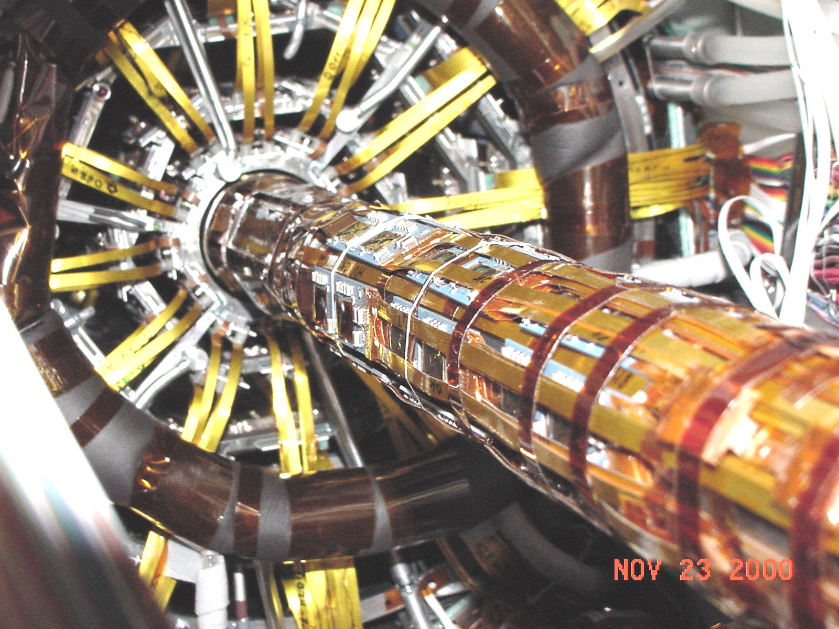
CDF: Silicon Vertex Detector

Slide 48
Conclusions
We have a month ahead of us
  Learn how an experimenters work
  Experimental setup
  Basic physics ideas
  Basic measurements
  Give a talk
Instructions for course
  get registered for a user account on subMIT our computing resource
  Review the projects to see which one you are most interested in

