Slide 1
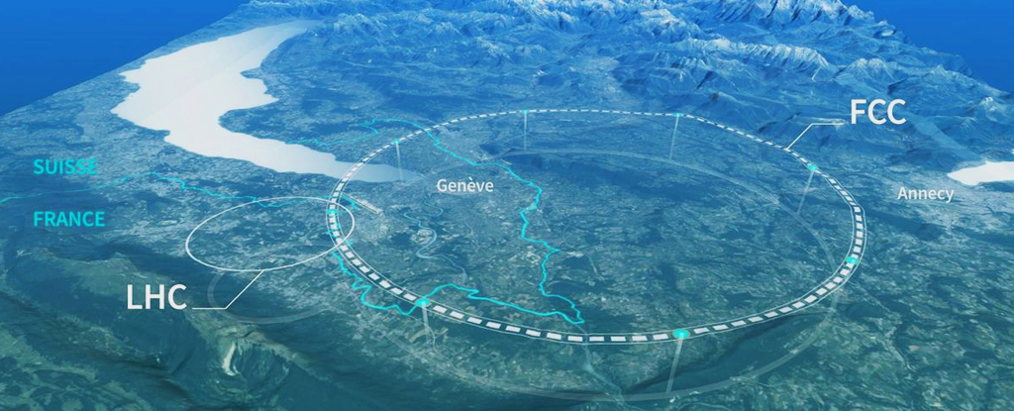
8.FCC - January Research Projects on
the Future Circular Collider (FCC-ee)
Introductory Lecture
[January 7, 2025]

Slide 2
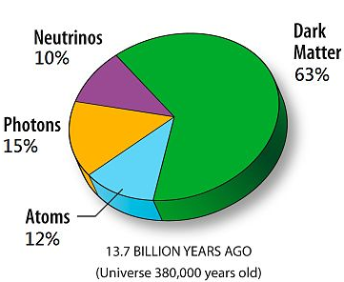
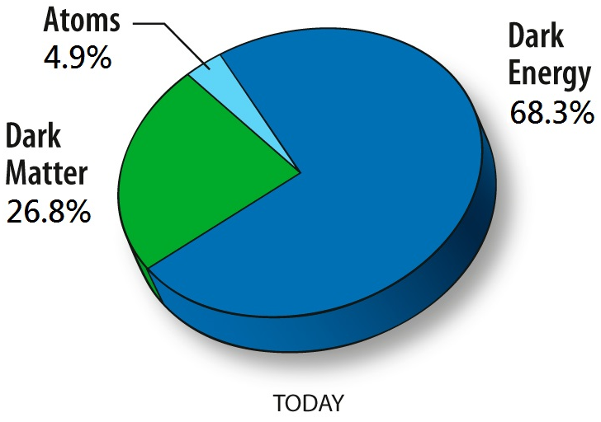
What’s next in Particle Physics?
Dark Matter
85.6% of all matter is dark!

Slide 3
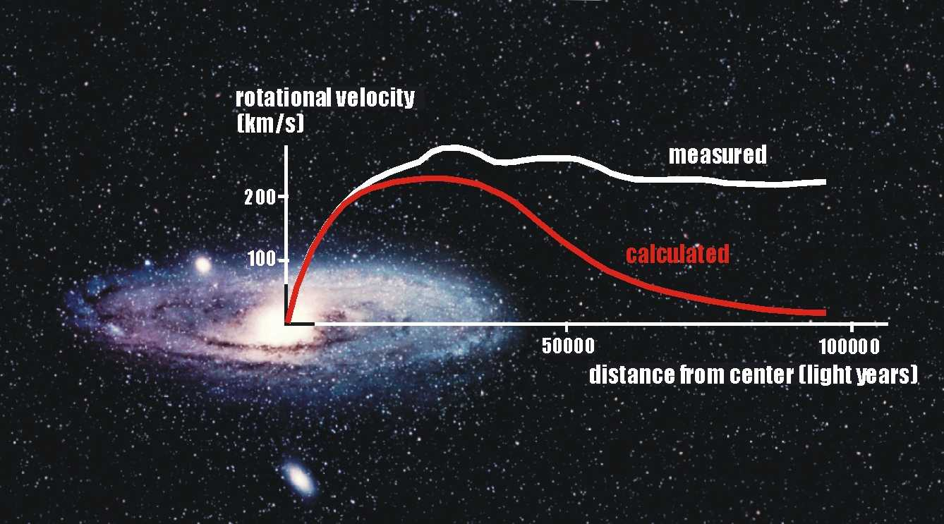
Rotational Velocity
gravitation
centripetal acceleration
Measured rotational velocity requires
additional 'dark' matter to be present.

Slide 4
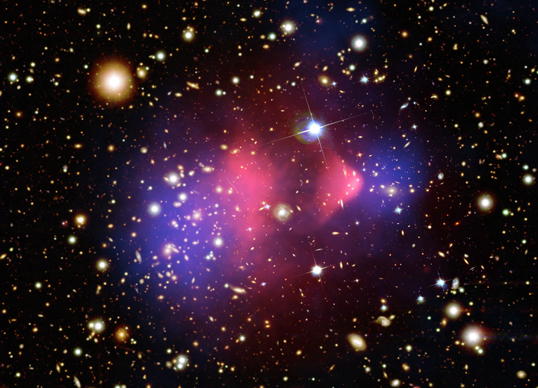
Gravitational Lensing
Bullet Cluster
visible matter
dark matter

Slide 5
How to think about particle collisions
Some basic ‘rules’
Single collision cannot be predicted: Quantum Mechanics is probabilistic
We need to study a long, ideally infinite number of collisions
We can draw diagrams how collisions happen
Certain rules apply: conservation laws (ex. Charge), coupling strength
Particles have mass and lifetimes ….
All ‘possible diagrams’ must be considered: simple diagrams are likely
e+
μ+
Z/γ
γ
μ-
e-
Feynman diagrams
Initial state
final state

Slide 6
Searching Dark Matter with CMS
Signature
Dark matter does not interact with detector
Sooo…. the detector is empty?
But if the initial state has radiation …. Well defined:
Standard Model
particles
Dark Matter
particles
Radiation in the initial state
Lepton(s), Jet(s), Photon(s), V ...

Slide 7
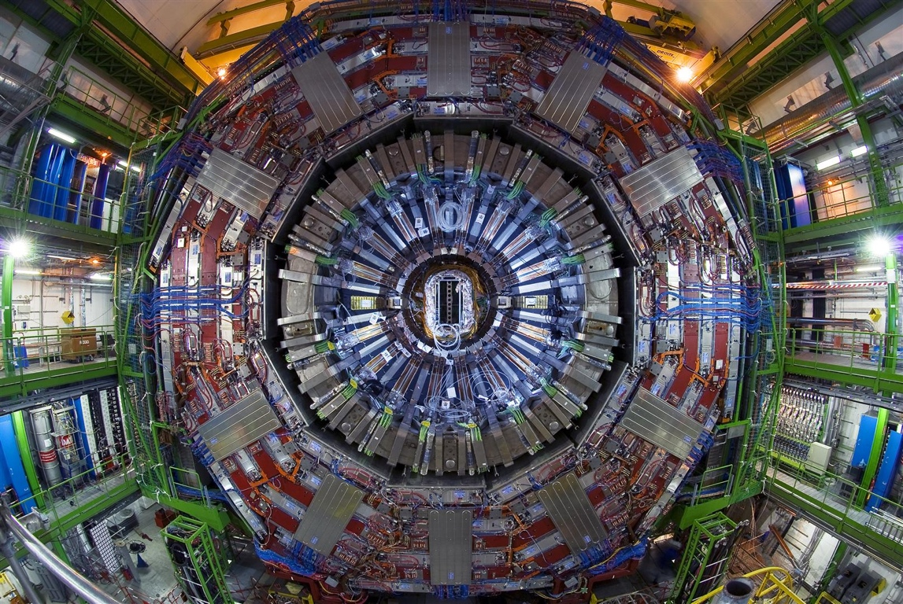
Compact Muon Solenoid

Slide 8
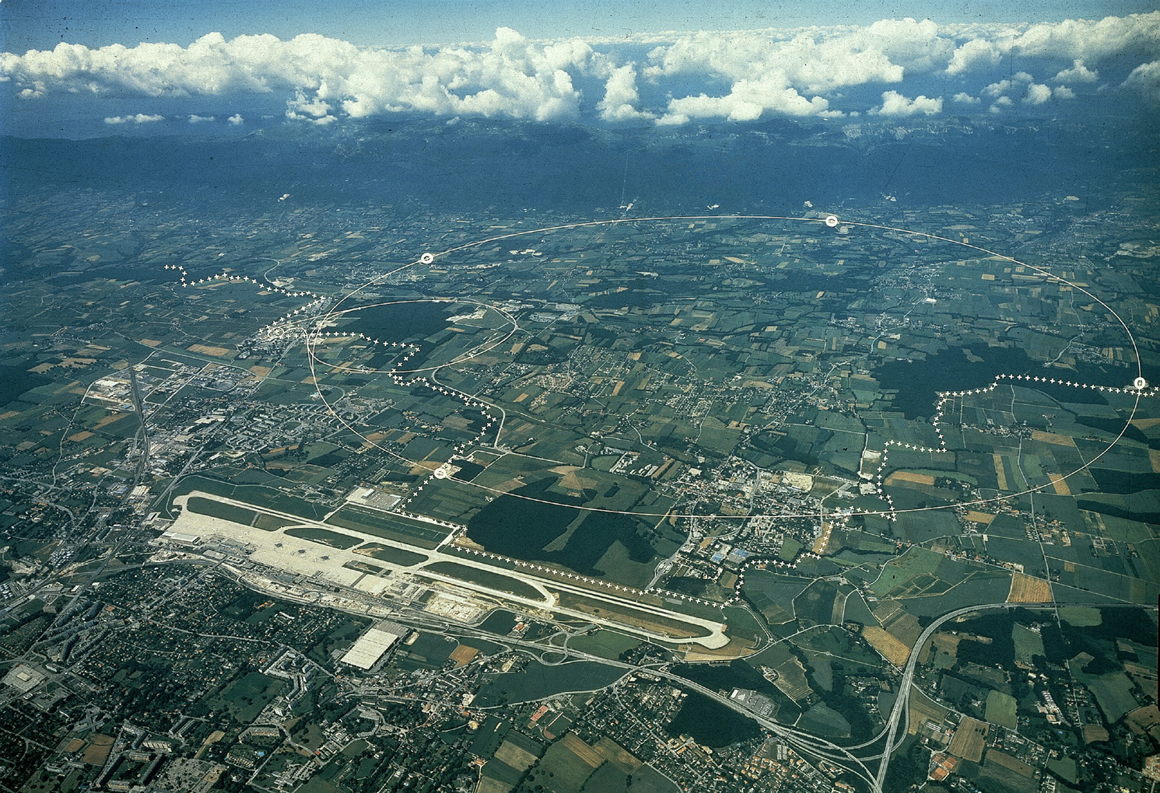
Overview: CERN (Geneva, Switzerland)‏
Check out serious YouTube: CERN LHC 2007
http://youtube.com/watch?v=s9XotvwgnaY
France
6 miles
Geneva airport
Switzerland
:
Check out fun YouTube: Day to Day Communications (1974)‏
http://youtube.com/watch?v=OymJC9KkWlg

Slide 9
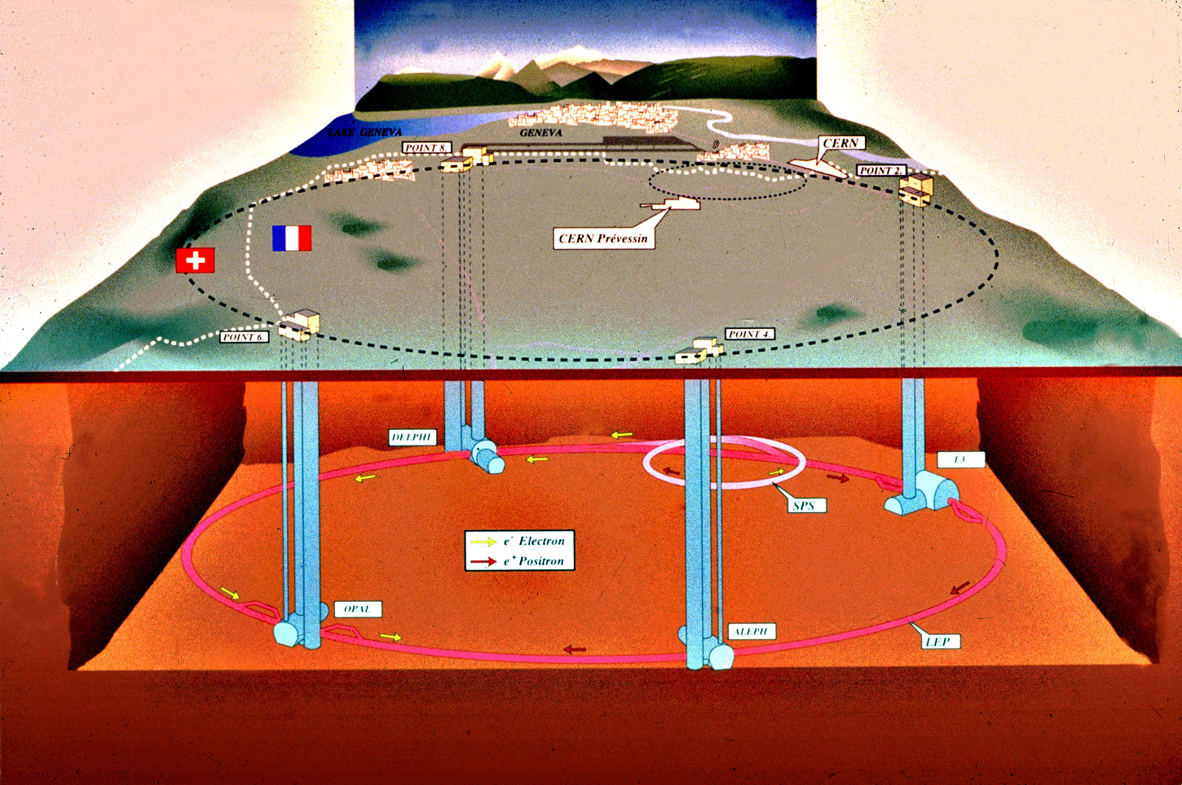
The LEP/LHC Tunnel Setup
Tunnel is 27 km long
50-150m below ground

Slide 10
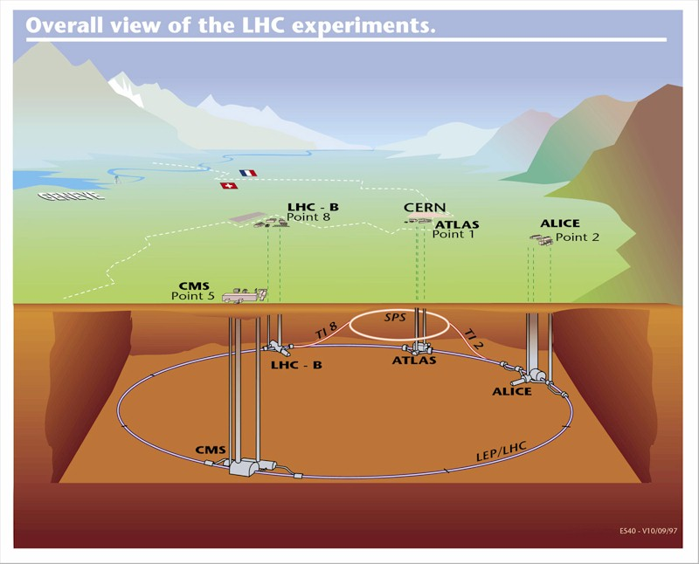
The LEP/LHC Tunnel Setup
Tunnel is 27 km long
50-150m below ground

Slide 11
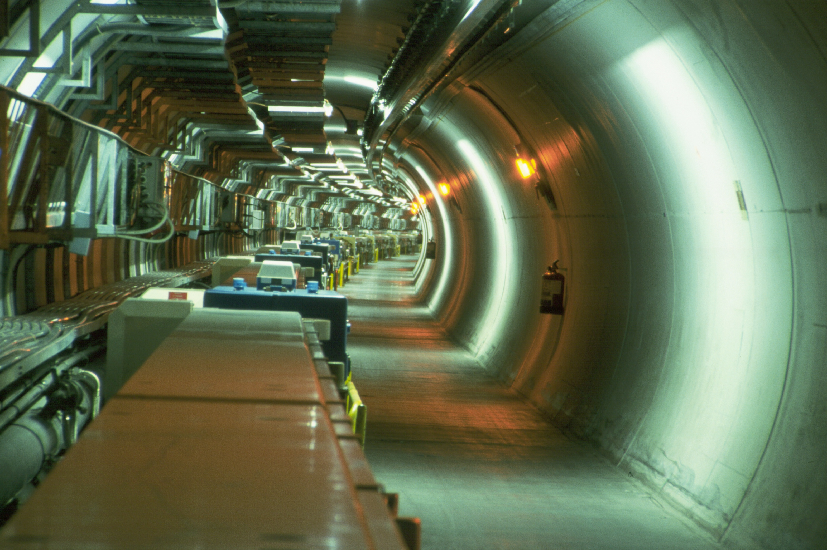
LEP Tunnel before LHC

Slide 12
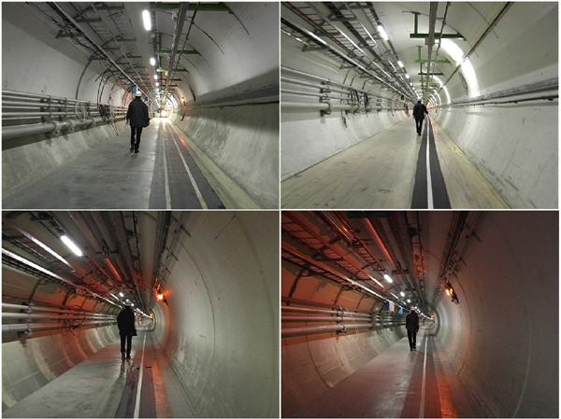
Empty Tunnel: LEP Disassembled

Slide 13
The LHC Dipoles

Slide 14
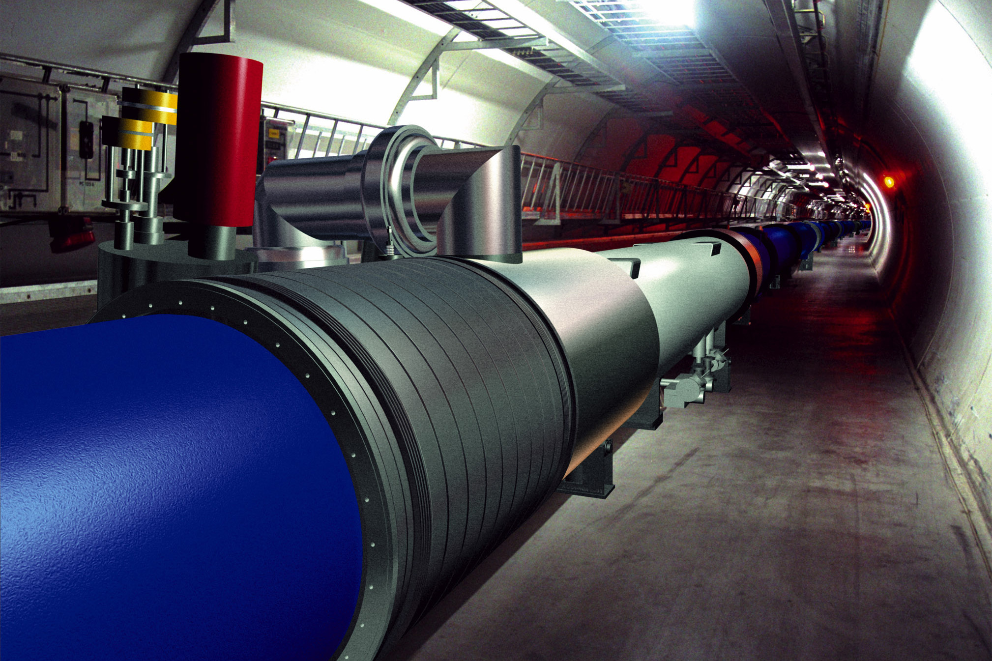
LHC Pictures: Simulation

Slide 15
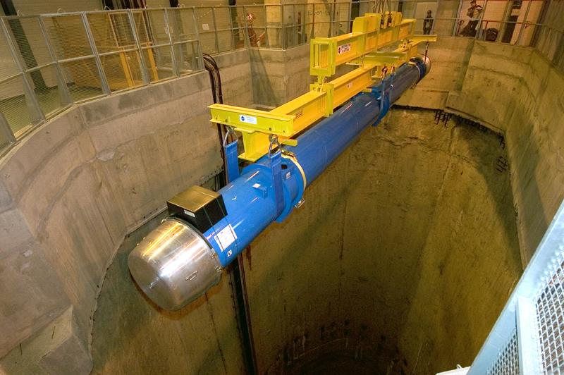
LHC Pictures: Real Dipoles

Slide 16
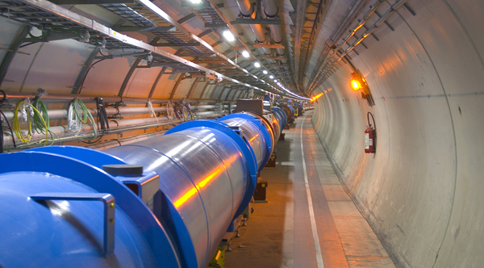
LHC Pictures: Tunnel with Beamlines

Slide 17
LHC Experiments
Two omnipurpose* detectors
Atlas
CMS (C.P. experiment)
One dedicated B physics experiment
LHCb (Eluned Smith experiment)
One dedicated heavy ion experiment
Alice
* multipurpose = do heavy ion and B physics as well

Slide 18
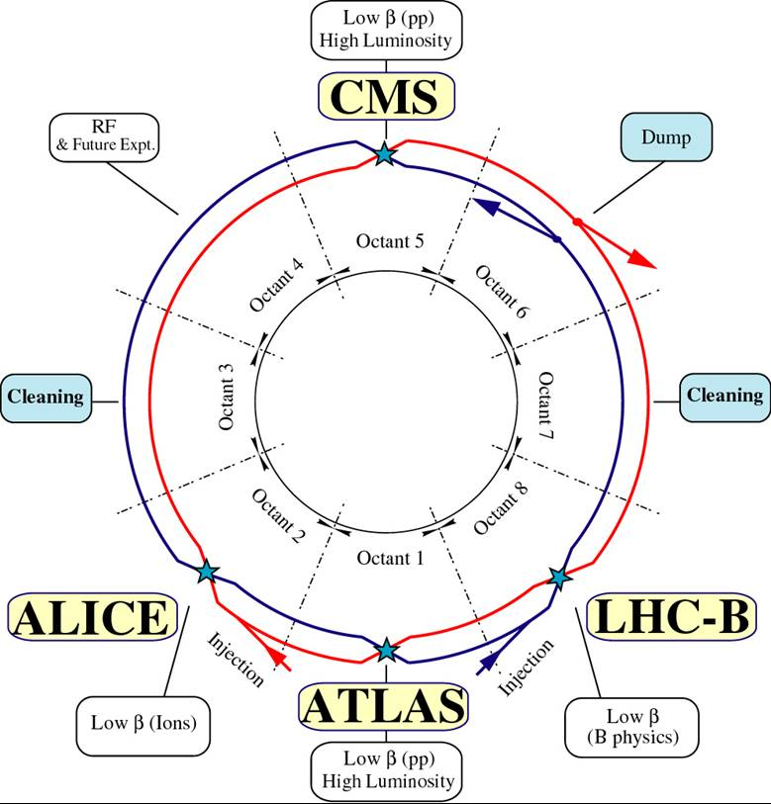
The LHC Experiments

Slide 19
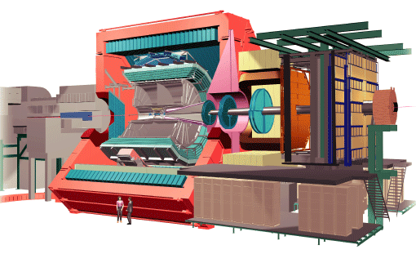
Alice: Detector Sketch
old L3 magnet
particle physicists do recycle

Slide 20
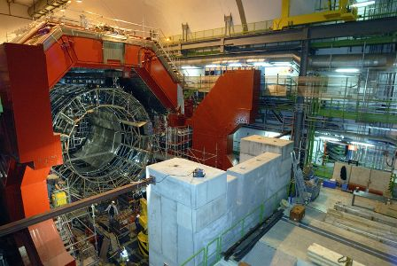
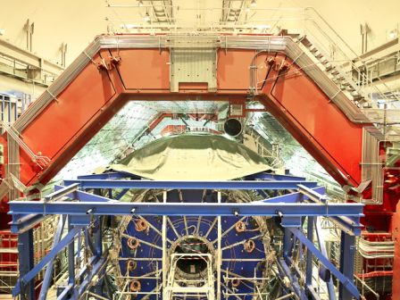
Alice: December 2006
April, 2007

Slide 21
Atlas/CMS Motivation
LHC is a new energy regime: uncharted territory
The guaranteed mission (seek and destroy)‏
find the Standard Model Higgs: completes SM, for now
do not find the SM Higgs: falsify the model because machine fully covers available phase space
The case for beyond the Standard Model
new energy regime opens new doors
anything beyond the Standard Model is a sensation
be it SUSY, extra dimensions, leptoquarks, Z', .... or even better: the completely unexpected

Slide 22
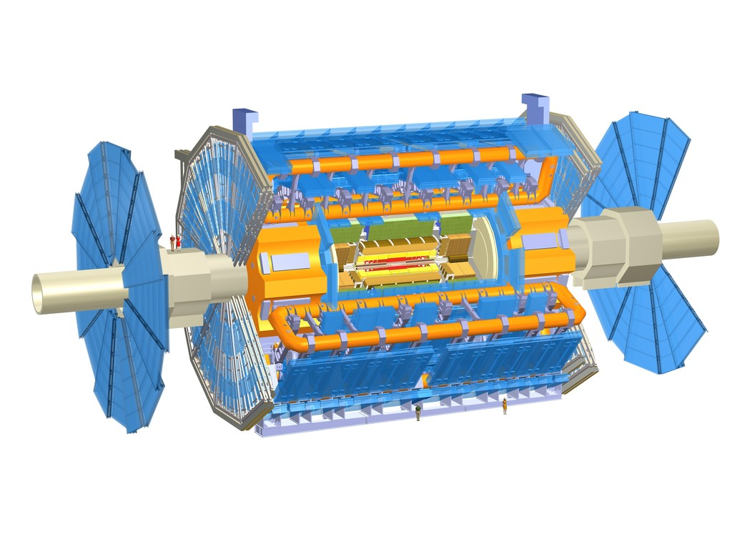
Atlas: Detector Sketch
the biggest collider detector ever, by far
eye catcher: central air core toroid magnet
7,000 ton weight, 25 m diameter, 45 m long
light weight construction: if wrapped in plastic it floats on water (22,000 m³)‏
still, weights more than half the Eiffel tower

Slide 23
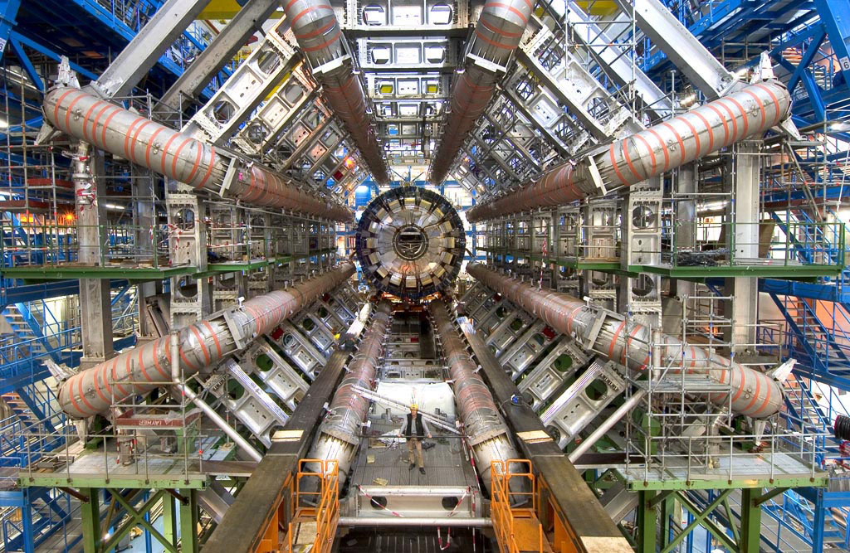
Atlas: Real Installation

Slide 24
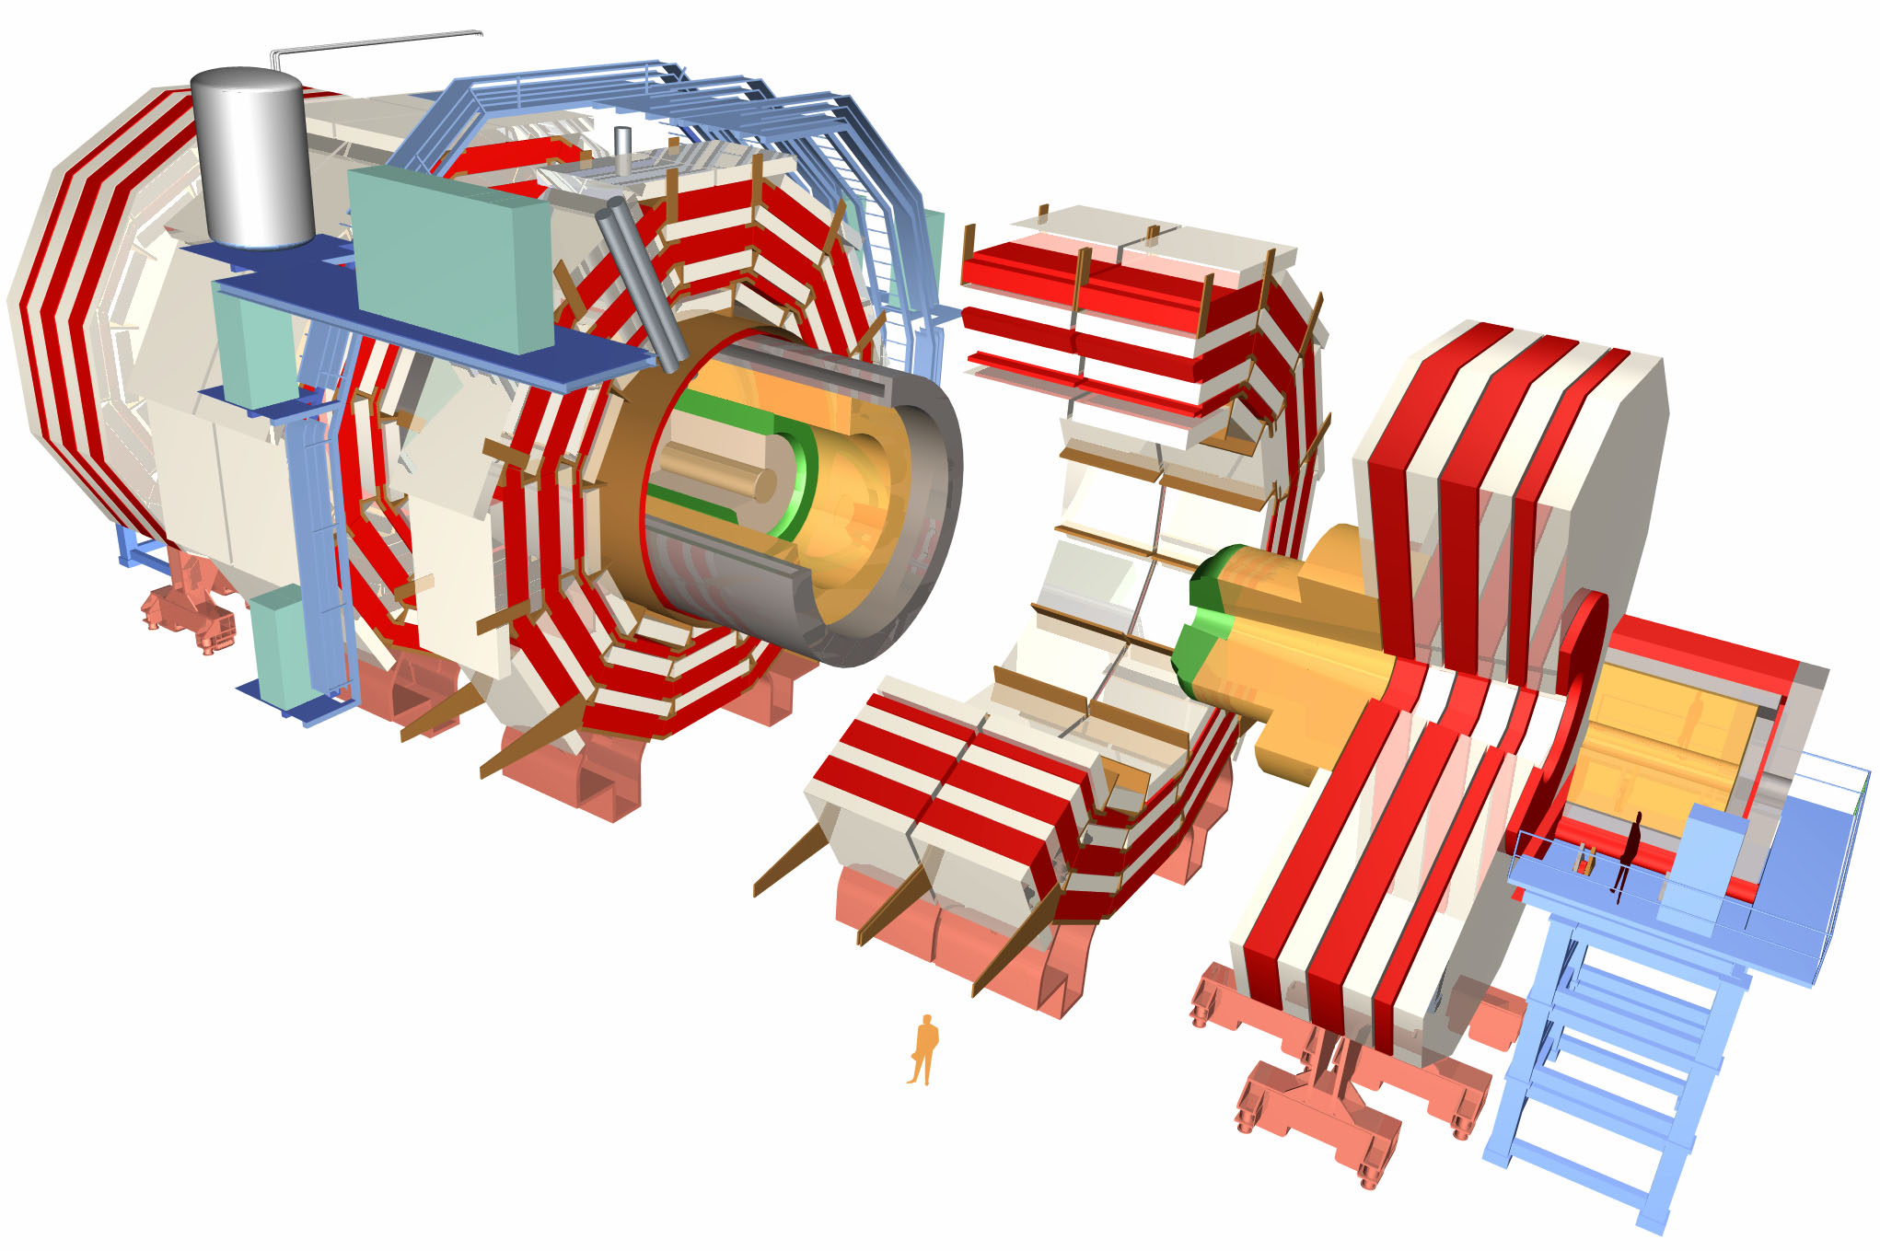
CMS – Compact Muon Solenoid
12,500 ton weight, 15 m diameter, 22 m long
compact does not mean small
volume smaller than Atlas by ~5.6, but
weights 30% more than the Eiffel tower
eye catcher: brilliant design in separately removable slices

Slide 25
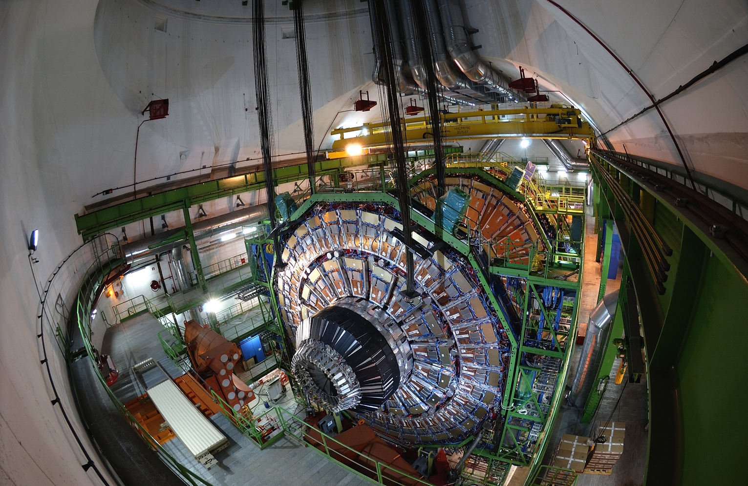
CMS: Installation

Slide 26
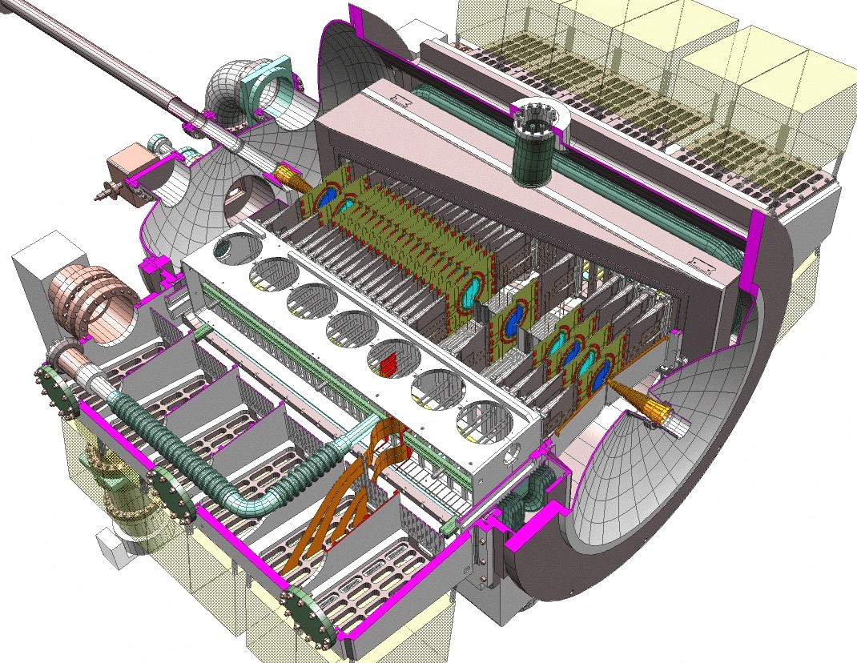
LHCb: Mission and Sketch
The Large Hadron Collider beauty experiment
for precise measurements of CP violation and rare decays

Slide 27
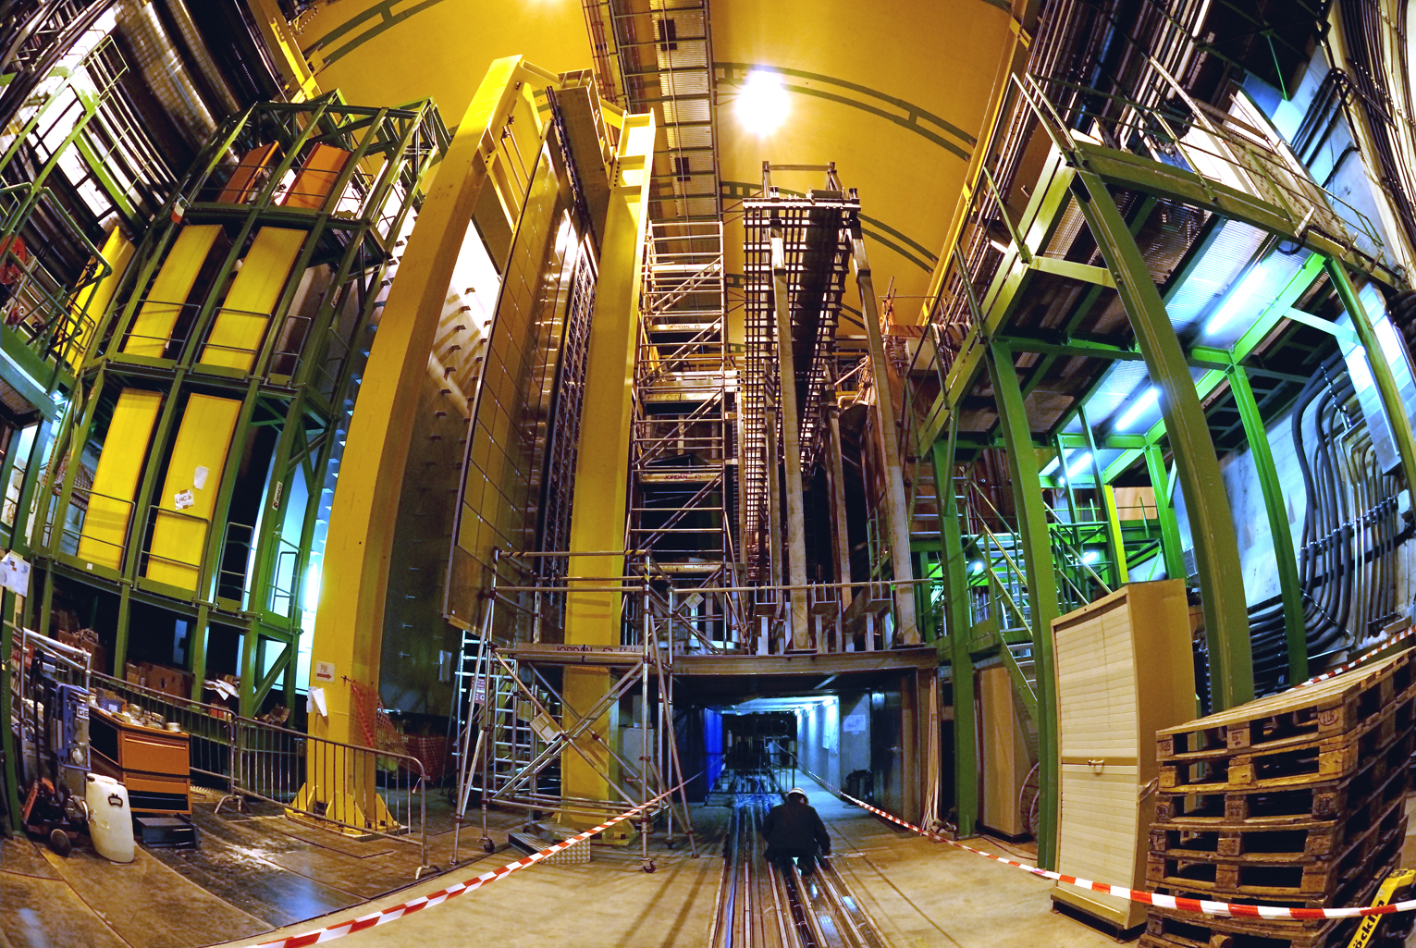
LHCb: At the Interaction Point

Slide 28
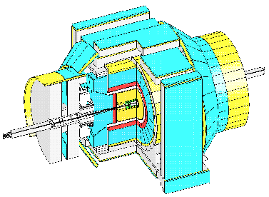
CDF: Sketch

Slide 29
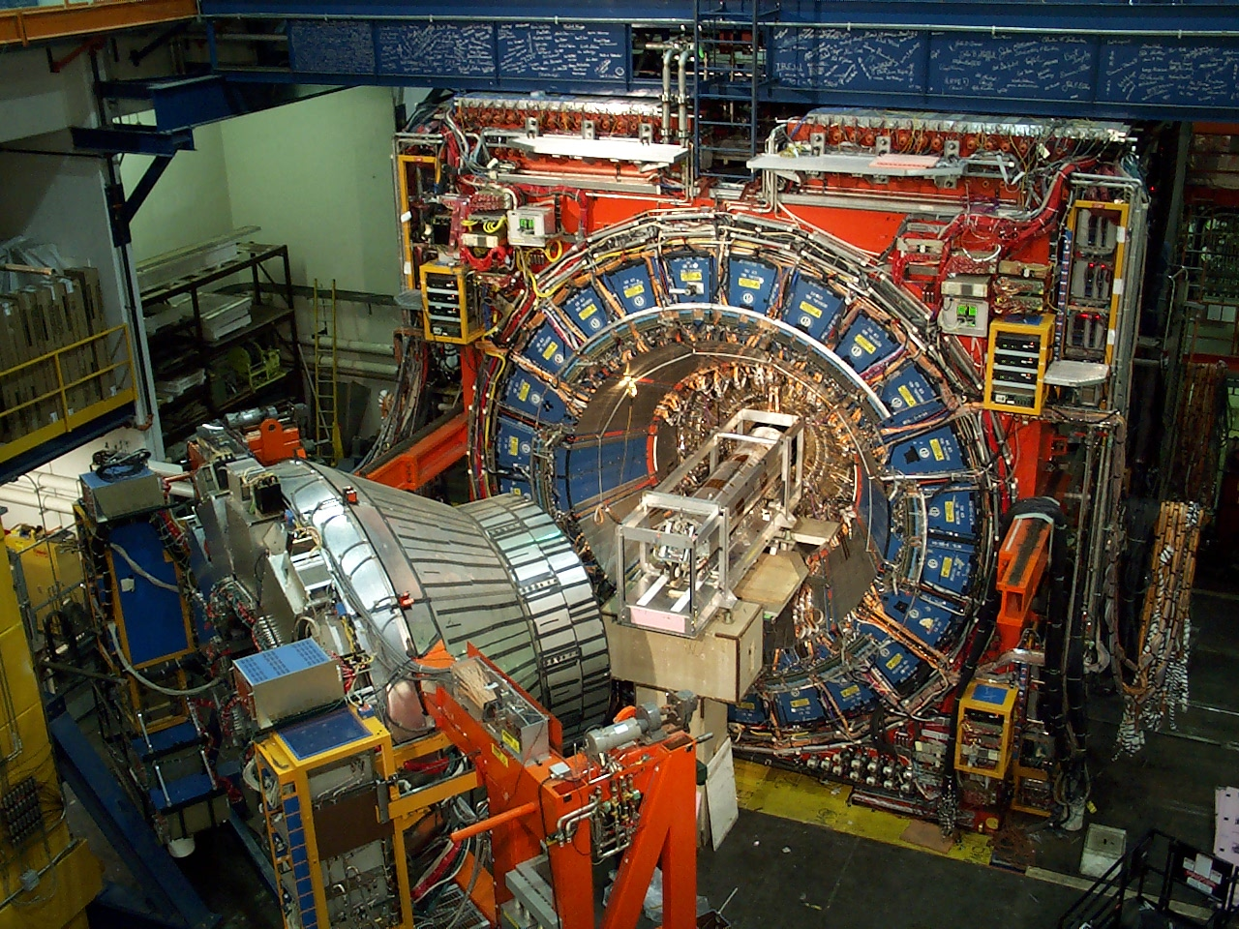
CDF Detector Pictures
_{Dimension:}
_{12mx12mx16m}
Dimensions

Slide 30
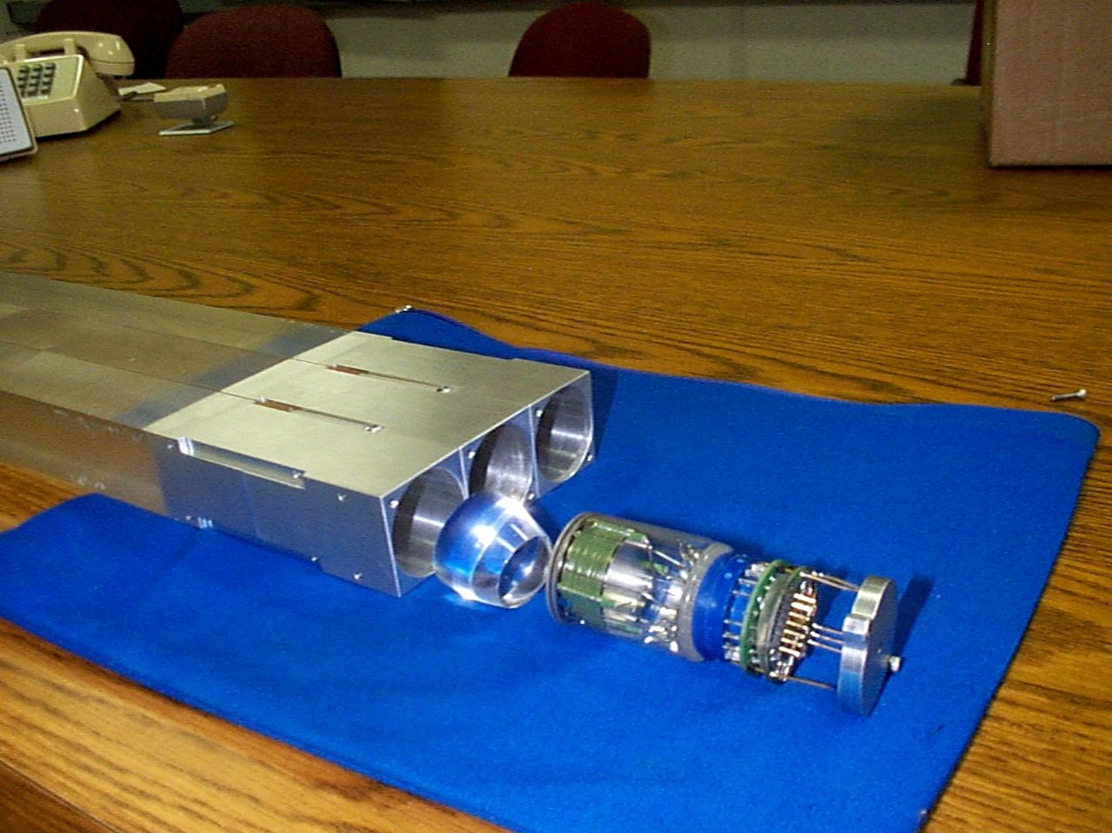
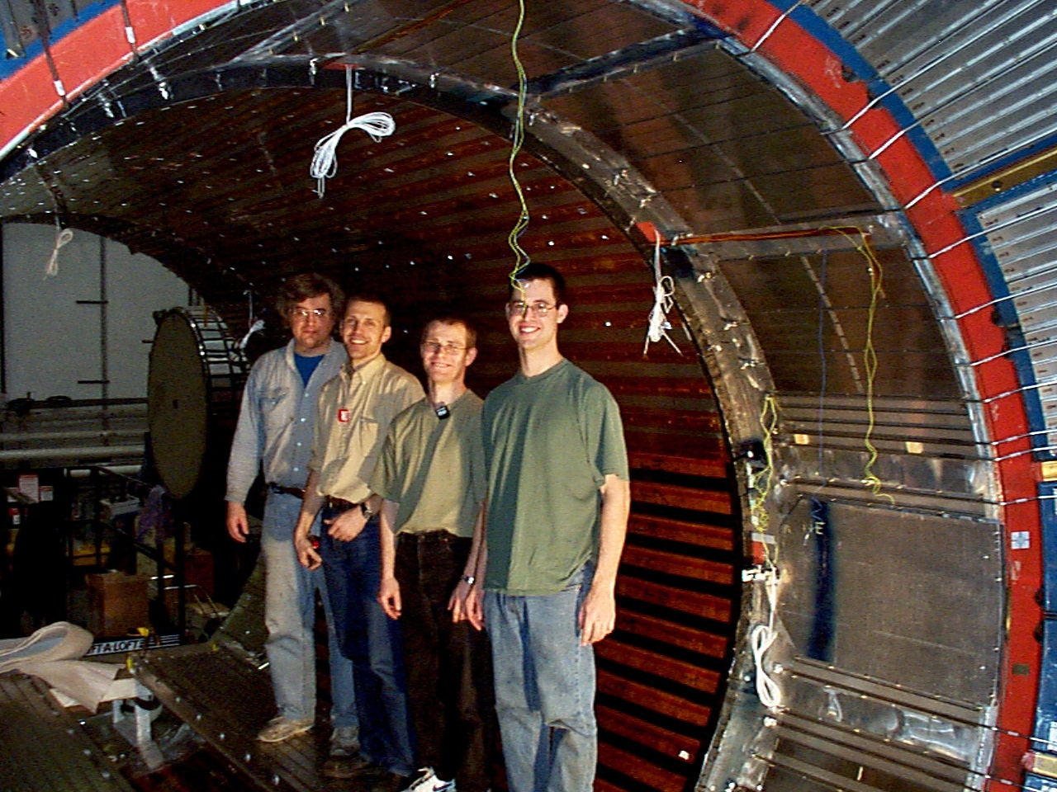
CDF: Time Of Flight Detector
scintillation bars
holders
happy MIT folks
photomultiplier
cone
pre-amp

Slide 31
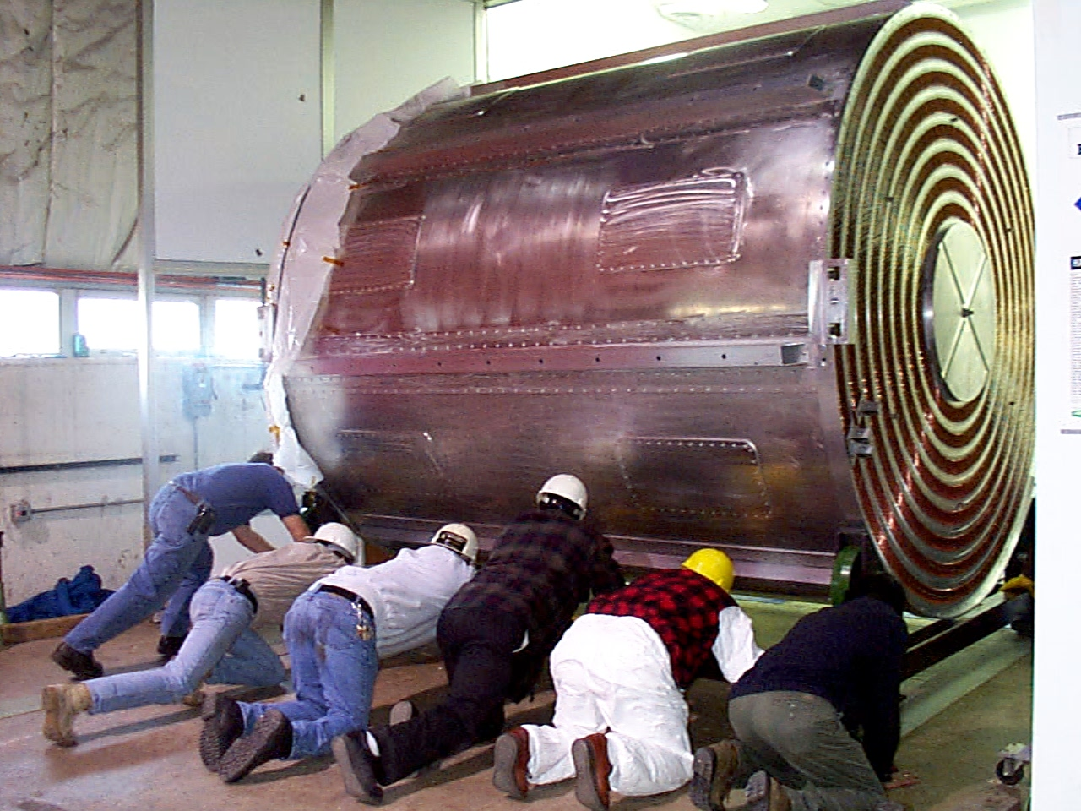
CDF: Central Outer Tracker

Slide 32
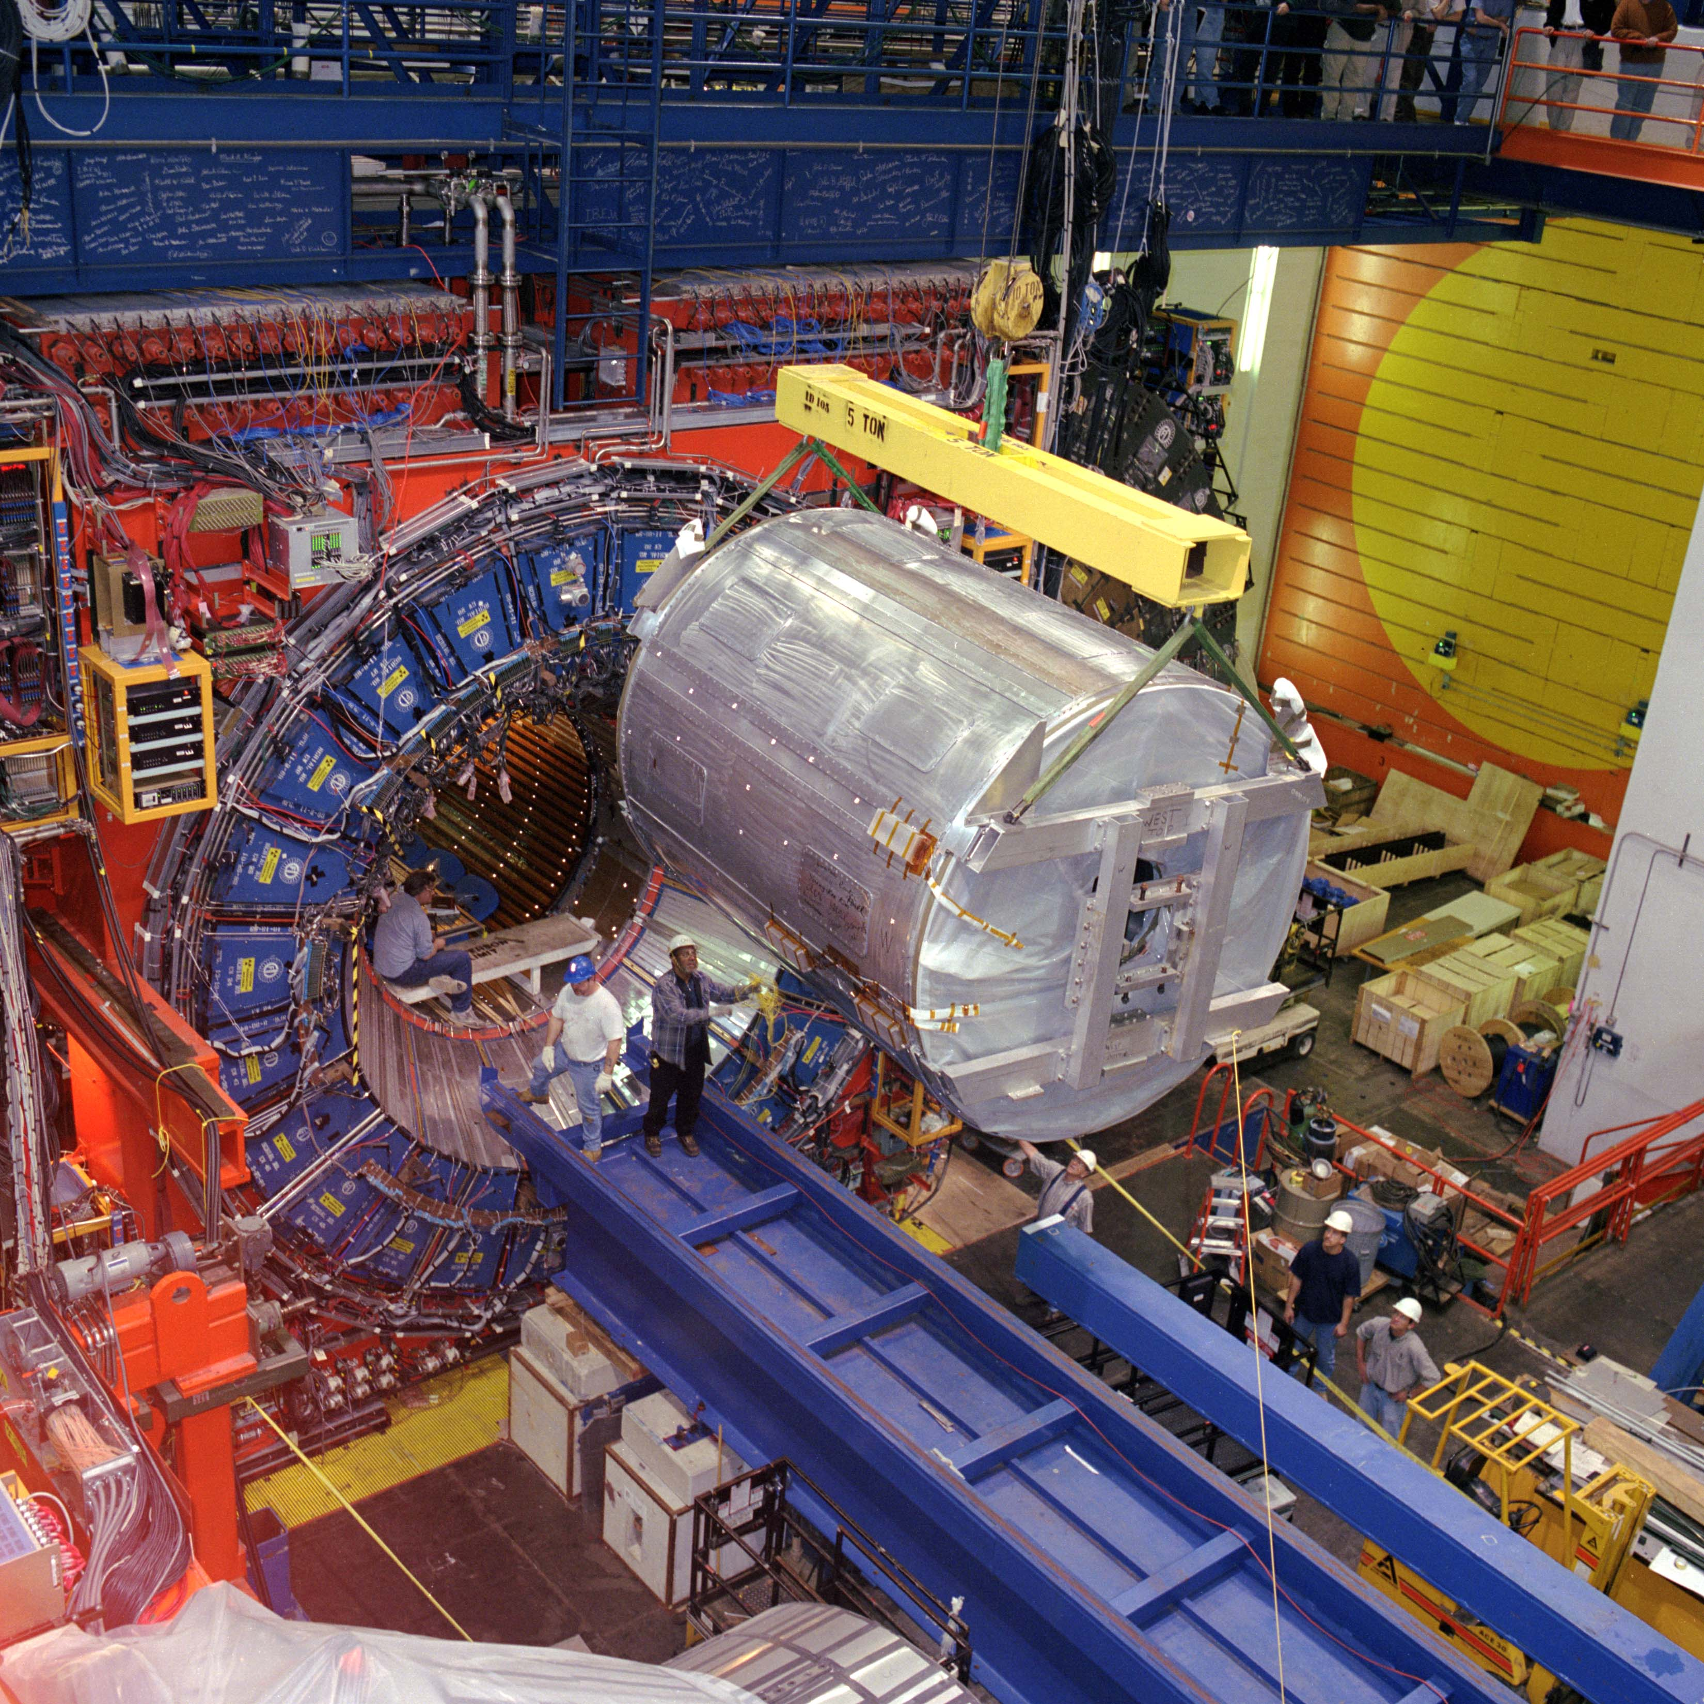
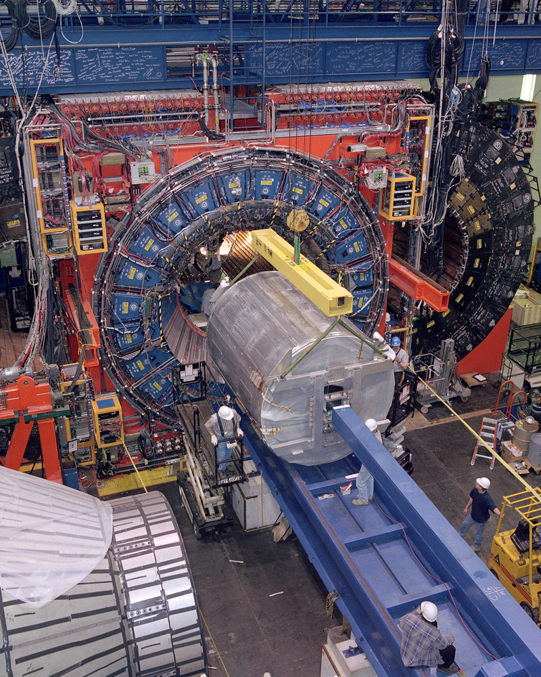
CDF: Central Outer Tracker

Slide 33
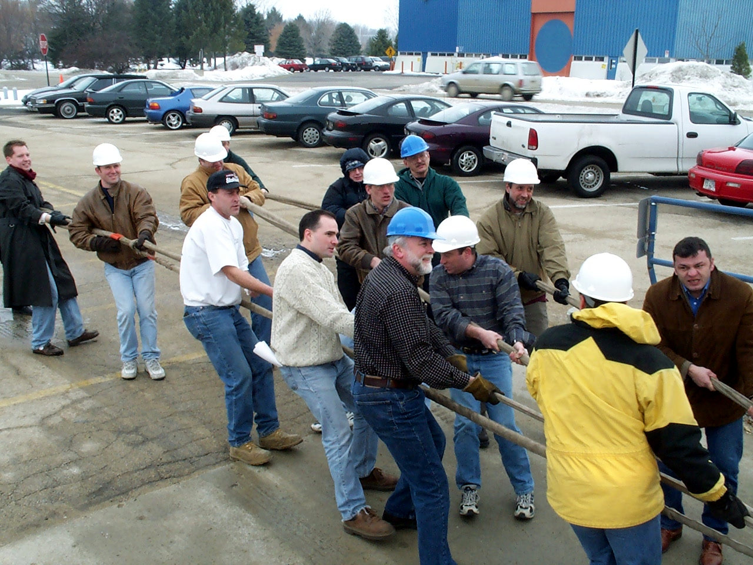
CDF: Silicon Detector

Slide 34
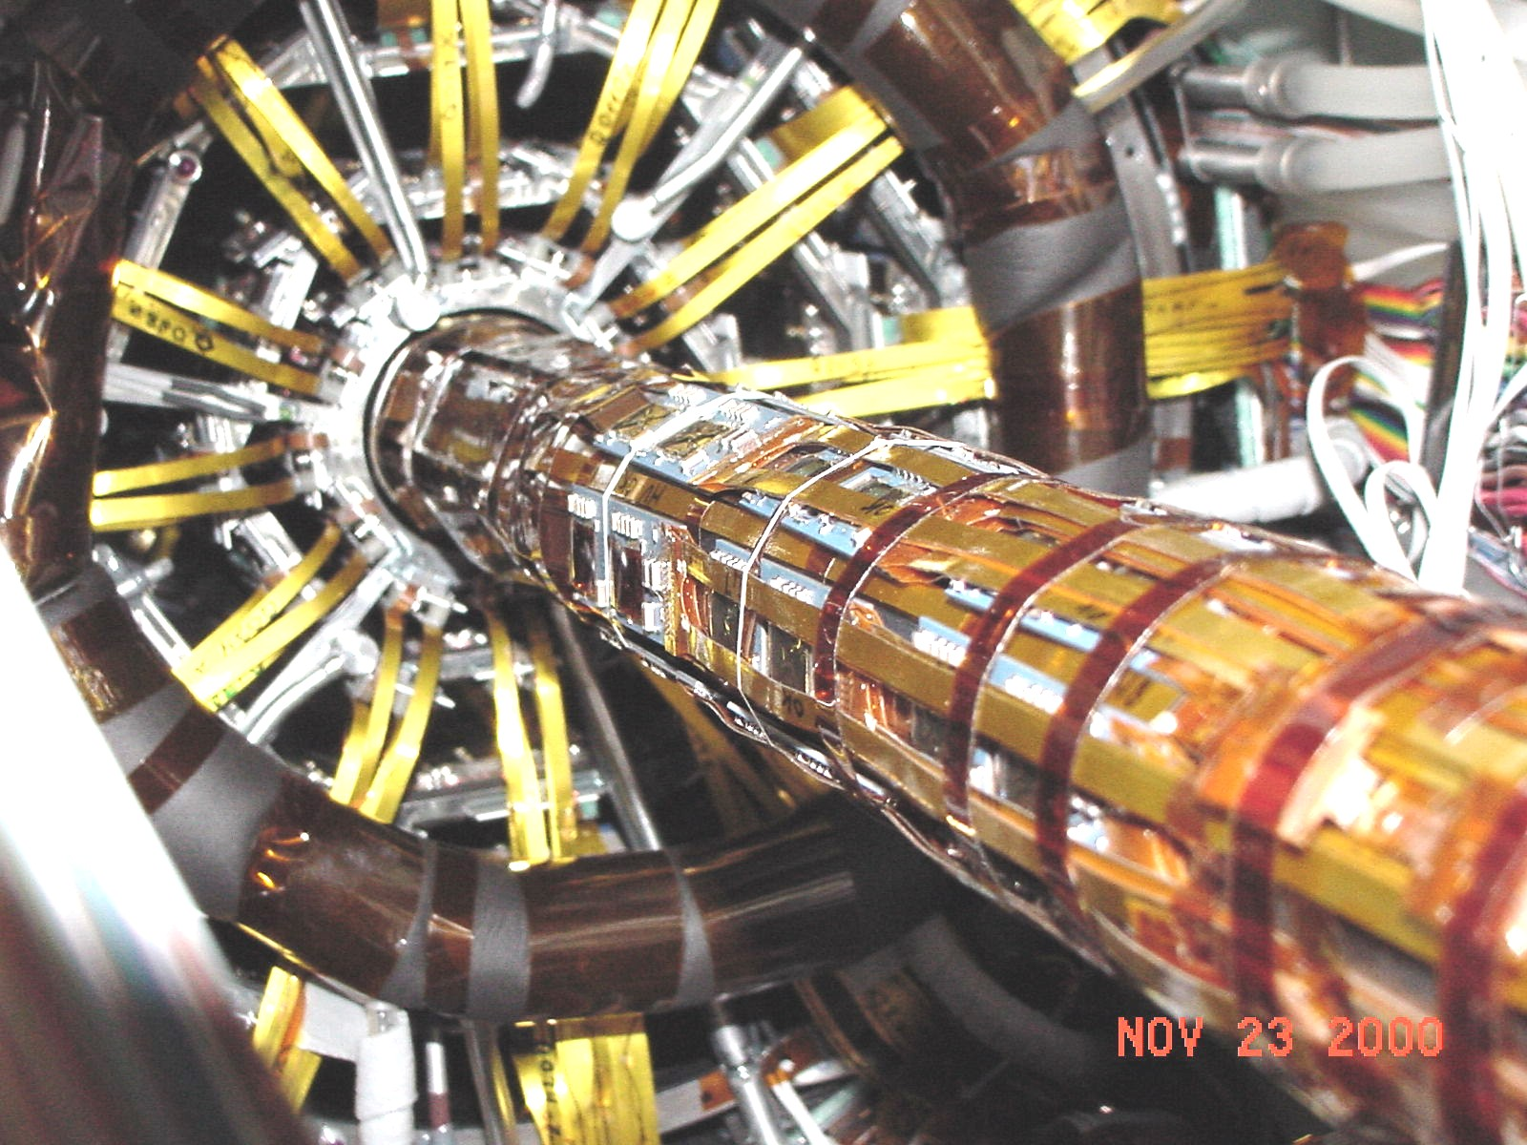
CDF: Silicon Vertex Detector

Slide 35
Conclusions
We have a month ahead of us
Learn how an experimenters work
Experimental setup
Basic physics ideas
Basic measurements
Give a talk
Instructions for course
get registered for a user account on subMIT our computing resource
Review the projects to see which one you are most interested in

