Slide 1
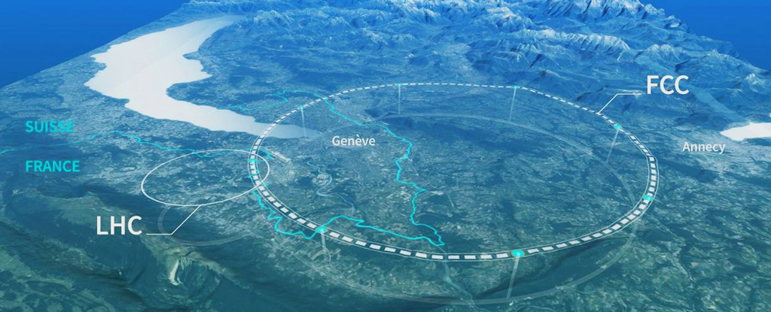
8.FCC - January Research Projects on
the Future Circular Collider (FCC-ee)
Accelerators … continued
[January 10, 2025]

Slide 2
Outline
Accelerators
why do we accelerate particles?
basic physics of accelerators
various accelerator types
hadron versus lepton colliders
examples of accelerators today
LEP, TeVatron, LHC
future of accelerators: ILC, FCC, muon collider

Slide 3
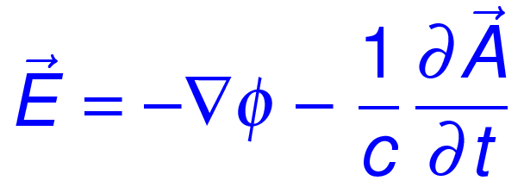
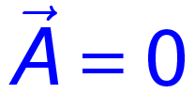
Basic Accelerator Physics
Lorentz Force:
electric force
magnetic force
Magnetic force perpendicular to velocity
→ no increase in velocity, but changes direction
Only electric force increases particle energy
From the Maxwell equations:
static:

Slide 4
Summary on Accelerator Types
Electrostatic accelerators
Acceleration tube: breakdown at 200 keV
Cockroft-Walton: improves to 800 keV
Van de Graaff: best electrostatic device at 25 MeV
AC driven accelerators
Linear: cavity design and length critical
Circular accelerators:
cyclotron: big dipole magnet, non-relativistic, up to 25 MeV
synchrotron: vacuum beamline, expandable, small magnets and cavities, synchrotron radiation large for light particles

Slide 5
Hadron versus Electron Colliders
From the physics point of view
From the accelerator point of view
Complementary devices

Slide 6
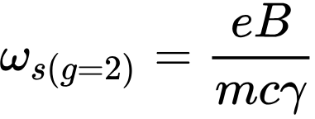
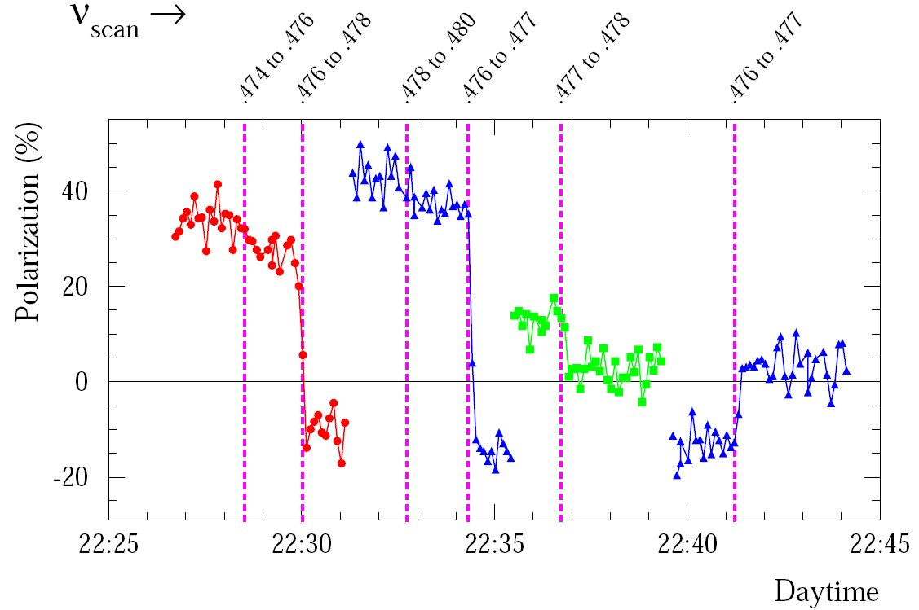
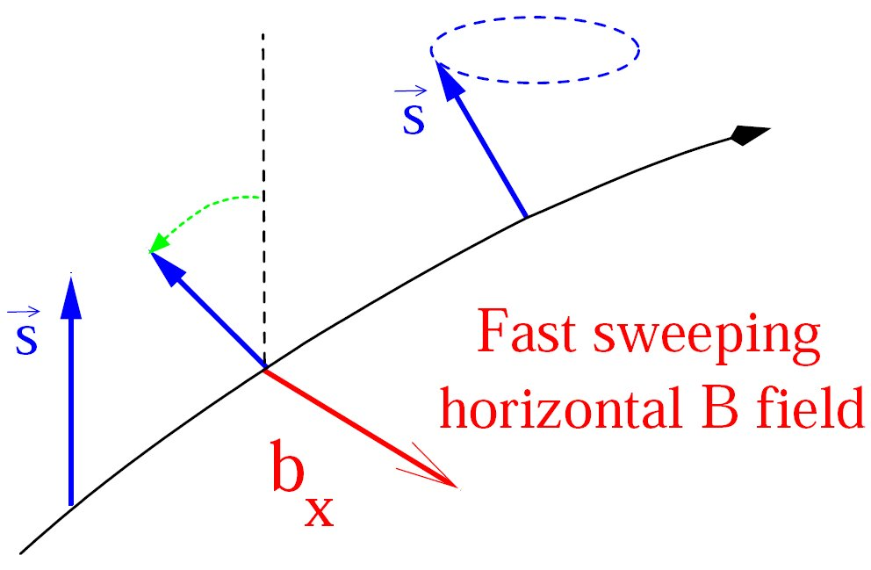
‘Modern’ Accelerators: LEP
Energy calibration (resonant depolarization)
Transverse polarization automatically builds up (Sokolov-Ternov)
Monitor transverse polarization level
Kick rotating electrons with periodic magnetic field
Tune in frequency which destroys polarization (resonance)
Very sensitive method: about 0.5 MeV on 45 GeV beams
Larmor
frequency
https://www.sciencedirect.com/science/article/pii/037026939290457F: PLB 284,3 (1992) 431

Slide 7
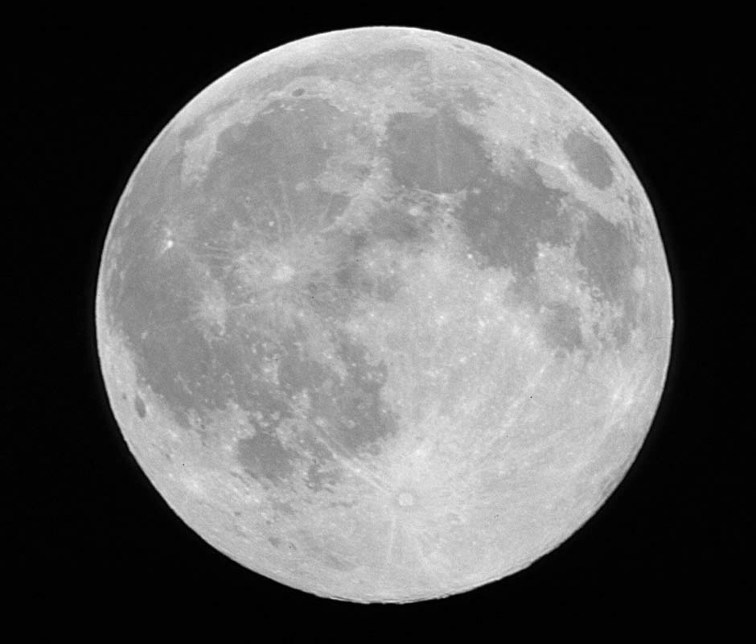
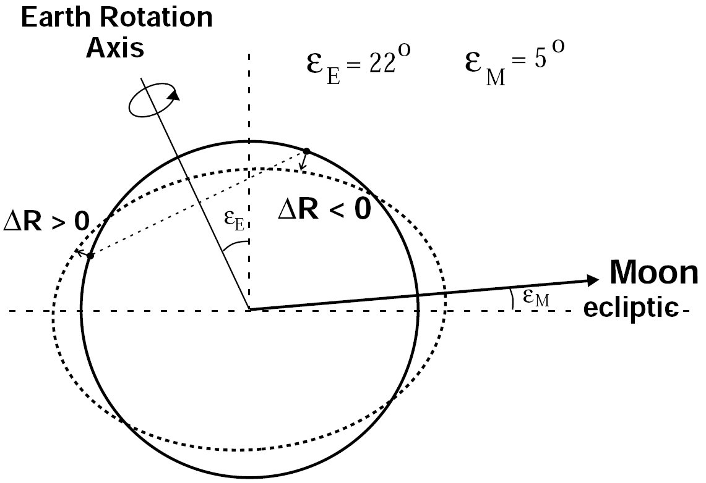
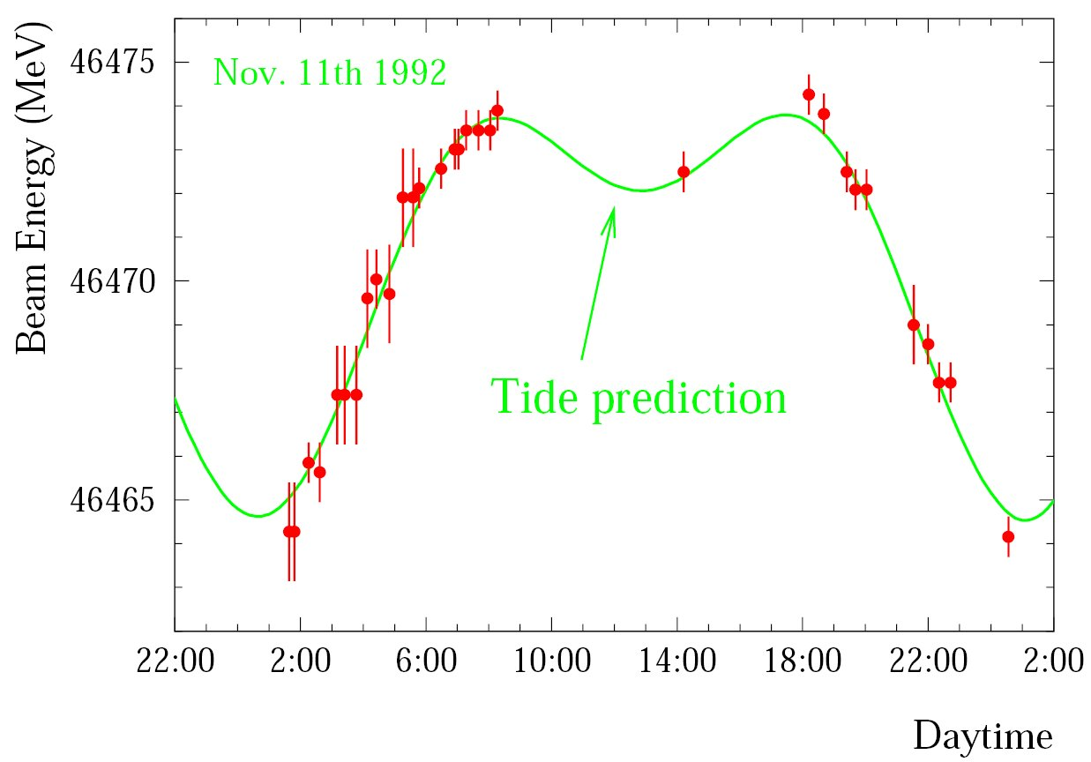
‘Modern’ Accelerators: LEP
Calibration nightmares: part 1
calibration changes sensitive to small changes in circumference:
fluctuations in first calibrations explained by tides
https://cds.cern.ch/record/250463/files/CM-P00061237.pdf

Slide 8
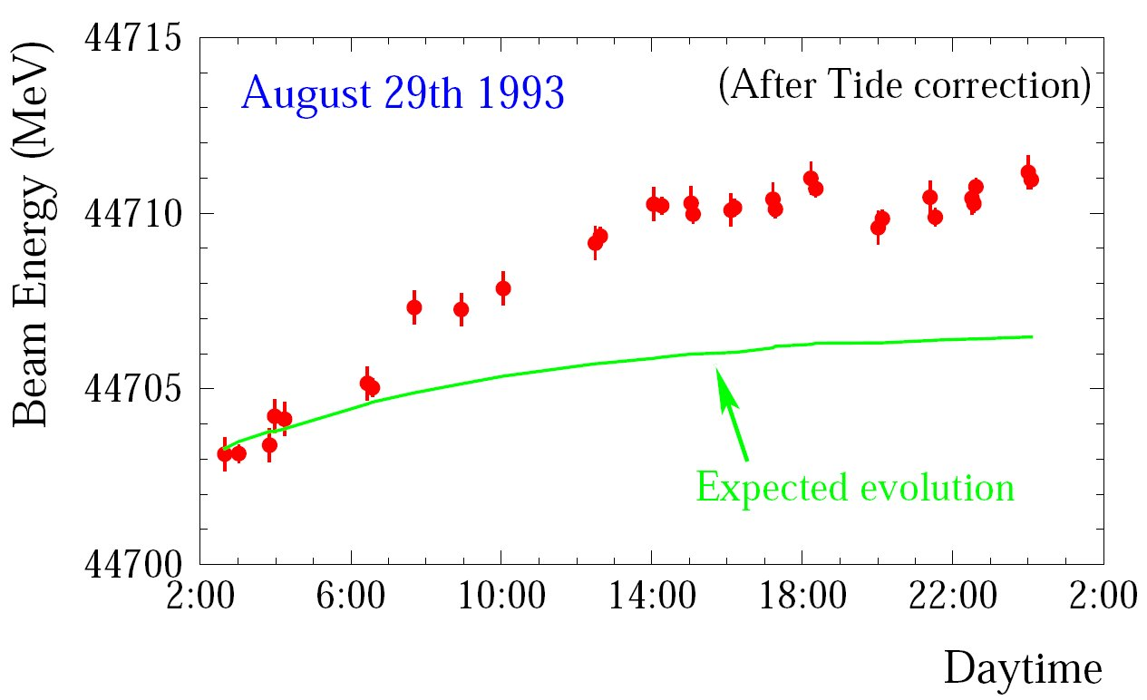
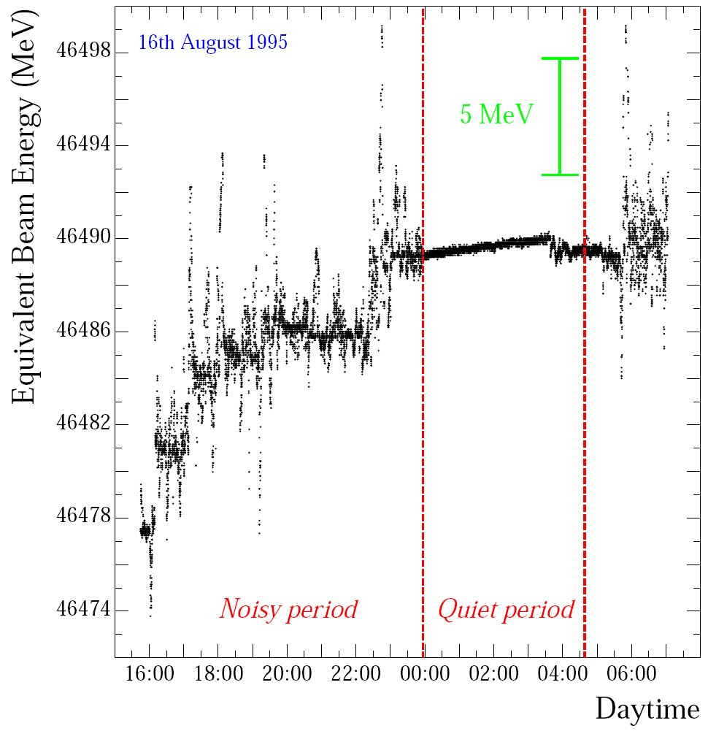
‘Modern’ Accelerators: LEP
Calibration nightmares: part 2
A daunting indication
will remain unexplained for 2 years ....
until an undergrad from Aachen (Mark Geitz) comes out for the summer
Smoking gun
man made problem
https://cds.cern.ch/record/334095/files/sl-97-047.pdf

Slide 9
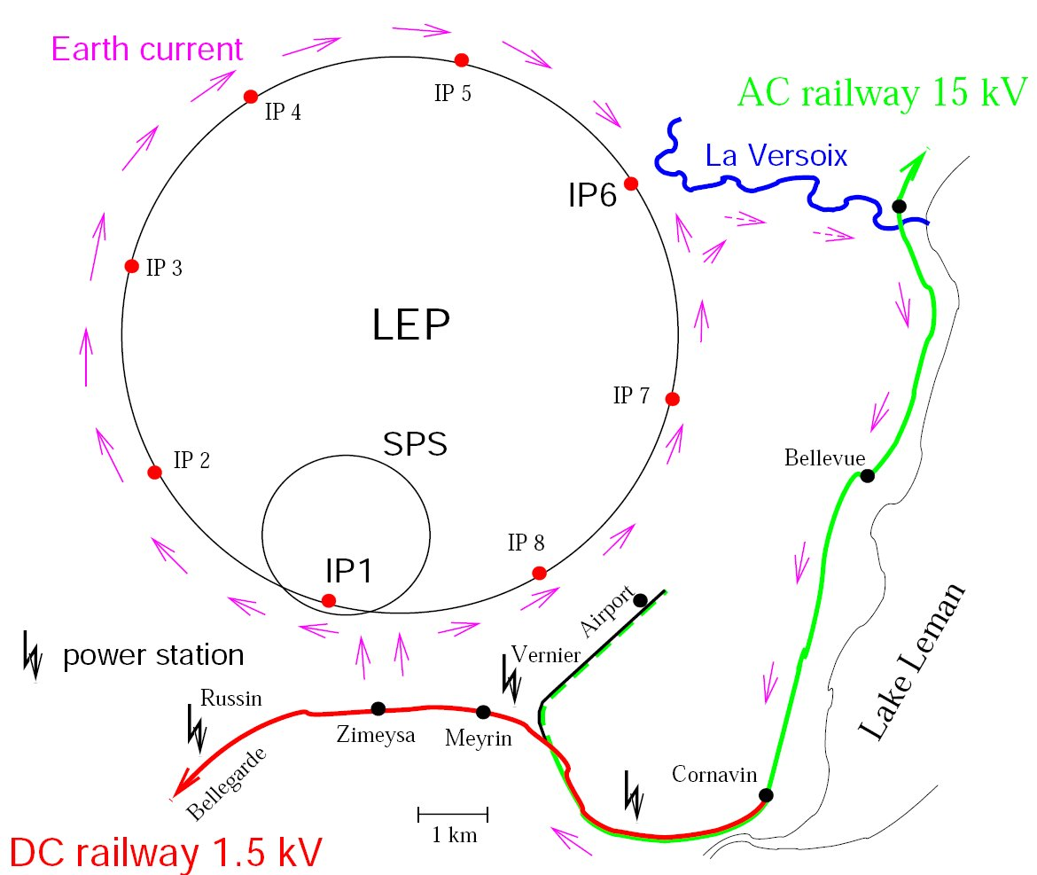
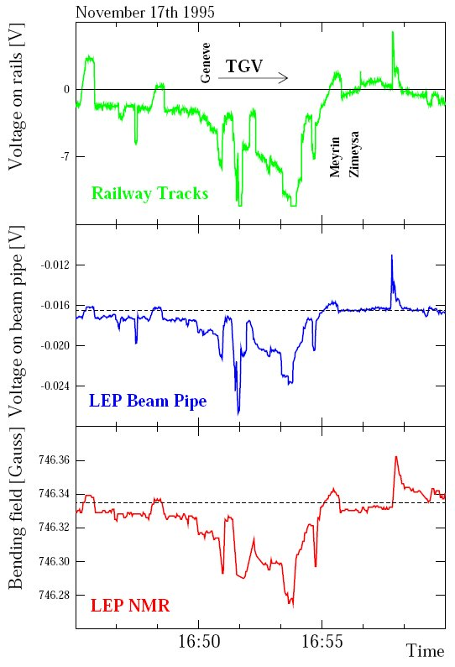
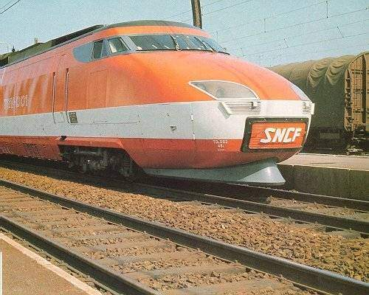
‘Modern’ Accelerators: LEP
The French DC trains caused the problem
1A current on beampipe

Slide 10
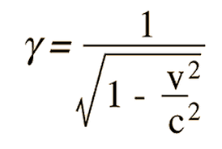
‘Modern’ Accelerators: LEP
The limits of LEP
synchrotron radiation energy: Esync∝γ⁴
at 100 GeV: ΔEbeam/Ebeam= 0.02 → Eloss /√s = 0.10
energy consumption: 20 MW (small village)
length of machine affects synchrotron radiation losses
tunnel completely full of cavities (superconductive)
wakefield: left in the cavity deposit energy
absorption of 40 kW at 4 K
corresponds to 10 MW energy needed
horizontal beam size increase: σx∝γ
touched beampipe walls
Derive gamma factor: https://www.youtube.com/watch?v=qXxtqK7G4Uw

Slide 11
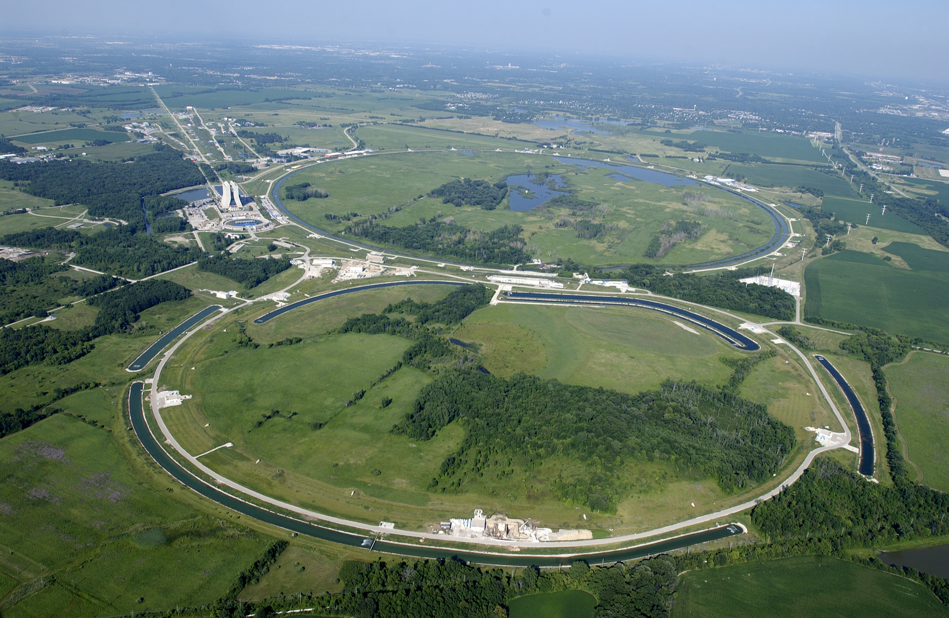
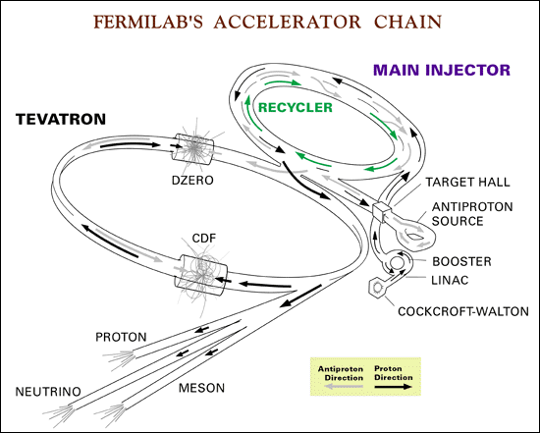
‘Modern’ Accelerators: Tevatron
TeVatron
Synchrotron: 1 km radius
operational: 1985-2011
at Fermilab (Chicago, USA)
detectors: CDF, Dzero
Ebeam: 1 TeV, p-pbar (1 mA)
physics goals: Higgs, NP, top, b
superconducting magnets: 4.2 T
complex acceleration chain
Cockroft-Walton (750 keV, H⁻⁻)
LINAC(400 MeV, strip to create p)
Booster (8 GeV)
Main Injector (120 GeV)
Tevatron (1 TeV)

Slide 12
Modern Accelerators: LHC
Large Hadron Collider (LHC)
Synchrotron: 4.5 km radius
Operational: 2007-2041?
at CERN (Geneva, Switzerland)
detectors: Alice, Atlas, CMS, LHCb + smaller
Ebeam: 7 TeV proton (0.5 A) → √s = 14 TeV
schedule: pilot run 2007, physics run 2008
physics goals: Higgs and New Physics Discovery
dipole magnets, the core of LHC (1232)
superconducting dipoles: B=8.4 T; T=1.9 K, I=11.7 kA
superfluid helium cooling

Slide 13
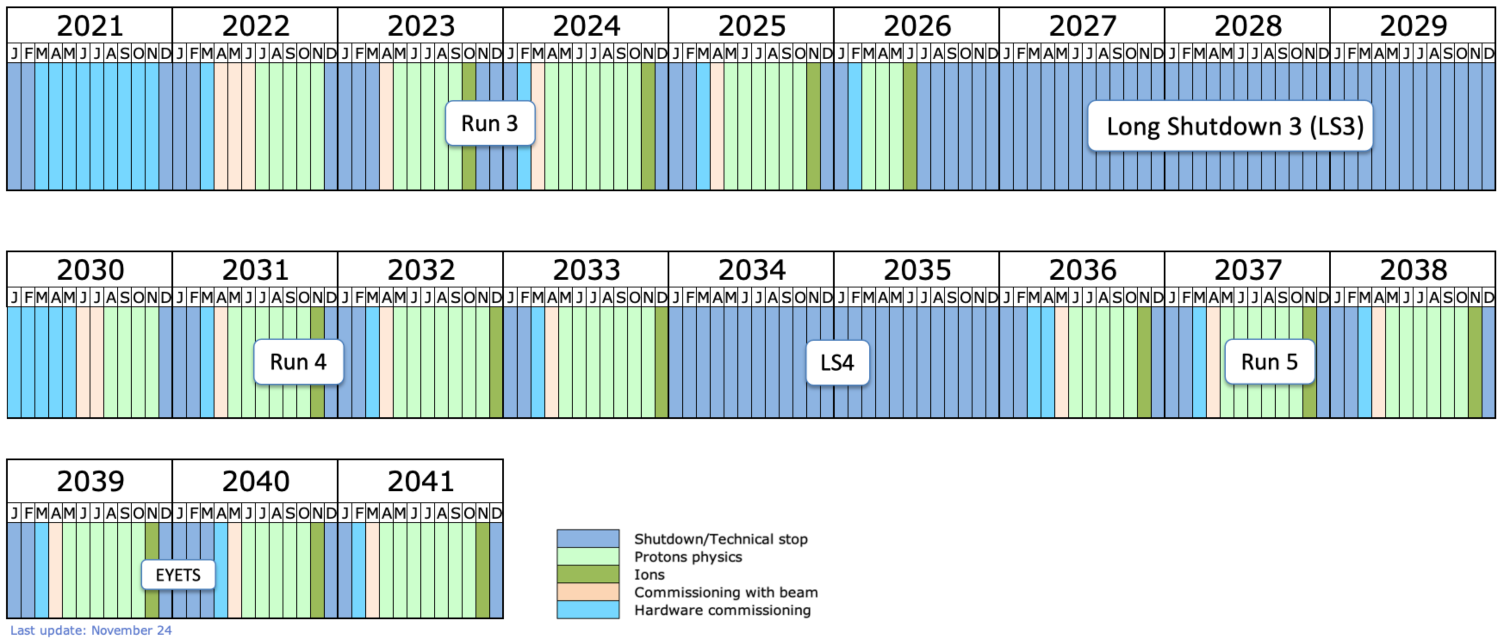
Modern Accelerators: LHC
Large Hadron Collider (LHC)
Long term schedule set into the early 40ies
There are some uncertainties projecting forward for so long

Slide 14
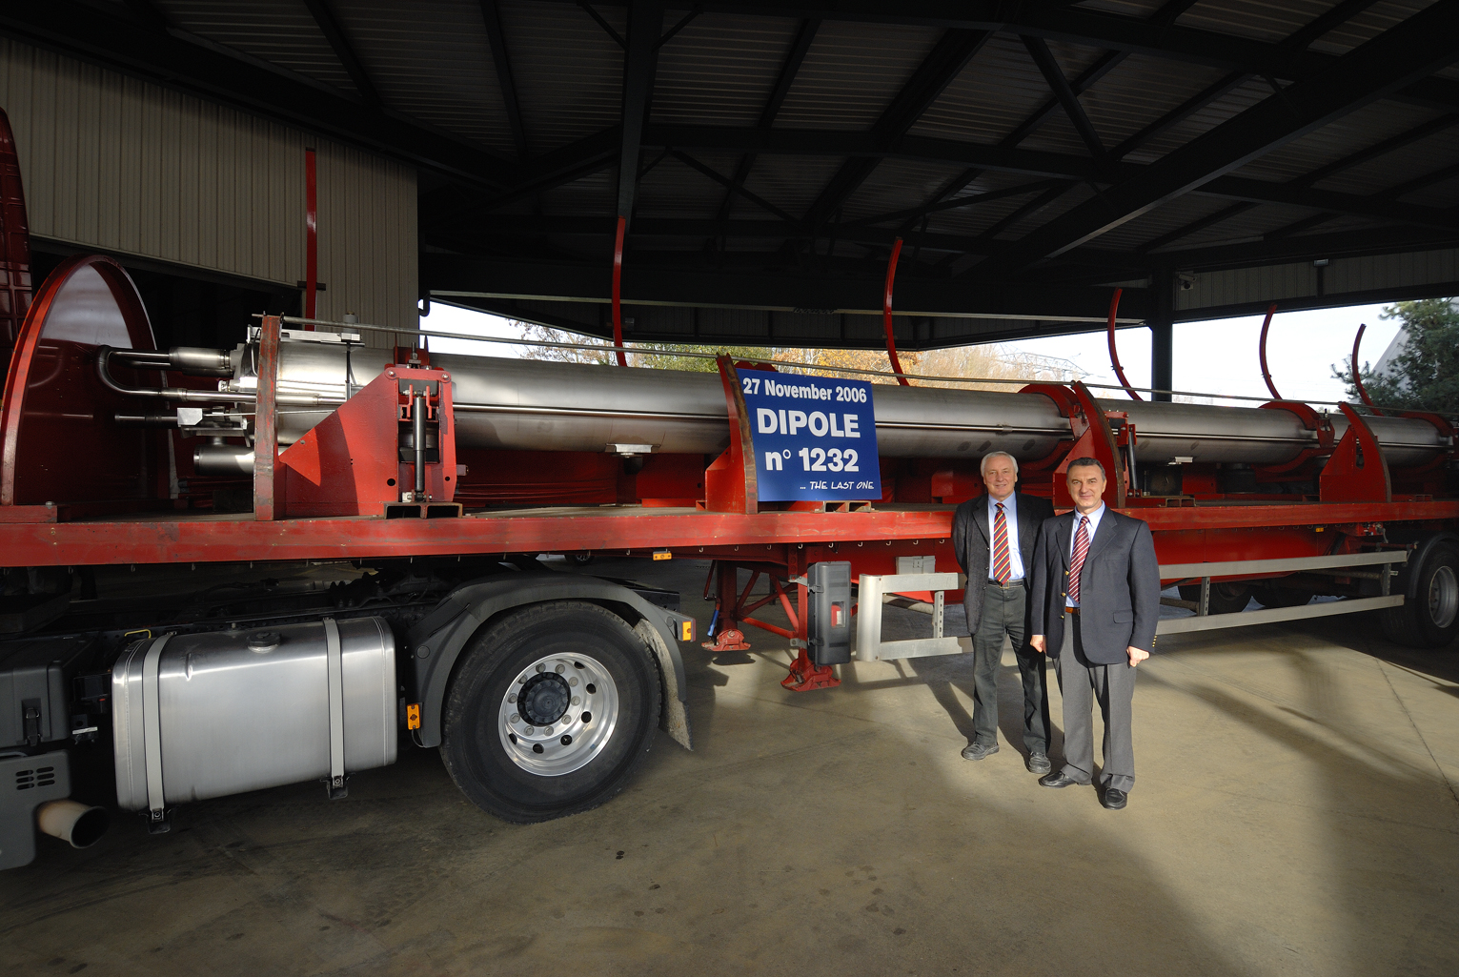
LHC Dipoles Complete

Slide 15
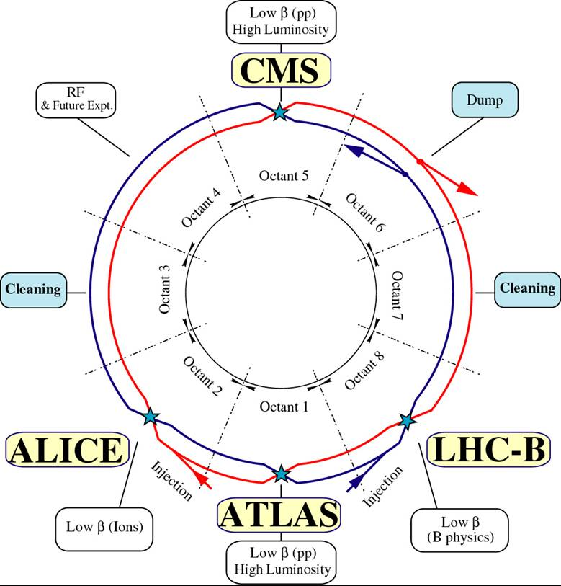
LHC Layout
Dipoles at 8.4 T
momentum: 7000 GeV
tunnel: 27000 m
arcs length: 22200 m
80% of arcs filled: F = 0.8
compare to
iron saturation: 2 T
Earth magnet:

Slide 16
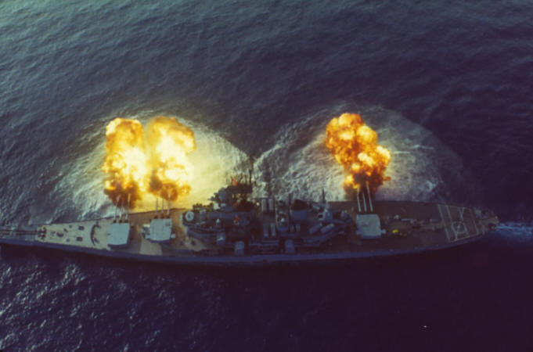
Energy Stored in an LHC Beam
Energy stored is huge
beams store 700 MJ: battleship gun is about 300 MJ
beam dump (70 μs) will create 10 TW of power, which is half the entire world's instantaneous power

Slide 17
Comparison
LEP
Luminosity: 10³² cm⁻⁻² s⁻⁻¹
number of bunches: 8 x 8,
bunch size: like a flat needle: 10 cm, 250 μm, 80 μm
TeVatron
Luminosity: 3 x 10³² cm⁻⁻² s⁻⁻¹
number of bunches: 36 x 36, per bunch: p-10¹¹, pbar-10¹⁰
bunch size: 30 cm, 30 μm, 30 μm
LHC
Luminosity: 10^{34/35} cm⁻⁻² s⁻⁻¹
number of bunches: 2800

Slide 18
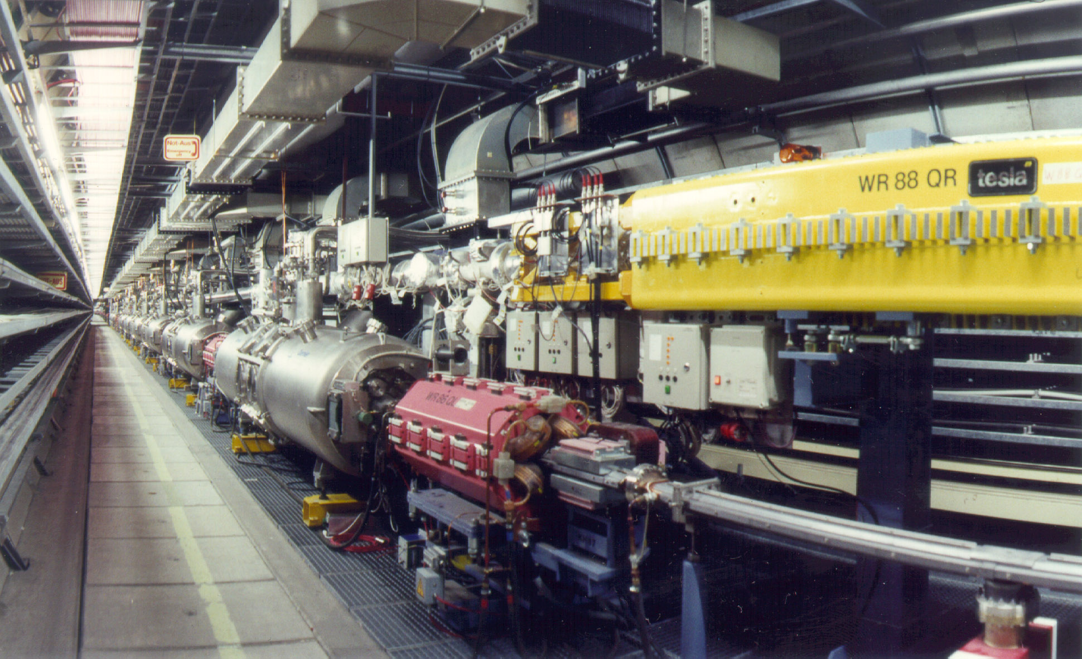
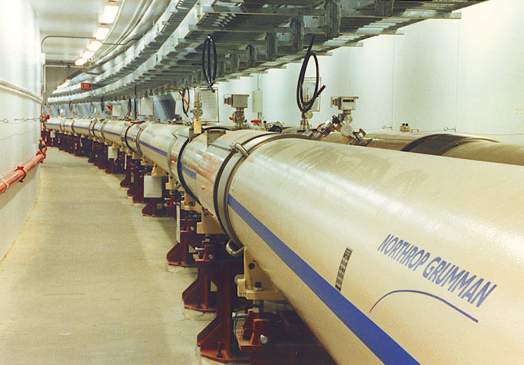
Other Accelerators
HERA, 1991 (Hamburg, Germany)
e (27.5 GeV) - p (920 GeV)
radius: 1 km, B = 5.5 T, T = 4.4 K
180 bunches, I = 0.5 mA
RHIC, 1999 (New York, USA)
Au - Au ... p – p at 250 GeV
radius: 0.60 km, B = 3.5 T; T = 4 K
57-114 bunches, I = 0.013 mA

Slide 19
Future of Accelerators
Linear collider, ILC (technically proven): 0.5-3 TeV
strong international collaboration
awaiting directions from LHC findings
political decision of location
VLHC (issue: magnet development): 40-200 TeV
95 km; B = 12 T; n = 20800 (~ FCC-hh)
520 km; B = 2 T; n = 130000
Muon collider (issues: source/lifetime) 0.5-4 TeV
lepton collider virtually without synchrotron radiation
Higgs factory (40,000 times larger coupling then e⁺e⁻⁻)

Slide 20
Conclusions
Motivation for particle acceleration
understand matter around us: “nuclear physics”
create new particles : “particle physics”
Particle acceleration types
electrostatic: limited to 25 MeV
AC driven: linear or circular, open ended
Modern Accelerators
LEP and LHC
Future accelerators: FCC, ILC, muon collider ....

Slide 21
Next Lecture
Particle Detectors Overview
Introduction and a bit of history
General organization of detectors
Particle interactions with matter
Tracking
Calorimetry
Modern integrated detectors
Conclusions and next lecture

