Slide 1
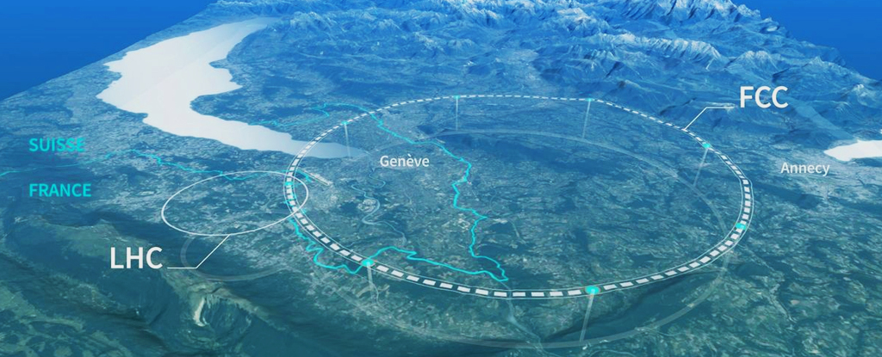
8.FCC - January Research Projects on
the Future Circular Collider (FCC-ee)
Particle Detectors
[January 13, 2025]

Slide 2
Lecture Outline
Particle Detectors Overview
  Introduction and a bit of history
  General organization of detectors
  Particle interactions with matter
  Tracking
  Calorimetry
  Modern integrated detectors
  Conclusions

Slide 3
Motherhood and Apple Pie
The ultimate goal of particle detectors is to determine the particles creation/decay point, its momentum and its type (mass).
Detecting particles always implies to interact with them. Its path is thus always affected by observation. If it's perfect it ain't real.
Particle detectors always rely on electromagnetic interaction (photons or charged particles).

Slide 4
Definitions and Units
Energy of a particle: E² = p²c² + m²c⁴
  energy, E, measured in eV (= 1.6 · 10⁻¹⁹ J)
  momentum, p, measured in eV/c
  mass, m, measured in eV/c²
  m_{bee} = 1 g = 5.8· 10³² eV/c²
  v_{bee} = 1 m/s → E_{bee} = 10⁻³ J = 6.25 · 10¹⁵ eV
  E_{p,LHC} = 14· 10¹² eV, but all protons 10¹⁴ → 10⁸ J
From special relativity
m = 100 T
v = 120 km/h

Slide 5
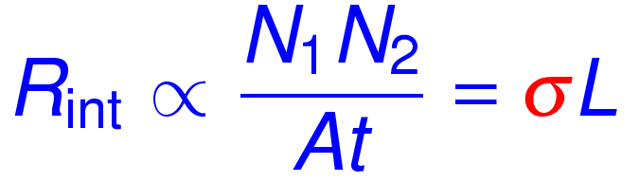
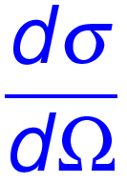
Definitions and Units
Cross Section, σ
  cross section or differential cross section expresses probability of a process to occur
  two colliding bunches: N₁/t collides with N₂/t
  rate is
  Differential cross section:
  fraction of cross section scattered in dΩ angular area
cross section is an area
1 barn = 10⁻²⁴ cm²
luminosity [cm⁻² s⁻¹]

Slide 6
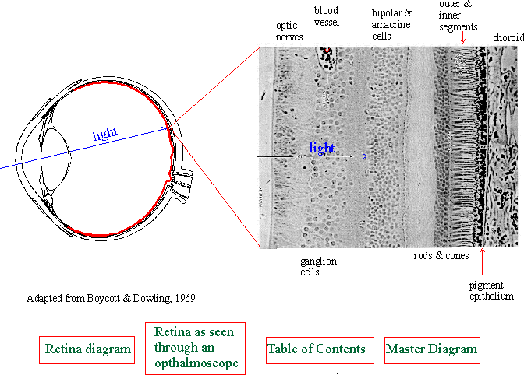

Natural Particle Detectors
Very common particle detectors: the eye
Properties of 'eye' detector
  highly sensitive to photons
  decent spatial resolution
  excellent dynamic range 1-10¹⁴
  automatic threshold adaptation
  energy discrimination, though limited range: wavelength
  modest speed: data taking at 10 Hz, inc. processing
  excellent data processing connection (at times)

Slide 7
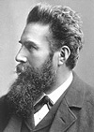
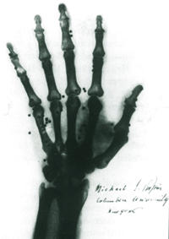
Extending the Eye
Photographic paper as detector
  1895 W.C. Röntgen (first Nobel prize in physics)
  detection of photons (x-rays) invisible to the eye
  Silver bromide or chlorides (emulsion)
  AgBr + energy → silver (black)
Properties of 'paper' detector
  very good spatial resolution
  good dynamic range
  no online recording
  no time resolution

Slide 8
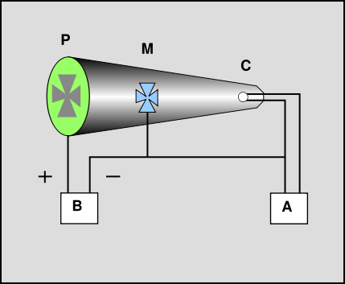
The Cathode Ray
1897 J.J.Thomson discovers the electron
From his publication:
“Cathod Rays”: Philosophical Magazine, 44, 293 (1897)
… The rays from the cathode C pass through a slit in the anode A, which is a metal plug fitting tightly into the tube and connected with the earth; after passing through a second slit in another earth-connected metal plug B, they travel between two parallel aluminum plates about 5 cm. long by 2 broad and at a distance of 1.5 cm. apart; they then fall on the end of the tube and produce a narrow well-defined phosphorescent patch. A scale pasted on the outside of the tube serves to measure the deflection of this patch….
Scintillation of glass caused the visible light patch

Slide 9
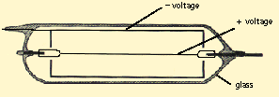
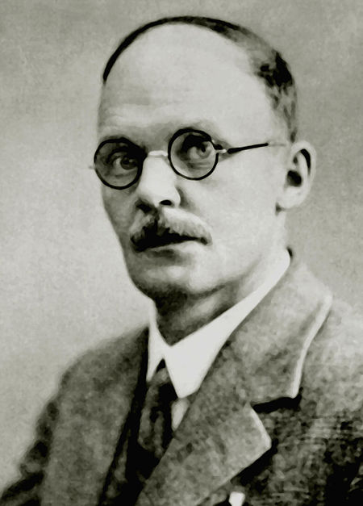
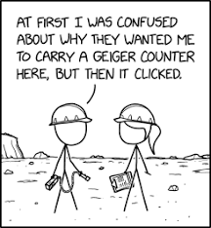
The First Electrical Signal
The Geiger counter
  a gas volume
  anode and cathode
  passing charge particle ionizes the gas
  ionization drifts:
    ion – cathode
    electron – anode
  pulse can be used in various ways, for example as a 'click' on a little speaker
Improved version called Geiger-Müller
Hans Wilhelm Geiger (1928)

Slide 10
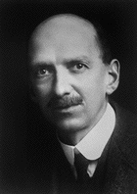
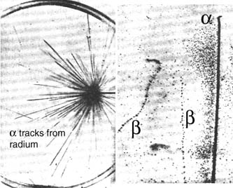
The First Tracking Detector
The Cloud Chamber
  an air volume saturated with water
  lower pressure to generate a super-saturated air volume
  charged particles cause
  condensation of vapor into
  small droplets
  droplets form along particle
  trajectory and are observed
  photographs allow longer
  inspections
Charles.T.R Wilson

Slide 11
Detectors and Particle Physics
Fruitful connection (experimenters/theorists)
  detectors allow one to detect particles
  experimenters study their behavior (informed by theory predictions)
  new particles are found by direct observation or by analyzing their decay products
  theorists predicts behavior of (new) particles
  experimentalists design the particle detectors to detect them and collect the data

Slide 12
Overview of Detectors
What do particle detectors measure?
  spacial locations
  momentum
  energy
  flight times
Modern detector types
  tracking (gas, solids)
  scintillation and light detectors
  calorimeters
  particle Id systems
Integral piece of detectors
  trigger systems
  data acquisition systems
  offline system

Slide 13
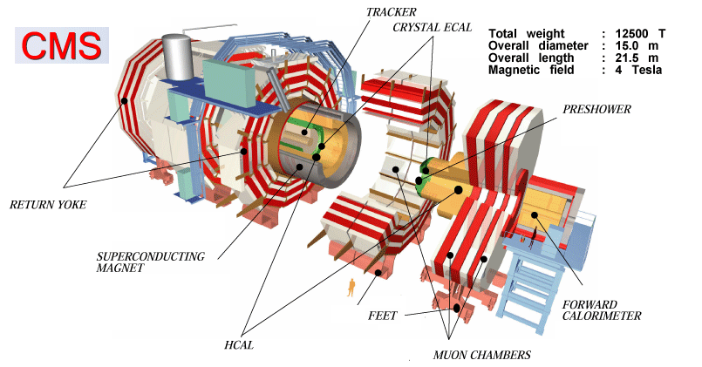
The Ideal Detector
Properties
  cover the full solid angle
  measurement of momentum and/or energy
  detect, track and identify all particles
  fast response, no deadtime
Limitations
  technology
  space
  budget

Slide 14
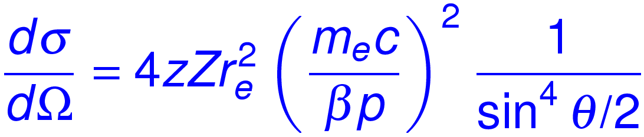
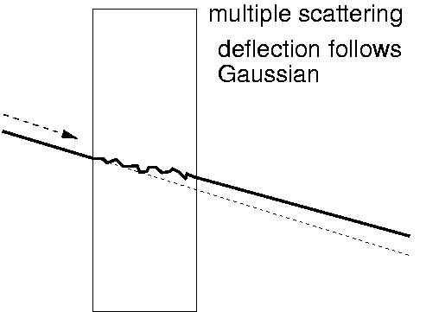
Following a Particle
Scattering with the nucleus, charge Z (Rutherford)
Particles do not scatter or very little
  if the material is thick they may scatter multiple times
Multiple scattering
  particle scatters multiple times
  the smaller the momentum the larger the effect
  Approximate by Gaussian around original direction

Slide 15
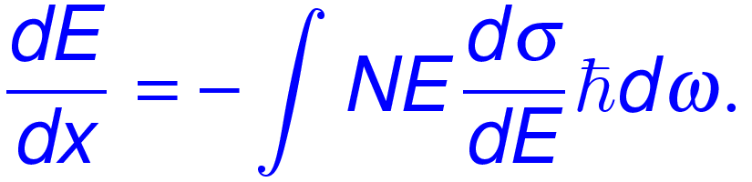
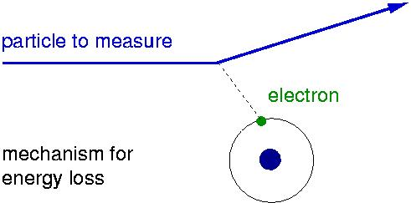
Following the Particle
Energy loss in matter
  multiple scattering? no! collision elastic (heavy nucleus)
  scattering with electrons from the atoms
  energy loss per length x
electron density
cross section per energy
for large enough interaction causes ionization, sometimes photon exits medium (later)

Slide 16
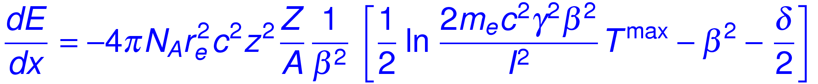
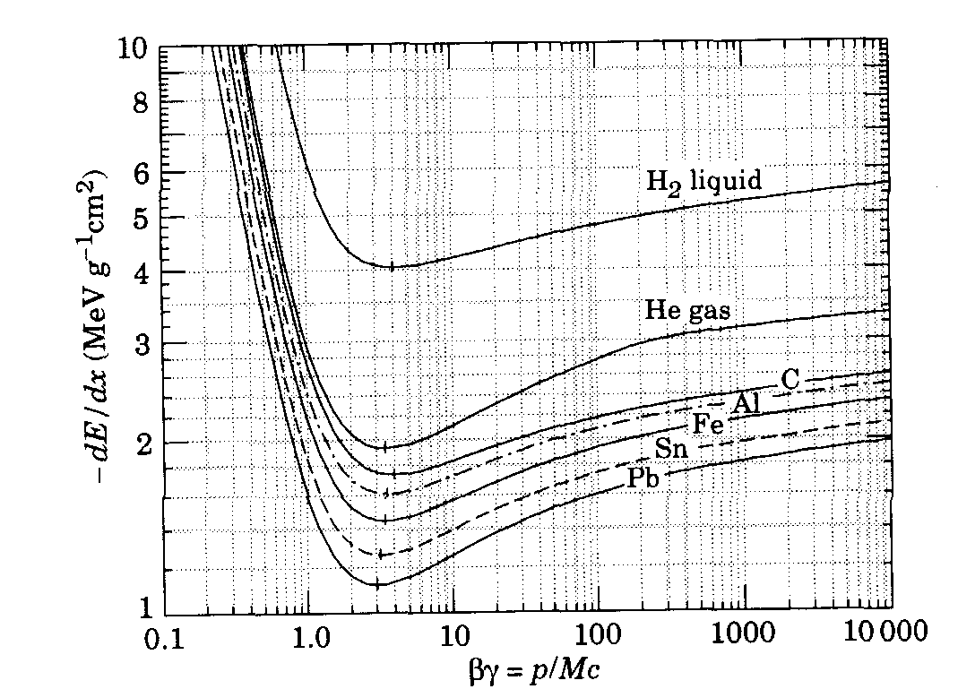
Bethe-Bloch Formula
Average differential energy loss dE/dx
in MeV/g/cm²
only valid for “heavy” particles (m>m_{μ})
independent of m, only depends on β
to first order proportional to Z/A (density of electrons)

Slide 17
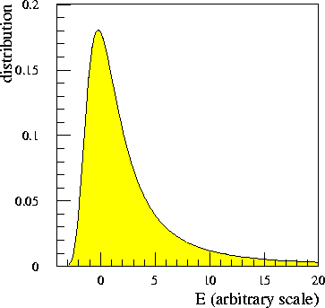
Practical Issues of Energy Loss
Energy loss is measured on finite path δx not dx
  thin material few discrete collisions
  causes large fluctuations and long tails
  for thick material many collisions and energy loss distribution looks more like a Gaussian
thick material
thin material

Slide 18
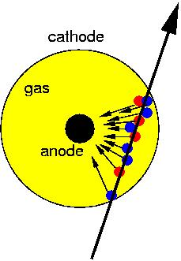
Tracking in Gas Detectors
Charged track ionizes the gas
  10-40 primary ion-electron pairs
  secondary ionization x 3 to 4
  → about 100 ion-electron pairs
  cannot be effectively detected
  amplifier noise about 1000 e⁻⁻
  number of ion-electron pairs has to be increased!
  velocity versus cathode increases
  electrons cause avalanche of ionization (exponential increase)

Slide 19
Calorimetry
General idea
  measure energy by total absorption
  also measure location
  method is destructive: particle is stopped
  quantity of detector response proportional to energy
  calorimetry works for all particles: charged and neutral
  mechanism: particle is forced to shower by the calorimeter material
  .... but in the end it is again ionization and excitation of the shower products which deposits the energy
  we distinguish electromagnetic and hadronic showers

Slide 20
Calorimetry: Electromagnetic
Electromagnetic shower
  Bremsstrahlung
  pair production
  quite simple shower
  electrons/photons only interact electromagnetically
Cloud chamber with lead absorbers
Photons either pair produce electron-positron or excite the atom or do Compton scattering
Large charge atoms are best materials, but also organic material is used: radiation length

Slide 21
Calorimetry: Hadronic
Hadronic cascades (showers)
  different processes involved
  EM showers included
  plus hadronic showers
    generating pions, kaons, protons
    breaking up nuclei
    also creating non detectable: neutrons, neutrinos, soft photons
    energy sum more difficult
    large fluctuation and limited energy resolution
  choose dense materials with large A: Uranium, Lead, ..
  nuclear interaction length determines depth of shower

Slide 22
Muon Detection
Muon is basically a track
  do standard tracking tricks
But muons are minimally ionizing
  penetrate through a lot of material
  it makes calorimetry with muons special
    does not get stuck in the calorimeter (missing energy)
    signature is recognizable and is used for selection of muons
  muons are really identified outside of the calorimeters they are the last remaining particles after calorimeter absorption (there are also neutrinos of course ...)
  typically at least 4 nuclear interaction length shield the muon detectors

Slide 23
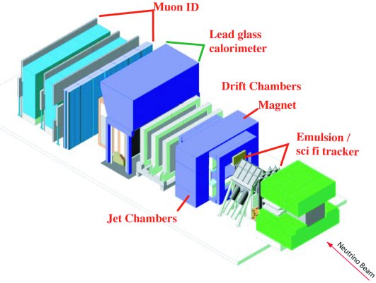
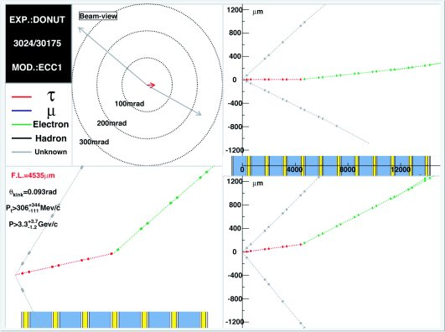
Modern Photographic Emulsions
Emulsions
  cannot be readout electronically
  scan optically
  has been fully automated
  low rate experiments only
  provide very precise locations better than 1 μm
  example: discovery of the τ neutrino – DONUT
  CHORUS also used them

Slide 24
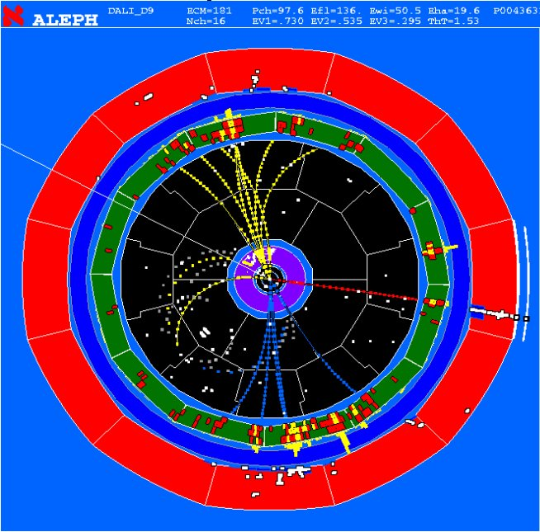
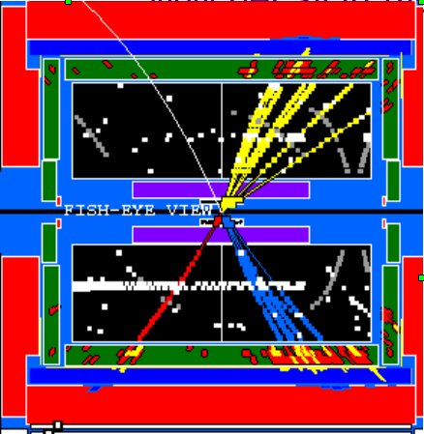
Examples of Modern Detectors
WW decay in Aleph
qq μν_{μ}
2 jets, muon, missing energy

Slide 25
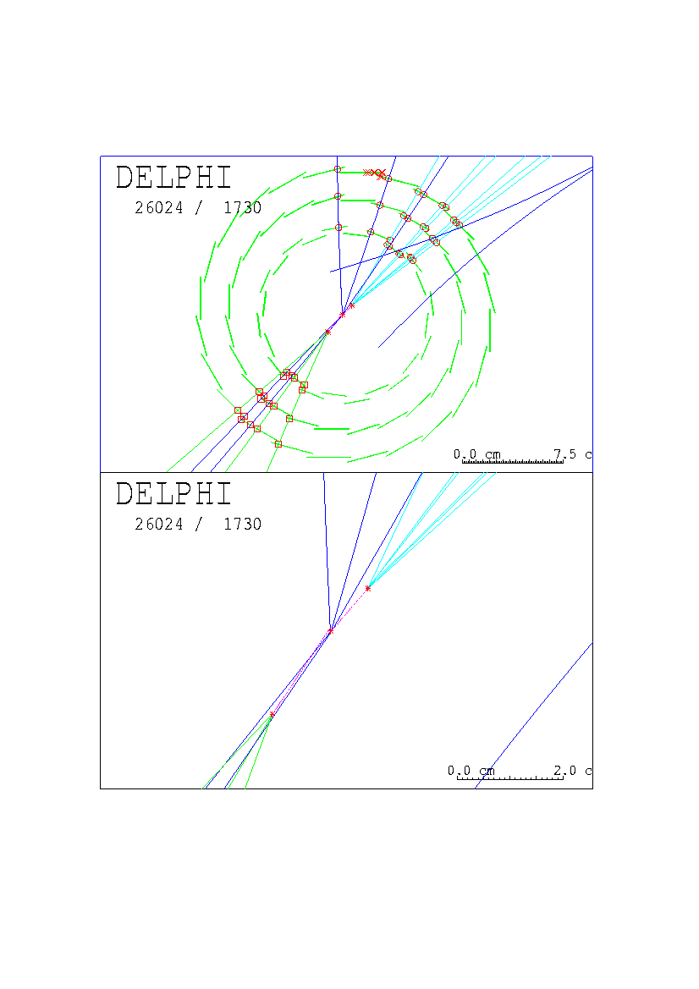
Examples of Modern Detectors
Delphi Detector
  B meson in micro vertex detector
  B flies for about 1 milimeter
  3 layers
  waver structure visible
  resolution: 10s of μm
For the FCC-ee
  Planning to get to 3 μm
  More then 3 layers for sure

Slide 26
Conclusion
Particle detectors follow simple principles
  detectors interact with particles
  most interactions are electromagnetic
  imperfect by definition but have gotten pretty good
  crucial to figure out what detector type goes where
Four main ideas
  track charged particles and then stop them
  stop neutral particles
  find the muons which are left
  Measure what is missing from energy conservation

