Slide 1
Higgs and Top physics

Slide 2
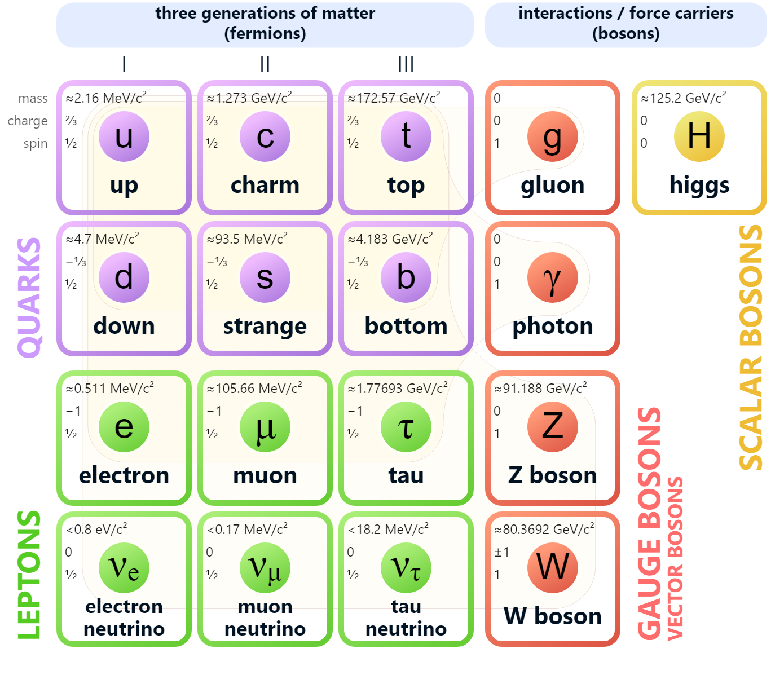
The Standard Model
Theoretical framework describing the fundamental particles and their interactions (excluding gravity)
Particle spectrum consists of bosons (force carriers) and fermions
All particles have been discovered and measured over the past decades, making the Standard Model complete
W/Z bosons extensively studied at LEP
Top discovered in 1996 at the Tevatron
Higgs recently discovered in 2012 at the LHC
Both Top/Higgs only being studied at hadron colliders

Slide 3
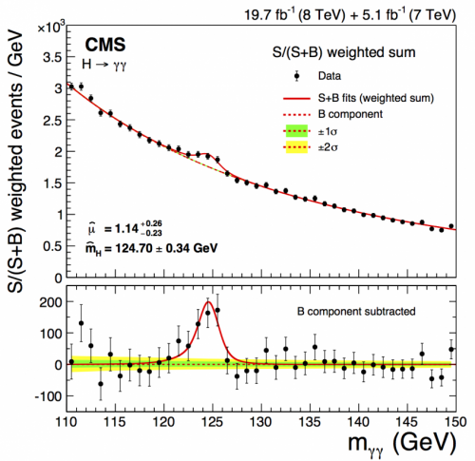
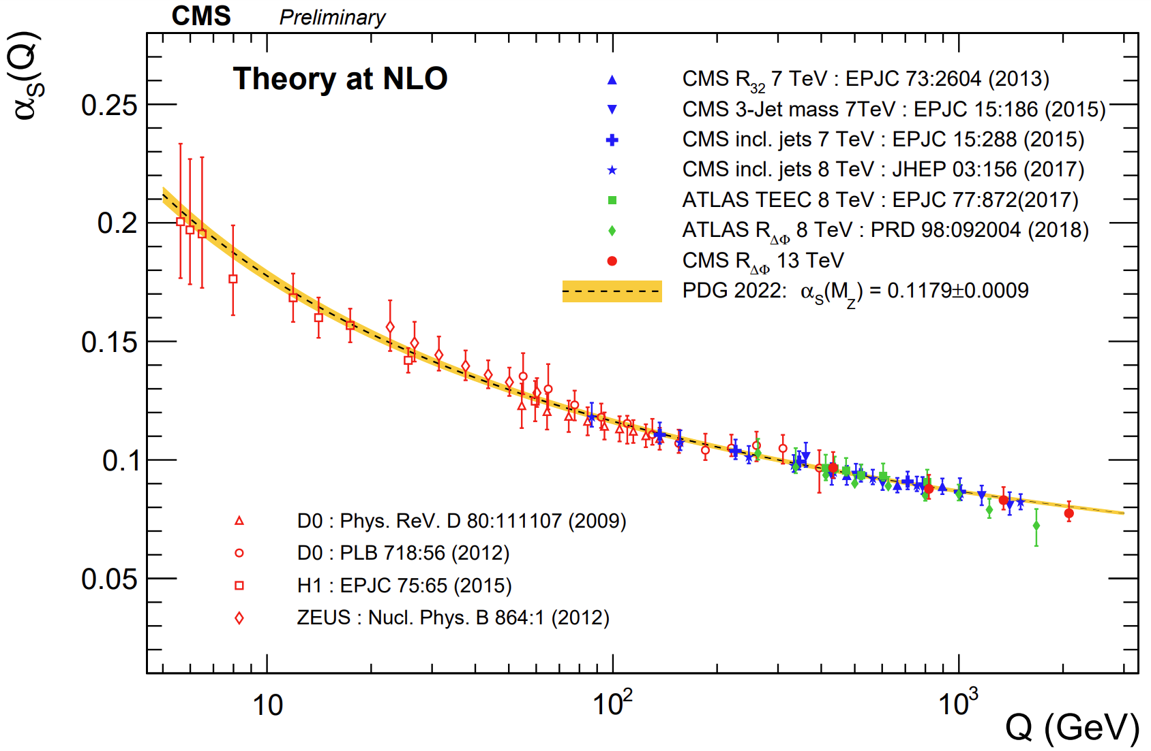
The present landscape
Key achievements of the Standard Model (SM)
Higgs discovery and properties; appears to be SM-like (could be a different particle!)
Precision measurements of SM parameters, including the top quark mass, W boson mass, and CP violation
Excellent agreement of the SM with experimental data across large energy scale
We know the SM is not sufficient – open questions in fundamental physics
Nature of dark matter
Matter-antimatter asymmetry: insufficient CP violation in SM
Hierarchy problem
Neutrino masses and oscillations
Unification and quantum gravity: theories beyond the SM
But no direct indication of new physics at LHC (so far)
What can HL-LHC do? Direct observation of new particles?
What can future colliders do?
What can precision physics do?
Notes:
Add line that precision physics can constrain new processes, as shown in the image

Slide 4
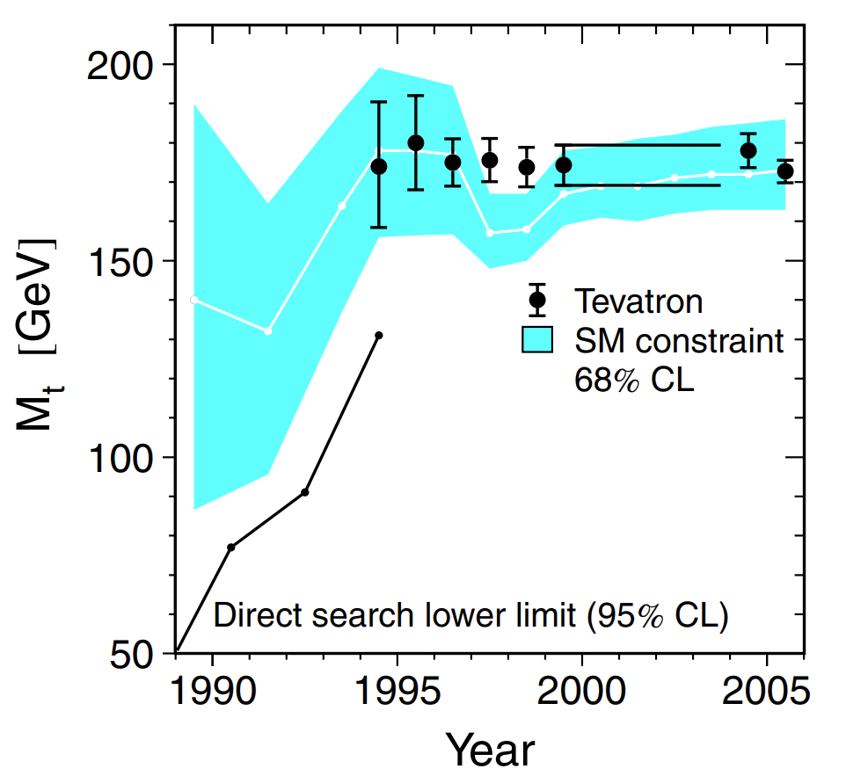
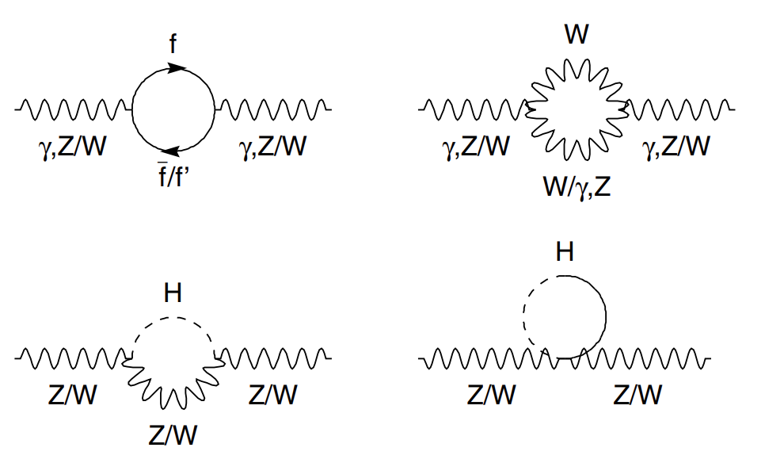
The power of precision measurements
Precision measurements allows to test the self-consistency of the SM
Increased effort in performing precision physics at the LHC using large datasets with succes (recent examples α_{s}, W mass)
LHC and HL-LHC will offer competitive precision physics
Electron-positron collider necessary to boost the precision measurements with order of magnitude(s)
Clean events, direct interpretation of results
Higgs and Top to be studied precisely using e⁺e– machines
History shows that precision measurements can guide us toward future discoveries
It may be our best opportunity to guide the search for new physics
Notes:
Top quark plot: https://cds.cern.ch/record/2054243/files/9789814644150_0005.pdf

Slide 5
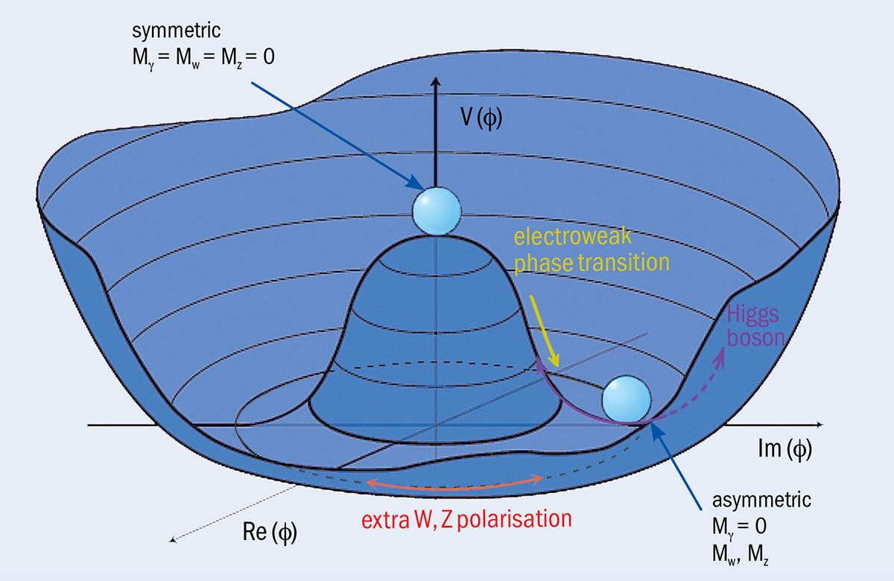
The Higgs boson
The Higgs mechanism is responsible for the mass of the elementary particles in the Standard Model (excluding neutrinos)
It is based on electroweak symmetry breaking
Higgs potential
Process through which the unified electroweak force separates into the electromagnetic and weak forces, as the Higgs field acquires a nonzero vacuum expectation value
Giving mass to the W and Z bosons while leaving the photon massless
Existence of a Higgs field H → Higgs boson
Theory developed in 1964 by Higgs, Englert and Brout

Slide 6
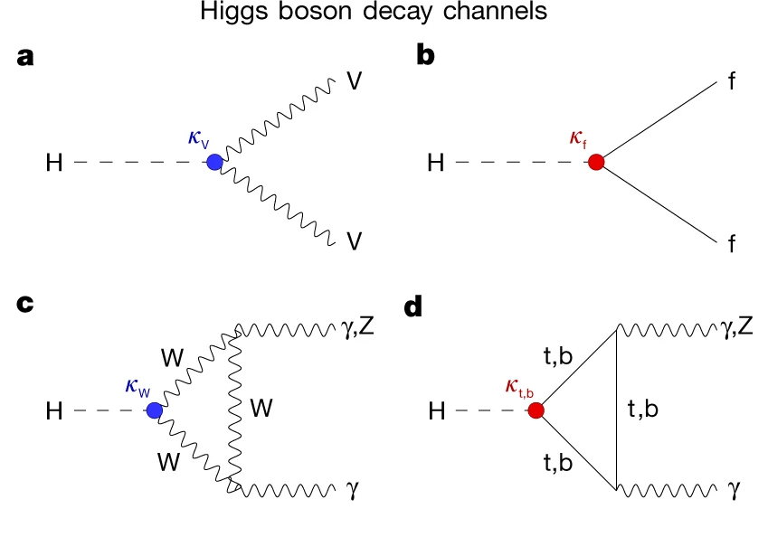
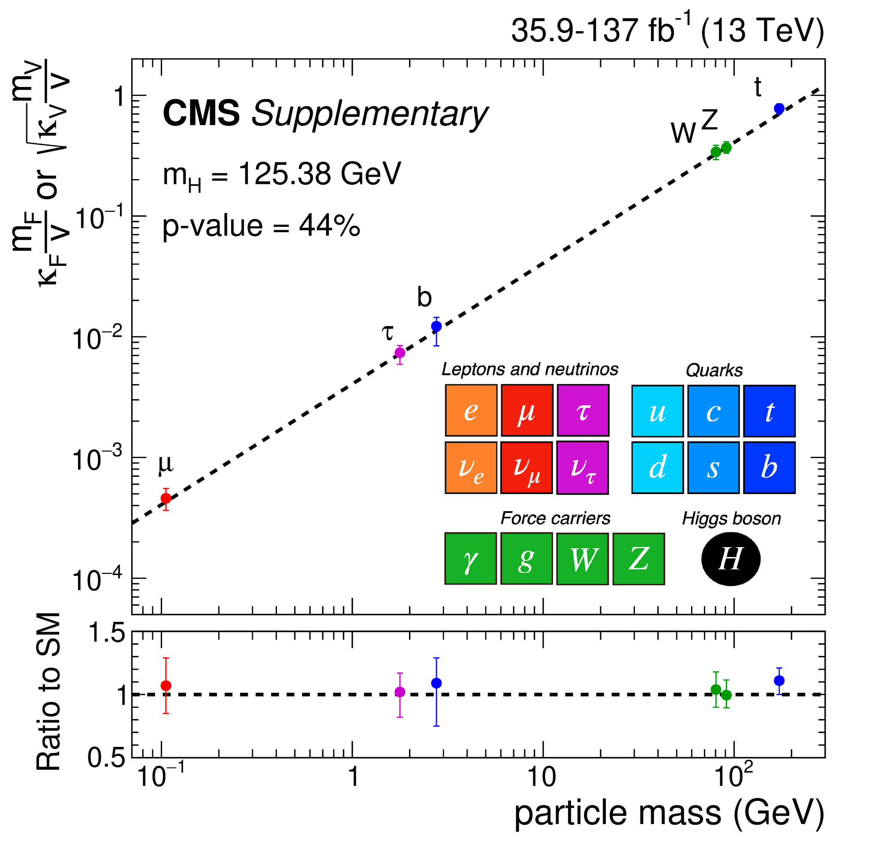
Higgs couplings
Elementary particles couple to the Higgs field (“Yukawa interaction”)
Coupling strength 𝜿 is linear with the mass of the fermion (or quadratic with vector boson mass)
Need to measure them accurately → any deviation with theory predictions can be interpreted as new physics

Slide 7
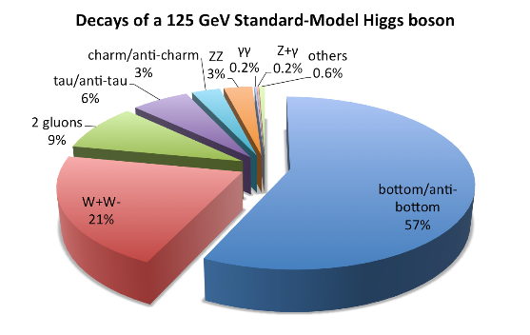
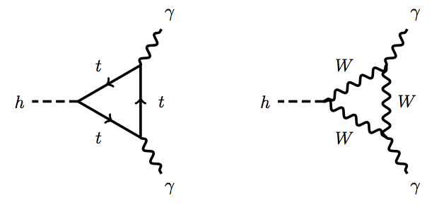
Where does the Higgs decay into
Higgs is not stable; it decays after 1.6 x 10⁻²² seconds
Higgs coupling linear with the particle’s mass
Preferentially decays to heavy particles
Including coupling to the Higgs boson itself (see next slide)
Discovery and properties are measured from most probable decays, i.e. heavy particles): bb, 𝜏𝜏, gluons, W⁺W–
Lighter couplings: cc, ZZ, 𝛾𝛾, Z𝛾, 𝜇𝜇
Very light couplings: u, d, e⁺, e–
Extremely difficult to measure (not to say impossible)
These are the building blocks of our universe, so they are important
Higgs to invisible
In SM only through H→ZZ*→vvvv (small probability, 0.1 %)
Higgs could decay to invisible dark matter particles
Higgs studies important for dark matter and physics beyond SM

Slide 8
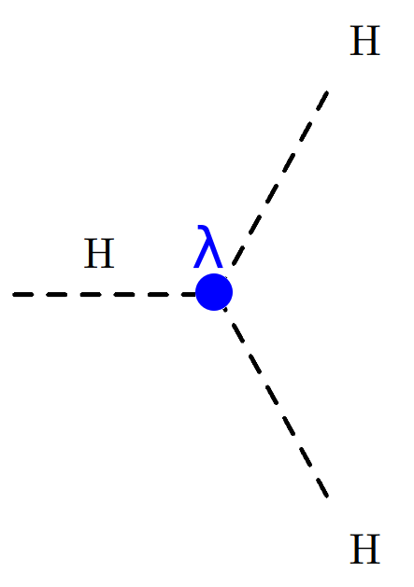
Measuring the Higgs potential
Proving its existence, measuring the Higgs potential is important
Quadratic term:
Higgs mass
Cubic term:
self-interaction
Quartic term:
Stability + self interaction
The Higgs boson itself is massive and can couple to itself
To measure the self-coupling at LHC need to produce di-Higgs
Very rare process → much data needed (HL-LHC)
FCC-ee can probe the self-coupling differently by accurately measure the cross-section (see later)
Notes:
https://cds.cern.ch/record/2908791/files/CR2024_144.pdf

Slide 9
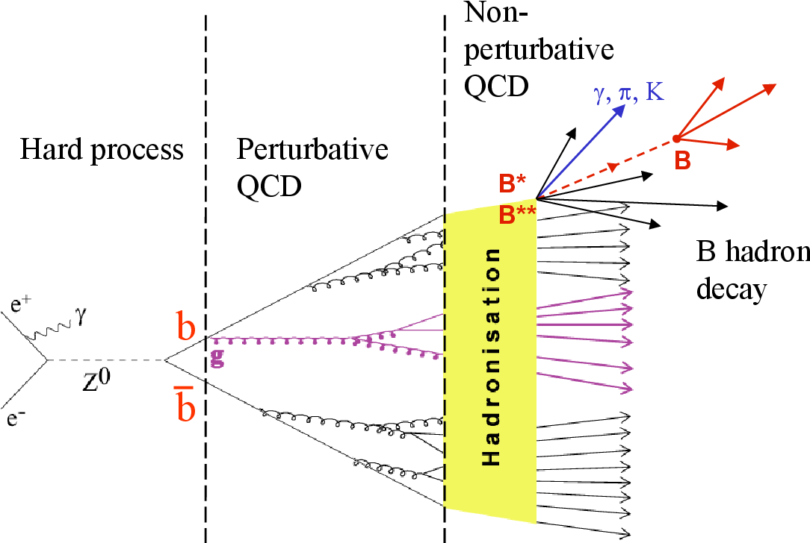
How do we measure these SM particles?
Muons: track + hits in outer muon detectors
Electrons: track + energy deposit in electromagnetic calorimeter
Taus: not stable; decays to electron/muon or hadronically with low particle content (jets)
Photons: no track + energy deposit in electromagnetic calorimeter
Neutrinos: can’t be detected → missing energy (negative vector sum of all what is visible)
Quarks and gluons: hadronize as hadronic jets
Quarks are confined and cannot exist freely
They hadronize to “hadrons“ (hadronic bound states)
The hadrons are usually short lived and decay to many particles
Spray of charged and neutral hadrons (e.g. pions, kaons, neutrons, …)
On average 40 particles per jet
Requires clustering of many particles into jets
Clustering algorithm depends on the event topology (how many jets you expect)

Slide 10
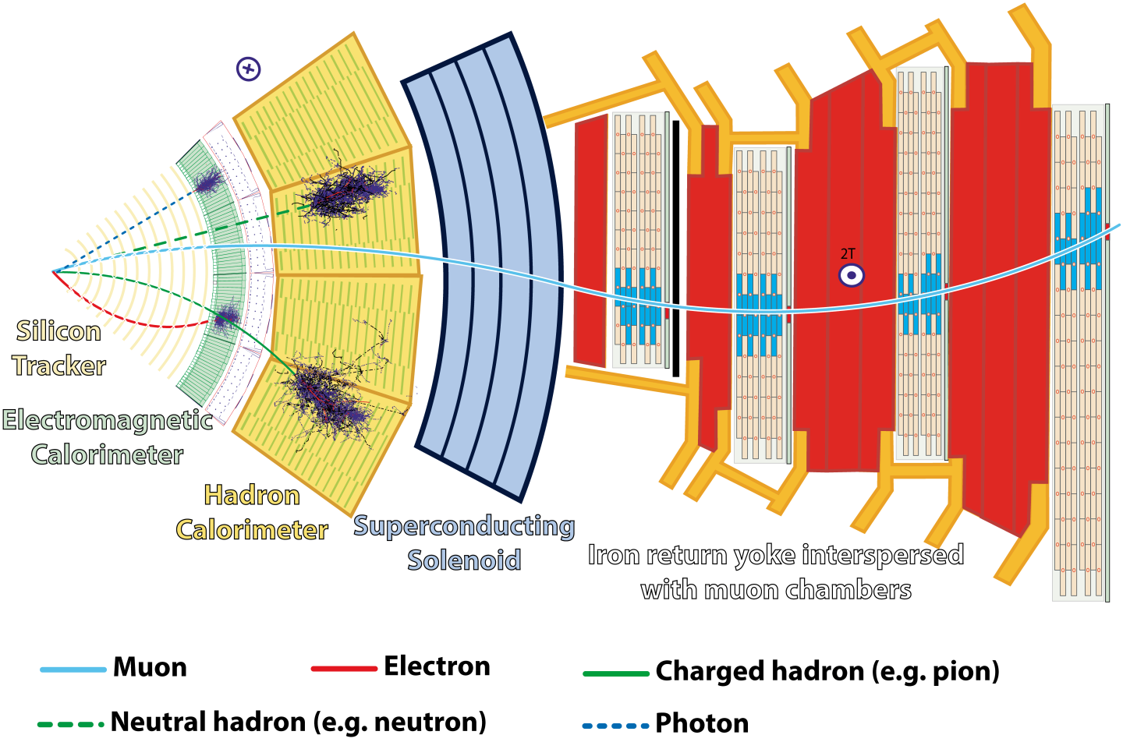
How do we measure these SM particles?

Slide 11
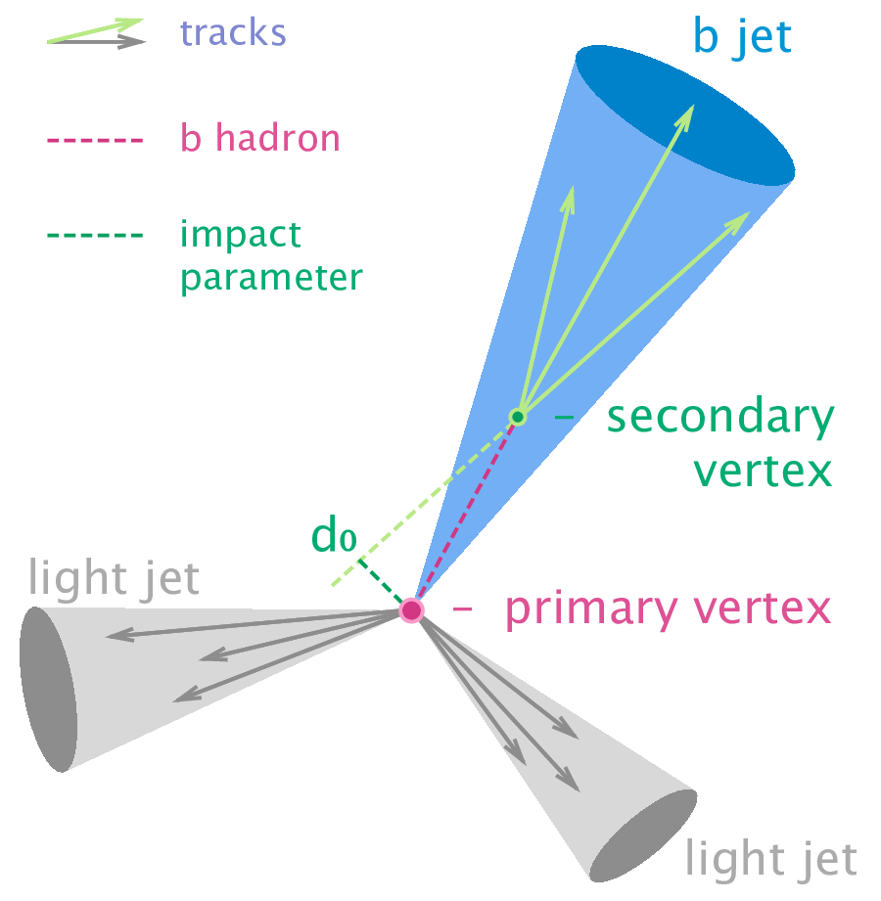
How do we know the flavor of the jet?
What is the underlying quark flavor of the jet?
Can be u/d/c/s/b/g; what about the top quark?
How to distinguish → look at the jet constituents!
b-jets come from b-hadrons and live relatively long (lifetime 𝜏 ~ 10⁻¹²s)
They travel before decay and hadronize
Distance c𝜏 ~ few mm → secondary vertex is detectable
c-quark similar, but shorter lifetime → shorter distances
s-quark tend to hadronize to kaons that carries a large fraction of the momentum
u/d quarks very difficult → jet charge?
gluons tend to have a higher particle multiplicity
Much more on this by E. Smith!
The jet flavor identification requires excellent detectors (granular, timing, vertexing)
Sophisticated flavor taggers based on neural networks to assign a flavor probability per jet, based on the jet constituents and their properties

Slide 12
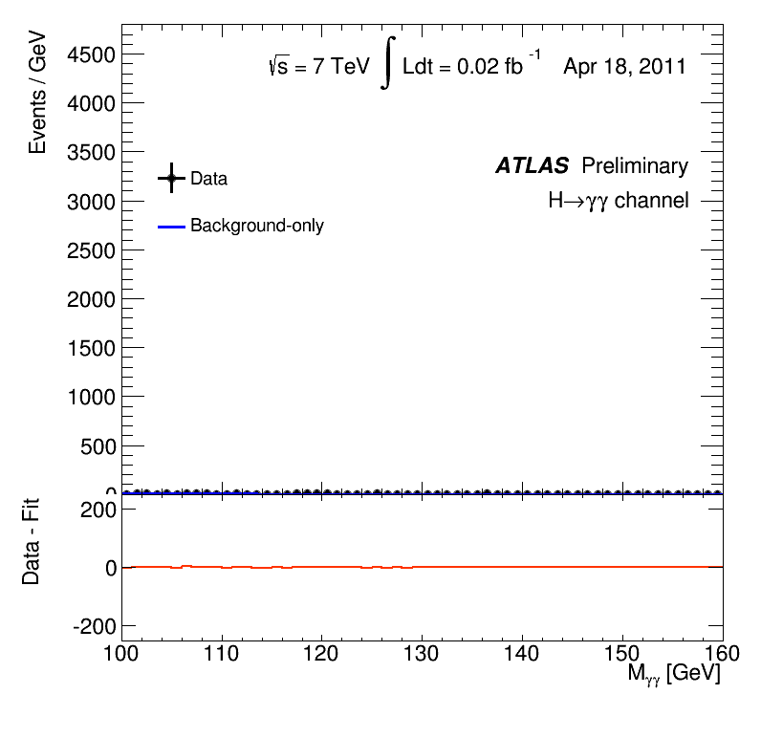
Discovery of the Higgs boson
At the HLC using two “golden” channels
H→ZZ* → 4 leptons (electrons, muons)
H→ 𝛾𝛾
These channels are not the most probable decay channels, but they are powerful in rejecting background events
bb, 𝜏𝜏, gluons are overwhelmingly produced at the LHC

Slide 13
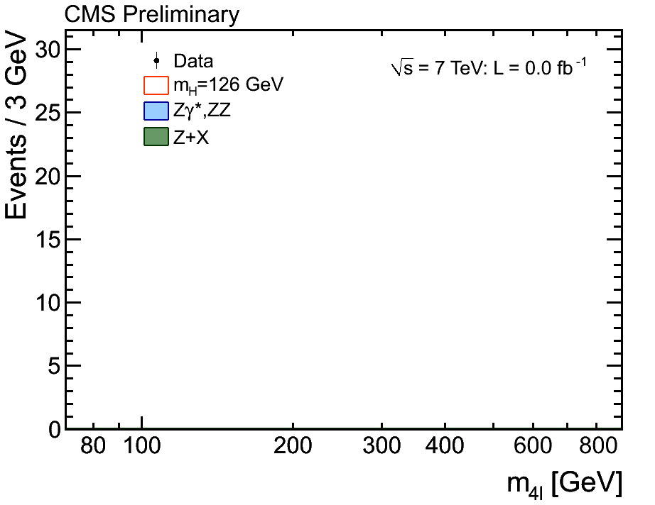
Discovery of the Higgs boson
At the HLC using two “golden” channels
H→ZZ* → 4 leptons (electrons, muons)
H→ 𝛾𝛾
These channels are not the most probable decay channels, but they are powerful in rejecting background events
bb, 𝜏𝜏, gluons are overwhelmingly produced at the LHC

Slide 14
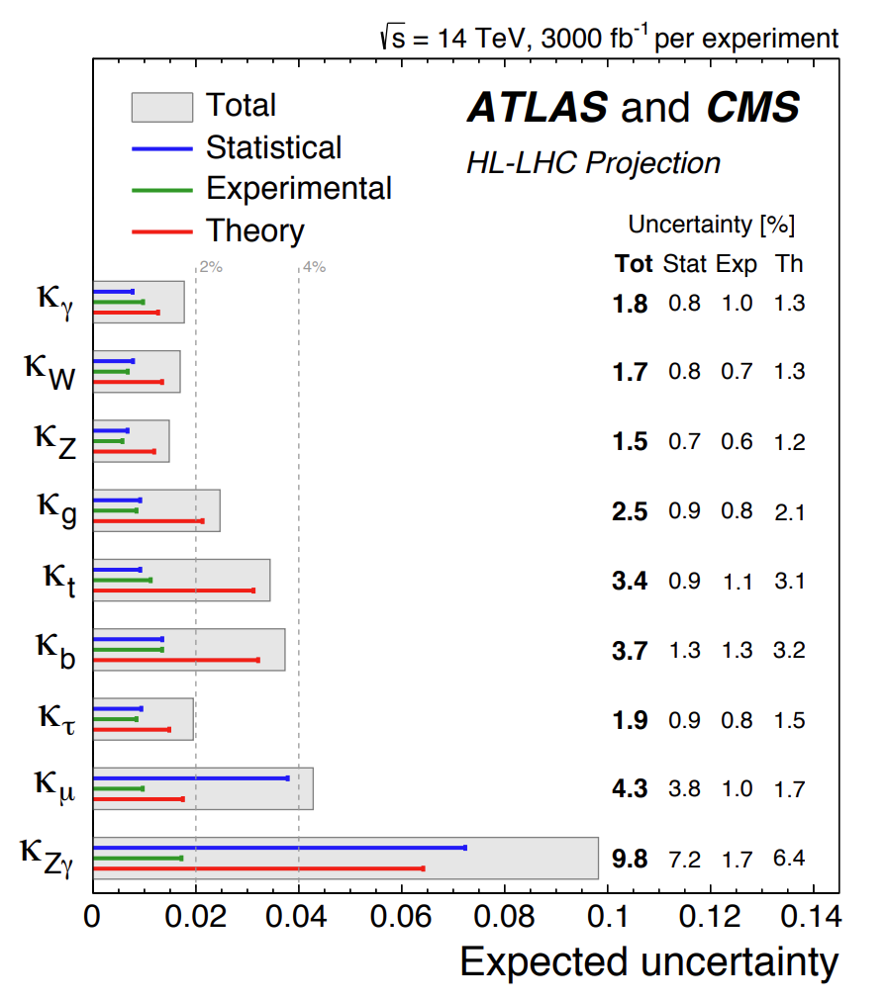
The need for precise Higgs measurements
HL-LHC will deliver about 20 times more data
Higgs couplings
Bosonic Higgs couplings to ~ 1.5–2 %
Fermionic Higgs couplings to ~ 2–4%
Good share between statistical and experimental uncertainties
Theory uncertainties dominant
Self-coupling ~ 50%
Fundamental properties mass (~ 20 MeV), width (~ 25%), invisible
Continue the study of the Higgs properties
Diversify the results using non-hadron collider
Improve all it’s properties: couplings, mass, width, self-coupling
Absolute determination of the couplings (see later)
Only possible at an electron-positron collider
Model-independence interpretation for Higgs width
Deviations sensitivity to BSM at tree and loop level
Probe unreachable phase space by hadron-colliders (first-gen, strange)
Notes:
Top quark plot: https://cds.cern.ch/record/2054243/files/9789814644150_0005.pdf

Slide 15
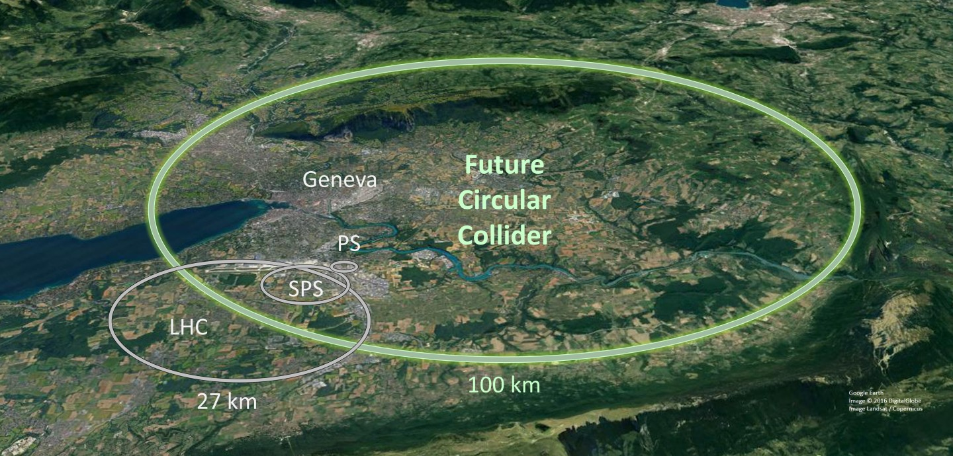
FCC-ee overview
Proposed circular e+/e- collider with ~ 100 km in circumference
Colliding at 4 interaction points
Facility to host hh collider at later stage (cfr. LEP–LHC)
Foreseen timeline: construction 2030–40, operation 40–55 (15y)
Multiple energy points exploiting large range of physics
Threshold | Center-of-mass | Luminosity (/ab) | Events
Z-pole | 91 GeV | 150 | 5x10⁶M Z
WW-pole | 161 GeV | 12 | 50M WW
H-pole | 240 GeV | 10.8 | 2M ZH
tt-pole | 365 GeV | 3 | 1M tt

Slide 16
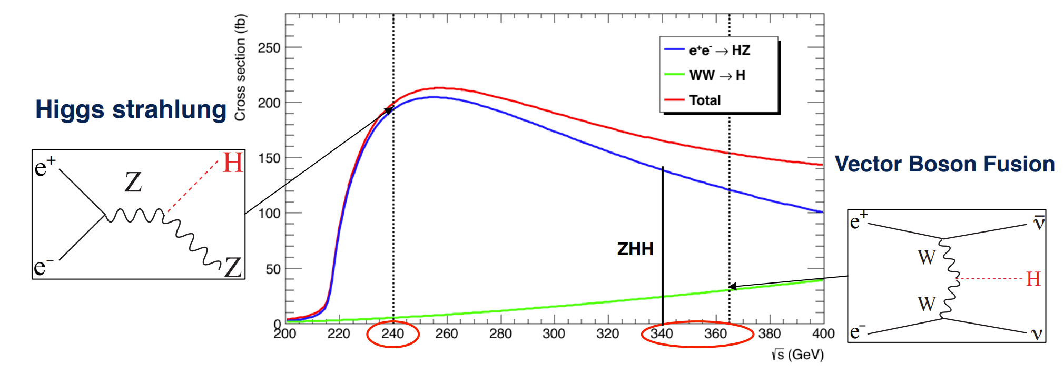
Higgs production at the FCC-ee
Total Higgs production @ FCC-ee
Threshold | ZH production | VBF production
240 GeV / 10.8 ab⁻¹ | 2 M | 50 k
365 GeV / 3 ab⁻¹ | 0.4 M | 0.1 M

Slide 17
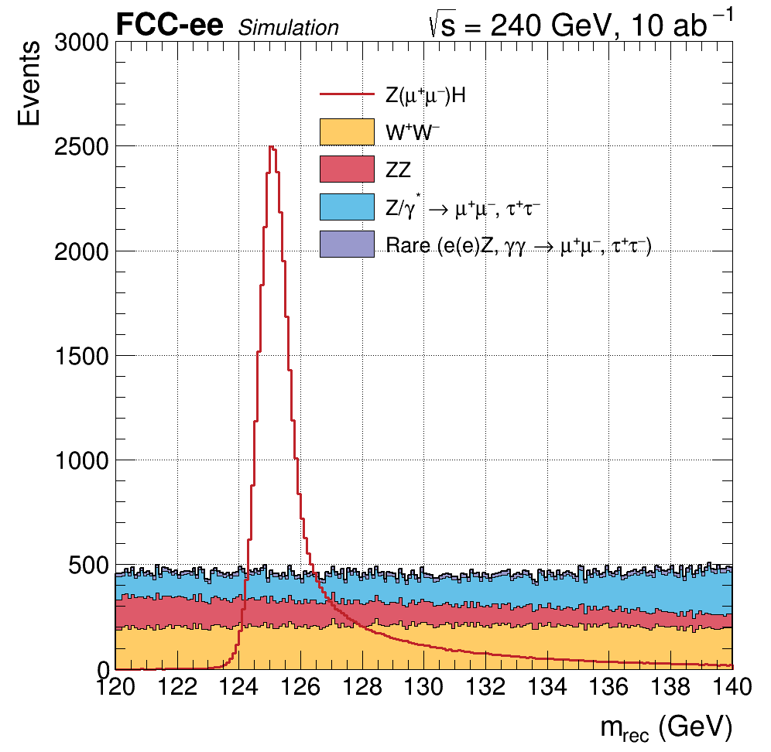
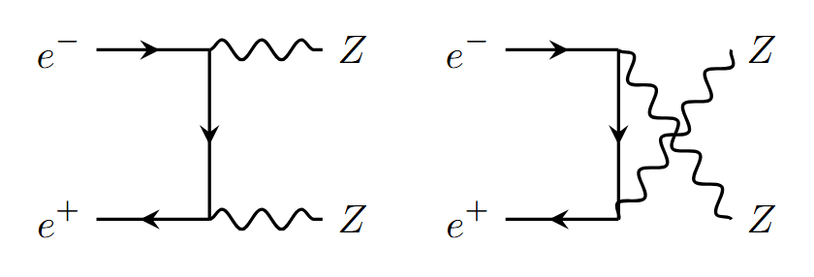
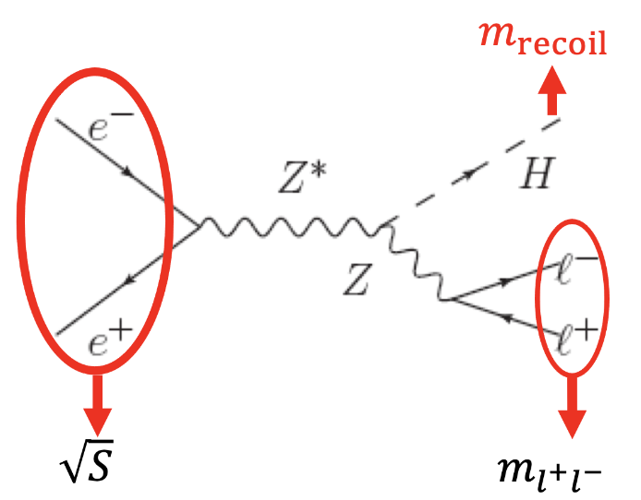
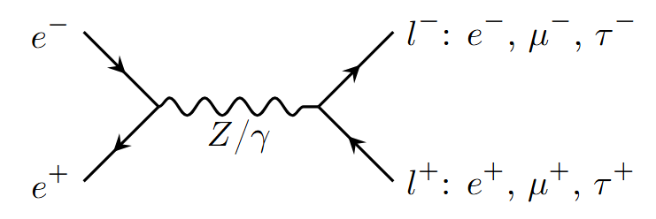
The ZH threshold and recoil method
Main strategy of Higgs analyses based on recoil method
Tag the Z boson (tight invariant mass constraints) using leptons or jets
Compute recoil, distribution sharp peaked at Higgs mass, width dominated by detector resolution
Tag additional decays of the Higgs – challenging in multijet environment
Backgrounds: dominated by vector boson (pair) production (WW, ZZ) and Z/γ*

Slide 18
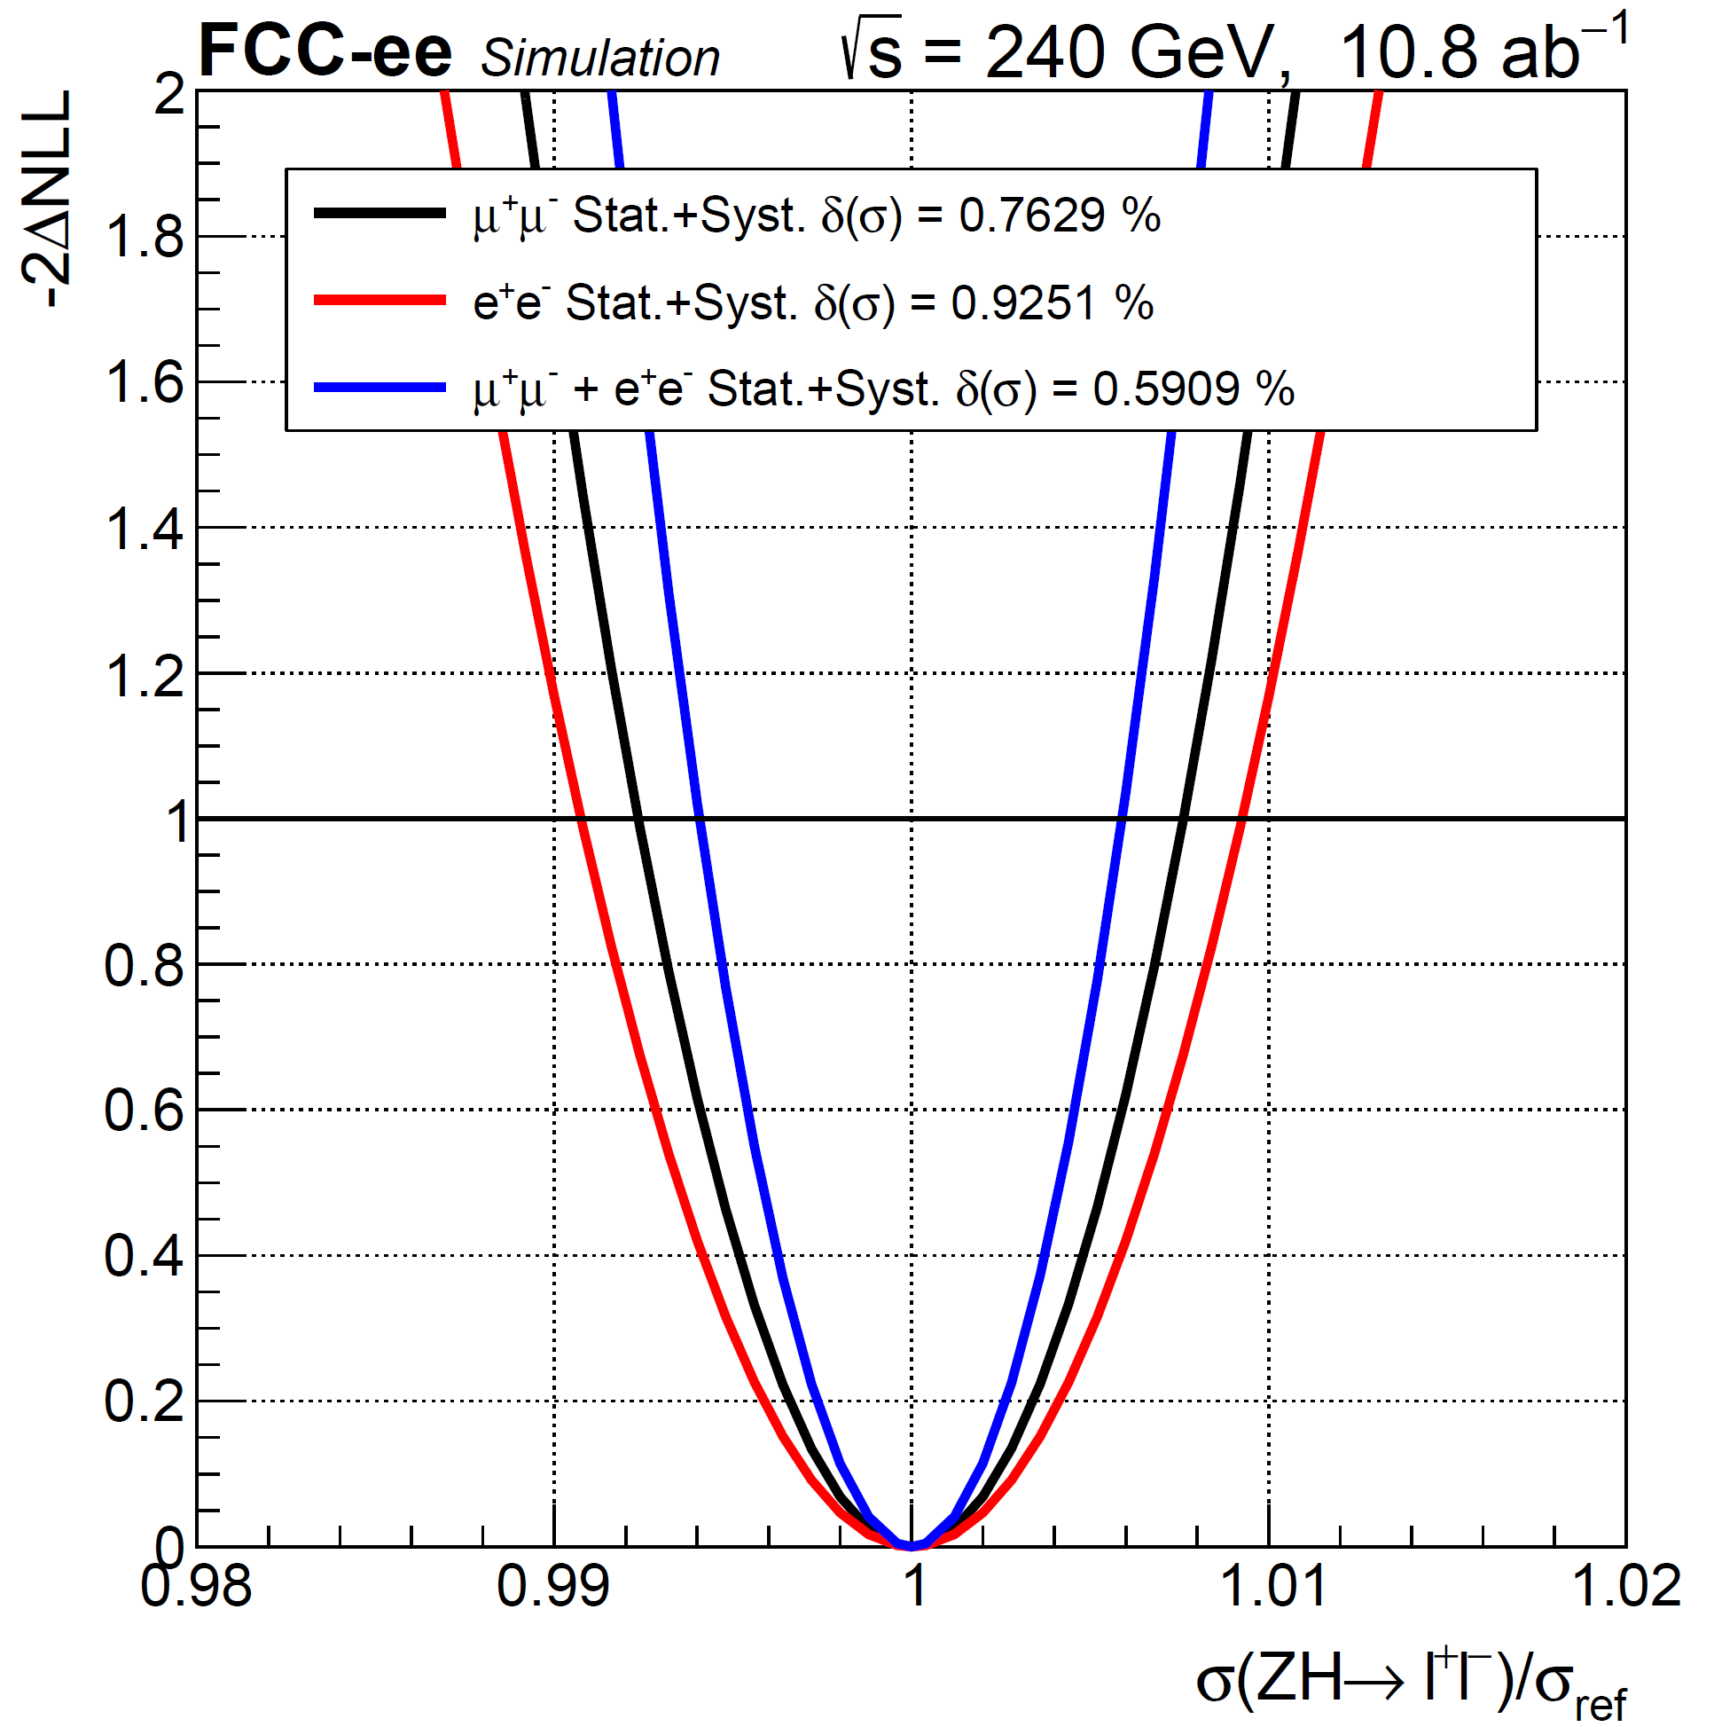
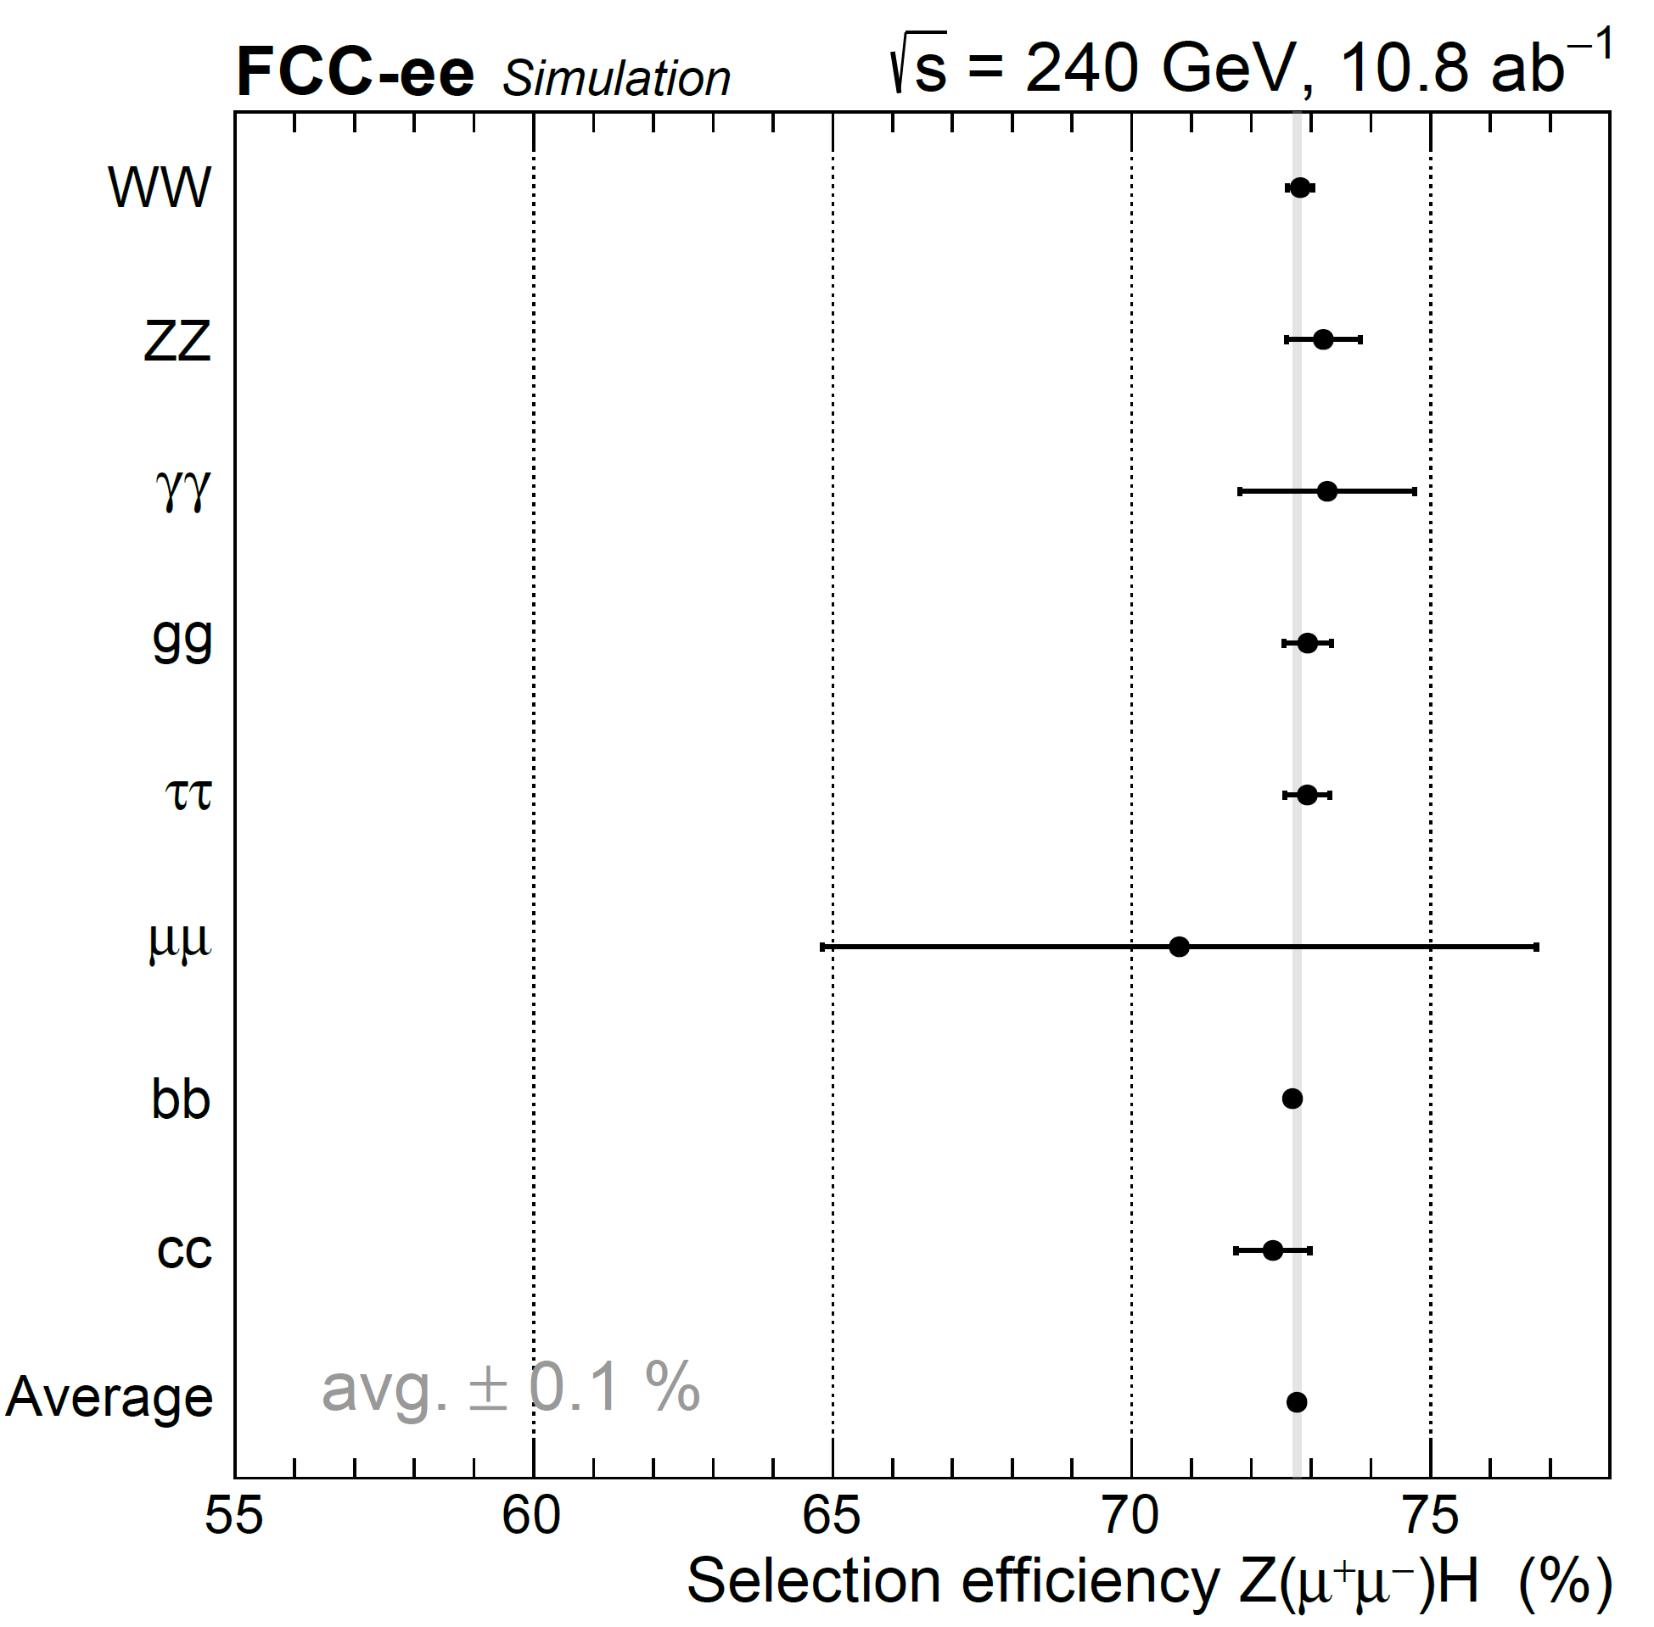
Total Higgs production cross-section
Crucial is to measure the total ZH production cross-section
Must be done independently of the decay mode, i.e. only look at the associated Z boson (challenging)
Unique to e⁺e⁻ colliders because of known initial state, not possible at hadron colliders
Similarly measure the HWW coupling strength at 365 GeV
FCC-ee sensitivity prediction to ~ 0.2%
Analysis in Z(𝜇𝜇)H(any) andZ(ee)H(any) – reaching 0.6%
Z(qq)H(any) work in progress → very challenging!
Notes:
Higgs decay-mode independent → challenge for Z(qq)
Nice talk about Higgs width: https://indico.nikhef.nl/event/2143/contributions/4569/attachments/2149/2522/HiggsWidth_ILC.pdf
Overview FCC-ILC: https://indico.cern.ch/event/401590/contributions/952379/attachments/1159512/1668744/HiggsPhysicsAtTheILC_Barklow_24Sep2015.pdf
Comparison FCC-ee and ILC result in similar results, due to polarization at ILC and higher lumi at FCC
Note 3y FCCee and 15y for ILC

Slide 19
Higgs coupling strengths
Start with the knowledge and measurements done at the LHC [2010-2026] and HL-LHC [2028-2040]
This based on extrapolated measurements of the two experiments CMS and ATLAS
Assume 20 years of running till 2040
FCC-ee will significantly improve many Higgs couplings
Just only for 2-3 years running!
Especially W/Z/gluon/quarks
Less in rare decays (𝜇𝜇, Z𝛾) → need more statistics
Uncertainty on coupling (%)
Ch. | HL-LHC | + 240 GeV | + 240+365 GeV
κ_{W} | 0.99 | 0.88 | 0.41
κ_{Z} | 0.99 | 0.20 | 0.17
κ_{g} | 2.00 | 1.20 | 0.90
κ_{γ} | 1.60 | 1.3 | 1.3
κ_{Zγ} | 10.0 | 10.0 | 10.0
κ_{c} | – | 1.50 | 1.30
κ_{t} | 3.20 | 3.10 | 3.10
κ_{b} | 2.50 | 1.00 | 0.64
κ_{μ} | 4.40 | 4.00 | 3.90
κ_{τ} | 1.60 | 0.94 | 0.66
Inv. | 1.9 | 0.22 | 0.19
Notes:
Numbers from https://arxiv.org/pdf/2209.07510.pdf Page 20
Overview FCC-ILC: https://indico.cern.ch/event/401590/contributions/952379/attachments/1159512/1668744/HiggsPhysicsAtTheILC_Barklow_24Sep2015.pdf
Comparison FCC-ee and ILC result in similar results, due to polarization at ILC and higher lumi at FCC
Note 3y FCCee and 15y for ILC

Slide 20
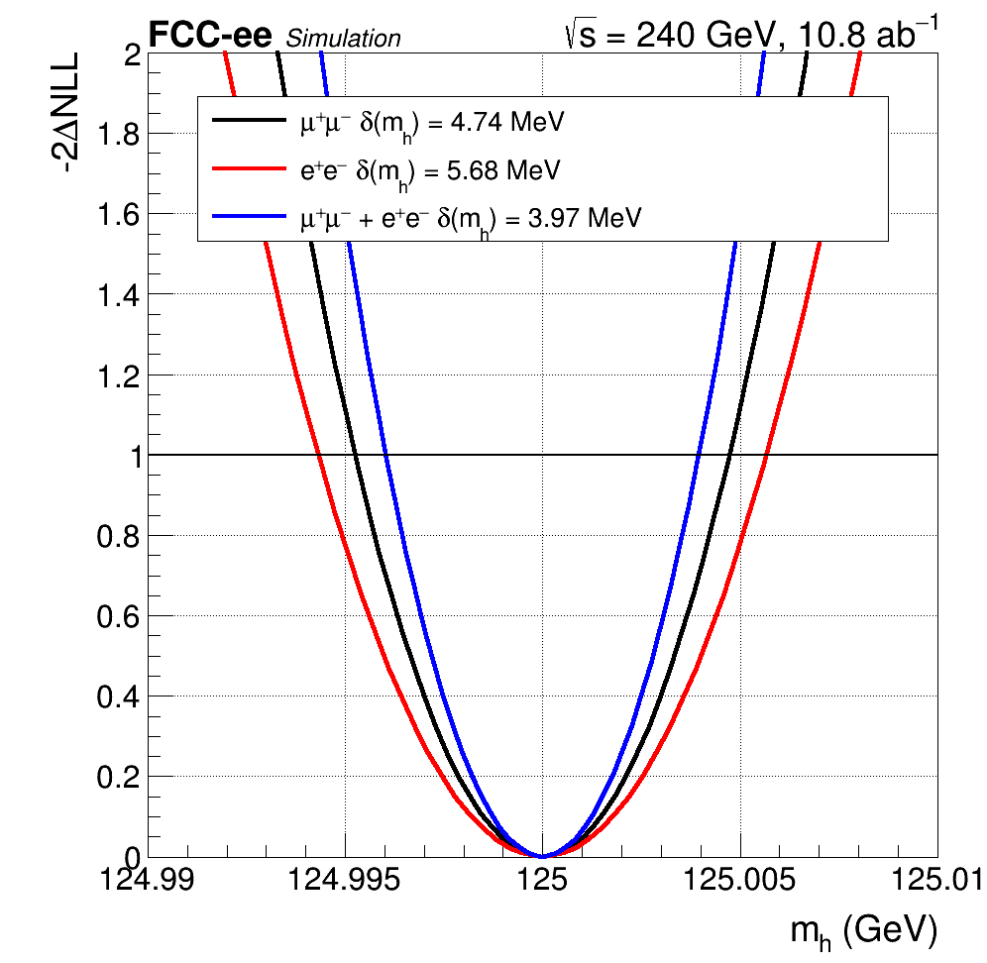
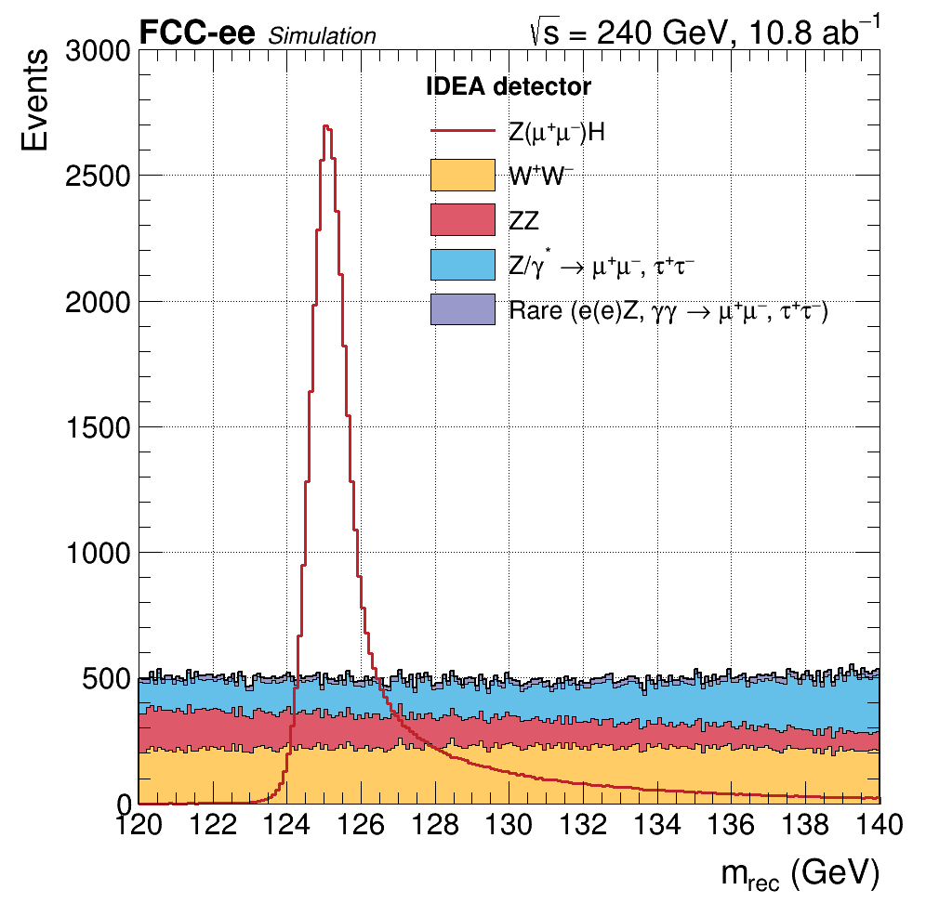
Higgs boson mass
Higgs mass enters SM parameters via radiative corrections
Depends logarithmically on m_{H}
Needs for FCC-ee in context of radiative corrections
Very high precision on cross-sections, sub-percent level
Translates to a Higgs mass requirement < O(10) MeV to control radiative corrections for the cross-sections and branching fractions
Measure Higgs mass at FCC-ee (240 GeV)
Recoil mass method using Z(𝜇𝜇)H and Z(ee) events
Total uncertainty of 4 MeV
Δr ~ ln(m_{H})
Δr ~ m_{t}²
Δr ~ new physics?
TODAY
~ 150 MeV
HL-LHC
~ 20 MeV
FCC-ee
4 MeV

Slide 21
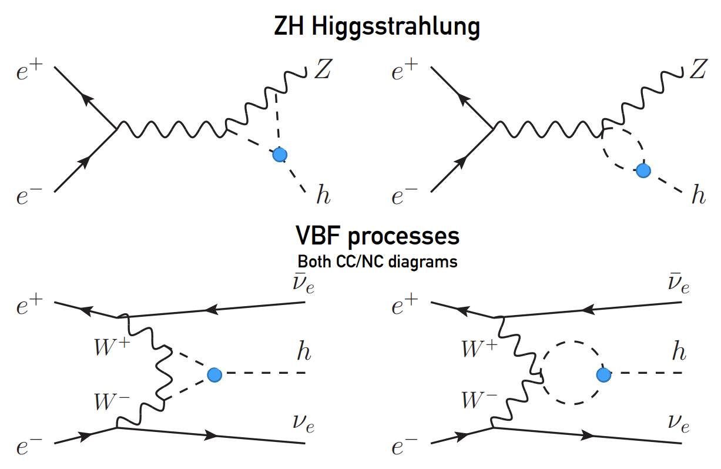
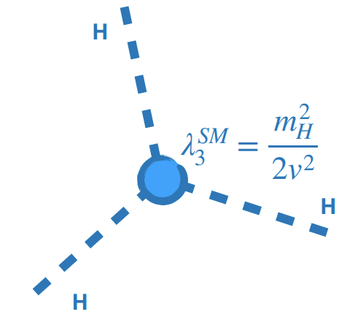
Higgs self coupling
Probe indirectly trilinear Higgs self coupling λ₃ through single Higgs boson cross section
Total cross section can be measured O(1%) at FCC-ee
Higgs decay-mode independent → challenge for Z(qq)
Probing NLO deviations from SM: δκ_{λ} = κ_{λ} – 1
C₁ sensitive to √s: exploit different sensitivities at both energies

Slide 22
Higgs resonant production
Higgs bosons can be produced at center-of-mass energy equal to the Higgs mass: e⁺e–→H
Similar to e⁺e–→Z, but Z has a width of 2.1 GeV whereas the Higgs has a very small width of only 4 MeV
It therefore requires to precisely know the instantaneous beam energy: the slightest deviation, and we’ll miss the Higgs!
Start already with a small cross-section due to very weak electron Yukawa coupling (electrons are light)
Initial state radiation → 40 % reduction
Beam energy spread ~ Γ_{H}: 𝛿E = 4.2 MeV → 45 % reduction
Potential uncertainty on the Higgs mass
Total convoluted cross section ~ 280 ab⁻¹: large luminosity needed!
Expectation to produce ~ 6k H bosons per year
Cope with large Z/𝛾 backgrounds
Need to run many years to get meaningful uncertainty on 𝜅_{e}
Nevertheless maybe the only way to access 𝜅_{e}?
arXiv:2107.02686

Slide 23
Top physics
Top quark is the heaviest particle in the SM
Unstable, immediately decays to t → b + W
Extensively studied at Tevatron and LHC
Top properties inferred by studying b and W decay products
At FCC-ee, top mass and width measured at threshold
Measure the cross-sections at different center-of-mass energies
Several energy points needed:
Relative large uncertainty on top mass (+/- 0.5 GeV from HL-LHC)
Need to constrain shape in optimal way
Example of multipoint scan at FCC-ee
5 GeV window [340, 345], each ~ 25 /fb
Theoretical QCD errors order of 40 MeV for mass and width
Systematic effects to be studied (but considered to be limited)
ttH
Δm_{t}
ΔΓ_{t}
Δm_{t}/ΔΓ_{t} (stat) ~ 8/11 MeV
Notes:
https://indico.cern.ch/event/469561/contributions/1977980/attachments/1220585/1785897/topLC.pdf

Slide 24
Conclusions
Higgs and top observed and studied at hadron colliders
Important to study precisely at lepton colliders: clean and different environment
FCC-ee offers unique ways to probe and improve the measurements Higgs couplings and fundamental properties
Detector design and novel analysis techniques are crucial to optimize the physics potential of the FCC-ee → you are part of it with your projects!

