Slide 1
DarkLight at ARIEL Update January 2025

Slide 2
Latest Experiment layout

Slide 3
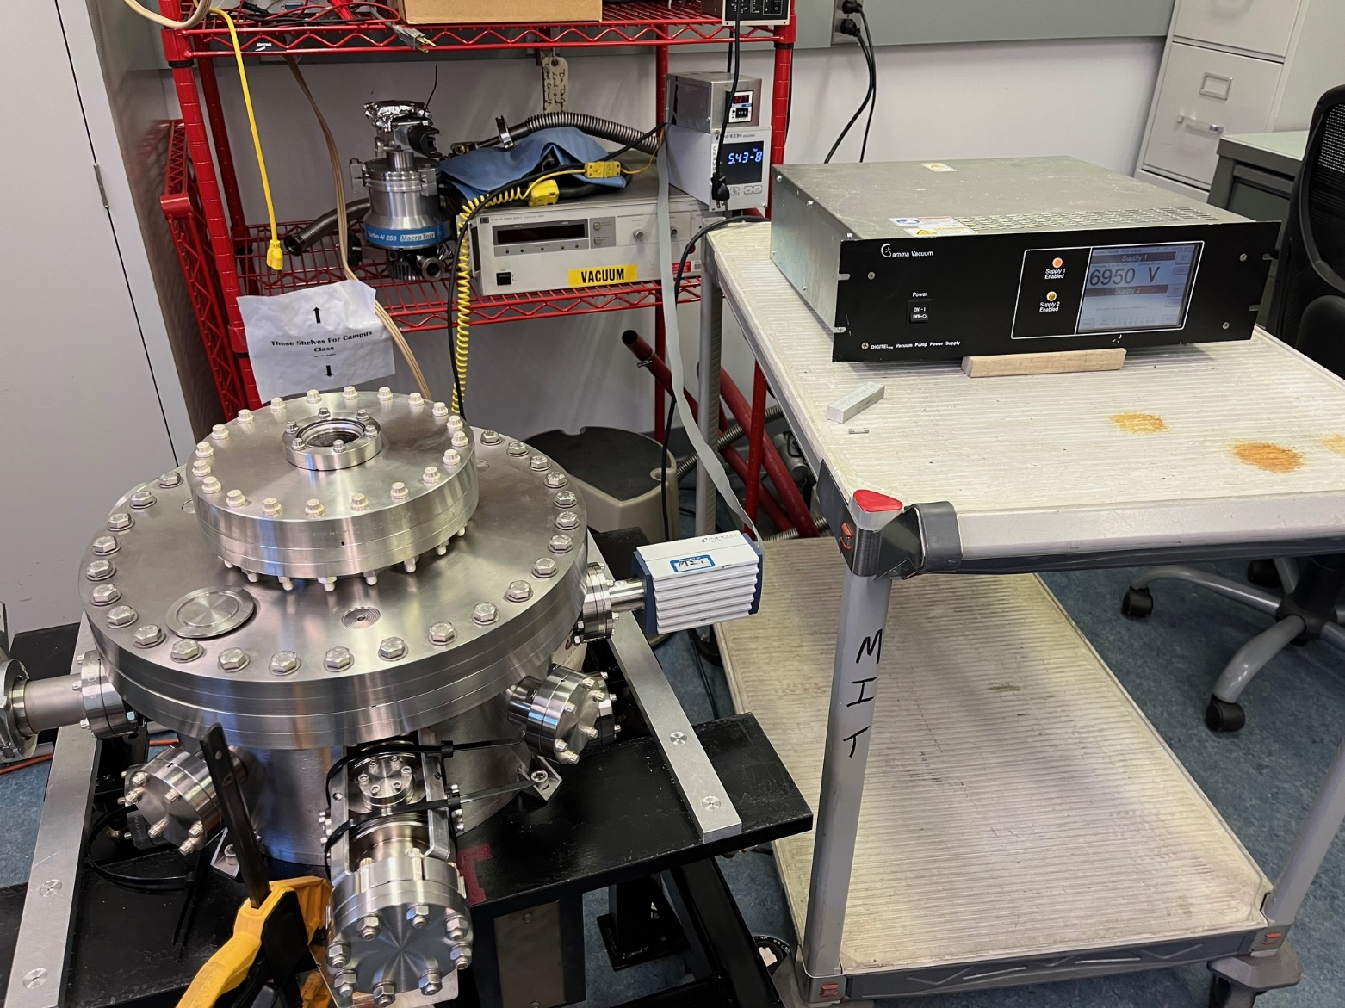
DarkLight Scattering Chamber
Added bellows to inlet tube to chamber.
Finished stand and assembled.
Ion pump installed and tested.
Chamber leak checked and pumped down to 2.3x10e-8 torr using ion pump.

Slide 4
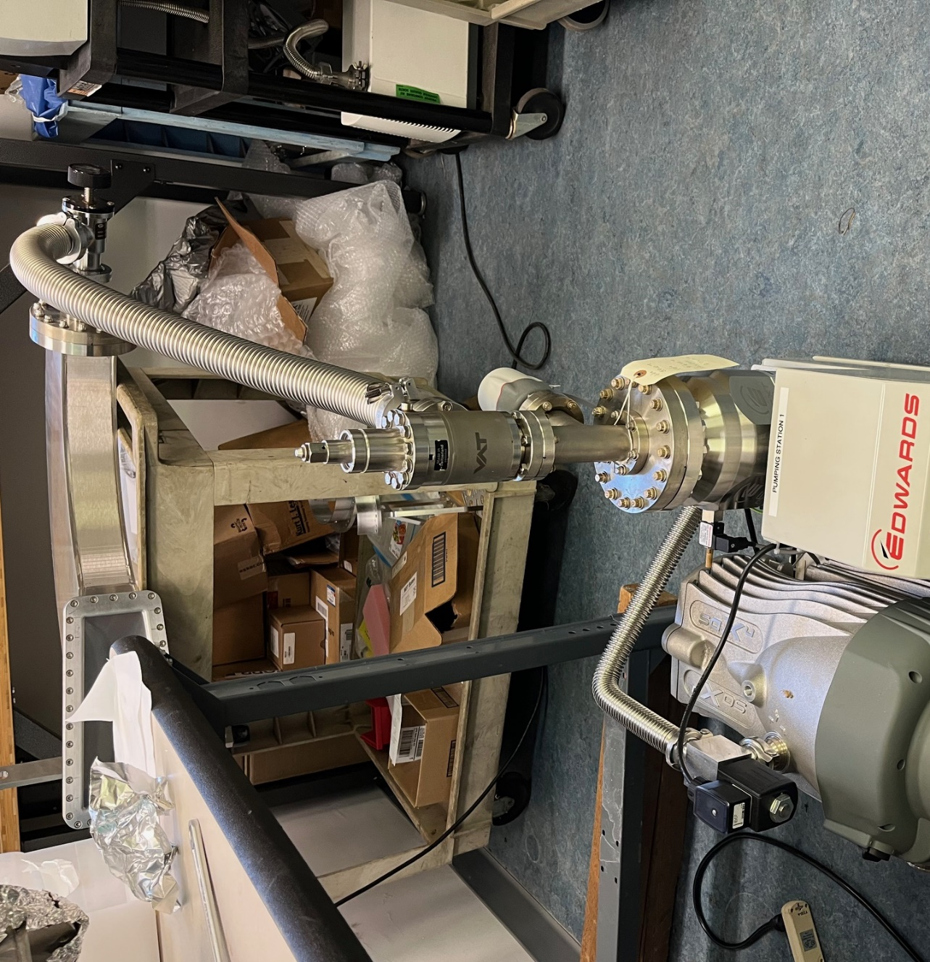
Dipole Vacuum Chambers
PEEK inserted into dipole chambers.
Windows assembled on to chambers.
Chambers leak checked and then pumped down to base pressure of pumping station (5x10e-7 torr).

Slide 5
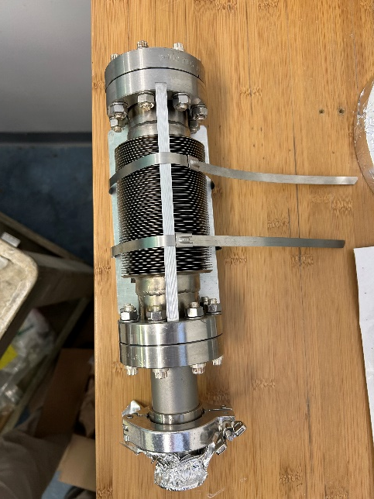
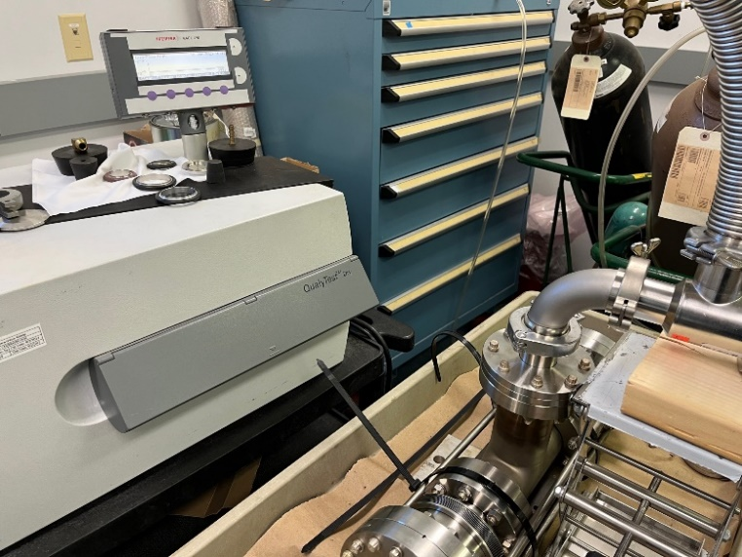
Collimator/Bellows
Collimator assembled into bellows spool piece and leak checked.
Beamline bellows fabricated and leak checked.

Slide 6
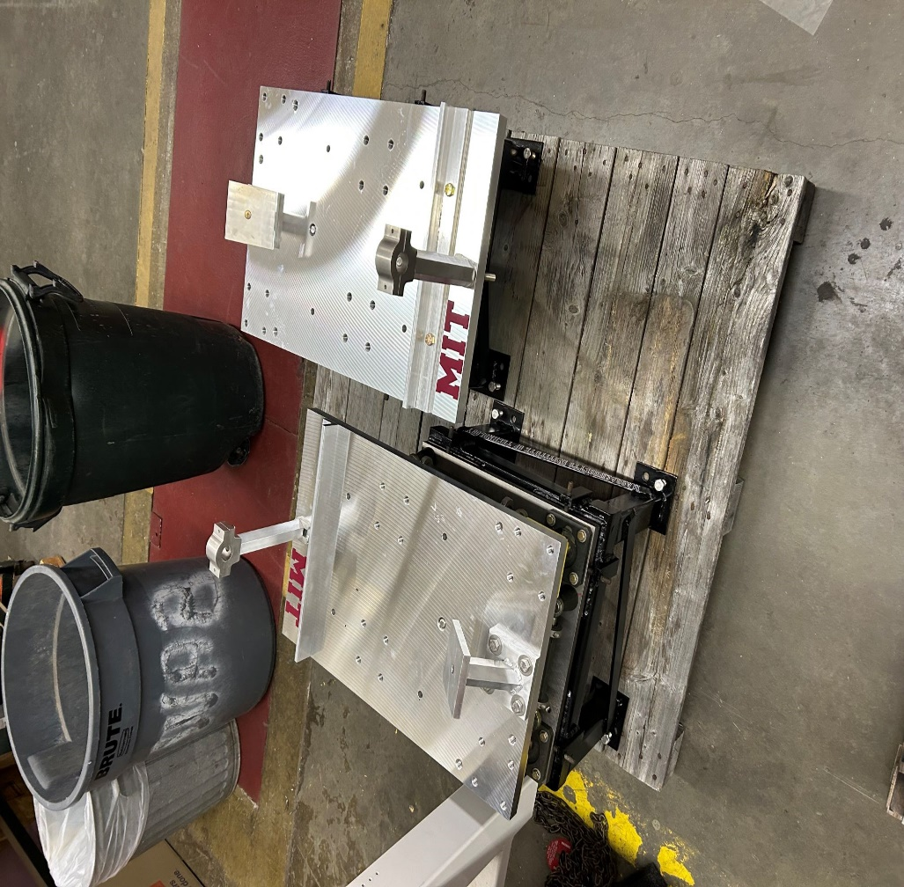
Dipole Magnet Stands
Dipole Magnet stands are finished and assembled.

Slide 7
Shipping
Shipping list in process.
Crates being procured.

Slide 8
Summary
All components procured, assembled and tested.
CAD updated and complete.
Drawing package almost done.
Finalizing packing list and crate procurement for shipping.
Anticipate shipping everything by the end of January.

