Slide 1
Topological Chiral Superconductors beyond pairing in a Fermi liquid
Luke Kim
30 Jan 2025
Reference: Phys. Rev. B 111, 014508

Slide 2
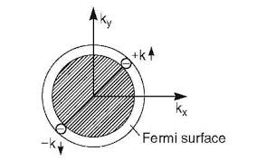
The Known Theory of Superconductors
BCS Theory
Relies on pairing of electrons
“Instability” of the Fermi surface
While BCS is not applicable to d-wave SCs, the importance of pairing still stands.

Slide 3
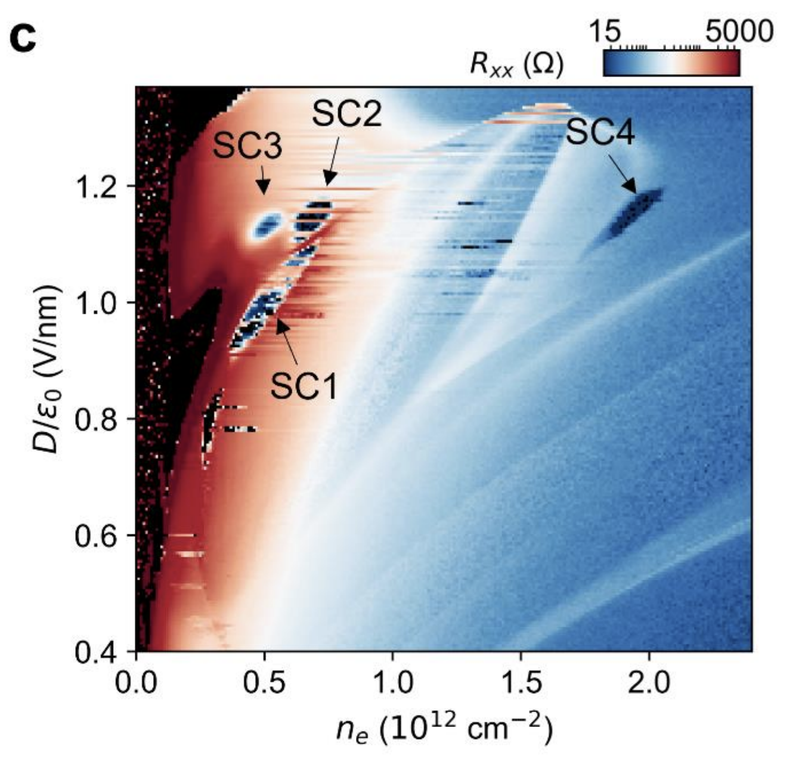
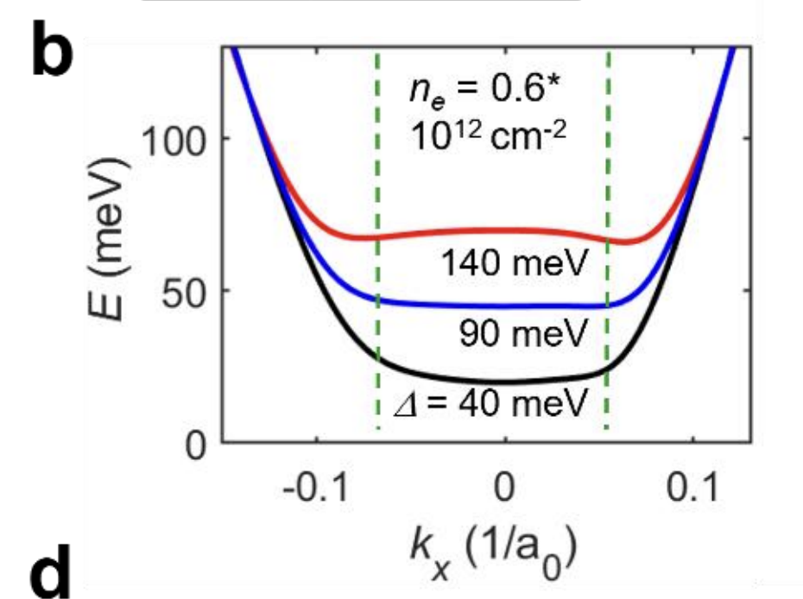
Motivation – Repulsive interaction-based Mechanism
Fermi liquid is a good picture at weak interactions: -> what if, the repulsive interactions are very strong?
Chiral SC has been observed in Graphene systems, prevailing over Fermi liquid and Wigner Crystals.

Slide 4
The Wavefunction
Is there a many-body system which favors repulsive interaction? -> The fractional quantum Hall states. (known as Laughlin wavefunction)
This means that we can use the Laughlin class wavefunctions as our variational form

Slide 5
Conditions
For this wavefunction to describe a superconductor, this must have a gapless mode (so that it becomes a superfluid).
Besides this, we must ensure that the energy per particle does not diverge at the thermodynamic limit: -> can be achieved by: a) setting the filling fraction of particles proportional to the gaples modes and b) adjusting the magnetic length accordingly

Slide 6
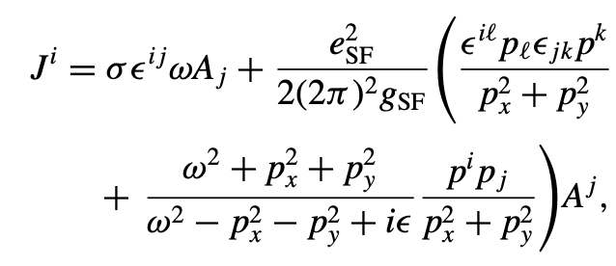
Properties
Unlike a typical QHE state, the response current is not quantized – the gapless mode provides a non-universal contribution to conductance.

Slide 7
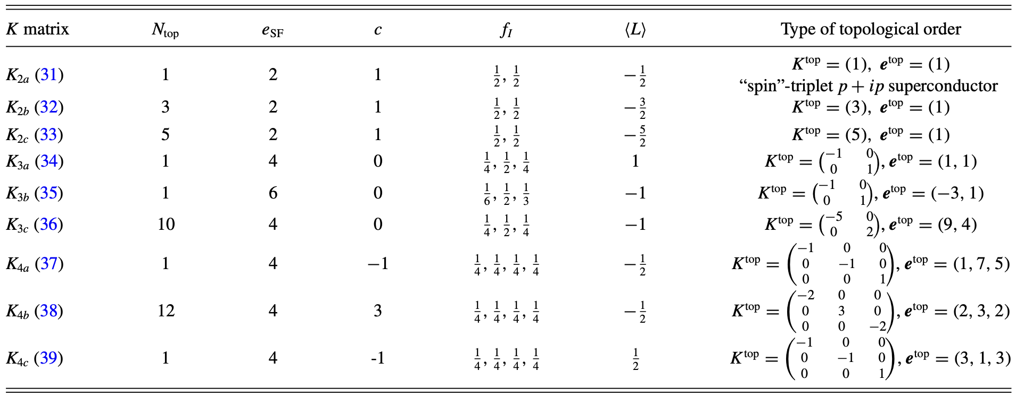
Properties
The states, having the same wavefunction class as FQH states, will have nontrivial Abelian topological order, which we can extract by separating out the gapless mode.

Slide 8
Are these states energetically plausible?
We consider a Hamiltonian $E=c_{2}k^{2}+c_{4}k^{4}$
IF energetically plausible, why doesn’t it appear in other more normal materials?
Goal: Check if the density region our chiral superconducting states become plausible at low enough densities before it becomes a Wigner crystal.
Numerics: this is where subMIT comes in.

Slide 9
Potential Energy
We calculate the pair distribution function of two electrons noted as $g_{IJ}(r_{1},r_{2})$ (I and J represent species of electrons)
This is done by employing MCMC on a system of 200 electrons. (~2 days computing time on 3 servers)
Total potential energy per particle:
Result:

Slide 10
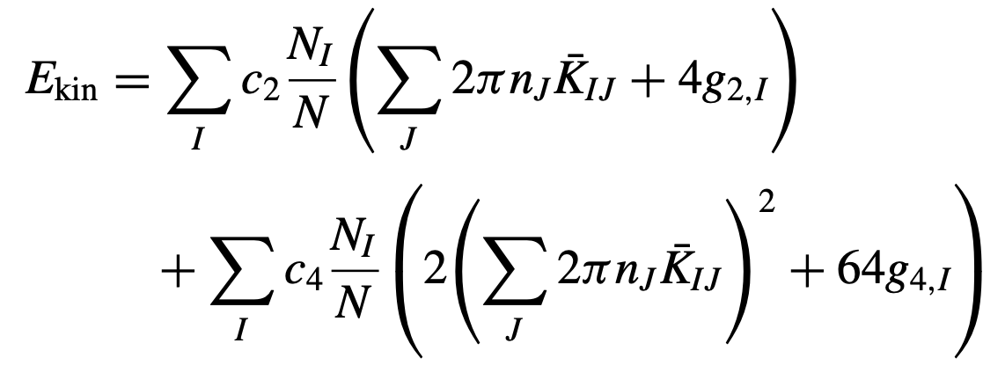
Kinetic Energy
A bit more involved process: we now sample the Green’s function of the system near zero: $G=C\left(1+g_{2}\left({\tilde{z}}^{∗}−z^{∗}\right)\left(z −\tilde{z}\right)+g_{4}{\left({\tilde{z}}^{∗}−z^{∗}\right)}^{2}{\left(z −\tilde{z}\right)}^{2}\right)× e^{\sum_{IJ}{πn_{J} K_{I_{0}J}^{+} {z\tilde{z}}^{∗} −\frac{{\left|z\right|}^{2}}{4 l_{I0}^{2}}}}e^{\sum_{IJ}{πn_{J} K_{I_{0}J}^{−} {z\tilde{z}}^{∗} −\frac{{\left|\tilde{z}\right|}^{2}}{4 l_{I0}^{2}}}}$
Once again use the Metropolis-Hastings algorithm to extract $g_{2}$ and $g_{4}$. (Around a week computation.)
Total Kinetic energy:

Slide 11
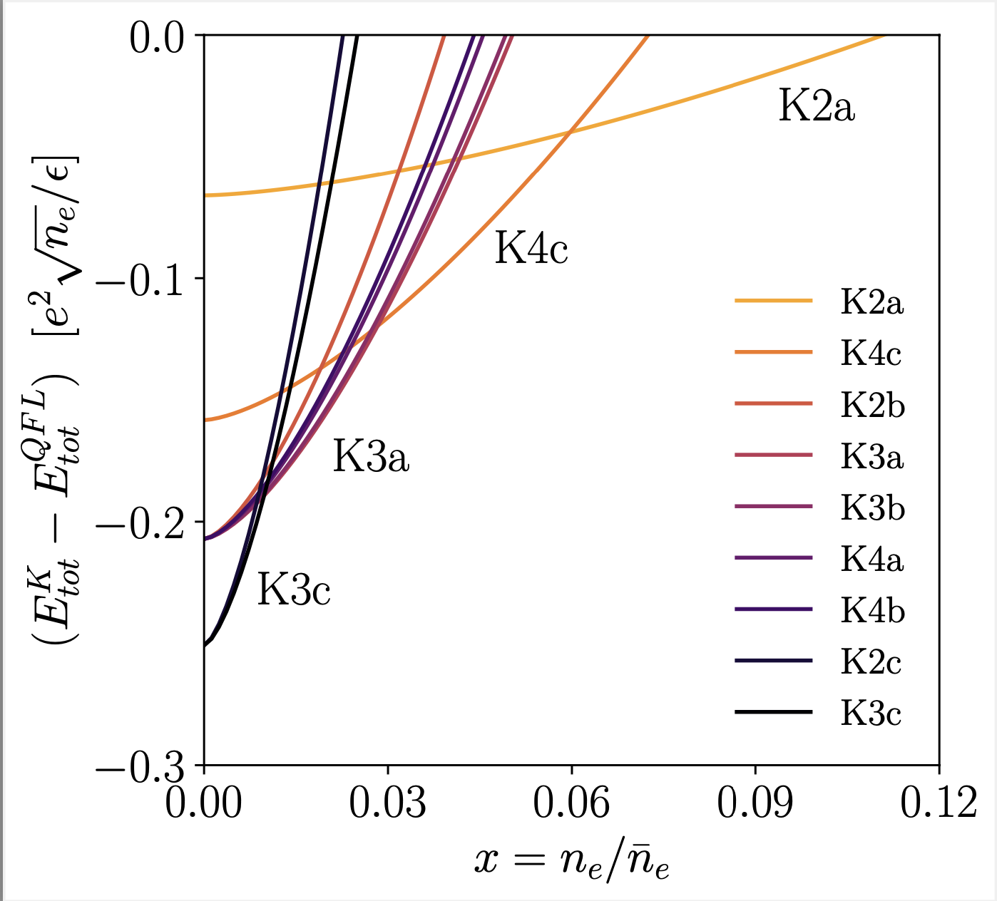
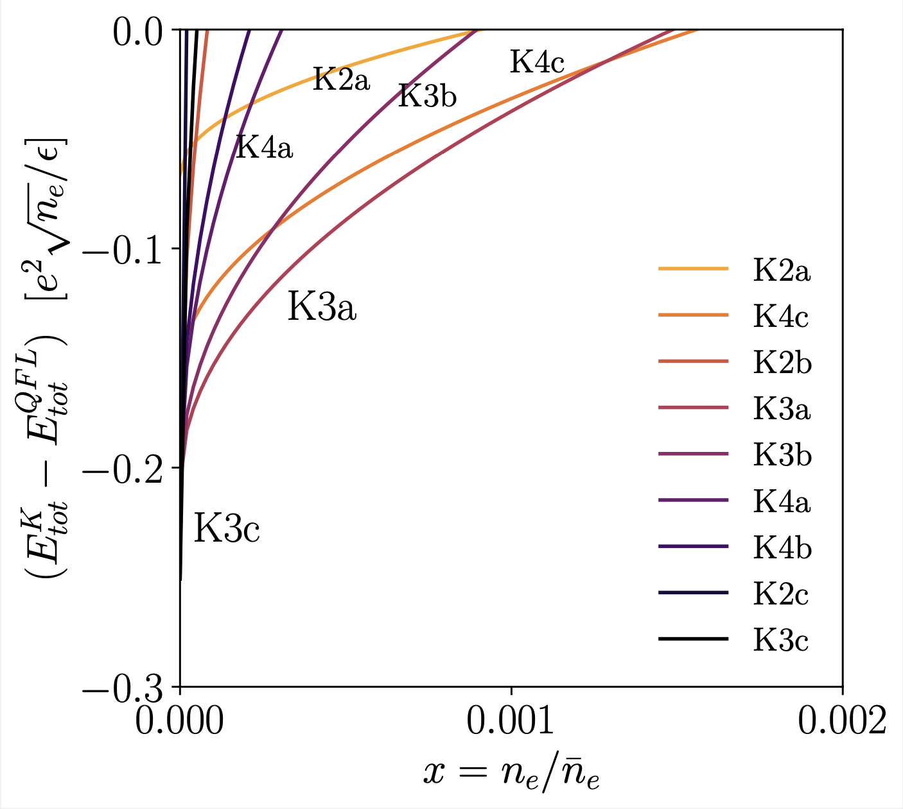
Comparison to Fermi Liquid
Having extracted the variational energy of our states to zeroth order, we compare with the Hartree-Fock energy
Our states are competitive at reasonable densities when we have the more ‘flat’ ${ε∝k}^{4}$dispersion.

Slide 12
Conclusion
We proposed a new repulsive-interaction based superconductivity which admits non-trivial topological order.
Inspired by recent experiments on graphene, we checked that these superconductors are competitive at flatter dispersion and could appear at low densities before it becomes a Wigner crystal.
Further questions: a) More variational optimization and comparison with beyond HF results. (More subMIT!) B) How does the physics change when Berry curvature is incorporated?

