Slide 1
SUMMARY OF MOSAIX CHARATERIZATION TALK EPIC COLLABORATION MEETING
Ivan Amos Cali, Leyre Flores, Gian Michele Innocenti, Anhelina Kostina, Lukas Tomasek
MIT group meeting
31/01/2025

Slide 2
Slide by Gregor Eberwein

Slide 3
Slide by Gregor Eberwein

Slide 4
MIT RESPONSIBILITIES FOR SVT
Jelena is part of the ALICE ITS3 design team of a 27 cm long MAPS detector
SVT has in place an agreement with ALICE ITS3 in order to reuse and repurpose its MAPS detectors
They will share the design files and the technology will be adapted to ePIC needs
MIT (us) are responsible of SVT WP2 (testing and characterisation)
Wafer probe-based characterization has emerged as the most efficient testing strategy for both SVT and ITS3

Slide 5
WHAT IS WAFER PROBING AND WHY?
What is wafer probing?
A wafer probing is a system used for electrical testing of the wafers of individual chips
Power on, read/write register, analogue and digital scans, threshold etc.
Why do we want to use it as main characterization technique?
It makes the process faster and more efficient
→ It is effectively the only viable solution for the SVT (~200 wafers to test)
Is this not done for most of our detectors?
Yes it is a technique that has been used for years but at MIT we want to go one step further a try a new technique that allows to get data at high-speeds, so far all the testing was at < 300 Mbps

Slide 6
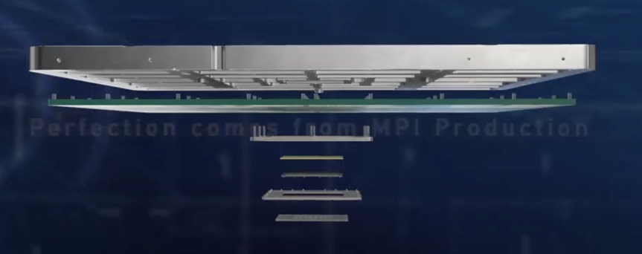
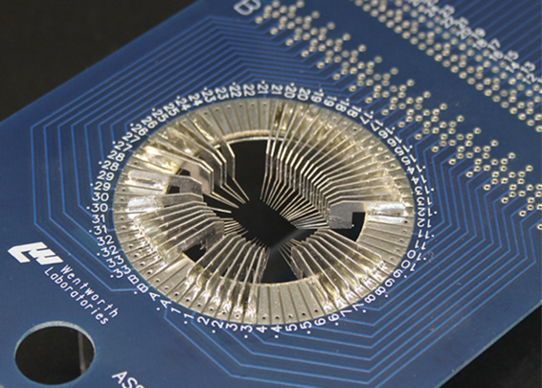
A DEDICATED WAFER PROBER @ CERN
HIGH SPEED
VERTICAL PROBE CARD
LOW SPEED
CANTILEVER PROBE CARD

Slide 7
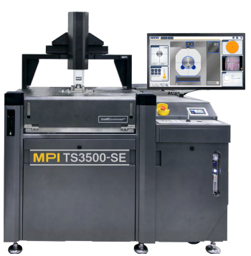
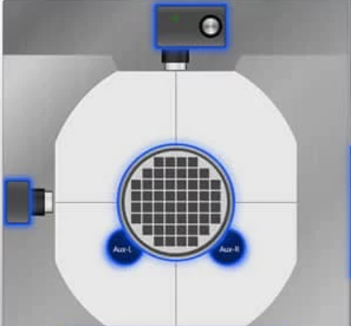
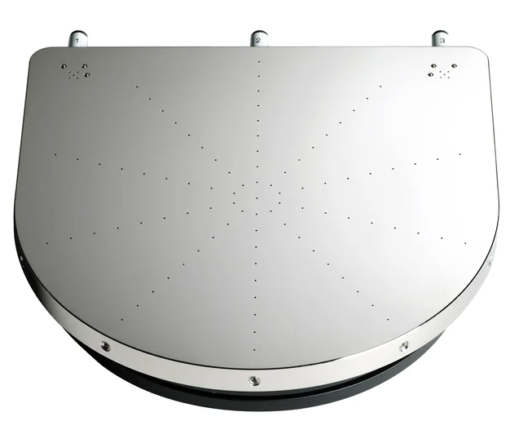
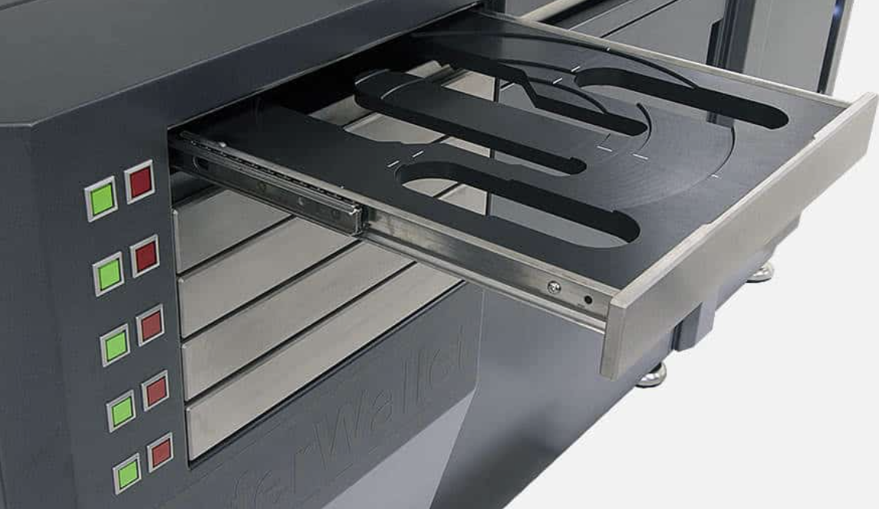
A DEDICATED WAFER PROBER @ CERN
MPI TS-3500 SE
Installed at the DSF lab
Wafer wallet for fully automatized testing
Multiple cameras available
Must for vertical probing
Capable to load 300 mm wafers
Micro-holes for accurate placing of ultra thin wafers

Slide 8
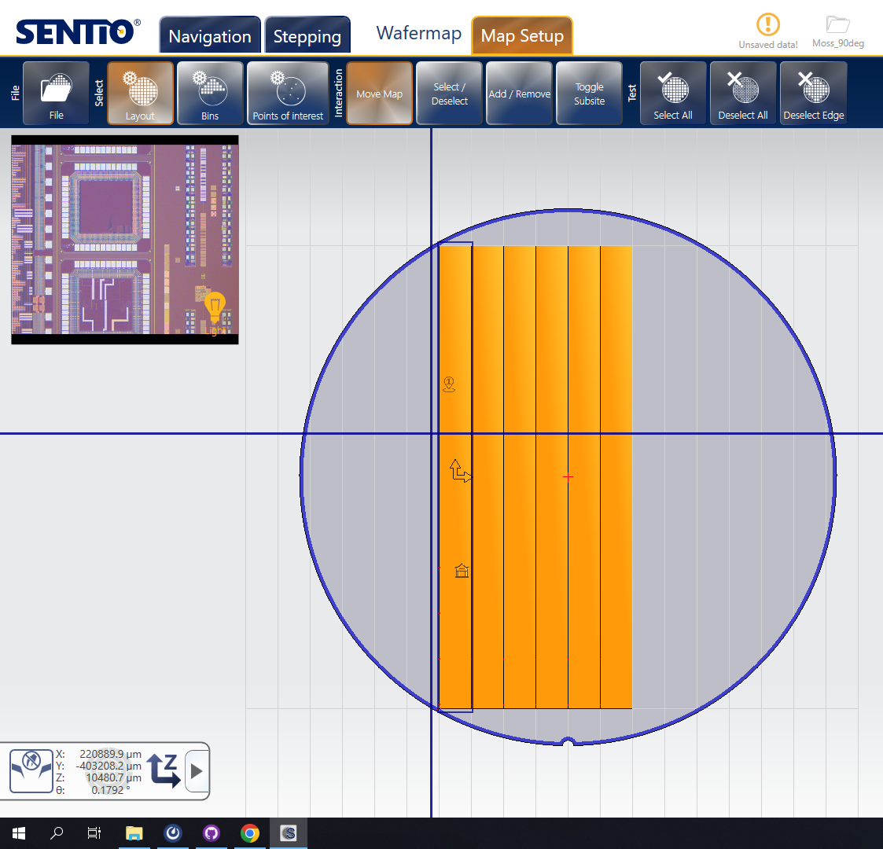
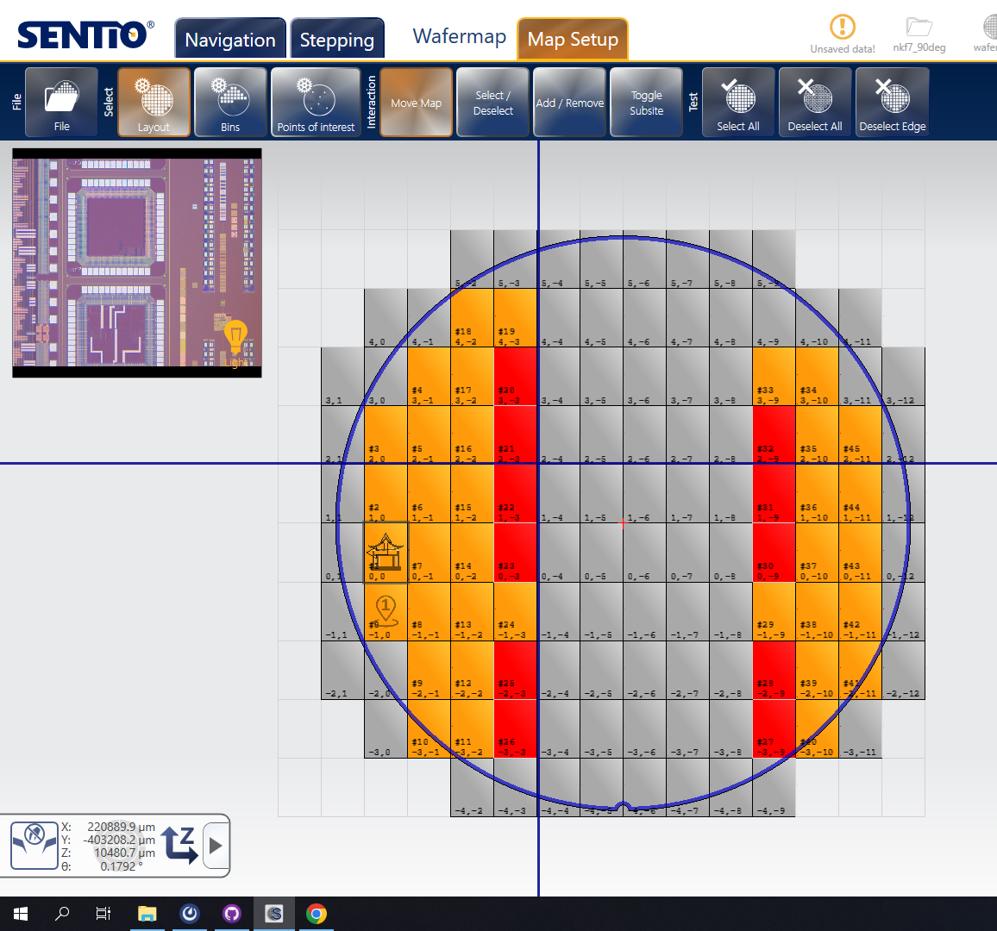
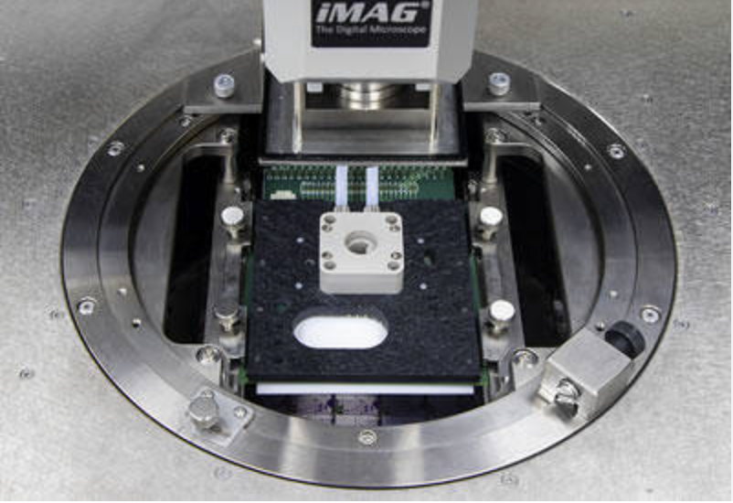
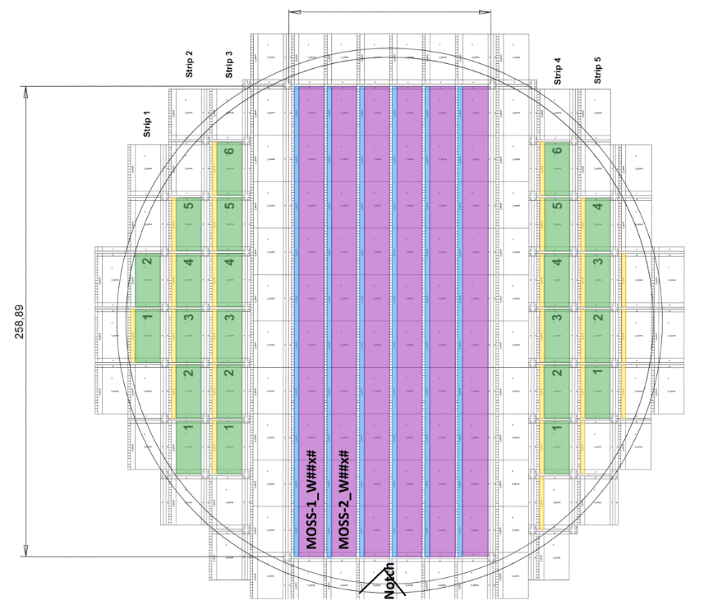
PROBE CAR SETUP AND WAFER MAP GENARATION
Wafer map generation
Probe card holder and alignment
Inclination adjust wheel
Screws for z position
Rails for X and Y

Slide 9
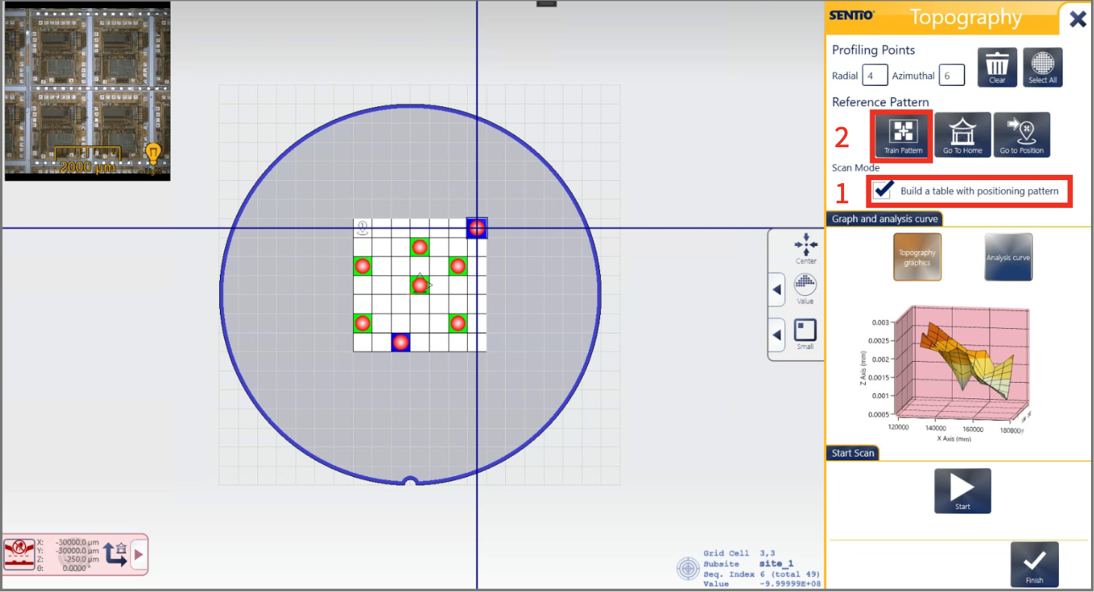
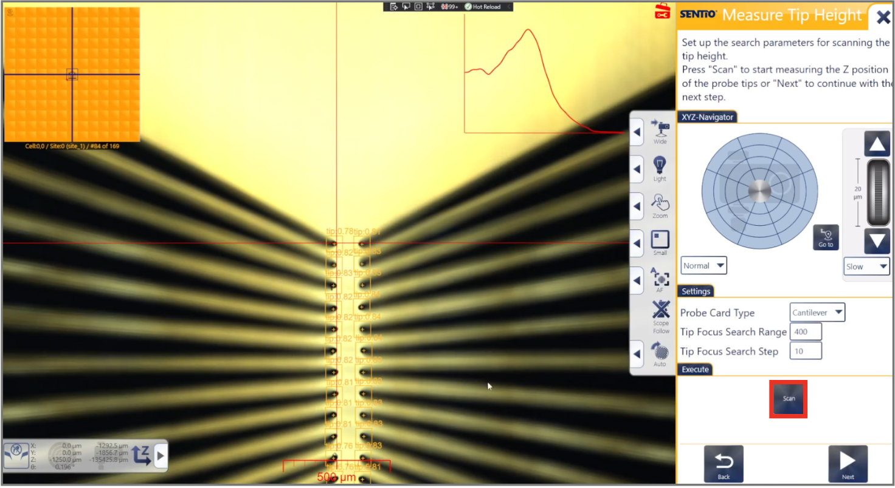
PROBE TO PAD ALIGNMENT
Topography maps
Pobe To Pad Alignment training (PTPA)
Uses light reflection to calculate the differences in heights across the wafer using the specified dies
Training procedure using marker, pads and tips to align needles to pads in X, Y and Z

Slide 10
DEVELOPING AUTOMATIC TESTING
Goal of sharing the projects and scripts with all the institutes involved in wafer probing testing
Github repository: https://github.com/SVT-WP2/MITWP1/tree/main
Currently to main folders:
Python projects: Sentio Software Remote commands scripts to operate the WP
Scripts: Bash scripts that allow to test a full system including DAQ, PS and WP commands
All the automatization process has been done using the features of vertical probing
Code snippet from the Scripts

Slide 11
WORKFLOW WAFER PROBE TESTING
~ 30 MIN
per wafer family
Wafer_name_project
Few min to load wafer
+ few sec per die
Probe card adjustments
WP remote control
New wafer installation
Manual Sentio Project Setup
Automatization scripts
Electrical Tests
MANUAL SETUP ONLY ONCE PER WAFER TYPE
AUTOMATIC TESTING
Readout and control HW
Analysis of results
Wafer alignment
Wafer map generation
PTPA training
Topography
Includes PS control
Wafer_name_project

Slide 12
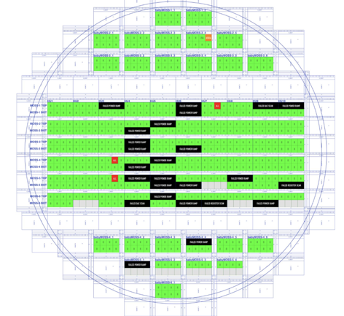
FIRST RESULSTS AND MACHINE VALIDATION
Tested all 25 babyMOSS top unit in the wafer in 25 minutes with ~identical results to ALICE using our new tools
Electrical tests as Digital Scan, PowerOnTest, Registers scan
ALICE ITS3 RESULTS
SVT RESULTS
W124A 3-1 HIT MAP
W124A 3-3 NOISY PIXELS
MIT group meeting

Slide 13
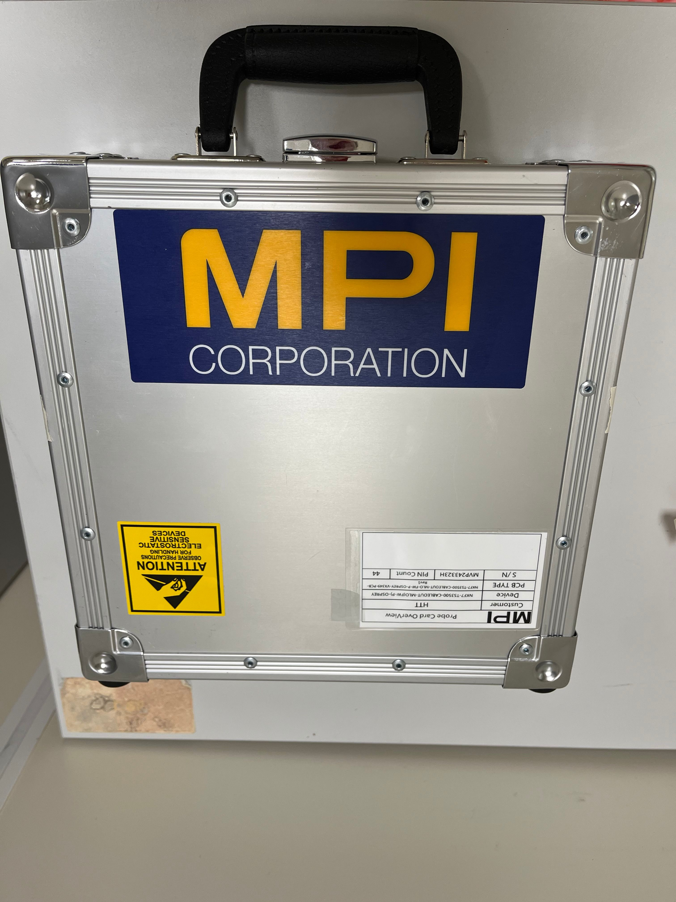
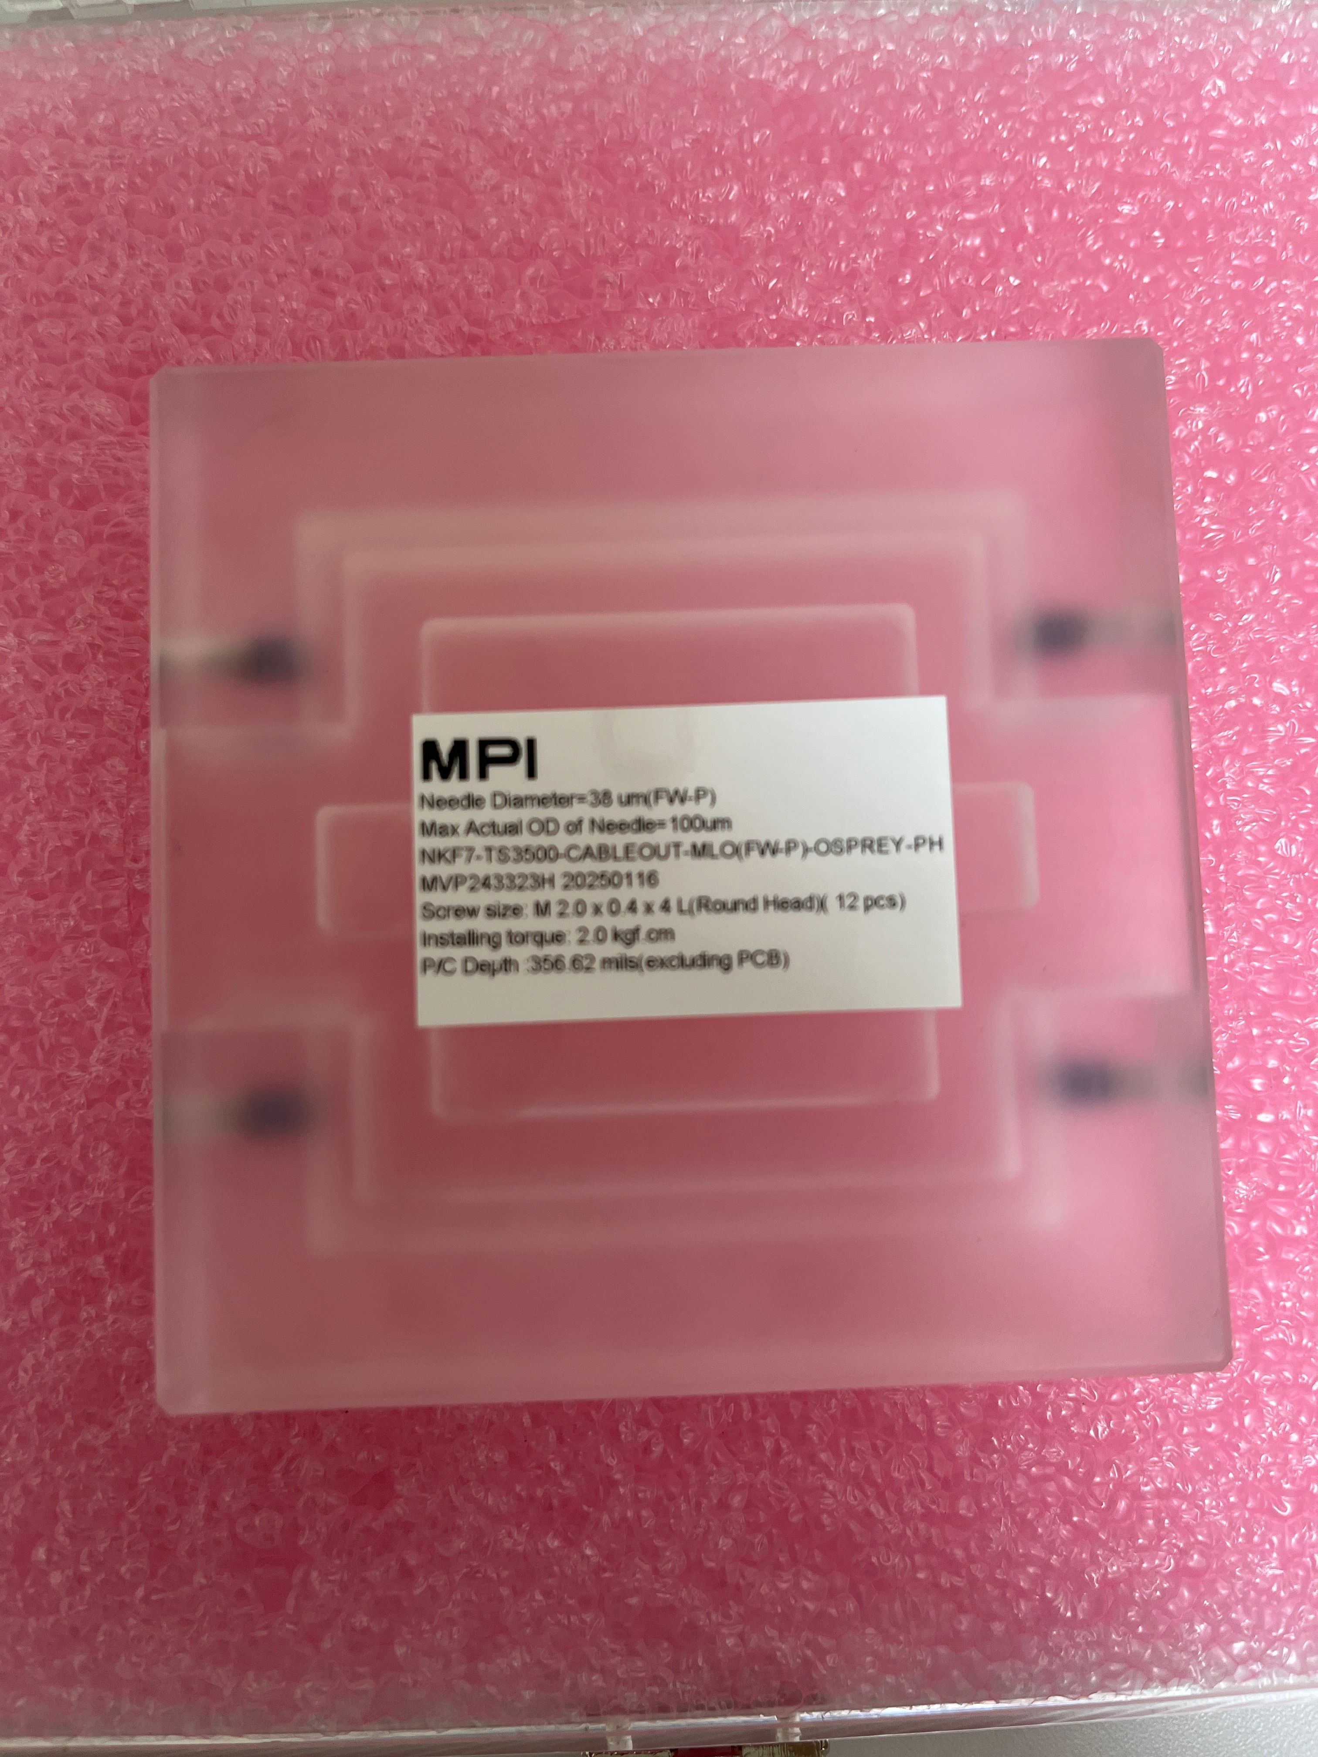
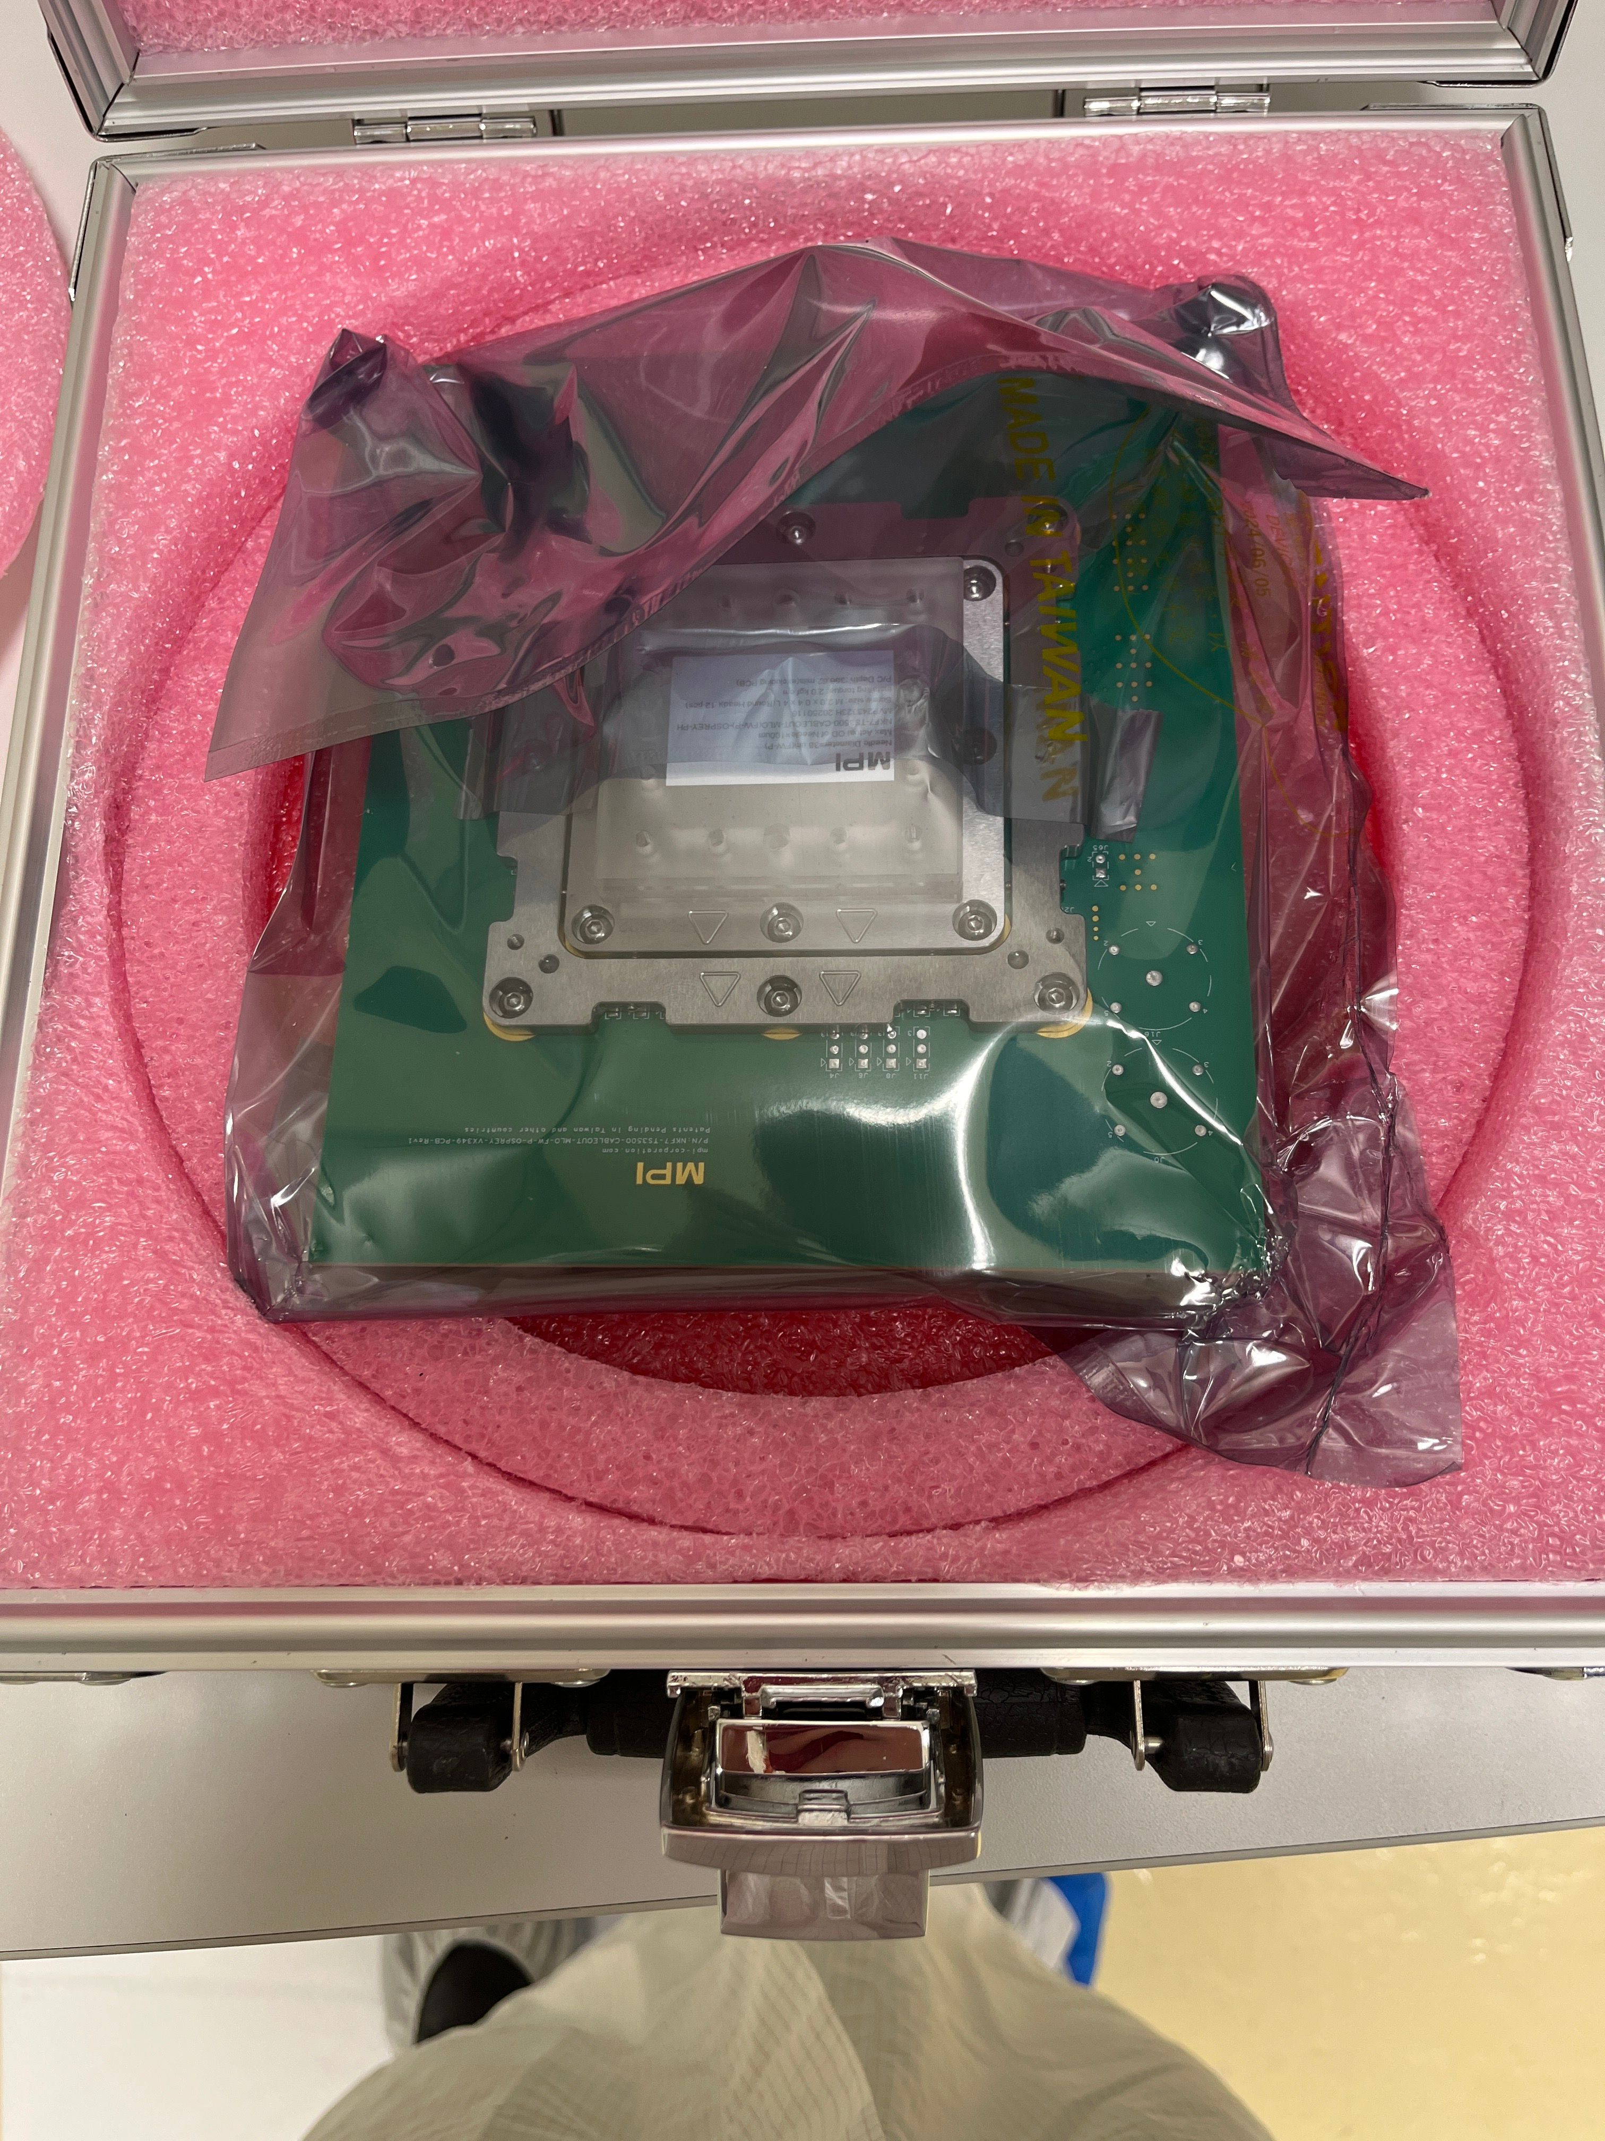
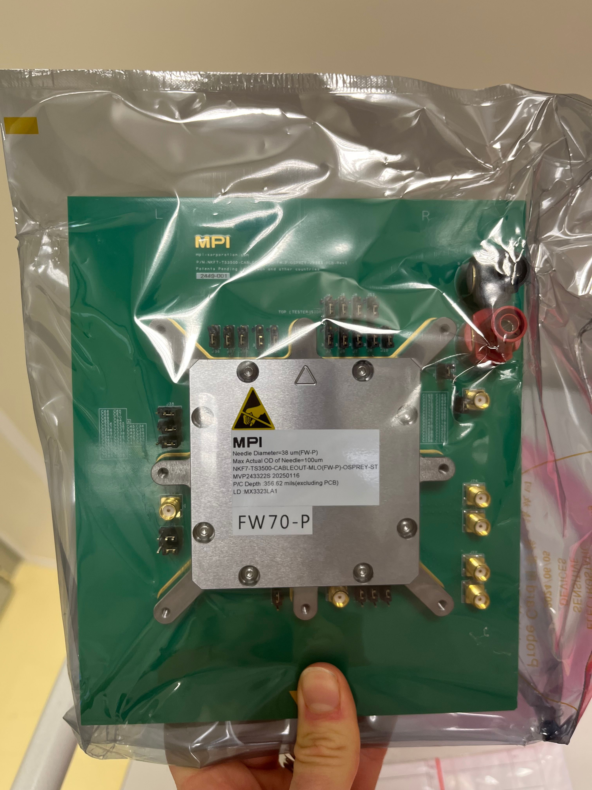
CURRENT STATUS OF THE SETUP
MIT group meeting

Slide 14
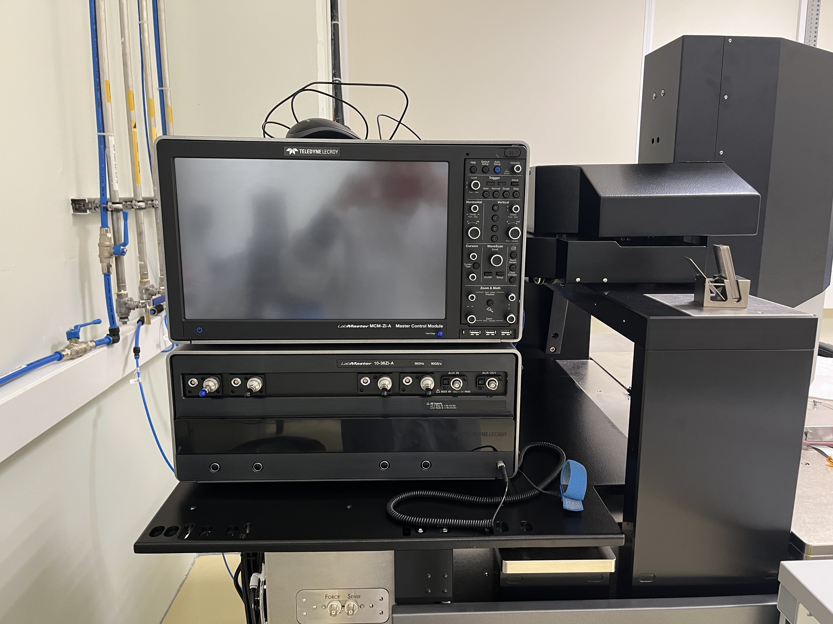
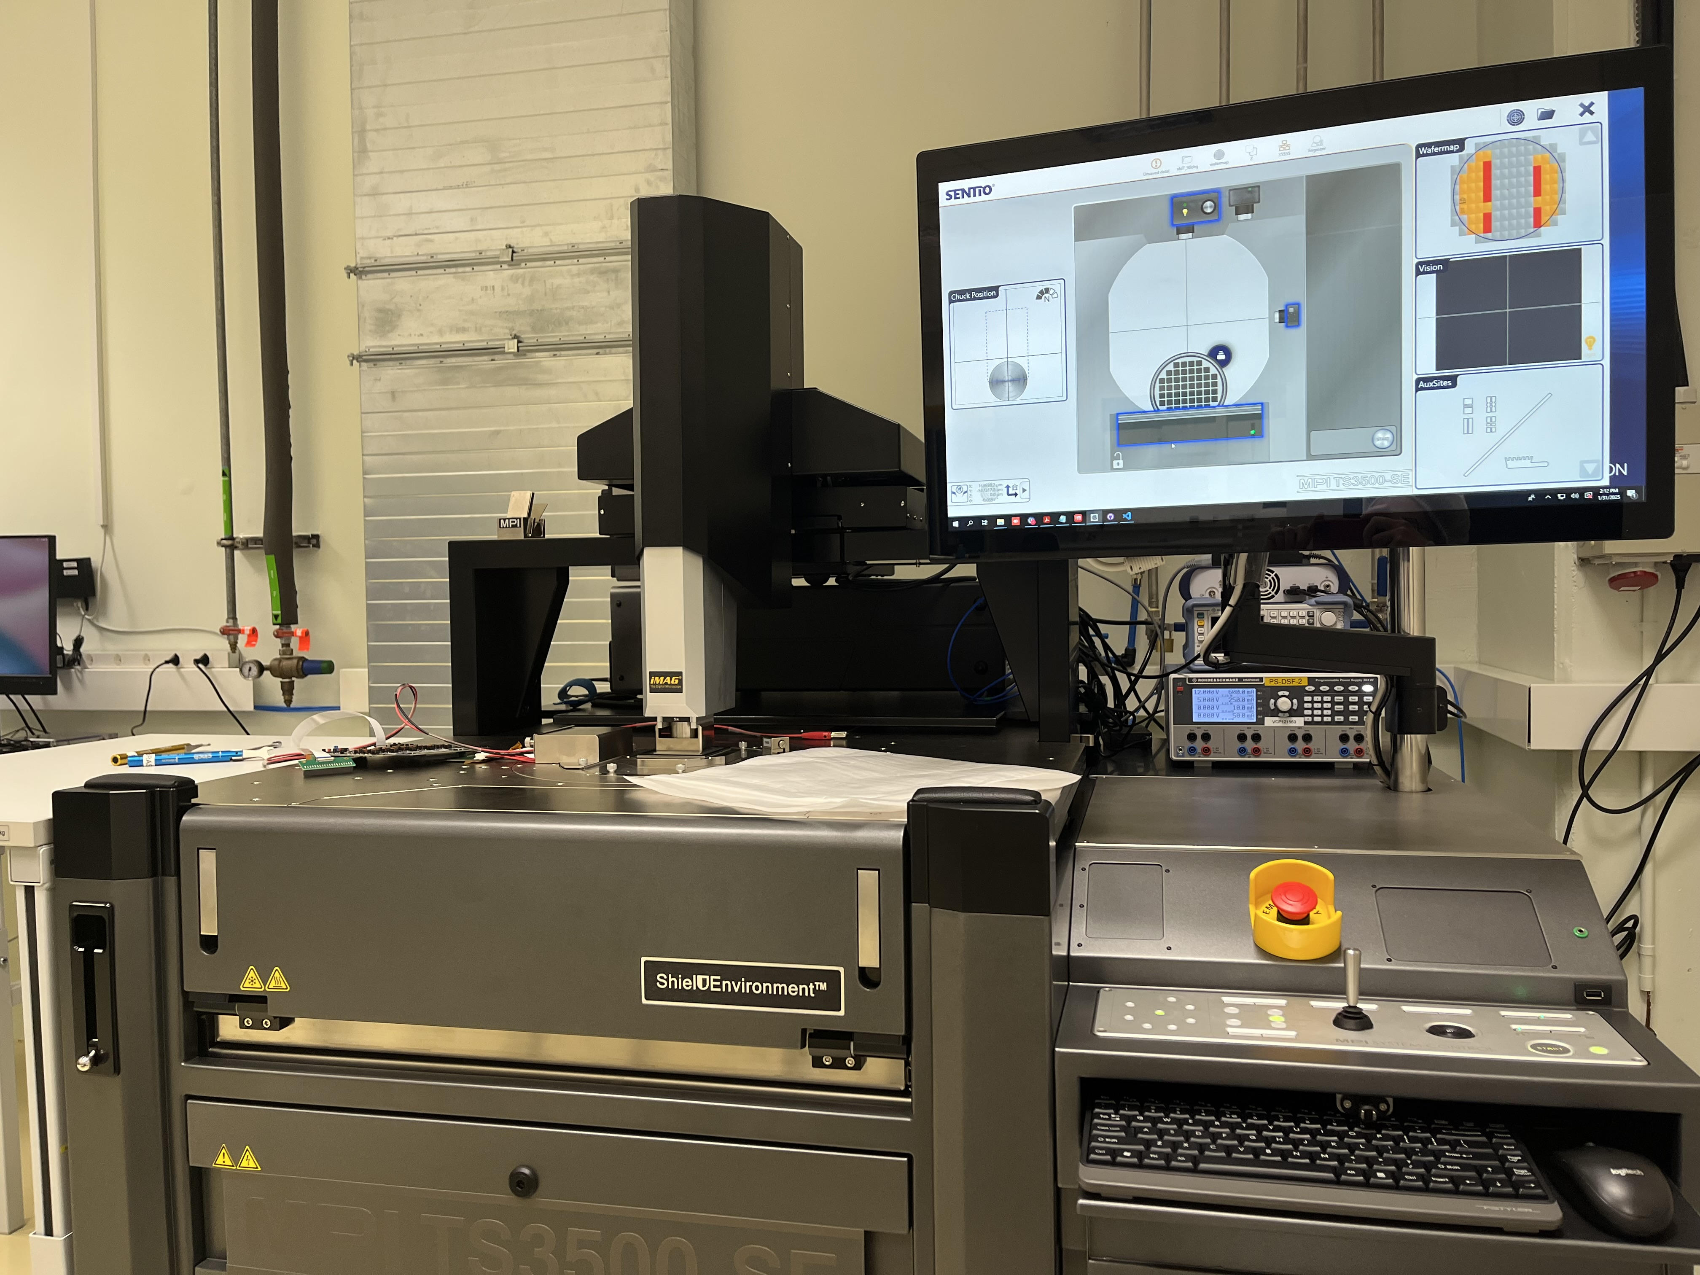
CURRENT STATUS OF THE SETUP
MIT group meeting

