Slide 1
Major limitations of existing fixed field ring accelerators
Malek HAJ TAHAR
Paul Scherrer Institut
Snowmass’21 Workshop on High Power Cyclotrons
07 September 2021

Slide 2
Disclaimer
Since a large number of different fixed field accelerator concepts exist, attention will be focused on the methods and aspects that are generally used (operating) nowadays.
It should be noted that this approach cannot give a complete overview of the field and some conclusions have exceptions.
The limitations discussed are so called because the focus is on what limits the achievable currents.

Slide 3
Overview
Magnetic field limitations
Beam extraction limitations
RF considerations
Summary

Slide 4
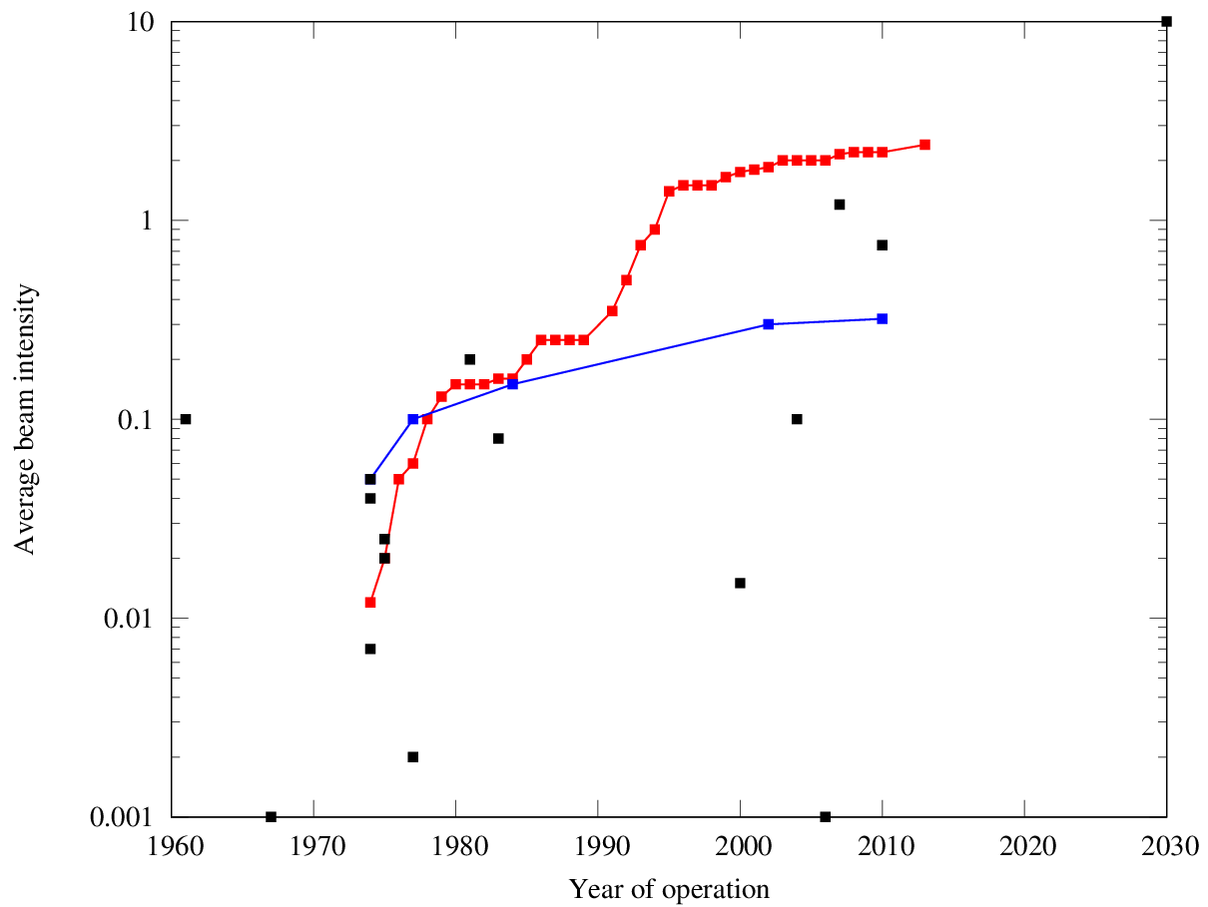
Livingston chart
10 mA
Major RF upgrades
Daeδalus
PSI 590 MeV ring
Livingston chart for beam intensity showing an increase by nearly one order of magnitude per decade since the 70s.
Tremendous effort to tune the machine..
TR 30
1 mA
IBA C70
Berkeley CP42
UCLA 60
TRIUMF 520 MeV ring
100 μA
UW 50
IBA C10
Dubna SC 700
Nevis SC 570
10 μA
ORIC 42
The numbers displayed represent the extraction energy in MeV
CERN SC 600
Gatchina SC 1000
Curie SC 200
PSI Proscan 250
SC = Synchro-Cyclotron
1 μA

Slide 5
To facilitate the discussion, we focus on 2 concepts aiming for High Intensity, CW vs pulsed ...

Slide 6
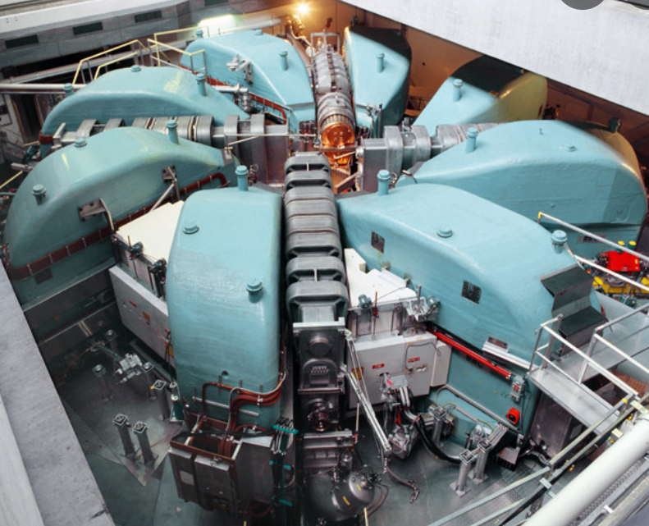
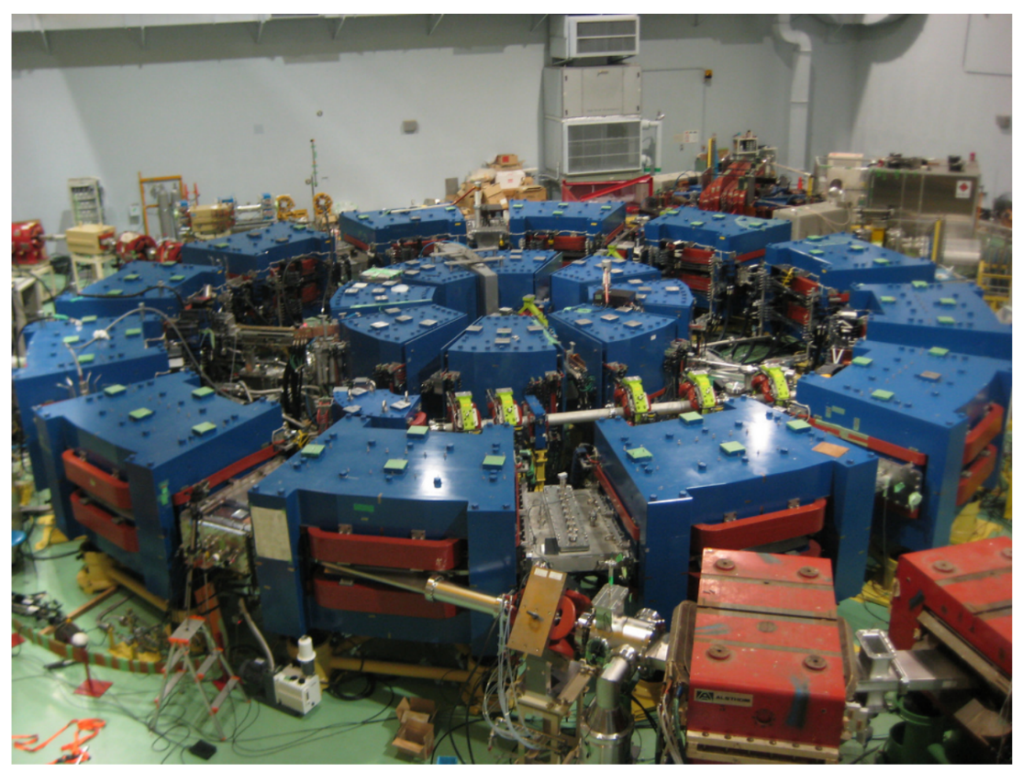
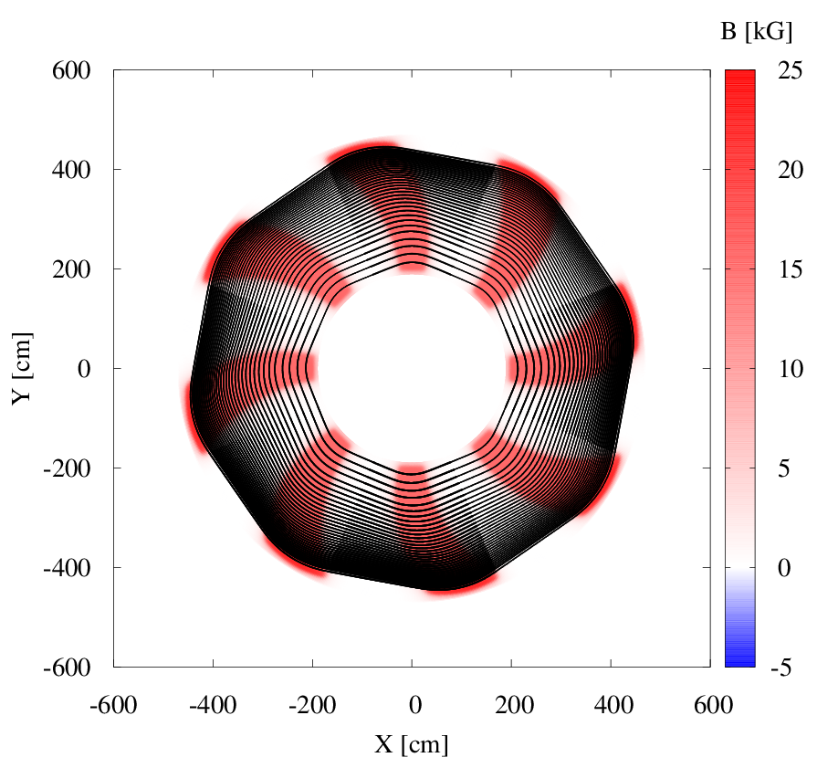
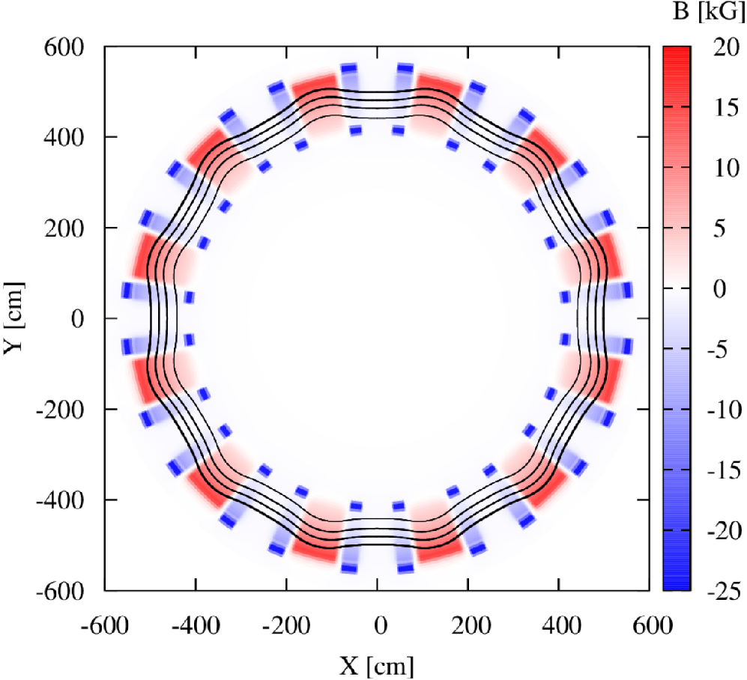
Separated Sector Cyclotrons
Over 40 years of upgrades!
Reinvented by Y. Mori et al
In ~ 2000
Scaling FFA
Example of several closed orbits in the PSI 590 MeV ring cyclotron in Villigen (constant step size in energy).
Example of several closed orbits for the KURRI 150 MeV scaling FFA at Kyoto. First beam in 2006.

Slide 7
Magnet considerations
In an FFA/cyclotron, magnetic field is a complicated function in radial and azimuthal coordinates such as:
For a cyclotron, $B_{m}\left(R\right)=B_{0}×γ(R)$ and the average field index $k=γ^{2}−1$
For a scaling FFA, $B_{m}\left(R\right)=B_{0}×{\left(\frac{R}{R_{0}}\right)}^{k}$ where $k=const$
$$B\left(R,θ\right)=B_{m}\left(R\right)×F(R,θ)$$
; $B_{m}$ is the average field at fixed radius and $k=\frac{R}{B_{m}}\frac{∂B_{m}}{∂R}$ is the average field index
For FFA, orbit compression often desired → large k values required → horizontal tune generally larger than the vertical one. FFA magnets are generally smaller than cyclotron magnets with k >> 1.
In practice, it is difficult to build magnets with large field index $k$ exactly as prescribed (case of scaling FFA and cyclotrons approaching the GeV level):
Proximity of the magnets
Variable gap size
Closed orbits distortion → path length + effective focusing differ in the neighbourhood of each orbit.
→ Field errors

Slide 8
2 types of field errors that can limit their performance:
- dipole field errors
- gradient field errors

Slide 9
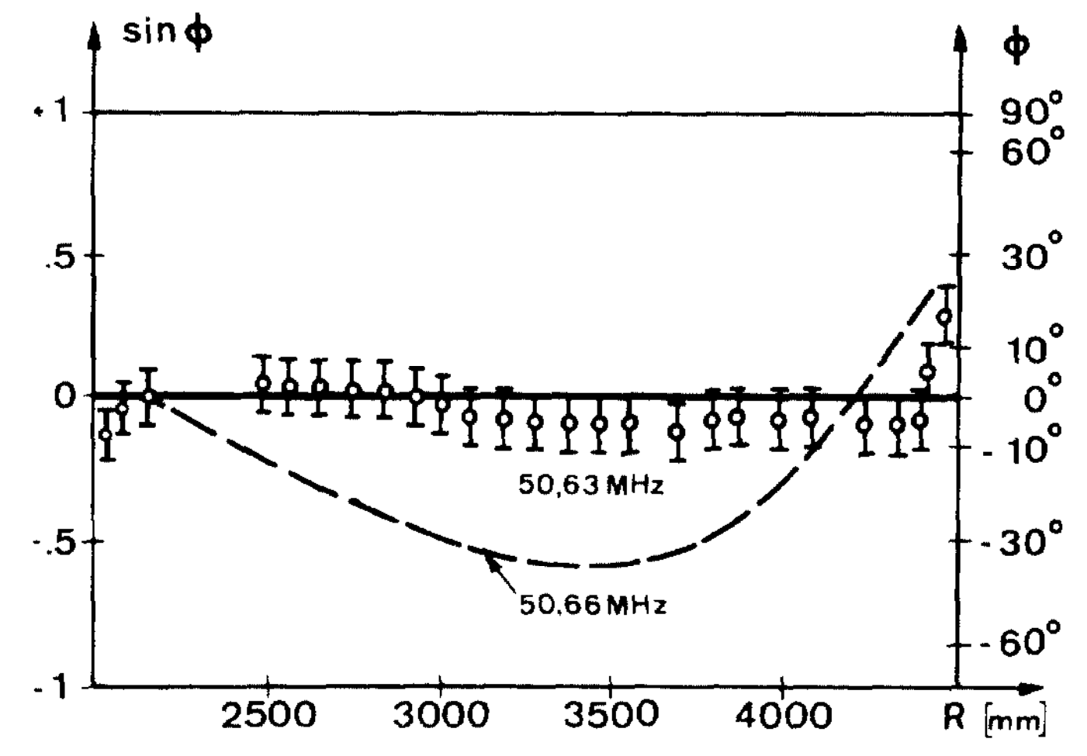
Dipole field errors
The concept of isochronism excludes phase stability
→ severe tolerances on magnetic field errors.
Constraint: the beam phase shall remain within $±\frac{π}{2}$, in order to accelerate it to full energy.
Level of isochronism generally aimed: 0.01 %.
Recalling that $\frac{∆B}{B}=γ^{2}\frac{∆f}{f}$, it results that a field change of $\sim 2×{10}^{−4}$ prohibits acceleration to full energy for the PSI 590 MeV ring for instance [ref 1]
B is the average field per turn.
RF phase of the accelerated particles as a function of radius for the 590 MeV PSI cyclotron. The magnetic field is isochronous to $±5°$ between 75 and 580 MeV without exciting any trim coil [ref 1]

Slide 10
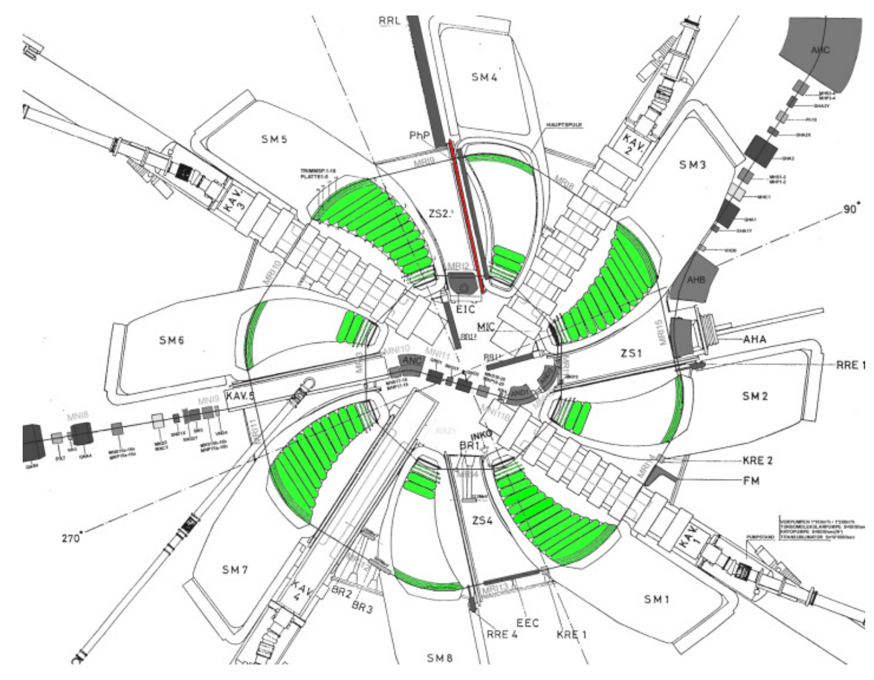
Dipole field errors-Remedies
Fine shimming of pole edges/adding field clamps [ref 2]
Correction trim coils to ease the beam extraction and overcome some resonance crossings [ref 3]
8-fold symmetry reduced by a factor of 2.
Harmonic coils to correct coupling resonances [ref 4]
Coarse isochronism $≡$ Main coils individually excitable
Layout of PSI ring cyclotron with trim coils (18) placed on top of the main magnets’ pole plates [ref 5, 6, 7]

Slide 11
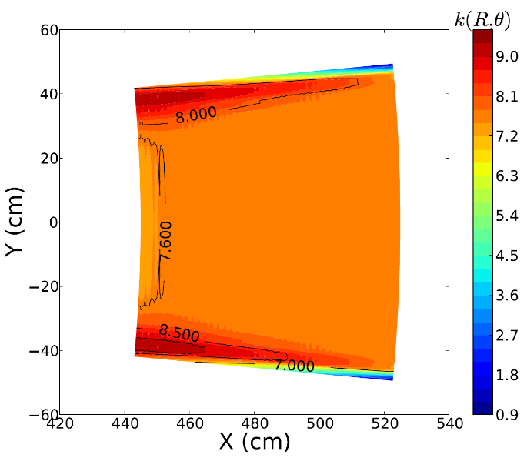
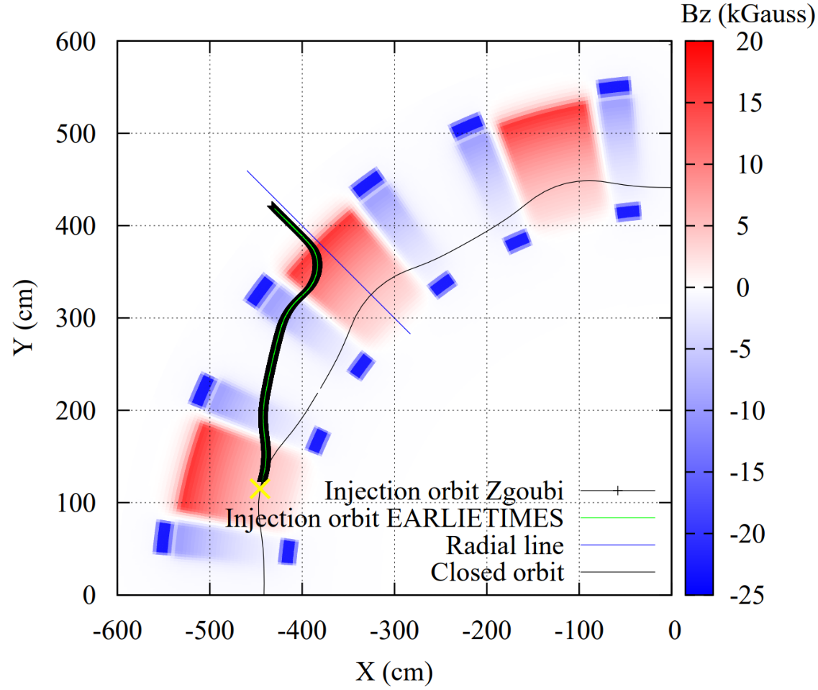
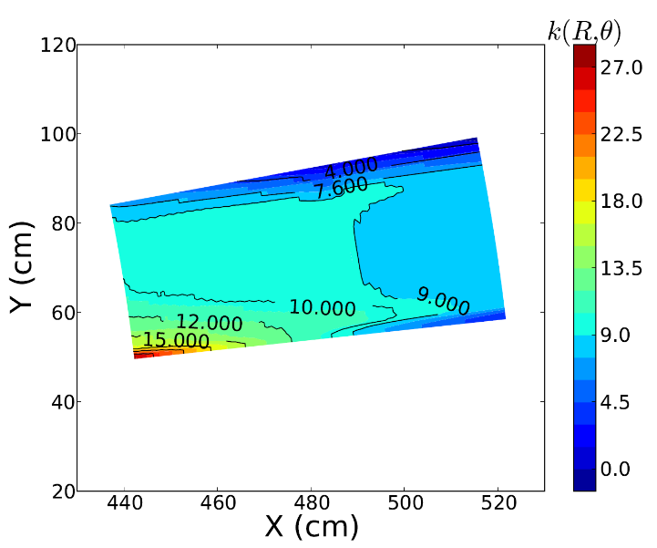
Gradient field errors
$$\left\langle k_{F}\right\rangle =7.6$$
Layout of the KURNS 150 MeV scaling FFA (larger of the two rings)
The field index is constant everywhere except in the interaction region between the F and D magnets:
No steel return yoke employed to facilitate the injection/extraction [ref 9] → the flux of the F magnet returns through the D magnet and alters its gradient (problem inexistent for booster ring).
$$\left\langle k_{D}\right\rangle =9.1$$
Map of the field index in the D and F magnets [ref 8]
Larger variations at low energies
Why gradient field errors matter (azimuthally)?

Slide 12
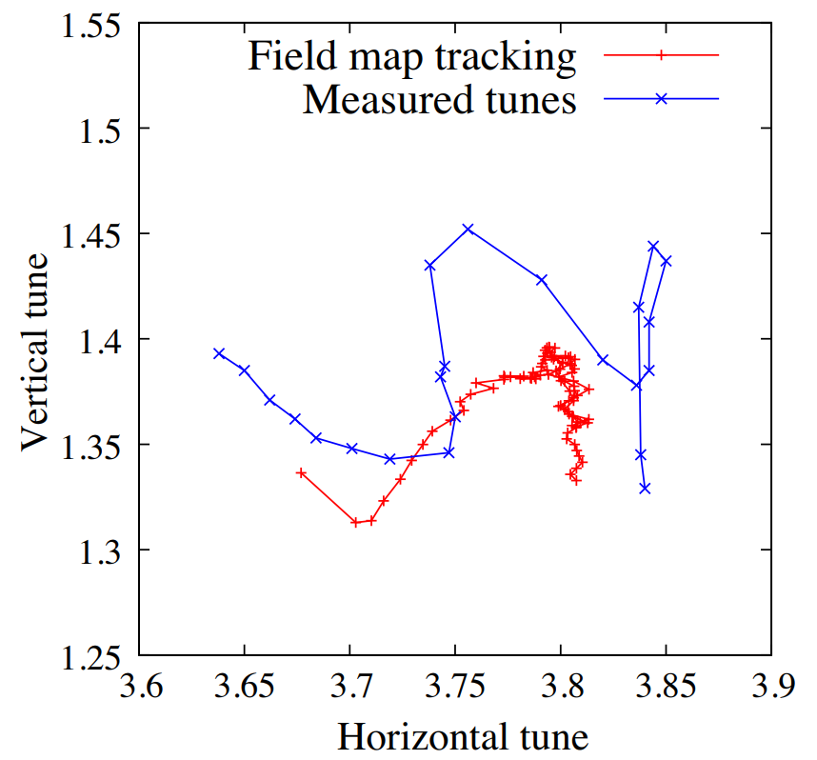
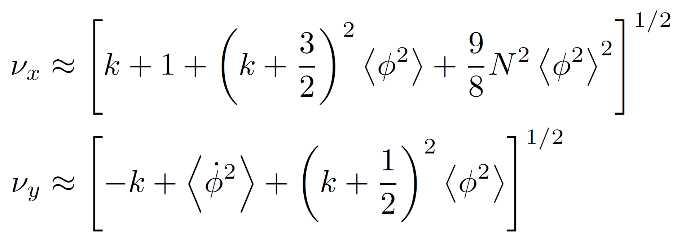
Gradient field errors → Resonances
Lessons learned: Making average k constant insufficient to guarantee a fixed tune machine. Scaling as originally prescribed must be valid locally as well as globally.
Average forces applied to the beam (cyclotron regime, no spiral angle assumed)
Deviations around the mean values of these forces
1 ms
20 ms
(AG focusing)
$$Q_{x}−2Q_{y}=1$$
Edge focusing
$∆{(ν}_{x,y}^{2})∝\frac{p_{ext}−p_{inj}}{p_{inj}}×\left|\frac{B_{D0}}{B_{F0}}\right|×\frac{k_{D}−k_{F}}{k}$ ; $\frac{R_{ext}−R_{inj}}{R_{inj}}≈\frac{1}{k+1}×\frac{p_{ext}−p_{inj}}{p_{inj}}$
Betatron tunes from 11 to 100 MeV (left to right) at the KURNS 150 MeV FFA [ref 8, 9, 10].
Tune excursion due to scaling imperfections is $∝∆k/k$ and to the FD ratio of the magnet.
Even for a cyclotron, gradient field errors will lead to strong tune variations and are often introduced at extraction to enhance the turn separation. Nearly negligible when rapidly crossed.

Slide 13
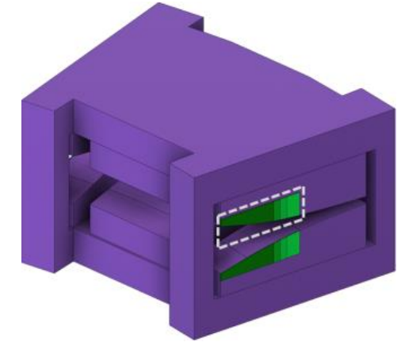
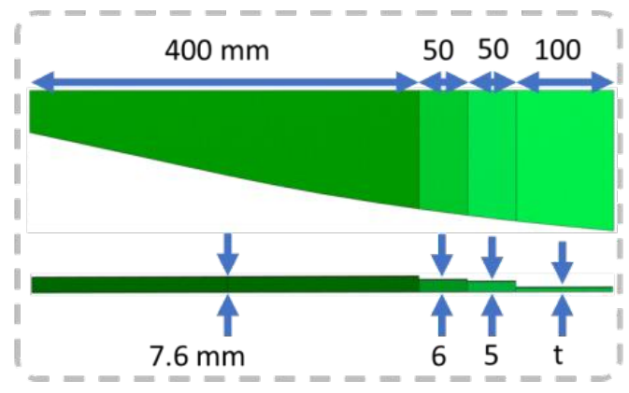
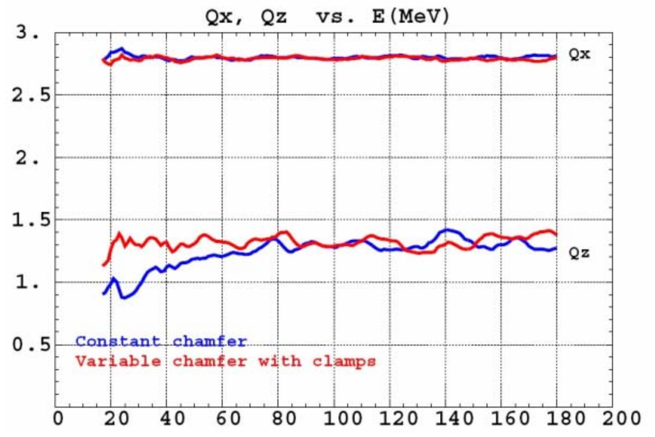
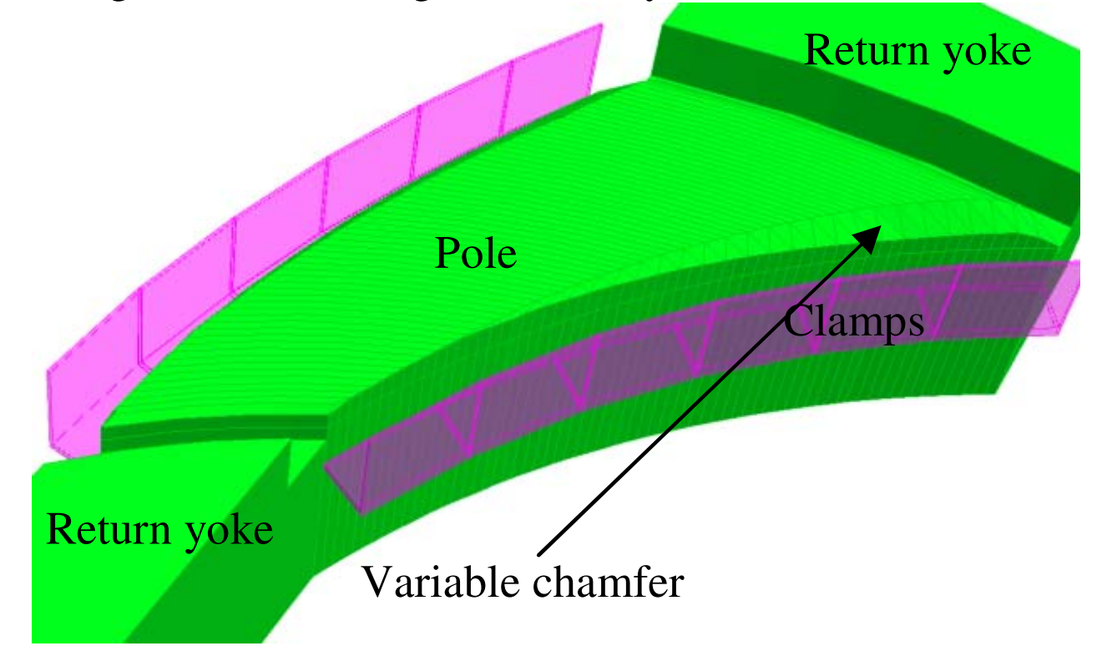
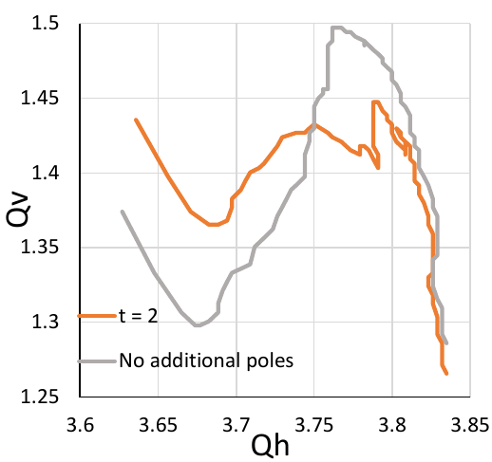
Gradient field errors-Remedies
Tuning can be tedious (combined function magnets).
Both quantities to adjust (revolution time, tunes) are average quantities.
Same approach applies both for cyclotrons and scaling FFA
Courtesy Yuhi Waga
Three possible remedies to field errors:
Field clamps: Shall primarily affect the edge focusing (vertical tunes)
Courtesy Thomas Planche
RACCAM spiral scaling FFA [ref 11]
Kyushu radial scaling FFA

Slide 14
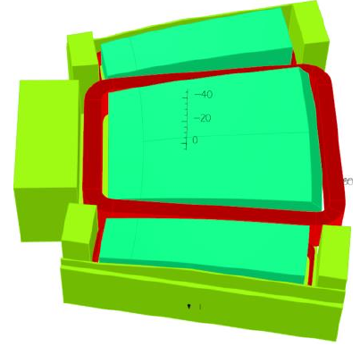
Gradient field errors-Remedies
Tuning can be tedious (combined function magnets).
Both quantities to fix (revolution time, tunes) are average quantities.
Same approach applies both for cyclotrons and scaling FFA
Courtesy Yuhi Waga
Three possible remedies to field errors:
Field clamps: Shall primarily affect the edge focusing (vertical tunes)
Flux return yokes

Slide 15
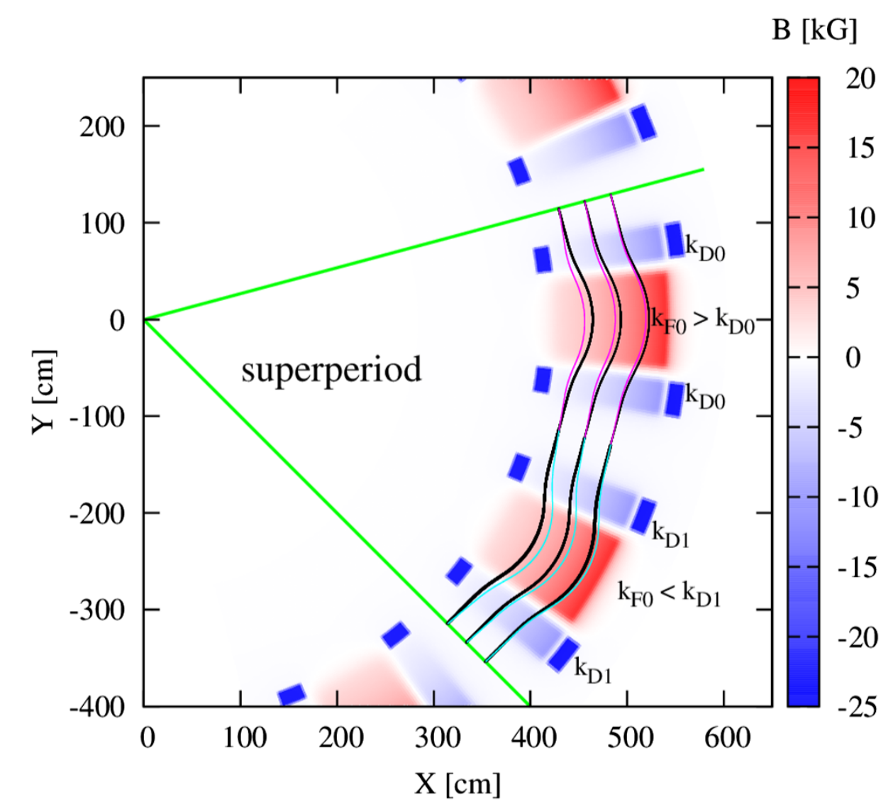
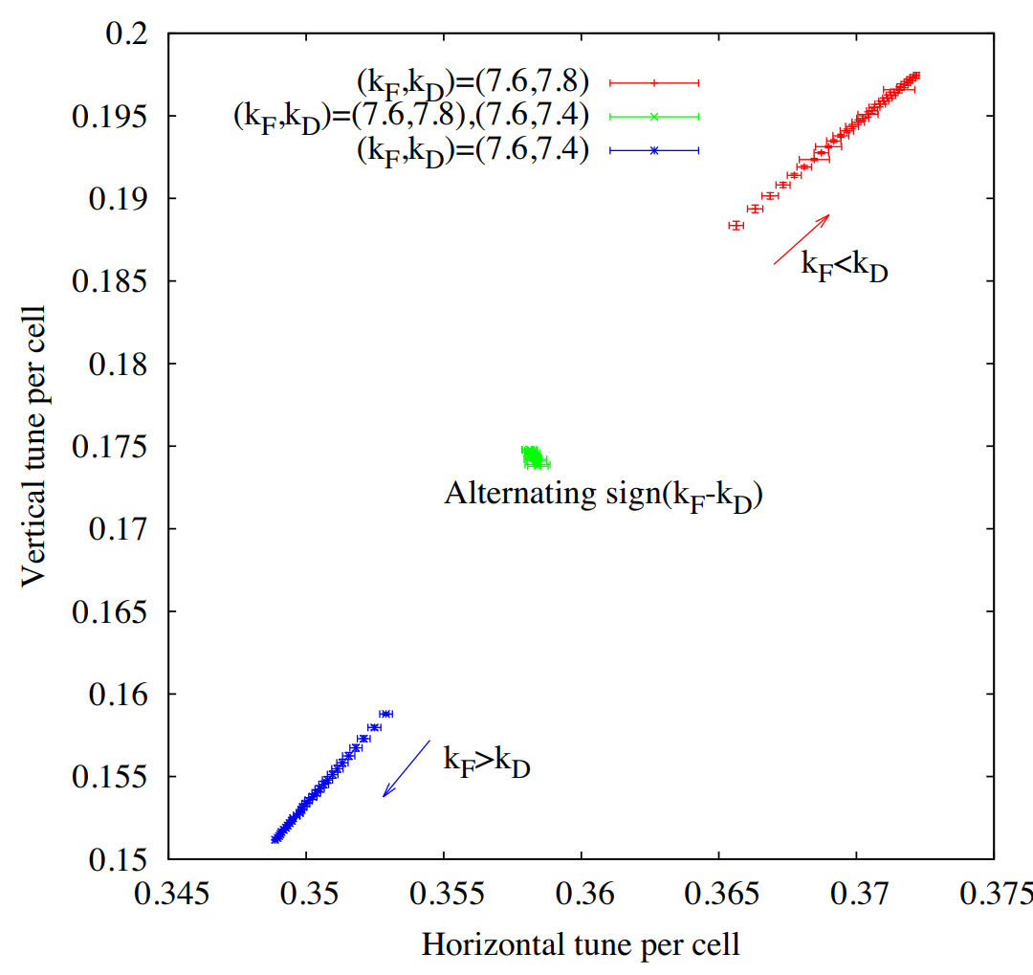
Gradient field errors-Remedies
Tuning can be tedious (combined function magnets).
Both quantities to fix (revolution time, tunes) are average quantities.
Same approach applies both for cyclotrons and scaling FFA
Three possible remedies to field errors:
Field clamps: Shall primarily affect the edge focusing (vertical tunes)
Flux return yokes
Trim coils: Aim to fix the tune by replacing the N-fold symmetry machine with N/2 or even N/3 symmetry.
$$∆{(ν}_{x,y}^{2})∝\frac{p_{ext}−p_{inj}}{p_{inj}}×\left|\frac{B_{D0}}{B_{F0}}\right|×\frac{k_{D}−k_{F}}{k}$$
Controls the monotonic behavior
Ways to mitigate magnetic field imperfections shall be considered in the preliminary design phase of the accelerator.

Slide 16
Beam dynamics are driven by the need to extract the highest current with low losses.

Slide 17
Beam Extraction challenges
Radial turn separation at extraction valid for any fixed field ring accelerator:
R is the radius at extraction
For a cyclotron $k=γ^{2}−1$
For a scaling FFA, k is constant
$∆E$ is the energy gain per turn
$$\frac{∆R}{R}=\frac{1}{1+k}×\frac{γ}{γ^{2}−1}×\frac{∆E}{m_{0}c^{2}}$$
For the same radius and energy at extraction, a fixed field alternating gradient will have a smaller turn separation due to its larger k value aiming for a more compact orbit excursion.
Above formula valid for a pencil beam only i.e. for a vanishing beam size.
Stripping H2+ or H- ions to circumvent the problem (see talks by T. Planche and L. Calabretta), yet the cost is a larger machine.
Next, the focus will be on the single turn extraction challenges

Slide 18
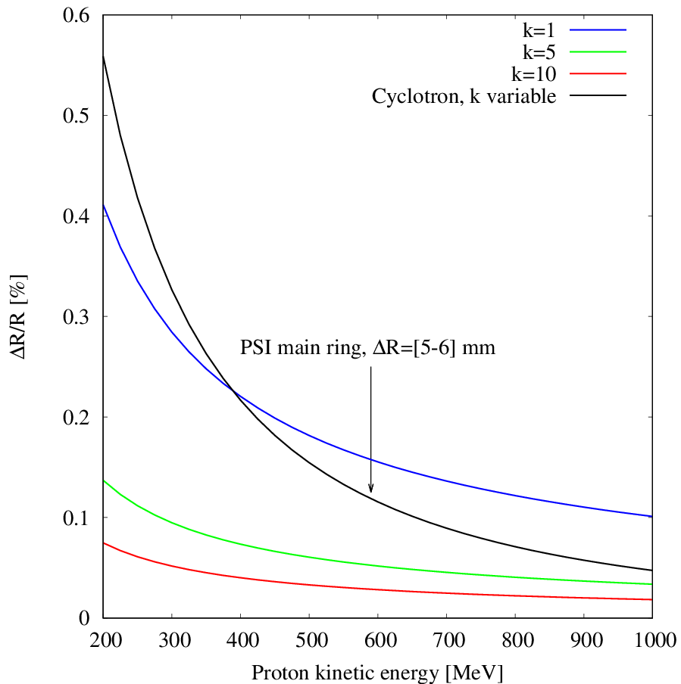
Beam Extraction challenges: Energy dependence
Observation: Small turn separation at extraction.
How to overcome?
Turn separation for various FFA concepts

Slide 19
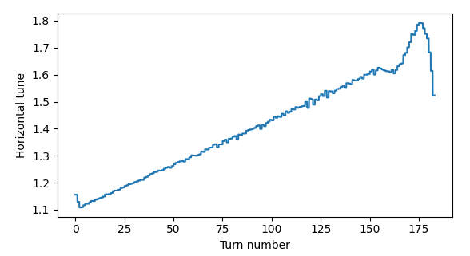
Beam Extraction challenges: Energy dependence
Observation: Small turn separation at extraction.
How to overcome?
Lower the horizontal tunes at the extraction region
Last 7 turns
Horizontal tunes as a function of turn number for the PSI ring cyclotron
Turn separation for various FFA concepts

Slide 20
Beam Extraction challenges: Energy dependence
Observation: Small turn separation at extraction.
How to overcome?
Lower the horizontal tunes at the extraction region
Inject the beam off-center
Optimize the dispersion function at injection (to reduce the contribution of the momentum spread at extraction)
→ Wins a factor 3 in turn separation [ref 12]
Flat-top system to further reduce the energy spread
Bunching the beam at injection
Collimation to clean the beam tails (several steps)
Increase the energy gain per turn $≡$ RF upgrades
Turn separation for various FFA concepts

Slide 21
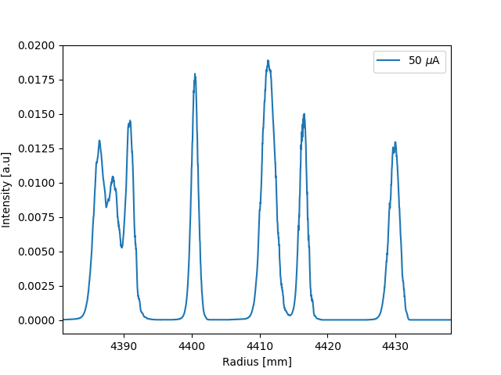
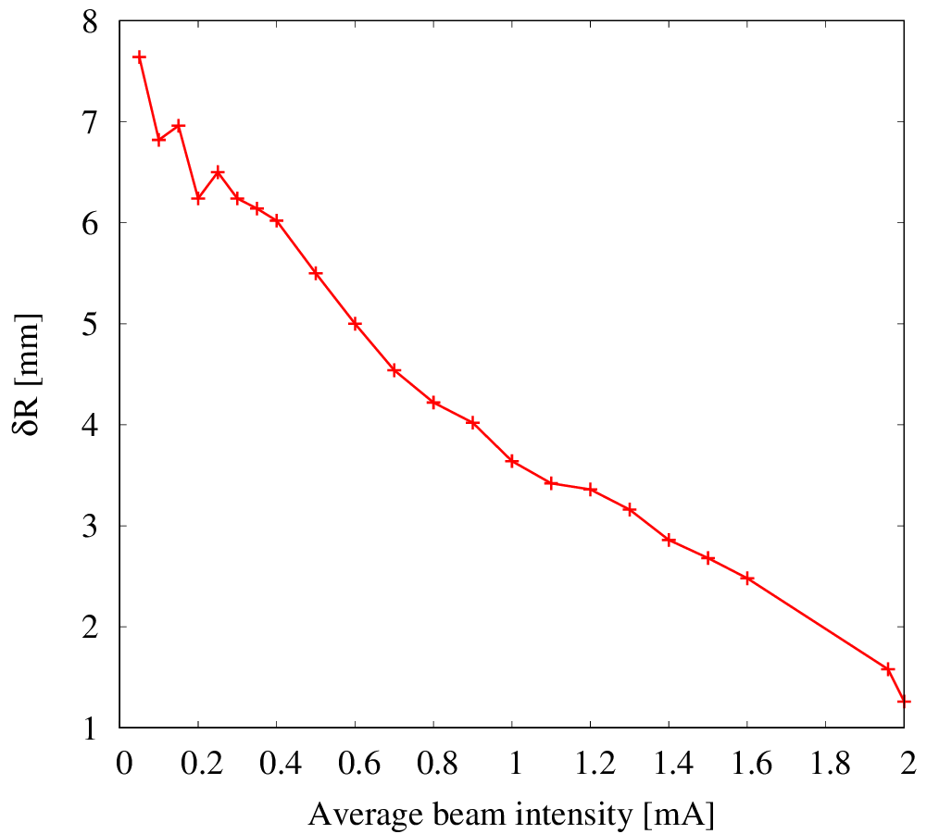
Beam Extraction challenges: Intensity dependence
14 mm
Operational experience at PSI proved that beam losses could be kept below 0.02 %
Extraction septum
Fine-tuning
Measured turn separation guaranteeing 99.98 % extraction efficiency (clean region where the inner electrode can be placed safely).
Radial probe measurement at the extraction region of the PSI 590 MeV cyclotron: Normalized bunch intensity. Experiment in the frame of the HIMB project by J. Snuverink, D. Reggiani, C. Baumgarten, H. Zhang and M. Haj Tahar.
→ Wider beam to accommodate more charge
The determining factor for low losses is the ratio of the width of the beam to the turn separation at extraction [ref 13].

Slide 22
Question: Large magnets are less tolerant to imperfections?
“Compactness is generally not an advantage for high intensity”
$$∆R ∝ R$$
Mike Seidel [ref 14]
Yet, for a hospital environment, compactness is a must …

Slide 23
Summary
State-of-the-art of fixed field light ion accelerators
Concept | Energy reach | Intensity reach | Operation mode | Orbit excursion/size | Peak current | Intensity limitations
Cyclotron | <= 1 GeV | mA level PSI: 2.4 mA | CW | Large | Low | Limited by turn separation at extraction
Synchro-Cyclotron | ~ 1GeV | μA level Dubna: 25 μA | Pulsed mode ($≤$ kHz) | Large | Low | Limited by RF capabilities
FFA (scaling) | No fundamental limit – AG | nA level KURNS: ~ 10 nA (ADS constraint) | Pulsed mode ($\sim$ kHz) | Small | High-large acceptance | Limited by RF capabilities + resonances
“The ion current from a synchro-cyclotron is typically $≤$1 % of that from a classical cyclotron under comparable conditions”
Above the GeV level, FFA shall be the obvious way to deliver high intensity beams (for fixed field rings). Yet, demonstrating such a capability is eagerly awaited for medium energy concepts.
M.K. Craddock and K.R. Symon [ref 15]

Slide 24
Acknowledgements
Special thanks go to:
Davide Reggiani, Jochem Snuverink, Andreas Adelmann, Christian Baumgarten and Hui Zhang from PSI for all useful discussions regarding cyclotrons.
François Méot, Shinji Machida, Scott Berg and Dejan Trbojevic for all discussions related to fixed field accelerators in general.
All members of the KURNS group in Japan, specifically Yoshihiro Ishi and Yoshiharu Mori for the stimulating work on the scaling FFA.

Slide 25
Reference lists
[1] The S.I.N. Ring Cyclotron after One Year of Operation (cern.ch)
[2] Magnets for cyclotrons
[3] Towards quantitative simulations of high power proton cyclotrons
[4] Correction of nur=3/2 resonance in triumf cyclotron
[5] S. Adam and W. Joho, PSI Technical Report No. TM-11-13, 1974.
[6] Matching of turn pattern measurements for cyclotrons using multiobjective optimization (aps.org)
[7] Measurements of the Beam Phase Response to Correcting Magnetic Fields in PSI Cyclotrons (cern.ch)
[8] Tune compensation in nearly scaling fixed field alternating gradient accelerators (aps.org)
[9] Practical Betatron Tune Behavior During Acceleration in Scaling FFAG Rings at KURNS (cern.ch)

Slide 26
[10] Progress on Simulation of Fixed Field Alternating Gradient Accelerators (cern.ch)
[11] 3-D magnetic calculation methods for SPIRAL scaling FFAG magnet design (in2p3.fr)
[12] The feasibility of high power cyclotrons - ScienceDirect
[13] Werner_Joho_Cyclotrons (psi.ch)
[14] Cyclotrons_Seidel_heraeus (gsi.de)
[15] Cyclotrons and Fixed-Field Alternating-Gradient Accelerators
[16] Phase compression-phase expansion effect

Slide 27
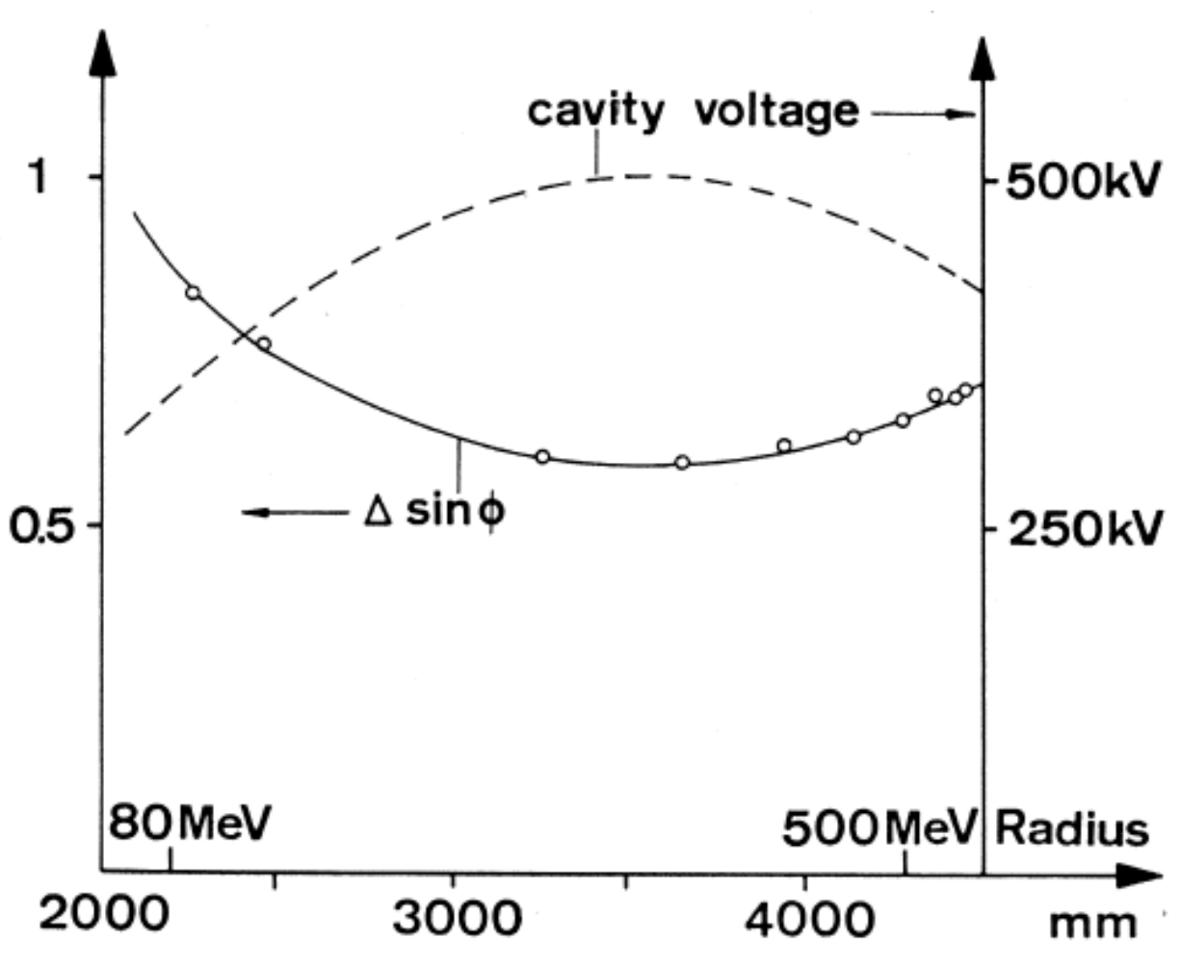
RF acceleration
Depending on the concept, the constraints on RF acceleration differ considerably:
Unlike cyclotrons, scaling FFAs operate like synchro-cyclotrons
Beam stacking technique, harmonic number jump, serpentine acceleration are potential candidates
Coupled to the oscillating RF electric field, there is a time-varying magnetic field according to:
$$rot \vec{E}=− \frac{d\vec{B}}{dt}$$
$E\left(r,t\right)=E\left(r\right) \cos{ϕ}$
$$\frac{∆f}{f}=\frac{1}{γ^{2}}\frac{\left\langle B_{y}^{rf}\right\rangle }{\left\langle B_{y}^{0}\right\rangle }$$
$$B_{y}^{rf}=−\frac{1}{ω_{rf}}×\frac{dE}{dr}×\sin{ϕ}$$
phase shift
$$ϕ=ω_{rf} t$$
As established by W. Joho [ref 16],
$$E_{G}(R)×∆\sin{ϕ\left(R\right)=const}$$
phase compression/phase expansion
The RF cavity causes orbit distortion → breakdown of the N-fold symmetry → resonances can be excited

