Slide 1


Production of radioisotopes for application studies at RIKEN RI Beam Factory
Nishina Center for Accelerator-Based Science, RIKEN
Hiromitsu Haba
CONTENTS
1. Production of RIs at RIBF
2. Chemistry of Superheavy Elements
3. Targeted α-particle Therapy
4. Summary and Perspectives

Slide 2
1. Production of RIs at RIBF

Slide 3
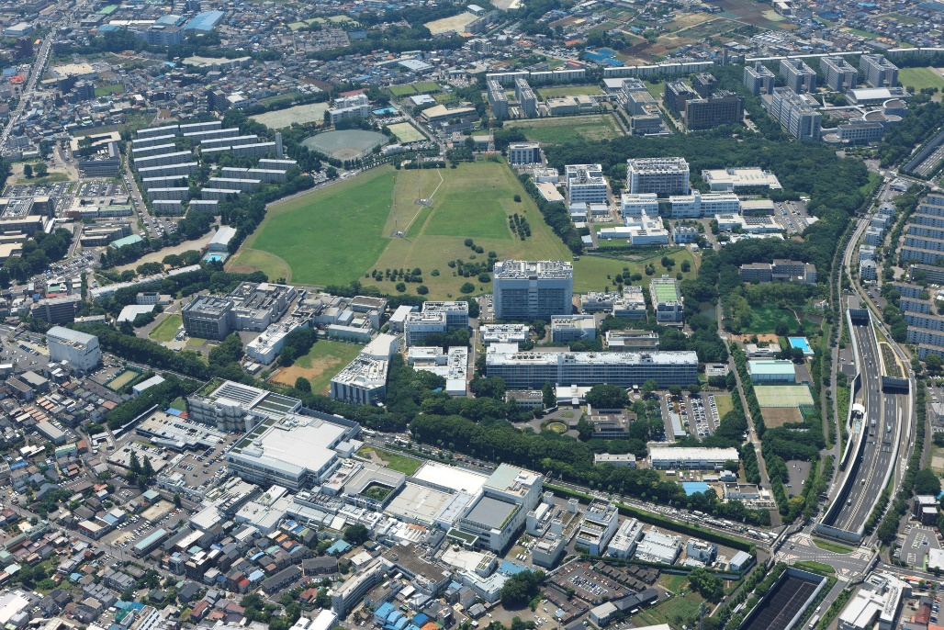

RIKEN
RIKEN is Japan’s largest and most comprehensive research organization for basic and applied science.
Since 1917, RIKEN has fostered pioneering, innovative research in fields spanning the entire range of the natural sciences, from developmental biology and neuroscience to quantum physics and computer science.
14 km to Olympic Stadium
RIBF
N
RIKEN Wako Campus (1967–)

Slide 4
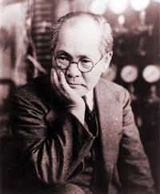
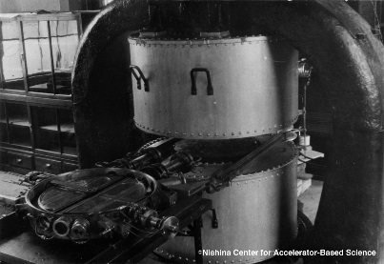
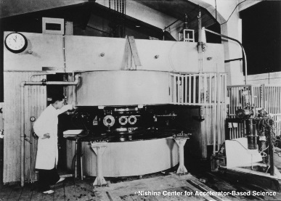
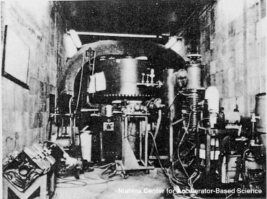
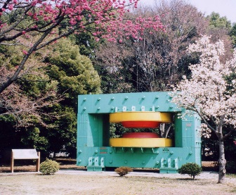
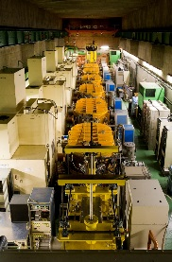
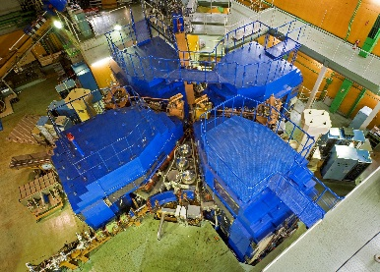
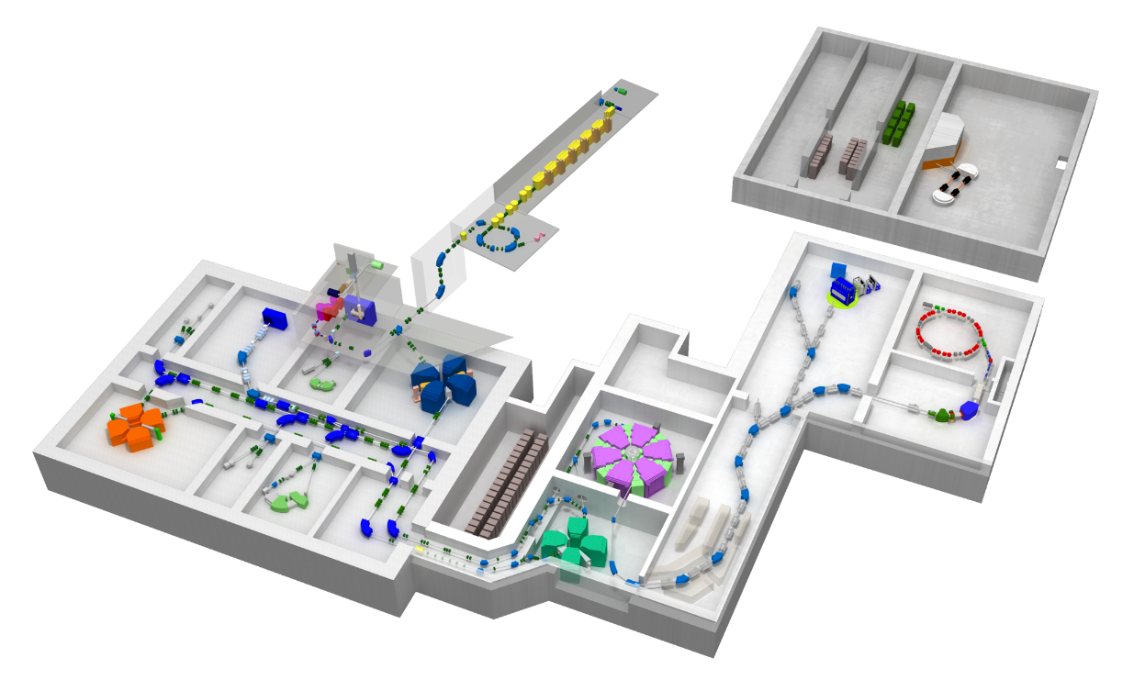
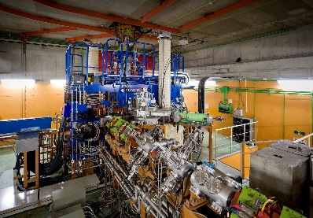
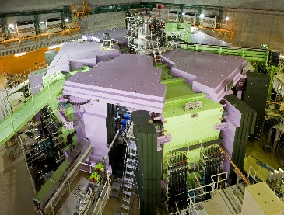
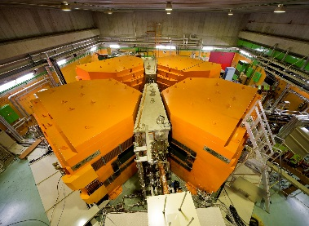
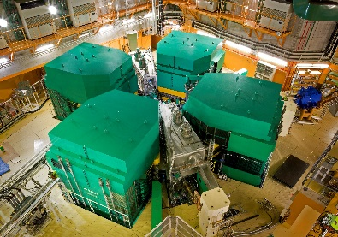
RIKEN accelerators and RI application studies
1937 Construction of 1st cyclotron
1938 Application of RIs as tracers for chemistry and biology
▪▪▪
2006 Construction of 7th – 9th cyclotrons → RIBF
1st
Dr. Y. Nishina
(1890～1951)
1937
2nd
3rd
4th
RILAC/
SRILAC
5th
1944
1952
1966
1981/2020
1987
6th
RILAC2
9th
2011
1989
2006
7th
8th
2006
0 50 mm
2006

Slide 5

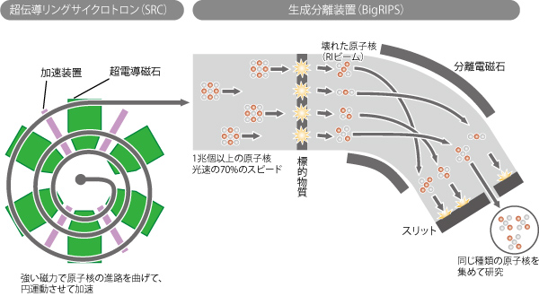
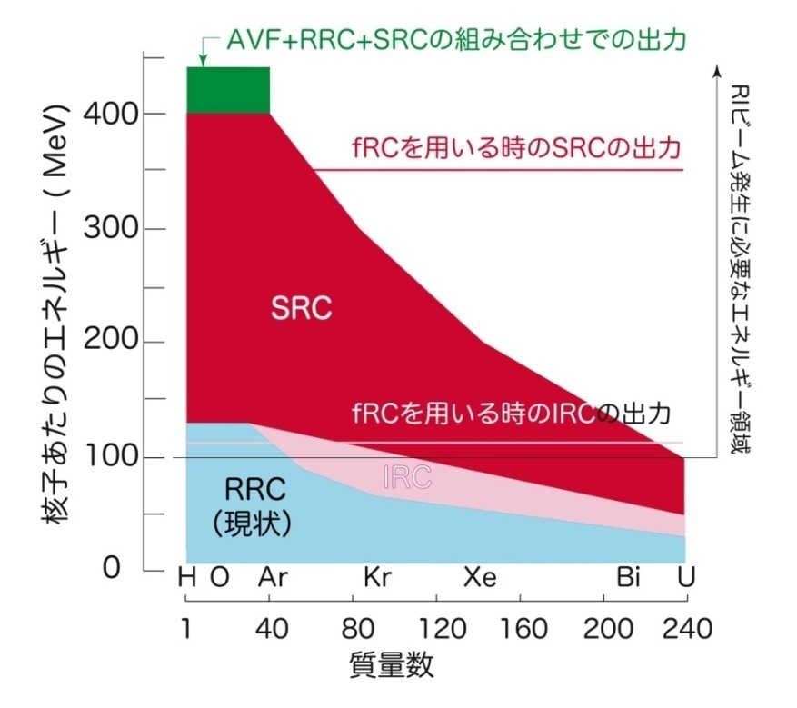
RIKEN RI Beam Factory (RIBF)
Acceleration of all ions up to ²³⁸U to 345 MeV/u (70% of c)
Production of RI beams in the whole mass region
Superconducting Ring Cyclotron (SRC)
SRILAC
RIs
Magnet
SC magnet
AVF
Beam
RILAC2
Target
RRC
Slit
Superconducting Ring Cyclotron (SRC)
RI beam
SRC
AVF + RRC + SRC
fRC
fRC
IRC
Energy for RI beam production
BigRIPS
Energy (MeV/u)
RI production
RRC
AVF
SRILAC
RILAC2
Mass number
+
RRC
+
fRC
+
IRC
+
SRC
+
BigRIPS
RI Beam

Slide 6

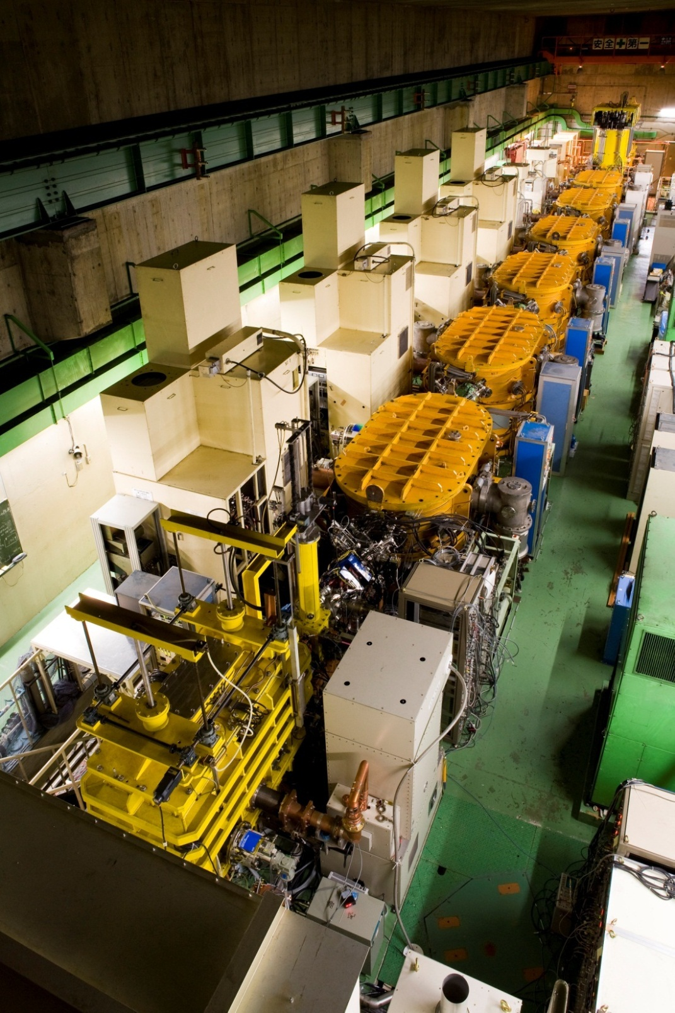

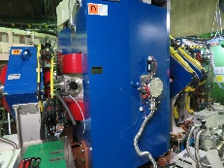
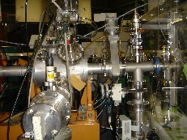
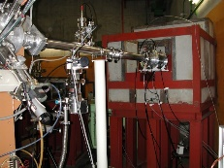
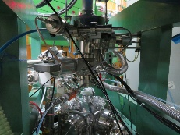
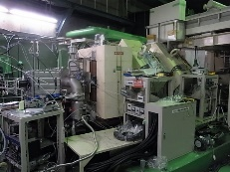
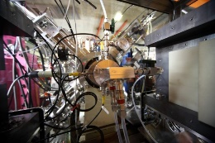
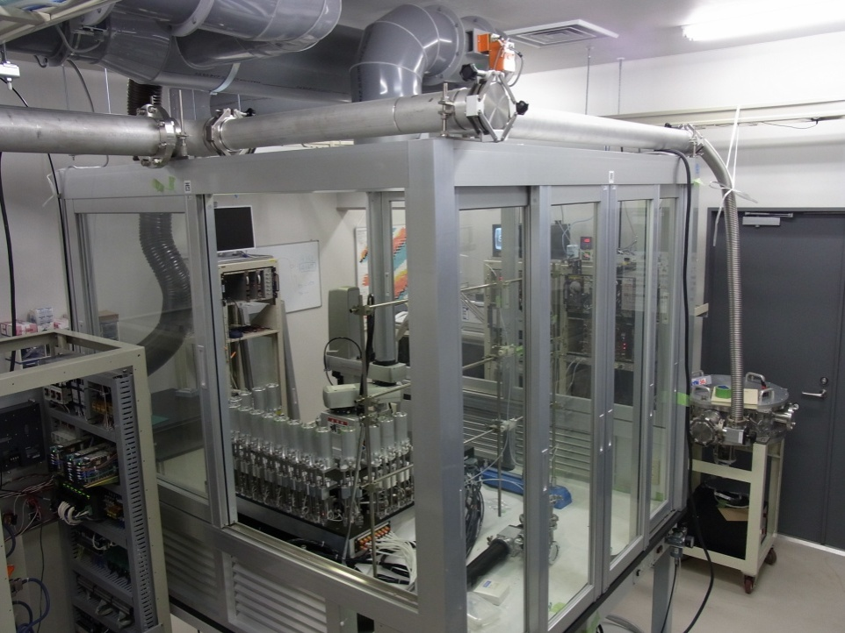
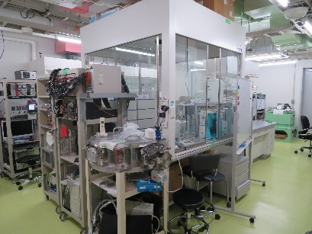
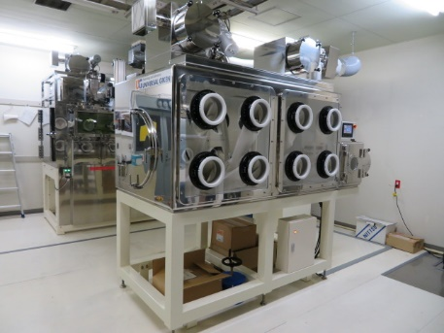
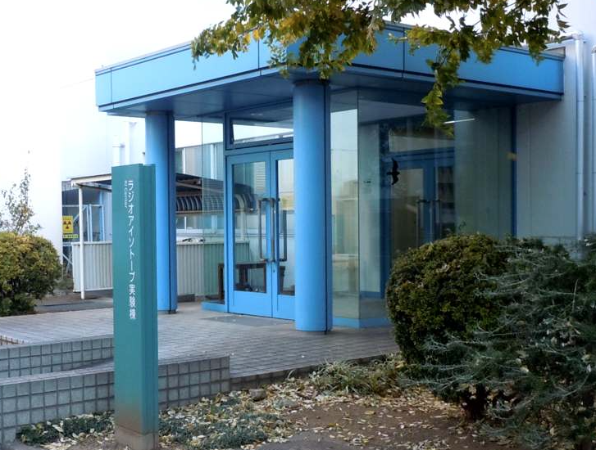
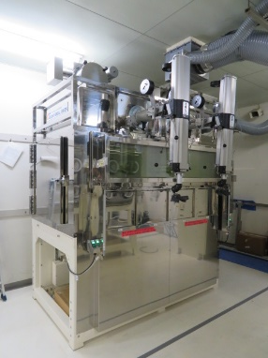
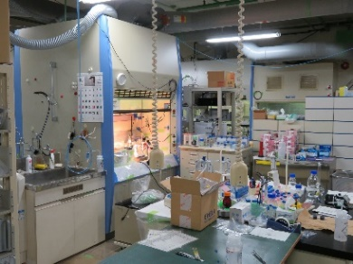
Facilities for production and application of RIs
E7b
E3b
GARIS III
E7V
GARIS I
AVF Cyclotron
C03
RIKEN Ring Cyclotron
SC Heavy-ion Linac
AVF hot lab.
Nucl. Chem. Lab.
RI Center
Hot lab.

Slide 7
(a) AVF Cyclotron
Production of ⁷Be (Z = 4) – ²⁶²Db (Z = 105)
12~30-MeV p (20 μA)
24-MeV d (15 μA)
29~50-MeV α (40 μA)
6~10-MeV ⁷Li, ¹¹B, ¹²C, ¹⁸O, ¹⁹F, and ²²Ne (1 pμA)
K70 AVF Cyclotron

Slide 8
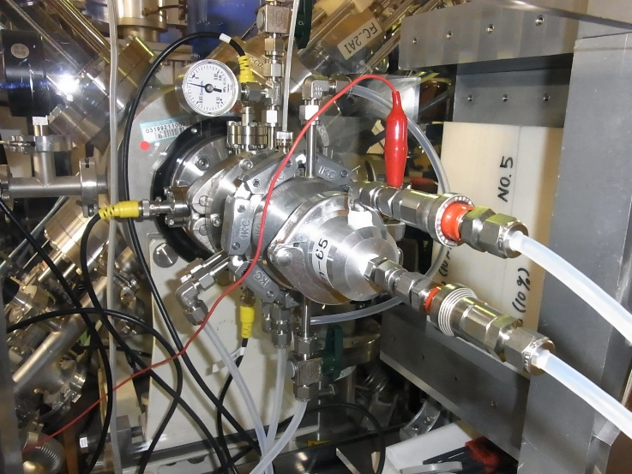
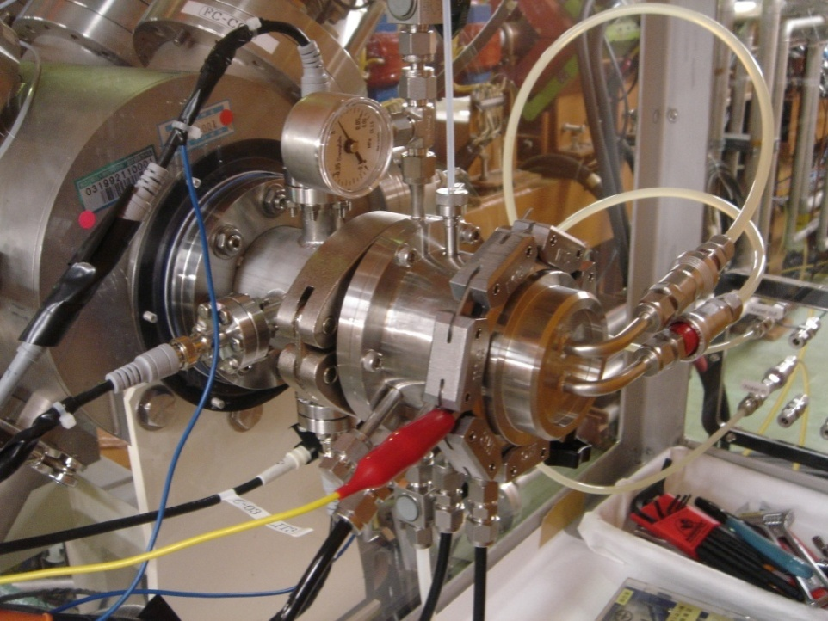
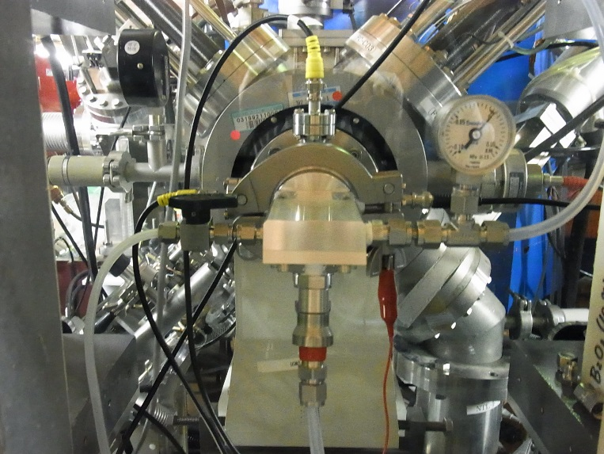
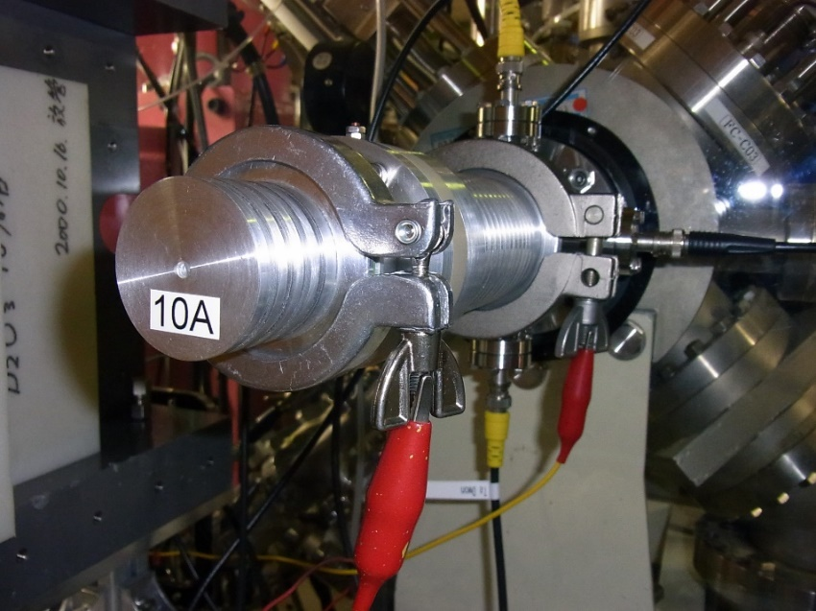
(a) AVF Cyclotron
Production of ⁷Be (Z = 4) – ²⁶²Db (Z = 105)
12~30-MeV p (20 μA)
24-MeV d (15 μA)
29~50-MeV α (32 μA)
6~10-MeV ⁷Li, ¹¹B, ¹²C, ¹⁸O, ¹⁹F, and ²²Ne (1 pμA)
Short-lived RIs
SHE RIs
Excitation function measurement
²¹¹At
K70 AVF Cyclotron

Slide 9
Classical gas-jet method for RI production
He cooling gas (30 L/min)
To Hot Lab.
Ta beam stopper
Be foil (10 μm)
Thick targets for long-lived RIs
Beams
(p, d, α, …)
TOF
Wobbler
Cooling water
(1.5 L/min)
RI
KCl
Gas-jet method
1. No chemical separation
2. Short-lived RIs (T_{1/2} = ~1 s)
3. Thin-targets prepared by
vacuum evaporation and
electrodeposition
4. Stack of different targets
→ Multitracer
Ta slit (φ9 mm)
Thin targets for short-lived RIs
He + KCl aerosol
(2 L/min)
0 50 mm

Slide 10
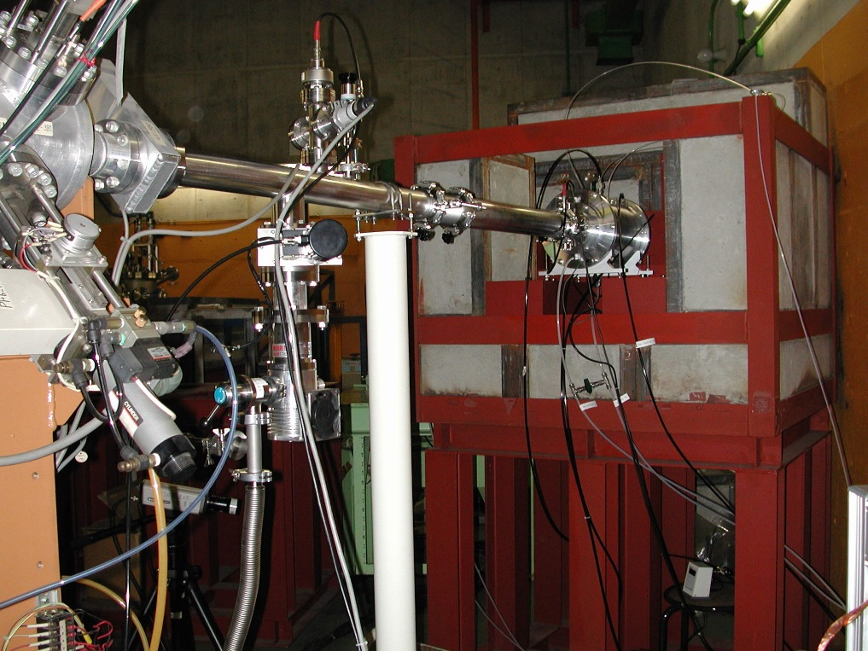
(b) RIKEN Ring Cyclotron (RRC)
Multitracer technology
RIs of a large number of elements are simultaneously produced from targets such as Ti, Ag, and Au irradiated with a 135 MeV/nucl. ¹⁴N (or ¹²C, ¹⁶O) beam from RRC [Ambe et al., Chem. Lett. 1991, 149 (1991). ]
.
135 MeV/nucl. ¹⁴N, 0.6 pμA
K540 RIKEN Ring Cyclotron
Multitracer production chamber
・Long-lived RIs
^{nat}Ti, ^{nat}Ag, ^{nat}Hf, ¹⁹⁷Au, and ²³²ThO₂ (1–5 g/cm²) → Chemical separation
・Short-lived RIs
^{nat}Cu, ^{nat}Ag, ¹⁹⁷Au, ^{nat}Ta, and ^{nat}Pb (1–5 μm x 30) → Gas-jet transport
H. Haba et al., Radiochim. Acta 93, 539 (2005).

Slide 11
γ-ray spectrum of the multitracer
^{nat}Ag(¹⁴N,xnyp)
2 weeks after the irradiation
Advantages of multitracer
• Multi-element analysis under an
identical experimental condition
• Rare RIs such as ²⁸Mg, ^{42,43}K, ⁴⁷Ca, and ²²⁵Ac
• Useful for bio-trace element research

Slide 12
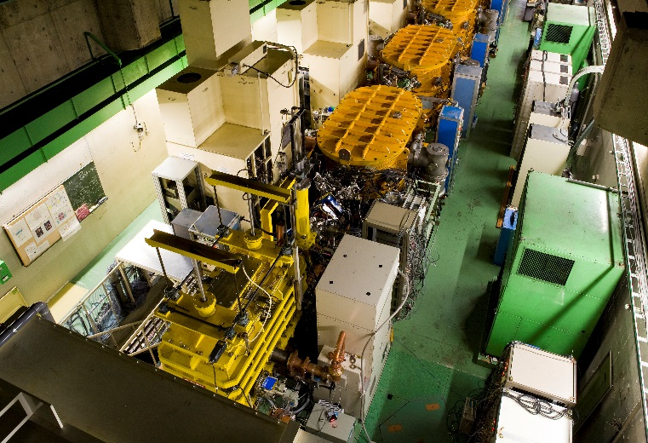
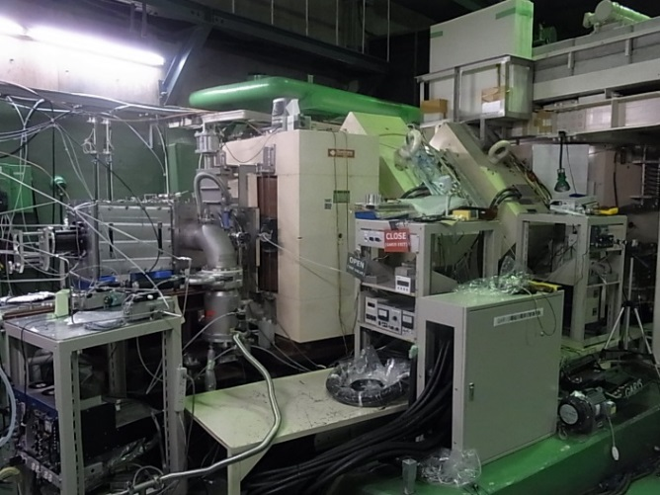
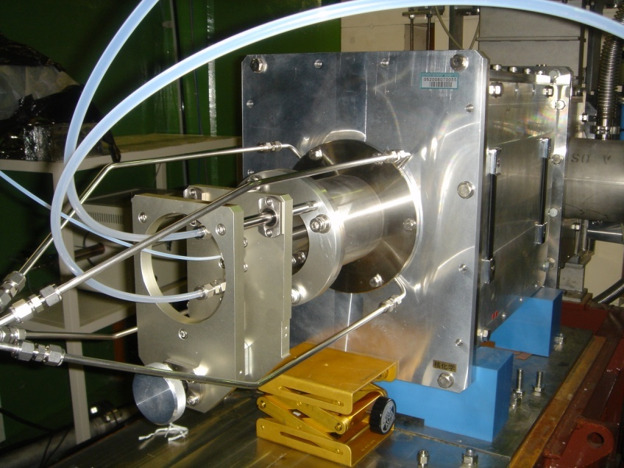
(c) RIKEN Liner Accelerator (RILAC)
Superheavy elements (Z ≥ 104) for chemistry studies
GAs-filled Recoil Ion Separator, GARIS
Gas-jet Transport System
Differential pumping section
Beam from RILAC
Mylar window
Evaporation Residues (ERs)
Focal plane
~100 kPa
Beam dump
Gas inlet
ERs
Chemistry apparatus
Rotating ²⁴⁸Cm target
~0.1
kPa
D2
He(KCl)
Elastic scattering beam monitor
D1
Q1
Q2
D: Dipole magnet
Q: Quadrupole magnet
0
100 mm
0
1
2 m
~7-MeV/u ¹⁸O, ¹⁹F, ²²Ne, ²³Na (3–7 pμA)
ERs
RILAC
GARIS
Gas-jet chamber

Slide 13
RIKEN RIs for application studies

Slide 14
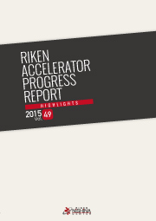
RIKEN RIs for application studies
AVF: Single RIs (⁷Be – ²⁶²Db)
RRC: Multitracer (⁷Be – ²²⁵Ac)
SRILAC: Superheavy elements (⁸⁵Zr – ²⁶⁶Bh)
RI application studies in the fields of physics, chemistry, biology, engineering, medicine, pharmaceutical and environmental sciences
RIKEN Accelerator Progress Report
Sect. “Radiochemistry and Nuclear Chemistry”
http://www.rarf.riken.go.jp/researcher/APR/

Slide 15

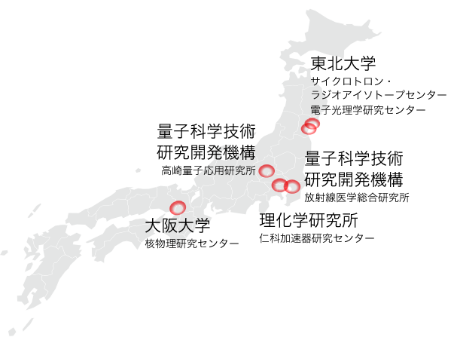



Contribution to society through RI distribution
Material Transfer Agreement
Platform for short-lived RI distribution
FY2007 – FY2020
FY2016 – FY2021, T. Nakano
RIs | Orders | Users | Activity (MBq)
⁶⁵Zn | 104 | 27 | 559.1
⁶⁷Cu | 1 | 1 | 5
⁸⁵Sr | 7 | 5 | 14.4
⁸⁸Y | 13 | 2 | 12.03
¹⁰⁹Cd | 36 | 15 | 214.15
Total | 161 | 50 | 804.68
FY2016 – FY2020 from RIBF
RIs | Orders | Users | Activity (MBq)
⁷Be | 1 | 1 | 0.45
^{44m}Sc | 7 | 4 | 30
⁶⁷Cu | 2 | 1 | 20
⁸⁸Zr | 13 | 12 | 21
⁹⁵Nb | 9 | 7 | 15
¹¹¹Ag | 3 | 2 | 0.72
^{121m}Te | 5 | 4 | 10
¹²⁴Sb | 2 | 2 | 4
¹⁴¹Ce | 2 | 1 | 0.022
¹⁷⁵Hf | 8 | 8 | 12
¹⁷⁹Ta | 5 | 5 | 6
²¹¹At | 79 | 21 | 4,876
Total | 136 | 68 | 4,995.2
FY2019 –
FY | RI | Orders | Activity (MBq)
2019 | ²¹¹At | 12 | 2,400
2020 | ²¹¹At | 16 | 3,200
Total |  | 28 | 5,600

Slide 16
RIKEN RIs for application studies
²¹¹At
²⁶¹Rf^{a,b}, ²⁶²Db
²⁶⁵Sg^{a,b}, ²⁶⁶Bh

Slide 17
2. Chemistry of Superheavy Elements

Slide 18
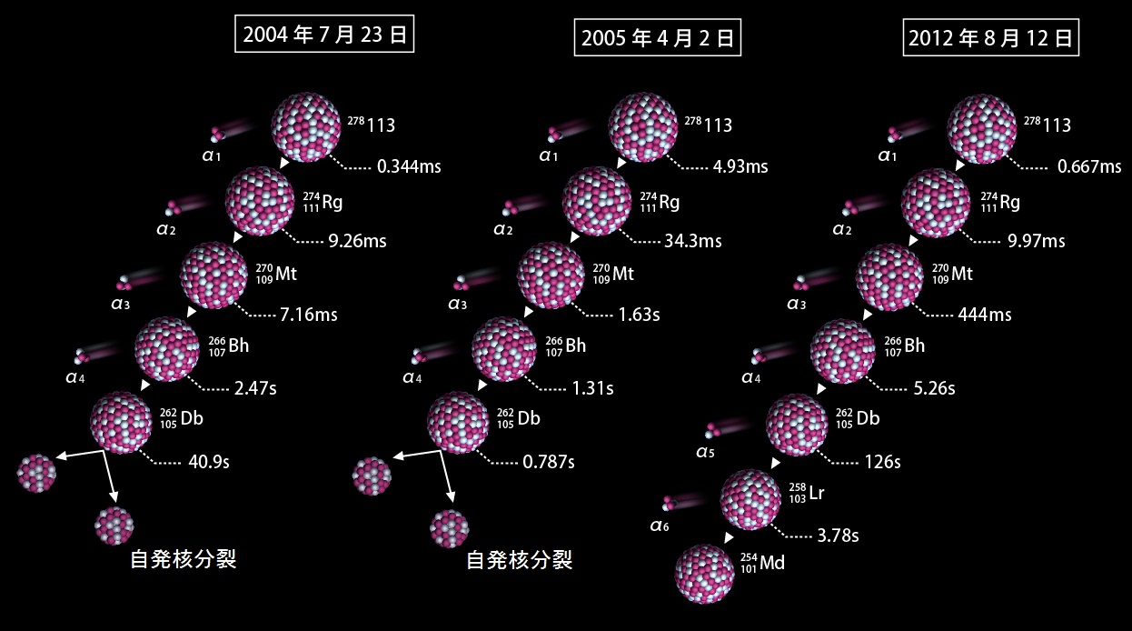
Production of element 113 at RIBF
Cold fusion reaction of ²⁰⁹Bi(⁷⁰Zn,n)²⁷⁸113
_{–13}
σ = 22⁺²⁰ fb
²⁰⁹Bi
(Z = 83)
²⁷⁹113
(Z = 113)
⁷⁰Zn
(Z = 30)
Z = 83 + 30
²⁷⁸113
Neutron
Projectile
Target
Nuclear Fusion
Compound nucleus
Evaporation residue
348-MeV ⁷⁰Zn
(0.5 pμA x 553 days)
July 23, 2004
April 2, 2005
August 12, 2012
Known isotopes
SF
SF
RILAC
JPSJ 73, 2593 (2004).
JPSJ 76, 045001 (2007).
JPSJ 81, 103201 (2012).

Slide 19
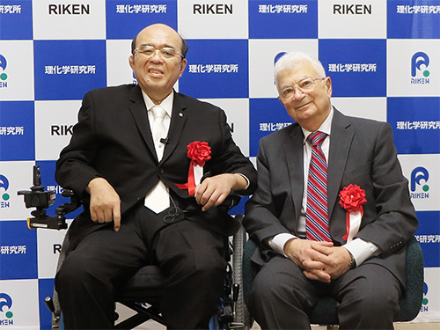
Nihonium – The first element discovered in Asian countries –
Naming ceremony in Tokyo, March 14, 2017
Atomic number | Element name | Element symbol
113 | nihonium | Nh
115 | moscovium | Mc
117 | tennessine | Ts
118 | oganesson | Og

Slide 20
Chemistry of new elements
Frontiers in chemistry
• Chemical properties, periodicity, and electronic structure of new elements?
→ Verification of the influence of relativistic effects on chemical properties
→ Construction of ultimate atomic and molecular models
• Small cross sections (nb or pb) and short half-lives (< 1min)
→ Rapid and effective chemical experiments with “single atoms” at accelerators
1. Direct
Contraction of inner orbital (s, p)
Energy levels of valence electrons
0
+
+
Ru
Os
Hs
–2
–4
nr
rel
nr
rel
nr
rel
m
=
m₀
h²
5s
a
=
=
a
0
1–(v/c)²
–6
5s_{1/2}
7s
1–(v/c)²
B
me²
B
6s
Energy / eV
6s_{1/2}
2. Indirect
Expansion of outer orbital (d, f)
–8
6d_{5/2}
–10
4d_{5/2}
7s_{1/2}
4d
5d_{5/2}
+
+
–12
4d_{3/2}
6d_{3/2}
–14
5d
5d_{3/2}
6d
3. Spin orbit coupling
The Chemistry of the Superheavy Elements,
M. Schädel (ed.), Kluwer Academic Publishers (2003).
–16

Slide 21
RIKEN Liner Accelerator (RILAC)
Superheavy elements (Z ≥ 104) for chemistry studies
GAs-filled Recoil Ion Separator, GARIS
Gas-jet Transport System
Differential pumping section
Beam from RILAC
Evaporation Residues (ERs)
Mylar window
Focal plane
~100 kPa
Beam dump
Gas inlet
ERs
Chemistry apparatus
Rotating ²⁴⁸Cm target
~0.1
kPa
D2
He(KCl)
Elastic scattering beam monitor
D1
Q1
Q2
D: Dipole magnet
Q: Quadrupole magnet
0
1
2 m
0
100 mm
¹⁸O, ¹⁹F, ²²Ne, and ²³Na
(~7-MeV/u, 3–7 pμA)
ERs
RILAC
GARIS
Gas-jet chamber

Slide 22
Production and decay studies of ²⁶¹Rf, ²⁶²Db, ²⁶⁵Sg, and ²⁶⁶Bh
²⁴⁸Cm(²²Ne,5n): 180/200 pb
²⁶⁵Sg
8.5 s 14.4 s
²⁴⁸Cm(²³Na,5n): 57 pb
²⁶⁶Bh
10.0 s
~1 h^{–1} (²⁶⁵Sg^{a,b})
~5 d^{–1} (²⁶⁶Bh)
8.84 (I_{ɑ} = 91/9), SF (b ≤ 50)
8.62–9.40
8.69
(I_{ɑ} = 20/80)
SF (≤ 51)
²⁴⁸Cm(¹⁸O,5n): 12/11 nb
²⁶¹Rf
68 s 2.6 s
²⁴⁸Cm(¹⁹F,5n): 2.1 nb
²⁶²Db
34 s
~0.5 min^{–1} (²⁶¹Rfª)
8.28,
SF (b < 13)
~5 h^{–1} (²⁶²Db)
SF (82)
8.46 (I_{ɑ} = 70), 8.68 (I_{ɑ} = 30)
8.51
(18)
²⁵⁷No
24.5 s
EC (b = 2.6)
²⁵⁸Lr
3.5 s
SF (b = 52)
8.222 (I_{ɑ} = 83), 8.323 (I_{ɑ} = 17)
8.565 (I_{ɑ} = 20), 8.595 (I_{ɑ} = 46),
8.621 (I_{ɑ} = 25), 8.654 (I_{ɑ} = 9)
  Haba et al., Chem. Lett. 38, 426 (2009).
  Haba et al., Phys. Rev. C 83, 034602 (2011).
  Haba et al., Phys. Rev. C 85, 024611 (2012).
  Murakami et al., Phys. Rev. C 88, 024618 (2013).
  Haba et al., Phys. Rev. C 89, 024618 (2014).
  Haba et al., Phys. Rev. C 102, 024625 (2020).
  Pre-separated SHE RIs are ready for chemistry experiments.

Slide 23
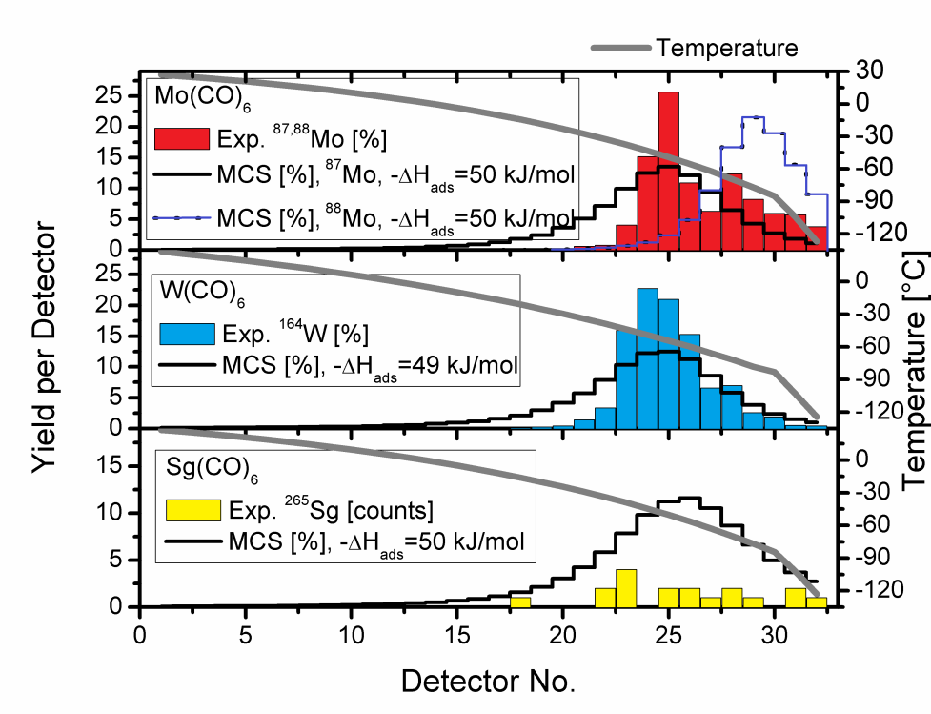
Synthesis of carbonyl complexes of SHEs
Sg + 6CO → Sg(CO)₆
CO collaboration: GSI, Mainz Univ., IMP, PSI, JAEA, …
• First organometallic compound of SHEs
Sg(0) – C chemical bonding
• Adsorption enthalpy (ΔH_{ads}) on SiO₂
ΔH_{ads}(Sg) ≈ ΔH_{ads}(Mo) ≈ ΔH_{ads}(W)
Group 6
^{nat}Zn(²⁴Mg,xn)^{87,88}Mo
¹⁴⁴Sm(²⁴Mg,xn)^{163,164}W
²⁴⁸Cm(²²Ne,5n)²⁶⁵Sg^{a,b}
5
₄₂Mo
6
₇₄W
₁₀₆Sg
7
GSI
J. Even et al., Science 345, 1491 (2014).

Slide 24
3. Targeted α-particle Therapy

Slide 25
²¹¹At for targeted α-particle therapy
Promising therapeutic RI for disseminated cancer, blood cancer, micro-metastatic cancer, …
Normal cell
β
• Shorter range of α particle in tissue and higher LET than those of β particle
Particle | Energy (MeV) | Range in tissue (μm) | LET (keV/μm)
α | 5–9 | 40–100 | 60–80, 240
β | 0.05–2.3 | 50–1200 | 0.2
²¹¹At
α
• High cytotoxicity and small influence for normal cell
Cancer cell
²⁰⁹Bi(α,2n)²¹¹At
²¹¹At
7.214 h
EC (58.2%)
α decay (41.8%)
E_{α} = 5.87 MeV
²¹¹Po
0.516 s
< 29 MeV
²⁰⁷Bi
31.55 y
²¹⁰At (²¹⁰Po)
²¹¹At
α decay (100%)
E_{α} = 7.45 MeV
²⁰⁷Pb
Stable
Hermanne et al., Appl. Radiat. Isot. 63 (2005) 1.

Slide 26
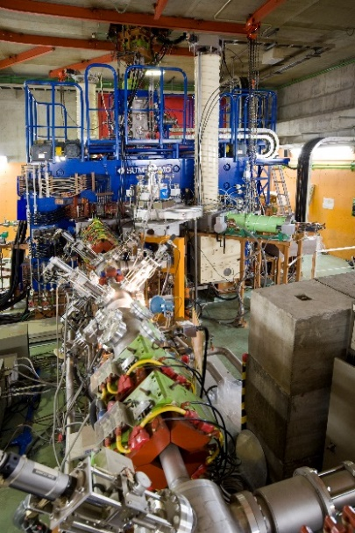

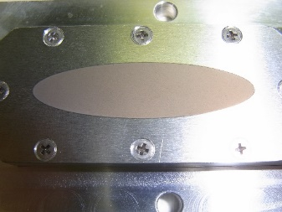
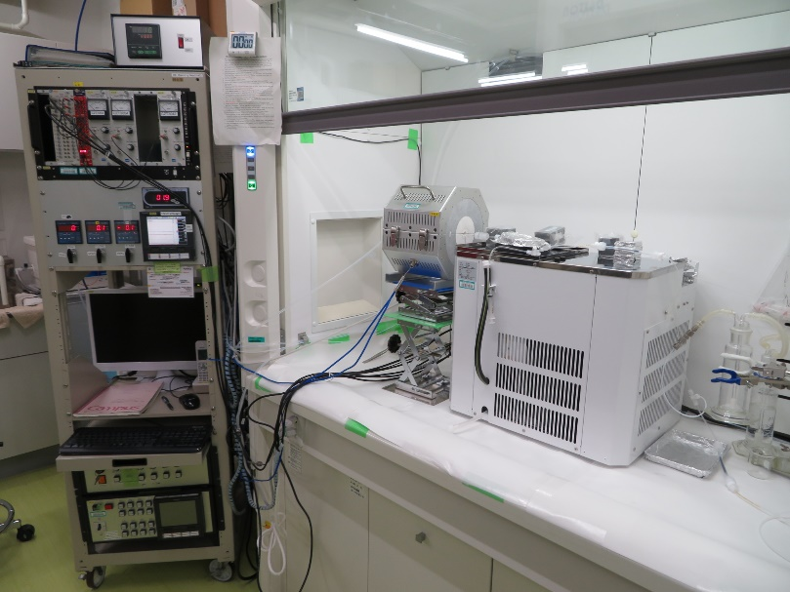
Development of production technology of ²¹¹At at AVF
Chem. purity: 99.999%
Thickness: ~20 mg/cm²
46 mm
850ºC
12 mm
Metallic ²⁰⁹Bi target
Oxygen
PFA trap cooled with C₂H₅OH at –100 ºC
29-MeV α
40 μA
Water- and helium-cooled target chamber
200 μL of H₂O, CH₃OH, CHCCl₃, …
(Chem. Yield: ~80%)
AVF
40 μA×1 h → 1.3 GBq of ²¹¹At (EOB)
²⁰⁹Bi target (M.P. 271.5ºC)
(~75 mg/cm²)
Be vacuum window (20 μm)
29-MeV α beam (40 μA)
15º
Beam wobbler
(2 Hz, φ3 mm)
Beam energy monitor
(TOF detector)
→ 29 (±1%) MeV
Al plate (1 mm)
Cooling water
(1.5 L/min, 10ºC)
Cooling He (30 L/min)
H. Haba, Drug Delivery System 35, 114 (2020) (in JP).

Slide 27
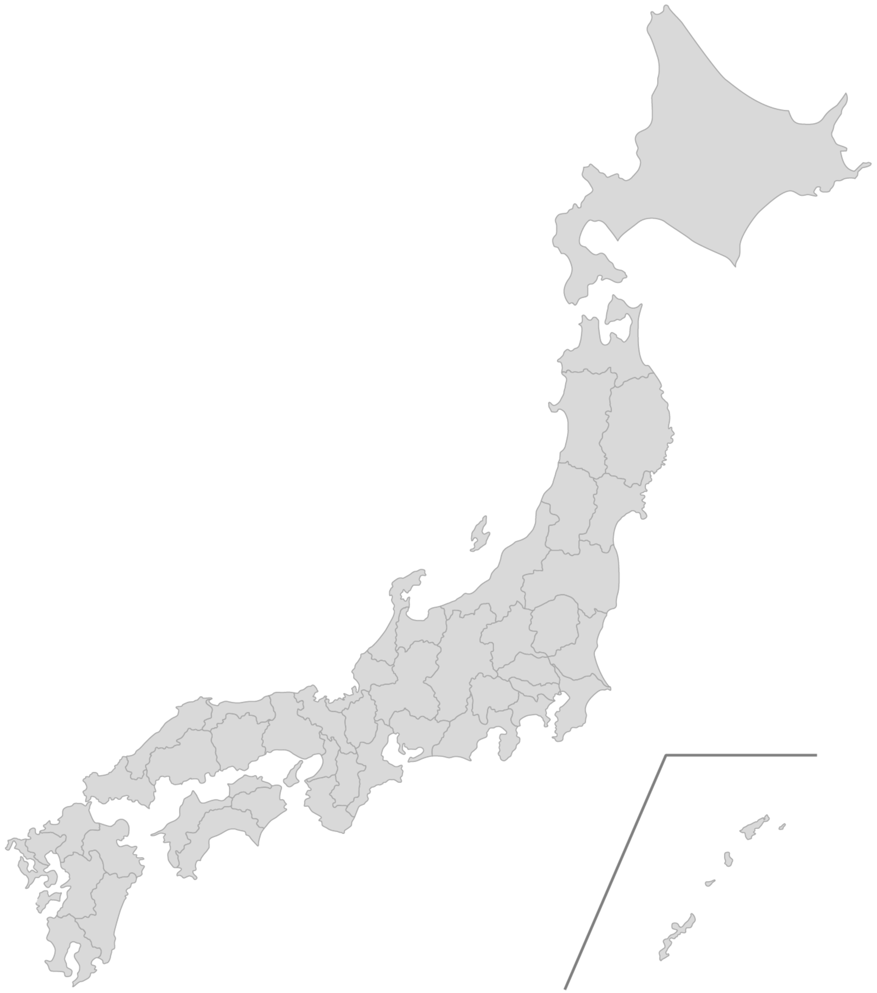
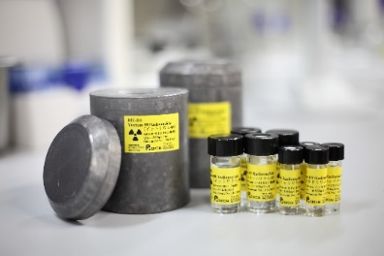
RIKEN RI platform for α-particle therapy
Distribution of ²¹¹At (2016–)
17 users (July, 2021)
→ R&D for nuclear medicine
Under development
• ²²⁵Ac (2018–)
²³²Th(¹⁴N,xnyp)²²⁵Ac@RRC
²²⁶Ra(p,2n)²²⁵Ac@AVF with JRIA
• ²¹²Pb (2017–)
²¹²Pb generator with ATOX Co., Ltd.
(²²⁸Th→)²²⁴Ra→→→²¹²Pb
Univ. Tokyo, Kavli IPMU
National Cancer Center Japan
QST Takasaki
Kanazawa Univ.
Univ. Tokyo
Isotope Science Center
Hospital
Osaka Univ.
Japan Radioisotope Association
RIKEN Kobe
RIKEN Wako
Biofunctional Synthetic Chemistry Lab.
Lab. for Pathophysiological and Health Science
Lab. for Nonnatural Amino Acid Technology
Univ. Tokyo, School of Engineering
Tohoku Univ.
Hoshi Univ.
Fujifilm Toyama Chemical Co., Ltd.
RIBF
Kindai Univ.

Slide 28


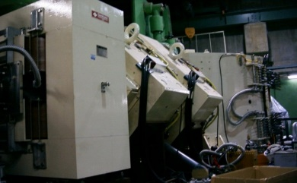

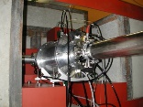

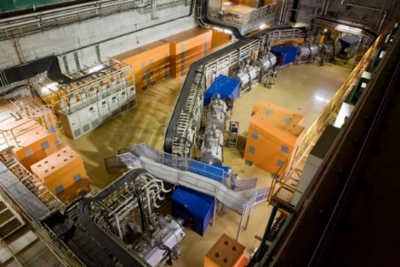
4. Summary and Perspectives
Production of >100 RIs for application studies at AVF, RRC, and SRILAC at RIKEN RIBF
•SHE chemistry: ²⁶¹Rf, ²⁶²Db, ²⁶⁵Sg, and ²⁶⁷Bh
•Targeted α-particle therapy: ²¹¹At
RIKEN RIs
SRILAC
Hot Lab.
GARIS
AVF
Hot Lab.
Hot Lab.
RRC
SRC
BigRIPS
RI Center

Slide 29

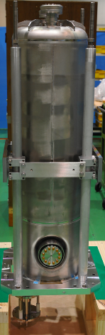




Upgrade of RILAC for RI production
Developments of large-scale RI production
Applications of SHE and medical RIs
Super-Conducting Quarter-Wavelength Resonator
SRILAC (Jan., 2020~)
QWR
Medical RIs
–
RI production beam line under construction
28 GHz ECRIS
SHE RIs
GARIS III
Nucl. Chem. Lab.

Slide 30
Upgrade of RILAC for RI production
Developments of large-scale RI production
Applications of SHE and medical RIs
• Cyclotrons, which can accelerate various heavy ions (²²Ne, ²⁶Mg, ⁴⁸Ca, ⁵⁰Ti, ⁵¹V, …) with energies of ~7–10-MeV/u and intensities of ~10 pμA, are necessary for superheavy element researches.
Super-Conducting Quarter-Wavelength Resonator
SRILAC (Jan., 2020~)
QWR
• Large-scale production and stable supply of the short-lived ²¹¹At (T_{1/2} = 7.2 h) are important issues.
• Low-cost (construction and operation) cyclotrons, which can accelerate 30-MeV alpha particles with an intensity of >100 μA, would boost the ²¹¹At-therapy.
Medical RIs
–
RI production beam line under construction
28 GHz ECRIS
SHE RIs
GARIS III
Nucl. Chem. Lab.

Slide 31

RIKEN RI Collaboration
RIKEN Laboratories
Ion Source Team, Nishina Center
Super Heavy Element Group, Nishina Center
Next-generation Imaging Team
Biofunctional Synthetic Chemistry Laboratory
Domestic Universities and Institutes
Osaka University
Niigata University
Kanazawa University
Tohoku University
University of Tsukuba
Kyoto University
Okayama University
Hokkaido University
University of Tokyo
Tokyo Metropolitan University
Fukushima Medical University
International University of Health and Welfare
Hamamatsu Univ. School of Medicine
Suzuka Univ. of Medical Science
Hoshi University
Kindai University
Japan Atomic Energy Agency
Takasaki, National Institutes for Quantum and Radiological Science (QST)
National Institute of Radiological Sciences, QST
National Cancer Center Japan
Oversea Universities and Institutes
Institute of Modern Physics
ATOMKI
Sunway University
Johannes Gutenberg University Mainz
Helmholtzzentrum für Schwerionenforschung GmbH
Helmholtz-Institut Mainz
Bern University
Paul Scherrer Institut
Saha Institute of Nuclear Physics
Umaru Musa Yar'adua University, Katsina
International Atomic Energy Agency
Public Interest Incorporated Association
Japan Radioisotope Association
Companies
Fujifilm Toyama Chemical Co., Ltd.
Metal Technology Co., Ltd.
ATOX Co., Ltd.
Chiyoda Technol Co., Ltd.
RIN Institute Inc.

