Slide 1
The Direct Injection System for the IsoDAR Cyclotron
Loyd Waites

Slide 2
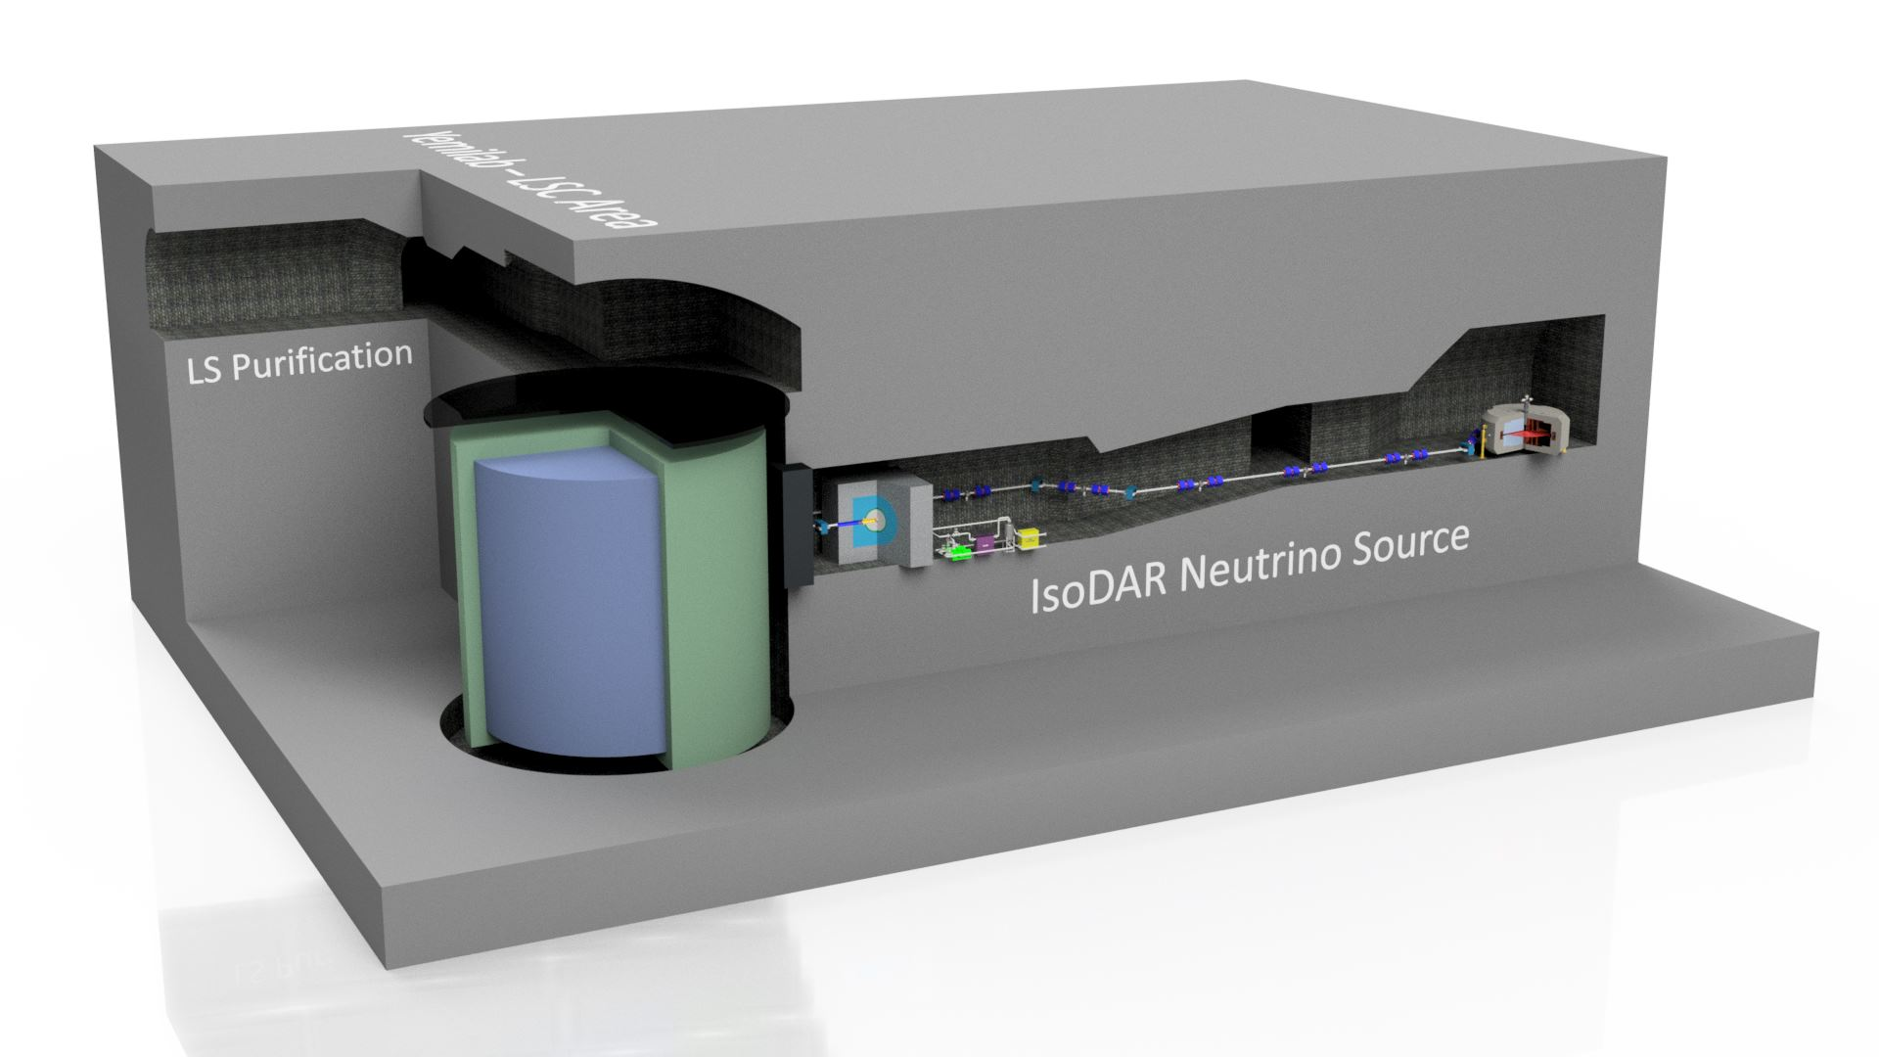

Slide 3
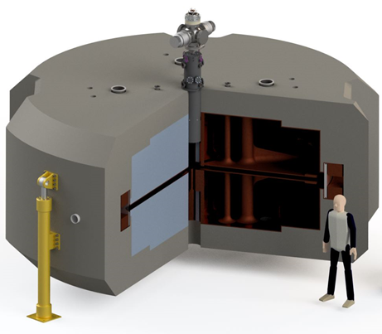
Innovation
Intense neutrino source requires intense proton source
10 mA beam current
10X higher than commercial
Built underground, at a reasonable cost

Slide 4
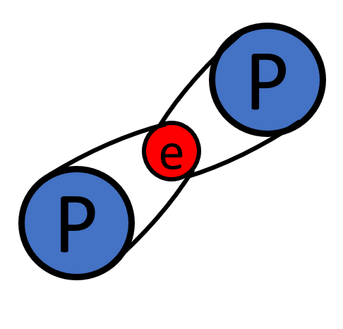
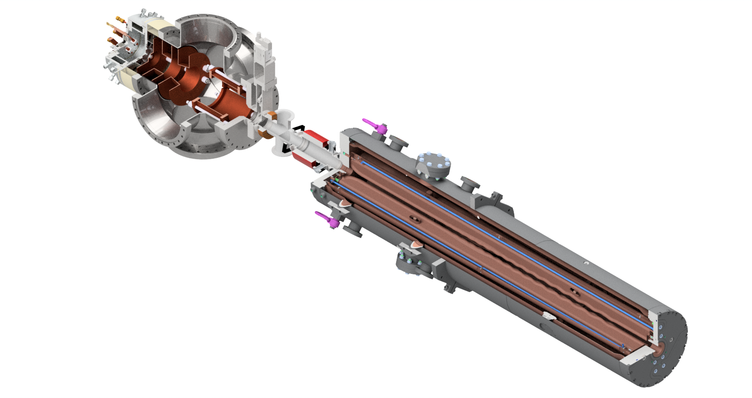
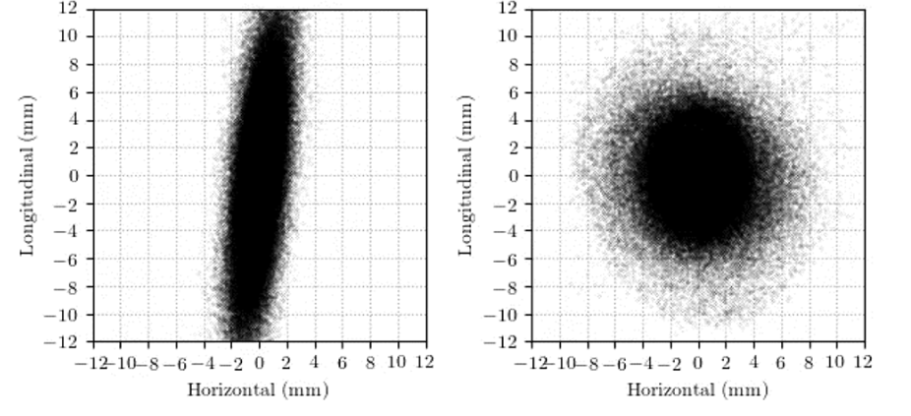
Three Paths to Higher Currents

Slide 5
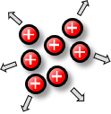
Use of H₂⁺
Problem
Solution
High beam intensity + slow beam velocity
Space charge ⇨ emittance growth
High impact of space charge in the low energy region
H₂⁺: Two units of charge for one in the low energy region
Remove electron by stripping ⇨ two protons
https://arxiv.org/abs/1807.03759

Slide 6
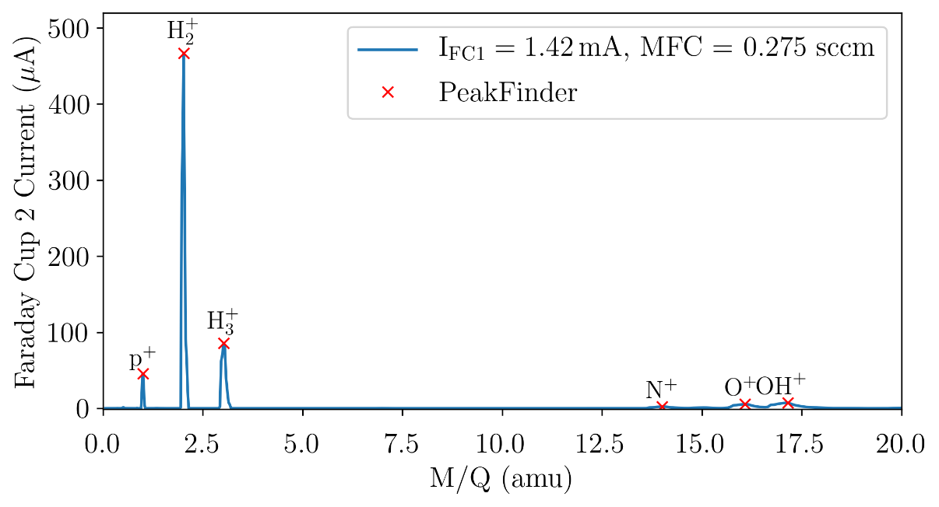
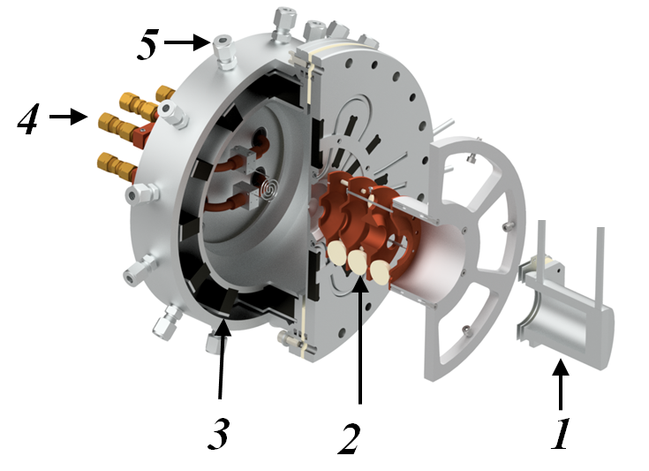
Experimental results
Currently Commissioning at 25% power
80% pure H₂ ⁺
High quality beam emittance: 0.05 π-mm-mrad (RMS, norm.)
Currently working to increase power
https://arxiv.org/abs/2008.12292

Slide 7
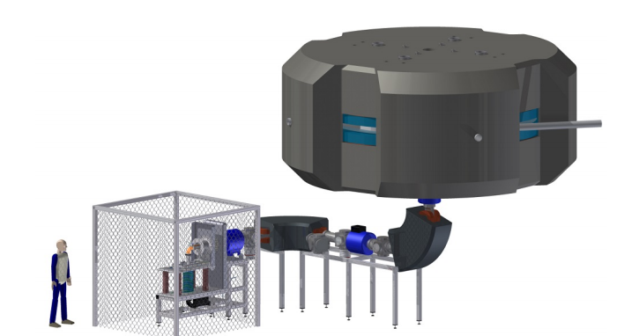
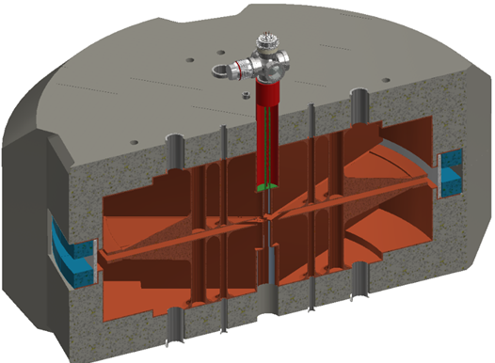
RFQ injection
Replaces large LEBT
Bunching allows for higher phase acceptance
Significantly higher transmission
RFQ-DIP
https://aip.scitation.org/doi/abs/10.1063/1.4935753 https://arxiv.org/abs/1807.03759

Slide 8
MIST-1 Ion Source
System Overview:
LEBT diagnostics
Electrostatic LEBT
Radio-Frequency Quadrupole (RFQ)
https://arxiv.org/abs/1807.03759
https://aip.scitation.org/doi/abs/10.1063/1.4935753

Slide 9
Particles are continuously focused transversally, while being bunched longitudinally
Highly accurate particle in cell (PIC) simulations using well-established WARP code

Slide 10
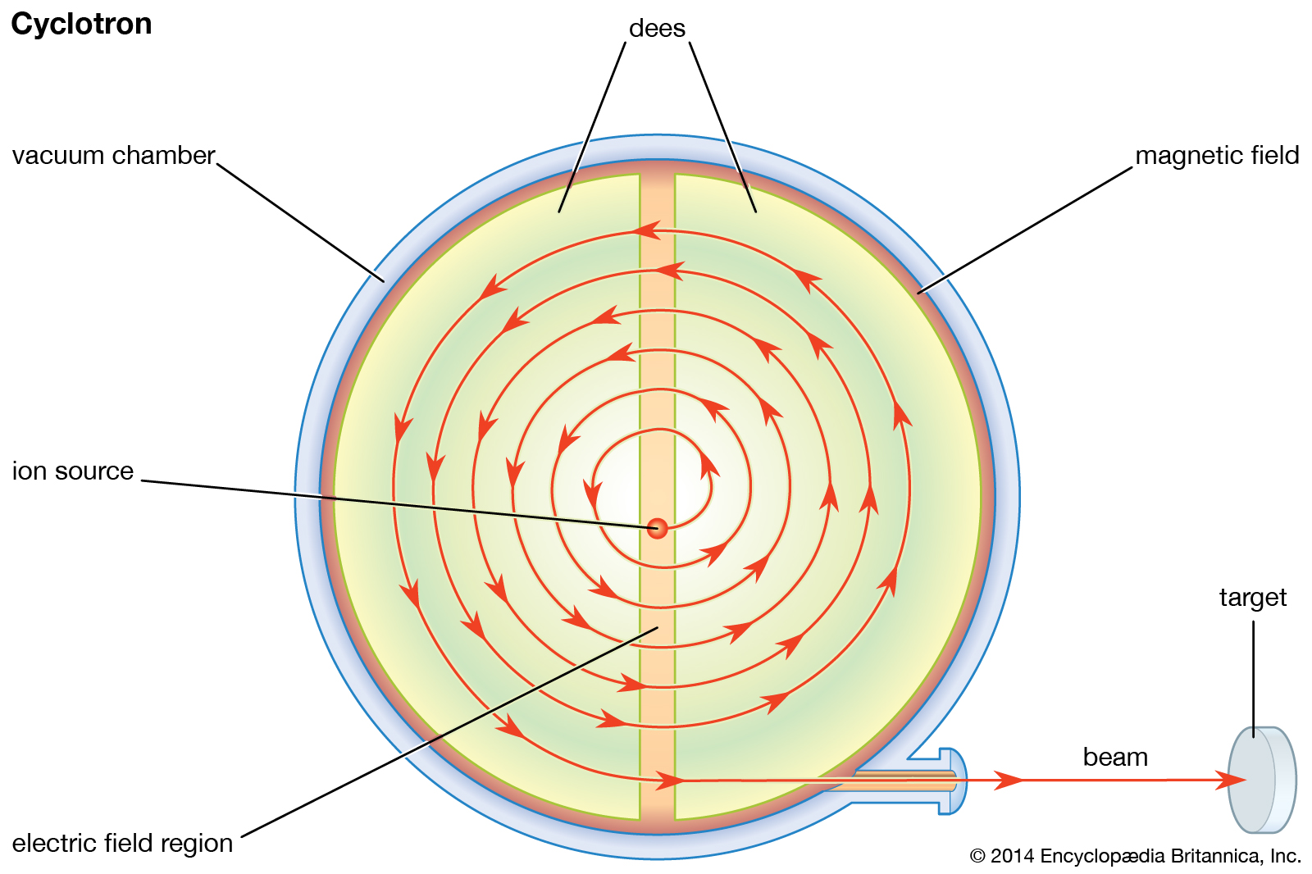
Vortex Motion

Slide 11
Vortex Motion
Trans.
Long.

Slide 12
Vortex Motion
Courtesy of Wiel Kleeven (Cyclotrons 2016)

Slide 13
PSI Injector II
Vortex motion effect experimentally observed in PSI Injector II
OPAL simulations with space charge matched experimental results
OPAL simulations see similar result in IsoDAR
Turn 0
Turn 5
Turn 10
Turn 20
Turn 30
Turn 40
https://journals.aps.org/prab/abstract/10.1103/PhysRevSTAB.13.064201

Slide 14
Without Space Charge
With Space Charge

Slide 15
Without Space Charge
With Space Charge

Slide 16
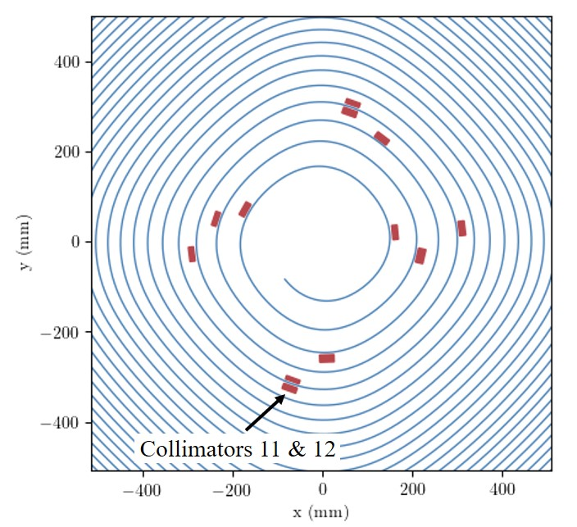
We performed highly accurate PIC simulations of our cyclotron design
In IsoDAR the halo is removed with collimators
Beam forms stable, round distribution (vortex) after 6 turns
Start
7 Turns, no coll. No SC
7 Turns, no coll.
7 Turns, 12 coll.
https://arxiv.org/abs/2103.09352
Notes:
Beam stays in this nice round shape for another 100 turns until energy has reached 60 MeV/amu

Slide 17
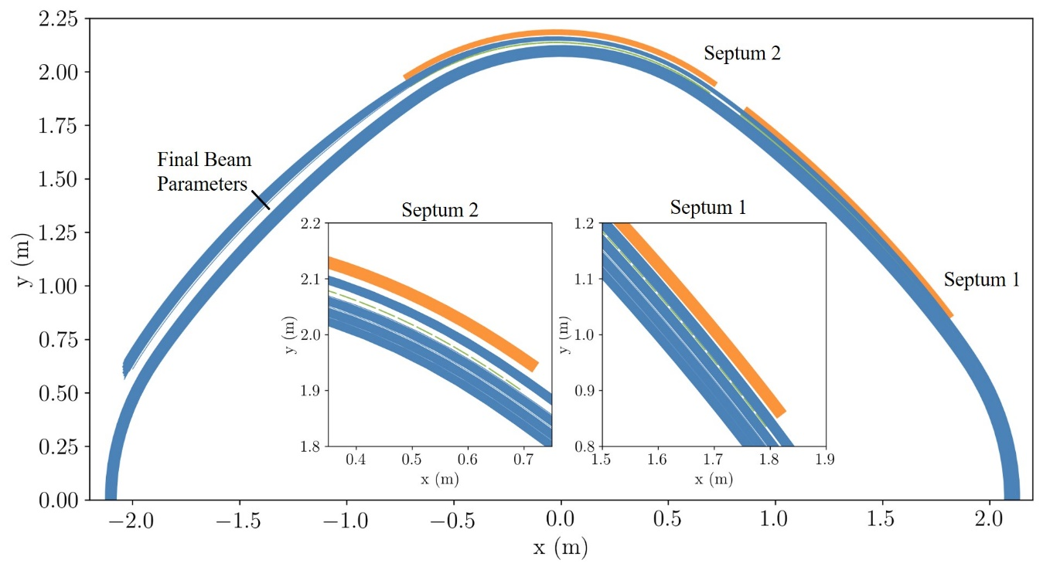
Beam can be extracted with good quality
Minimal losses at 60 MeV/amu: ~ 100 Watts
RMS Size:
Vertical: 7.5 mm
Longitudinal: 11 mm
Vertical: 1.9 mm
RMS, normalized emittance:
vertical: 0.44 mm-mrad
Radial: 3.8 mm-mrad
Longitudinal emittance:
0.1 MeV-deg
https://arxiv.org/abs/2103.09352
Notes:
Beam can be split off nicely and then be guided through the yoke out of the cyclotron. There, we strip away the electron and transport 10 mA of protons to the target.

Slide 18
Conclusions
The IsoDAR cyclotron leverages new developments in accelerator technology to push the limits of beam power from a compact system, leading to exciting applications in neutrino physics.

