Slide 1

Spiral Inflectors for High Power Cyclotrons
Hugo Barnard
Snowmass’21 Workshop on High Intensity Cyclotrons
7-9 September 2021
hbarnard@tlabs.ac.za

Slide 2
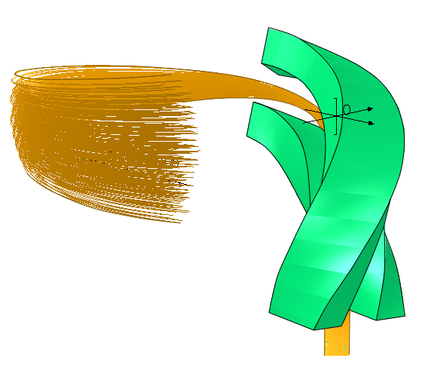

Problems with spiral inflectors
Standard Spiral Inflector (C1)
Emittance blow-up from coupling (6D unchanged, projected 2D can grow)
Vertical defocussing
Longitudinal debunching
3 mm input beam diameter:
> 5 mm longitudinal spread at 1st acceleration gap
≈35° rf phase spread (h=6, magnetic radius 49 mm)
Source [1]
$$\left(ℓ | x\right), \left(ℓ | x^{′}\right), \left(ℓ | y\right), \left(ℓ | y^{′}\right)≠0$$

Slide 3
Possible solution: Electric field gradients
Dubna (1)
Dubna (2)
Sumitomo
iThemba (C2)
Source [2]
Source [3]
Source [4]

Slide 4
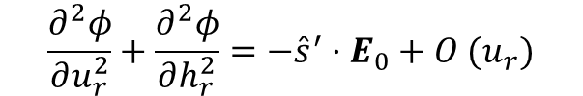




General design
Non-rectangular coordinate system $(u_{r}, h_{r}, s)$
$$∇^{2}φ=0$$
subject to
$$φ(0,0,s)=φ_{0}$$
$E\left(0,0,s\right)=E_{0} {\hat{u}}_{r}$
$$\frac{∂^{2}φ}{∂u_{r}^{2}}+\frac{∂^{2}φ}{∂h_{r}^{2}}=−{\hat{s}}^{′}⋅E_{0}+O (u_{r})$$
$$φ=φ_{0}−u_{r}E_{0}−Q_{1}E_{0}\frac{u_{r}^{2}−h_{r}^{2}}{2}−Q_{2}E_{0}u_{r}h_{r}−\frac{u_{r}^{2}}{2} {\hat{s}}^{′}⋅E_{0}+O(u_{r}^{3})$$
Q₁(s), Q₂(s) design parameters, Q₁=Q₂=0 is traditional Belmont-Pabot design
Numerically optimised $Q_{1}\left(s\right), Q_{2}\left(s\right)$
Q₂
Q₁
Standard
Vertical Only
Vertical and Longitudinal

Slide 5
Results from testing
No buncher:
With the buncher:
Vertical Only
Vertical + Longitudinal

Slide 6
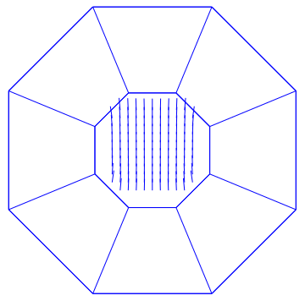
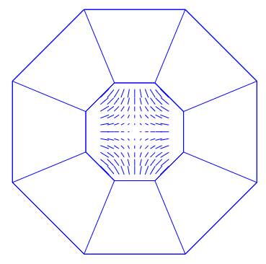
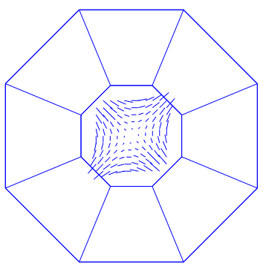




Permanent Magnet Spiral Inflector
Potential similar to electric case:
$$B=−∇ψ$$
$$B=−{\hat{h}}_{r}\frac{E_{0}}{v}$$
$$\left(E={{\hat{u}}_{r}E}_{0}\right)$$
$∇ψ⋅\hat{s}=0$ ➔ $ψ\left(0,0,s\right)=ψ_{0}$
Q₁, Q₂ – quadrupole fields
B₀
Q₁
Q₂
Source [5]

Slide 7
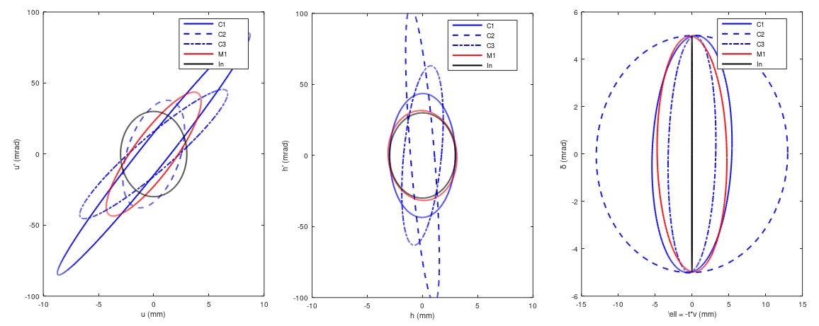
Comparison of Electric and Magnetic cases
Guide:
C1 – Standard Electric
C2 – Strong Vertical Focusing
C3 – Vertical + Longitudinal Focusing
M1 – Standard Magnetic
In – Nominal input beam at collimator

Slide 8
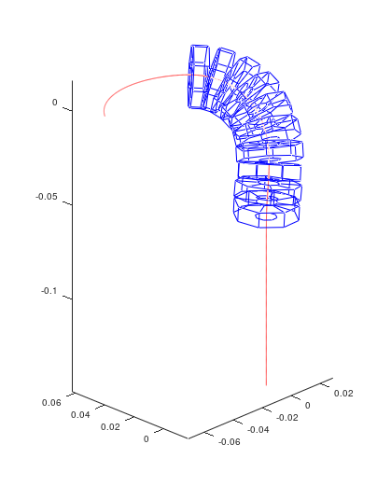
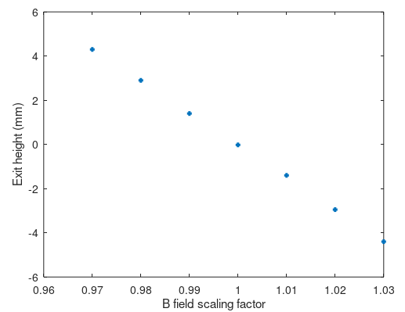
Practical Considerations
Neodymium magnets - Magnetisation (dipole density) unaffected by external magnetic field?
Temperature sensitive – Don’t operate above 80 °C - Screen off to avoid hitting it with the beam
Sensitivity to manufacturing imperfections:

Slide 9
References
1 - Barnard, A. H., et al. "Longitudinal and vertical focusing with a field gradient spiral inflector." Physical Review Accelerators and Beams 24.2 (2021): 023501.
2 - Ivanenko, I. A. "Methods of compensation of the beam vertical divergence at the exit of spiral inflector in cyclotrons." Proc. 21st Int. Conf. on Cyclotrons and their Applications (Cyclotrons' 16). 2016.
3 - Smirnov, V. L. "Central Region Design in a Compact Cyclotron." Physics of Particles and Nuclei Letters 16.1 (2019): 34-45.
4 - Tsutsui, H. Patent EP2391190A2, JP 2010120716 (2010)
5 - Calabretta, Luciano, Mario Maggiore, and Danilo Rifuggiato. "Review of High Power Cyclotrons and Their Applications." 22nd Int. Conf. on Cyclotrons and their Applications (Cyclotrons' 19), Cape Town, South Africa, 23-27 September 2019. JACOW Publishing, Geneva, Switzerland, 2020.

