Slide 1
MAPS Neural Network Test Results
Dominic Stewart-Guido

Slide 2
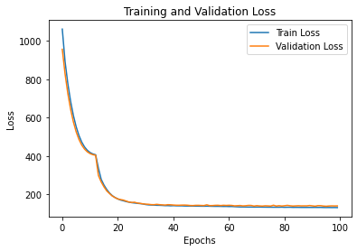
With Default Settings

Slide 3
Conclusions
Can’t differentiate between lower angles well.
Can be used for rejecting particles that hit many sensors.
Hopefully can be improved.
Can we try changing specifications?

Slide 4
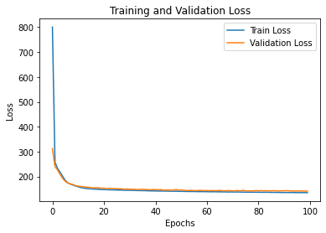
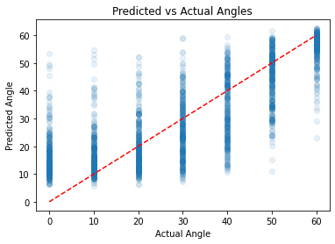
# Define the neural network model
model = keras.Sequential([
layers.Dense(8, activation='tanh’, input_shape=(X_train.shape[1],)),
layers.Dense(32, activation='tanh'),
layers.Dense(8, activation='relu'),
layers.Dense(1)

Slide 5
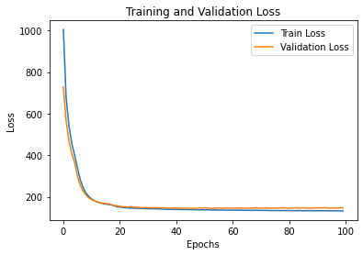
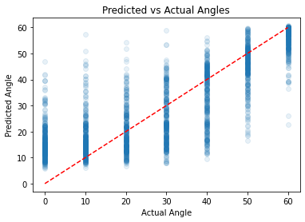
# Define the neural network model
model = keras.Sequential([
layers.Dense(16, activation='tanh’, input_shape=(X_train.shape[1],)),
layers.Dense(16, activation='tanh'),
layers.Dense(16, activation='tanh'),
layers.Dense(1)
random_state=50
Was 42 before

Slide 6
Conclusions
By tweaking the specifications, even slightly, the training curve was able to be made much steeper.
This is very valuable for making a simple network, which is among the most crucial design aspects for hardware implementation.
Still not be able to achieve high accuracy for small angles.

