Slide 1
Axion dynamics and topics in Chern-Simons theory
Hajime Fukuda (LBL)
References: 2010.02221 HF & K. Yonekura
(See also 2010.02763)

Slide 2
Outline
Axions are gauge Bosons
Chern-Simons term and anomaly inflow
Examples:
Magnetic monopoles and the Witten effect
Axion strings and charges on the string

Slide 3
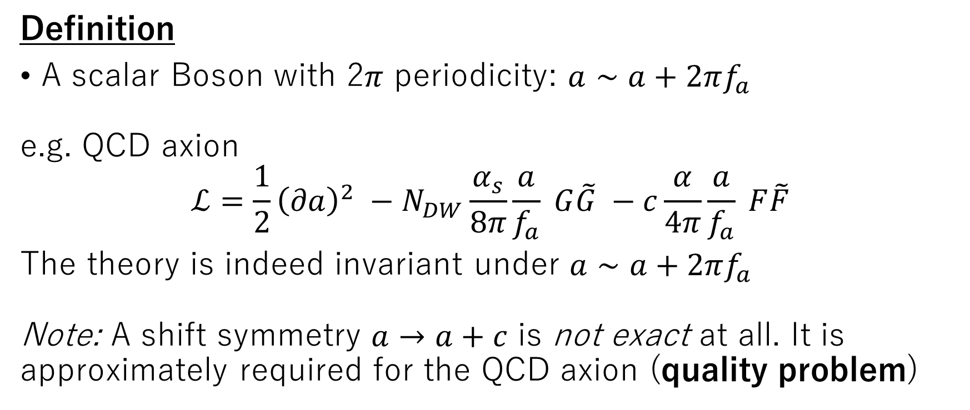
Axion
Definition
A scalar Boson with 2$π$ periodicity: $a∼a+2πf_{a}$
e.g. QCD axion
$$ℒ=\frac{1}{2}{\left(∂a\right)}^{2} −N_{DW}\frac{α_{s}}{8π}\frac{a}{f_{a}} G\tilde{G} −c\frac{α}{4π}\frac{a}{f_{a}} F\tilde{F}$$
The theory is indeed invariant under $a∼a+2πf_{a}$
Note: A shift symmetry $a→a+c$ is not exact at all. It is approximately required for the QCD axion (quality problem)

Slide 4
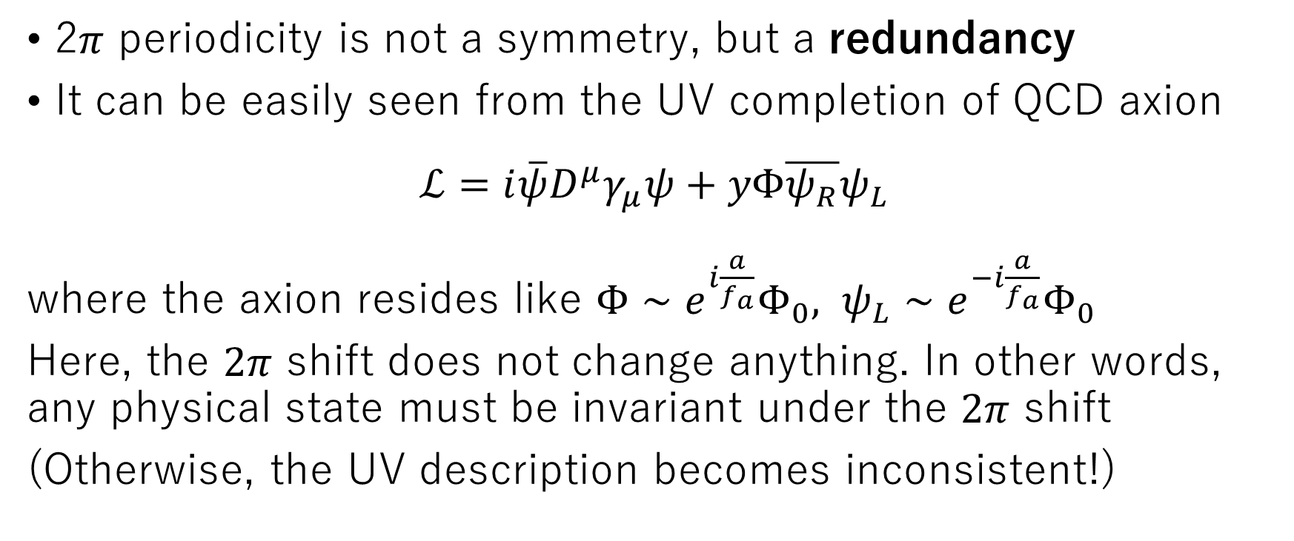
Symmetry and redundancy
2$π$ periodicity is not a symmetry, but a redundancy
It can be easily seen from the UV completion of QCD axion
$$ℒ=i\overline{ψ}D^{μ}γ_{μ}ψ+yΦ\overline{ψ_{R}}ψ_{L}$$
where the axion resides like $Φ∼e^{i\frac{a}{f_{a}}}Φ_{0}, ψ_{L}∼e^{−i\frac{a}{f_{a}}}Φ_{0}$
Here, the $2π$ shift does not change anything. In other words, any physical state must be invariant under the $2π$ shift
(Otherwise, the UV description becomes inconsistent!)

Slide 5
Redundancy and gauge “symmetry”
Such a redundancy is called a gauge “symmetry”; the Boson which nonlinearly transforms under the “symmetry” is called a gauge Boson
In this sense, the $2π$ shift is a gauge symmetry and the axion is a “0-form” gauge Boson.
Let’s see a comparison with a familiar example:
U(1) 1-form gauge symmetry (QED)
Differential form

Slide 6
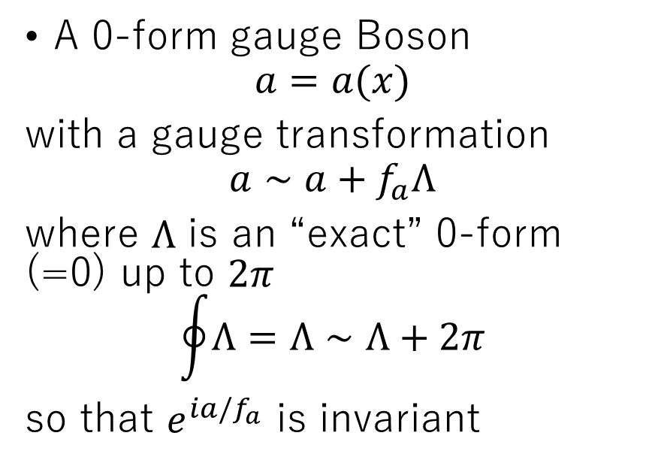
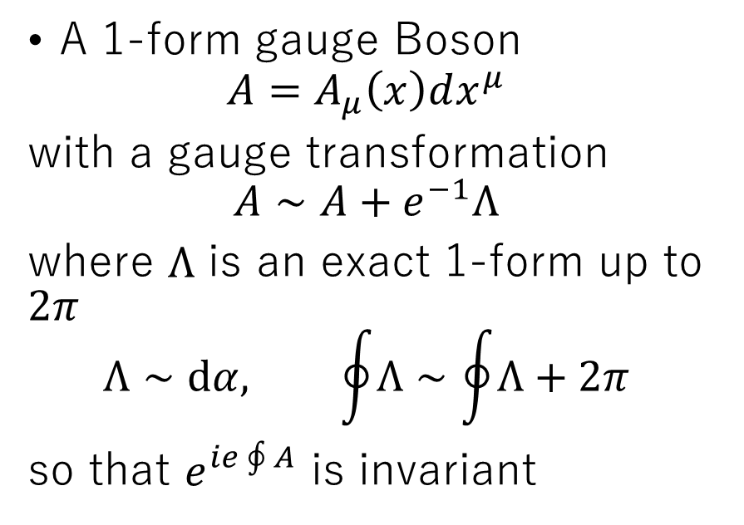
Photon and Axion
Photon
Axion
A 1-form gauge Boson
$$A=A_{μ}\left(x\right)dx^{μ}$$
with a gauge transformation
$$A∼A+e^{−1}Λ$$
where $Λ$ is an exact 1-form up to $2π$
$$Λ∼dα, \oint{Λ}∼\oint{Λ}+2π$$
so that $e^{ie\oint{A}}$ is invariant
A 0-form gauge Boson
$$a=a(x)$$
with a gauge transformation
$$a∼a+f_{a}Λ$$
where $Λ$ is an “exact” 0-form (=0) up to $2π$
$$\oint{Λ}=Λ∼Λ+2π$$
so that $e^{ia/f_{a}}$ is invariant

Slide 7



Electric & magnetic charge (Photon)
The field strength is
$$F=dA=\frac{1}{2}\left(∂_{μ}A_{ν}−∂_{ν}A_{μ}\right)dx^{μ}dx^{ν}$$
Its magnetic dual is
$$\tilde{F}=d\tilde{A}≡⋆F=\frac{1}{4}ε_{μνρσ}F^{ρσ}dx^{μ}dx^{ν}$$
2-form
(D-2) =
2-form
$$S$$
$$S′$$
Around electron:
$$\frac{1}{e}\int_{S}{⋆F}=N_{e}$$
Around monopole:
$$\frac{e}{2π}\int_{S^{′}}{F}=N_{m}$$

Slide 8
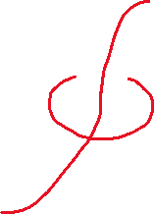


Electric & magnetic charge (Axion)
The field strength is
$$F=da=∂_{μ}a dx^{μ}$$
Its magnetic dual is
$$H=d\tilde{B}≡−⋆F=−\frac{1}{3!}ε^{μνρσ}∂_{σ}a dx^{μ}dx^{ν}dx^{ρ}$$
1-form
(D-1) =
3-form
$S$ (3-dim surface)
Around “monopole” = axion string:
$$\frac{1}{2πf_{a}}\int_{S^{′}}{F}=N_{m}$$
Around “electron” = instanton:
$$f_{a}\int_{S}{⋆F}=N_{e}$$
$S′$ (1-dim surface)

Slide 9
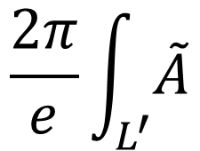
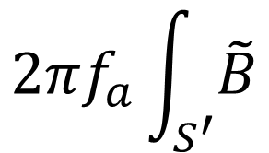
Gauge interaction with matter
Photon
Axion
0-form
$$e\int_{L}{A}=\int_{L}{A_{μ}\frac{dx^{μ}}{dτ}dτ}$$
$$\frac{a}{f_{a}}$$
electron
instanton
2-form
$$t$$
$$\frac{2π}{e}\int_{L^{′}}{\tilde{A}}$$
$$t$$
$$2πf_{a}\int_{S^{′}}{\tilde{B}}$$
monopole
axion string
$$S$$
$$L, L′$$
The interaction is used to estimate the axion emission from strings

Slide 10
Chern-Simons term
A non-trivially gauge invariant interaction is the Chern-Simons term
$$S_{CS}=\frac{2πκ_{i_{1}…i_{n}}}{n!}\int{A_{i_{1}}∧F_{i_{2}}…∧{F_{i}}_{n}}, δS_{CS}=2πN$$
Chern-Simons term introduces non-trivial deformation on the dual EM fields
$A_{i}$ is a p-form gauge field
(you can think p=0,1, D=4 in practice)
normalization:
$$\int{F},∫\tilde{F}≡\frac{2π}{e^{2}}\int{⋆F}∈Z$$

Slide 11
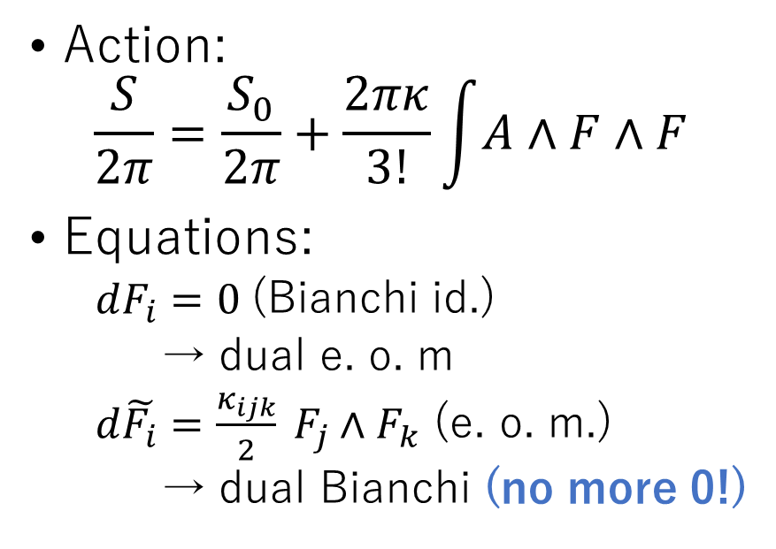
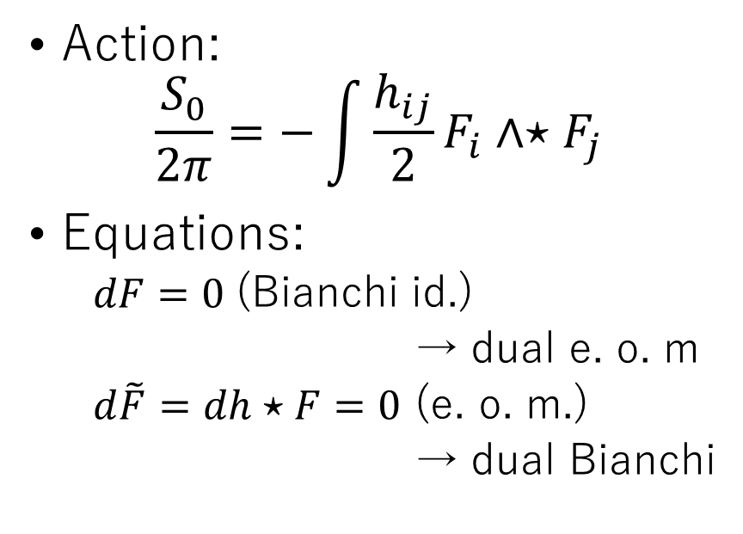
Chern-Simons term and duality
Without CS
With CS (3-terms)
Action:
$$\frac{S_{0}}{2π}=−\int{\frac{h_{ij}}{2}}F_{i}∧{⋆F}_{j}$$
Equations:
$dF=0$ (Bianchi id.)
→ dual e. o. m
$d\tilde{F}=dh⋆F=0$ (e. o. m.)
→ dual Bianchi
Action:
$$\frac{S}{2π}=\frac{S_{0}}{2π}+\frac{2πκ}{3!}\int{A∧F∧F}$$
Equations:
$dF_{i}=0$ (Bianchi id.)
→ dual e. o. m
$d\tilde{F_{i}}=\frac{κ_{ijk}}{2} F_{j}∧F_{k}$ (e. o. m.)
→ dual Bianchi (no more 0!)
duality

Slide 12
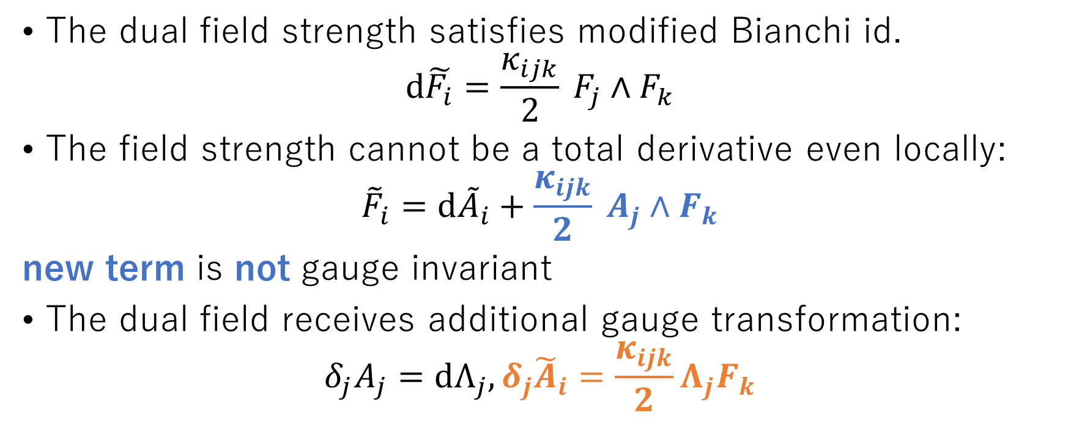
Modified Bianchi and gauge transformation
The dual field strength satisfies modified Bianchi id.
$$d\tilde{F_{i}}=\frac{κ_{ijk}}{2} F_{j}∧F_{k}$$
The field strength cannot be a total derivative even locally:
$${\tilde{F}}_{i}=d{\tilde{A}}_{i}+\frac{κ_{ijk}}{2} A_{j}∧F_{k}$$
new term is not gauge invariant
The dual field receives additional gauge transformation:
$$δ_{j}A_{j}=dΛ_{j}, δ_{j}{\tilde{A}}_{i}=\frac{κ_{ijk}}{2}Λ_{j}F_{k}$$

Slide 13
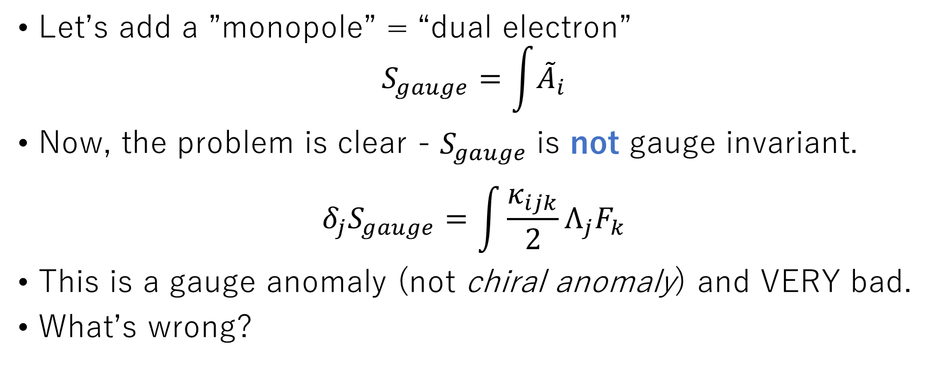
Matter and anomaly
Let’s add a ”monopole” = “dual electron”
$$S_{gauge}=\int{{\tilde{A}}_{i}}$$
Now, the problem is clear - $S_{gauge}$ is not gauge invariant.
$$δ_{j}S_{gauge}=\int{\frac{κ_{ijk}}{2}Λ_{j}F_{k}}$$
This is a gauge anomaly (not chiral anomaly) and VERY bad.
What’s wrong?

Slide 14
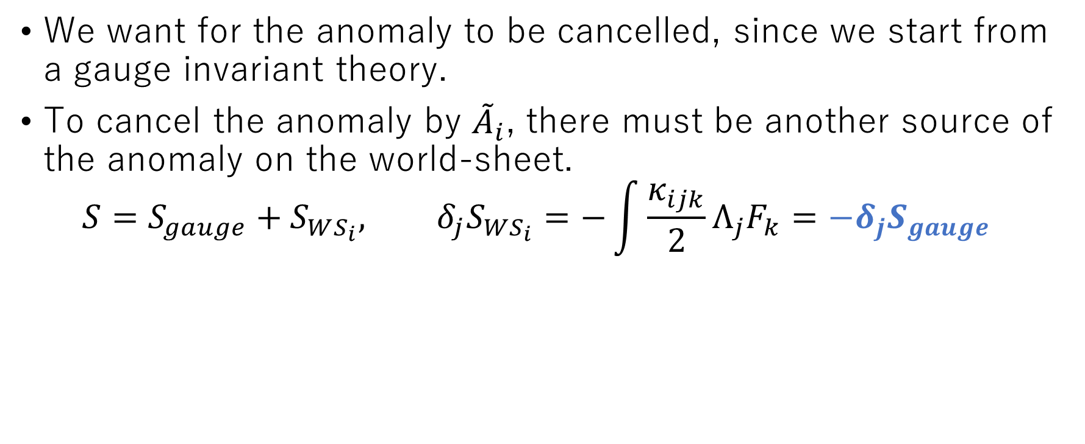
Anomaly inflow and matching
We want for the anomaly to be cancelled, since we start from a gauge invariant theory.
To cancel the anomaly by ${\tilde{A}}_{i}$, there must be another source of the anomaly on the world-sheet.
$$S=S_{gauge}+S_{WS_{i}}, δ_{j}S_{WS_{i}}=−\int{\frac{κ_{ijk}}{2}Λ_{j}F_{k}}=−δ_{j}S_{gauge}$$
$S_{WS_{i}}$ = world-sheet action of “monopole” of $A_{i}$
Anomaly inflow Callan & Harvey 84

Slide 15

Current on the world-sheet
In general, $A_{j}$ gauge tr can be written using a current
$$δ_{j}S_{WS_{i}}=\int{dΛ_{j}∧J_{ij}}$$
where $J_{ij}$ is a gauge current of $A_{j}$ on $WS_{i}$
Now, due to the anomaly matching,
$$dJ_{ij}=κ_{ijk}F_{k}$$
This is “covariant anomaly”
Bardeen & Zumino 84, Naculich 87, HF & Yonekura 20
The $i$ monopole world-sheet theory must have a $j$ current
The gauge current must be anomalous up to $F_{k}$

Slide 16
Ok, let’s see examples
As a familiar example, let’s take the axion-photon system
$$S_{CS}=\frac{2π}{2}\int{aF∧F}$$
The rule is
Take i, j = photon, k = axion
The $i$ monopole world-sheet theory must have a $j$ current
The gauge current must be anomalous up to $F_{k}$

Slide 17
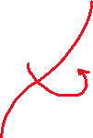
Witten effect revisited
The $i$ monopole world-sheet theory must have a $j$ current
The gauge current must be anomalous up to $F_{k}$
According to the rule,
The monopole world-sheet theory has a photon (=electric) current
The electric current is anomalous, $dJ_{0}=da$
“A monopole carries an electric charge which depends on the axion background”
This is nothing but the Witten effect: “A monopole carries an electric charge $\frac{θ}{2π}$”
$$ΔQ=\int{dJ_{0}}={⟨a⟩}_{1} −{\left\langle a\right\rangle }_{0}=1$$
axion string
HF & Yonekura, 20
monopole

Slide 18

Another examples
$$S_{CS}=\frac{2π}{2}\int{aF∧F}$$
With the rule:
Take i = axion, j, k = photon
The $i$ monopole world-sheet theory must have a $j$ current
The gauge current must be anomalous up to $F_{k}$

Slide 19

Charge on the axion string
The $i$ monopole world-sheet theory must have a $j$ current
The gauge current must be anomalous up to $F_{k}$
According to the rule,
The axion string has a photon (=electric) current
The electric current is anomalous, $dJ_{1}=dA$
“A axion string carries an electric charge & current which depends on the background electric field”
$$E$$
$$∂_{t}I=−\frac{α}{2π}E$$
Axion strings are actually “superconducting”!
(Just like a heterotic string and the Green-Schwarz mechanism)
Witten 85;
HF Manohar Murayama Telem20

Slide 20
Summary
Axion is a 0-form gauge field
The Chern-Simons term introduces anomaly inflow on axion strings and magnetic monopoles
Accordingly,
Magnetic monopoles obtains electric charge (Witten effect)
Axion strings are superconducting

