Slide 1
Experiment Overview: sPHENIX
Christof Roland / MIT
For the sPhenix Collaboration

Slide 2
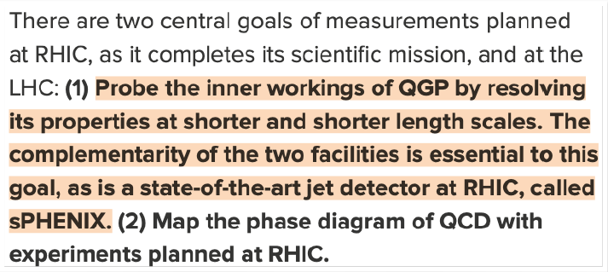
The sPHENIX Mission
2015 US NP LRP
WG5 for 2019 ECFA Document
“As the temperature dependence of transport properties can be accessed experimentally by varying the center of mass energy over a logarithmically wide range, the combined analysis of LHC data and future high precision data from RHIC offers a qualitatively novel handle on the temperature dependence of properties of hot and dense matter. The Town Meeting observes that the recently approved sPHENIX proposal targets these opportunities by bringing greatly extended capabilities to RHIC…
Study hot QCD using low energy hadrons, jets, electromagnetic radiation, heavy quarks and exotic bound states*
Compare LHC data and results obtained at RHIC on equal footing to extract the temperature dependence of medium transport properties
  Requires a detector system at RHIC with comparable capability as the state of the art CERN experiments
    Large acceptance EM and hadronic calorimetry, precision tracking and vertexing, high rate capability and efficient trigger system
  Study multi-scale probes (jets over a wide kinematic range, heavy flavor, quarkonia)
*2023 US NP LRP

Slide 3
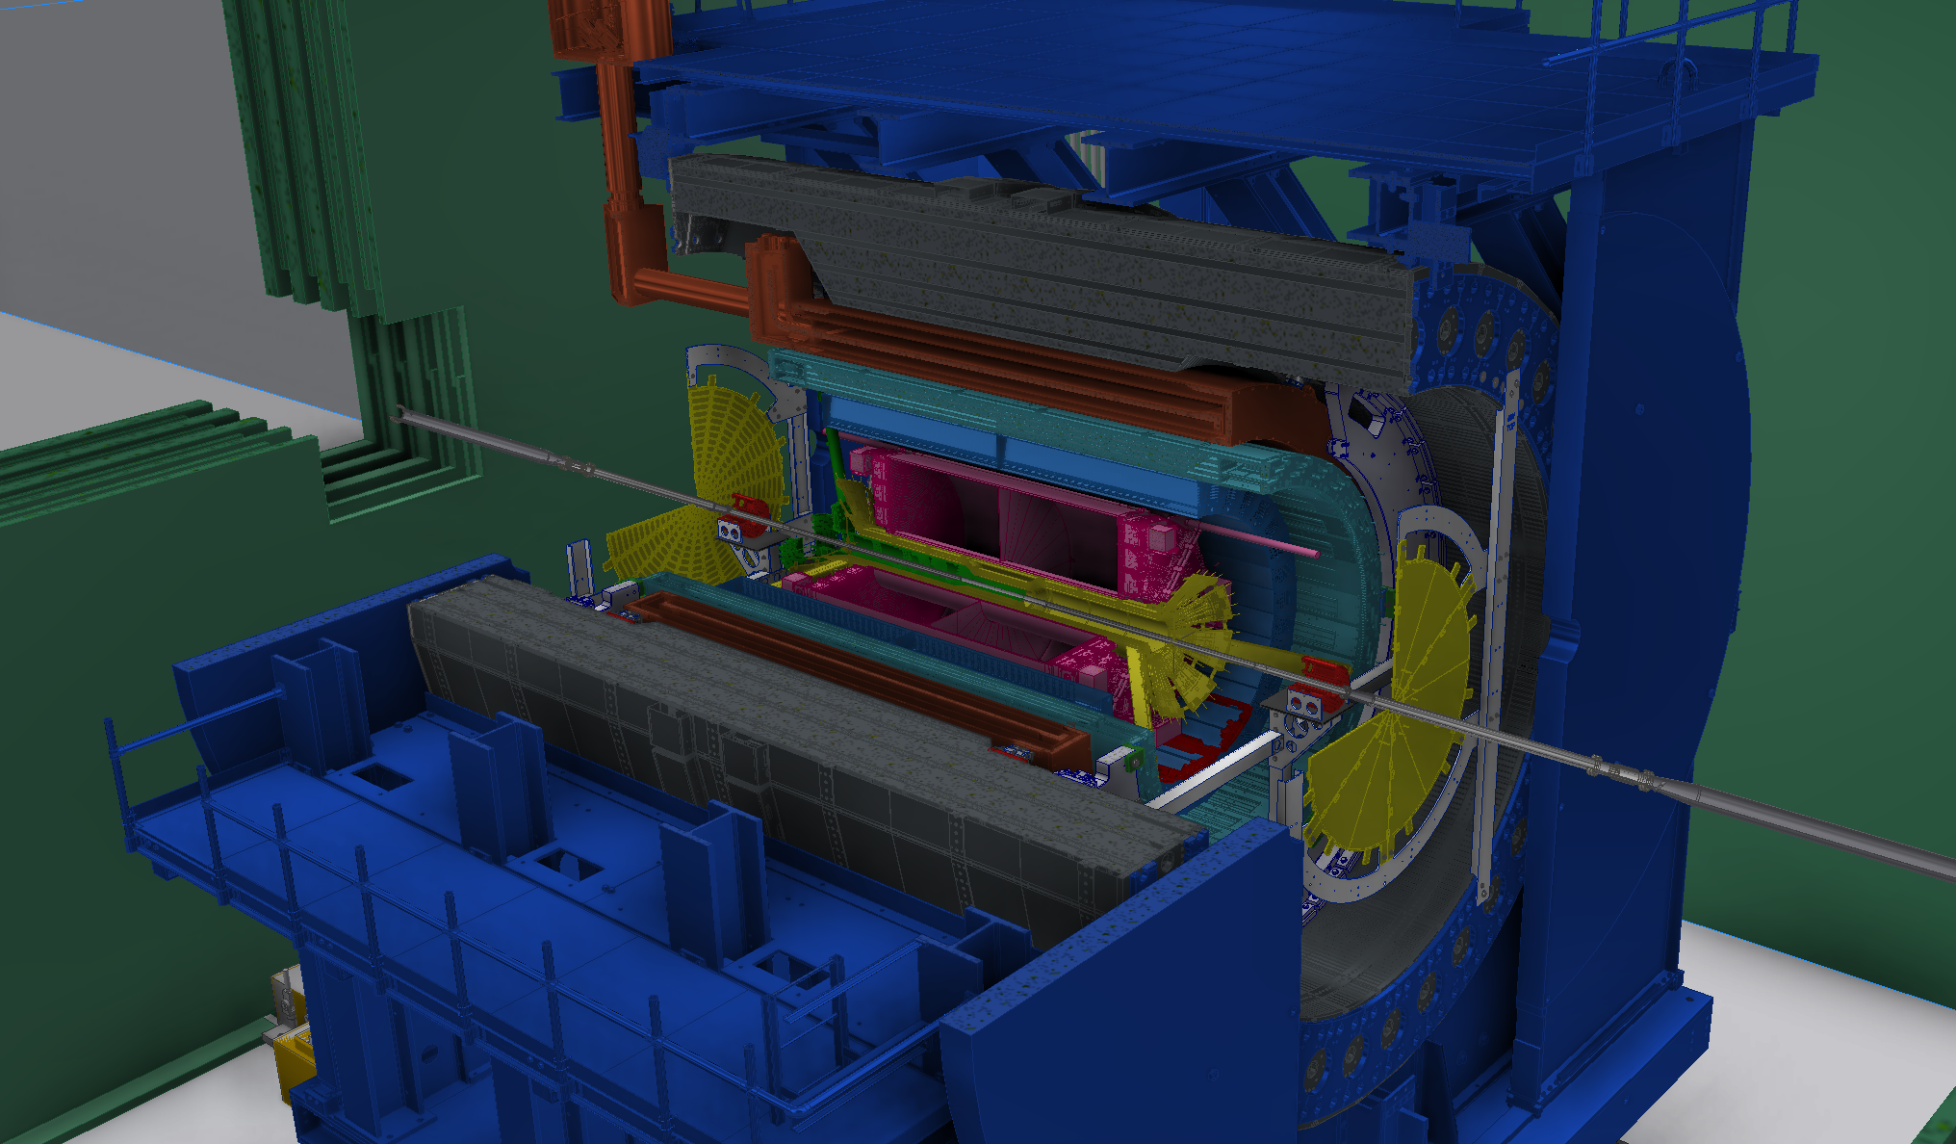

The sPHENIX Experiment
MAGNET
sEPD
oHCAL
MVTX
EMCAL
TPC
iHCAL
MinBIAS
INTT
TPOT

Slide 4
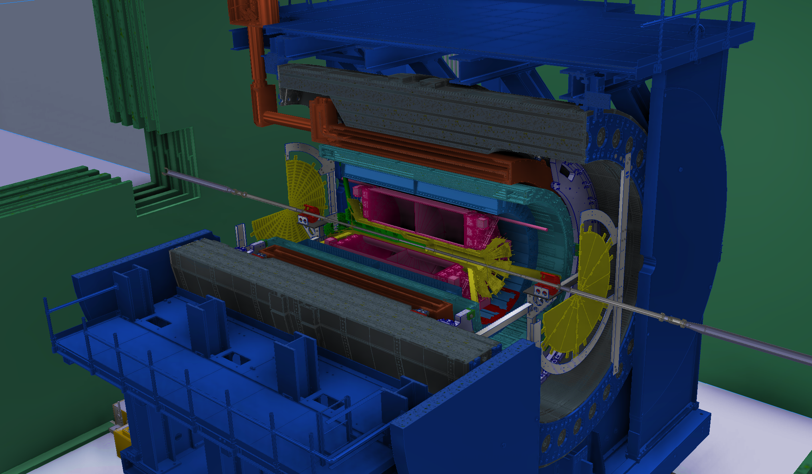
sPHENIX: Tracking
1.4T MAGNET
MVTX: precision vertexing
      MAPS technology, 29 x 27μm pixels
INTT: resolve bunch crossing
Silicon Strips, 78μm x 16 or 20 mm
TPC: momentum resolution
GEM based, continuous readout
TPOT: tracking calibration
Micromegas, strip readout
All tracking detectors capable of streaming read out
MVTX
MAPS,Precision vertexing
INTT
TPC
TPOT

Slide 5
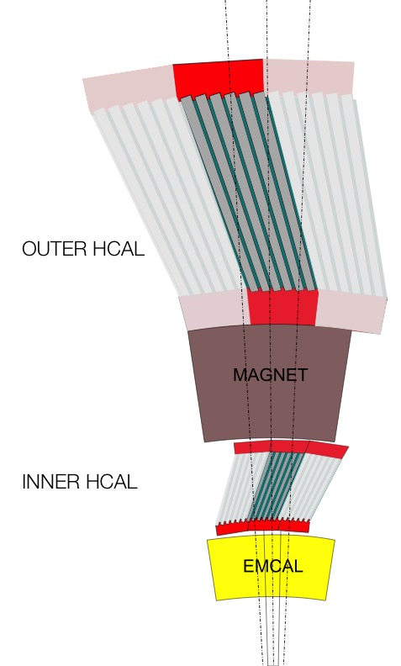

sPHENIX: Calorimetry
Hermetic electromagnetic + hadronic calorimeter stack in $\left|η\right|<1.1$
oHCAL
Steel/plastic scintillator HCAL
SiPM readout
Magnet
Tungsten/SciFi EMCal
EMCAL
iHCAL

Slide 6
sPHENIX: Event Selection
sEPD
oHCAL
EMCAL
iHCAL
High DAQ rate 15 kHz
Trigger system based on full calorimetry (jets and photons) and min. bias detector (inelastic collisions and vertex range)
Equiped with event plane detector
MinBIAS

Slide 7
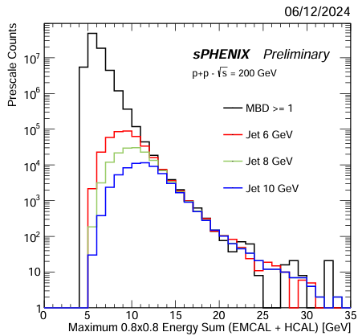
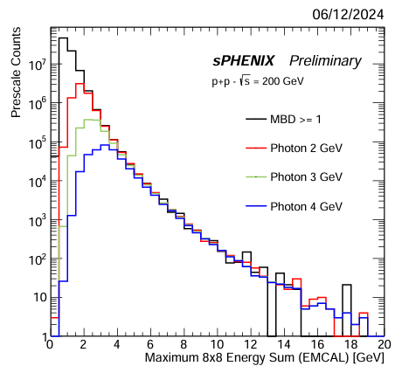
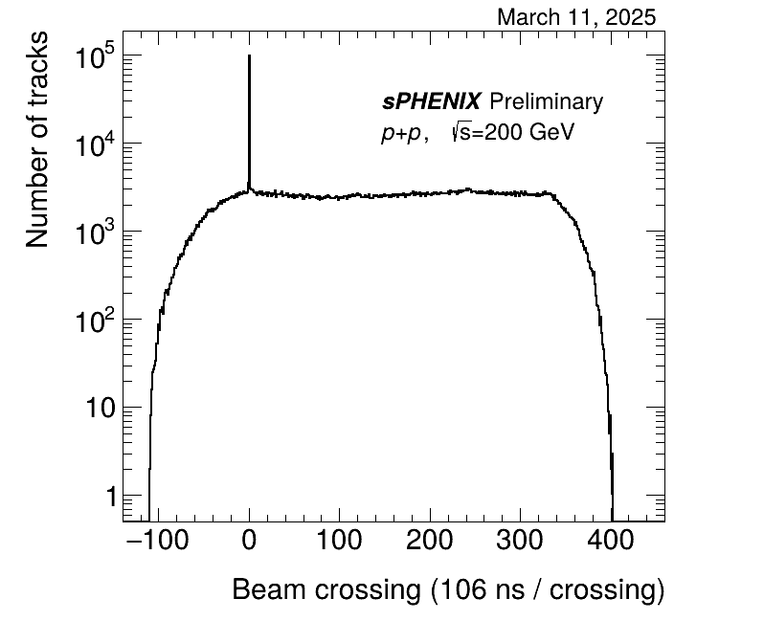
Data taking and streaming readout
Jet Trigger
Photon Trigger
Triggered readout
  To be used for Au+Au data taking
Extended readout
  Continue readout out the tracking detectors for a limited time after a physics trigger
  Used in pp data taking to sample additional min bias pp collisions for heavy flavor studies
  At nominal physics trigger rate this allows to sample unbiased pp collisions at O(200kHz)
Triggered crossing
36 μs unbiased collisions

Slide 8
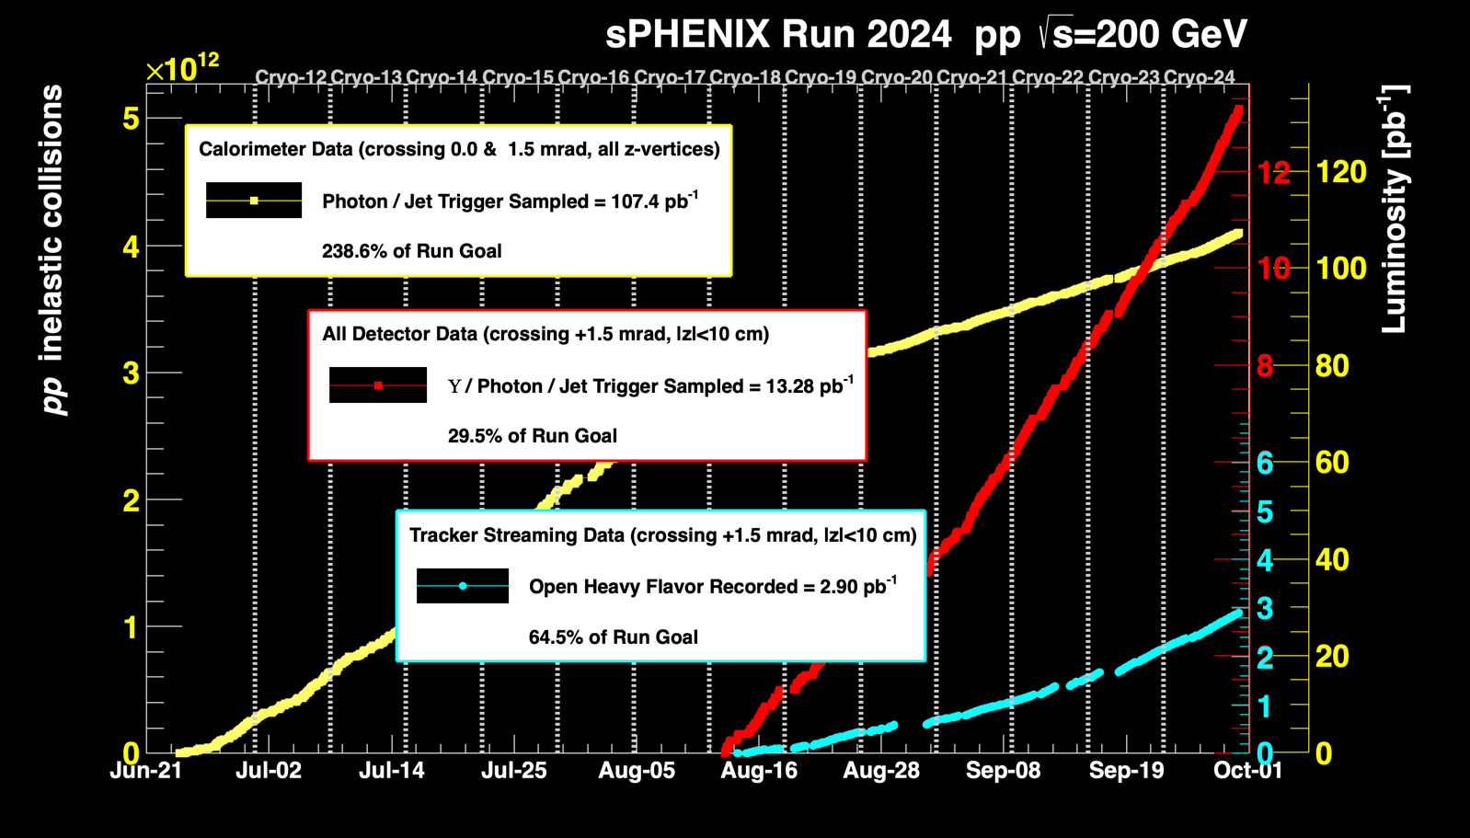
sPHENIX Timeline and Data Taking
Detector installation completed early 2023
2023 AuAu commissioning run
  first sPHENIX physics full calorimeter events
  Cut short by accelerator incident
2024 pp production run + short AuAu period
  Finalize commissioning of tracking detectors
  Calorimeter + Si Tracker data:
    107.4 pb⁻¹ (238.6% of Run Goal)
  Y/Photon/Jet Triggered data, full detector:
    13.28 pb⁻¹ (29.5% of Run Goal)
  Tracker Streaming Data for open heavy flavor:
    2.90 pb⁻¹ (64.5 % of Run Goal)
2025 AuAu
  Target integrated luminosity: 7 nb⁻¹
  Starting now!

Slide 9
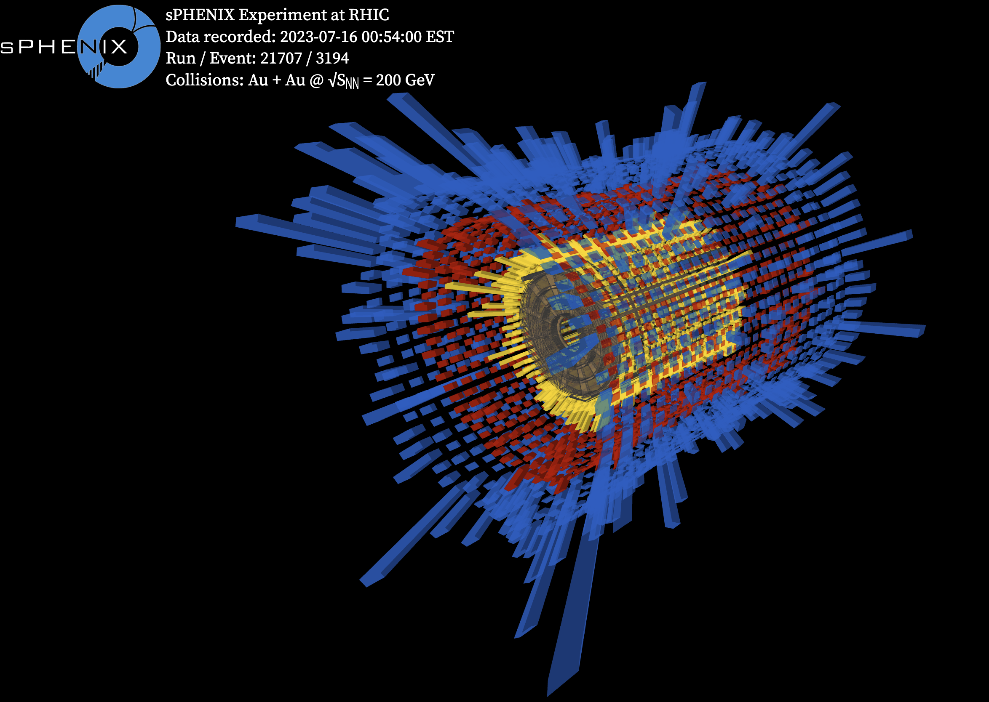
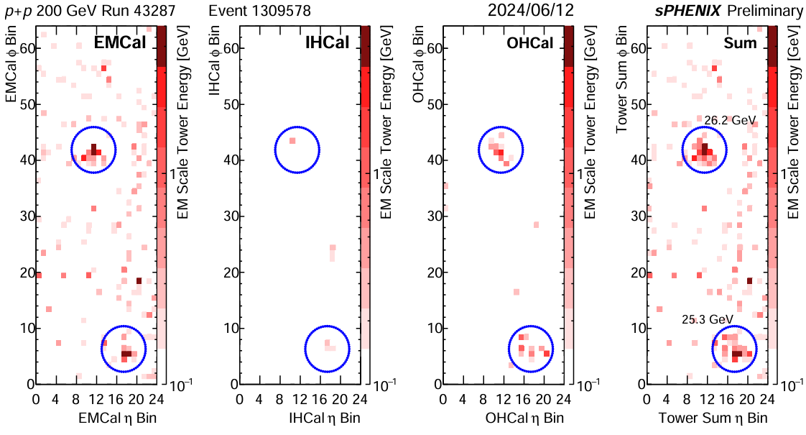
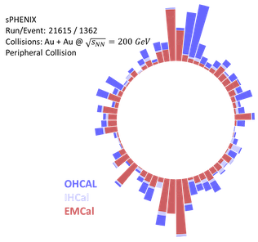
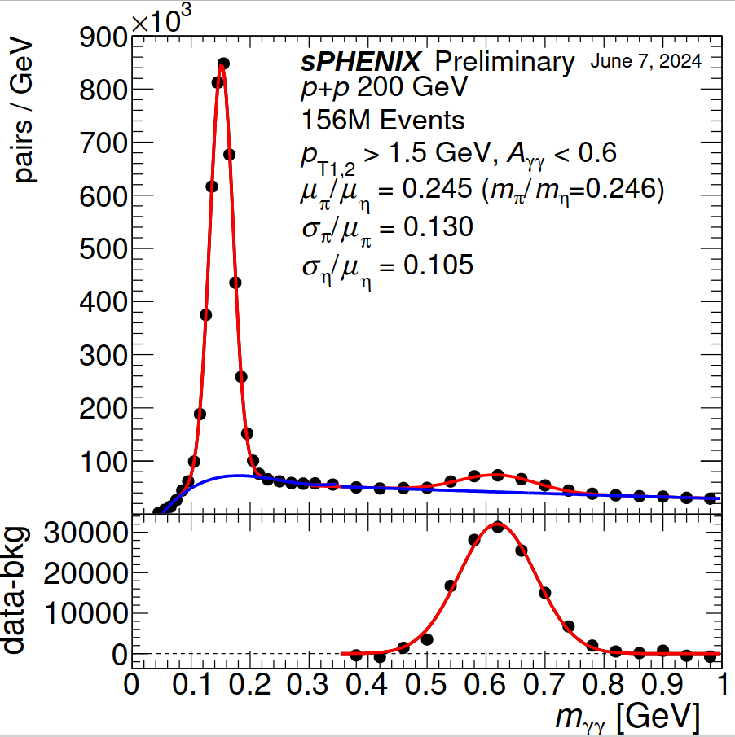
Detector Performance: Calorimeters
EM and Hadronic Calorimeters
  Fully functional since early in commissionning run
  Provide physics object triggers
    Jets, Photons
pp Dijet Event
AuAu Dijet Event incl. background
π⁰, η in pp (EMcal)

Slide 10
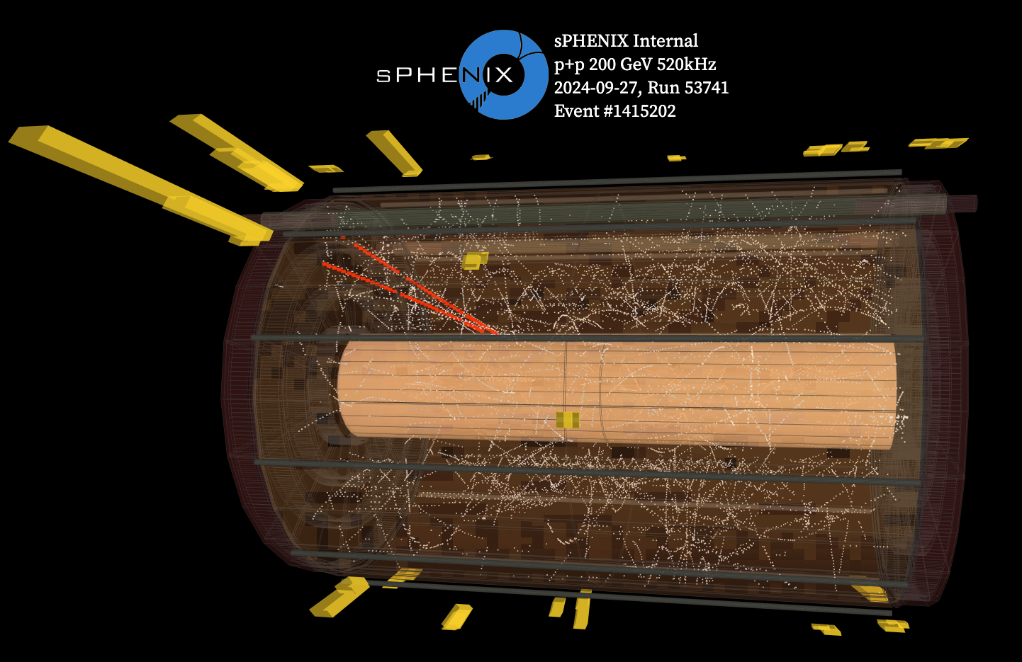
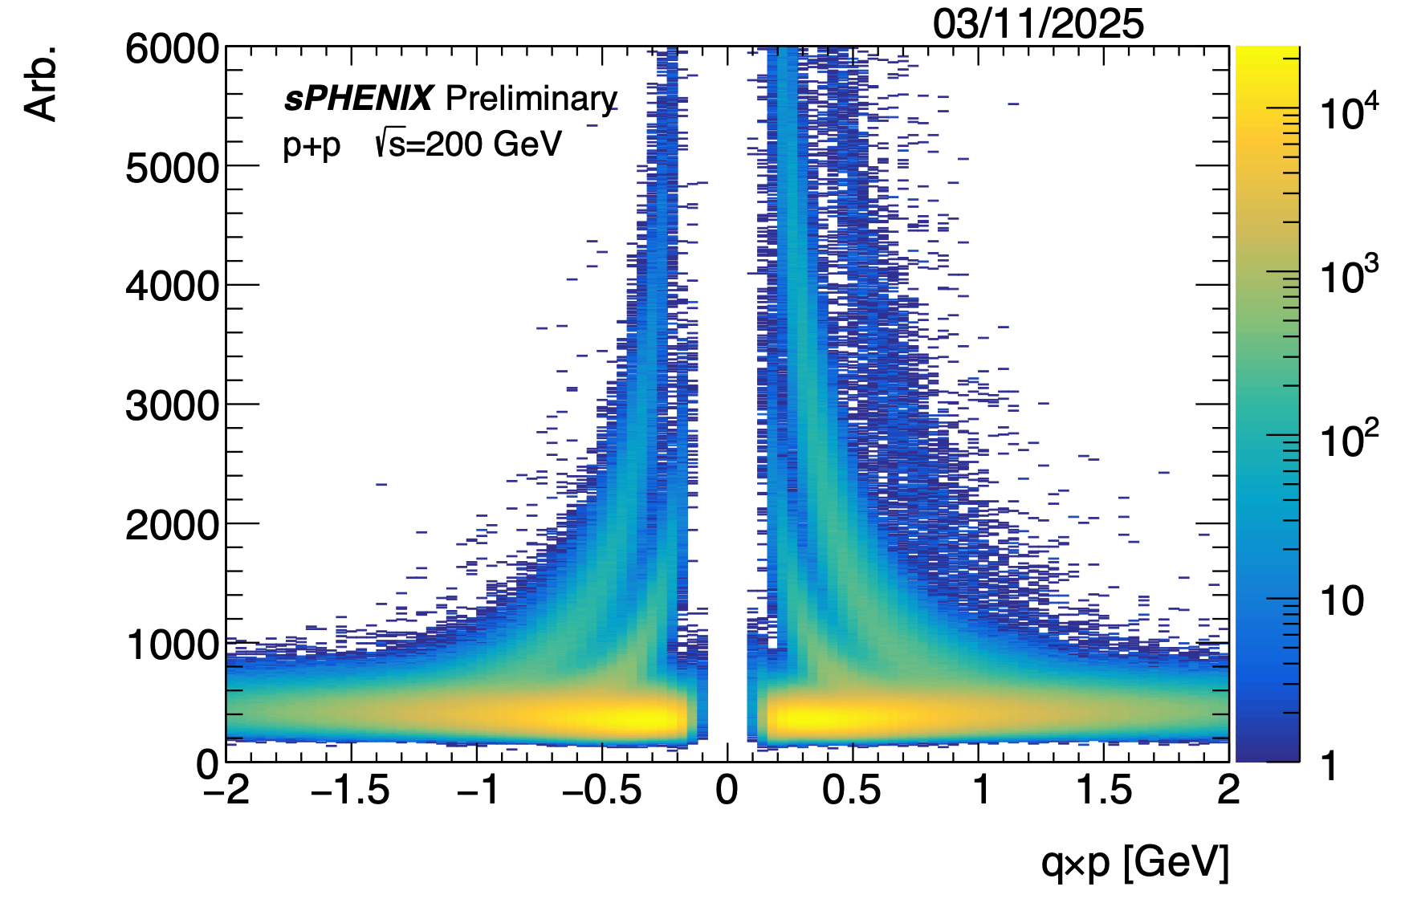
Detector Performance: Tracking
Photon conversion event
Track reconstruction works well
  Match TPC to Silicon and Calorimeters
    Vertex resolution from MVTX
    INTT provides bunch crossing number
    Momentum and dE/dx from TPC
d
K⁰
Λ
φ
p
K
π

Slide 11
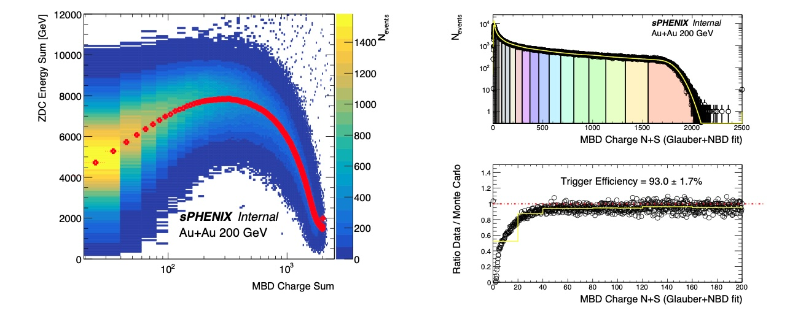
Physics commissiong
Remeasure standard physics candles
  Commission analysis procedures
  Check consistency with published results
π⁰ v₂ using EMcal
Collision Centrality based on MDB and ZDC
Note Link goes here

Slide 12
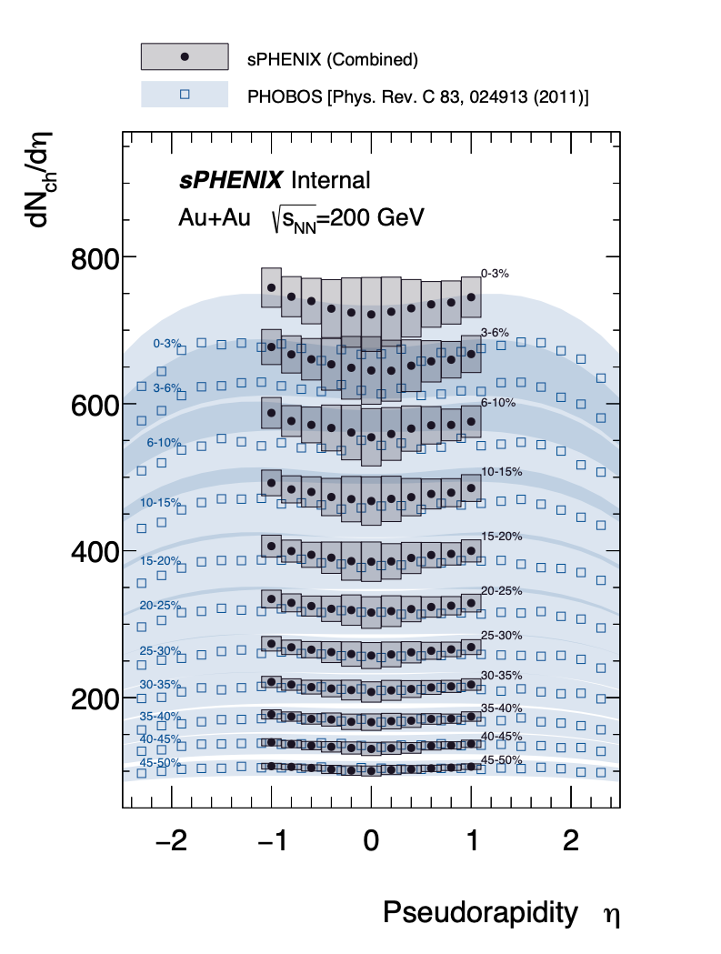
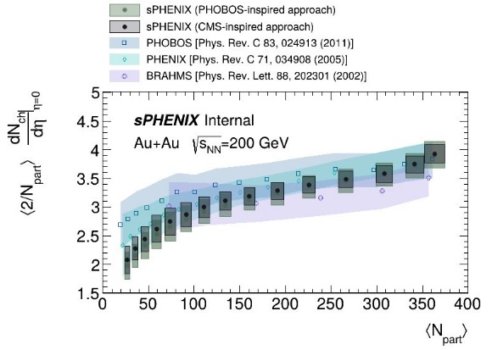
Bulk Observables: AuAu
Charged particle multiplicity
  Based on silicon detectors
    2 hit correlations
    Hit Triplet counting
Arxiv Link goes here
  See Presentation by Hao-Ren Jheng - 4/10/25, 9:40 AM
  sPHENIX measurements of collective behavior in small and large systems

Slide 13
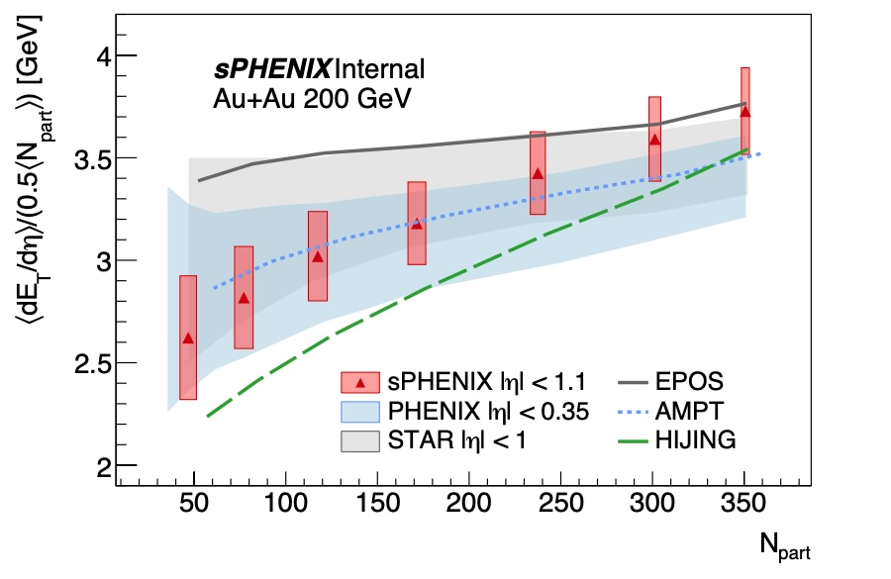
Bulk Observables: AuAu
Transverse Energy Production
  Measured with EM and hadronic calorimeters
  Wide pseudorapidity acceptance
Arxiv Link goes here

Slide 14
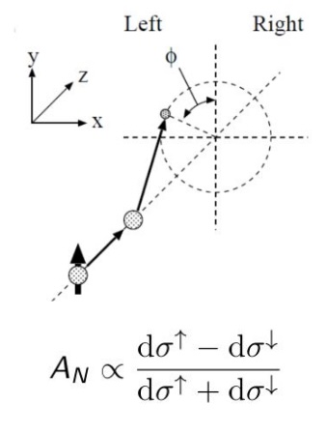
Cold nuclear matter: pp
Cold nuclear matter program: spin physics
  π⁰ and η transverse single-spin asymmetries A_{N}
  Provides information about the spin structure of the proton
Note Link goes here

Slide 15
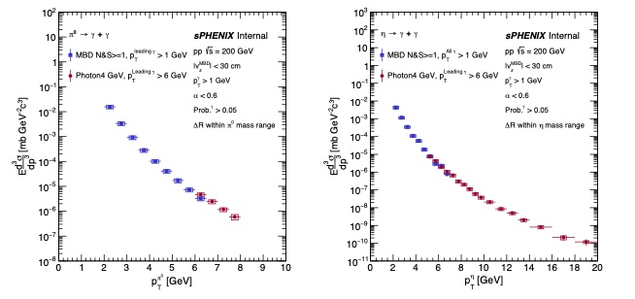
High p_{T} particles: π⁰ and η in pp
Dataset collected with min bias and photon triggers
  Understanding of EMCal energy scale & response
  Comparisons to NLO pQCD
  Constraints for direct photon measurements
Note Link goes here
  See Presentation by Jaebeom Park - 4/10/25, 9:40 AM
  sPHENIX measurements of high-p_{T} neutral mesons and isolated photons in p+p collisions

Slide 16
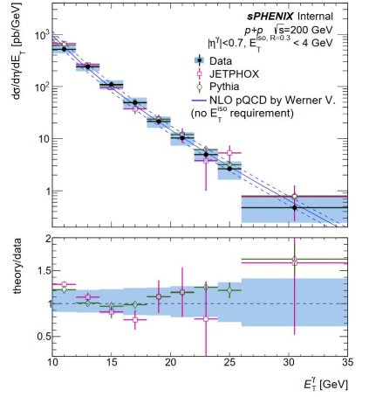
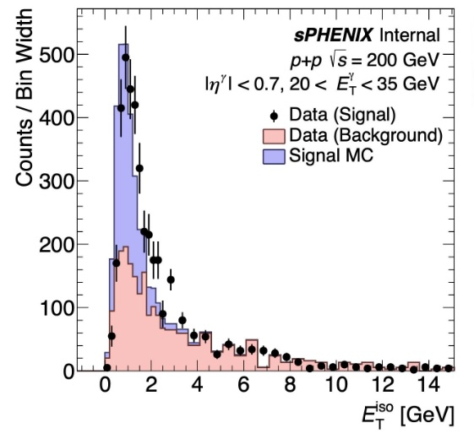
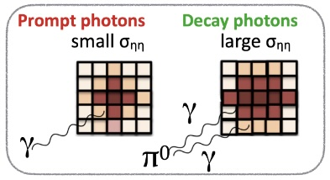
High p_{T} particles: Photons
Isolated Photons in pp
  Important reference to select exactly defined parton topologies
  Essential to controll purity of Photon sample
Control background of high z leading pi0s and fragmentation photons
  Shower shape
  Isolation criteria
  (Angular correlation with associated jet)
Note Link goes here
  See Presentation by Jaebeom Park - 4/10/25, 9:40 AM
  sPHENIX measurements of high-pT neutral mesons and isolated photons in p+p collisions

Slide 17
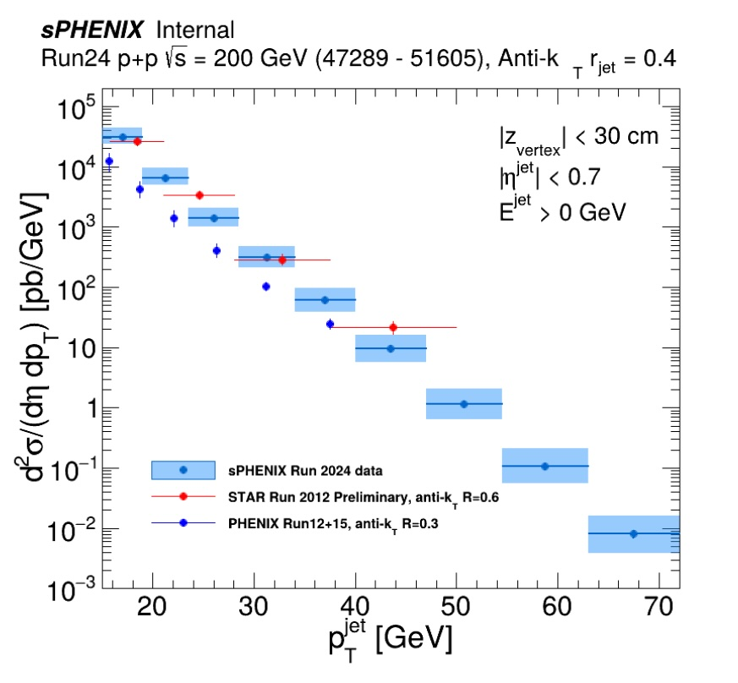
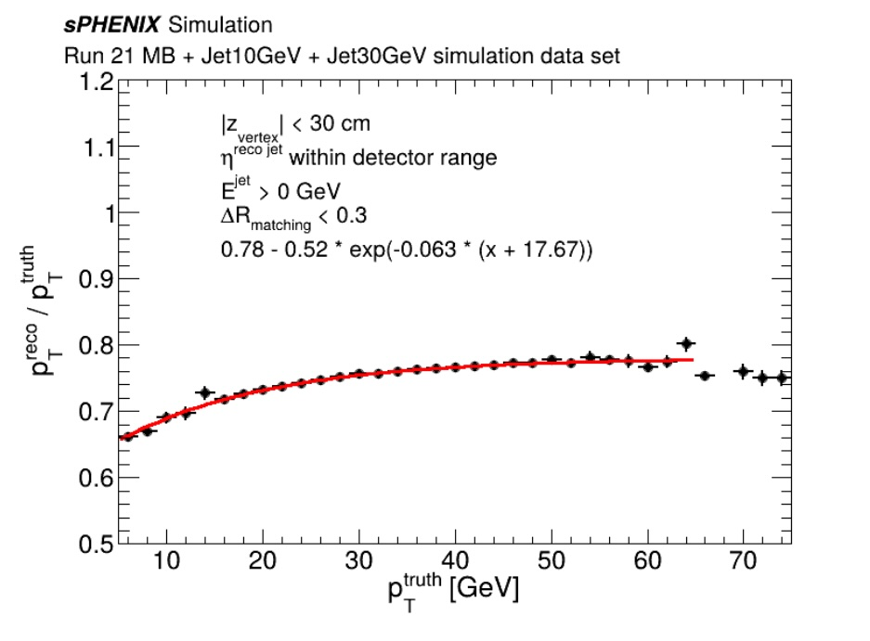
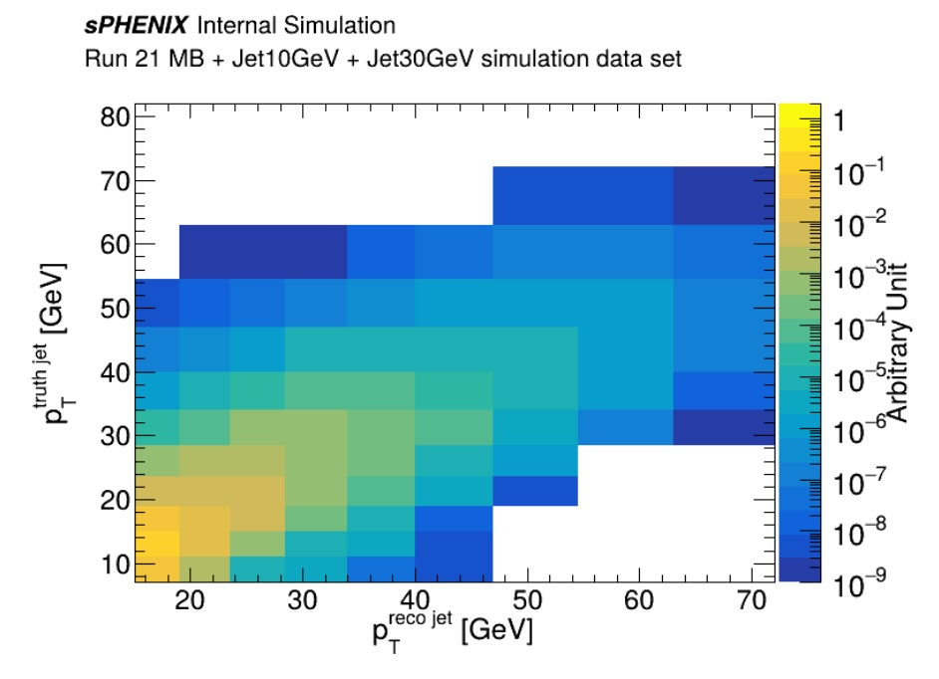
Jets: Inclusive spectra in pp
Inclusive jet spectra in pp
  Based jet triggered dataset
  Corrected for jet p_{T} scale
  Unfolded to MC final state particle level
Jet p_{T} scale
Jet p_{T} unfolding matrix
Note Link goes here

Slide 18
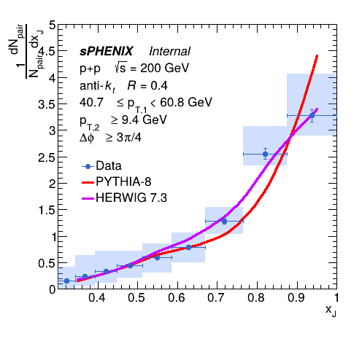
Jets: Dijet correlations in pp
Dijet p_{T} balance
Dijet angular correlation
Dijets: jet p_{T} scale corrected, Unfolded to final state particle level
Data well described by PYTHIA
Note Link goes here
See Presentation by Virginia Bailey - 4/8/25, 8:40 AM
sPHENIX measurement of dijet correlations in p+p
collisions over a large kinematic range

Slide 19
sPHENIX Projections: AuAu statistics
RHIC run 25 is underway!
  Au+Au Luminosity target: 7nb⁻¹
Goal of overlapping parton kinematics with LHC measurements​is within reach

Slide 20
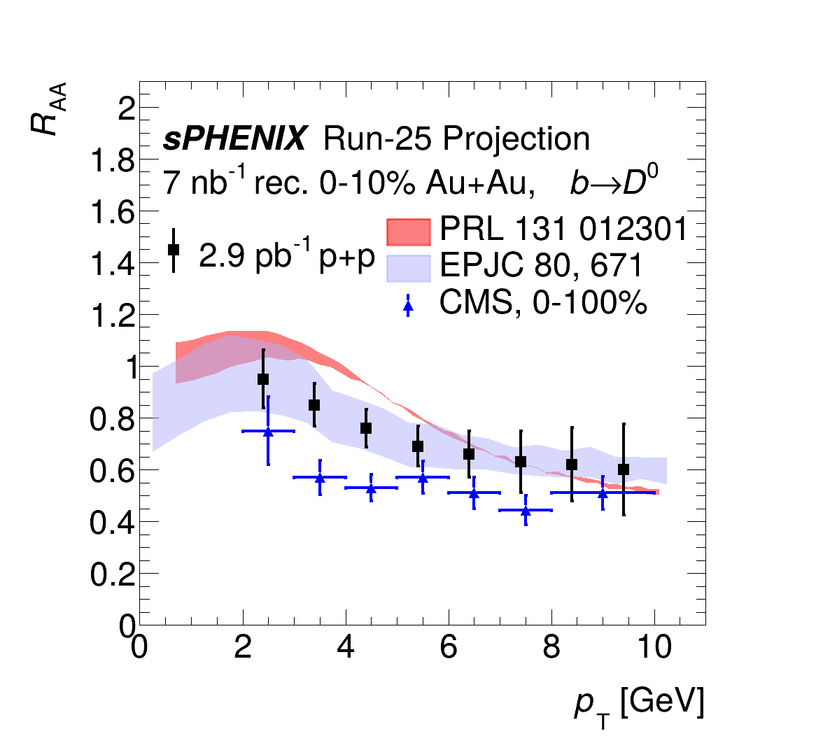
sPHENIX Projections: AuAu Physics
Examples of key physics observables based on pp datasets recorded in 2024 and expected integrated luminosity for AuAu in 2025
R_{AA} of non-prompt b → D⁰’s
Photon - Jet p_{T} balance
b Jet v₂
Notes:
With the target luminosity, sPHENIX can measure the modifications in detail

Slide 21
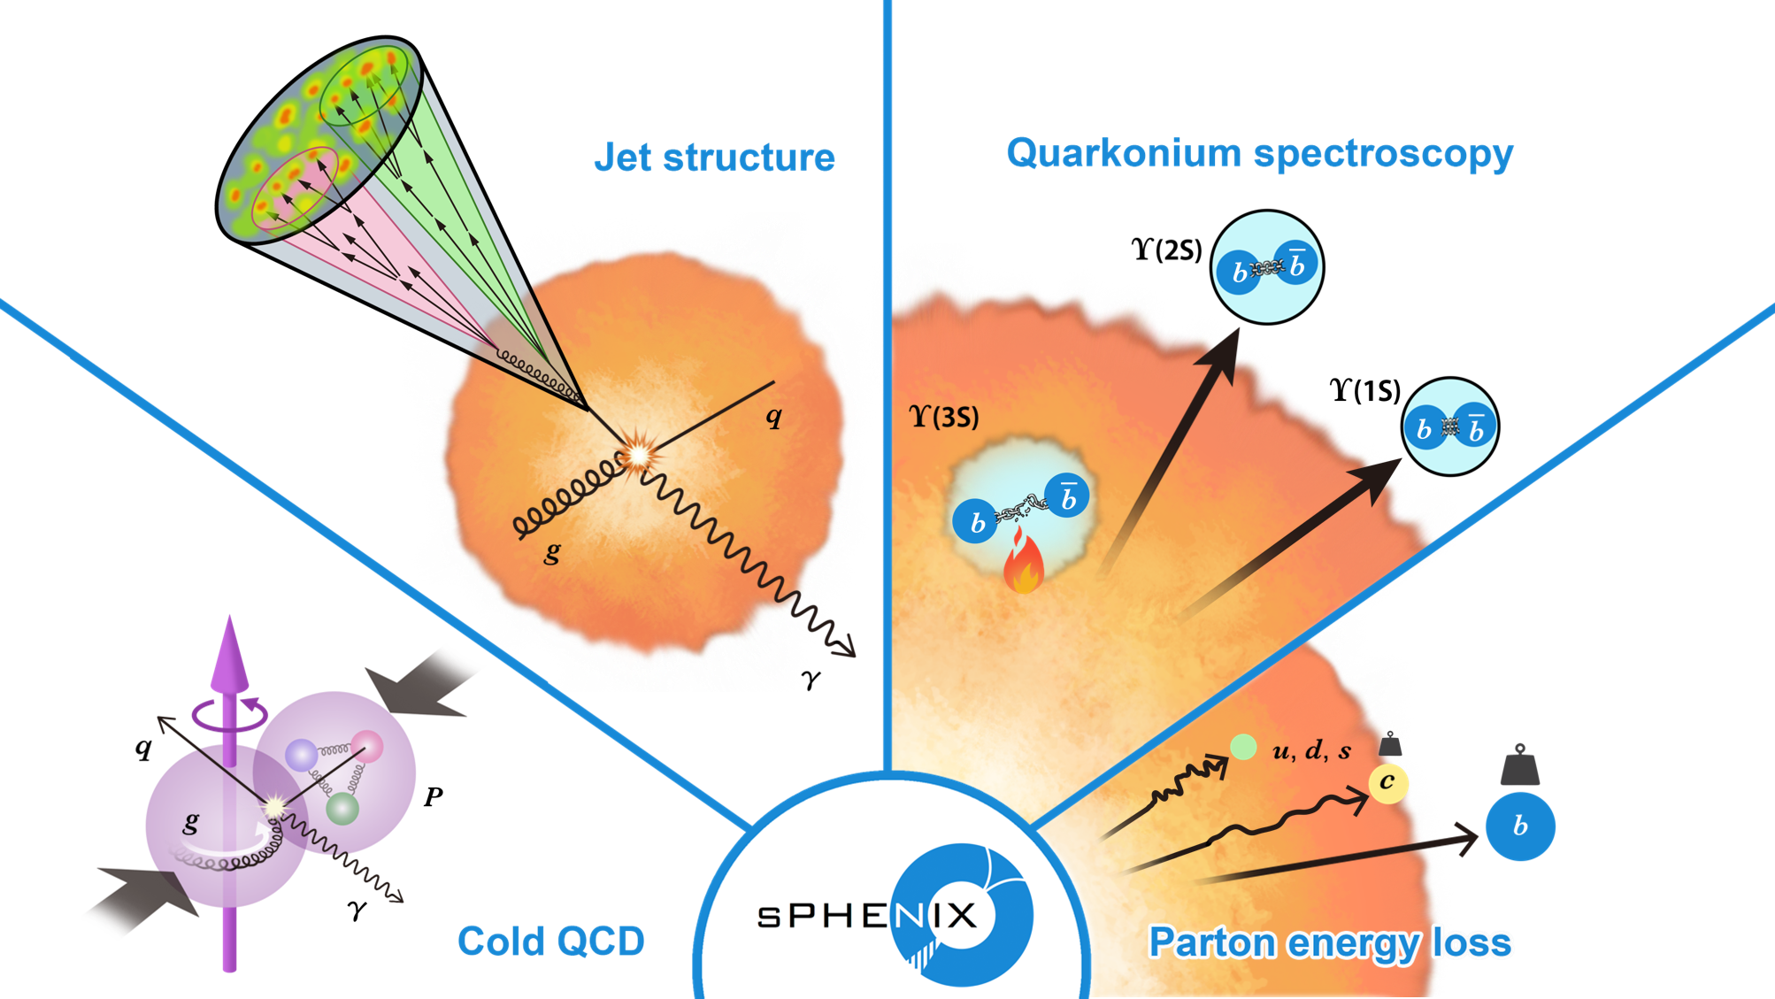
Summary
sPHENIX is fully commissioned
  Recorded substantial pp reference dataset in 2024
  Demonstrated
    jet, photon and track reconstruction
    physics analysis capability of large scale datasets
      Remeasure standard physics candles
      First publications submitted
    Extraction of pp reference data from recorded dataset well underway
  Well equipped to complete the RHIC science mission
  Looking forward to a successful AuAu run on 2025!

Slide 22
Talks at QM2025
sPhenix presentations
sPHENIX measurement of dijet correlations in p+p collisions over a large kinematic range
  Virginia Bailey (Georgia State University) - 4/8/25, 8:40 AM
sPHENIX measurement of the / ratio in p+p collisions at RHIC
  Joe Osborn (Brookhaven National Laboratory) - 4/10/25, 9:00 AM
sPHENIX measurements of collective behavior in small and large systems
  Hao-Ren Jheng (Massachusetts Inst. of Technology (US)) - 4/10/25, 9:40 AM
sPHENIX measurements of high-pT neutral mesons and isolated photons in p+p collisions
  Jaebeom Park - 4/10/25, 9:40 AM
sPhenix posters
Ejiro Naomi Umaka Yuko Sekiguchi Takashi Hachiya Thomas Marshal Gregory Ottino Weihu Ma; Jingyu Zhang Bade Sayki Ming Xiong Liu Xuan Li Skaydi Grossberndt Virginia Bailey Daniel Lis Emma McLaughlin Stefan Bathe Apurva Narde David Stewart Yeonju Go Dylan Neff Nihil Kumar Blair Seidlitz Xudong Yu Hanna Bossi | sPHENIX charged hadron v_2 for Au+Au collisions at 200 GeV sPHENIX measurement of long-range two-particle correlations in high-multiplicity p+p collisions sPHENIX Performance of the Intermediate Si tracker sPHENIX Data-Driven Calculation of Tracking Efficiency sPHENIX Alignment of the MVTX Tracking Detector sPHENIX electron ID with machine learning sPHENIX Electron Identification for Prompt $J/\psi$ Decays using CNN Algorithms sPHENIX Event Multiplicity Dependence of Heavy Flavor Jet Production in p+p Collisions sPHENIX Heavy Flavor Jet Studies with Machine Learning Algorithm in p+p Collisions sPHENIX measurement of Large $R_L$ Energy-Energy Correlator on Calorimeters in Dijet events in pp at 200 GeV sPHENIX photon-jet measurements in proton-proton collisions sPHENIX Measurement of Dijet Correlations in pp sqrt(s) = 200 GeV sPHENIX measurement of dET/dη in Au+Au Collisions at 200 GeV sPHENIX commissioning with proton and nuclear beams sPHENIX measurement of the first full calorimeter jet spectrum in p+p collisions at RHIC sPHENIX track reconstruction in streaming-readout data sPHENIX Novel Jet Background Subtraction and Full Detector Simulation Using Self-Supervised Generative AI Models sPHENIX measurement of neutral meson transverse single spin asymmetry in high-statistics polarized p+p collisions sPHENIX measurement of high-p$_T$ neutral meson production in p+p collisions sPHENIX measurements of isolated photon production in p+p collisions sPHENIX high-statistics measurements of D meson production in p+p collisions sPHENIX machine learning on FPGAs for event selection

Slide 24
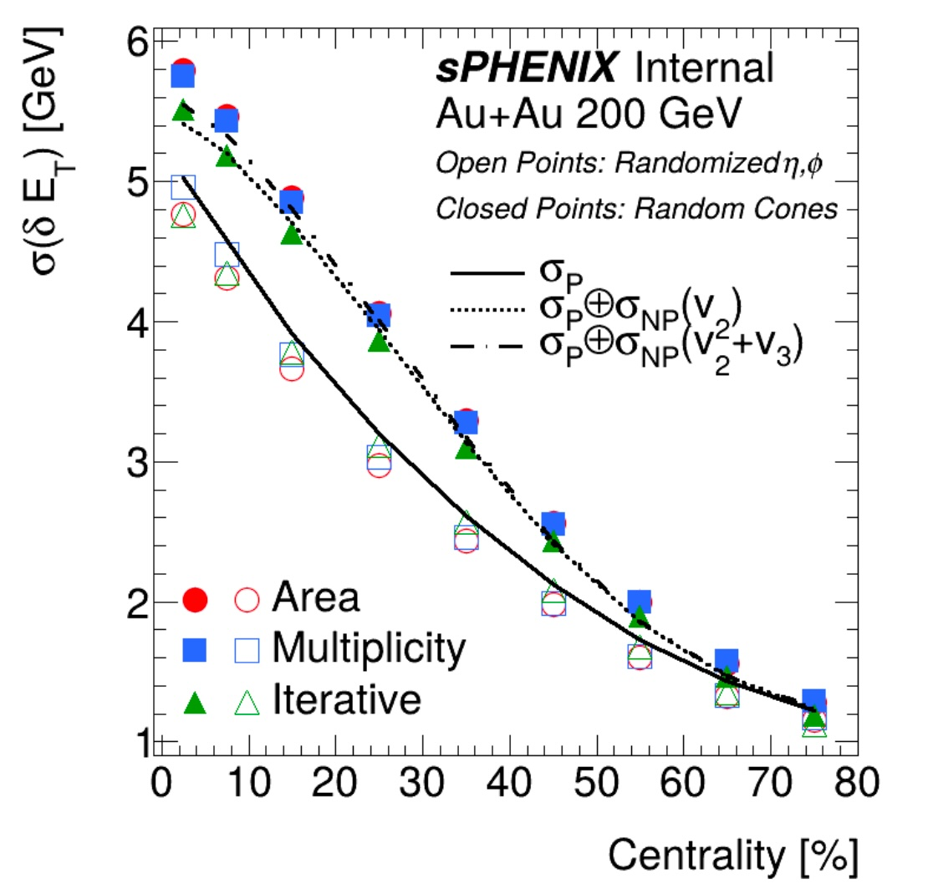
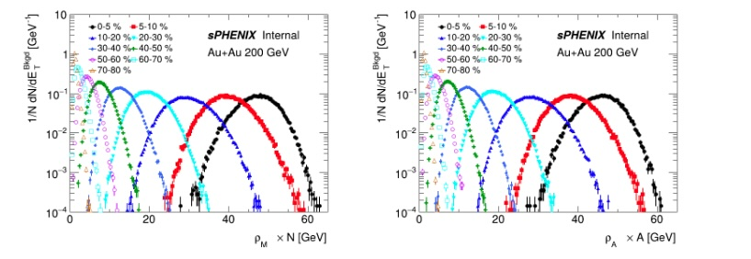
Preparing for the 2025 AuAu run
Note to self: PPG04
Underlying event characterization for jet reconstruction
  with calo windows, random cones, and embed jets
Comparisons of jet background fluctuations between subtraction methods
  Multiplicity based (New!)
  Area based (ALICE/STAR)
  Iterative subtraction (ATLAS/CMS)
Note Link goes here

Slide 25
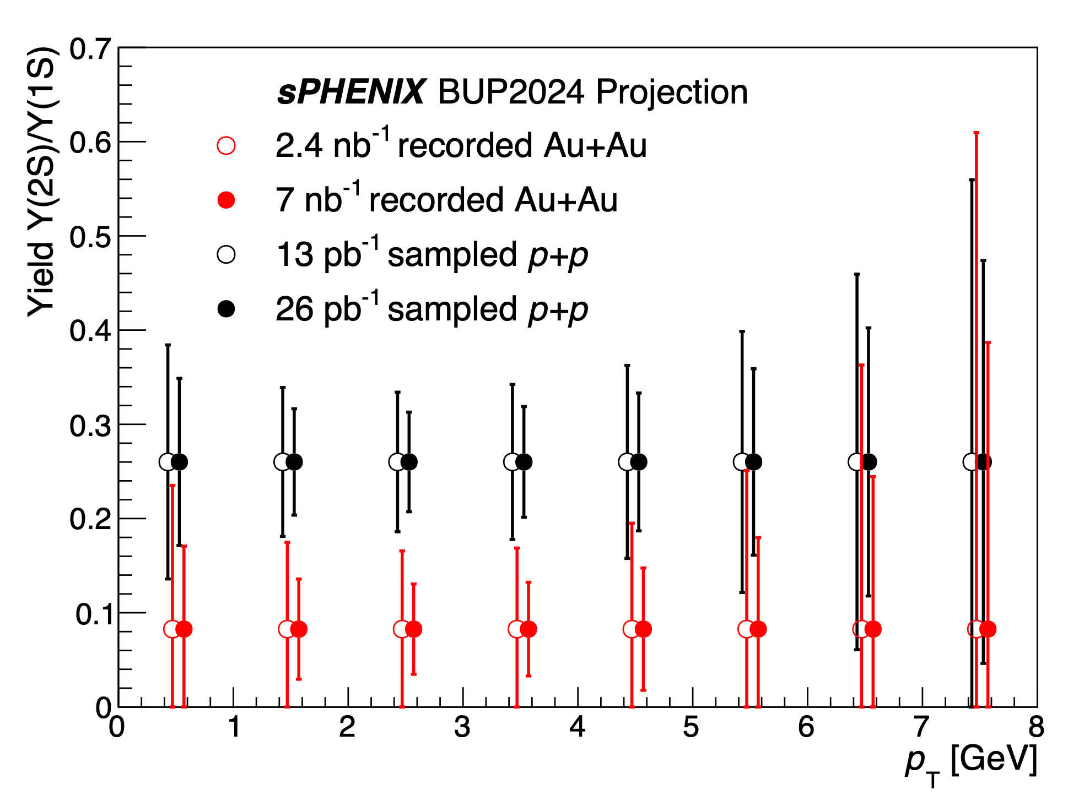
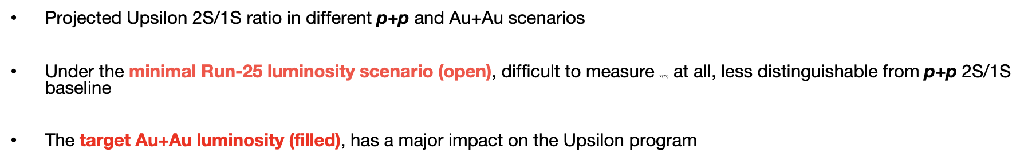
sPHENIX Projections: AuAu - Upsilons
Projected Upsilon 2S/1S ratio in different p+p and Au+Au scenarios
Under the minimal Run-25 luminosity scenario (open), difficult to measure $Υ(2S)$ at all, less distinguishable from p+p 2S/1S baseline
The target Au+Au luminosity (filled), has a major impact on the Upsilon program
Notes:
With the target luminosity, sPHENIX can measure the modifications in detail

Slide 26
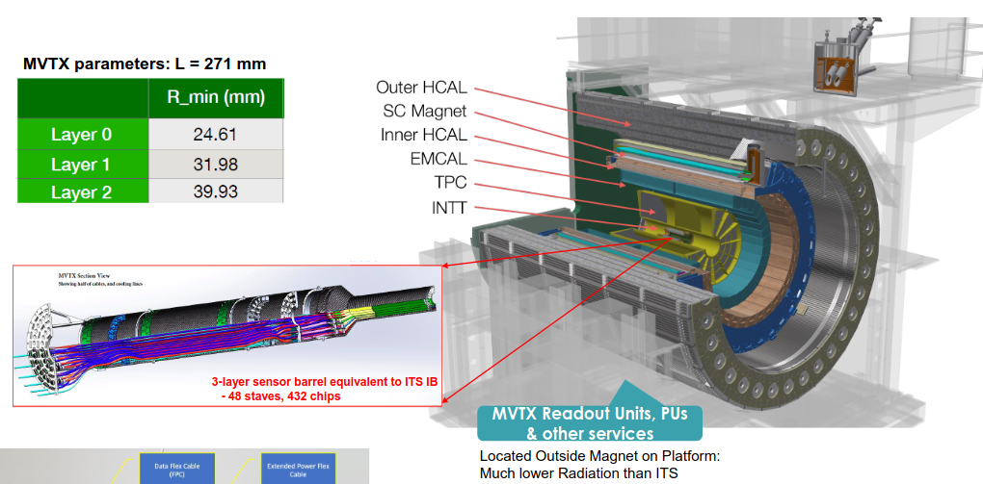
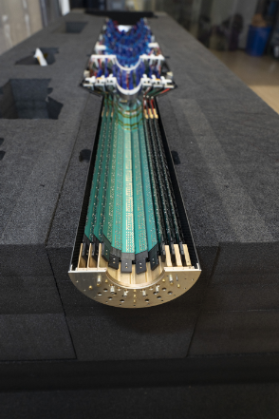
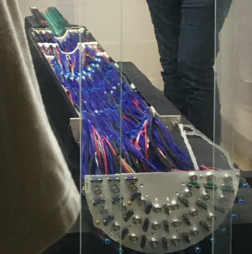
MVTX - Maps-based VerTeX detector
MAPS: Monolithic Active Pixel Sensors
  ALPIDE CMOS Pixel
  29 x 27 μm
48 staves/3 layers
  9 ALPIDE chips/stave
  2.4 < r < 4 cm, |η| < 1.1, full φ
  Copy of ALICE ITS2 inner barrel
Identifies track vertex position
  O(10 μm) vertex position resolution
  4 μs integration time
  Streaming or triggered readout
  Key to sPHENIX Heavy Flavor Program

Slide 27
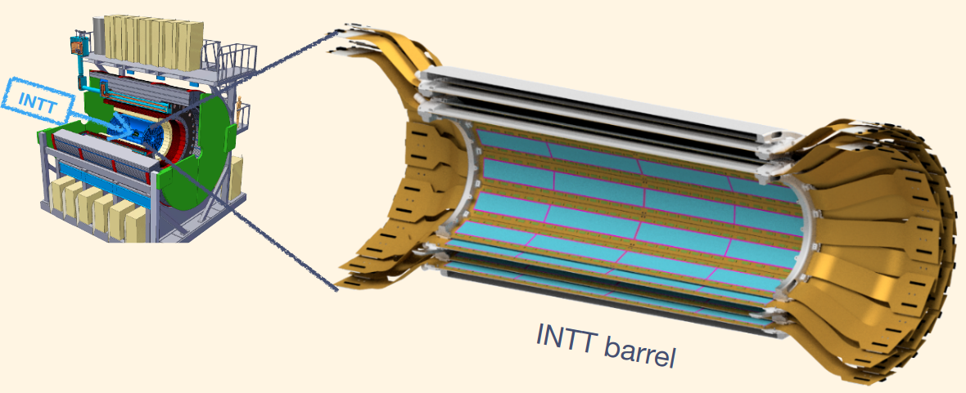
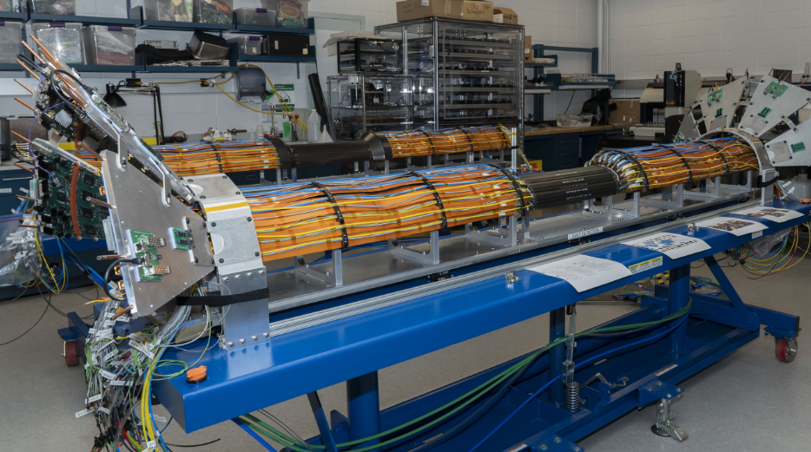
INTT - INTermediate silicon Tracker
Silicon Semiconductor Strip Detectors
  2 kinds of Hamamatsu silicon modules
  78 μm x 16 or 20 mm
56 staves/2 layers
  32+20 chips/stave
  7 < r < 11 cm, |η| < 1.1, full φ
Precision Timing + Hit Interpolation
  O(100 ns) - resolves bunch x-ing
  O(10 μm) resolution in rφ
  O(1 cm) resolution in z

Slide 28
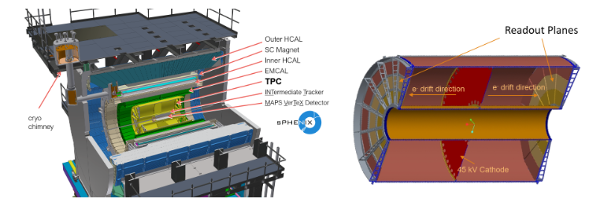
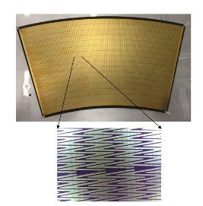
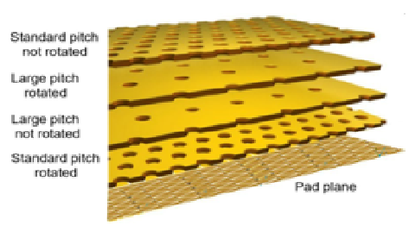
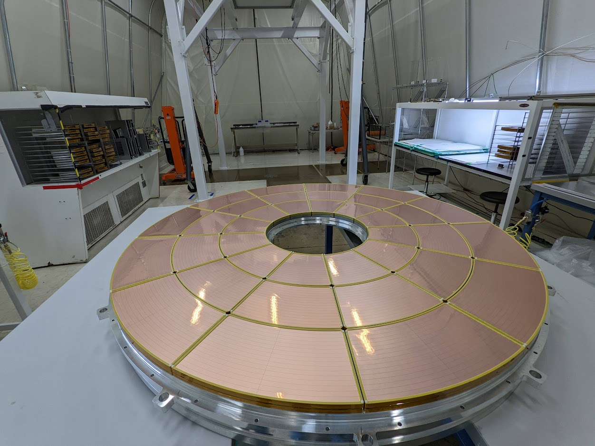
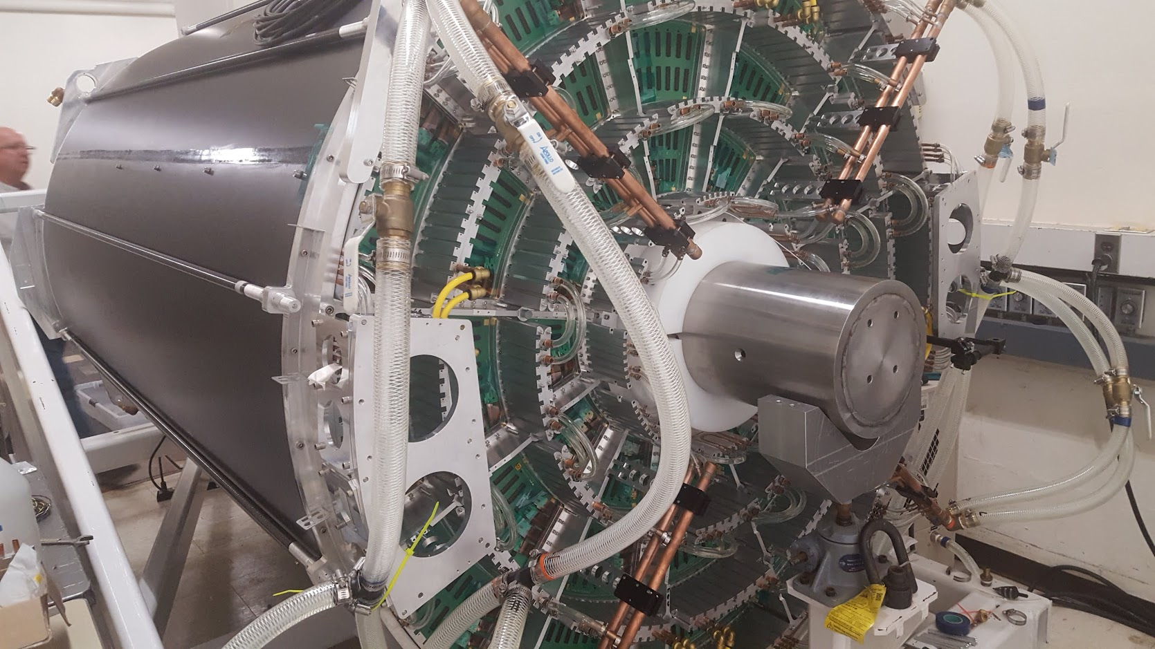
TPC - Time Projection Chamber
Gaseous Drift Detector
  Ar/CF₄/iC₄H₁₀ 75/20/5 % drift gas
    O(10 μs) drift time
  GEM (Gaseous Electron Multiplier) amplification
    4 Kapton + Copper GEMs / module
  Un-gated like ALICE TPC
    Allows for streaming readout
  Zig/Zag segmented copper sensor pads
    Improved position resolution
72 GEM modules/2 sides
  36 modules / full φ
  3 modules / full r
  20 < r < 78 cm, |η| < 1.1, full φ
Measures Momentum
  Target momentum resolution:
    Δp/p = 0.02 for p ~ 5 GeV
  O(150 μm) spatial resolution

Slide 29
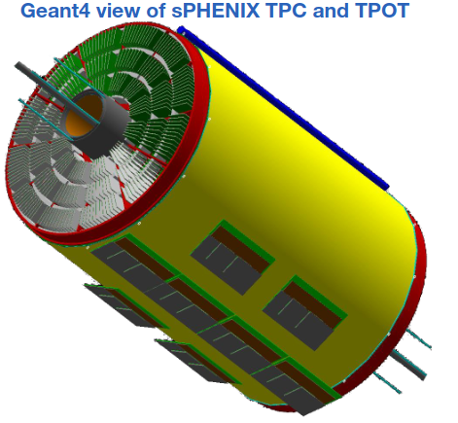
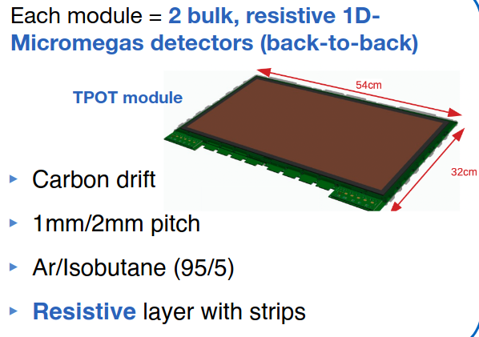
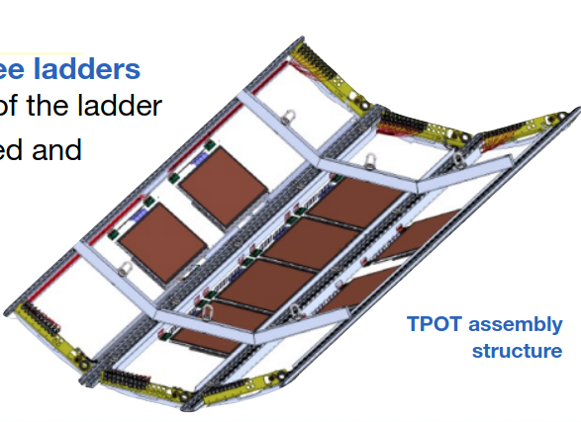
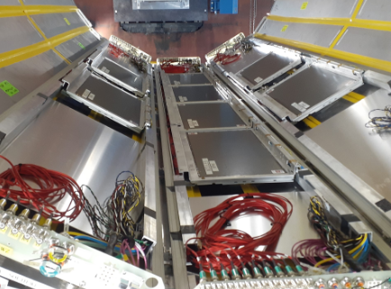
TPOT - Time Projection chamber Outer Tracker
Gaseous Drift Detector
  Ar/iC₄H₁₀ 95/5 % conversion gas
    3 mm conversion length
  Micromegas amplification
  Resistive layer w/ strips for readout
8 modules/bottom of TPC
  Partial coverage
Provides reference for TPC
  O(100 μm) spatial resolution
  Calibrates Distortions
TPOT NIM Performance Paper: NIM-A 1066 (2024) 169615

Slide 30
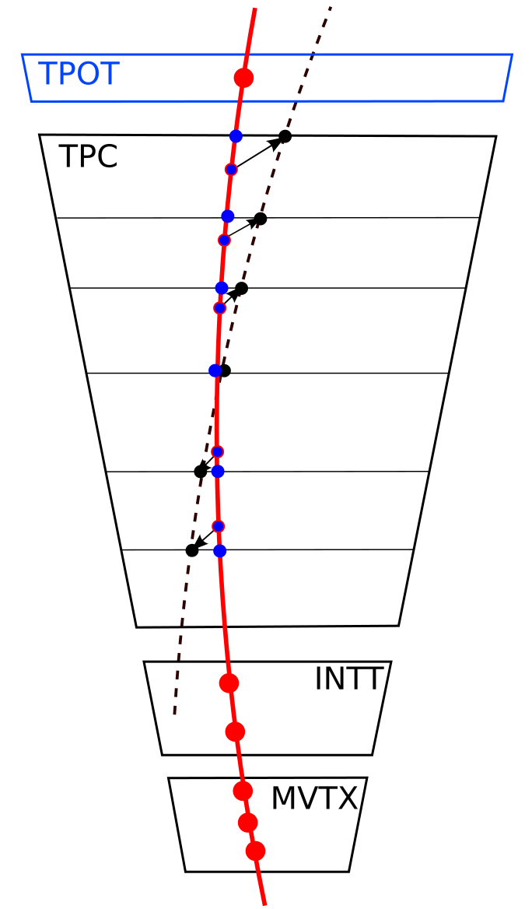
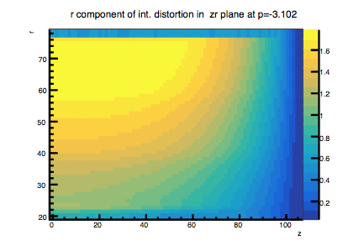


Factoring Distortions in the TPC
Static Distortion:
  external E, B fields: non uniformity and alignment
  expected to be O(1-2cm)
  does not change
  mixes with module alignment, module edge effects, etc
Average Distortion:
  average spacecharge
  expected to be O(1-2mm)
  changes slowly with lumi. and ambient conditions
Event-by-Event (ExE) Distortion:
  fluctuations in spacecharge
  expected to be <O(100um)
  changes rapidly (78ms for full refresh)
simulated δr in r-z slice
static
1.8cm
0.15cm
average
<100um
fluctuation

Slide 31


Correction Schemes
Distortion monitors operate on three time scales:
Very Slow: Direct lasers measure static distortions over ~hours of non-beam running
Slow: Track residual calc. measures average distortions with ~10 minute samples in TPOT acceptance, after statics corrected.
Fast: Diffuse laser flashes on CM measures (2D) distortion fluctuations at kHz after averages corrected.
Fast: Digital current + field maps provides orthogonal, but indirect, measure of SC distortion

Slide 32


Diffuse Laser Concept
Calibration pattern from diffuse UV laser light on aluminum (vs ENIG)
  Max rate much faster than IBF drift time
Pads: precise r,ɸ
Laminations: easy registration, ɸ
z position relative to trigger monitors drift velocity

Slide 33


Direct Laser Concept
Builds on fixed laser injection in STAR, ALICE: Ionize the gas through 2γ process on trace impurities.
Space constraints: Inject laser through ports in readout plane
First fully steerable laser in a collider TPC
  quartz bar delivers beam with angles preserved via total internal reflection
  Overlapping coverage
  Fires at 10s of Hz
Straight-line laser tracks probe static distortions throughout the volume

Slide 34




EMCAL - ElectroMagnetic CALorimeter
Tungsten-Scintillating Fiber Sampling Calorimeter
  Light guide + silicon photomultiplier (SiPM)
  Pre-amp board sums signals from SiPMs
64 sectors: 32 azimuthal x 2 longitudinal
  |η| < 1.1, full φ
  96 modules / sector - 1 module = 2x2 towers
  Towers have projective geometry
  Each tower is Δη x Δφ = 0.025 x 0.025
Performance Specs
  0.83 λ_{int}, 20 X₀
  Moliere Radius: 2.3 cm
  Energy Resolution: = 5 % ⨁ 16 % / √E

Slide 35

EMCAL - ElectroMagnetic CALorimeter
EMCAL (test beam) performance:
  IEEE Trans.Nucl.Sci. 68 (2021) 2, 173-181
  Linea35rity and resolution for 2.5 x 2.5 cm² cut centered on a tower
EMCAL reconstruction:
  Proton-proton data show good invariant mass peaks for π⁰ and η

Slide 36



HCAL - Hadronic CALorimeter(s)
Inner + Outer
  Al (inner) and steel (outer) absorber plates
  Scintillating tiles w/ embedded WLS fibers
32 sectors (both inner & outer HCAL)
  |η| < 1.1, full φ
  48 towers / sector
  (1 tower = 4/5 tiles (I/O))
  Towers have projective geometry
  Each tower is Δη x Δφ = 0.1 x 0.1
Performance Specs
  5 λ_{int} for both calos combined
  Energy Resolution: = 14 % ⨁ 81 % / √E for hadrons

Slide 37
Courtesy of Misaki Ouchida (Hokkaido University)
See more science art from Misaki
Notes:
Multi-scale probes (jets over a wide kinematic range, heavy flavor, quarkonia)

Slide 38


Why do Jets at RHIC?
Jets are showers of particles from initial hard scatterings before Quark Gluon Plasma (QGP) formation
QGP temperature/temperature evolution different at LHC and RHIC
Different mixtures of quark vs. gluon jets
sPHENIX Proposal

Slide 40


