Slide 1
Long-range near-side correlation in e⁺e⁻ collisions at 183-209 GeV with ALEPH archived data
MIT HIG group's work was supported by US DOE-NP
Michael Peters, in collaboration with Yu-Chen (Janice) Chen, Yi-Chen, Pao-Ti Chang, Yen-Jie Lee, and Marcello Maggi, Austin Baty, Anthony Badea, Chris McGinn, Jesse Thaler, Gian Michelle Innocenti, and Tzu-An Sheng
arXiv: 2312.05084
Analysis note: 2309.09874
[Phys. Lett. B 856, 138957 (2024)]

Slide 2
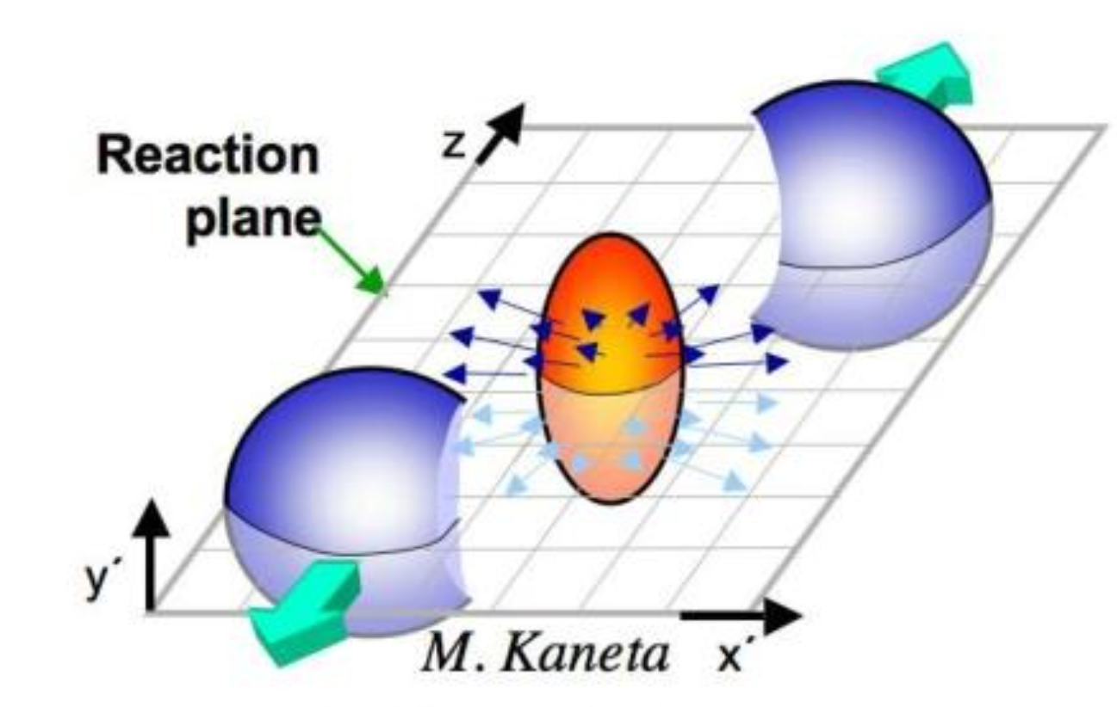
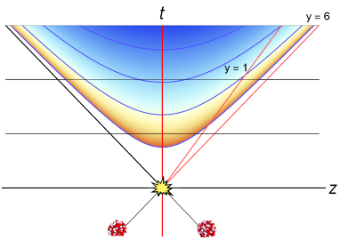
Long-range near-side correlations: The “Ridge” in HI collisions
Ridge correlation:
long-range (large Δη) near-side (small Δɸ)
Large correlation for pairs of particles with large $Δη$ and small $Δφ$
Large $Δη$ -> causally disconnected for single point-like interaction, hence “long-range”
Hints at existence of collective behavior, i.e. QGP

Slide 3
The “Ridge” in pp collisions
Also observed in high-multiplicity pp collisions at the LHC in 2012
Initial-state anisotropy may create ridge in this case
System thought to be too small to produce collective interactions
[CMS: JHEP 1009 (2010) 091 ]

Slide 4
The “Ridge” in pp collisions
Proposed explanations include:
Initial-stage effect (e.g. CGC)
Escape mechanism, after one or a few scatterings (AMPT, Pythia with Rope Mechanism, multi-parton scattering…)
Final-state effect due to “mini-QGP”
Among others…
[CMS: JHEP 1009 (2010) 091 ]

Slide 5
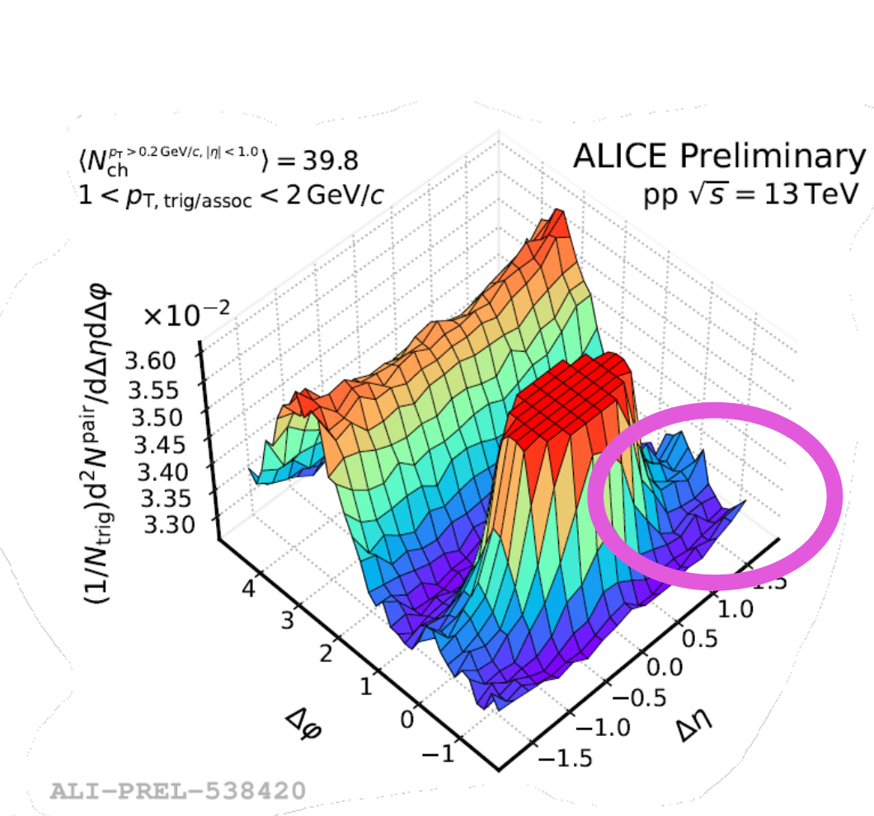
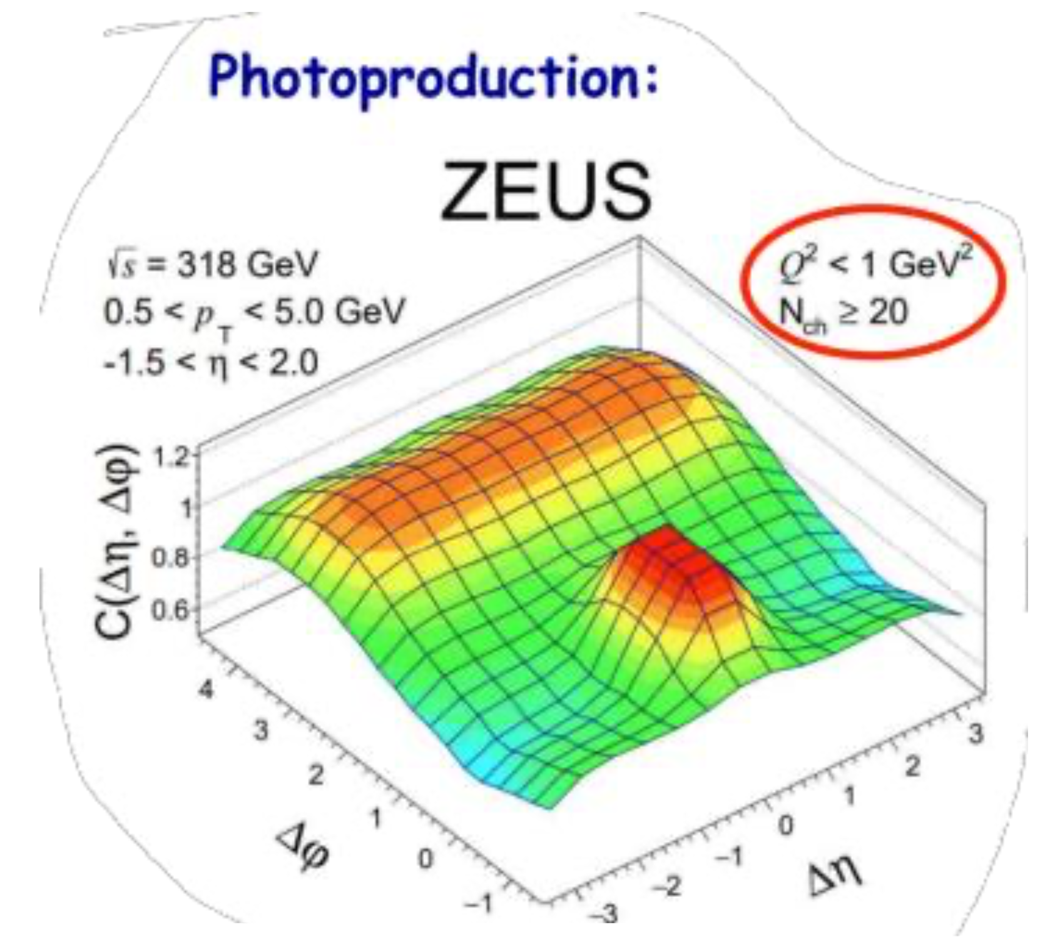
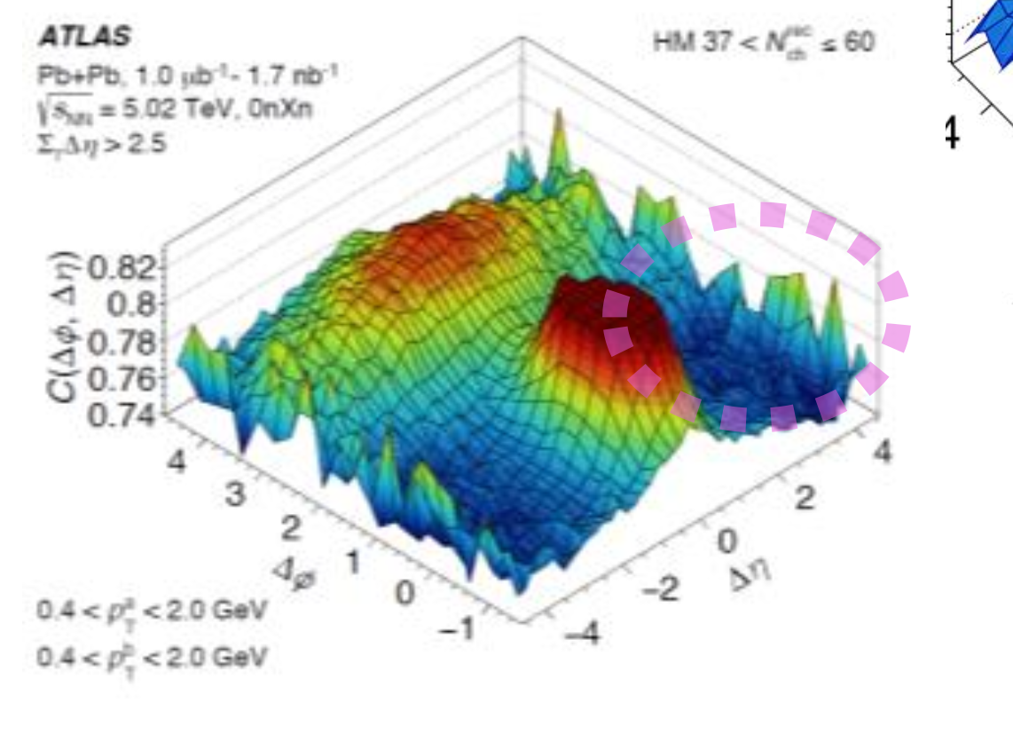
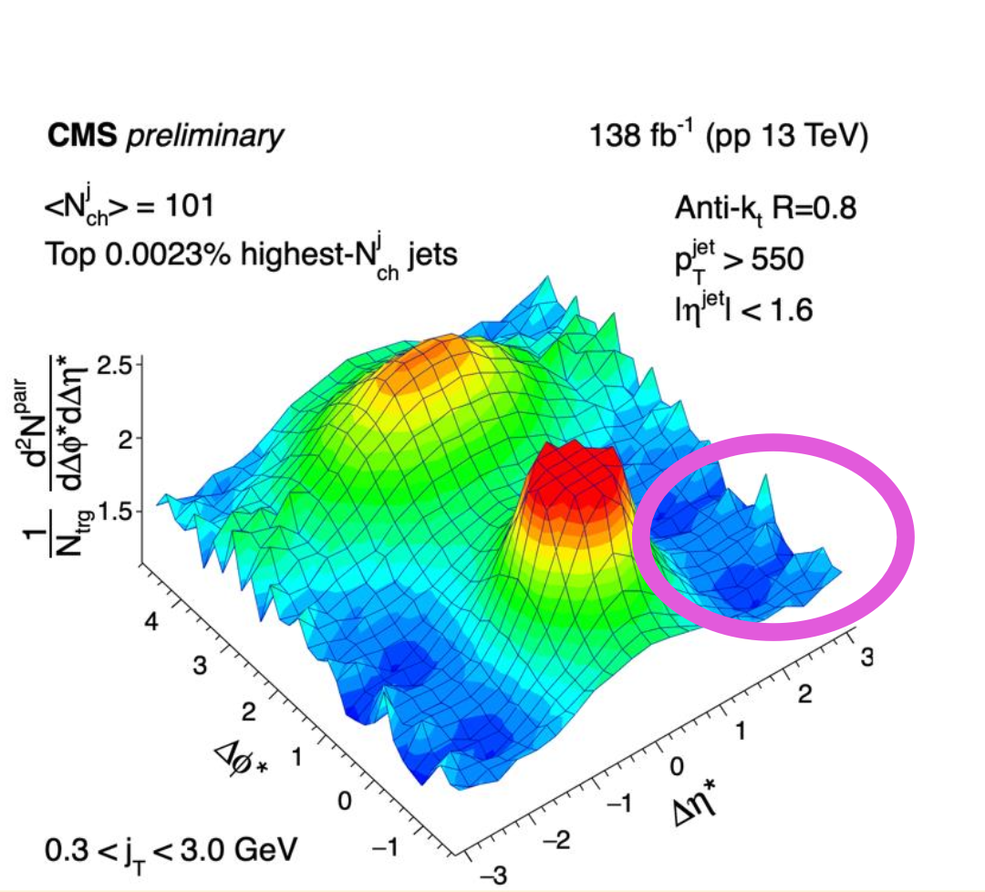
Emergence of “ridge-like” behavior?
HM pPb
HM PbPb
HM pp
LM pp
?
Transverse size
Early stage complexity
LM 𝛄p
LM 𝛄A
HM pp jets
LM e⁺e⁻
Credit: Yen-Jie Lee
Multiplicity

Slide 6
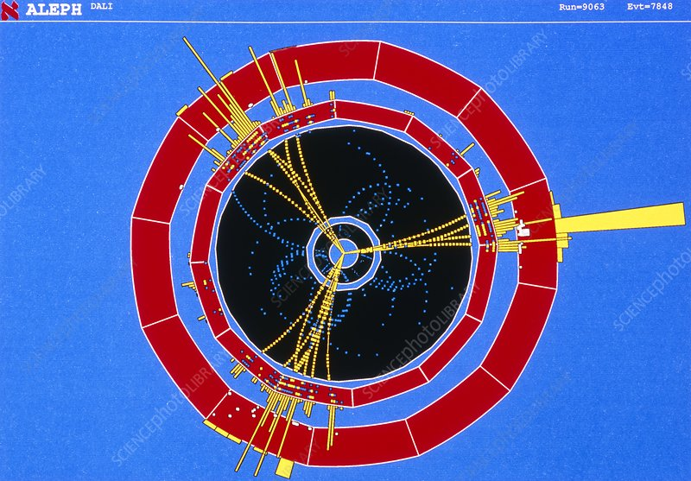
Electron-positron collisions: a QCD laboratory
Many advantages as a reference system for correlation studies:
No gluon ISR, no beam remnant
Structureless beam (no beam PDF, no MPI)
Point-like collisions (good kinematic control for final states)
Colorless initial state
Parton shower and hadronization occur in vacuum

Slide 7
ALEPH data re-analysis
Hermetic general-purpose detector on LEP collider
Large e+e- datasets taken from 1992-2004
Pythia6 MC archived along with data
Re-analyzed using MIT Open Data Format
Hadron Calorimeter
Superconducting Magnet (1.5T)
Electromagnetic Calorimeter
Muon Chamber
Time Projection Chamber
Inner Tracking Chamber
*Acknowledgement:
we would like to thank Roberto Tenchini and Guenther Dissertori from the ALEPH collaboration for the useful comments and suggestions on the use of ALEPH data

Slide 8
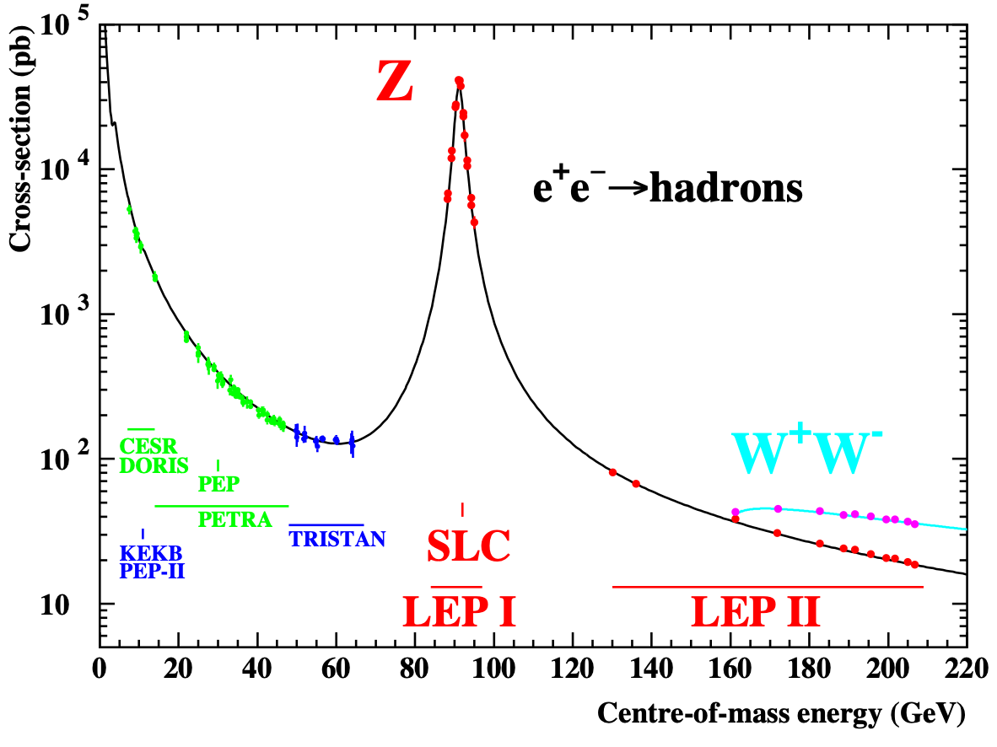
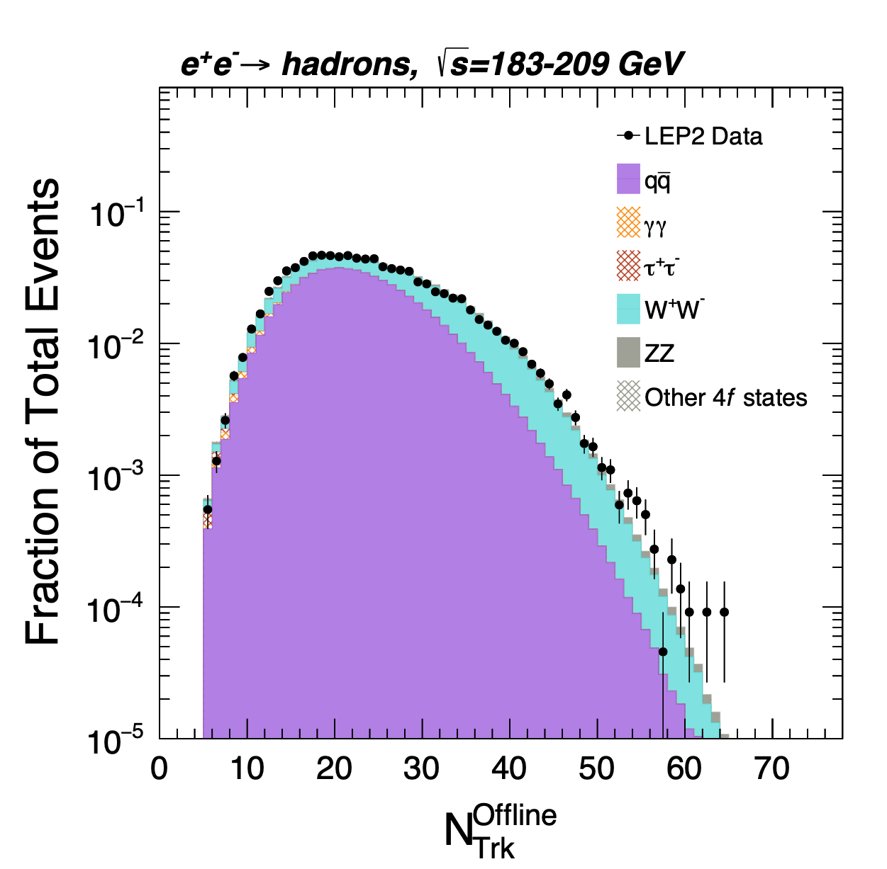
LEP I and LEP II datasets
LEP I dataset (1992-1995): Z-pole energies (91 GeV)
LEP II dataset (1996-2000): higher energy (183-209 GeV), significant WW production
WW events dominate high-multiplicity data (two color strings instead of one)
$$e^{+}e^{−}→W^{+}W^{−}→4f$$

Slide 9
Thrust Distribution
Thrust measures event shape, from “spherical” (thrust=0.5) to “pencil-like” (thrust=1)
Good agreement between thrust distribution in this analysis and previous ALEPH Collaboration analyses
$$T=\max_{\hat{n}}{\frac{\sum_{i}{\left|\vec{p_{i}}⋅\hat{n}\right|}}{\sum_{i}{\left|\vec{p_{i}}\right|}}}$$

Slide 10
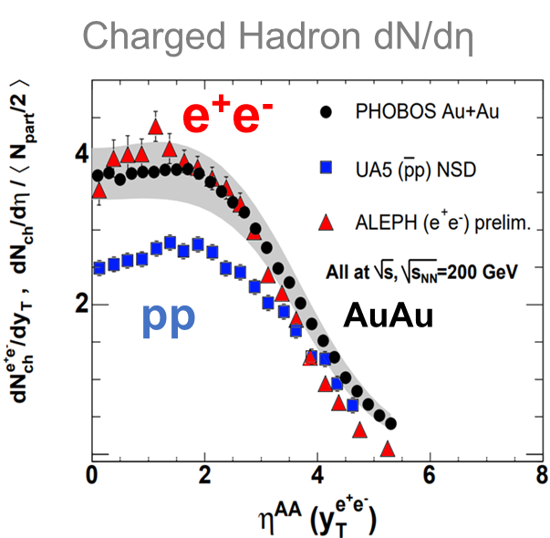
Two-particle correlation w.r.t. the thrust axis
Thrust axis used as reference to focus on medium expanding perpendicular to outgoing final-state axis
$dN/dη$ distributions in e+e- relative to thrust axis similar to those in pp and AuAu relative to beam axis
Δη = η1 - η2
φ1
φ2
e¯
e⁺
Beam pipe
10

Slide 11
Two-particle correlation: the observable
Correlation between pairs of tracks’ $(η,φ)$ coordinates relative to thrust axis
trigger particle
φ2
Δη = η1 - η2
φ1
ɸ
Reference z axis
$$\frac{1}{N_{trk}^{corr}}\frac{d^{2}N^{pair}}{dΔηdΔφ}$$
η

Slide 12
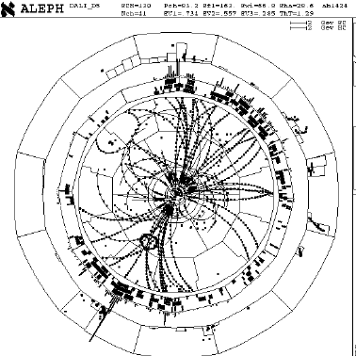
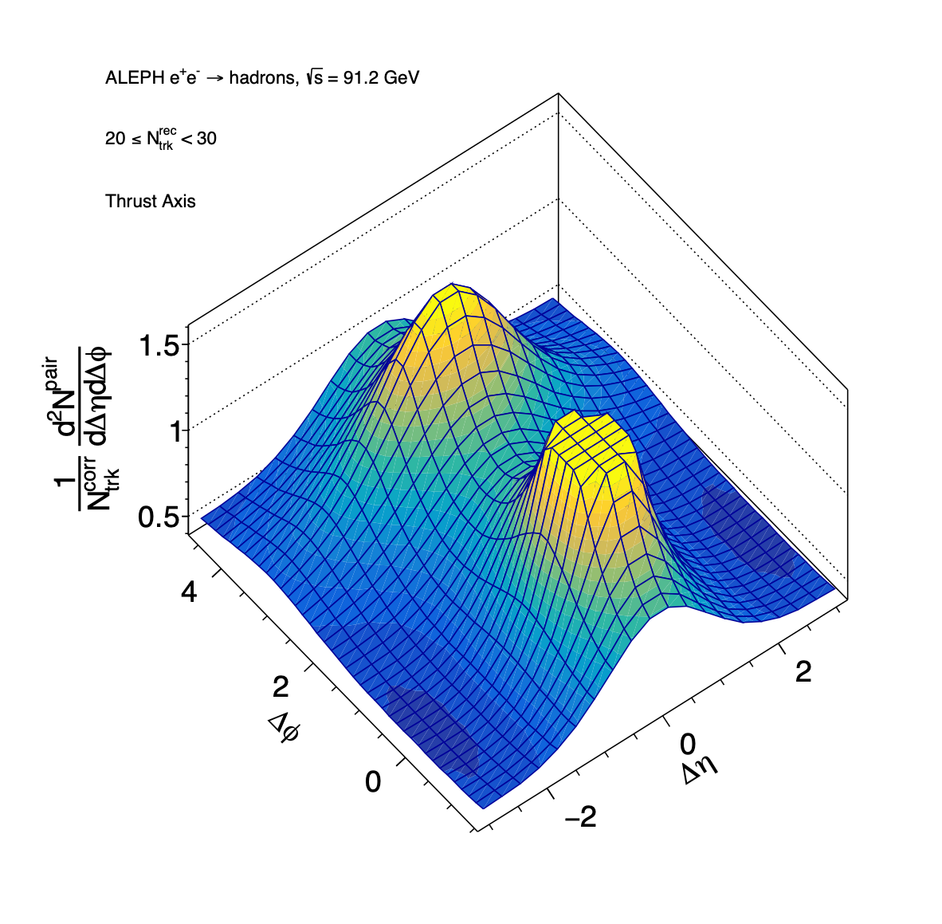
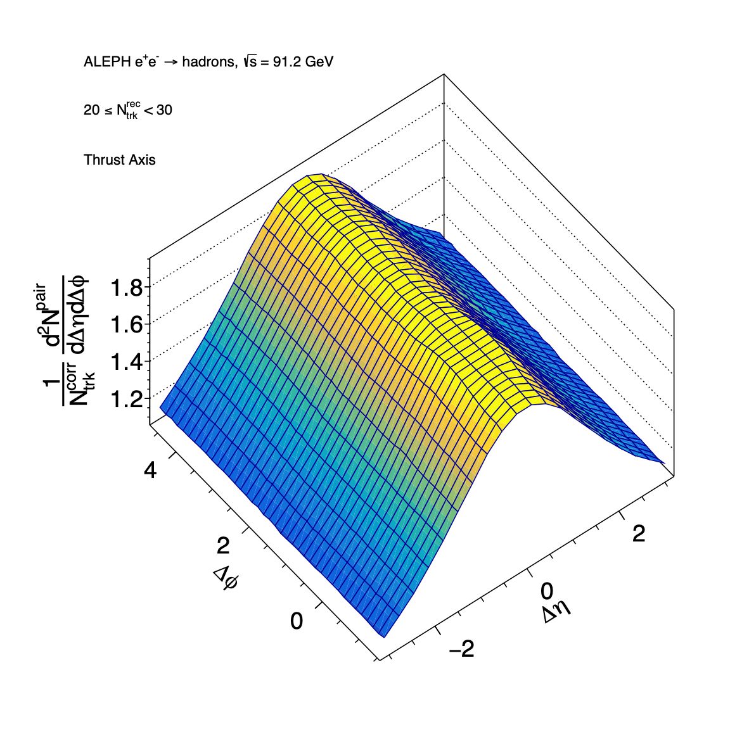
Background reduction via event-mixing
Event 1
Background from random pairing recovered using pairs of tracks from two different events
Same event
Mixed events
Event 2
Signal
(raw correlation function)
Background
(random pairing)

Slide 13
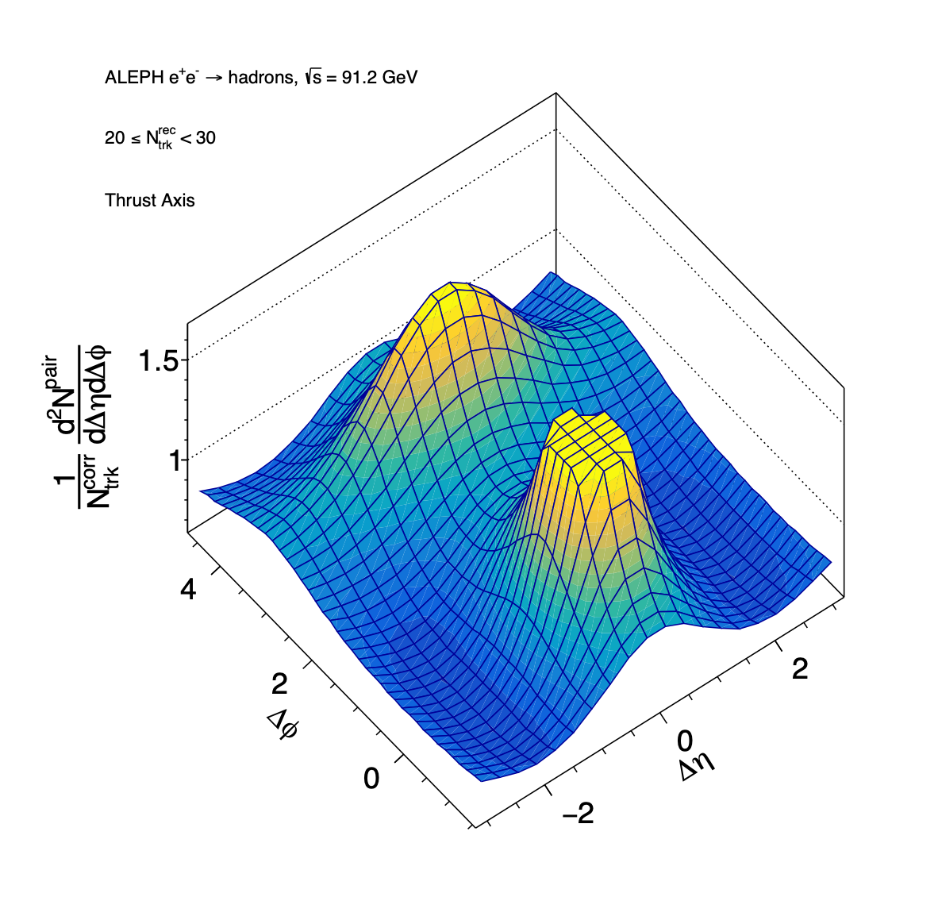
Extraction of observable
$$\frac{1}{N_{trk}^{corr}}\frac{d^{2}N^{pair}}{dΔηdΔφ}=B(0,0)×\frac{S(Δη,Δφ)}{B(Δη,Δφ)}$$
Signal
(raw correlation function)
Background
(random pairing)
=
Normalization of $B(Δη,Δφ)$

Slide 14
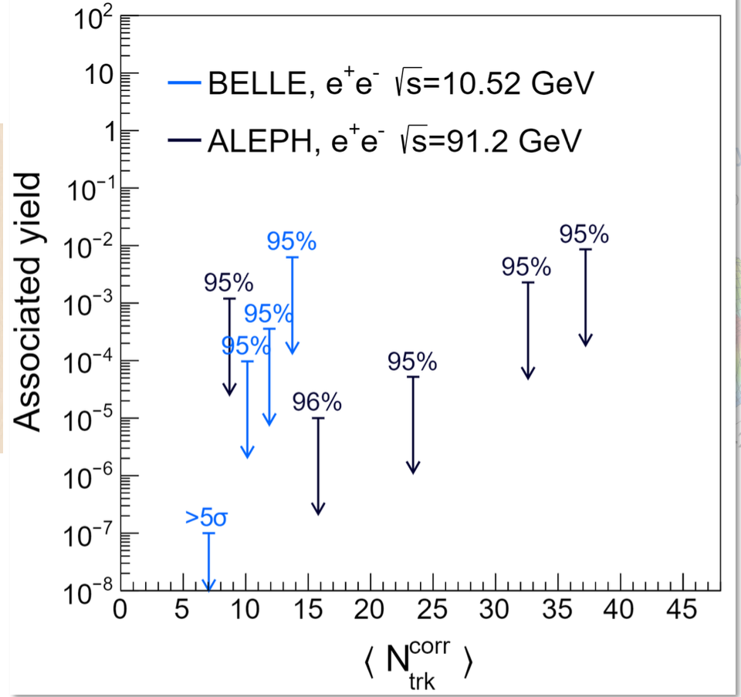
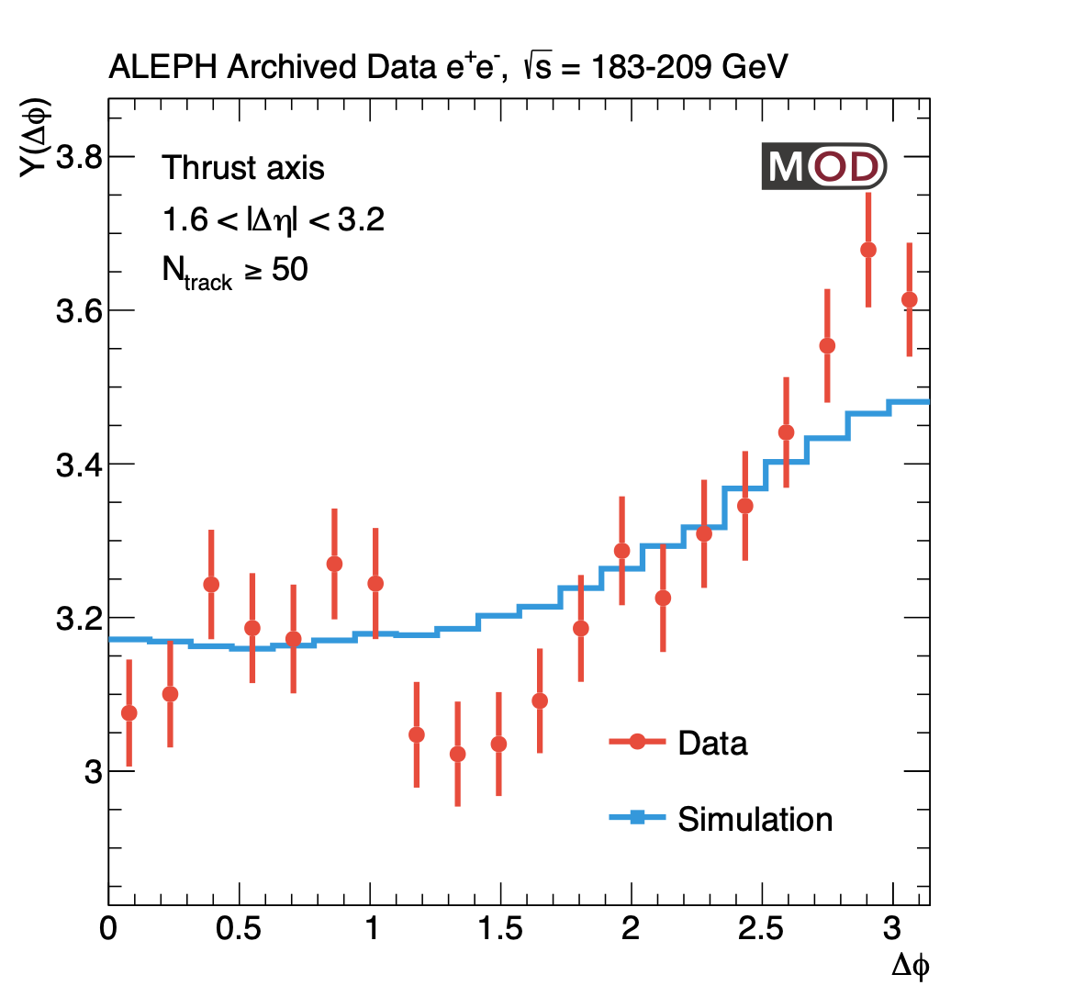
Previous two-particle correlation results
Belle (√s=10.52 GeV)
2019 re-analysis of LEP I data showed no significant yield associated with “ridge” feature
2022 BELLE analysis agreed
[Phys. Rev. Lett. 128, 142005 (2022)]
LEP-I (Z-pole)
Ridge-like yield estimation
[Phys. Rev. Lett. 123, 212002 (2019)]

Slide 15
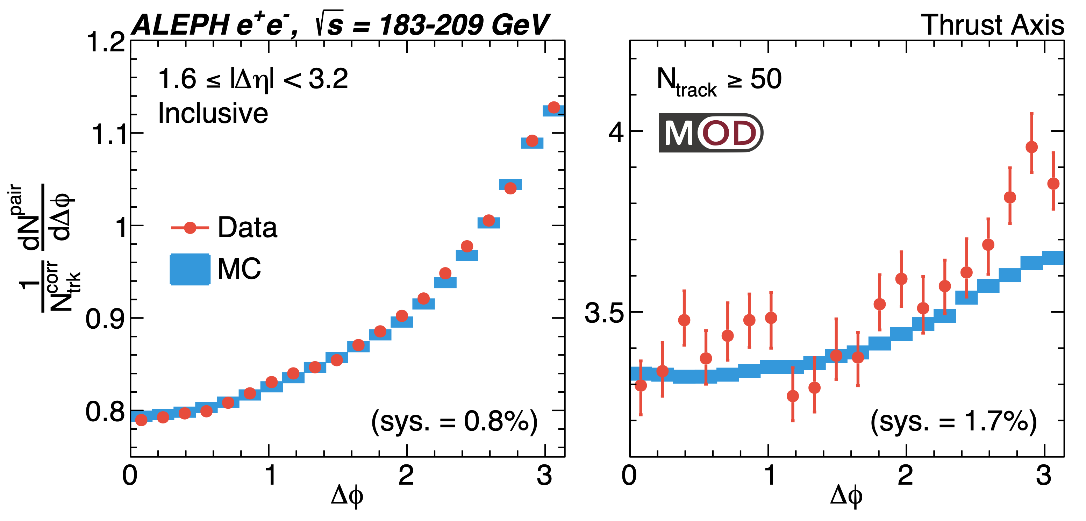
Two-particle correlation >183 GeV at LEP II
Generally good agreement between data and MC for LEP II re-analysis

Slide 16
High-multiplicity (Ntrack>=50) LEP II results
Interesting features in high-multiplicity long-range near-side correlations
Possible hint of excess over MC

Slide 17
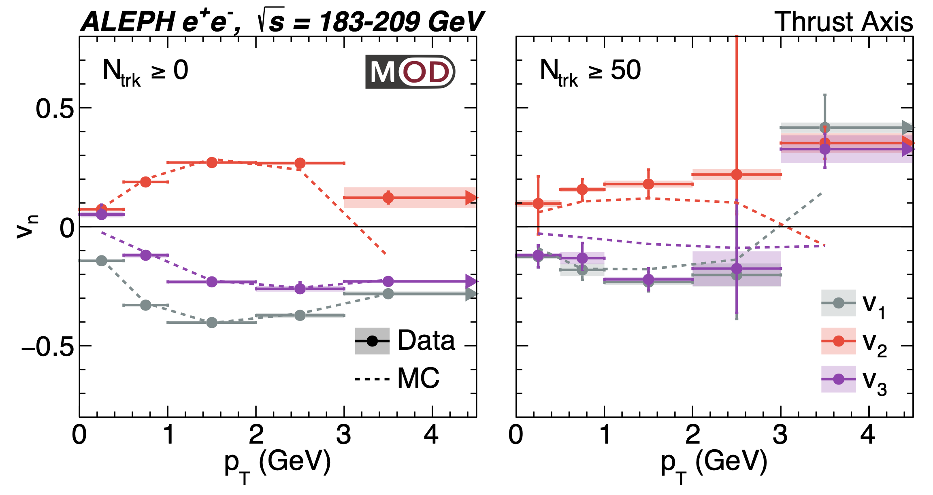
“Flow-like trend” coefficients
Inclusive NTrk
High-multiplicity
Sign change for $v_{2}$ and $v_{3}$
Coefficients found by taking Fourier transform of yield
$$Y(Δφ)=\frac{1}{N_{trig}}\frac{dN^{pairs}}{dΔφ}=\frac{N^{assoc}}{2π}(1+\overset{n_{max}}{\underset{n=1}{∑}}2V_{nΔ}cos(nΔφ))$$
Assuming factorization: $v_{n}\{2,1.6<|Δη|<3.2\}=sign(V_{nΔ})\sqrt{V_{nΔ}}$

Slide 18
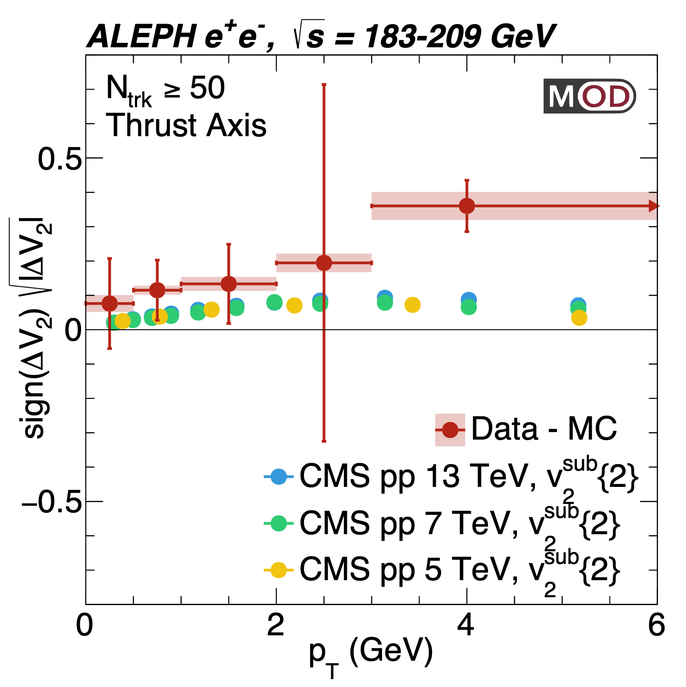
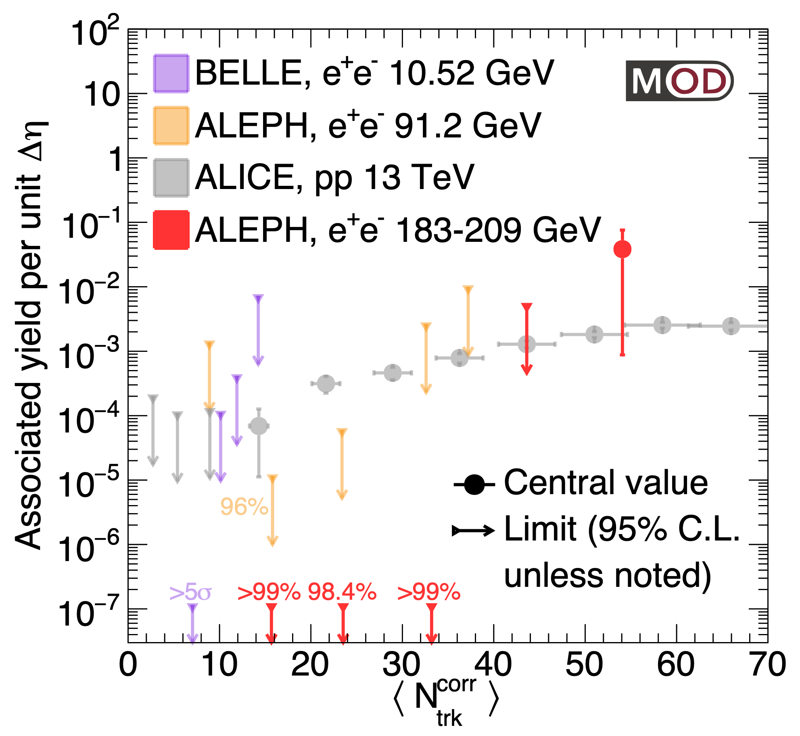
Similarity to low-multiplicity pp collisions?
Ridge-like yield estimation
Measured coefficients seem to be similar to CMS and ALICE measurements in low-multiplicity pp collisions at a variety of beam energies

Slide 19
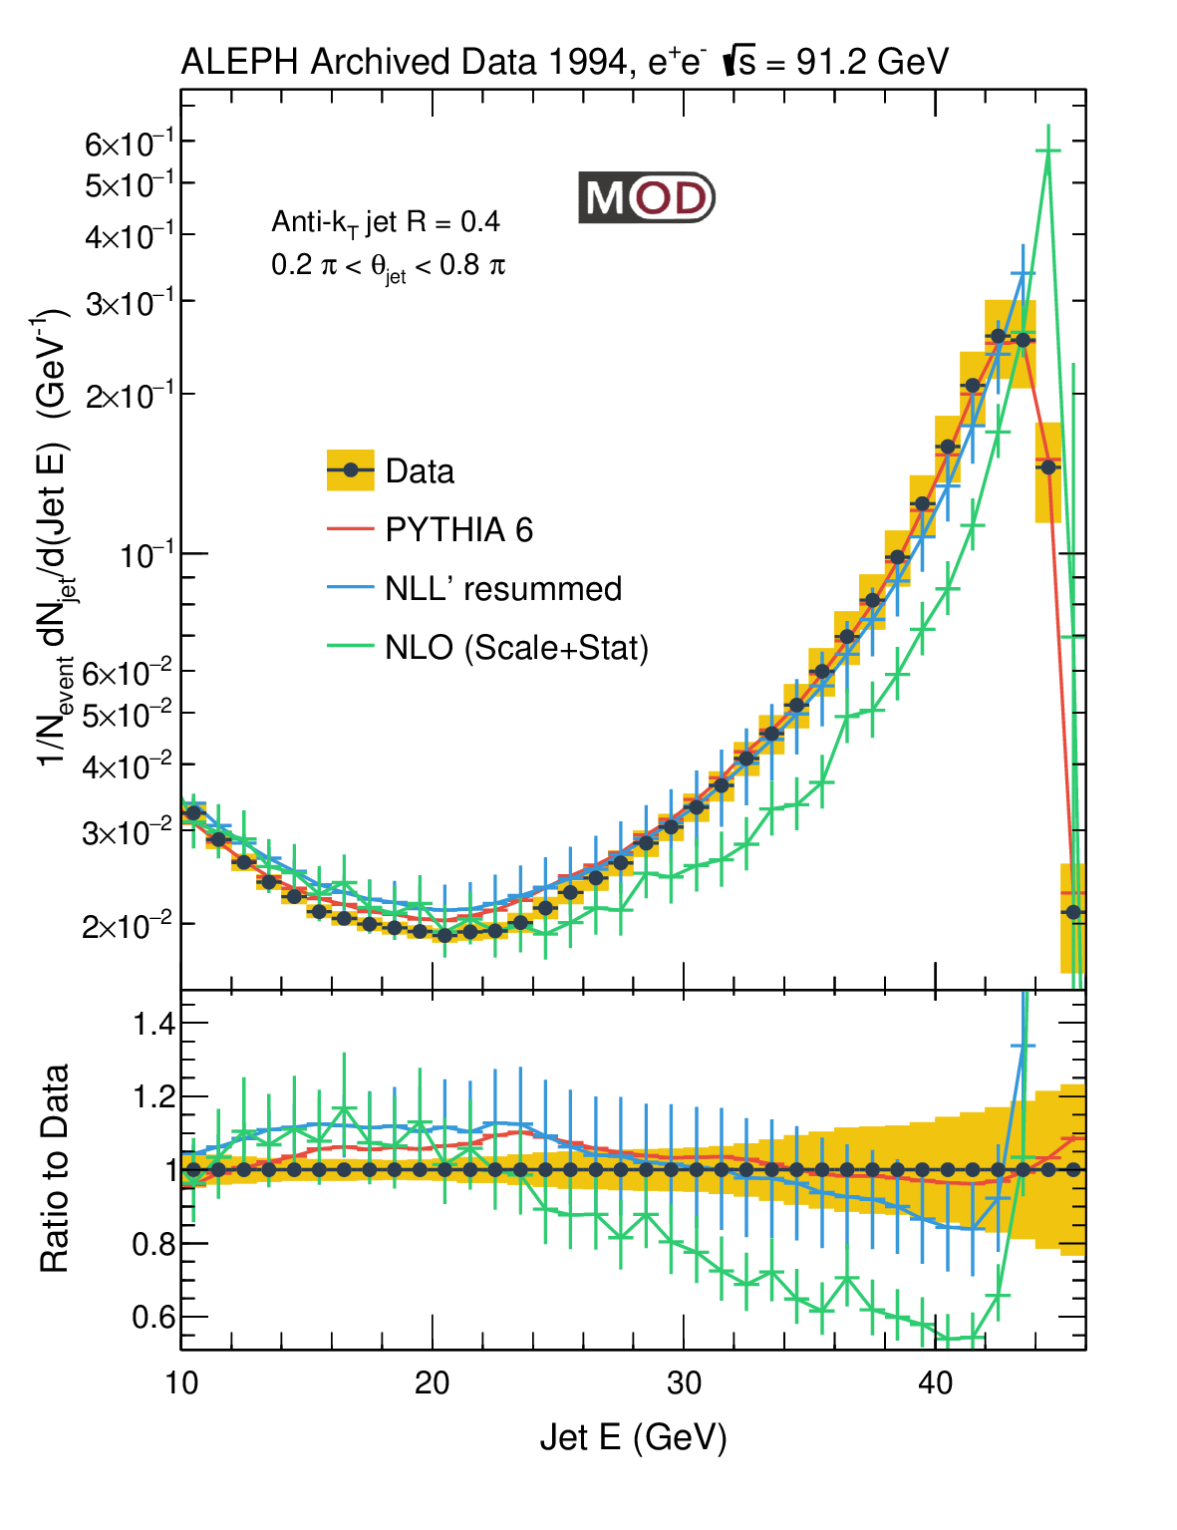
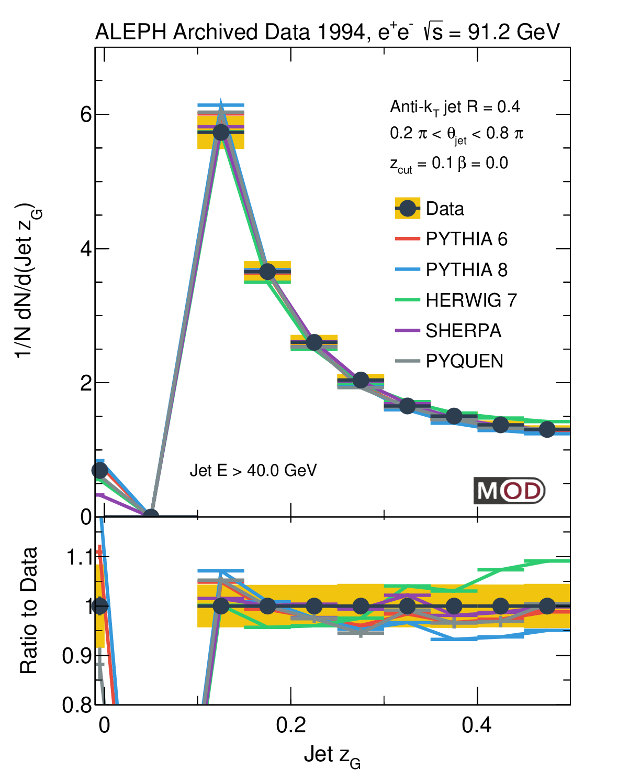
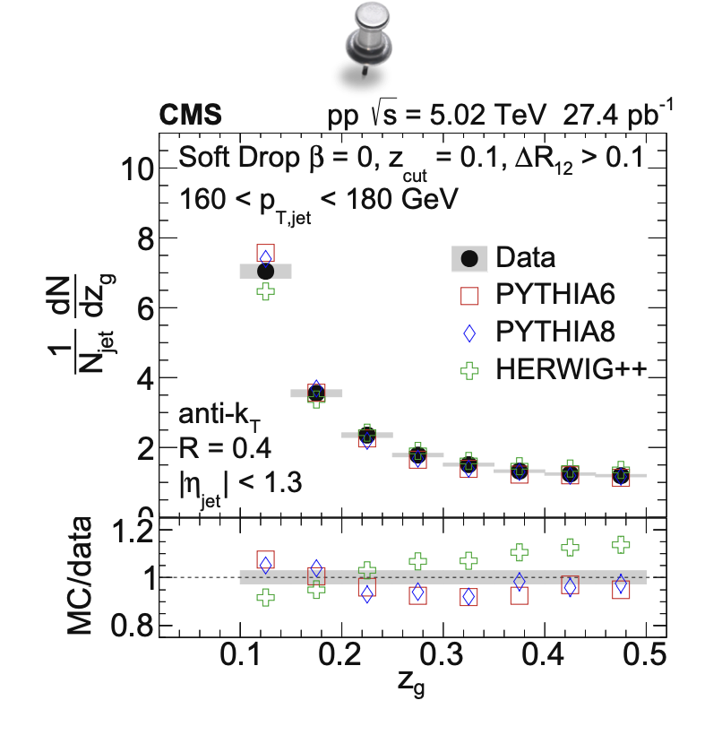
Other observables: Jet Substructure
Rising edge of jet energy spectrum sensitive to jet function
Jet energy sharing $(z_{g})$ shows similar trend between e+e- and pp collisions
ALEPH jet
[JHEP 06 (2022) 008]

Slide 20
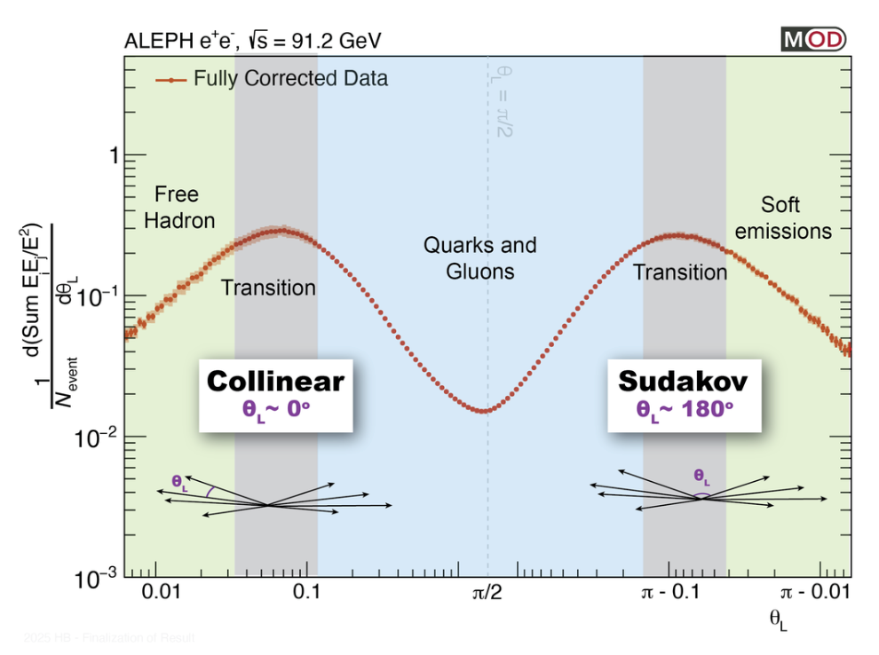
Other observables: Energy-Energy Correlator
Theorists (Ian Moult + collaborators, Iain Stewart, et al.) interested in this quantity in particular:
Directly sensitive to theory parameters (ex: 𝛼_𝑆)
Constraining non-perturbative parameters in lattice QCD
Unique opportunity in 𝑒^+ 𝑒^− to access the 2-point correlator from collinear to back-to-back limit
Excellent agreement between archived data and theory calculation
Analysis currently in internal review

Slide 21
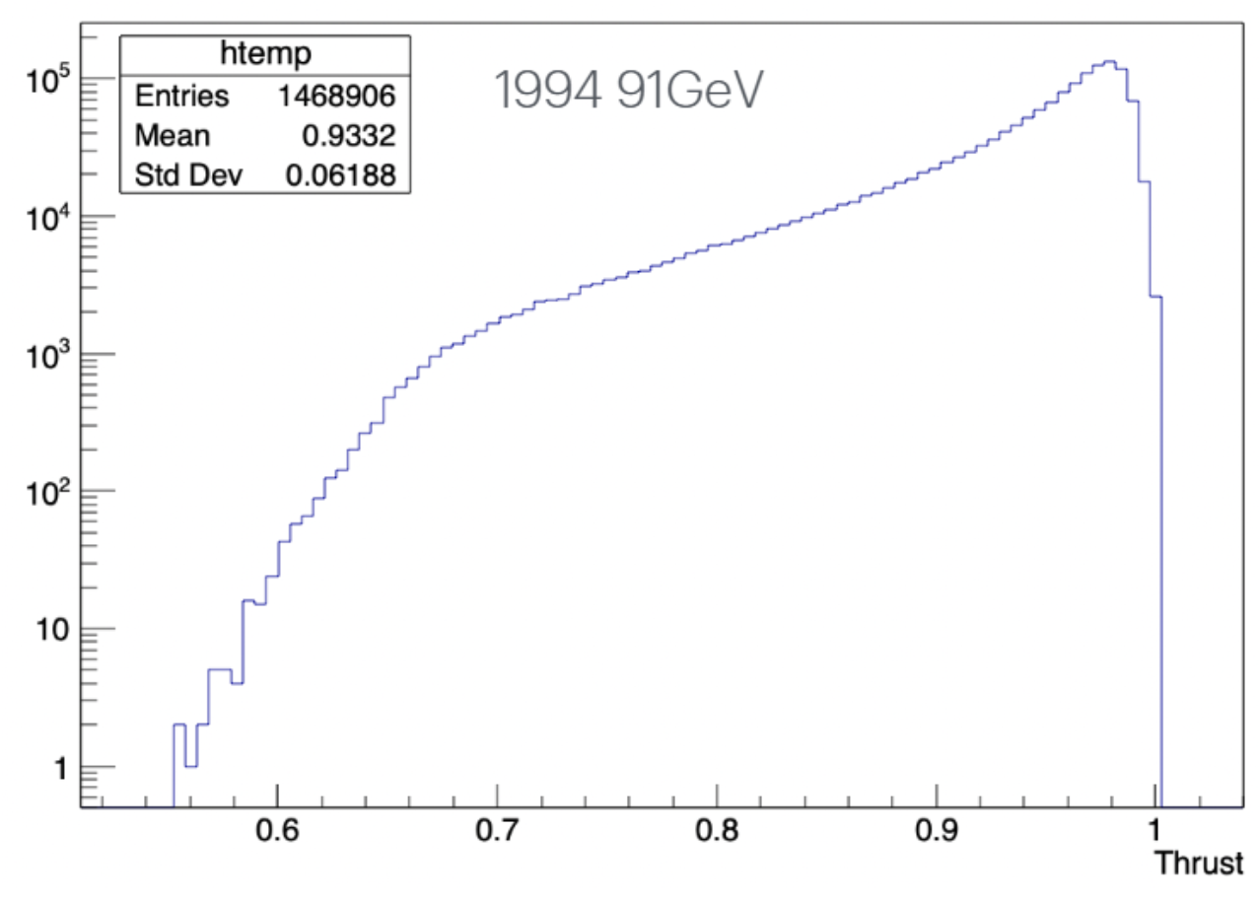
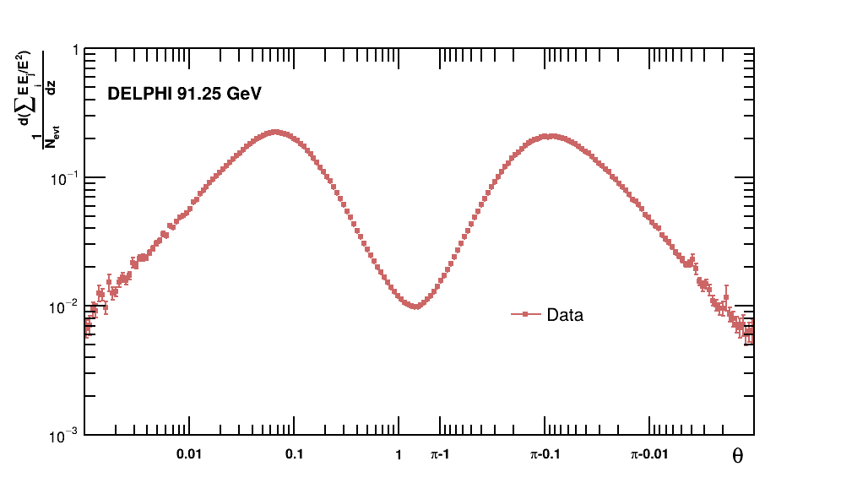
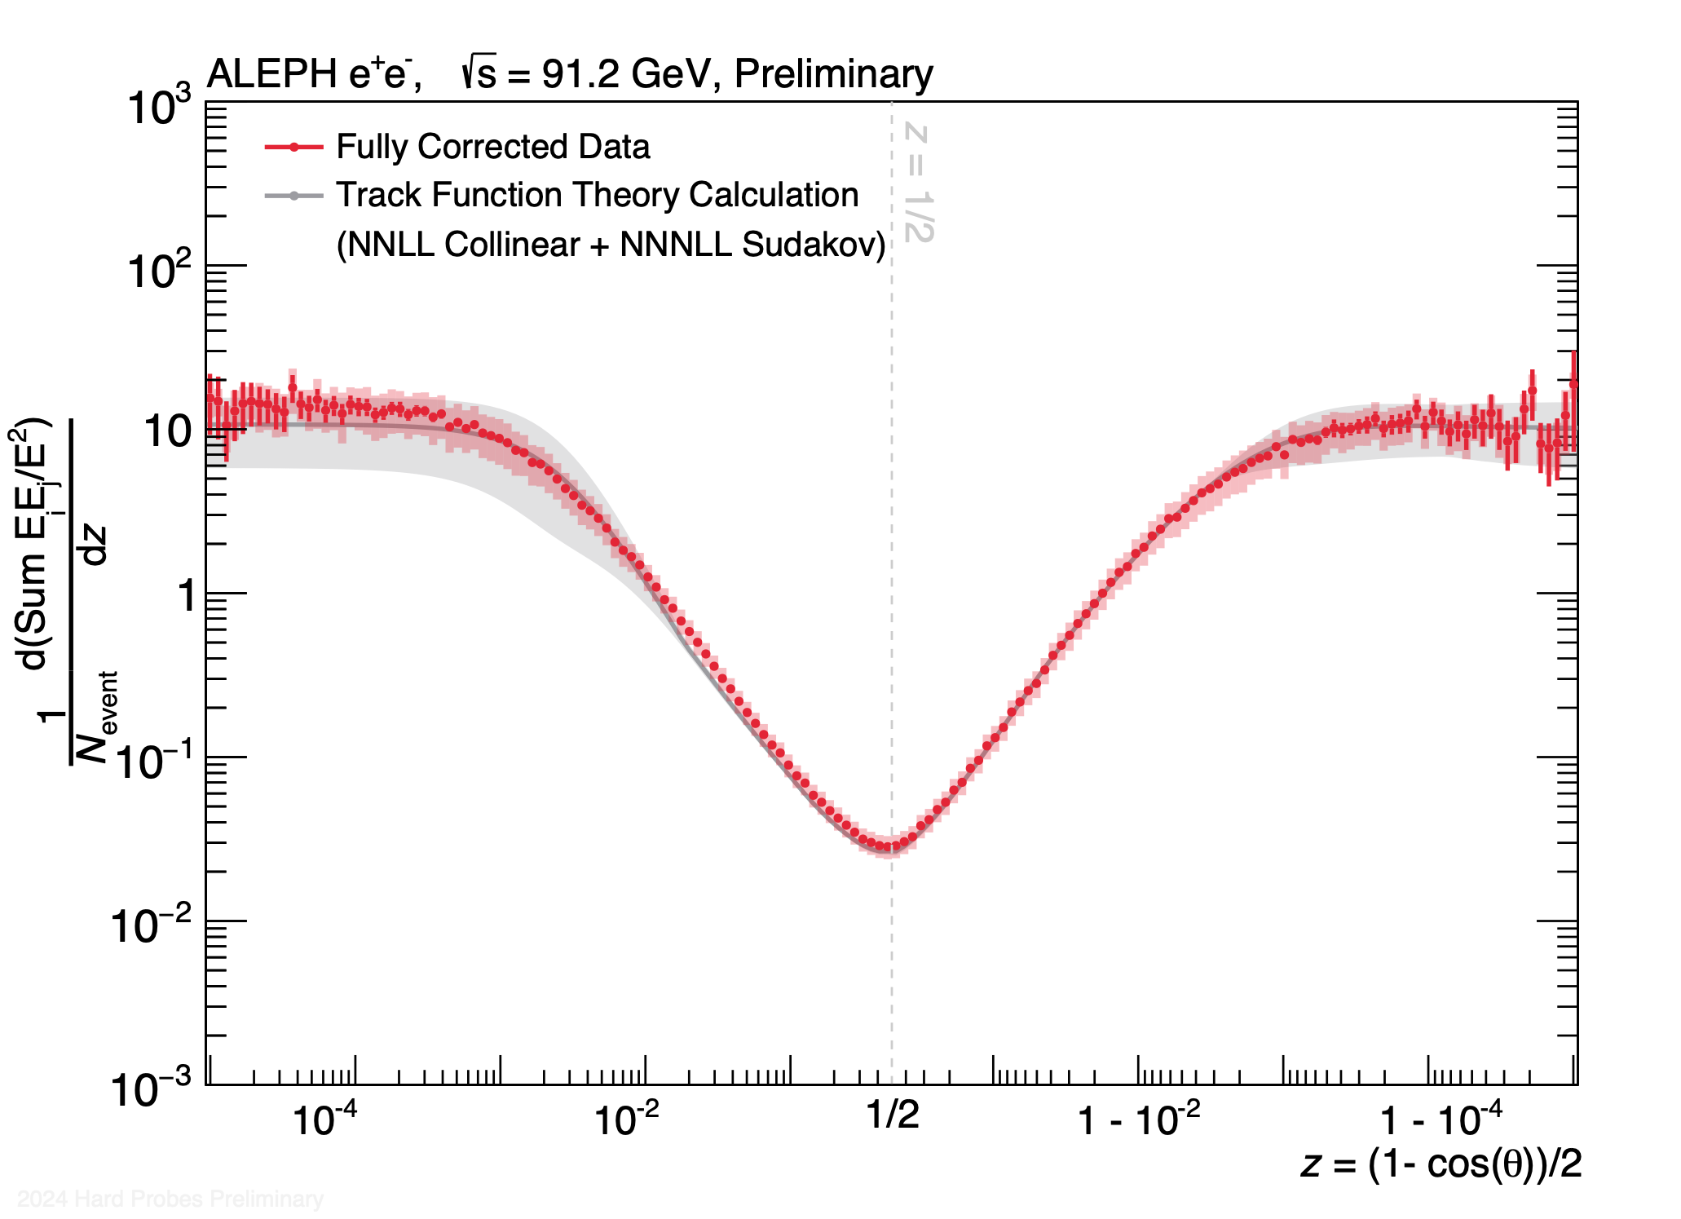
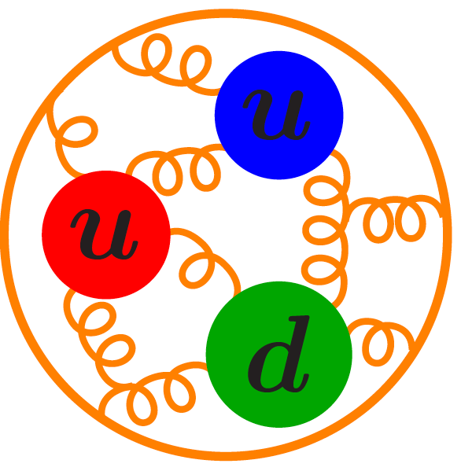
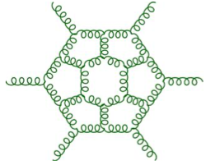
Other datasets: DELPHI archived data
Extremely useful as a cross-check of ALEPH re-analyses
Re-analysis actively in progress
Thrust distribution already substantially similar to ALEPH, EEC corrections under active development

Slide 22
Conclusions
Electron-positron collisions allow for investigation of smallest possible collision systems for flow-like characteristics
Re-analysis of LEP II data reveals possible signs of an excess long-range near-side yield relative to MC
Hints at a “bridge” between pure hard scattering and flow in pp collisions
Plenty of avenues for further use of electron-positron collision data as a versatile laboratory for QCD investigation

Slide 23
Backup

Slide 24
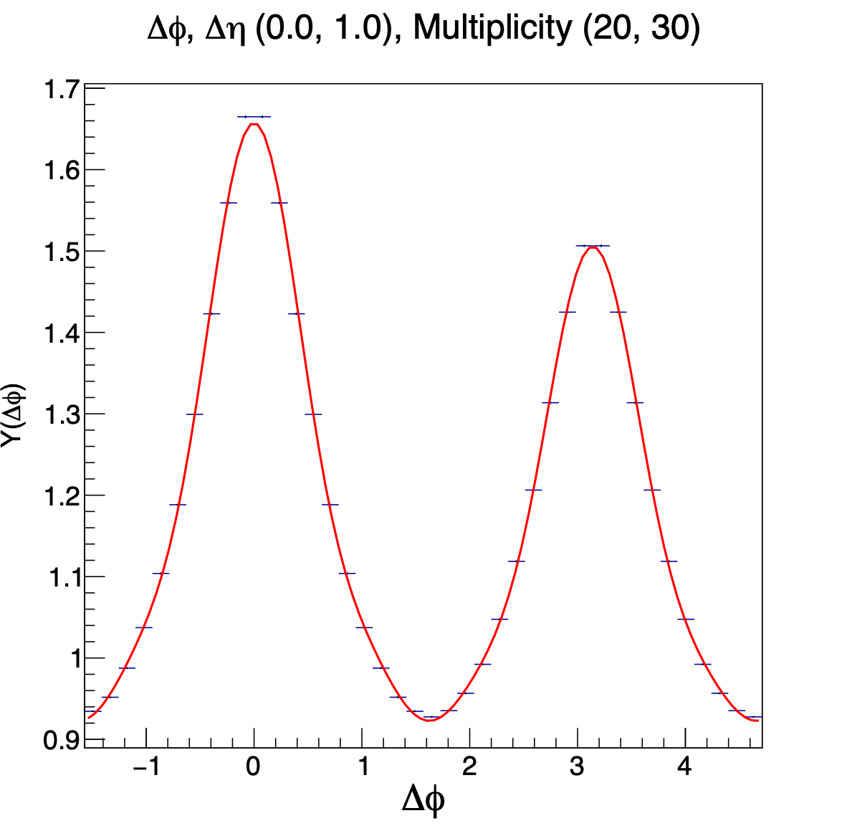
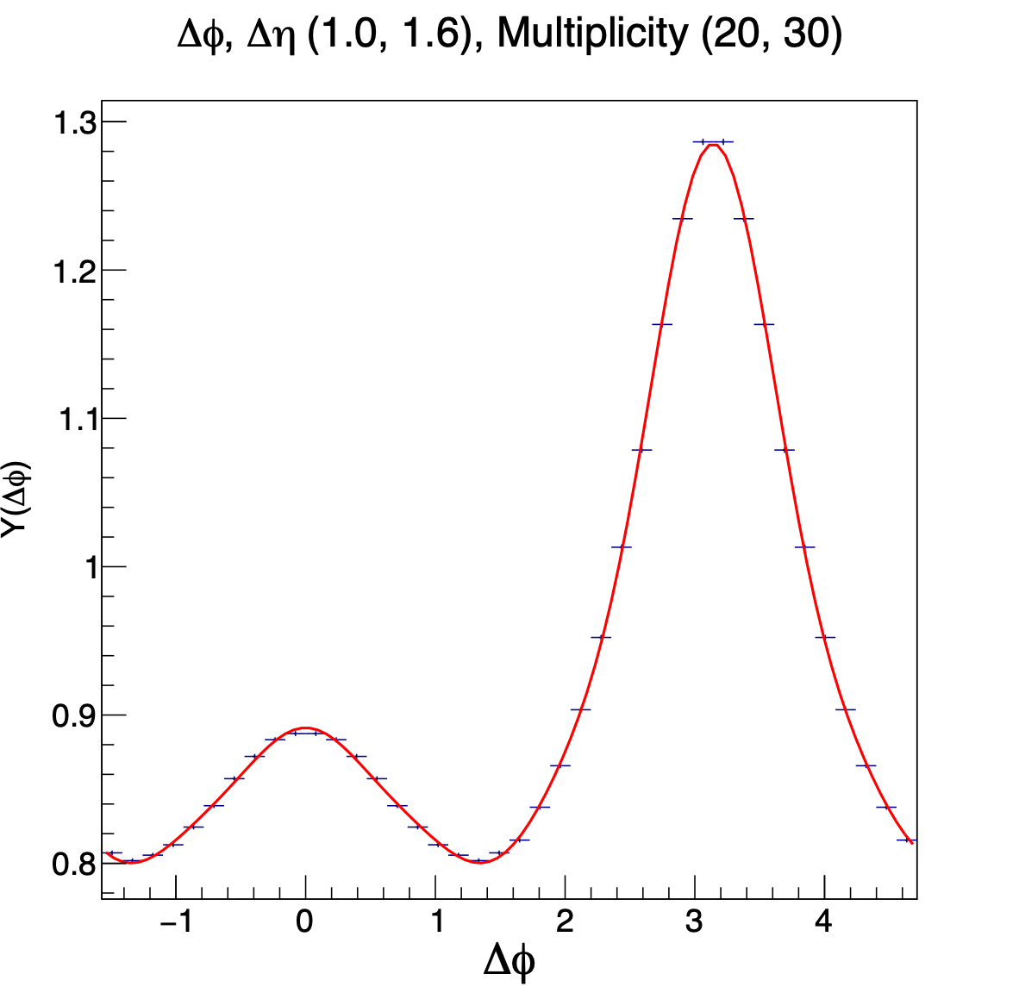
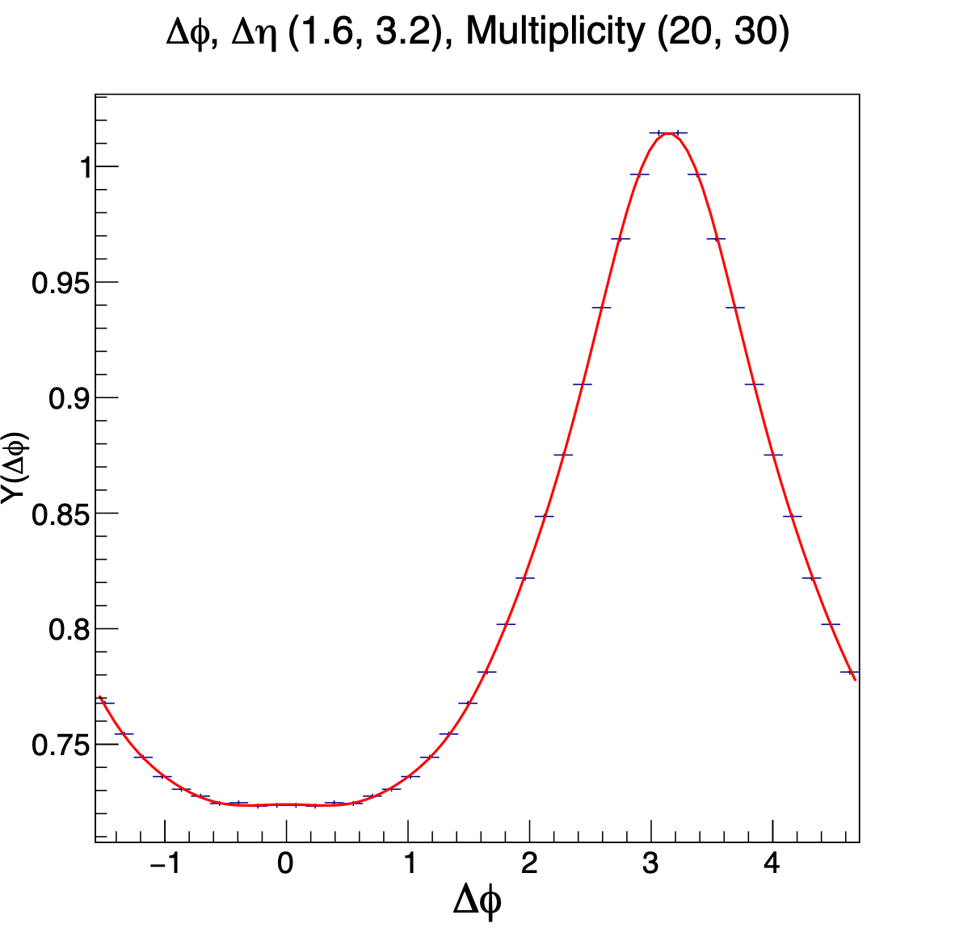
Azimuthal differential associated yield $Y(Δφ)$
Two-particle correlation function
(per-trigger-particle associated yield)
Associated yield vs. Δɸ
$$Y(Δφ)=\frac{1}{N_{trig}}\frac{dN^{pair}}{dΔφ}=\frac{1}{Δη_{max}−Δη_{min}}∫_{Δη_{min}}^{Δη_{max}}\frac{1}{N_{trig}}\frac{d^{2}N^{pair}}{dΔηdΔφ}dΔη$$
$$\frac{1}{N_{trig}}\frac{d^{2}N^{pair}}{dΔηdΔφ}$$
Δη = η1 — η2
Δφ = φ1 — φ2 ~ 0
Long Range
(1.6 ≤ |∆η| < 3.2)
Short Range
Middle Range

Slide 25
Understanding 2PC in $e^{+}e^{−}$— Intra-jet correlations
Two-particle correlation function
(per-trigger-particle associated yield)
Origin-peak intra-jet correlations @ near side (Δη,Δɸ)~(0,0)
$$\frac{1}{N_{trig}}\frac{d^{2}N^{pair}}{dΔηdΔφ}$$
Δη = η1 — η2 ~ 0
Δφ = φ1 — φ2 ~ 0

Slide 26
Understanding 2PC in $e^{+}e^{−}$— Inter-jet correlations
Two-particle correlation function
(per-trigger-particle associated yield)
Inter-jet correlations @ away side (Δɸ~π)
$$\frac{1}{N_{trig}}\frac{d^{2}N^{pair}}{dΔηdΔφ}$$
Δη = η1 — η2
Δφ = φ1 — φ2 ~ π

Slide 27
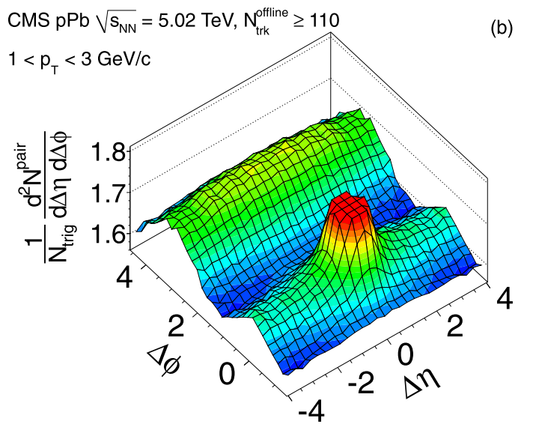
Understanding 2PC in $e^{+}e^{−}$ — Ridge(-like) correlations
Two-particle correlation function
(per-trigger-particle associated yield)
Ridge correlations @ long range, near side
$$\frac{1}{N_{trig}}\frac{d^{2}N^{pair}}{dΔηdΔφ}$$
pPb
pA: Phys. Lett. B718 (2013) 795-814
long range in large |Δη|
Δη = η1 — η2
Δφ = φ1 — φ2 ~ 0
ridge enhancement

Slide 28
Searching for emergence of azimuthal correlation in $e^{+}e^{−}$
√s ≥ 183 GeV
What will happen in higher energy LEP-II sample?
Allowing for higher event multiplicity up to NTrk ≥ 50
Opening up more complicated color-string configuration Dominant W⁺W⁻ event at high multiplicity showcases a 2-color-string configuration
$$e^{+}e^{−}→q\overline{q}$$
$$e^{+}e^{−}→W^{+}W^{−}→4f$$

Slide 29
Selected list of analyses
e⁺e⁻
•ALEPH LEP1 (91 GeV) PRL 123 (2019) 21, 212002
•ALEPH LEP2 (183-209 GeV): Phys. Lett. B 856, 138957 (2024)
•Belle Off-resonance 10.52 GeV : PRL 128 (2022) 14, 142005
•Belle On-resonance (Y(4S)): JHEP 03 (2023) 171
γp
•CMS pPb photonuclear: PLB 844 (2023) 137905
•ZEUS ep neutral current DIS: JHEP 04 (2020) 070
•ZEUS ep photonuclear: JHEP 12 (2021) 102
•H1 ep neutral current DIS: (preliminary) H1prelim-20-033
γPb
•ATLAS PbPb photonuclear: PRC 104 (2021) 1, 014903
pp
•ALICE MB: https://arxiv.org/pdf/2311.14357.pdf
•CMS Single Jet in pp: CMS-HIN-21-013 arXiv:2312.17103

Slide 30
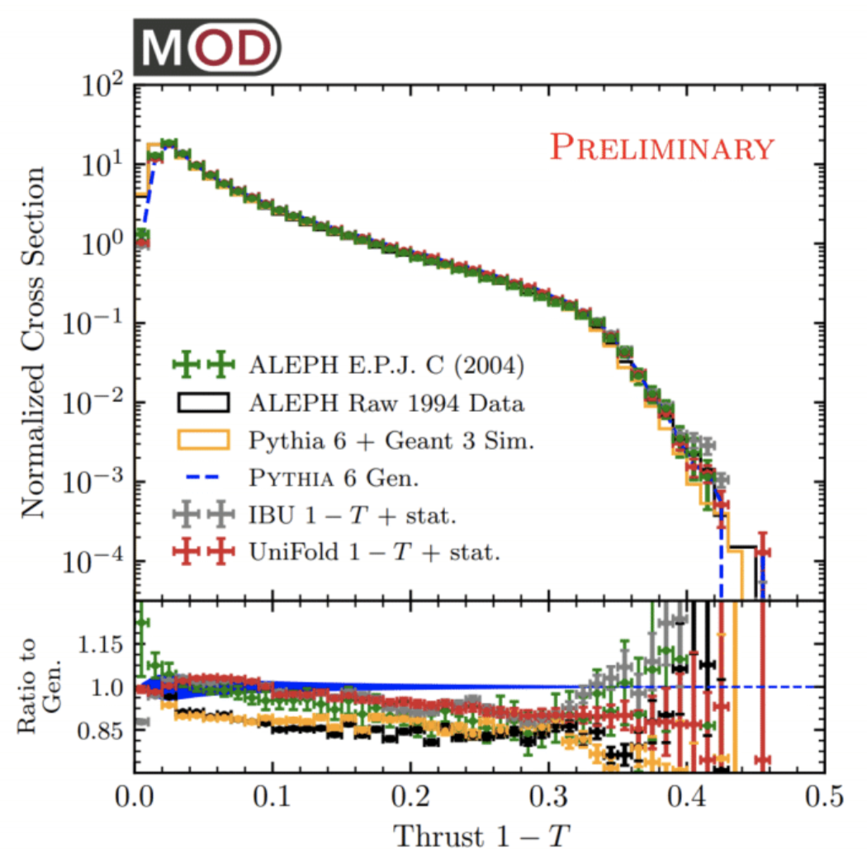
High quality archived data
(slides from BOOST 2022
by Yi Chen)
Badea, Komiske, Metodiev, Thaler, Nachman, Lee, paper in preparation
(link to animation)
ALEPH: EPJC 35 (2004) 456
Published results can be reproduced
Big thanks to ALEPH collaboration and MIT open data

Slide 31
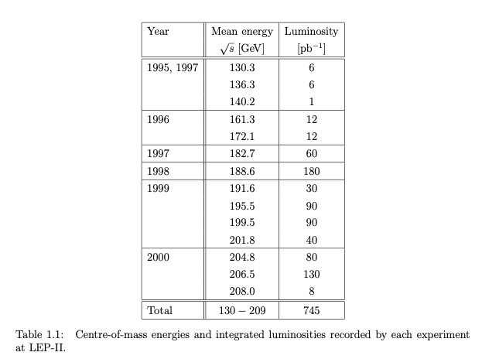
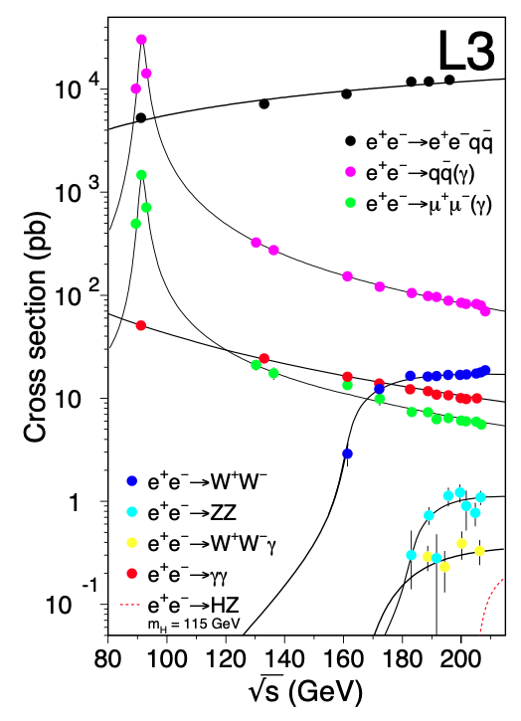
LEP-II data & MC processes
Year v.s. √s v.s. int. L
√s v.s. X-section
Hadronic $q\overline{q}$ production
QED processes
two-photon processes
Four fermion processes
Diverse decay channels above $\sqrt{s}$ = 180 GeV

Slide 32
LEP-II event selections
Acceptance Polar angle of sphericity axis: $7π/36<θ_{lab}<29π/36$
Hadronic event selection ≥ 5 tracks $$E_{chgd.}≥15GeV$$
Hadronic $q\overline{q}$ production
QED processes
two-photon processes
Four fermion processes

Slide 33
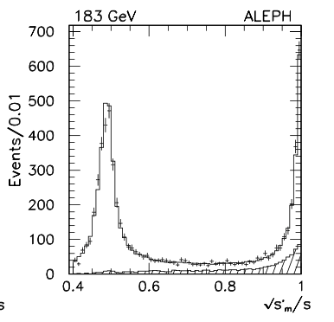
LEP-II event selections
Radiative return to the Z$\sqrt{s}$ ~ 90 GeV
Acceptance Polar angle of sphericity axis: $7π/36<θ_{lab}<29π/36$
Hadronic event selection ≥ 5 tracks $$E_{chgd.}≥15GeV$$
QED processes
Hadronic $q\overline{q}$ production
Ref: hep-ex/9904011
two-photon processes
Four fermion processes
ISR cut
Required on the visible mass and the reconstructed center-of-mass energy

Slide 34
LEP-II physics processes
$$e^{+}e^{−}→q\overline{q}$$
$$e^{+}e^{−}→W^{+}W^{−}→4f$$

Slide 35
Selection
Selection
Track Selection:
Particle flow candidate 0, 1, 2 (charged hadron / $e^{±}$ / $μ^{±}$)
Number of TPC hits for a charged tracks (N_{TPC}) >= 4, $χ$²/ndf < 1000
|d0| < 2 cm
|z0|< 10 cm
|cosθ|<0.94
p_{T}> 0.2 GeV (transverse momentum with respect to beam axis)
Neutral Hadron Selection:
Particle flow candidate 4, 5 (ECAL / HCAL object)
E> 0.4 GeV
|cosθ|<0.98
Event Selection:
Number of good charged particles >= 5 (including charged hadrons and leptons)
Number of good ch+neu. particles >= 13
E_{charged} > 15 GeV
|cos(θ_{sphericity})|<0.82
Two-particle correlations
Residual MC correction

Slide 36
Corrections
Selection & efficiency correction
To calibrate the nonuniform detection efficiency and misconstruction bias
Reconstructed tracks are weighted by the inverse of the efficiency correction factor:
$$ε(p_{T},θ,φ,N_{trk}^{rec})={\left[{\frac{d^{3}N^{reco}}{dp_{T}dθdφ}}/{\frac{d^{3}N^{gen}}{dp_{T}dθdφ}}\right]}_{N_{trk}^{rec}}$$
A closure test is performed by comparing the p_{T}, θ, φ distributions of the generator level and those of the corrected reconstructed level
Two-particle correlations
Efficiency correction
Residual MC correction

Slide 37
Corrections
Selection & efficiency correction
To deal with remaining possible reconstruction effects
Bin-by-bin correction: the correction factor is derived from the histogram ratio of MC correlation functions at the reconstruction and generator level as $C(Δφ)=\frac{Y(Δφ)_{gen,i_{g}}}{Y(Δφ)_{reco,i_{r}}}$
Final data correlation results are obtained from the multiplication of the original correlation function with the bin-by-bin correction factor
Two-particle correlations
Efficiency correction
Residual MC correction

Slide 38
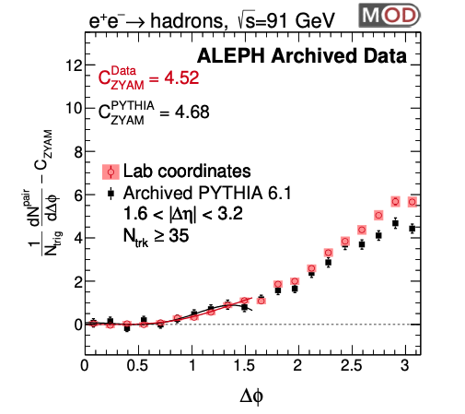
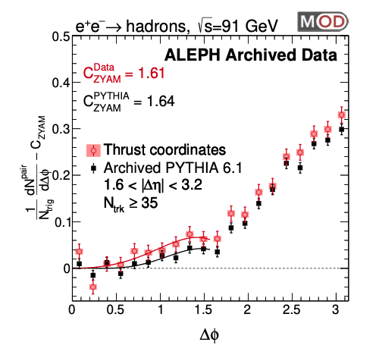
Long-range correlations (c.f. MC)
LEP1
Beam axis
Good agreement with MC!
$$5≤N_{trk}<10$$
$$10≤N_{trk}<20$$
$$20≤N_{trk}<30$$
$$N_{trk}≥30$$
$$N_{trk}≥35$$
Thrust axis

