Slide 1
Introduction to the Bates Laboratory
Boleslaw Wyslouch
April 14, 2025

Slide 2
What is Bates Laboratory?
Originally site of a nuclear physics accelerator studying the structure of matter, led by MIT physicists
1974-2005 operated as a National User Facility for the Department of Energy Office of Science
In 2005 buildings & equipment transferred to MIT; Bates became a Research and Engineering Center for nuclear physicists around the country
Lab named after William H. Bates, Representative for the 6th District 1950-1969
Notes:
A

Slide 3
Resources and Activities
About 15 engineers, scientists and technicians with broad and deep experience in accelerators, particle detectors, cryogenics and magnet design and construction
Main activities today geared towards collaboration with national and international laboratories in Nuclear Physics
Research equipment for experiments at JLab, BNL, Oak Ridge, Los Alamos, FRIB, DESY and others
Computing center for data handling and analysis for experiments at LHC (CMS and LHCb) and JLab (CLAS)
Engineering help for LNS experiments and R&D on campus

Slide 4
Bates is also a resource beyond fundamental physics
Small Accelerators and X-ray sources for medical applications, national security
Accelerator for radiation treatments at Mass General Hospital and elsewhere
Lincoln Lab X-ray testing, using long, shielded tunnel
In the past: R&D and engineering work with L3 Technologies, Passport Systems, Raytheon
Some MIT projects take advantage of space and buildings
Solar energy devices, now moving to Thermal Battery/4th Power
MIT Nuclear Engineering accelerator projects
Preparation for the Green Steel project

Slide 5
Role of Bates
Help in early-stage development of ideas, prototyping, and implementation of various experiments and mechanical projects
Enable real-size equipment design and construction at MIT
Involve students and postdocs: workforce development
Advice and help to advanced MIT engineering projects

Slide 6
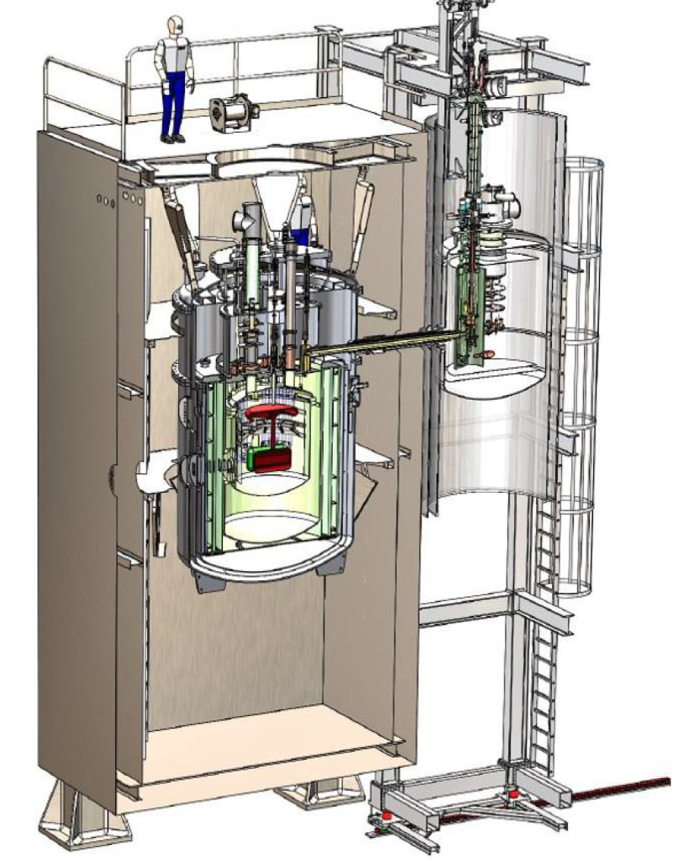
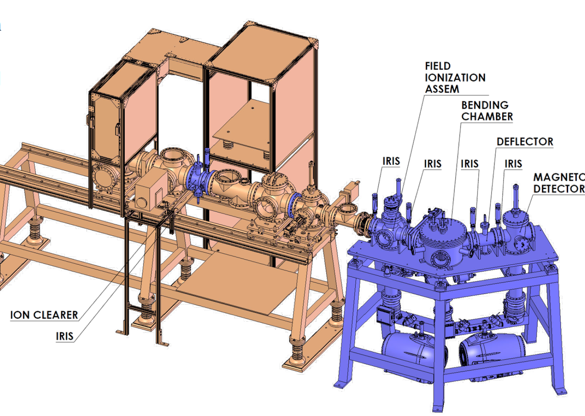
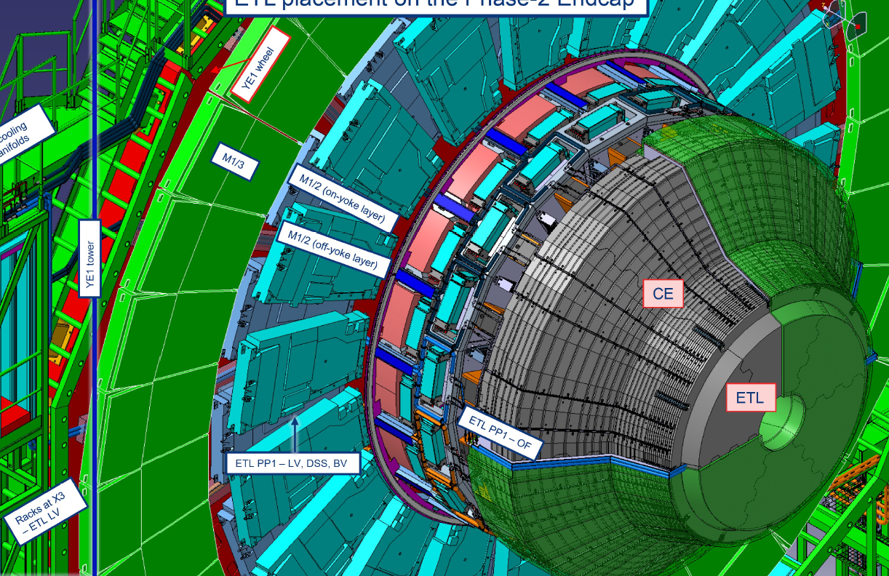
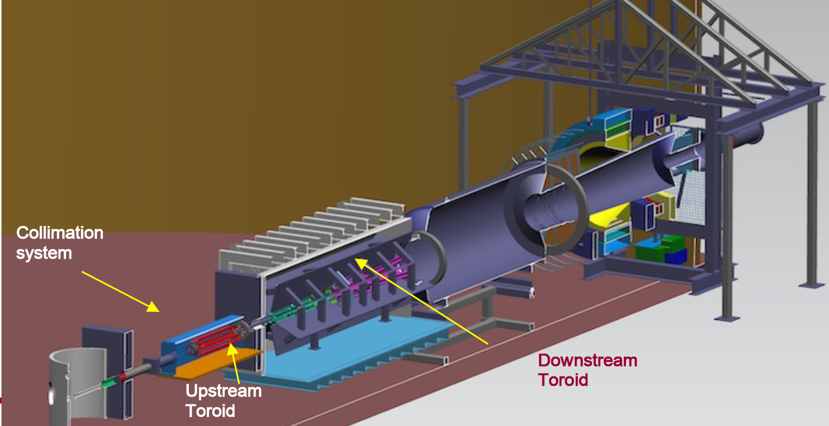
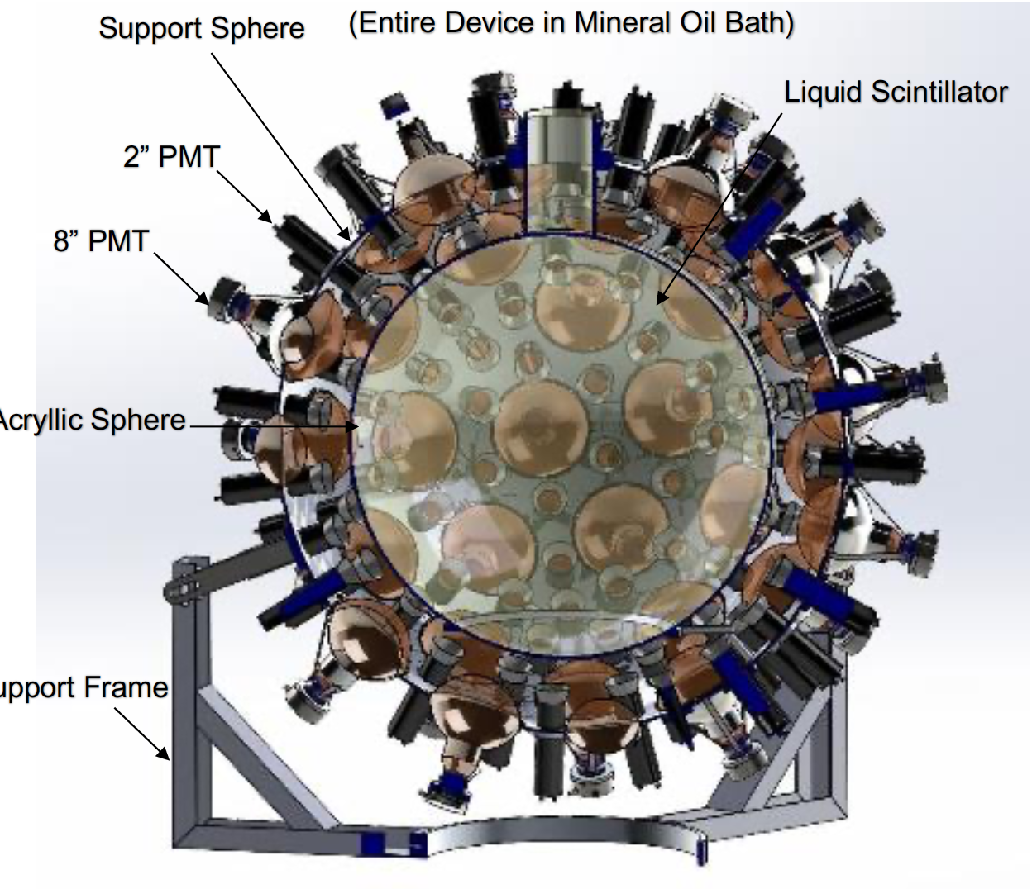
Examples of projects I
Neutron EDM @ ORNL
CRIS @ FRIB
sPHENIX vertex @ BNL
MTD @ CERN
NuDot @ underground
Moller @ JLab

Slide 7
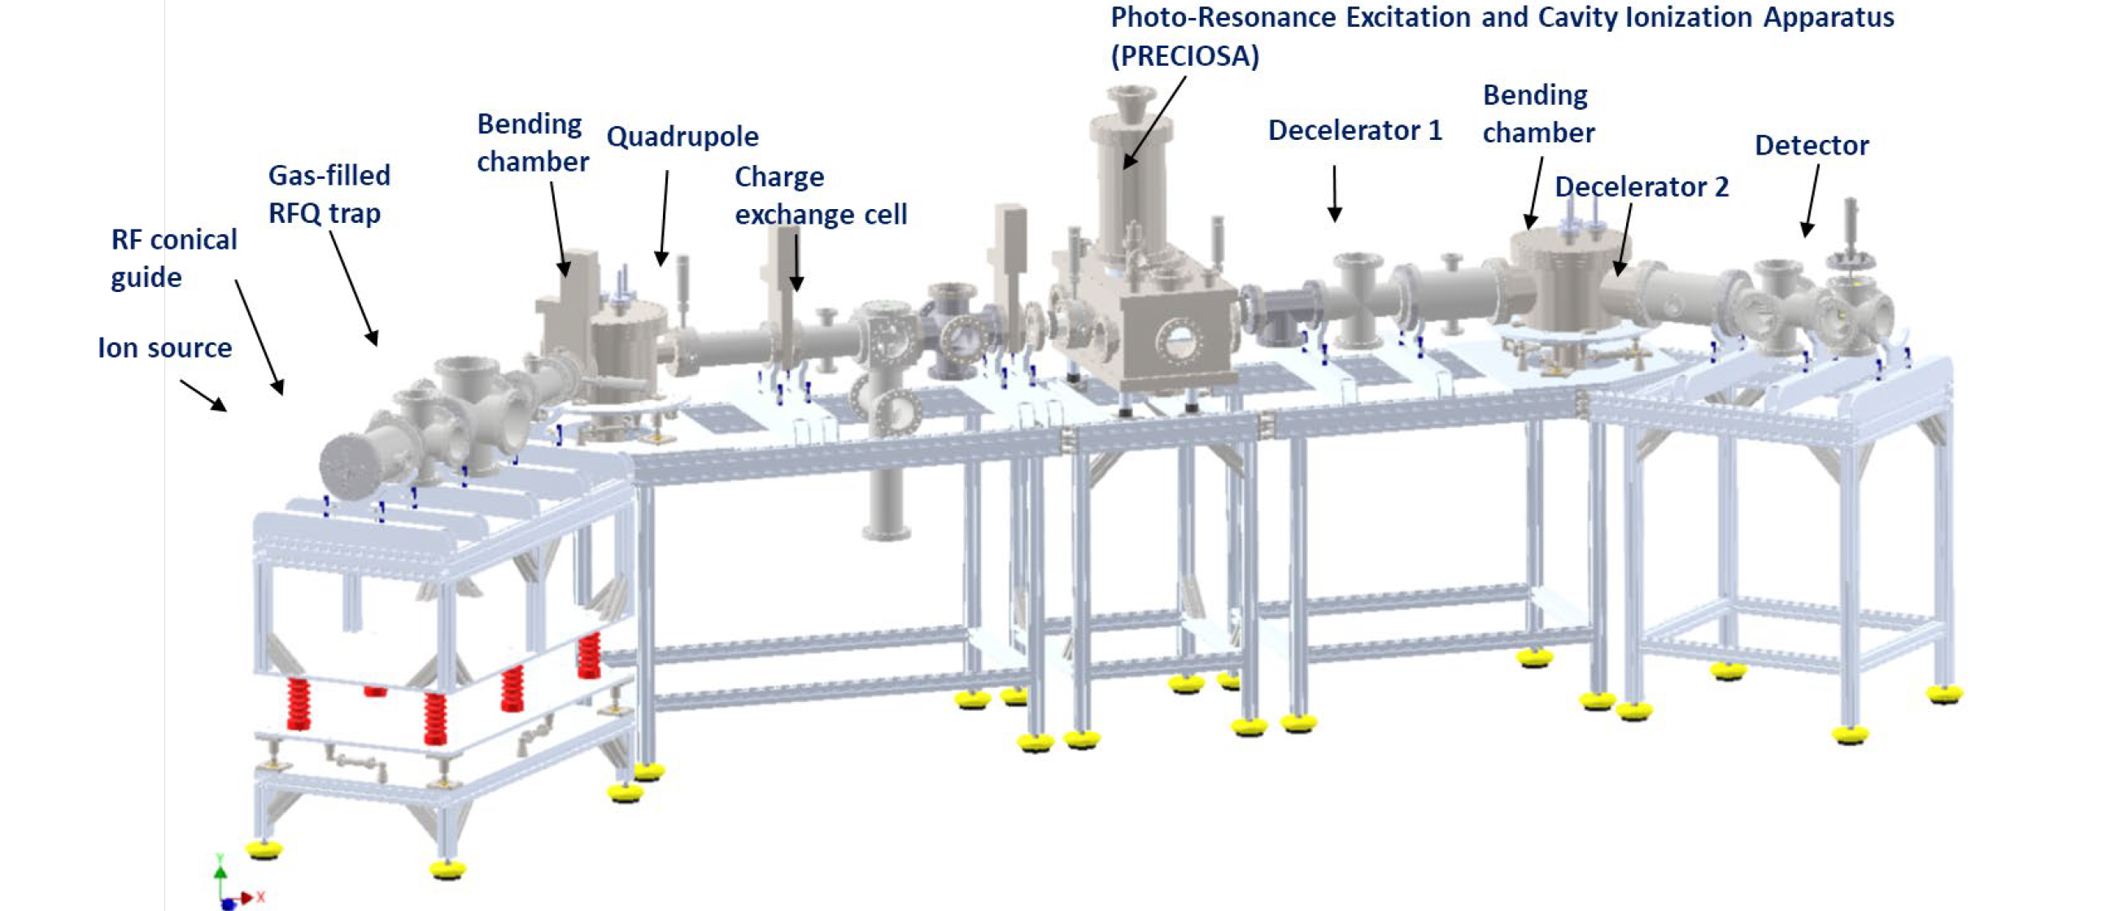
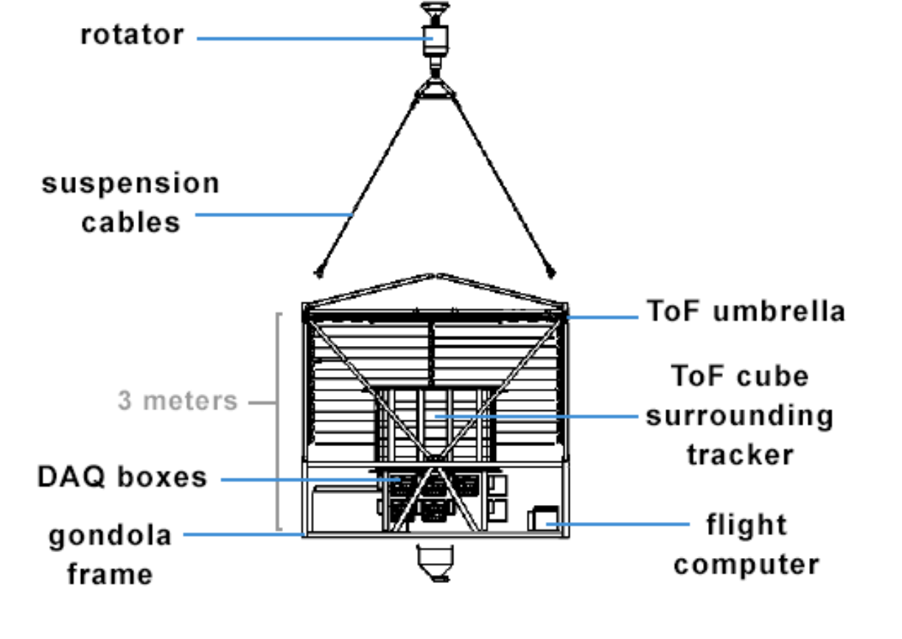
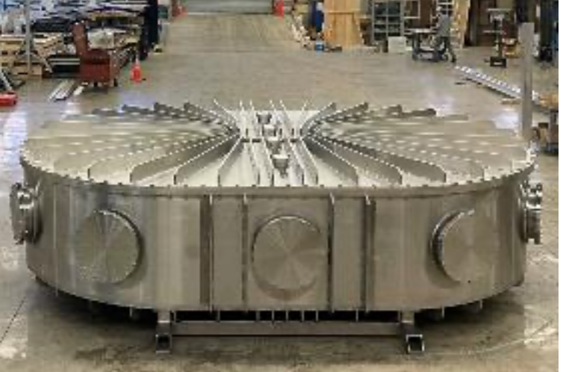
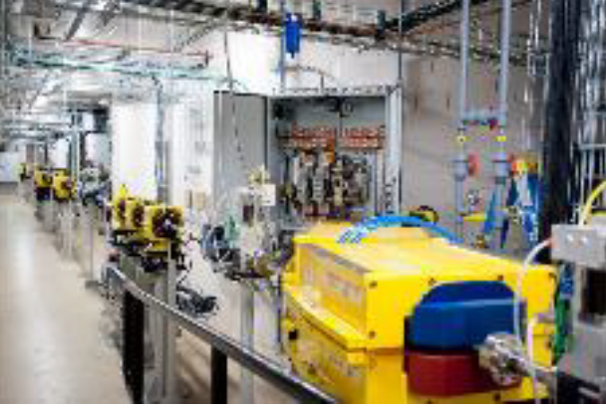
Examples of projects II
GAPS @ Antarctica
ABRACADABRA @ MIT
PRECIOSA @ MIT
SPARC @ PSFC
PROTOM @ Hospitals
Lorax @ Lincoln Labs

Slide 8
Summary
Bates Lab is a great source of engineering support for the US and MIT scientific community, mostly nuclear physics but also Nuclear Engineering and others
The expertise available on site allows for major projects to be built and operated here, e.g. Computing Facility
The available space and equipment makes it attractive for small and medium scale projects to quickly set up and get going
Notes:
, including

