Slide 1
Proposal to EIC:
IR Magnets
H. Witte, on behalf of MIT Team (Z. Hartwig, O. Hen, E. Ihloff, J. Bessuille, S. Chamberlain, R. Vieira, S. Smith, T. Golfinopoulos, …)
Dr. Holger Witte
Associate Director, MIT Bates
3/11/2025
Notes:
Maximum character recommendations:
Contact info: 145
Main title: 38
Secondary title: 100
Update all text fields with your relevant information.

Slide 2
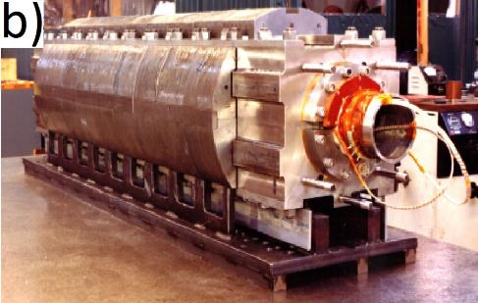
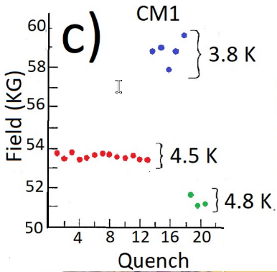
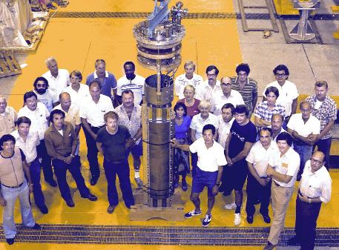
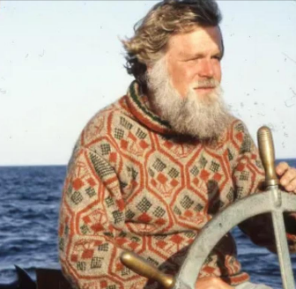
One should always start with a joke…
… but I don’t have one (at least a good one)
An interesting story will have to do
1980: problems with the Isabelle magnet
Isabelle: 400 GeV Center of Mass energy
Required field: 5T
Only first magnet worked, others after 45 training quenches
The Bob Palmer Magnet (‘the Rebellion’)
Alvin Tollestrup, Carl Goodzeit, Rick Fernow, Bill Sampson…
$40k budget (Nick Samios)
‘Borrowed’ cable from FNAL
Peter Marston, MIT: machining of tooling parts, cured stack of cable (a bill that was never paid?)

Slide 3
Overview
Proposal
Challenges B0pF
New concept for B0pF
Quenches
Structural improvements
Workplan/Schedule

Slide 4
Proposal
MIT takes responsibility for B0pF
Design
Detectors
Cryostat
Integration
Testing
Manufacturing
In-house or with industrial partner
‘Turn-key’ delivery

Slide 5
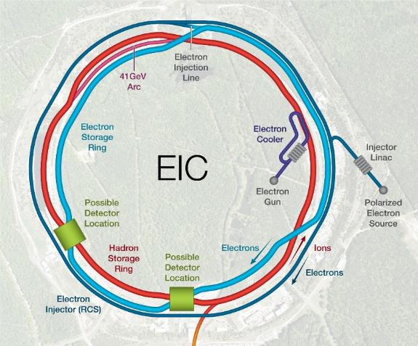
EIC IR: Overview
Rear
Forward
IR location: IR6
Magnet Technology Challenges:
Crosstalk
Field/gradient requirements
Apertures
CCT Magnets: Q1ApR, Q1eR, B0ApF
Skew quads, vertical corrector
Each rectangle: required minimum aperture, not magnet size
Things are tight – Tapered CCT magnets to solve (some) of the issues

Slide 6
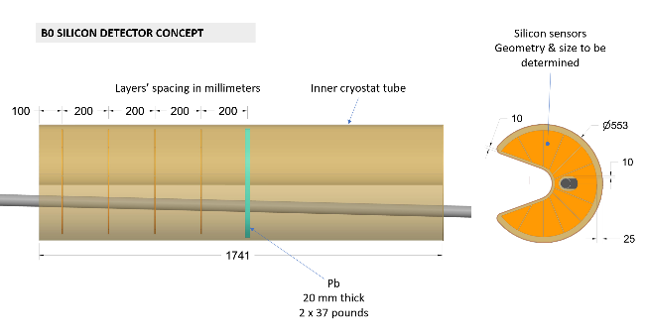
B0pF Forward Spectrometer
Measures particles emerging from the breakup of the colliding hadrons
Only ~6m from IP
Beams not very separated (crossing angle 25mrad)
Beams share magnet aperture
Hadrons: 1.3T field
Electrons: 14T/m gradient
Present implementation: combined function magnet
Large aperture quadrupole; zero field axis shifted with dipole
Space constraints/large aperture
Requires 2K
B0pF is essential for the forward side of the IR (beyond its importance for physics)
Courtesy of
K. Hamdi (BNL)

Slide 7
B0pF – Initial Workplan
Re-evaluate design of B0pF
Present implementation is based large aperture quadrupole, which may not be ideal
Preliminary studies show that a pure dipole could lead to a lower peak field
Requires bucking coil for electron beam
Address structural and quench issues
Larger cable
Approach: wire in groove
Individual turns supported by steel former
VPI soldering technique, developed at MIT (PSFC)
Used successfully for HTS, transfer concept to LTS
(NbTi has a history of performance in soldered configurations)

Slide 8
Statement of Problem
B0pF: large aperture, high field magnet
Aperture: ~0.6m
B_{peak}, wire: 4.8T
Stored energy: 800kJ
Direct wind technology limitations
HFDW magnet trained to only ~1260A
~3.15T aperture field, ~80mm aperture
(designed for 5.6T)
Small cable (1.42mm dia)
Stored energy: ~28kJ
Challenges direct wind
mechanically ‘soft’ structure
Large cable not possible (intrinsic limitation)
Low current: quench protection issues

Slide 9
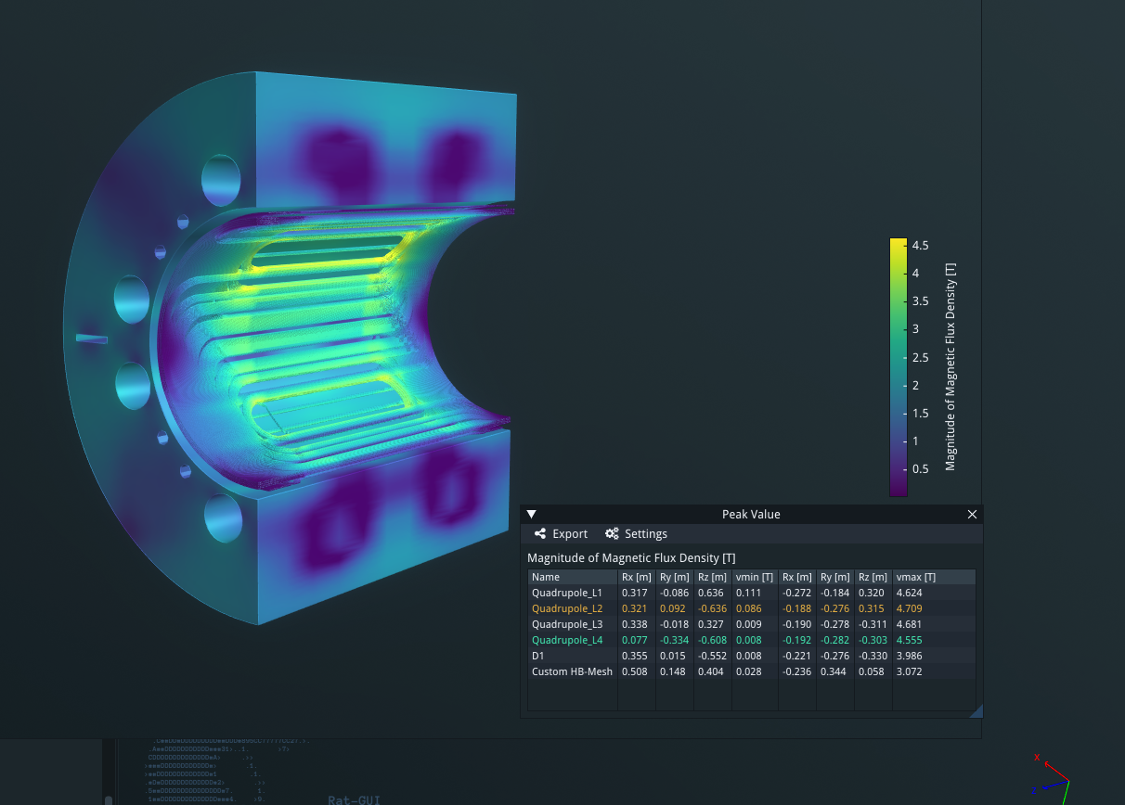
B0PF Peak Field Calculation (energize hadron dipole and quadrupole in series with 1058A )

Slide 10
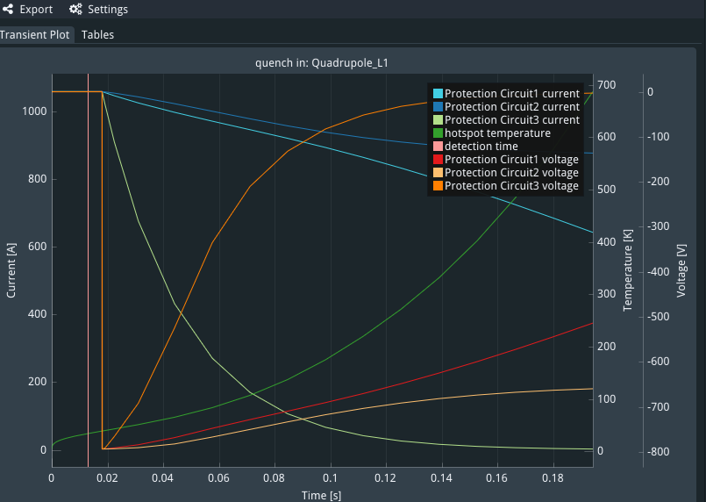
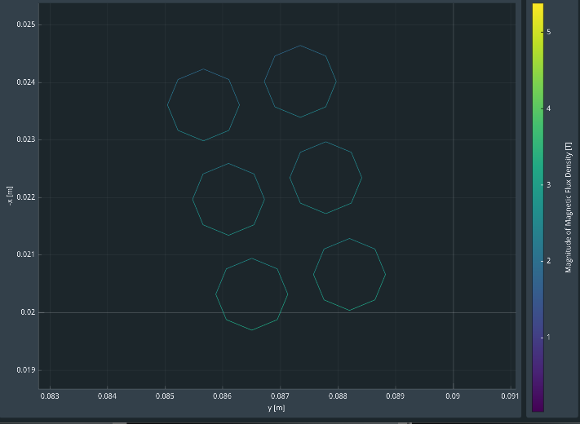
B0PF quench simulation results 0.75ohm dump resistor /10ms quench delay/0.1V voltage threshold /3-loop protection circuits/no QP heater
~1.8mm
10
10
Wire spacing – transverse quench propagation velocity?

Slide 11
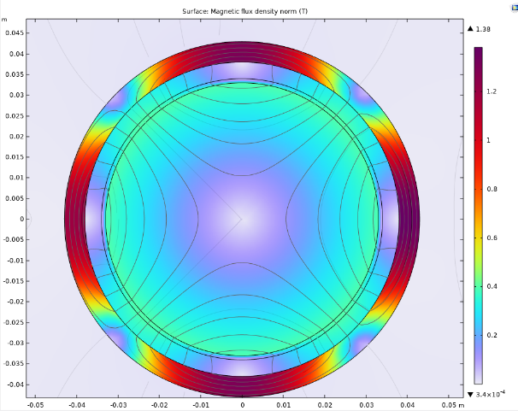
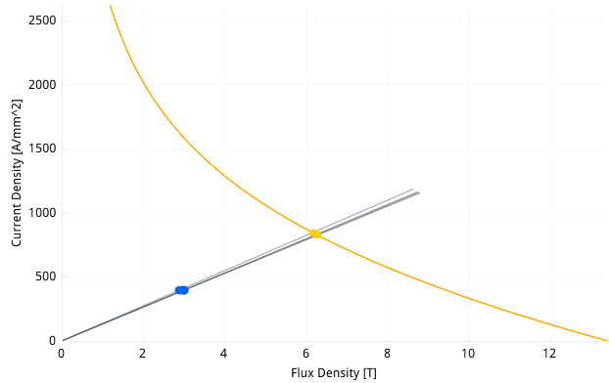
B0pF – New Design
Based on pure dipole (CCT)
Lower peak field on wire: 2T vs 4.7T
Larger Cable: 6.25mm² vs 1.2mm²
1.065mm strand, Cu:Sc 1.6
7 strands
Quenches safely (70K, single dump resistor)
20 ms delay
Margin: 50%
Energy: 400kJ vs 800kJ
Compensation concept
Bucking coil – reduces field to mT
Iron collar (also return yoke for quad)

Slide 12
Addressing the Mechanical Issues
Direct wind technique:
Voids are filled with fibre glass cloth
Tension roving overwrap
Fill with epoxy
Can this be supported better?
Use same technique which was successful for 20T HTS large aperture magnet for fusion
Wire in groove
Key: vacuum pressure solder impregnation
Peak IxB: 800 kN/m (B0pF: two orders of magnitude lower)
Restrict movement, avoid quenches

Slide 13
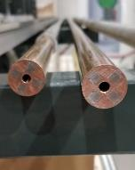
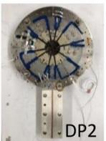
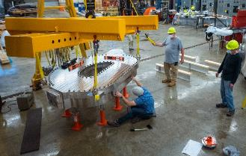
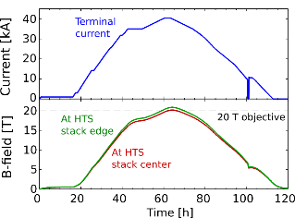
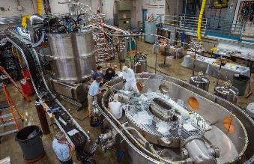
What was the SPARC Toroidal Field Model (TFMC) Coil Project?
1. Developed REBCO conductor technologies (2017-2019)
2. Designed and built the TF model coil (2019-2021)
VIPER cables
NINT coils
3. Built and commissioned the test facility
(2020-2021)
4. Achieved 20 tesla full performance test
(2021)
Completed in ~4 years by MIT and CFS in partnership with our vendors

Slide 14
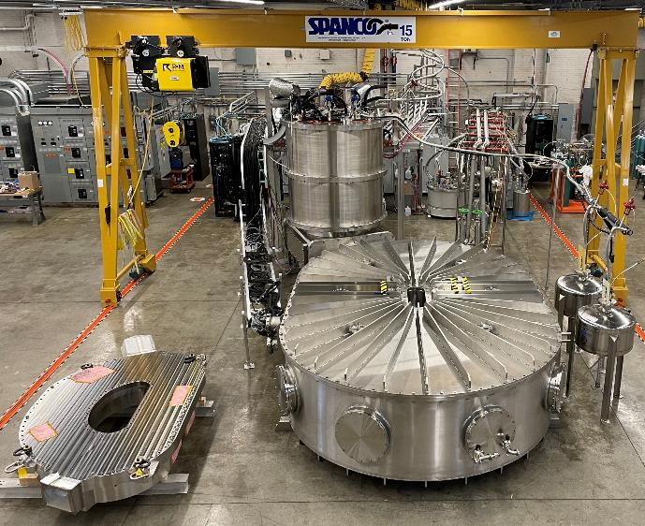
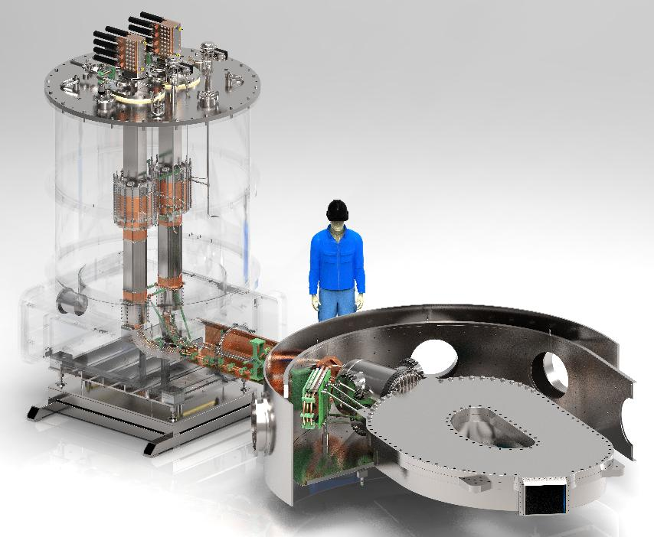
The TFMC Project in one picture: magnet and test facility
The TFMC was designed and primarily fabricated (w/ external vendors) and assembled at MIT with REBCO procurement+ QA/QC and pancake winding at CFS

Slide 15
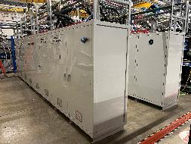
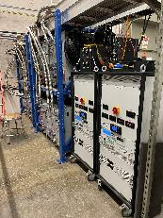
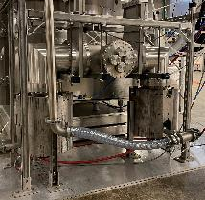
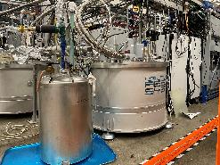
The TFMC Project in one picture: magnet and test facility
15-ton gantry crane
Supercritical helium 600 W @ 20 K, 14 bar
50 kA, ±10 V Power supply
Cryo control racks and compressors
Data acquisition & PLCs
Binary LN2/SHe current leads
Instrumentation harnesses
3-axis Hall sensors (“Teslameters”)
Cryocooler arrays and cryoabsorber
Fiber optic current monitor
Turbo pumps with iron shielding
LN₂ reservoirs feeding shields
TFMC
Vacuum cryostat, 20 m³

Slide 16
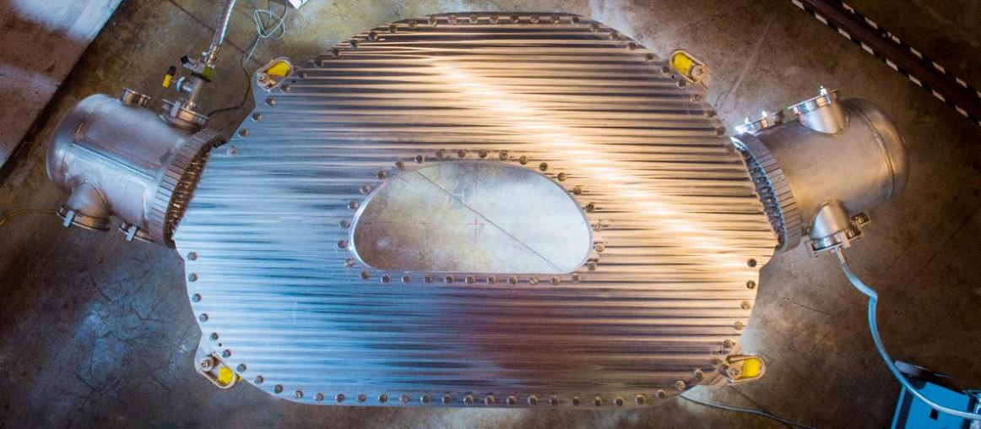
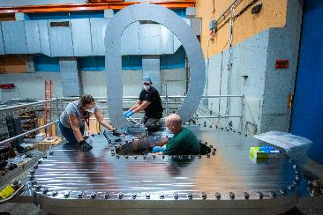
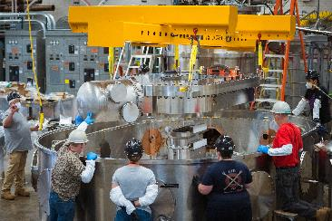
The TFMC is a large scale 20 T no-insulation REBCO magnet
Nominal Design Parameter | Value
Number of pancakes | 16
Total turns | 256
Total REBCO tape | 270 km
Operating temperature | 20 K
Coolant type | Supercrit. He
Operating coolant pressure | 20 bar (max)
Operating terminal current | 40 kA
Peak magnetic field | 20 T
Peak IxB force on REBCO | 800 kN/m
Inductance | 0.14 H
Magnetic stored energy | 110 MJ
WP mass | 5,113 kg
WP current density | 153 A/mm²
WP + case mass | 10,058 kg
WP + case linear size | 2.9 x 1.9 m

Slide 17
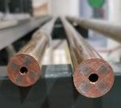
LL #3: REBCO has proven impressively resilient to vacuum pressure solder impregnation in VIPER cables and TFMC
REBCO survive and enable high-quality solder with low-frequency, small voids over long lengths with excellent bonding to solve challenges in high-field magnets
VPI soldering was successfully developed for VIPER cables and for TFMC
Process results in acceptable solder-induced Ic degradation (~2-3%) for full-scale HTS conductors
Over 100+ VPI solder processes to date
Adaptation to cables, coils, plates, …
VPI soldering REBCO is a critical enabler:
Demonstrated stability against high IxB cyclic loads
Enabled simple, robust, ~nΩ electrical joints
Provides high levels of thermal stability
For B0pF: highest performance VPI solder to immobilize NbTi cable, allowing traditional insulation technique
Current transfer (e.g. joints)
Solder
Current sharing
IxB load transfer
HTS stack
Heat transfer

Slide 18
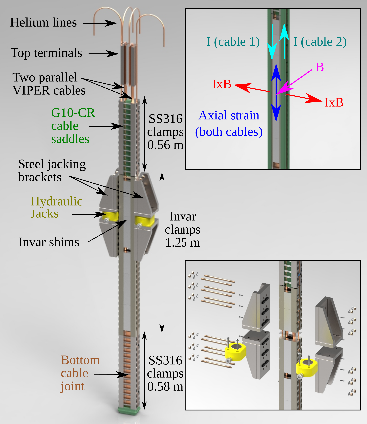
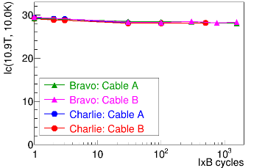
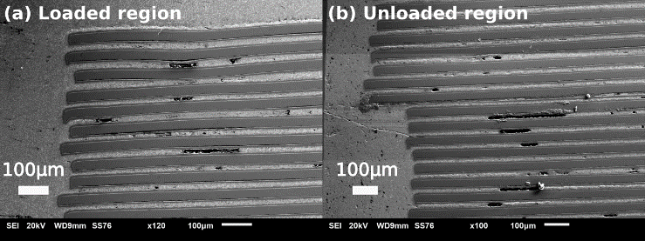
LL #4: VPI solder stabilized REBCO has survived high IxB loading, relevant axial strain, and thermal cycling
VIPER Cables: Consistent, stable Ic (<5% Ic degradation) after 1500 IxB cycles at 382 kN/m loading (all angles on REBCO stack) with ~0.3% axial strain and thermal cycles
TFMC: Negligible Ic degradation after fabrication and several IxB cycles at >800 kN/m (perp. to REBCO plane) (small, isolated damage in low-frequency solder voids)
REBCO operational performance at the tape- or stack-level to date exceeds what is required for high-field SC fusion cables/magnets.

Slide 19
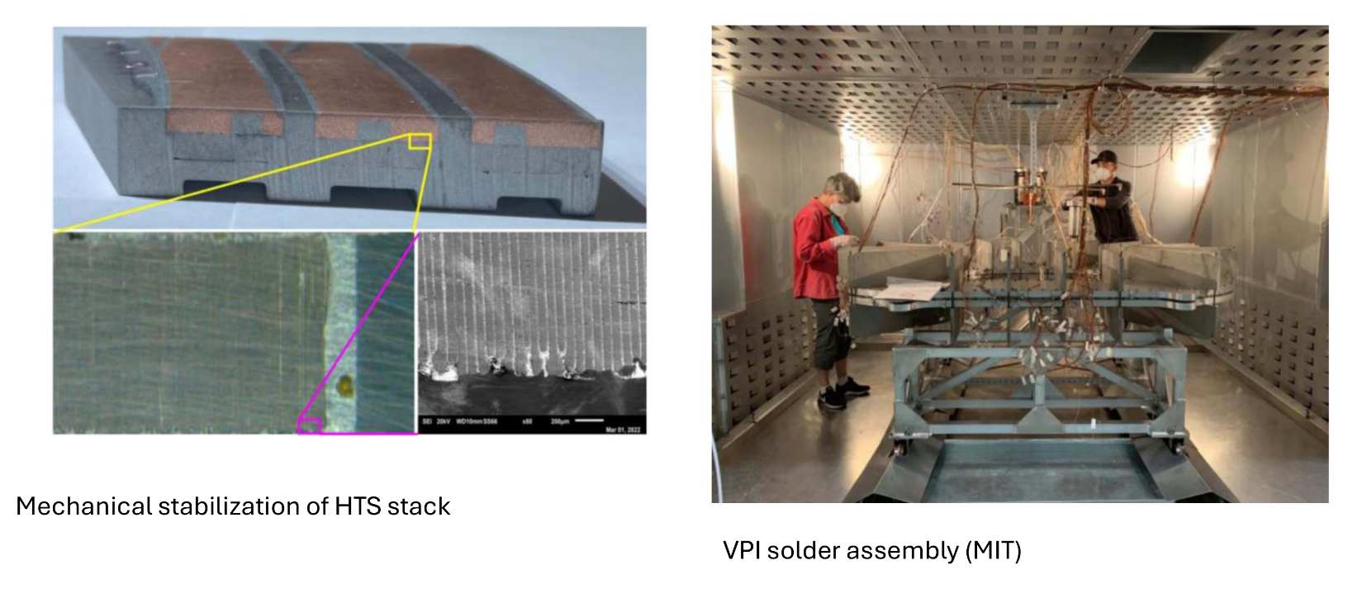
VPI Soldering

Slide 20
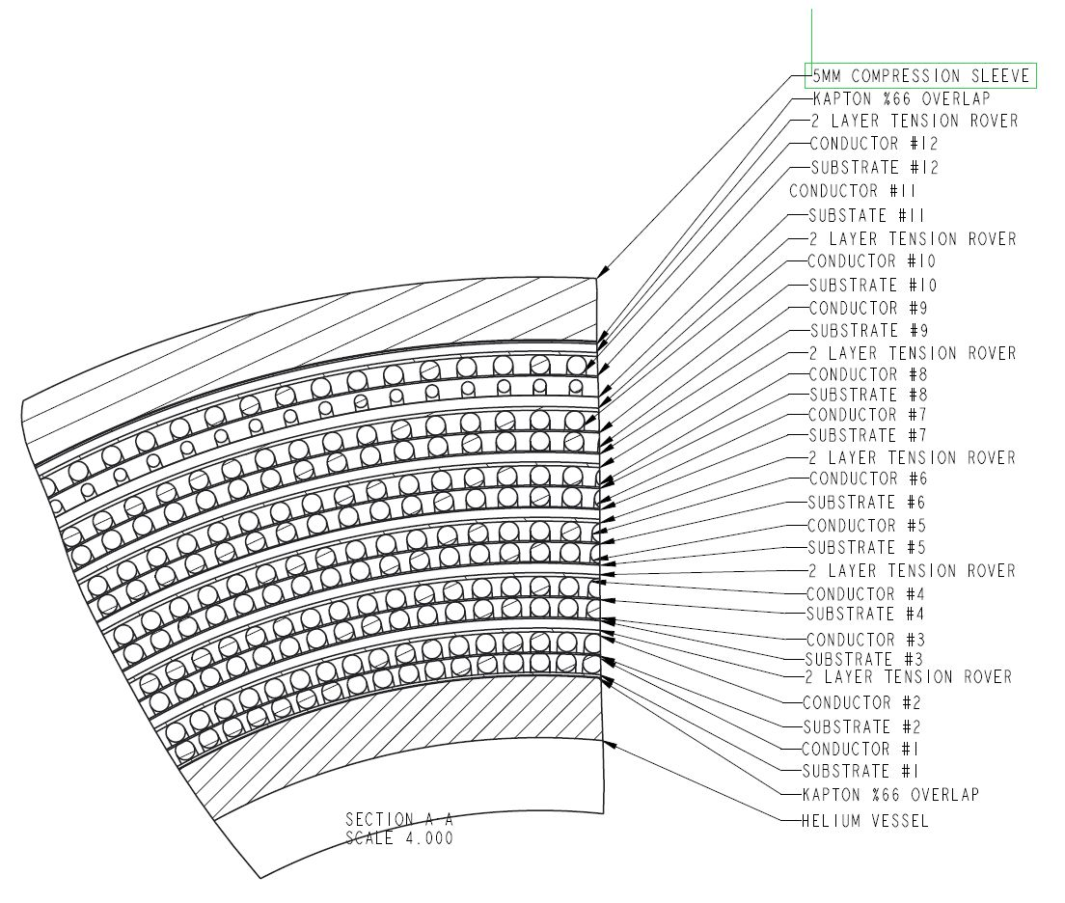
Direct Wind - Coil Construction
Cross section drawing;
Inner Helium Vessel (Coil Support Tube).
12 layers of 6 around 1 superconducting cable (1.575mm dia.).
Wound in pairs
Each layer wound on B-stage substrate.
Large gaps filled with 5 layers b-stage fiberglass cloth.
Interstitial areas between conductors, filled with Stycast 2850 FT.
Tension Roving added after each double layer (20lbs@ 18 turns/inch)
.75mm thick layer of machined fiberglass (after each double layer).
Outer compression sleeve (.1mm diametric interference fit with coil).

Slide 21
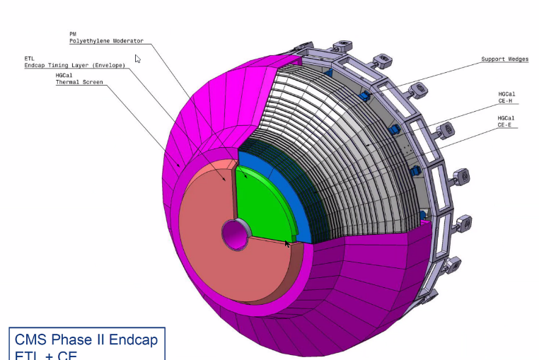
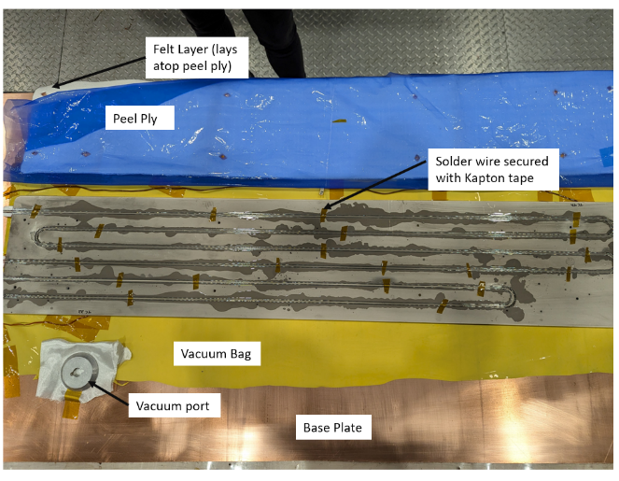
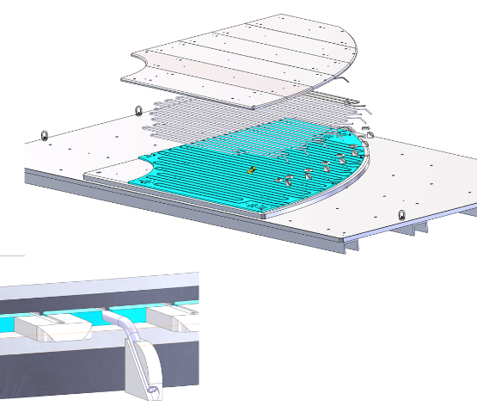
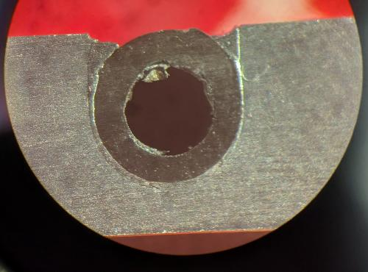
CMS@LHC ETL Evaporators/Cooling Plates
Need very thin Al plates (6.35 mm thick /~ 3 m linear size)
Silicon detectors need to operate at -25C with good uniformity (1K)
Only 98mm space available
CO2 evaporative cooling
Stainless cooling tubes
Need excellent thermal contact: vacuum-bagged reflow soldering (adaptation of VPI process)

Slide 22
LBNL: CCT Magnet
What are the chances of this working?
LBNL experience – Nb₃Sn

Slide 23
LBNL - CCT

Slide 24
Why B0pF?
B0pF important not only for physics but also for machine
Separation between beams
Standalone magnet
Relatively easy to separate out
Combination with detectors – MIT can provide complete package
Not that sensitive to conductor placement
Bucking coil wrecks havoc on field quality – sextupole (known)
Large aperture

Slide 25
Initial Work Plan
Conceptual EM Design
B0pF: study dipole vs. quadrupole
Fringe field
Bucking coil for electron quad
Basic quench analysis
Margin/loadline
Choice of conductor/cable
Field quality
Field map for physics
Milestone: preliminary choice of design concept
Structural analysis
Stress/strain analysis of typical direct wind magnet
Stress/strain analysis of improved design

Slide 26
Preliminary Schedule

Slide 27
Open Issues/Questions
Collaboration
EIC?
Engage students
Construction
In-house/industrial
VPI process: MIT
VPI impregnation
Insulated vs non
Measurement equipment
No rotating coil setup
What does it take to make a small demonstrator?
Fail fast, fail early
MIT has capability to turn around prototypes fast, all in-house (including testing)
NbTi strand
Preliminary design based on 1.065mm dia strand

Slide 28
Magnet Technology at MIT - Expertise
Magnet design expertise
EIC IR expertise
Cryo expertise
Vacuum expertise
Structural mechanics expertise
Software
COMSOL
ANSYS
Opera
PSFC
VPI soldering technique
Quench protection

Slide 29
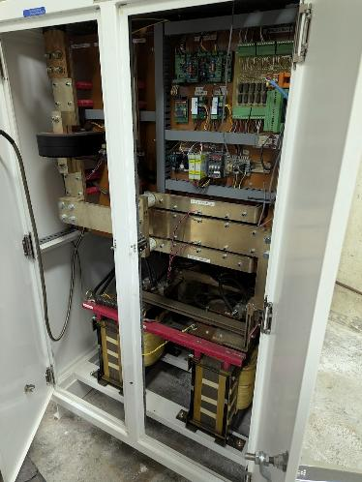
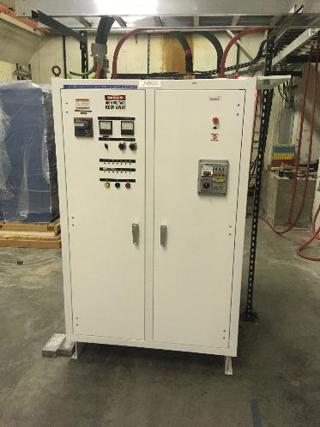
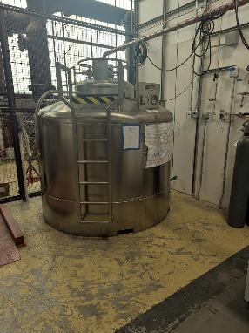
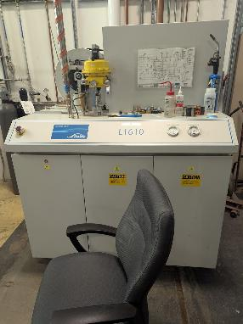
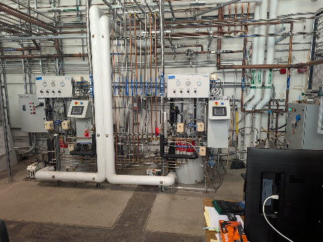
Magnet Technology at MIT – Facilities/Equipment
MIT Bates
~80 acres of land
100,000 square feet of office and lab space
12 MW of power available
Power supplies
2400A, 215kW PS
Bates HPRC
PSFC
Fabrication and VPI solder capabilities
He Liquifier
New Linde 70L/h cryoplant
C.f. AUP magnet: needs 1000L (15000lbs)
Superconducting magnet test facility (50 kA, 10V)
Various cryostats

Slide 30
Things to discuss
Collaboration
Scope
B0pF
Direct wind machine for larger cable?
Testing?
Q1ABpF? (tapered quads)
B0ApF?
Strand/cable
Next steps

Slide 31
Summary
MIT: long experience in Magnet Technology
Francis Bitter Lab, PSFC
Peter Marston
Bruce Montgomery
20T all HTS fusion magnet
B0pF: challenging magnet, but MIT has the technology to make this work
VPI soldering technique
Larger cable to address quench issues
Integration with detectors
Other opportunities?
Bates and PSFC: experienced team, eager to get to work
Teams have a long history working together

Slide 32
Additional Slides

Slide 33
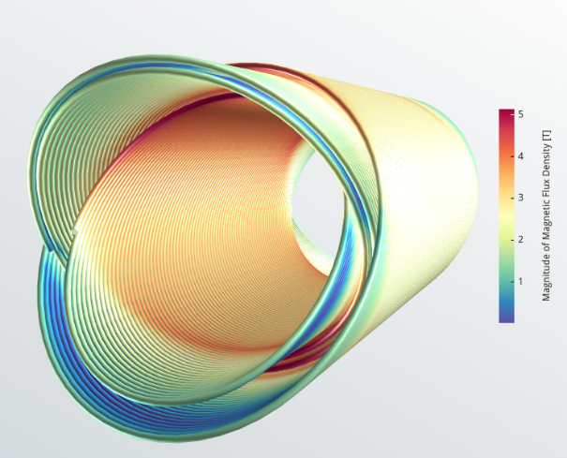
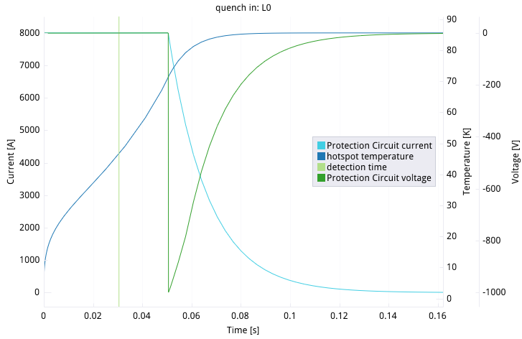
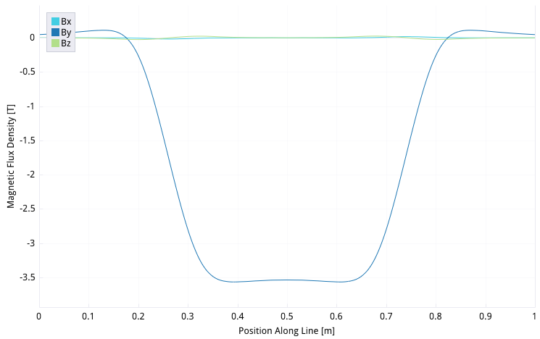
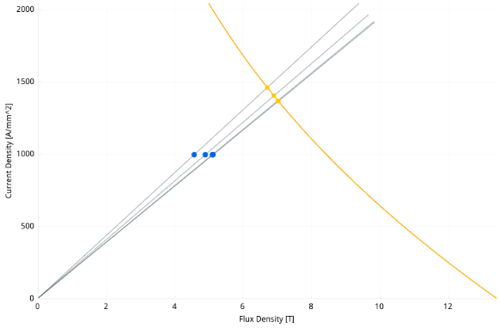
B0ApF
Requirements:
Aperture: 120mm (coil)
Length: 0.6m (magnetic length)
Field: 3.3T
(c.f. HFDW: 80mm aperture, max. 3.1T)
Same cable as B0pF
Hot spot <90K

Slide 34
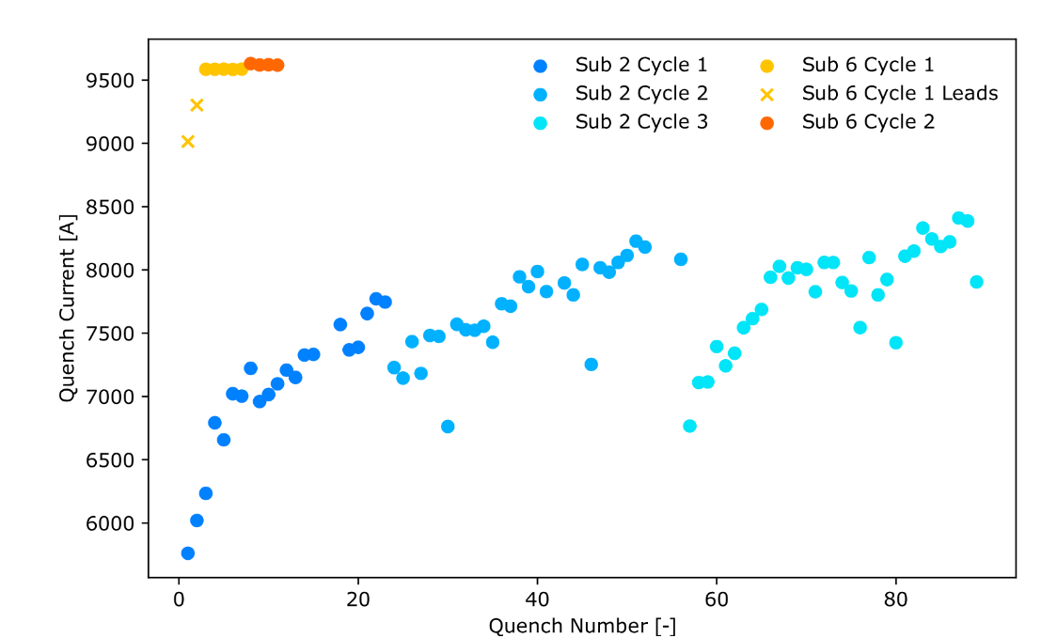
Training Free CCT

