Slide 1
Quantization Results
Dominic Stewart-Guido

Slide 2
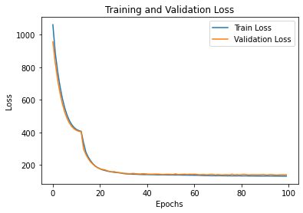
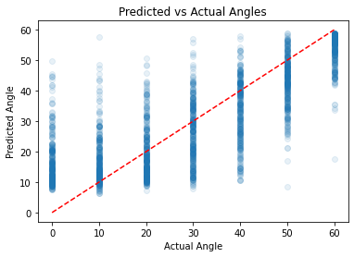
Recalling Base Network Results

Slide 3
Changing Parameters
Initial Parameters:
Updated to:
model = keras.Sequential([
layers.Dense(8, activation='tanh’, input_shape=(X_train.shape[1],)),
layers.Dense(32, activation='tanh'),
layers.Dense(8, activation='relu'),
layers.Dense(1)

Slide 4
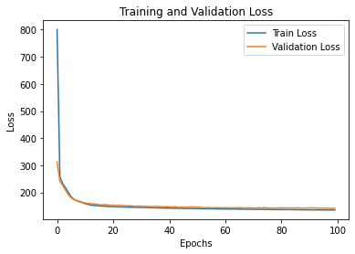
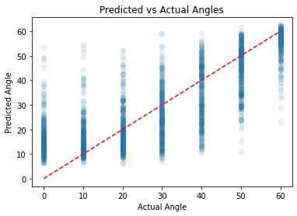
Changing Parameters
Able to get noticeable improvements right away!

Slide 5
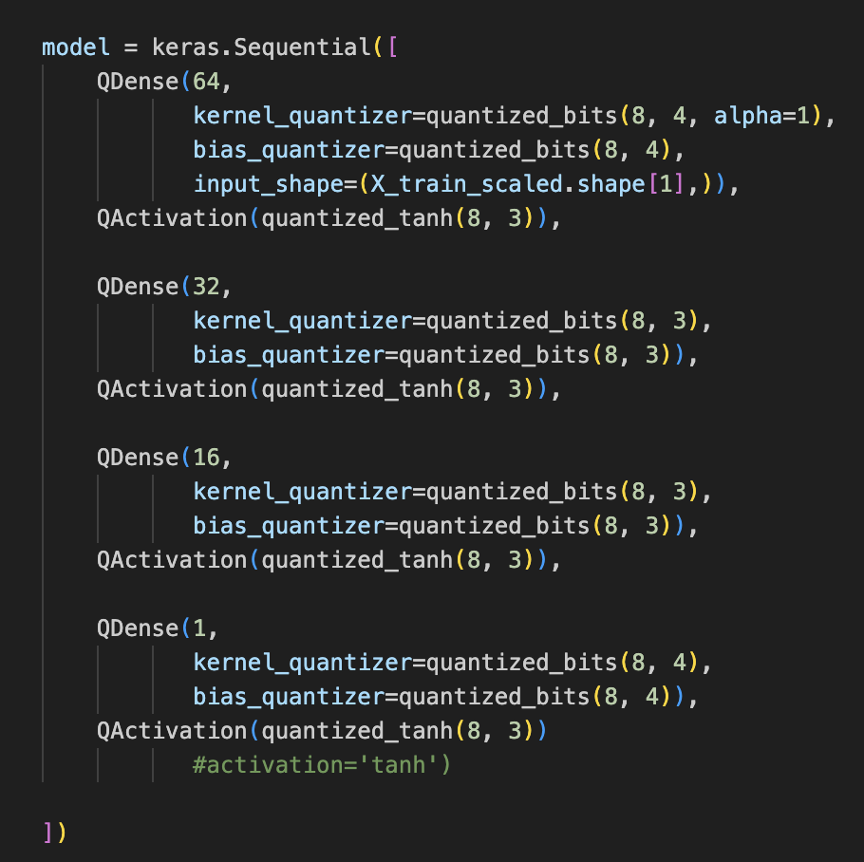
Quantizing the Network
Base Keras model converted to Qkeras
New specifications

Slide 6
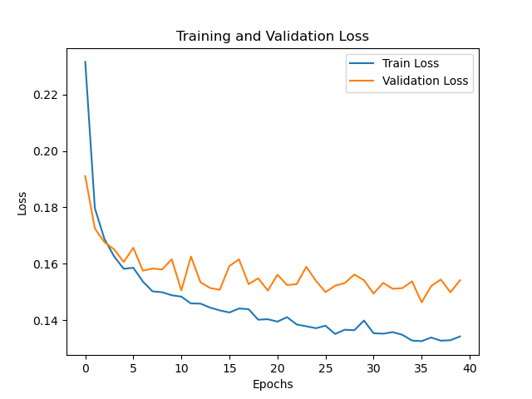
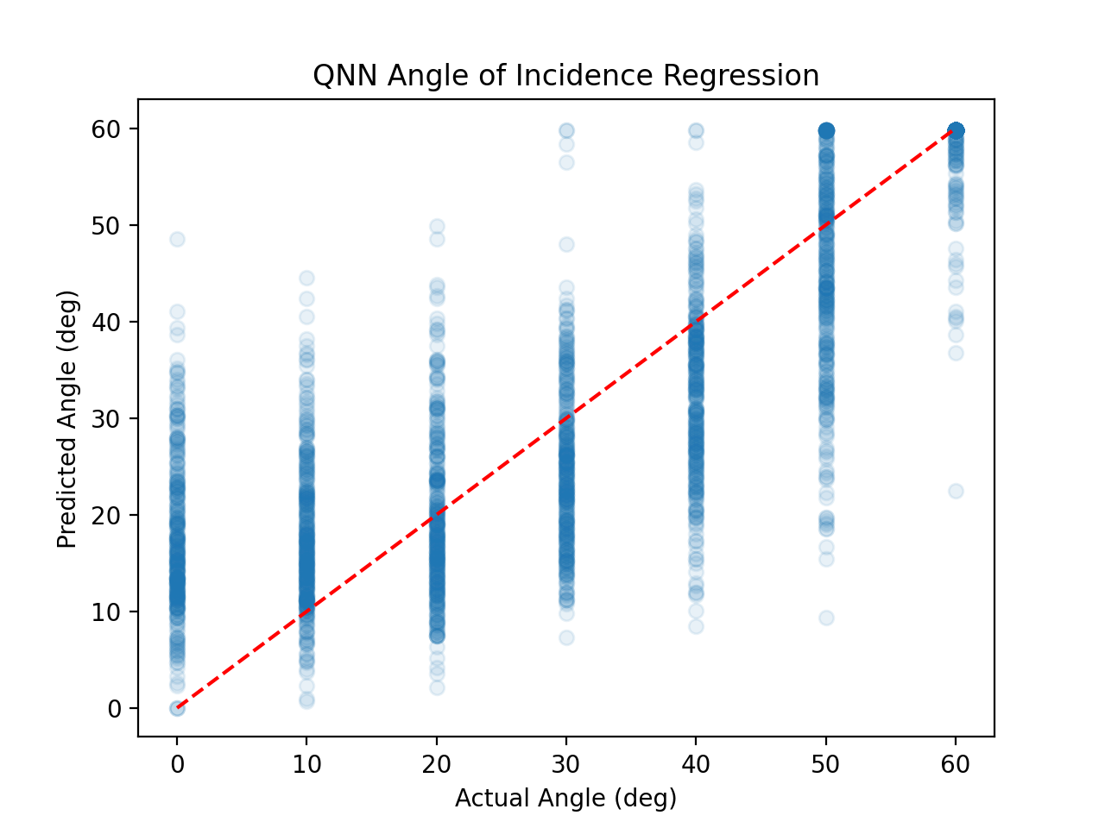
Results
Here loss normalized to 60² = 3600

Slide 7
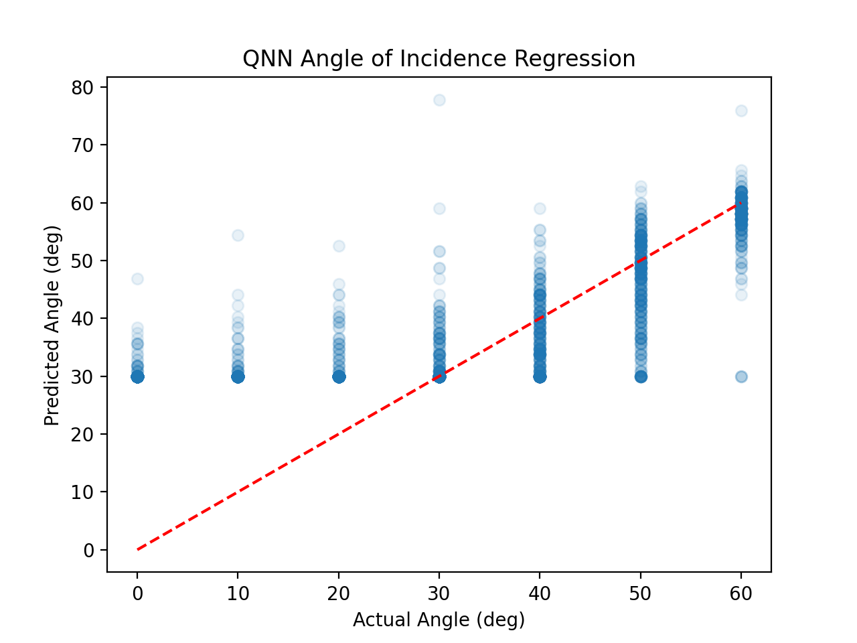
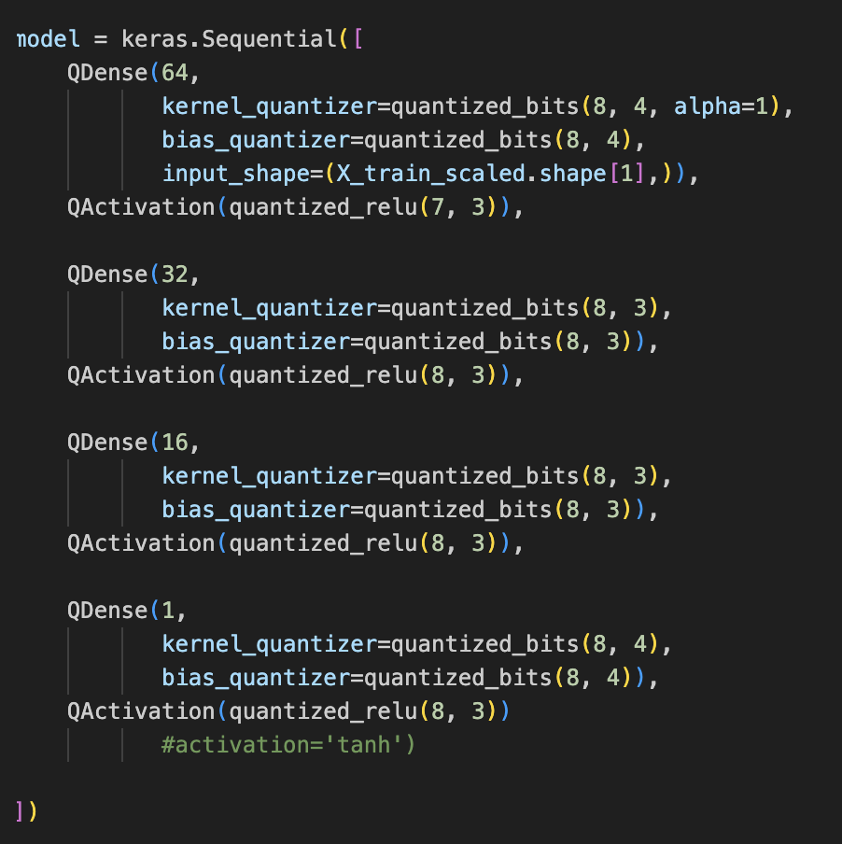
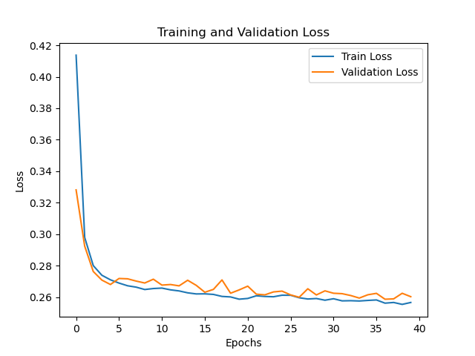
Making Changes
Changed activation to relu
(8,3) to (7,3) on one
Higher resolution for large angle but also more loss!
Lower discrepancy between train and validation

Slide 8
Conclusion
Improvements are more subtle and may be trickier with quantized network.
There seem to be some drawbacks between the impacts on loss, overfitting, high angle accuracy.
We can try more variations.

