Slide 1
DAQ + SlowCtrl status

Slide 2
Status 6/30 9:24 am
i.e., outdated.

Slide 3
Overview of DAQ system
FE: GEM left
[on vme-left.dl]
MIDAS server
DLFridge
ROOT Files
FE: GEM right
[on vme-right.dl]
SlowCtrl
Online Analysis with Visual Cooker (visco)
FE: Trigger
[on dltdc.dl]
Note: No mhttp, no mlogger. No midasconverter. The ROOT files can be analyzed by visco while being written. Please provide a variant of your plugins that only need one pass.

Slide 4
Overview of SlowCtrl system
Most power supplies, hall probe
EPICS server
Postgres SQL DB
DLFridge
Jaya gateway for beam line variables
Web App
ODB gateway

Slide 5
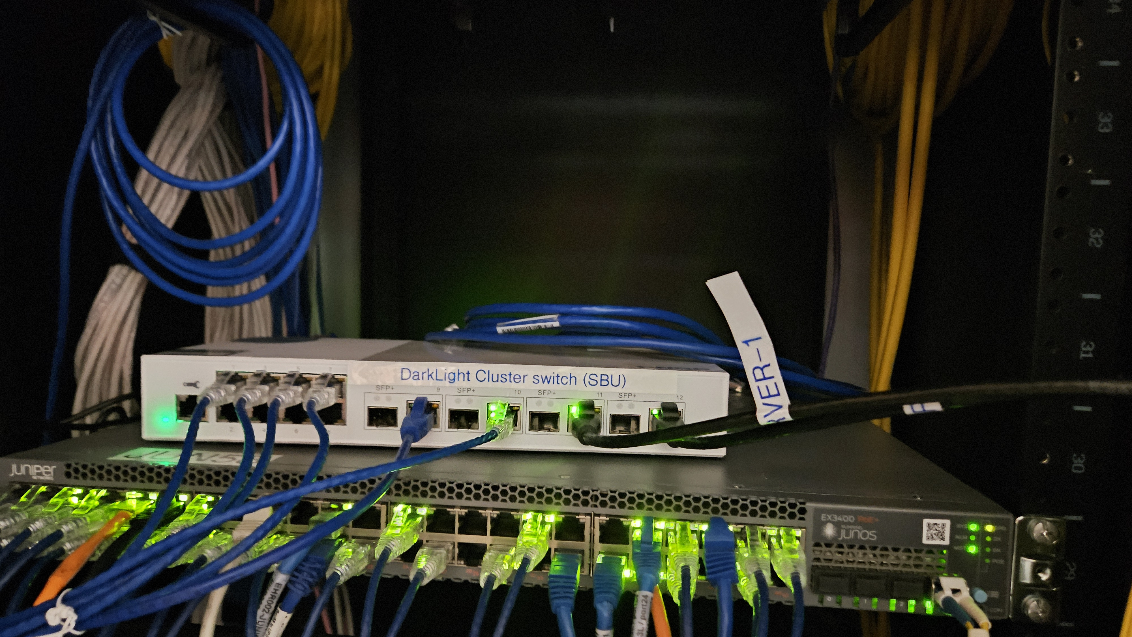
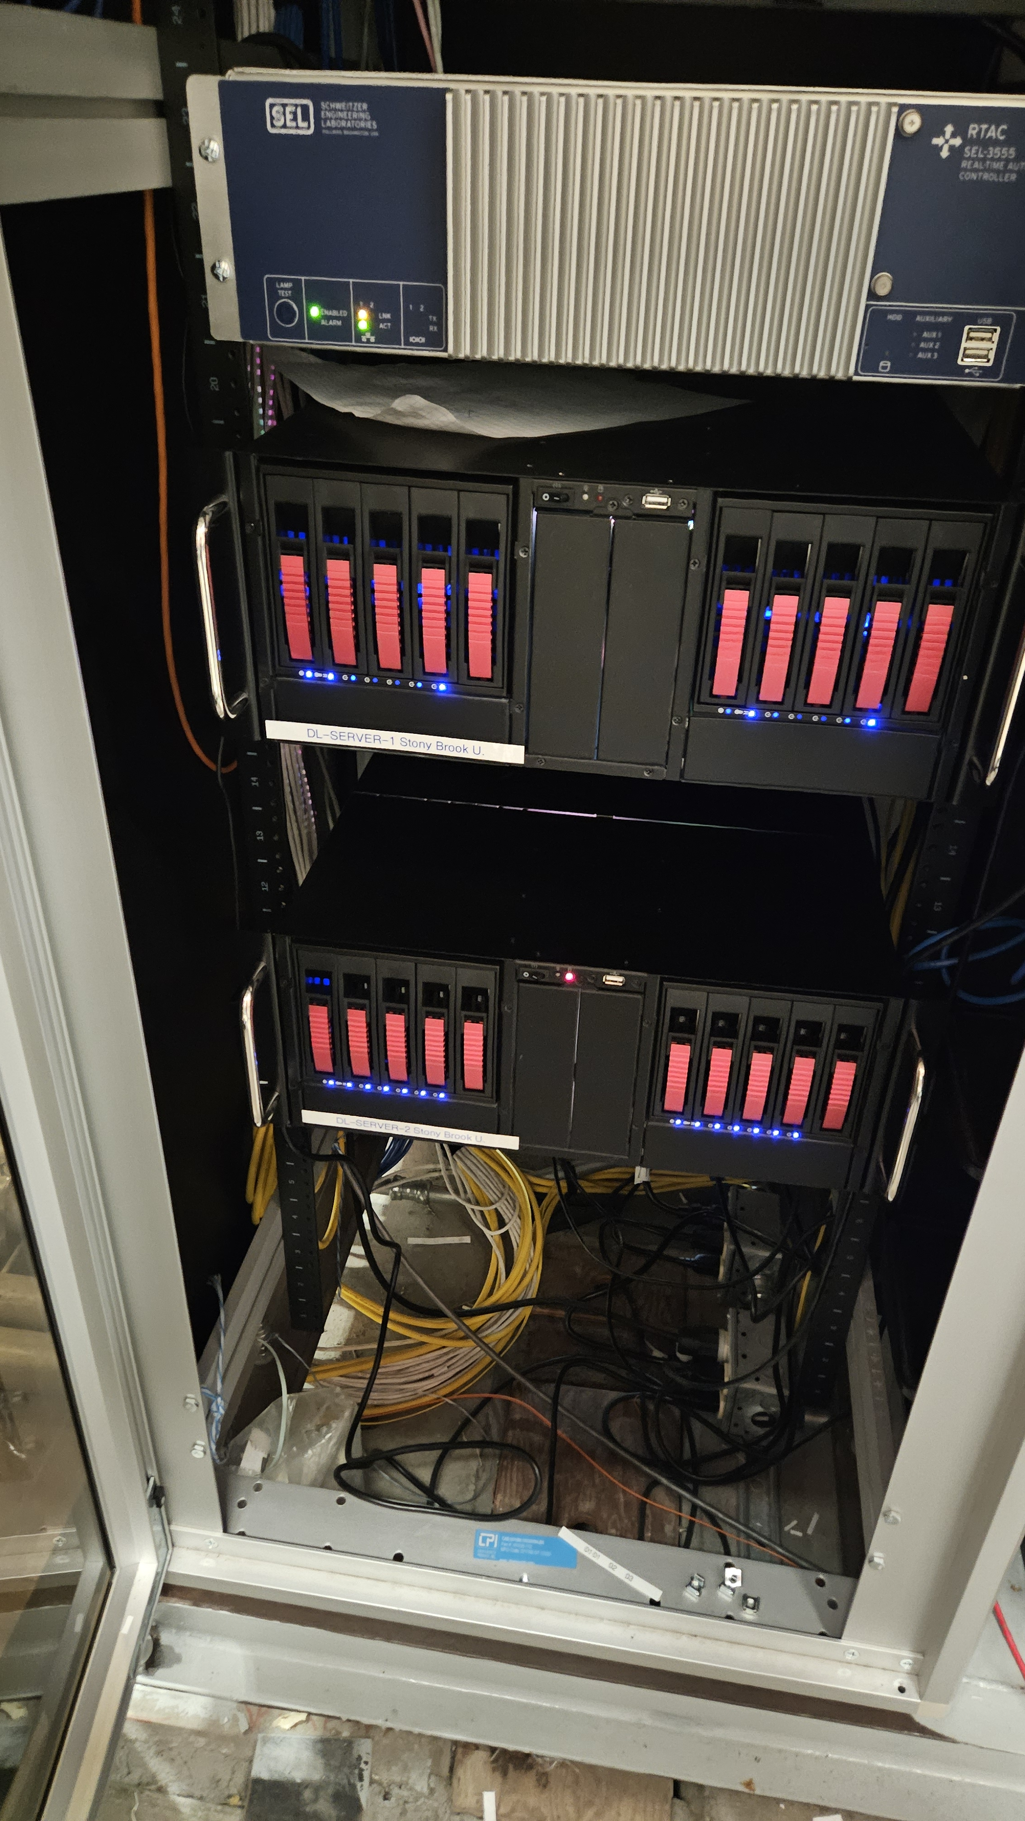
Where is stuff? Servers [A/Cd hut on the roof]
Clusterswitch.dl
2x10Gig bonded link to rackswitch.dl
dl-server-1.triumf.ca / dl-server-1.dl
Cores for slurm tasks
1 gig to TRIUMF, 10gig to our network
dl-server-2.triumf.ca / dl-server-2.dl
All services
mserver
PostgreSQL
DLFridge
Elog
Slowctrl-web
Home dirs
LDAP
Cores for slurm tasks
1 gig to TRIUMF, 10gig to our network

Slide 6
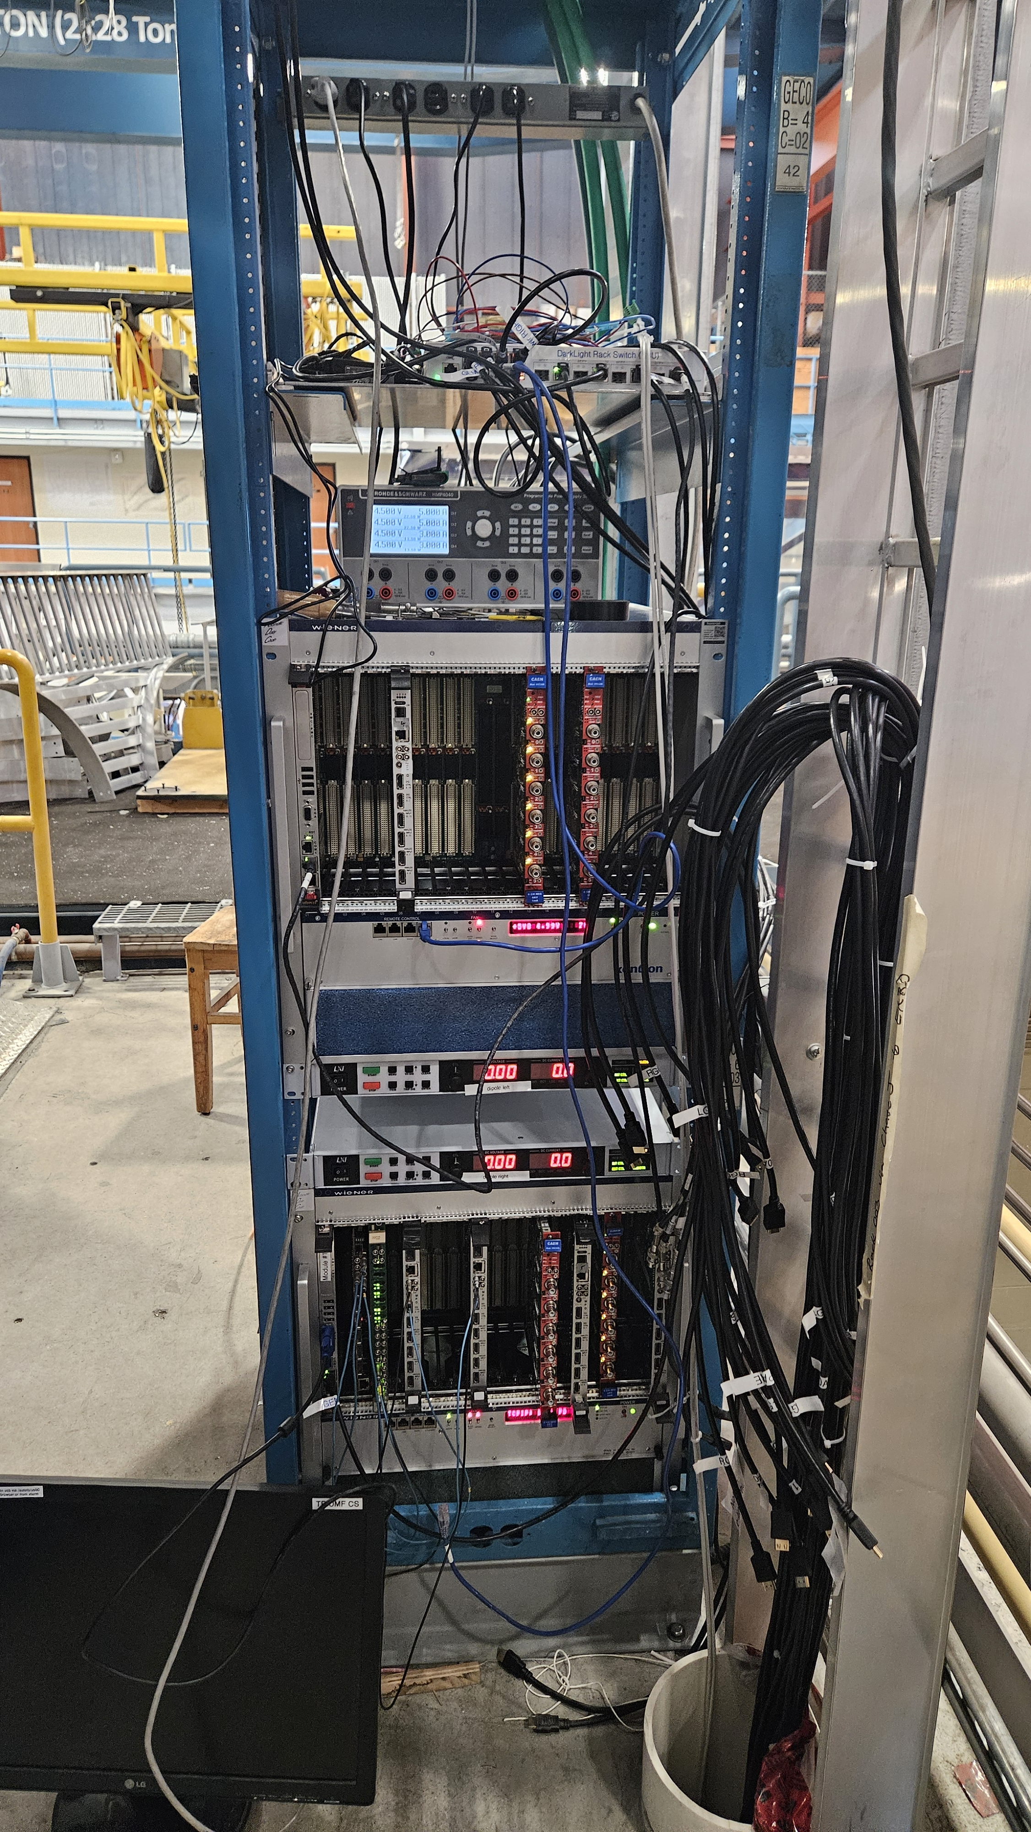
Where is stuff? Rack (on the roof)
Space for Trigger electronics
Rackswitch.dl
Hall-left.dl and hall-right.dl [behind]
Field/temperature measurement
Gemlv.dl
APV low voltage supply
vme-left.dl
MPDs For beam-left GEMs
HV?
dipole-left.dl
Dipole power for beam-left spectrometer
dipole-right.dl
Dipole power for beam-left spectrometer
vme-right.dl
MPDs For beam-right GEMs
HV?

Slide 7
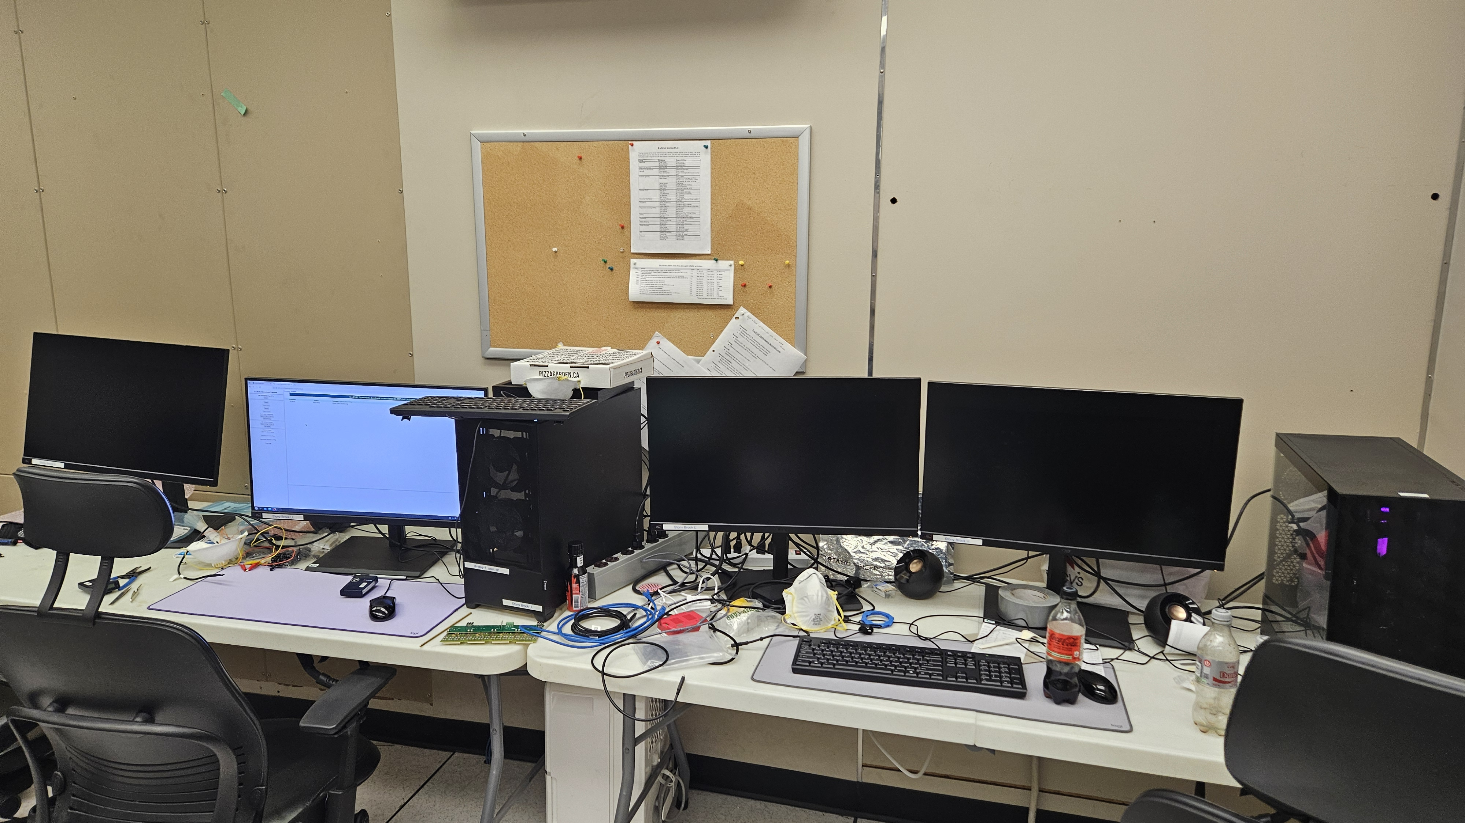
Where is stuff? Counting room
dl-daq-2.triumf.ca / dl-daq-2.dl
For slowctrl
dl-daq-1.triumf.ca / dl-daq-1.dl
For online analysis

Slide 8
Accounts and stuff
All accounts have a shared home
Please be considerate how much you write to home – it’s a shared 4TB disk, and it also contains the database
Special accounts
dlcluster
This will run analysis jobs for near-online analysis via slurm
Also
daq
Runs mserver, dlfridge and the frontends
Slowctrl
Runs slow ctrl web app, epics

Slide 9
Passwords
For dl-daq-1 and dl-daq-2:
User is dl1 and dl2.
Password is …
For slowctrl web user:
Use slowctrl and pw ….
Without this, you can only view things
With it, you can change things.

Slide 10
NB.:
Only dl-server-* and dl-daq-* are in the TRIUMF network.
Local systems / internal network is separate, “dl” domain
From TRIUMF, you can access them from your computer, but it’s not automatic:
You need to set a network route to 192.168.17.x via gateway dl-server-2.triumf.ca
You need to set your DNS server to dl-server-2.triumf.ca
No, I cannot make that easier
Services are reachable via:
Slowctrl.dl = dl-server-2.triumf.ca/slowctrl
Elog.dl = dl-server-2.triumf.ca/elog

Slide 11
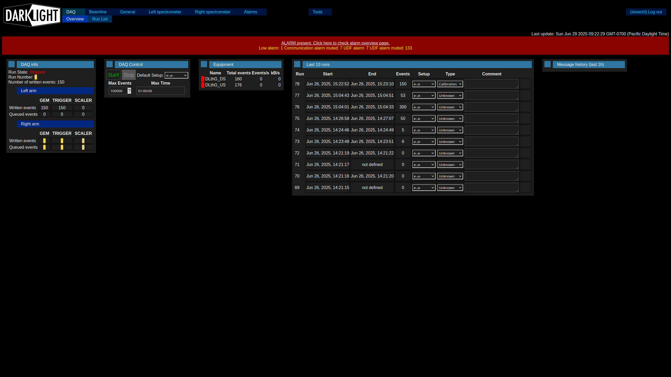
A tour of the slow ctrl: DAQ

Slide 12
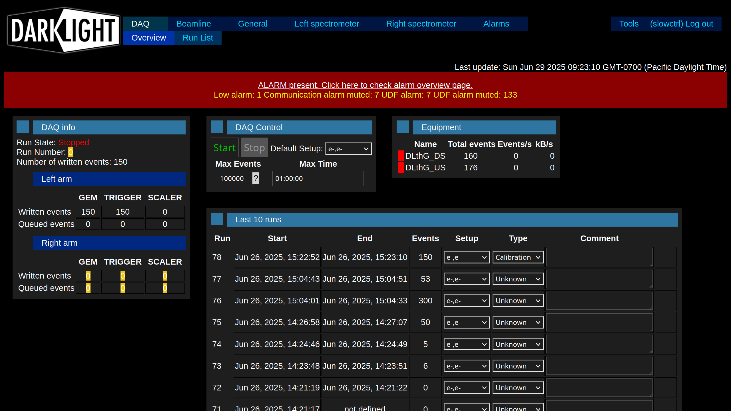
A tour of the slow ctrl: DAQ (zoom)

Slide 13
https://dlshifts.cfnssbu.physics.sunysb.edu/

Slide 14
Open questions/tasks
Control of Trigger PS
What to do with Trigger scaler
Only in SlowCtrl?
Also in the root file? How synchronized?
Does GEM readout work?
Does sync work?
One GEM HV seems broken? Works in the beginning, but disconnects from bus after a while
Lower crate controller locks up when connected to network
Pressures from BL
Second PPG32
GEM zero suppression on FE or in DLFridge possible?
Magnet power + interlock test
Add trigger config to slowctrl

