Slide 1

Accelerator status and plans
Stephanie Diana Rädel
Accelerator Division

Slide 2

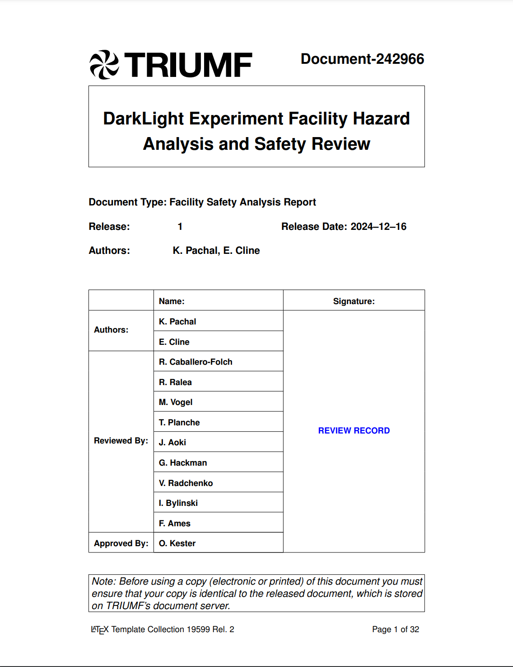
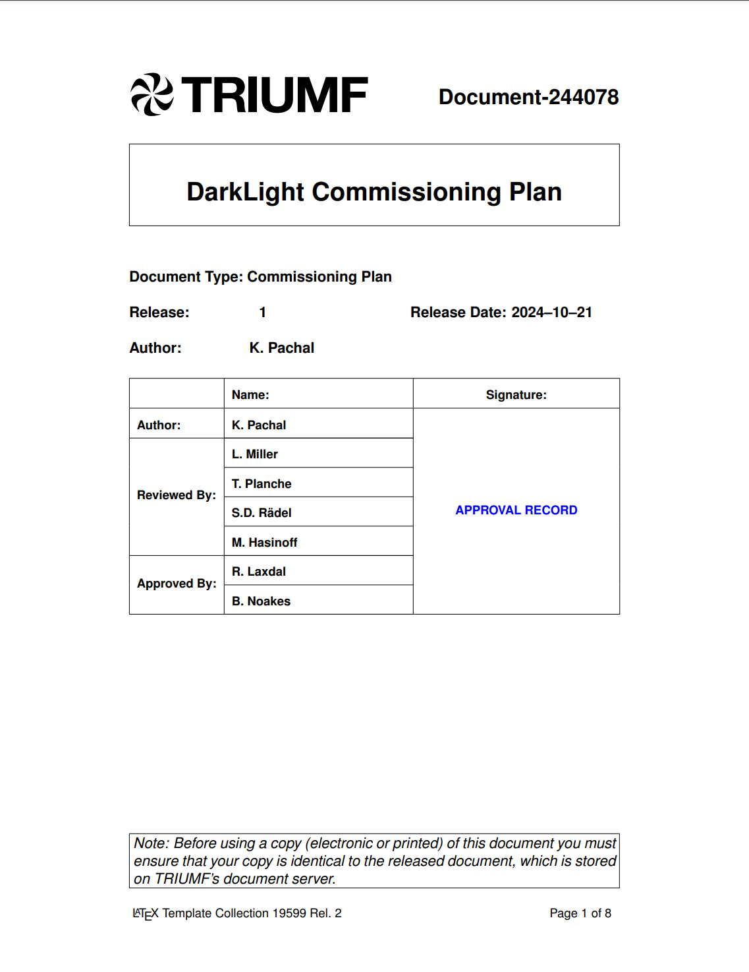
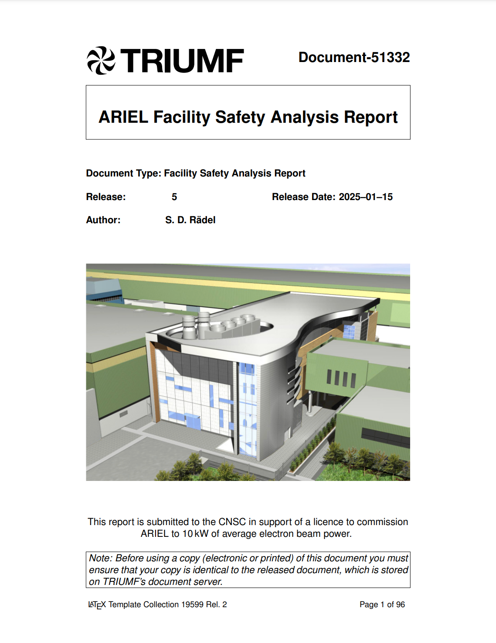
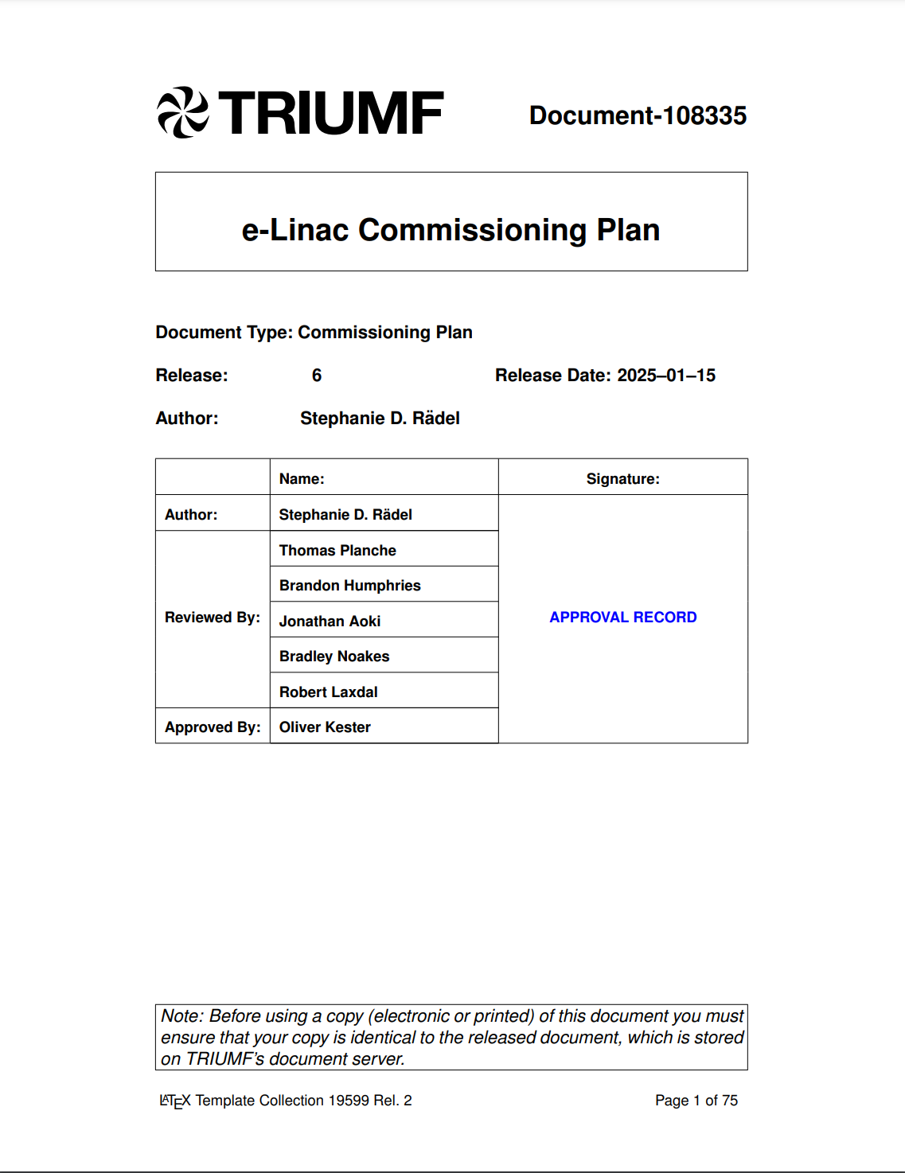
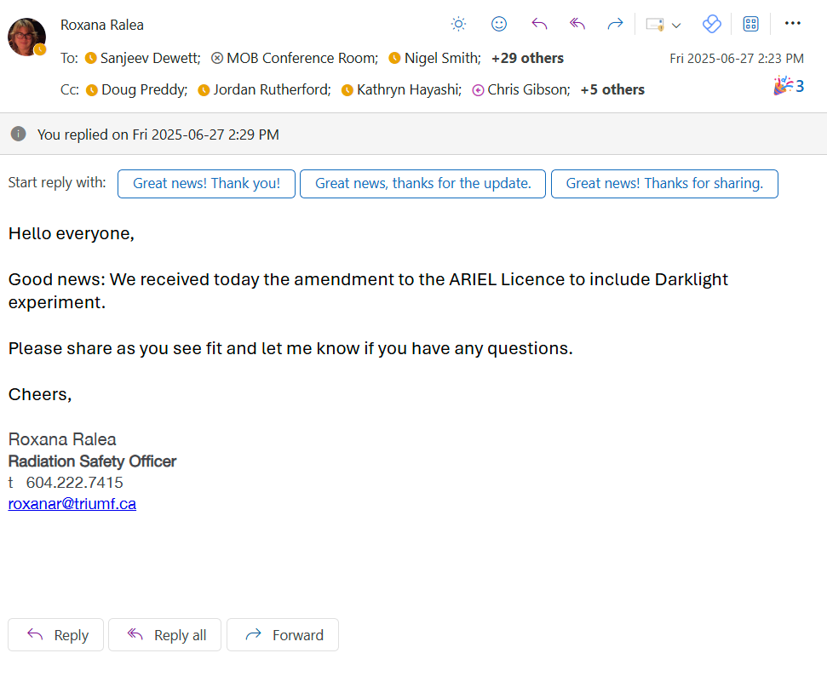
Document package for CNSC
JANUARY
2025
SUN
MON
TUE
WED
THU
FRI
SAT
6
13
20
27
7
14
21
28
1
8
15
22
29
2
9
16
23
30
3
10
17
24
31
4
11
18
25
5
12
19
26
Package submission end of January
CNSC approval received on June 27th
JUNE
2025
SUN
MON
TUE
WED
THU
FRI
SAT
1
8
15
22
29
2
9
16
23
30
3
10
17
24
4
11
18
25
5
12
19
26
6
13
20
27
7
14
21
28

Slide 3
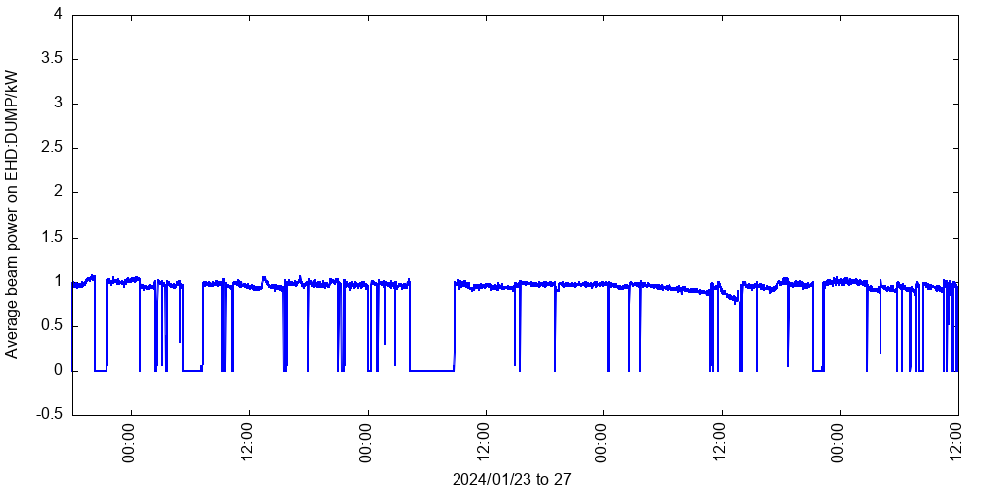
3-day beam delivery January 2024
over 50 trips

Slide 4
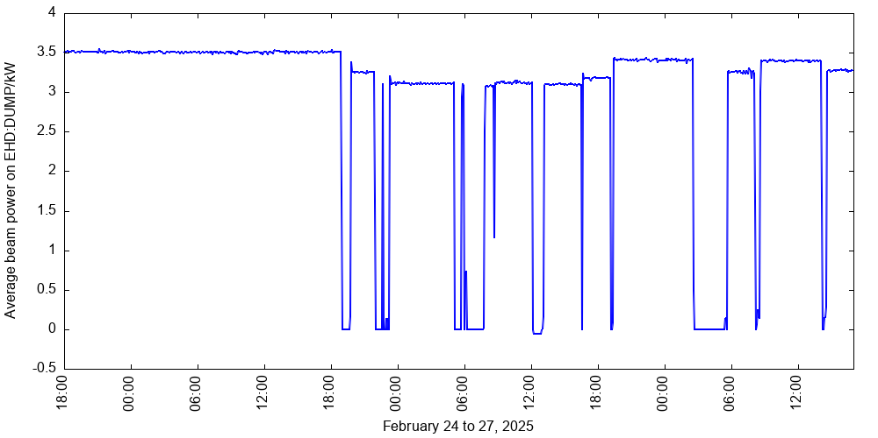
3-day beam delivery February 2025
1 day , 2 h , 26 min
27.9 MeV

Slide 5
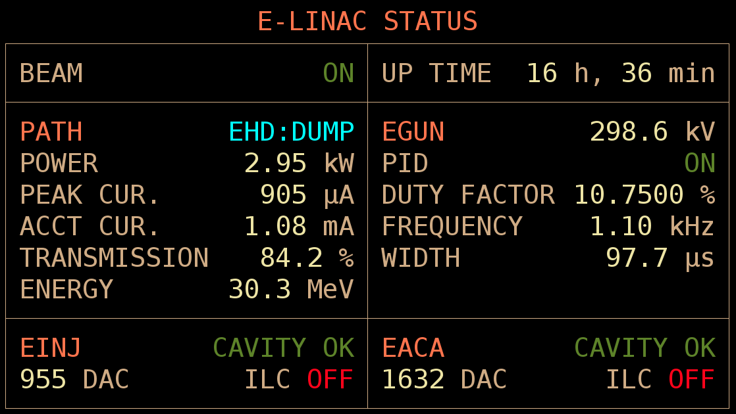
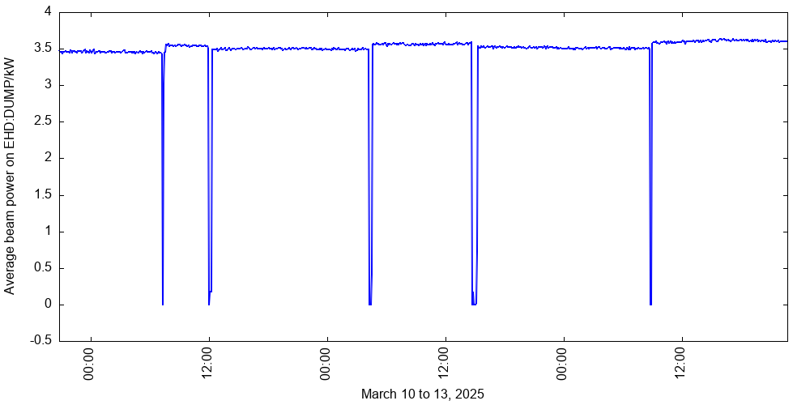
3-day beam delivery March 2025
97.89%

Slide 6
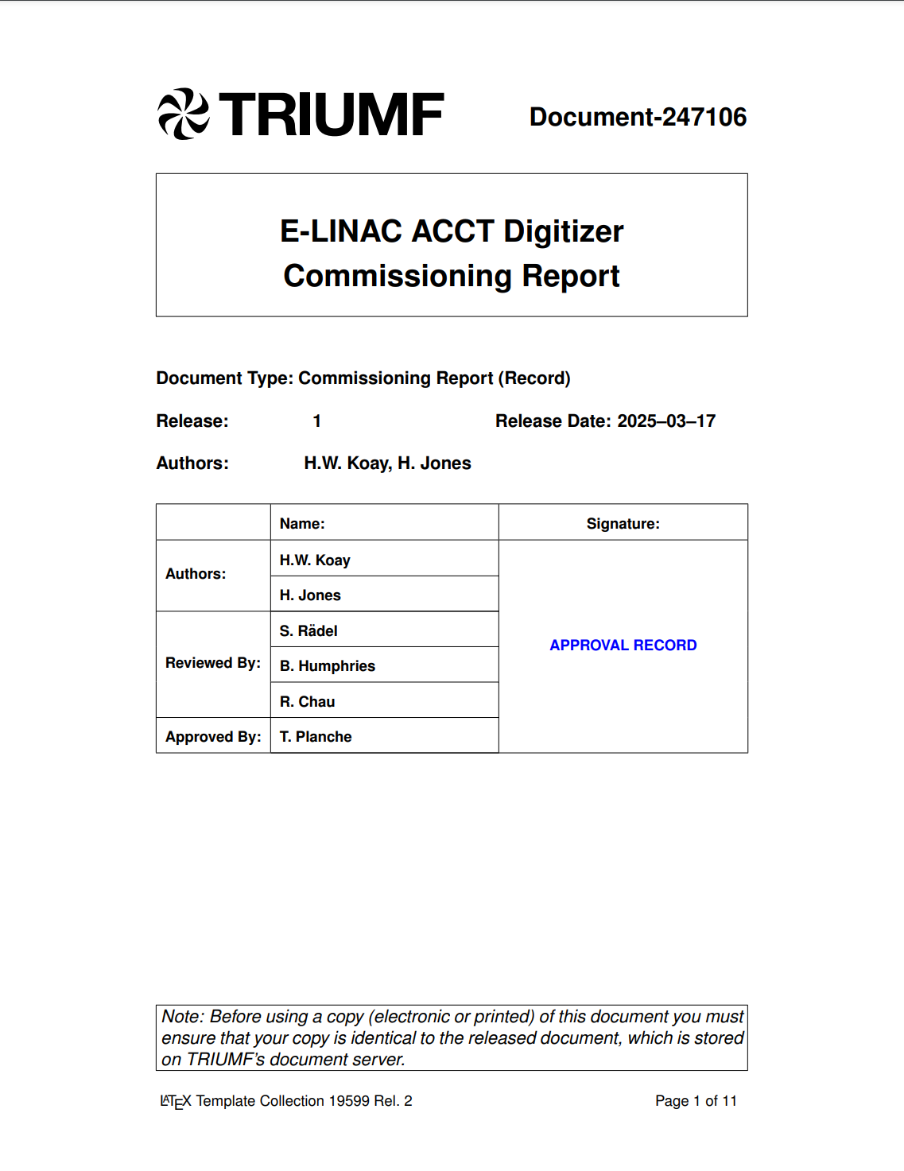
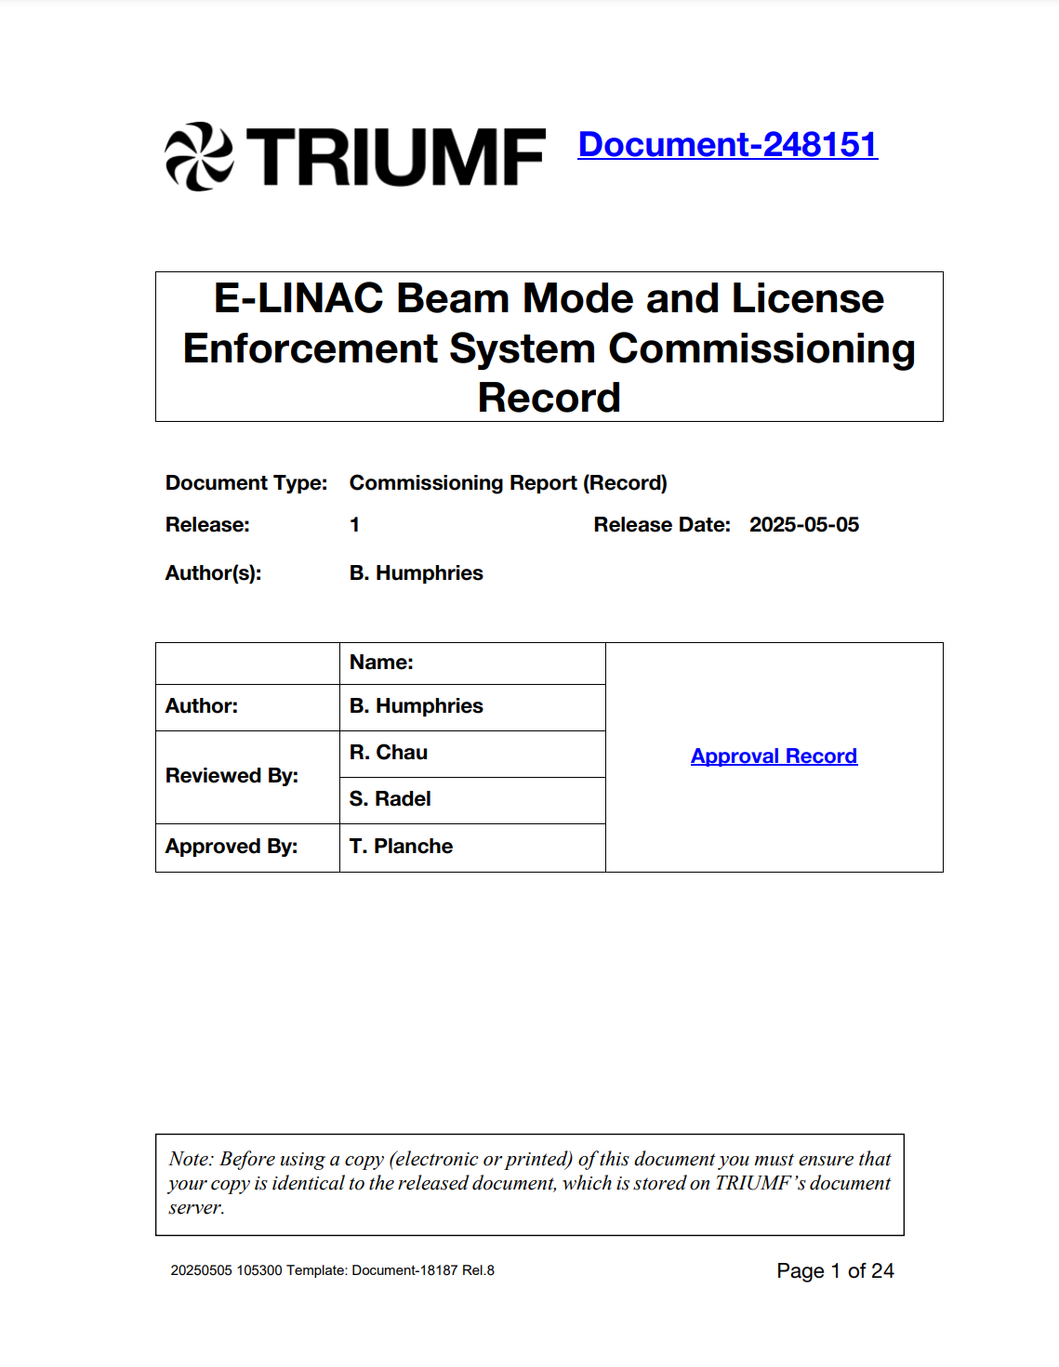

March/April
Brandon Humphries focussed on License Enforcement System (LES) commissioning before parental leave
whenever it was possible he trained operators
  4 fully trained DCR operators
essential for

Slide 7
Status
APRIL
2025
SUN
MON
TUE
WED
THU
FRI
SAT
7
14
21
28
1
8
15
22
29
2
9
16
23
30
3
10
17
24
4
11
18
25
5
12
19
26
6
13
20
27
We just got out of our shutdown, which started April 28th
Checked cryogenic system
  modules are cool again (2K) since June 10th
The high-voltage regulation unit of EACA's KPS is no longer operational
  Yanyun tried to resolve the problem with Ampegon over two weeks
  The only option is a replacement unit
  Tried to shortcut ordering replacement unit, was not successful
  Ampegon confirmation on received pre-payment June 24th
In March/April the current draw increased over time => had a chance to test our gun
MAY
2025
SUN
MON
TUE
WED
THU
FRI
SAT
5
12
19
26
6
13
20
27
7
14
21
28
1
8
15
22
29
2
9
16
23
30
3
10
17
24
31
4
11
18
25
JUNE
2025
SUN
MON
TUE
WED
THU
FRI
SAT
1
8
15
22
29
2
9
16
23
30
3
10
17
24
4
11
18
25
5
12
19
26
6
13
20
27
7
14
21
28

Slide 8
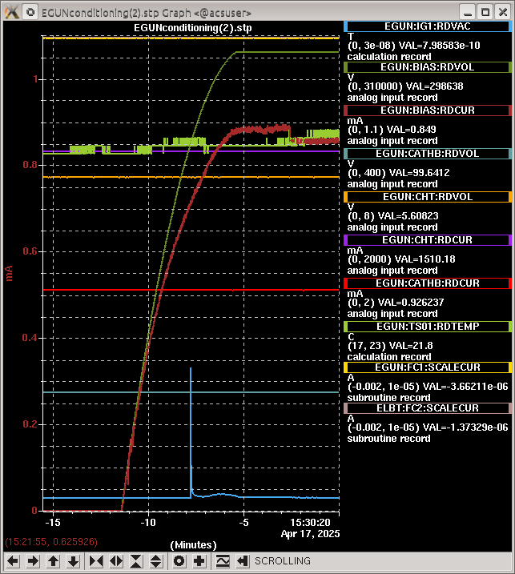
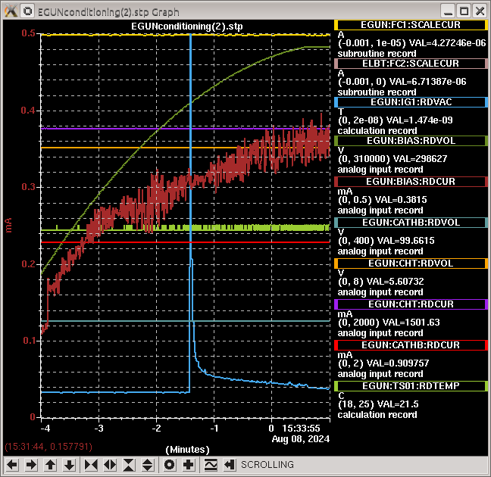
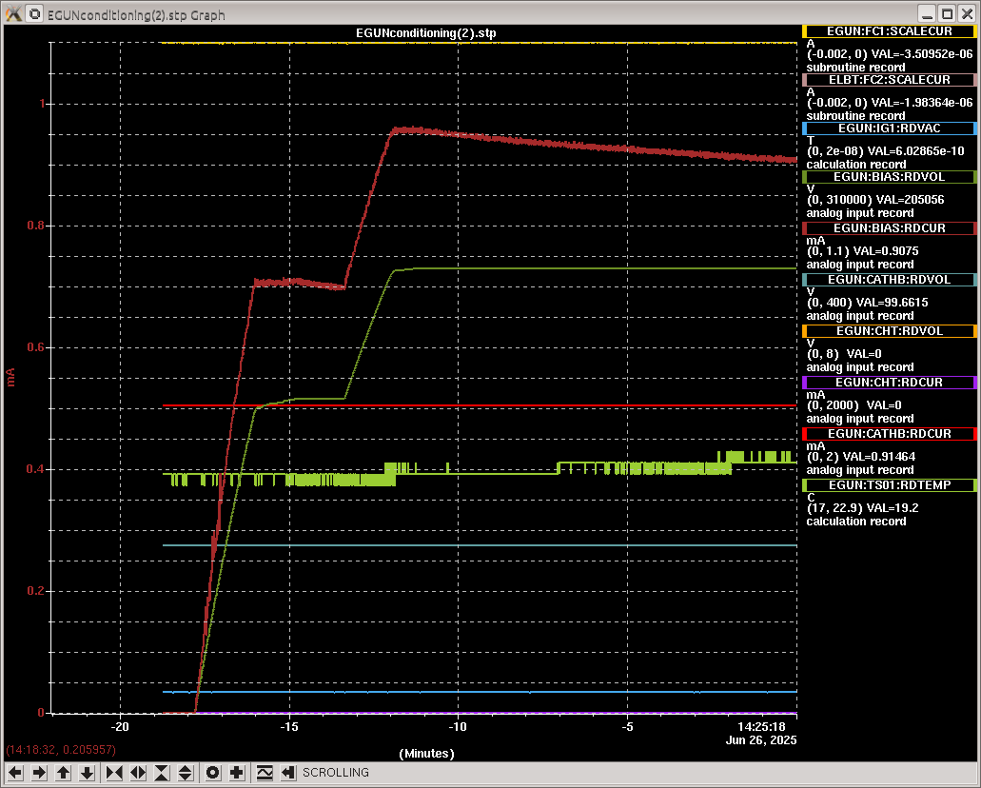
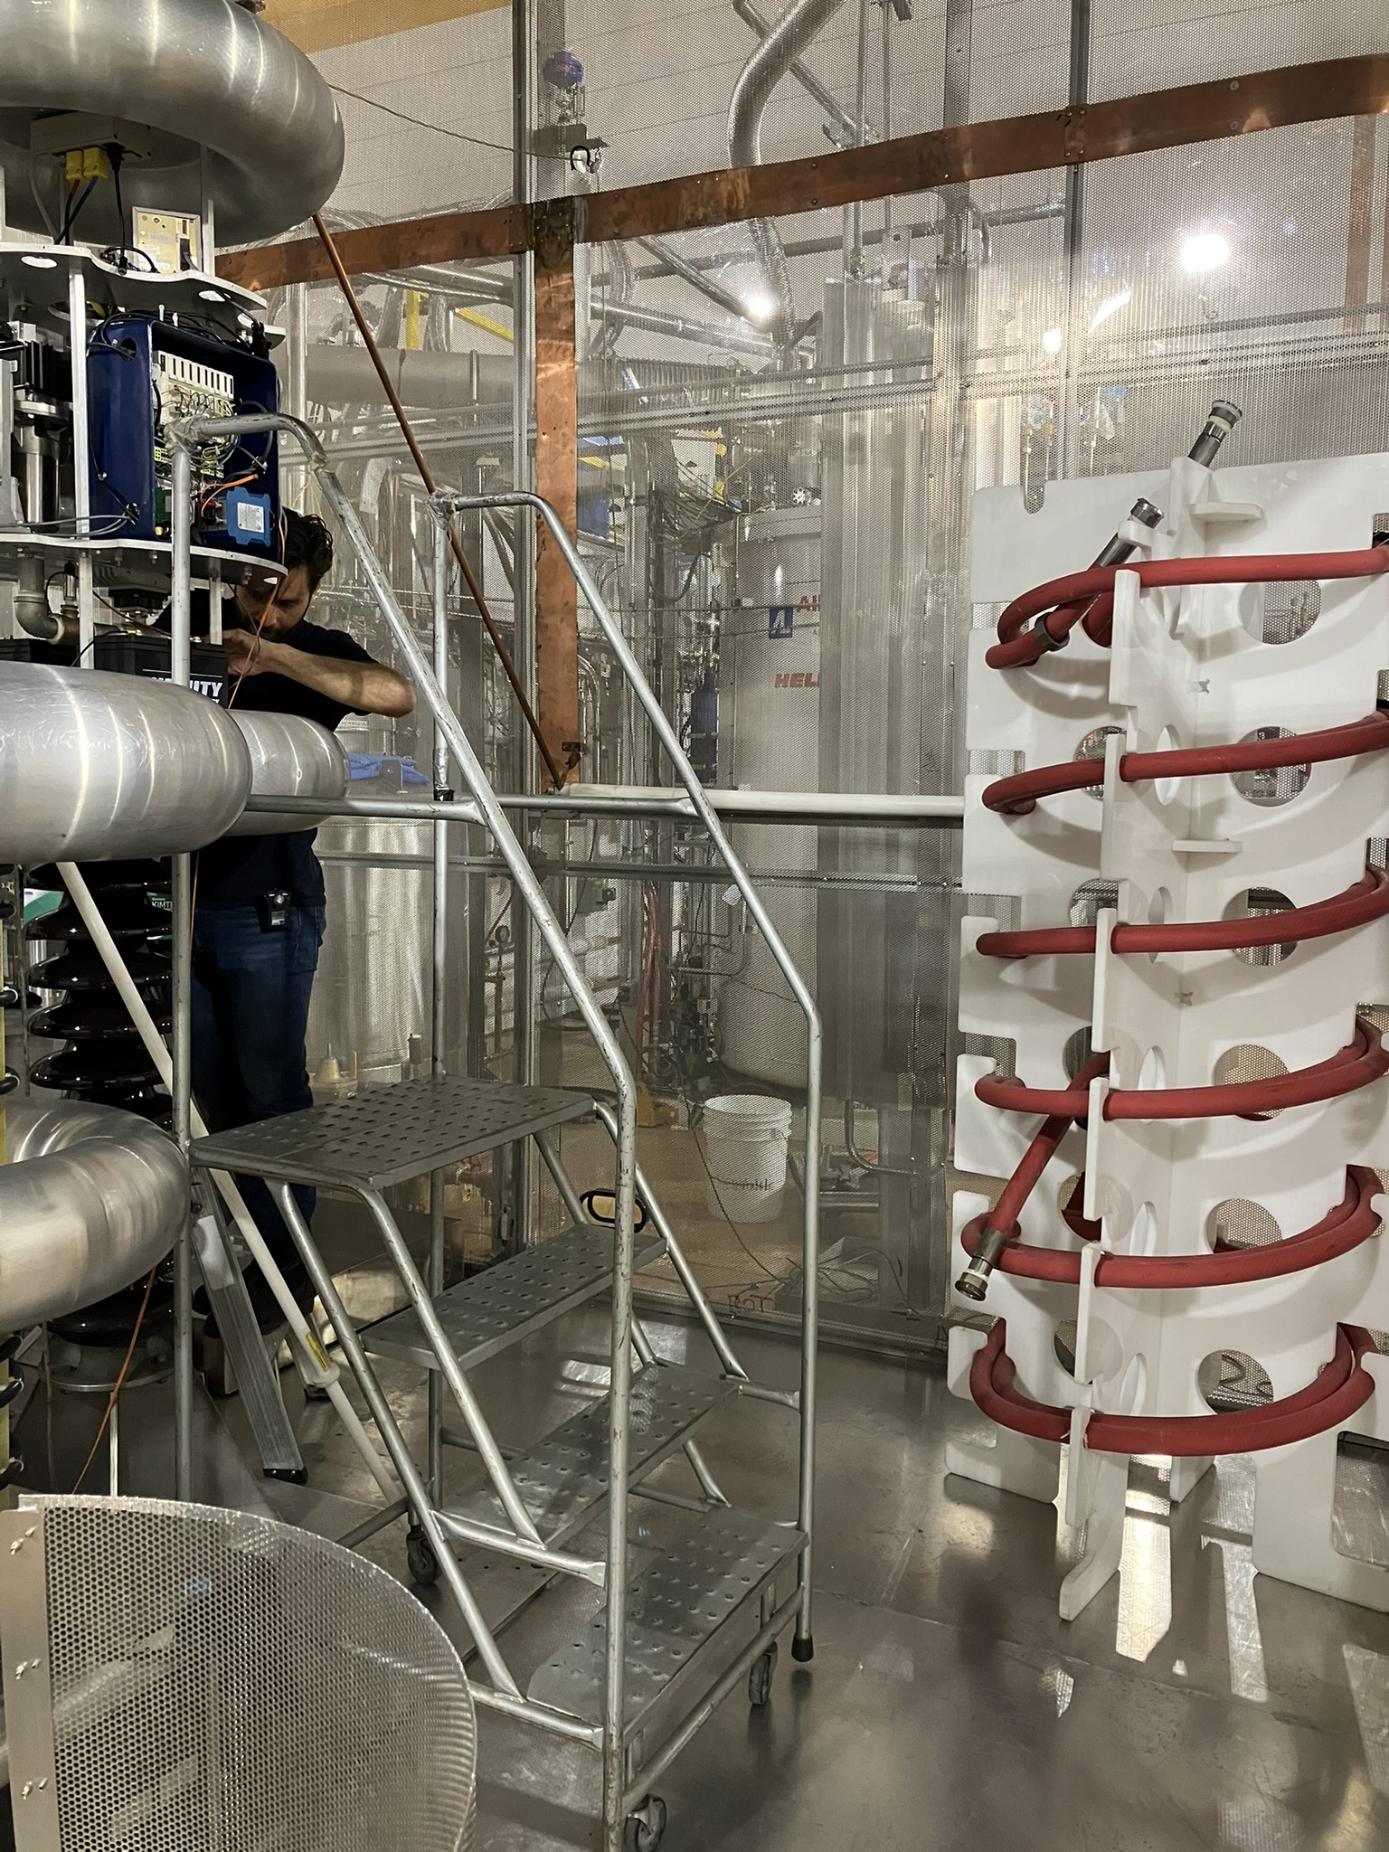
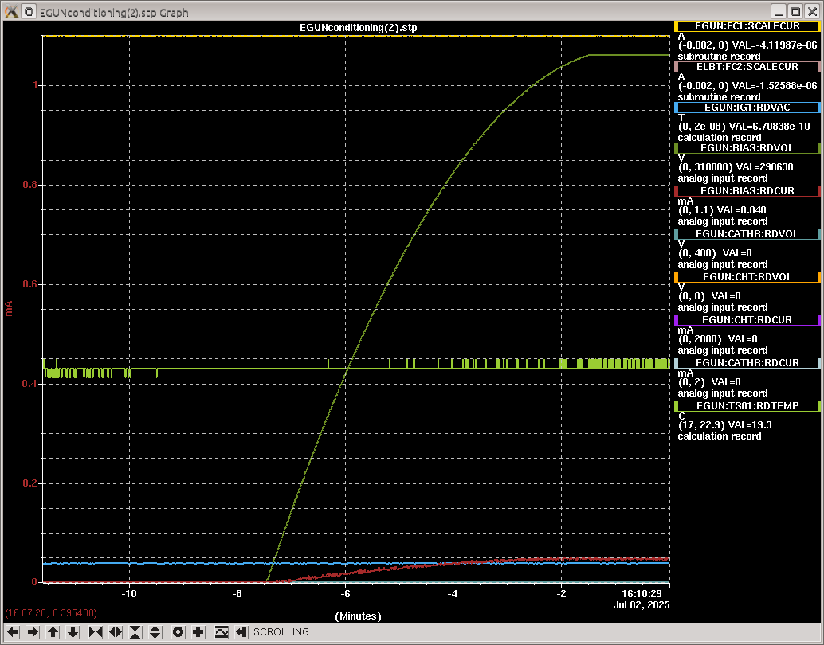

EGUN Test
Current draw at the end of ramping the gun to 300 kV increased over time
Our limit is 1 mA
After end of shutdown, it didn’t stay the same, it still increased
Current plan: purchase and install different type of water hoses

Slide 9
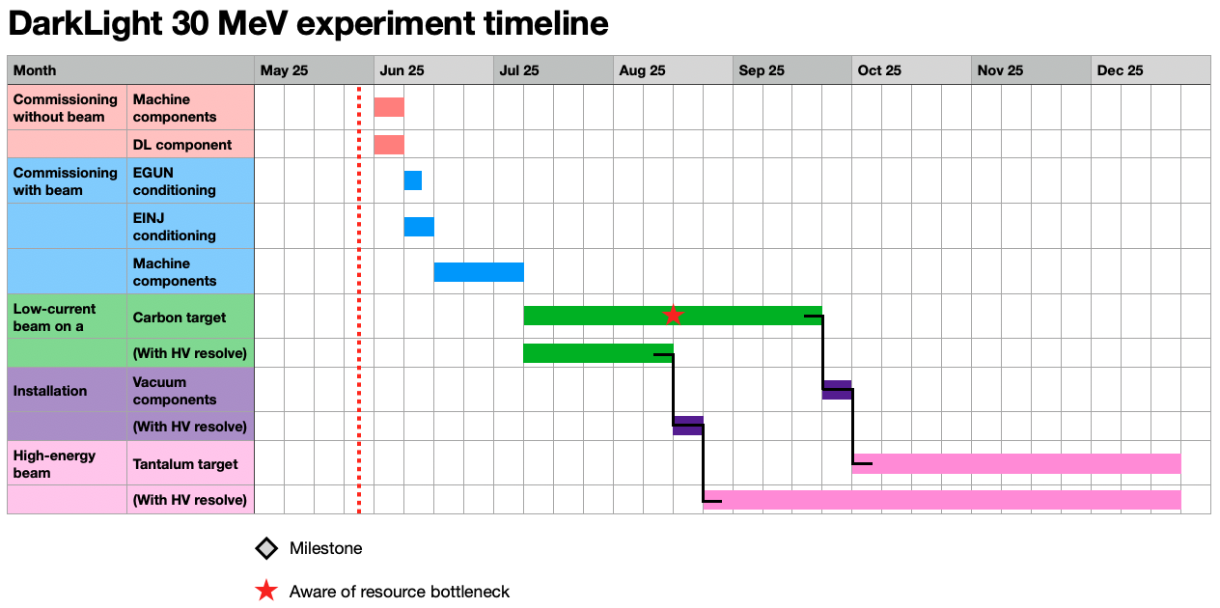

Timeline
2026
LABWIDE SHUTDOWN

Slide 10















Thank you
Merci
www.triumf.ca
Follow us @TRIUMFLab

