Slide 1
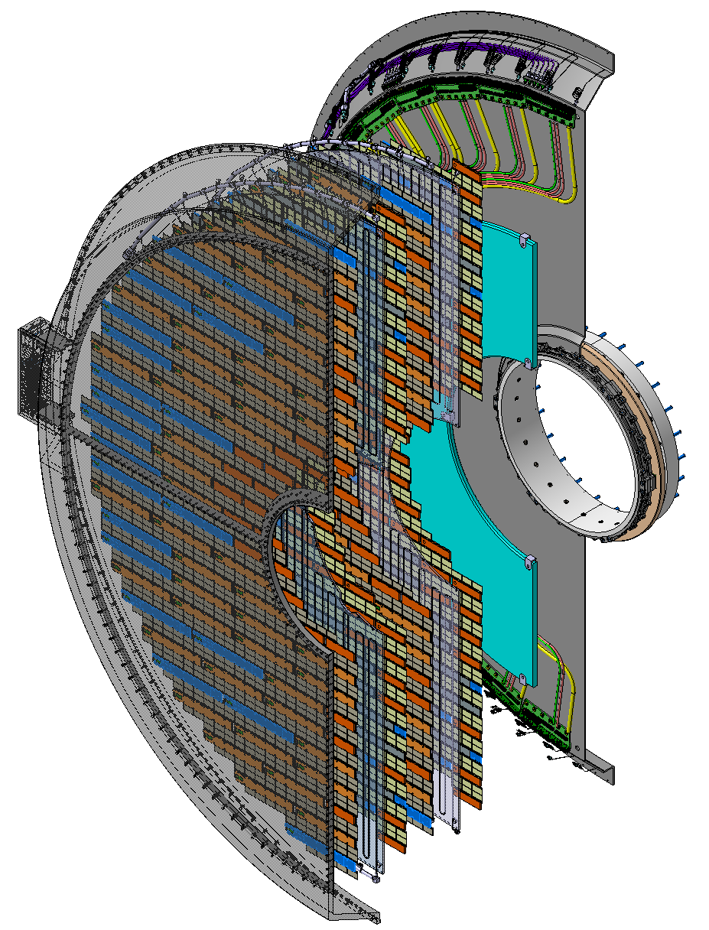
Overall ETL structure
Two End Caps, each made out of two self-contained Half-End Caps (Sides)
Each Half-Endcap contains two large Al cooling plates (DEEs) covered with modules and readout/power boards on both sides. Nominal 1.7 sides, ideally 2 sides
A backplate holds the cables and patch panels; DEEs attach to it. It forms a tight boundary with HGCAL’s thermal barrier.
Each Half-Endcap is thermally insulated from the outside. The thermal screen completes the detector on the side away from HGCAL
Cables leave each half-endcap via the Service Channels on HGCAL
The complete “sandwich” needs to fit within 99 mm envelope along the z-axis
Both Half-Endcaps are attached to a collar at the center, interfacing to the HGCAL

Slide 2
MIT responsibilities
Responsible for 100% of the mechanical support structure for CMS ETL
All work presently funded by DOE NP funded sub-contract from Rice University and DOE HEP via Fermilab as well as some discretionary funds
Work is focused at Bates Laboratory and at CERN
Jason Bessuille (~100%), Tricia Smith (~10%), Prajwal MohanMurthy (25%), David Schmid (100%)
Expect intense engineering and structure production through most of 2026
Starting in 2027, the work shifts to the integration of modules on the mechanical structure
Transition from engineers to postdocs and students. David Schmid in the leading role for ETL
2027-2029 integration, testing, etc.
Installation in the cavern 1 year before LHC-HI start, presently February 2029

Slide 3
Mechanical elements, Status as of October 8, 2025
DEEs
Well understood: design, prototype, production steps
Final design still needs to be polished: screw holes, etc
Working on the solution to bi-metal deformations, not yet final
Backplate
In principle, it is understood, but a detailed design is urgently needed. MIT engineer in charge
Mockup to study cable routing and PP0 attachments is being prepared
Thermal Screen
Generally understood, good example from HGCAL, but needs final design, thermal evaluation. Several people are looking into this
Service Channel
No work recently, it needs to be done, but it should be straightforward
Auxiliary Tools
DEE handing tool “Spider” is ready, at CERN
Picture Frames and Rotating Support is at 90% design, lower priority for now

Slide 4
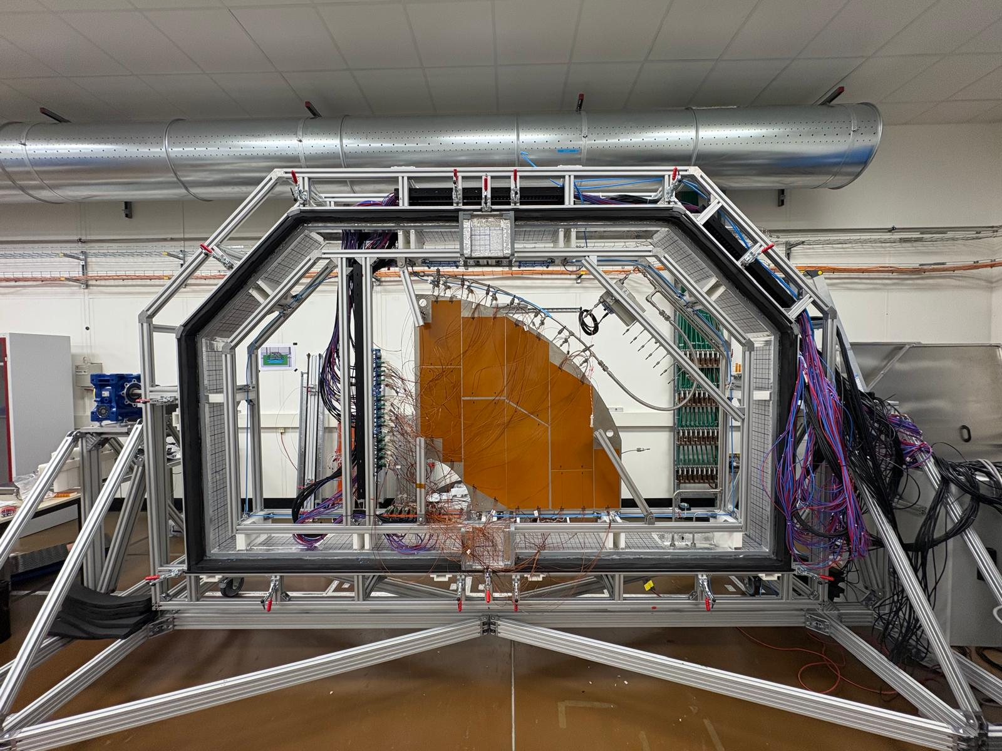
Preparation for the Wedge test: @TIF on Tuesday, 22 Sept, 2025

Slide 5
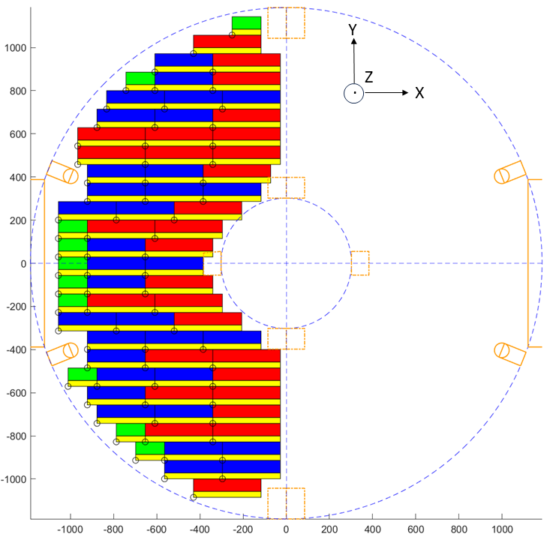
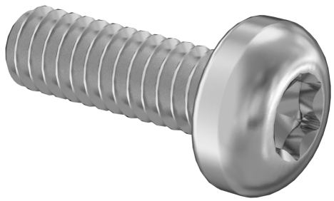
Modules and Electronics are attached by small M2 screws: Positions!
RBF{3,6,7} Locations: Known for all configurations
For example:
10 x RBF3
33 x RBF6
28 x RBF7
M2 Torx
www.mcmaster.com/90362A137
$5.45 per 100 screws
@[30-34] N·cm

Slide 6
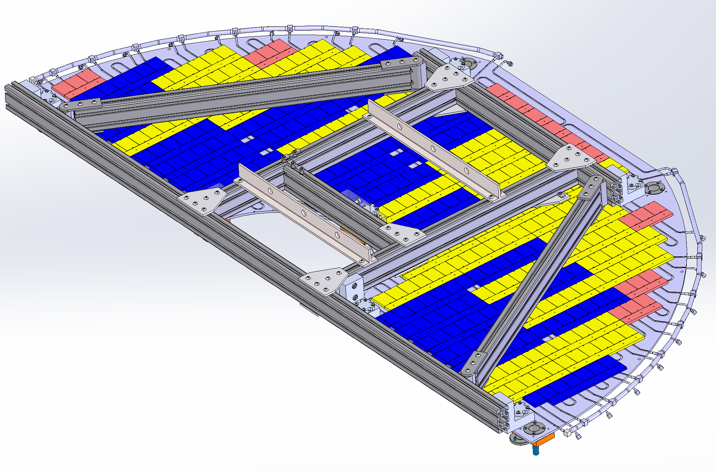
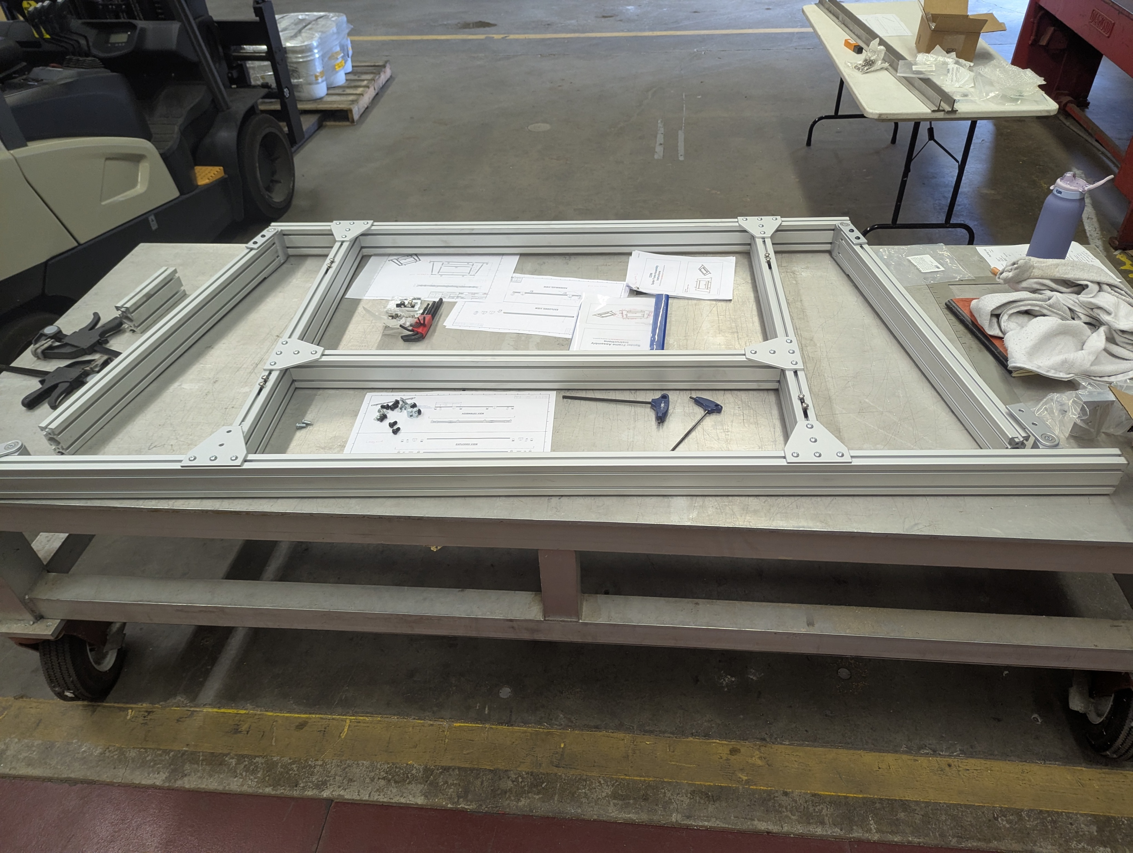
Integration Tools: Spider and Picture Frame
Spider frame functionalities:
Mounting assembled DEEs into the Coldbox for the C6F14 commissioning;
DEE transport from the Coldbox to the back support plate for the final steps of the detector assembly.
Spider is now at CERN
Picture frame is designed to ensure a reliable:
DEE shipment before the detector assembly;
Dee storage after having mounted electronics before cold commissioning.
We will produce Picture Frame(s) later
Spider frame: transport

Slide 7
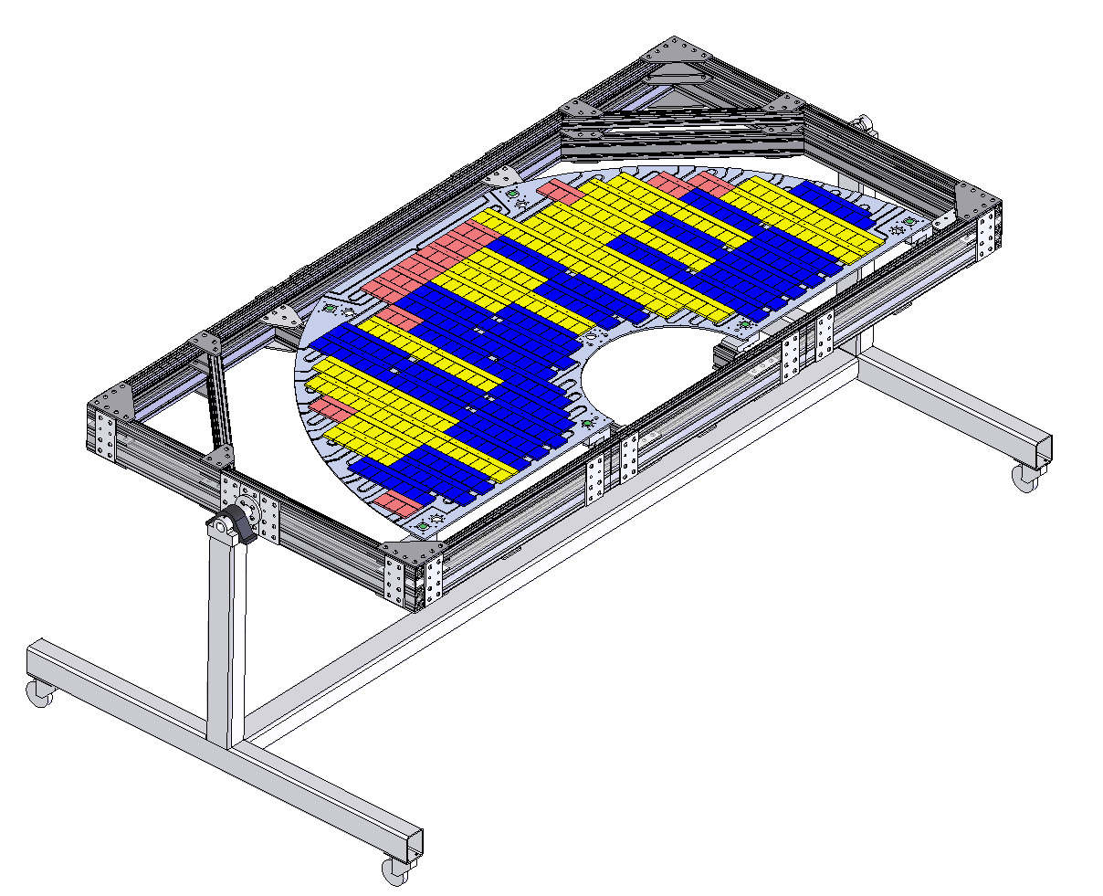
Picture Frame on a rotator

