Slide 1
Stefano - Recent Progress
TWEPP Proceeding waiting for JINST comments
Mosaix Probe Card mechanical concept validated by MPI – waiting for the design
previous design are locked – cannot extract different formats for Ansys simulations
SVT SW Work on WP agent in progress:
Global wafer maps completed – to be compared/merged with Yasser version
WIP: link with SENTIO maps to store global ASIC identifiers after testing
        Most of the WPAgent functionalities tested with Angelina successfully
        The core functionalities for the operation of the machine are there
        Work is still needed to:
        solve rare timeouts errors / compatibility with UI / sequence of operations for UI
First draft design and simulation for the aluminum structures proposed by Gregor is ongoing,
It would be good to understand if it is doable to glue the aluminum layer on a 1 layer PCB + wirebond
…guaranteeing perfect planarity
(thickness of the glue layer to be understood… a chat with Rui would be useful)

Slide 2
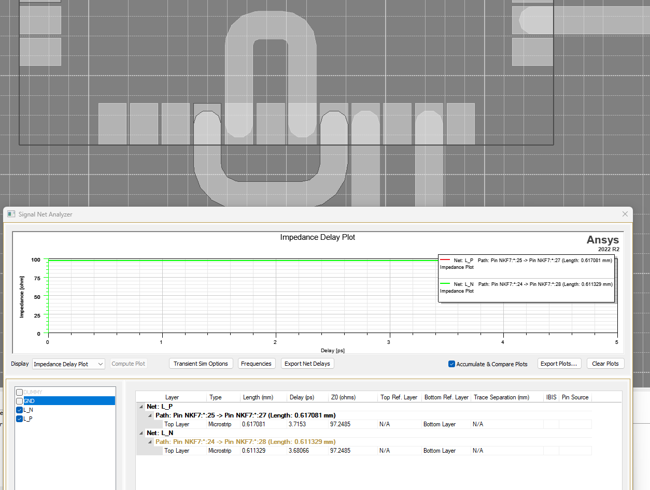
Stefano - Recent Progress
The Aluminum structure is laser etched on a dielectric, guaranteeing good planarity and fine pitch structures,
but, for 10Gb/s diff pair signals a GND reference layer is needed
aluminum
1
substrate
2
Glue … planarity? Thickness?
Copper + ENIG
substrate
Proposal:
Complete the design by next week and ask for quotations then:
Testing 1) with the loopback
Testing 2) for the individual diff pair test
glue – wirebonding -> longer time and higher risk to damage the needles
NKF7 Loopback length: ~ 0.6mm
… order of magnitude of the needles length
possibly it might work without reference plane?

