Slide 1
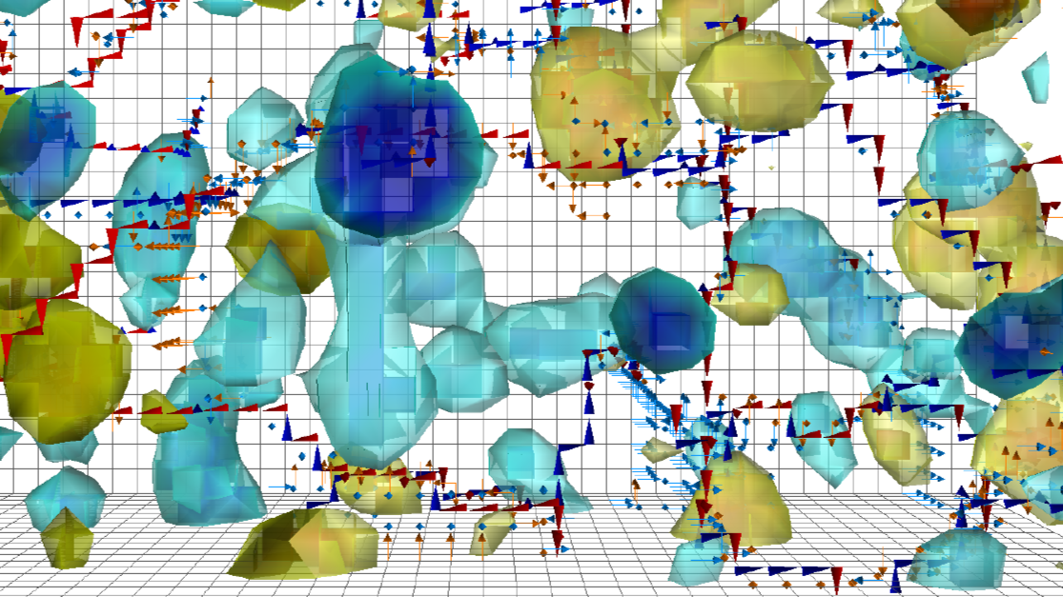





Understanding the finite-temperature phase structure of QCD with center vortices
Jackson Mickley
In collaboration with
Derek Leinweber (CSSM)
Chris Allton, Ryan Bignell (Fastsum)
Phys. Rev. D 110, 034516 (2024), arXiv:2405.10670 [hep-lat]
Phys. Rev. D 111, 034508 (2025), arXiv:2411.19446 [hep-lat]
Simons Collaboration on Confinement and QCD Strings Workshop
MIT, 18-20 May 2026

Slide 2
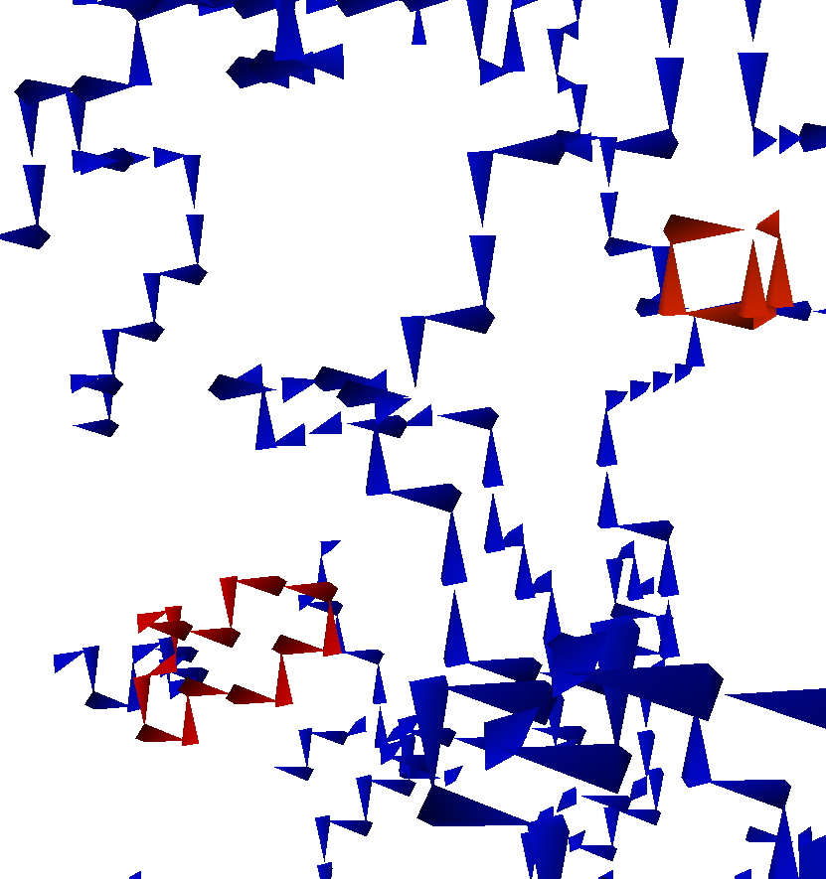
Overview
Introduction to center vortices
  Why do we care about finite temperature?
  Vortex identification on the lattice
Vortex geometry in full QCD
  Reveals three distinct regimes of finite-temperature QCD
  Quantified by vortex statistics: cluster extent, vortex density, branching points
Comparison to the pure-gauge theory
  Single well-defined phase transition
  Correspondence with the second transition in full QCD

Slide 3
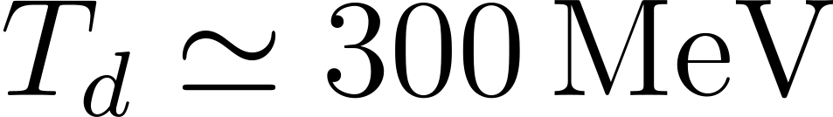
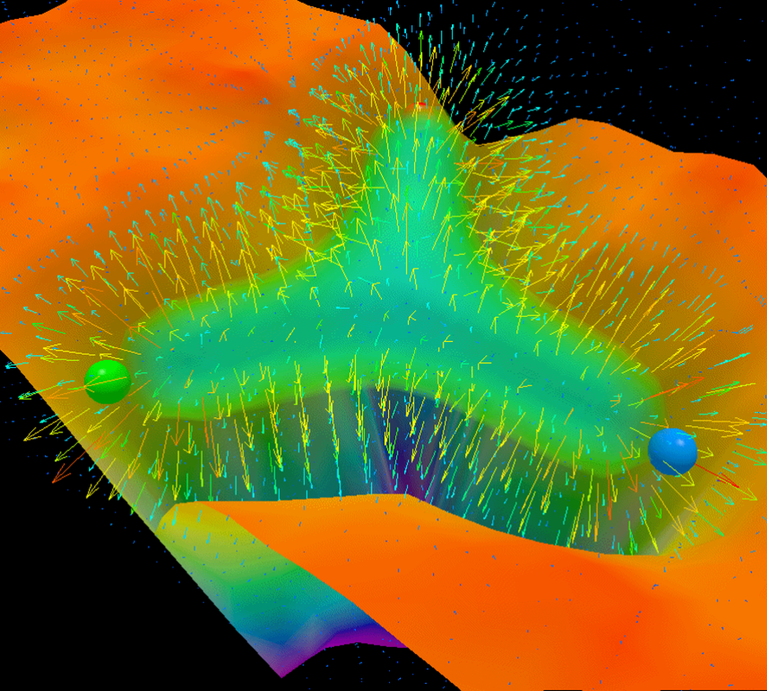


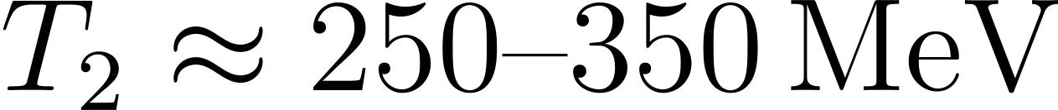
Deconfinement in QCD
Quarks and gluons confined at low temperatures
  Expected to break down at high temperatures
In pure gauge, critical temperature
  First-order phase transition
In full QCD, established transition at
  Chiral transition: crossover in chiral condensate
  Believed to be the deconfinement transition
Growing evidence for two transitions in full QCD
  Chiral-spin symmetry, monopole condensation, color screening, other topological considerations
  2nd transition temperature
  Demands detailed study in high-temperature regime

Slide 4
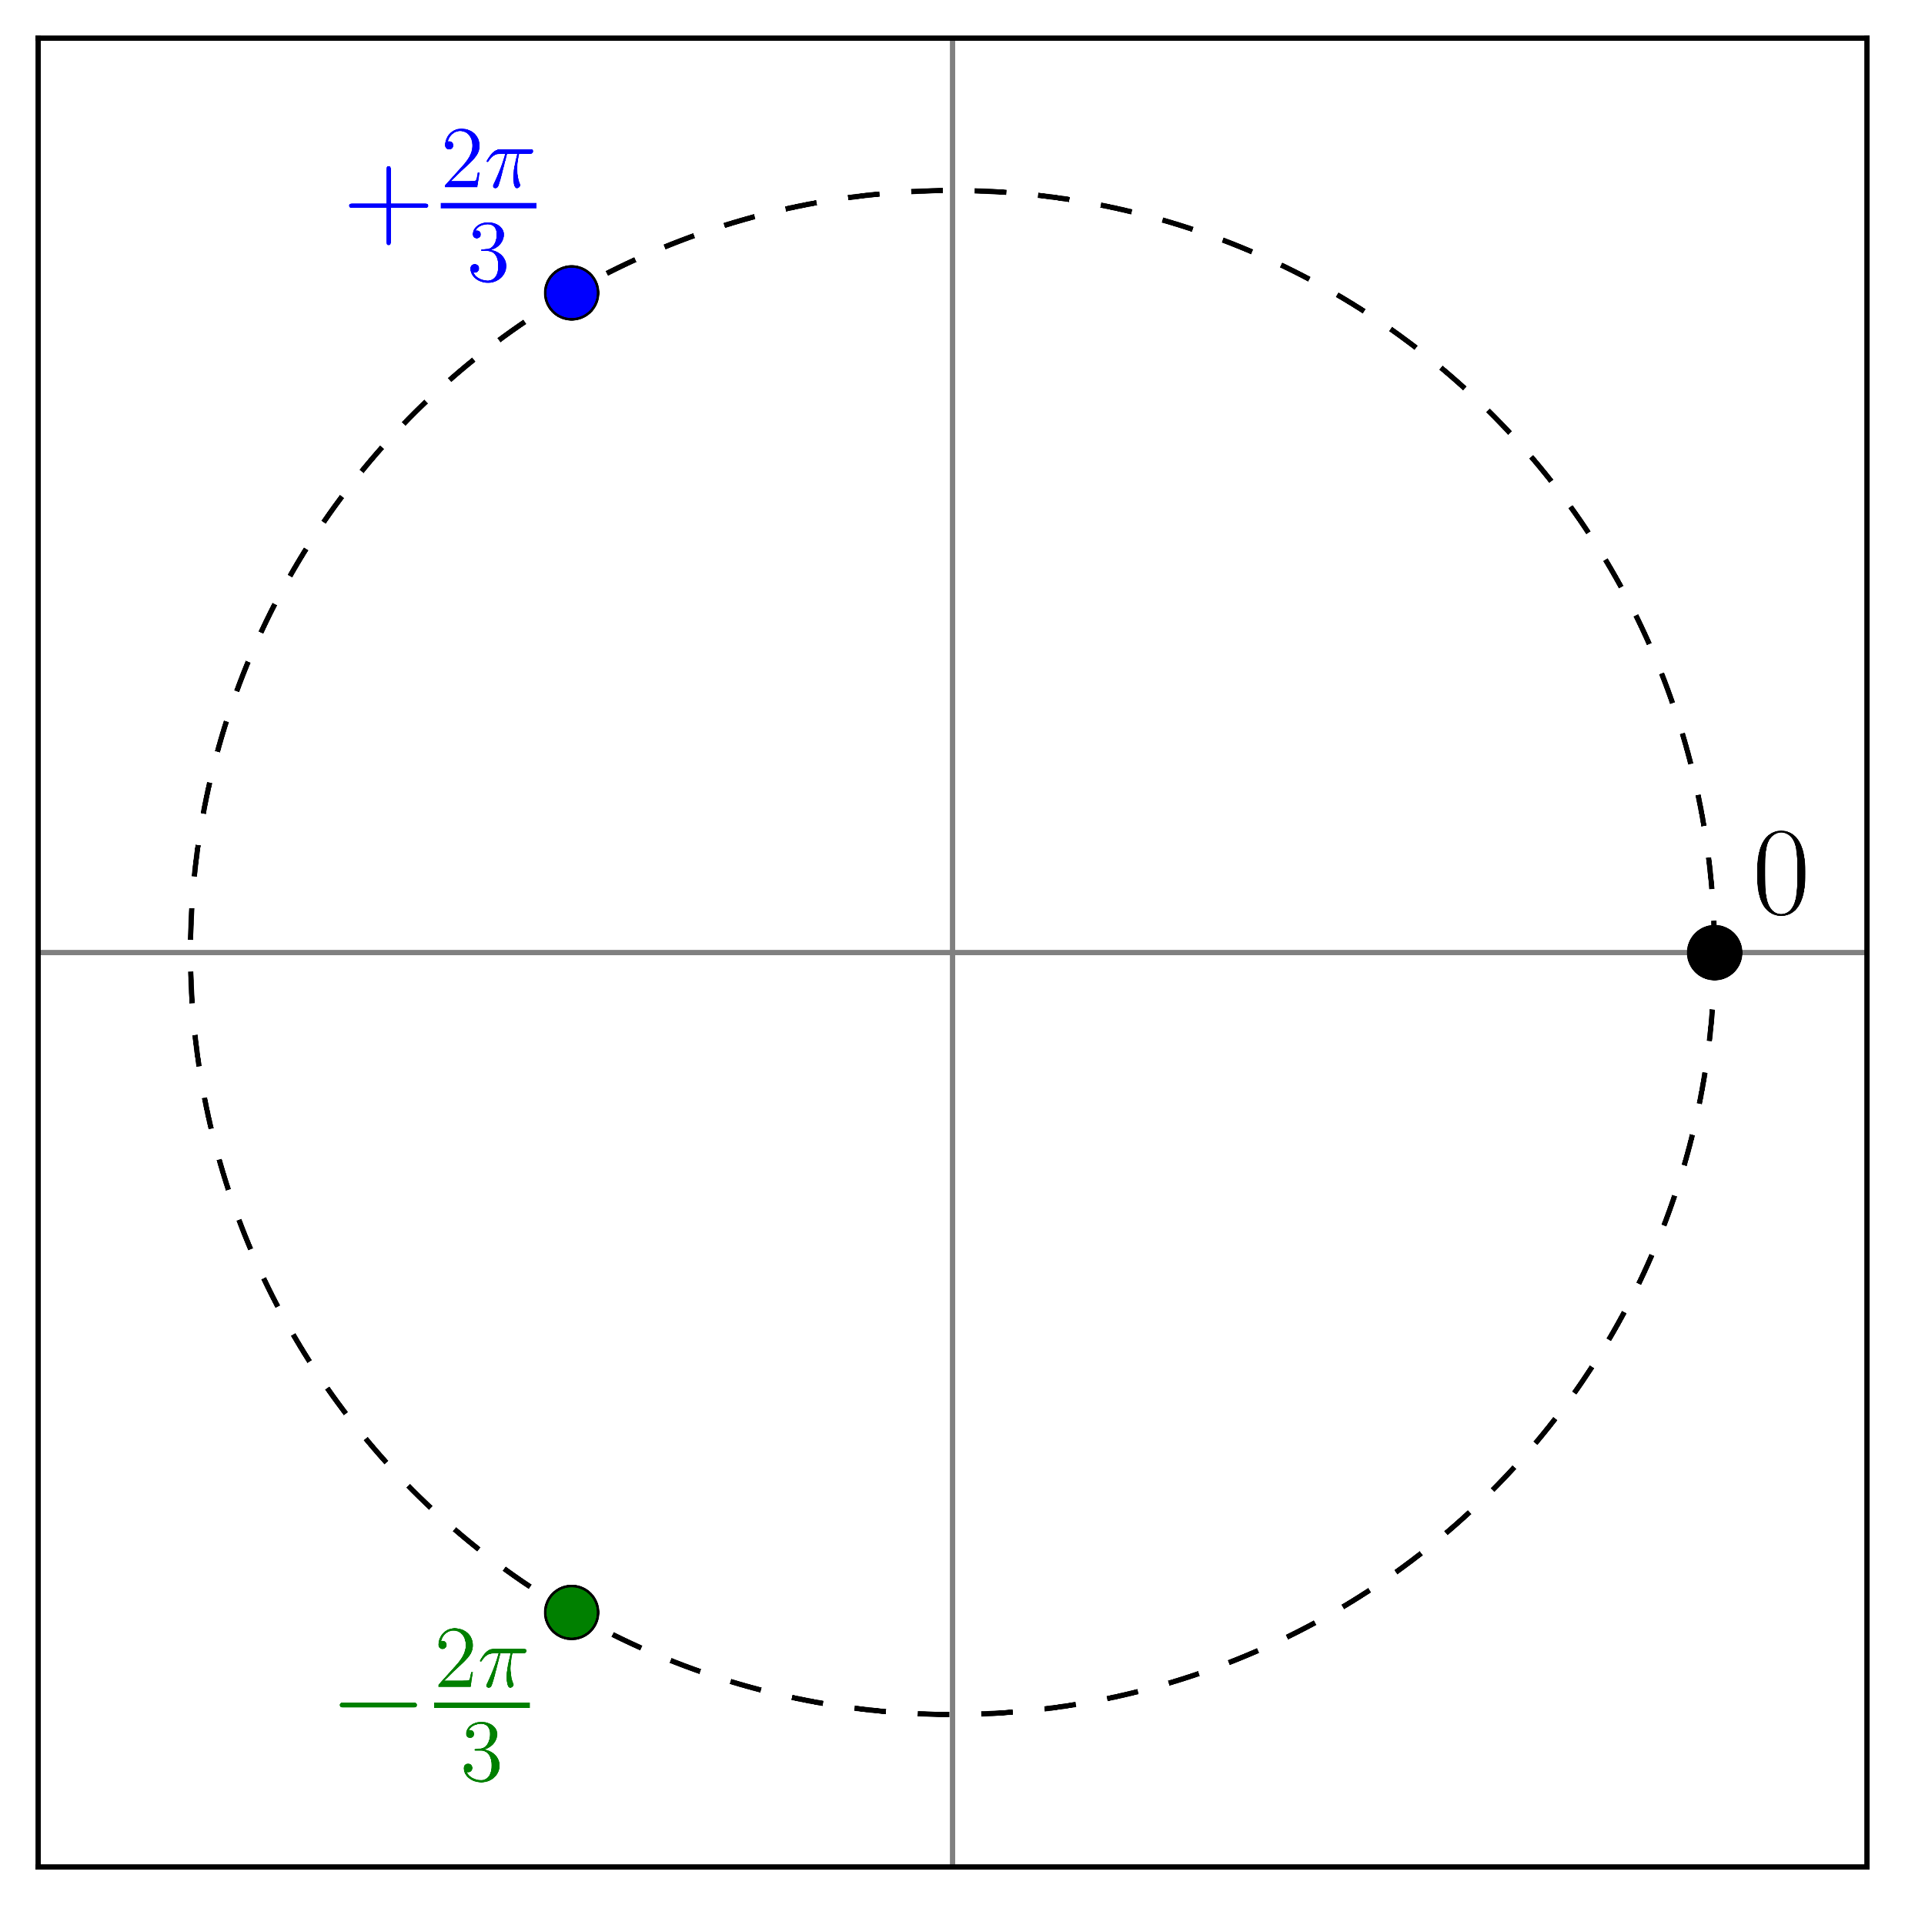



What are center vortices?
Center vortices are surface-like topological defects that exist in the QCD vacuum
  Form the conserved flow of “center charge”
  Quantized by the center of :
Any Wilson loop that encircles a vortex picks up a factor of
  i.e.
In 4D, vortices forms closed surfaces
  Reduced to closed lines in 3D cross-section of the vortex sheet
  Slice through various dimensions to build understanding of surface in 4D

Slide 5
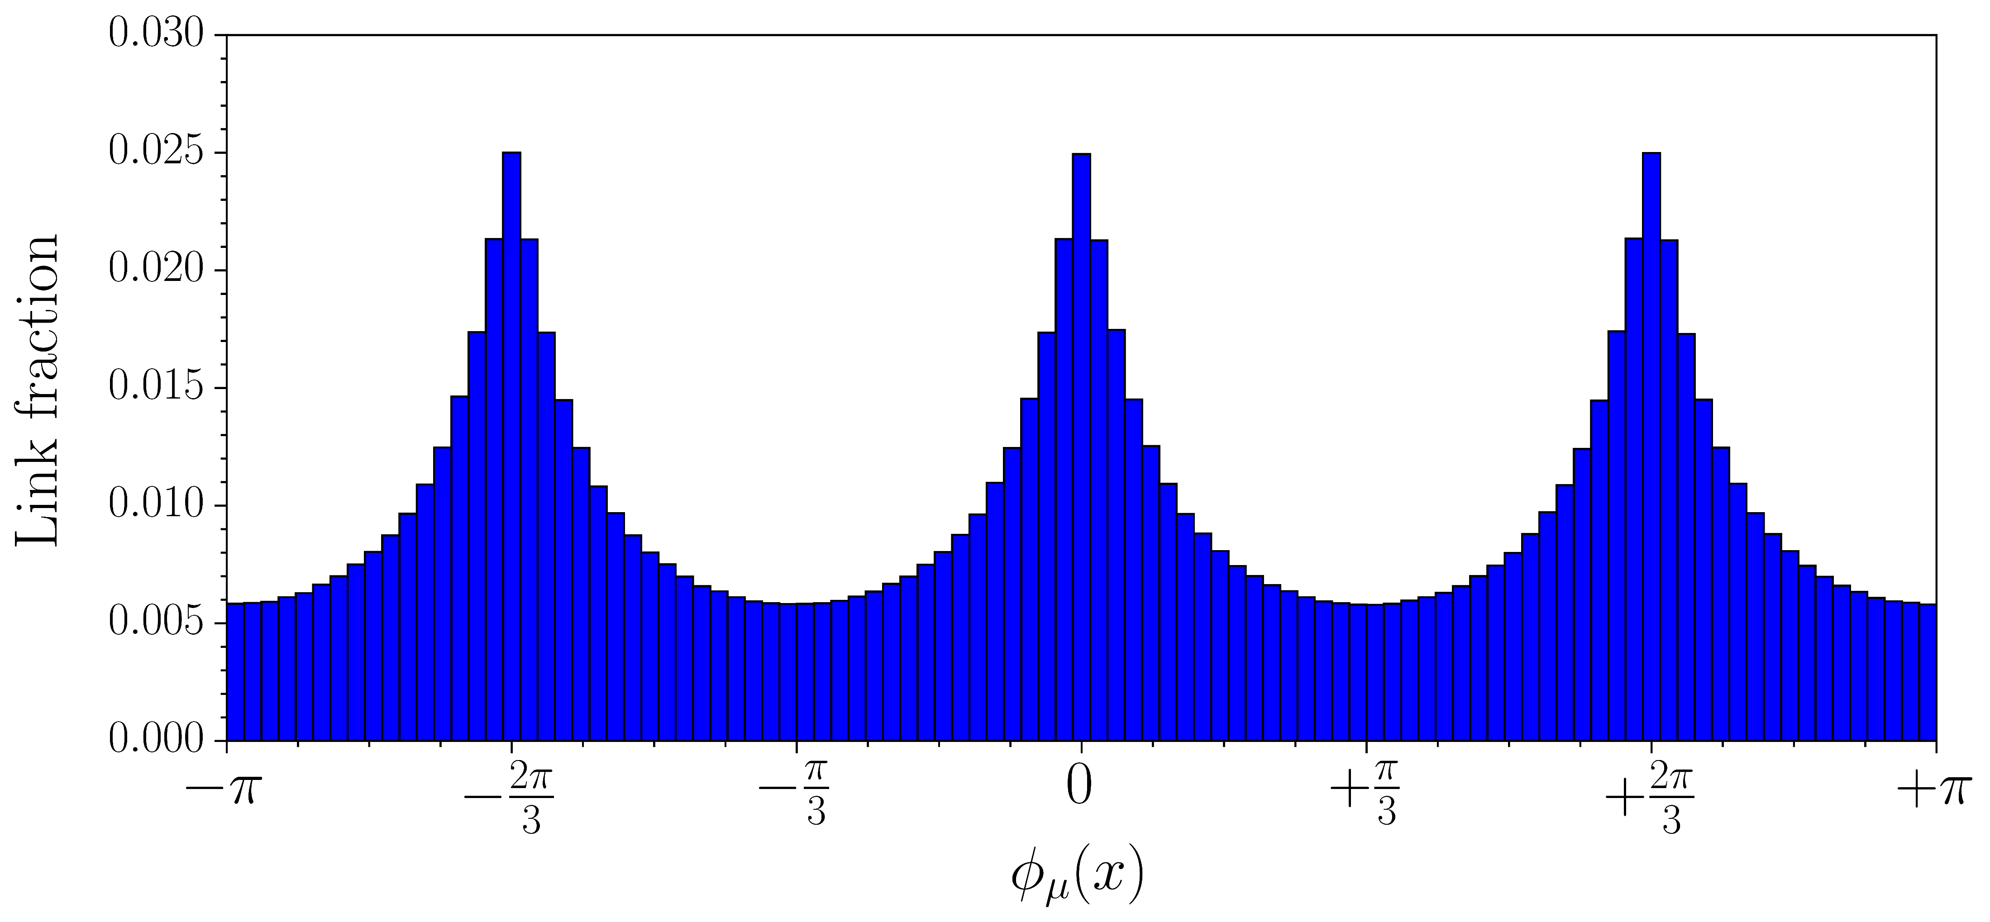
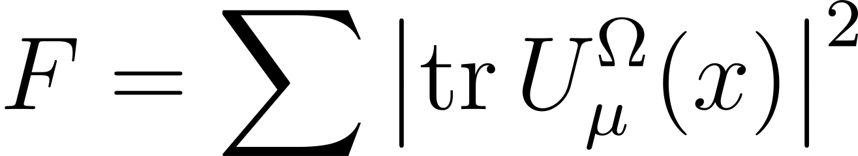
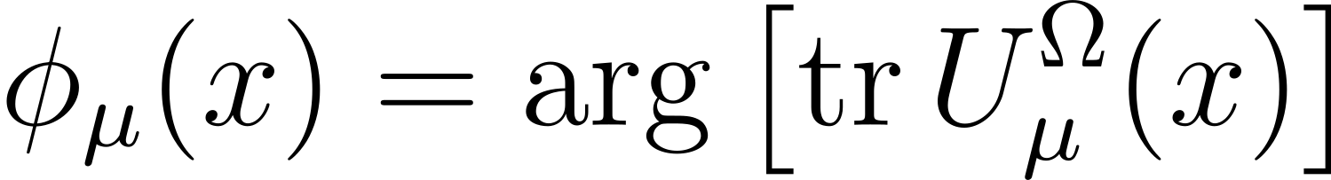
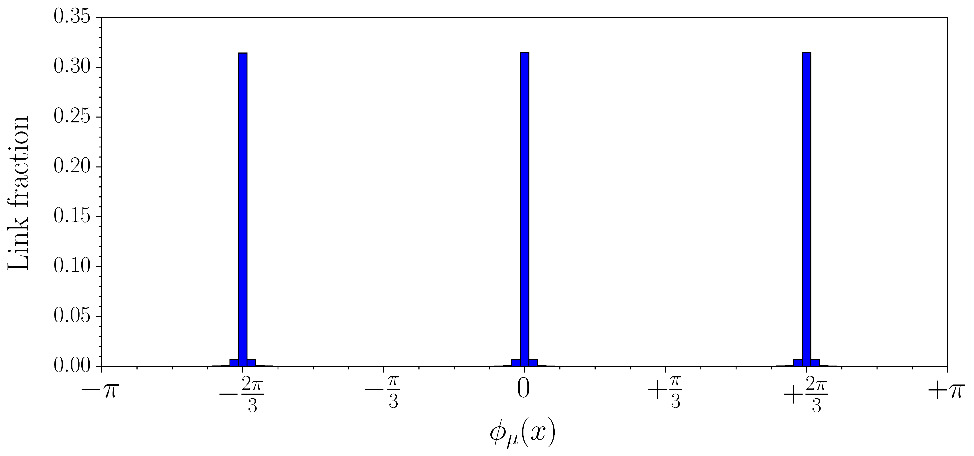

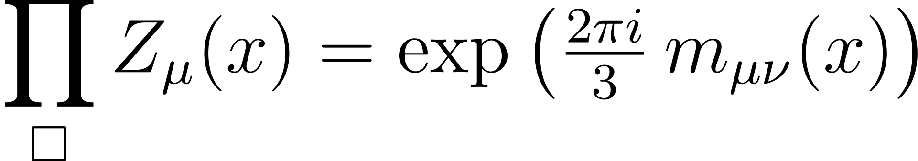


Identification on the lattice
“Maximal Center Gauge”: bring each link as close as possible to an element of
  Maximize the functional
Project links onto nearest element
  defined by
Vortices identified by nontrivial plaquettes in center-projected field
  with
In 3D slices, render arrows piercing nontrivial plaquettes
  Show oriented flow of center charge

Slide 6
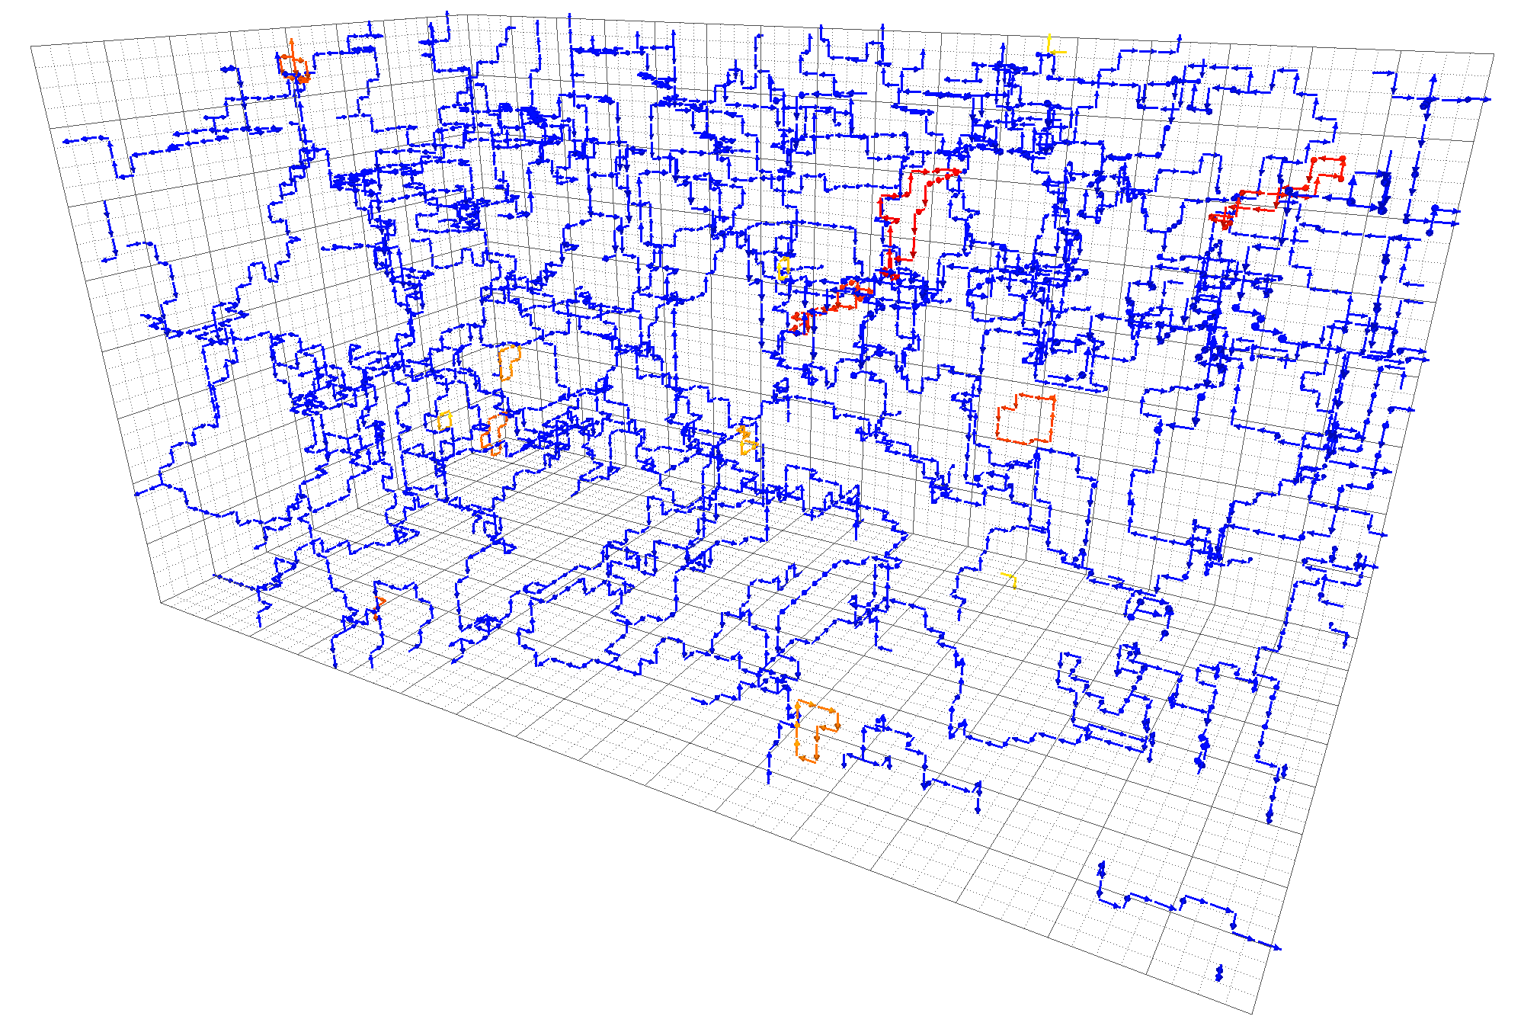
Example: pure-gauge theory

Slide 7
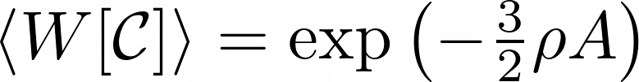

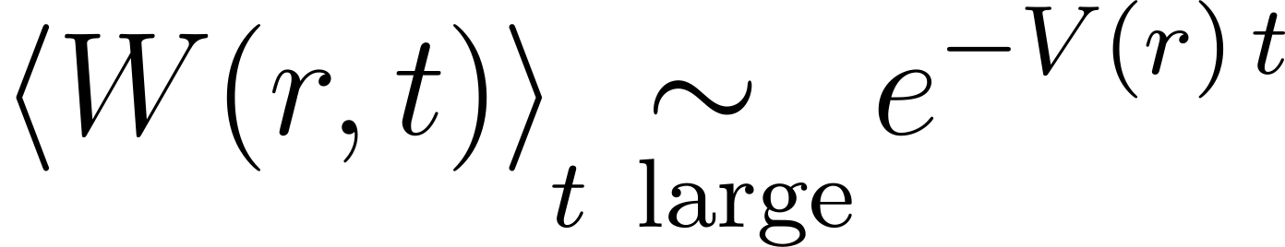


Center vortices and confinement
Center vortices percolate spacetime
  Generates an area law for large Wilson loops
  In :
Area law connected to confinement of static heavy quarks
  Space-time loops give access to quark-antiquark potential:
  Area law gives linear potential
No percolation means loss of confinement
  Vortex clusters have a finite size – trivial expectation value for large loops
  i.e. no area law

Slide 8

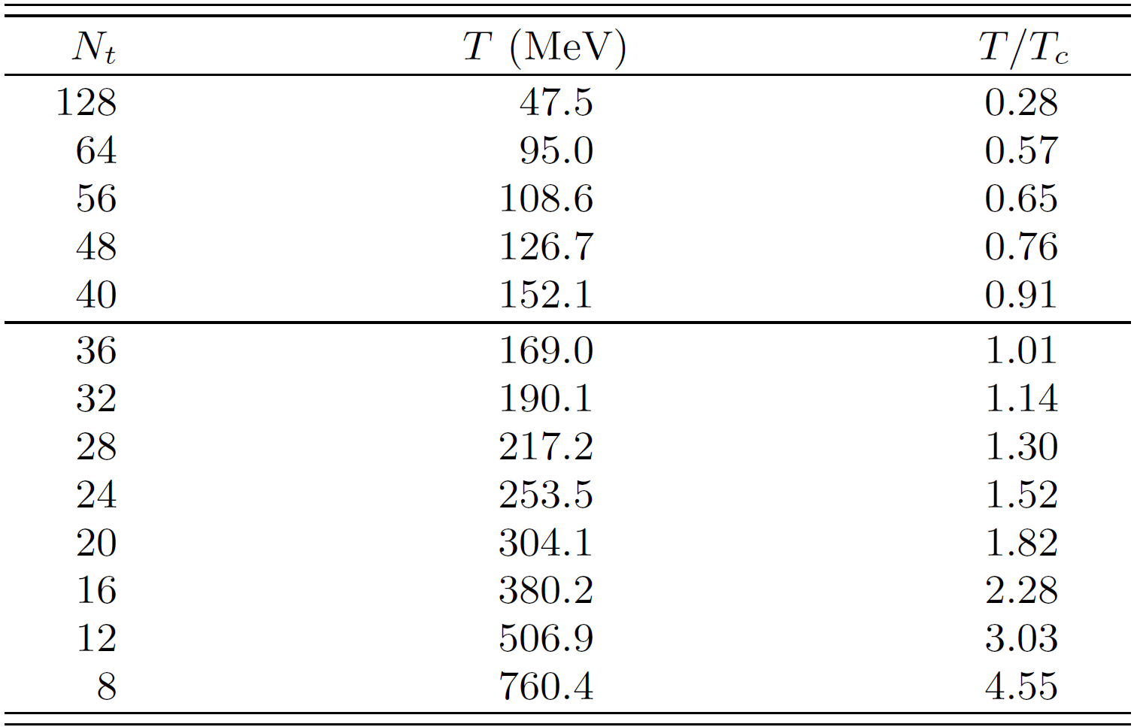




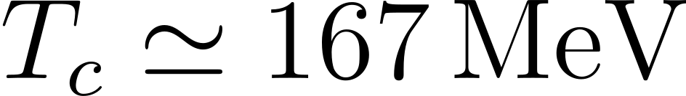




Dynamical ensembles (Fastsum)
Anisotropic lattice: temporal spacing smaller than spatial spacing
  Temperature governed by inverse temporal extent:
  Finer temperature resolution
Anisotropy parameter
Pion mass
  Chiral transition temperature
Ensembles are
  Symanzik-improved anisotropic gauge action
  Wilson tadpole-improved clover fermion action (stout-smearing on spatial links at )

Slide 9




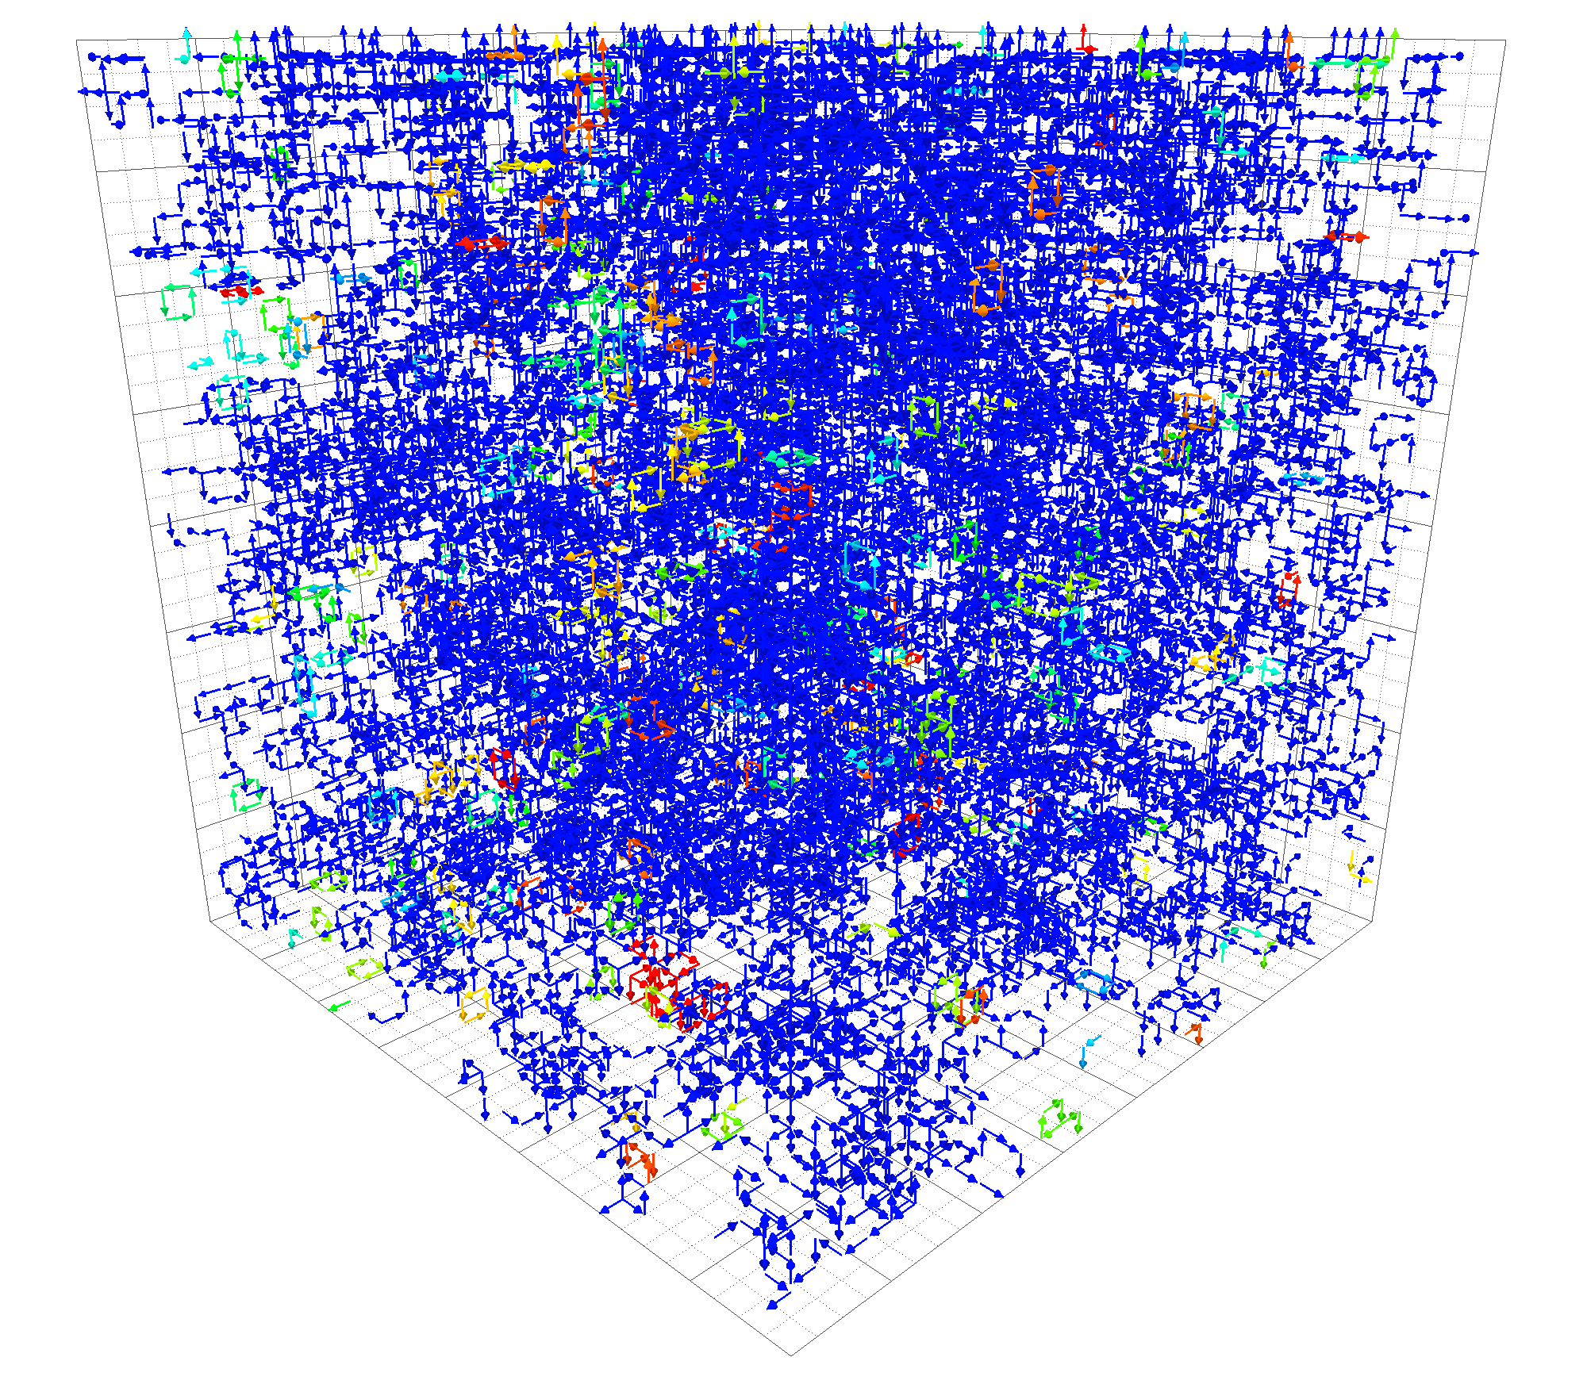
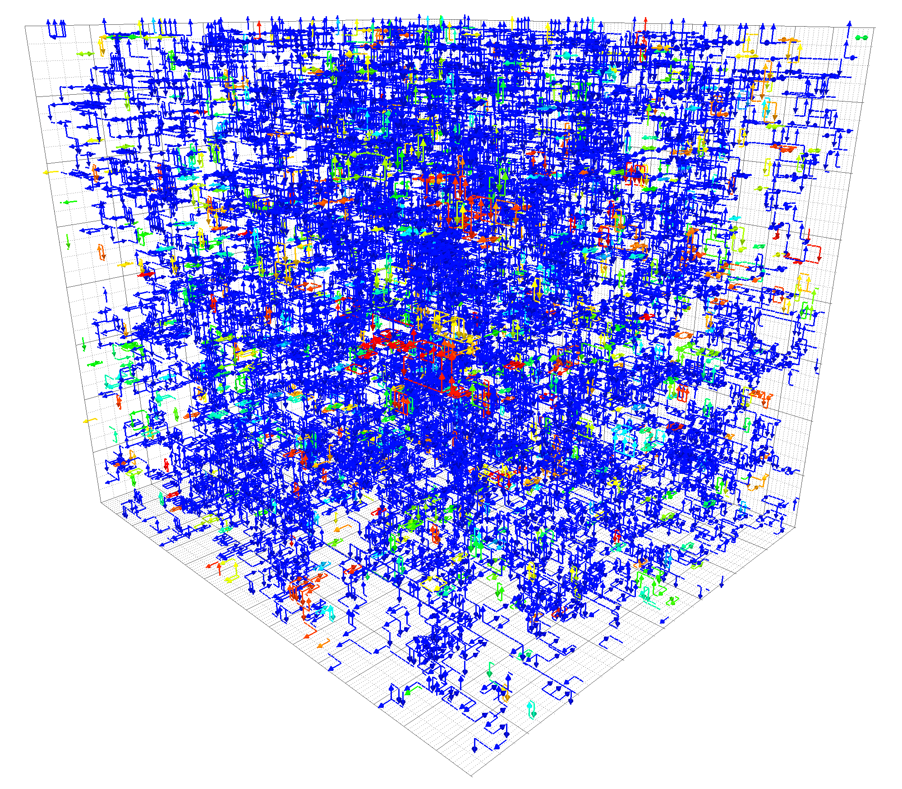
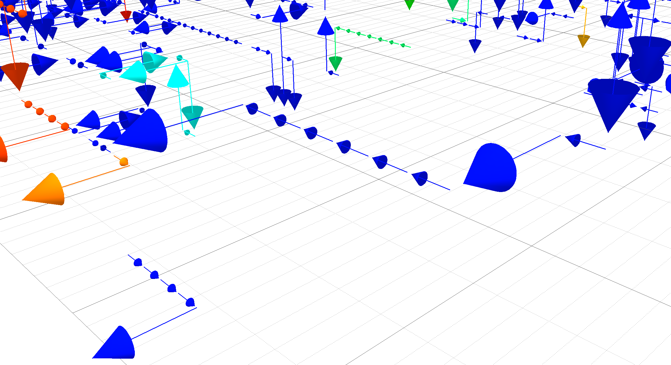
Full QCD:
Temporal (fixed- ) slices
  Visualizing
Spatial (fixed- ) slices
  Visualizing

Slide 10

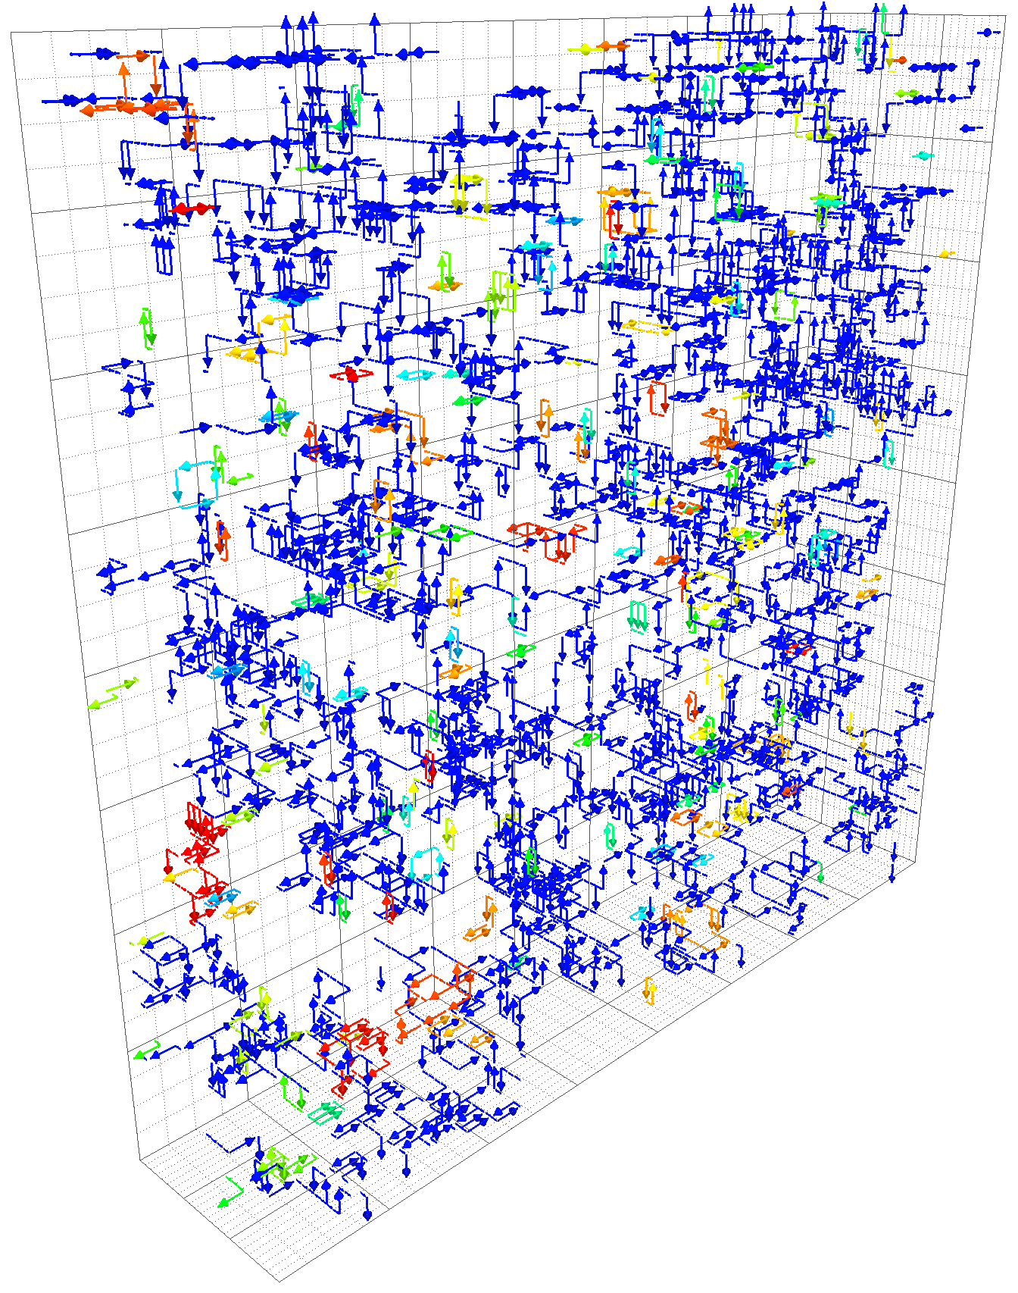
Full QCD:
Spatial (fixed- ) slices
  Visualizing

Slide 11

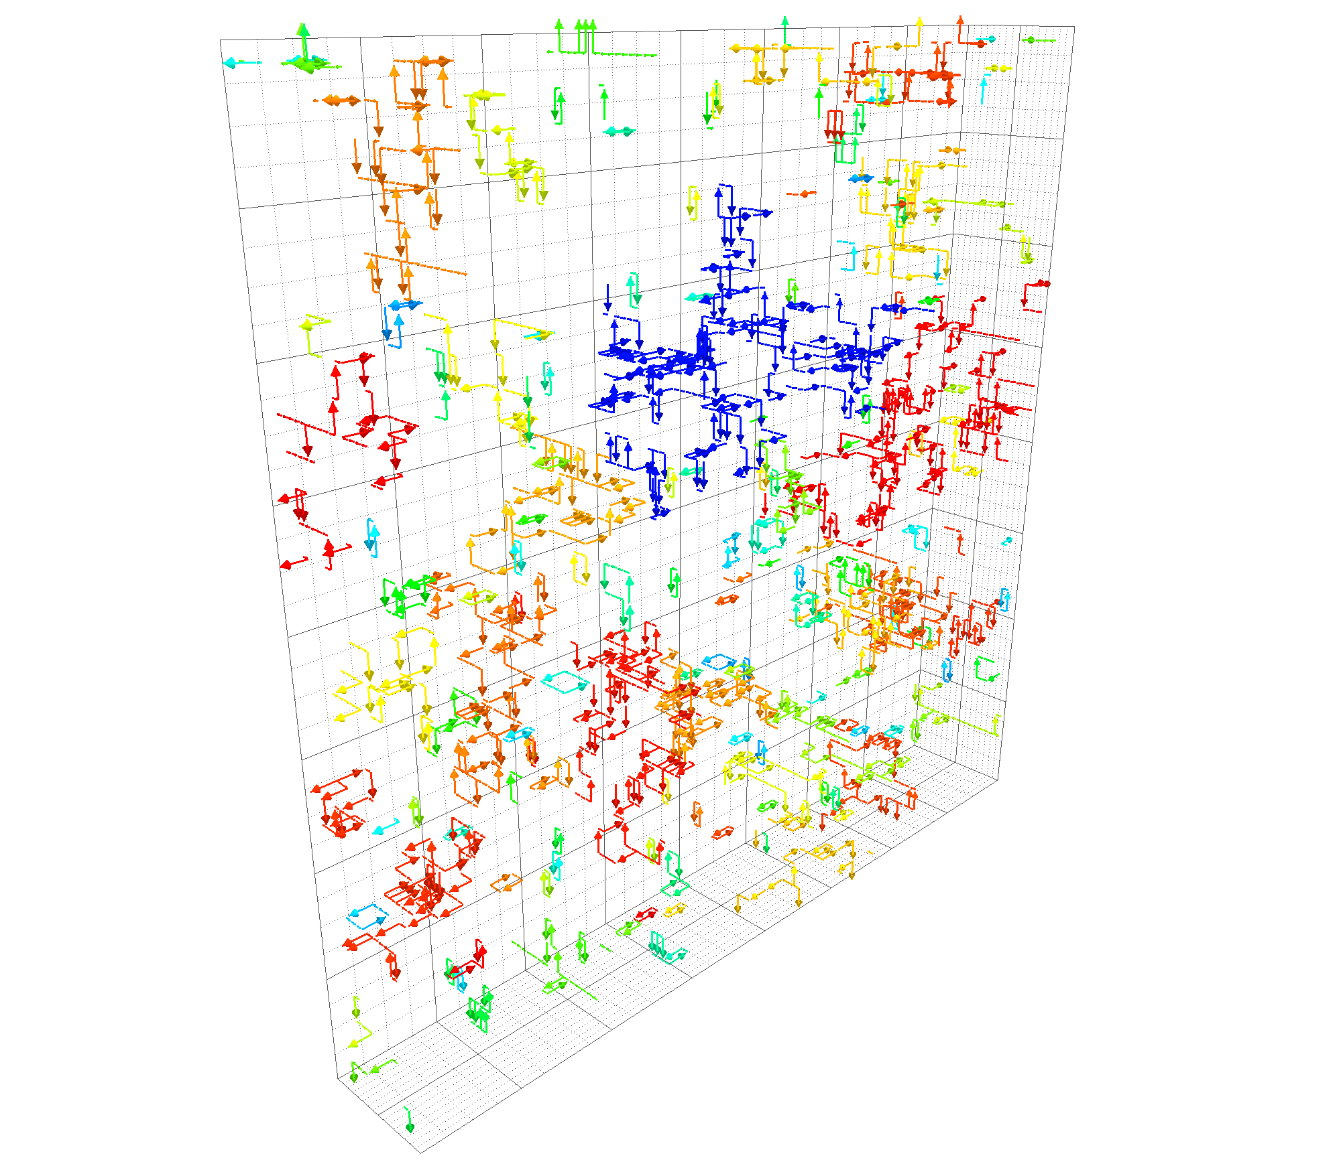

Full QCD:
Spatial (fixed- ) slices
  Visualizing
Loss of percolation occurs around
  Individual clusters no longer fill the entire volume – have a finite size
  Provides initial evidence for a transition near twice the chiral transition

Slide 12

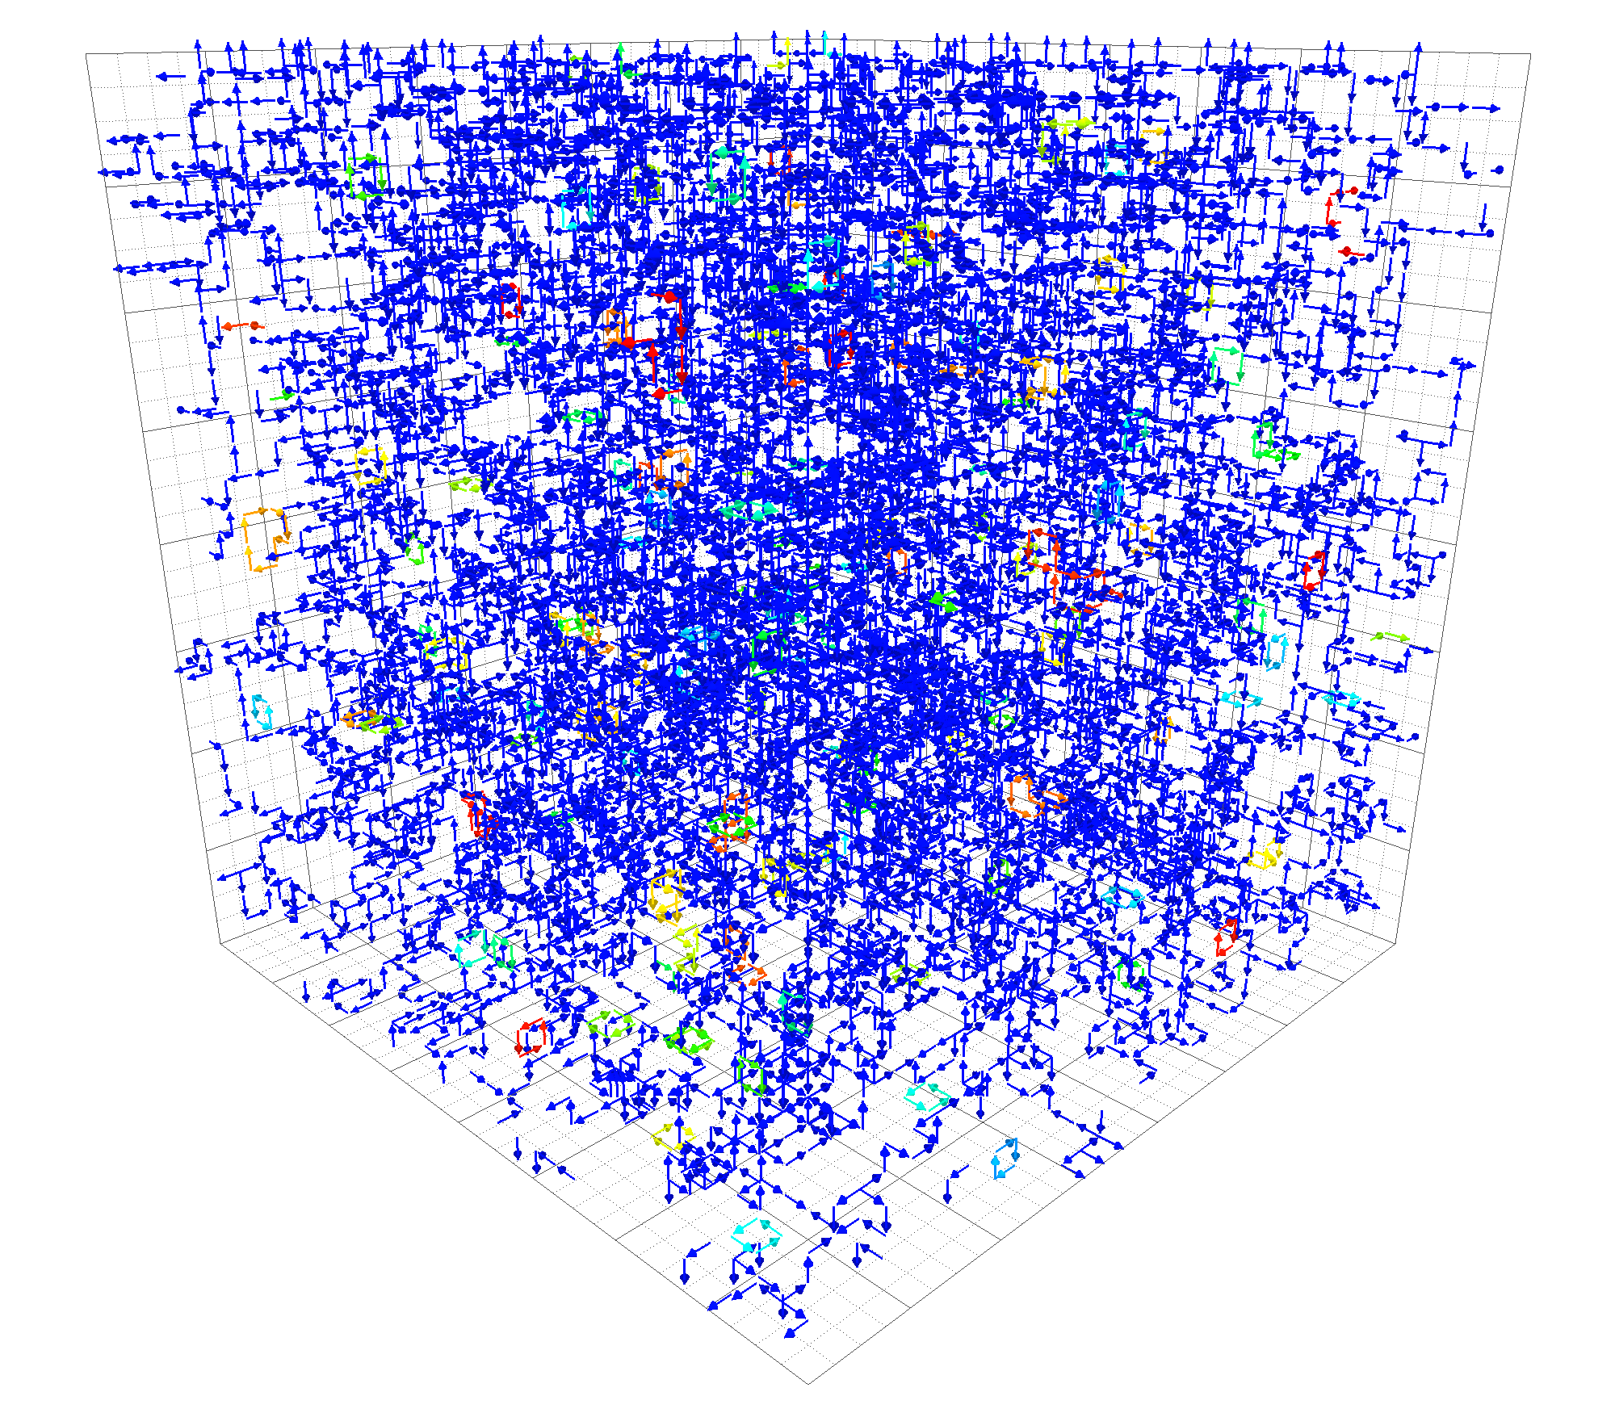
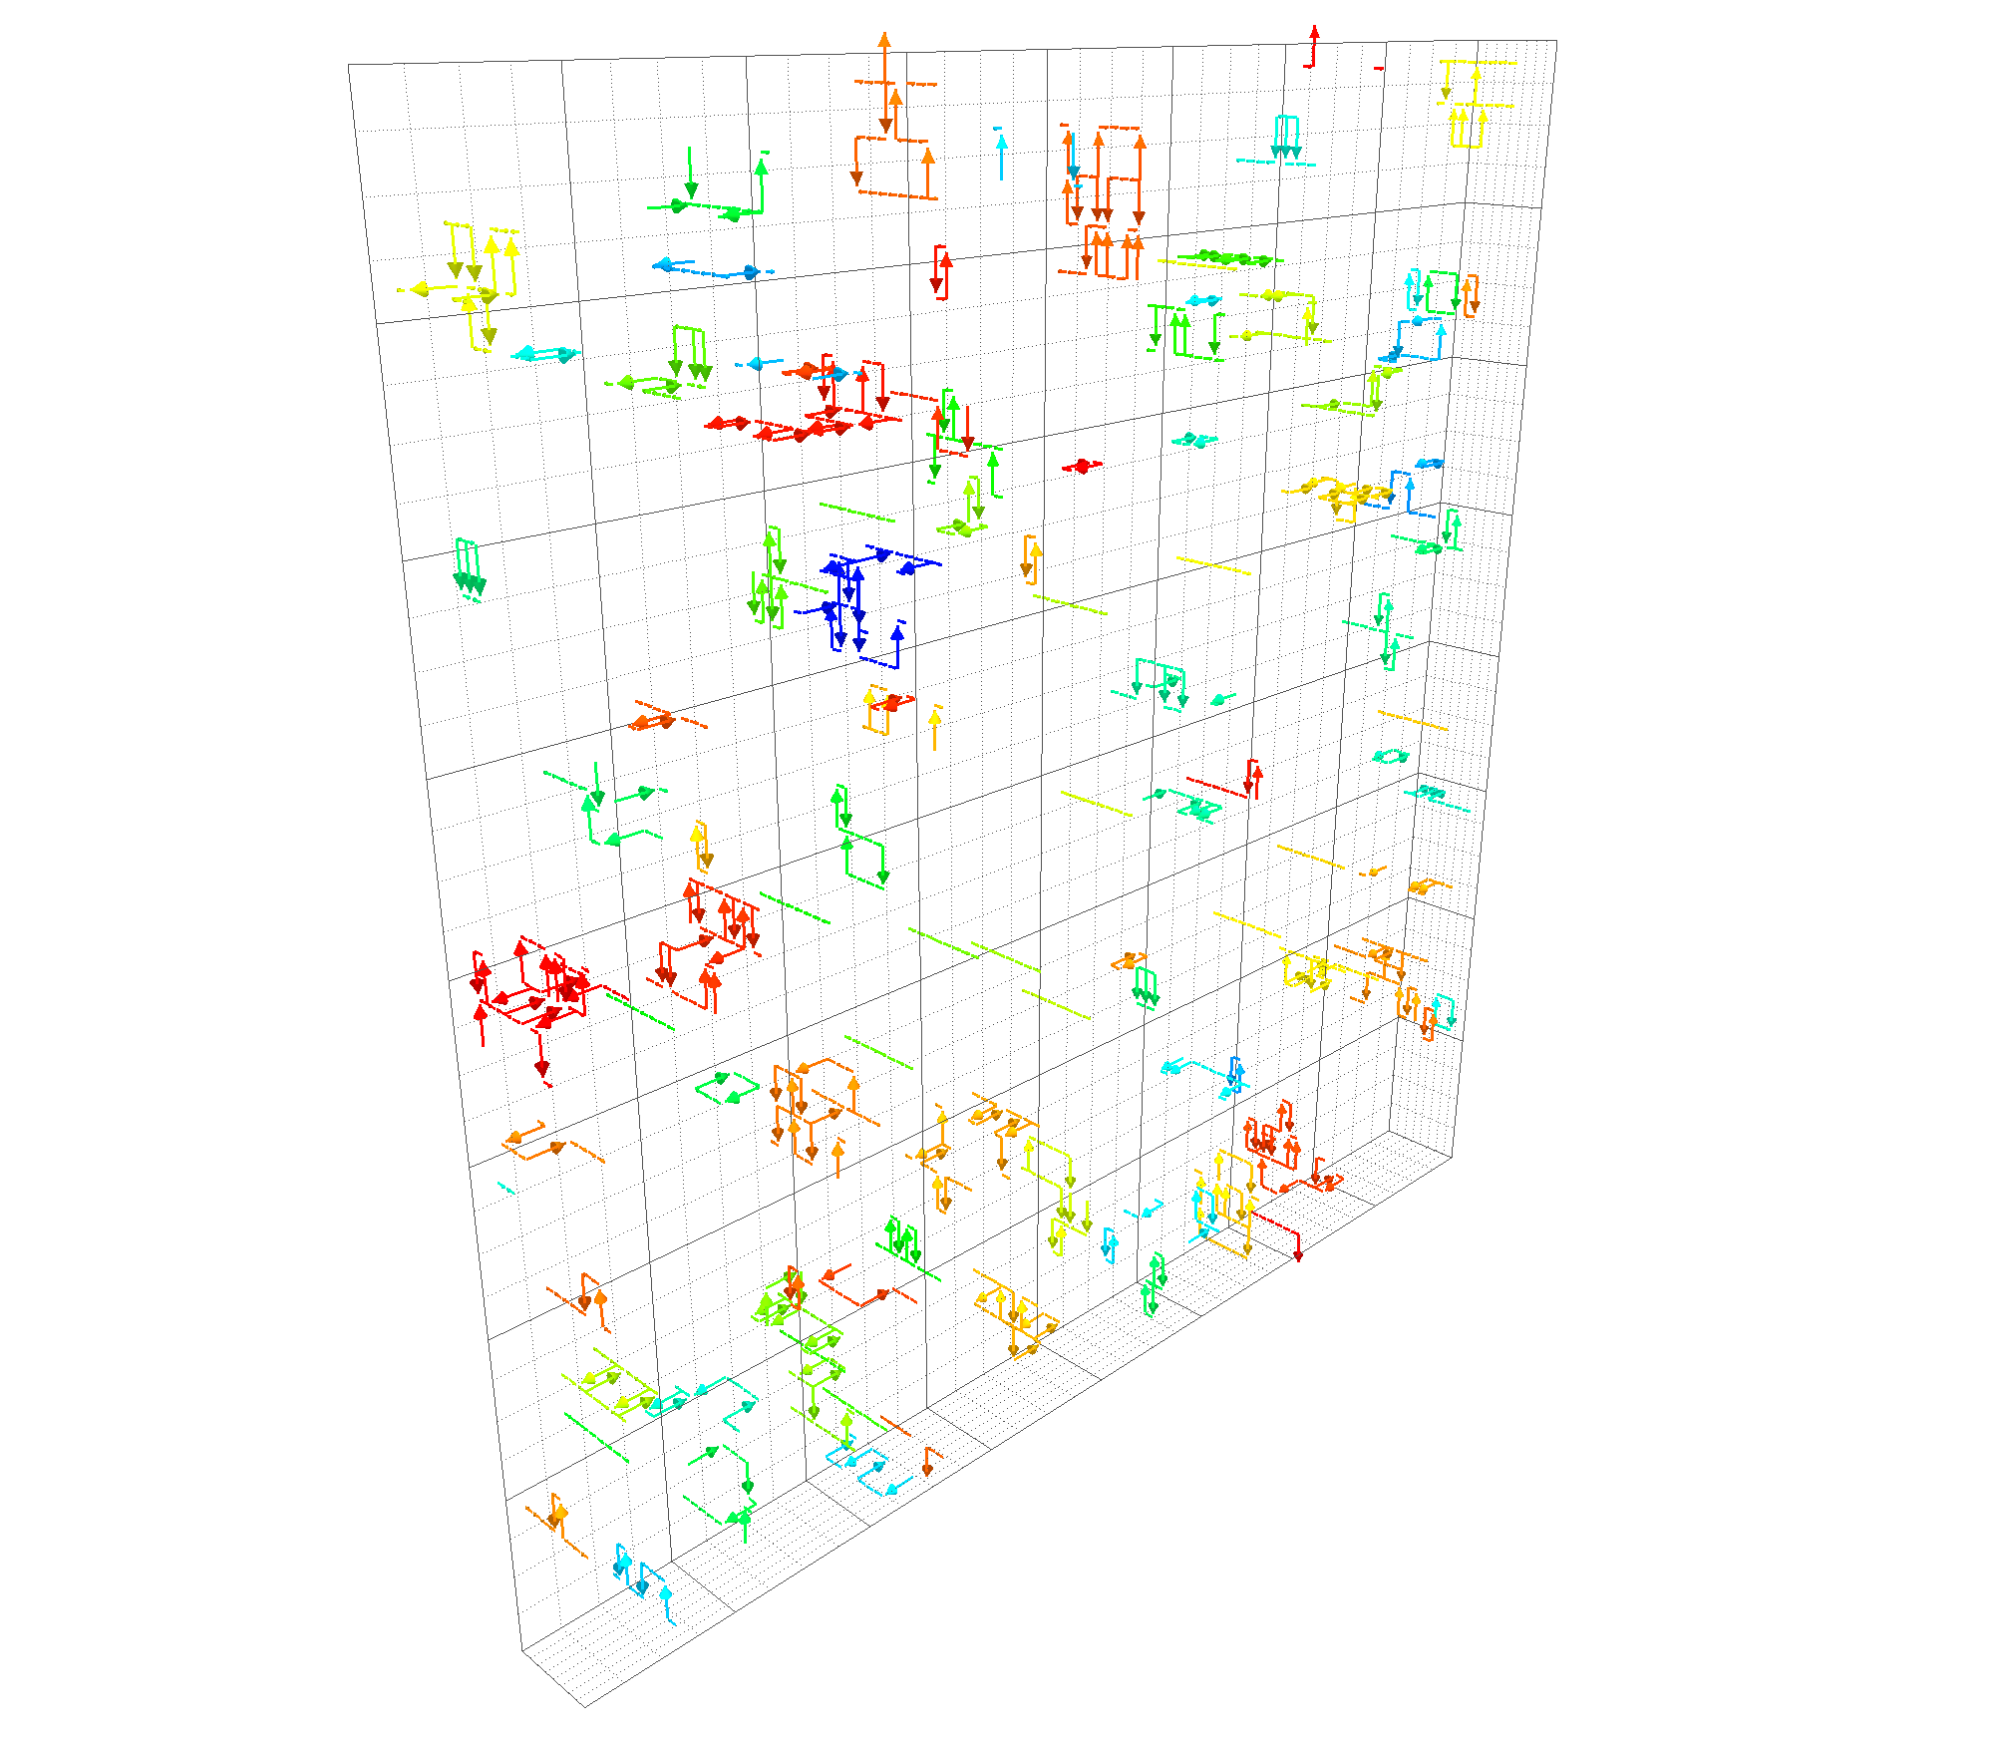
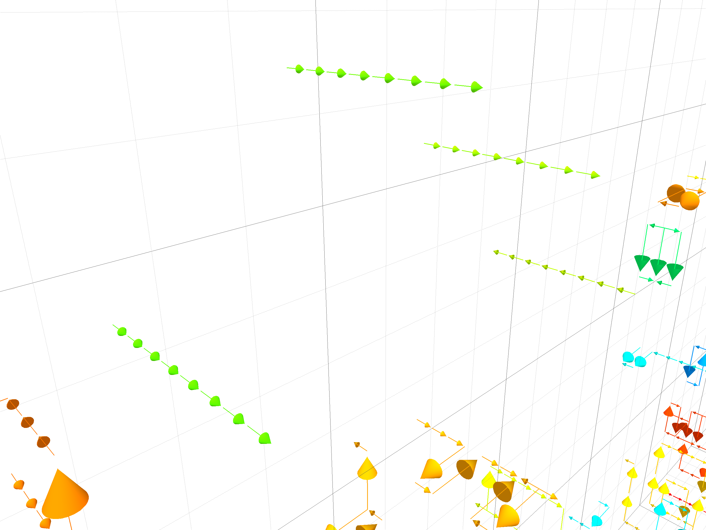
Full QCD:
Temporal (fixed- ) slices
  Visualizing
Spatial (fixed- ) slices
  Visualizing

Slide 13
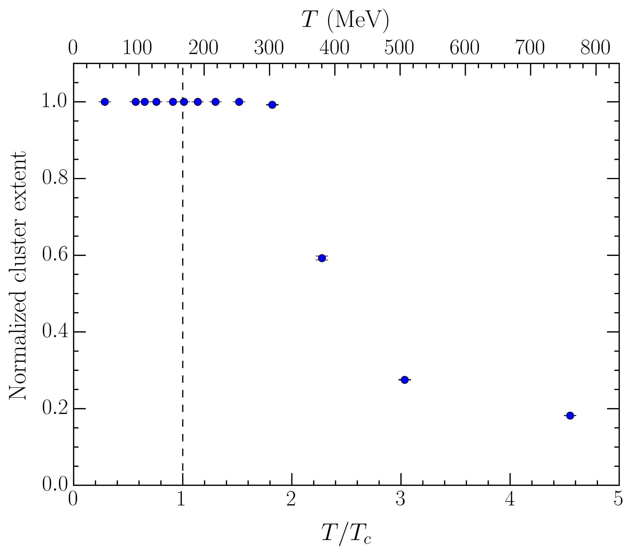
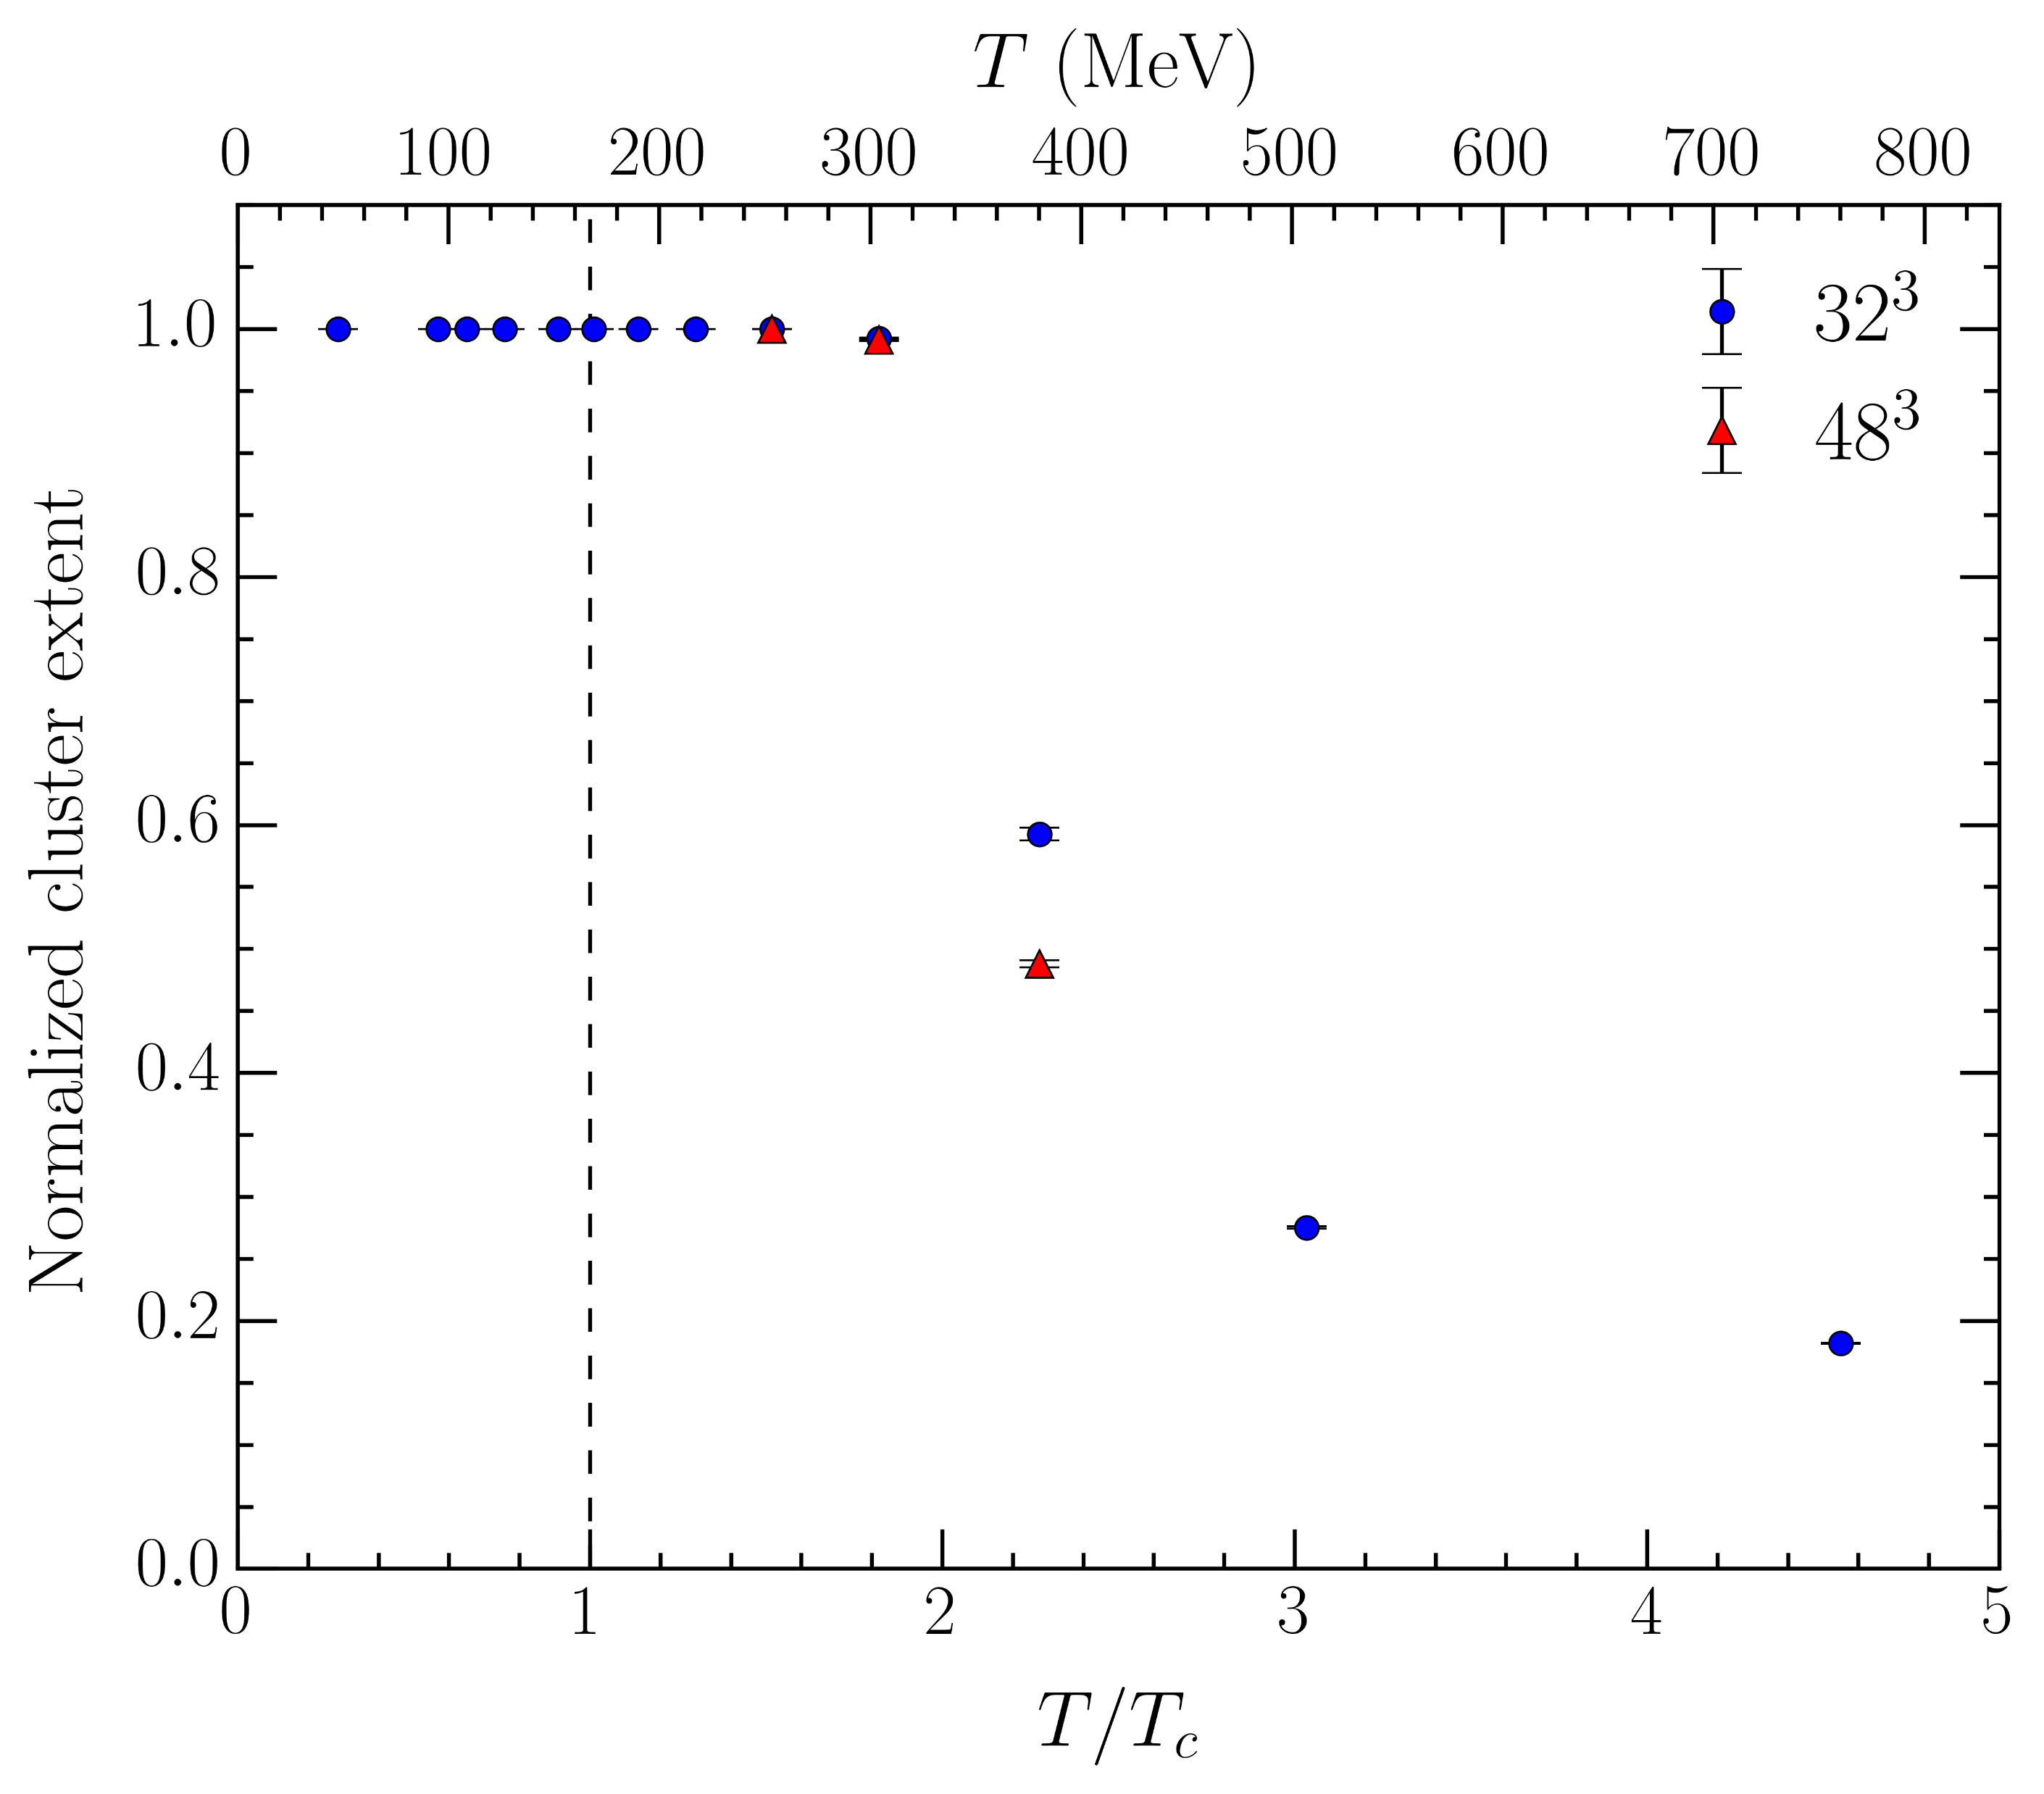

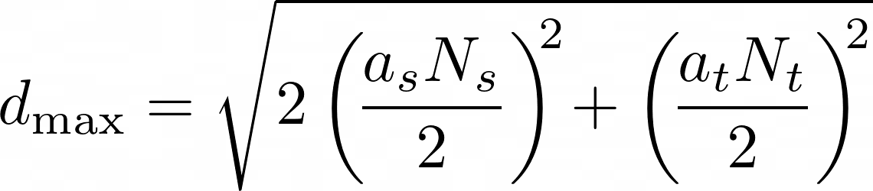




Cluster extent
Calculate maximum distance between any two vortices in the same cluster
  Measures the “extent” of the cluster
Calculate maximum possible such distance on the lattice
Normalize: Cluster extent
  Should be for percolation
Ensembles with larger spatial volume
Transition connected to deconfinement around

Slide 14
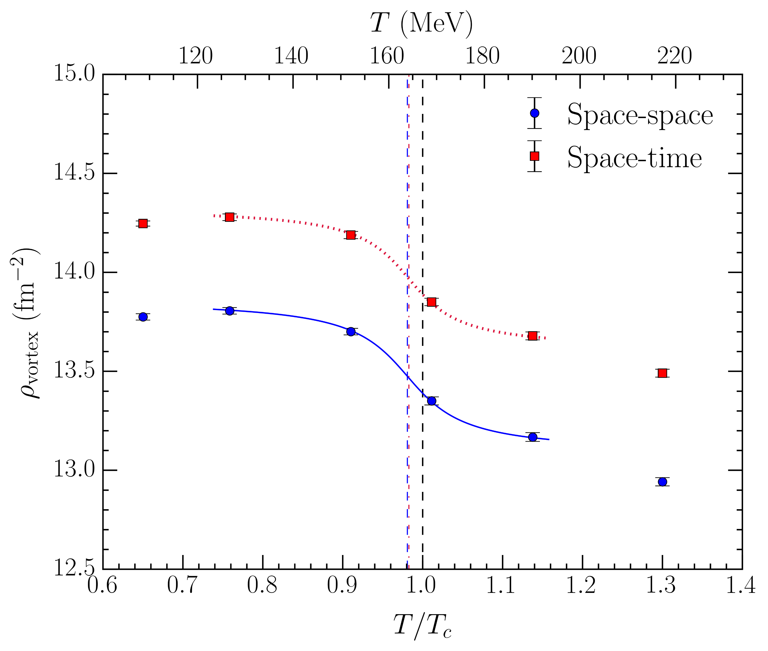
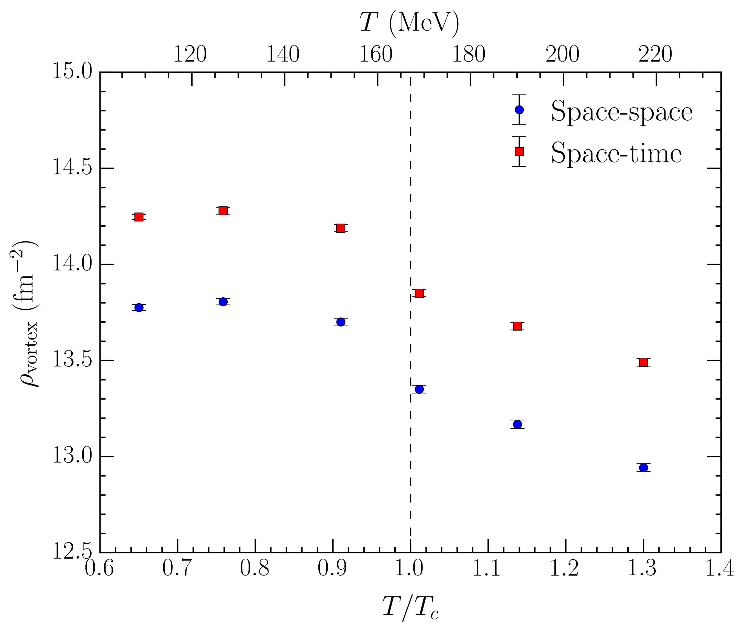
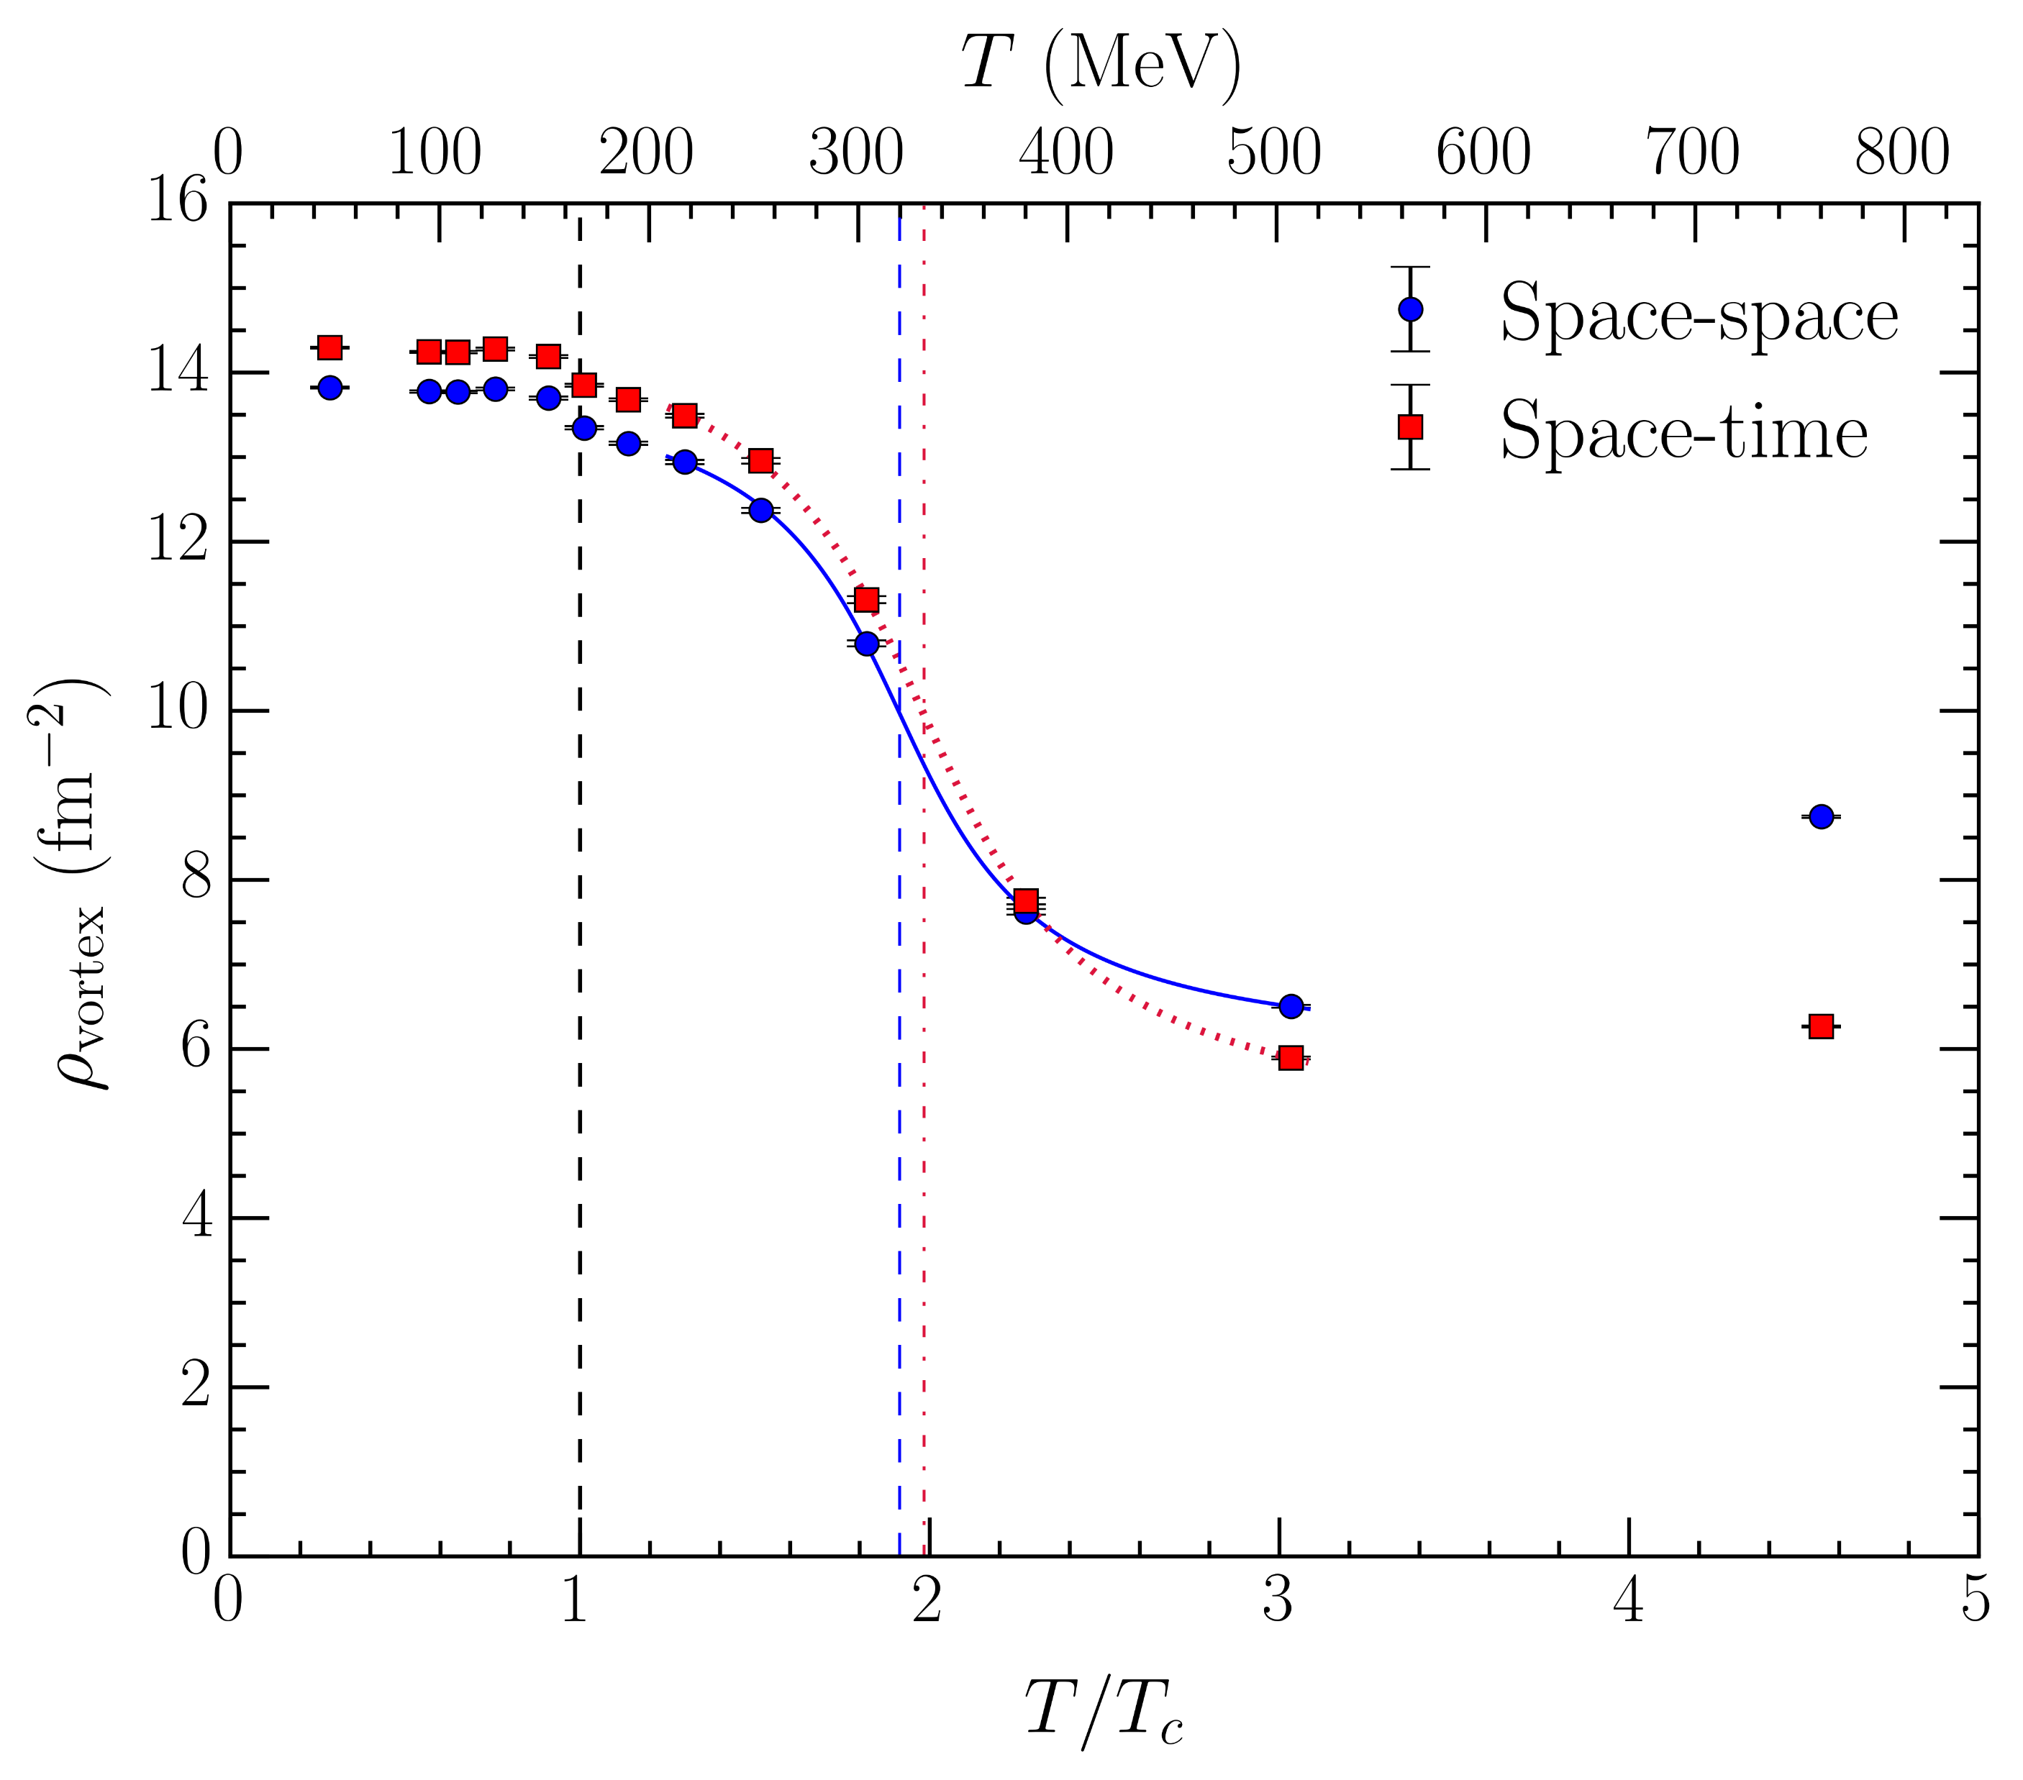
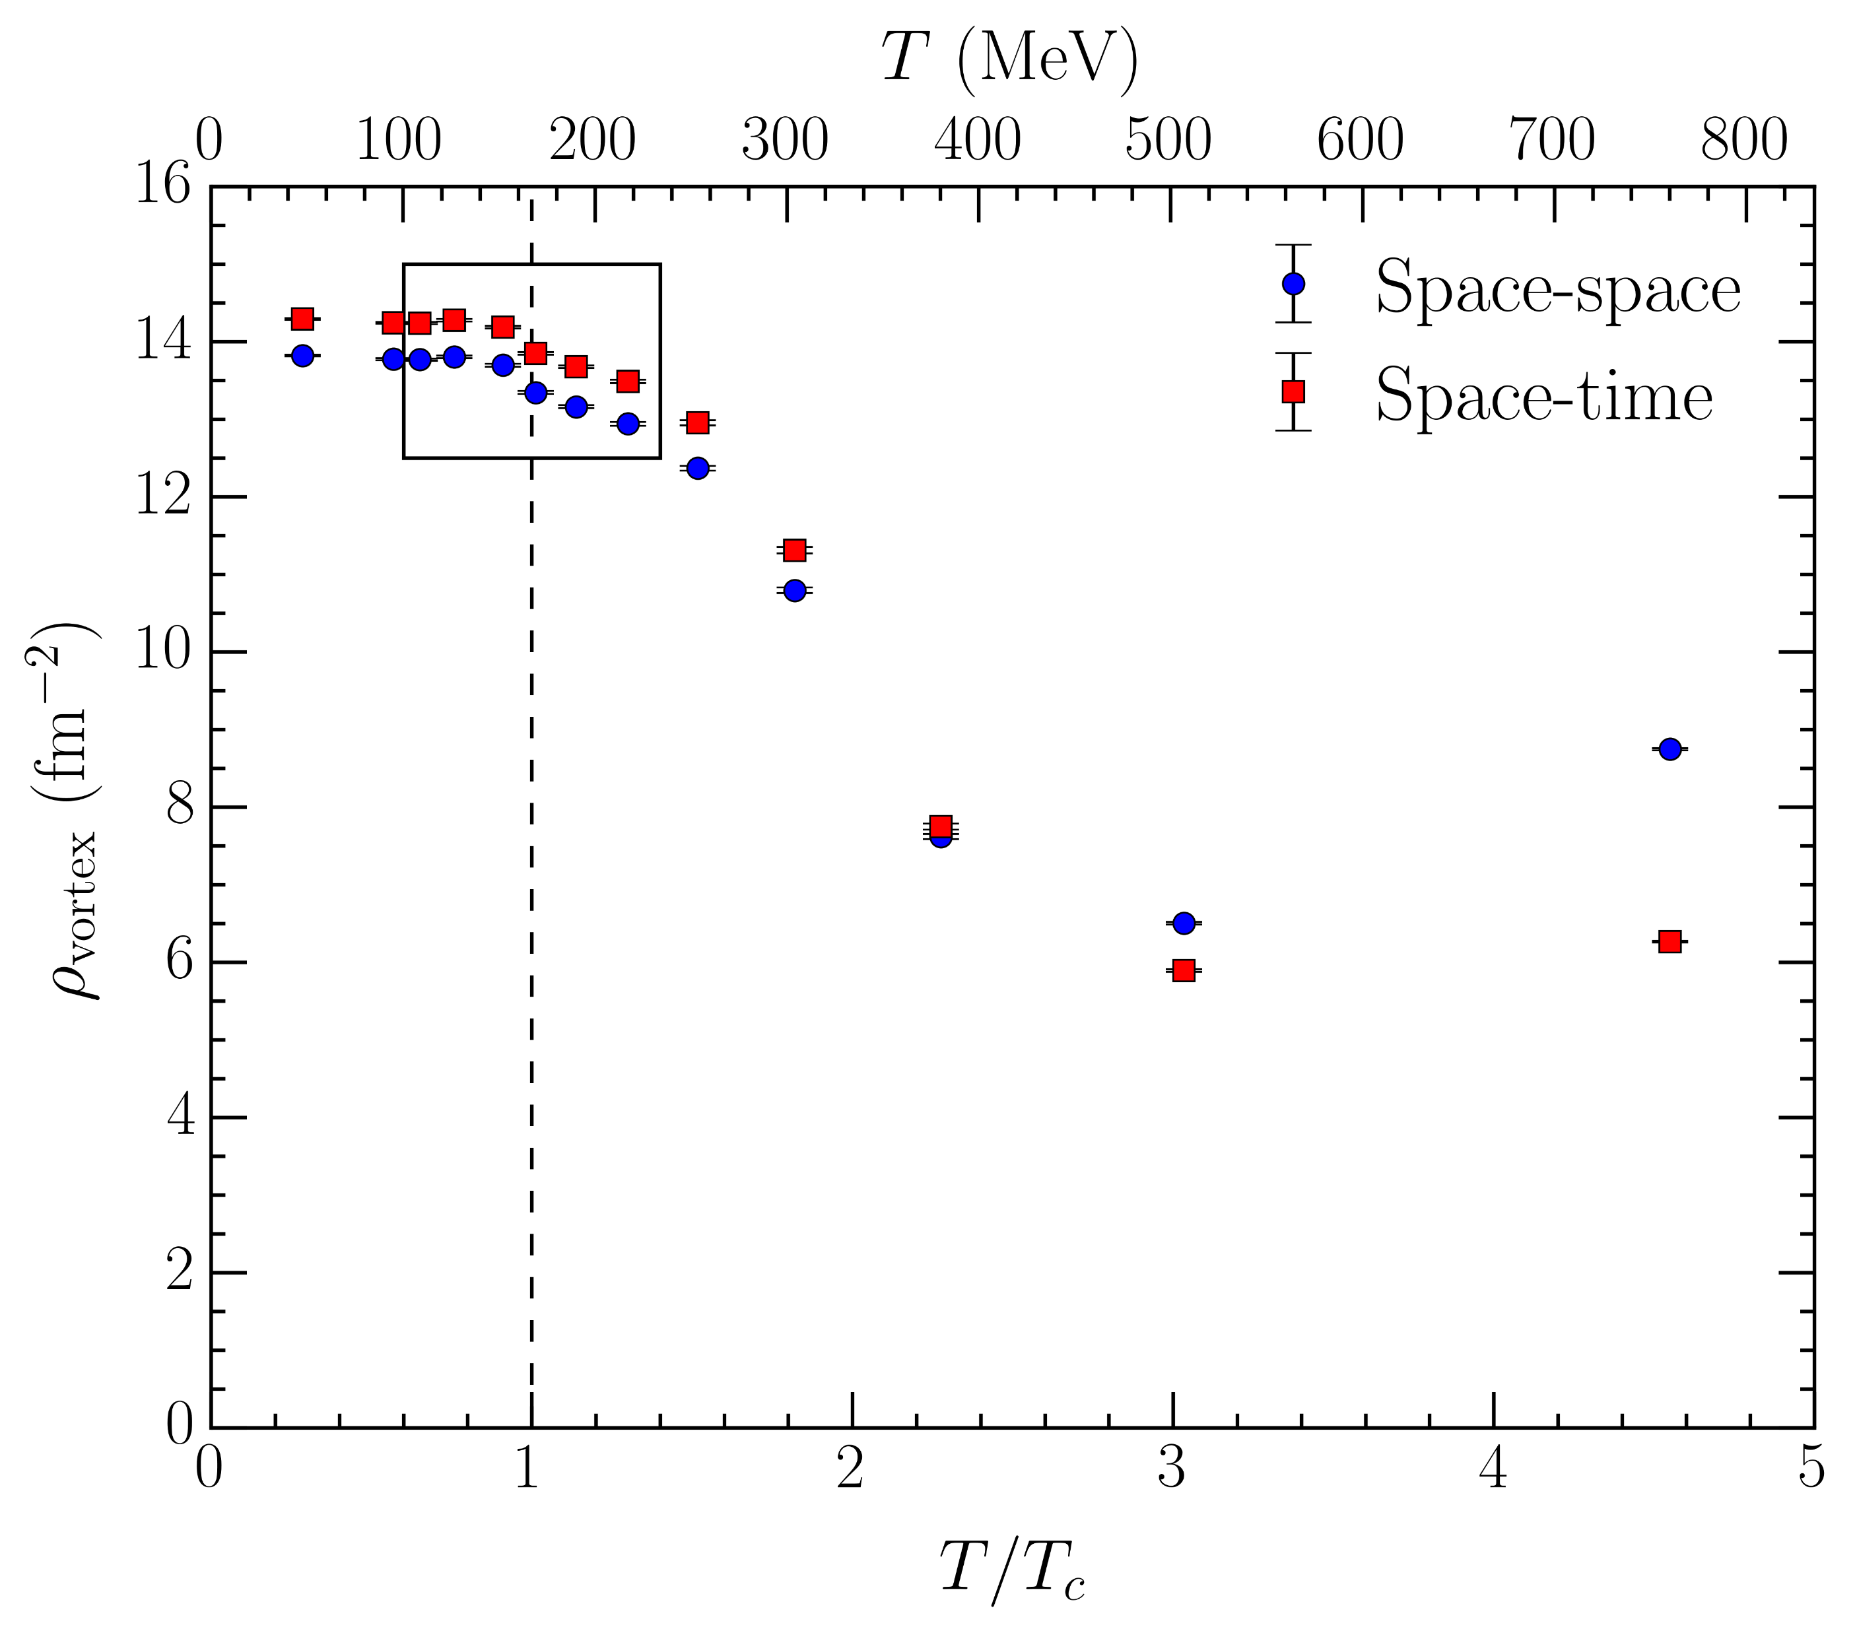
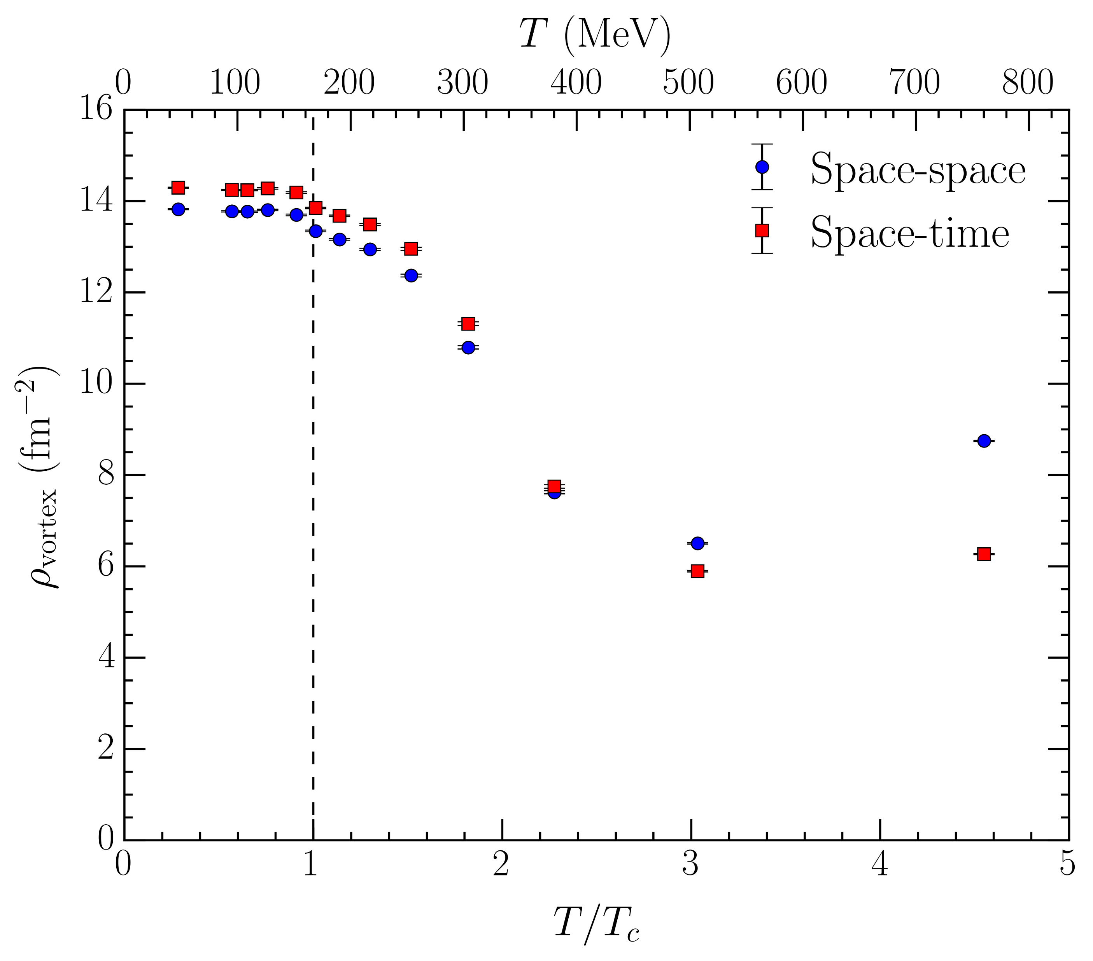
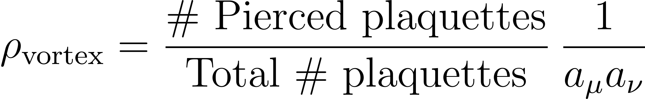

Vortex density
Vortex density is the number of vortex piercings per unit area
  Calculate separately for space-space and space-time plaquettes
Sensitive to chiral transition!
  Fit crossover ansatz for estimate of
Similar behaviour for second transition!
  Gives
  First precise estimate of second transition temperature

Slide 15
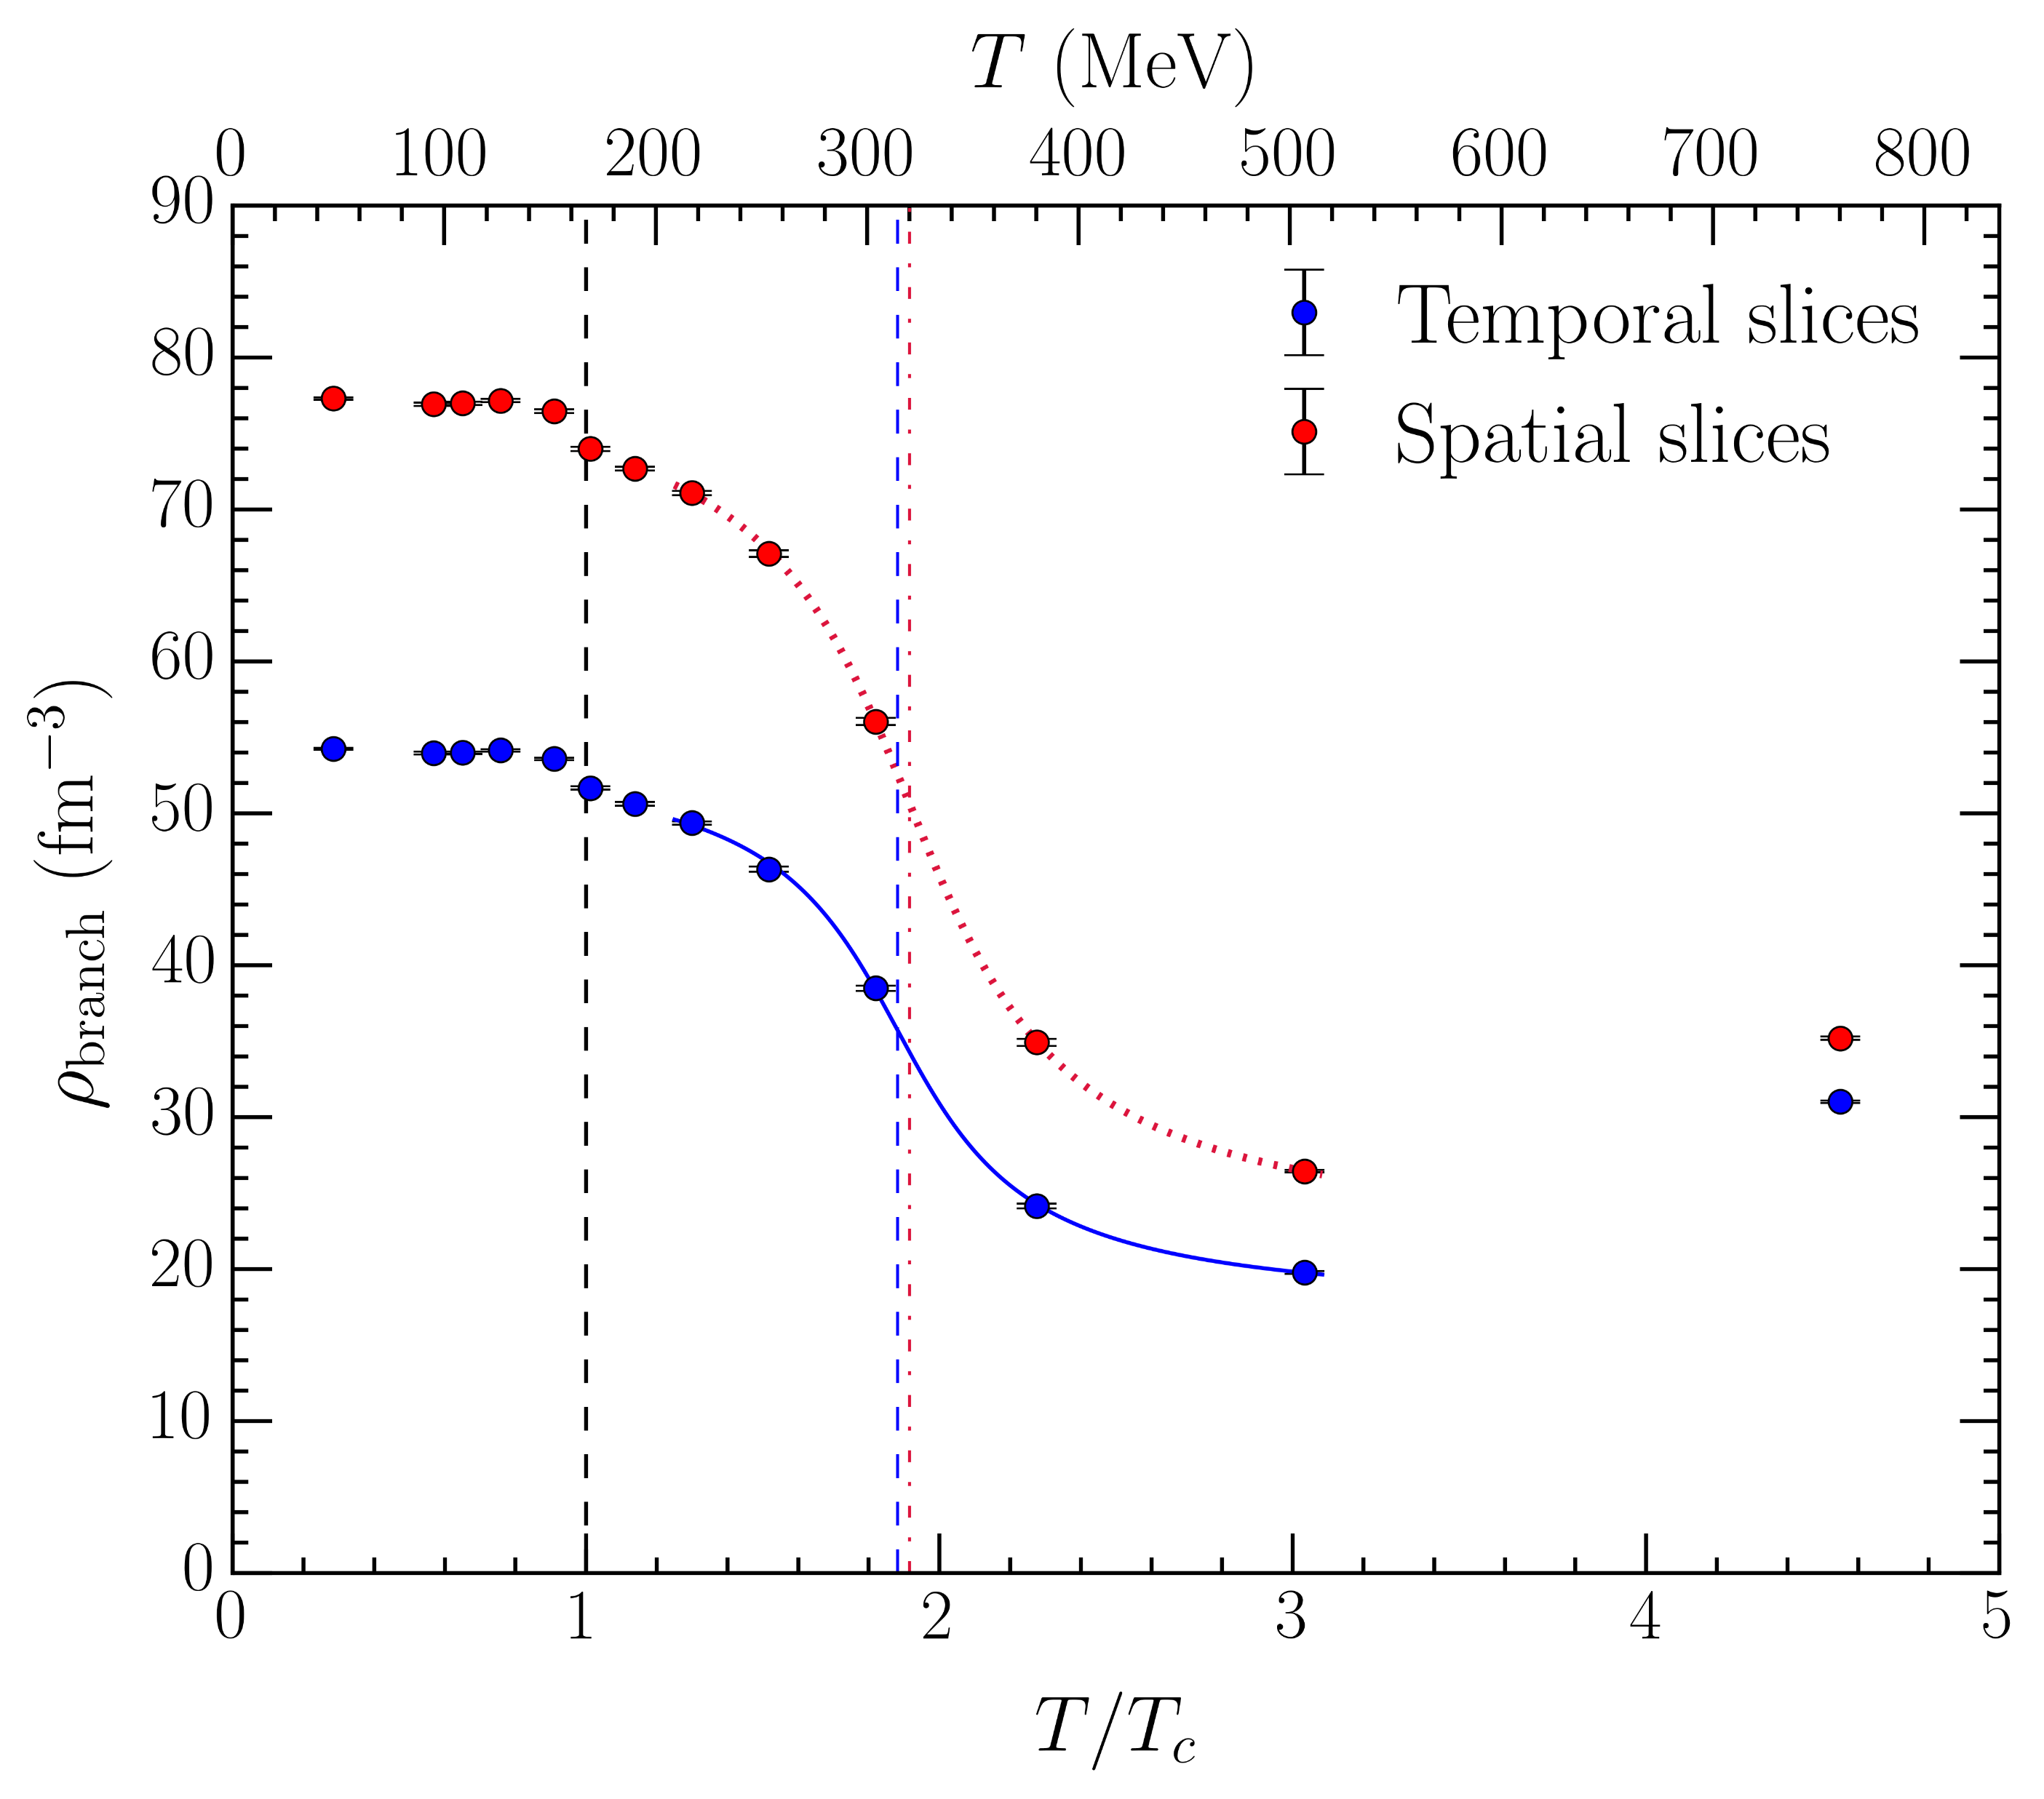
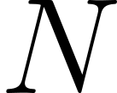
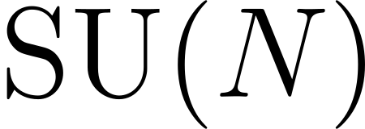
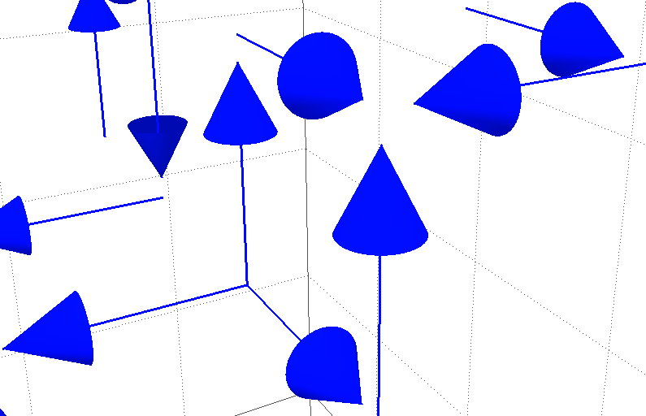
Branching/monopole points
Center charge only conserved modulo in gauge theory
  Allows branching/monopole points at which three vortex lines converge

Slide 16

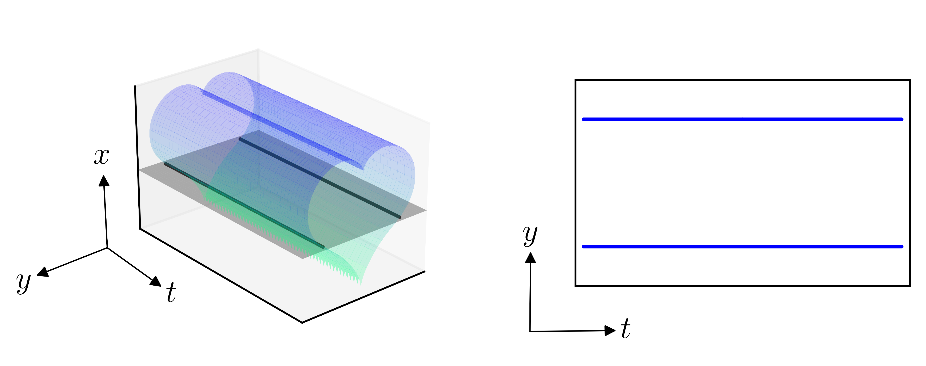
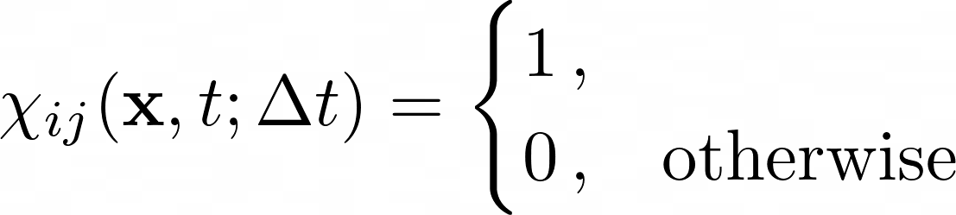
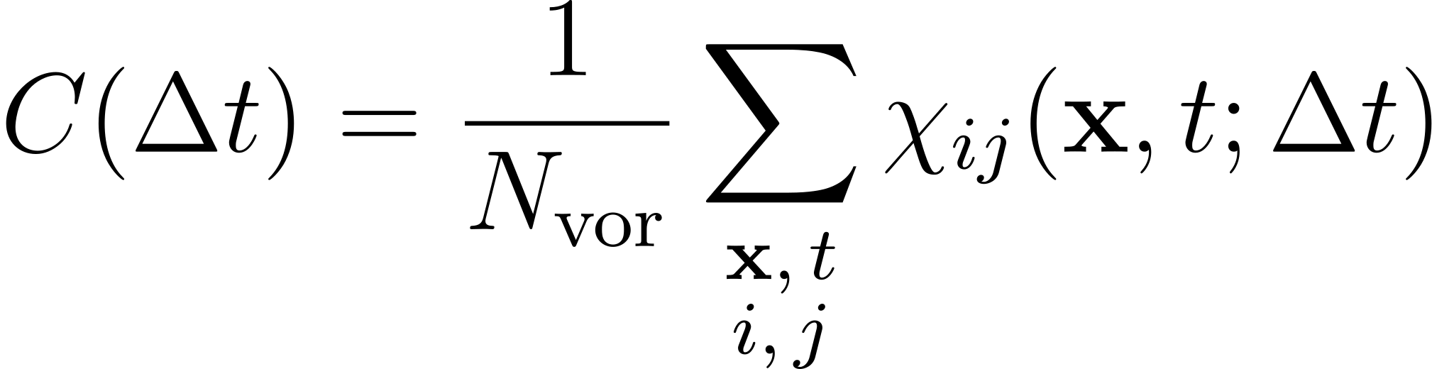
Temporal alignment
Temporal alignment of vortex sheet
  Preferentially lies in space-time planes
  Slicing through spatial dimensions picks up lines parallel to temporal axis
Suppose a space-space plaquette at time is pierced by a vortex
  Is the same plaquette also pierced in the same direction at ?
Define indicator function
Correlation:
Spatial (fixed- ) slice

Slide 17
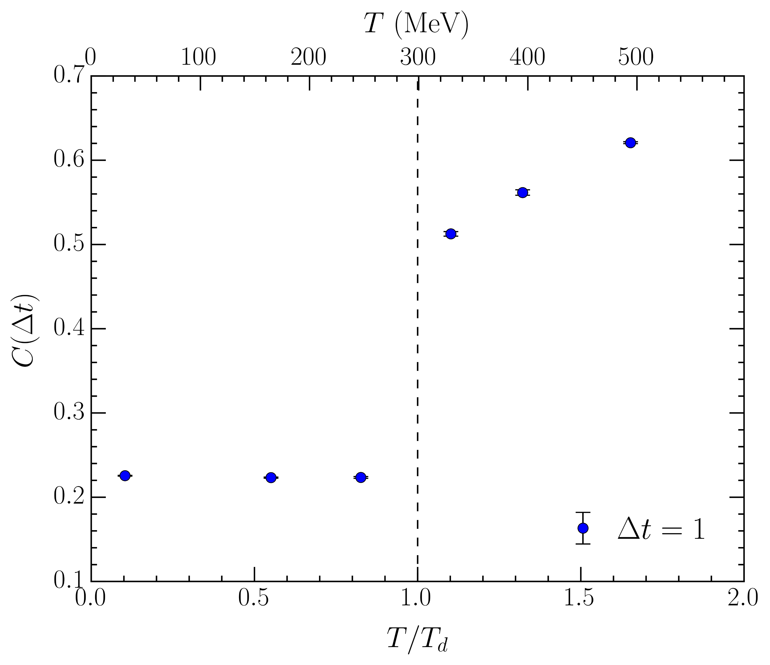
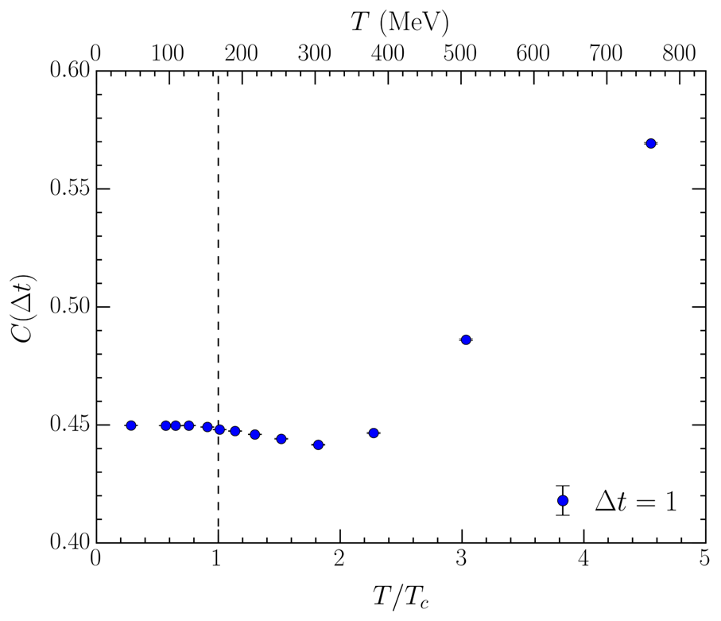
Comparison to pure gauge: temporal alignment
Vortex correlation measure along temporal dimension
  Pure gauge
  Full QCD
17

Slide 18
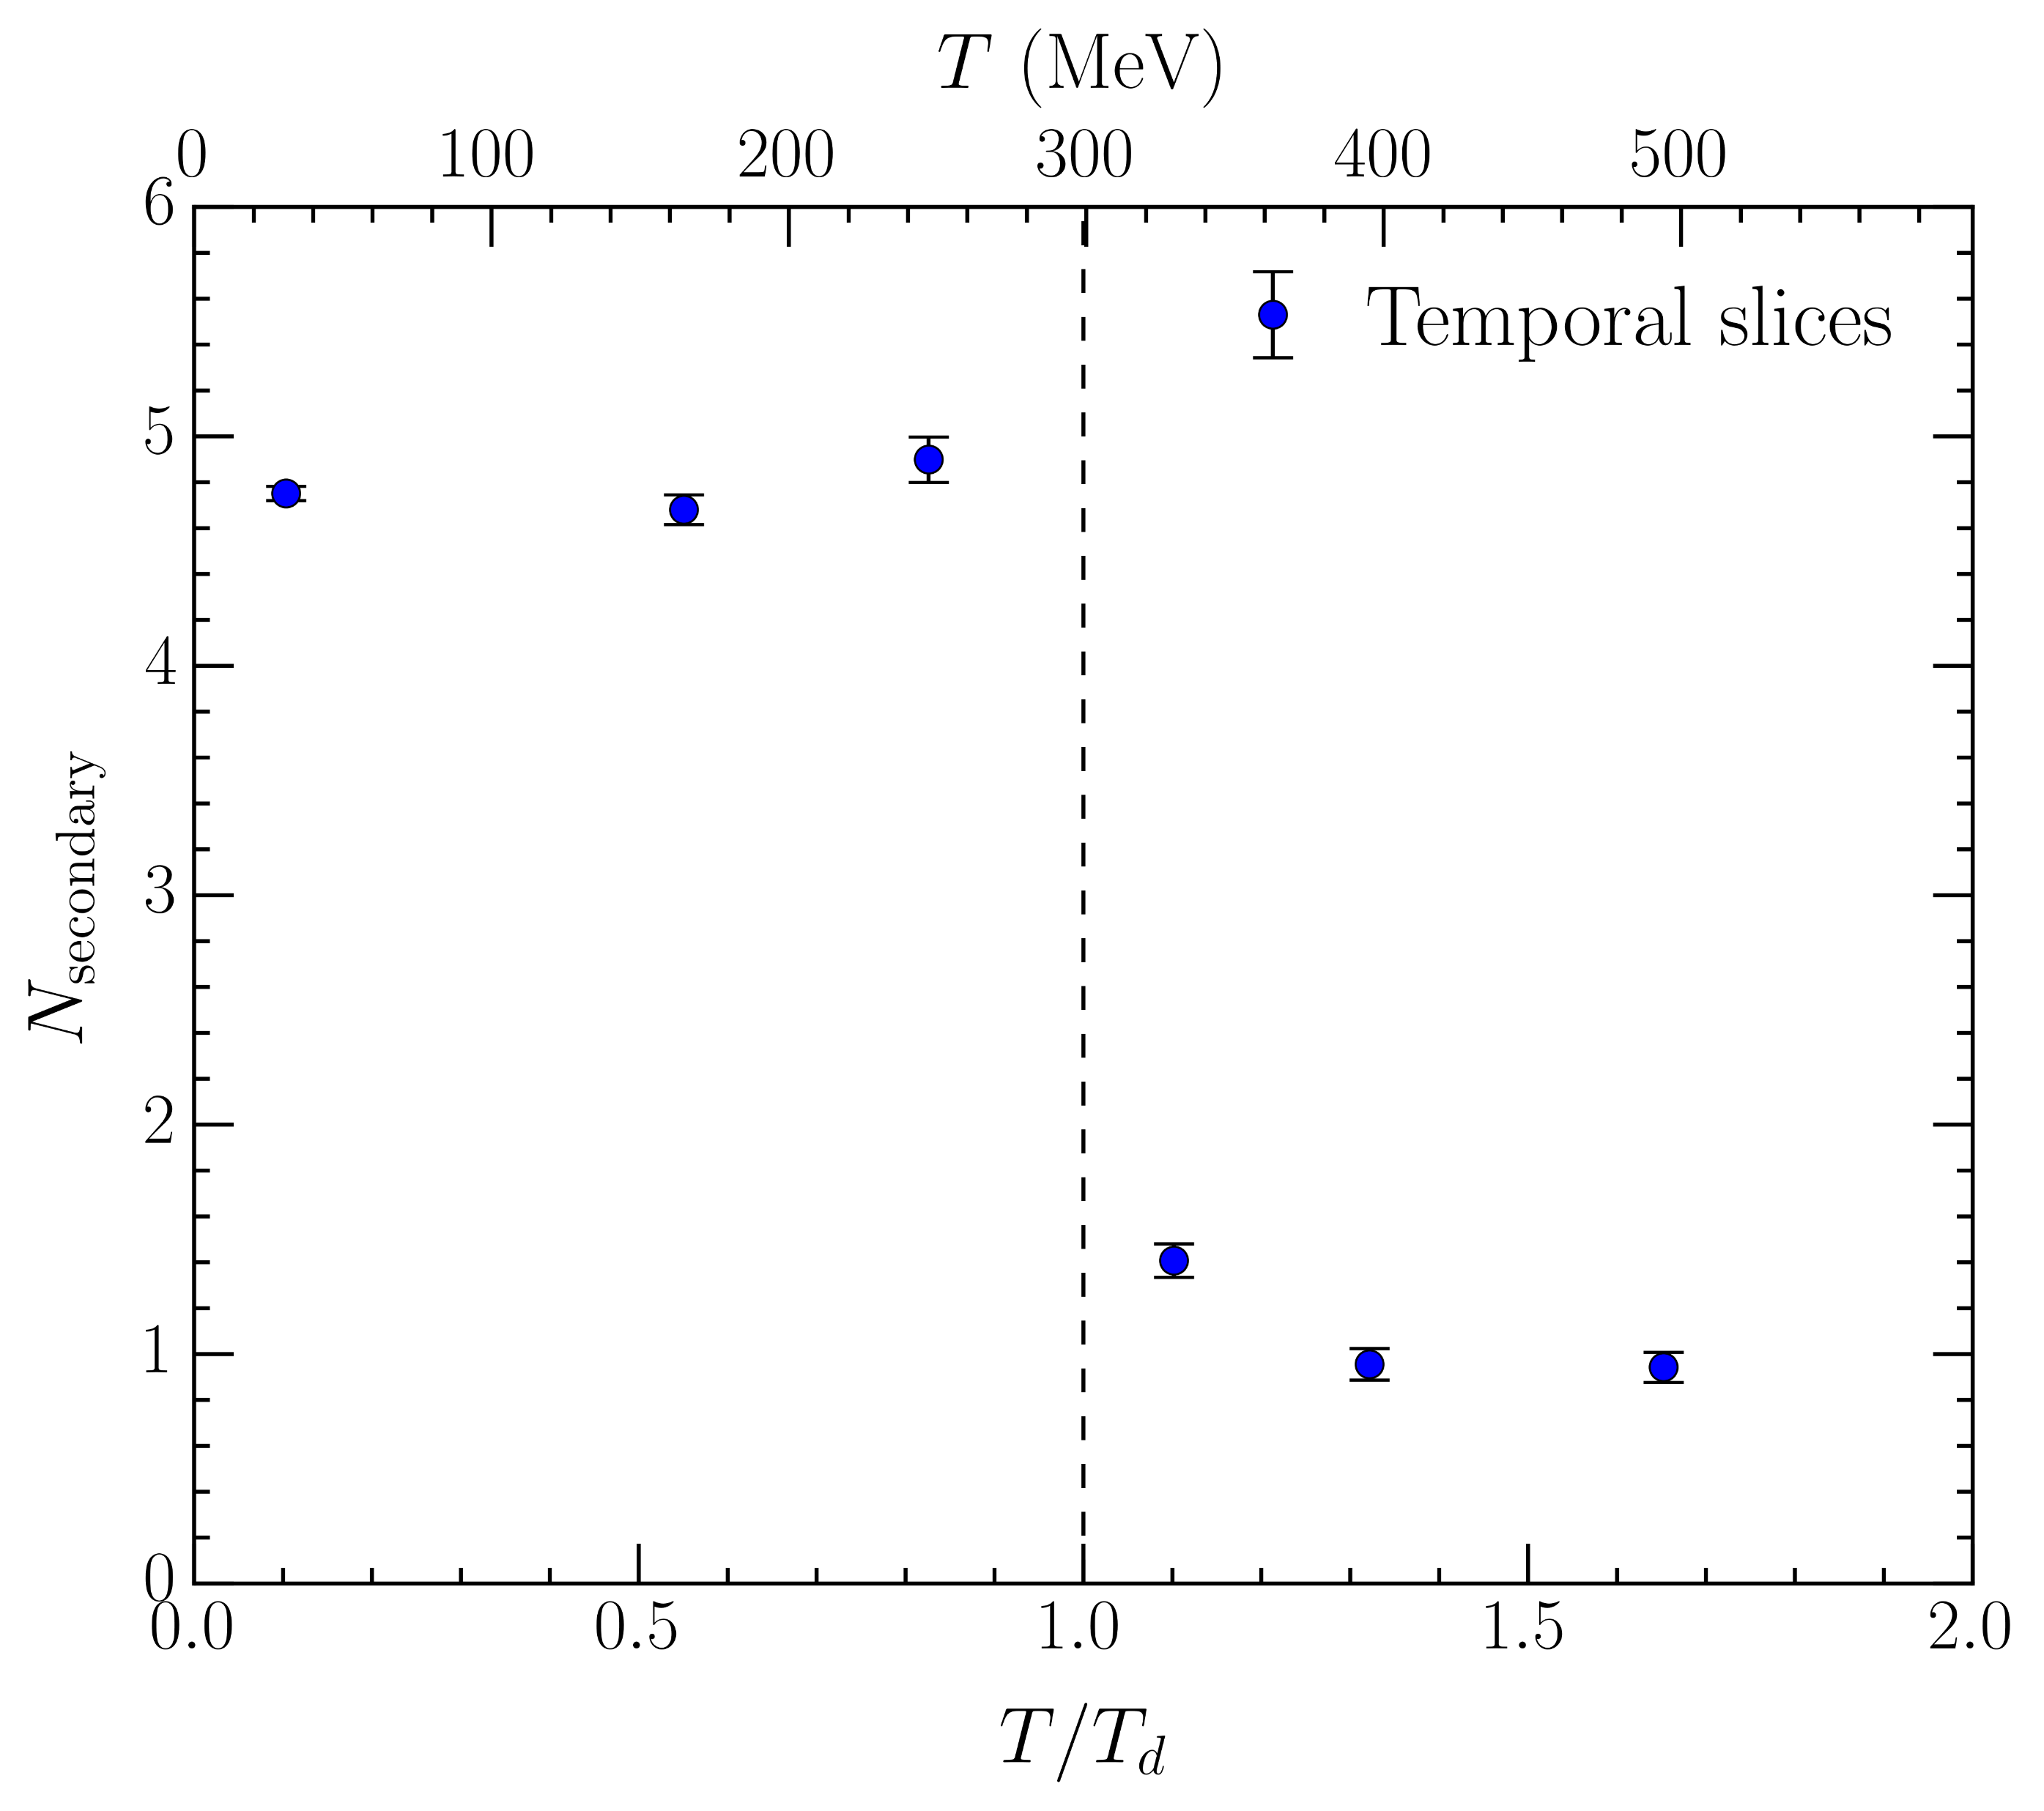
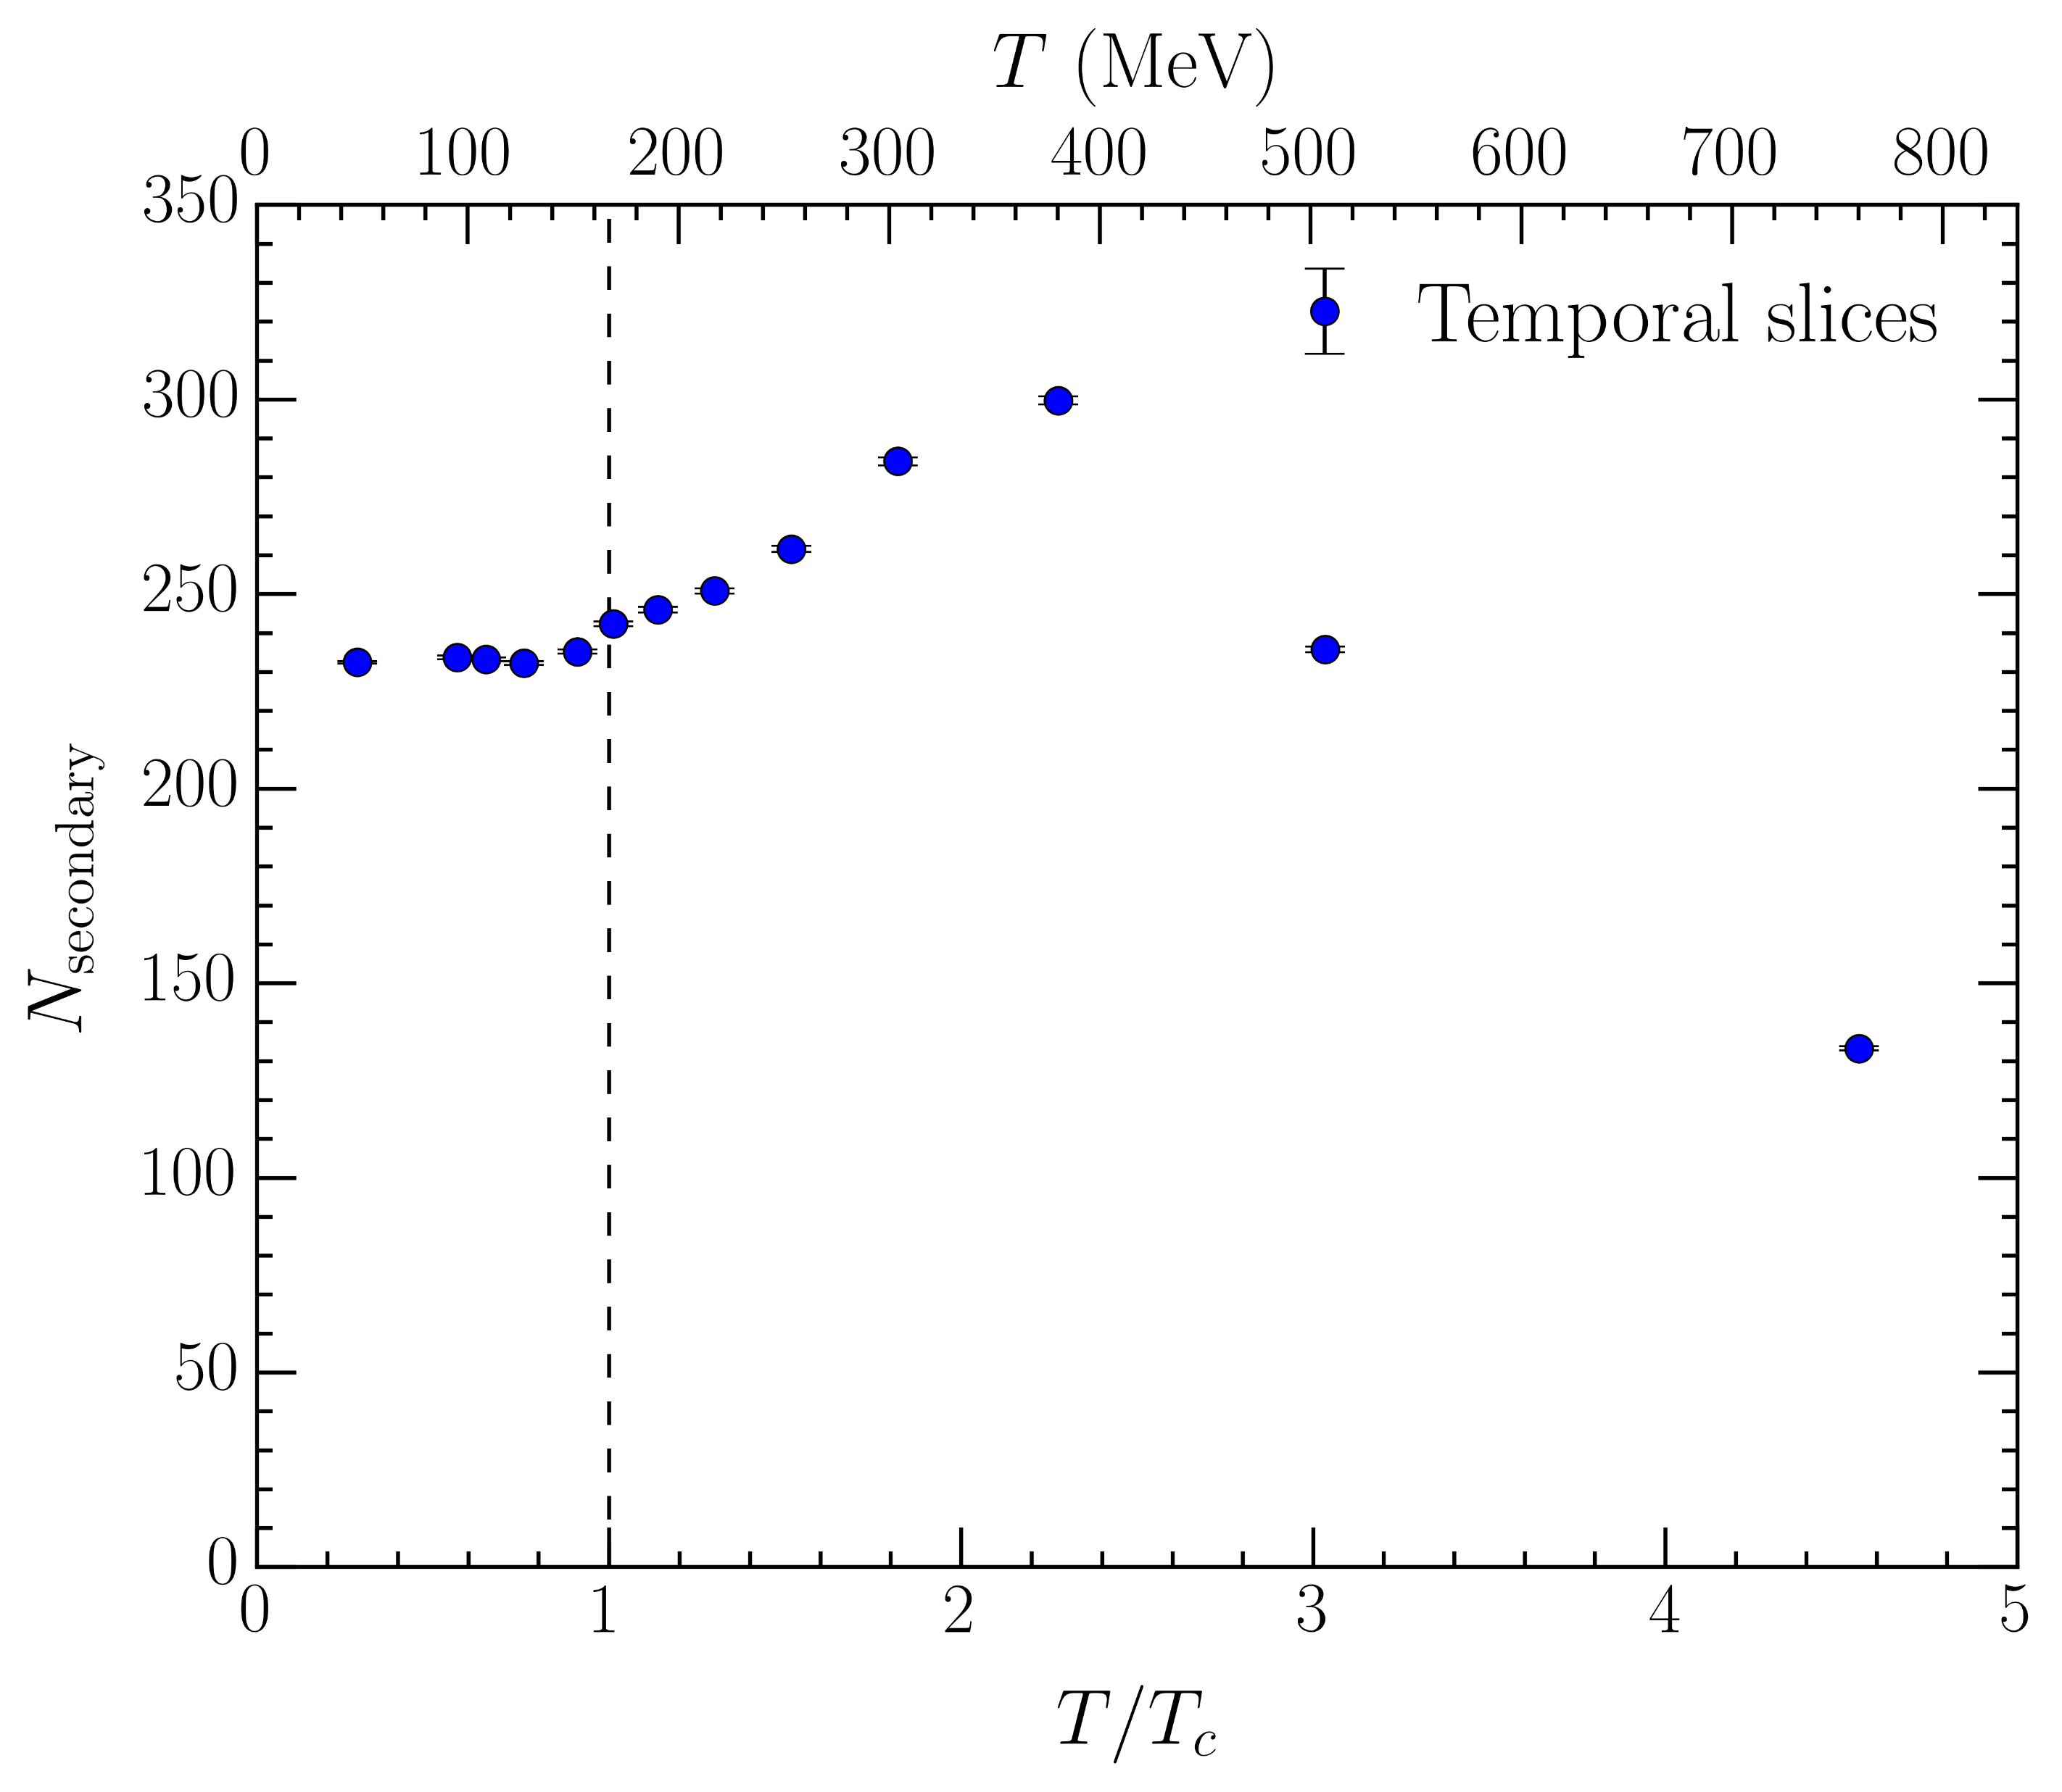
Comparison to pure gauge: secondary loops
Average number of secondary loops in temporal slices of the lattice
  Pure gauge
  Full QCD
18

Slide 19

Conclusion
Percolating centre vortices imply confinement via area law
  Loss of percolation means loss of confinement
Reveals a second transition connected to deconfinement in full QCD
  Established corresponds to a chiral transition
  Percolation not lost until
Precise determination given by vortex density:
Correspondence with phase transition in the pure-gauge theory
  Similar temperature, temporal alignment, secondary loops, etc.
Future work?
  Higher anisotropy – “Generation 3” ensembles with
  Potential pion mass dependence
  Wilson loop and Polyakov loop correlator calculations?
2604.11916

Slide 20
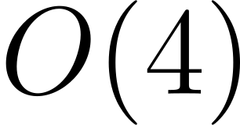
References on two transitions
Chiral-spin symmetries from meson correlators
  L. Y. Glozman, Acta Phys. Polon. Supp. 10, 583 (2017) [arXiv:1610.00275 [hep-lat]]
  C. Rohrhofer et al., Phys. Rev. D 96, 094501 (2017) [arXiv:1707.01881 [hep-lat]]
  C. Rohrhofer et al., Phys. Rev. D 100, 014502 (2019) [arXiv:1902.03191 [hep-lat]]
  C. Rohrhofer, Y. Aoki, L. Y. Glozman, and S. Hashimoto, Phys. Lett. B 802, 135245 (2020) [arXiv:1909.00927 [hep-lat]]
  L. Y. Glozman, O. Philipsen, and R. D. Pisarski, Eur. Phys. J. A 58, 247 (2022) [arXiv:2204.05083 [hep-ph]]
  L. Y. Glozman, Prog. Part. Nucl. Phys. 131, 104049 (2023) [arXiv:2209.10235 [hep-lat]]
  T.-W. Chiu, Phys. Rev. D 107, 114501 (2023) [arXiv:2302.06073 [hep-lat]]
  L. Y. Glozman, Prog. Part. Nucl. Phys. 131, 104049 (2024) [arXiv:2402.05852 [hep-lat]]
Monopole condensation
  M. Cardinali, M. D’Elia, and A. Pasqui (2021), arXiv:2107.02745 [hep-lat]
Color screening of quark-antiquark pair in gluonic background
  A. Bazavov, N. Brambilla, P. Petreczky, A. Vairo, and J. H. Weber (TUMQCD), Phys. Rev. D 98, 054511 (2018) [arXiv:1804.10600 [hep-lat]]
  A. Bazavov and J. H. Weber, Prog. Part. Nucl. Phys. 116, 103823 (2021) [arXiv:2010.01873 [hep-lat]]
  A. Bazavov, D. Hoying, R. N. Larsen, S. Mukherjee, P. Petreczky, A. Rothkopf, and J. H. Weber (HotQCD), Phys. Rev. D 109, 074504 (2024) [arXiv:2308.16587 [hep-lat]]
scaling of chiral condensate
  A. Y. Kotov, M. P. Lombardo, and A. Trunin, Phys. Lett. B 823, 136749 (2021) [arXiv:2105.09842 [hep-lat]]
  A. Y. Kotov, A. Trunin, and M. P. Lombardo, PoS LATTICE2021, 032 (2022) [arXiv:2111.15421 [hep-lat]]
  A. Y. Kotov, M. P. Lombardo, and A. Trunin, PoS LATTICE2021, 111 (2022) [arXiv:2111.03406 [hep-lat]]
  A. Y. Kotov, M. P. Lombardo, and A. Trunin, EPJ Web Conf. 258, 05012 (2022)
Spectral density of Dirac operator
  A. Alexandru and I. Horvath, Phys. Rev. D 100, 094507 (2019) [arXiv:1906.08047 [hep-lat]]
  A. Alexandru and I. Horvath, Phys. Rev. Lett. 127, 052303 (2021) [arXiv:2103.05607 [hep-lat]]
  X.-L. Meng, P. Sun, A. Alexandru, I. Horváth, K.-F. Liu, G. Wang, and Y.-B. Yang ($χ$QCD, CLQCD), JHEP 12, 101 (2024) [arXiv:2305.09459 [hep-lat]]
Other various topological considerations
  E. Shuryak (2017), arXiv:1701.08089 [hep-lat]
  M. Hanada, H. Ohata, H. Shimada, and H. Watanabe, Prog. Theor. Exp. Phys. 2024, 041B02 (2024) [arXiv:2310.01940 [hep-th]]
  M. Hanada and H. Watanabe, Prog. Theor. Exp. Phys. 2024, 043B02 (2024) [arXiv:2310.07533 [hep-th]]
20

Slide 21
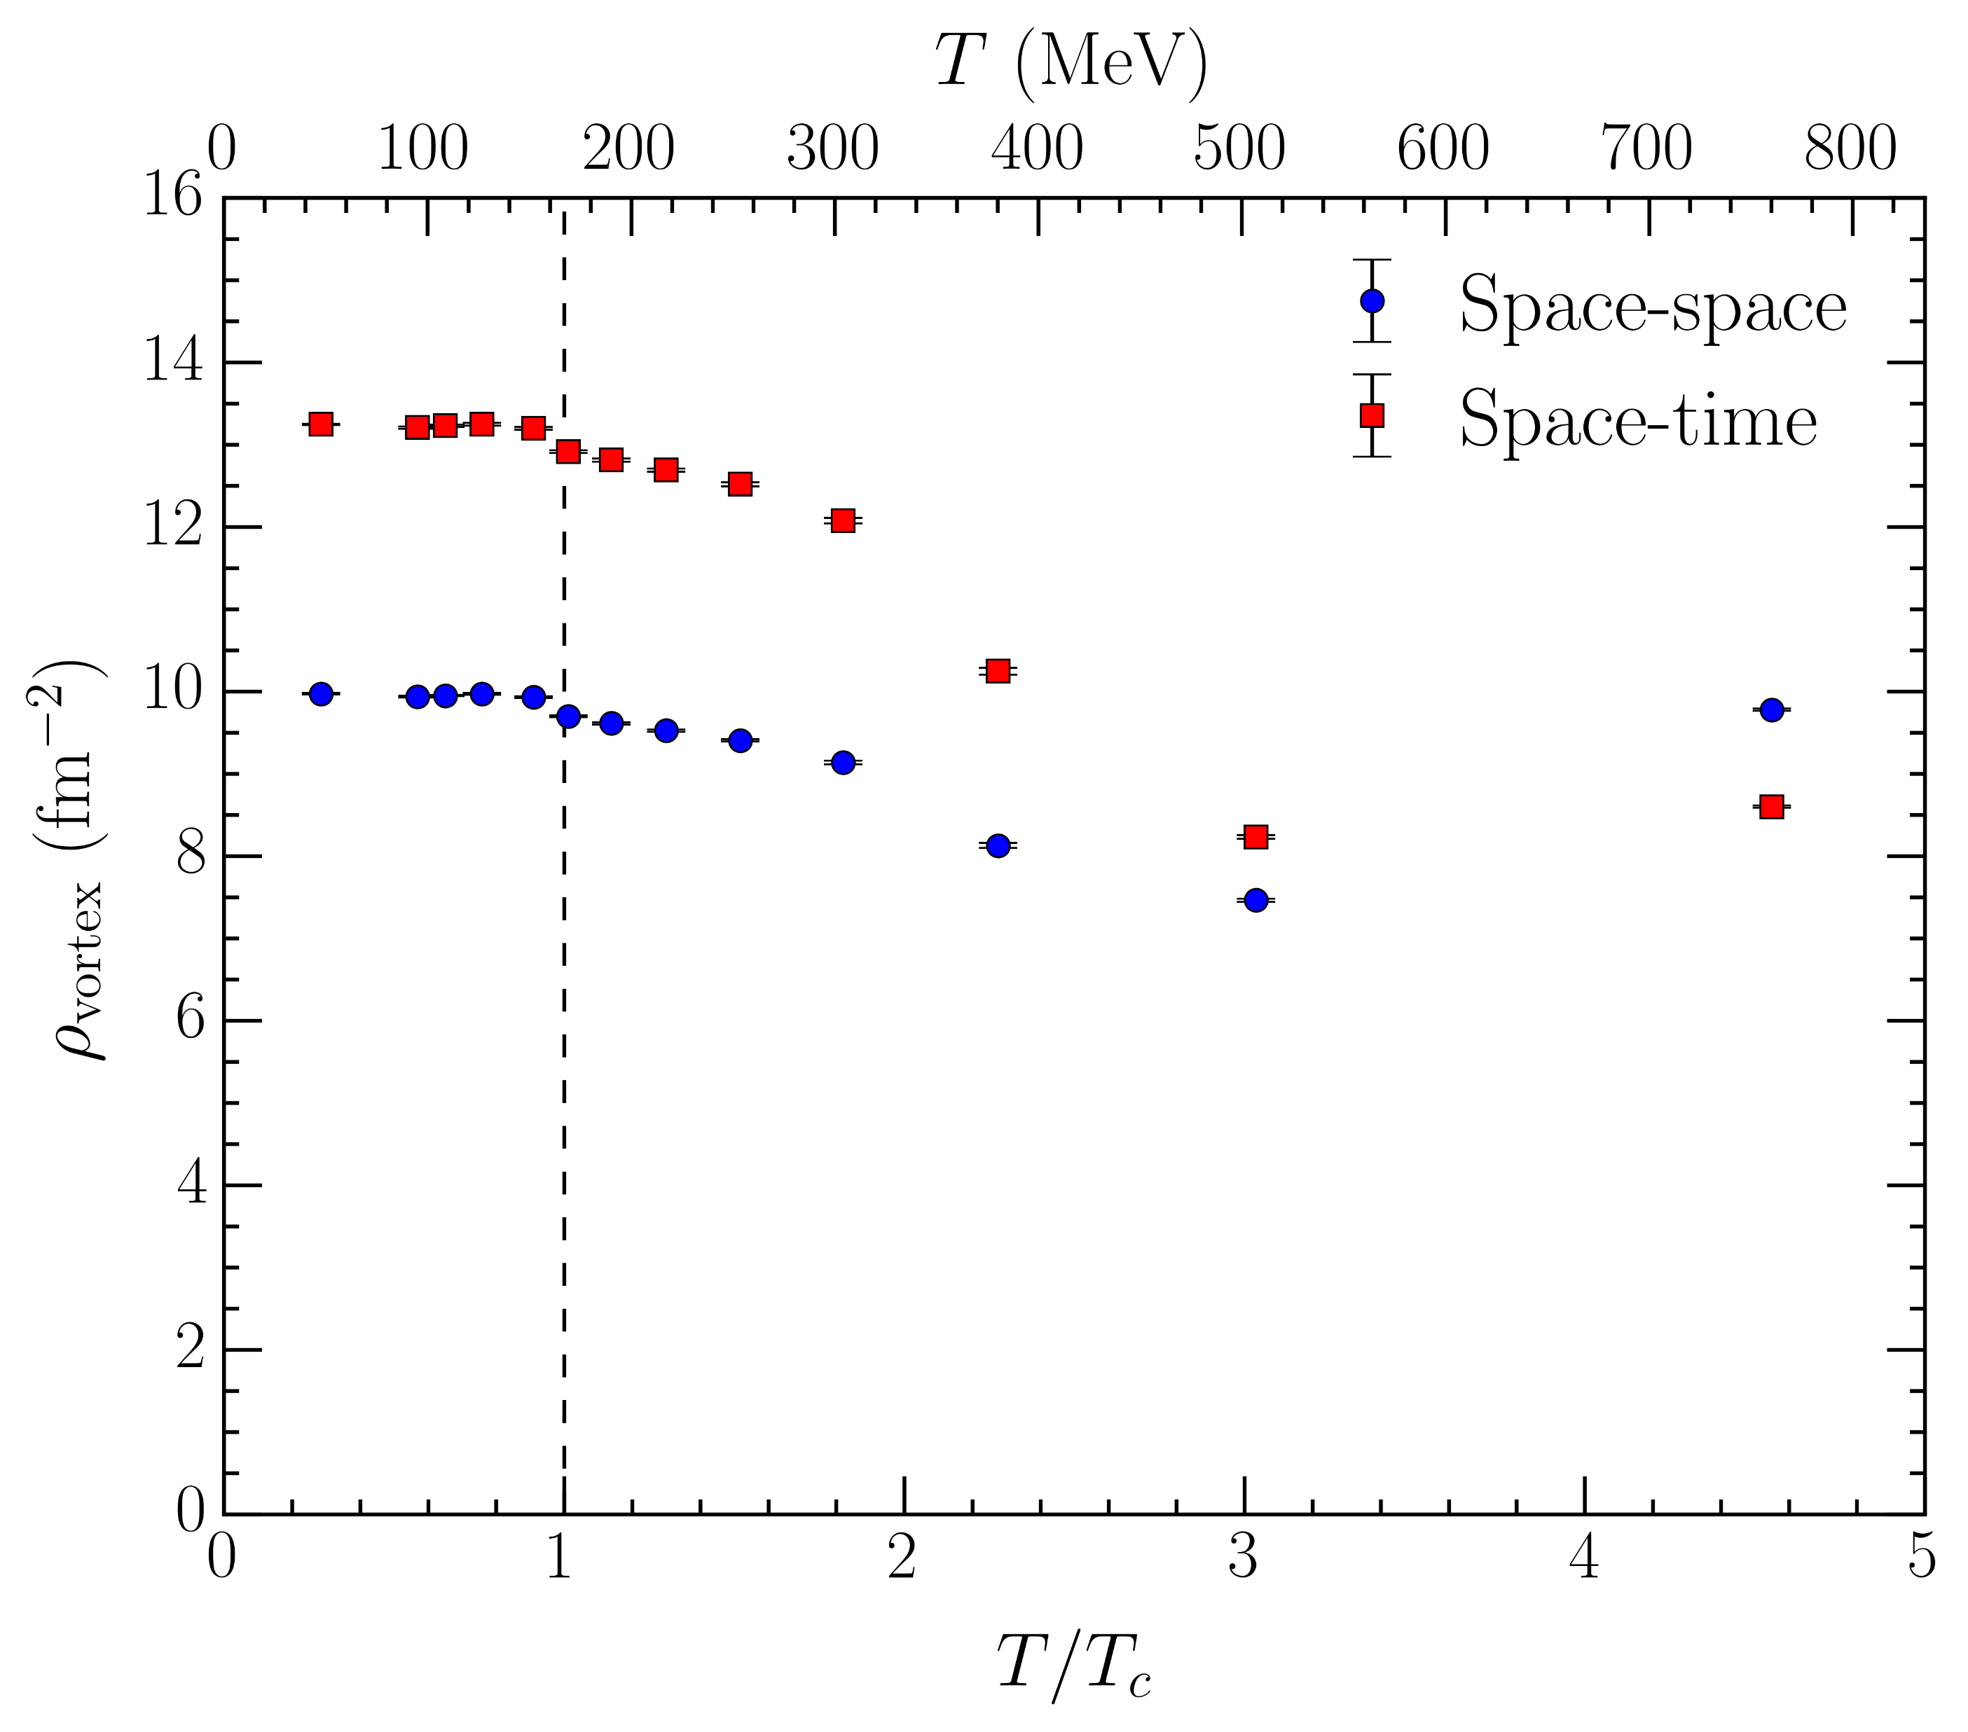

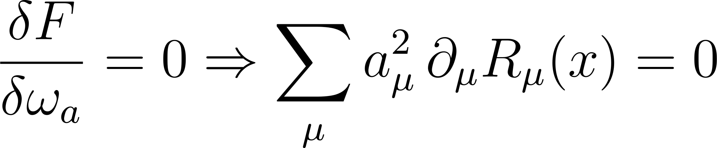
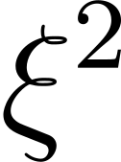
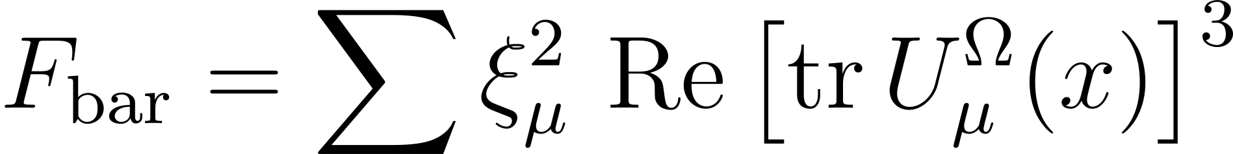
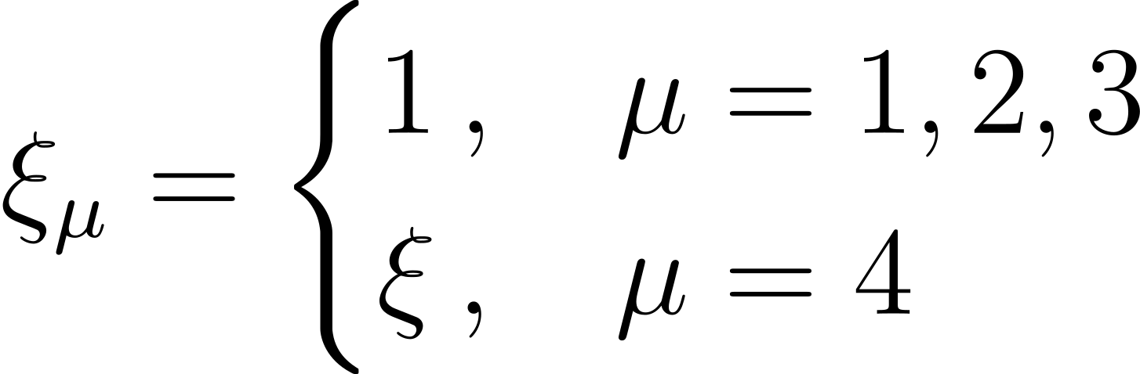
Anisotropic gauge fixing
Apply “standard” MCG functional on anisotropic lattice
  Different vortex densities in space-space and space-time orientations
Take functional derivative of and expand about the identity
  Multiply temporal term by
Do other functionals improve the matching?
  “Baryonic functional” is slightly better

Slide 22



Temporal alignment: other
Vortex correlation measure along temporal dimension
  Pure gauge
  Full QCD
22

Slide 23









Pure gauge: lattice details
Temperature given by (inverse) period of temporal dimension
Ensembles are
  Iwasaki renormalization-group-improved action
  Fixed lattice spacing
  100 configurations for each

Slide 24



Pure gauge:
Temporal (fixed- ) slices
  Visualizing
Spatial (fixed- ) slices
  Visualizing

Slide 25



Pure gauge:
Temporal (fixed- ) slices
  Visualizing
Spatial (fixed- ) slices
  Visualizing

Slide 26



Cylinders..?
Spatial (fixed- ) slice
Temporal (fixed- ) slice
Vortex sheet aligns with temporal dimension above

Slide 27







Algorithmic concerns?
Could the alignment be an algorithmic effect?
  Ergodicity of Markov chain
  Lattice-spacing dependence
Ergodicity: thermalize 100 independent hot starts
  Utilize Wilson action
  still increases through
  Correlation is slightly smaller, but alignment persists
Continuum limit: halve the lattice spacing ( )
  Double the lattice volume ( )
  Alignment is even stronger!

Slide 28










Not-so-secondary clusters

Slide 29

Vortex density (pure gauge)
Space-time density
  Significant drop at – matches strong temporal alignment in pure gauge
  Soft decrease above
Space-space density
  Also decreases through
  Rapid increase above – growing disorder in spatial dimensions

Slide 30












Area law
Consider plane of area pierced by vortices
  Probability that vortices pierce Wilson loop of area :
Wilson loop expectation value:
  Simplifies to
Keep vortex density constant as we take infinite-volume limit
Find
Suppose clusters have a finite size, i.e. maximum separation between vortices
  Only nontrivial contribution from strip of width within perimeter of Wilson loop
  Leads to perimeter law:

Slide 31













Two transitions?
Bulk changes in vortex geometry point toward a second QCD transition
  Occurs at a higher temperature
Established transition at is purely a chiral transition
  Onset of chiral symmetry restoration
Second transition is connected to deconfinement
  Occurs at a temperature close to the pure-gauge transition
Future improvements?
  Investigate pion mass dependence
  “Gen3” ensembles – double the anisotropy
31

