Slide 1
Consideration of Rates in the DarkLight@ARIEL Test Experiment
Maximum incident energy = 30 MeV
Scattering angle = 45º
Tantalum target of thickness 10 microns (0.0024 r.l.) = 6 x 10¹⁹ Ta cm⁻²
Beam current: ~ 10 microamps
Processes: Elastic ~ Z², Moller~Z, pair production, giant dipole resonance,

Slide 2
Stopping power of electrons in Tantalum vs. energy
HVRL ARIEL

Slide 3
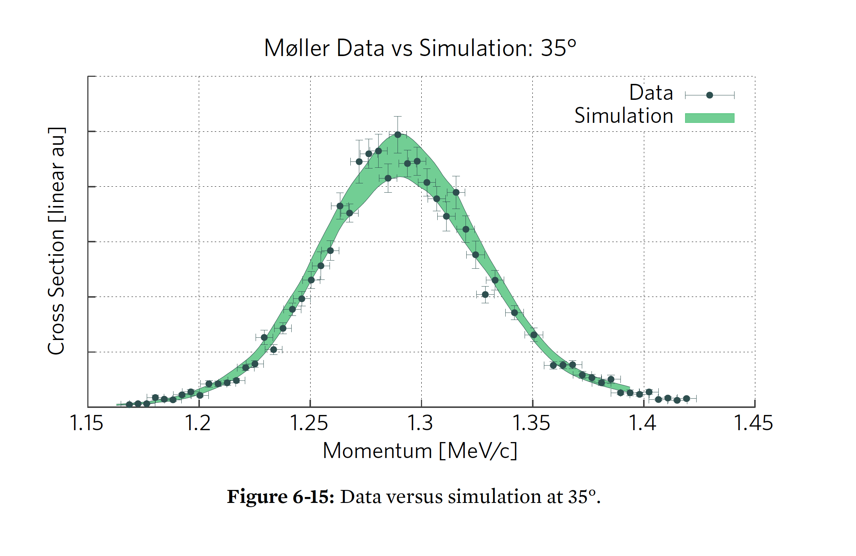
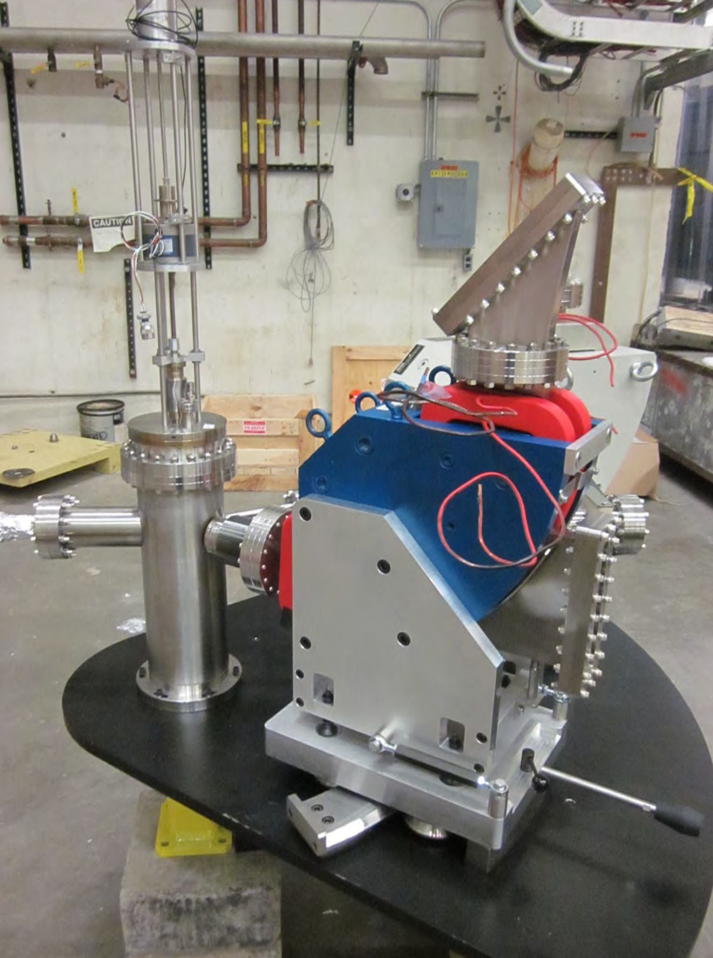
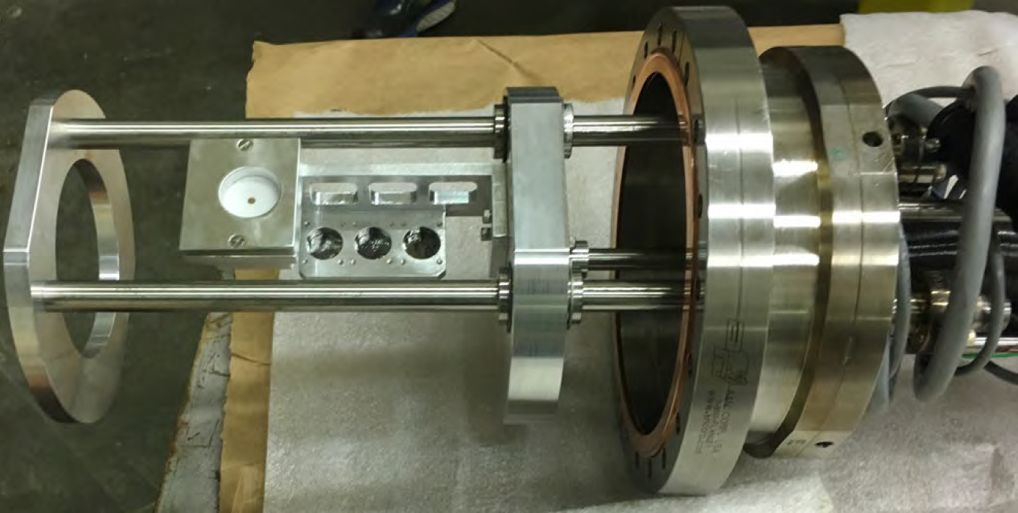
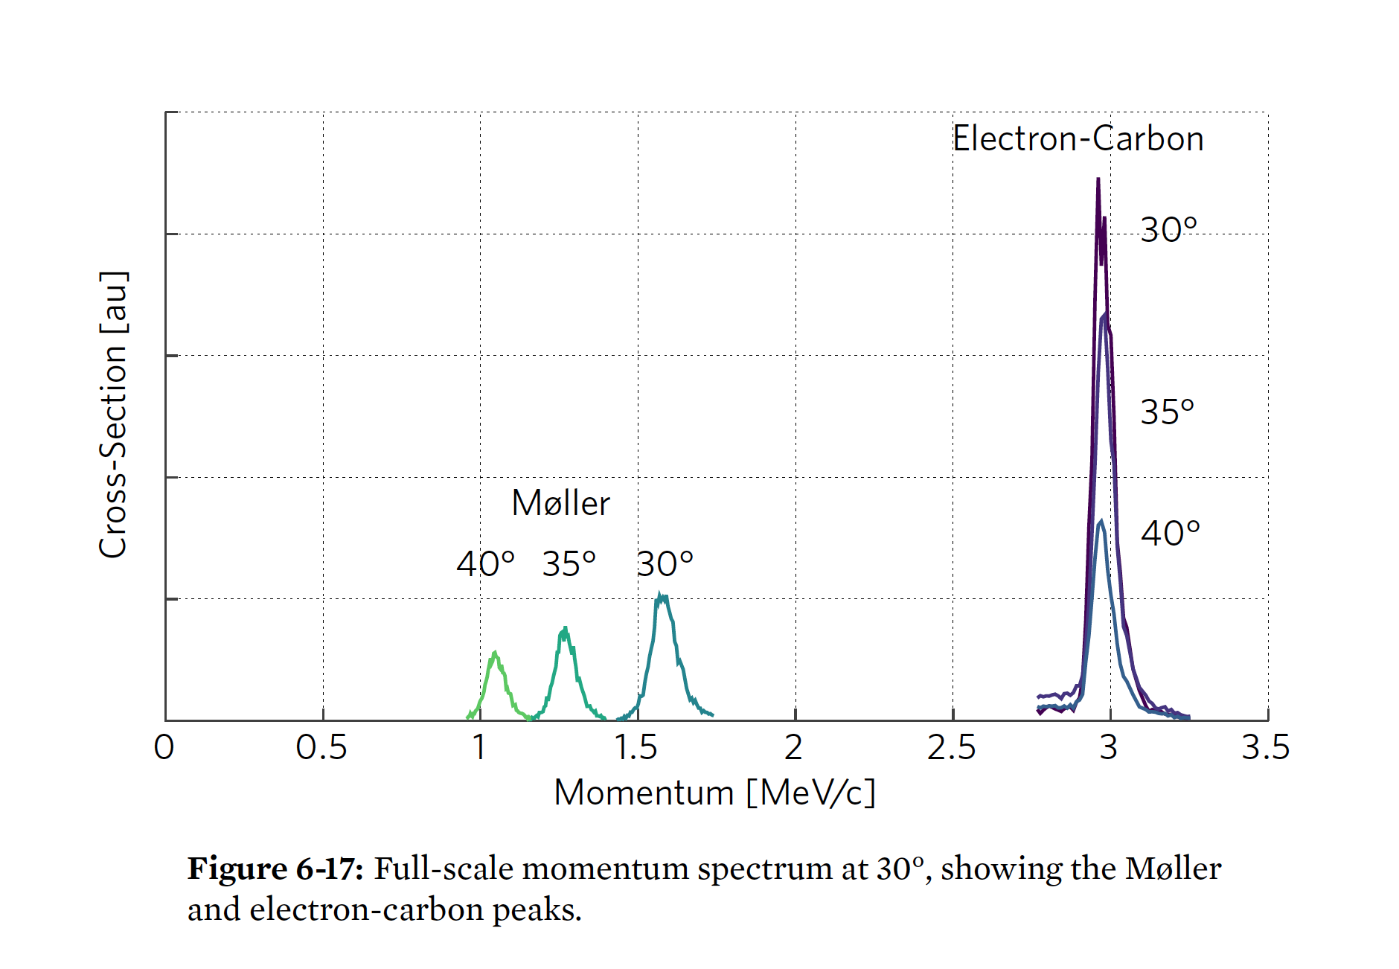
HVRL Experiment
Motivated by desire to check calculation of Moller scattering that included electron mass. Originally proposed in NSF MRI at JLab FEL.
Carried out at 2.5 MeV.
Moller measurements at higher energy,
e.g. 30 MeV of significant scientific interest.

Slide 4
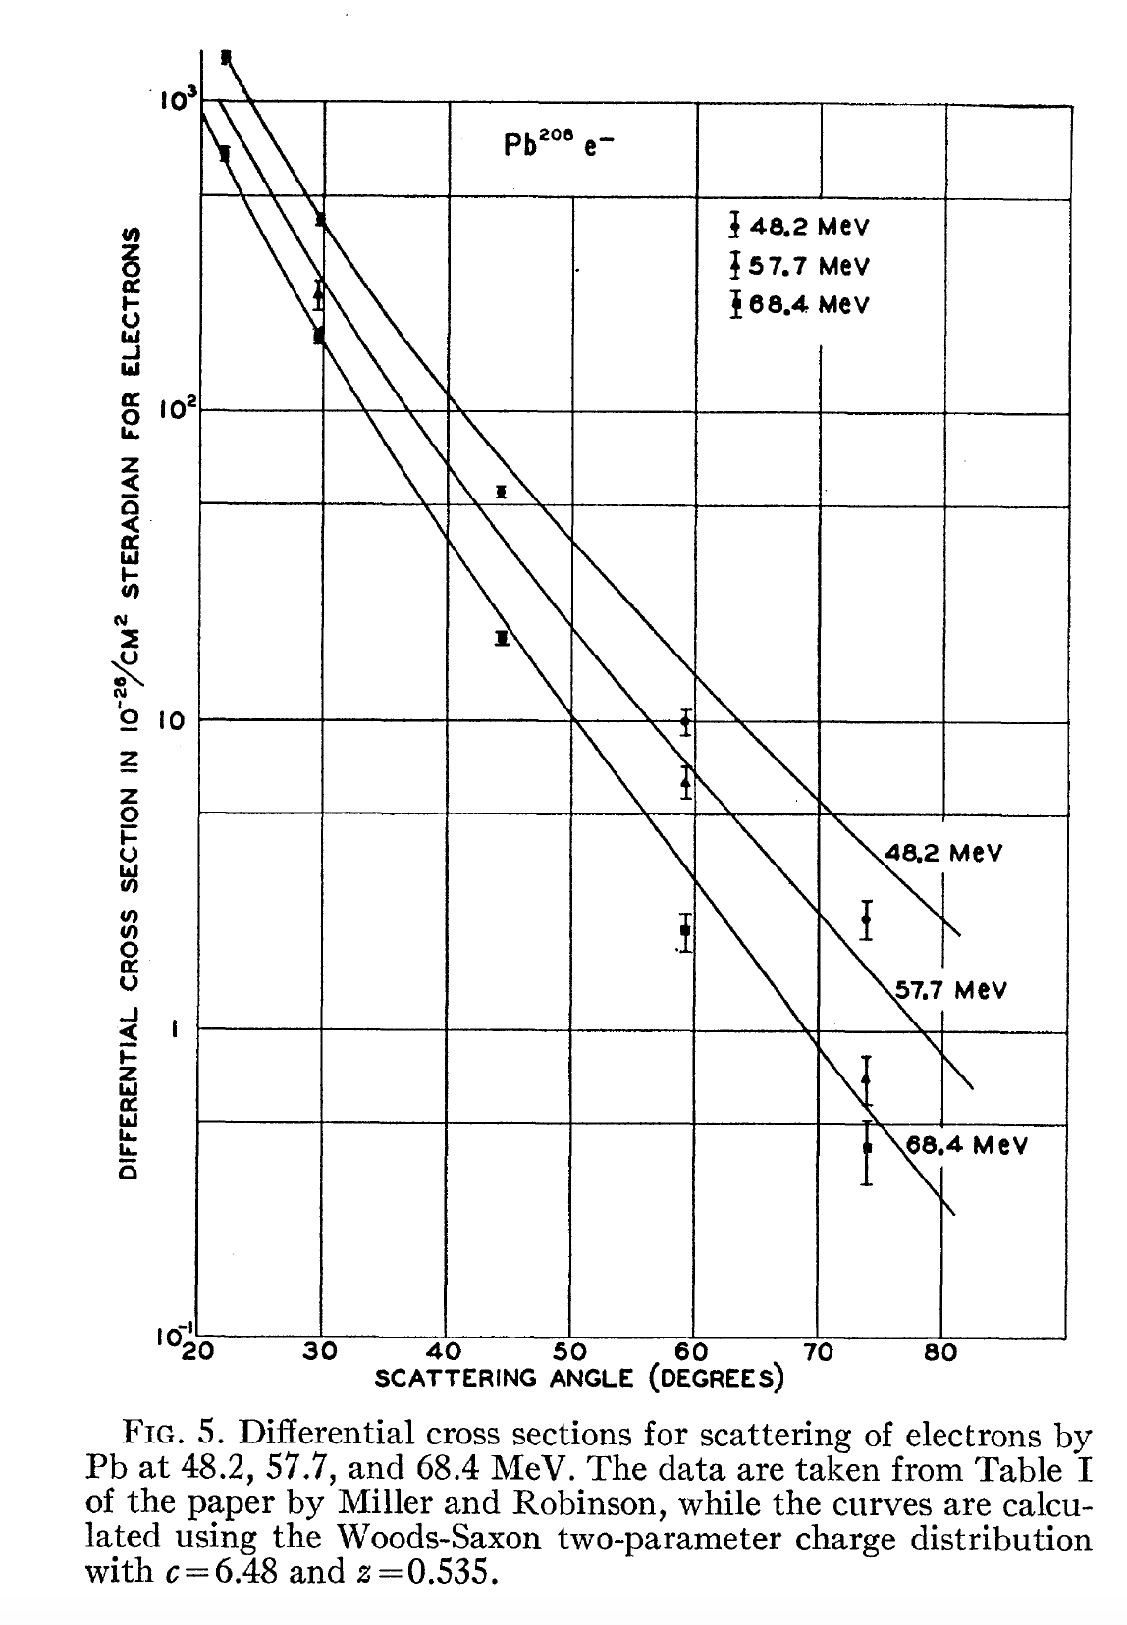
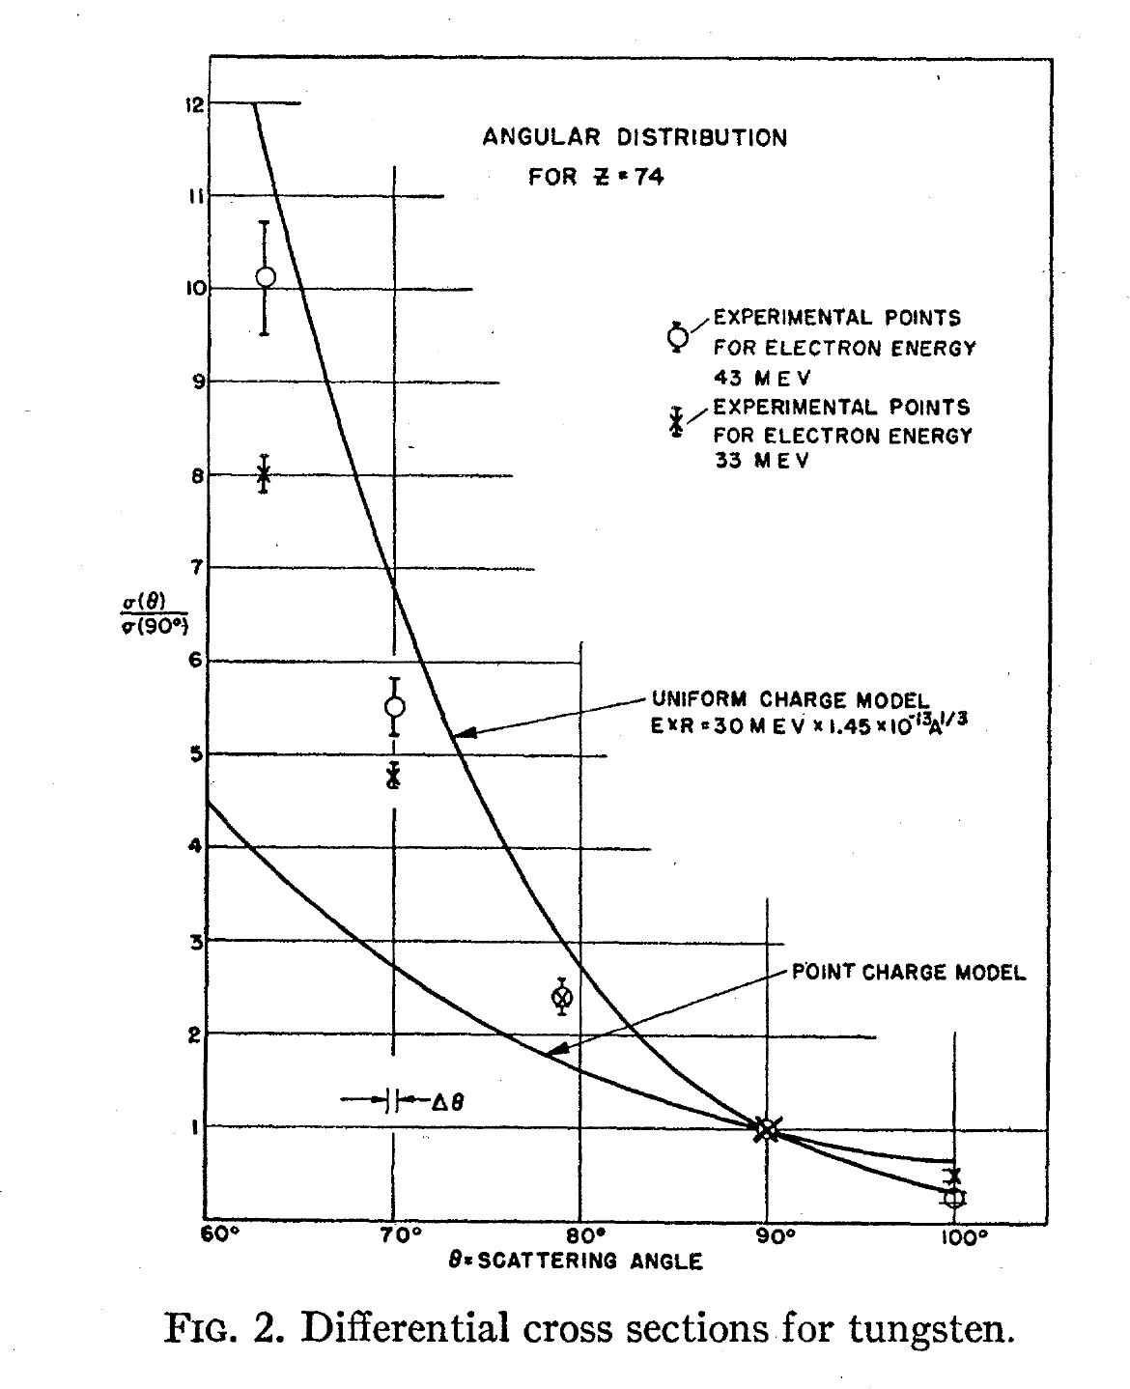

Slide 5
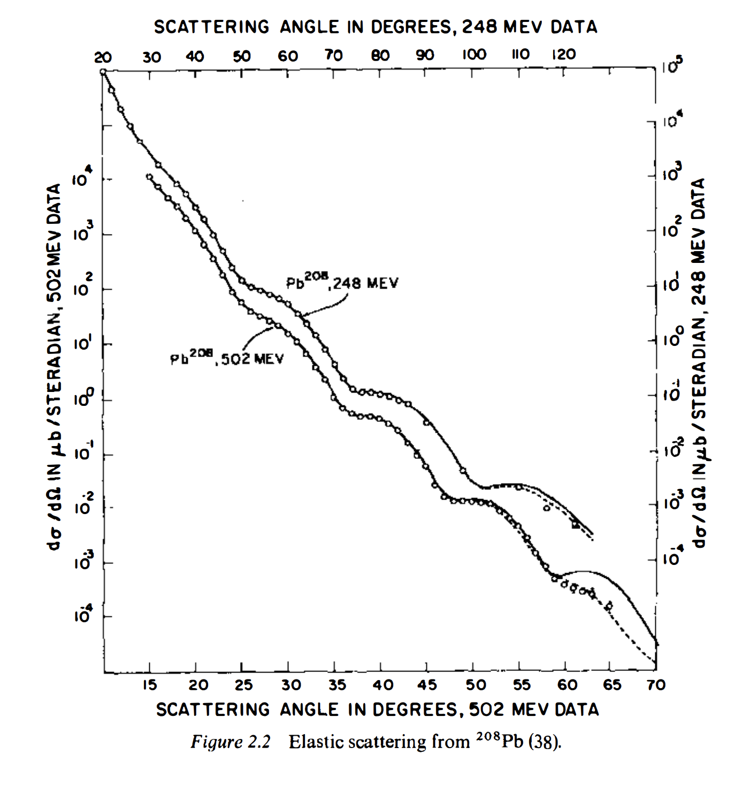

Slide 6
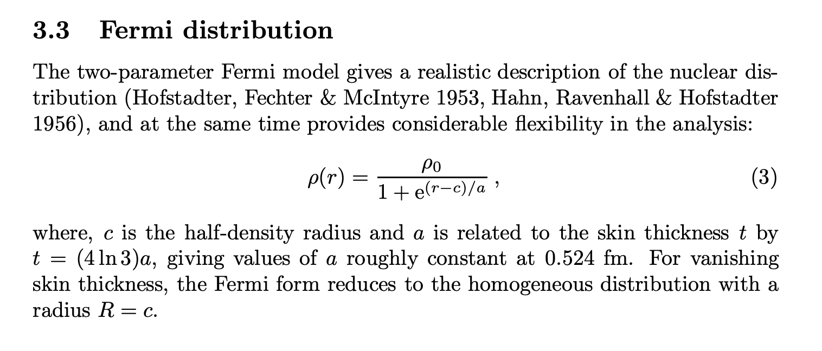
Ground state charge density

Slide 8
Luminosity ~ 10³² cm⁻² s⁻¹

Slide 9
Self-Confining Radioactive-Isotope Ion Target (SCRIT) at RIBF
Luminosity ~ 10²⁷ cm⁻² s⁻¹
150 MeV electron beam

Slide 10
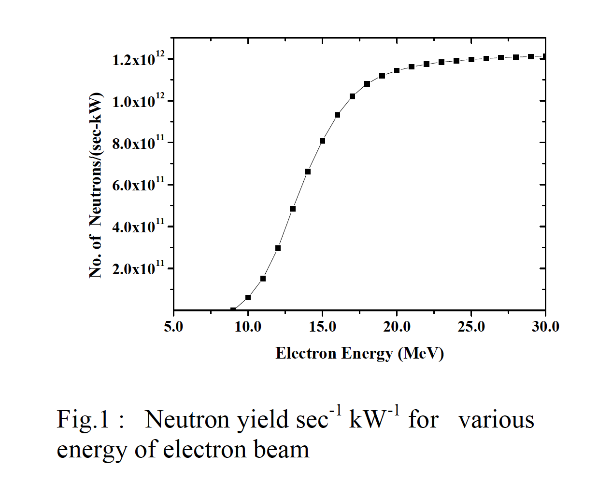
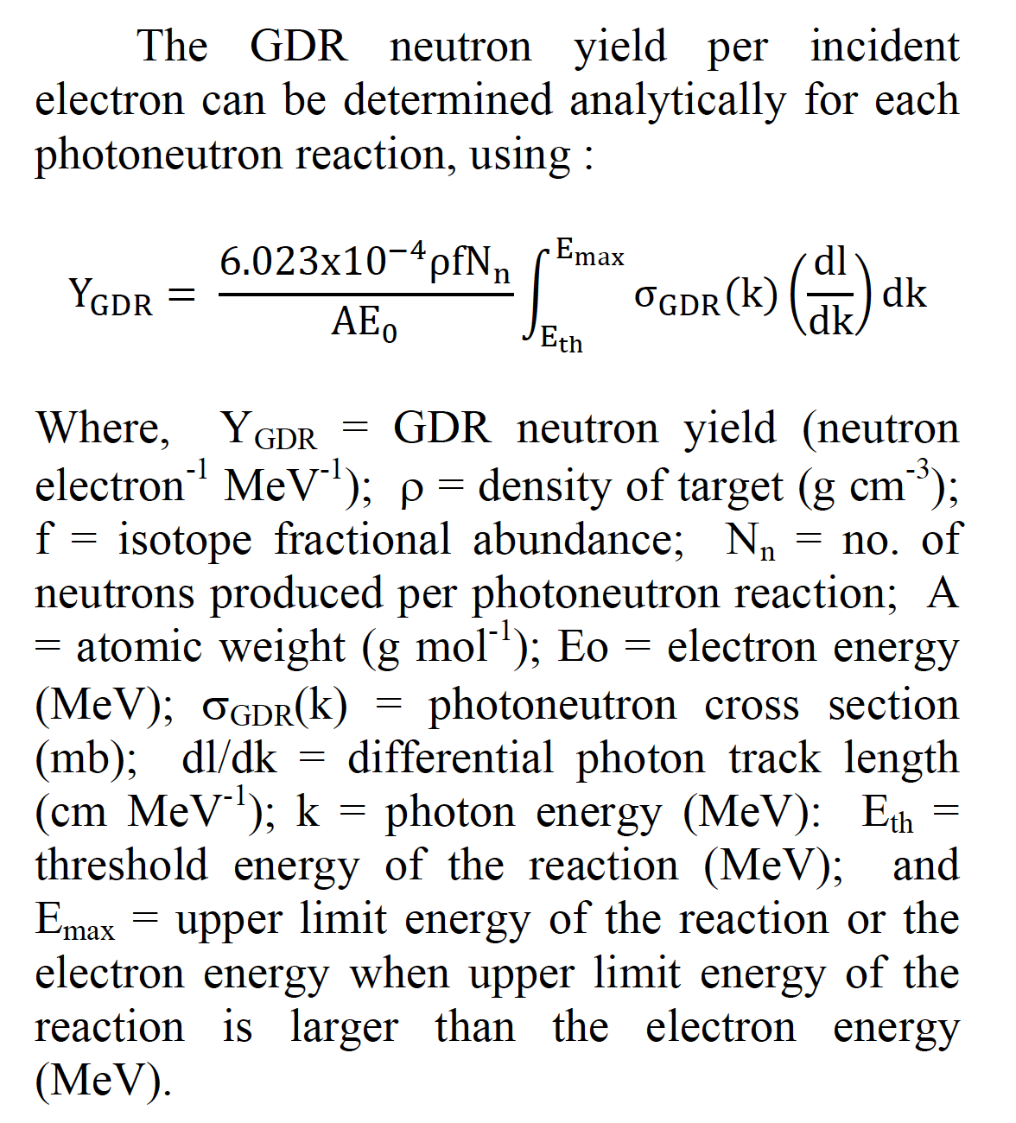
Neutron Production

Slide 11
Positron Production

Slide 12
Summary
Installation of HVRL experiment at ARIEL will allow measurement of SM background rates
- elastic scattering
- Moller scattering
- positron production (also at threshold)
- neutron and photon backgrounds (detectors in vault)
Demands on detector performance are low. Rates are high.
However, this will require a significant effort from the collaboration to execute.
Suggest we implement simulation codes FLUKA, ELSEPA, ….

