Slide 1
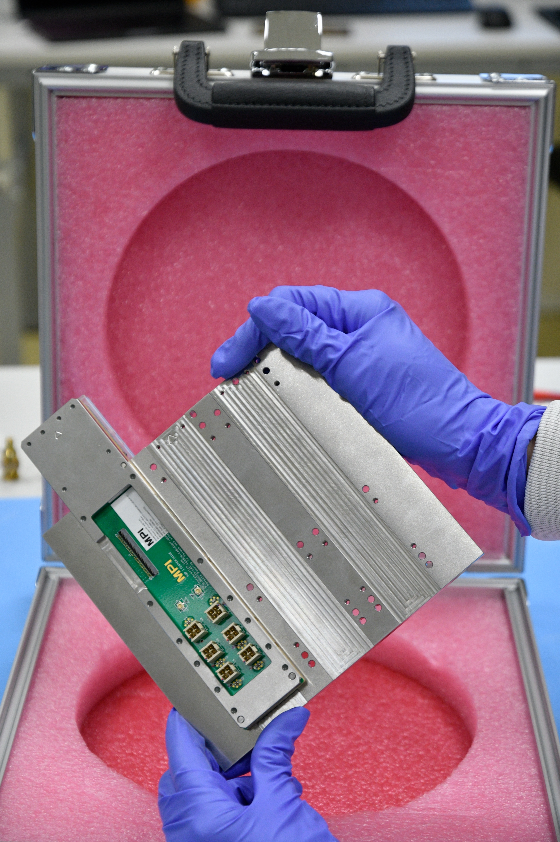
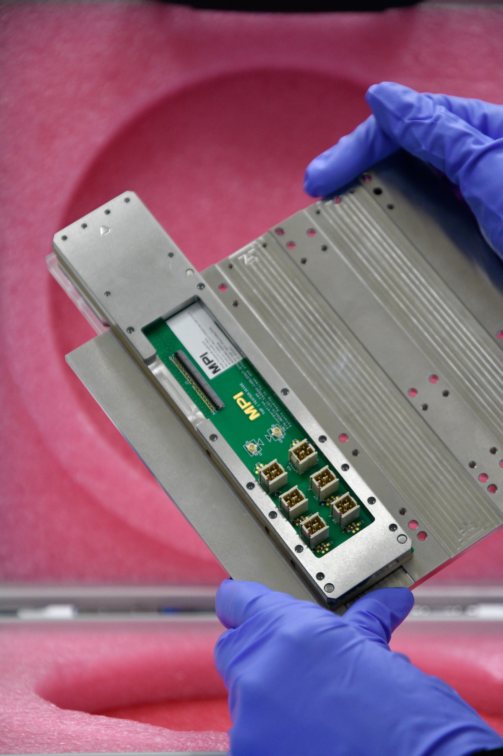
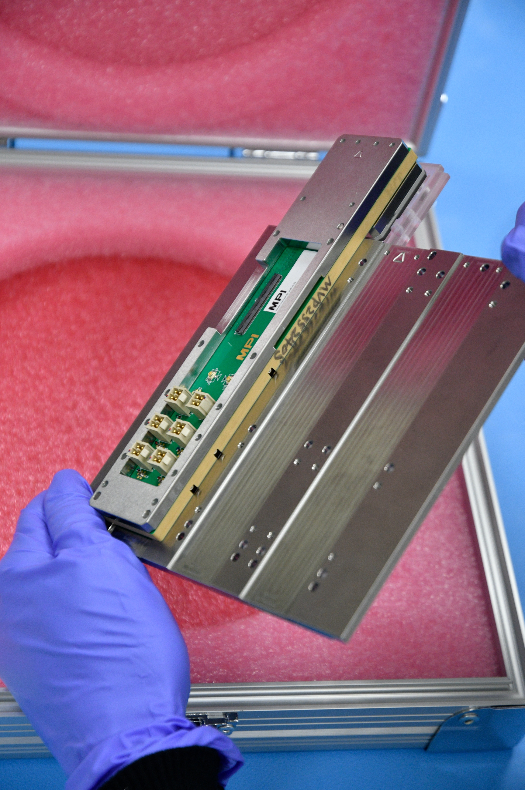
Recent Progress
Mosaix Probe Card – V0 Arrived March 6th at CERN, cables and hardware necessary to connect it to the Testing setup are (almost) ready (see next slide for FPC issue)

Slide 2
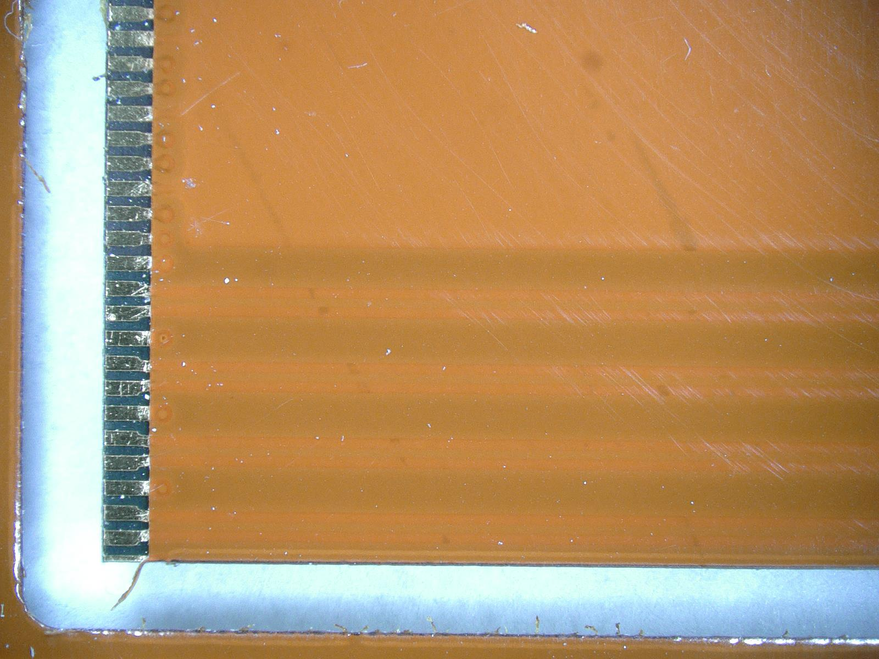
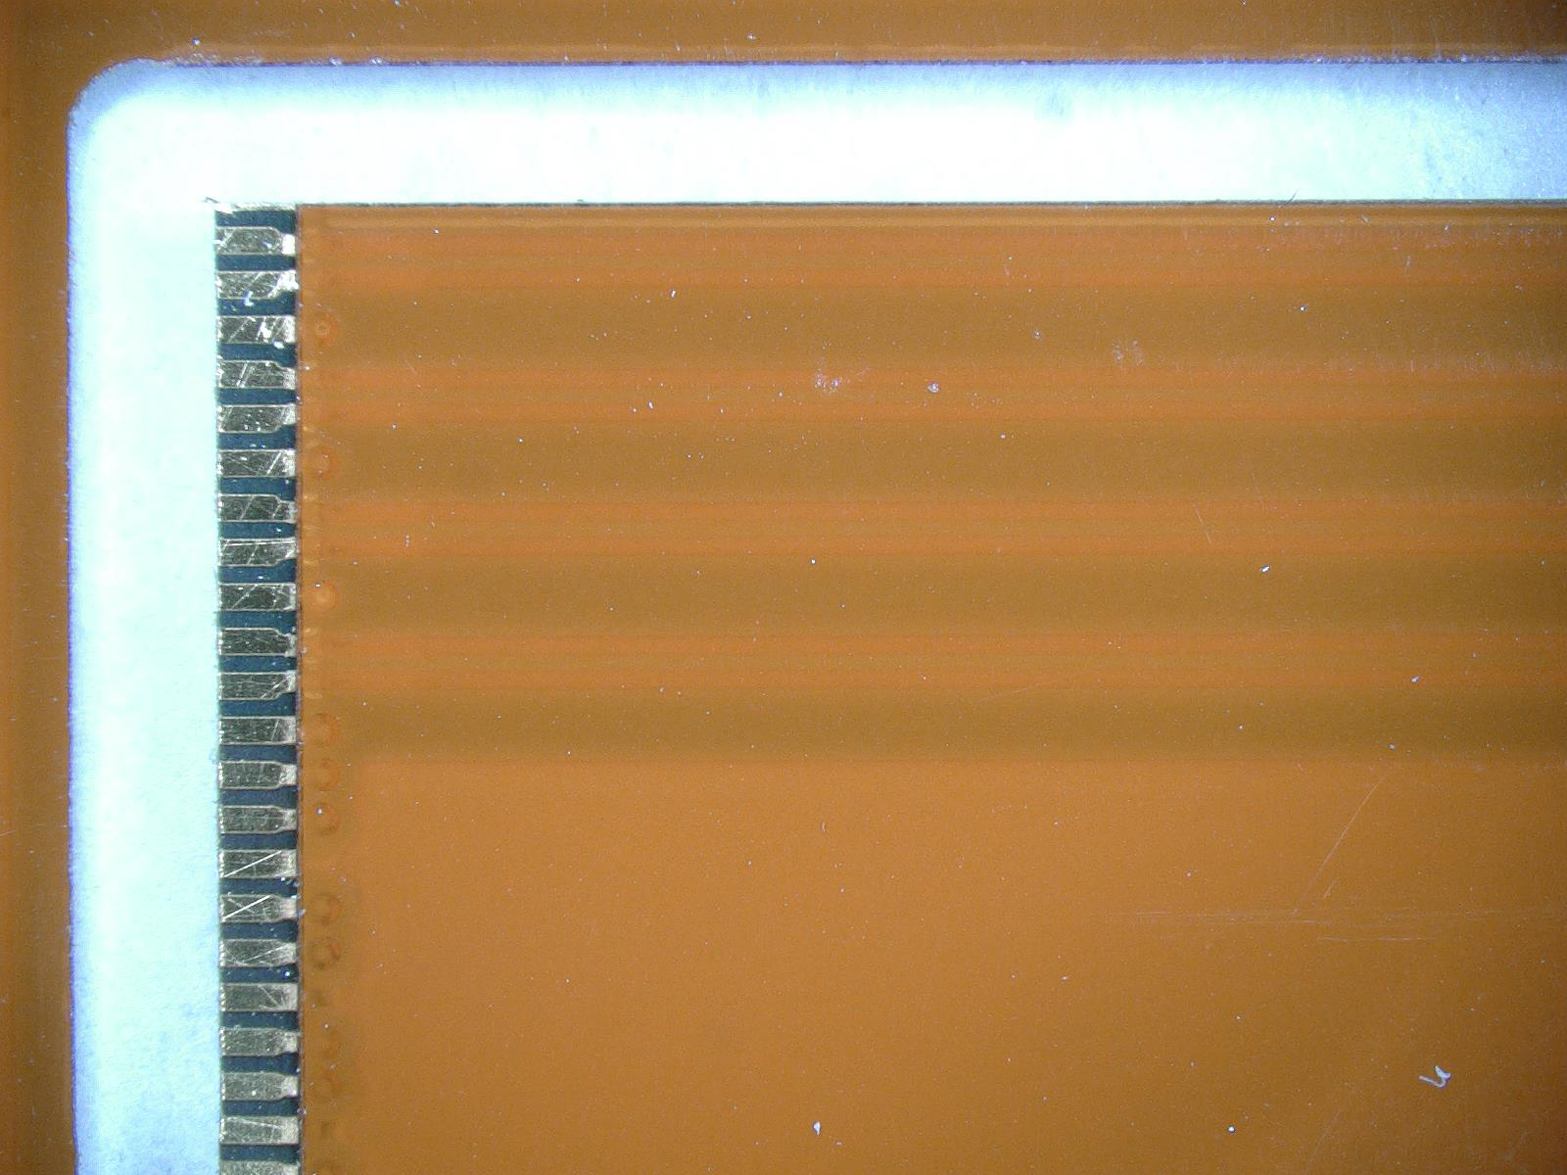
Recent Progress
Mosaix Probe Card – V0 Arrived March 6th at CERN, cables and hardware necessary to connect it to the Testing setup are (almost) ready FPC delivered March 6th from the PCB workshop – we realized on March 11th that they have been incorrectly cut Although we might try to use them anyway – new ones should be ready sometime next week The Top and Bottom pins are cut – these are TXVSS (high speed grounds) Using the FPC might still be possible, but placing it in the connector may be difficult and damage the connector

Slide 3
Recent Progress
Mosaix Probe Card – V1 FPC only Proposal draft design for MPI completed and sent Monday 2nd of March – waiting for a feedback Pros: Minimized interconnects for better signal integrity, easier handling of the cables outside the WP (could be important when testing multiple MOSAIX in parallel!) Cons: Fabrication and Assembly might be technologically challenging, MPI feedback is needed
Initial testing of ER2 in DSF, to be continued Continued support to ITS3 testing team in the operation of the Wafer Prober – functionality tests still ongoing
SVT SW on WP Agent Implementation of WPAgent improvements actively ongoing in collaboration with Angelina

