Slide 1
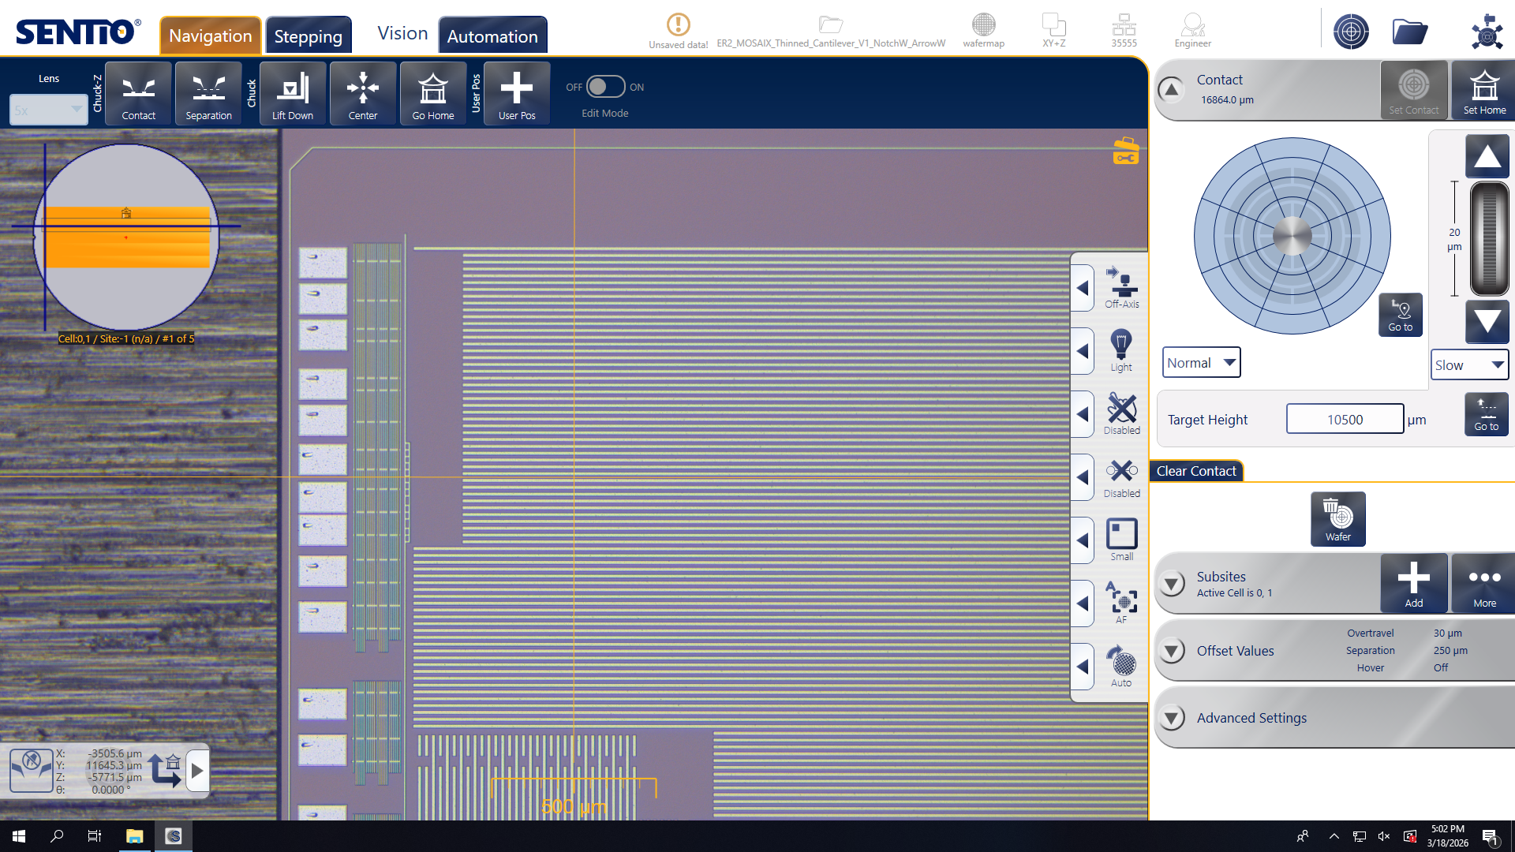
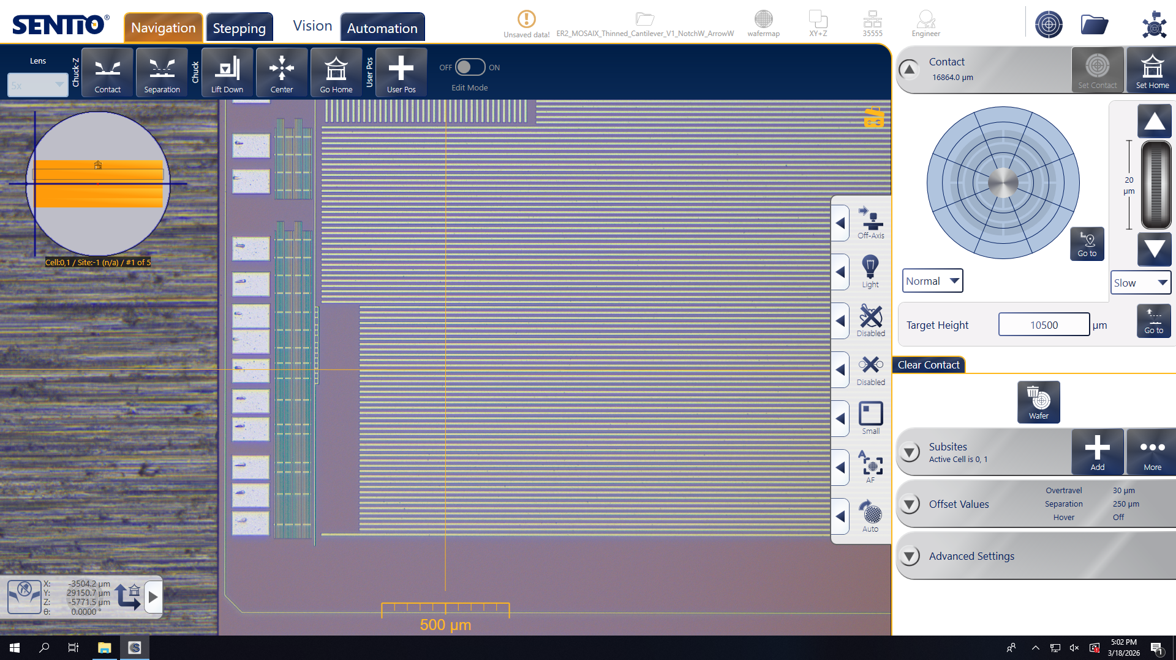
Recent Progress
Testing of ER2 in DSF, to be continued
Continued support to ITS3 testing team in the operation of the Wafer Prober – functionality tests still ongoing
Support to ITS3 running Impedance scan over a full wafer – results presented by Gregor to ITS3
Support to ITS3 in the preparation to contact thinned wafers for the Qualification Model:
Successful touch with the Cantilever Probe Card of a thinned L2 thinned Pad Wafer
SVT SW on WP Agent
Implementation of WPAgent improvements actively ongoing in collaboration with Angelina

