Slide 1
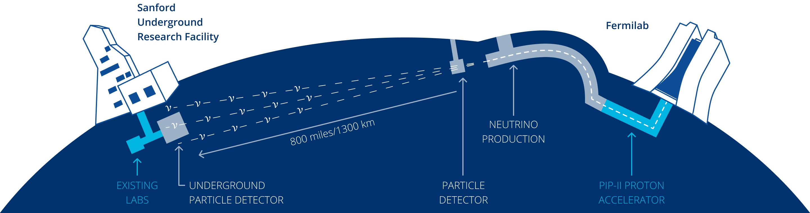



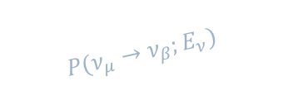
Brooke Russell
Deep Underground Neutrino Experiment
DUNE is a long-baseline neutrino experiment that probes fundamental questions of particle physics by precisely measuring neutrinos from accelerator and astrophysical sources.
$$P(ν_{μ}→ν_{β};E_{ν})$$
$$Φ(ν_{μ},E_{ν})$$
$$σ(ν_{β}, E_{ν})$$
$$R(ν_{β},E_{rec},E_{ν})$$
$$σ(ν_{β}, E_{ν})$$
$$R(ν_{β},E_{rec},E_{ν})$$
To achieve these science goals, DUNE combines four design choices:
A wideband beam → world’s most intense (>2 MW) accelerator neutrino beam
A high-performance movable near detector
Four* 17kt LArTPC far detectors → largest of its kind
Longest experimental baseline of 1300 km
MIT works closely with BNL’s Electronics Detector Group (EDG) on the DUNE Near Detector & Far Detectors
*to be completed in two phases

Slide 2
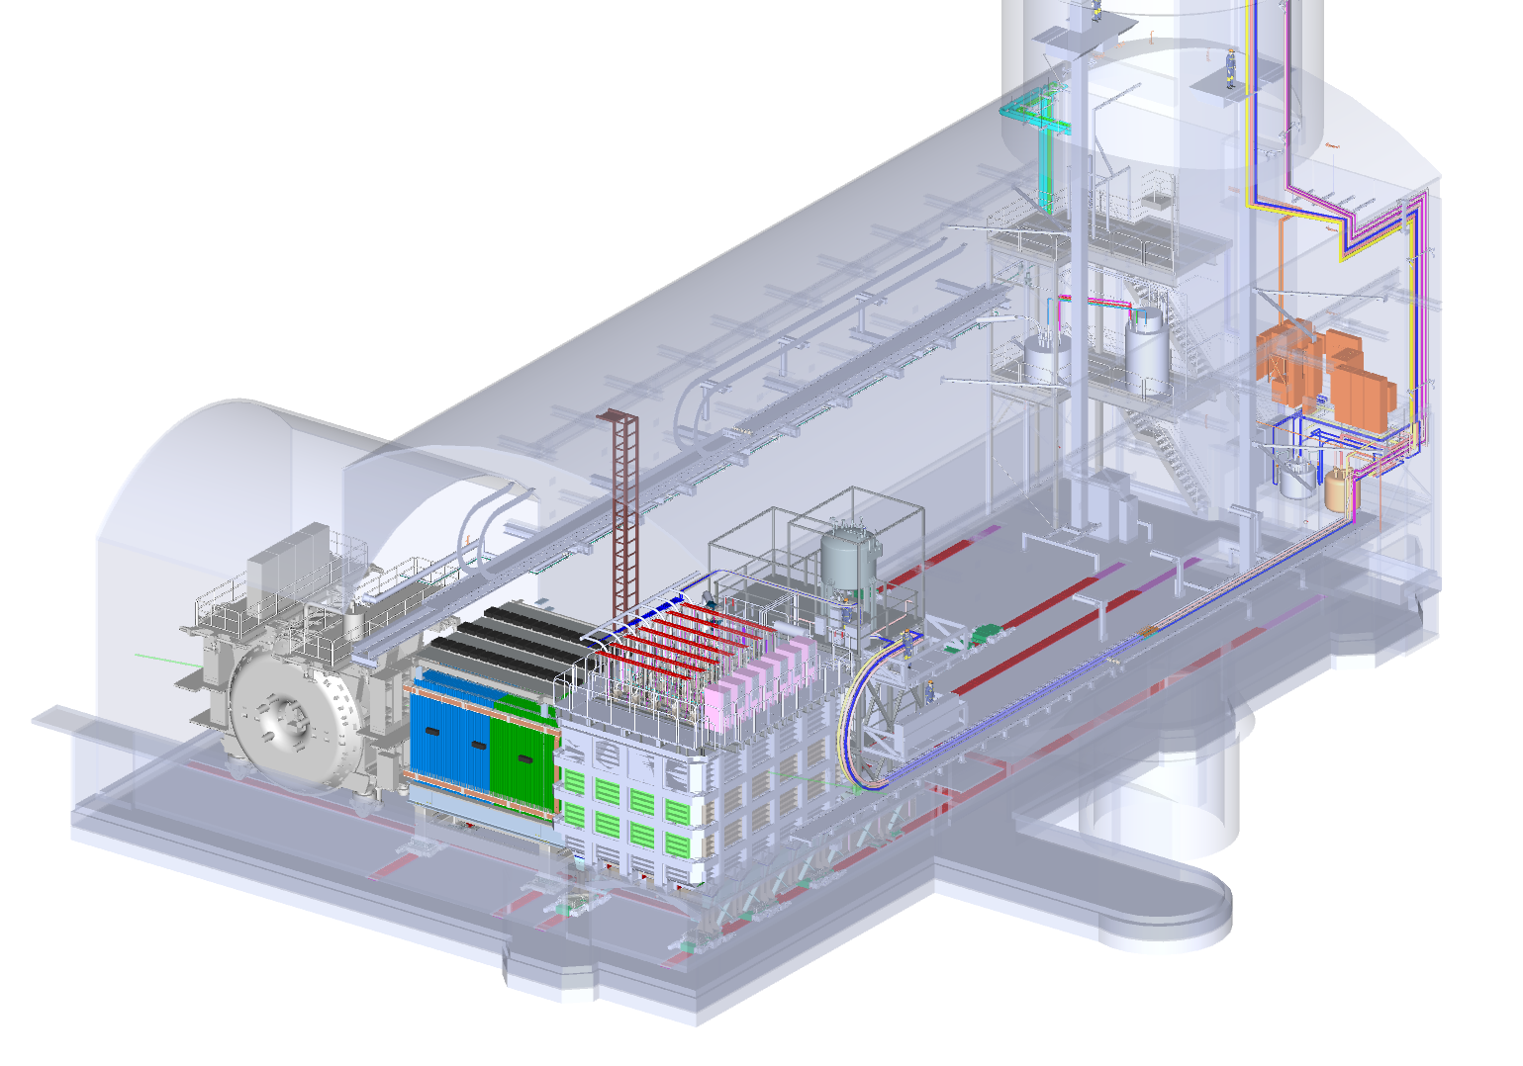
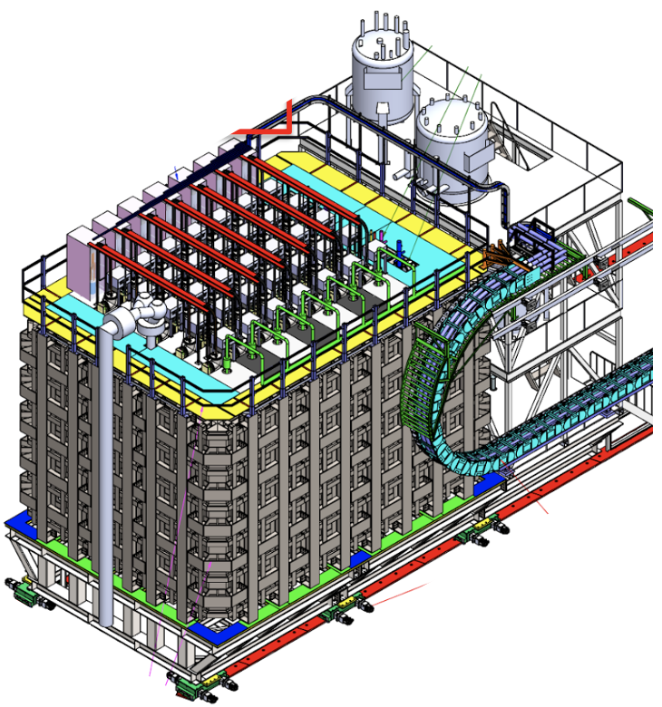

Brooke Russell
NDLAr: Liquid Argon Near Detector
Purpose:
- Measure LBNF beam neutrino-argon interactions in a LArTPC → Enable accurate prediction of Far Detector signals
Key requirements:
- Large enough to constrain relevant neutrino interactions (except for forward-going muon → purpose of TMS)
- Signal fidelity at least as good as the Far Detectors
- Off-axis motion to decouple systematics
Near Detector Hall @ Fermilab
NDLAr

Slide 3
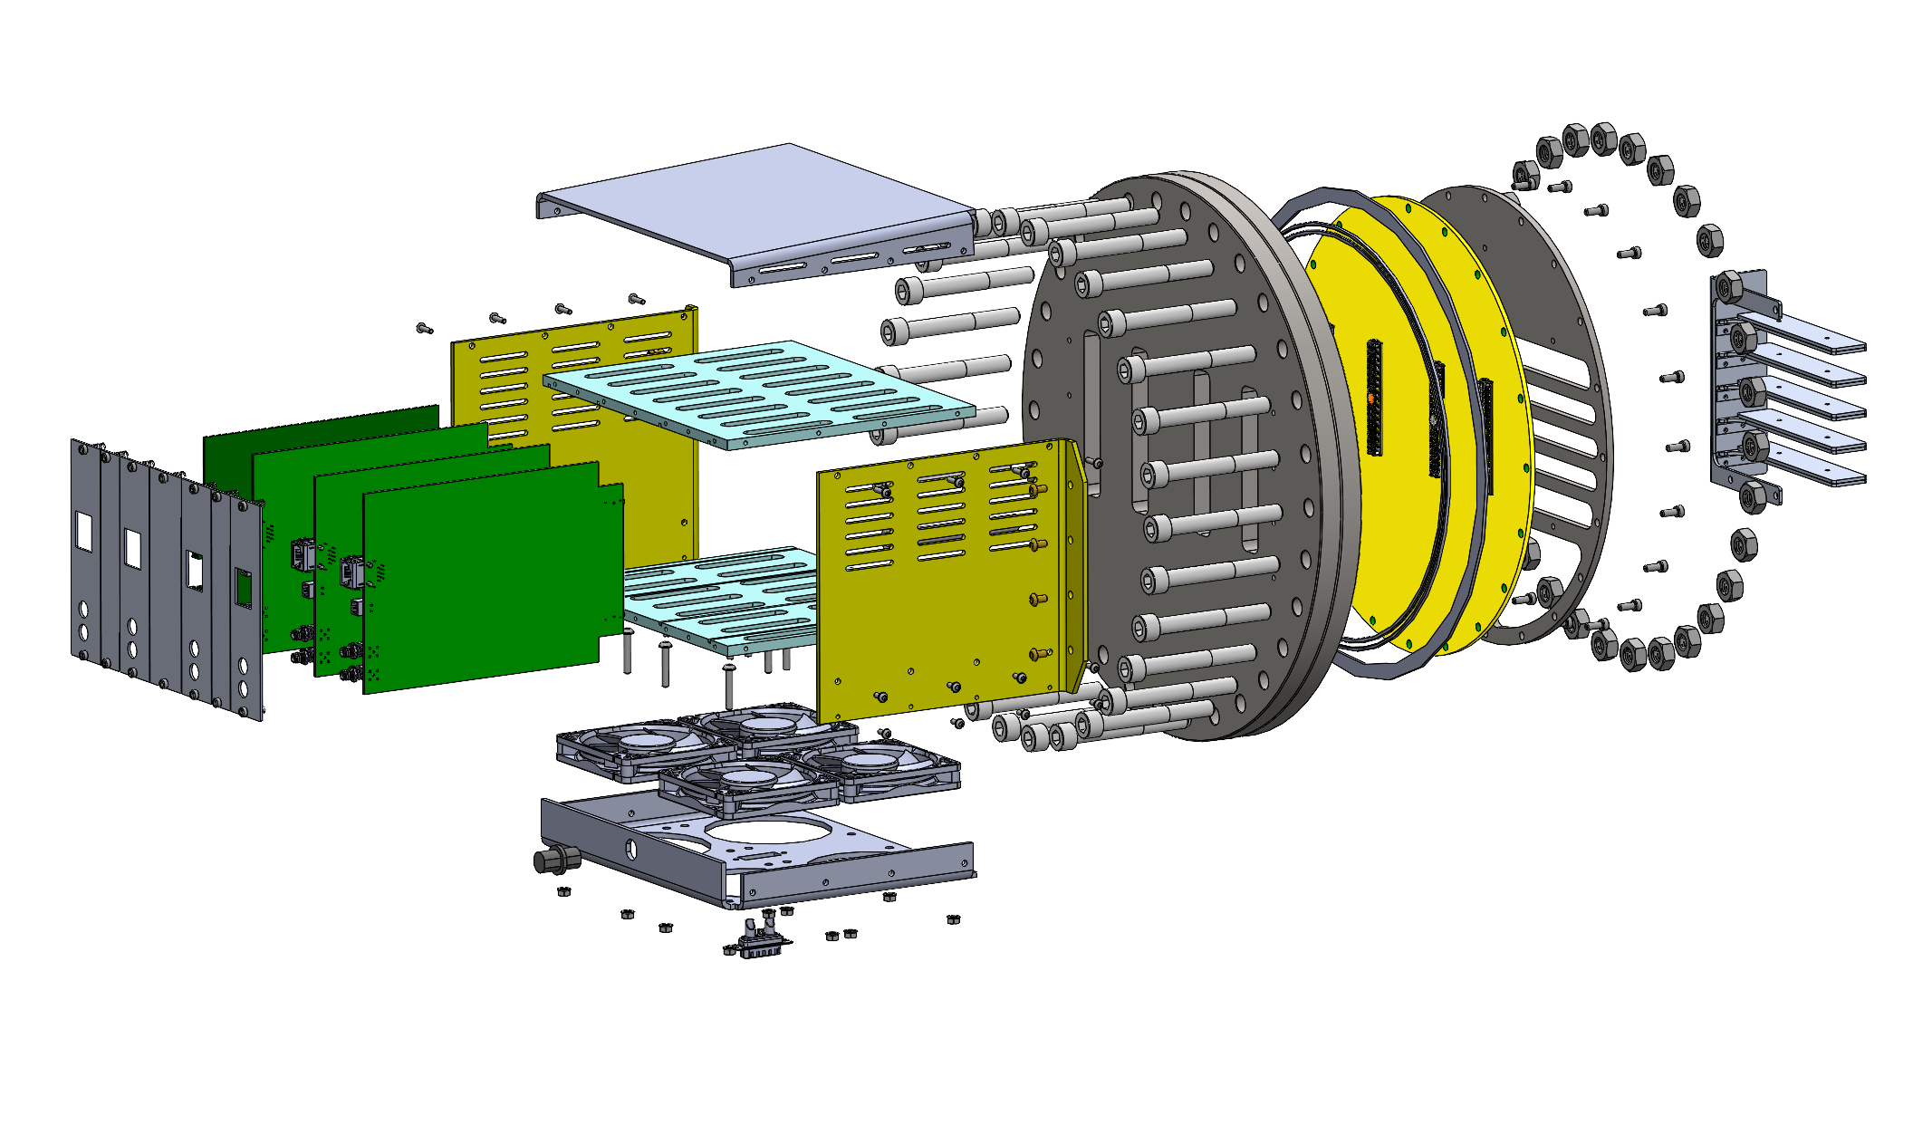
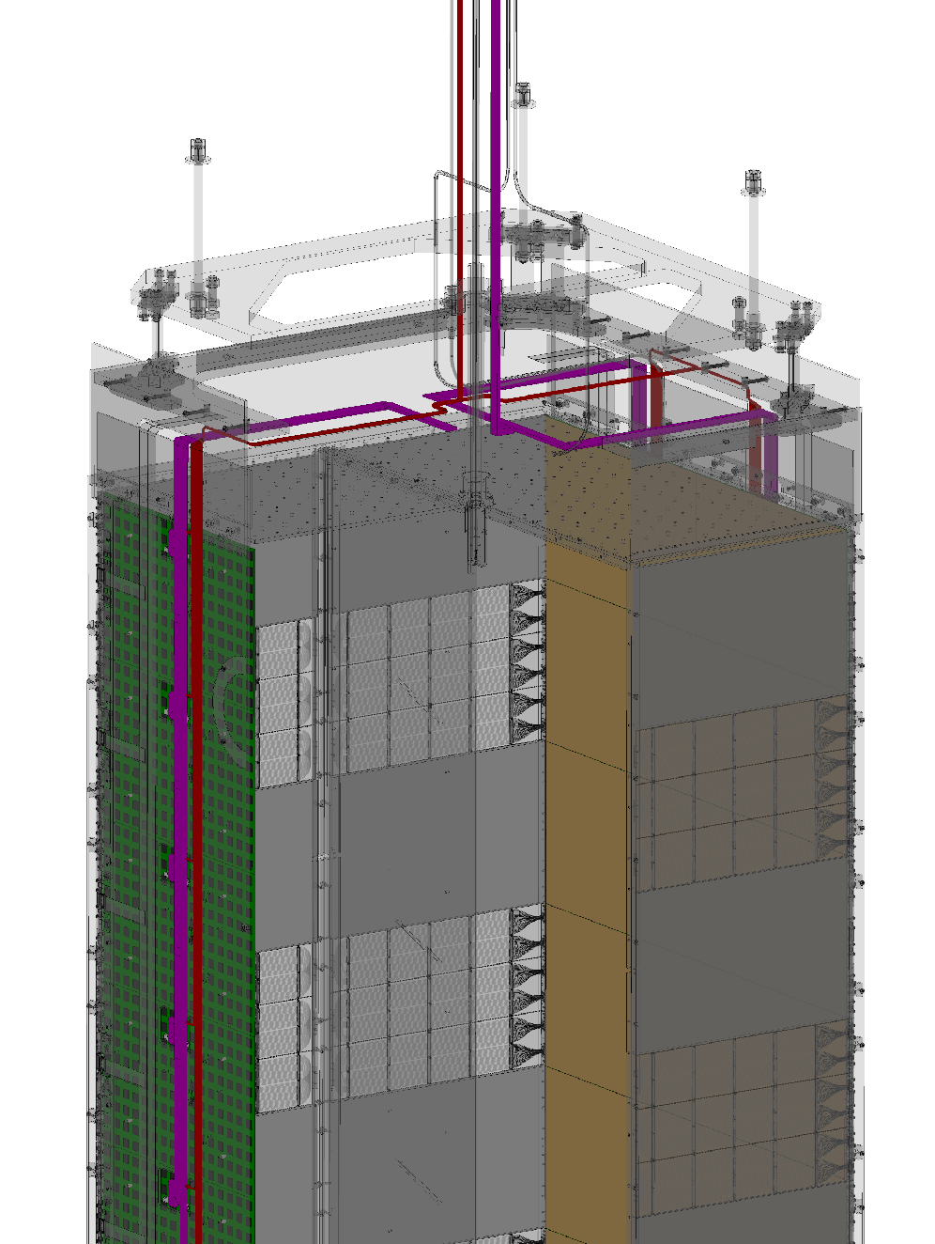
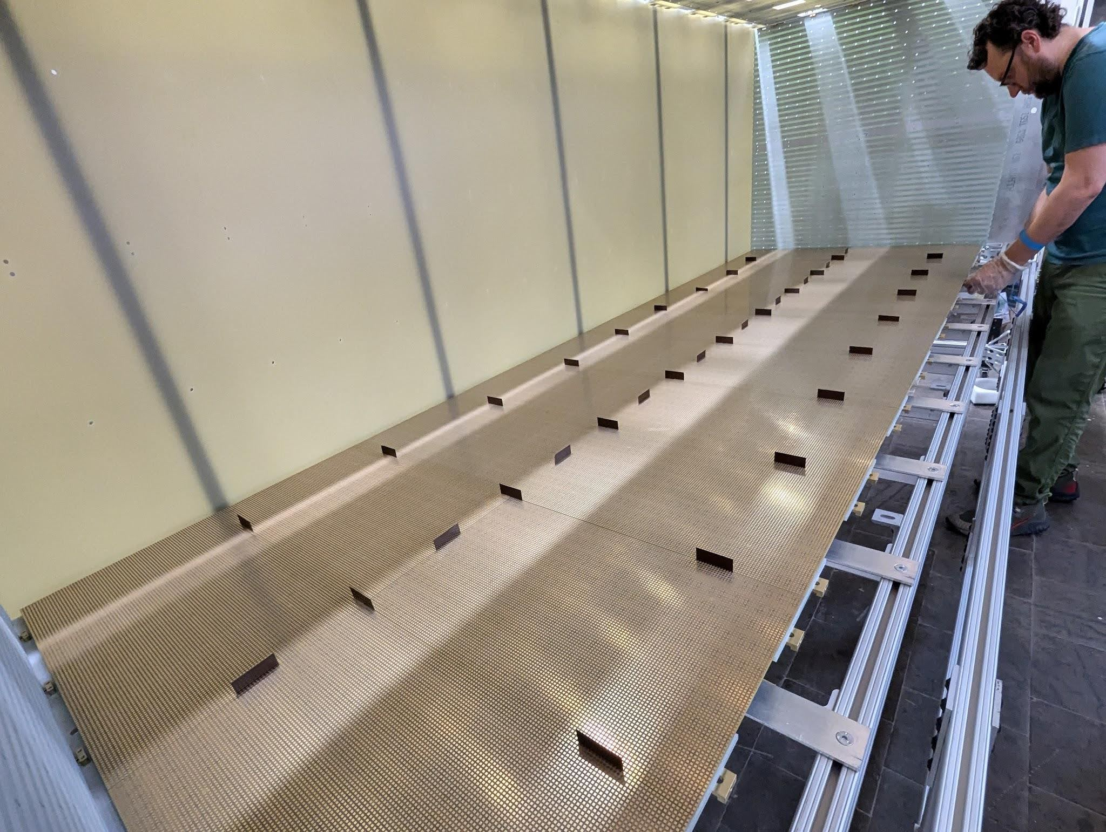
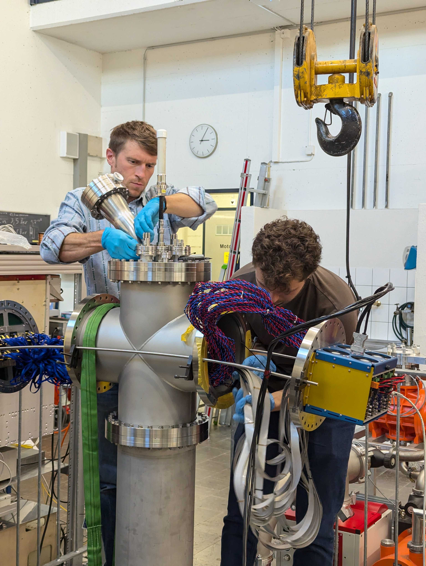
Brooke Russell (L3)
NDLAr Charge Readout System
Pixel Array Control, Monitor, and Network Card (PACMAN)
Scope:
200 m² pixel-based charge-sensitive anodes
- 14.336M channels driven by 224k ASICs
- 1400 large-format anode tiles, data cables & power cables
- Warm controllers driving cold electronics, providing data acquisition & timing system interfacing
PACMAN Enclosure
Flange PCB
Power and Data Cables
FSD Anode Assembly
FSD Feedthrough Installation
Partnering Institutions:
Bern, BNL, Caltech, Chicago, Colorado State, HKUST, LBNL, Michigan State, MIT, Ohio State, Penn, Rutgers, Syracuse, UC Davis, UC Irvine, UCSB, UTA, York
Anode Pixel Tile with ASICs

Slide 4
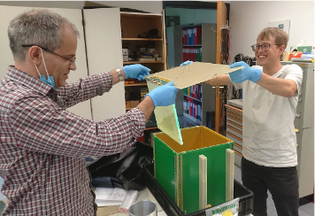
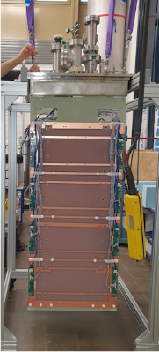
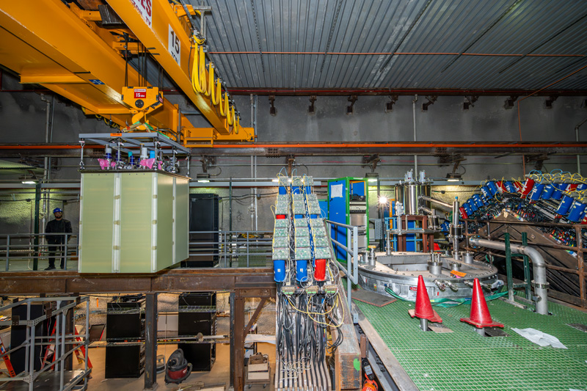
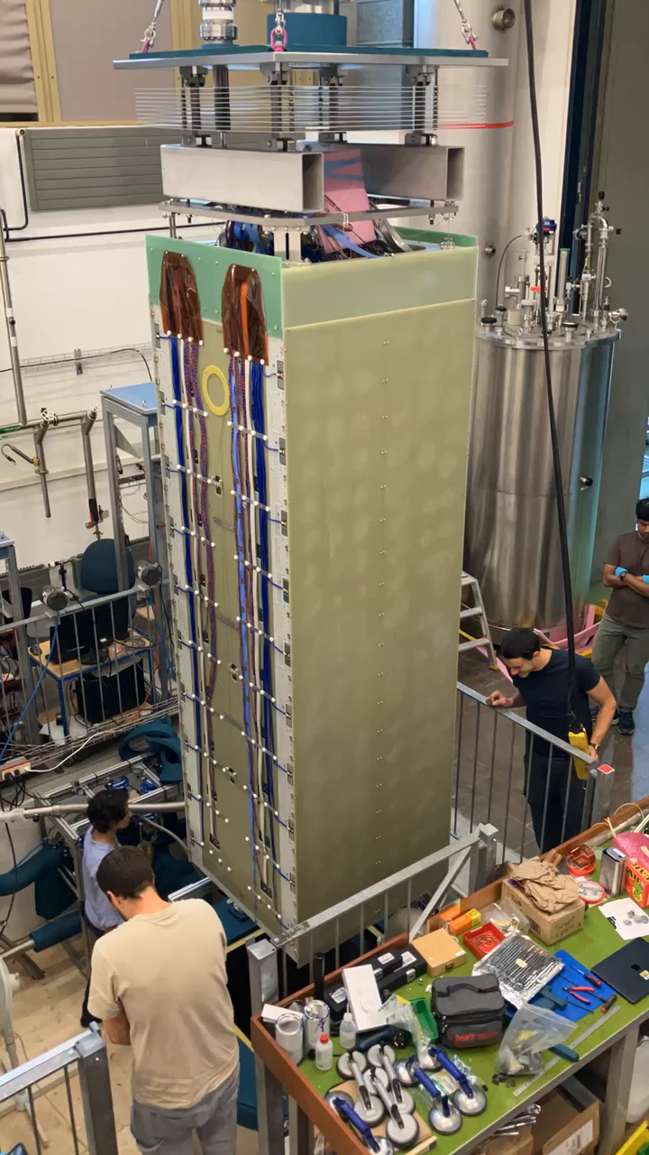
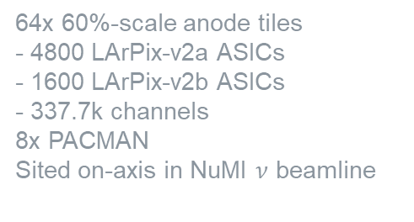
Brooke Russell (L3)
NDLAr Prototyping
SingleCube
Module-0
2x2 Demonstrator
Full-Scale Demonstrator
1x 60%-scale anode tiles
- 100 LArPix-v2a ASICs
- 4900 channels
1x PACMAN
64x 60%-scale anode tiles
- 4800 LArPix-v2a ASICs
- 1600 LArPix-v2b ASICs
- 337.7k channels
8x PACMAN
Sited on-axis in NuMI $ν$ beamline
40x 100%-scale anode tiles
- 6400 LArPix-v2d ASICs
- 409.6k channels
4x PACMAN
>150 scientists/engineers from ~40 institutions in NDLAr consortium supporting detector development & data analysis
16x 60%-scale anode tiles
- 1600 LArPix-v2a ASICs
- 78.4k channels
2x PACMAN

Slide 5
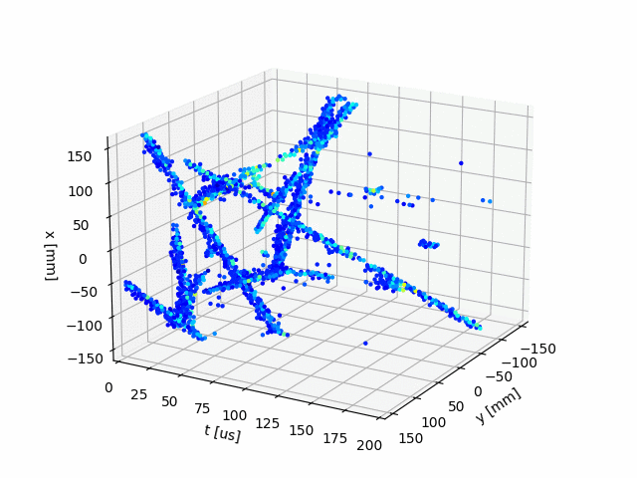
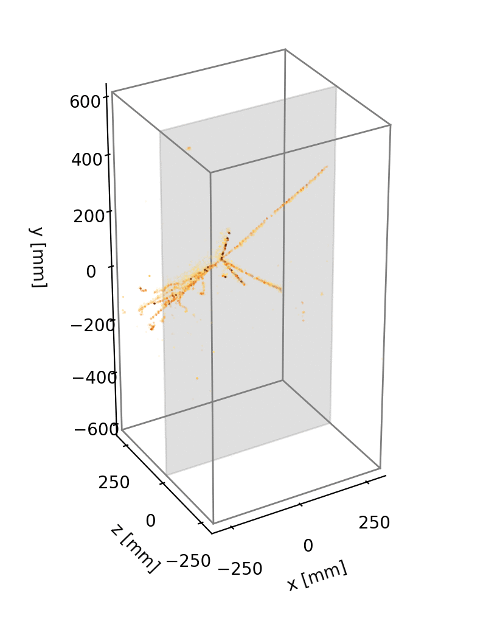
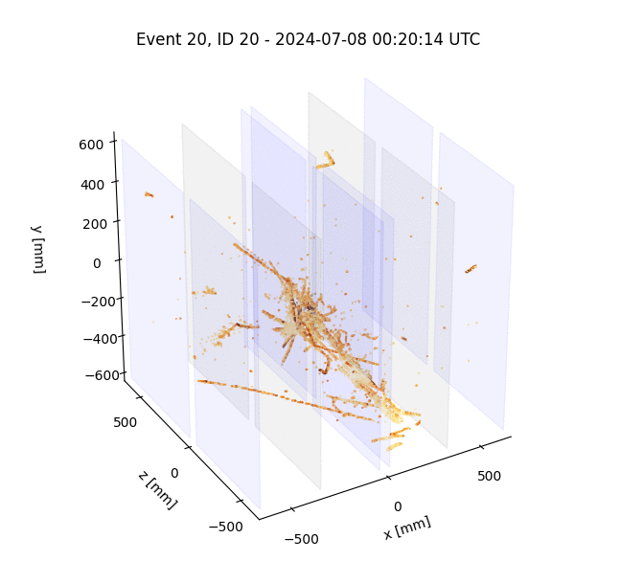
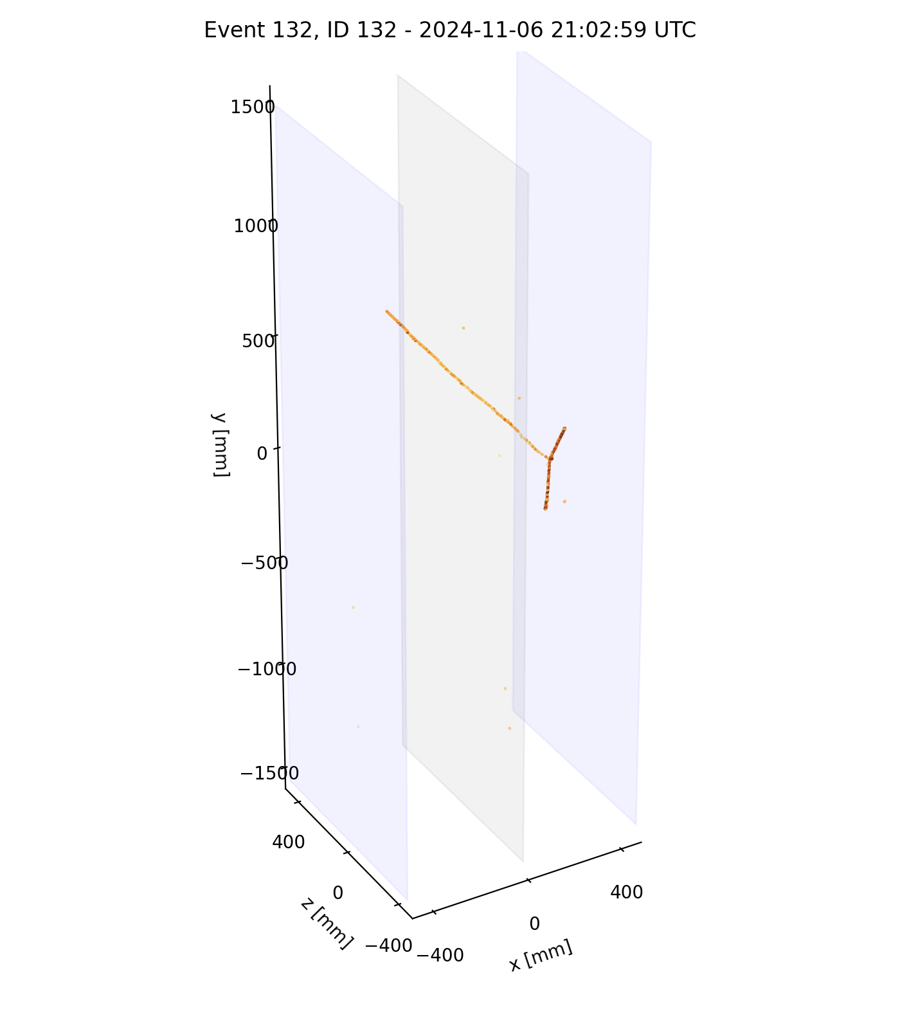
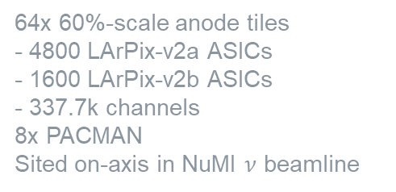
Brooke Russell (L3)
NDLAr Prototyping
SingleCube
Module-0
2x2 Demonstrator
Full-Scale Demonstrator
1x 60%-scale anode tiles
- 100 LArPix-v2a ASICs
- 4900 channels
1x PACMAN
64x 60%-scale anode tiles
- 4800 LArPix-v2a ASICs
- 1600 LArPix-v2b ASICs
- 337.7k channels
8x PACMAN
Sited on-axis in NuMI $ν$ beamline
40x 100%-scale anode tiles
- 6400 LArPix-v2d ASICs
- 409.6k channels
4x PACMAN
Raw data from O(100k)-channel systems demonstrates the end-to-end system architecture
16x 60%-scale anode tiles
- 1600 LArPix-v2a ASICs
- 78.4k channels
2x PACMAN
Towards final design, we are focused on system refinement for higher fidelity & robustness ➔ BNL has played a critical role in convergence to final design

Slide 6
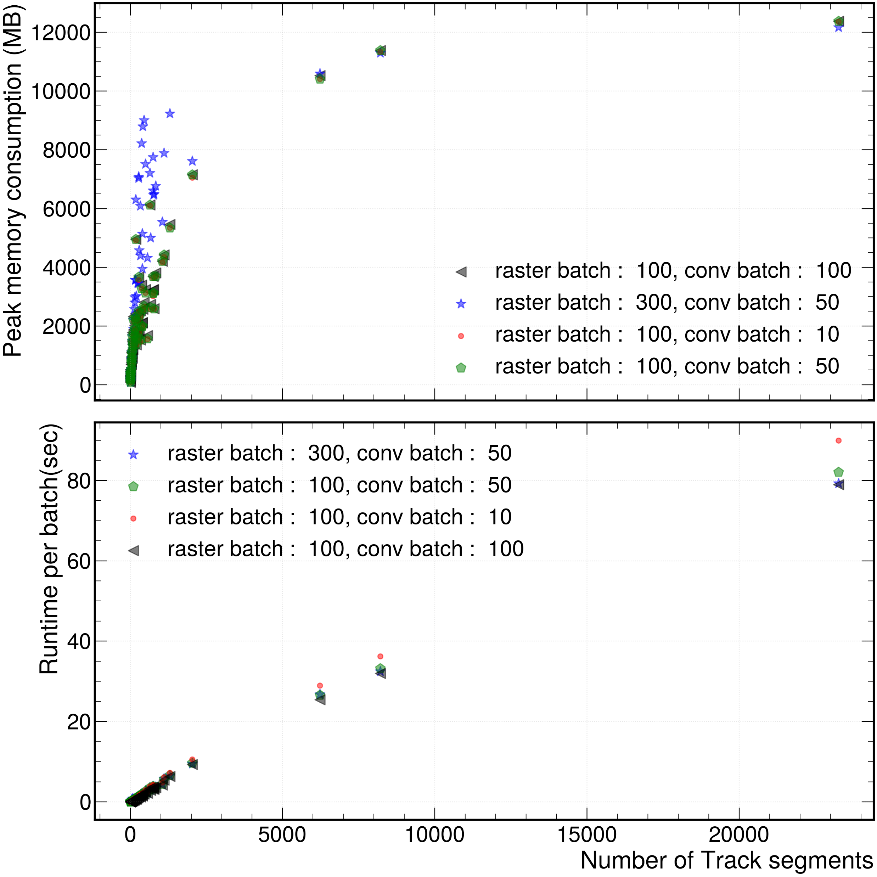
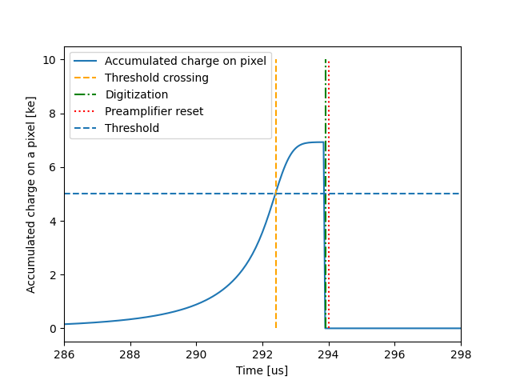
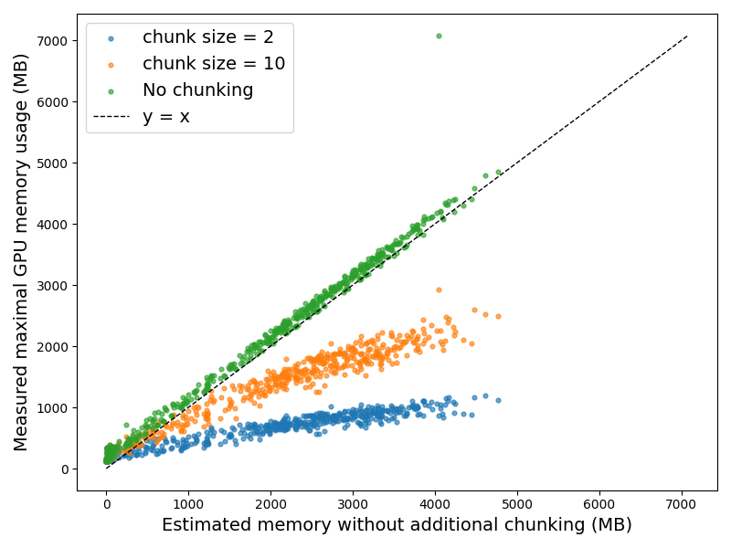
GPU-Accelerated Analytic Detector Simulation
Existing BNL-MIT Collaboration
Brooke Russell (L3)
TRED GPU-accelerated simulation package for pixelated Time Projection Detectors
Numerical integration using an effective-charge calculation based on Gaussian quadrature rules ➔ capture sub-pixel structure without requiring dense sampling
Efficient FFT-based computation of induction signals on electrodes using a spare, block-binned tensor representation ➔ low memory usage and scalable runtime
arXiv: 2602.12052; Accepted for publication at IEEE Transactions on Nuclear Science
Collaboration with Yousen Zhang and Xin Qian from BNL

Slide 7
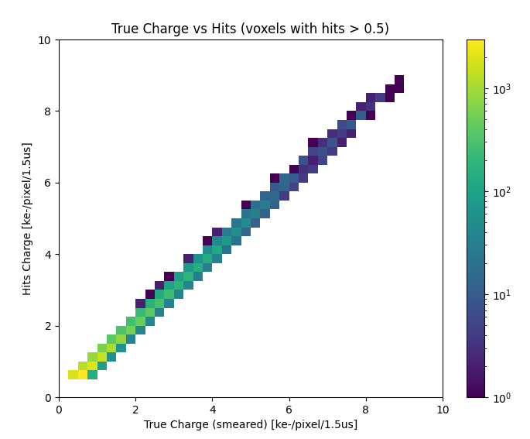
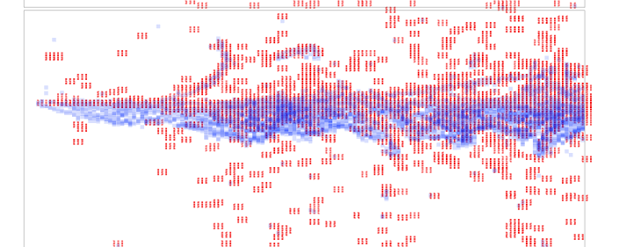
Signal Processing
Existing BNL-MIT Collaboration
Brooke Russell (L3)
Deconvolution procedure developed to account for:
Slow sampling, charge integral, channel threshold
Systematic misalignment from zero-suppression due to threshold
Paper in preparation
3 GeV positron
Beam
Drift
Drift-Beam view
Red: True ionization charges
Blue: Recorded hits
Tradeoff in spatial resolution for charge resolution
Collaboration with Yousen Zhang and Xin Qian from BNL

Slide 8
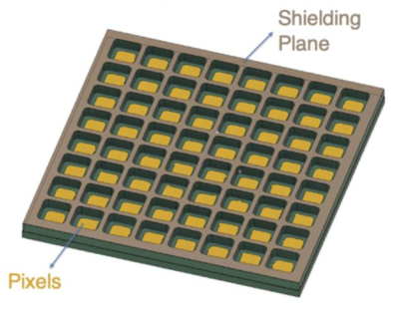
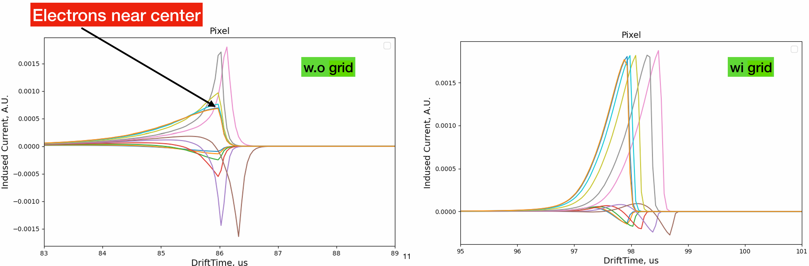
Shield Plane Development
Existing BNL-MIT Collaboration
Brooke Russell (L3)
NDLAr anode shield plane alternative design in development to mitigate pre-triggers in pixel readout response
Collaboration with Sergey Martynenko (EDG) and consulting from Bo Yu (Instrumentation Dept.) from BNL

Slide 9
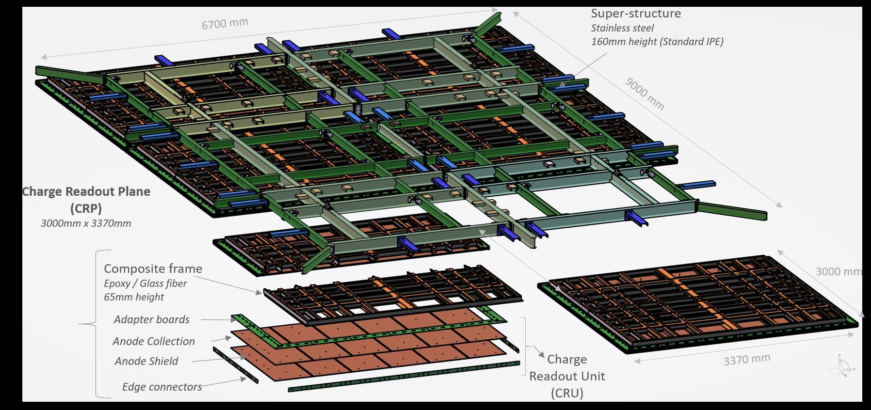
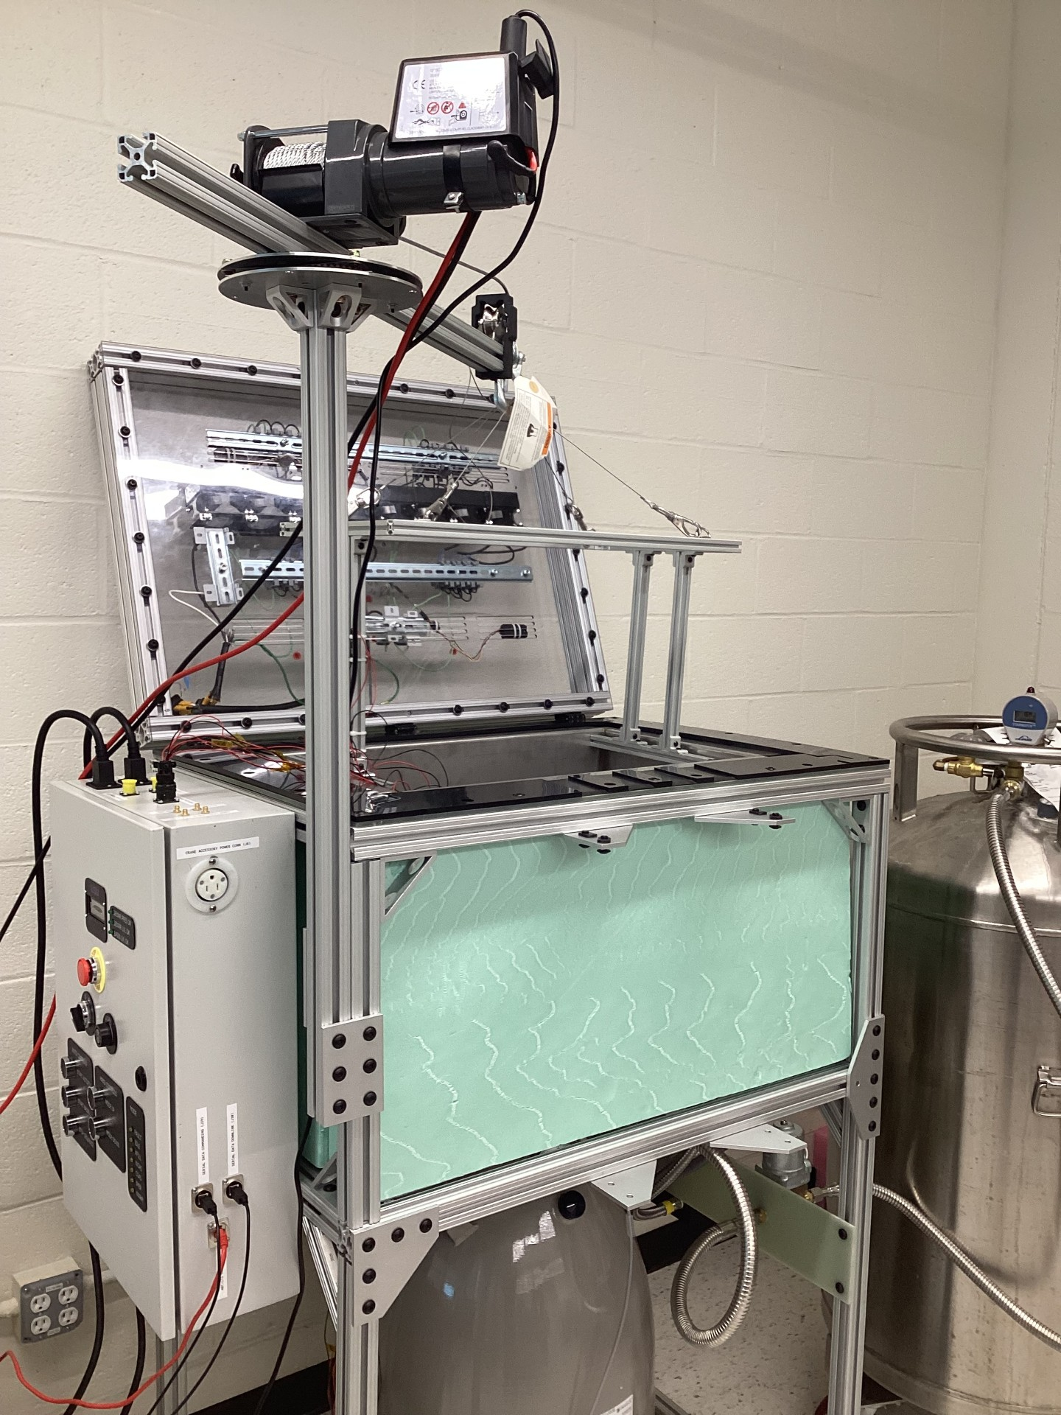
Far Detector 1 Component Characterization
Existing BNL-MIT Collaboration
Brooke Russell
BNL serves as the lead US lab on Far Detector 1; Steve Kettel (BNL Far Detector Technical Coordinator) asked Russell to get involved in component testing
@ MIT
Far Detector 1 to be instrumented with 80x Charge Readout Plane (CRP) anodes
- 3 m x 3.37 m perforated PCBs with copper strips
Adapter board (960 units) and edge card (1920 units) quality control testing at MIT
Optical pre-qualification to ensure no missing or out of placement components
Cryogenic test stand for channel-wise signal injection response characterization
Production testing anticipated to start this Fall
Collaboration with Matthew Worcester, Niccolo Gallice, and Steven Linden from BNL

Slide 10
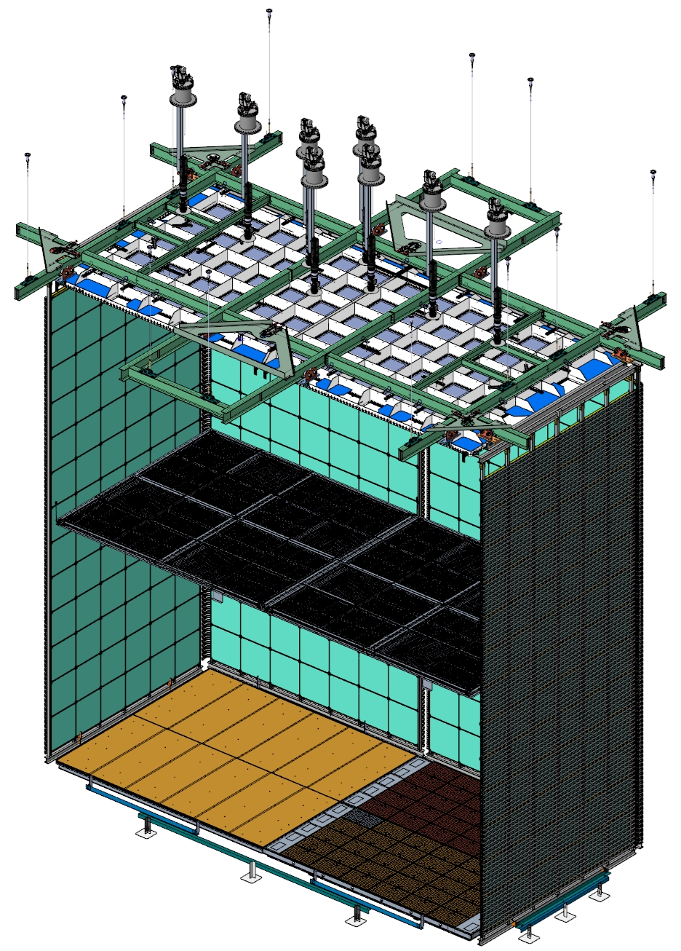
DUNE Phase 2 Far Detector 3
Prospective Future BNL-MIT Collaboration
Brooke Russell
ProtoDUNE-III at NP02 will serve as a large-scale engineering prototype for the mass production, installation, and integration of Phase II components
Kettel (BNL, strip-based charge readout) and Russell (MIT, pixel-based charge readout) are leading proponents of competing technologies
A hybrid solution may be viable on a technically limited schedule, specifically perforated PCB shield plane + pixel anode
Optical charge readout
Strip-based
charge readout
Pixel-based
charge readout

Slide 11
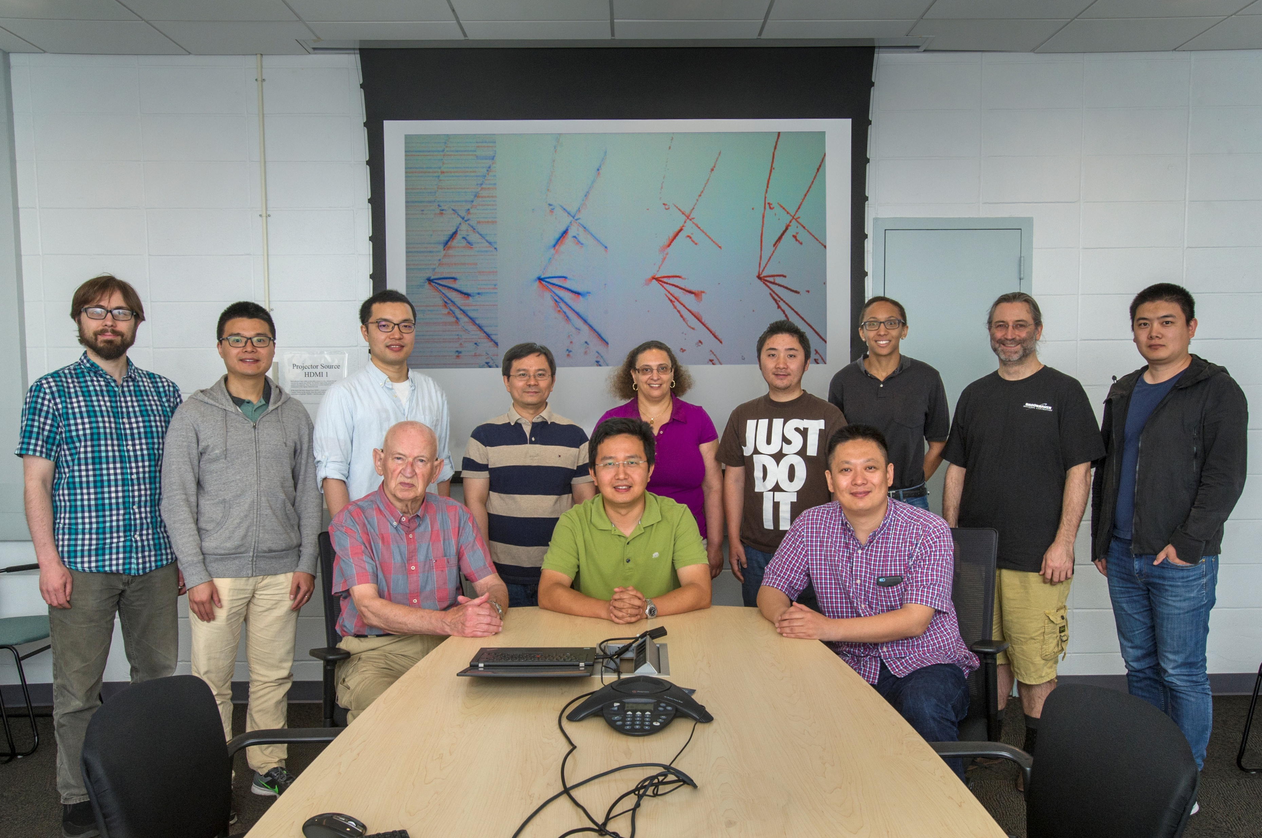
DUNE off-beam data analysis
Prospective Future BNL-MIT Collaboration
Brooke Russell
BR DOE SCGSR Nov. ’16 – May ‘17
In-residence with BNL EDG Nov. ‘16 – Aug. ‘19
Far Detector 1 anticipated to start taking physics data in Q2 2030
DUNE beam-based science anticipated Q4 2032
Early discussions among Jung (Stony Brook), Qian (BNL), and Russell (MIT) to coordinate joint off-beam physics analyses and technical targets
Looking to leverage DOE SCGSR program for MIT students to work in-residence at BNL with EDG DUNE section
BNL EDG MicroBooNE section
JINST 12 (2017) 08, P08003 (158 citations)
JINST 13 (2018) 07, P07006 (191 citations)
JINST 13 (2018) 07, P07007 (160 citations)

Slide 12


Summary
Brooke Russell
Long-standing productive research relationship with BNL EDG group
MicroBooNE (past), Daya Bay (past), DUNE (present)
Pixel readout signal modeling and deconvolution for pixel-based near detector
Far detector 1 component testing and characterization
New areas for future collaboration as DUNE transitions to phase 1 operations
Prospective trilateral team for off-beam physics
Potential hybrid charge readout solution for far detector 3

