Slide 1
The Hadronic Physics Group at MIT
History and Current Role
Talk Presented at the Symposium on QCD and Nuclei
Robert P. Redwine
Laboratory for Nuclear Science
Massachusetts Institute of Technology
10 October 2021

Slide 2
The MIT Hadronic Physics Group formed about the time medium-energy accelerators (electron and proton) were being constructed at locations around the world. The idea was to use these higher-energy, high-flux, beams to study nuclear and nucleon structure in more detail than had been possible with the lower-energy nuclear physics accelerators available up until that time.
This transition began around 1970, although it continued for quite some time after that.

Slide 3
The Hadronic Physics Group at MIT
Common interests in the study of nuclear and particle physics.
Collaborative in approach, sharing resources to be most effective in leadership roles in important experiments.
Major efforts over the years at MIT/Bates, BNL, JLab, DESY, CERN, LAMPF, PSI, TRIUMF, Mainz, FRIB, ORNL.
We are very proud to have trained many of the leaders in our field and in other fields.

Slide 4
Current Faculty and Research Scientists in the Hadronic Physics Group
Faculty: William Bertozzi, Ronald Garcia Ruiz, Or Hen, Stanley Kowalski, June Matthews, Richard Milner, Robert Redwine, Michael Williams
Research Scientists: T. William Donnelly, Shalev Gilad, Douglas Hasell

Slide 5
The Bates Linear Electron Accelerator was a focus of the research done by the Hadronic Physics Group for many years. It remains an important part of our research capabilities. Although the accelerator is no longer operated as a user facility, its unique space, equipment, and especially technical staff are major contributors to our research. I will now review some of the history and personnel at Bates.

Slide 6
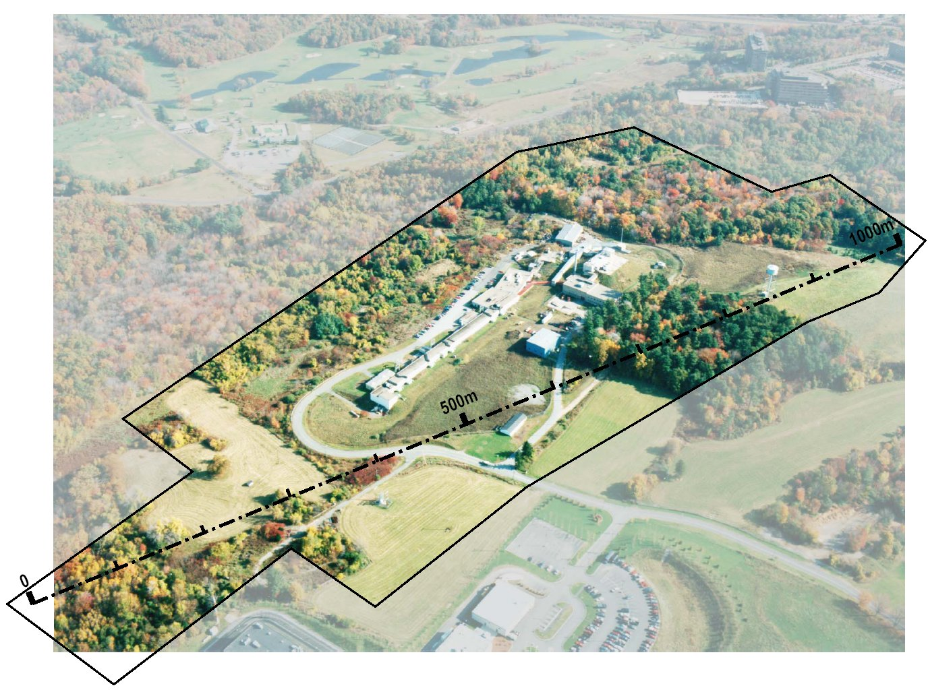
Bates: MIT’s own accelerator laboratory

Slide 7
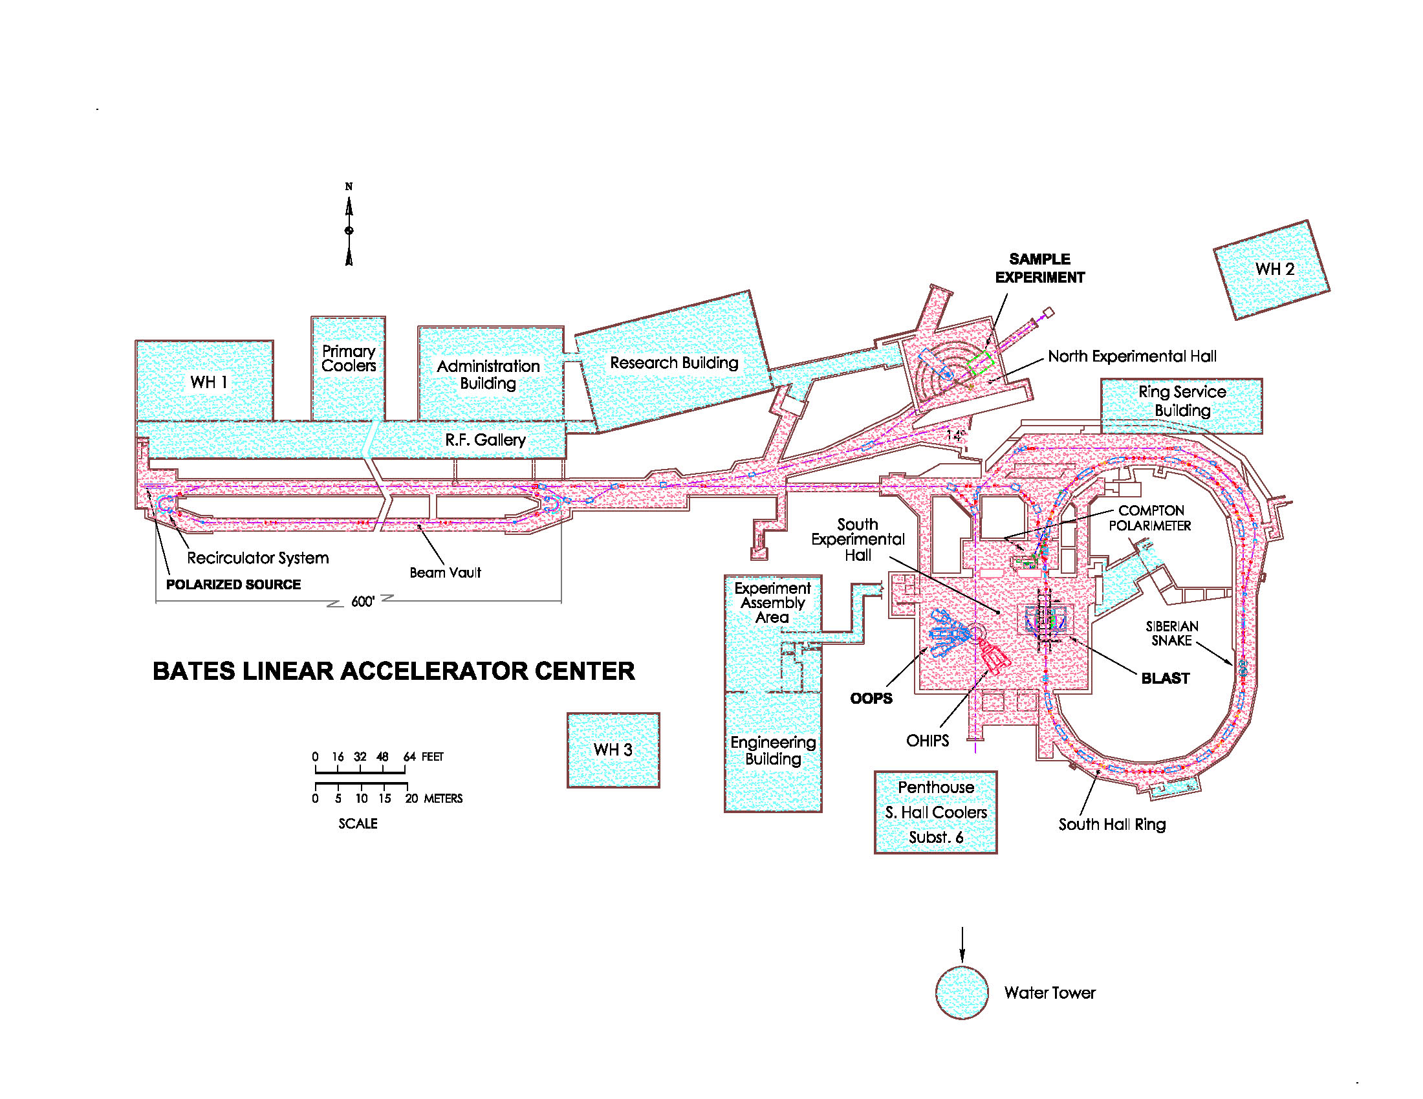

Slide 8
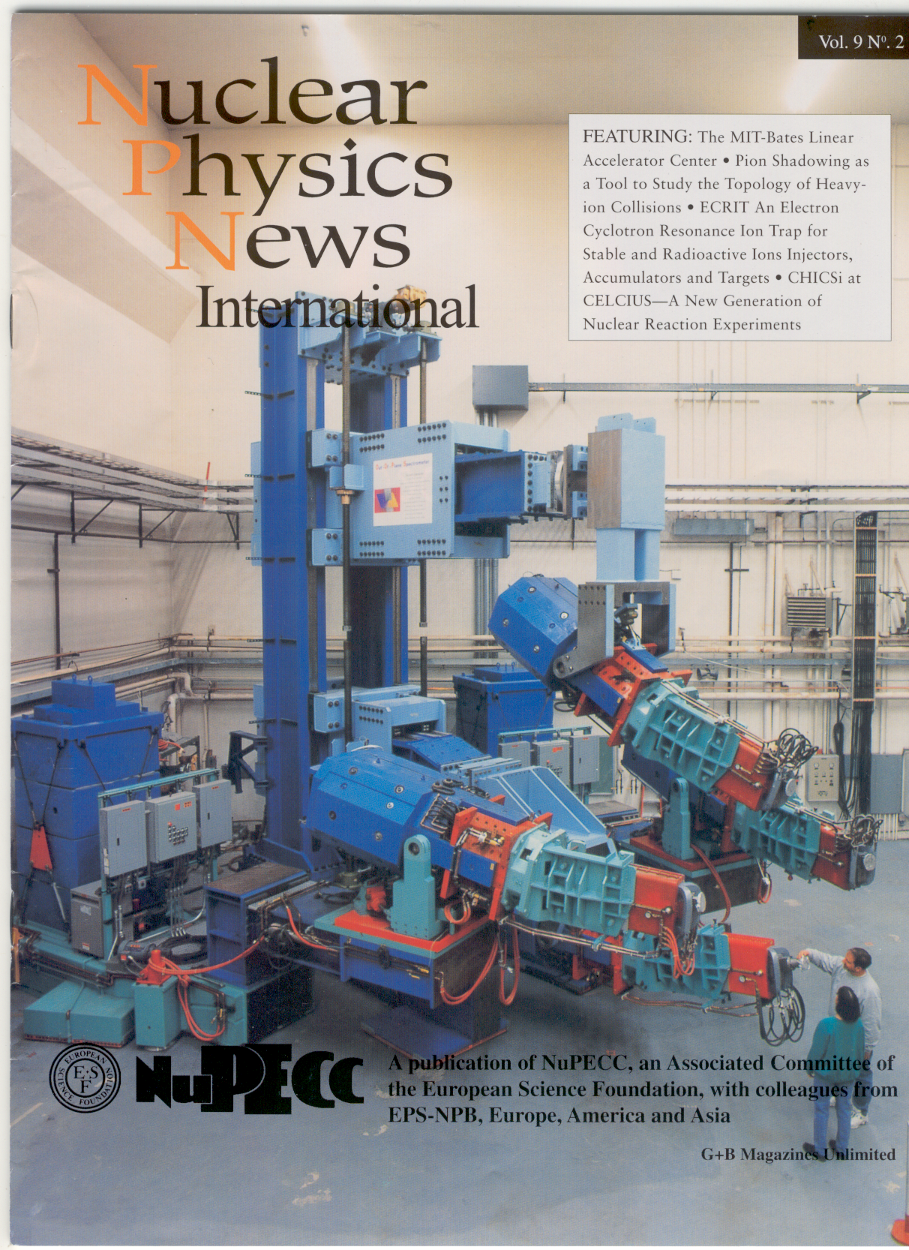
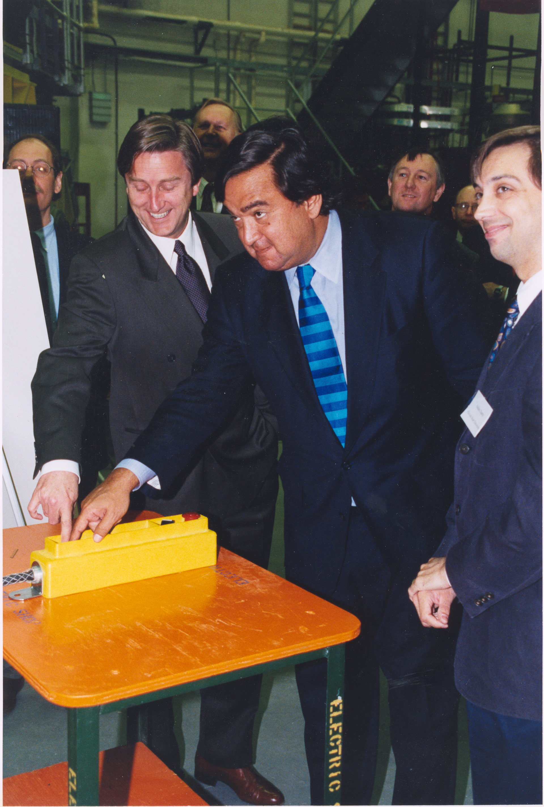
April 1999
April 1999

Slide 9
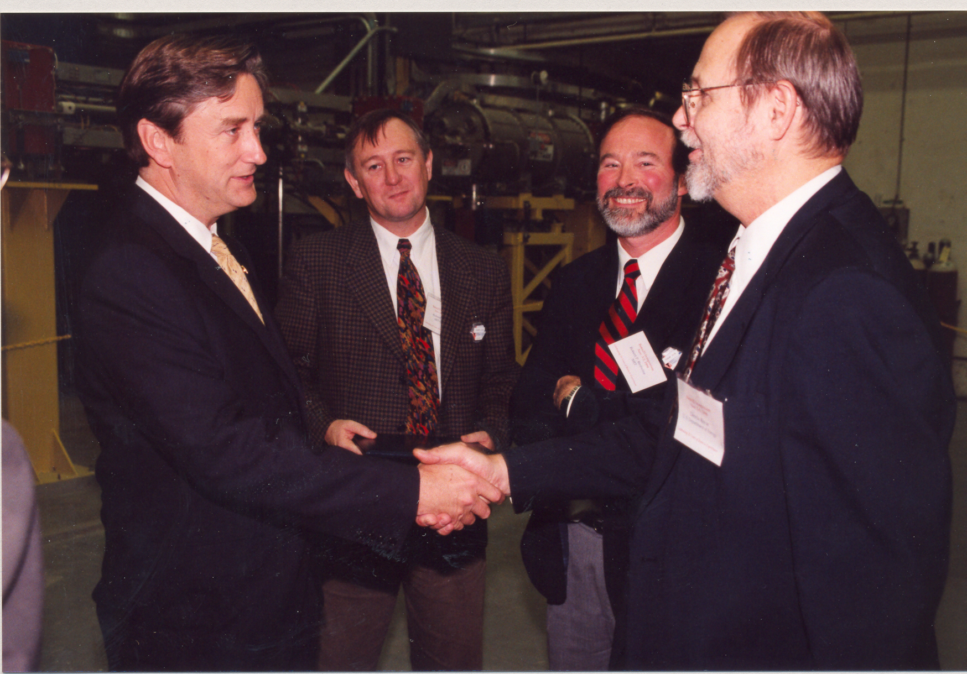

Slide 10
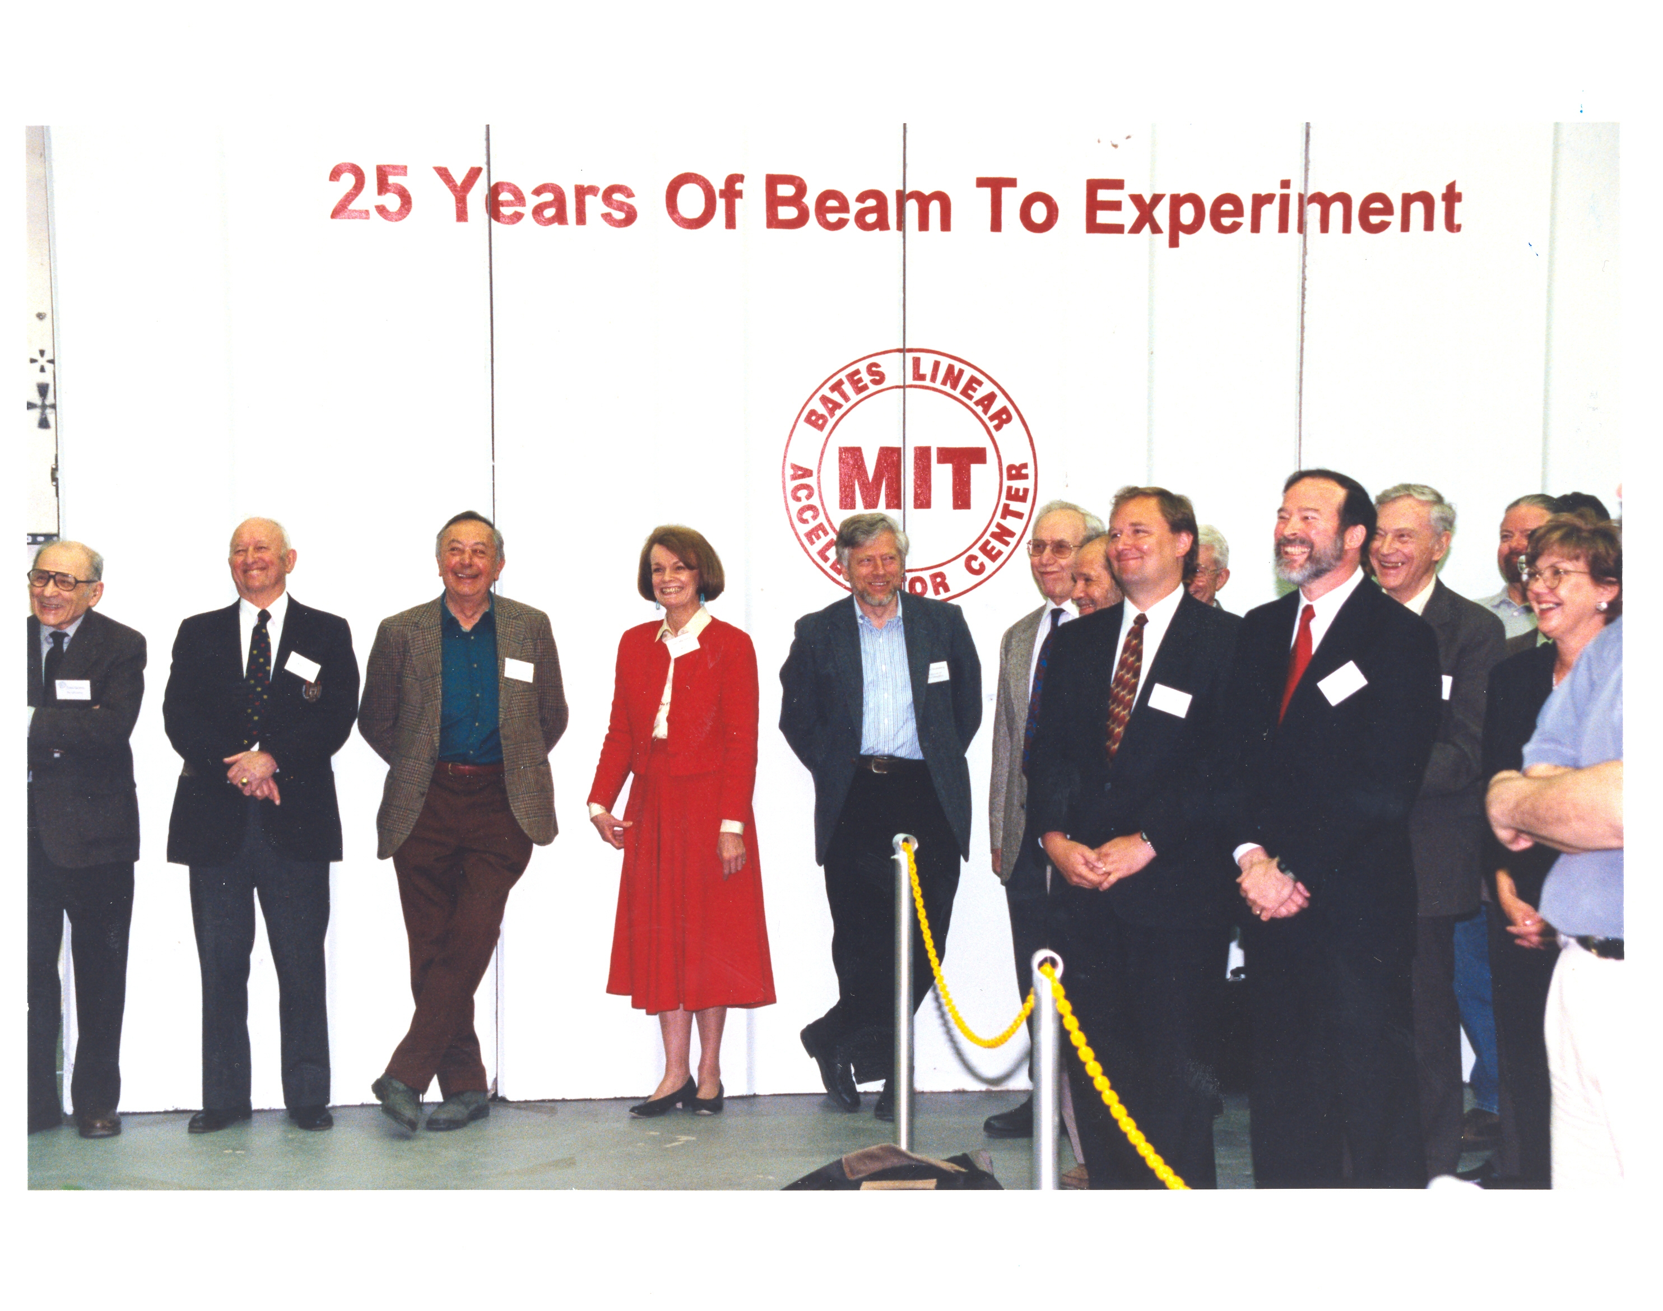

Slide 11
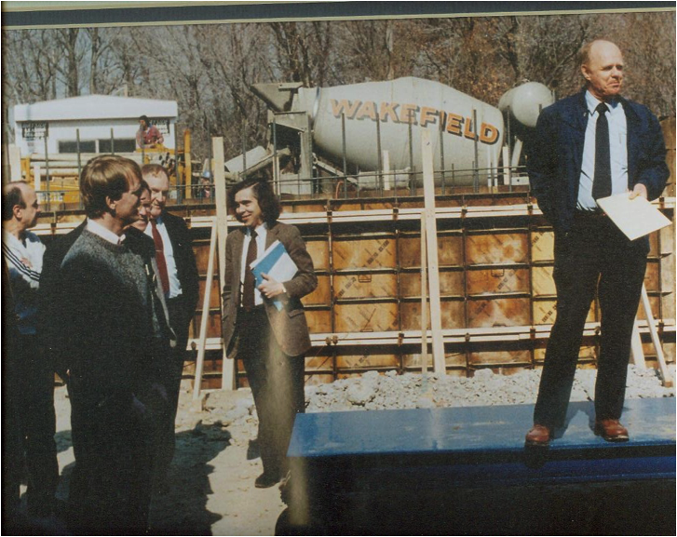

Slide 12
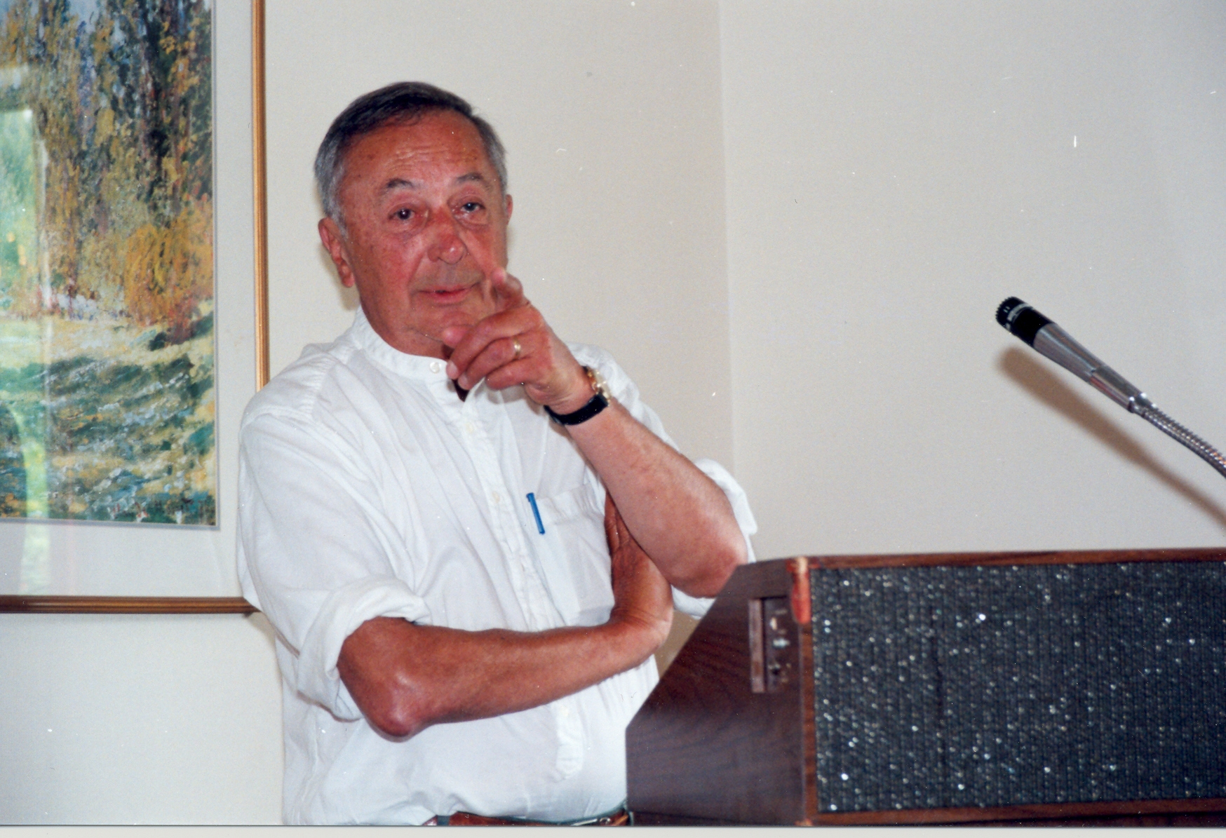
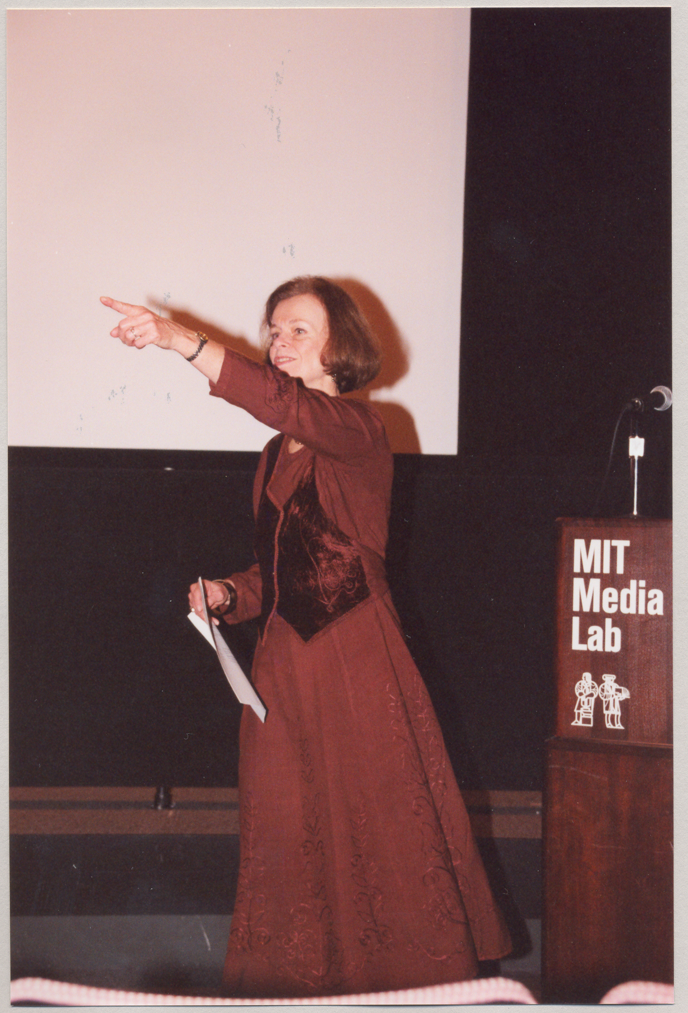
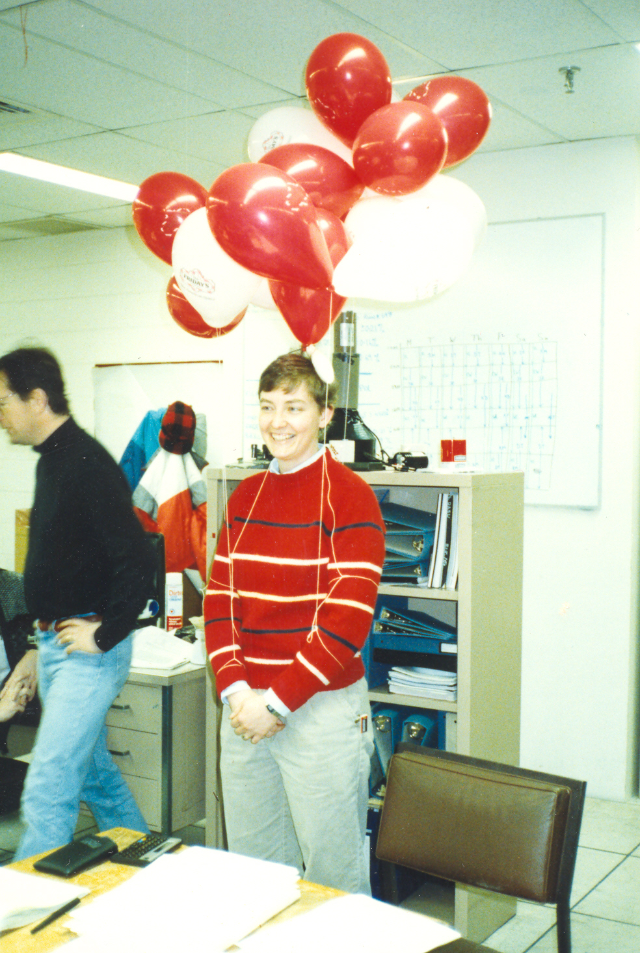
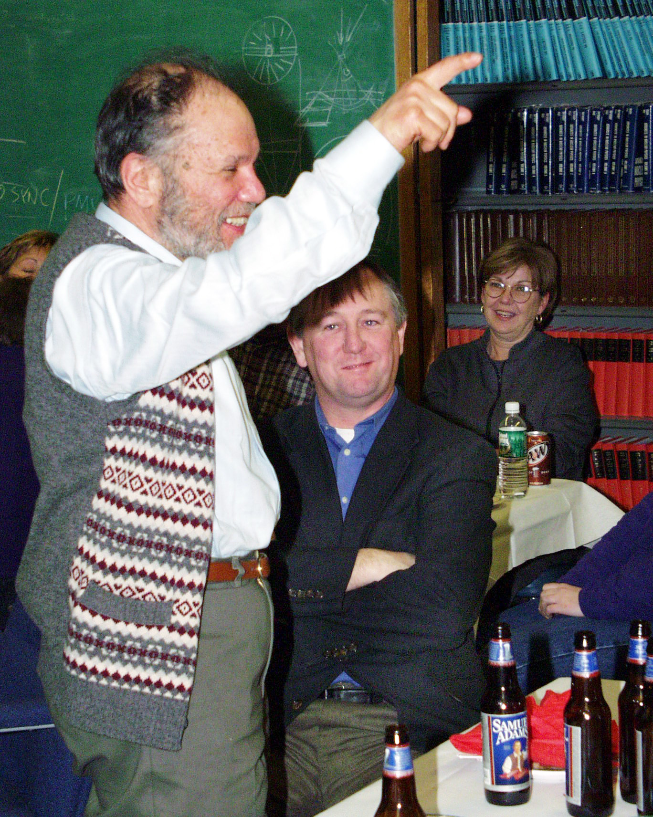

Slide 13
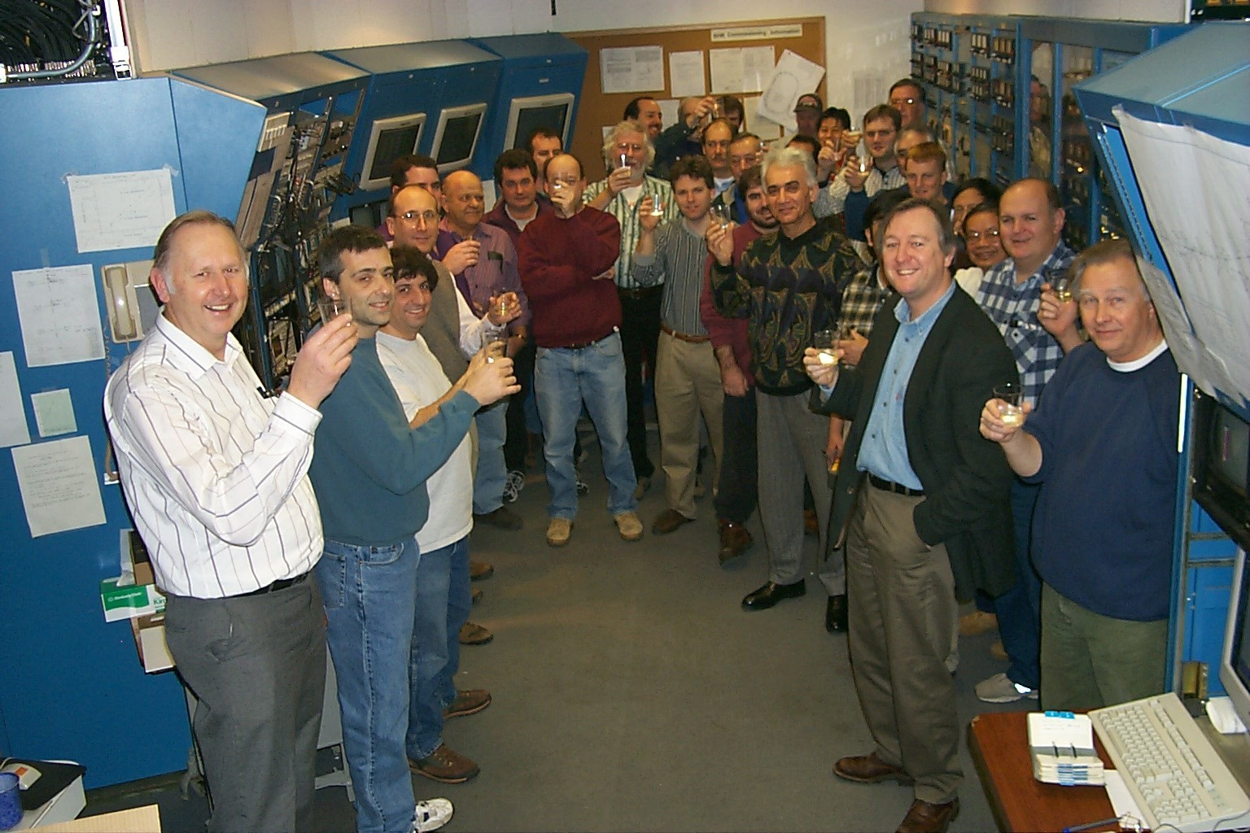
215 mA in the South Hall Ring, January 18th, 1999
215 mA in South Hall Ring – January 18, 1999

Slide 14
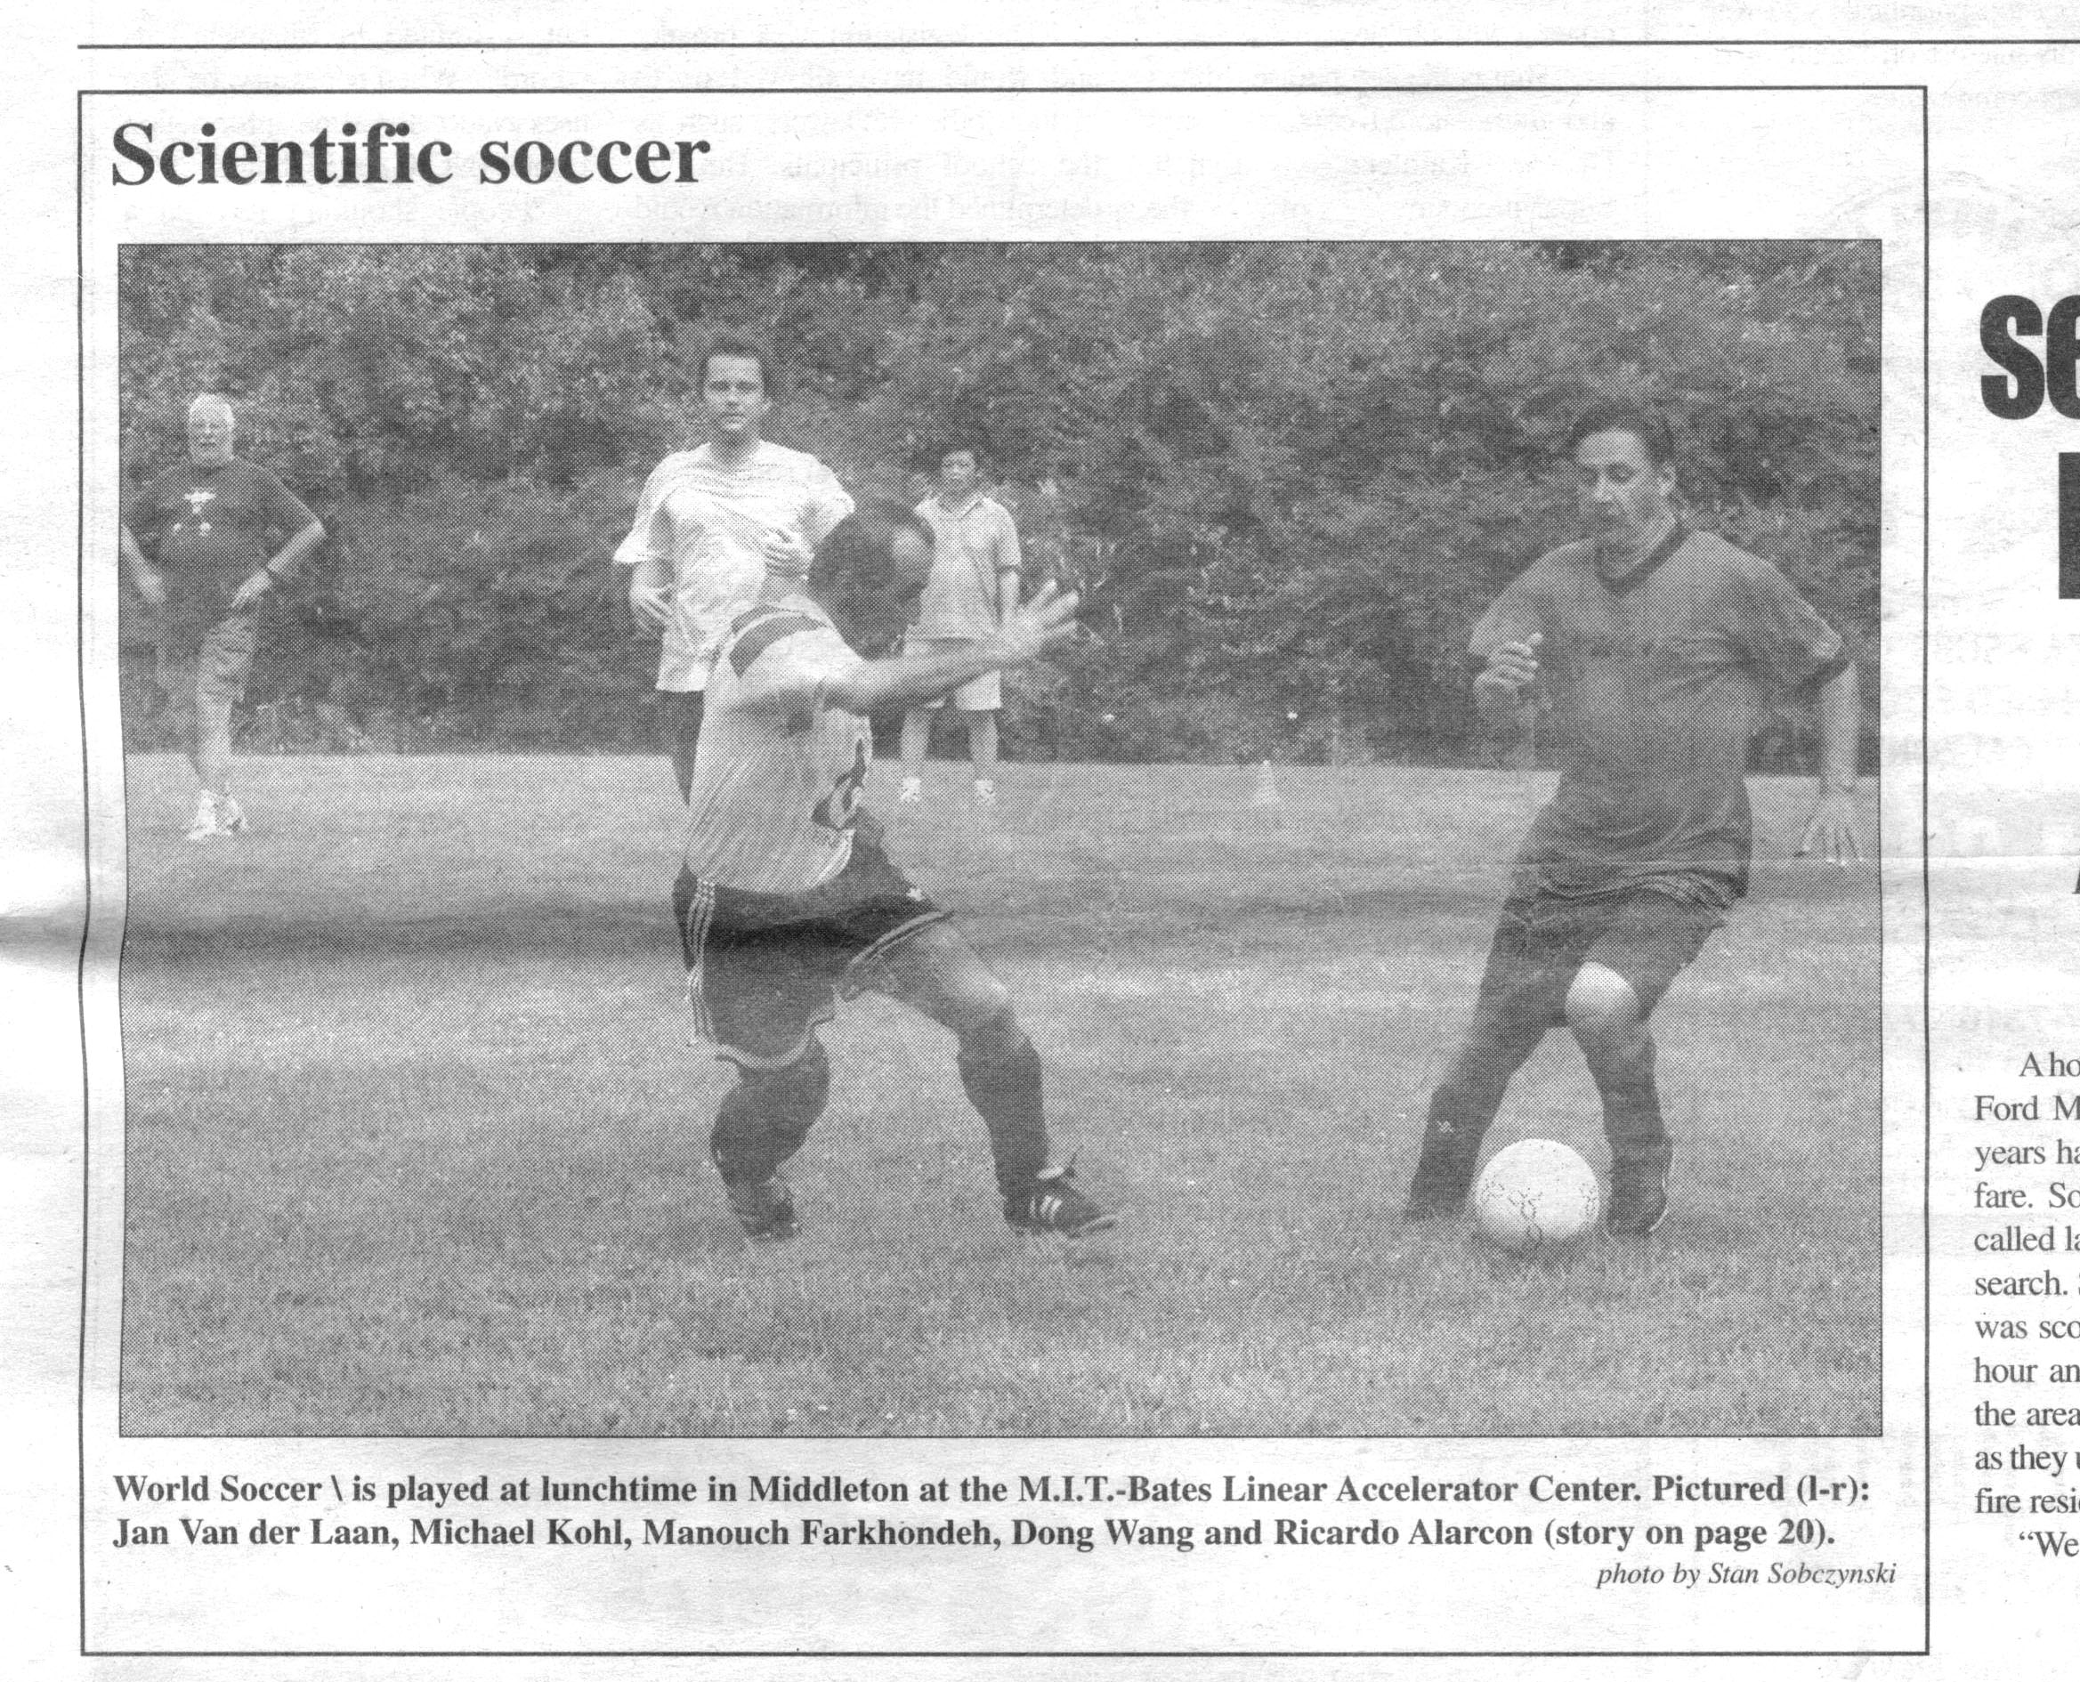

Slide 15
Some Research Highlights
This is by no means a comprehensive list. I hope that it shows a representative picture of the research that the Hadronic Physics Group members have done over the years.

Slide 16
Important Accomplishments of the Hadronic Physics Group Using the Bates Accelerator
High resolution electron scattering, using energy-loss spectrometry technique. Energy resolutions of 10⁻⁴ obtained. This revolutionized the field.
Pioneering coincidence experiments using the 1% high-duty-factor linac.
Measurements on ²H, ³H, and ³He.
First experiment to measure the neutron charge form factor. This led to the more precise experiment at JLab.
First parity-violating electron scattering experiment on ¹²C. This was followed by the SAMPLE experiment and led to many other measurements at Mainz and JLab. Most recently, QWeak.
Internal target experiments using the South Hall Ring.
Linac recirculator to double the beam energy.
Polarized electron source engineered at MIT and reproduced at Mainz and JLab.

Slide 17
Finally concerning Bates experiments, I will discuss the Bates Large Acceptance Spectrometer Toroid (BLAST). BLAST used the high-duty-factor electron beam in the Bates South Hall Ring and was the last major campaign at Bates before the accelerator ended its time as a user facility.

Slide 18
Bates Large Acceptance Spectrometer Toroid
Proposed in 1991, funded in 1998-2001, installed in 2002, commissioned in 2003, production data taking from November 2003 to June 2005
      500 pb⁻¹ on vector and tensor polarized deuterium
      94 pb⁻¹ on polarized hydrogen
Large acceptance detector designed to carry out complete measurement of spin-dependent electron scattering from polarized hydrogen, deuterium and ³He internal gas targets using the South Hall Ring (constructed 1988-92)
11 Ph.D. theses
BLAST yielded precise data on: proton and neutron form factors, deuteron form factors, and the spin structure of the deuteron.

Slide 19
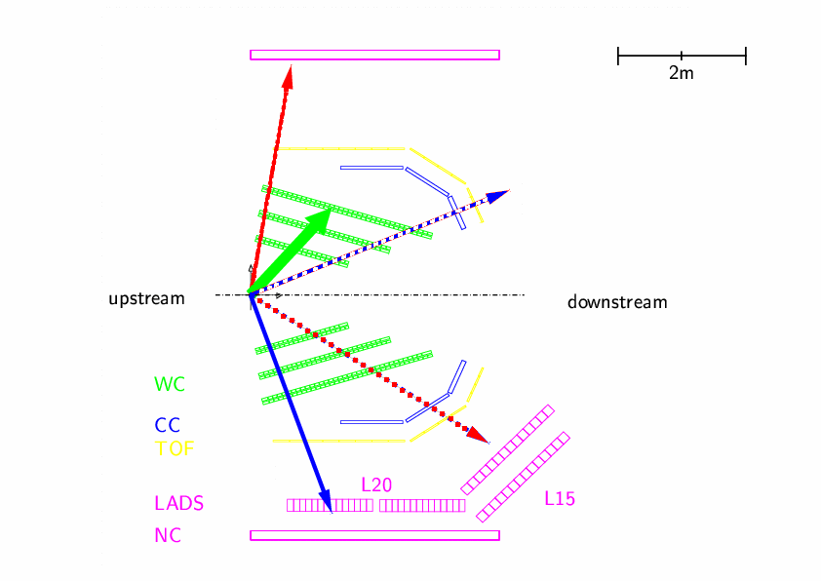
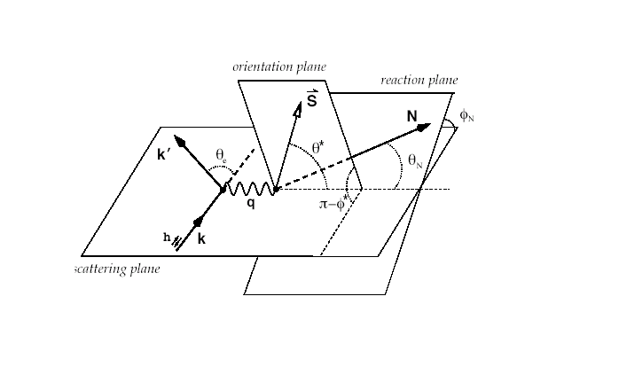
Spin-Dependent Electron Scattering
T.W. Donnelly and A.S. Raskin,
Ann. Phys. (N.Y.) 169, 247 (1986)
Electron
Left
Electron
Right
Scattering plane
  incident and scattered electron
  q vector
Orientation plane
  direction of target spin vector
Reaction plane
  reaction product momenta
For BLAST
  target spin angle 32° or 47°
Electron scattering into left sector
  q ┴ s_{T}
  Enhanced neutron detection in right
Electron scattering into right sector
  q // s_{T}

Slide 20
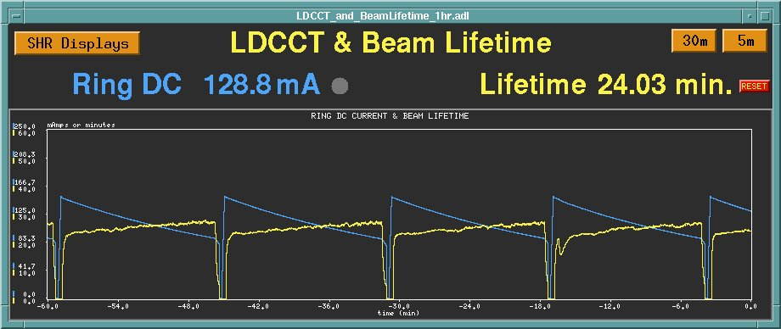
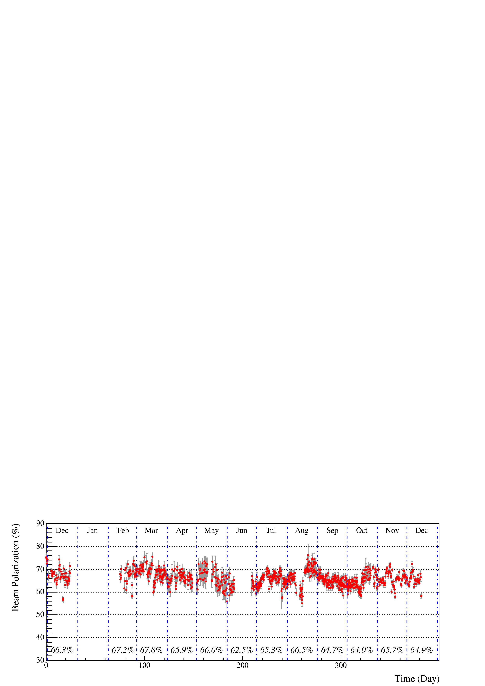
Stored Polarized Electron Beam in Bates SHR for BLAST
Dec 2003 – Dec 2004
Accelerator complex and
BLAST experiment fully
automated
Stored currents: routinely fill to 250 mA, lifetime of 35 minutes
Beam Polarization: ~65% with rapid reversal (flipper)

Slide 21
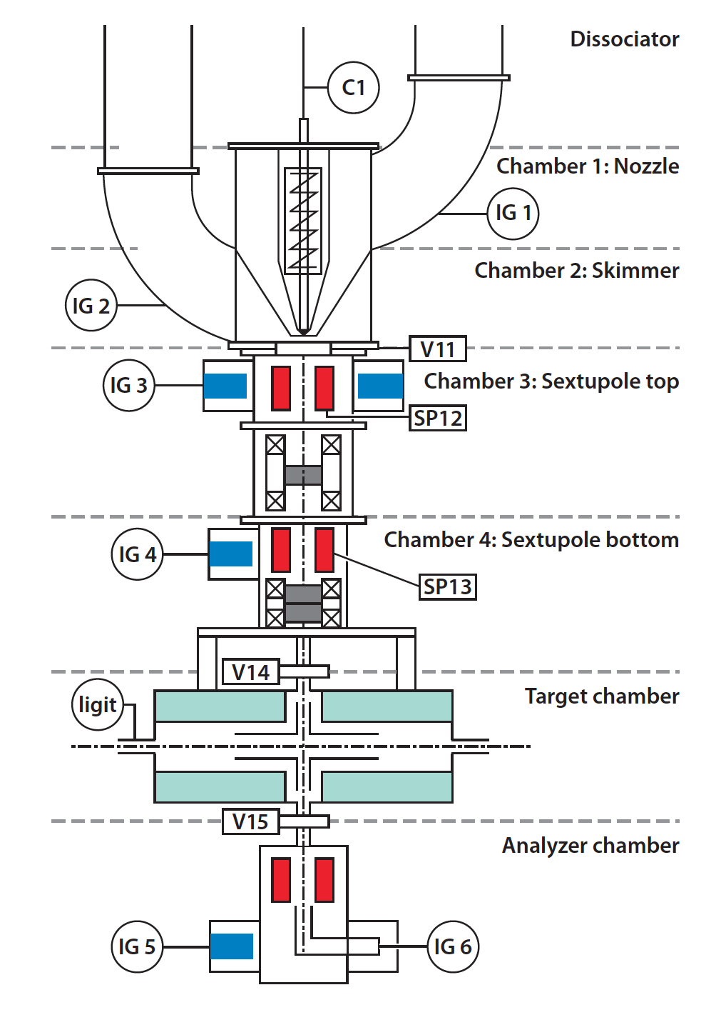
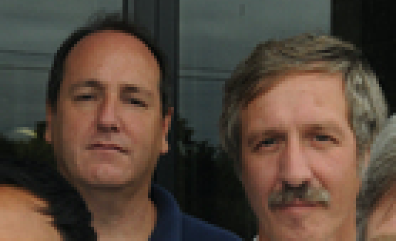
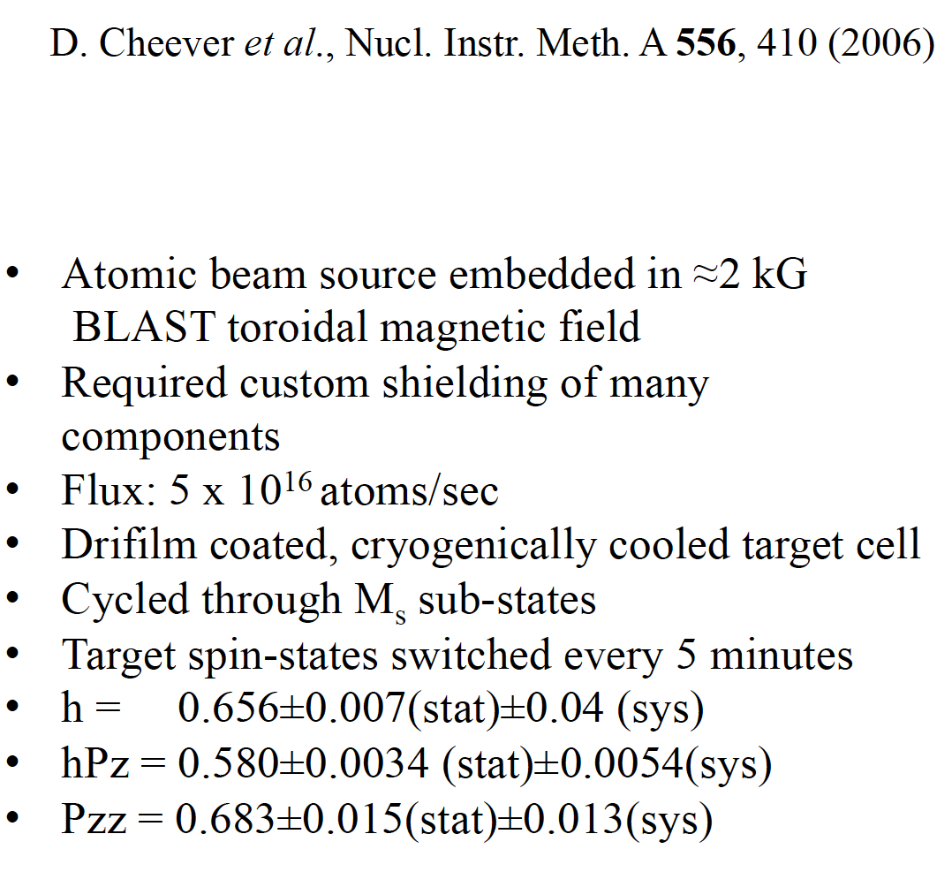
BLAST Atomic Beam Source
E. Ihloff E. Tsentalovich
D. Cheever et al., NIMA 556, 410 (2006)

Slide 22
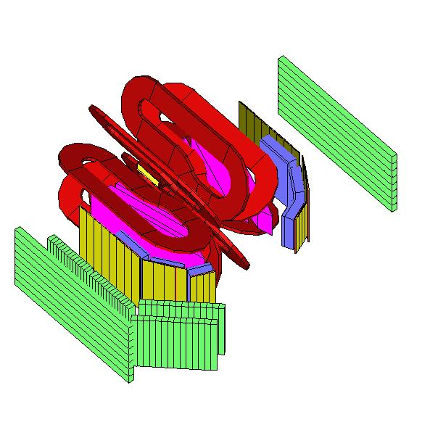
BLAST Detector
DRIFT CHAMBERS
Toroidal magnetic field
  3.8 kG max
Drift Chambers
  3 chambers/sector
  2 superlayers/chamber (±5°)
  3 sense layers/superlayer
  18 tracking layers/sector
  954 sense wires
Cerenkov Detectors
  1 cm thick aerogel
  Electron identification
Time of flight scintillators
  16 vertical bars, 2.5 cm thick
  Trigger and relative timing
Neutron detectors
  10 cm thick in left sector
  25-30 cm thick in right sector
2 level, 8 channel trigger system
  Concurrent data acquisition
TARGET
BEAM
MAGNET
CERENKOV
TOF
BEAM
NEUTRON

Slide 23
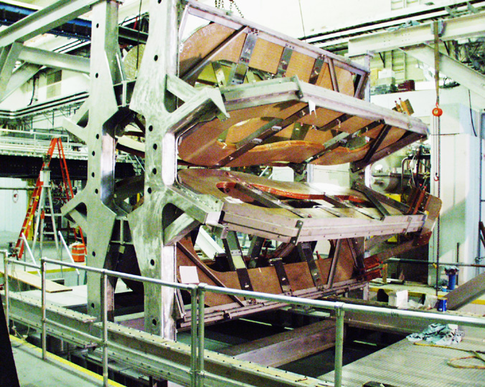
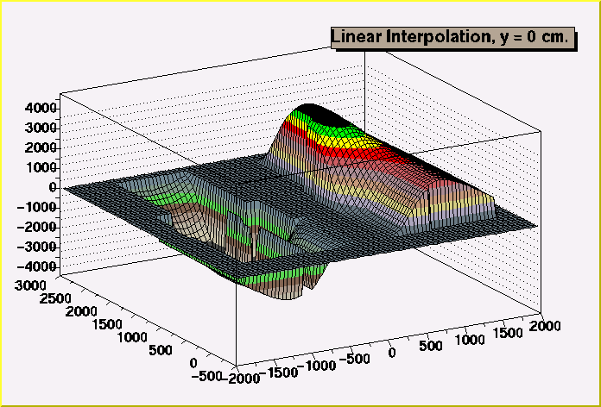
BLAST Toroid
8 copper coils
  6730 A
  3700 G
field mapped (3D)
  coil position adjusted
  ±1% of calculated
  minimize target field
  tracking

Slide 24
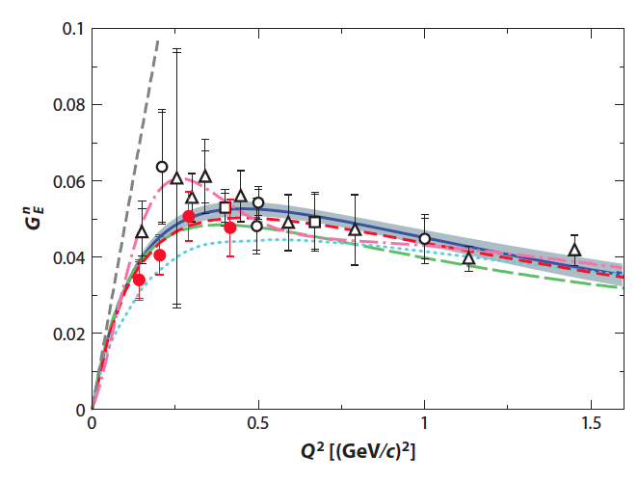

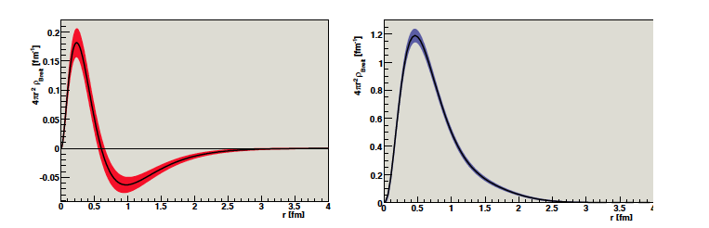
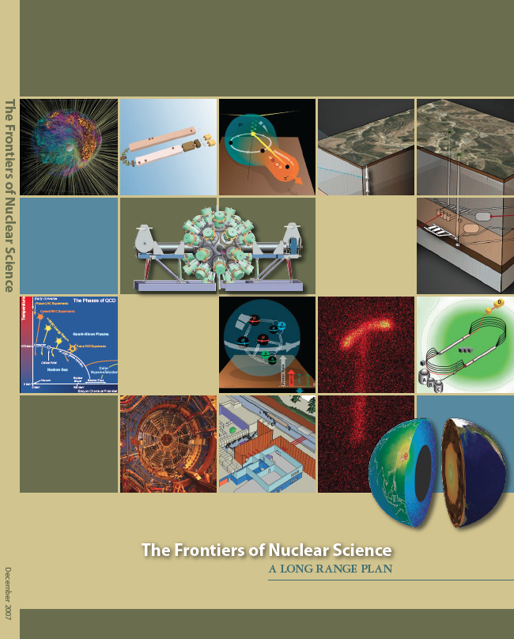
Charge Distribution of Neutron
E. Geis et al.,
Phys. Rev. Lett. 101,
042501 (2008)
D.K. Hasell et al.,
Ann. Rev. Nucl. and Part. Sci.
61, 409 (2011)
Highlighted
in
neutron
proton

Slide 25
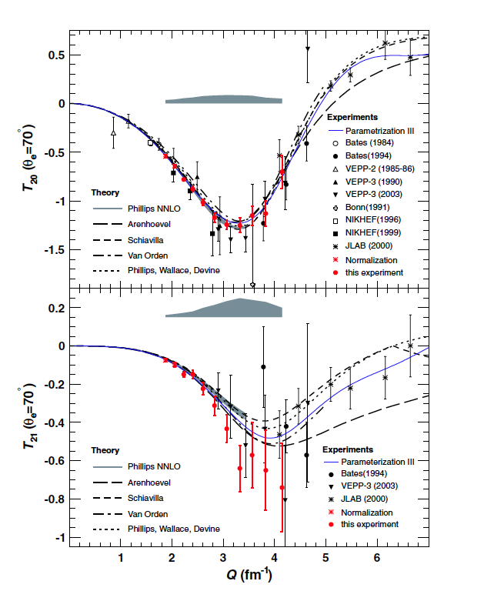
Precision measurement of deuteron tensor analyzing powers with BLAST
C. Zhang et al.,
Phys. Rev. Lett. 107, 252501 (2011)
Precision data validate effective field theory

Slide 26
Now, Reviews of Some Experiments at Other Laboratories
First, the HERMES experiment at DESY, led by Richard Milner

Slide 27
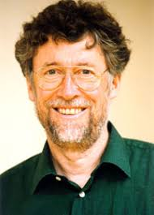
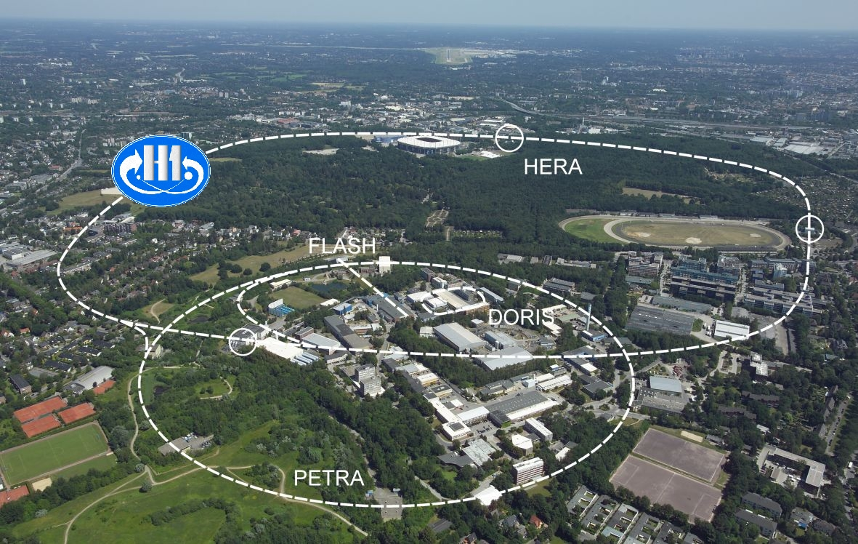



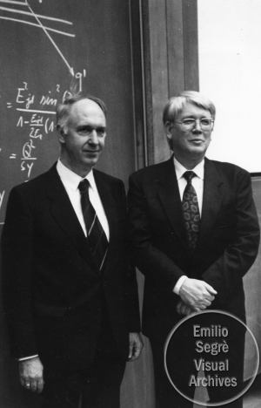
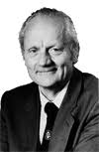
DESY Laboratory, Hamburg, DE
A. Wagner
HERA 1992-2007
V. Soergel
B. Wiik
G. Voss

Slide 28
Polarized e-/e+
Beam in HERA
Realization of HERMES
January 2, 1990: HERMES proposal submitted to DESY
October 1990: HERMES conditionally approved upon demonstration of >50% electron
polarization in HERA (achieved in August 1992)
October 2, 1992: HERMES officially approved
Summer 1994: Full test experiment installed in E. Hall and successfully operated
October 17, 1994: Beginning of HERMES detector installation
February 1995: HERMES detector
rolled in
August 1995: HERMES data taking
on polarized ³He begins

Slide 29
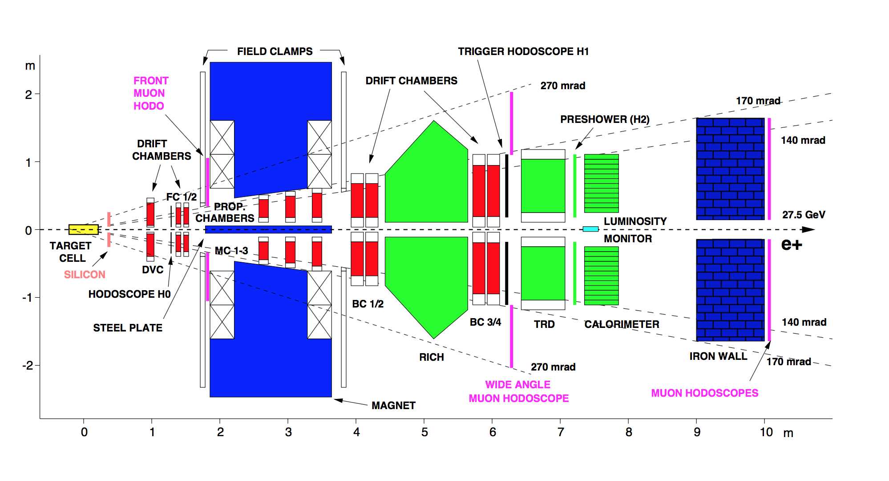
HERMES Spectrometer

Slide 30
HERMES Scientific Output
Run I: 1995-2000
Long. pol. targets of ³He, ¹H and ²H
DIS and SIDIS
Run IIa: 2002-2005
Trans. pol. targets of ¹H and ²H
Transversity and TMDs
Run IIb: 2005-2007
Recoil detector - GPDs
80 scientific papers
90 Ph.D. theses

Slide 31
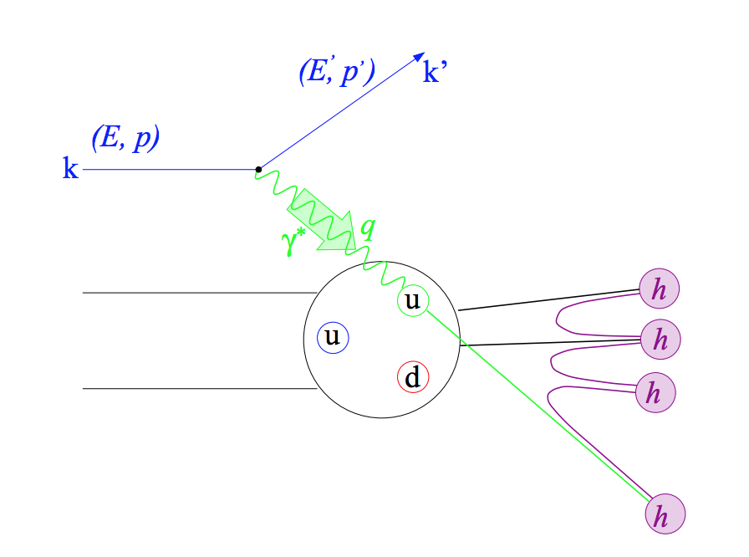
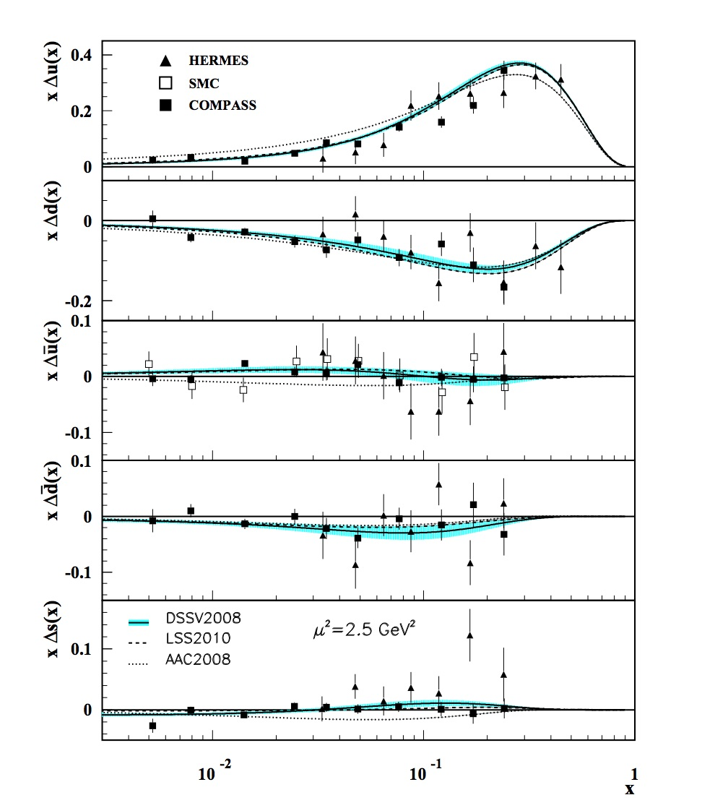
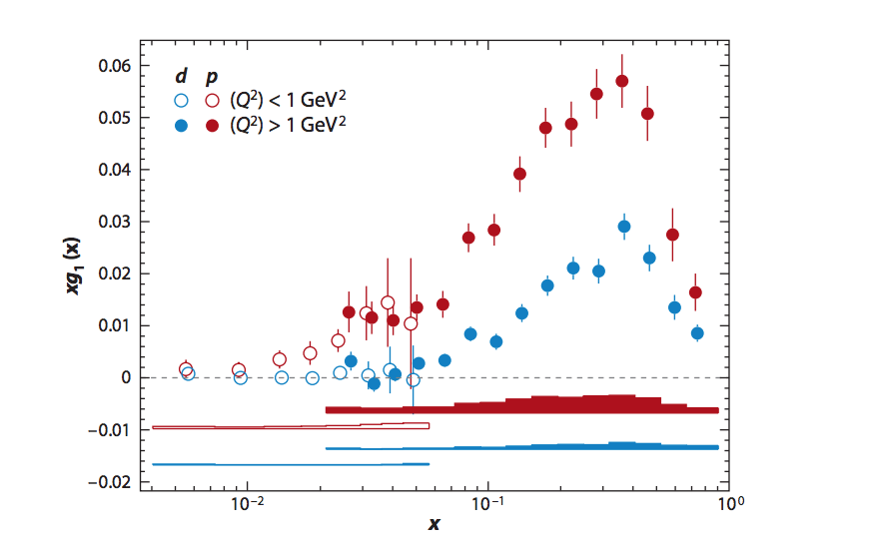
Flavor Dependence of Quark Polarizations
Violent
destruction of
proton!
C. Diaconu et al., Ann. Rev. Nucl. Part. Sci,
60, 101 (2010)

Slide 32
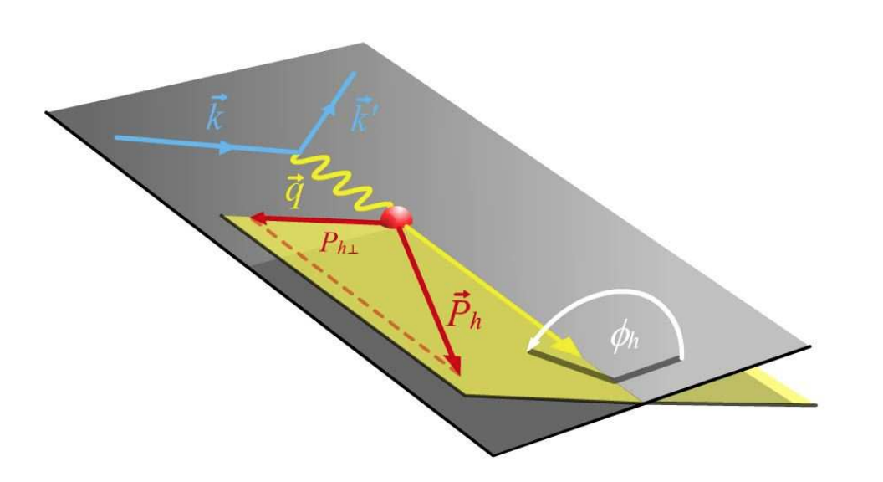
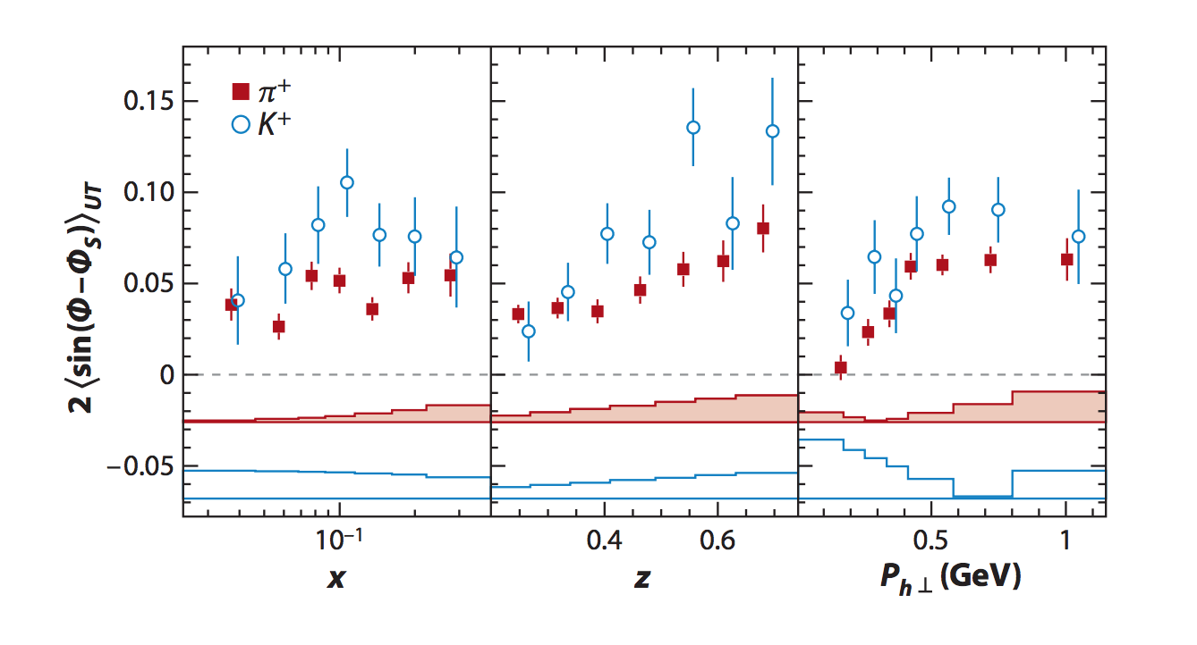
Transverse Momentum Dependence
First observation of Sivers effect!
SIDIS from a
transversely
polarized target
Orbital angular momentum of quarks inside proton is non-zero!

Slide 33
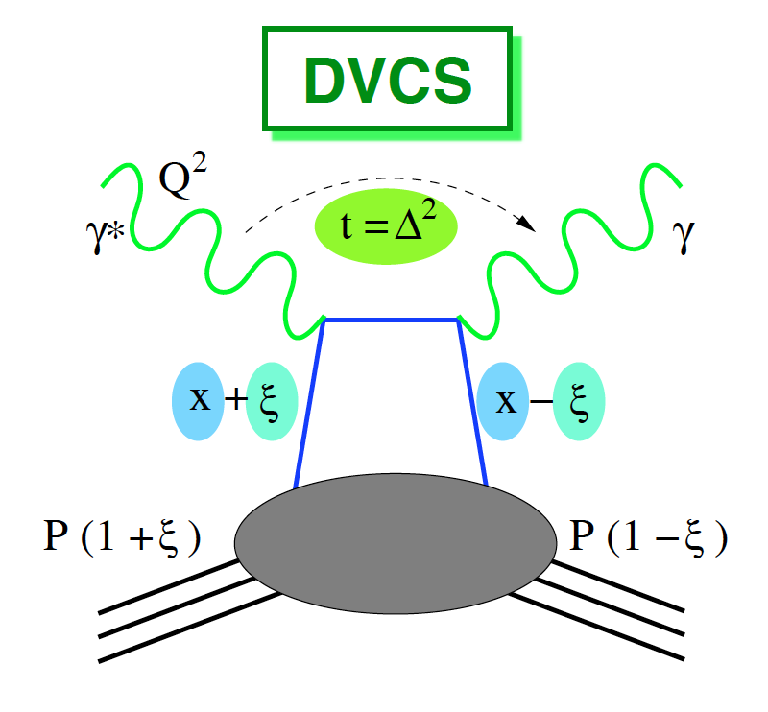
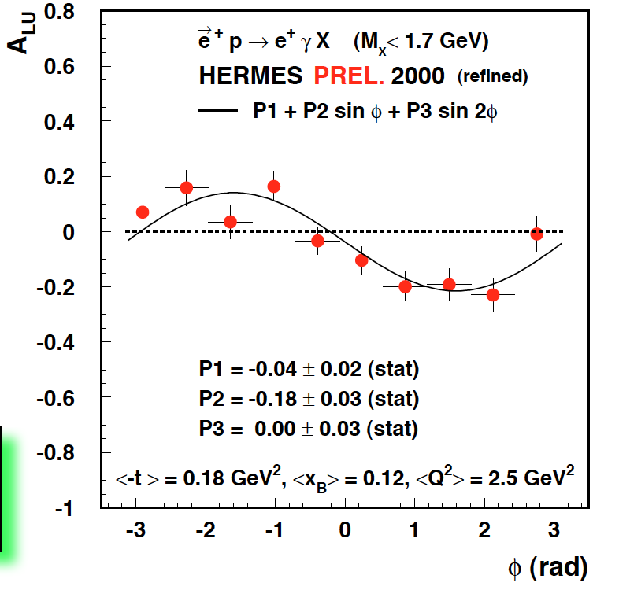
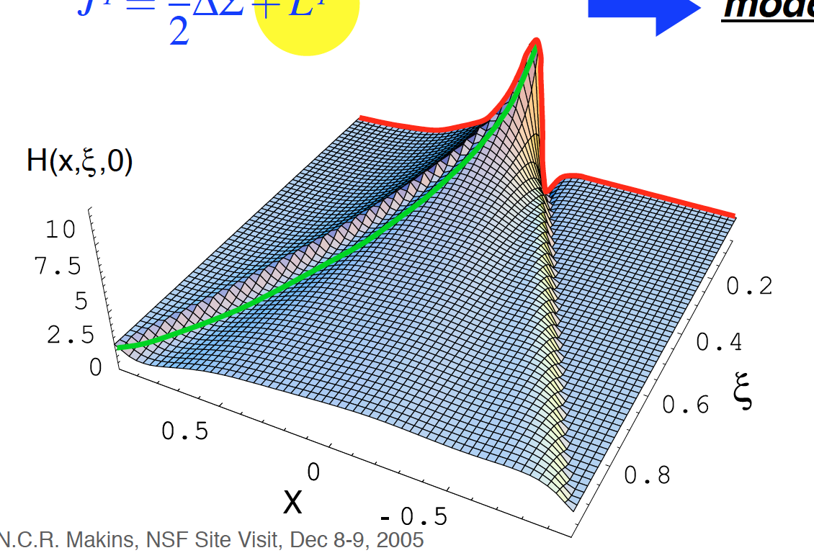
Hard Exclusive Processes
First measurement!
Generalized Parton Distributions

Slide 34
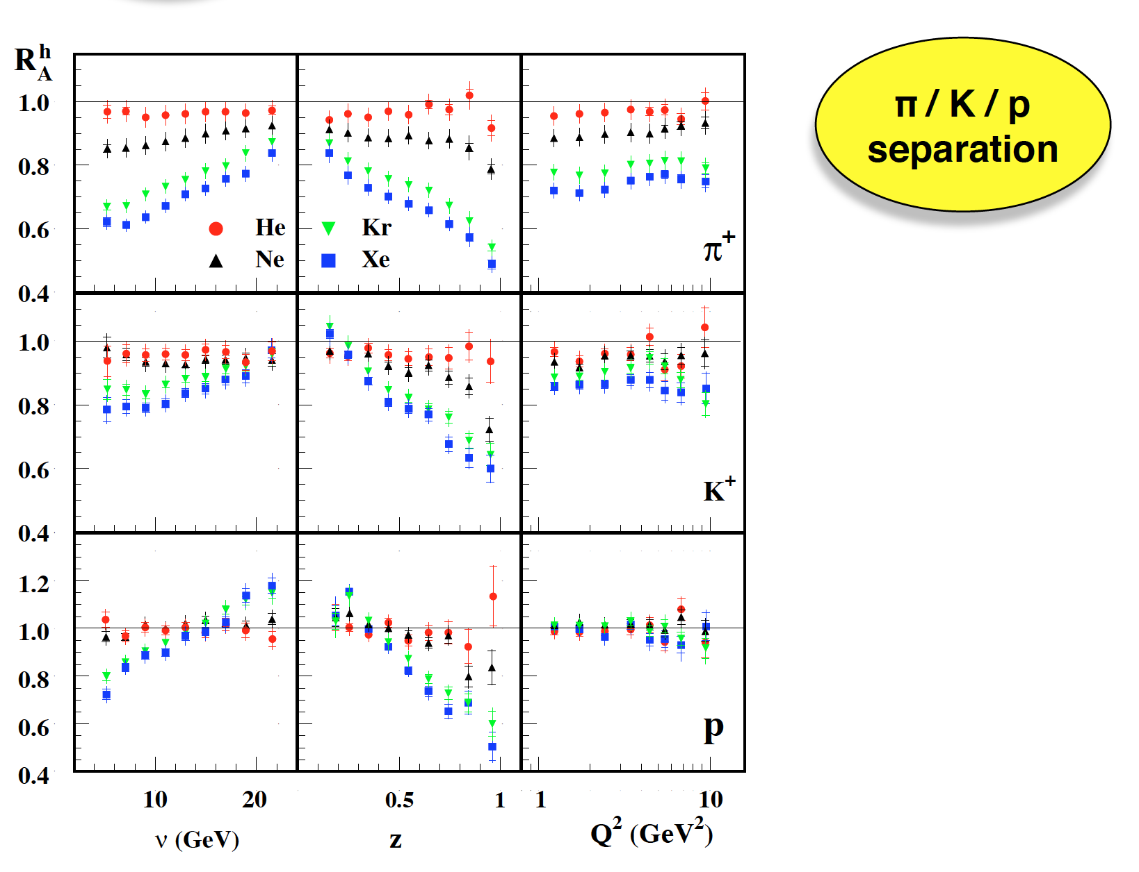
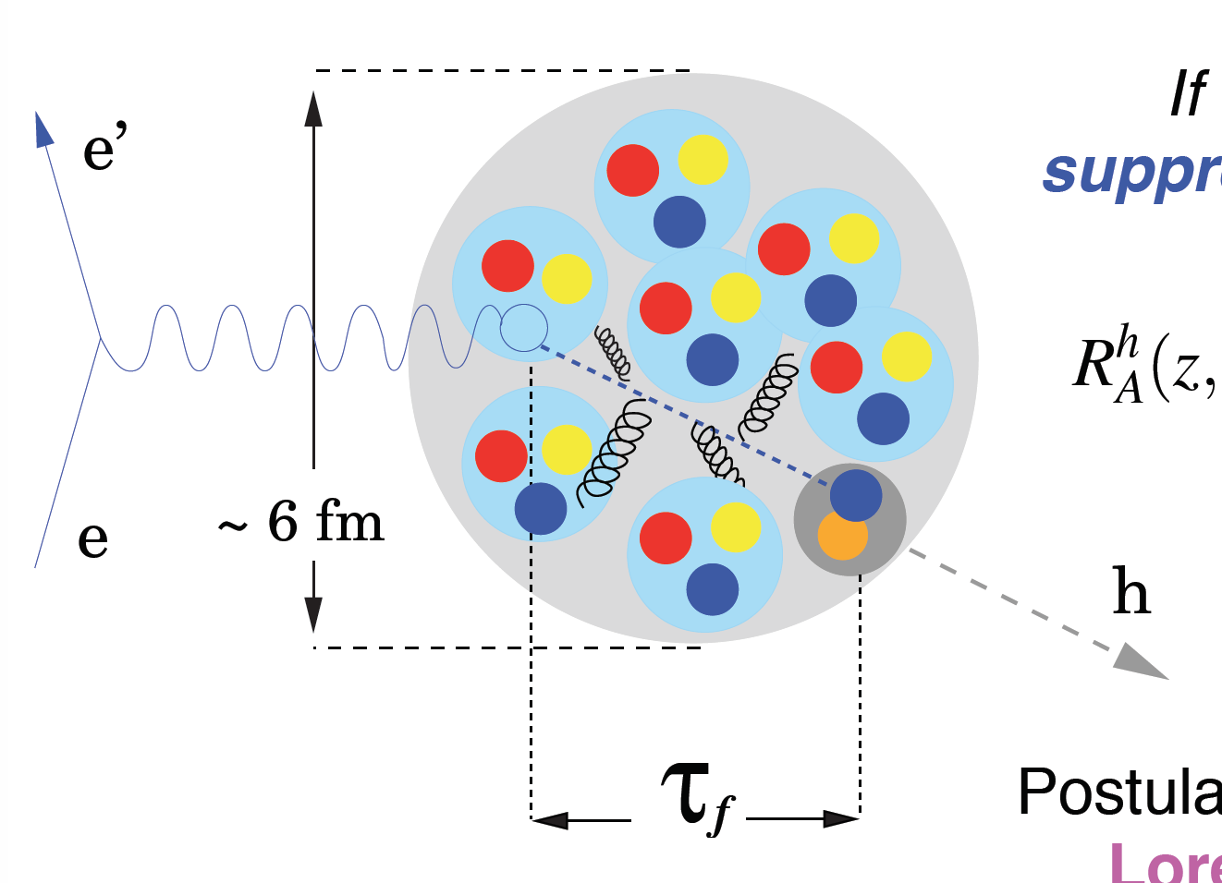
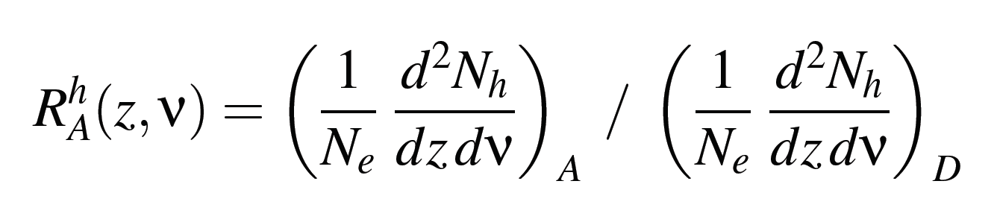
Hadron Attenuation in Nuclei

Slide 35
Hadron Attenuation in Nuclei
Important baseline to understand
parton propagation
in Quark Gluon Plasma

Slide 36
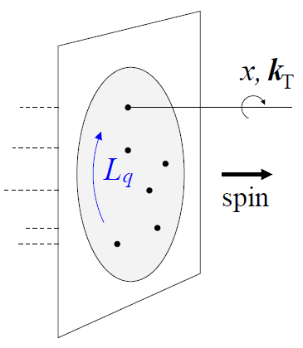


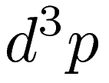
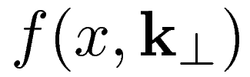
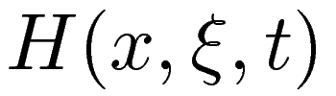
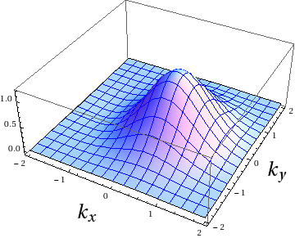
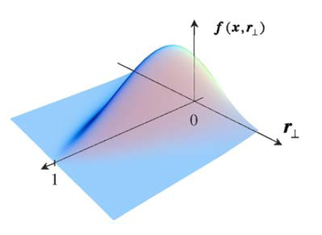
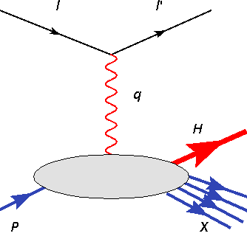

Twenty First Century Proton
A central goal of high-energy electron scattering is to determine the 3D partonic picture of the nucleon and the nucleus. This is encoded in Generalized Parton Distributions and
Transverse Momentum Dependent Distributions
Wigner distribution
Transverse
Momentum
Dependent
distributions
Generalized
Parton
Distributions
Orbital motion
accessible!
SIDIS
DES

Slide 37
Twenty First Century Proton
A central goal of high-energy electron scattering is to determine the 3D partonic picture of the nucleon and the nucleus. This is encoded in Generalized Parton Distributions and
Transverse Momentum Dependent Distributions
Wigner distribution
HERMES had a major influence
on this development
Transverse
Momentum
Dependent
distributions
Generalized
Parton
Distributions
Orbital motion
accessible!
SIDIS
DES

Slide 38
Next, the OLYMPUS experiment at DESY
OLYMPUS made important use of the former BLAST detector.

Slide 39


Discrepancy in Proton
Form Factor Ratio
Jefferson Lab 2000
All Rosenbluth data from SLAC and JLab in agreement
Dramatic discrepancy between Rosenbluth and recoil polarization technique
Contribution of multi-photon exchange widely accepted explanation of discrepancy
Dramatic discrepancy!
>800 citations
Notes:
39
Even more dramatic with linear scale in Q2

Slide 40

Definitive determination of
contributions beyond single photon exchange
2

Slide 41




DORIS

Slide 42

The Experiment
Electrons/positrons (100mA) at 2 GeV in DORIS storage ring at DESY: data taken in fall 2012 before DORIS ceased operation.
Unpolarized internal hydrogen target 3x10¹⁵ at/cm² Lumi = 10³³ / (cm²s)
Large acceptance detector for e-p in coincidence: utilized existing BLAST
Redundant monitoring of luminosity:
Pressure, temperature, flow, current
Small-angle elastic scatt. at high ε / low Q²
Symmetric Moller/Bhabha scattering
Measured ratio of positron-proton to electron-proton
unpolarized elastic scattering with goal of ≈1% stat.+sys.
January 1, 2013
RM, Uwe Schneekloth, Michael Kohl,
Douglas Hasell

Slide 43

The Magnetic Toroid
MIT and DESY
MIT and DESY

Slide 44

Drift Chambers MIT
Complete chambers rewired at DESY in summer 2010 by teams of MIT students
R. Redwine, D. Hasell and J. Kelsey

Slide 45







OLYMPUS Results
Jan
Bernauer
Brian Lauren
Henderson Ice
Colton Rebecca
O’Connor Russell
Axel
Schmidt
Douglas Hasell, Michael Kohl
Single Photon Exchange Rules!
Where are the Hard Two-Photons?
B. Henderson et al.
Phys. Rev. Lett. 118, 092501 (2017)

Slide 46

















Exotic Atoms and Molecules for Nuclear science @MIT
PI
Graduate students
R.F. Garcia Ruiz
A. Brinson
S. Udrescu
F. Pastrana
Postdocs
A. Vernon
S. Wilkins
J. Karthein
I. Belosevic
Leading role at international
collaborations:
Support LNS/Bates
A. Convertino
E. Ihloff
D. Petterson
C. Vidal

Slide 47









Precision studies of exotic atoms and molecules
for nuclear science
What is the nature of the nuclear force?
Connection with QCD?
How do nuclear phenomena emerge?
What are the properties of nuclear matter?
What are the limits of nuclear existence?
?
²H
⁸He
¹²C
⁶⁰Ca
¹¹Li
²³O
Neutron star
Why is there more matter than antimatter in the universe?
Are there new fundamental particles and forces?
What are the properties of Dark Matter?
T-reversal
e⁻
e⁻
EDM
MDM
EDM
²²³Ra
Z=88, N=136

Slide 48

Development of a new beamline at FRIB
-> Supported by Bates@LNS-MIT
December 2020: CRIS project started Dec 2020
May 2021: Beamline Design completed
June-August 2021: Experimental parts purchased
Installation at FRIB expected in March 2022

Slide 49

Efforts Mike Williams is Leading

Slide 50
Study of Short-Range Correlations in Nuclei
This has long been a significant interest of June Matthews.
Or Hen has recently been leading very impressive studies of such correlations and he will tell you about them in his talk later today.

Slide 51
Pion-Nucleus Interactions
Much of the work on the so-called Meson Factories (LAMPF, PSI, TRIUMF) involved using pions produced by the high-intensity proton beams to study pion-nucleus interactions. Our efforts were largely concentrated on studying the absorption of pions on nuclei. The main finding was that such absorption occurs primarily on n-p pairs.

Slide 52
Search for Neutron EDM
A non-zero value of the neutron electric dipole moment would indicate a violation of fundamental symmetries (T-violation) and would be a critical test of the Standard Model.
The Standard Model prediction for the neutron EDM is ~ 10⁻³¹ e-cm. Extensions to the SM imply a value of nEDM several orders of magnitude larger.
For some years the most stringent upper limit for nEDM was 3 X 10⁻²⁶ e-cm, which came from a reactor experiment at ILL (Grenoble).
There are several efforts underway around the world to improve the upper limit (or make a discovery). The Paul Scherrer Institute recently reported an upper limit of 1.8 X 10⁻²⁶ e-cm. This is of course only slightly better than the previous upper limit.

Slide 53
On the next slide the measured 90% confidence level upper limits for nEDM are shown as a function of time, including the recent PSI result (in red). Also shown are expectations for a non-zero value from different extensions to the Standard Model.

Slide 54

■

Slide 55
nEDM Search at the Spallation Neutron Source at ORNL
Measure precession of polarized neutrons with parallel and anti-parallel B and E fields. A difference in precession rates would indicate an EDM.
Current limitation is not statistics, but systematics, e.g. knowledge of and uniformity of the magnetic field.
We will use polarized ³He as a “co-magnetometer”. The precession will take place in a volume of superfluid ⁴He.
The reaction we will actually measure is
n + ³He → p + t

Slide 56


Search for Neutron EDM
Measurement Cycle
Load collection volume with polarized ³He atoms
Transfer polarized ³He atoms into measurement cell
Illuminate measurement cell with polarized cold neutrons to produce polarized UCN
Apply a π/2 pulse to rotate spins perpendicular to B₀
Measure precession frequency
Remove reduced polarization ³He atoms from measurement cell
Flip E-field & Go to 1.
Notes:
This figure shows the apparatus. The measurement cycle starts by loading a collection volume with polarized ³He atoms. The polarized ³He atoms are transferred into measurement cell – small temperature gradients push the helium-3 from warmer to colder regions – a technique known as heat-flush. The measurement cell is illuminated with polarized cold neutrons to produce polarized ultra-cold neutrons. A π/2 pulse rotates the spins perpendicular the primary magnetic field. We measure the precession frequency continuously. The we reverse the heat flush to Remove reduced polarization ³He atoms from measurement cell; flip the electric field and repeat.

Slide 57
Current Status and MIT Roles
The experiment is currently in the phase of demonstrating the feasibility of the most challenging technical aspects.
We do expect that additional competing experiments will be reporting initial results reasonably soon. We also expect that ultimately our experiment will be the most sensitive.
MIT has contributed to various aspects of the nEDM project: design of the neutron guide, plans for the ³He Atomic Beam Source, initial concept for slow controls, cryogenic engineering, film burner tests, and light collection efficiency tests. Our main effort at this time is evaluation and improvement of the ³He Atomic Beam Source. We recently added a postdoctoral fellow (Mark Broering) who is focusing on this effort.
As the experiment goes forward, we expect to increase our involvement and commitment, especially building on the capabilities of the Bates Research and Engineering Center. The expertise at Bates is very important to this project.
R. Redwine serves as Chair of the nEDM Collaboration Board.

Slide 58
Conclusion
I hope that this talk has helped you understand the role that the MIT Hadronic Physics Group has played in nuclear physics research and education. I very much appreciate your attention and we are delighted that you are participating in the Symposium.

