Slide 1
Optimizing the Z-boson Mass and Width Measurements
By Rujuta Sane, Denis Siminiuc, Isabella Torres

Slide 2
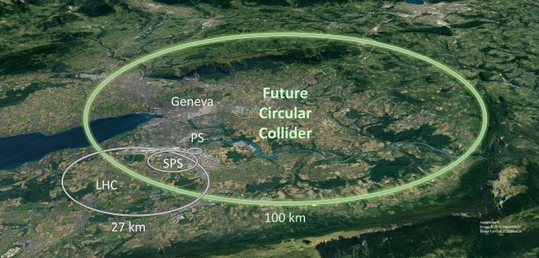
FCCee Study
The goal of the Future Circular Collider (FCC) feasibility study is to design a new infrastructure for a particle collider. It is proposed to build a large, 100km circular tunnel that will collide electrons and positrons (FCCee). The goal is to reach higher energies and intensities than those of the previous Large Electron-Positron Collider (LEP).

Slide 3
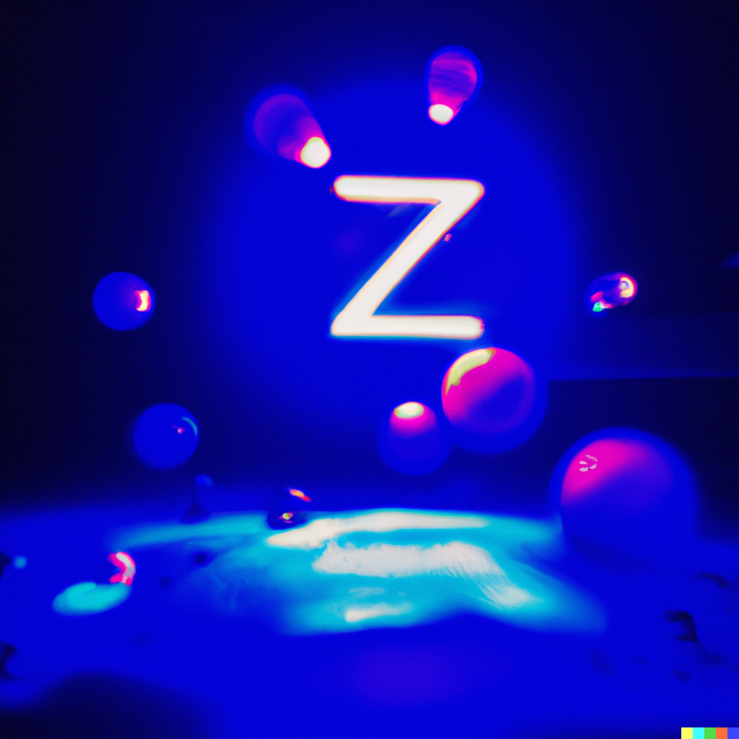
Project Overview
Goal: Minimize the error on the Z-boson mass and width measurements by determining the optimal number of energy points and what luminosity to run the accelerator at.
Questions:
What is the optimal number of off-peak energy points?
How spread should the energy points be?
How do we divide luminosity among the points?
Notes:
It takes a lot of time and energy to run a particle accelerator, so we want to make sure we are doing it as efficiently as possible from the first place
Goal is to determine how many energy points to trun the accelerator at how much time should be spent at each of these points in order to minimize the error when we measure the Z-boson mass and width
Our goal is to minimixe the error on our Z-boson mass and width measurements by determining the optimal number of energy points and luminosity to run the accelerator at.

Slide 4
Measuring the Z-boson Mass and Width
Make samples with 3 or 5 energy points at varying distances from the peak
Fit samples with a Breit-Wigner distribution
Determine the error of the mass and width for different luminosity ratios
Notes:
We will go into detail about each of these parameters in

Slide 5
Luminosity
In the program, we iterate over the luminosity ratios using a for loop in increments of 10% from 10% to 90%
The ratio is the amount of luminosity used on peak divided by the total luminosity, in our case: 150 ab^-1.
The purpose of this iteration was to find the optimal luminosity used on the peak that minimizes the error in the Z boson mass and width measurements.
Notes:
Ab ^-1 atto

Slide 6
Energy Points
We found the number of points that minimizes the error in our measurement
We ran the fit over 3 points (1 on peak, 2 off peak) and 5 points (1 on peak, 4 off peak) and analyzed the obtained errors
We observed certain tradeoffs between 3 and 5 points:
Using 3 points allowed us to have a greater cross section measurement for each selected point but sacrificed curve precision
Using 5 points allowed us to have a greater distribution of data but increased the uncertainty for each point

Slide 7
Point Distribution
Our third and final parameter is the distance of the points from the peak
We wanted to see if the distribution of the 3 points and the 5 points from the peak affected the calculated error value of the Z mass and width.
We aimed to keep the points within the range of the Z boson width
This is important because the probability of producing Z bosons decreases rapidly once we are outside the width

Slide 8
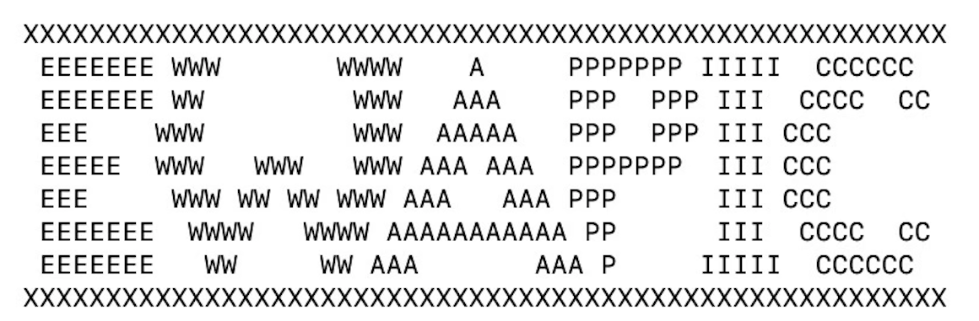
How did we do the fitting?
We installed a program named EWAPIC that takes as input a number of energy points, their cross-sections, and the luminosity ratio, and creates a fit. This program uses the Kuip programming language and it is based on a very detailed script that calculates several features of the ee collision.
Notes:
We are going to need to run the program twice.

Slide 9
Data obtained from the first fitting:
From running this fitting program we obtain an accurate measurement of the cross-section using the calculated expected value at the three or five energy points.
Data obtained from the second fitting:
After we input the cross-section values from the first fit, we can actually observe the values of the Z mass and width alongside with their errors.
Notes:
The second fit gives us the values of the Z-mass and the Z width alongside with their error.

Slide 10
Statistical error of cross-section at energy points(uncertainty)
An interesting element that we had to calculate was the statistical error of the cross sections of the points.
Notes:
A fourth parameter that is calculated automatically. We modified the script to obtain this number.

Slide 11
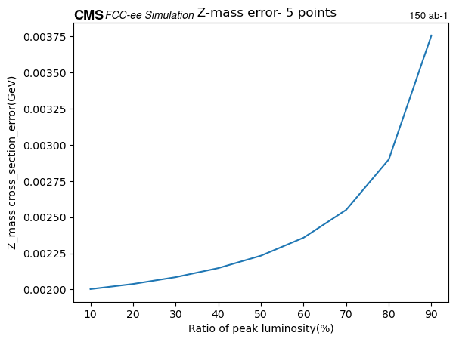
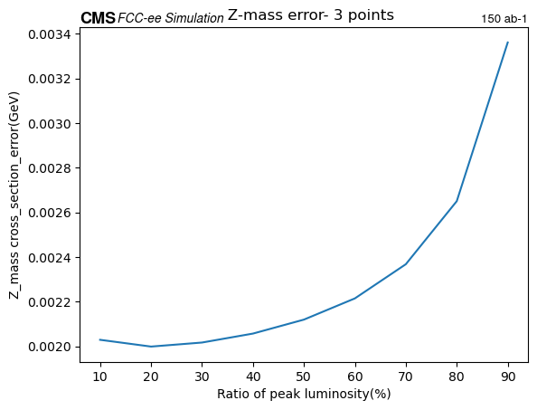
Z-mass Error:
Distance from peak: 0.689 GeV
Notes:
Here, we ran the fitting program with 5 points and then with 3 points and we notice that the minimum error is smallest when we use three points and a luminosity ratio of 20%. But it is also interesting that at the luminosity ratio of 10%, the value of the mass error is smaller in the 5-points fitting.

Slide 12
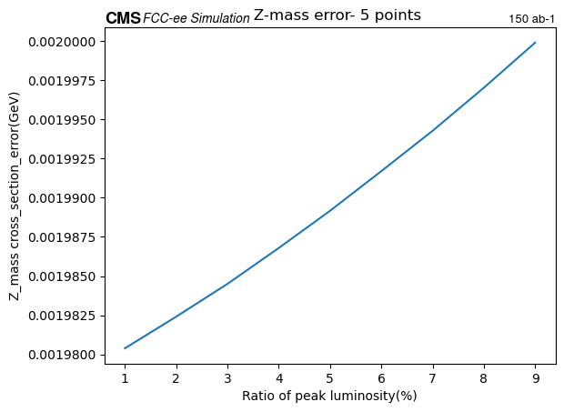
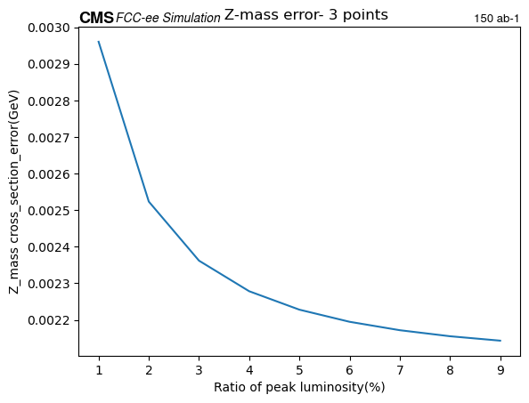
A Closer Look
Notes:
This made us curious to see the trend when we use extremely small luminosities. We observed this very intriguing feature: the error on the 5-points fitting is increasing linearly, but the error in the 3-points graph is decreasing and then increasing.

Slide 13
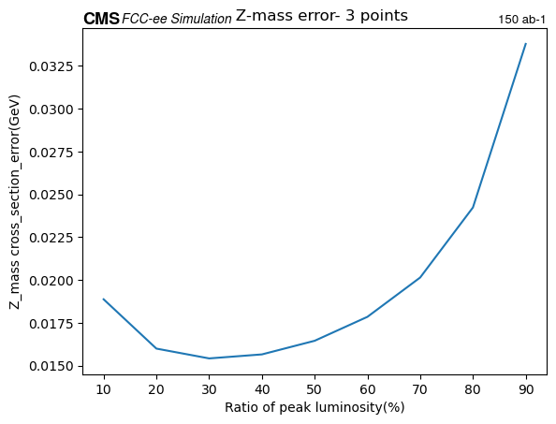
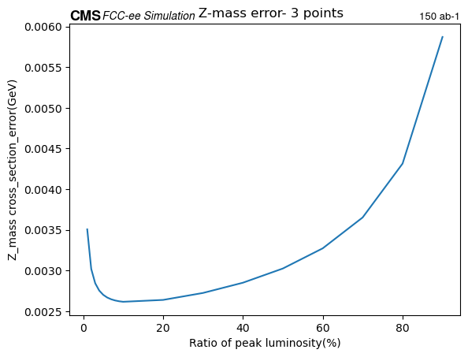
Distance from Peak
Distance: 0.389 GeV
Min. Error: 0.0155 GeV
Distance: 0.689 GeV
Min. Error: 0.0020 GeV
Distance: 2.689 GeV
Min.Error: 0.0026 GeV
Notes:
This slide shows how we changed the distance from the peak and we obtained different error rates. Based on several runs of the programs, we were able to see the shape of a graph which has as axis the mass error and the points where we ran the program. We noticed that the error decreases until the energy reaches 90.5 GeV and then the error increases again.

Slide 14
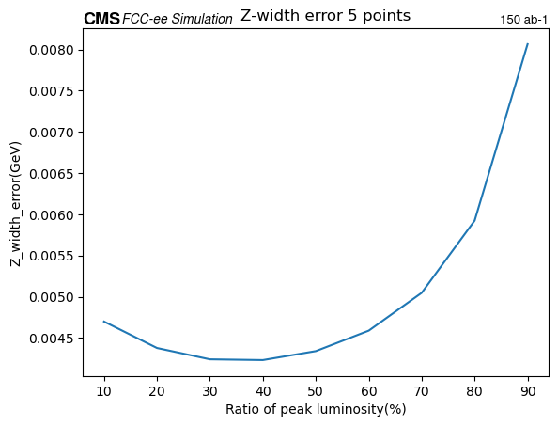
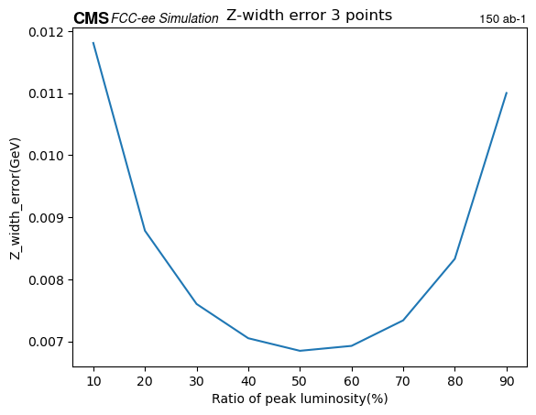
Z-width Error:
Notes:
These are the graphs of Z_width_error and Luminosity ratio. On the left, we have the fit with 5 points and on the left we have the fit with 3 points. We notice that the error of the 5-points fit is significantly smaller than the 3-points fit(0.004 compared to 0..07). .Both these functions look like parabolas.

Slide 15
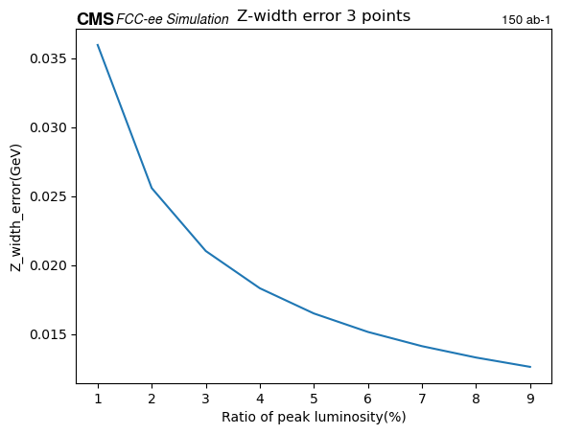
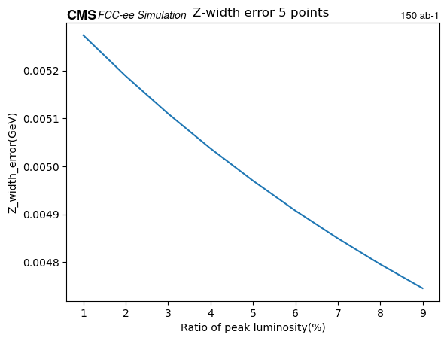
A Closer Look- Z Width Error
Notes:
Here, we are looking at the same graphs, but different luminosities. We notice that unlike the mass at those luminosities, the width actually presents the same feature on the graphs. They are both decreasing, almost linearly.

Slide 16
Limitations
Analyze effects of varying the distribution of the luminosity among the off-peak points
Testing with 4 energy points do determine the significance of the peak
Ran more trials at varying distances to better determine the optimal distance between points

Slide 17
Conclusions
Mass error is optimized with:
Five energy points
Very minimal time at the peak
Width error is optimized with:
Five energy points
Error decreased as distance between tail points and peak increased
35% of time spent at the peak
Notes:
If the energy value is outside the width of the Z boson the accelerator must run at a much higher luminosity to produce the same number of Z particles. As a result
Optimizing the error varies based on what measurement you are taking

Slide 18
Citations
Lavezzo L 2023, Z-boson, <https://openai.com/blog/dall-e/>
FCC Collider, 2022, <https://home.cern/science/accelerators/future-circular-collider>

