Slide 1
EJPA Topical Issue
Current issue name simply: Short Range Correlations

Slide 2
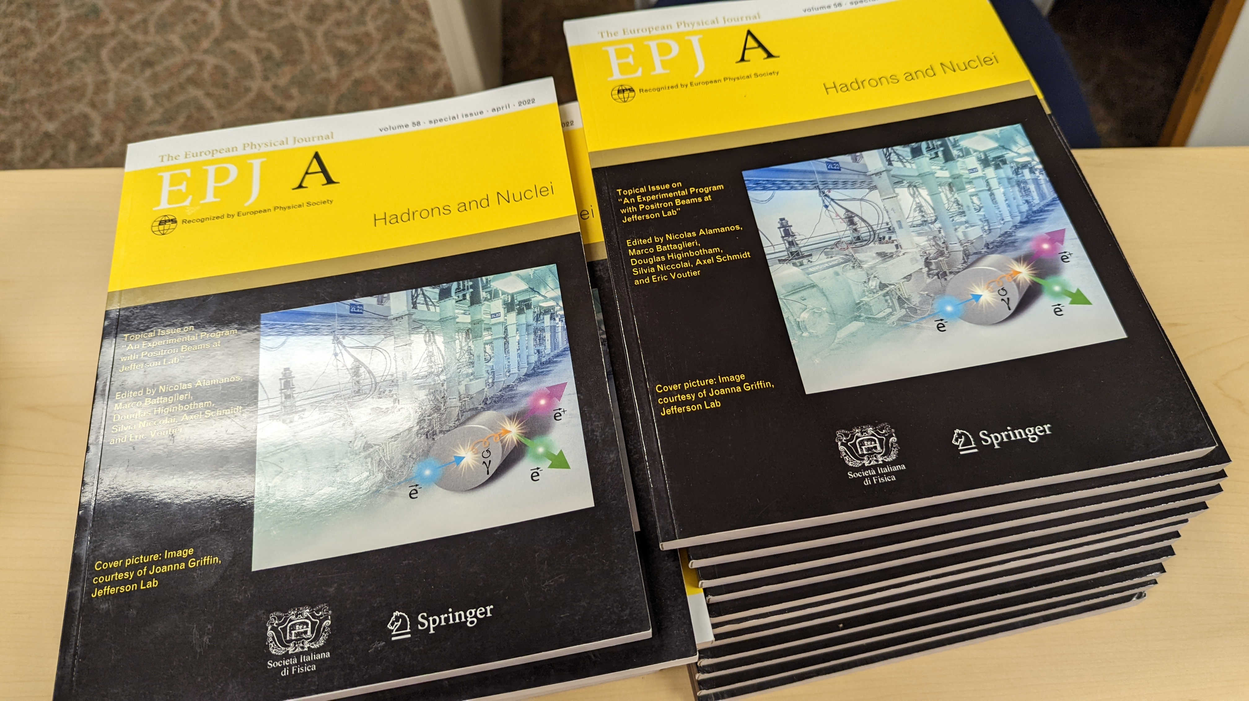

Slide 3
General Information About EJPA Contributions
Manuscripts should be prepared following the instructions for authors available at: https://www.springer.com/journal/10050/submission-guidelines
The LaTeX template can be downloaded at: https://www.springernature.com/gp/authors/campaigns/latex-author-support
General information about the journal can be found on http://epja.epj.org/

Slide 4
Homework for the coming week!
Please let me know if you have a contribution you would like to make. To be proactive, we will also be reaching out to people who contributed to this meeting.
Postdocs / Students please discuss with your advisors first!
Once there is agreement on a title and the lead author, let me know and I can send you an official invitation letter.
Finally, do we want a more inclusive name then simply, “Short Range Correlations”; e.g. “Short Range Correlations and the EMC Effect”, “Short Range Correlations from Hadronic to Partonic Degrees of freedom”, “Some Great Name I Haven’t Thought of Yet”

