Slide 1
EIC Project and Accelerator
Rolf Ent (Jefferson Lab)
This talk is given on behalf of the EIC User Group, the Host Laboratories for the EIC Experimental Program, and the EIC Project
2022 Town Hall Meeting on Hot and Cold QCD
September 23rd 2022

Slide 2

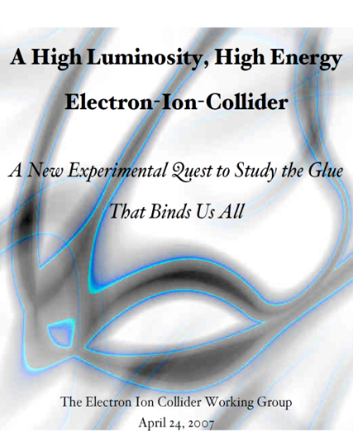


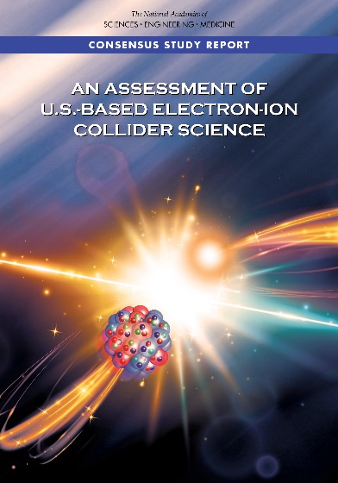
The Scientific Foundation for an EIC was Built Over Two Decades
Electron-Ion Collider..absolutely central to the nuclear science program of the next decade.
2002
“a high-energy high-luminosity polarized EIC [is] the highest priority for new facility construction following the completion of FRIB.”
2007
The science questions that an EIC will answer are central to completing an understanding of atoms as well as being integral to the agenda of nuclear physics today.”
2009
2010
Gluons and the Quark Sea at High Energies
2012
2013
2015
Major Nuclear Physics Facilities for the Next Decade
2018
NSAC
2021
“…essential accelerator and detector R&D [for EIC] should be given very high priority
in the short term.”
“We recommend the allocation of resources …to lay the foundation for a polarized Electron-Ion Collider…”
March 14, 2013
“..a new dedicated facility will be essential for answering some of the most central questions.”
“The quantitative study of matter in this new regime [where abundant gluons dominate] requires a new experimental facility: an Electron Ion Collider..”

Slide 3
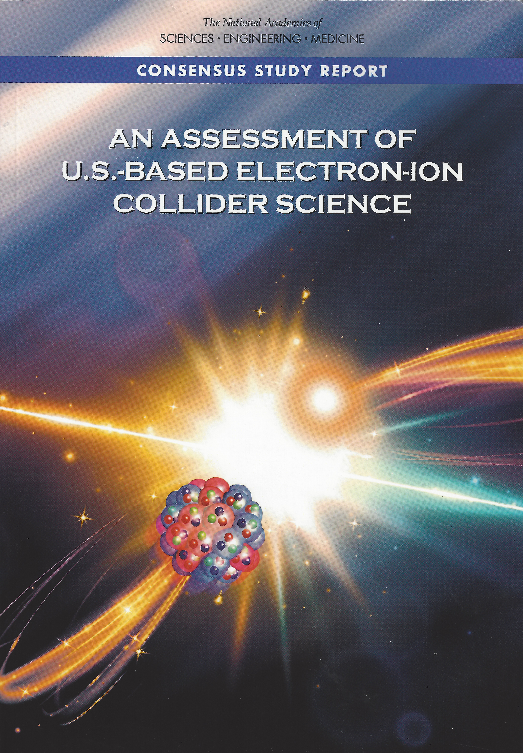
EIC Science – Findings of the NAS Committee
2018
Finding 1: An EIC can uniquely address three profound questions about nucleons — neutrons and protons — and how they are assembled to form the nuclei of atoms:
  How does the mass of the nucleon arise?
  How does the spin of the nucleon arise?
  What are the emergent properties of dense systems of gluons?
Finding 2: These three high-priority science questions can be answered by an EIC with highly polarized beams of electrons and ions, with sufficiently high luminosity and sufficient, and variable, center-of-mass energy.
EIC science is compelling,
timely and fundamental
Developed by NAS committee with broad science perspective

Slide 4


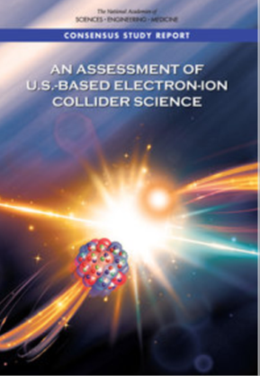
NAS Report on EIC Requirements
The EIC requirements have remained consistent, see e.g., the 2012 white paper and 2015 NSAC Long Range Plan

Slide 5
EIC Science Landscape
EIC: Understanding the Glue that Binds Us All - Without gluons, there would be no nucleons, no atomic nuclei… no visible world!
A huge leap in accessible kinematics landscape (into the land of gluons and the quark sea) for polarized e-N and unpolarized e-A reactions!

Slide 6
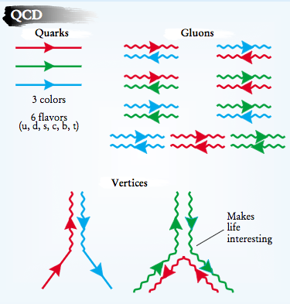
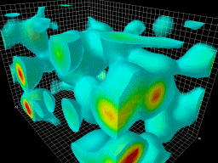
EIC: 21st Century Laboratory of Emergent Dynamics in QCD
Massless gluons & almost massless quarks, through their interactions, generate most of the mass of the nucleons
Gluons carry ~50% of the proton’s momentum, a significant fraction of the nucleon’s spin, and are essential for the dynamics of confinement
Properties of hadrons – composite systems of quarks and gluons – are emergent phenomena and inextricably tied to the properties of the QCD vacuum. Striking examples besides confinement are spontaneous symmetry breaking and anomalies
The nucleon-nucleon forces emerge from quark-gluon interactions: how this happens remains a mystery
The goal is to provide us with an understanding of the internal structure of the proton and more complex atomic nuclei that is comparable to our knowledge of the electronic structure of atoms, which lies at the heart of modern technologies

Slide 7
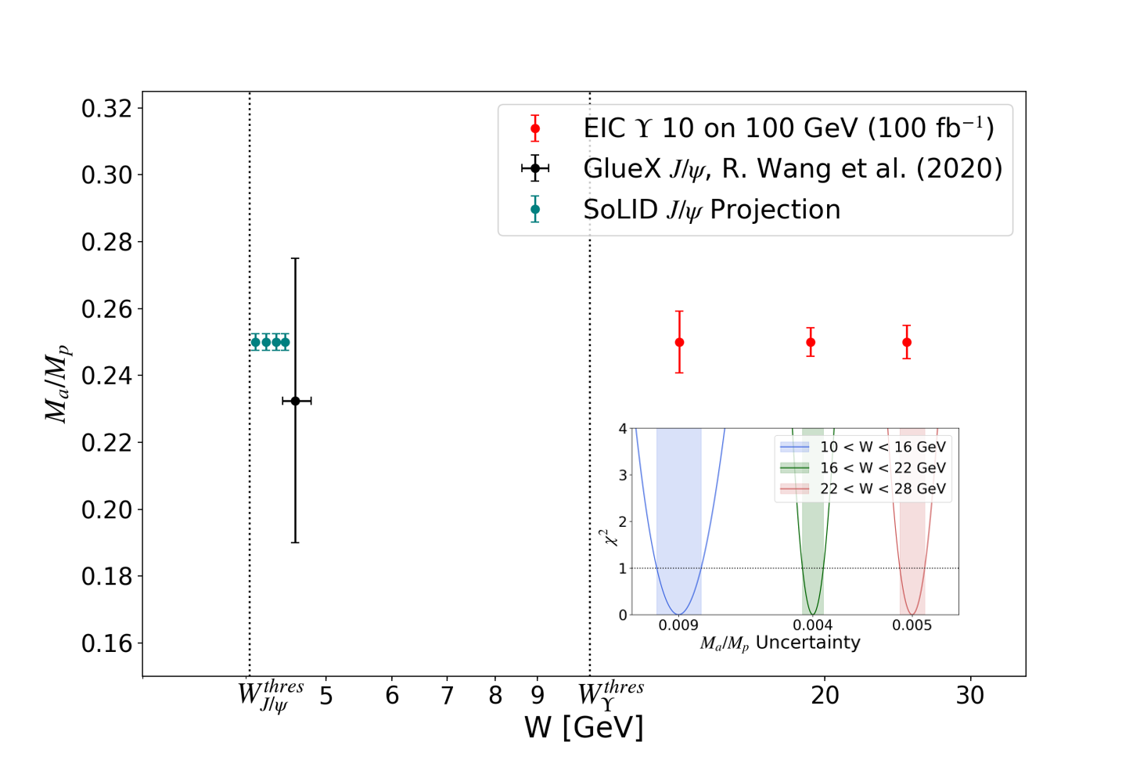
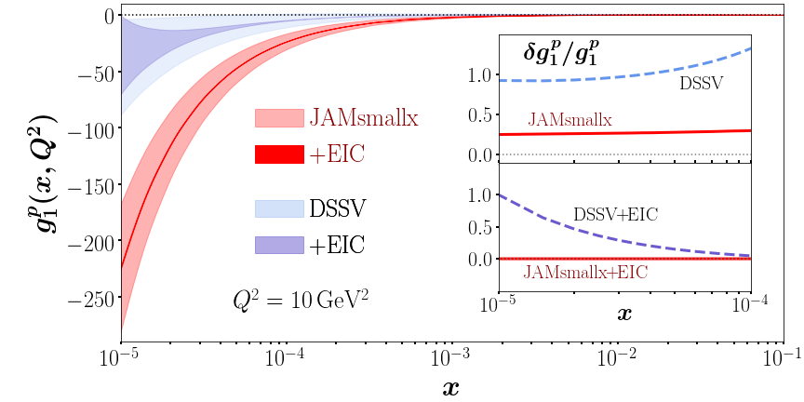
The EIC Will Deliver
Some highlight plots from new EIC White Paper (full draft will be released for EICUG feedback in November)
Mass
Spin
Pion PDF uncertainty ratio
Imaging
Nuclei

Slide 8


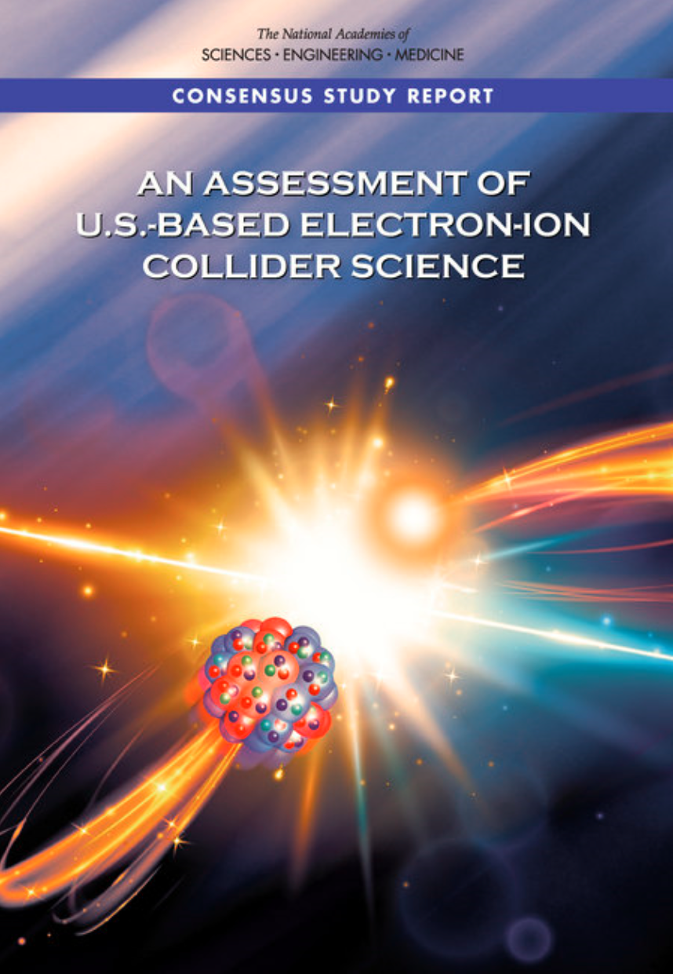

EIC Scope
Project Design Goals
High Luminosity: L= 10³³ – 10³⁴cm⁻²sec⁻¹, 10 – 100 fb⁻¹/year
Highly Polarized Beams: 70%
Large Center of Mass Energy Range: E_{cm} = 29 – 140 GeV
Large Ion Species Range: protons – Uranium
Large Detector Acceptance and Good Background Conditions
Accommodate a Second Interaction Region (IR)
IR-8
IR-6, ePIC Detector
IR-8
p/A beam
e beam
p: 41 GeV, 100 to 275 GeV
e: 5 GeV to 18 GeV

Slide 9
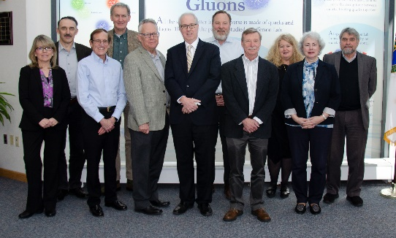
EIC Project Recent History
Event | Date
DOE Mission Need Statement Approved | January 22, 2019
Critical Decision – 0 (CD-0) Approved | December 19, 2019
DOE Site Selection Announced | January 9, 2020
Feb 28, 2020 @ JLab
Integrated partnership in all Project phases, including co-hosting the EIC experimental program.
BNL - TJNAF Partnership Agreement | May 7, 2020
Conceptual Design Review | November 16-18, 2020
DOE Office of Science CD-1 Review | January 26-29, 2021
DOE Independent Cost Review | January - February 2021
CD-1, Alternative Selection and Cost Range, Approved | June 29, 2021
CD-2/3A, Baseline/Long Lead Procurement | January 2024

Slide 10
EIC Project – Path to CD-2/3A and CD-3
DOE OPA Status Review (Remote) October 19-21, 2021(A)
Funding Discussion at DOE ONP (In-Person) April 26, 2022 (A)
FPD Status Update at BNL (Hybrid) June 28-30, 2022 (A)
Cost and Schedule Scrutiny Meetings July - September 2022
Project Detector Meetings 2022
  Technical Subsystem Reviews Feb. – Dec. 2022
  Pre-Resource Review Board Kickoff Meeting October 2022
DOE OPA Status Review - Confirm CD-2/3A Plans Jan. 30 – Feb. 2, 2023
Preliminary Design and Director’s Reviews June 2023
DOE CD 2/3A OPA Review and ICR, requires pre-TDR October 2023
DOE CD 2/3A ESAAB Approval January 2024
DOE CD 3 OPA Review, requires TDR ~January 2025
DOE CD 3 ESAAB Approval ~April 2025
OPA = Office of Project Assessment
FPD = Federal Project Director
ICR = Independent Cost Review
ESAAB = Energy Systems Acquisition Advisory Board
TDR = Technical Design Report

Slide 11
EIC Science – Findings of the NAS Committee
Finding 3: An EIC would be a unique facility in the world and would maintain U.S. leadership in nuclear physics.
Finding 4: An EIC would maintain U.S. leadership in the accelerator science and technology of colliders and help to maintain scientific leadership more broadly.
EIC science is compelling,
timely and fundamental
Developed by NAS committee with broad science perspective

Slide 12
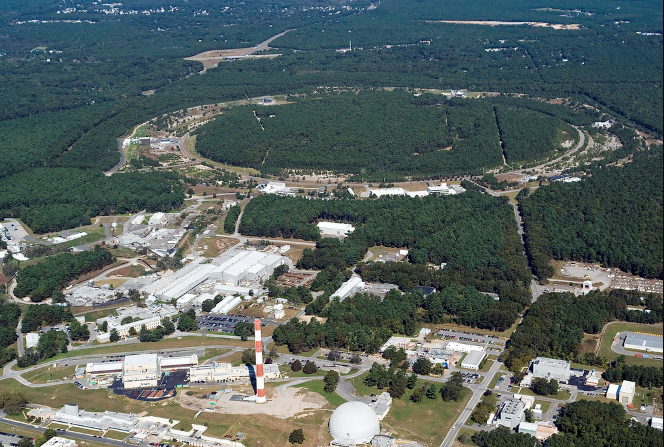

EIC Accelerator Design Overview
Hadron storage ring (HSR): 40-275 GeV (existing)
  up to 1160 bunches, 1A beam current (3x RHIC)
  bright vertical beam emittance (1.5 nm)
  strong cooling (coherent electron cooling, ERL)
Electron storage ring (ESR): 2.5–18 GeV (new)
  up to 1160 polarized bunches
    high polarization by continual reinjection from RCS
  large beam current (2.5 A) ➔ 9 MW SR power
  superconducting RF cavities
Rapid cycling synchrotron (RCS): 0.4-18 GeV (new)
  2 bunches at 1 Hz; spin transparent due to high periodicity
High luminosity interaction region(s) (new)
  L = 10³⁴ cm⁻²s⁻¹
  superconducting magnets
  25 mrad crossing angle with crab cavities
  spin rotators (produce longitudinal spin at IP)
EIC

Slide 13
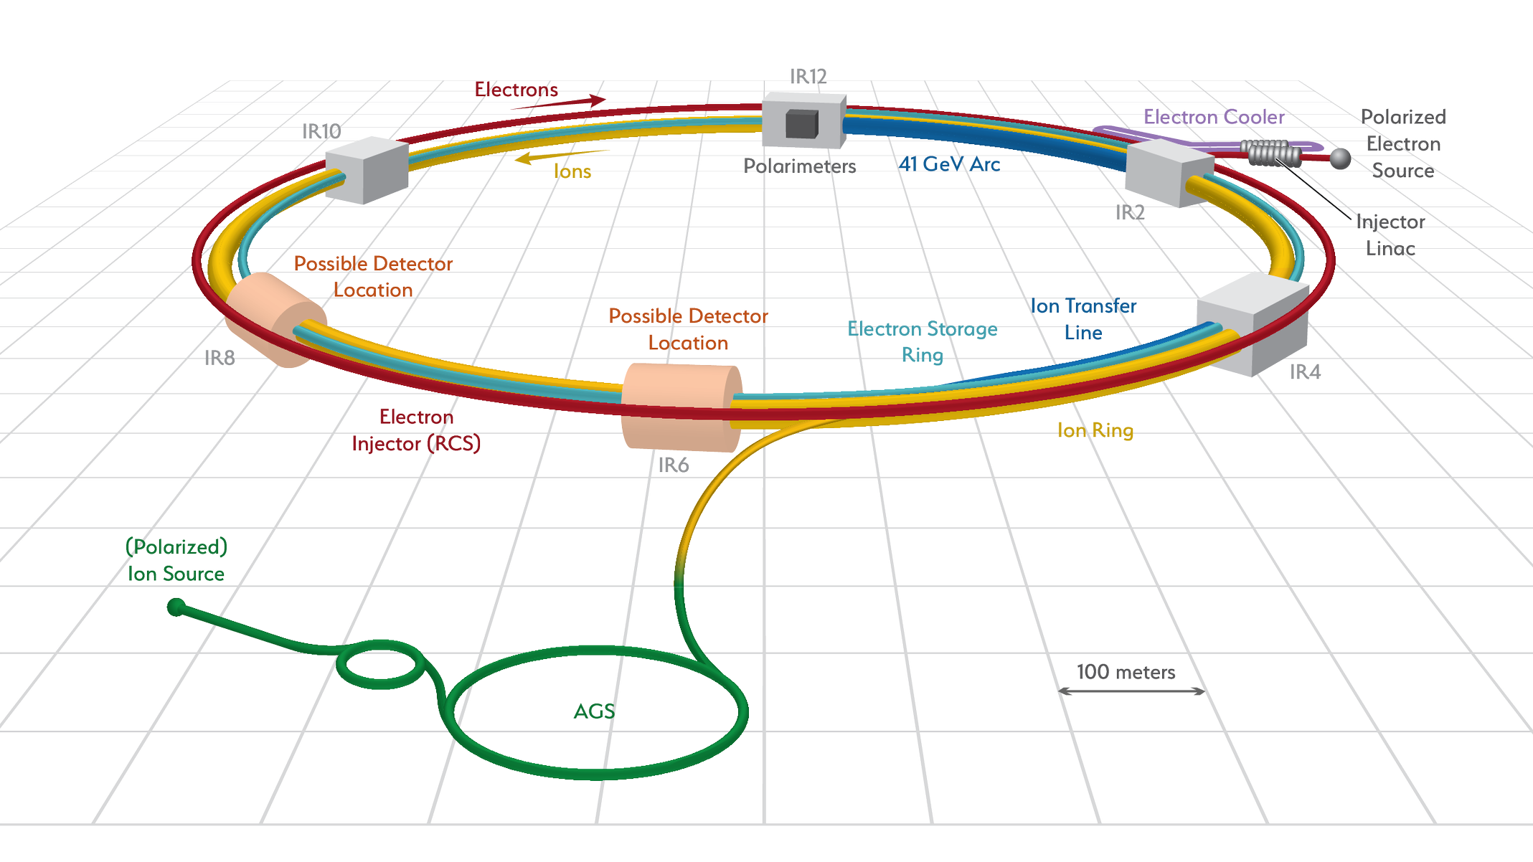
Accelerator Science and Technology – Ongoing EIC R&D
Cooler Electron Source
ESR
Vacuum R&D
Electron Injection
Fast Kicker
Strong Cooling
Polarized e⁻ Source
ESR Cavity
Prototype
HSR Vacuum Upgrade
ESR RF 500kW FPC
2nd IR
ePIC
Hadron Polarimetry
ESR RF HOM Damper
Crab Cavity
Prototype
Proton Injection
Fast Kicker
IR Design and Magnet Prototyping
IR Vacuum Chamber
Existing tunnel and
experiment halls
ONLY US-Based Collider in foreseeable future! Allows to remain at frontier of Accelerator S&T
… and enable applications (isotopes, space radiation, water treatment, etc.)

Slide 14
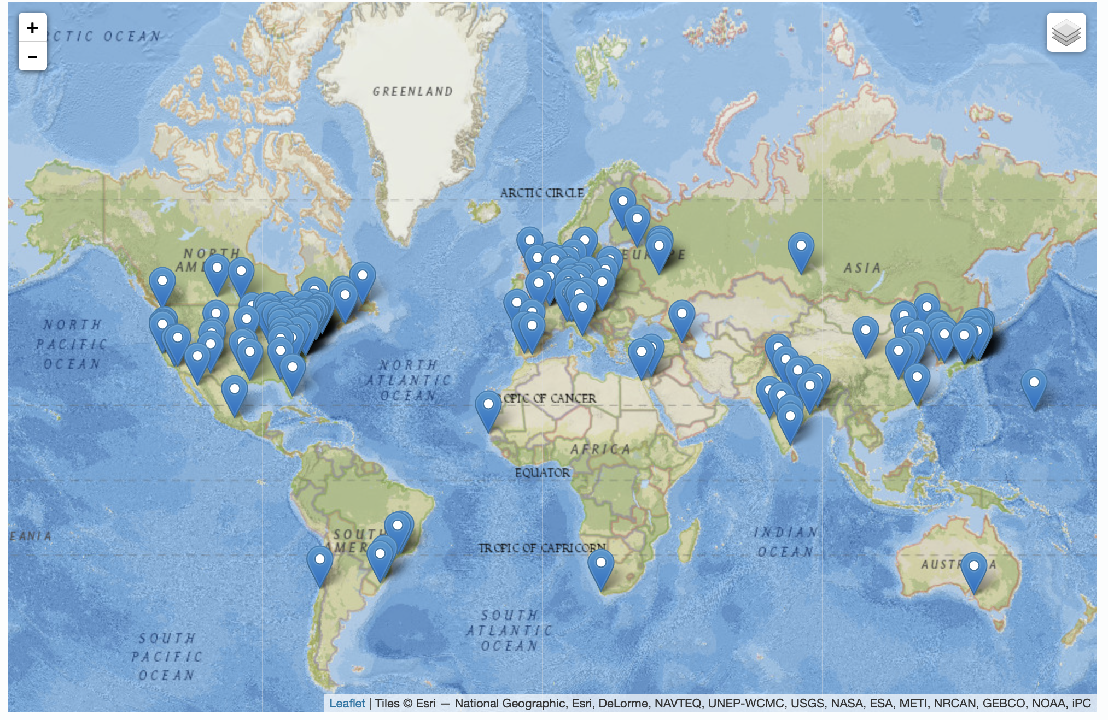
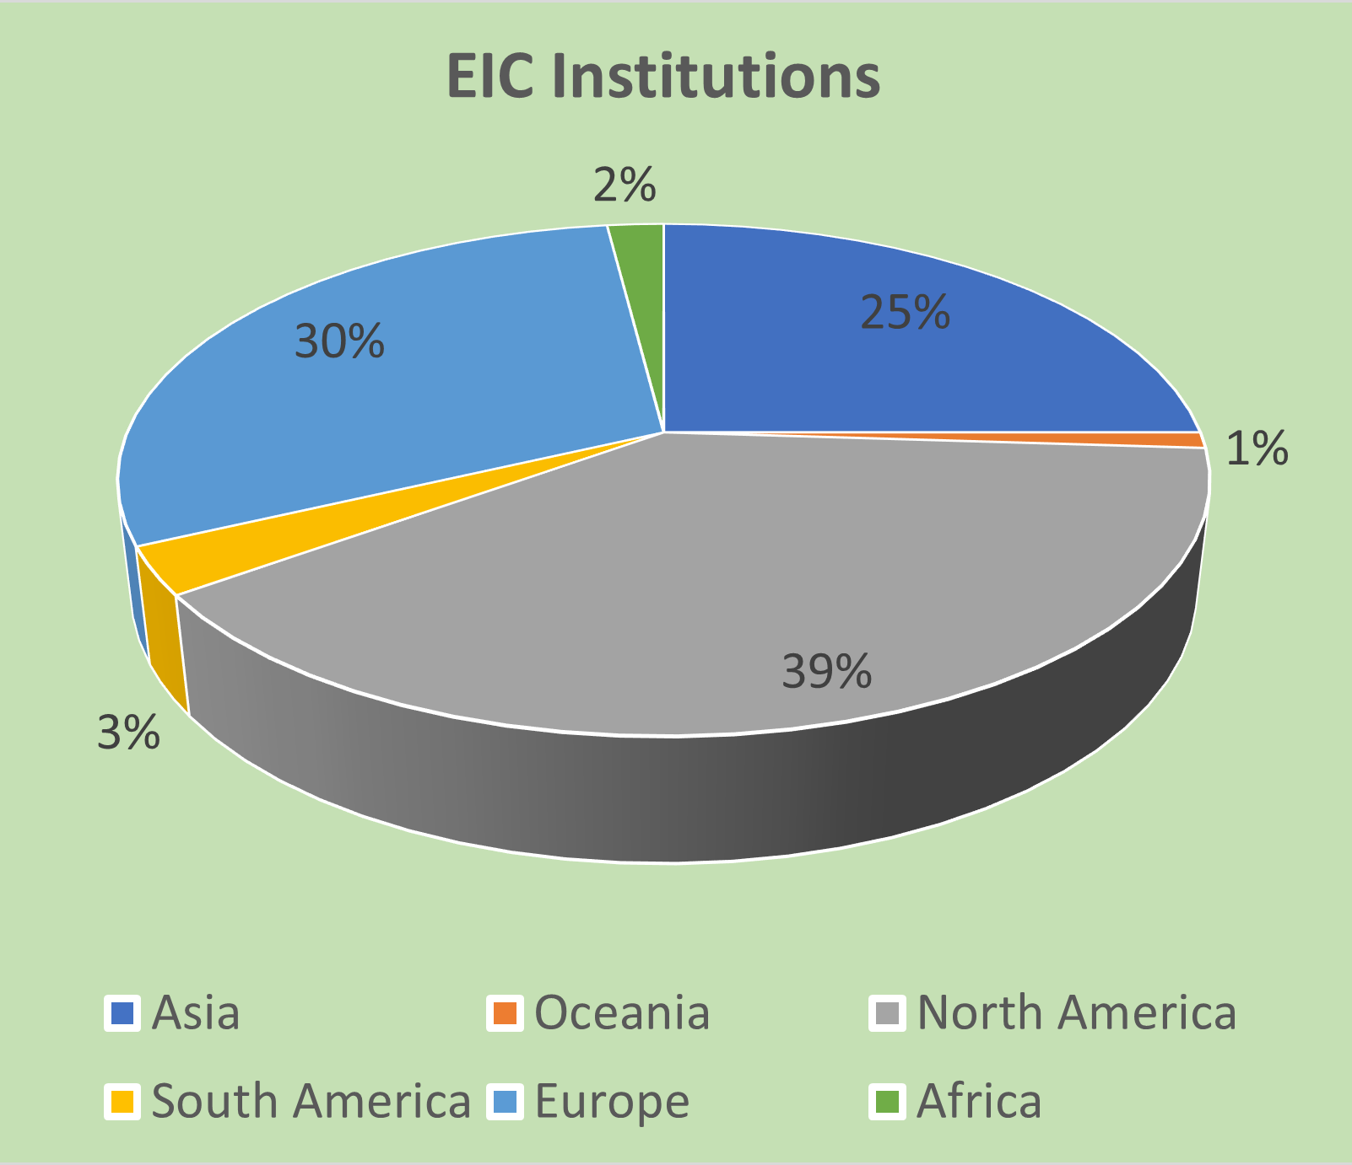
Worldwide Interest in EIC
The EIC User Group: https://eicug.github.io/
Map of institution’s locations
Formed 2016 –
1361 collaborators,
36 countries,
267 institutions as of September 20, 2022.
Strong and Growing International Participation.
Annual EICUG meeting
2016 UC Berkeley, CA
2016 Argonne, IL
2017 Trieste, Italy
2018 CUA, Washington, DC
2019 Paris, France
2020 Miami, FL
2021 VUU, VA & UCR, CA
2022 Stony Brook U, NY
2023 Warsaw, Poland
14

Slide 15
EIC User Group Organization
The EIC User Group: https://eicug.github.io/
EIC User Group Steering Commitee
Renee Fatemi (Univ. Kentucky, USA) (Chair)
Marco Radici (INFN-Pavia, Italy) (Vice Chair)
Yuri Kovchegov (OSU, USA) (Member at large)
Silvia Dalla Torre (INFN-Trieste, Italy) (Member at large)
Tanja Horn (CUA, USA) (Member at large)
Rolf Ent (JLab Representative)
Thomas Ullrich (BNL Representative)
Daria Sokhan (Saclay, France) (EU Representative)
Asmita Mukherjee (IITB, India) (International Representative)
Olga Evdokimov (UIC, USA) (IB Chair)
Previous Members: Christine Aidala, John Arrington, Daniel Boer (Netherlands), Wouter Deconinck (Canada), Abhay Deshpande, Yuji Goto (Japan), Charles Hyde, Barbara Jacak, Richard Milner, Ernst Sichtermann, Bernd Surrow, Rik Yoshida

Slide 16
EICUG-Driven Yellow Report Activity
Year-long EIC User Group driven Yellow Report activity http://www.eicug.org/web/content/yellow-report-initiative
Different Physics (5) and Detector (8) Working Groups
Timeline:
  December 2019 Kick-off meeting at MIT (only in-person meeting!!!)
  March 2020 1st meeting at Temple
  May 2020 2nd meeting at Pavia/Italy
  July 15-17, 2020 remote EIC-UG Meeting
  September 2020 3rd meeting at CUA
  November 2020 4th meeting at UCB/LBL
  January 12, 2021 Sent to external reviewers
  February 2021 Yellow Report on arXiv
Science Requirements and Detector Concepts for the EIC
  arXiv:2103.05419 – 361 citations as of 09/17/22
  Appeared as one volume in Nucl. Phys. A 1026 (2022) 122447
Drives science requirements and detector concepts for the EIC
  Led to reference detector @ CD-1
  Functioned as seed for detector proposal process

Slide 17
Experimental Program Preparation
Year-long EIC User Group driven EIC Yellow Report activity
  Science Requirements and Detector Concepts for the EIC
  arXiv:2103.05419 – 361 citations (09/17/22)
  Appeared as one volume in Nucl. Phys. A 1026 (2022) 122447
Drives the requirements of EIC detectors
BNL and TJNAF Jointly Leading Efforts Towards Experimental Program | BNL and TJNAF Jointly Leading Process to Select Project Detector
2020 | Call for Expressions of Interest (EOI) https://www.bnl.gov/eic/EOI.php | May 2020
 | EOI Responses Submitted | November 2020
 | Assessment of EOI Responses | On-going
2021 | Call for Collaboration Proposals for Detectors https://www.bnl.gov/eic/CFC.php | March 2021
 | BNL/TJNAF Proposal Evaluation Committee | Spring 2021
 | Collaboration Proposals for Detectors Submitted | December 2021
✔️ | Decision on Project Detector – “ECCE” | March 2022
 | Guide process to joint “Detector-1” Collaboration | Spring 2022
 | EPIC Collaboration* Formed – 160 institutions | July 2022
*Merger of two large ATHENA and ECCE proposals

Slide 18
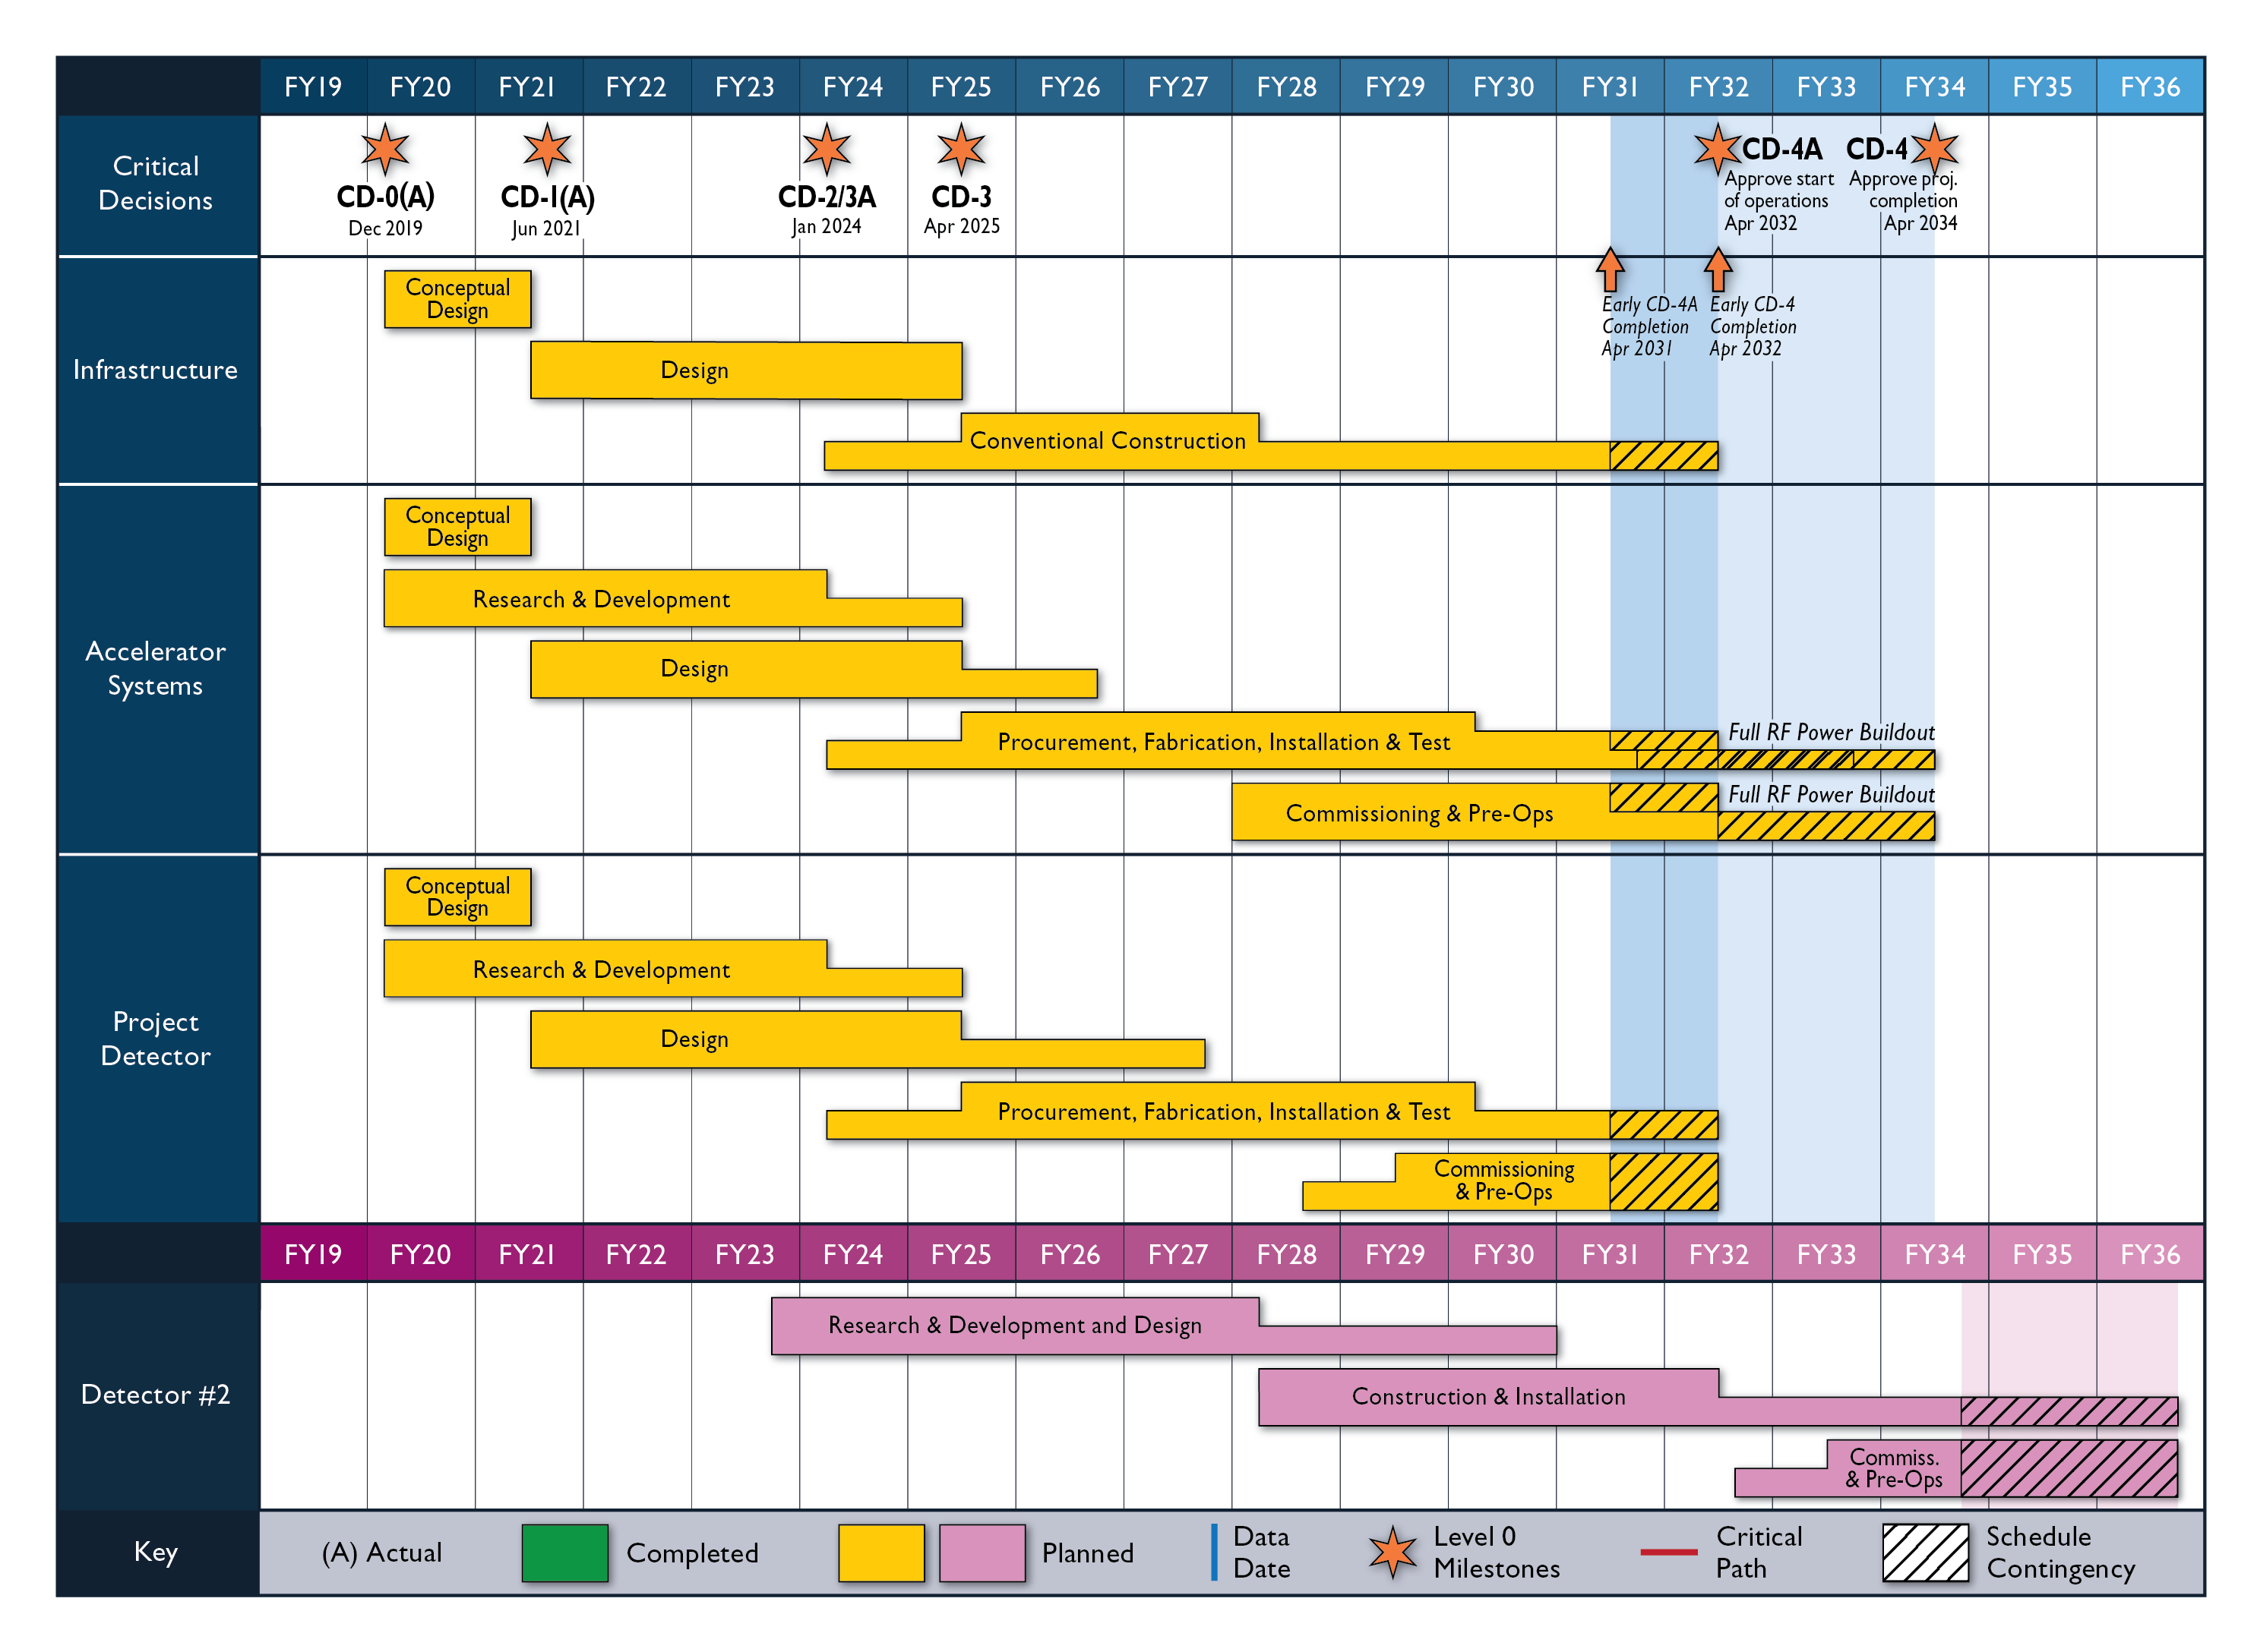
High Level EIC Reference Schedule
Construction Phase
Science Phase
The thinner bars indicate that R&D and design
can continue at a small level beyond CD-2 and CD-3
for LLP construction
starts at CD-2/3A
Notional Schedule
2nd IR and
Schedule
Generic Detector R&D

Slide 19
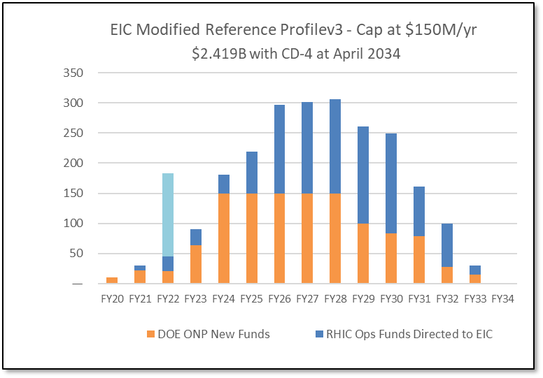
Latest News on the Funding and Schedule
Inflation Reduction Act:
$217M to Nuclear Physics in FY22 to be spent by FY27.
Includes EIC (to get to CD-2) – $138.24M.
(IRA funds can ONLY be used for project scope, but NOT to add scope)
Schedule: CD-2/3A = January 2024; CD-3 = April 2025; CD-4 Project Completion = 2034
RHIC operations conclude and EIC tunnel work starts in June 2025
Cost: CD-1 cost range of $1.7B-$2.8B
→ The DOE funding to ensure CD-2/3A timeline (baselining, start of long-lead procurement items) and CD-3 (start of construction) seems secured.

Slide 20
Take-Away Messages
During the last QCD Town Meeting (2014) the vote for an EIC was unanimous. Since then, the strong and worldwide interest of the community in the EIC has grown rapidly. “Now is the time to realize the EIC in the U.S.” (LRP 2015).
The NAS Report concluded: “EIC science is compelling, timely and fundamental.”
The EIC Science Case is as strong as, if not stronger than, before.
The EIC is executed as a partnership of BNL and JLab, in strong collaboration with the large EIC user community.
The EIC User Group continues growing, and currently stands at 1361 members in 36 countries.
  This is a strong community that has delivered on the EIC Science White Paper, the Yellow Report, and three detector proposals.
  Efforts towards the ePIC detector and a path to a 2nd detector are ongoing.
Recent IRA funding results in a phase change – the schedule for EIC to CD-3 (~2025) is likely to be technically driven.
  This underscores DOE/SC is committed to EIC as a top priority
  The focus of the EIC Project will be schedule, schedule, schedule
There will be one EIC with this high level of performance in the world.
  This will keep the U.S. on the frontiers of nuclear science, accelerator, and detector technologies.

Slide 21
Suggested Recommendation
Recommendation: We recommend expeditious completion of the EIC as the highest priority for facility construction
The EIC is a powerful and versatile new accelerator facility, capable of colliding high-energy beams ranging from heavy ions to polarized light ions and protons with high-energy polarized electron beams. In the 2015 Long Range Plan the EIC was put forward as the highest priority for new facility construction and the expeditious completion remains a top priority for the nuclear physics community. The EIC, accompanied by a general-purpose large-acceptance detector, ePIC, will be a discovery machine that addresses fundamental questions such as the origin of mass and spin of the proton as well as probing dense gluon systems in nuclei. It will allow for the exploration of new landscapes in QCD, permitting the “tomography”, or high-resolution multidimensional mapping of the quark and gluon components inside of nucleons and nuclei. Realizing the EIC will keep the U.S. on the frontiers of nuclear physics and accelerator science and technology.

Slide 22


Slide 23
EIC Timeline – What Is Coming
CD-0 approval December 19, 2019
Community-wide Yellow Report effort Dec. 2019 – Feb. 2021
CD-1 review (includes CDR) January 26-29, 2021
Call for Collaboration Proposals for Detectors March 6, 2021
CD-1 approval June 29, 2021
DOE/OPA Status Review October 19-21, 2021
Status Update to Federal Project Director June 28-30, 2022, @BNL
Cost and Schedule Event(s) May-June 2022
Technical Subsystem Reviews January – December 2022
OPA Status Review Jan. 30 – Feb. 2, 2023
Preliminary Design Complete & Review May 2023
Final Design/Maturity Readiness for CD-3A Items May 2023
CD-2/3A review (expectation), requires pre-TDR ~October 2023
CD-2/3A (expectation) ~January 2024
CD-3 review (expectation) ~January 2025
CD-3 (expectation), requires TDR ~April 2025

