Slide 1
The RHIC COLD QCD Program
Elke-Caroline Aschenauer (BNL)
2022 NSAC Long-Range Plan Town Hall Meeting on Hot and Cold QCD
MIT, September 23 -25, 2022

Slide 2
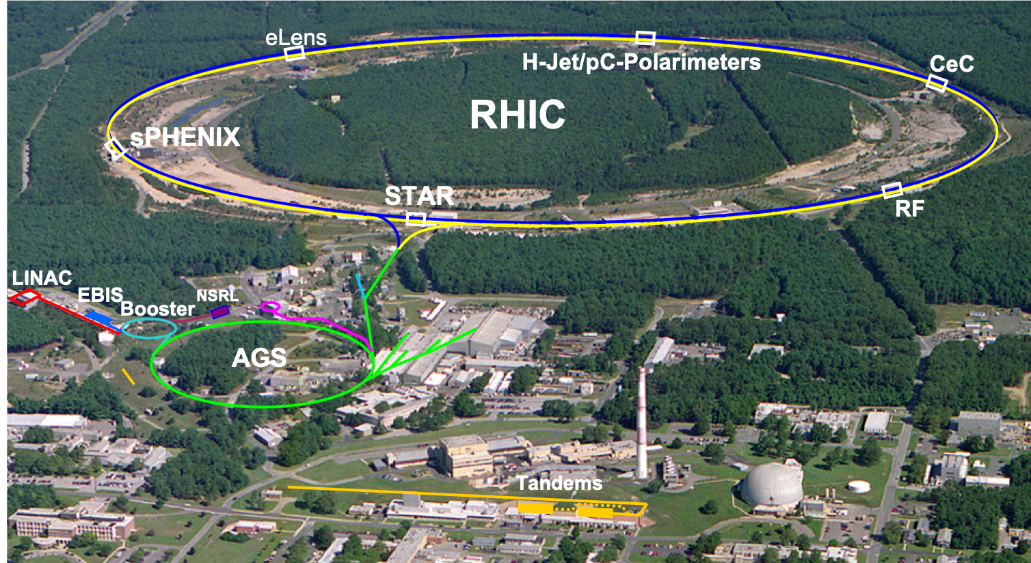
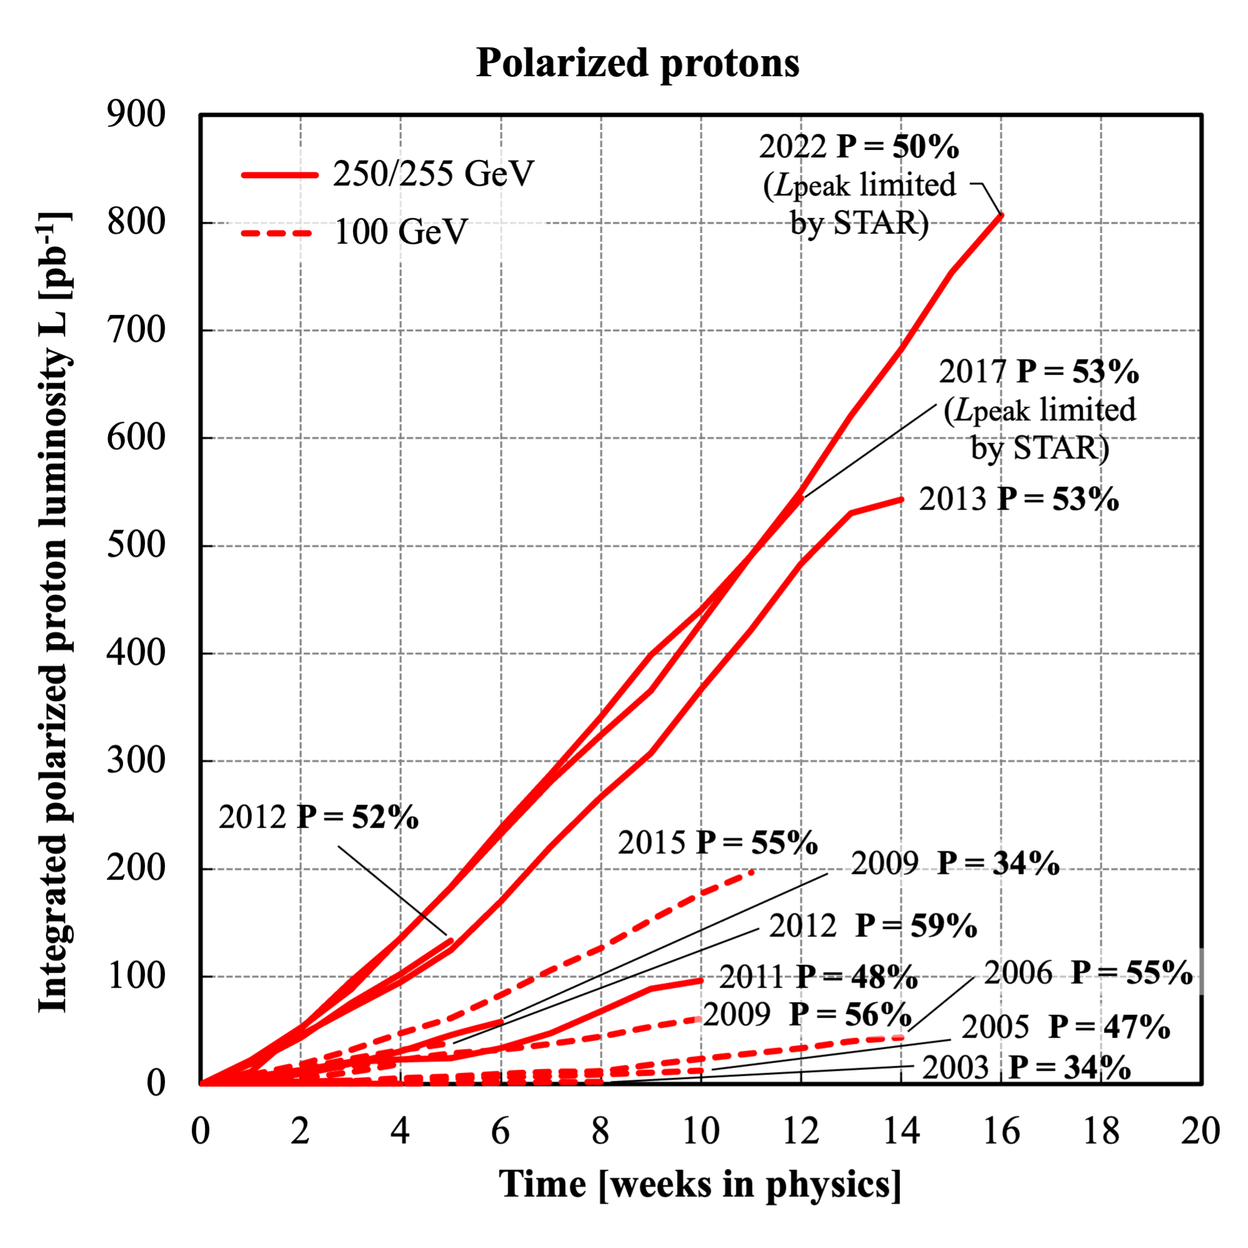
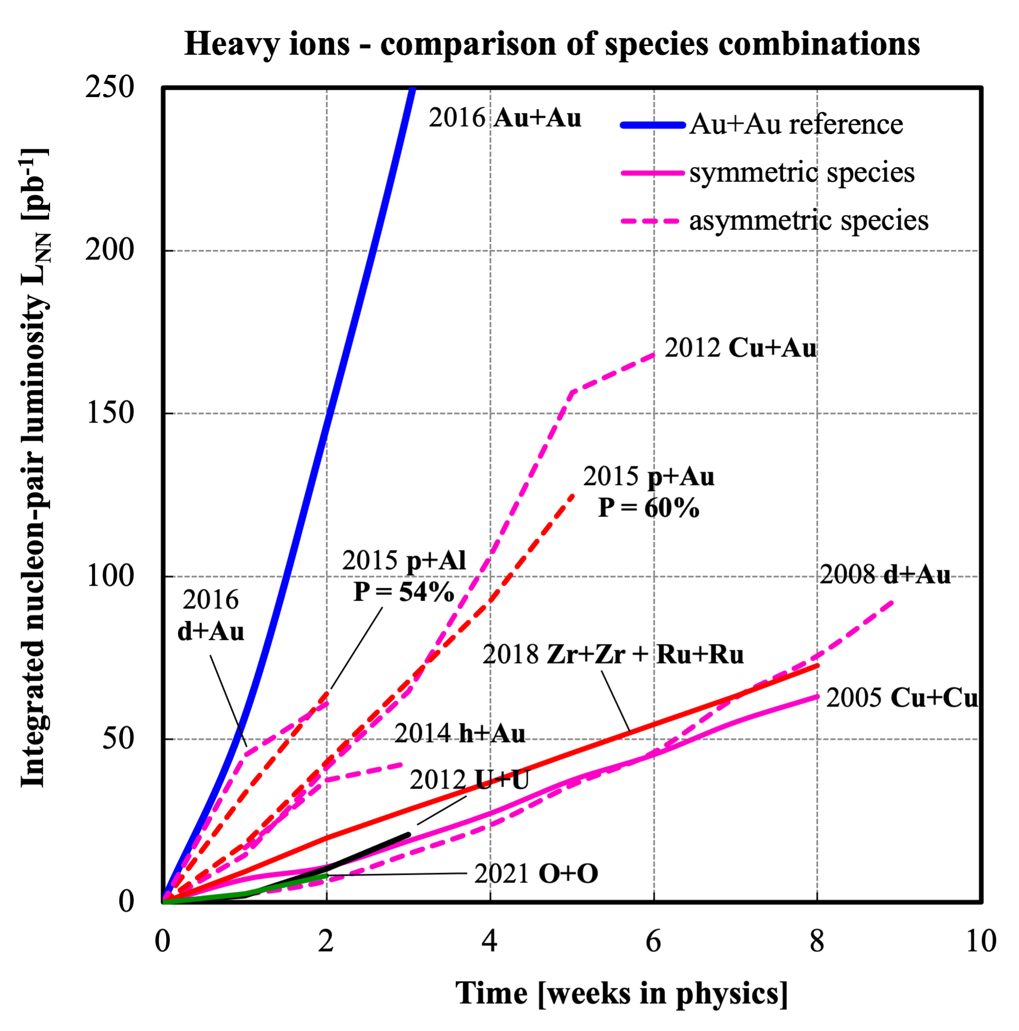
RHIC at BNL
PHENIX
Extremely successful pp and pA runs since last LRP
2015: pp (long. & transv.) @ 200 GeV , p↑Al and p ↑Au @ 200 GeV
2017: p↑p↑@ 510 GeV
2022: p↑p↑@ 510 GeV
2024: p↑p↑ @ 200 GeV and p↑Au @ 200 GeV
Major improvements in the determination of beam polarization systematics since 2017
H-jet (absolute polarization) 3% uncertainty due to H₂ contamination eliminated → now less than 0.1%
pC (fast relative polarization): improvements include stability of Carbon targets, hardware, and analysis methods
Polarization systematic uncertainty: previous uncertainty 3.3% → now 1.3% → approaching EIC requirements

Slide 3
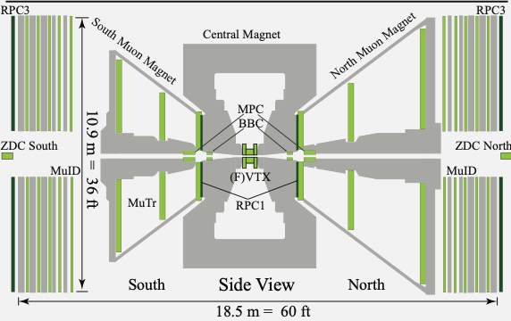
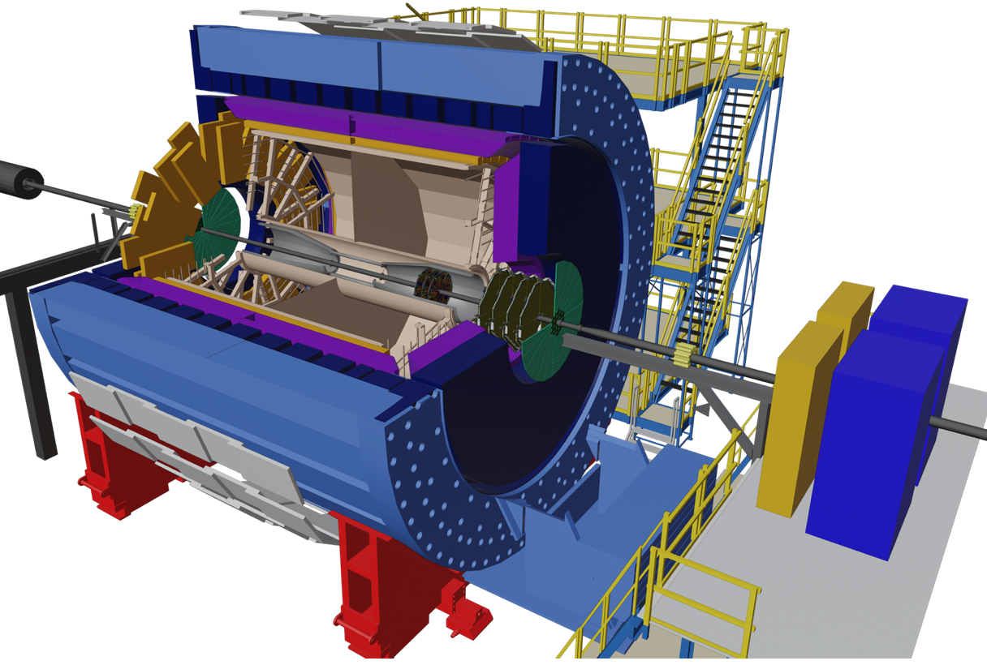
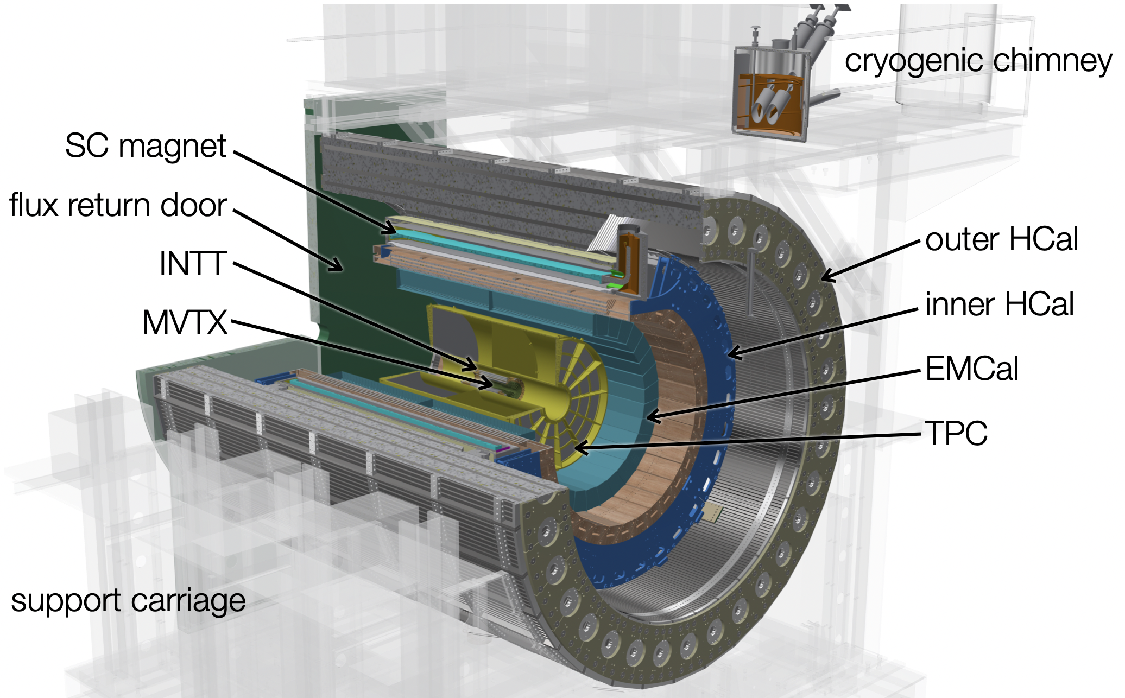
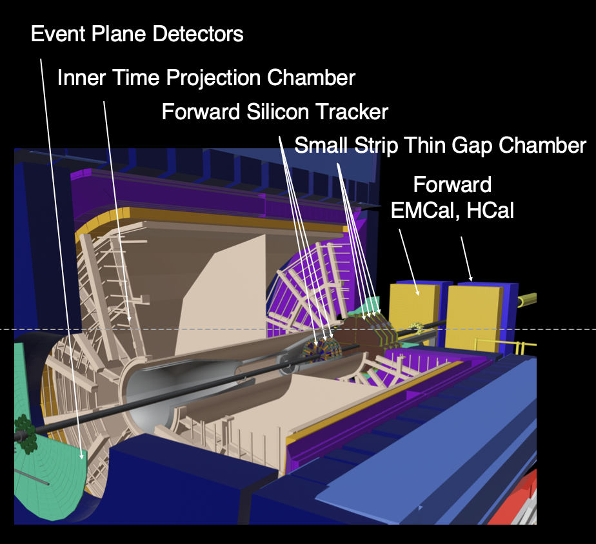
The RHIC Experiments
PHENIX
STAR
sPHENIX
-0.35 < η < 0.35
1.2 < |η| < 2.4 muon arms
|η| < 3 vertex trackers
Rapidity coverage
-1 < η < 4
-1 < η < 1
Particle Identification
e/h separation,
μ, γ, π⁰ Identification
π,K,p PID via dE/x, ToF
e/h separation,
μ, γ, π⁰ Identification
e/h separation,
γ, π⁰ Identification
Data Taking
2000 to 2016
2000 to 2025
2023 to 2025
Recent Upgrades
entirely new detector

Slide 4
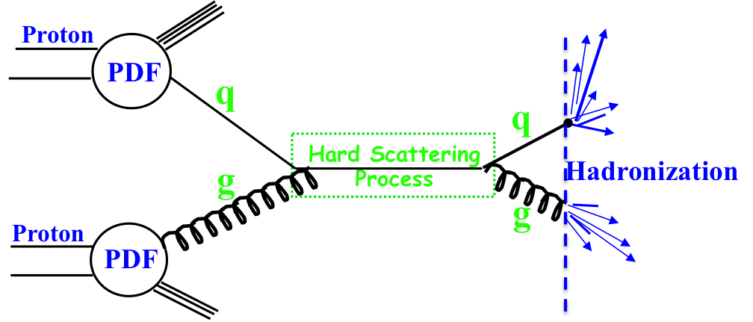
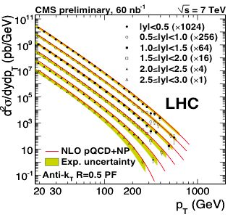

Why pp & pA Cold QCD
Complementarity
QCD has two concepts which lay its foundation
factorization and universality
To tests these concepts and separate probe dependent phenomena from
intrinsic nuclear properties
different complementary probes are critical
Probes: high precision data from ep, pp, e+e-
Factorization
Universality
Example: Measure PDFs at HERA at √s=0.3 TeV:
Predict pp and measurements at √s=0.2, 1.96 & 7 TeV
$$p\overline{p}$$
(un)polarized cross section ~
PDF ⊗ hard-scattering ⊗ Hadronization
hard-scattering : calculable in QCD
PDFs and Hadronization: need to be determined experimentally

Slide 5
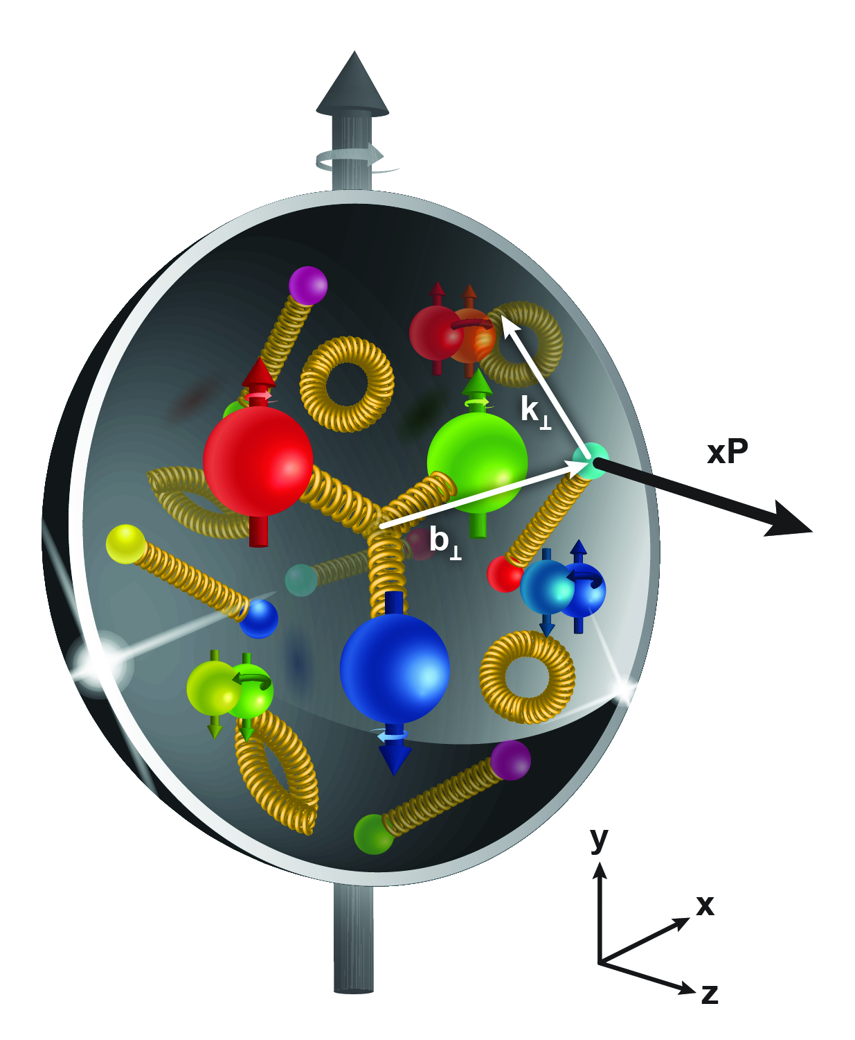



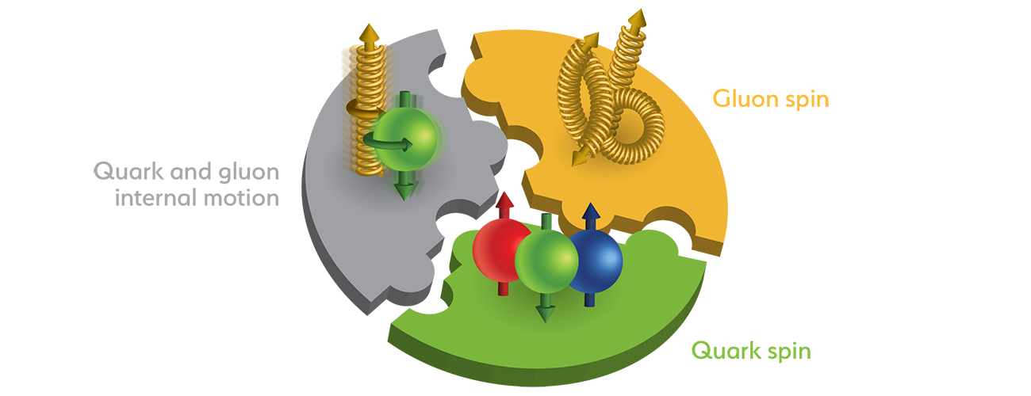
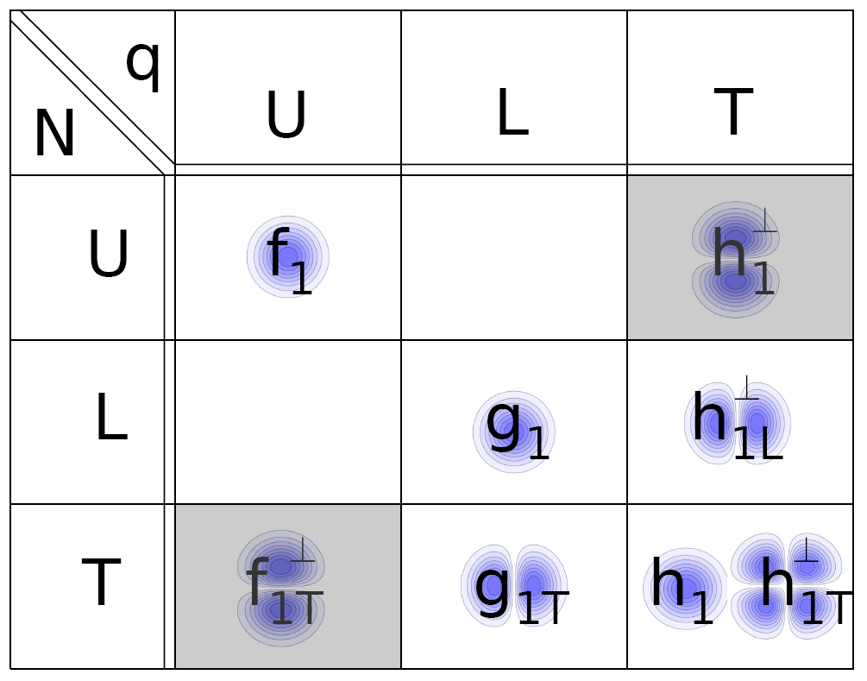
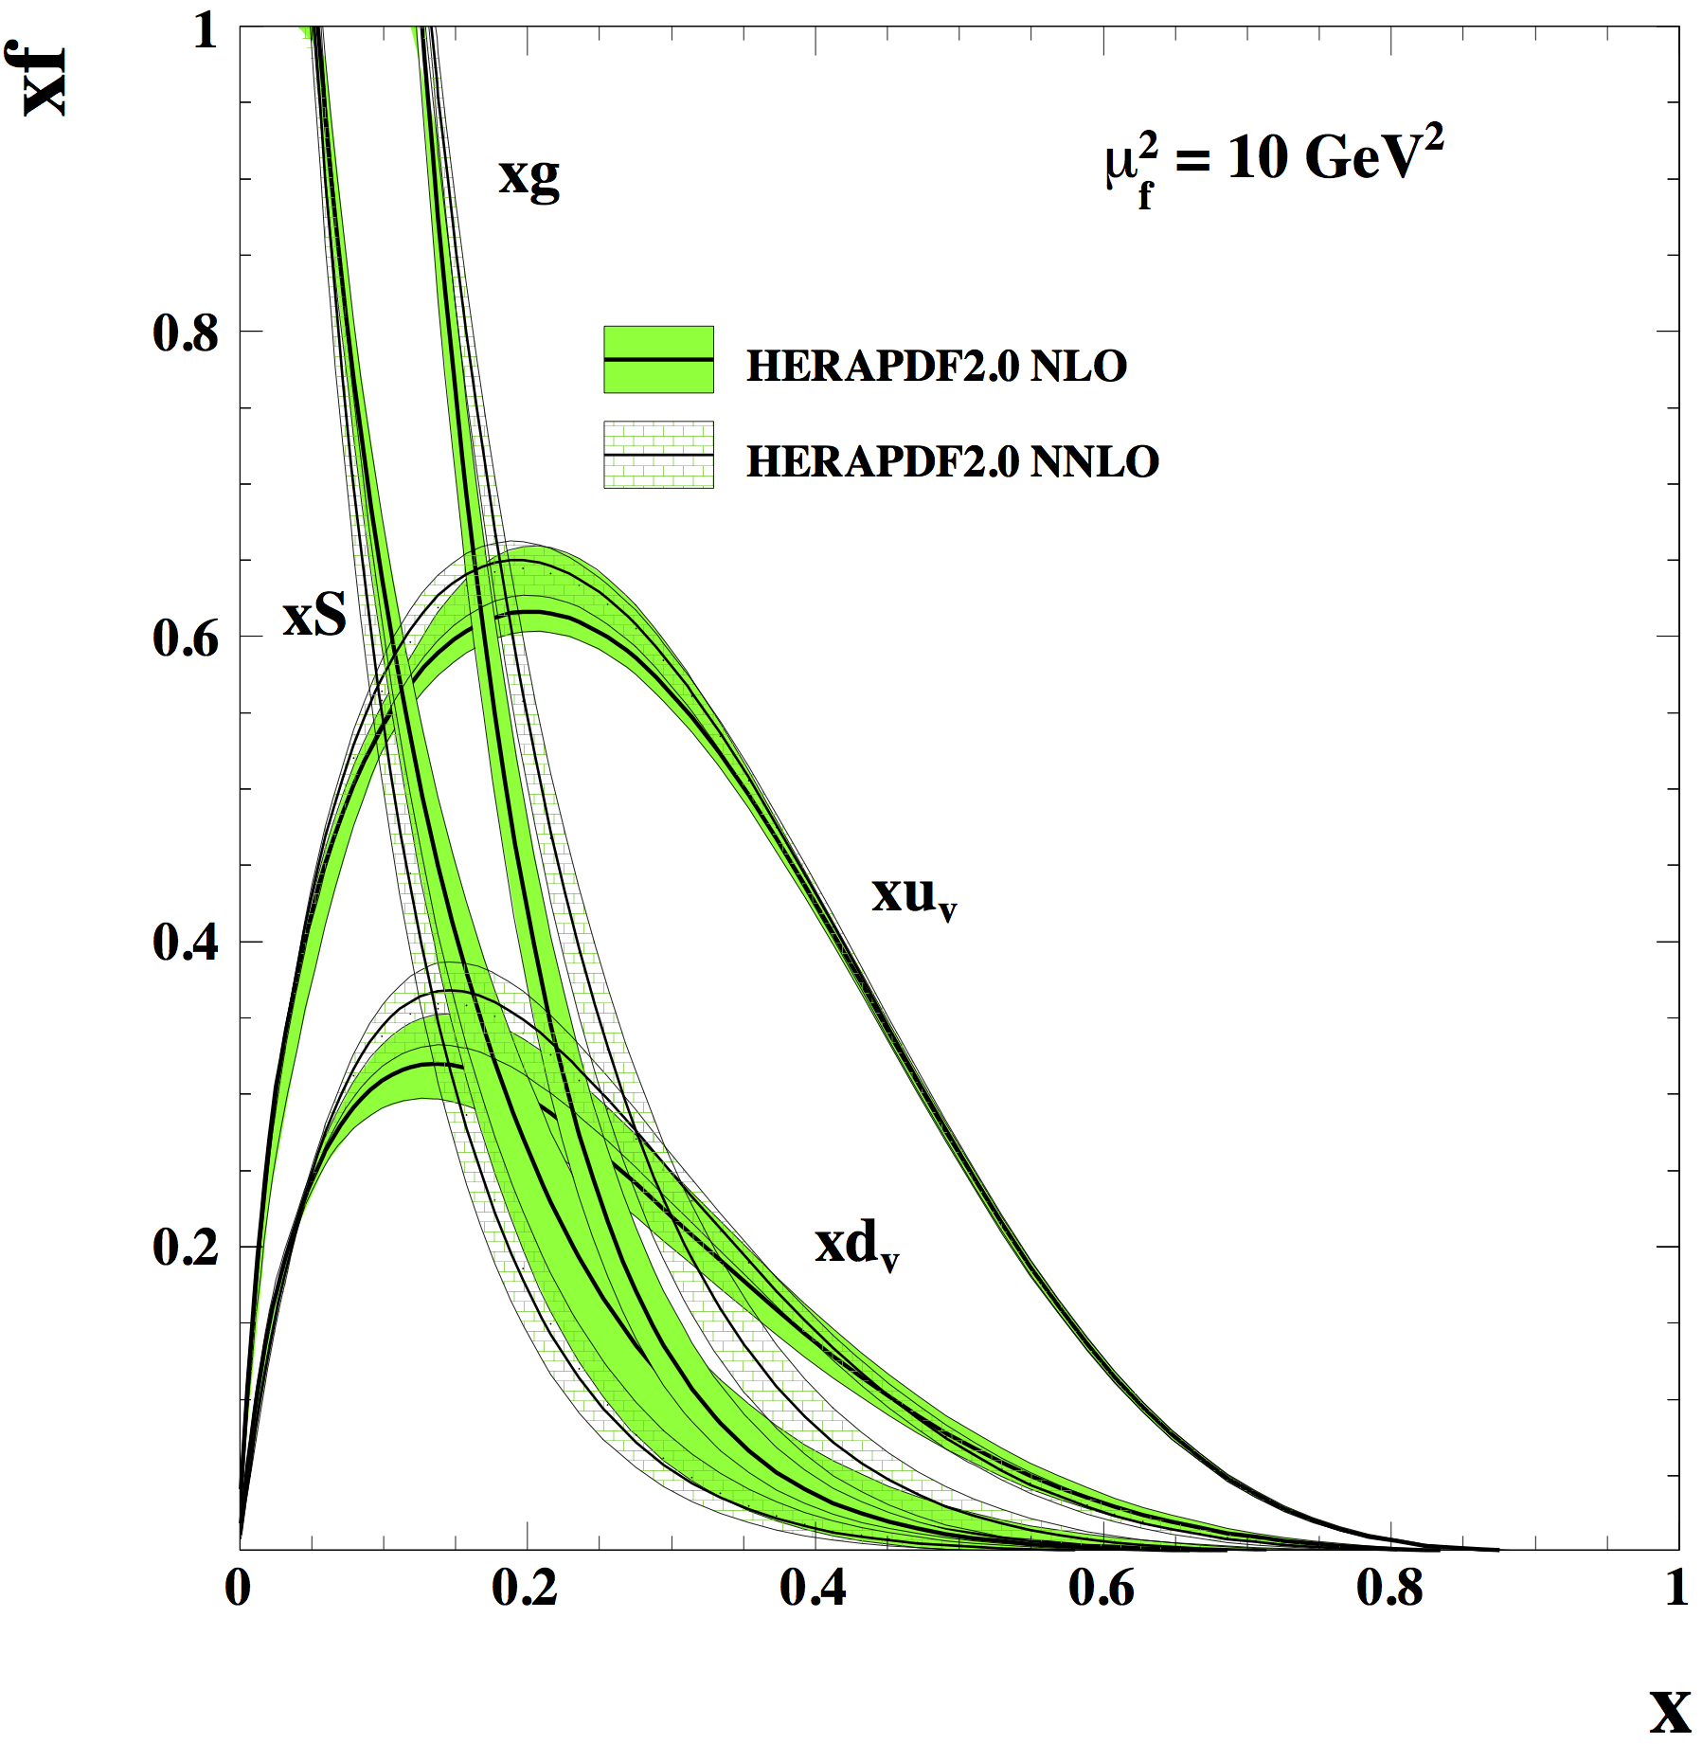
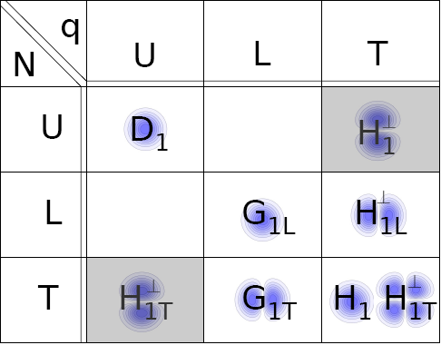
Pillars of the RHIC Cold QCD Program
1d Structure
What makes up spin
of the proton
3d Hadron Structure
spatial & momentum
L_{g,q}
ΔG
Δq
(n)PDFs
& (n)FF
TMD PDFs / FF
GPDs
Helicity PDFs
unpolarized
pp, pA
longitudinal
polarized pp
transverse
polarized pp, pA

Slide 6

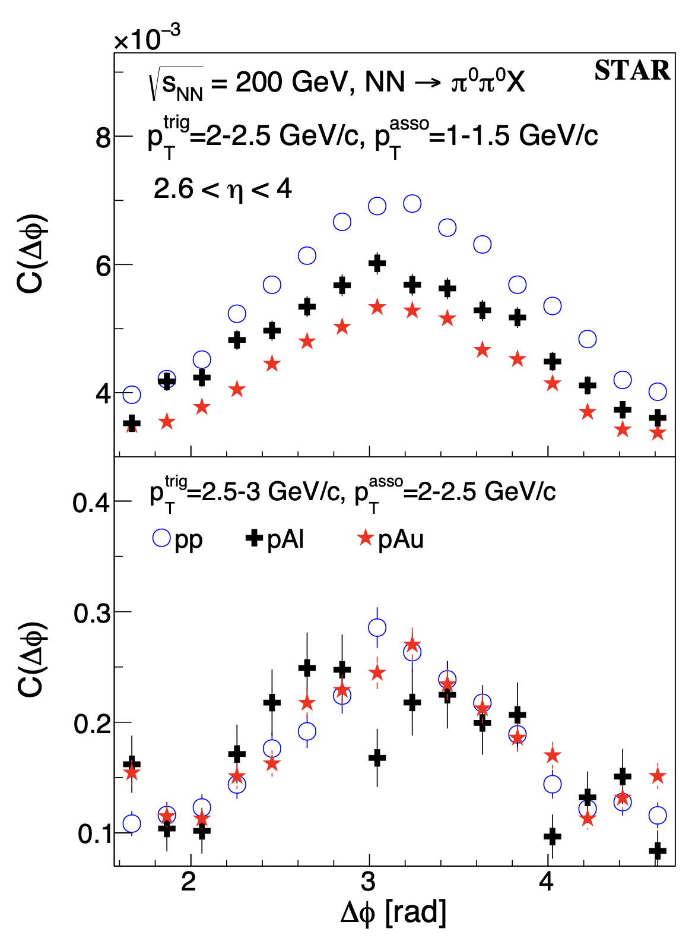
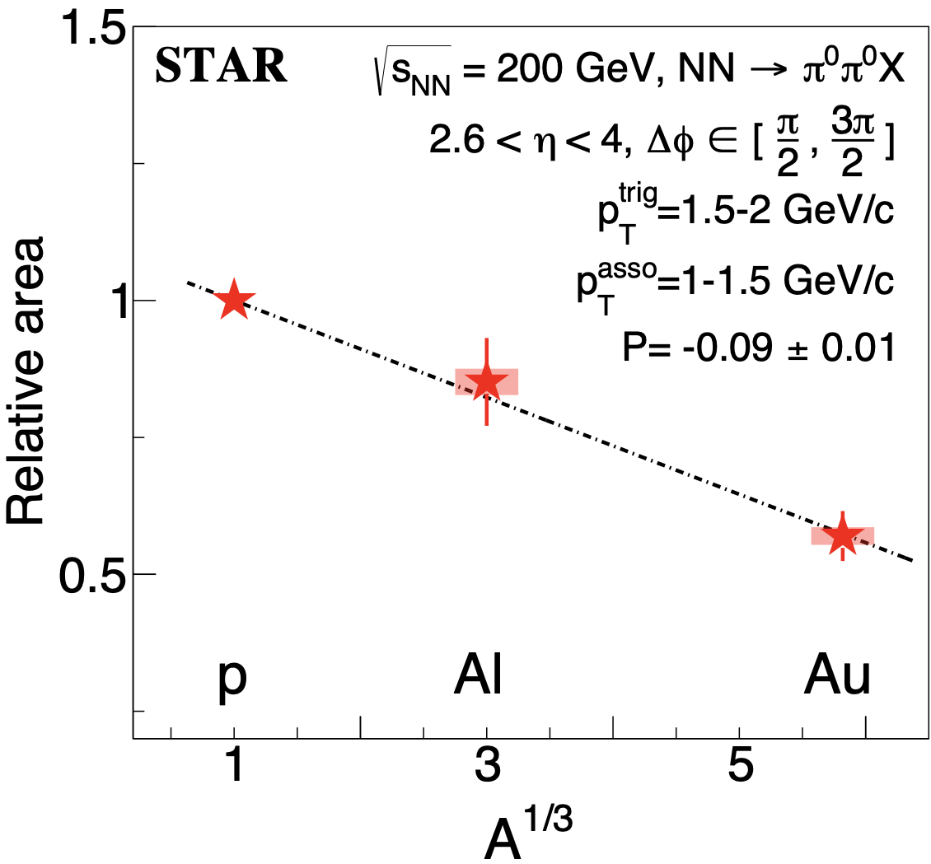
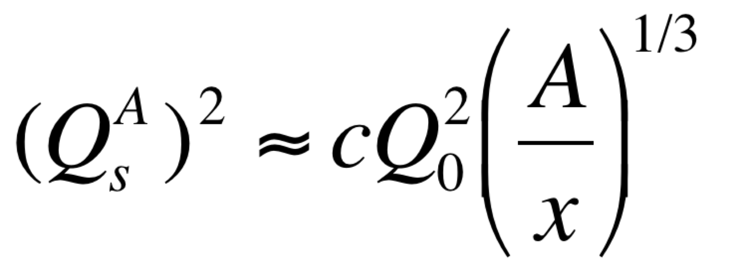
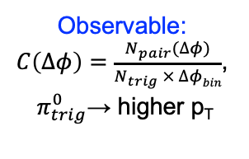
Probing Non-linear Effects in QCD
Forward rapidities at STAR provide an absolutely
unique opportunity to have very high gluon densities
→ proton – Au collisions
combined with an unambiguous observable
counting experiment of di-hadrons in pp and pA
Saturation: Disappearance of backward jet in pA
p
p
p
A
Phys.Rev.Lett. 129 (2022) 092501
Observable:
$C\left(∆φ\right)=\frac{N_{pair}(∆φ)}{N_{trig} × ∆φbin}$,
$π_{trig}^{0}$→ higher p_{T}
A dependence: at low p_{T} more suppression in pAu than pAl relative to the pp
x dependence: at high p_{T} (large x) no suppression in pA
Details: X. Chu Fr. @ 18:10

Slide 7
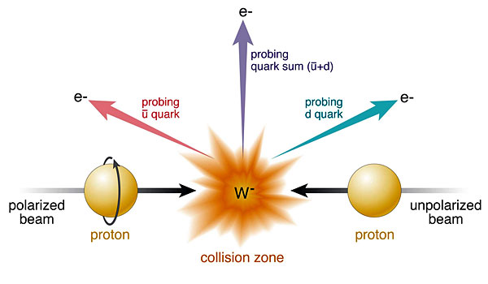
W-Production
Ws naturally separate quark flavors
rapidity: sea vs. valence quarks
Ws are maximally parity violating
Ws couple only to one parton helicity
longitudinal polarized protons:
unpolarized protons:
Complementary to SIDIS:
very high Q²-scale 6400 GeV²
extremely clean theoretically
No Fragmentation function
stringent test on theory approach
for SIDIS
UNIVERSALITY of PDFs

Slide 8
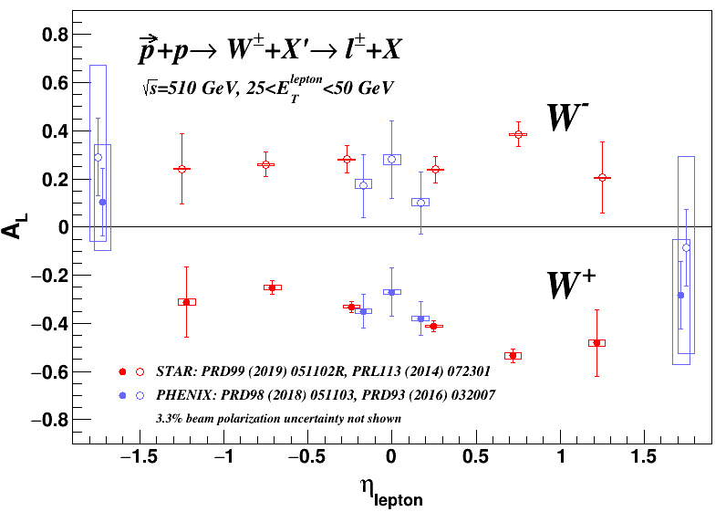
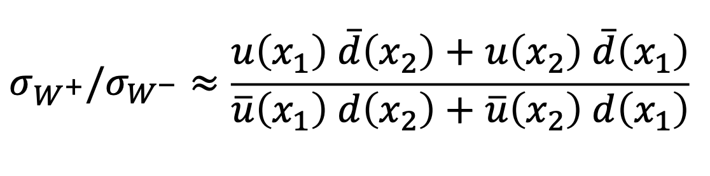
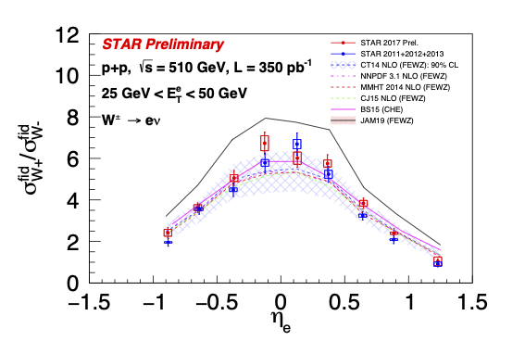
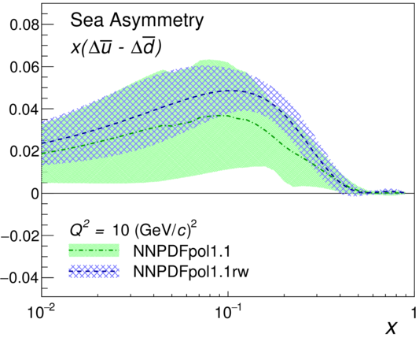



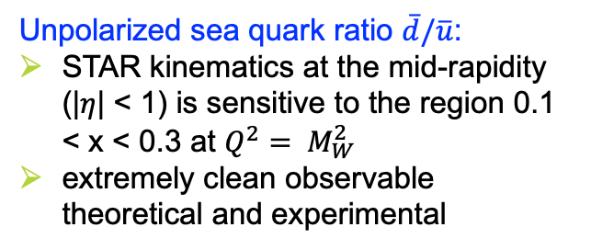

W-Production
Unpolarized sea quark ratio $\overline{d}/\overline{u}$:
STAR kinematics at the mid-rapidity (|$η$| < 1) is sensitive to the region 0.1 < x < 0.3 at $Q^{2}= M_{W}^{2}$
extremely clean observable theoretical and experimental
Polarized light sea quarks $∆\overline{q}, \overline{q}$:
Final results from the RHIC W-program (2009-2013):
STAR: PRD 99 (2019) 051102R
PHENIX: PRD 98 (2018) 032007
Run11-13, PRD 103, 012001(2021)
STAR: Impact study based on NNPDFpol1.1
RHIC – results:
unpolarized:
polarized:
$$\overline{u} − \overline{d}<0$$
  arXiv:1702.05077
Δ$\overline{u} −\text{D}\overline{d}>0$
δ$\overline{u} −\text{d}\overline{d} ??$

Slide 9
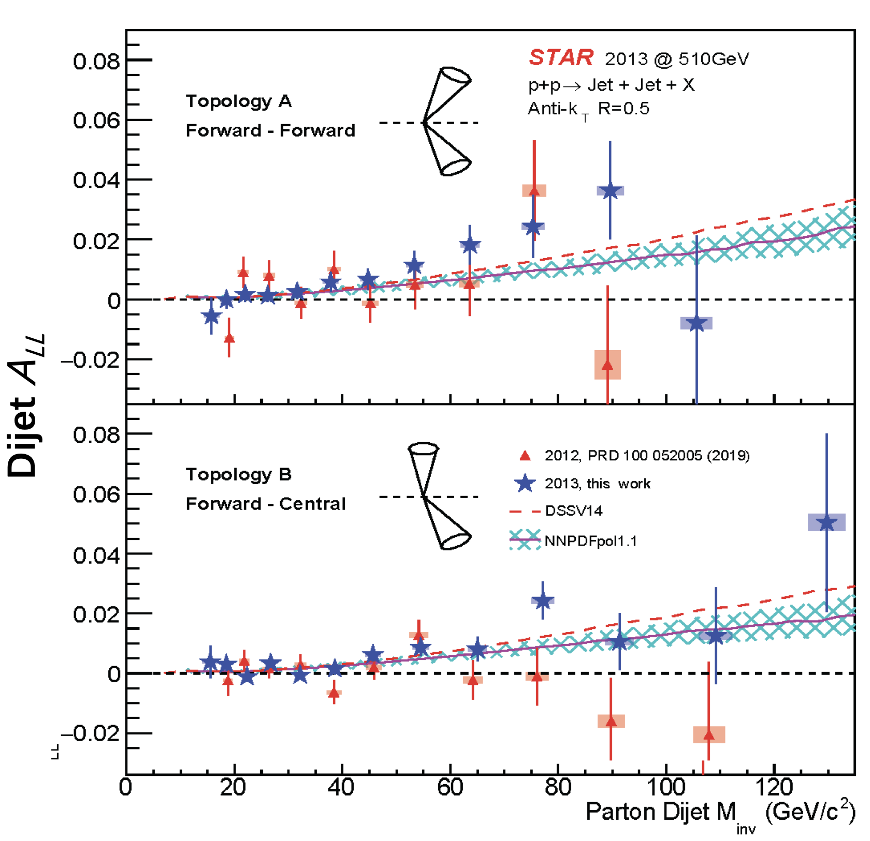
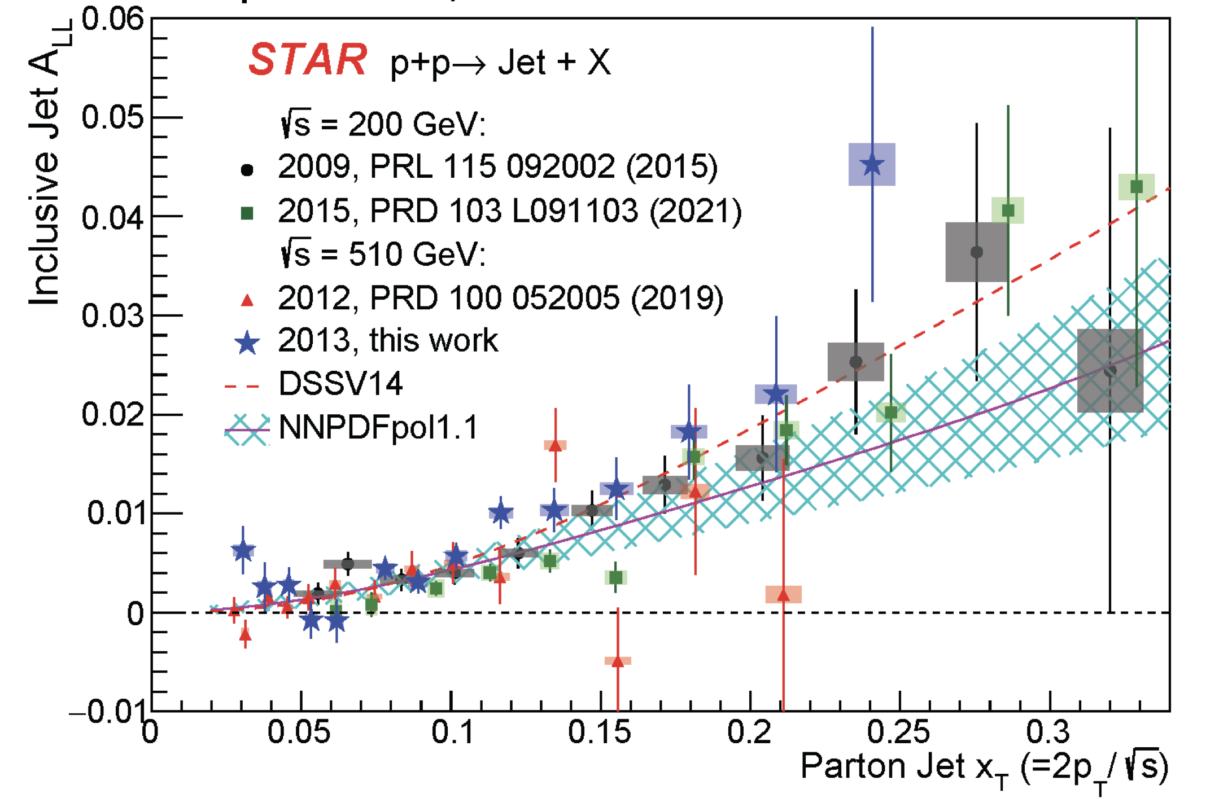
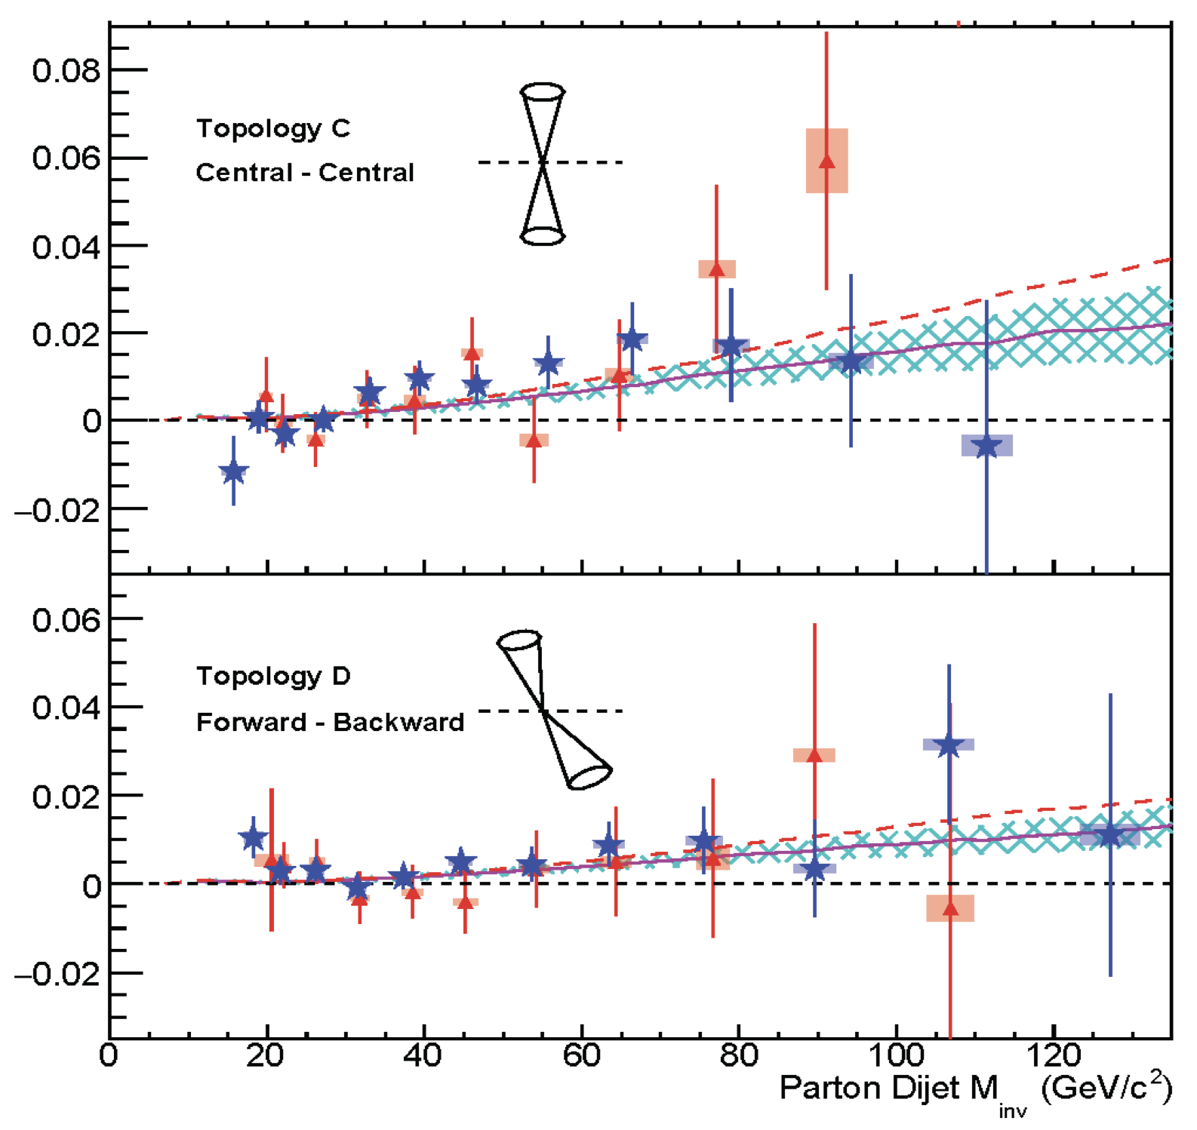
Helicity PDFs: ΔG
Golden probes for Δg:
Double spin asymmetry A_{LL} for jets, di-jets and meson-production
Remember: to increase x-range covered: go to higher √s (200 GeV → 500 GeV)
or
go to higher rapidity: -1<η<1 → -1 <η<1.8)
or both
Di-jets: constrain the shape of the Δg(x,Q2)
→ 5 papers since last LRP→ still ~2 papers to come
Phys. Rev. D 105 (2022), 092011
more results in backup

Slide 10
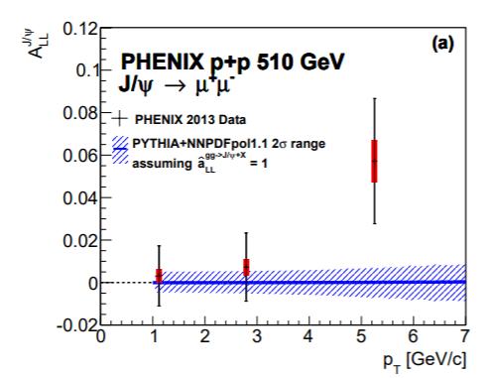
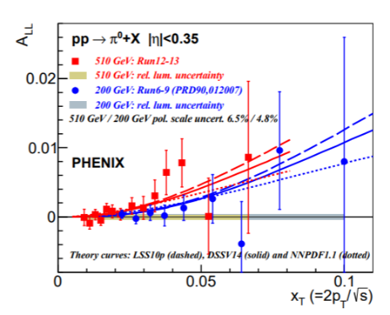
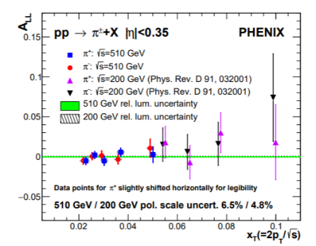
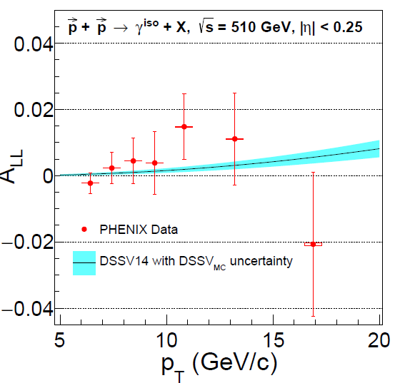
ΔG through Inclusive Meson Production
PRD 94 (2016) 112008
PRD 93 (2016) 011501
PRD 102 (2020) 032001
arxiv:2202.08158
PHENIX has measured a wide variety of probes at 200 & 510 GeV
Very precise data
Asymmetries are small
Limited sensitivity to non-zero gluon polarization
RHIC has concluded data taking with longitudinal polarized beams

Slide 11
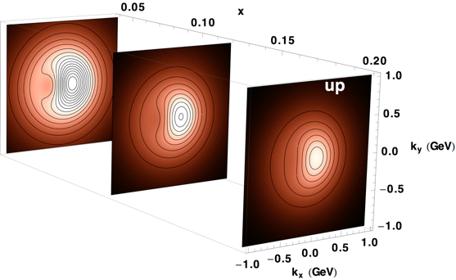
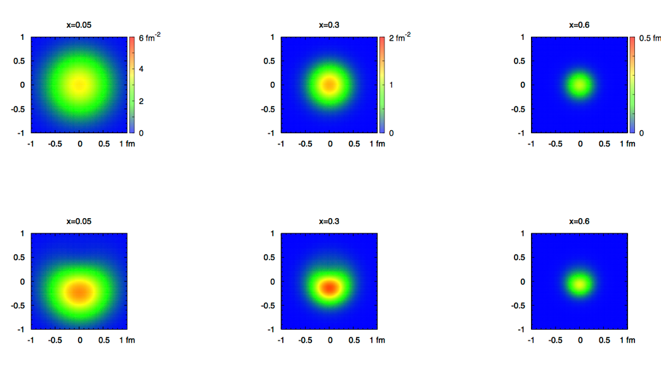
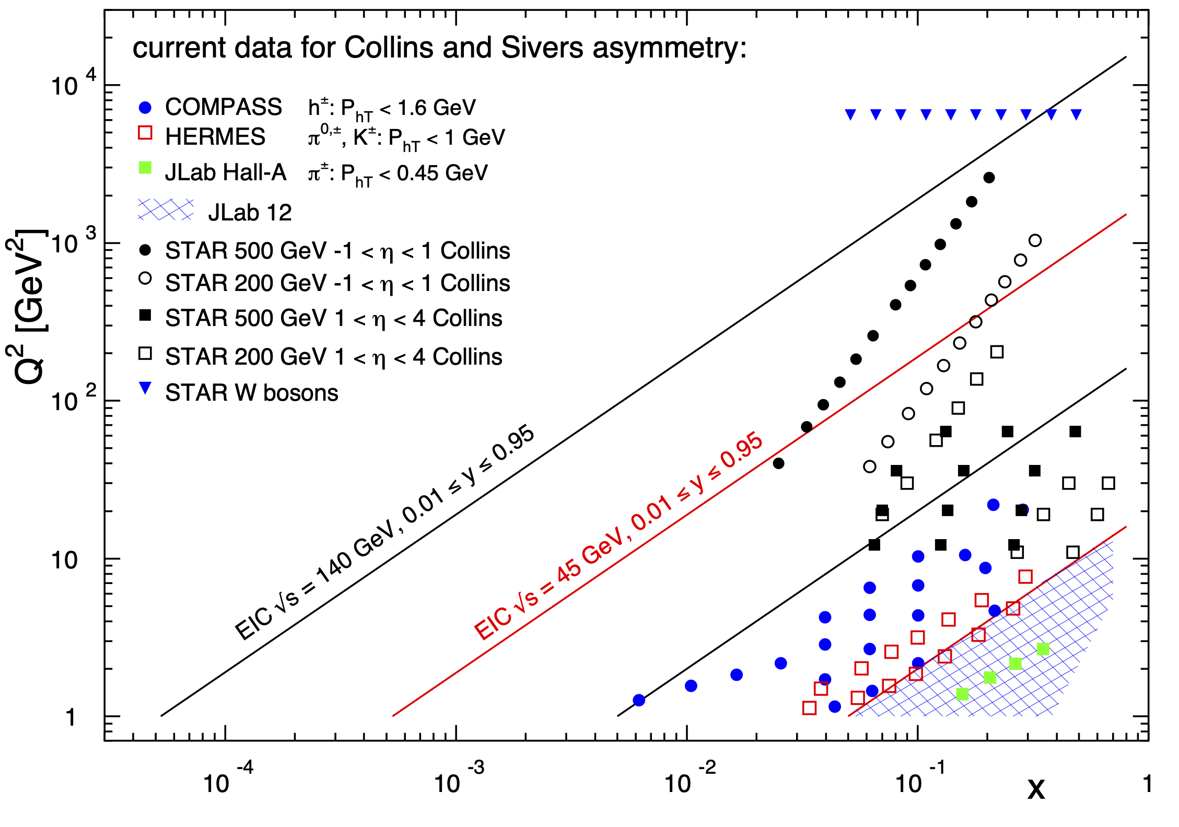
3d Imaging of Quarks and Gluons
Wigner function
W(x,b_{T},k_{T})
∫d²b_{T}
∫ d²k_{T}
Momentum
space
Coordinate
space
Quarks
f(x,k_{T})
f(x,b_{T})
Quarks
down quark
x
Before RHIC, TMDs came only from fixed target data, e.g. ep → high x @ low Q²
need to establish concept at high Q² and wide range in x
RHIC unique kinematics: from low to high x at high Q² → TMD evolution
high precision data to test factorization and universality of TMD

Slide 12
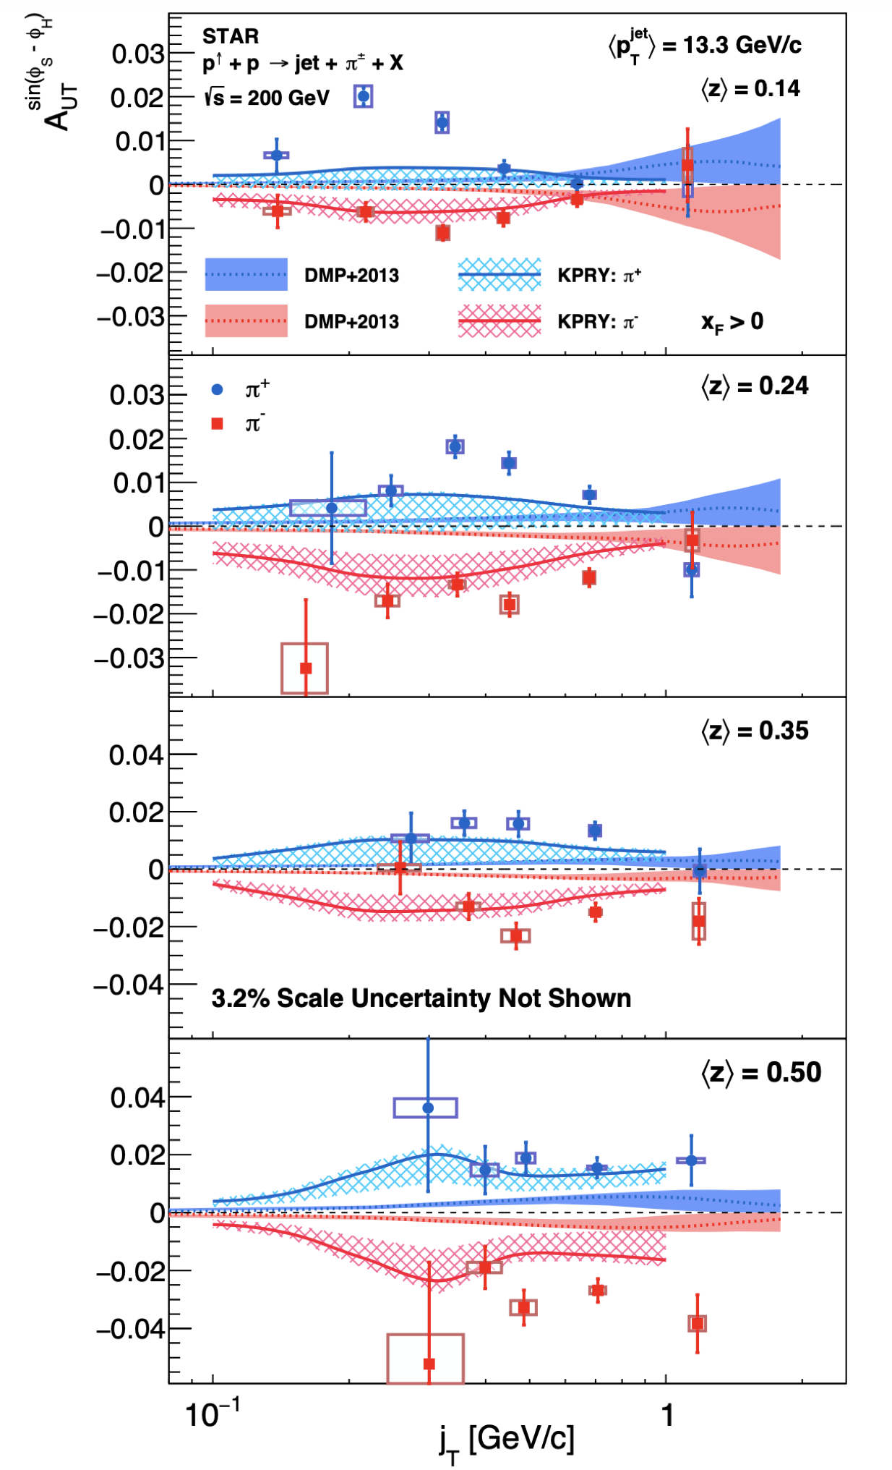
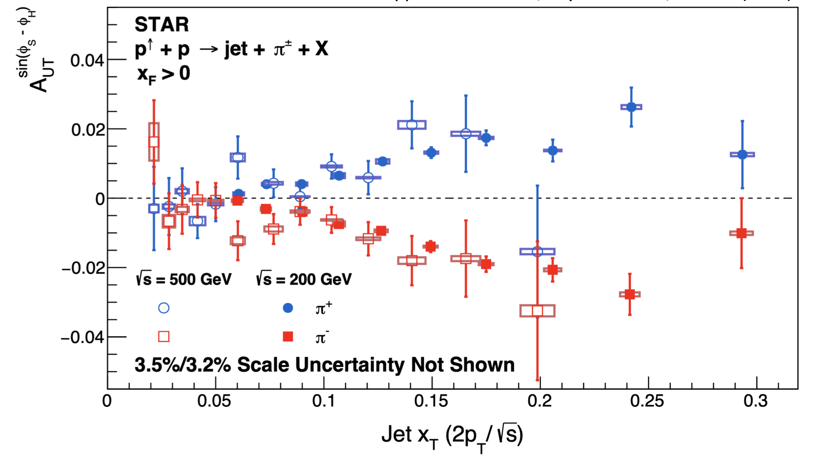
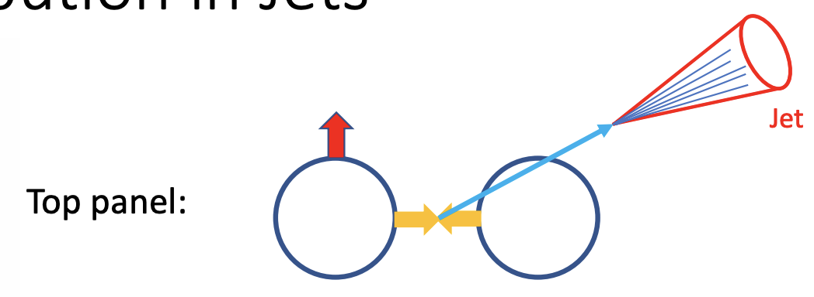
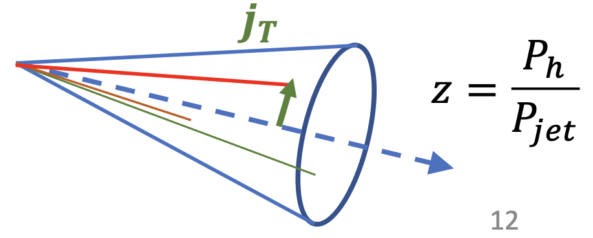

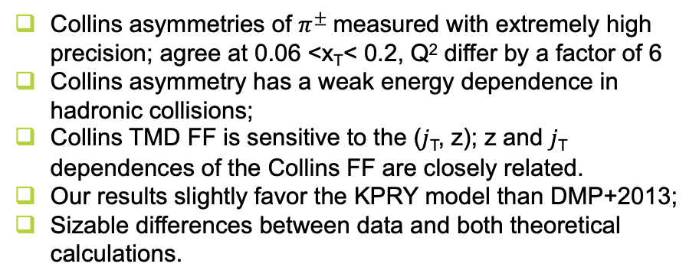
Collins asymmetry for $π^{±}$ in jets (mid-rapidity)
arXiv:2205.11800, accepted by PRD
2012 + 2015
$$x^{F}>0$$
Collins asymmetries of $π^{±}$measured with extremely high precision; agree at 0.06 <x_{T}< 0.2, Q² differ by a factor of 6
Collins asymmetry has a weak energy dependence in hadronic collisions;
Collins TMD FF is sensitive to the (𝑗_{T}, z); z and 𝑗_{T} dependences of the Collins FF are closely related.
Our results slightly favor the KPRY model than DMP+2013;
Sizable differences between data and both theoretical calculations.
more results in backup

Slide 13
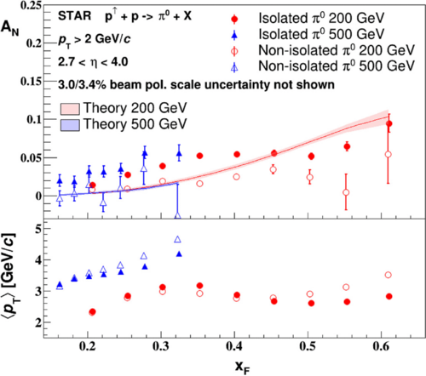
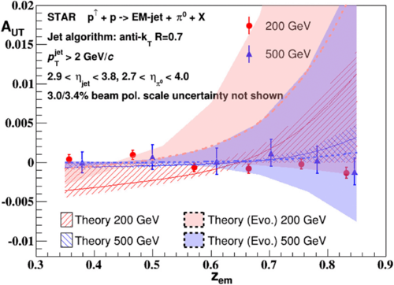
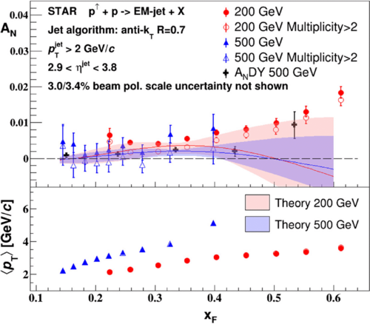
TMDs at forward rapidities 2.7 < η < 4
π⁰ A_{N}
π⁰ in EM jets A_{UT}
incl. EM jets A_{N}
STAR, PRD 103 (2021) 92009
Weak dependence on the center-of-mass energy
Measured small A_{N} Collins asymmetry for π⁰ within EM jets
  small contribution from Collins to π⁰ A_{N}
A_{N} decreases for non-isolated π⁰ and higher-multiplicity EM jets
  additional mechanism needed to explain asymmetries → diffractive subprocesses?
Test Twist-3 FF is responsible for large A_{N} will be able with STAR forward upgrade → A_{N} for h^{+/-}
Comparison with
Z. Kang et al., PLB 774, 635 (2017)
L. Gamberg et al., PRL 110, 232301 (2013)
J. Cammarota et al., arxiv:2002.08384
π⁰ A_{N}
weak p_{T} dependence
strong x_{F} dependence
RHICf: PRL 124, 252501 (2020)

Slide 14

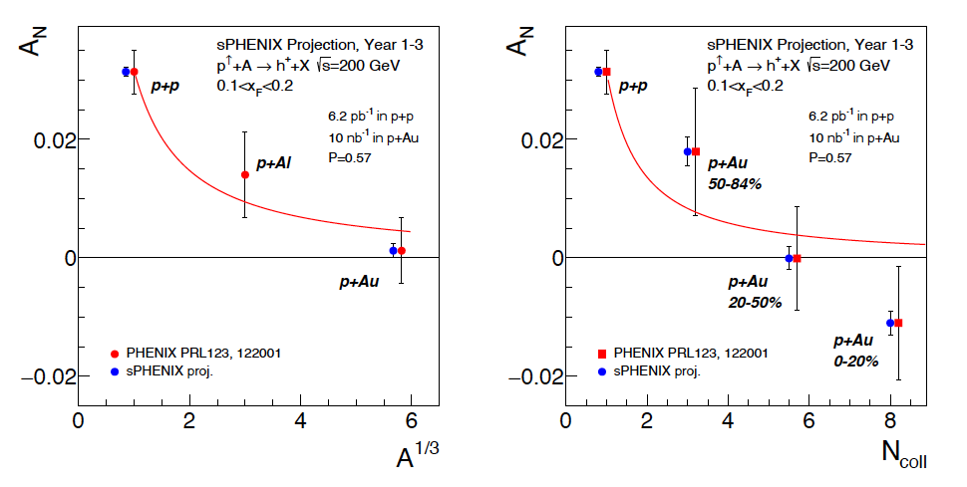
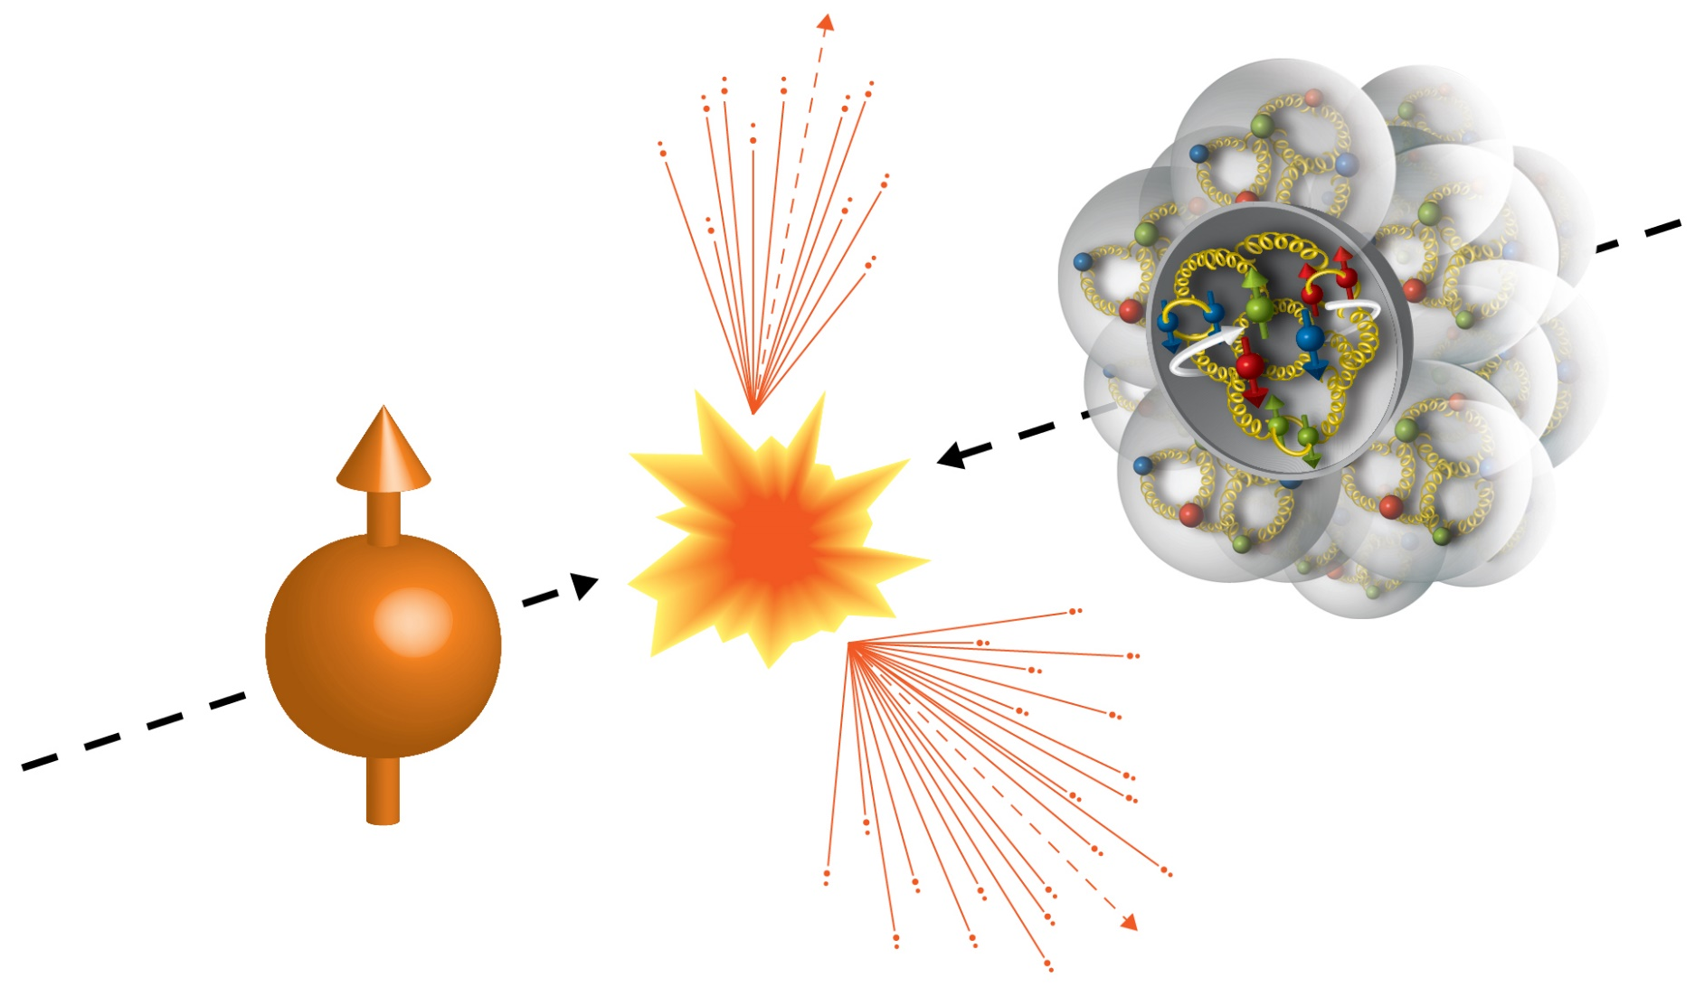
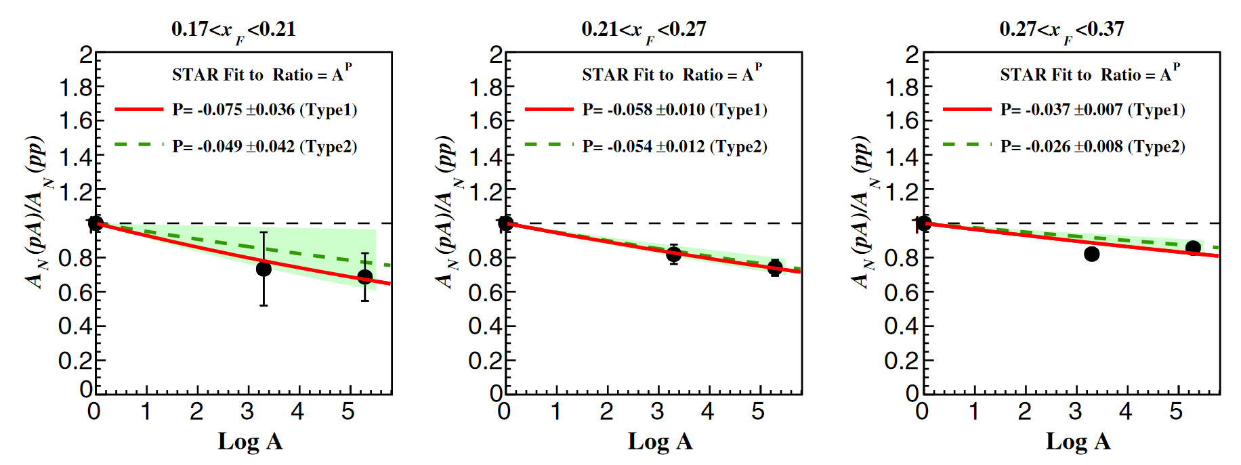

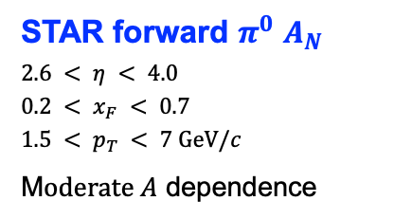
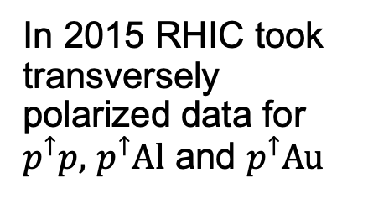
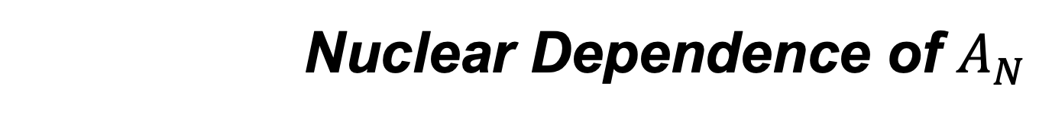
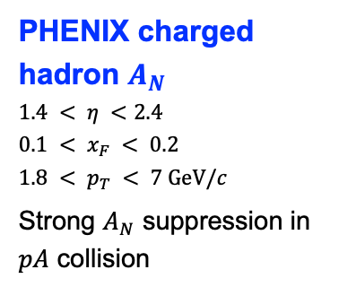
Nuclear Dependence of $A_{N}$
In 2015 RHIC took transversely polarized data for $p^{↑}p,$ $p^{↑}Al$ and $p^{↑}Au$
PHENIX, PRL 123, 122001 (2019)
PHENIX charged hadron $A_{N}$
$$1.4 < η <2.4$$
$$0.1 < x_{F} < 0.2$$
$$1.8 < p_{T} < 7 GeV/c$$
Strong $A_{N}$ suppression in $pA$ collision
STAR, PRD 103, 072005 (2021)
STAR forward $π^{0}$ $A_{N}$
$$2.6 < η < 4.0$$
$$0.2 < x_{F} < 0.7$$
$$1.5 < p_{T} < 7 GeV/c$$
M$oderate A$ dependence

Slide 15
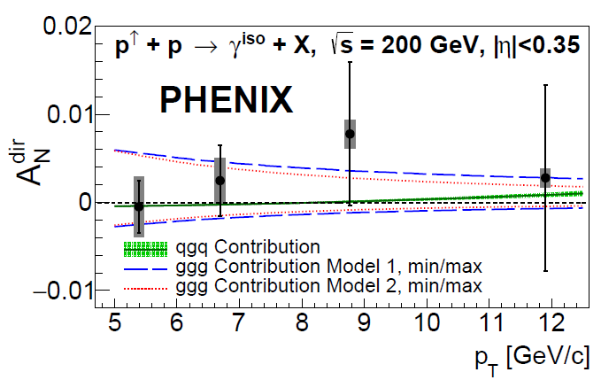


TMD Physics with PHENIX
Phys. Rev. Lett. 127 (2021) 162001
arXiv 2204.12899 submitted to PRL
First measurement from PHENIX
Constrains twist-3 ETQS function
  Dominated by ggg correlator
  Small contribution from qgq correlators
  Related to Sivers-TMD
Larger asymmetries expected at forward rapidity
Almost only gluon related, no final state effects → tri-gluon correlation
Potential to constrain parameter ranges in D meson A_{N} theory calculations: PRD78, 114013
Comparison of charges provides further sensitivity
$$−∫d^{2}k_{⊥}\frac{\left|k_{⊥}^{2}\right|}{M}f_{1T}^{⊥q}\left(x,k_{⊥}^{2}\right)=T_{q,F}\left(x,x\right)$$

Slide 16




Test non-universality of Sivers-function
DIS:
γq-scattering
attractive FSI
QCD
pp:
qqbar-anhilation
repulsive ISI
A_{N}$=\frac{1}{P}\frac{\sqrt{N_{R}^{↑}N_{L}^{↓}}−\sqrt{N_{L}^{↑}N_{R}^{↓}}}{\sqrt{N_{R}^{↑}N_{L}^{↓}}+\sqrt{N_{L}^{↑}N_{R}^{↓}}}$
Sivers_{DIS} = - (Sivers_{DY} or Sivers_{W} or Sivers_{Z0})
Data from run 2017 and projection from 2017+2022
Improved statistic from run 2011 25${ pb}^{−1}$ to run 2017 350 ${ pb}^{−1}$
450 ${ pb}^{−1}$ more data from run 2022 with Forward Upgrade and extended η coverage by STAR iTPC

Slide 17




3d Spatial Imaging through UPC
UPC:
worldwide only access to GPD E for gluons
→ J/Ψ production in p↑Au or p↑p (500 GeV)
Forward rapidity gives access to the large asymmetry region
2015 polarized pA data:
STAR forward upgrade → closer to J/Ψ threshold
Complementary to JLab experiments for J/Ψ production at threshold
Details: Zh. Tu Sa. @ 9:10 am

Slide 18
The STAR Forward Upgrade
STAR forward upgrade was fully operation for 2022 p↑p↑@ 510 GeV
Goals for TMDs:
Increase statistics for A_{N} DY
→ TMD evolution world best constraint → A_{N}(W^{+/-} Z⁰)
→ Sivers sign change
Unravel the mystery what is the underlying process of A_{N}
→ measure A_{N} for h^{+/-} and π⁰
→ clear prediction of importance of special Collins like FF
flavor tagging of the Twist-3 equivalent of the Sivers fct.
→ Observable h^{+/-} with z > 0.5 in jet
STAR forward
upgrade:
2.5 < η < 4
Silicon
sTGC
ECal
HCal
Combines:
Electromagnetic and Hadronic Calorimetry
with SiPM readout & new ADC + trigger modules
with Tracking
Silicon detectors and
small-strip Thin Gap Chambers (sTGC)
Goals for Saturation:
Expand the number of observables:
rigorous test of theory predictions
get a handle on the different gluon distributions
provide variety of high precision data to test universality of CGC RHIC ←→EIC
study of evolution/universality of Q_{s}² with A and x for different probes
Requirements from Physics:
good e/h separation
hadrons, photon, π⁰ identification
Detector | pp and pA | AA
ECal | ~10%/√E | ~20%/√E
HCal | ~50%/√E+10% | ---
Tracking | charge separation photon suppression | 0.2<p_{T}<2 GeV/c with 20-30% 1/p_{T}

Slide 19






sPHENIX – Cold QCD Program
Currently being installed, going to start taking data in 2023 – pp & pA running in 2024
The sPHENIX barrel will be able to measure jets, heavy flavor, direct photons, h^{+/-} to probe
Sivers effect with $γ$-jet, di-jet
Transversity with Collins and IFF through $h$ in jet and di-hadron
Trigluon correlation function with direct photons and heavy flavor
Hadron $A_{N}$ in pp vs pA

Slide 20


Summary
Unique RHIC forward and midrapidity pp/pA program addressing
fundamental questions in QCD
arxiv:1602.03922
essential to the mission of the RHIC physics program
Have realized all the promises of the 2016 RHIC Cold QCD Plan
pp/pA program essential to fully realize the scientific promise of the EIC
  to separate probe dependent phenomena from intrinsic nuclear properties
RHIC 2024: p↑p↑ and p↑Au @ 200 GeV enables measuring new observables due to new capabilities, sPHENIX and STAR forward upgrade
RHIC pp/pA
EIC
universality
factorization
evolution
critical to fully capitalize on EIC
science program

Slide 21
Recommendations
To fully capitalize on the recent investments that led to the construction of the sPHENIX detector and significant new forward and mid-rapidity capabilities at STAR, continuation of RHIC operations is necessary to enable collection of the last pp, pA, and AA data. These data are required for completion of the RHIC Hot and Cold QCD missions and to fully exploit the complimentary to LHC studies which probe different kinematics and the unique polarization of the proton beam at RHIC.
Continued strong funding of the RHIC Hot and Cold QCD experimental analysis groups and computing facilities well beyond the final operation of RHIC. This will enable effective and timely production, analysis and publication of the wealth of data collected, and to be collected. The unprecedented detail and uniqueness of the RHIC data sets have discovery potential on their own and are critical to fully accomplish the scientific mission of the EIC. Continued support of the experimental groups is also critical to ensure the continued effective training of the next generation of experimentalists in preparation for EIC operations.
Continued strong funding of the RHIC Hot and Cold QCD theoretical groups and Topical collaborations well beyond the final RHIC operations. This support is critical to ensure that the knowledge generated by analyses of the RHIC data are fully incorporated into the next-generation of theoretical interpretations.

Slide 22


Slide 23






Jet Cross-sections
$$dσ_{pp→jet+X}\left(Q^{2}\right)=\sum_{a,b}{\int{f_{a}(x_{a},Q^{2})f_{b}\left(x_{b},Q^{2}\right)d{\hat{σ}}_{a+b→jet+X}(x_{1}x_{2}Q^{2}}){dx}_{1}{dx}_{2}}$$
proton structure
hard process + PS + hadronization
200 GeV:
$$0.067<x_{T}=\frac{2p_{T}}{√s}<0.5$$
final results in two rapidity bins
further reduce systematics
500 GeV:
$$0.021<x_{T}=\frac{2p_{T}}{√s}<0.32$$

Slide 24


Helicity PDFs: ΔG
“Ultimate” data set: forward dijets at 510 GeV
Final longitudinal data acquired by STAR (2012, 2013) at 500 GeV, ~250 pb⁻¹ integrated luminosity.
“Pushes all the buttons” to reach lowest possible
gluon x values: large η, highest √s, using dijets
Preliminary results for 2012 (left) and 2013 (right) are
in excellent agreement
with each other, both favoring A_{LL} values slightly higher than global fit expectations.
All systematic uncertainties
for the two data sets are finalized, so a combined
result (including their correlated uncertainties) can be published very soon.
STAR has concluded longitudinally polarized data taking

Slide 25


Diffractive EM-jet A_{N} at forward rapidities
Motivation: Measure diffractive contributions to A_{N} in polarized p+p collisions
two possible diffractive channels:
Only 1 proton track on FMS side and no proton track on the away side
Only 1 proton track on FMS side and only 1 proton track on the away side
Requirements: The scattered proton must be detected by Roman Pot.
Limitation: They are relatively rare processes but have been observed at STAR.

Slide 26

Diffractive EM-jet A_{N} at forward rapidities
Transversely polarized p↑+p at √s = 200 GeV collected in 2015
The cross-ratio method is used to extract the diffractive EM-jet A_{N}.
A non-zero A_{N} for x_{F} > 0 is observed with 3.3-sigma significance for diffractive process at forward rapidity.
Large A_{N} is observed in high x_{F} region
Sign of A_{N} is negative. Theoretical inputs are needed to understand the different sign.
A_{N} at x_{F} <0 is consistent with 0.
Systematic uncertainties (boxes) mainly come from cuts for reducing background events.

Slide 27


Sivers Asymmetries in Dijets
Correlation between proton spin and parton $k_{T}$
$\left\langle \vec{S}⋅(\vec{p}×{\vec{k}}_{T})\right\rangle ≠0$
Enhance quark flavor with charge tagging
  Track $p_{T}$ weighted charge
  $η_{total}=η_{1}+η_{2}$
  Unfolded to parton $\left\langle k_{T}\right\rangle$
More data on disk, $\sqrt{s}=510 \text{GeV}$
$\sqrt{s}=200 \text{GeV}$, publication in preparation

Slide 28


Forward rapidity pp Physics
Goals for TMDs:
Increase statistics for A_{N} DY
→ TMD evolution world best constraint ← → A_{N}(W^{+/-} Z⁰)
→ Sivers sign change
Unravel the mystery what is the underlying process of A_{N}
→ measure A_{N} for h^{+/-} and π⁰
→ clear prediction of importance of special Collins like FF
flavor tagging of the Twist-3 equivalent of the Sivers fct.
→ Observable h^{+/-} with z > 0.5 in jet
Kanazawa et al. PRD 89, 111501 (2014)
A_{N} for jets with tagged h⁺, h⁻
stringent test for opposite sign
but equal magnitude of
u and d quark Sivers fct.

