Slide 1
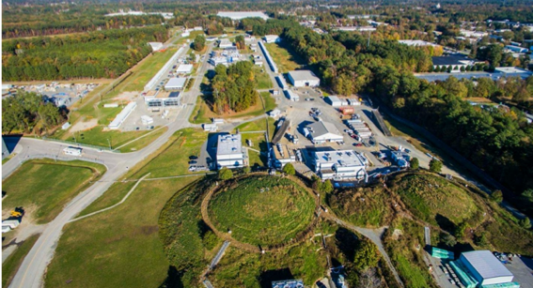
Jefferson Lab Upgrade Perspectives
Cynthia Keppel
2022 Town Hall Meeting on Hot and Cold QCD
MIT- September 23-25, 2022

Slide 2
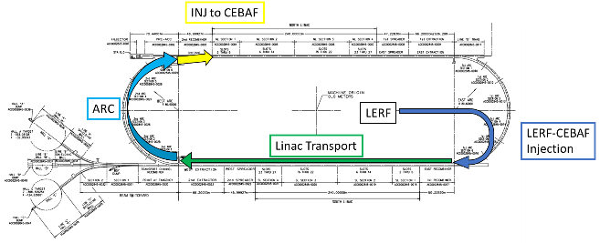

Jefferson Lab Accelerator Upgrades, the ‘Big Picture’
Capitalizing on recent science insights and US-led accelerator science and technology innovations, develop a staged program at the luminosity frontier
Positrons (e+) in the LERF (former FEL) with transport to CEBAF
Energy Upgrade for 650 MeV Electron (e-) Injection in the LERF
Replace arcs on each side with new FFA permanent magnet arcs to upgrade to 22 GeV

Slide 3
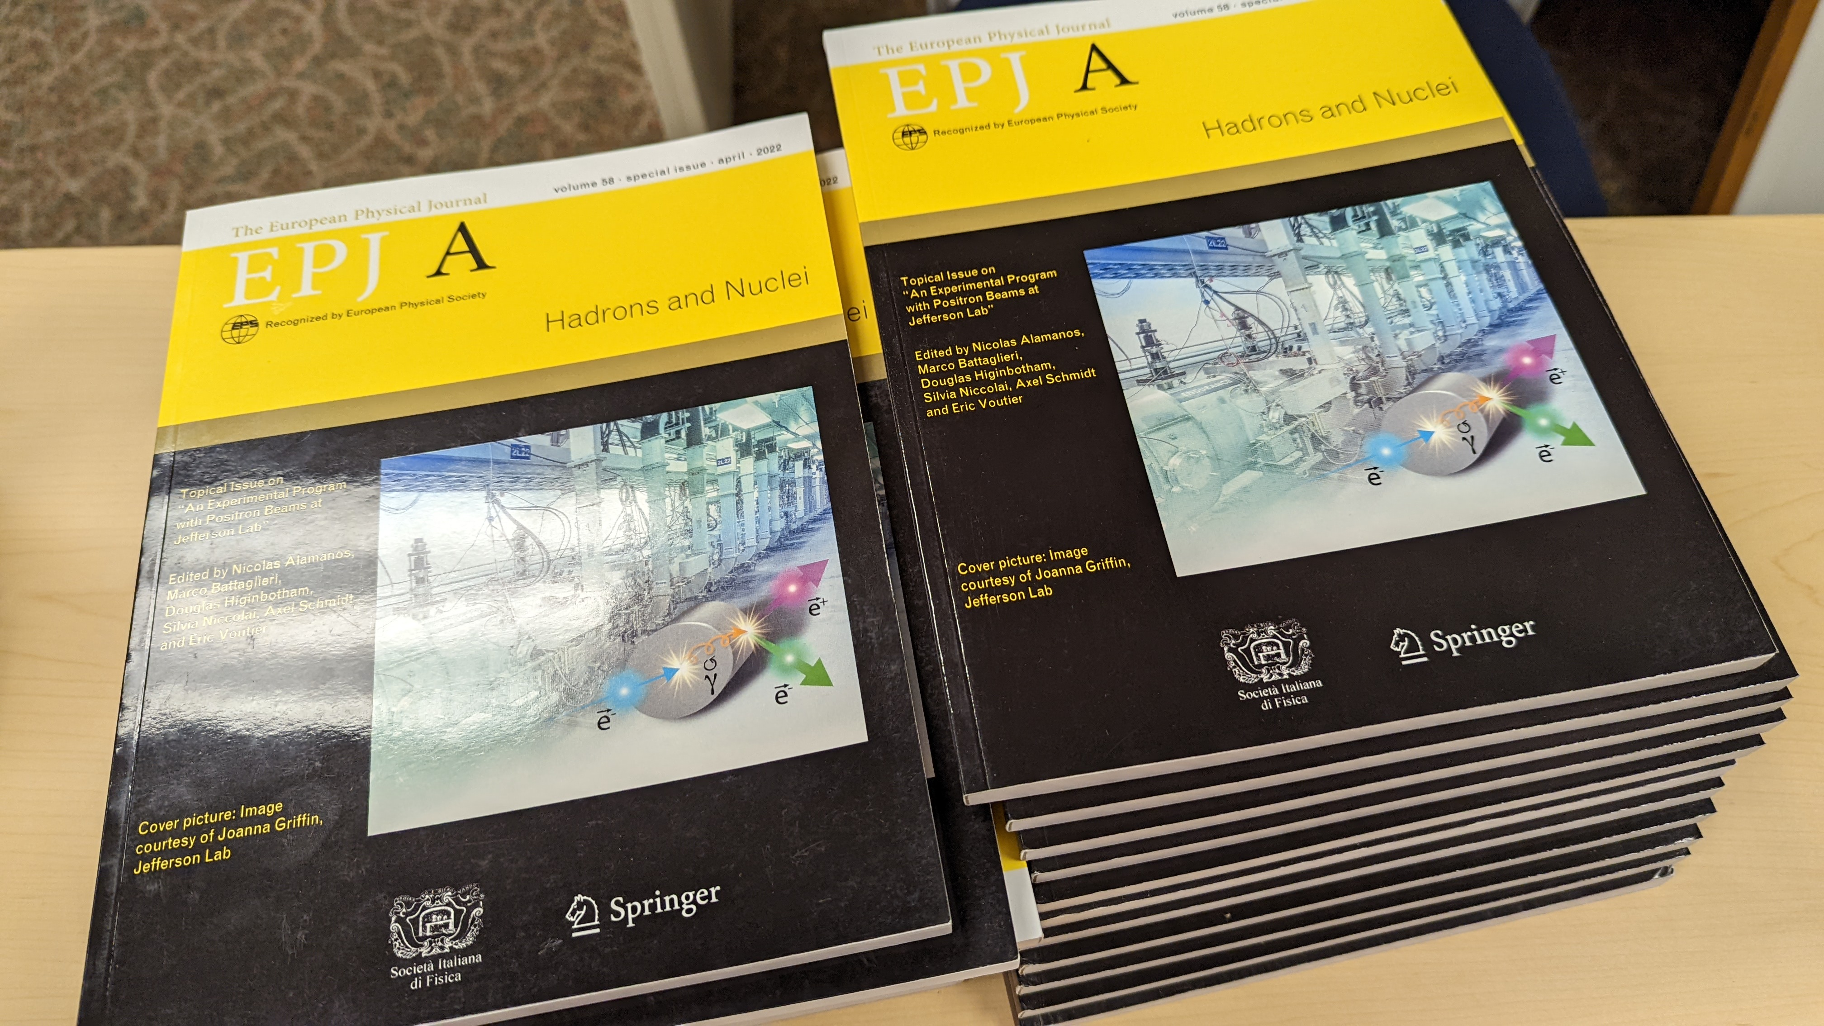
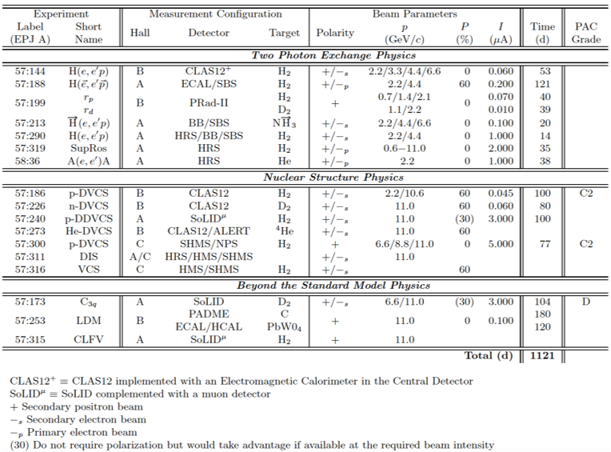
Leverages accomplishments since the 2015 LRP…
Robust program evolved for positron beams at JLab
Eur.Phys.J.A 57 (2021) 8, 261
See Axel Schmidt, Carlos Munoz Camacho talks at this meeting by for science case…
Development of new accelerator technology
EIC site downselect
I will focus here on the Jefferson Lab 22 GeV upgrade, which leverages the former and facilitates the latter

Slide 4
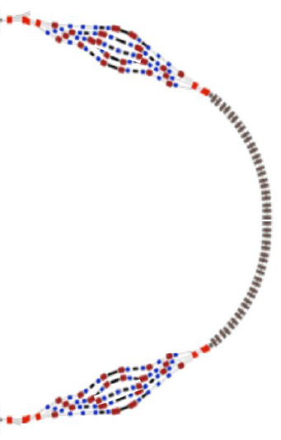
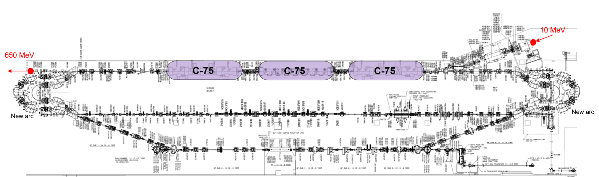

FFA CEBAF with -like Arcs
CEBAF 22 GeV Upgrade: leveraging accelerator breakthrough
Hardware needed:
  ~650MeV injector (e.g. 2-pass-recirculating compact injector in LERF)
  Replace arcs on each side with new FFA permanent magnet arcs
    (One pair of arcs to 22 GeV in 6 extra passes)
$300M--$500M cost estimate

Slide 5
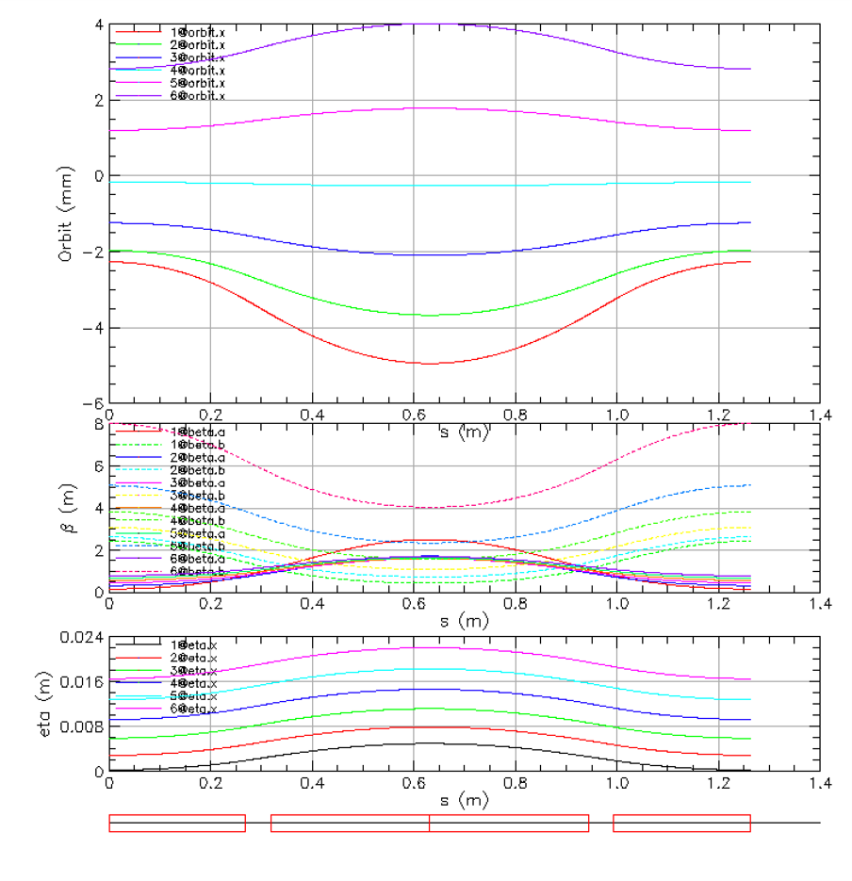
Compact FFA Cell – How Does it Work?
Large momentum acceptance FFA cell, configured with combined function magnets capable of transporting multiple energy beams through the same string of permanent magnets (six beams with energies spanning a factor of two)
magnets: from 38cm² to 78cm²
BD
BF
BD
1 T
50 T/m
1 T
50 T/m
Closely spaced orbits for all six beams (~ 1 cm)
Extremally low dispersion (a few mm) in a combined function lattice
Self similar beta functions for different energy beams
BD
BF
BD

Slide 6
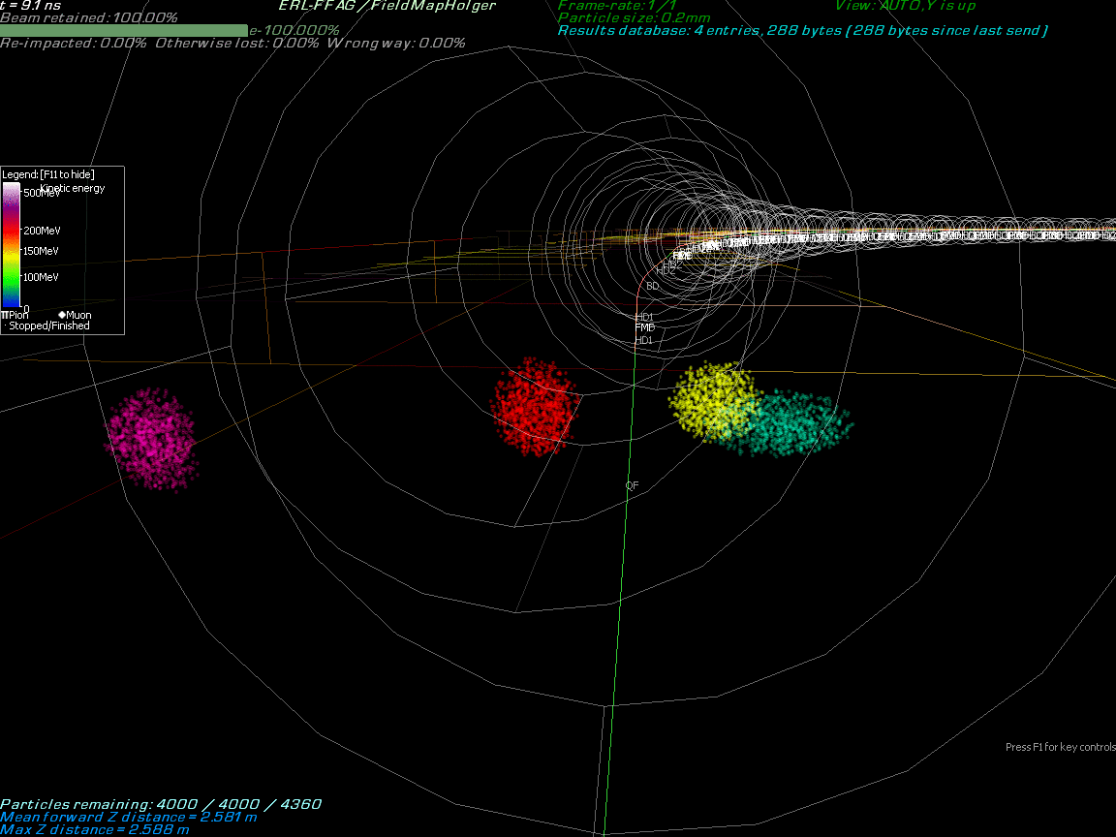
Multi-Energy Beam Dynamics in FFA Arc
2019-2022
Stephen Brooks
BNL

Slide 7
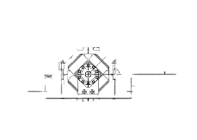
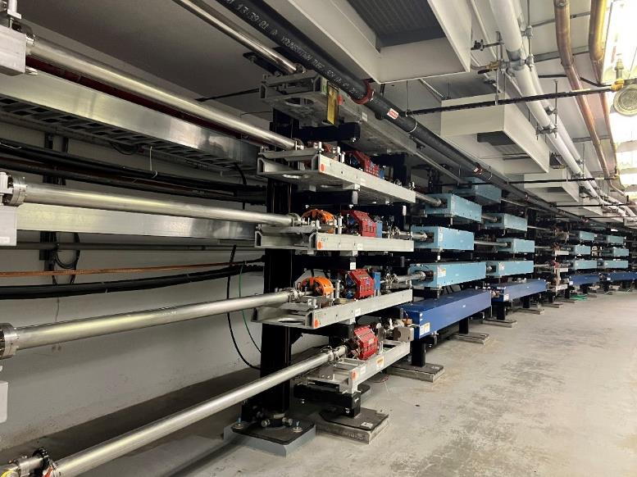
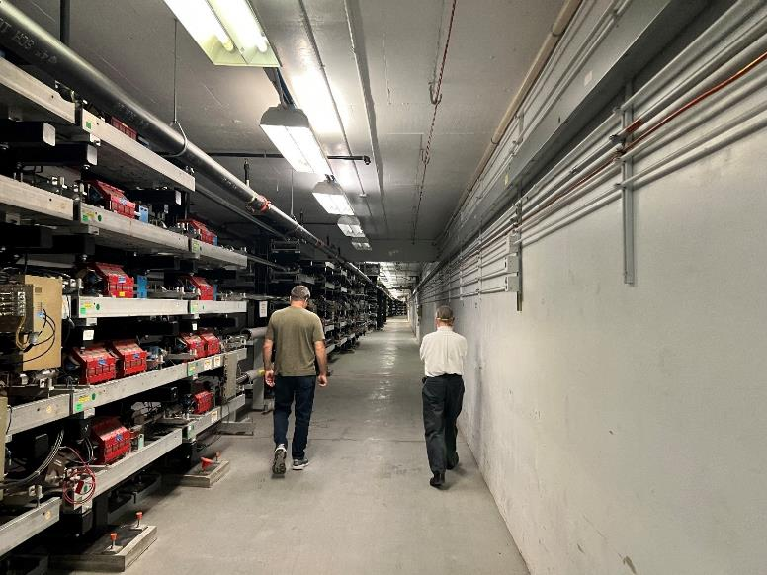
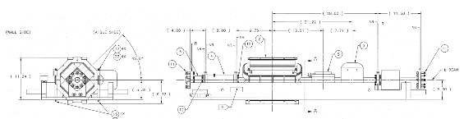
Transport and Upgrade CEBAF to 22 GeV
Remove top pass of Dipoles and Quad girders
All passes of Dipoles and Quad girders move up one level
Running girder transport line at aisle side corner of tunnel
Potential to use a “sit-in” style girder for smaller profile
after 6 FFA passes →

Slide 8
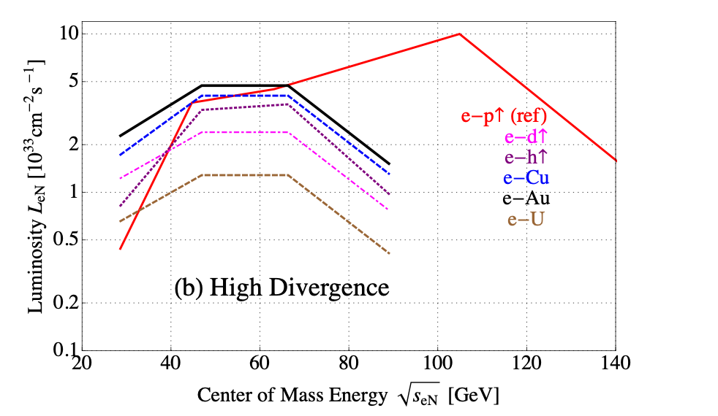
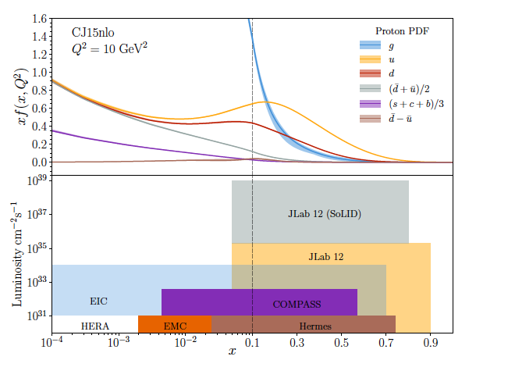
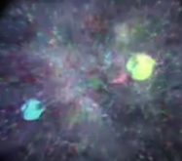
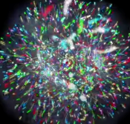
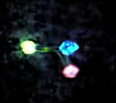
JLab Upgrade: Science at the Luminosity Frontier
Probability Distribution
EIC Luminosity
IPAC2021
Probability Distribution
Precision measurements in the valence quark regime requiring high luminosity are the purview of JLab12, providing overlap with EIC
The focus of the EIC will be low x, with higher luminosity than other colliders
The 22 GeV upgrade will provide important overlap into the sea quark region.
JLab 22
Luminosity (cm⁻²s⁻¹)
2030s-2040s
Fraction of nucleon momentum
Physics with CEBAF at 12 GeV and Future Opportunities
(Nov 30, 2021)
e-Print: 2112.00060 [nucl-ex], Accepted to Progress in
Particle and Nuclear and Physics

Slide 9
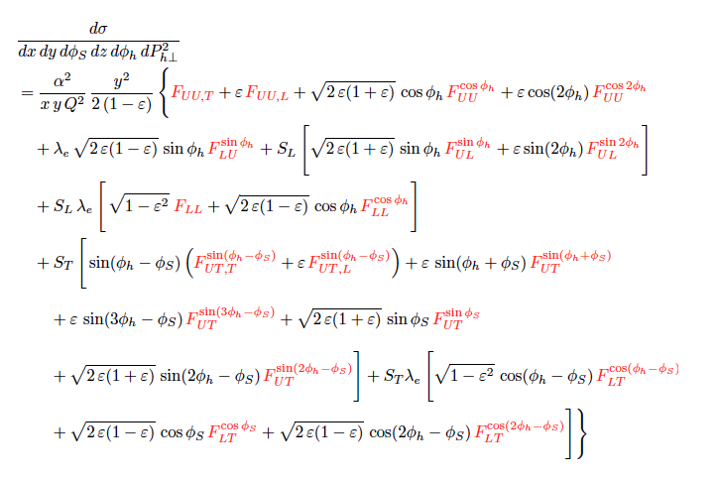
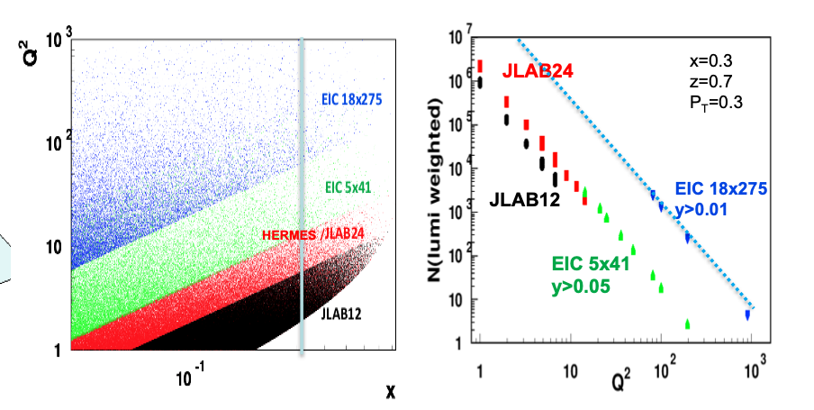
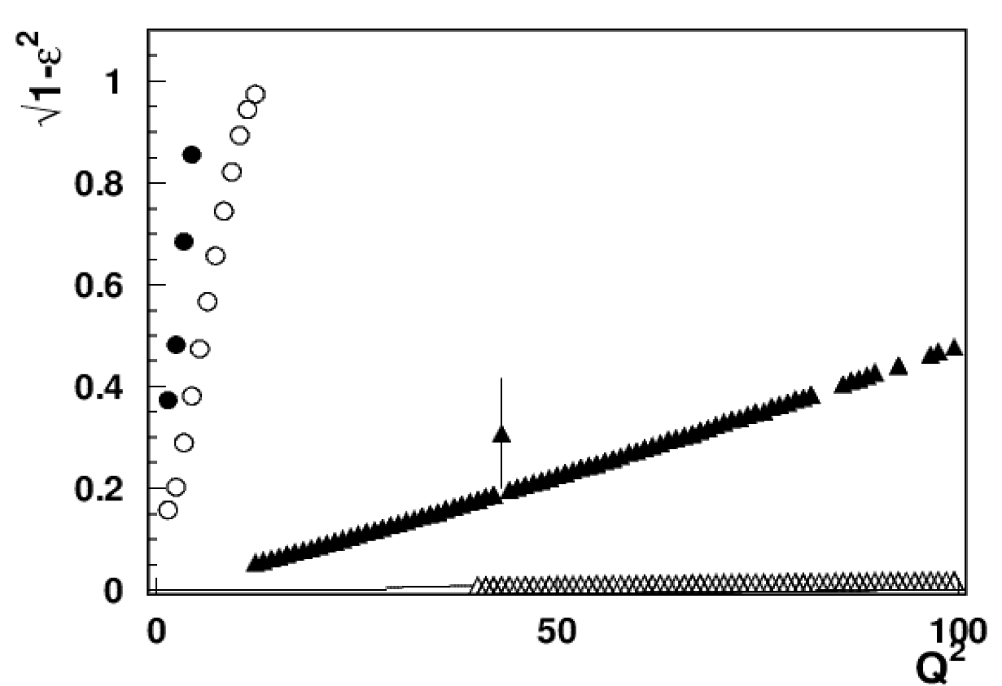
Example: 3D Imaging in Valence Regime via SIDIS
At large x fixed target experiments are sensitive to ALL Structure Functions
For EIC, observables surviving the ε→1 limit (F_{UU}, F_{UL}, Transversely pol. F_{UT})
Complementary, overlapping measurements for full scientific understanding
CLAS12
X=0.3
CLAS24
Similar projections for SoLID
EIC 5x41
EIC 18x275
x-section from Bacchetta et al, 1703.10157
9
H.Avakian/A. Bacchetta

Slide 10
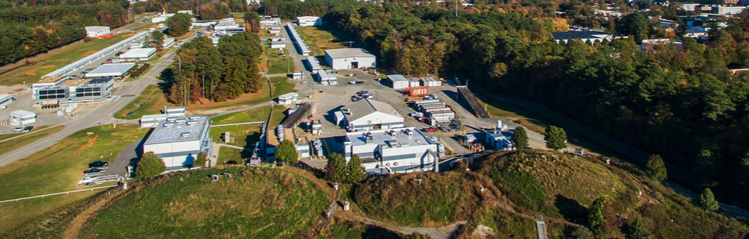
Not only an extension to larger Q²…
High Energy Workshop Series 2022
https://www.jlab.org/conference/hews22#
We are pleased to announce an upcoming series of summer workshops being organized jointly between the laboratory and the Jefferson Lab Users Organization (JLUO) to probe the science that would be opened up by a higher energy electron beam (~20-24 GeV) at Jefferson Lab. We are particularly interested in identifying key measurements that are not possible to access at 12 GeV, that initially utilize largely existing or already-planned Hall equipment, and that leverage the unique capabilities of luminosity and precision possible at Jefferson Lab in the EIC era.
10

Slide 11
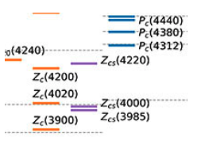
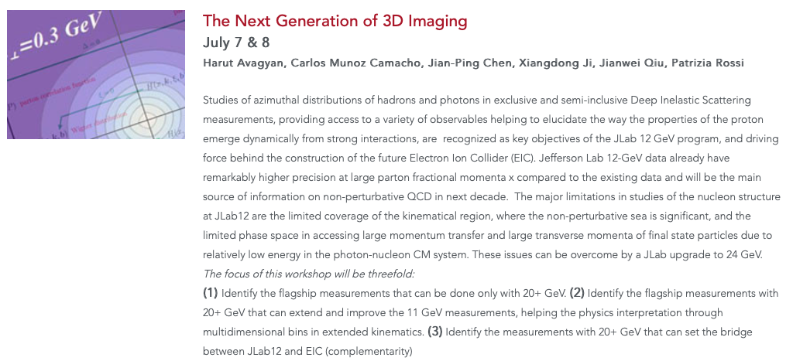
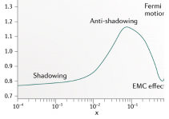
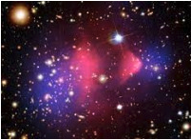
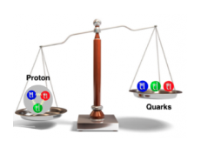
High Energy Workshop Series 2022
Hadron Spectroscopy with a CEBAF Energy Upgrade
The Next Generation of 3D Imaging
Science at Mid x: Anti-shadowing and the Role of the Sea
38 registered p.
8 talks
55 registered p.
13 talks + Summary talk
43 registered p.
14 talks
Physics Beyond the Standard Model
J/Psi and Beyond
Goal to have a first version white paper document ready in a few weeks
To be discussed also at upcoming Trento workshop (September 26-30)
37 registered p.
6 talks
38 registered p.
7 talks + two 1 slide pres.

Slide 12
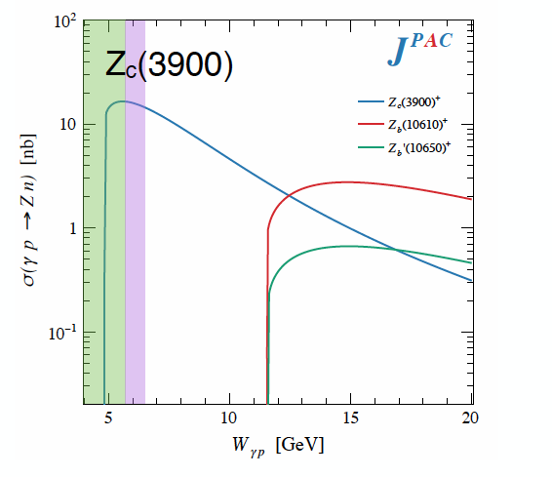
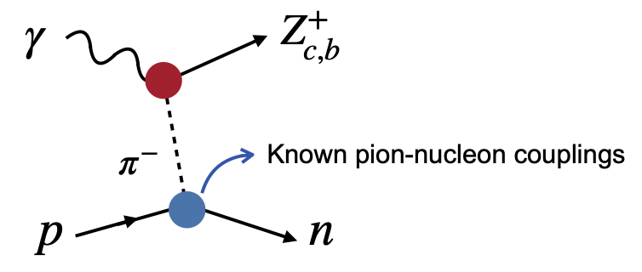
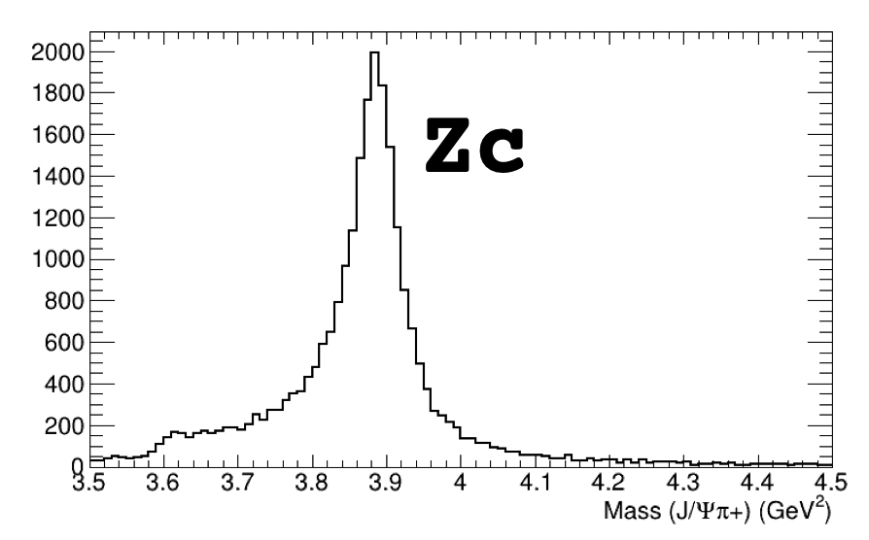
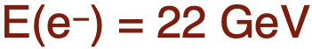

Hadron Spectroscopy
CEBAF @ 20+ GeV : XYZ states & other charmonia can be studied
Tetraquark candidates observed in B decays, e⁺e⁻ colliders
Significant theoretical interest and progress, but internal structure not yet understood
Never direcly produced using photon/lepton beams
$$γp→Jψπ^{+}n$$
Photoproduction provides an alternative mechanisms to study such states
Initial simulations from GlueX and CLAS12 demonstrate the capabilities of the existing detectors to measure these reactions
Full CLAS12 signal MC simulation
12
D. Glazier

Slide 13
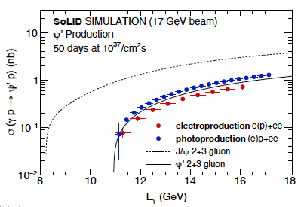
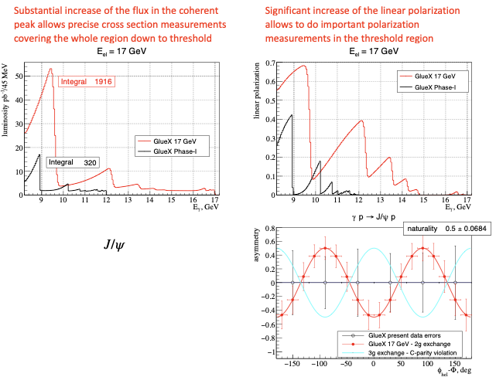
J/ψ and ψ’ photoproduction
Golden processes to pin down:
existence/confirmation of pentaquark resonances
nucleon structure (mass, gluon distribution…)
Initial pentaquark limits
GlueX 20+ Projection
S. Joosten
L. Pentchev
13

Slide 14
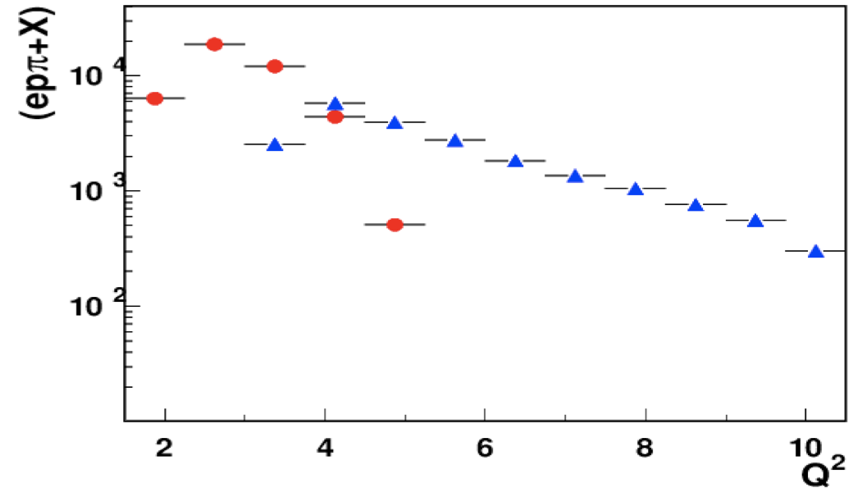
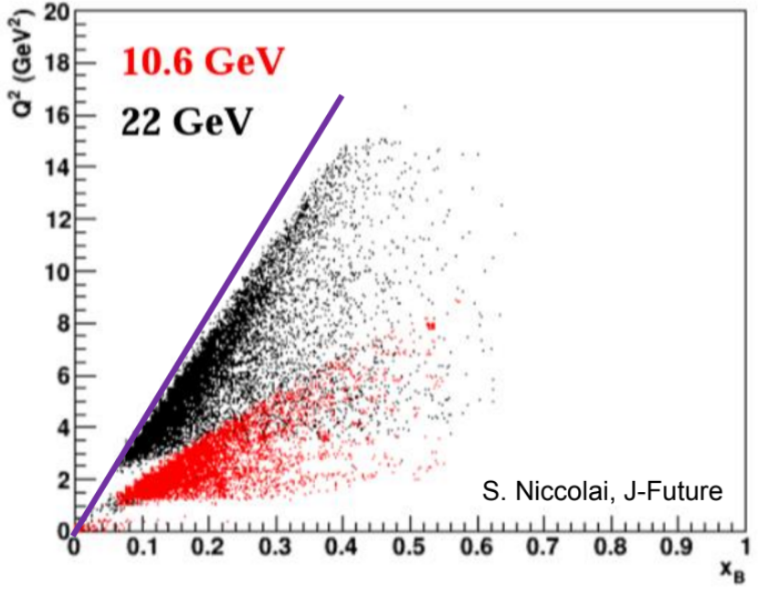
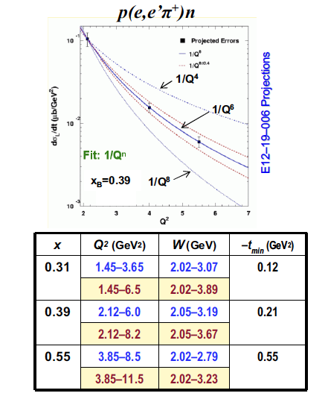
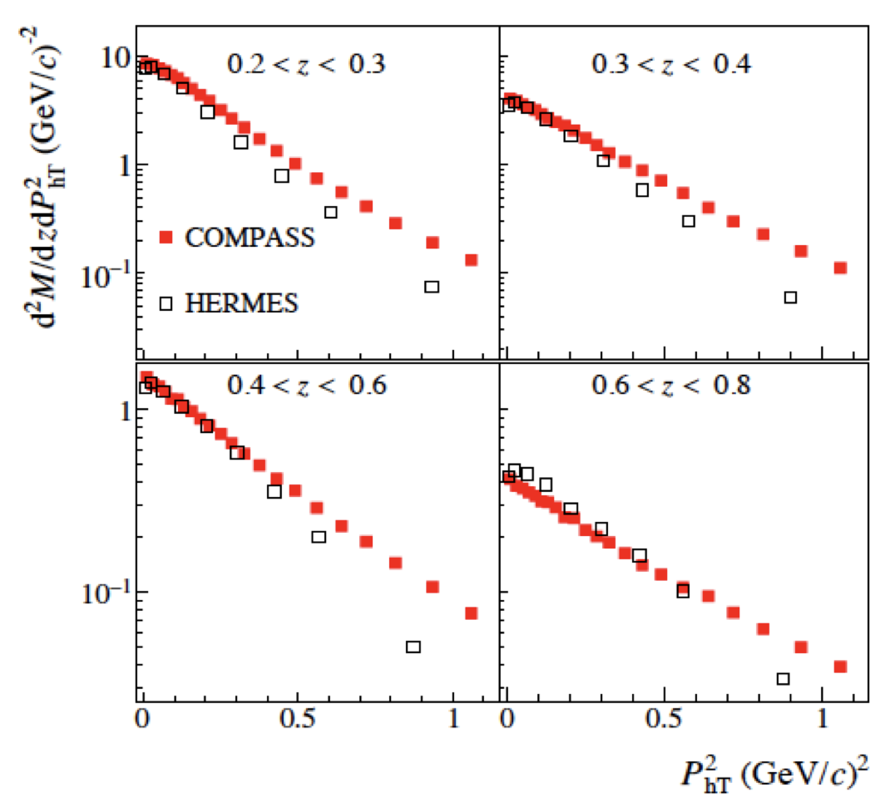
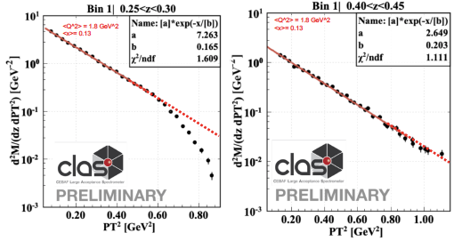
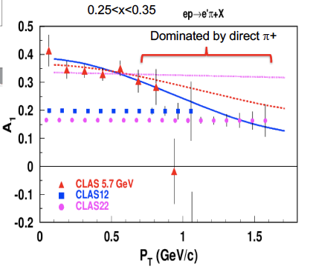
3D Imaging: Enhancement of Q² & P_{T} range
CLAS12
CLAS22
Q² evolution studies possible
More cleanly separate pure twist-2 CFFs
Significantly increase of the relevant Q² range for the Q^{n} scaling test
Larger P_{T} range and high luminosity is the key for a better insight into the problem
14

Slide 15
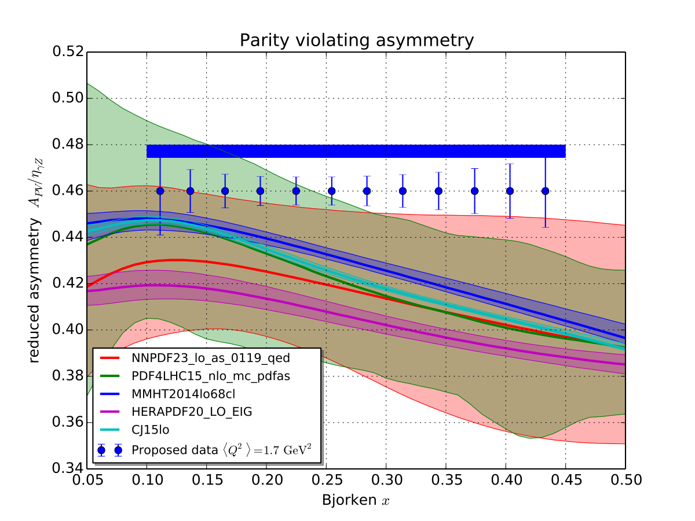
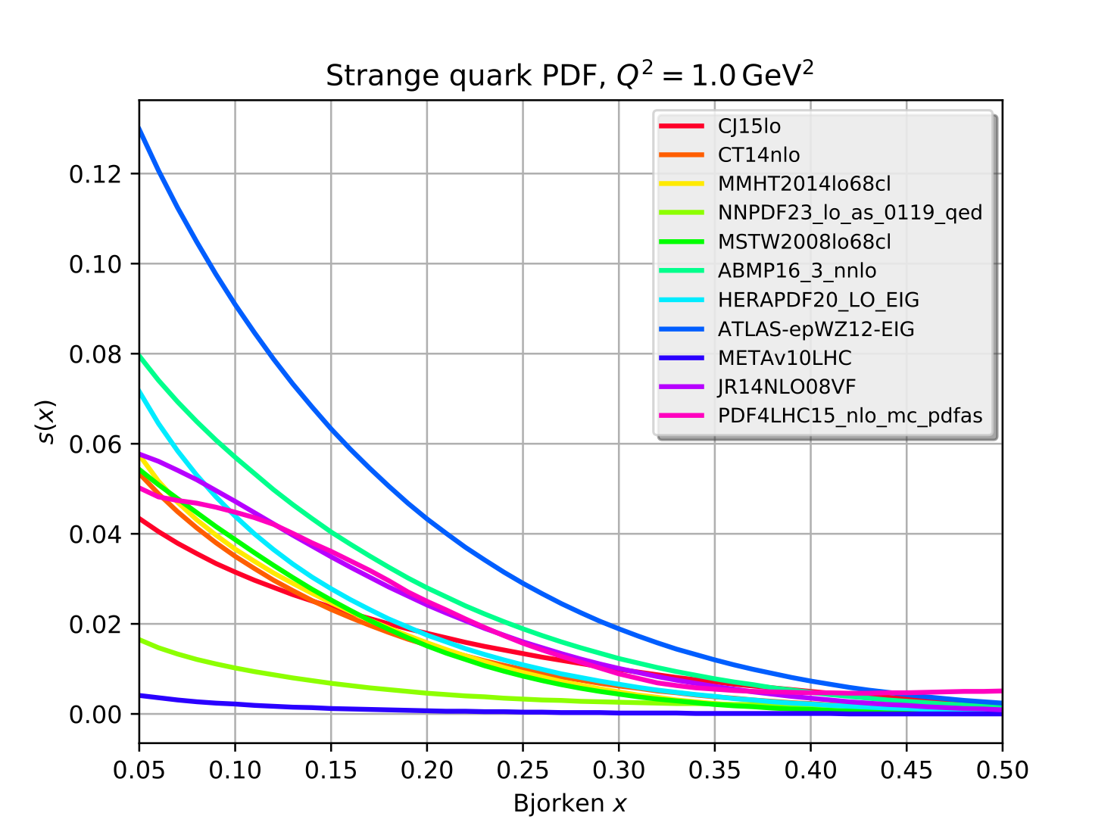
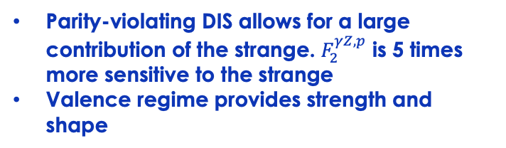
Unambiguous Access to Strange Quarks
Current Situation
Parity-violating DIS
di-muon production in neutrino-nucleus scattering – nuclear corrections introduce significant uncertainty
W and Z rapidity distributions
W+c production
Semi-inclusive K production: choice of fragmentation function negates inclusion in global fits
Parity-violating DIS allows for a large contribution of the strange. $F_{2}^{γZ,p}$ is 5 times more sensitive to the strange
Valence regime provides strength and shape
LHC results inconclusive
17 GeV
22 GeV
Order of magnitude differences
Projections with SoLID@22 GeV have significant impact as well
15

Slide 16
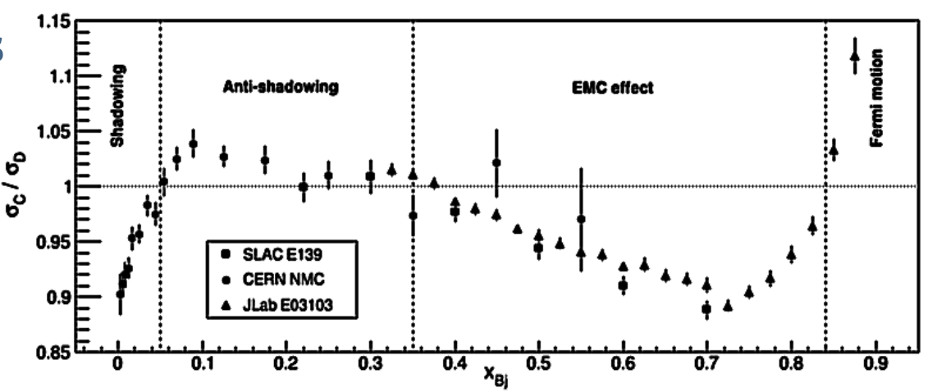
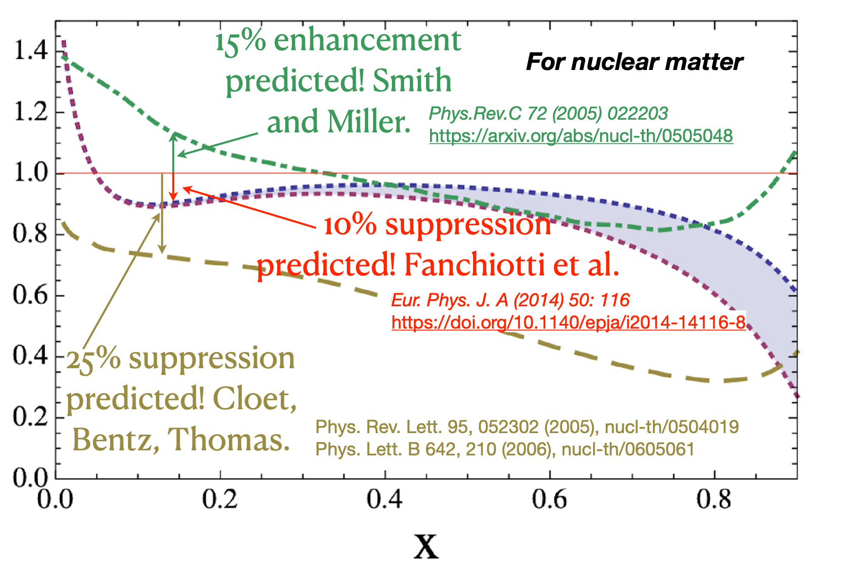
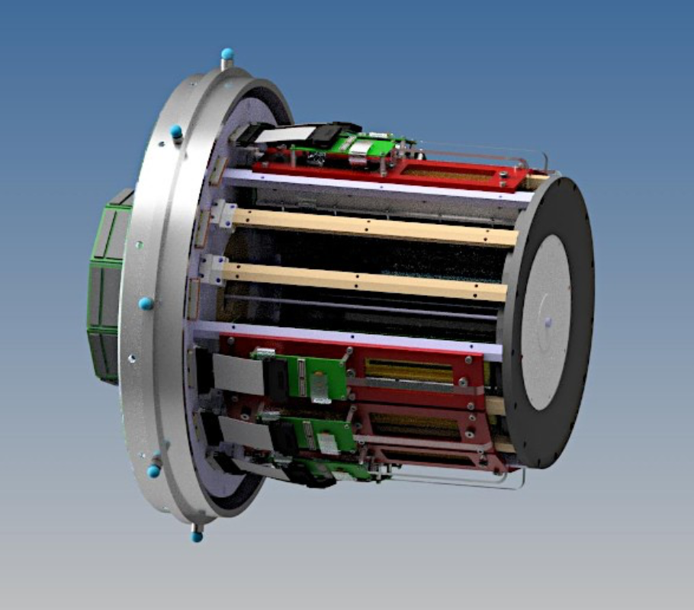
Anti-Shadowing: solving a multi-decade mystery
Anti-Shadowing region (0.1 < x < 0.3) is fascinating!
Near-equally dominated by valence quarks, sea-quarks, and gluons - anti-quark and gluon PDFs, together with their spin and flavor dependence, are of great interest in the anti-shadowing region
The transition between shadowing and the EMC regimes – a testing ground for different descriptions
Where are the nuclear pions remains a major question - is there still a nuclear anti-quark puzzle?
Hundreds of theoretical papers and predictions
Anti-Shadowing is the least studied nuclear structure function effect experimentally - flavor and spin dependence essentially uncharted in this regime, no tagged measurements
Small!
JLab at ~22 GeV is an anti-shadowing regime machine
e-A (x, Q²) “transition” range accessible for the first time in decades
High precision required: high luminosity, fast target changes targets, focusing spectrometers
Polarized beam and target mapping across A, N, Z
L/T separations, nuclear tagging, mirror nuclei,.. – ALL STANDARD at JLab

Slide 17
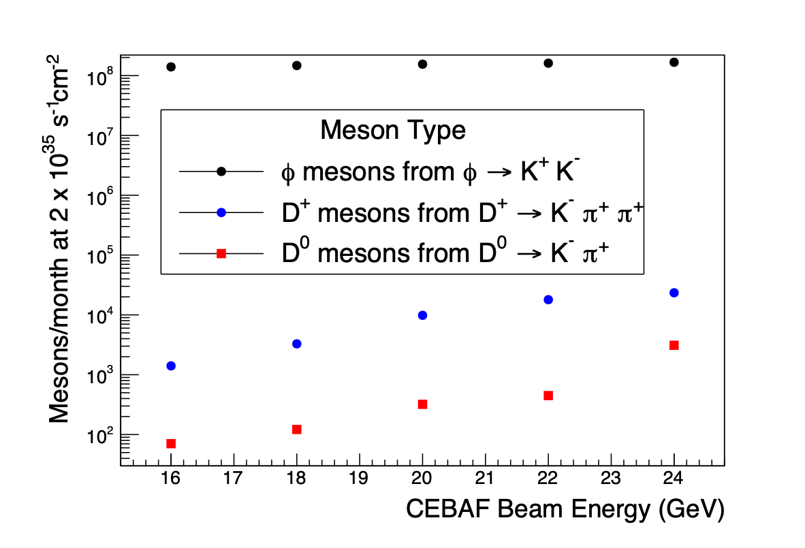
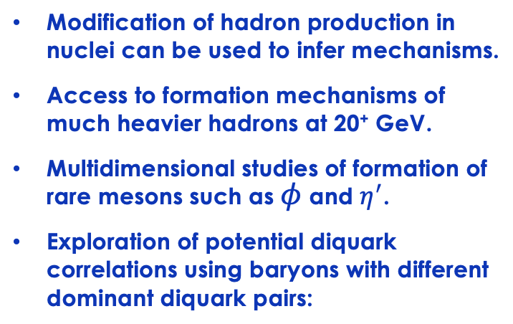
Understanding Hadron Formation using Nuclei
Modification of hadron production in nuclei can be used to infer mechanisms.
Access to formation mechanisms of much heavier hadrons at 20⁺ GeV.
Multidimensional studies of formation of rare mesons such as $φ$ and $η^{′}$.
Exploration of potential diquark correlations using baryons with different dominant diquark pairs:
Arrington et al., https://doi.org/10.1016/j.ppnp.2022.103985
Yin et al., https://doi.org/10.1103/PhysRevD.100.034008
Brooks and Lopez, https://doi.org/10.1016/j.physletb.2021.136171

Slide 18
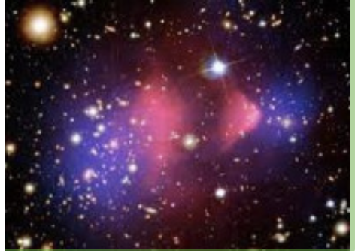
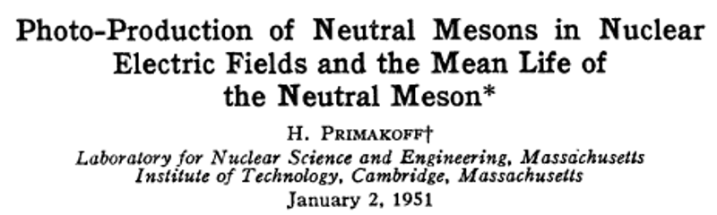
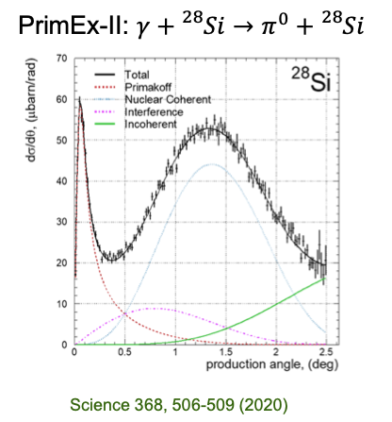
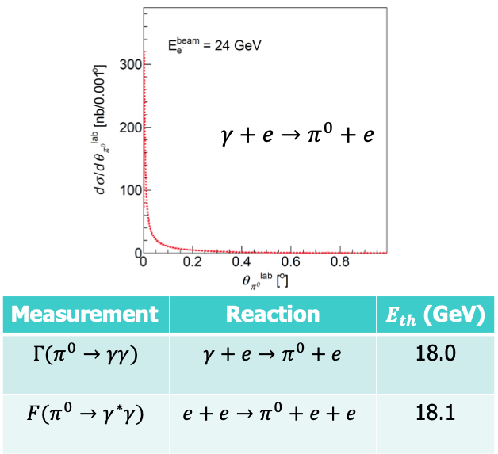
Physics Beyond the Standard Model
Favorable experimental condition:
A high energy beam
A high Z nuclear target
Very forward angles to reduce QCD background
π⁰ Primakoff production off electron target will eliminate nuclear backgrounds
L. Gan
18

Slide 19


Community Interest Forwarding Science Program
Also numerous invited talks at other workshops and more workshops in the planning phase

Slide 20
Conclusions
CEBAF 22 GeV upgrade capitalizes on existing investments
  Scientific program with existing Hall equipment
  Re-purpose of idle LERF accelerator
  Leverage new FFA accelerator technology with resistive magnets
Strong science case for JLab energy upgrade in development
  Unique measurements at the luminosity frontier
  Complementary to EIC
  Leverages precision capabilities of Jefferson Lab
20

Slide 21
LRP: Suggested Text for a CEBAF Energy Upgrade Initiative
Capitalizing on recent science insights and US-led accelerator science and technology innovations, we strongly recommend the allocation of resources to develop a cost-effective energy upgrade of CEBAF, and its construction in a timeframe compatible with the EIC construction. This will enable a worldwide unique nuclear science program at the luminosity frontier.
The last decade has provided multiple science surprises such as the discovery of exotic states in the charmonium sector at facilities worldwide, the so-called “XYZ” states. Studies of the 3D structure of hadrons and hadronization provided deeper access to quark-gluon dynamics and opened new opportunities to understanding QCD in its full complexity. In addition, mysteries of the visible matter around us remain unsolved, such as a small enhancement of partons found in nuclei at the interface of the quark- and gluon-dominated regions, the so-called “anti-shadowing” region, that to date lacks explanation and can only be further studied at the luminosity frontier.
Capitalizing on recent innovations enabled by accelerator science and technology, a cost-effective energy upgrade of the 12-GeV CEBAF at Jefferson Lab to a 22 GeV facility has become feasible. Such an upgrade would permit a worldwide unique nuclear science program with fixed targets at the luminosity frontier, roughly five decades above that possible with a collider. Beyond its nuclear science opportunities, this will further steward best-in-class accelerator technology within the US.
21

