Slide 1
Open questions in cold QCD:
̶̶ ̶ a personal list
Xiangdong Ji, University of Maryland
2022 Town Hall Meeting on Hot & Cold QCD
MIT, Sept 23-25, 2022

Slide 2
Criteria for questions
The big picture, will not go into very detailed topics.
Questions that may be answerable either in experiment or theory or both.
Not limited to 5-10 years.
No particular order.
Only some brief comments given to avoid misinterpretation.
Not the final list, not an expert in many areas, welcome comments.

Slide 3
Open questions in cold QCD
How does QCD (non-pert. QFT) work?
Can confinement be proven and experimentally tested in cold QCD?
What do existence and non-existence of exotics states tell us about properties of QCD?
Why is the proton’s spin not 17/2?
What is the role of gluon in hadron structure, in hadron masses in particular?

Slide 4
Open questions in cold QCD
How to understand the universality & saturation properties of nucleon/nucleus wave function at small-x and to test it in exp?
How does hadronization happen?
What is the phase diagram of nuclear matter as function of density and isospin?
Can a quantum computer help in solving QCD?
….

Slide 5
Q1: how does QCD (non-pert. QFT) work?
Experiment
Calculation
Understanding?
We don’t have a simple language to explain empirical rules and strong interaction phenomenology.
  Quark models
  Instantons
  …

Slide 7
(non-pert) QFT is hard!
“QFT feels like it’s an animal you can touch from many places, but you don’t quite see the whole animal.” said Nathan Seiberg, a physicist at the Institute for Advanced Study.
“Particles are not objects that are there forever,” said David Tong, Professor at U. Cambridge “It’s a dance of fields.” “Quantum field theories are by far the most complicated objects in mathematics, to the point where mathematicians have no idea how to make sense of them.”
“Quantum field theory emerged as an almost universal language of physical phenomena, but it’s in bad math shape,” said Dijkgraaf, director of IAS “And for some physicists, that’s a reason for pause.”

Slide 8
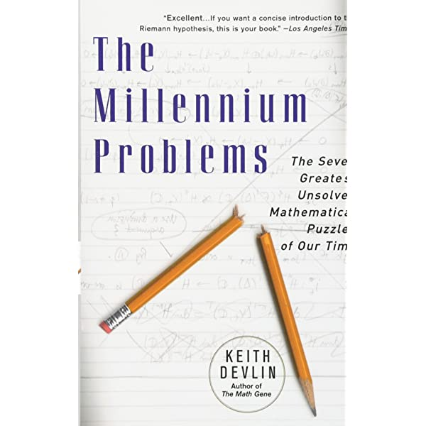
Q2: Can confinement be proven and experimentally tested in cold QCD?
Proving confinement is a well-known millennium, million-dollar math question.
Lattice QCD was invented by K. Wilson to explain confinement. Many evidences in lattice QCD (flux tubes, dual SC etc).

Slide 9
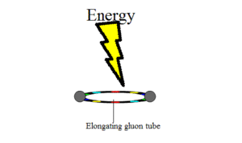
Experimental signatures for confinement
What are the evidence of confinement?
  No colored states!
  Deconfinement phase transition/crossover?
  Exotic gluon states (flux tube excitation)?
How does confinement affect the low-energy hadronic structure? (MIT bag model, confinement radius, constituent relativistic quarks?)

Slide 10
Q3: What do existence and non-existence of exotics tell us about QCD?
High-lying hadron states (resonances) are hard to calculated from lattice QCD
  Great progress in calculating phase-shift on lattice
Much of the theory about these states depend on models (quark models, strings, molecules, etc)
How does QCD decide certain states exist, and others do not? Are they just accidents as deuteron is bound and (nn) is not.
or, exotics will teach us something interesting about QCD, like Quark model/diquarks? one shall derive it from QCD, through confinement/χ symmetry.

Slide 11
Q4: Why is proton’s spin not 17/2?
We have the quark model (textbooks) which gives a simple explanation what the proton spin is ½.
However, the quark model does not seem to work in terms of QCD quarks and gluons: spin crisis
What is the spin structure of the nucleon in QCD quarks and gluons?
Message in this
is interesting but not hugely illuminating

Slide 12
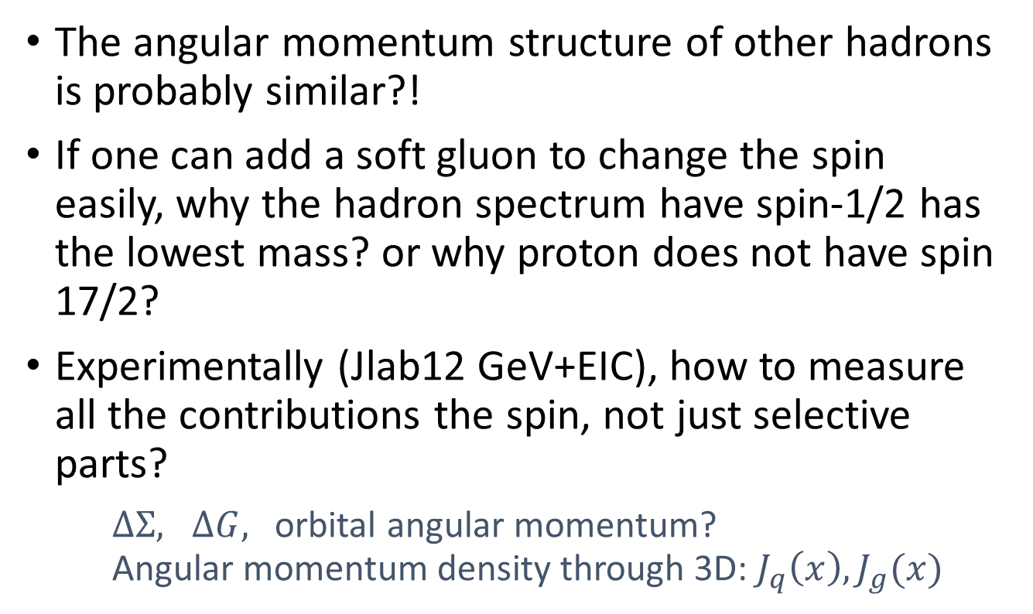
Q4: Why proton’s spin is not 17/2?
The angular momentum structure of other hadrons is probably similar?!
If one can add a soft gluon to change the spin easily, why the hadron spectrum have spin-1/2 has the lowest mass? or why proton does not have spin 17/2?
Experimentally (Jlab12 GeV+EIC), how to measure all the contributions the spin, not just selective parts?
$ΔΣ, ΔG,$ orbital angular momentum?
Angular momentum density through 3D: $J_{q}\left(x\right), J_{g}(x)$

Slide 13
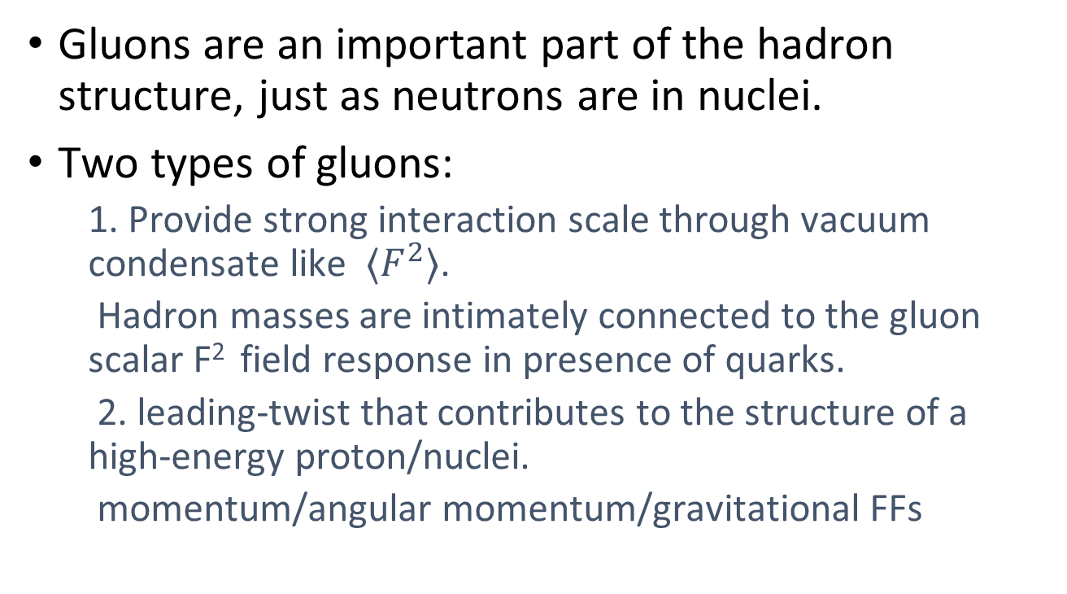
Q5: What is the role of gluon in hadron structure, in hadron mass in particular?
Gluons are an important part of the hadron structure, just as neutrons are in nuclei.
Two types of gluons:
  1. Provide strong interaction scale through vacuum condensate like $⟨F^{2}⟩$.
  Hadron masses are intimately connected to the gluon scalar F² field response in presence of quarks.
  2. leading-twist that contributes to the structure of a high-energy proton/nuclei.
  momentum/angular momentum/gravitational FFs

Slide 14
Q5: What is the role of gluon in hadron structure, in hadron masses in particular?
First type:
  Probe it experimentally through heavy-quarkonium production
  Understand connection of the gluon scalar field with confinement (scalar radius=confinement radius?)
Second type:
  3D structures: gateway to understand the fundamental properties of hadrons
  Deep exclusive processes
  Challenge for lattice QCD

Slide 15
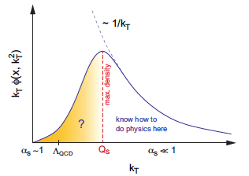
Q6: How to understand the universality & saturation properties of nucleon/nucleus wave function at small-x and to test it in exp?
Wave function of a hadron depends on its momentum. (Bound state properties vs. scattering: many description of small-x physics has been formulated in terms of scattering)
Strong evidence that small-x (momentum) part of the fast hadron is universal and shows saturation.
Why saturation happens?
  Perturbatively, through non-linear evolution
  Non-perturbatively, through adding up non-Abelian gauge field of valence quarks (MV model)
  Are they the same?
  What is the mechanism in terms of structural physics?

Slide 16
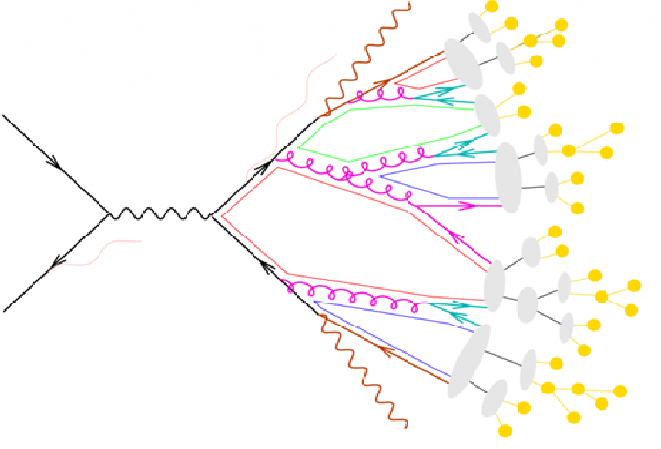
Q7: How does hadronization happen?
Fascinating phenomena!
How does color flow?
hard to calculate from first principles, only modeling so far.

Slide 17
Q8: What is the phase diagram of nuclear matter as function of density and isospin?
It is well-know that QCD systems with finite potential has a sign problem. Need progress in theory.
Phenomenologically, it has been suggested that something interesting might happen at high-density
  Superfluidity, color-flavor locking?
  Strange matter..
Experiments?
  Neutron star
  Laboratory tests

Slide 18
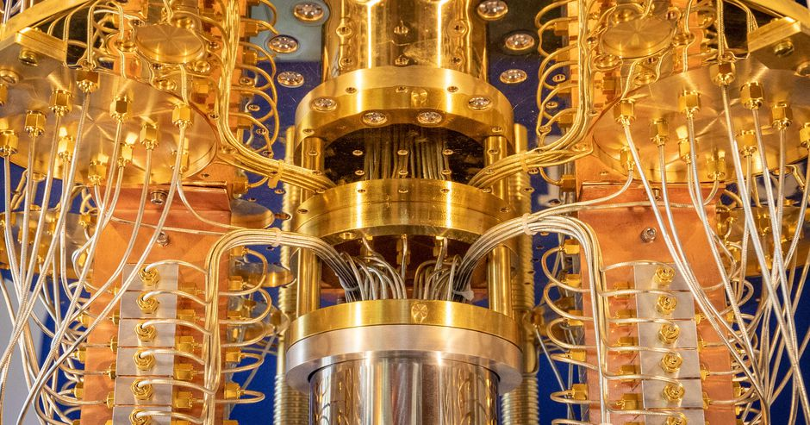
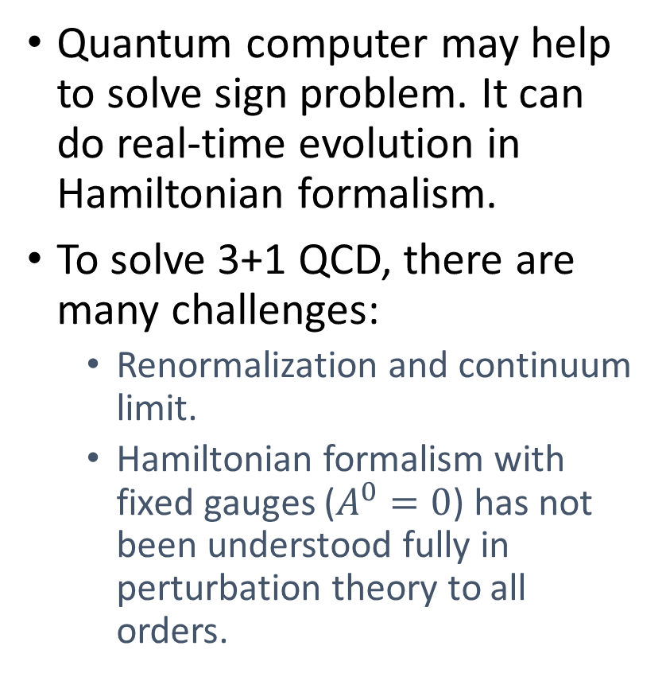
Q9: Will a quantum computer help to solve QCD?
Quantum computer may help to solve sign problem. It can do real-time evolution in Hamiltonian formalism.
To solve 3+1 QCD, there are many challenges:
  Renormalization and continuum limit.
  Hamiltonian formalism with fixed gauges ($A^{0}=0$) has not been understood fully in perturbation theory to all orders.

Slide 19
Conclusions
QCD is one of the most fascinating and deep physics theories which will take a long time to understand, an indication of intellectual depth of our field.
Next 5-10 years, expect much progress in theory (lattice QCD) and JLab12 GeV program.
Beyond that, there is EIC (& quantum computer?)

Slide 20
Support theory!

