Slide 1
QCD in Nuclei and
Cold Nuclear Matter
Lawrence Weinstein
Old Dominion University
9/24/2022
2022 Town Hall Meeting on Cold and Hot QCD

Slide 2
What can nuclei teach us about QCD?
Hadrons: learn about isolated few-quark and gluon(?) states
Nuclei: how do other nucleons modify these states?
  What is the partonic structure of nuclei?
    Short range correlated (SRC) nucleons
    Nuclear PDFs and TMDs
  How/which nucleons are modified?
    All nucleons modified a little
    SRC nucleons modified a lot
Reactions with the nuclear medium
  How do fast partons interact in nuclei? How do they hadronize?
  How do we make small-size hadrons and how do they interact with the nucleus?

Slide 3
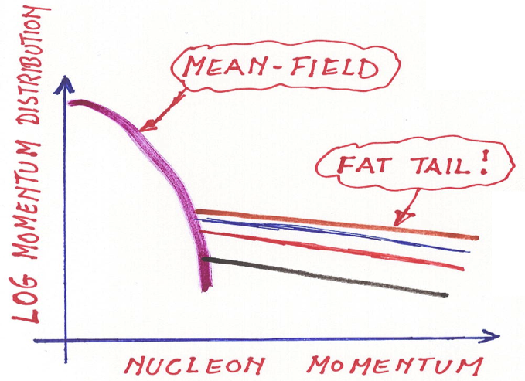
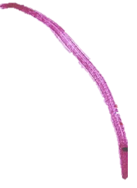
Short-range correlations tell us about the isospin-structure of the NN force.
A-1
n
A-2
p
~80%
~20%
~k_{F}
Subedi et al., Science 320, p. 1476 (2008)

Slide 4
Even in neutron-rich nuclei, np-pairs predominate.
For nucleons with ≈300–600 MeV/c
O. Hen et al., Science 346 p. 614 (2014)
M. Duer et al., PRL122, 172502 (2019)
M. Duer et al., Nature 560, p. 617 (2018)

Slide 5
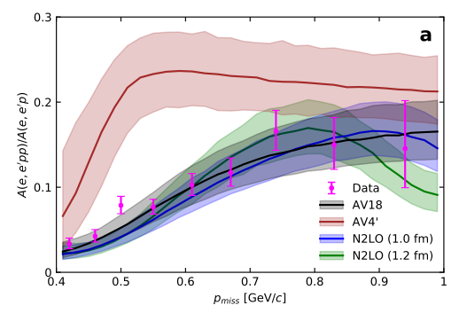
This gives way at very high momentum.
Evidence of a scalar repulsive core!
Scalar
Tensor
A. Schmidt et al., Nature 578 p. 540 (2020)

Slide 6
A=3 nuclear structure in CLAS12
R. Cruz, D. Nguyen et al. PRL (2020)
(e,e’p) →
  Short-range few-body nuclear structure.
  Short-range NN interaction
  Reaction mechanisms
(e,e’pN)/(e,e’p) →
  isospin structure of short-range NN interaction
³H(e,e’pn)/³H(e,e’p)
Projected
E12-20-005

Slide 7
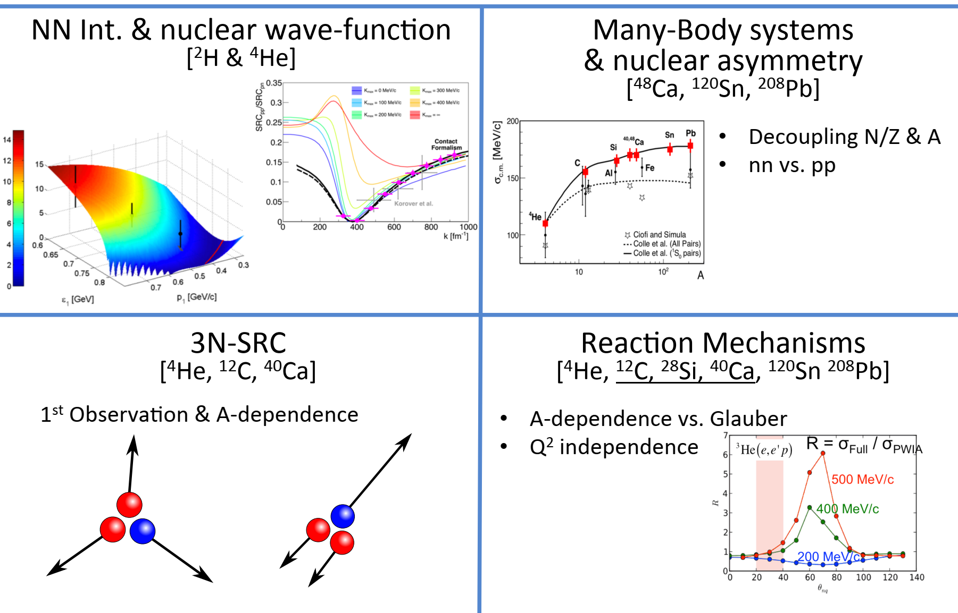
Measuring SRCs in nuclei
(e,e’p), (e,e’pN) and (e,e’ppN) data taken 2021/22: CLAS12 Run Group M
Notes:
Three nucleon SRCs?
Constraining the short range NN interaction
Understanding factorized effective theories
SRC formation mechanisms

Slide 8
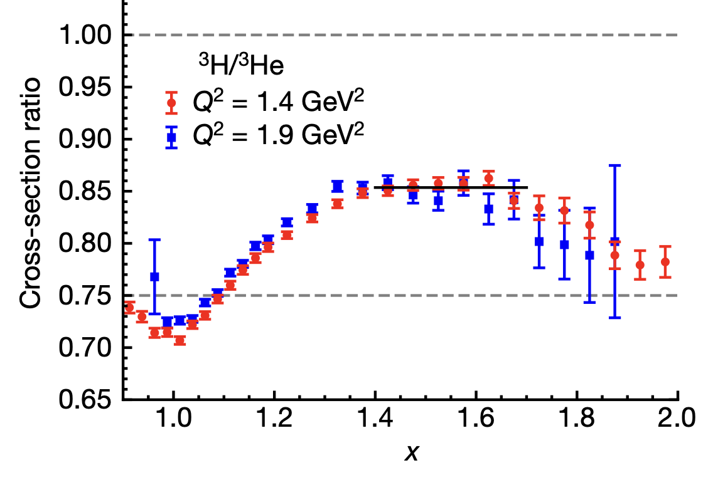
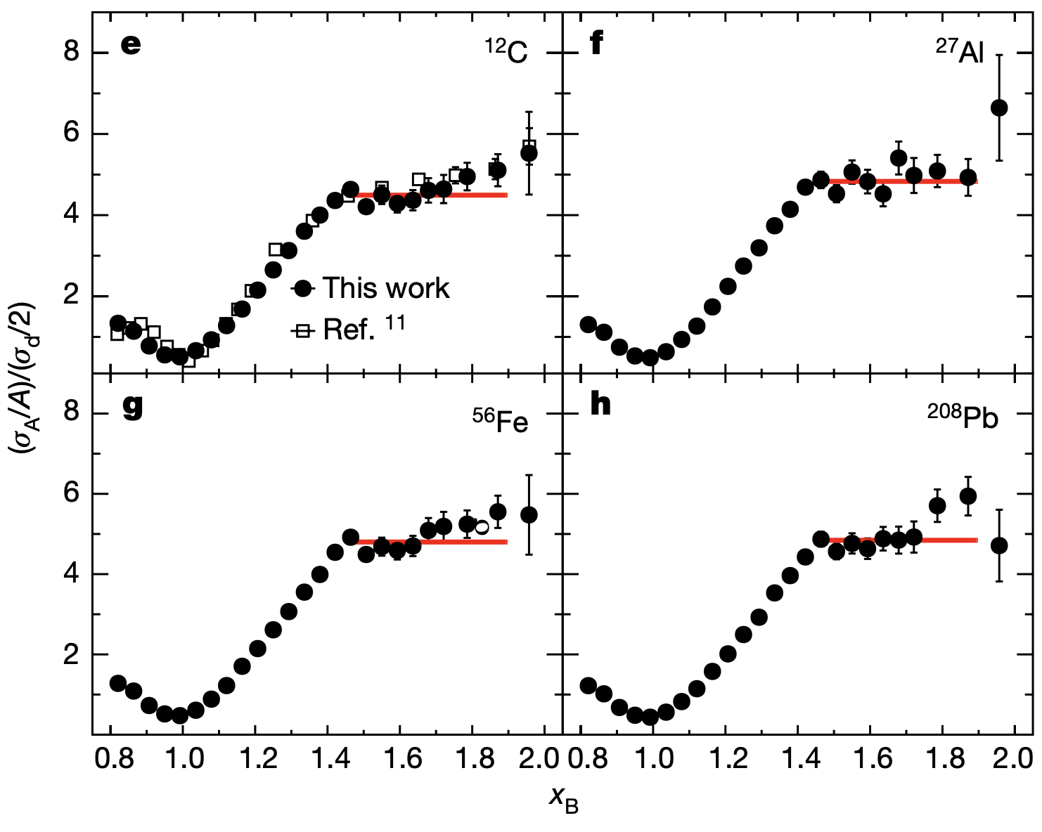
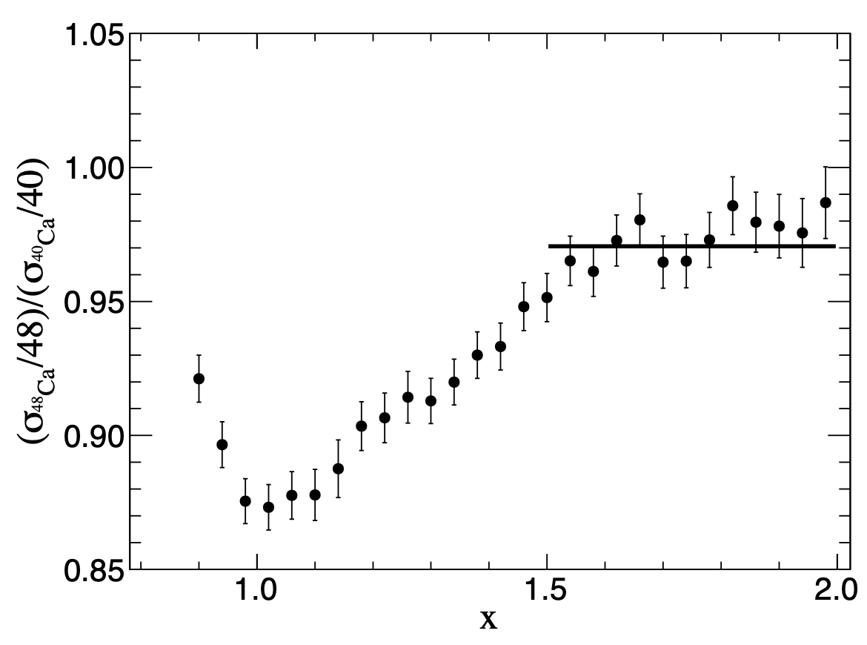
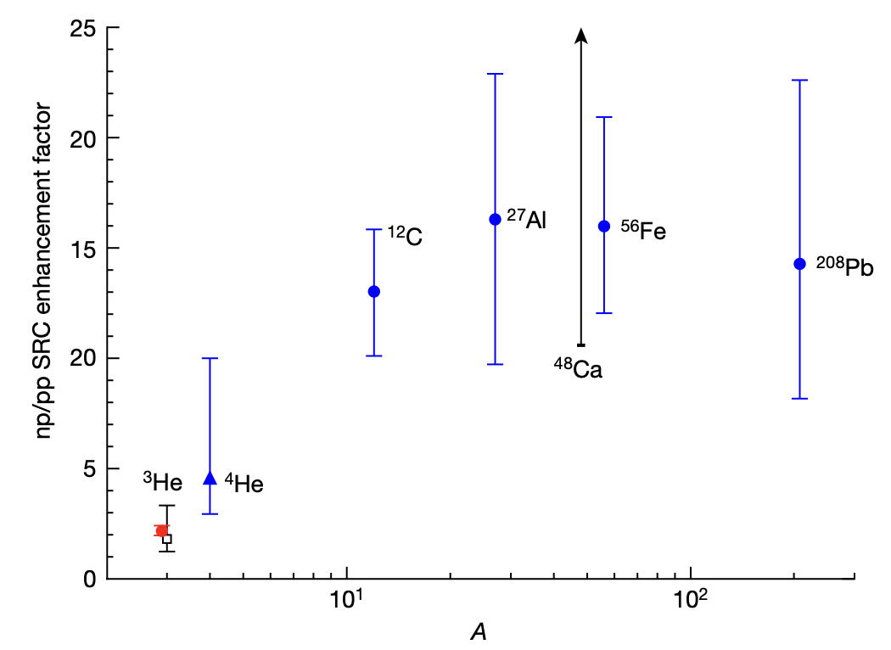
Inclusive A(e,e’) ratios
A=3
Calcium 40 and 48
C, Al, F and Pb / d
3H/3He cross section ratio
Ca48 / Ca40
Ratio to d
x
Nguyen et al, Phys.Rev.C 102 (2020), 064004
np/pp enhancement factor
x
Schmookler, et al, Nature 566, p354 (2019)
Increasing x increases nucleon momentum sampled
Inclusive cross section ratios give:
Existence and abundance of SRC pairs
Some information on np vs pp pairs
A
Li, et al, Nature 609, p41 (2022)

Slide 9
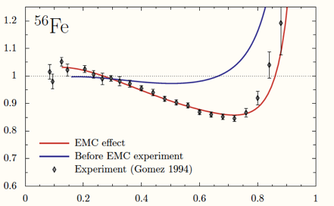
Quark distributions
modified in nuclei (EMC Effect)
Original Expectation
Iron / Deuterium Structure Function
Ratio
Experimental
Observation
0 0.2 0.4 0.6 0.8 1
x_{B}
Aubert et al., PLB (1983); Ashman et al., PLB (1988); Arneodo et al., PLB (1988); Allasia et al., PLB (1990); Gomez et al., PRD (1994); Seely et al., PRL (2009); Schmookler et al., Nature (2019)

Slide 10
Quark distributions
modified in nuclei
Iron / Deuterium Structure Function
Ratio
(Anti) Shadowing
EMC Region
Fermi- Motion
0 0.2 0.4 0.6 0.8 1
x_{B}
Aubert et al., PLB (1983); Ashman et al., PLB (1988); Arneodo et al., PLB (1988); Allasia et al., PLB (1990); Gomez et al., PRD (1994); Seely et al., PRL (2009); Schmookler et al., Nature (2019)

Slide 11
Happens in all nuclei
³He
²⁰⁸Pb

Slide 12
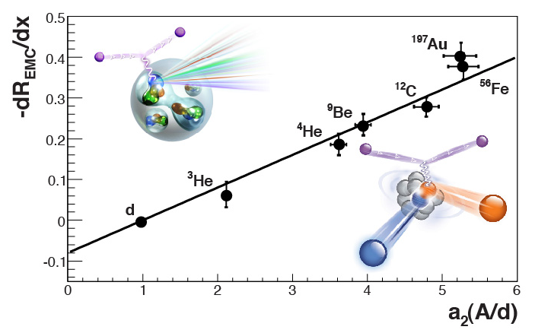
Correlates with SRC probability
EMC Slopes
0.35 ≤ X_{B} ≤ 0.7
SRC Scaling factors X_{B} ≥ 1.5
SRC data from Fomin et al
EMC data from Gomez et al and Seely et al
Weinstein et al, PRL106, 052301 (2011)
Hen et al, PRC85, 047301 (2012)
Hen et al, RMP 89, 045002 (2017)

Slide 13

$$F_{2}^{A} = ZF_{2}^{p}+NF_{2}^{n} + n_{SRC}^{A}\left(\text{Δ}F_{2}^{p}+{\text{Δ}F}_{2}^{n}\right)$$
EMC ratios
$$\text{Δ}F_{2}^{p}+{\text{Δ}F}_{2}^{n}$$
Are only SRC nucleons modified?
B. Schmookler, Nature (2019)

Slide 14
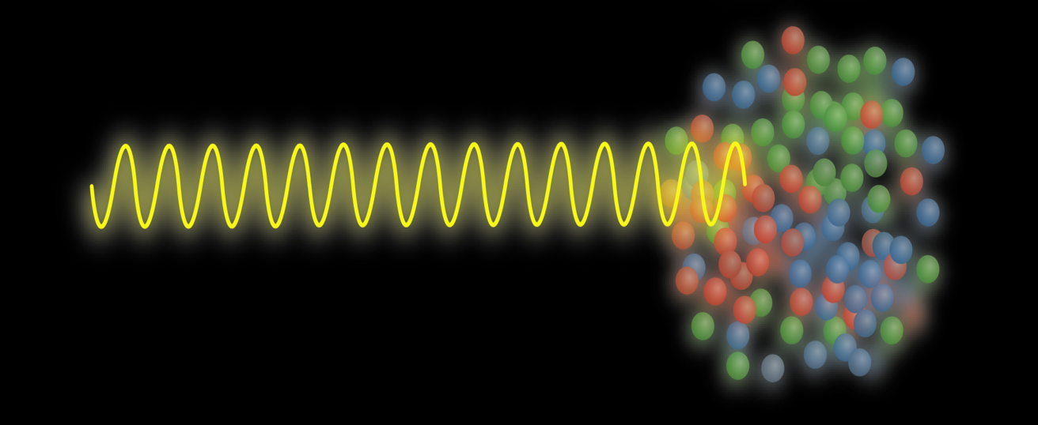
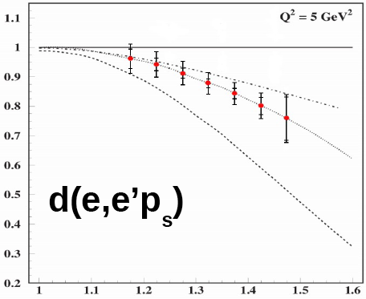
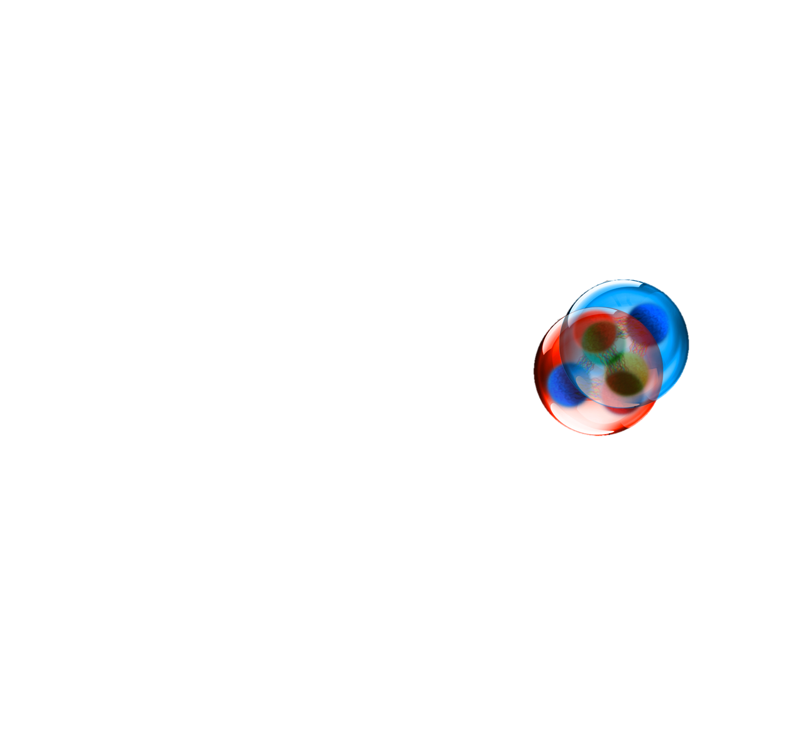
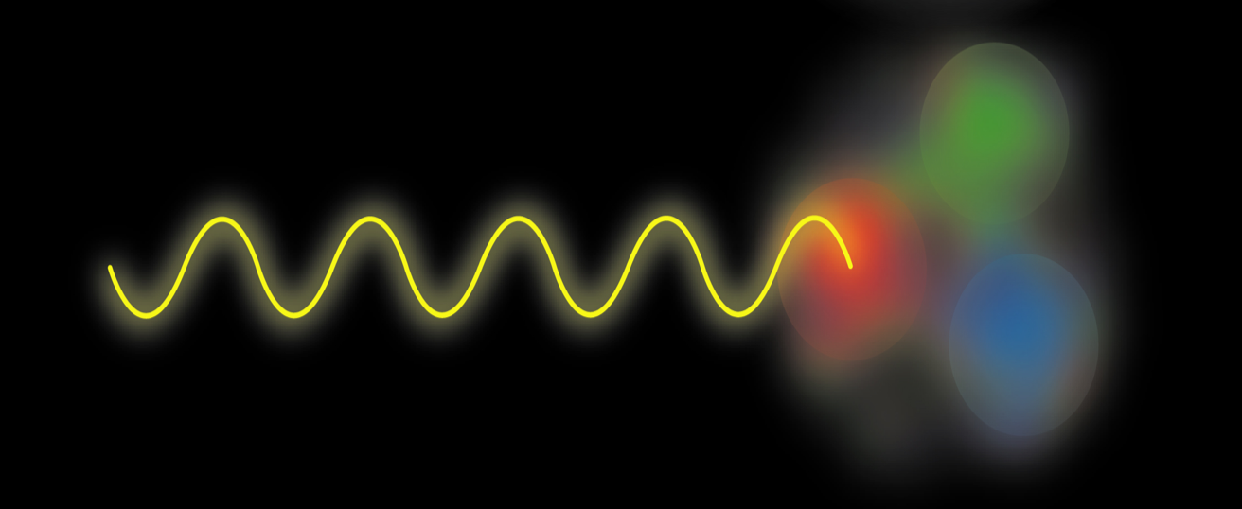
Which nucleons are modified:
Tagged EMC
Parton Information
e'
LAD experiment E12-11-107
e
G^{eff}/G^{n}
Nucleon Information
1
1.5
0
0.4
With easy extensions to the EIC
(GeV/c)

Slide 15
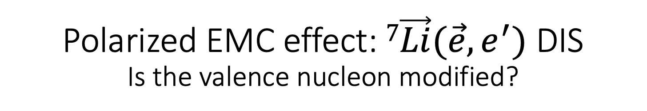
Polarized EMC effect: $7\vec{Li}(\vec{e},e^{′})$ DIS
Is the valence nucleon modified?
Most EMC experiments average over all nucleons
Measure modification of polarized structure function g_{1p} on a single valence nucleon!
Δσ Ratio ∝ [N⁺-N⁻](⁷Li) / [N⁺-N⁻](p)
NNM = Shell model (p 87% pol.)
SNM = Standard Nuclear Model (convolution w/out change in medium; equiv. to SRC model) QMC = Mean Field (Quark-Meson Coupling)
MSS (rescaling/modified sea scheme)
S/AS = Shadowing / Antishadowing (Guzey/Strikman)
CQS = Chiral Quark Soliton (Smith/Miller)
QMC prediction
Expected data for g_{1p}(bound)/g_{1p}(free)
with various predictions
(CLAS12 Run Group G)

Slide 16
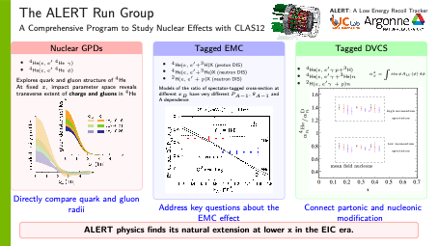

Slide 17
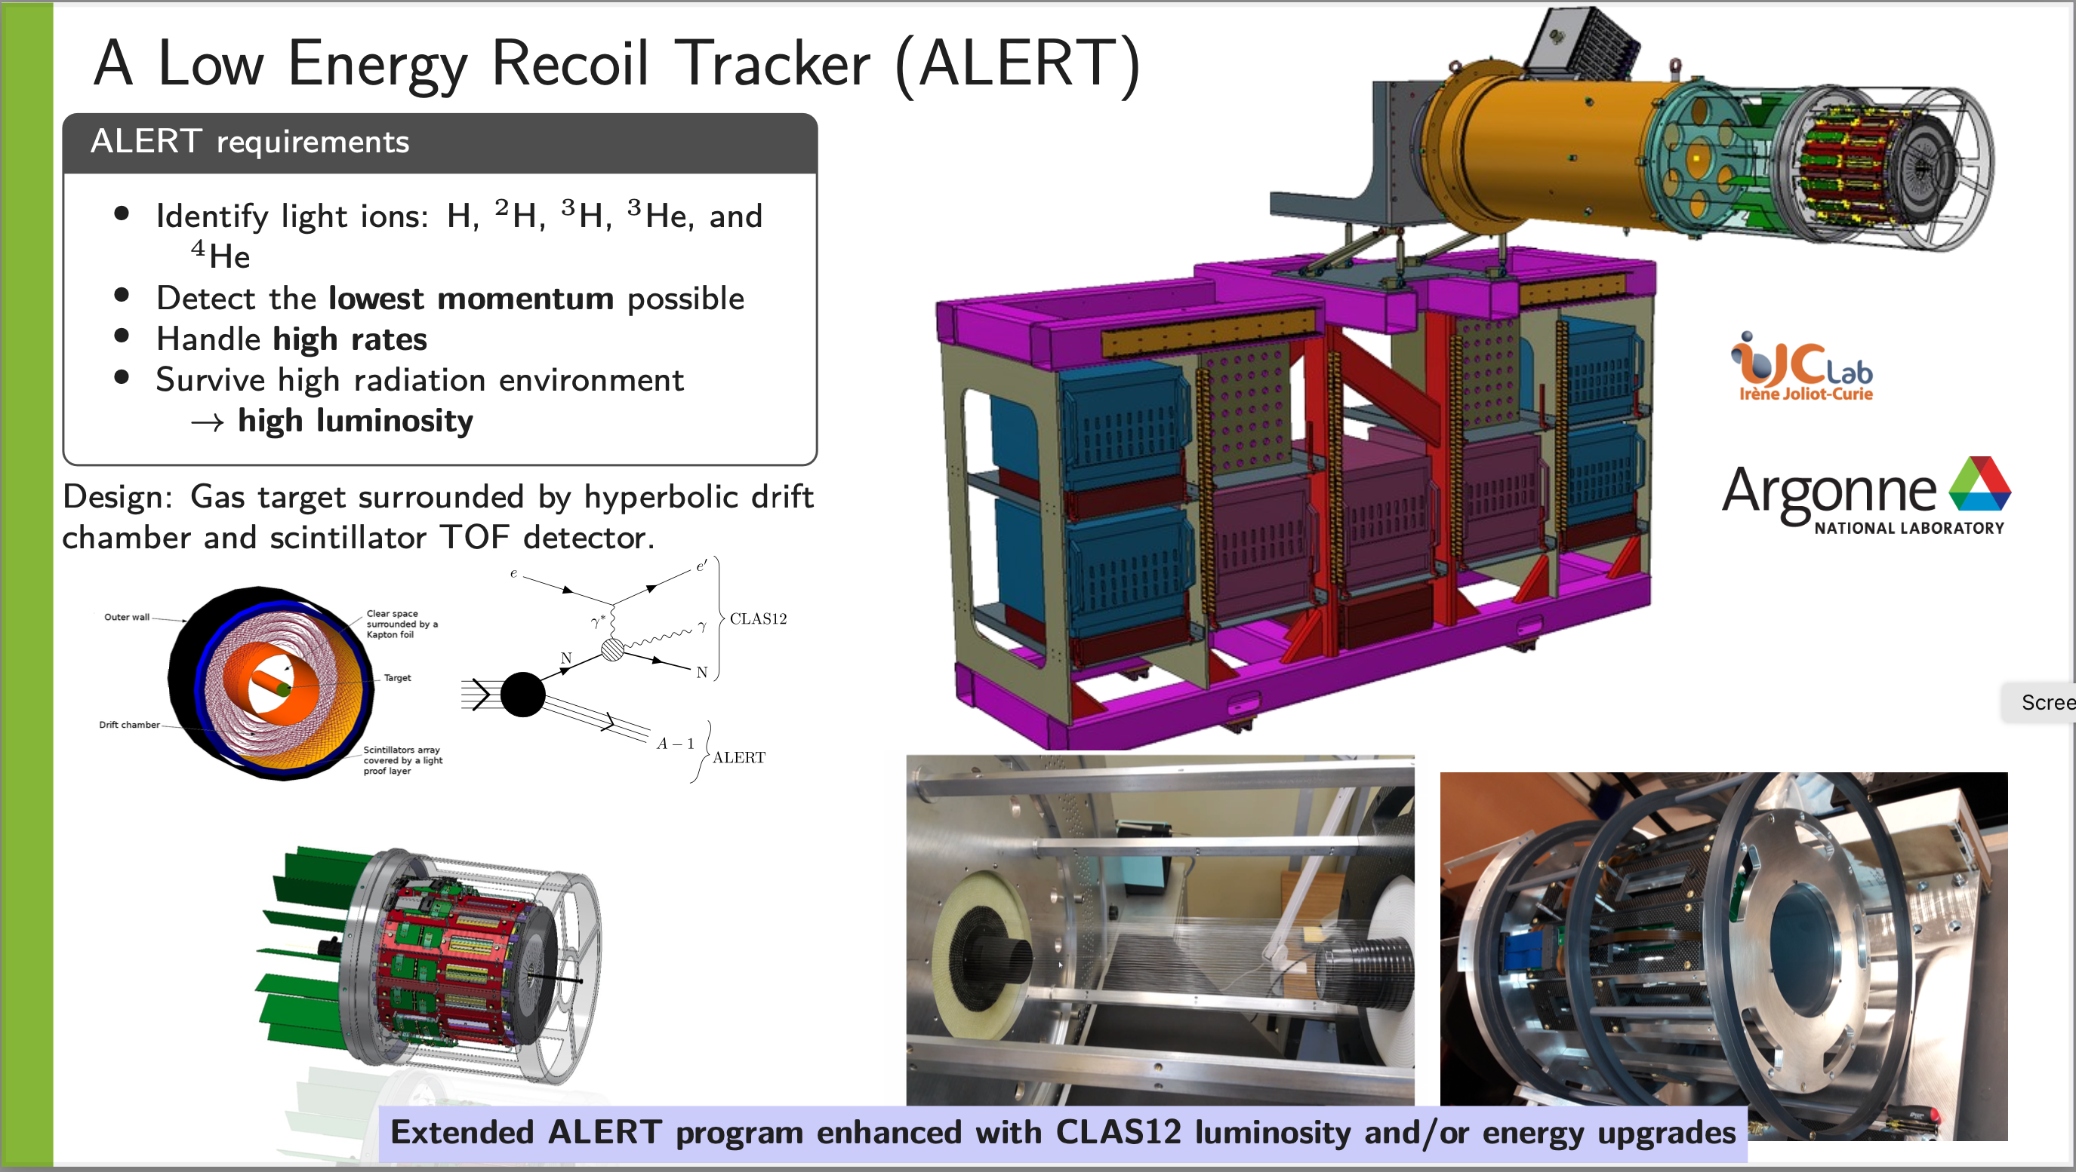

Slide 18
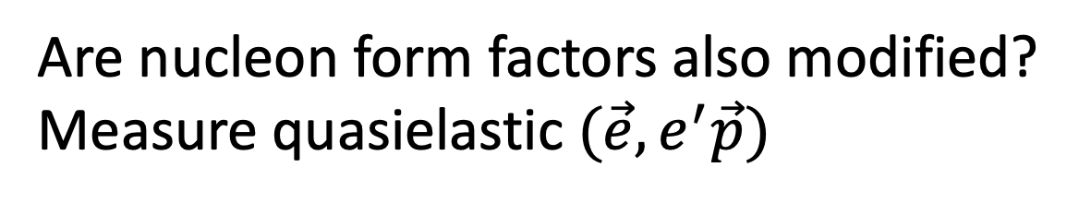
Are nucleon form factors also modified? Measure quasielastic $(\vec{e},e^{′}\vec{p})$

Slide 19
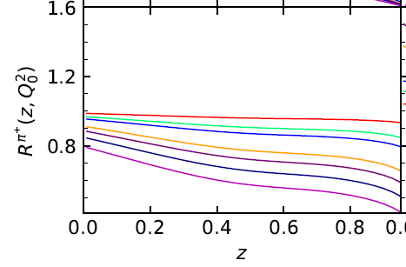
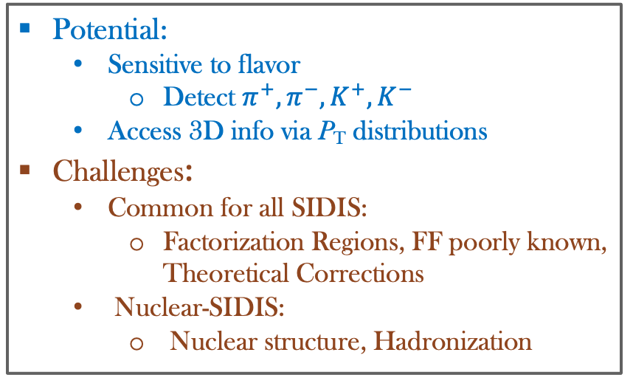
Nuclear SIDIS: PDFs, TMDs, etc
Unpolarized SIDIS Cross Section (Factorization, LO, P_{T} integrated ):
nFF Ratios
Free or Nuclear Fragmentation Function
Pia Zurita, arXiv:2101.01088
He4/p
Free or Nuclear PDF (nPDF)
Pb/p
Potential:
  Sensitive to flavor
    Detect $π^{+},π^{−},K^{+},K^{−}$
  Access 3D info via P_{T} distributions
Challenges:
  Common for all SIDIS:
    Factorization Regions, FF poorly known, Theoretical Corrections
  Nuclear-SIDIS:
    Nuclear structure, Hadronization
FFs are significantly modified in heavy nuclei
Key: take advantage of the Potential while minimizing the Challenges
Light nuclei are easier
Need close collaboration with theorists in global analysis

Slide 20
SIDIS with A=3 in CLAS12
Tritium and Helium-3:
Complements nucleon SIDIS measurements
Complementary to other efforts, such as MARATHON and Ca-Isotopes
Minimize Challenges w/ A=3:
  Precise nuclear calculations
  Small hadronization effects
  Fragmentation functions
    Nuclear effects should be small and very similar
  Many theoretical corrections are similar
Small (~ 5% at high-z) effects in 4He nFF
Large effects in Xe nFF
(Pia Zurita, arXiv:2101.01088)
He4
Multiplicity-ratios (A/d)
Xe
Unique advantage with mirror nuclei: SIDIS cross-section ratios
Jlab Experiment C12-21-004

Slide 21
SIDIS cross section ratio sensitive to Flavor EMC Effect
3He
Cocuzza, Sato, Melnitchouk
Tritium
JAM smeared offshell
JAM smeared
JAM free
Sensitive to flavor dependence of EMC effect

Slide 22
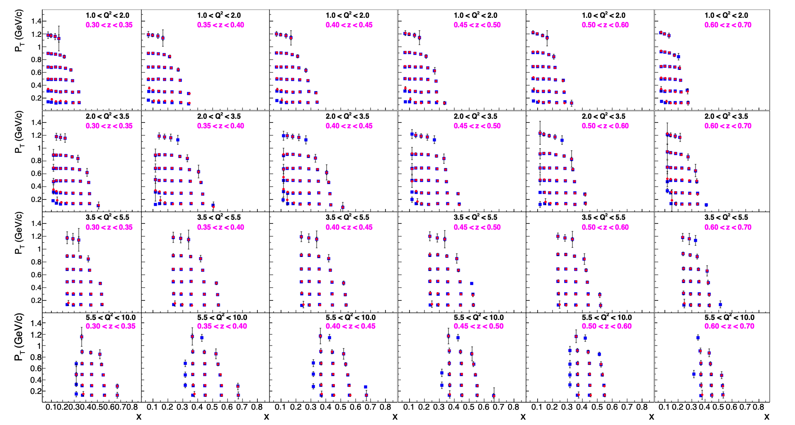

SIDIS with A = 2, 3 – Projected Results
$$π^{+}$$
$$π^{−}$$
High precision, wide kinematic coverage
(4D bins)
Cross section ratios → flavor dependent EMC effect
Provide inputs for d/u at large x
Cross sections → unpolarized TMDs and FFs, and their nuclear effects in 3D

Slide 24
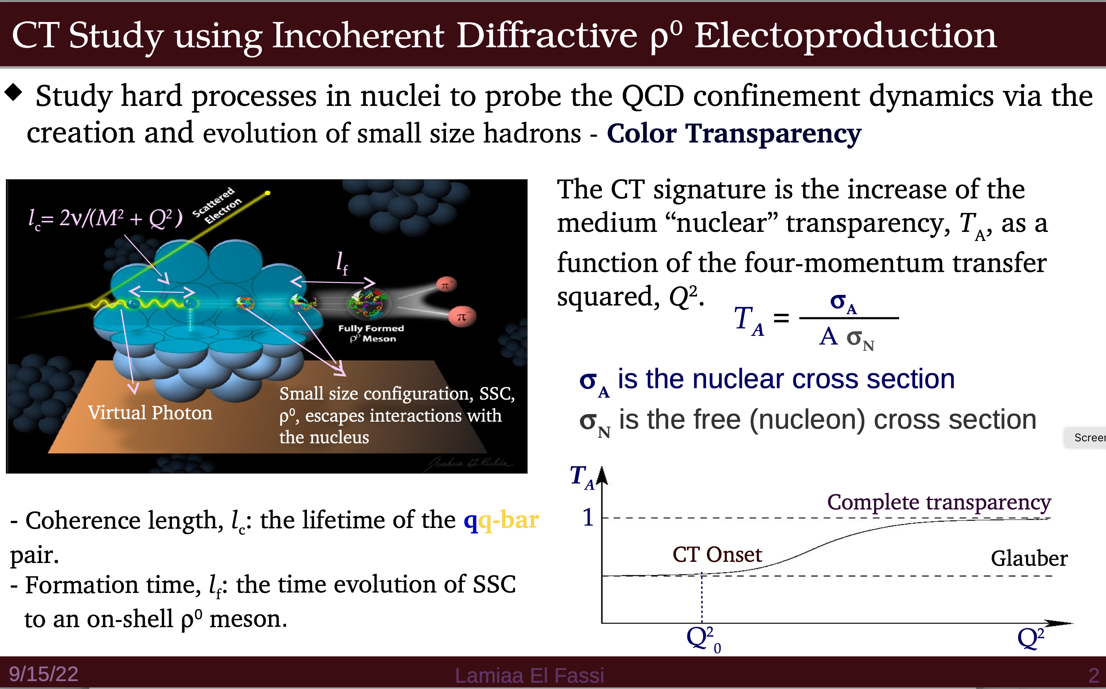

Slide 25
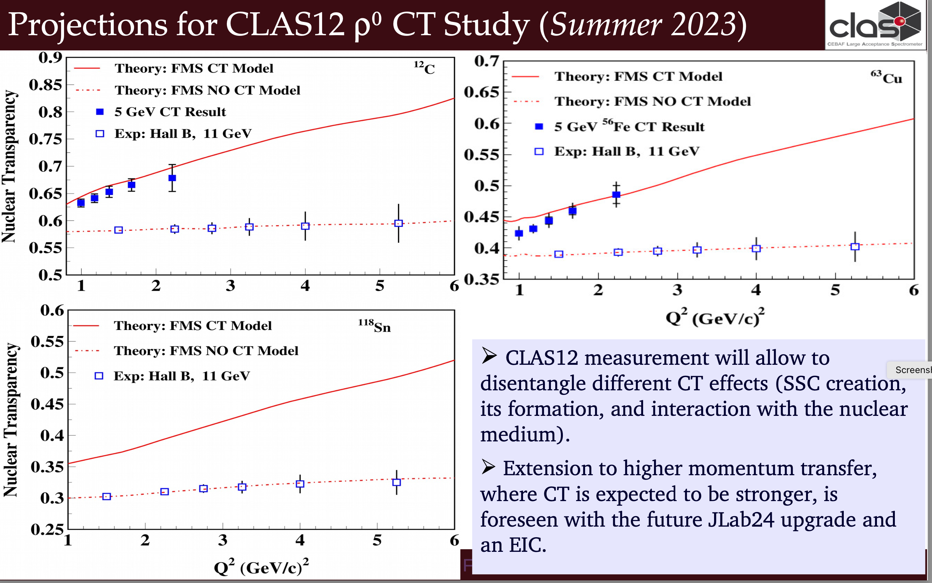

Slide 27
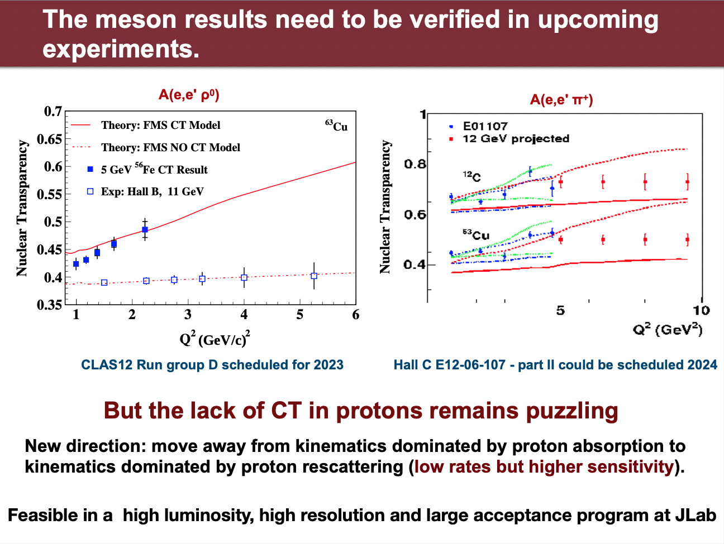

Slide 28
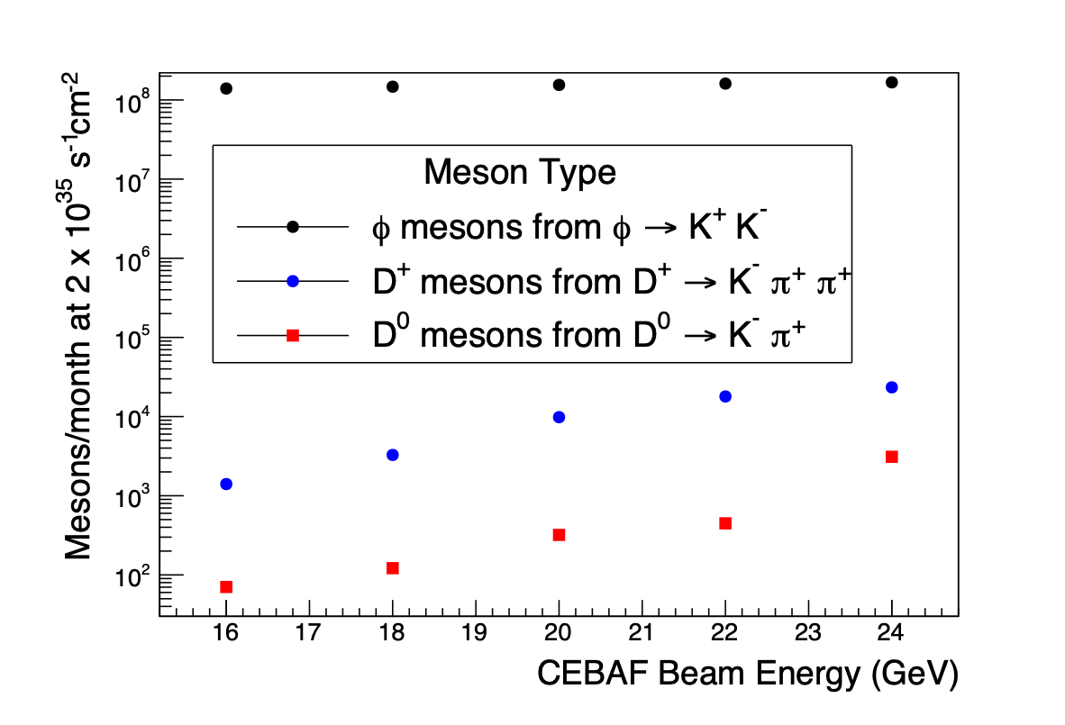



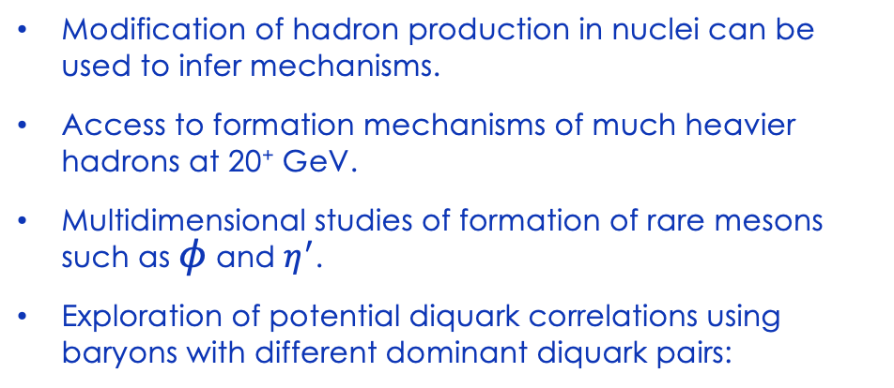





Understanding Hadron Formation using Nuclei
Modification of hadron production in nuclei can be used to infer mechanisms.
Access to formation mechanisms of much heavier hadrons at 20⁺ GeV.
Multidimensional studies of formation of rare mesons such as $φ$ and $η^{′}$.
Exploration of potential diquark correlations using baryons with different dominant diquark pairs:
Arrington et al., https://doi.org/10.1016/j.ppnp.2022.103985
Baryon | Mass | Dominant diquark
Proton | 940 | [ud]u
 | 1100 | [ud]s
 | 1200 | [us]u
 | 1300 | [us]s
 | 2300 | [uc]d-[dc]u
 | 2500 | {uu}c
 | 2500 | [uc]s-[sc]u
 | 2600 | {us}c
 | 2700 | {ss}c
$$Λ$$
$$Σ$$
$$Ξ$$
$$Λ_{c}$$
$$Σ_{c}$$
$$Ξ_{c}$$
$$Ξ_{c}^{′}$$
$$Ω_{c}$$
Brooks and Lopez, https://doi.org/10.1016/j.physletb.2021.136171
Yin et al., https://doi.org/10.1103/PhysRevD.100.034008

Slide 29
What can nuclei teach us about QCD?
What is the partonic structure of nuclei?
How/which nucleons are modified?
What is the short distance structure of the NN interaction?
How do fast partons interact in nuclei? How do they hadronize?
  Are there diquark correlations?
How do we make small-size hadrons and how do they interact with the nucleus?
There is a rich program of JLab experiments to explore these topics
  With extensions to 24 GeV JLab and to the EIC

Slide 30
Added after the talk, following comments

Slide 31
E12-14-002 – Hall C @ 11 GeV
Precision Measurements and Studies of a Possible Nuclear Dependence of R = σ_{L}/σ_{T}
Spokespersons: S. Malace, S. Alsalmi, E. Christy, D. Gaskell, W. Henry, C. Keppel, P. Solvignon, H. Szumila-Vance
Few direct measurements of R_{A}-R_{D} at any x
SLAC E140 made measurements at large x, found no nuclear dependence of R
Neglected Coulomb corrections → re-analysis hints at a nuclear dependence of R at large x
Non-zero R_{A}-R_{D} has important consequences for our understanding of the EMC effect
Will measure R_{D}-R_{p}, R_{A}-R_{D} for C, Cu, Au for x=0.1-0.6
→ Significant overlap with E140, but more x/Q² settings

Slide 32
E12-14-002 – Hall C @ 11 GeV
New, precise measurements of R_{D}-R_{p} at large x and Q²
Will measure R_{A}-R_{D} in copper over wide range of x
Carbon and gold at some additional kinematics
Q² dependence at fixed x
Additional measurements to test Coulomb corrections in DIS

