Slide 1

TMD: Theory and Measurements
@ZhongboK
Acknowledgment: J.P. Chen, L. Gamberg, H. Gao, B. Jacak, Z.-E. Meziani, A. Prokudin, P. Souder, I. Stewart, A. Vossen, X. Zheng, M. Zurek, and collaborators
2022 Town Hall Meeting on Hot and Cold QCD
September 23 – 25, 2022

Slide 2
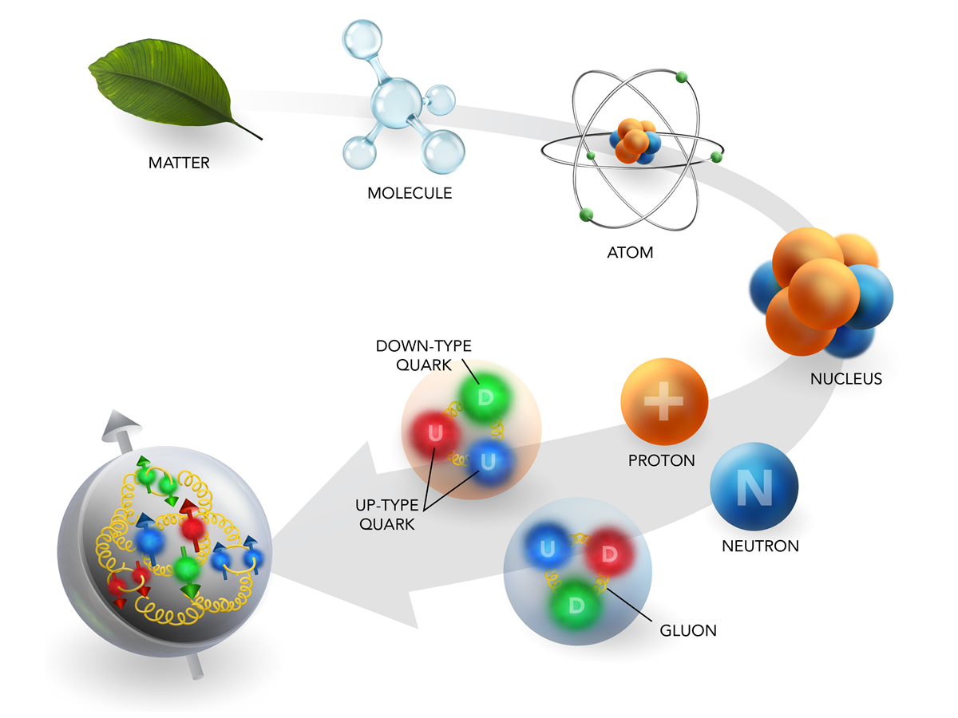
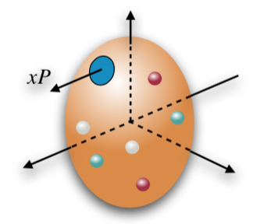
EIC era: Imaging of proton and nucleus
Unraveling the mysteries of relativistic hadronic bound states
Traditionally, collinear parton distribution functions (PDFs) provide a fundamental description of the 1D structure

Slide 3
Transverse Momentum Dependent distributions (TMDs)
3D imaging in momentum space
  Both longitudinal and transverse motion
  What are the quantum correlations between the motion of the quarks/gluons, their spin and the spin of the proton? (TMD PDFs)
  Similarly precision information on hadronization (TMD FFs)
Proton spin

Slide 4
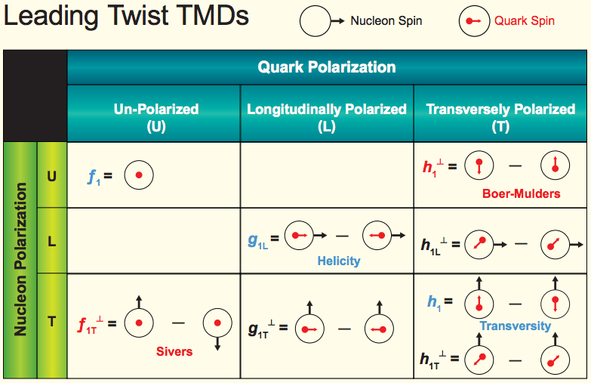
TMDs with polarization
TMD PDFs
Transversal Helicity
Quark Polarization
U L T
TMD FFs
Pion
Collins

Slide 5


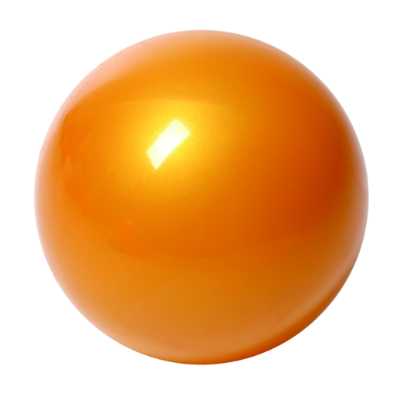
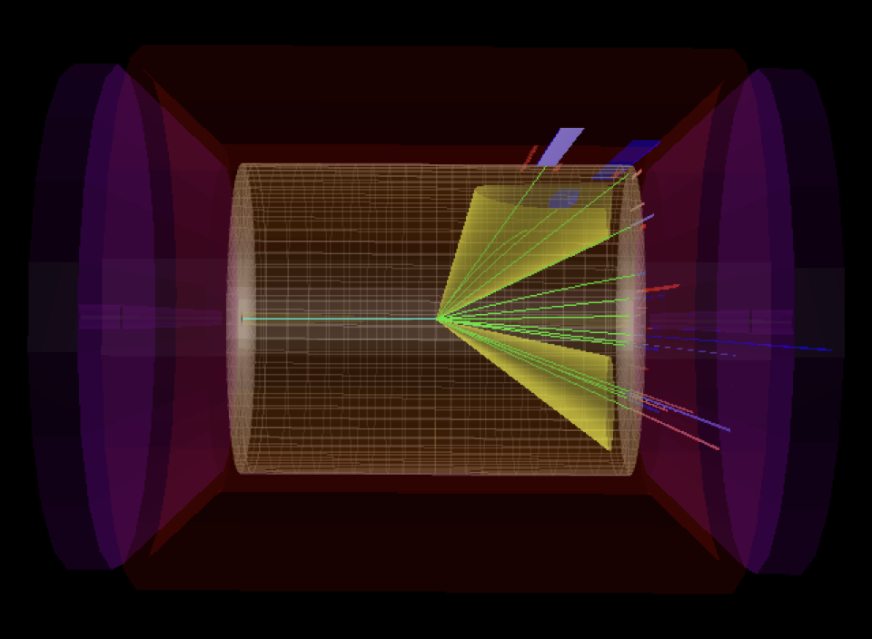

Processes to extract TMDs
Standard processes: SIDIS, Drell-Yan, dihadron in e⁺e⁻
New opportunities: jets and jet-like observables
h₁
electron
p
p
p
h₂
h
EIC
quark

Slide 6
Well-established TMD factorization
Drell-Yan production
mimic “parton model”

Slide 7
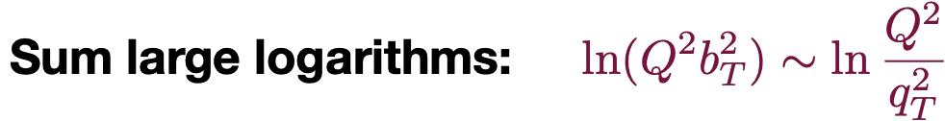
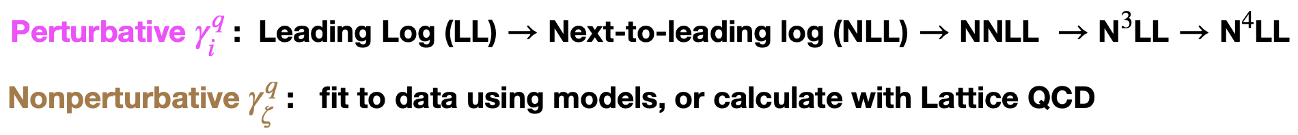
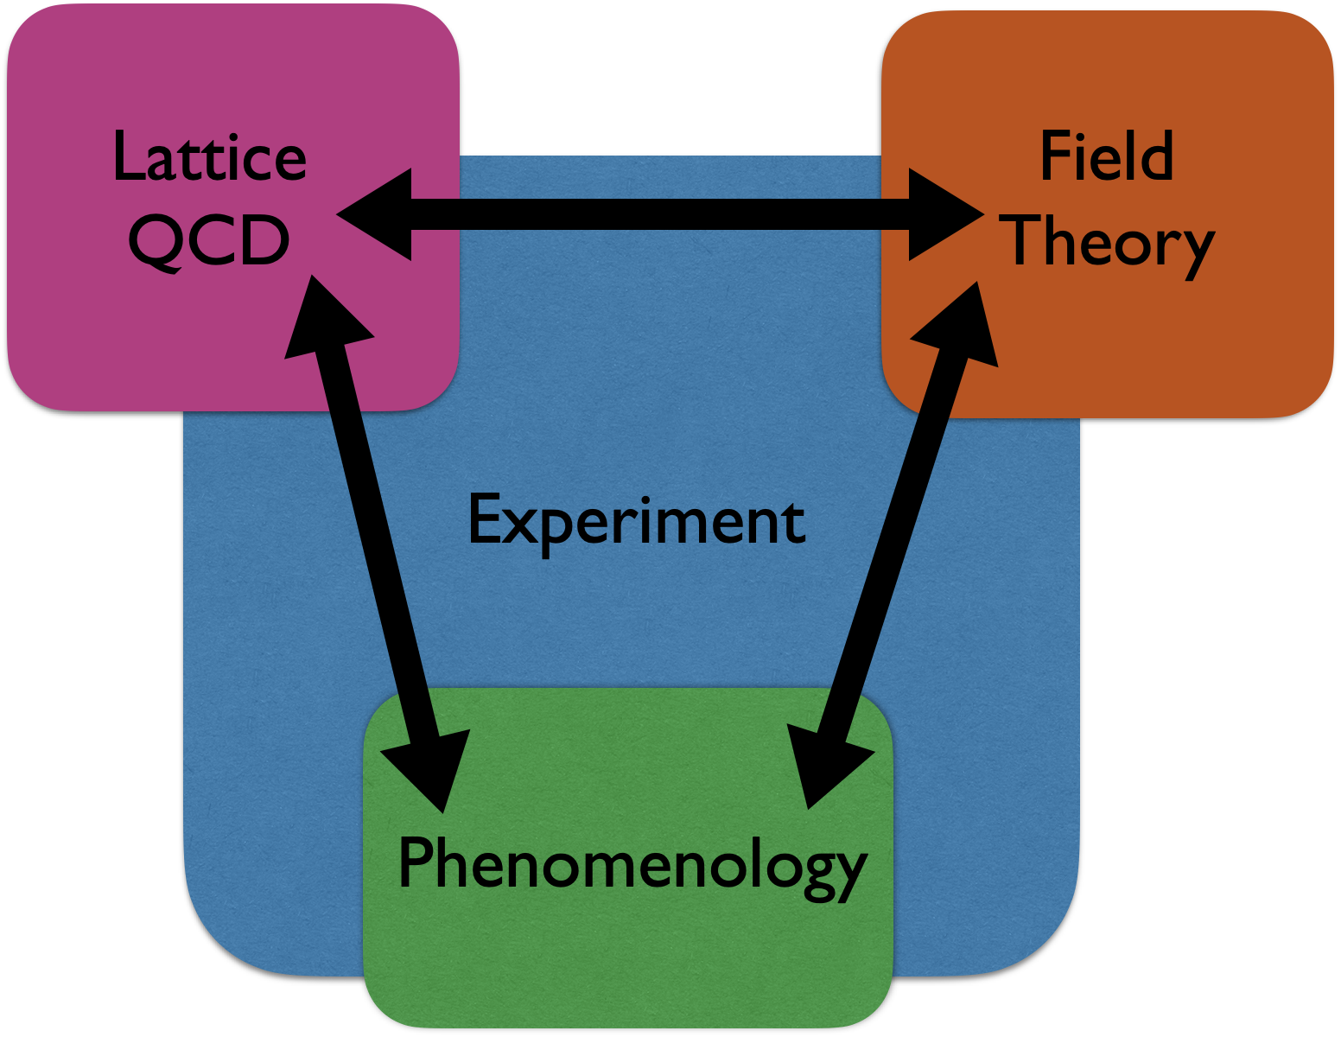
TMDs: definition and evolution
TMD definitions and evolution: full understanding
  Usual renormalization scale + a rapidity scale
Collins-Soper kernel
Courtesy of I. Stewart

Slide 8
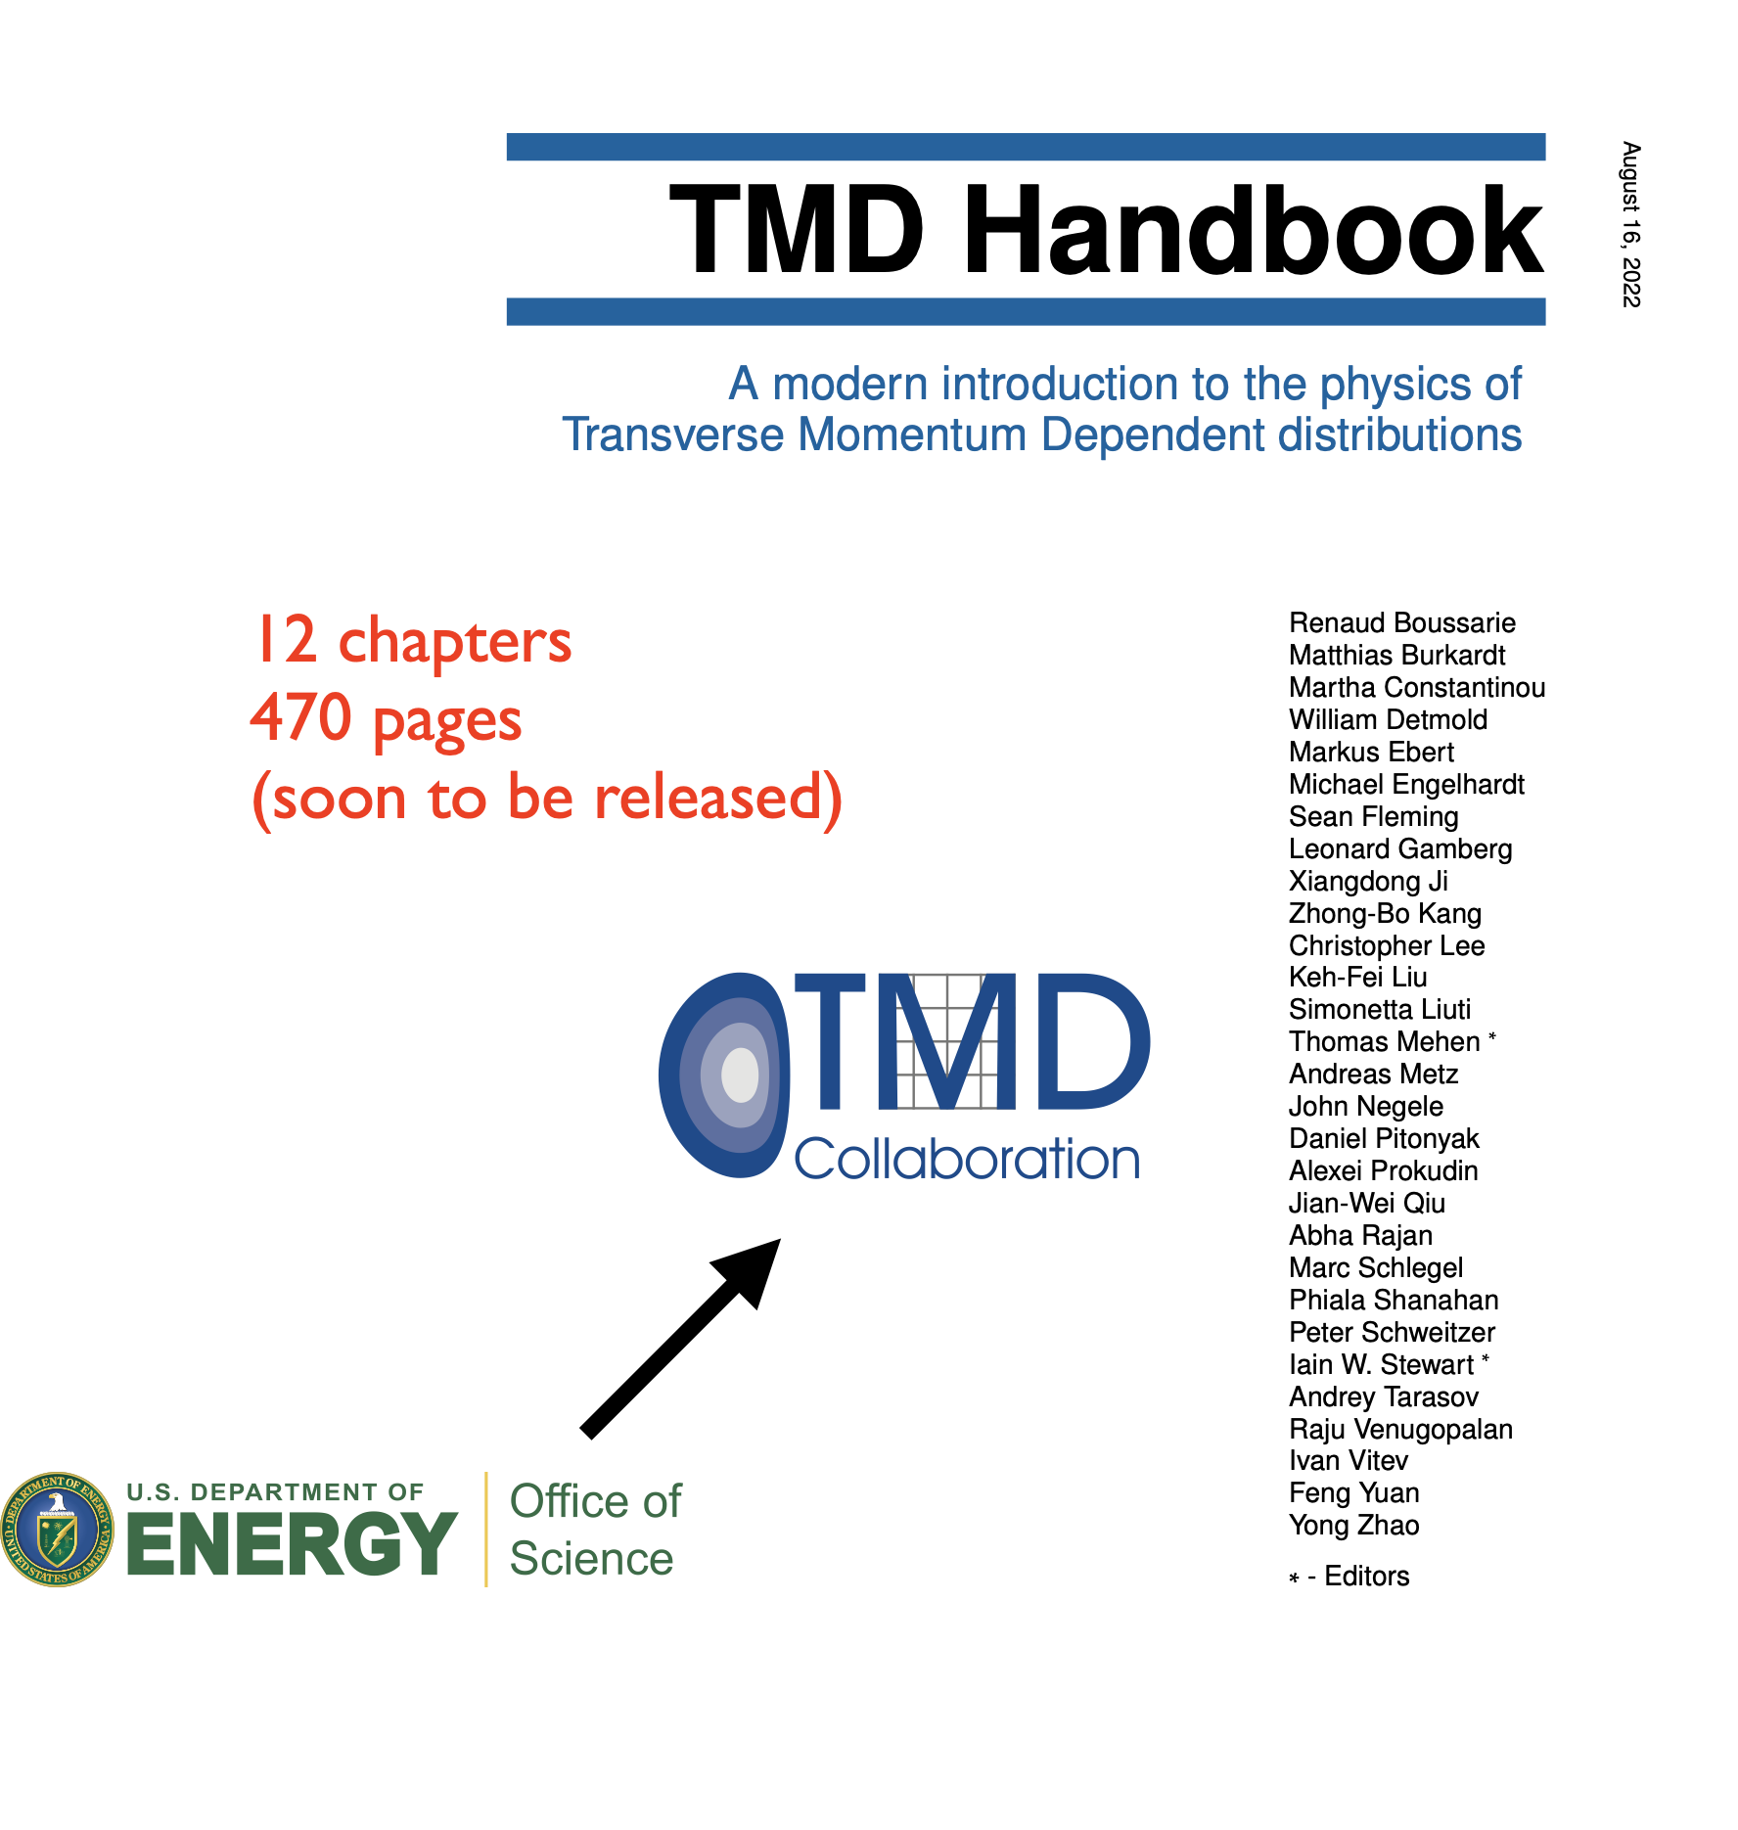
TMD topical collaboration

Slide 9
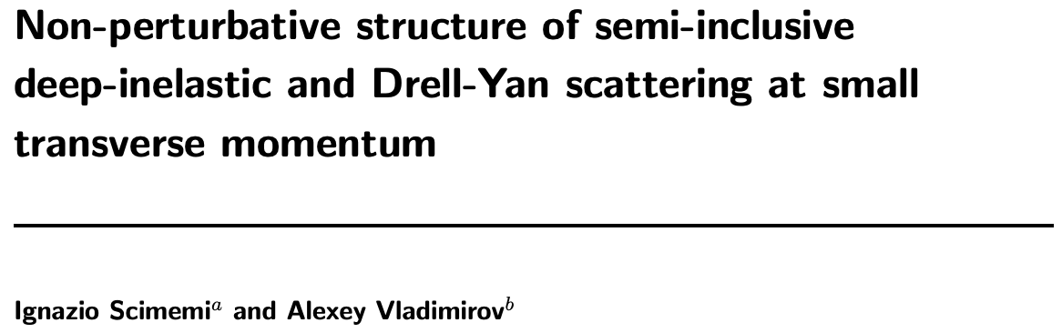
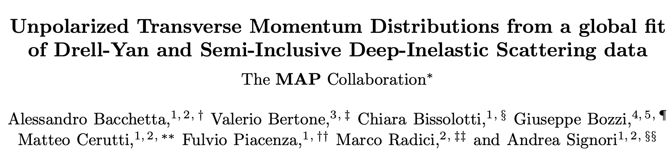
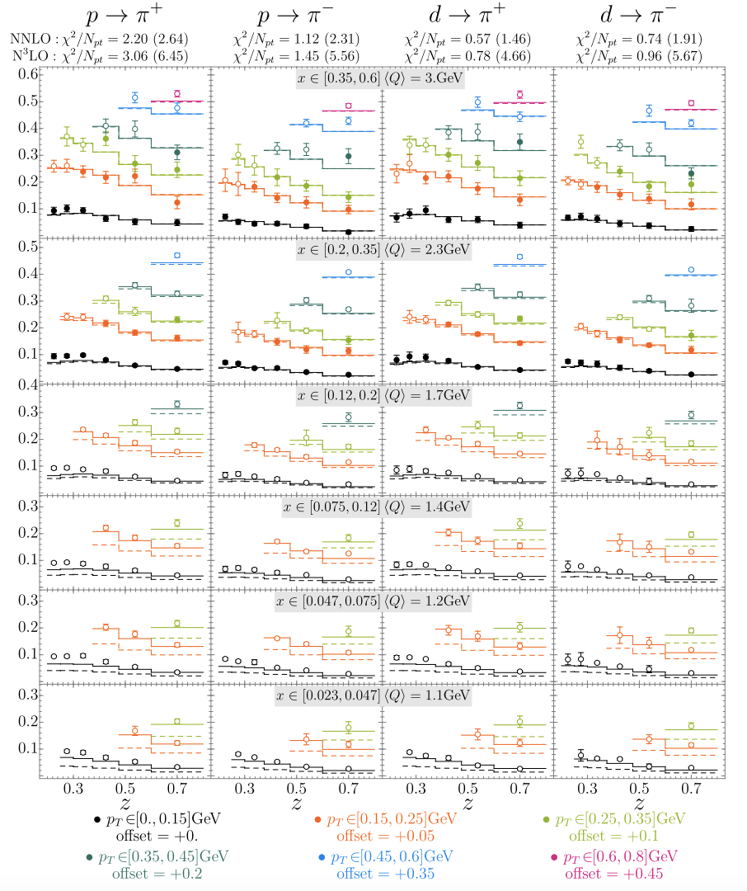
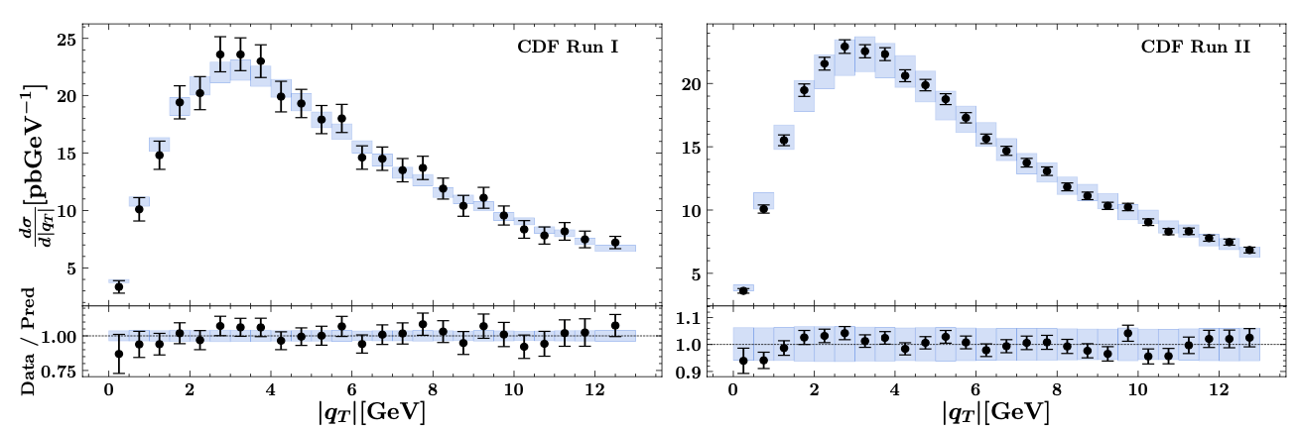
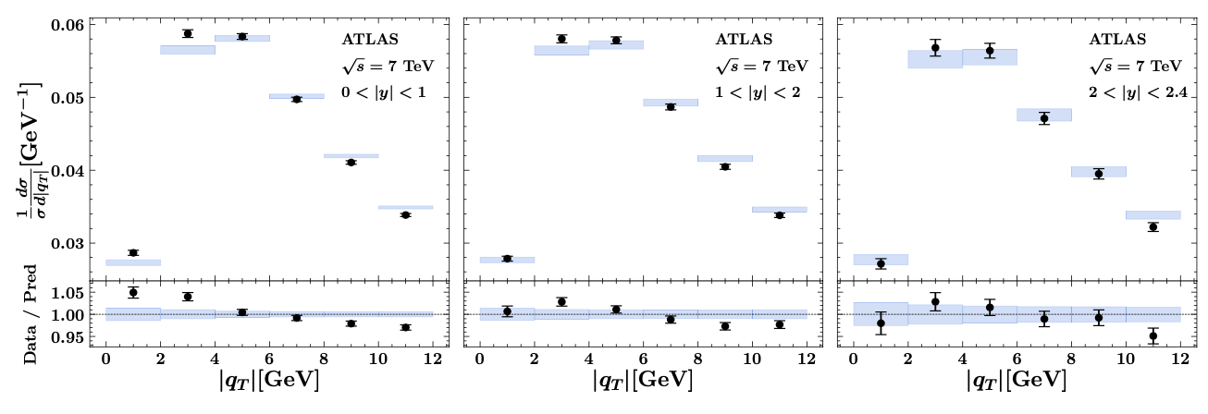
Unpolarized cross sections
Good fit achieved in the “TMD region” (N³LL)
JHEP (2020)
2206.07598
SIDIS
Drell-Yan

Slide 10
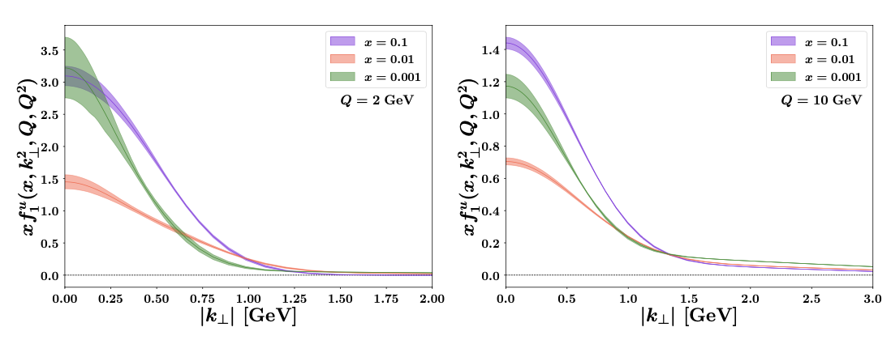

Unpolarized TMDs
Extracted unpolarized TMD PDFs and FFs
Useful tools
2206.07598
2103.09741

Slide 11
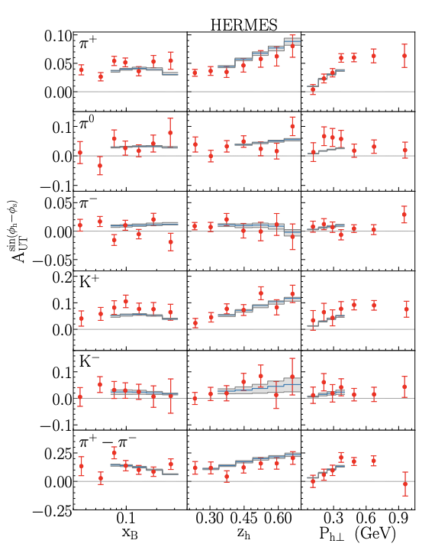
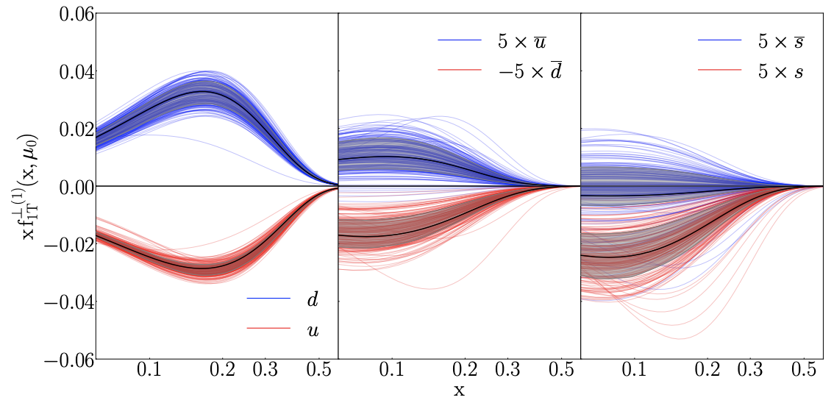
Progress from standard processes
Take an example: Sivers function
  Data: Jlab 12, HERMES, COMPASS, RHIC W boson
Echevarria, Kang, Terry, JHEP (2021)

Slide 12
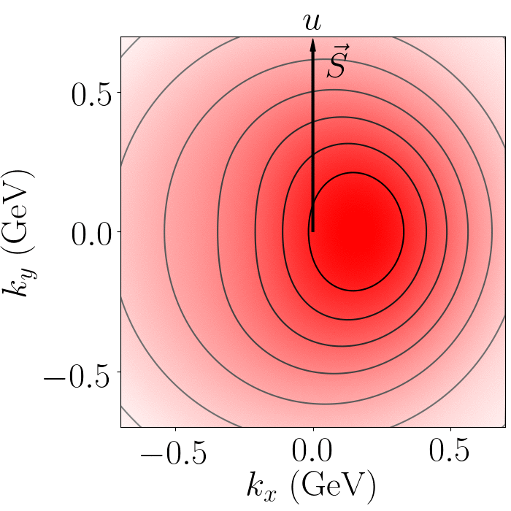
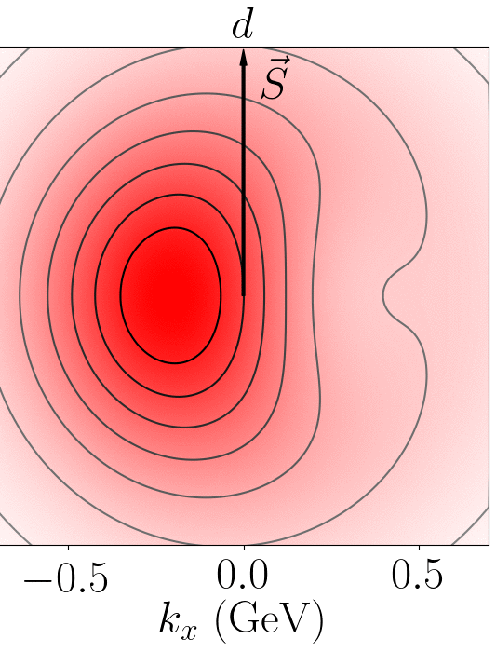
Distorted distribution
Sivers correlation leads to a distortion in u/d quark distribution
  Left or right shift

Slide 13
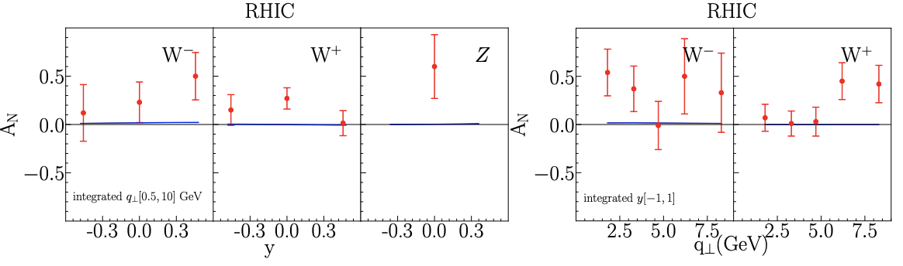
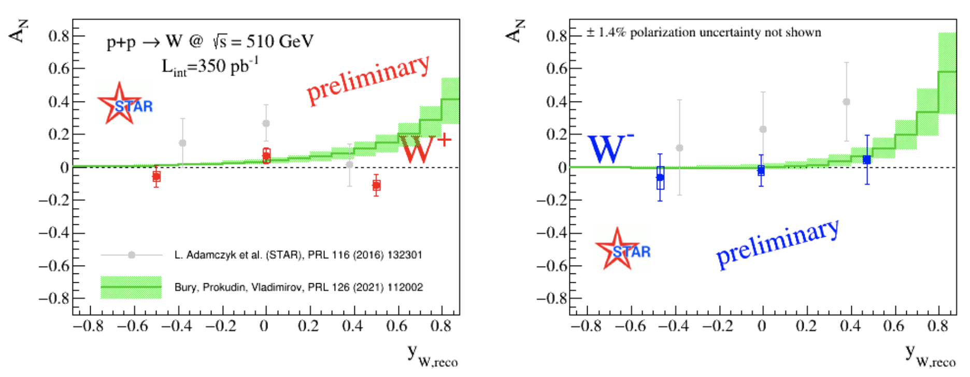
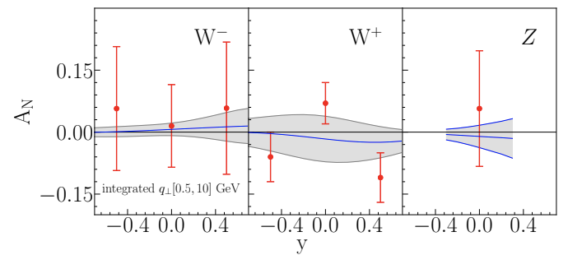
RHIC data: update
Previously, some tension in fitting (2016) RHIC W/Z data (very large asymmetry), but consistent with recent (2021) data
  Emphasizing the importance of the precision measurement
OLD data
NEW data
Bury, Vladimirov, Prokudin
Echevarria, Kang, Terry

Slide 14

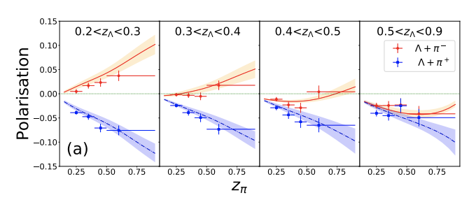
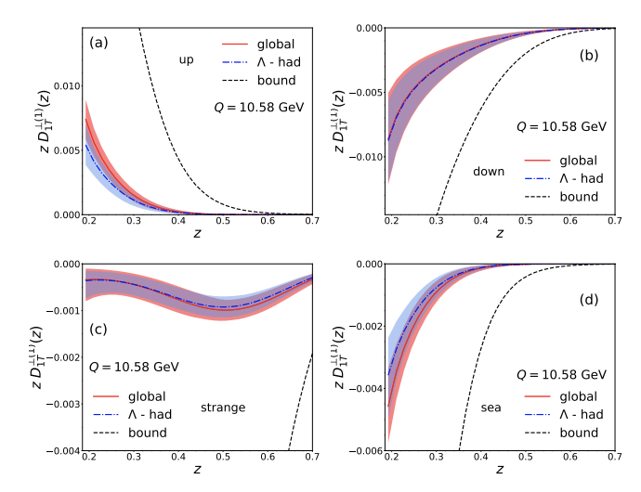

Polarized TMD FFs
BELLE
Next chapter: Belle II at SuperKEKB will push frontier by providing 50x Belle dataset
  $Λ^{↑}−{\overline{Λ}}^{↑}$
  Jets
  Precision QCD from event shapes, energy-energy correlators
  Multidimensional heavy flavor FFs
  Tuning of (spin dependent) MC
  Details in snowmass whitepaper: e-Print: 2204.02280 [hep-ex]
D’Alesio, Murgia, Zaccheddu, 20, see also, Carlos, Terry, Kang, 20
Courtesy of A. Vossen

Slide 15
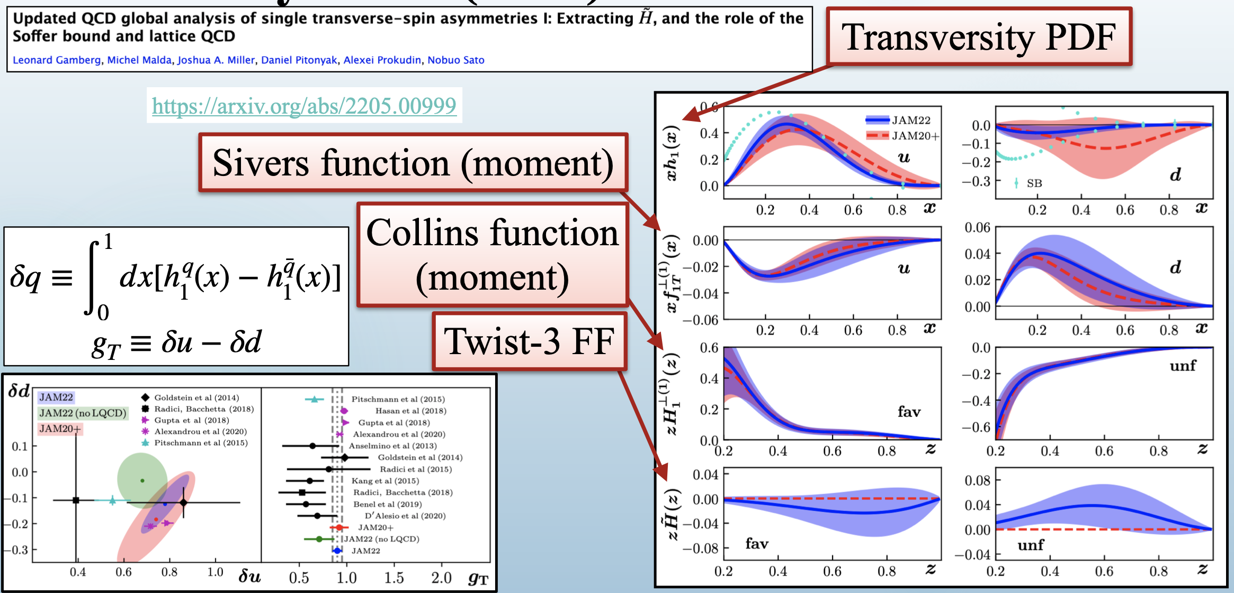

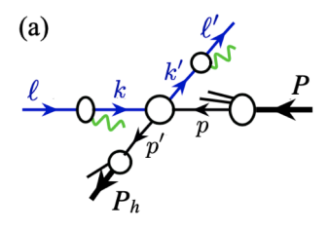
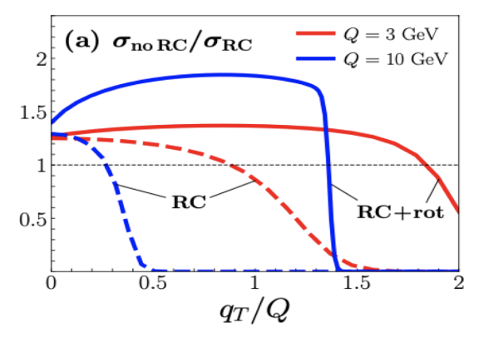


Many more other theoretical/phenomenological progress
JAM 3D fitting: SIDIS, DY, e+e-, and hadron in pp
Observables directly in the lab frame (vs Breit frame)
Rethink QED radiative corrections in DIS/SIDIS
Advancement in perturbative calc
  OPE of TMD to collinear functions: 3-loop
  CS evolution kernel: 4-loop
Courtesy of C. Cocuzza,
Jlab User Group Meeting 2022
Gao, Michel, Sun, Stewart, 2209.11211, flash talk J. Michel Friday evening

Slide 16
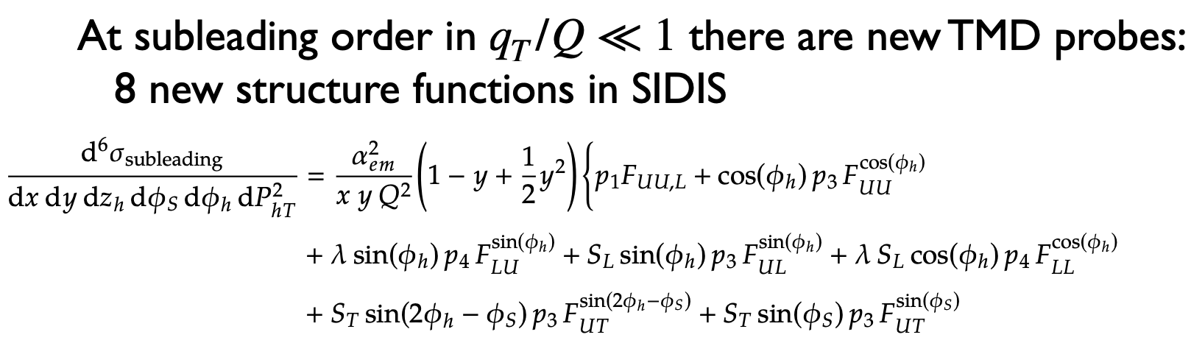
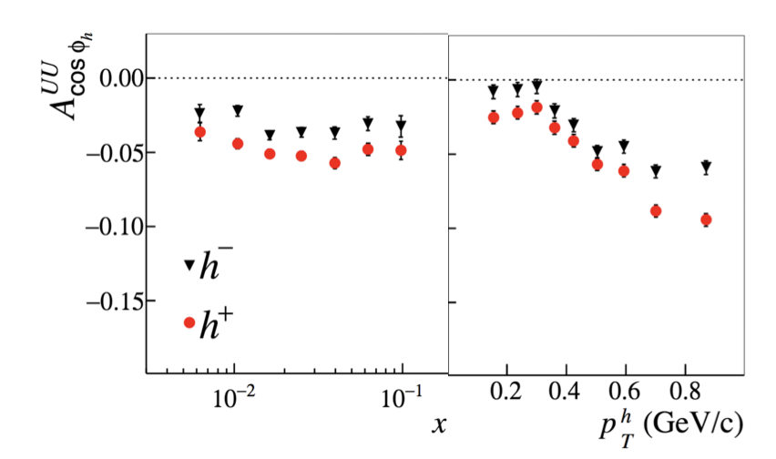

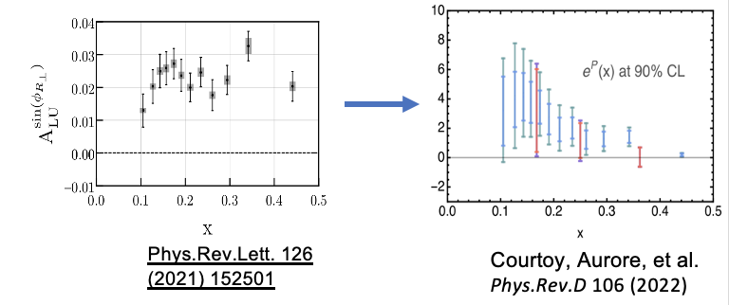
TMDs at subleading power
Moving beyond leading-power observables
  Famous Cahn effect (‘78): twist-3 TMD effect
  CLAS12: e(x)
    Beam spin asymmetry
    (single & dihedron)
COMPASS 14
Earlier: Bacchetta, Echevarria, Pisano, Prokudin, 19, …
Recent: Ebert, Gao, Stewart, 22
Rodini, Vladimirov, 22
Gamberg, Kang, Shao, Terry, Zhao, 22

Slide 17
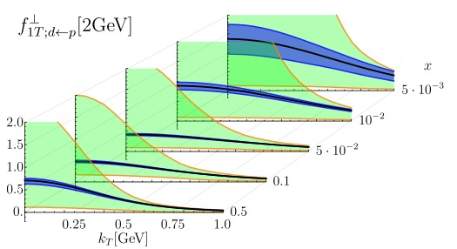
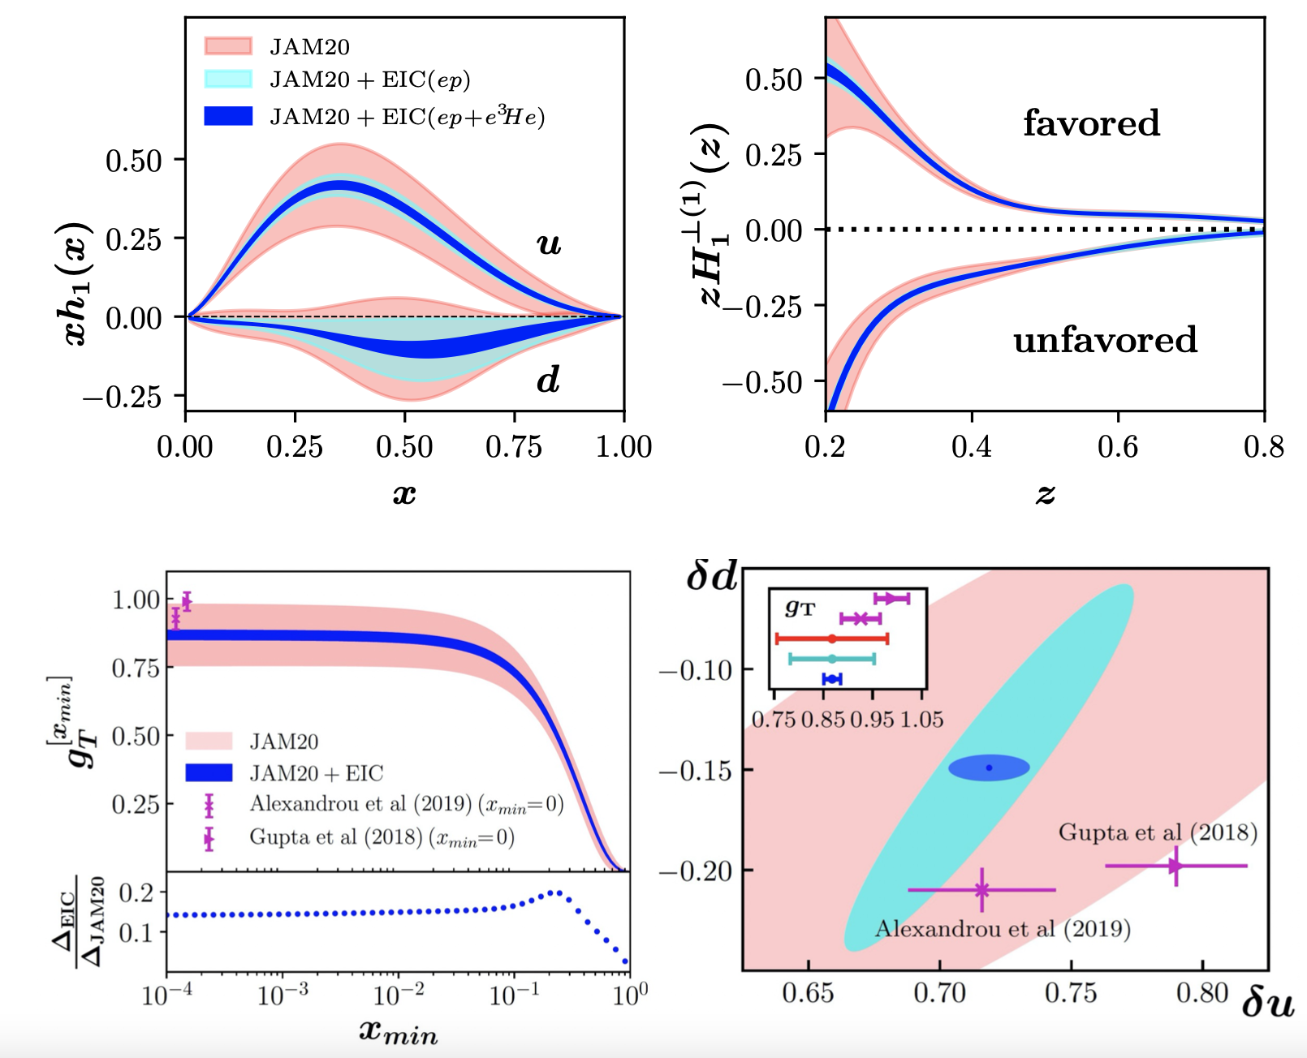
Impact at future experiments: EIC
How EIC would improve the extraction of the TMDs is well documented in the EIC Yellow report, and studies continue as new ideas/observables arise

Slide 18
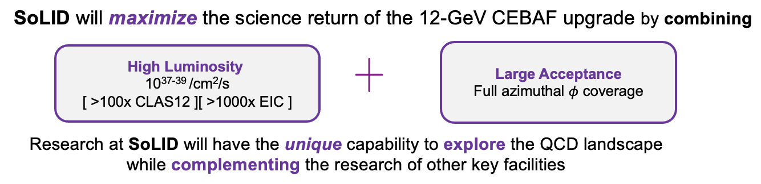
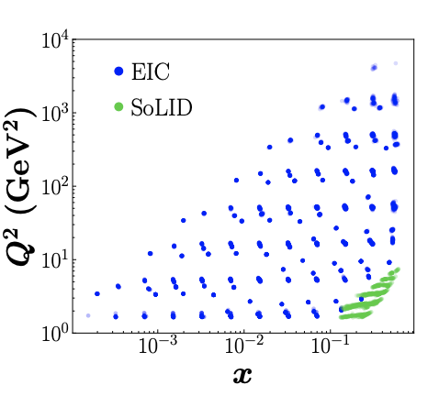
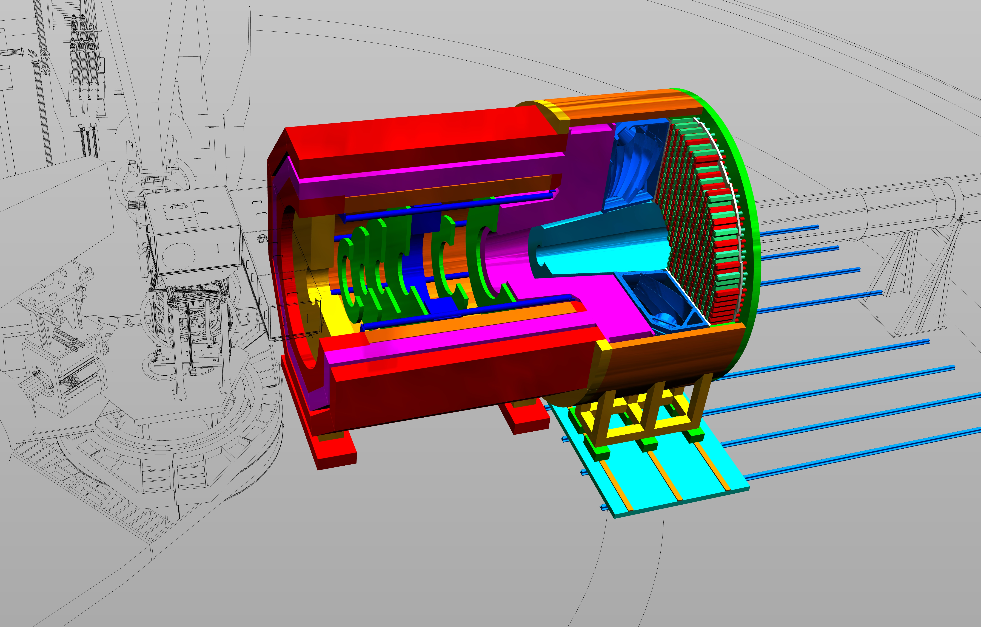
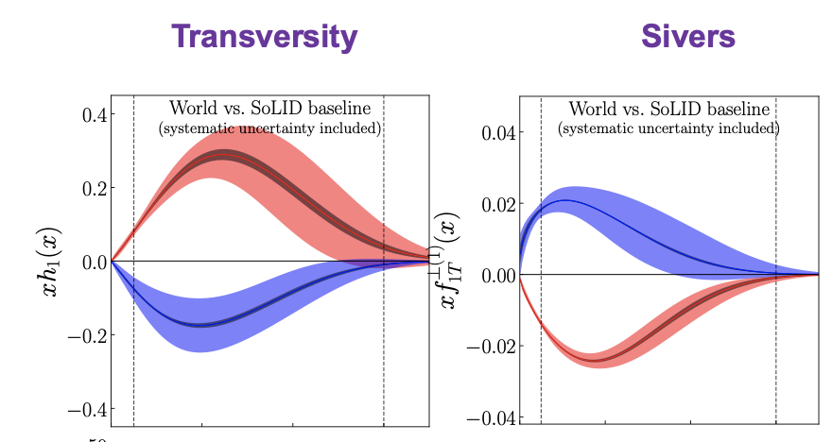
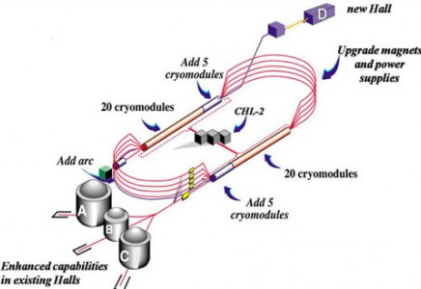
Impact at SoLID@JLab
Courtesy of J.P. Chen

Slide 19
Jets for 3D imaging
Designed by M. Arratia

Slide 20
Jets are useful tools for TMD physics
Active study at the EIC
  EIC jet papers grow exponentially
EIC

Slide 21
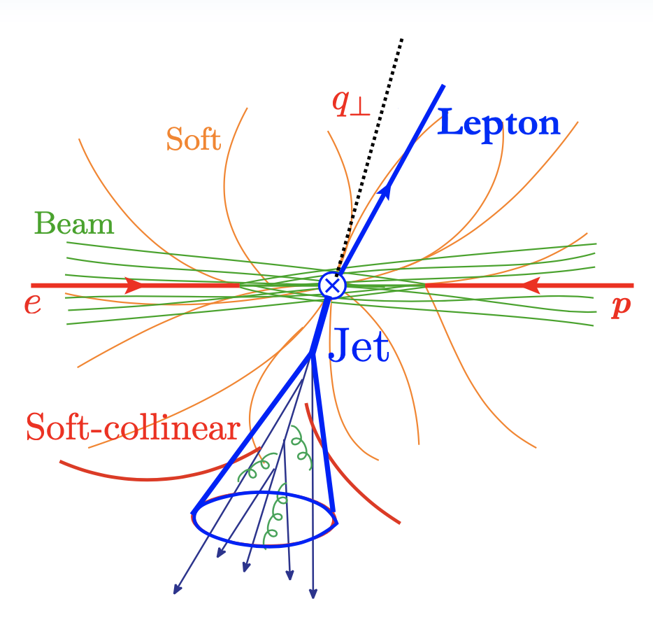
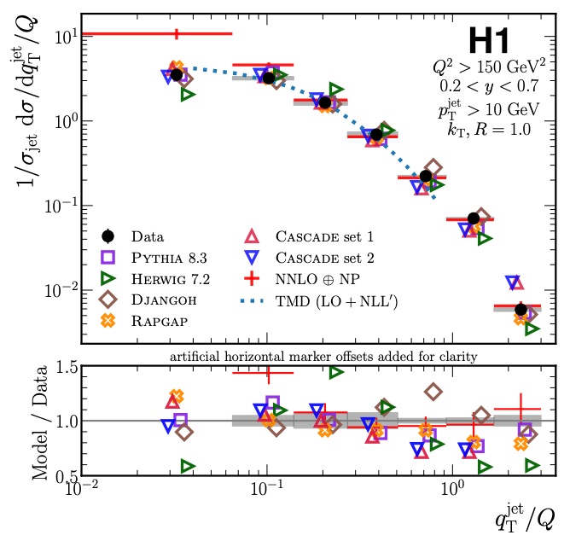
Back-to-back lepton-jet production
Probing TMD PDFs
  Unpolarized scattering: recent HERA measurement
  Transversely polarized proton scattering: Sivers function (right plot)
Liu, Ringer, Vogelsang, Yuan, 18, 20, …
Arratia, Kang, Prokudin, Ringer, 2007.07281
Kang, Lee, Shao, Zhao, 2106.15624
HERA, arXiv:2108.12376, PRL 22
Arratia, Kang, Prokudin, Ringer, PRD 20

Slide 22
Jet substructure: polarized jet fragmentation function
One can further measure distribution of hadrons inside the jet
  Two axes: imbalance controls TMD PDFs, while the hadron transverse momentum w.r.t jet axis controls TMD FFs
Kang, Lee, Zhao, PLB 20
Arratia, Kang, Ringer, Prokudin, 20
Kang, Lee, Shao, Zhao, JHEP 21
Kang, Terry, Vossen, Xu, Zhang, PRD 22
quark

Slide 23
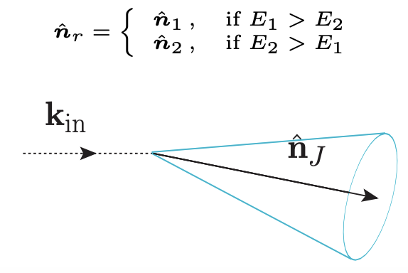
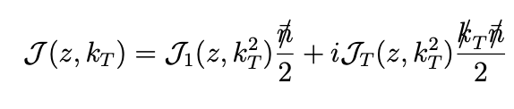
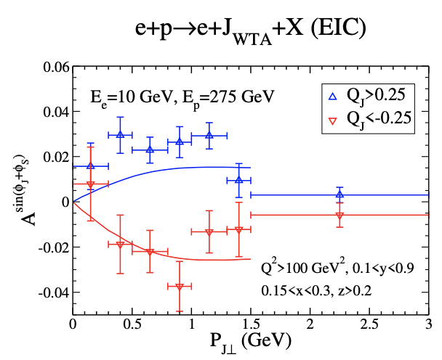
Utilizing different jet axis
Winner-take-all (WTA) jet axis
Gutierrez-Reyes, Scimemi, Waalewijn, Zoppi, JHEP 19
Lai, Liu, Wang, Xing, 2205.04570

Slide 24
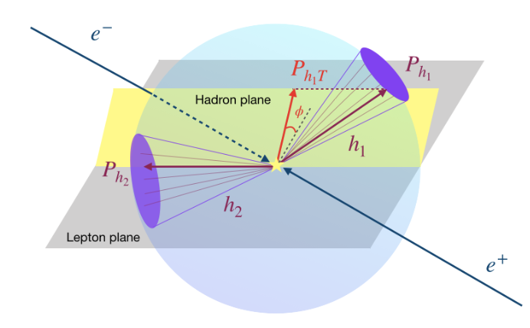
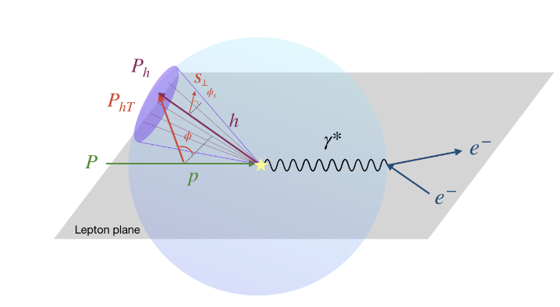


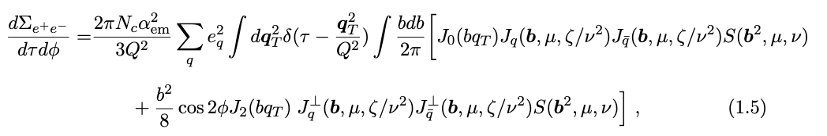
Jet-like: energy-energy correlator (EEC)
EEC in the back-to-back region would be sensitive to the TMD physics
  Generalize to include azimuthal angle
  Sensitive to polarized TMDs: Collins jet function (sum rule to Collins function), Sivers function, etc
Moult, Zhu, 2019
Li, Makris, Vitev, 2021
Kang, Lee, Shao, Yuan, Zhao, to appear

Slide 25
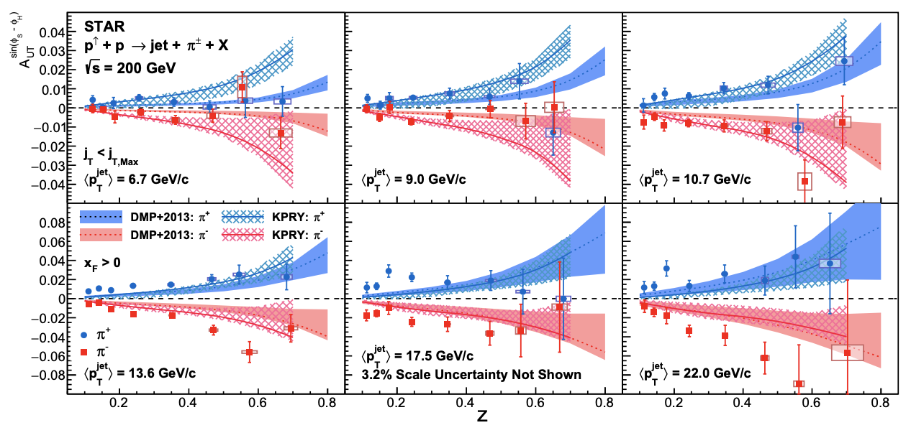
Collins effect inside the jet
STAR measurements: Collins asymmetry for hadron inside the jet in transversely polarized p+p collisions
STAR, 2205.11800
Kang, Prokudin, Ringer, Yuan, 1707.00913, PLB
Kang, Kyle, Zhao, arXiv:2005.02398, PLB

Slide 26
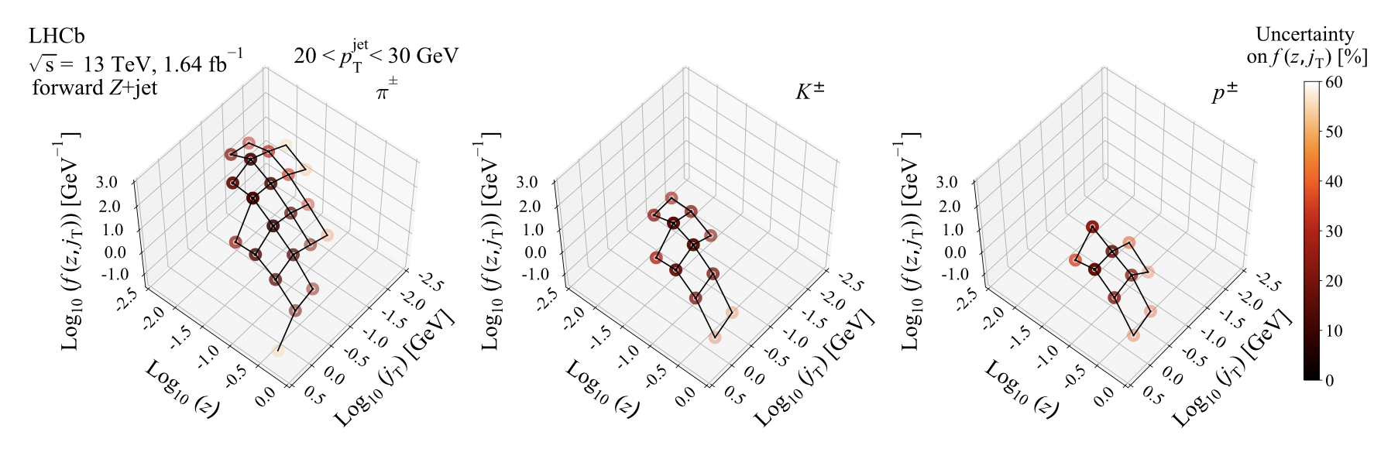
Jet fragmentation function at LHC
Example: recent LHCb measurement Z-tagged jet production
LHCb, 2208.11691

Slide 27
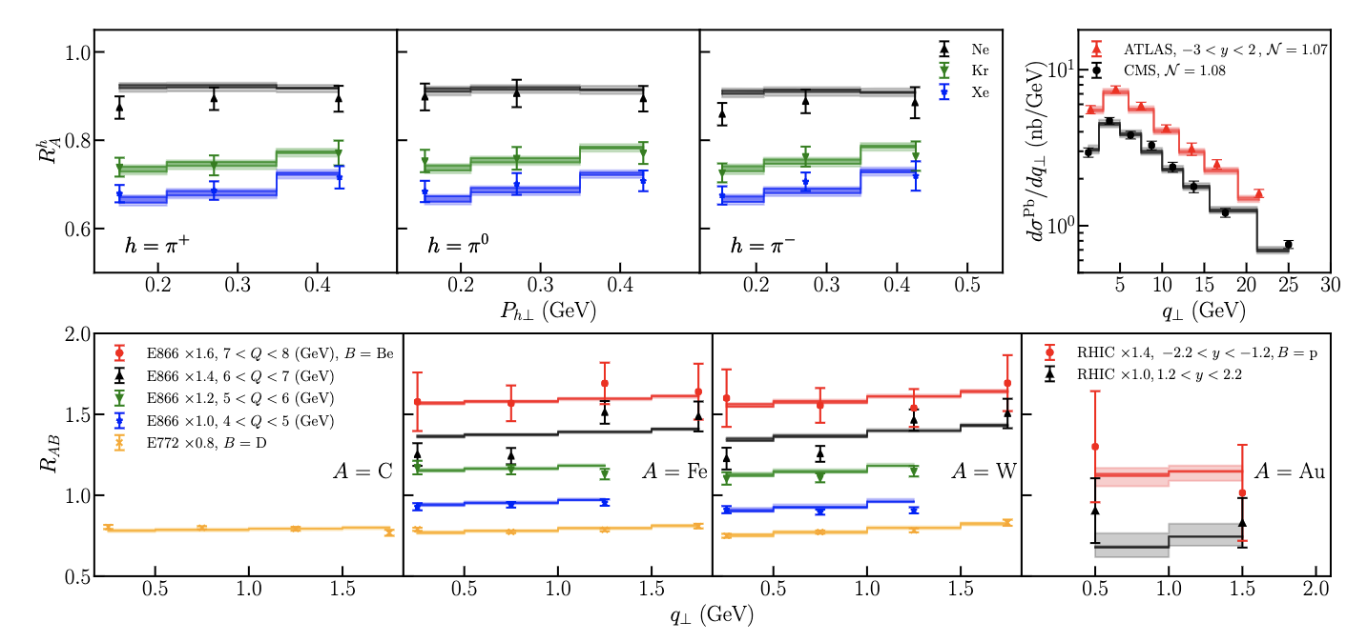
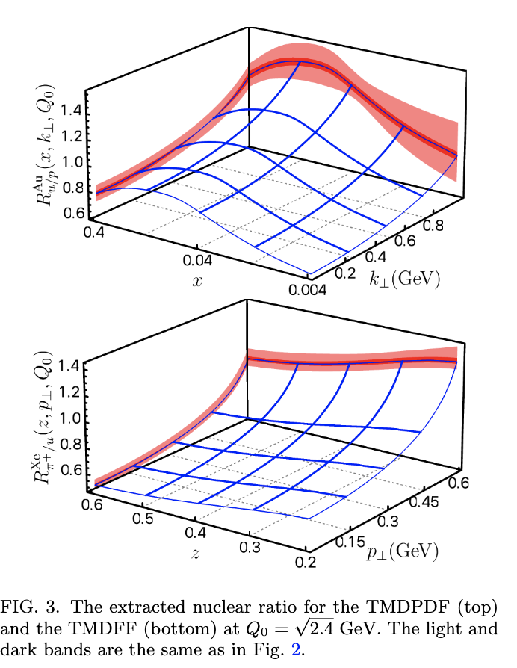
Global fits of nuclear TMDs
Nuclear TMD PDFs and TMD FFs
  Use the same spirit of nuclear PDFs, i.e., assume perturbative TMD evolution is the same, only modify non-perturbative component
Alrashed, Anderle, Kang, Terry, Xing, 2107.12401

Slide 28


Get ready for jet TMD in p+A
RHIC cold QCD plan: 2024 pp and pA run
  Theory is ready now
Courtesy of M. Zurek

Slide 29



Summary
Great progress has been made for TMD structure of the proton
Jets are new tools for 3D imaging at our disposal
Current: HERMES, COMPASS, Jlab 12, HERA, RHIC spin, and LHC provide great experimental measurements for TMD physics
Future: ElC, together with other experiments such as SoLID and BELLE II, will make even more significant contributions to TMD physics
Thank you!

Slide 30


