Slide 1
Visualization of the Subatomic World
https://www.youtube.com/watch?v=G-9I0buDi4s
This work was a collaborative effort of:
Christopher Boebel (Film Producer, MIT, MA)
Rolf Ent (Physicist, Jefferson Lab, VA)
James LaPlante (Animator, Sputnik Animation, Portland, ME)
Joseph McMaster (Film Producer, MIT, MA)
Richard Milner (Physicist, MIT, MA)
It was funded by the MIT Center for Art, Science & Technology and by Jefferson Lab, Newport News, VA
We gratefully acknowledge the significant role of Rik Yoshida in initiating the project.
Notes:
This video is motivated by the desire to explain the structure of matter, as physicists understand it at present. Studying how the visible matter in the universe is constructed from elementary constituents is a major subfield of science internationally. In the United States, there are two flagship user facilities supported by the Office of Nuclear Physics of the U.S. Department of Energy at Long Island, New York and at Newport News, Virginia where the quark and gluon structure of nuclei is studied in experiments that use large detectors. A major new accelerator, the Electron-Ion Collider (EIC), is being developed in the U.S. for this research and it is anticipated that EIC will start operation in the 2030s.

Slide 2
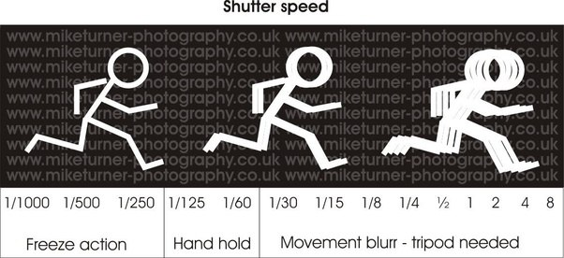
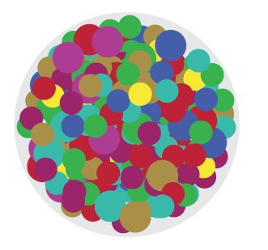
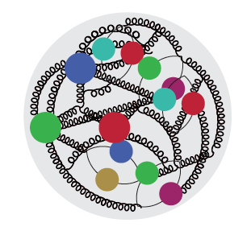
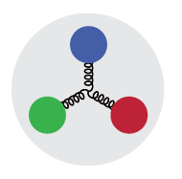
Visualization
The camera is a device to capture an image on a desired medium, e.g. CCD or film.
Movie cameras capture a series of individual images in time to give the illusion of having captured motion.
Essential elements of any camera are
- the focus which uses a lens to gather light from a selected image → pixel size
- the shutter which is a door that opens for a definite time to allow selected light to reach the medium.
Use this analogy to visualize the proton structure from available proton structure function data → Snapshots where 0 < x < 1 is the shutter exposure time and 1/Q is the pixel size.
-
x ≈ 10⁻⁴
Probe gluon dominance
short exposure time
x ≈ 10⁻²
Probe quark sea and gluons
medium exposure time
x ≈ 0.3
Probe valence quarks
long exposure time

Slide 3
Proton Structure - Artistic Visualization

Slide 4
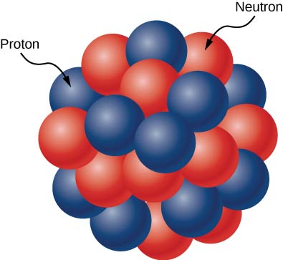
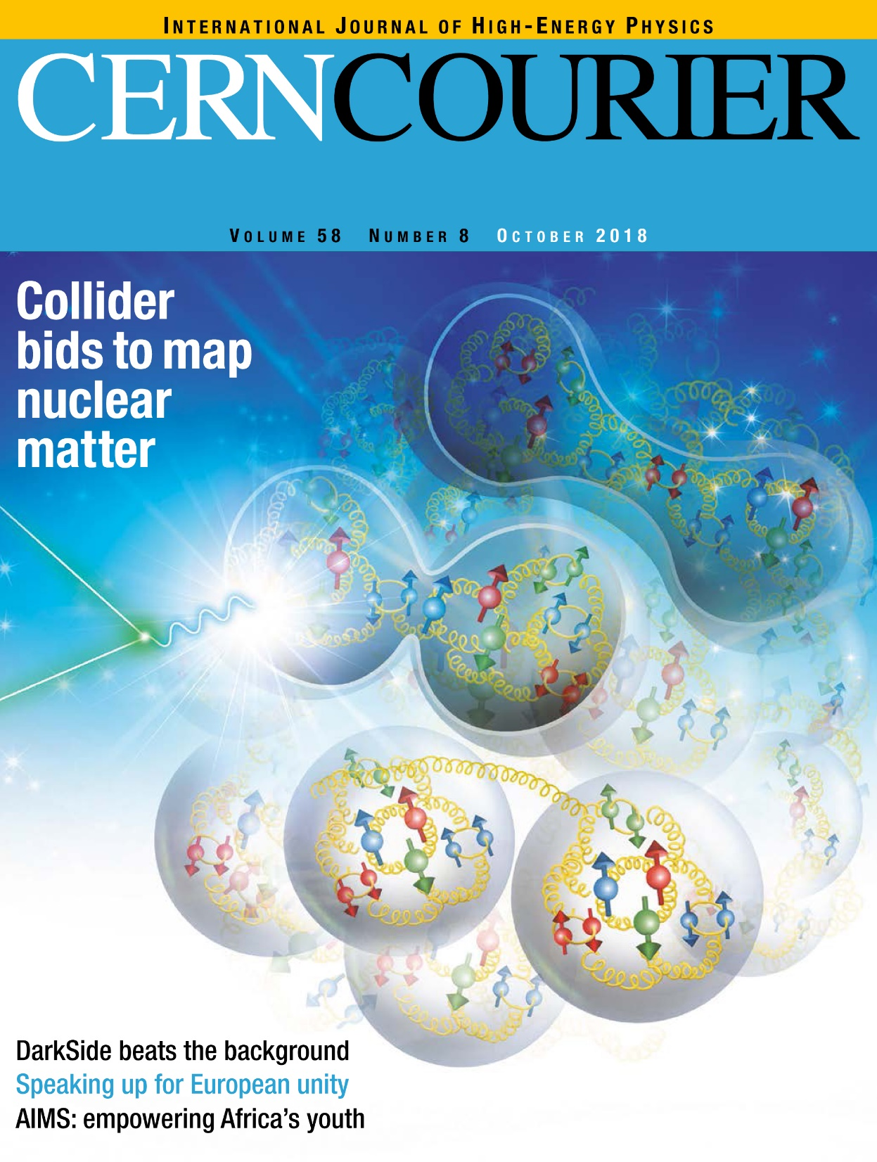
Next: Nucleus Structure
Animate the atomic nucleus as a densely packed collection of fuzzy, kneadable balls with two identities: protons and neutrons. The animation aims to describe motion and binding, and state-of-the-art nuclear models to be visually communicated.
Animate the quark and gluon structure of the neutron.
Animate a series of different nuclei with their various numbers of protons and neutrons (Deuterium: 1 p and 1 n, Helium-4: 2 p and 2 n, Carbon-12: 6 p and 6 n, Calcium-40: 20 p and 20 n, Zircon-90: 40 p and 50 n, Lead-208: 82 p and 126 n).
Take the animation of the Lead-208 nucleus and now insert our proton and neutron visualizations; show a quark-gluon based animation of nuclear binding, short-range correlations, exotic gluons and saturation.

Slide 5
Closing Thought
After the U.S. Long Range Plan is completed, consider creating a brief video on Youtube to summarize the recommendations including animations.

