Slide 1
ENGAGING INDIGENOUS WOMEN INTO GLUON SATURATION SEARCH IN NUCLEUS
Cesar Luiz da Silva
Krista Smith
Los Alamos National Lab
Town Hall Meeting on Hot & Cold QCD

Slide 2
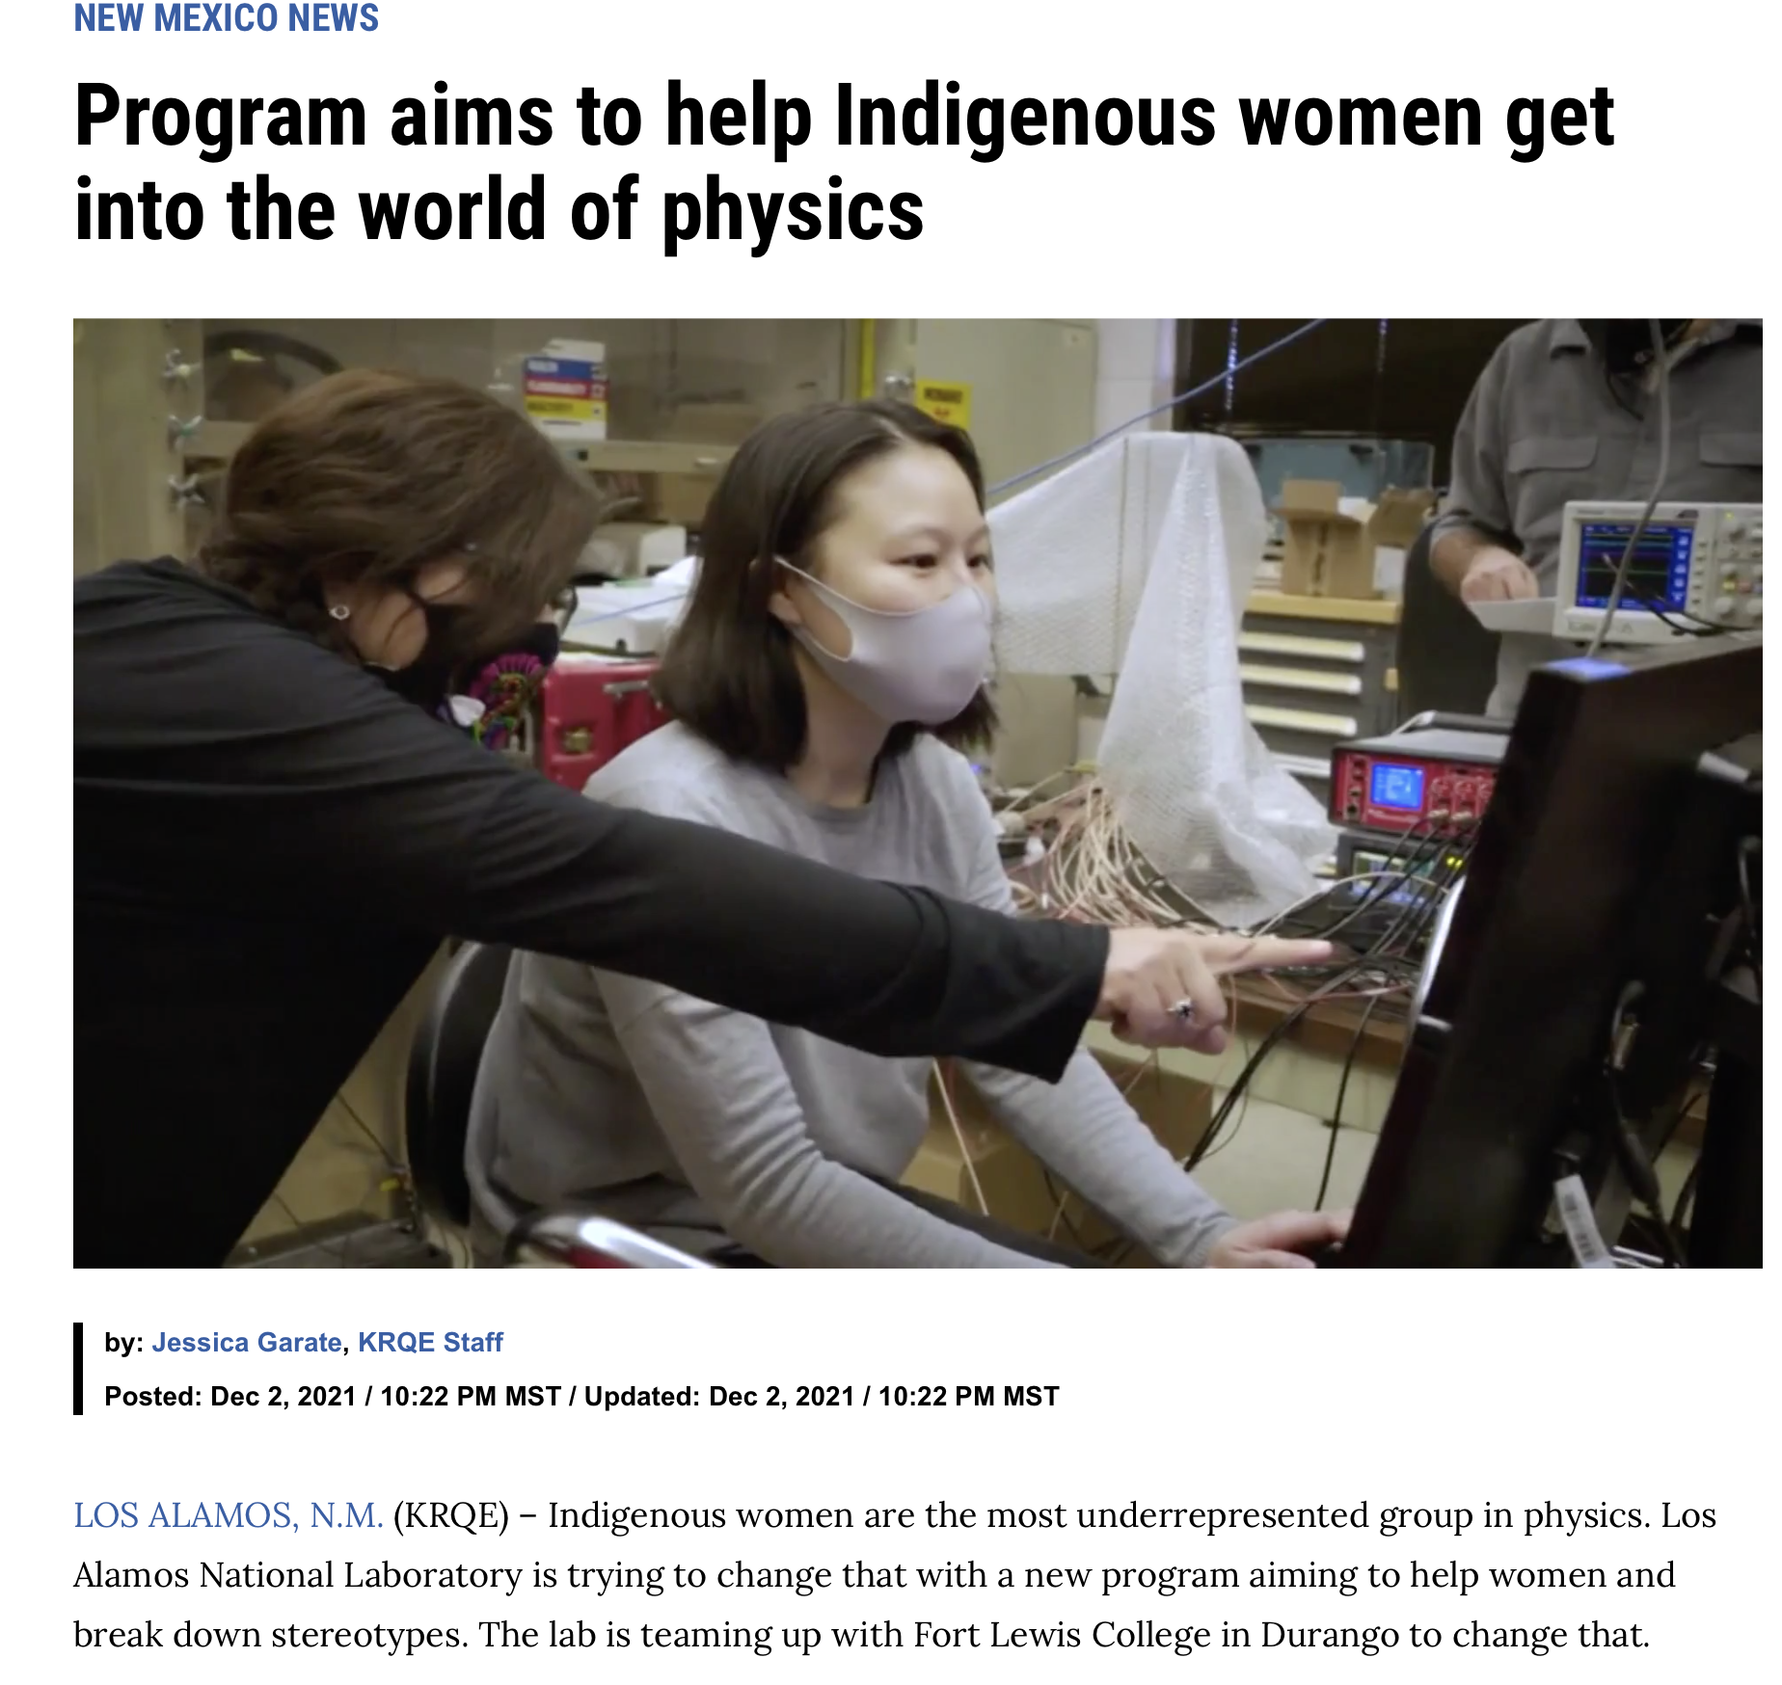
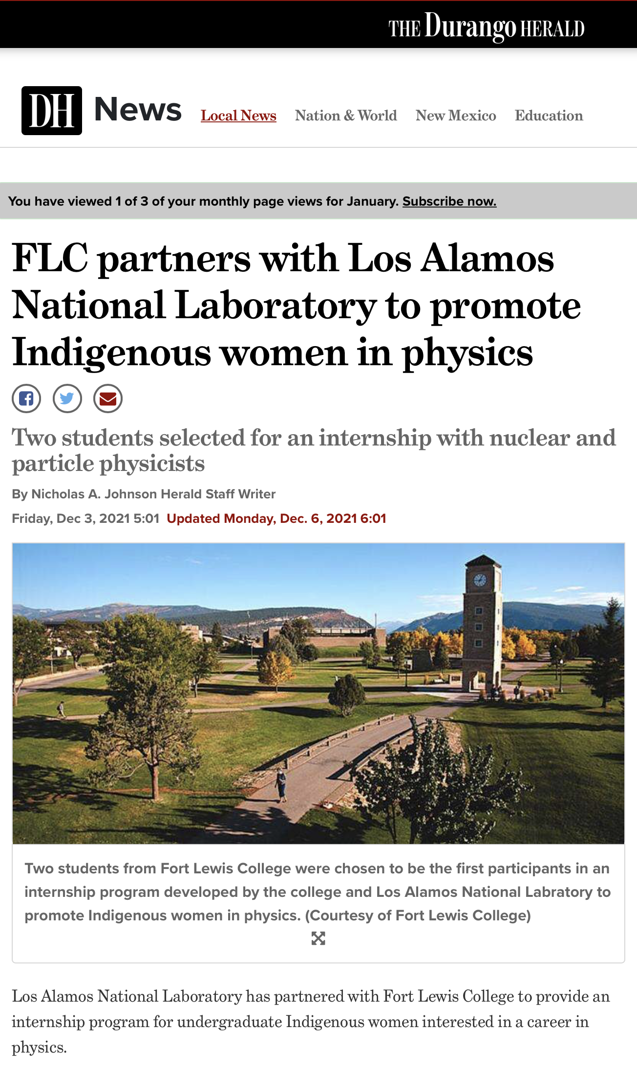
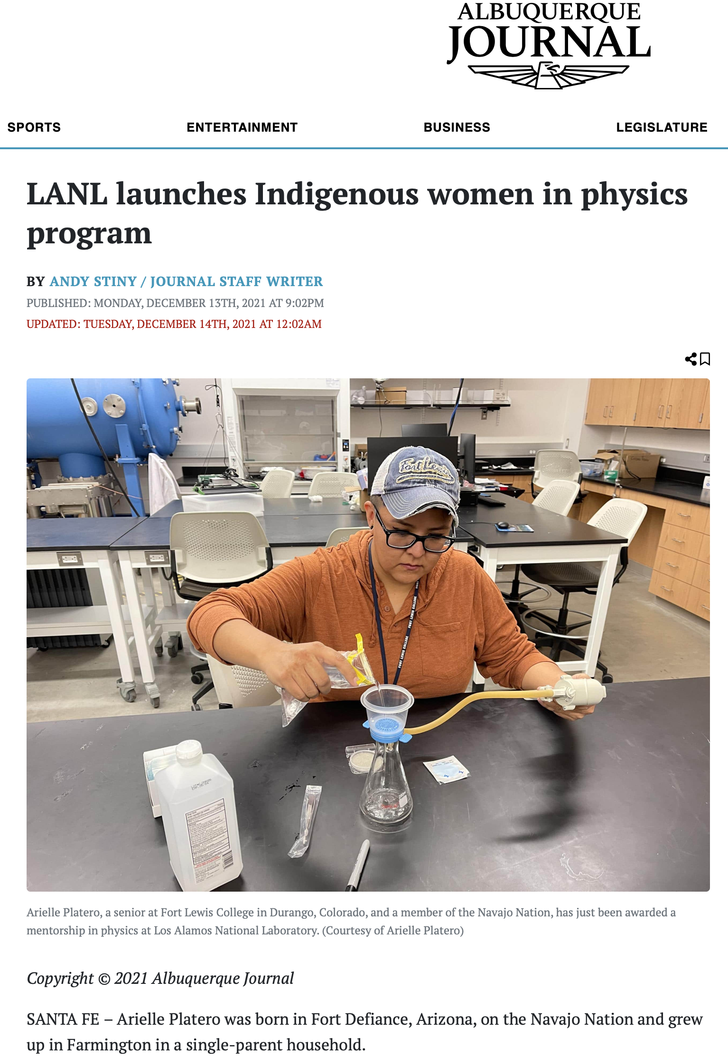
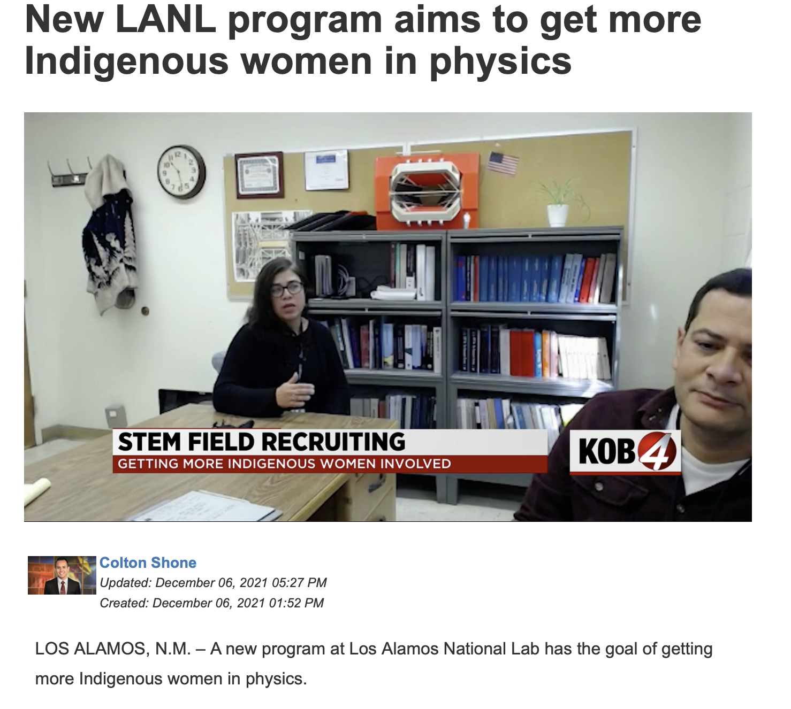
Massive local news outlet coverage to the diversity FOA awarded by LANL
QCD and gluon saturation introduction
Particle detectors for high-energy nuclear physics
Help assembly a prototype for the magnet station tracker for LHCb
Visit CERN to take data acquisition shifts for LHCb and socialize
Introduction to data analysis

Slide 3
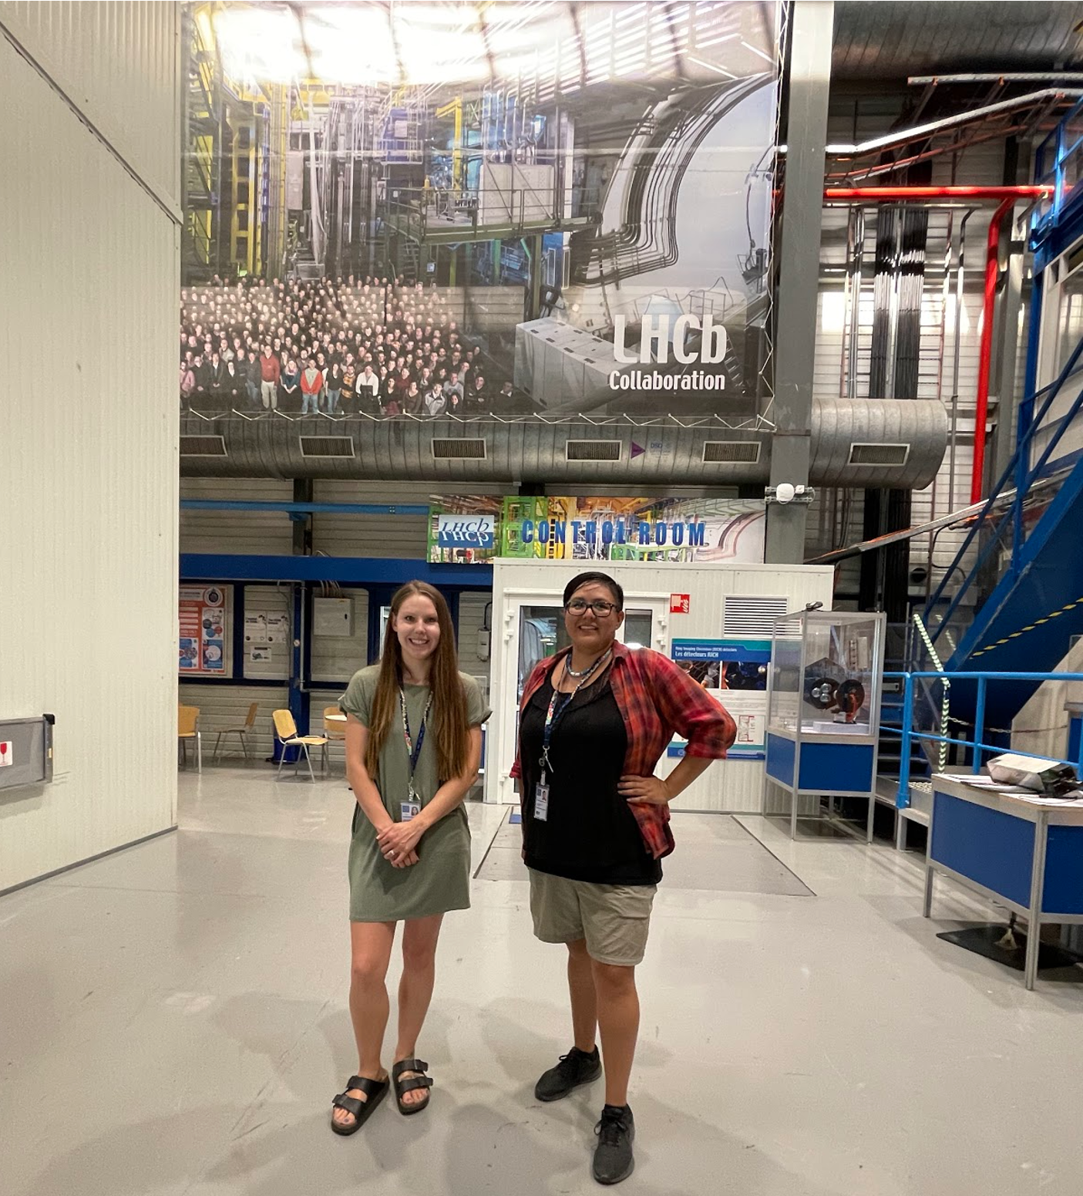
ACKNOWLEDGMENTS :
Speakers in our introduction sessions
Christine Nattrass (UTK)
Powtawche Valerino (NASA)
Tara Fortier (NIST)
Jennifer McLoud-Mann (UWB)
Kate J. Daniel (Bryn Mawr)
Darren Harvey (LANL)
Carol Scarlett (Florida A&M)
Laurie Williams from Fort Lewis Collage for engaging the students to the program
Astrid Morreale for starting the program at LANL
DOE/NP for the FOE 0002456 initiative, a reference for a bigger program in OS
Julie Nelson and Arielle Platero to be the first students in the program
Lots of lessons learned in the first year.
More students from Fort Lewis coming for the second year.
Essential program to help the most under represented group gets in touch with high-energy nuclear physics.
Julie Nelson
Cheyenne River
Sioux Tribe
Arielle Platero
Navajo Nation

