Slide 1
A SMALL-X PHYSICS PROGRAM WITH THE LHCb DETECTOR
Cesar Luiz da Silva
Los Alamos National Lab
Town Hall Meeting on Hot & Cold QCD

Slide 2
JLab and MIT proton visualization.
https://arts.mit.edu/visualizing-the-proton/
https://www.youtube.com/watch?v=Dt8FZ4ksWiY

Slide 3
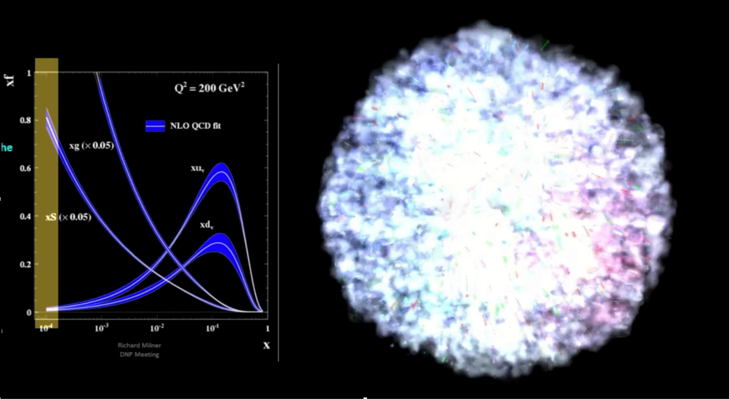
Limits of the QCD factorization ?
Strong force condensate with gluons ?

Slide 4
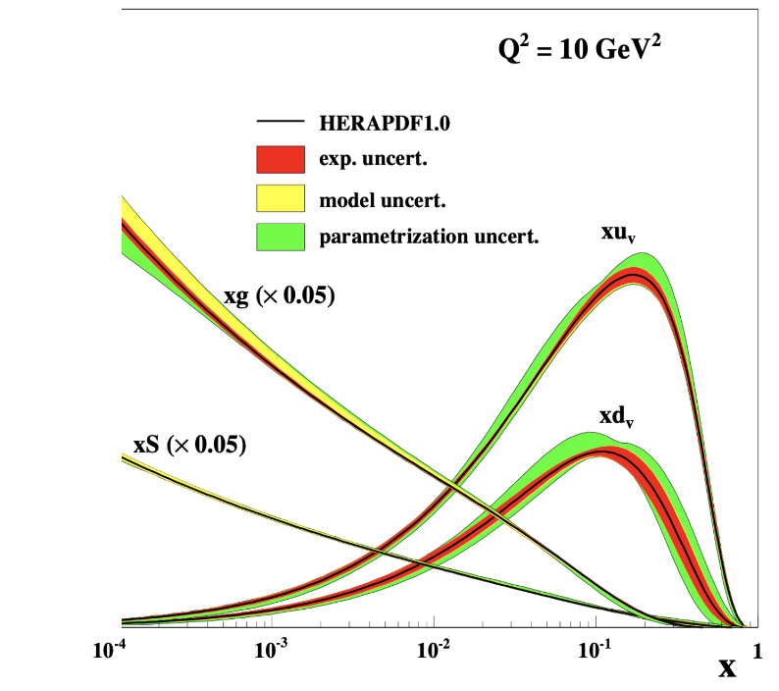
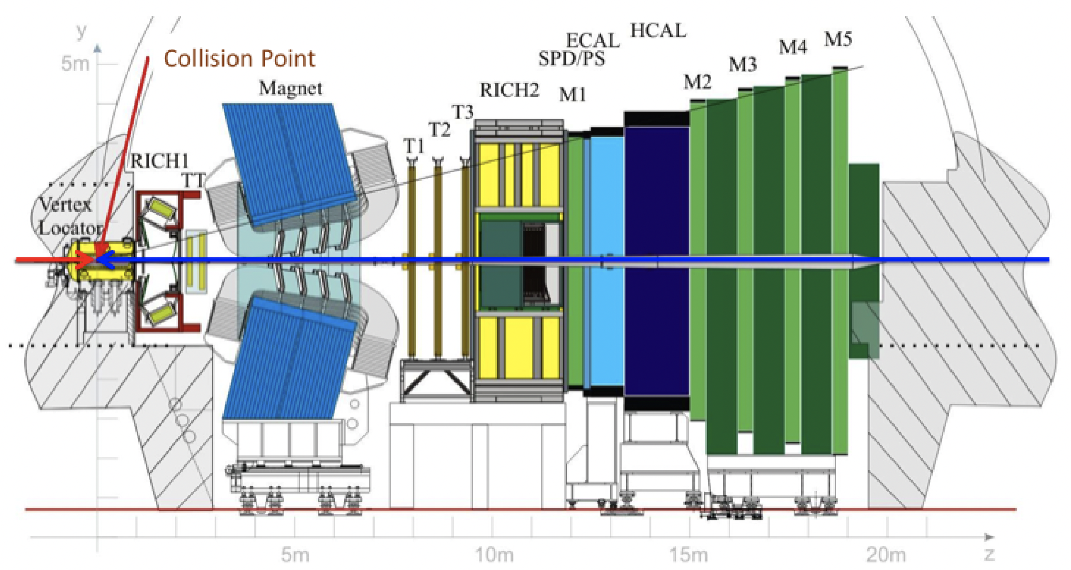
LHCb - Large Hadron Collider beauty
$${10}^{−6}<x<5⋅{10}^{−4}$$
Full instrumentation in the small-x region
Vertex + tracking + pK$π$ PID + calorimetry + muons
Collider and fixed target (p,Pb+gas)
10⁻⁶
10⁻⁵

Slide 5
Vast Physics Program Ahead
Heavy flavor (see Matt’s presentation)
Direct photons + hadron correlation directly probing gluon x and Q² (result publicly available early 2023)
Fragmentation functions in pA and PbPb
Low mass Drell-Yan
UPC : quarkonia, $ρ$, exotica
Vector and scaler mesons : $η^{0},φ,ω,ρ,η^{′},f_{0}\left(980\right), f_{2}\left(1270\right)…$
10⁻⁶
10⁻⁵

Slide 6
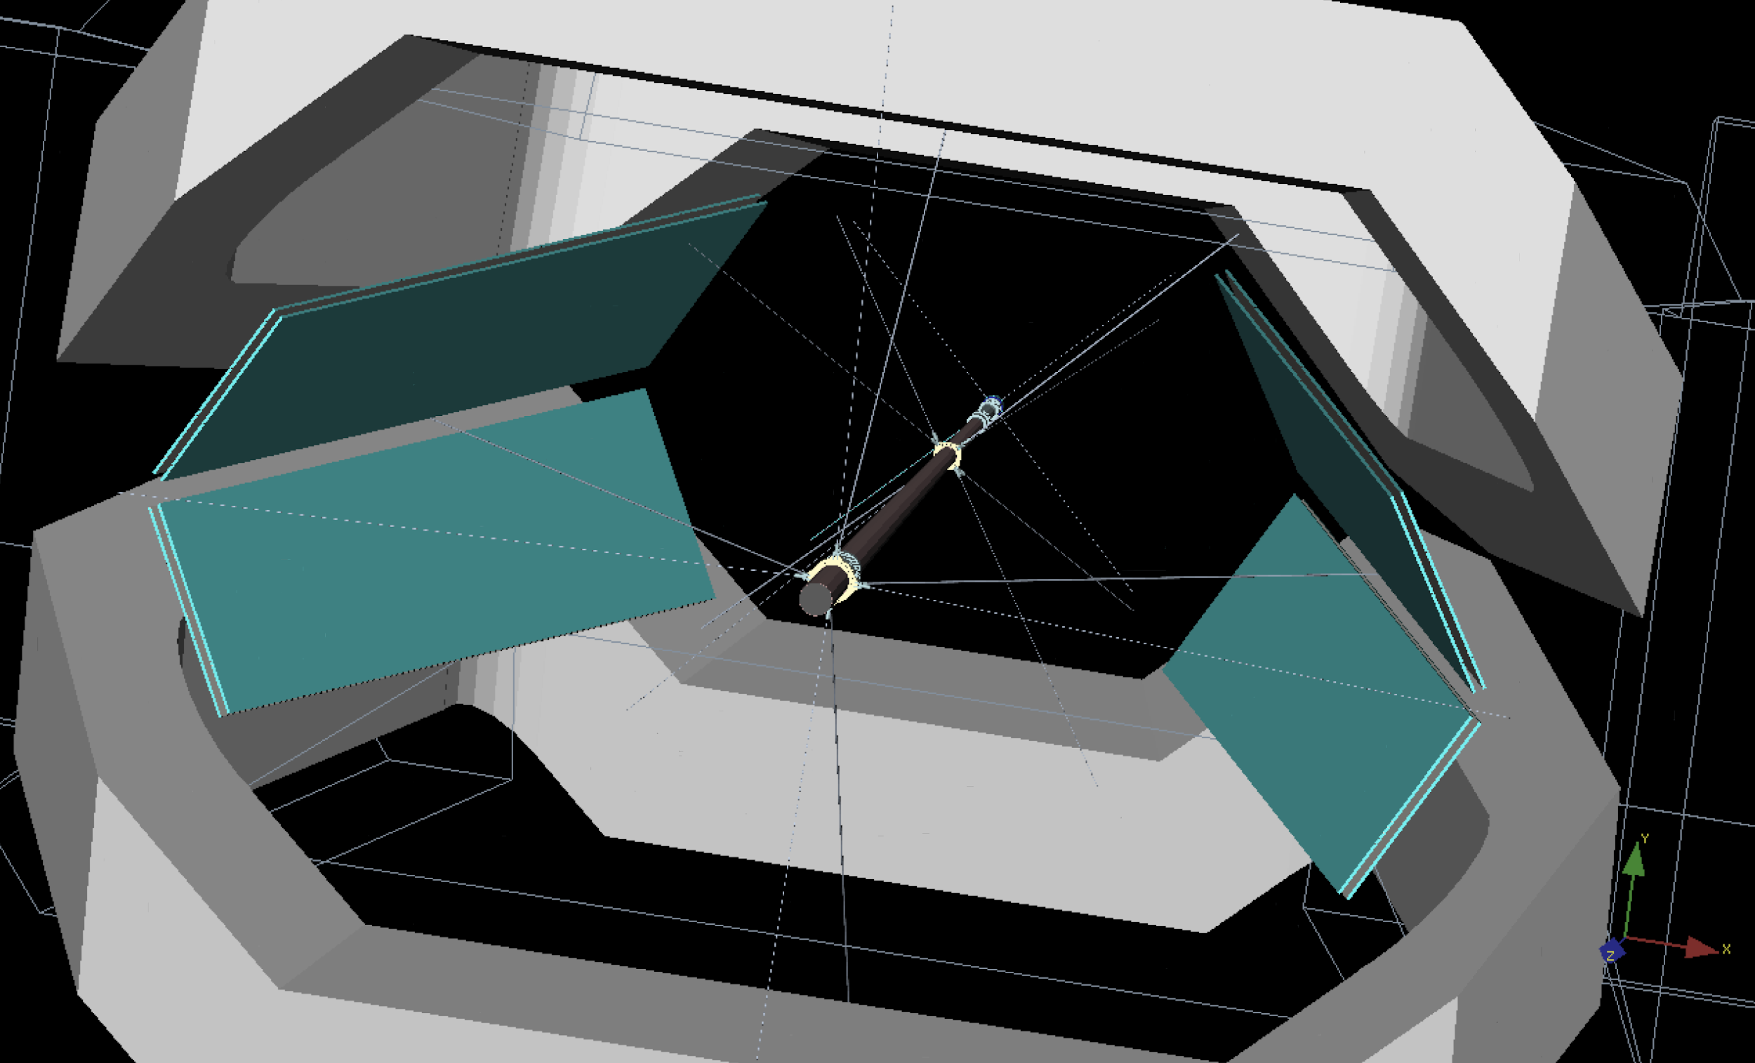
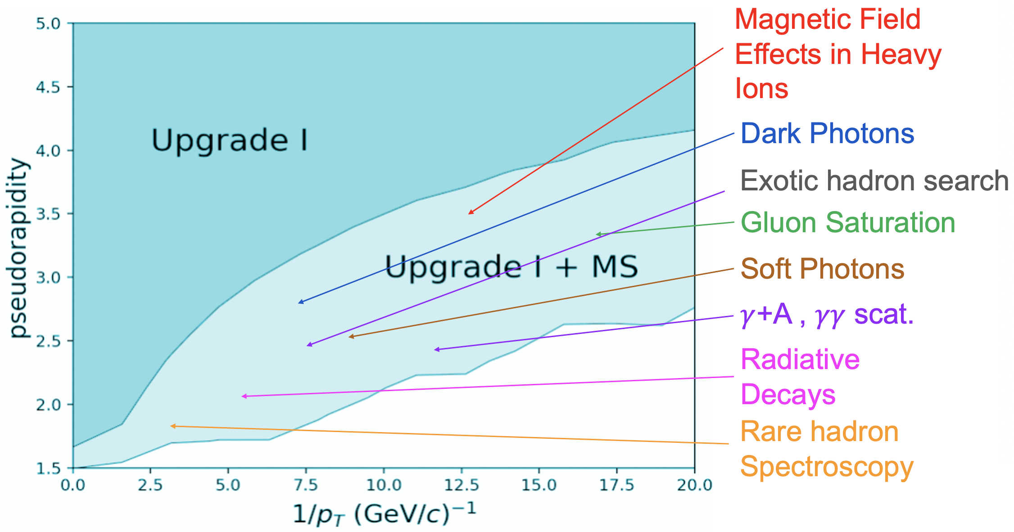
MAGNET STATION
Magnet Station Upgrade : A scintilator-based soft particle tracker probing deep into the gluon saturated regime and other physics never reached in LHC …
Installation during LS3 (2026-2028)

