Slide 1
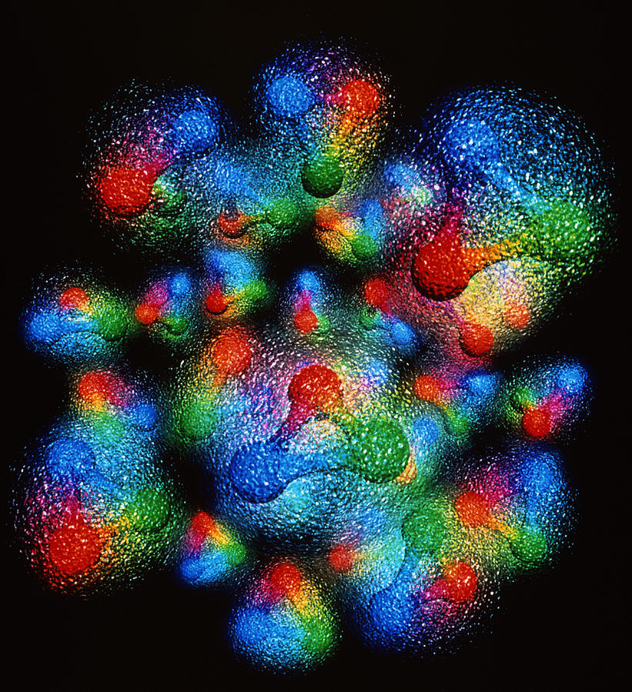
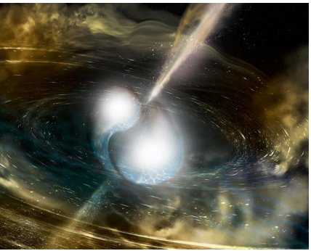
Can angular momentum of quarks and gluons in the proton be observed?
2022 TownHall Meeting
September 29th, 2022
SIMONETTA LIUTI
UNIVERSITY OF VIRGINIA

Slide 3
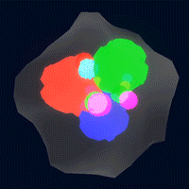

DVES Global Analysis@UVA
DVCS formalism
B. Kriesten et al, Phys.Rev. D 101 (2020)
B. Kriesten and S. Liuti, Phys.Rev. D105 (2022), arXiv 2004.08890
B. Kriesten and S. Liuti, Phys. Lett. B829 (2022), arXiv:2011.04484
ML
J. Grigsby, B. Kriesten, J. Hoskins, S. Liuti, P. Alonzi and M. Burkardt, Phys. Rev. D104 (2021)
M. Almaeen, J. Grigsby, J. Hoskins, B. Kriesten, Y. Li, H. W. Lin and S. Liuti,
``Benchmarks for a Global Extraction of Information from Deeply Virtual Exclusive Scattering,'' [arXiv:2207.10766 [hep-ph]].
GPD Parametrization for global analysis
B. Kriesten, P. Velie, E. Yeats, F. Yepez-Lopez and S. Liuti,
Phys. Rev D 105 (2022), arXiv:2101.01826

Slide 4

Is the information on J_{q,g}(t) in DVCS data?
What information is in the data?

Slide 5
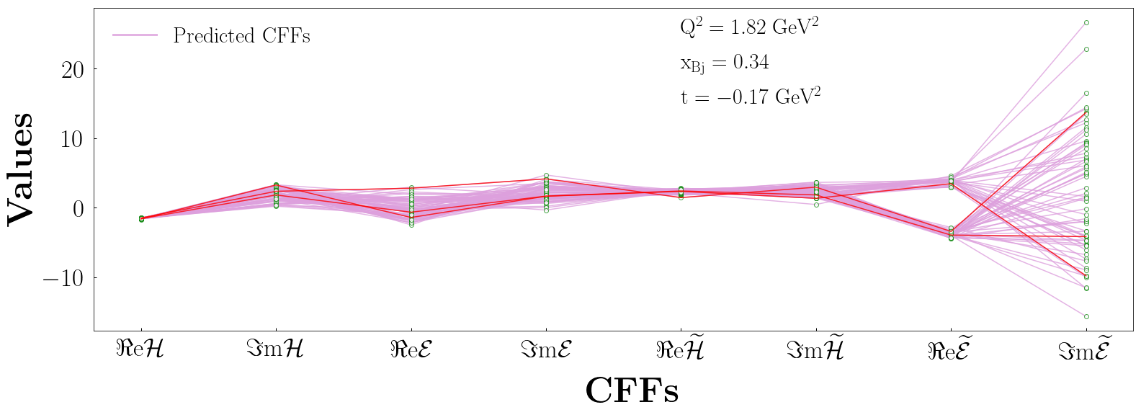
Going beyond standard fitting procedures: Variational Autoenconder example
Graph by Manal Almaeen
M. Almaeen, J. Grigsby, J. Hoskins, B. Kriesten, Y. Li, H. W. Lin and S. Liuti, in preparation

Slide 6
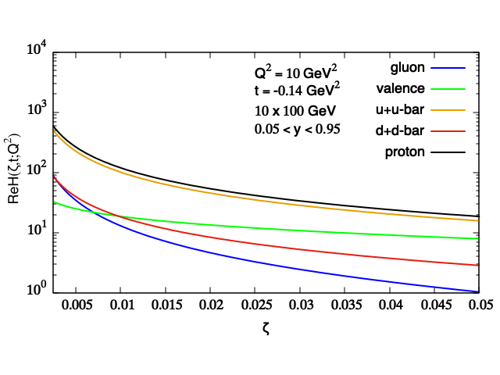
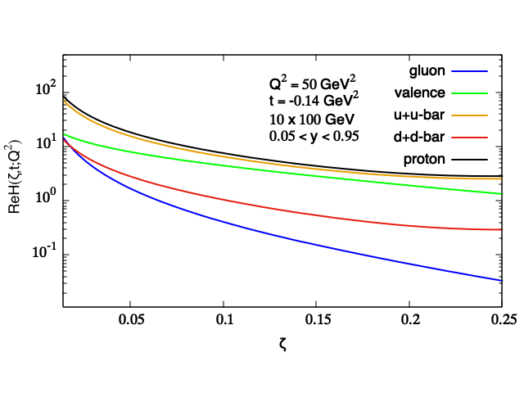
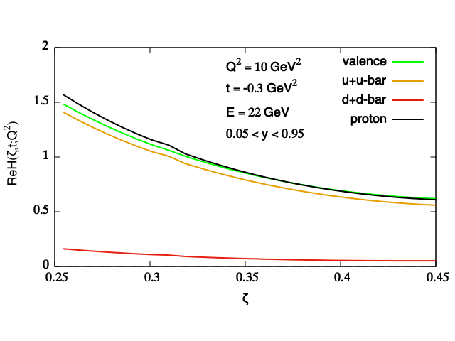
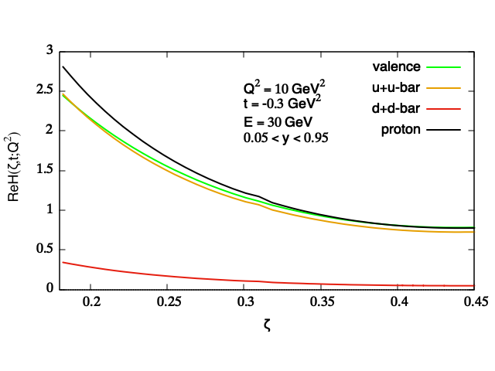
Projections based on UVA global fit of DVCS
EIC
EIC
Re H
Re H
valence
gluon
gluon
valence
x_{Bj}
x_{Bj}
Jlab 12 GeV+
Jlab 12 GeV+
Re H
Re H
valence
valence
x_{Bj}
x_{Bj}

Slide 7
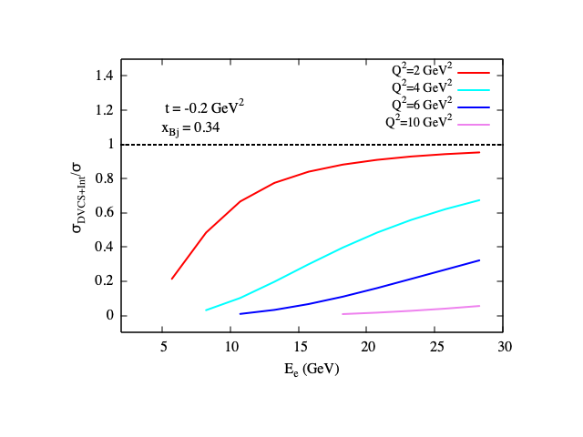
Signal size
DVCS/(DVCS+BH)

