Slide 1

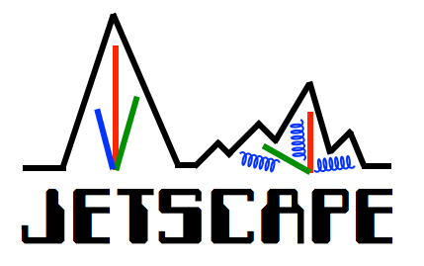

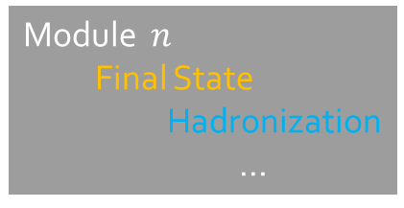
Modular Event Generators
Rainer J Fries
Texas A&M University
Modular simulation frameworks: Seamless horizontal or vertical integration of different approaches to study various aspects of complex problems.
Coarse grained
Brownian Motion
Fluid dynamics
…
JETSCAPE+X-Scape: Modular frameworks for event generation in A+A, p+A, p+p, e+e- …
Module 1 ……….
Initial State
pQCD
…
Module $n$
Final State
Hadronization
…
Microscopic
Molecular dynamics
Boltzmann transport
…
Phys.Rev.C 103 (2021) 5, 054904
Module 1
Module 2
Module 3
Modularity is the key for systematic studies
and for the quantification of theoretical/modeling uncertainties!
Option 1
Option 2
Option 3

Slide 2
Modular Event Generators
Rainer J Fries
Texas A&M University
Wide range of applicability:
Flexible+user friendly+small enough for single PIs to use their local HPRC resources to test new ideas.
Powerful enough for collaborative use on a large scale for bleeding edge global analyses.
21st Century NP
Machine Learning
Data
Theory
Simulation
HP Computing
Bayesian Analysis
Wide range of applicability:
Highly collaborative (experiment, theory, statistics, computer science): transfer of ideas & new ideas!
Naturally connects to modern statistical analysis (in JETSCAPE part of the software package)
What are the needs in the NP community in the near-intermediate future (RHIC, EIC, Jlab)?
Requires community buy-in, infrastructure and long term planning (> 5 years to productive physics)
The time to plan for the next generation is now.

