Slide 1
US-based MicroPattern Gaseous Detector Center - A Community User Facility
Need for US-MPGD center for NP, HEP, Medical application and beyond:
Large number of US institutions engaged in MPGD activities
limited inter-disciplinary interaction between the institutions
The community needs a dedicated US-based MPGD User Facility with a:
Production workshop like to the SiDet Facility for at FNAL
Detector R&D Lab like the RD51 / GDD Lab at CERN
US-MPGD center will be greatly beneficial for EIC detector development
Jefferson Lab is an excellent place for an MPGD center in the US
At the forefront in the deployment of large MPGDs in NP experiments
In-house MPGD expertise and beam test capabilities for MPGD tests
MPGD Center @ JLab: RD51 / GDD-like R&D Lab
GDD-RD51 Lab @ CERN
MPGD Production Workshop
Similar to SiDet Facility at FNAL, or MPT workshop at CERN
Fabrication of large MPGDs (µRWELLs, GEMs, flexible PCBs…)
MPGDs production for detector R&D and prototyping for the community
MPGD Detector R&D Lab
Similar to the RD51 / GDD Lab at CERN ➔ in-house and external users' space with local technical and scientific support team
Equipment and Instrumentation for detector assembly, testing, irradiation, high-rate and aging studies..
Exchange of ideas between MPGD detector development groups
MPGD Center @ JLab: MPGD Production Facility
Large area resistive MPGD
Magnetron sputtering machine

Slide 2
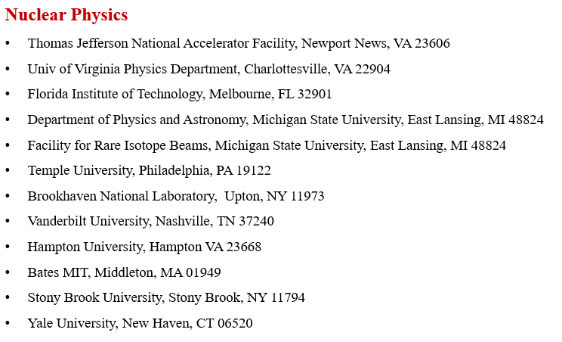
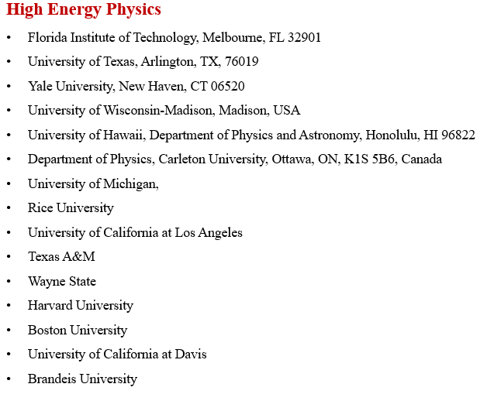
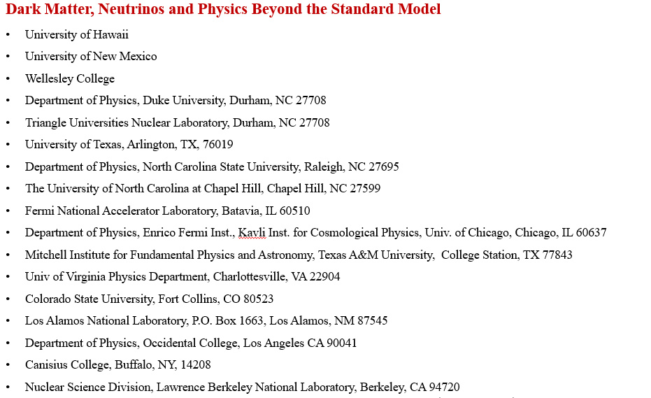
Subset of MPGD Community in the US
List of US institutions involved in MPGD development / activities for experiments in different fields of physics
Presented/discussed also at Snowmass with broad support
Sidebar or mention in NP long range plan would be helpful!

