Slide 1
Thank you for joining Laboratory for Nuclear Science!
Bolek Wyslouch
LNS Director
September 6, 2022

Slide 2
What is LNS?
“Research home” for all activities in Nuclear and Particle Physics at MIT
It consists of multiple research groups supported by administrative and computing services groups.
Overlaps with two academic divisions in the Physics Department:
NUPAX (experimental): focus of today’s meeting, J. Formaggio talk about NUPAX will follow my talk
NUPAT (theory)
It hosts the Institute for AI and Fundamental Interactions (IAIFI)
It operates Bates Research and Engineering Center

Slide 3
Starting research in LNS
At MIT graduate students start research immediately after arrival
Initially slow start: taking courses, exams etc.
But always dedicating some % of your time to research: becoming ~100% after ~2-2.5 years
Experimental research is done within groups led by faculty collaborating with research scientists, postdocs and students
This year you, the new students, will spend the month of September looking around and then joining a group
Most students stay with the same group for the duration of their PhD studies but each year there are several students who change groups after a year or two

Slide 4
The Thesis
Most of the education in research is done by “apprenticeship”: working with senior physicist(s)
The exact topic it usually agreed between you and your research supervisor 1-2 years in advance of thesis defense
Average start-to-finish duration at MIT is 5.8 years. (summer of 2028)

Slide 5
Resources for your research at MIT
One of the largest concentrations of particle and nuclear physicists at a US university: wide range of activities
Research programs at multiple world’s finest laboratories: CERN, Fermilab, Brookhaven, Jefferson Lab, Los Alamos, Space Station, X-ray satellite, Gran Sasso, South Pole and many others
Lab-wide computing support with access to large local resources: “Submit” system
Bates engineering laboratory north of Boston: building detectors
Close collaboration with other MIT laboratories: e.g. accelerator R&D at MIT Plasma Lab

Slide 6
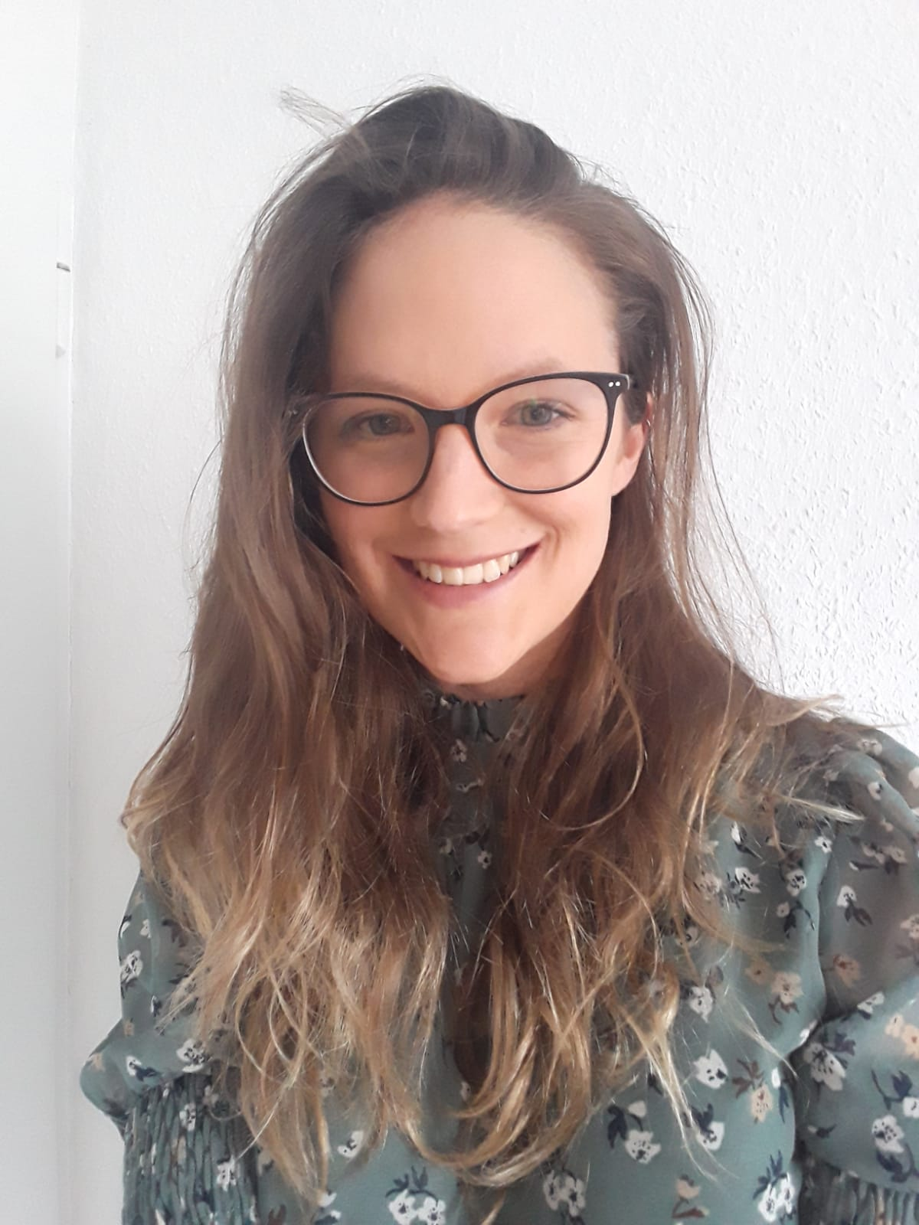
We are 15 full time faculty in nuclear and particle experimental physics
Notes:
…so I like to think that my group is a humble continuation of this tradition

Slide 7
Experimental research areas and faculty at LNS
Cosmic rays, Dark Matter with Alpha Magnetic Spectrometer: Ting
Hadron Structure and Fundamental Interactions, Studies of Few-Nucleon Systems at Jlab, Mainz, Oak Ridge, DESY, CERN, Los Alamos, Brookhaven: Hen, Milner, Williams
High Energy Physics with CMS at LHC: Harris, Paus
High Energy Physics with LHCb at LHC: Smith (1/23), Williams
Heavy Ion Physics at LHC and RHIC: Lee, Roland, Wyslouch
Neutrinos: Neutrino properties, mass, flavor, Axions, Dark Matter: multiple experiments: Conrad, Formaggio, Winslow
Exotic nuclei and radioactive molecules: Garcia Ruiz

Slide 8
Choice of the research supervisor/group
Starting today and until September 29, 2022 you will have various opportunities to get to know all the research groups at LNS:
Presentations
Formal and informal meetings with the groups
Individual conversations with researchers
By September 30 you will have to email me a prioritized list of your preferences with at least two group choices
I will then talk to you, the relevant faculty and the LNS fiscal office to see what is possible
Everyone will be assigned shortly after
Note: in the last ~5 years everyone got their first choice

Slide 9
Choosing the group
Several introductory talks from several research groups following NUPAX talk
Physics with AMS: Yi Jia
HEP Physics with CMS: C. Paus
Studying QCD and Beyond with Electron Scattering, R. Milner
Heavy ion Physics at RHIC and LHC, G. Roland
During September, various groups may organize welcome meetings, please go and see them
Send emails yourself, stay proactive, contact professors, students or postdocs

Slide 10
Summary
Welcome to the Laboratory for Nuclear Science
Please use your September judiciously and carefully to look around and explore the research at the laboratory
Good luck with your classes
Feel free to talk to me and our division leader Prof. Formaggio in case of any questions or issues. We are here to help!
Talk to research groups and research leaders to find out about the wide variety of research taking place at LNS

