Slide 1
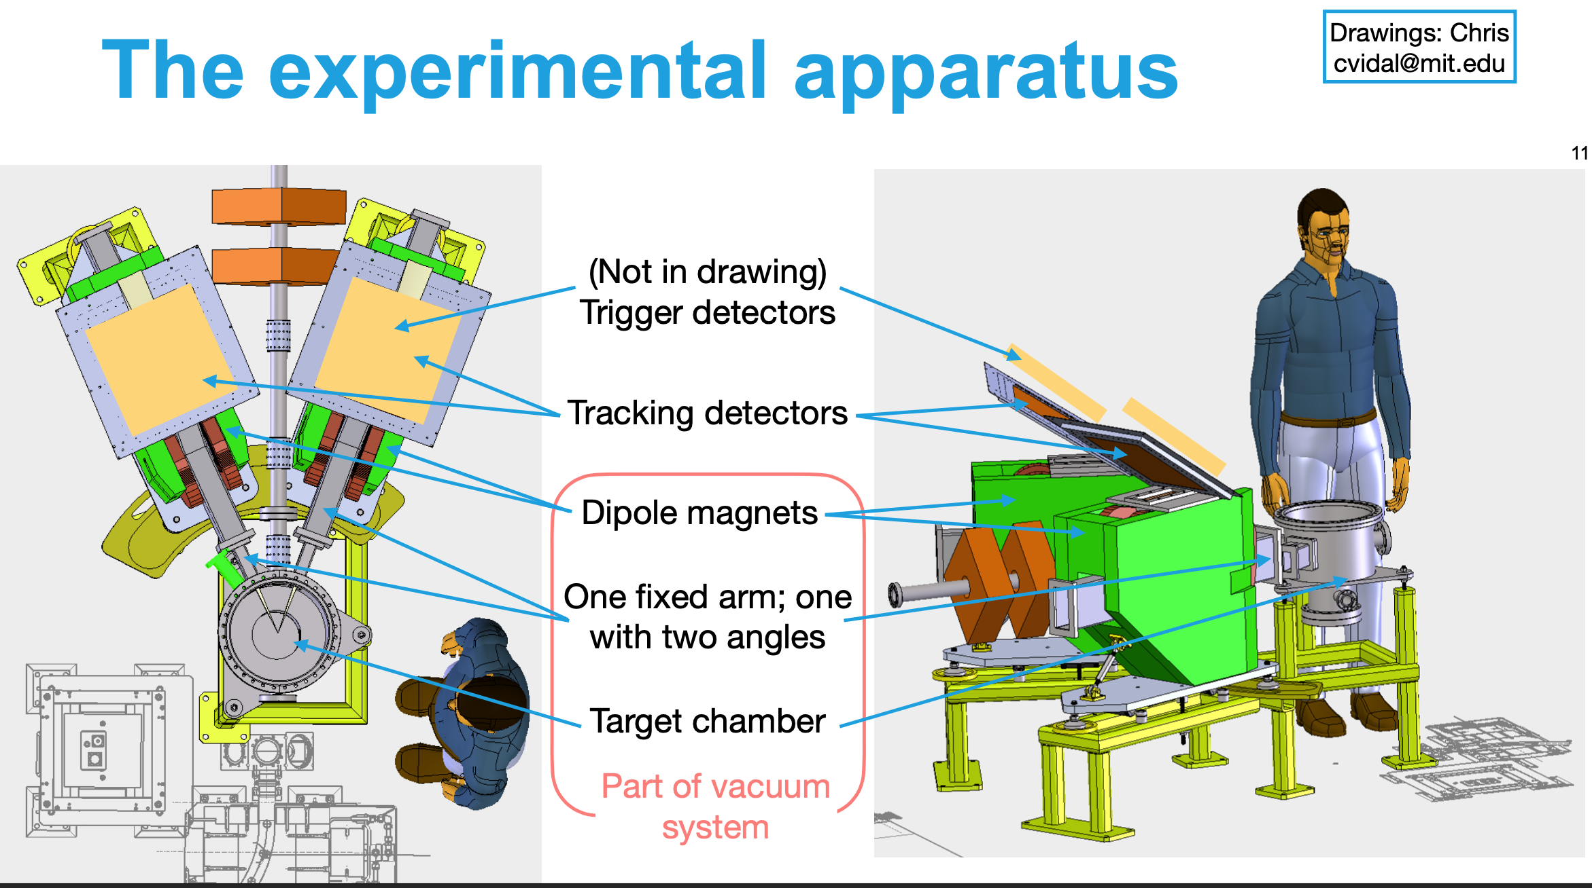

68 cm
33 cm
8 -- 15 x 3.8 cm² scint
30 cm
15 cm
26 cm

Slide 2
electron (3.6 MHz)
positron (30 kHz)
15cm
15cm
8-o
7-o
6-o
5-o
4-o
3-o
2-o
1-o
8-i
7-i
6-i
5-i
4-i
3-i
2-i
1-i
16-i
15-i
14-i
13-i
12-i
11-i
10-i
9-i
16-o
15-o
14-o
13-o
12-o
11-o
10-o
9-o
3.8cm
3.8cm
Different FPGA programs required
Need to be able to trigger on single counters for calibration.
Need to adjust timing for each counter to account for the different path lengths in the spectrometers.
Need to form L-R coincident triggers for each bar, then form OR of 8 e- bars, 8 e+ bars, then trigger e- * e+
Need to generate the fast trigger for readout of the GEM tracking chambers – within 1 usec (??)
For each of the 16 scintillators that have signals above threshold –
  -- make in-out coincidence
  -- make electron – positron coincidence ( want < 200 psec time resolution )
  -- output LE and TE time for an offline time walk correction

Slide 3
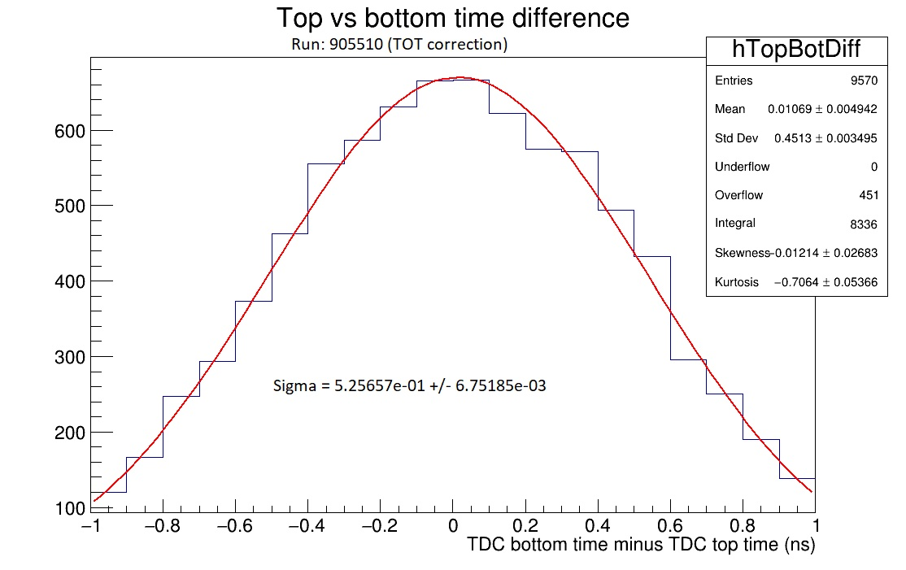

DL Prototype Bar #1 = 3mm x 30mm x 150mm with 4 SiPMs
BC-408
$$σ=525±7 psec$$
$σ=534±9 psec$
at 53.4 V

Slide 4
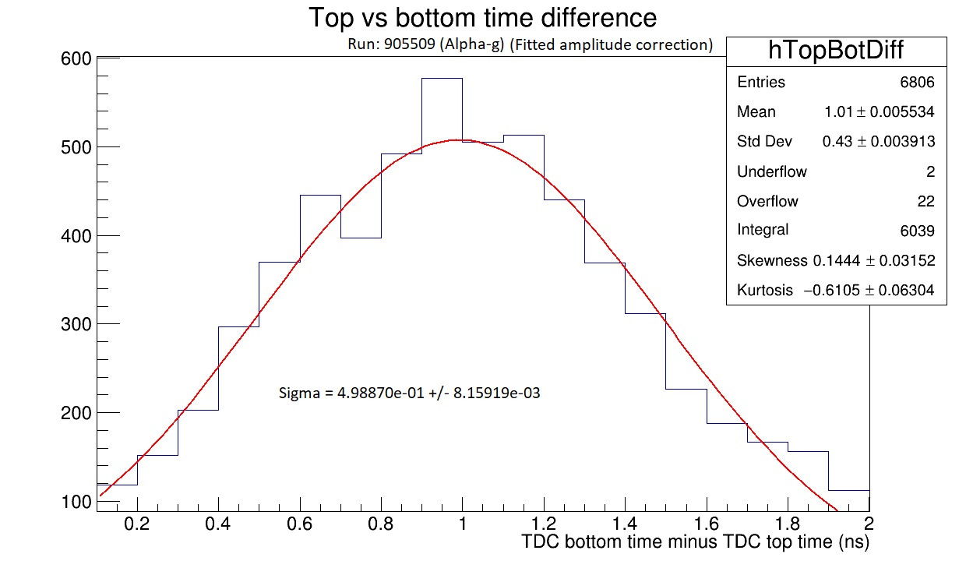
Alpha Bar 20mm x 20mm x 700mm with 6 SiPMs
$$σ=499±8 psec$$

Slide 5
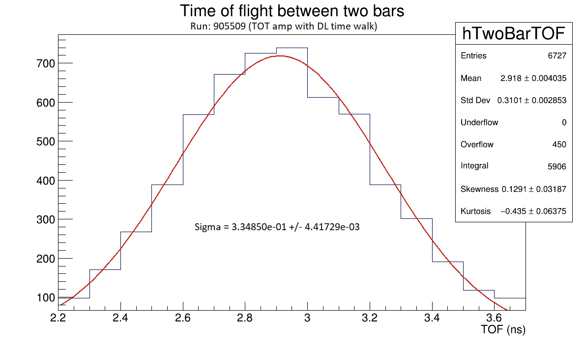

TOF Alpha bar with #1 DL Prototype Bar
$$σ=335±4 psec$$

Slide 6
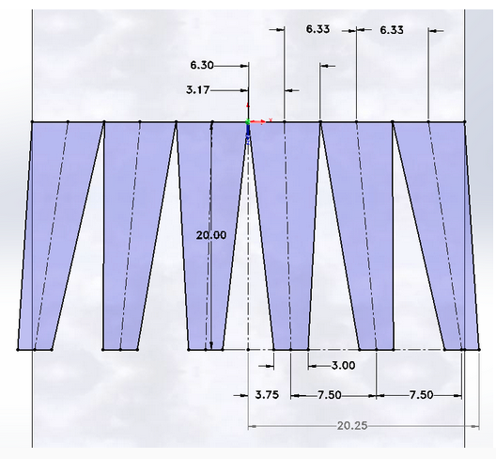
v1b -- 6 SiPM DarkLight Scintillator 38mm wide
BC-404
SiPM spacing at 7.50mm to match
existing frontend readout board

Slide 7
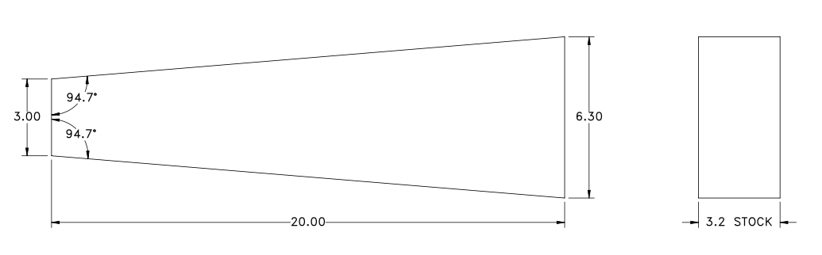
v2 -- 6 SiPM DarkLight Scintillator 38mm wide
BC-404

Slide 8
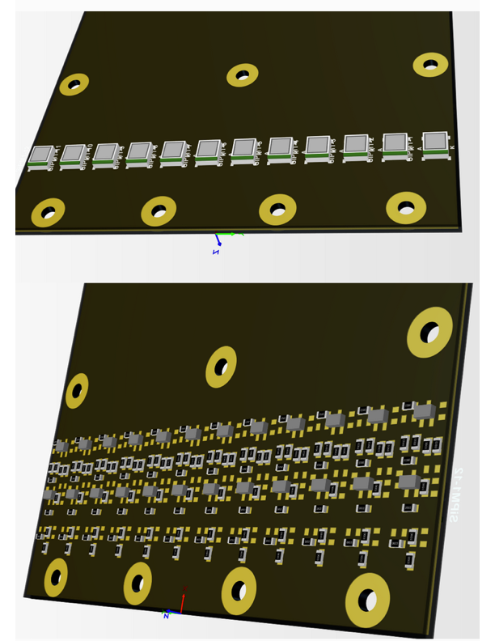
NEW v2 front end readout card(1)
holds 12 SiPMs/2 scintillators
SUM(6)→fast amp→discriminator
FPGA will check e+ e- coincidence
FPGA will readout LE and TE time

Slide 9
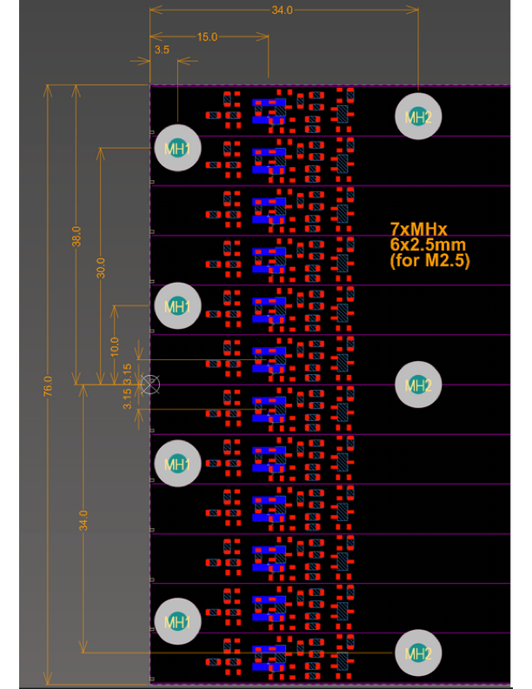
NEW v2 front end readout card(2)
holds 12 SiPMs/2 scintillators
SUM(6)→fast amp→discriminator
FPGA will check e+ e- coincidence
FPGA will readout LE and TE time
will go for manufacturing in 1-2 wks
Next Stages—
design power dist’n board
design test pulse system
develope trigger FPGA system

Slide 11
