Slide 1

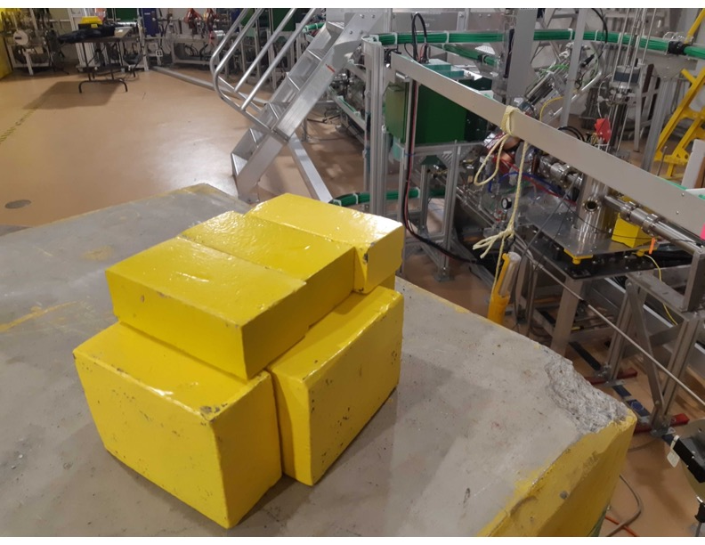
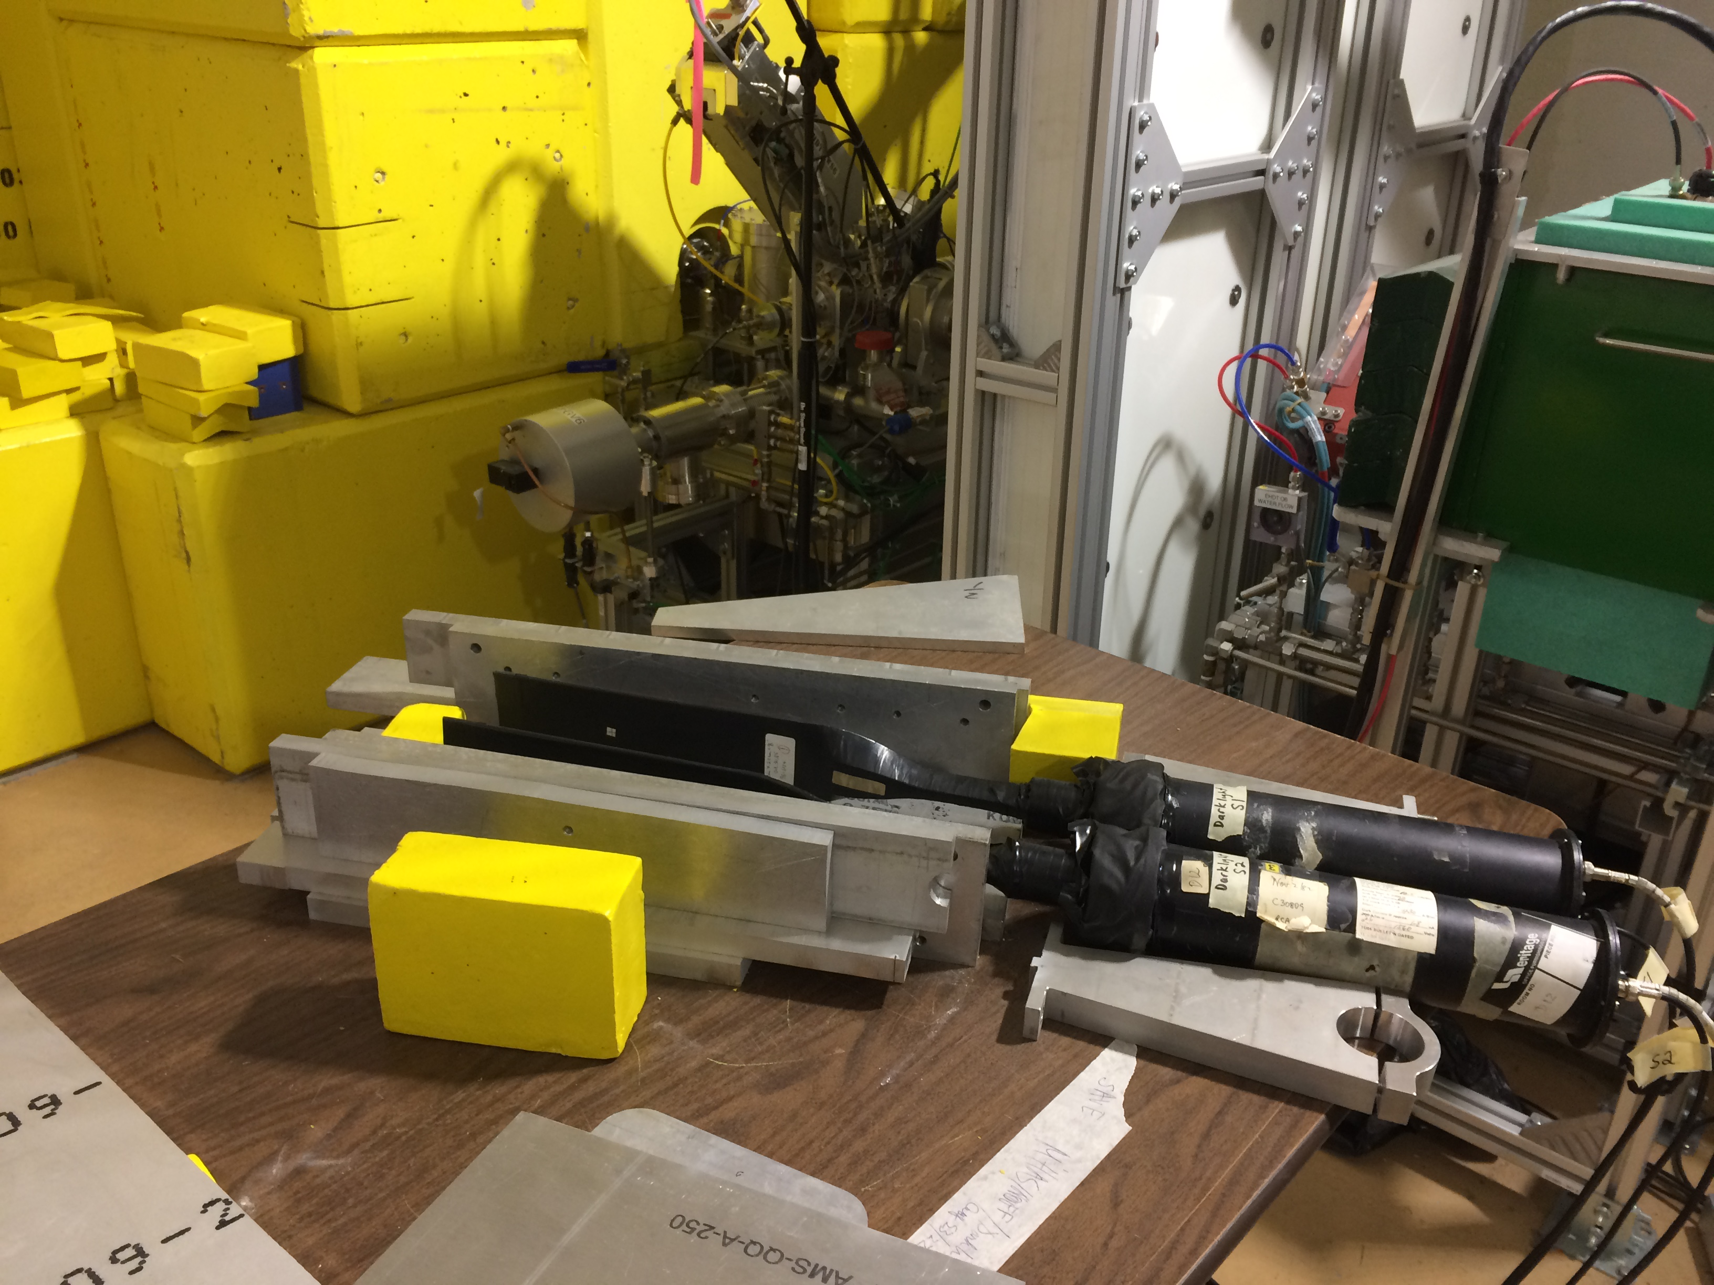
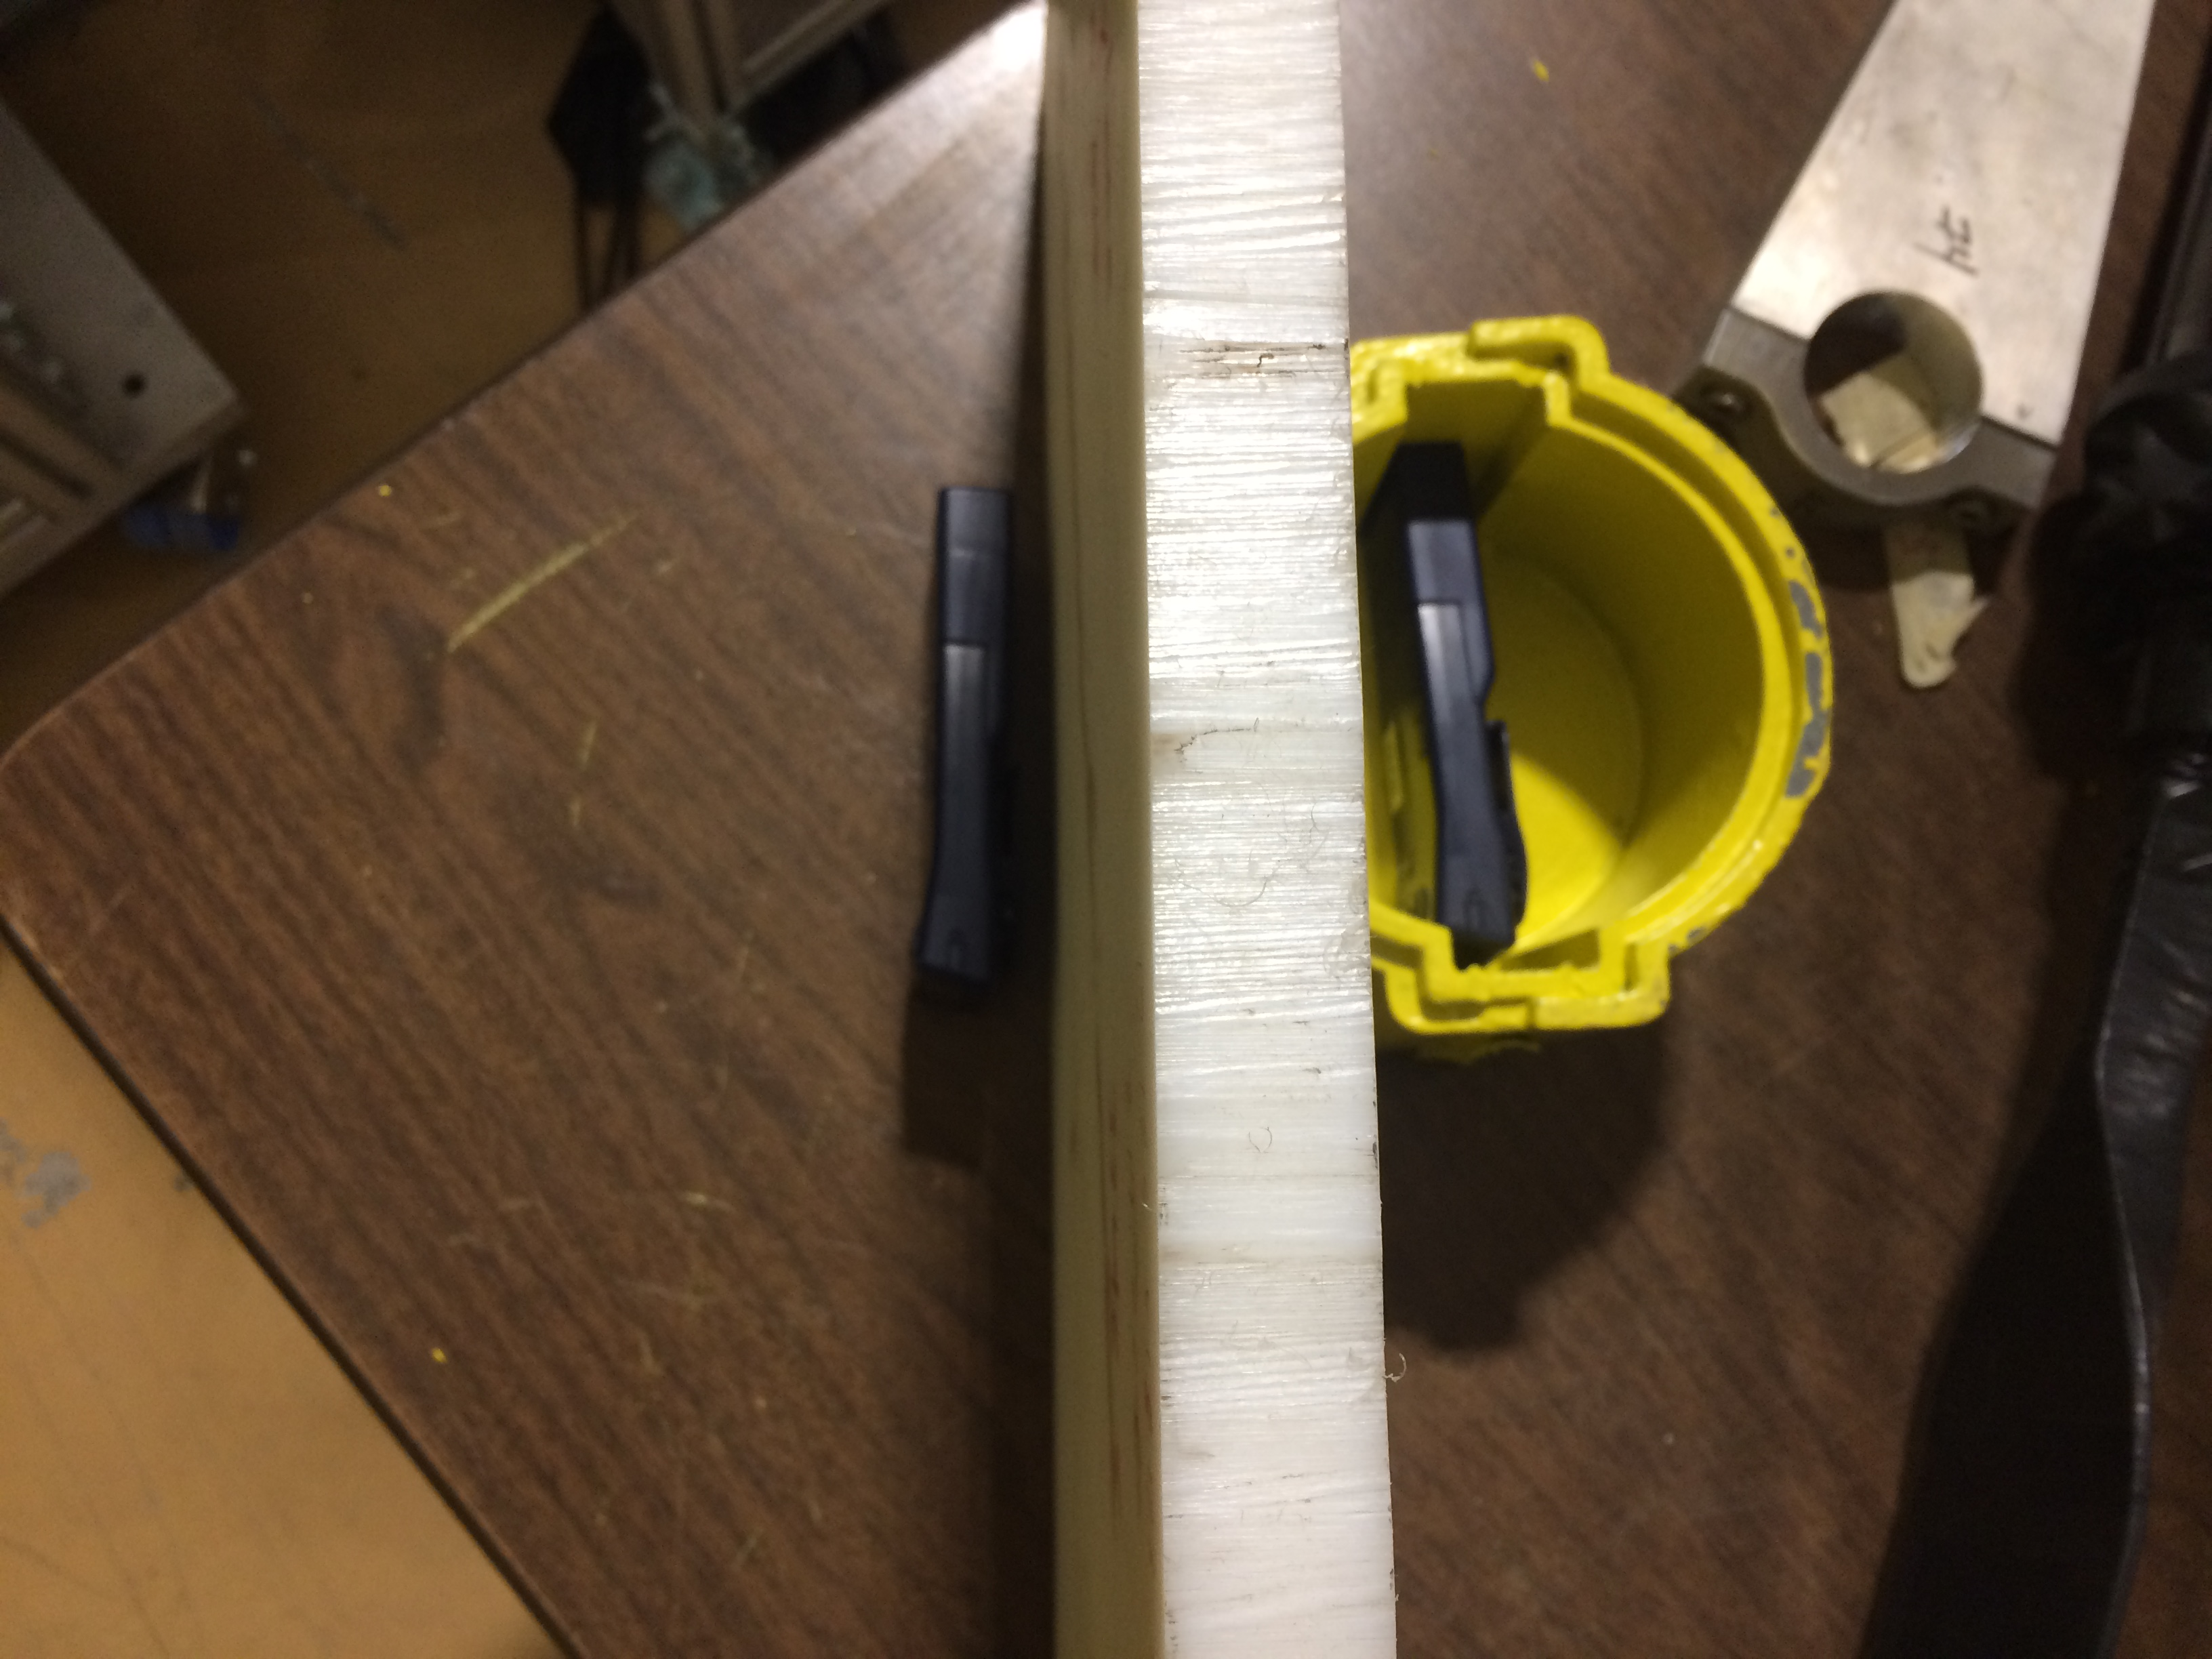
Compare shielding effectiveness
7.5 cm Lead
2.5 cm Al
2.5 cm Polyethlyene + 1 cm Lead
E_{γ} = (0.015 – 7) MeV
E_{n} = (2x10⁻⁸ – 15) MeV

Slide 2
Inside 7.5 cm Lead House
Nov 7/22 E = 29.2 MeV
Power = 1.4 kW
Near Dump
n-flux ~ 4 x 10¹ n/cm²s/kW
γ-flux ~ 5.6 x 10³ γ/cm²s/kW
Near Cryomodule
n-flux ~ 0.3 x 10¹ n/cm²s/kW
γ-flux ~ 0.8 x 10³ γ/cm²s/kW
SUMMARY
n N_dump = 13 x N_cryo
γ N_dump = 7 x N_cryo

Slide 3
Oct 7/22 E = 29.8 MeV
2.5cm Al shielding
Power ~ 1.7 kW DF ~ 10 %
D-875 inside
n-flux ~ 8.8 x 10¹ n/cm²s/kW
γ-flux ~ 5.9 x 10⁴ γ/cm²s/kW
D-870 outside
n-flux ~ 2.6 x 10² n/cm²s/kW
γ-flux ~ 1.8 x 10⁵ γ/cm²s/kW
D870/D875
n-flux ~3.0
γ-flux ~3.3

Slide 4
Oct 7/22 E = 29.8 MeV
2.5cm Al shielding
Power ~ 1.7 kW DF ~ 10 %
D-875 inside
n-flux ~ 8.8 x 10¹ n/cm²s/kW
γ-flux ~ 5.9 x 10⁴ γ/cm²s/kW
D-870 outside
n-flux ~ 2.6 x 10² n/cm²s/kW
γ-flux ~ 1.8 x 10⁵ γ/cm²s/kW
D870/D875
n-flux ~3.0
γ-flux ~3.3

Slide 5
2.5cm Polyethylene/1.0 cm Pb
Nov 18/22 E = 30.0 MeV
Power = 1.1 kW DF 10-15%
Both Near Dump
Unshielded -- placed in front
n-flux ~ 4.0 x 10³ n/cm²s/kW
γ-flux ~ 2.5 x 10⁵ γ/cm²s/kW
Shielded -- placed behind
n-flux ~ 0.2 x 10³ n/cm²s/kW
γ-flux ~ 0.9 x 10⁵ γ/cm²s/kW
SUMMARY
n N_unsh = 20 x N_sh
γ N_unsh = 3 x N_sh

Slide 6
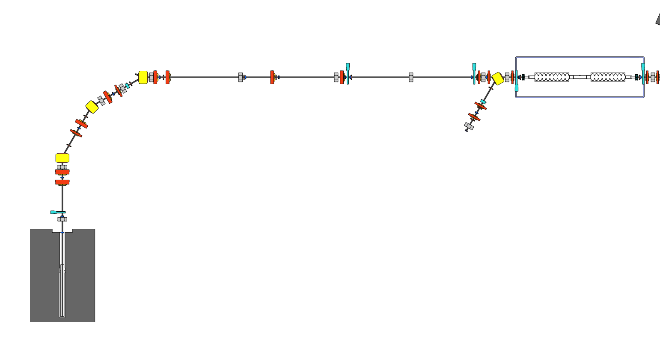
Compare Dump & Cryomodule locations
near Cryomodule
near Dump

Slide 7
Oct 13/22 E = 29.8 MeV
Unshielded
Power ~ 1.5 kW DF ~ 10 %
D-870 near Dump
n-flux ~ 5.3 x 10² n/cm²s/kW
γ-flux ~ 3.5 x 10⁵ γ/cm²s/kW
Note ~10 min time shift
D-875 near Cryomodule
n-flux ~ 0.3 x 10² n/cm²s/kW
γ-flux ~ 0.2 x 10⁵ γ/cm²s/kW
Summary
n N_dump = 18 x N_cryo
γ N_dump = 18 x N_cryo

Slide 8
Oct 14/22 E = 29.8 MeV
Unshielded
Power ~ 1.5 kW DF ~ 10 %
D-870 near Dump
n-flux ~ 5.3 x 10² n/cm²s/kW
γ-flux ~ 2.7 x 10⁵ γ/cm²s/kW
Note ~10 min time shift
Note ~10 min time shift
D-875 near Cryomodule
n-flux ~ 0.3 x 10² n/cm²s/kW
γ-flux ~ 0.16 x 10⁵ γ/cm²s/kW
Summary
n N_dump = 18 x N_cryo
γ N_dump = 17 x N_cryo

Slide 9
Oct 20/22
No Shielding E = 29.9 MeV
Power ~ 6.0 kW DF ~ 60 %
D-870 near dump
n-flux ~ 3.3 x 10² n/cm²s/kW
γ-flux ~ 1.0 x 10⁵ γ/cm²s/kW
D-875 near Cryomodule
n-flux ~ 0.6 x 10² n/cm²s/kW
γ-flux ~ 1.0 x 10⁵ γ/cm²s/kW
SUMMARY
n N_dump = 5 x N_cryo
γ N_dump = 1 x N_cryo

Slide 10
Oct 27/22
No Shielding E = 29.3 MeV
Power ~ 1.15 kW DF ~ 7.5 %
D-870 near dump
n-flux ~ 9.0 x 10² n/cm²s/kW
γ-flux ~ 2.7 x 10⁵ γ/cm²s/kW
D-880 near Cryomodule
n-flux ~ 0.3 x 10² n/cm²s/kW
γ-flux ~ 1.0 x 10⁵ γ/cm²s/kW
SUMMARY
n N_dump = 30 x N_cryo
γ N_dump = 3 x N_cryo

Slide 11
Oct 31/22
No Shielding
Power ~ 7 kW DF ~ 94%
D-870 near dump
n-flux ~ 2.8 x 10³ n/cm²s/kW
γ-flux ~ 8 x 10⁵ γ/cm²s/kW
D-880 near cryomodule
n-flux ~ 14 n/cm²s/kW
γ-flux ~ 2.1 x 10⁴ γ/cm²s/kW
SUMMARY
n N_dump = 200 x N_cryo
γ N_dump = 38 x N_cryo

Slide 12
2.5cm Polyethylene/1.0 cm Pb
Nov 21 Beam Tuning
Unshielded placed in front
Shielded placed behind
Rates are very high
in both locations

Slide 14
Aug 5 Beam on Target
only 10% reaches the dump
14:25 -- 1 um Tgt
14:50 – 10 um Tgt
D883 on floor—shielded
by concrete blocks
D883 on white block

